Slide 1


Semileptonic decays at LHCb
第二十二届全国重味物理和CP破坏研讨会（HFCPV2025）
王纪科

Slide 2
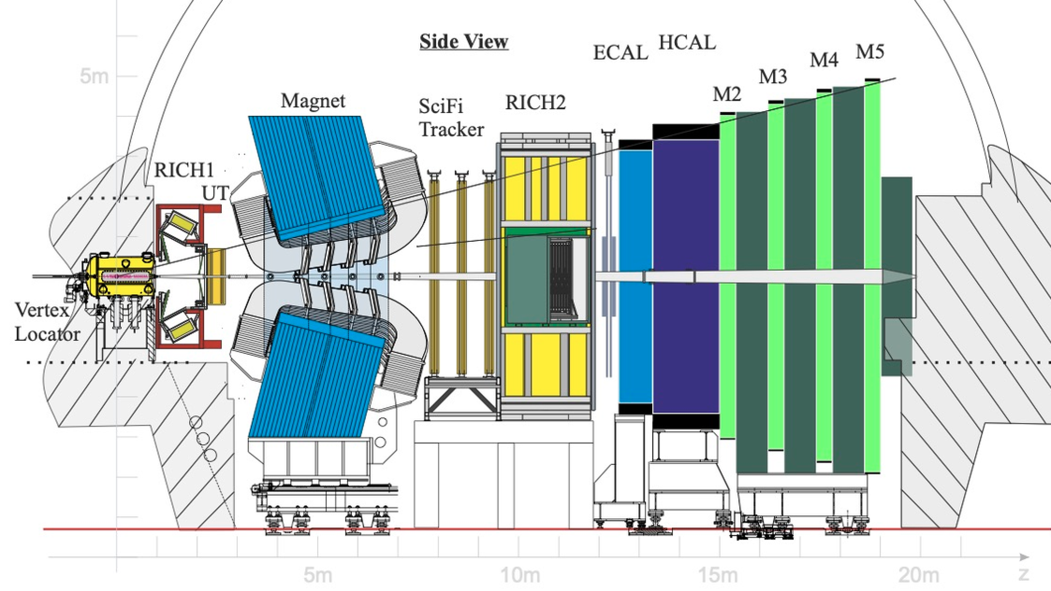
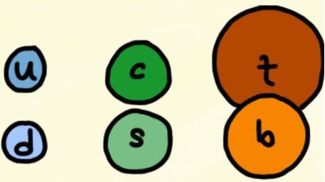
LHCb and the Physics
Focus on HF quarks
Charm
Bottom
Indirect search for new physics: CP violation + rare decays
Understanding strong interactions: hadron properties, new hadronic states
Others: electroweak physics, heavy-ion physics, ...
Notes:
Lhcb是位于欧洲核子研究中心大型强子对撞机实验之一，主要目标基于重味夸克研究cp破坏、稀有衰变，强子态等，理解标准模型，寻找新物理

Slide 3
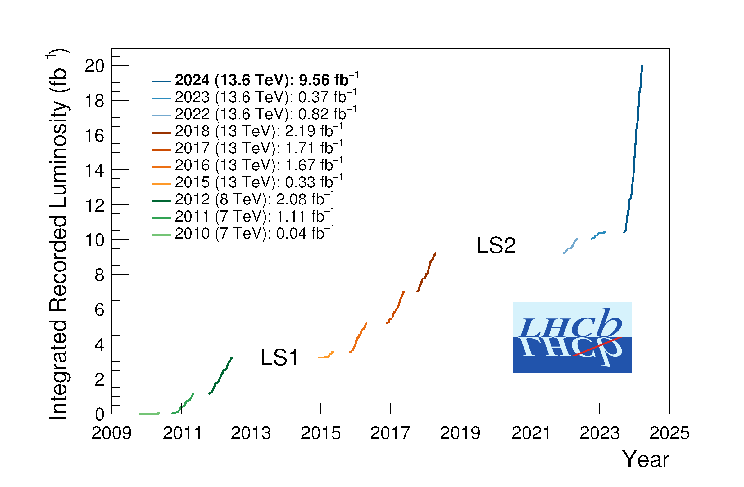


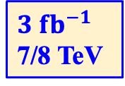
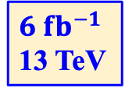
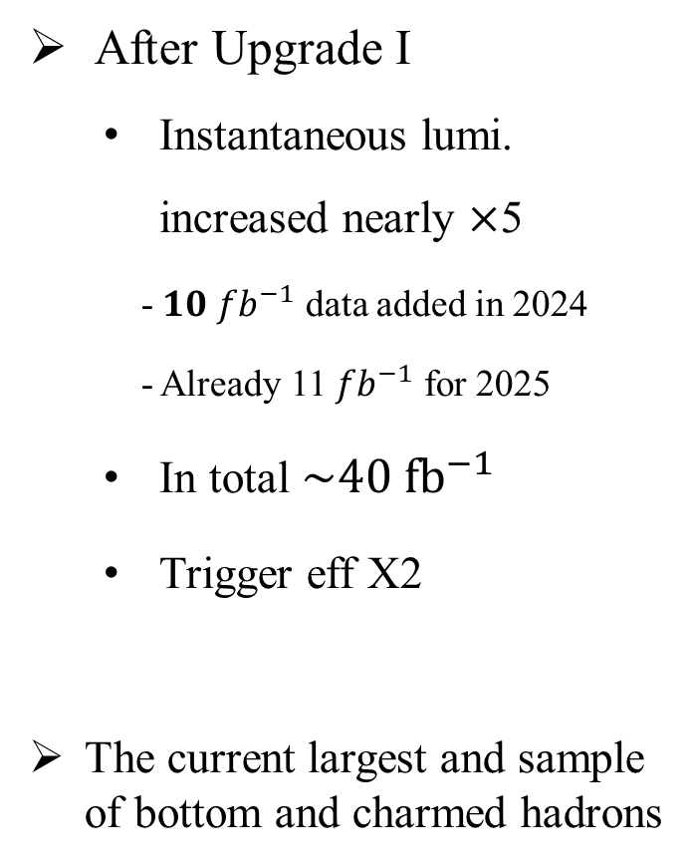
$pp$ Collision data
After Upgrade I
Instantaneous lumi. increased nearly $×$5
- 𝟏𝟎 ${fb}^{−1}$ data added in 2024
- Already 11 ${fb}^{−1}$ for 2025
In total $\sim 40 fb^{−1}$
Trigger eff X2
The current largest and sample of bottom and charmed hadrons
$10 fb^{−1}$
13.6 TeV
$6 fb^{−1}$
13 TeV
$3 fb^{−1}$
7/8 TeV
Upgrade I
一期
二期
三期
Notes:
LHCb实验参与了LHC 1，2期取数，目前正基于1一期升级的探测器进行三期取数。三期数据瞬时亮度提高近5倍，而且触发效率提高2倍，预计总有效数据量可提高5倍以上，将收集世界上数量最多，种类最全的重味强子样本。

Slide 4
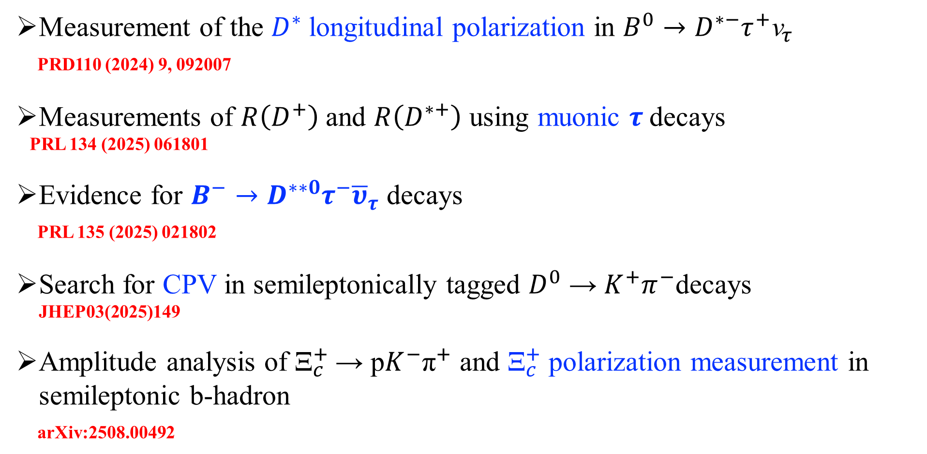
Cover the following Semileptonic decays
Measurement of the $D^{∗}$longitudinal polarization in $B^{0}→D^{∗−}τ^{+}{\text{ν}}_{τ}$
PRD110 (2024) 9, 092007
Measurements of $R\left(D^{+}\right)$and $R\left(D^{∗+}\right)$ using muonic $τ$decays
PRL 134 (2025) 061801
Evidence for $B^{−}→D^{∗∗0}τ^{−}{\overline{υ}}_{τ}$ decays
PRL 135 (2025) 021802
Search for CPV in semileptonically tagged $D^{0}$ → $K^{+}π^{−}$decays
JHEP03(2025)149
Amplitude analysis of ${\text{Ξ}}_{c}^{+}$→ p$K^{−}{\text{π}}^{+}$ and ${\text{Ξ}}_{c}^{+}$ polarization measurement in semileptonic b-hadron
arXiv:2508.00492

Slide 5
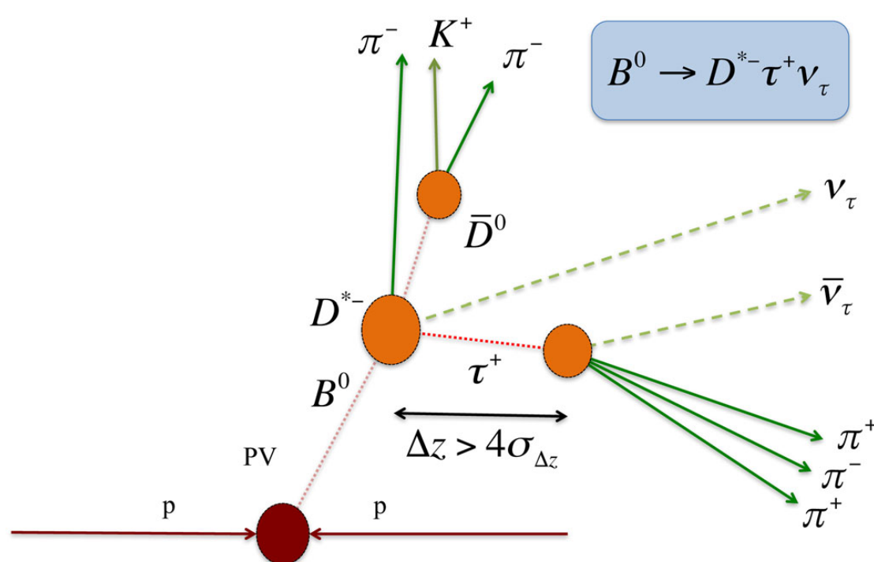
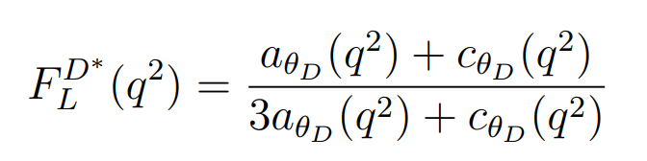

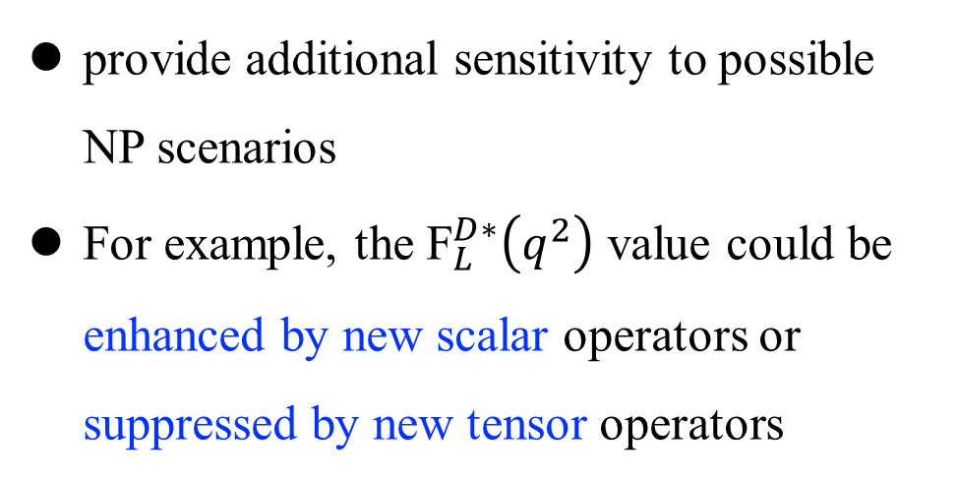

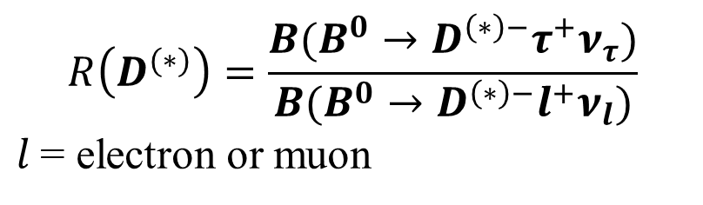
Measurement of the $D^{∗}$longitudinal polarization in $B^{0}→D^{∗−}τ^{+}{\text{ν}}_{τ}$
PRD110 (2024) 9, 092007
$$R\left(D^{(∗)}\right)=\frac{B(B^{0}→D^{\left(∗\right)−}τ^{+}ν_{τ})}{B(B^{0}→D^{\left(∗\right)−}l^{+}ν_{l})}$$
$l$= electron or muon
Long-standing tension with SM 3.3$σ$
provide additional sensitivity to possible NP scenarios
For example, the ${\text{F}}_{L}^{D∗}\left(q^{2}\right)$ value could be enhanced by new scalar operators or suppressed by new tensor operators
longitudinal polarization ${\text{F}}_{L}^{D∗}\left(q^{2}\right):$
Notes:
aθD(q²)和cθD(q²)包含了强子效应和基本耦合，它们依赖于q²。 q2即τντ系统的平方不变质量，该值通过B介子与D∗介子动量的平方差计算得出。

Slide 6
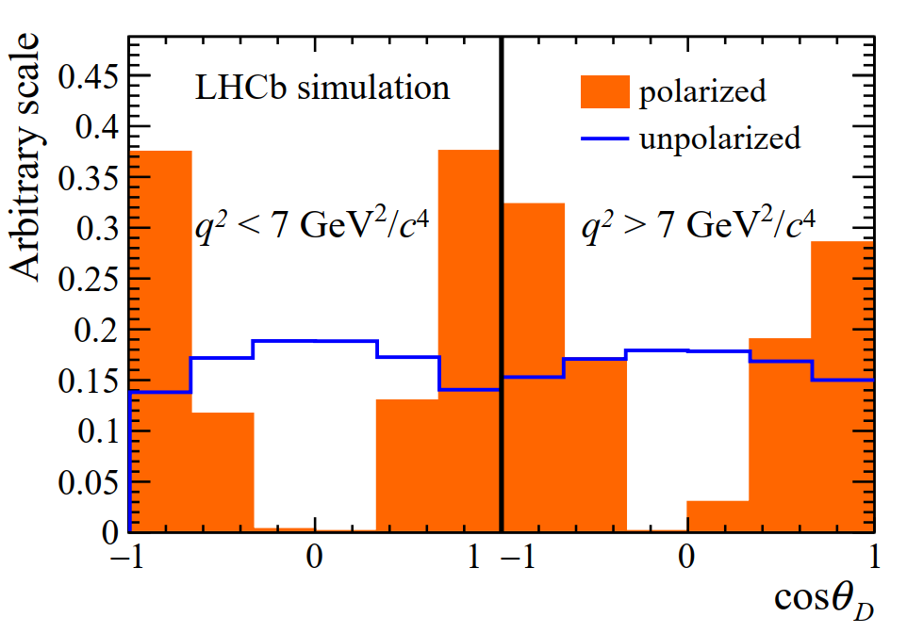
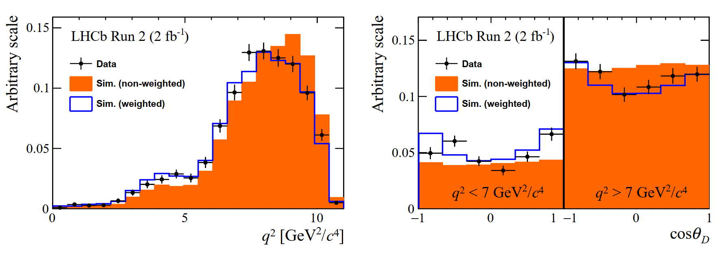
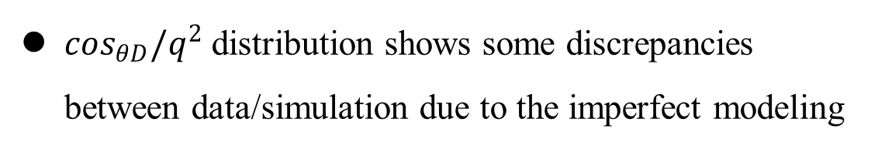
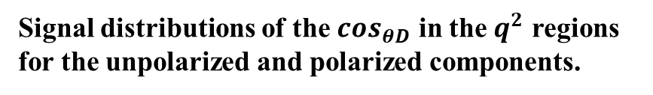
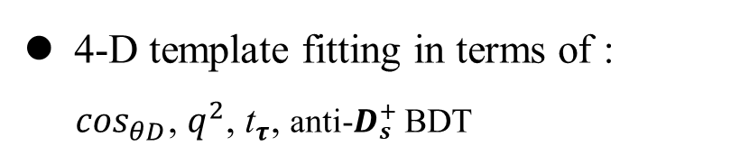
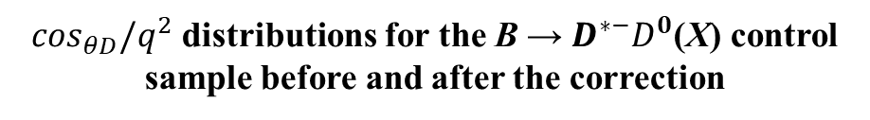
Measurement of the $D^{∗}$longitudinal polarization in $B^{0}→D^{∗−}τ^{+}{\text{ν}}_{τ}$
PRD110 (2024) 9, 092007
4-D template fitting in terms of :
$\cos_{θD}$, $q^{2}$, ${\text{t}}_{τ}$, anti-$D_{s}^{+}$ BDT
$\cos_{θD}/q^{2}$ distribution shows some discrepancies between data/simulation due to the imperfect modeling
Signal distributions of the $\cos_{θD}$ in the $q^{2}$ regions for the unpolarized and polarized components.
$\cos_{θD}/q^{2}$ distributions for the B → $D^{∗−}D^{0}$(X) control sample before and after the correction

Slide 7
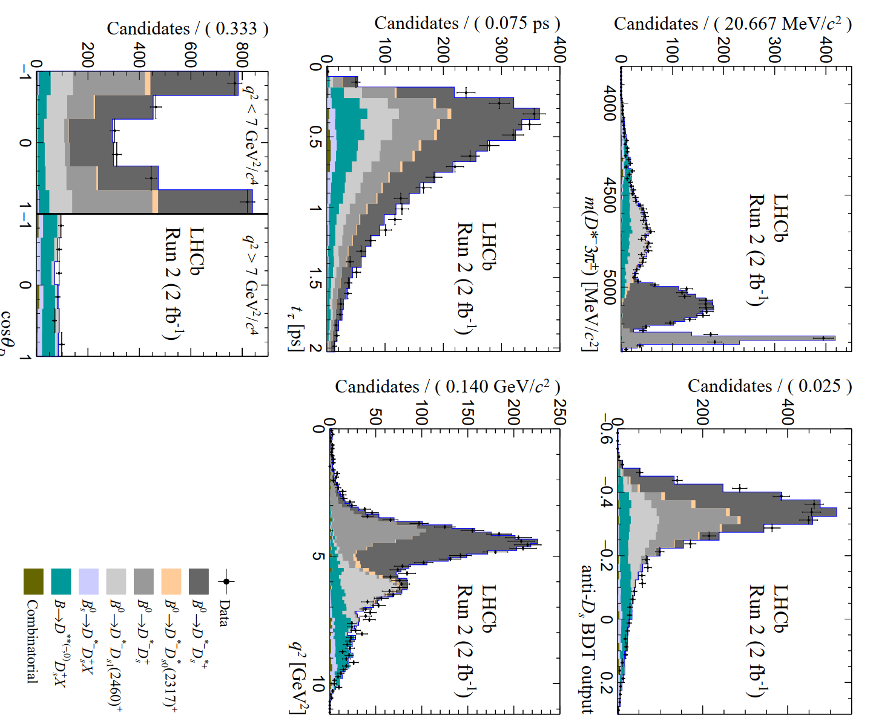
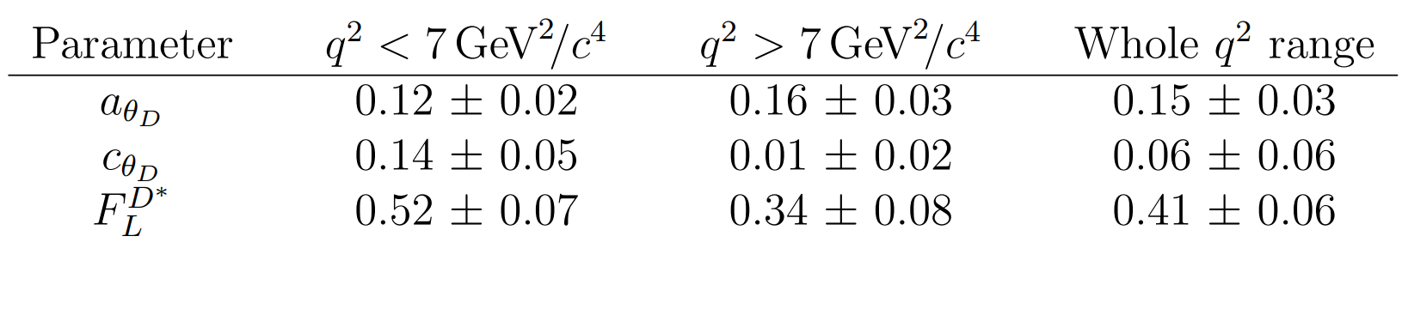
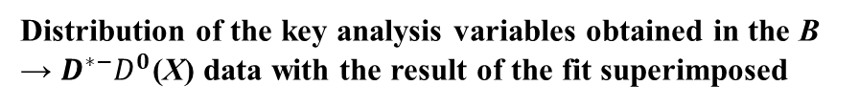
Measurement of the $D^{∗}$longitudinal polarization in $B^{0}→D^{∗−}τ^{+}{\text{ν}}_{τ}$
PRD110 (2024) 9, 092007
4-D template fitting with 19 free pars:
Final measured results:
compatible with SM predictions and with the results obtained by the Belle experiment.
Distribution of the key analysis variables obtained in the B → $D^{∗−}D^{0}$(X) data with the result of the fit superimposed

Slide 8
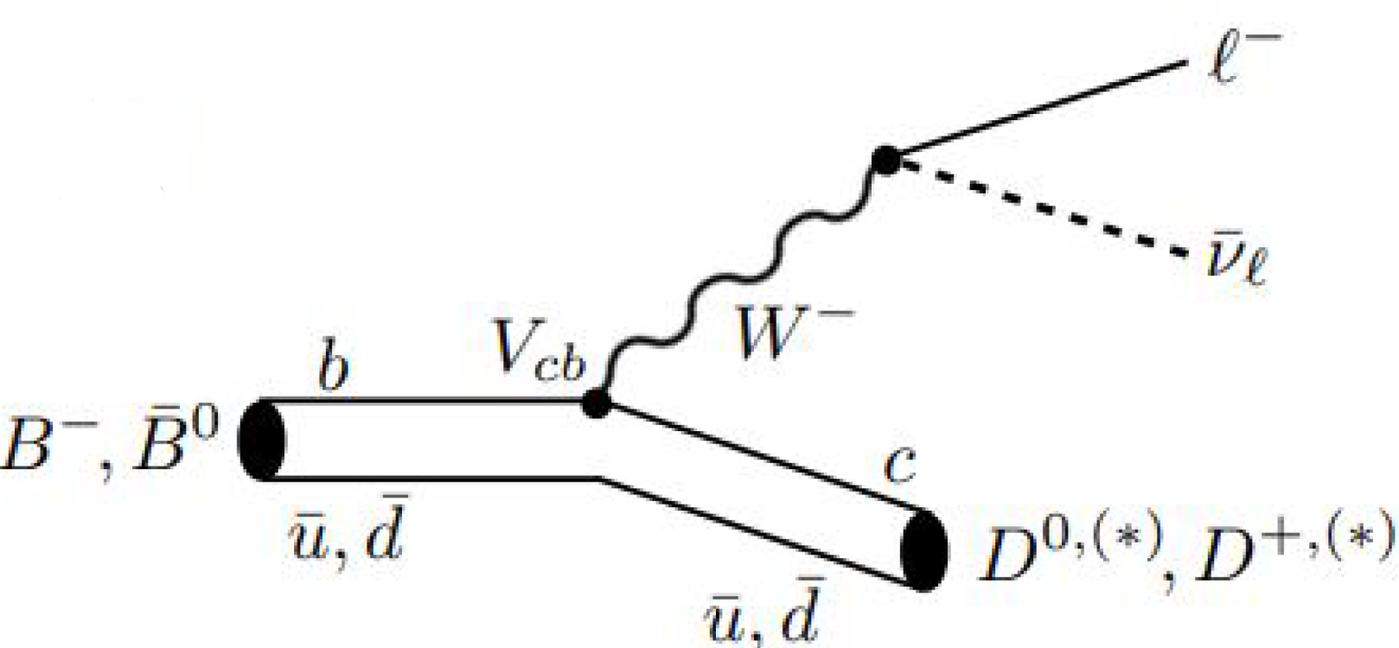
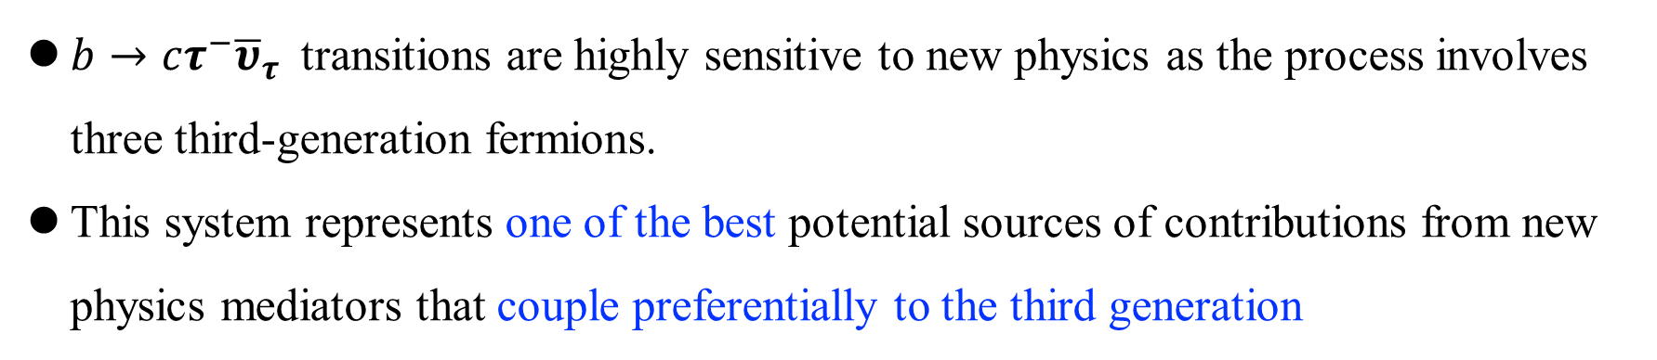
Measurements of $R\left(D^{+}\right)$and $R\left(D^{∗+}\right)$ using muonic $τ$decays
PRL 134 (2025) 061801
$b→cτ^{−}{\overline{υ}}_{τ}$transitions are highly sensitive to new physics as the process involves three third-generation fermions.
This system represents one of the best potential sources of contributions from new physics mediators that couple preferentially to the third generation

Slide 9
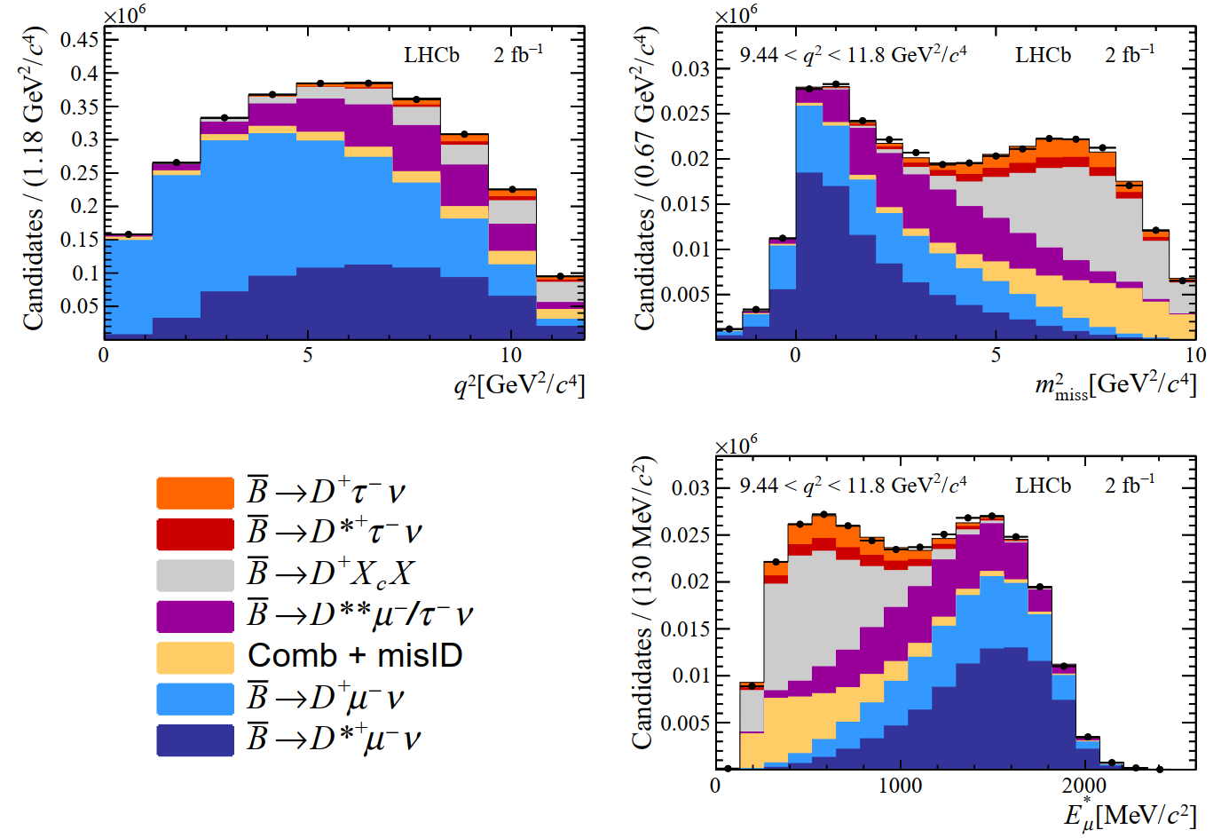
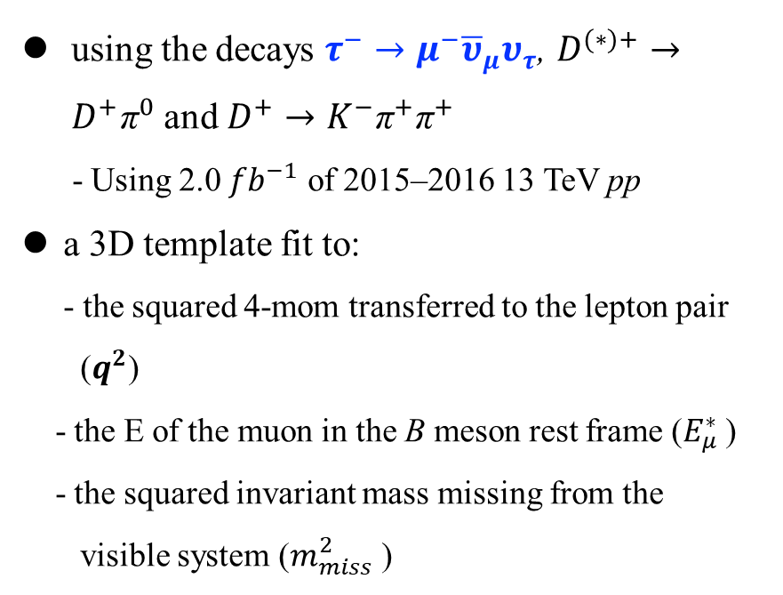
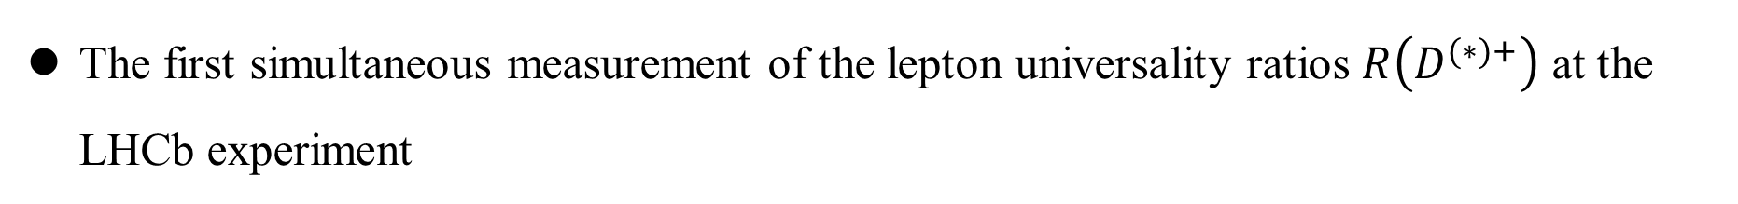
Measurements of $R\left(D^{+}\right)$and $R\left(D^{∗+}\right)$ using muonic $τ$decays
PRL 134 (2025) 061801
The first simultaneous measurement of the lepton universality ratios $R\left(D^{(∗)+}\right)$ at the LHCb experiment
using the decays $τ^{−}→μ^{−}{\overline{υ}}_{μ}υ_{τ}$, $D^{(∗)+}→D^{+}{\text{π}}^{0}$ and $D^{+}→K^{−}{\text{π}}^{+}{\text{π}}^{+}$
- Using 2.0 ${fb}^{−1}$ of 2015–2016 13 TeV pp
a 3D template fit to:
- the squared 4-mom transferred to the lepton pair
($q^{2}$)
- the E of the muon in the B meson rest frame ($E_{μ}^{∗}$)
- the squared invariant mass missing from the
visible system ($m_{miss}^{2}$ )
The three kinematic variables in the signal isolation region
Notes:
- to separate the signal and the normalisation from the backgrounds.

Slide 10
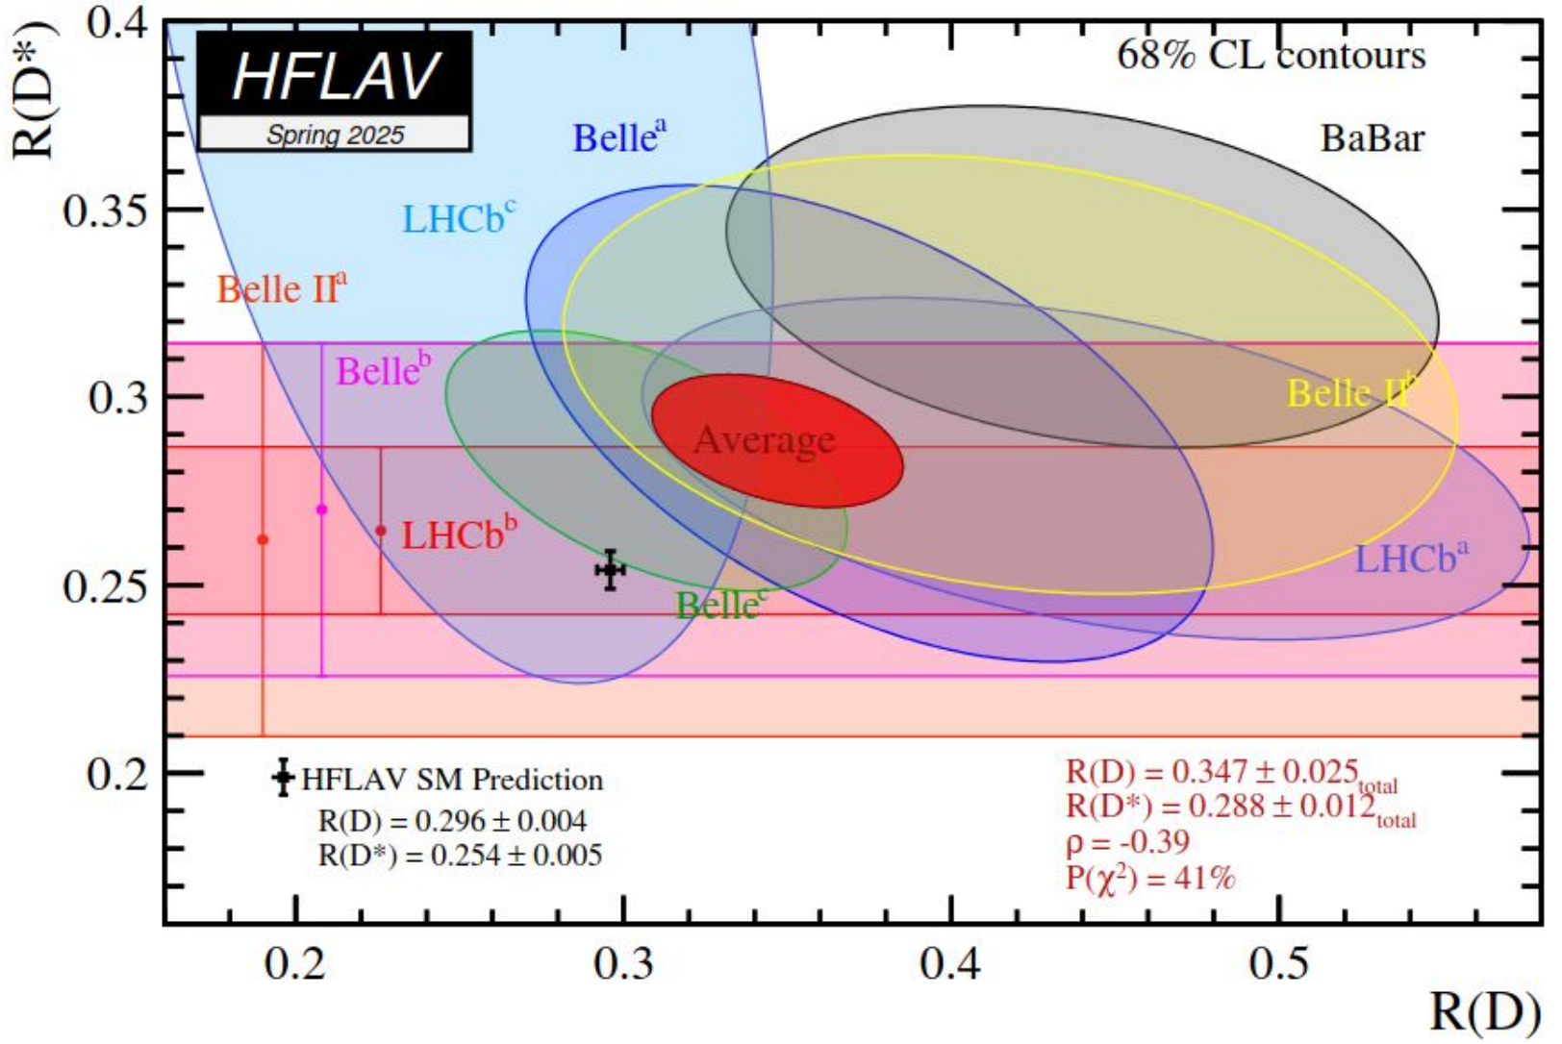
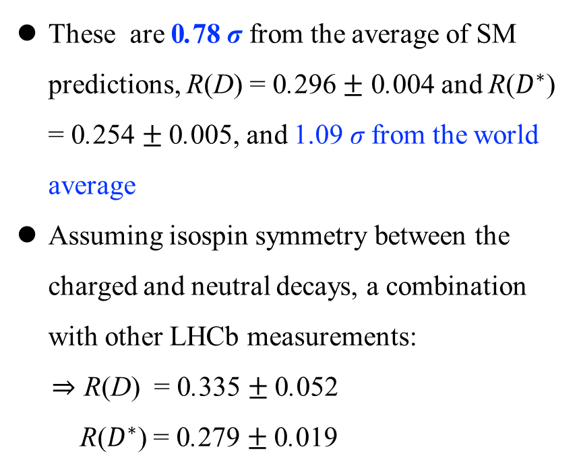
Measurements of $R\left(D^{+}\right)$and $R\left(D^{∗+}\right)$ using muonic $τ$decays
PRL 134 (2025) 061801
The results in the following:
R($D^{+}$) = 0.249 $±$0.043 $±$ 0.047, R($D^{∗+}$) = 0.402 $±$0.081 $±$ 0.085
These are 0.78 σ from the average of SM predictions, R(D) = 0.296 $±$ 0.004 and R($D^{∗}$) = 0.254 $±$0.005, and 1.09 σ from the world average
Assuming isospin symmetry between the charged and neutral decays, a combination with other LHCb measurements:
⇒ R(D) = 0.335 $±$0.052
R($D^{∗}$) = 0.279 $±$0.019

Slide 11
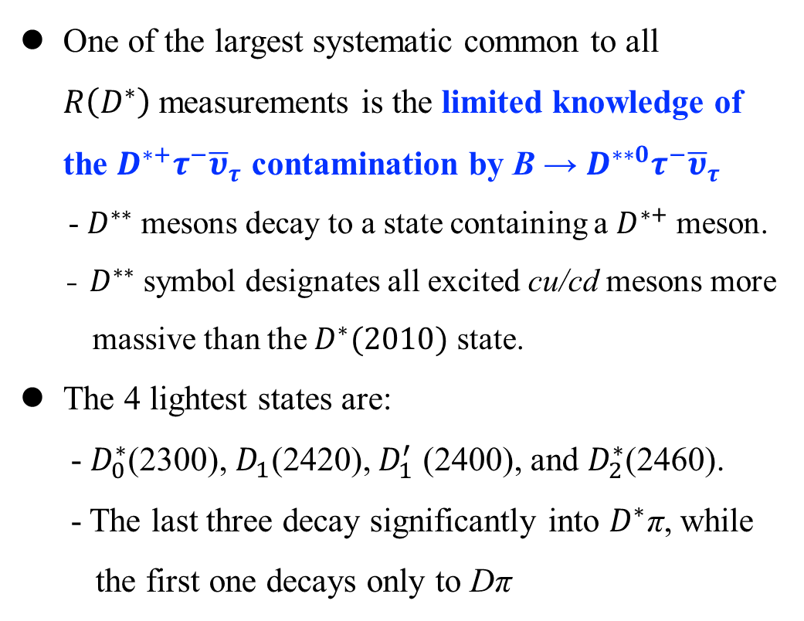
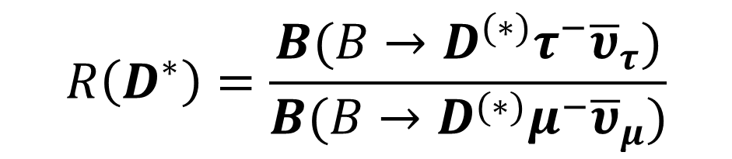
Evidence for $B^{−}→D^{∗∗0}τ^{−}{\overline{υ}}_{τ}$ decays
PRL 135 (2025) 021802
LFU: that the 3 charged leptons have exactly the same properties and couplings, except for their masses.
Experimentally, evidence of LFU violation is found in semileptonic B decays:
One of the largest systematic common to all $R\left(D^{∗}\right)$measurements is the limited knowledge of the $D^{∗+}τ^{−}{\overline{υ}}_{τ}$ contamination by B → $D^{∗∗0}τ^{−}{\overline{υ}}_{τ}$
- $D^{∗∗}$mesons decay to a state containing a $D^{∗+}$meson.
- $D^{∗∗}$symbol designates all excited cu/cd mesons more
massive than the $D^{∗}(2010)$ state.
The 4 lightest states are:
- $D_{0}^{∗}$(2300), $D_{1}$(2420), $D_{1}^{′}$ (2400), and $D_{2}^{∗}$(2460).
- The last three decay significantly into $D^{∗}$π, while
the first one decays only to Dπ
$$R\left(D^{∗}\right)=\frac{B(B→D^{(∗)}τ^{−}{\overline{υ}}_{τ})}{B(B→D^{(∗)}μ^{−}{\overline{υ}}_{μ})}$$
Calls for more investigations of potential systematic effects ⇒

Slide 12
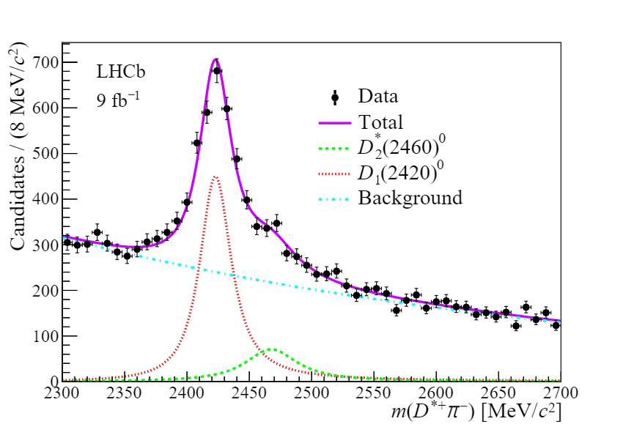
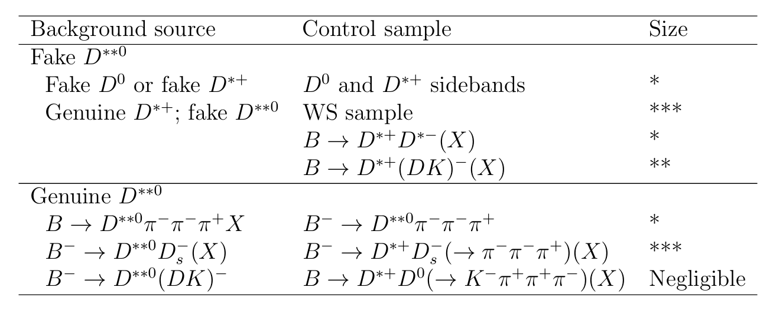


Evidence for $B^{−}→D^{∗∗0}τ^{−}{\overline{υ}}_{τ}$ decays
PRL 135 (2025) 021802
Distribution of the $D^{∗+}π^{−}$ mass for all selected $D^{∗∗0}π^{−}π^{−}π^{+}$ candidates
List of the various background categories and the control samples
- Fake and Genuine $D^{∗∗0}$
Notes:
D**0 -> D*+ and pi-.

Slide 13
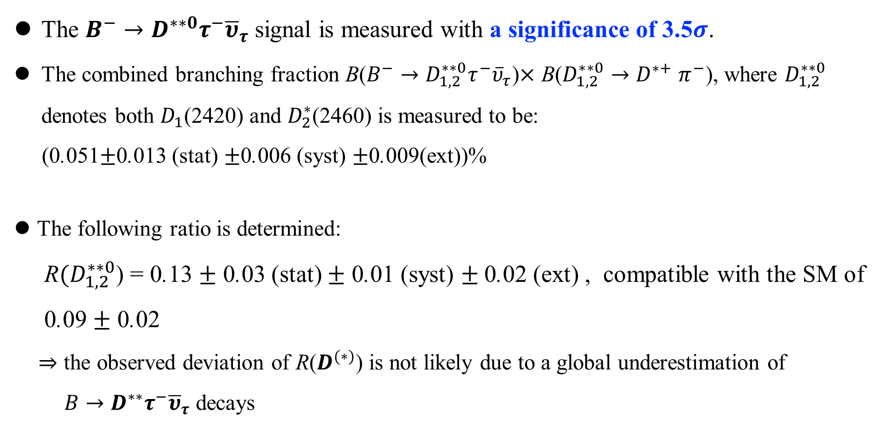
Evidence for $B^{−}→D^{∗∗0}τ^{−}{\overline{υ}}_{τ}$ decays
PRL 135 (2025) 021802
The $B^{−}→D^{∗∗0}τ^{−}{\overline{υ}}_{τ}$ signal is measured with a significance of 3.5$σ$.
The combined branching fraction B($B^{−}→D_{1,2}^{∗∗0}τ^{−}{\overline{υ}}_{τ}$)$×$ B($D_{1,2}^{∗∗0}{→D}^{∗+}$ $π^{−}$), where $D_{1,2}^{∗∗0}$ denotes both $D_{1}$(2420) and $D_{2}^{∗}$(2460) is measured to be:
(0.051$±$0.013 (stat) $±$0.006 (syst) $±$0.009(ext))%
The following ratio is determined:
R$(D_{1,2}^{∗∗0}$) = 0.13 $±$ 0.03 (stat) $±$ 0.01 (syst) $±$0.02 (ext) , compatible with the SM of
0.09 $±$ 0.02
⇒ the observed deviation of R($D^{(∗)}$) is not likely due to a global underestimation of
$B→D^{∗∗}τ^{−}{\overline{υ}}_{τ}$ decays

Slide 14
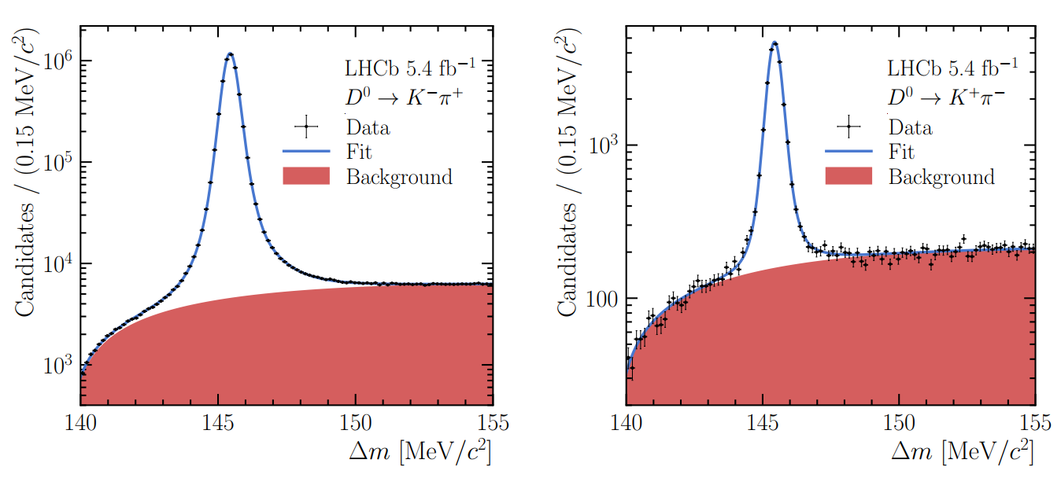
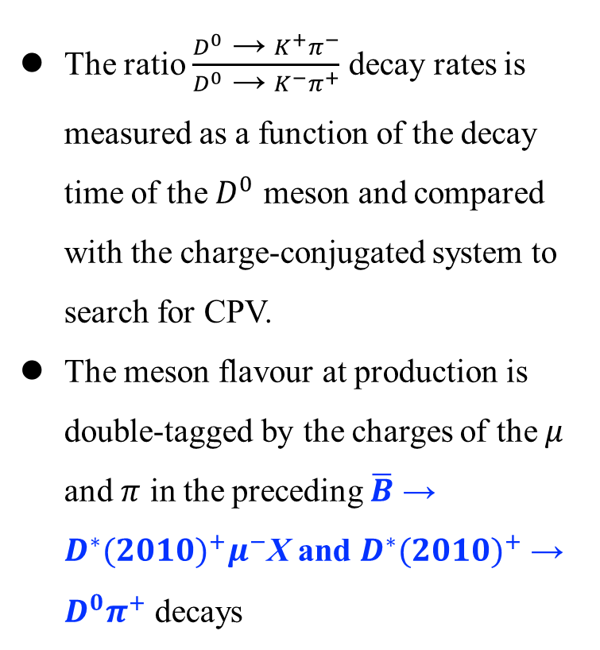
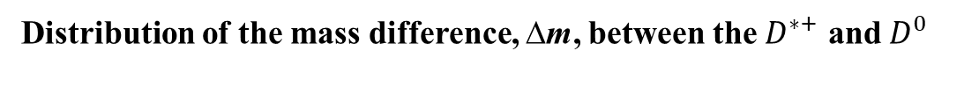
Search for CPV in semileptonically tagged $D^{0}$ → $K^{+}π^{−}$decays
JHEP03(2025)149
The ratio $\frac{D^{0} \text{→ }K^{+}π^{−}}{D^{0} \text{→ }K^{−}π^{+}}$ decay rates is measured as a function of the decay time of the $D^{0}$ meson and compared with the charge-conjugated system to search for CPV.
The meson flavour at production is double-tagged by the charges of the $μ$ and $π$ in the preceding $\overline{B}$ → $D^{∗}{(2010)}^{+}μ^{−}$X and $D^{∗}{(2010)}^{+}$→ $D^{0}π^{+}$ decays
Distribution of the mass difference, ∆m, between the $D^{∗+}$ and $D^{0}$
Notes:
要求D0介子来源于D∗(2010)+ → D0π+衰变，因此其在产生时的flavor可通过伴随π介子的电荷来推断。我们知道了 $D^{0}$ 在产生时的初始味道，然后通过其衰变末态，我们可以追踪它在传播过程中是否发生了味道改变（混合）或CP破坏。

Slide 15
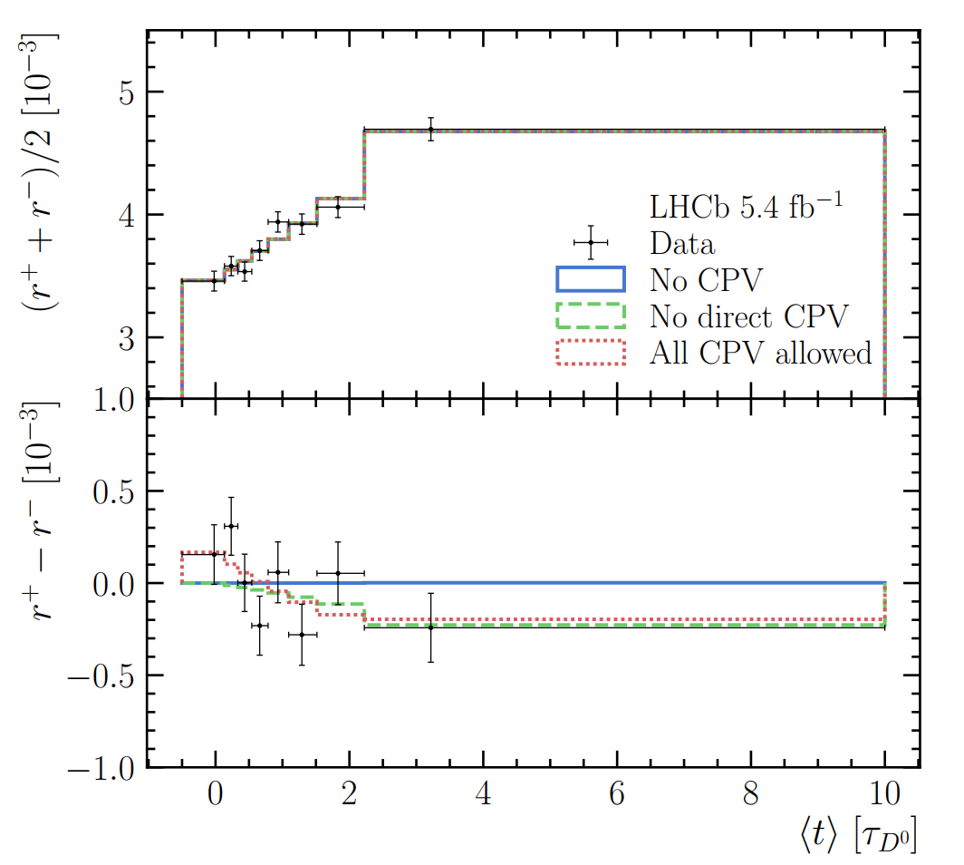
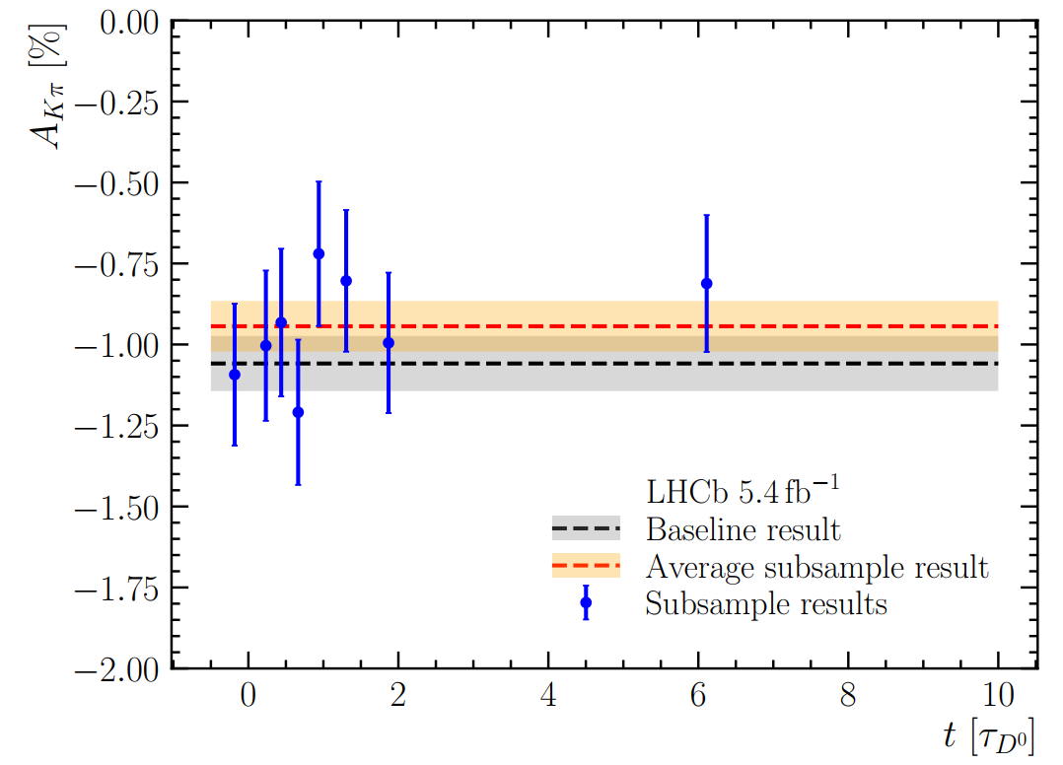
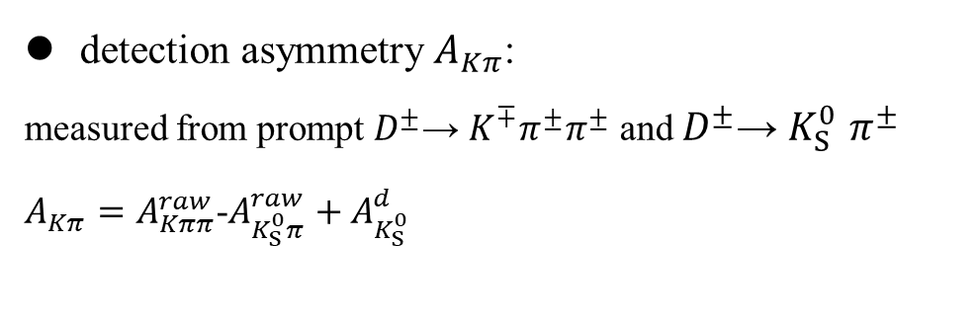
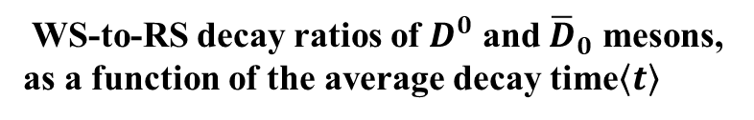
Search for CPV in semileptonically tagged $D^{0}$ → $K^{+}π^{−}$decays
detection asymmetry $A_{Kπ}$:
measured from prompt $D^{±}$→ $K^{∓}π^{±}π^{±}$ and $D^{±}$→ $K_{S}^{0}$ $π^{±}$
$A_{Kπ}=A_{Kππ}^{raw}$-$A_{K_{S}^{0}π}^{raw}+A_{K_{S}^{0}}^{d}$
JHEP03(2025)149
WS-to-RS decay ratios of $D^{0}$ and ${\overline{D}}_{0}$ mesons, as a function of the average decay time$\left\langle t\right\rangle$

Slide 16
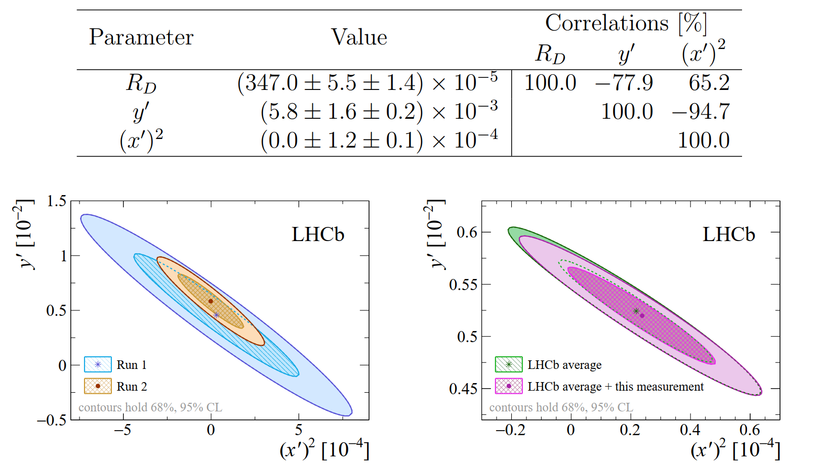
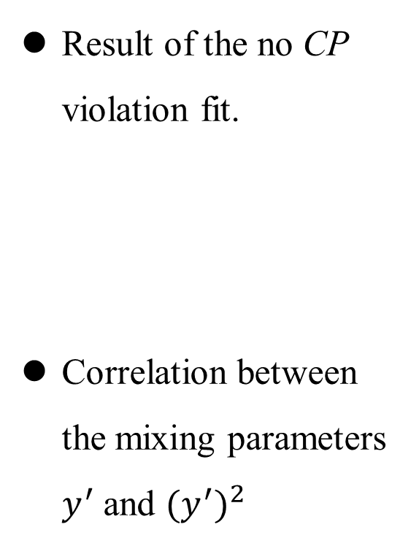
Search for CPV in semileptonically tagged $D^{0}$ → $K^{+}π^{−}$decays
JHEP03(2025)149
Result of the no CP violation fit.
Correlation between the mixing parameters $y^{′}$ and ${{(y}^{′})}^{2}$

Slide 17
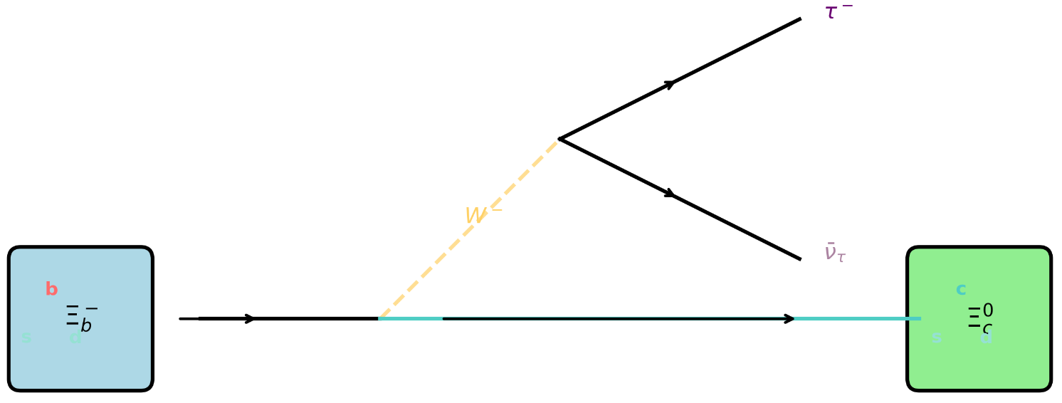
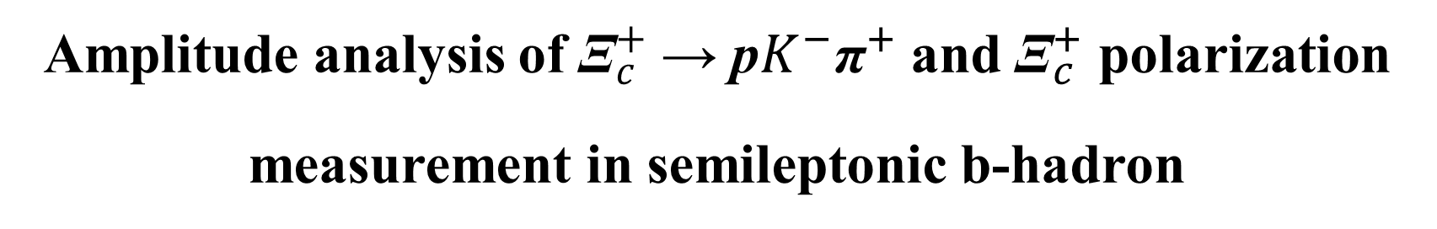
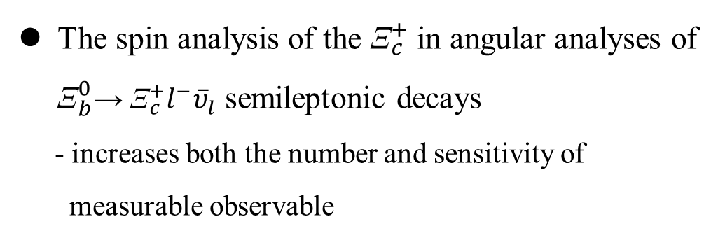
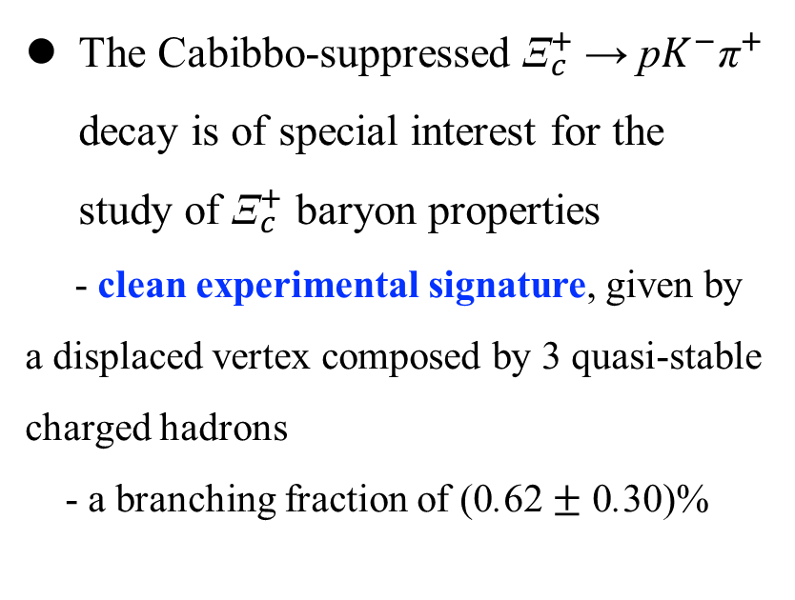
Amplitude analysis of ${\text{Ξ}}_{c}^{+}$→ p$K^{−}{\text{π}}^{+}$ and ${\text{Ξ}}_{c}^{+}$ polarization measurement in semileptonic b-hadron
arXiv:2508.00492
The Cabibbo-suppressed ${\text{Ξ}}_{c}^{+}$→ p$K^{−}{\text{π}}^{+}$ decay is of special interest for the study of ${\text{Ξ}}_{c}^{+}$ baryon properties
- clean experimental signature, given by a displaced vertex composed by 3 quasi-stable charged hadrons
- a branching fraction of (0.62 $±$ 0.30)%
The spin analysis of the ${\text{Ξ}}_{c}^{+}$ in angular analyses of ${\text{Ξ}}_{b}^{0}$→ ${\text{Ξ}}_{c}^{+}l^{−}{\overline{υ}}_{l}$ semileptonic decays
- increases both the number and sensitivity of
measurable observable

Slide 18
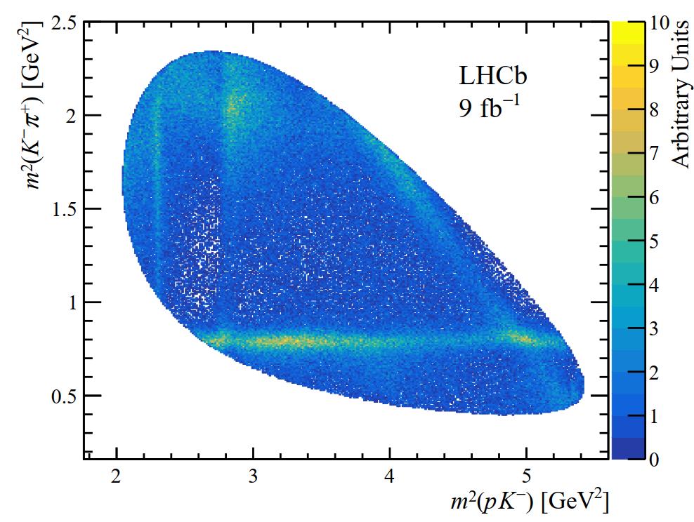
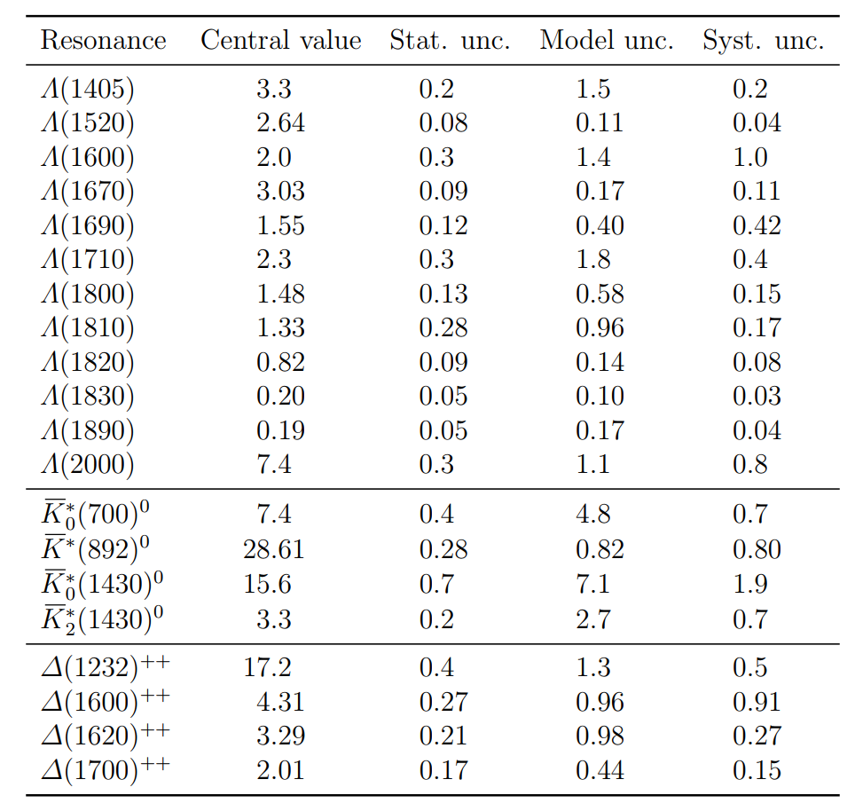
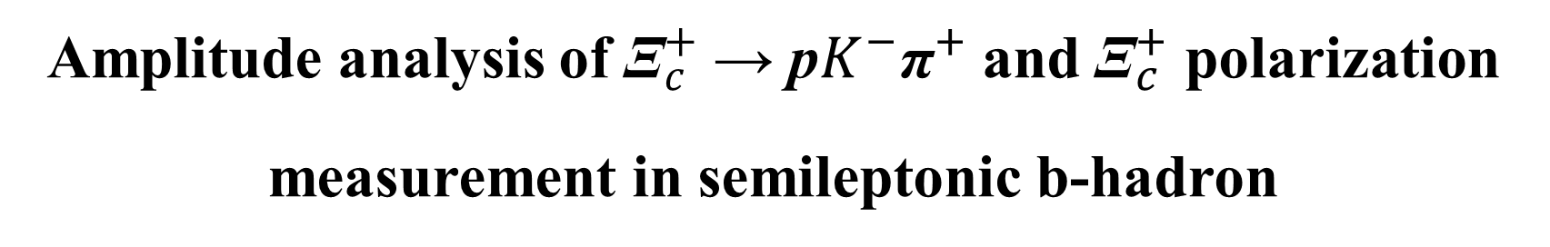

Amplitude analysis of ${\text{Ξ}}_{c}^{+}$→ p$K^{−}{\text{π}}^{+}$ and ${\text{Ξ}}_{c}^{+}$ polarization measurement in semileptonic b-hadron
arXiv:2508.00492
Rich structures: Λ resonances are visible as vertical bands, ${\overline{K}}^{∗}$as horizontal bands and ${\text{∆}}^{++}$ as diagonal bands.
Fit fractions in % of the resonant contributions included

Slide 19
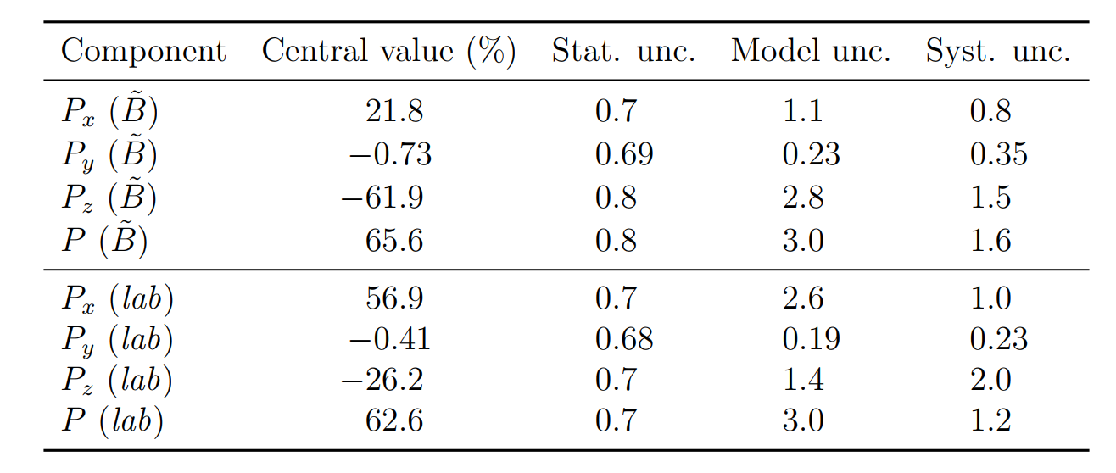


Amplitude analysis of ${\text{Ξ}}_{c}^{+}$→ p$K^{−}{\text{π}}^{+}$ and ${\text{Ξ}}_{c}^{+}$ polarization measurement in semileptonic b-hadron
arXiv:2508.00492
Strong force production: the baryon polarization is difficult to predict in the nonperturbative regime of QCD
⇒ its measurement discriminates among
different low-energy QCD approaches.
polarization measurements enable access to charm-baryon electric and magnetic dipole moments via spin precession
Neither AmAn of the ${\text{Ξ}}_{c}^{+}$→ p$K^{−}{\text{π}}^{+}$ decay, nor ${\text{Ξ}}_{c}^{+}$ polarization measurements, have been performed previously.
Measured ${\text{Ξ}}_{c}^{+}$polarization components and magnitude in $\tilde{B}$ and lab frames

Slide 20
Summary
Even just with Run-I/II data, many new results are still on the way, stay tuned.
Already collected lots of Run-III data, will soon have more rich and more exciting physics results inside!

Slide 21
Thanks！

