Slide 1
CSNS RCS Diagonal Cut-Plane BPM: Accuracy vs. Calibration
M. A. Rehman
On behalf of the CSNS Beam Instrumentation group
Many thanks to CSNS Alignment & Survey, Mechanical, PS group
2025-05-29

Slide 2
Content
Reveal the Edge Effect in RCS BPM
The EM field of the beam is distorted in the vicinity of the edges of the BPM [1]
J-PARC MR also reported a similar issue [2, 3]
Simulations
CST simulations to reveal the edge effect
Calibration of the BPM with wire mapping
Frequency Dependence
Wire Mapping without Dummy pipe
Wire Mapping with Dummy pipe
Temperature influence on BPM
[1] J. H. Cupérus, NIM145 (1977) 233-243
[2] T. Toyama, IPAC10 MOPE012
[3] T. Toyama, OHO School 2009 (Japanese)
[4] K. Satou, OHO School 2020 (Japanese)

Slide 3
CST Simulations

Slide 4
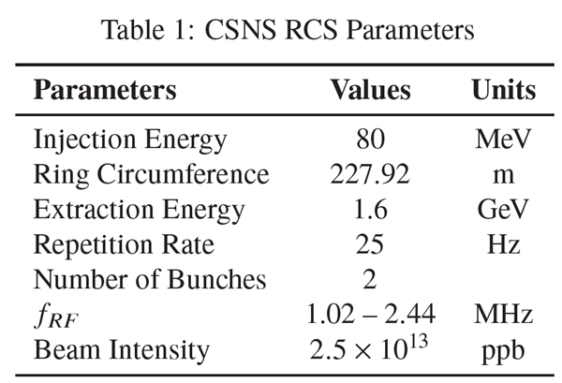
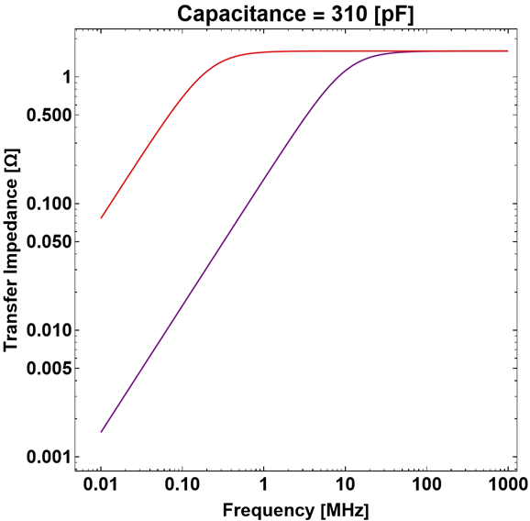
CSNS RCS BPM Structure
32 Diagonal cut BPMs are instrumented in RCS
Several of them are placed inside steering magnet (limited space)
Rib structure on body to prevent eddy current
BPMs are 45^{O} rotated for convenient access to attach cables
Diagonal Cut BPM design by
Prof. Taoguang Xu
Corrector
Magnet
B
BPM
A
D
C

Slide 5
CST Simulations
Only BPM
Bunch charge 1 µC, Bunch Length 7000 mm/1σ (24 ns/1σ ), β = 1
¼ Region, 0 to x/y:60 mm, with 10 mm step
BPM with Upstream Bending Magnet Pipe (Exaggerated Condition)
Bunch charge 1 µC, Bunch Length 7000 mm, β = 1
¼ Region, 0 to x:60 mm, y: 40 mm, with 10 mm step
BPM with Upstream Bellows and Bending Magnet Pipe (Realistic)
Bunch charge 1 µC, Bunch Length 7000 mm, β = 1
¼ Region, 0 to x:60 mm, y: 40 mm, with 10 mm step

Slide 6
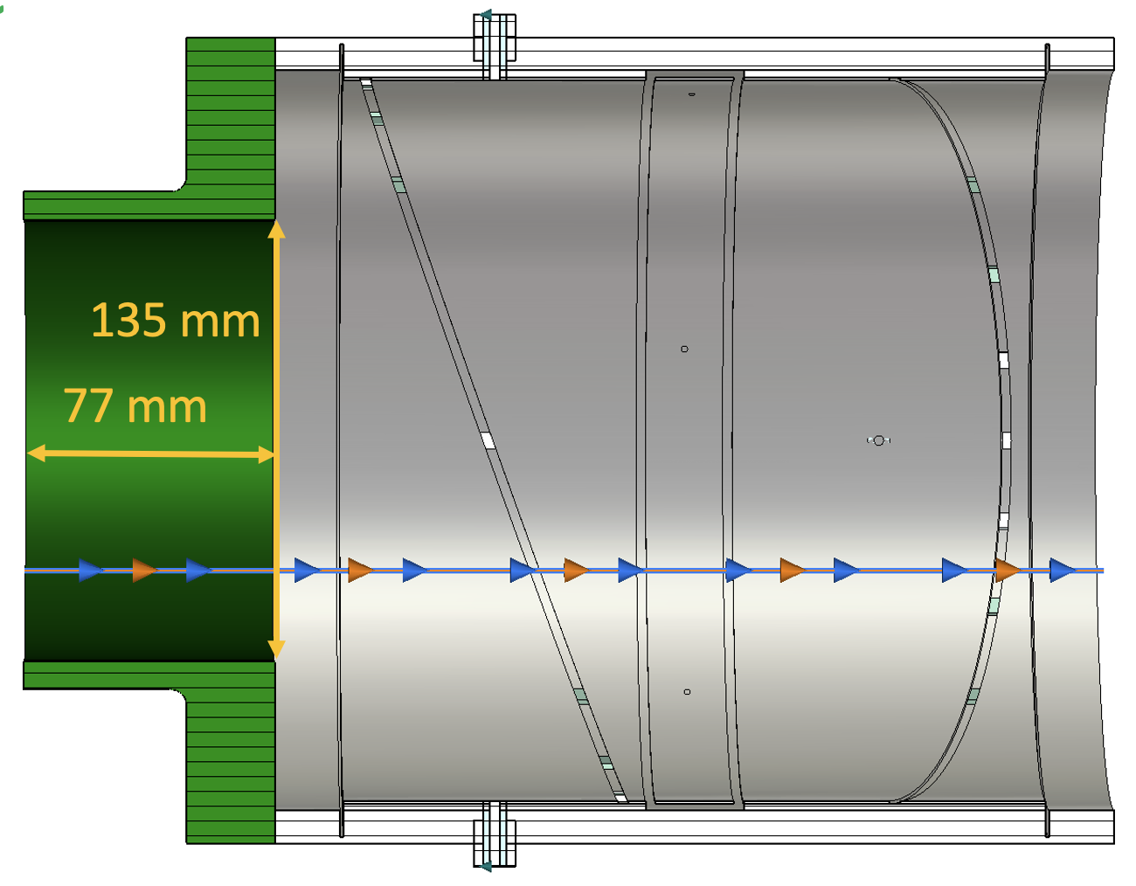
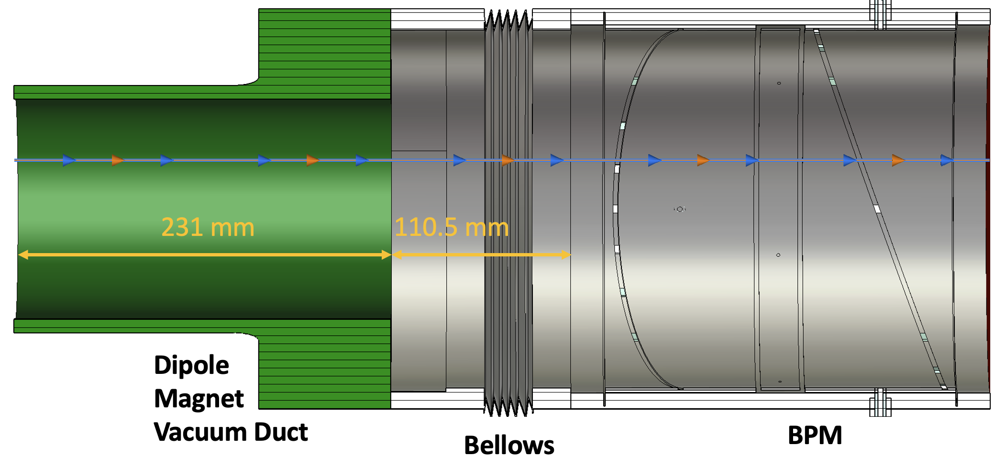
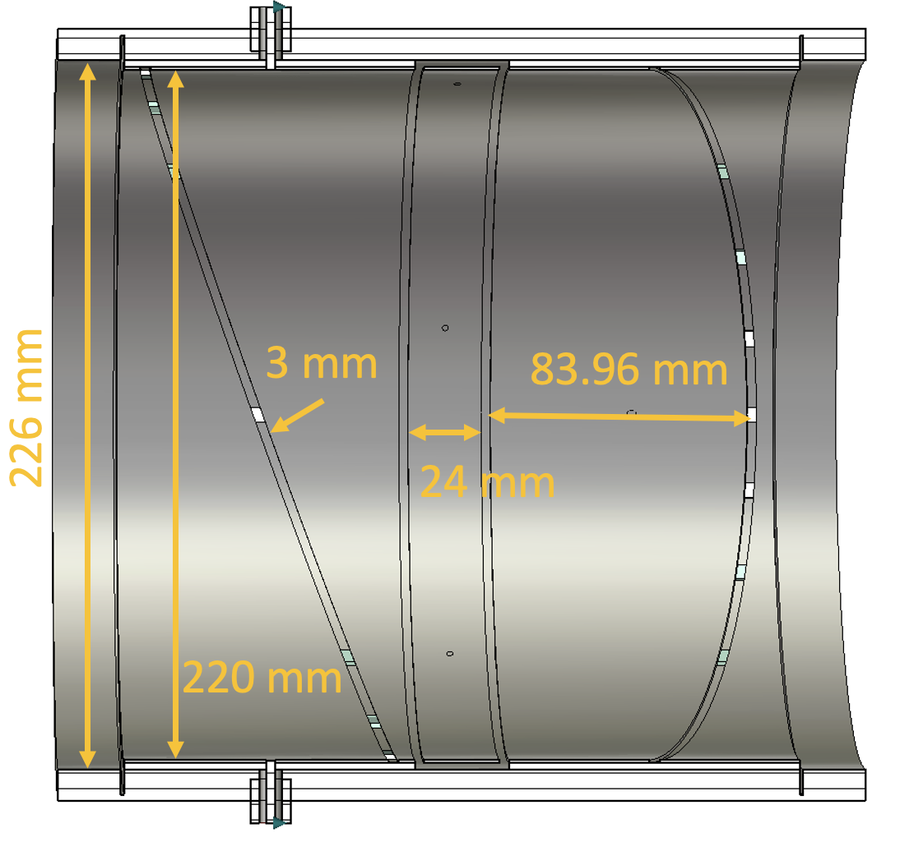
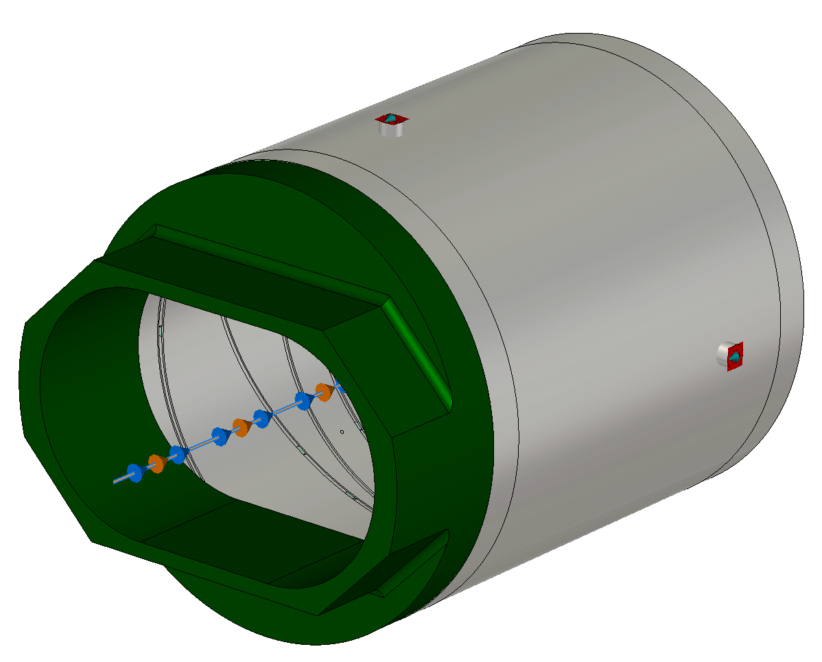
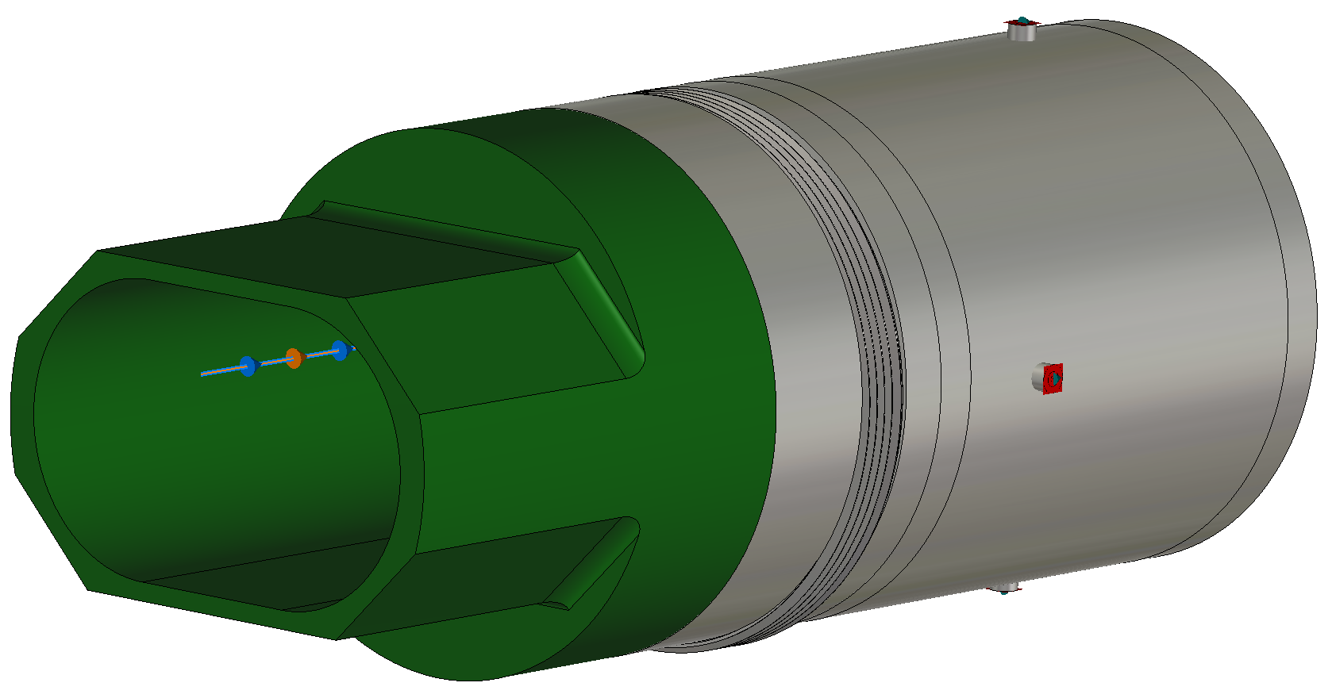
CST Simulated Models: Three Scenarios
Scenario 3: BPM+realistic pipe
(R1BPM04 case)
Scenario 2: BPM+short pipe
Scenario 1: only BPM
218 mm

Slide 7
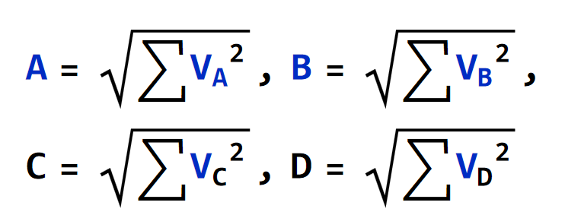
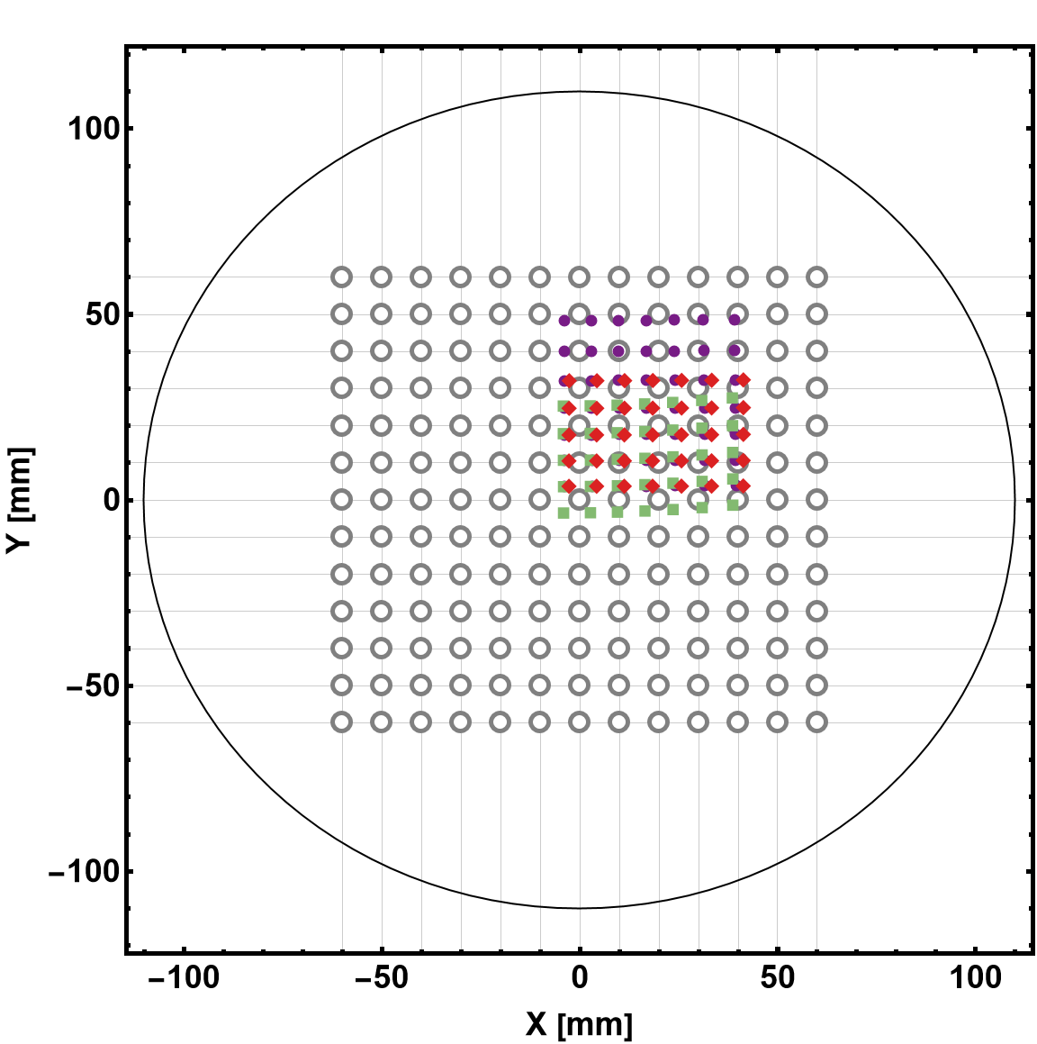
Evaluation of position map in simulation
To find offset and calibration constant polynomial fit
3rd Order Polynomial was used
The mapping function obtained from the wire mapping ignores the BM pipe!
To estimate these errors in the CST Simulation
Let’s consider the X_{raw} = Log[A/C] and Y_{raw} = Log[B/D] from the case BPM + Bellows + Pipe
But the Fitting function from the BPM only!!
 | C_{00,x} [mm] | C_{00,y} [mm] | C_{10,x} [mm] | C_{01,y} [mm]
Senario1 | 5.45 | -5.42 | 161.30 | 161.73
Senario2 | 6.05 | 4.88 | 162.11 | 155.02
Senario3 | 3.94 | -5.54 | 157.91 | 165.11

Slide 8
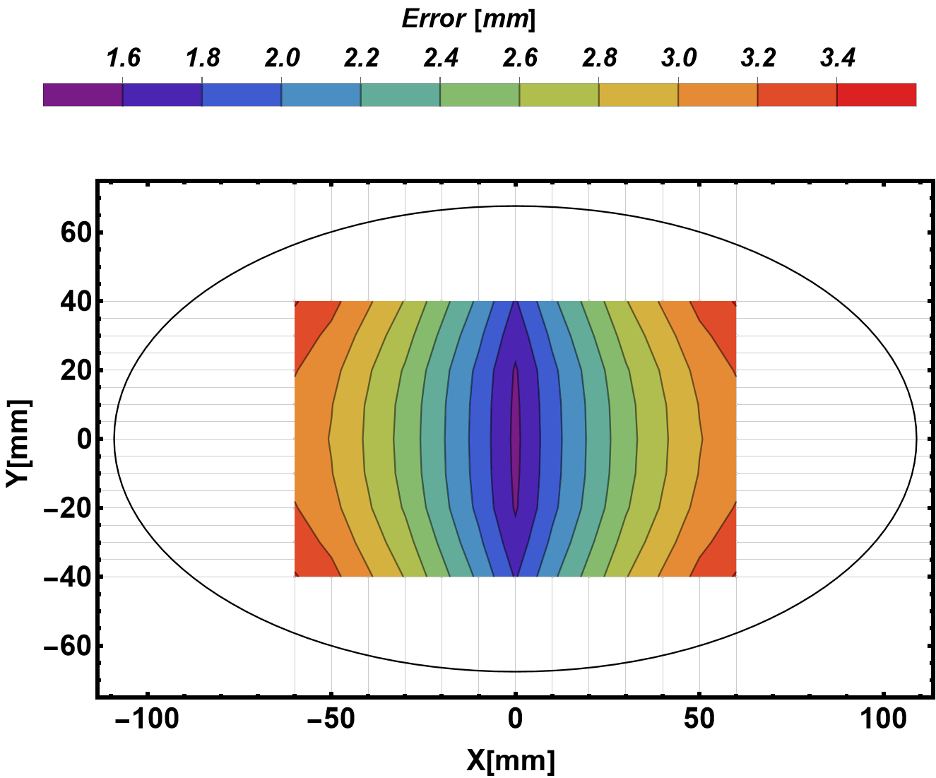
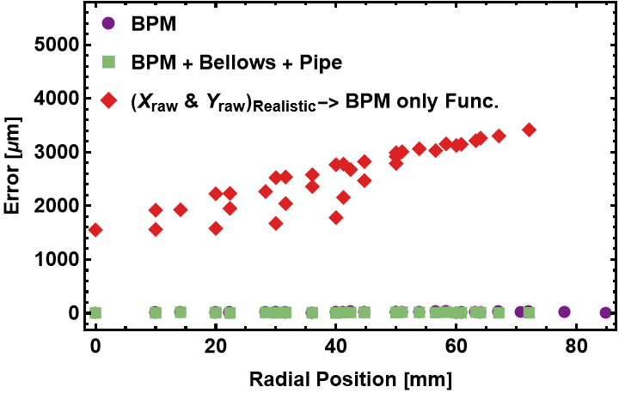
Offset estimation in simulation
X_{raw} and Y_{raw} from the realistic case
but the Fitting function from the BPM only!!
The accuracy error is ? mm to?mm within the measurement range from 0 mm to ±10 mm
R.YANG: Offset in hor. and ver. (NOT 45 deg tilt!)

Slide 9
BPM calibration in lab.
Many thanks to the Alignment and Survey Group (J. Liang, T. Wang)

Slide 10
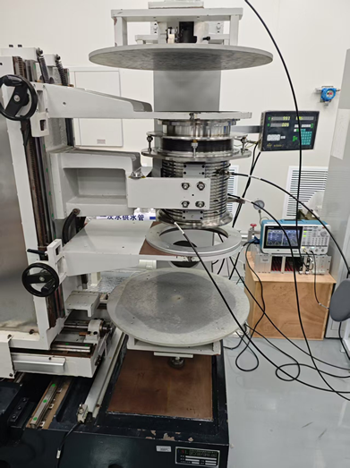
Calibration system in D1
BPM and wire (Molybdenum: Ø_{d}=100 µm) aligned with accuracy of 100 µm (Measured)
Transverse mover precision is 5 µm (Measured)
Transverse mapping range is ±60 mm
Tektronix signal generator (AFG31000)
V_{pp}=5 V, Frequency = 1-10 MHz (Varied)
Bergoz-BB Electronics
Dynamic range: -70 dBm to +5 dBm
BW: 10 MHz
ADC Bit: NI Digitizer 16-bit
A thermocouple to monitor temperature
Bellows
BPM
X/Y Mover

Slide 11
Survey of the calibration system
R.YANG: Conclusion of this page
1.First Measure Coordinate of BPM
Coordinate Measuring Machine（CMM）
Brand: HEXAGON
Model: PILOT 15.30.12
error | BPM calibration 01-BPM calibration 02
 | X/mm | Y/mm | Z/mm
F1 error | -0.004 | 0.005 | -0.003
F2 error | 0.012 | -0.007 | 0.030
F3 error | 0.057 | -0.040 | 0.010
F4 error | 0.057 | -0.039 | 0.013
error | BPM calibration 04-BPM calibration 03
 | X/mm | Y/mm | Z/mm
F1 error | 0.003 | 0.003 | -0.002
F2 error | 0.030 | -0.016 | -0.015
F3 error | 0.004 | -0.001 | 0.002
F4 error | 0.002 | -0.002 | -0.004
error | BPM calibration 04-BPM calibration 01
 | X/mm | Y/mm | Z/mm
F1 error | 0.007 | 0.013 | -0.001
F2 error | 0.012 | 0.002 | -0.001
F3 error | 0.013 | -0.006 | 0.003
F4 error | 0.007 | -0.006 | -0.002
BPM calibration 01 |  |  |  |  | BPM calibration 02
point name | X/mm | Y/mm | Z/mm |  | point name | X/mm | Y/mm | Z/mm
F1 | -88.214 | 185.064 | 244.628 |  | F1 | -88.218 | 185.070 | 244.626
F2 | -88.026 | 190.152 | 51.868 |  | F2 | -88.014 | 190.145 | 51.897
F3 | 87.936 | 189.844 | 51.456 |  | F3 | 87.993 | 189.804 | 51.465
F4 | 87.988 | 185.130 | 244.477 |  | F4 | 88.045 | 185.090 | 244.490
BPM calibration 03 |  |  |  |  | BPM calibration 04
point name | X/mm | Y/mm | Z/mm |  | point name | X/mm | Y/mm | Z/mm
F1 | -88.211 | 185.074 | 244.630 |  | F1 | -88.207 | 185.077 | 244.628
F2 | -88.044 | 190.170 | 51.882 |  | F2 | -88.014 | 190.154 | 51.866
F3 | 87.944 | 189.838 | 51.457 |  | F3 | 87.948 | 189.838 | 51.459
F4 | 87.993 | 185.126 | 244.479 |  | F4 | 87.995 | 185.123 | 244.475

Slide 12
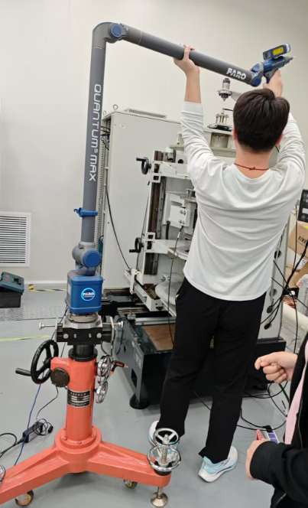
Survey of the calibration system
R.YANG: Conclusion of this page
Laser Scanner
Brand: FARO
Model: S730
X axis
error(forward-goning)
max | 0.03mm
min | -0.012mm
RMS | 0.006mm
error(reverse-goning)
max | 0.008mm
min | -0.042mm
RMS | 0.005mm
Y axis
error(forward-goning)
max | 0.022mm
min | -0.045mm
RMS | 0.017mm
error(reverse-goning)
max | 0.025mm
min | -0.065mm
RMS | 0.016mm

Slide 13
Survey of the calibration system
R.YANG: Conclusion of this page
Laser Scanner
Brand: FARO
Model: S730
Error of BPM Center and Wire Position
Test 01 | X(mm) | Y(mm) |  | Test 02 | X(mm) | Y(mm)
Top Flange center of BPM-Wire | 0.018 | 0.038 |  | Top Flange certer of BPM-Wire | -0.079 | 0.02
Bottom Flange center of BPM-Wire | -0.005 | 0.014 |  | Bottom Flange certer of BPM-Wire | -0.052 | 0.011
Test 03 | X(mm) | Y(mm)
Top Flange center of BPM-Wire | -0.066 | 0.072
Bottom Flange center of BPM-Wire | -0.088 | -0.018

Slide 14
Test of the BPM electronics

Slide 15
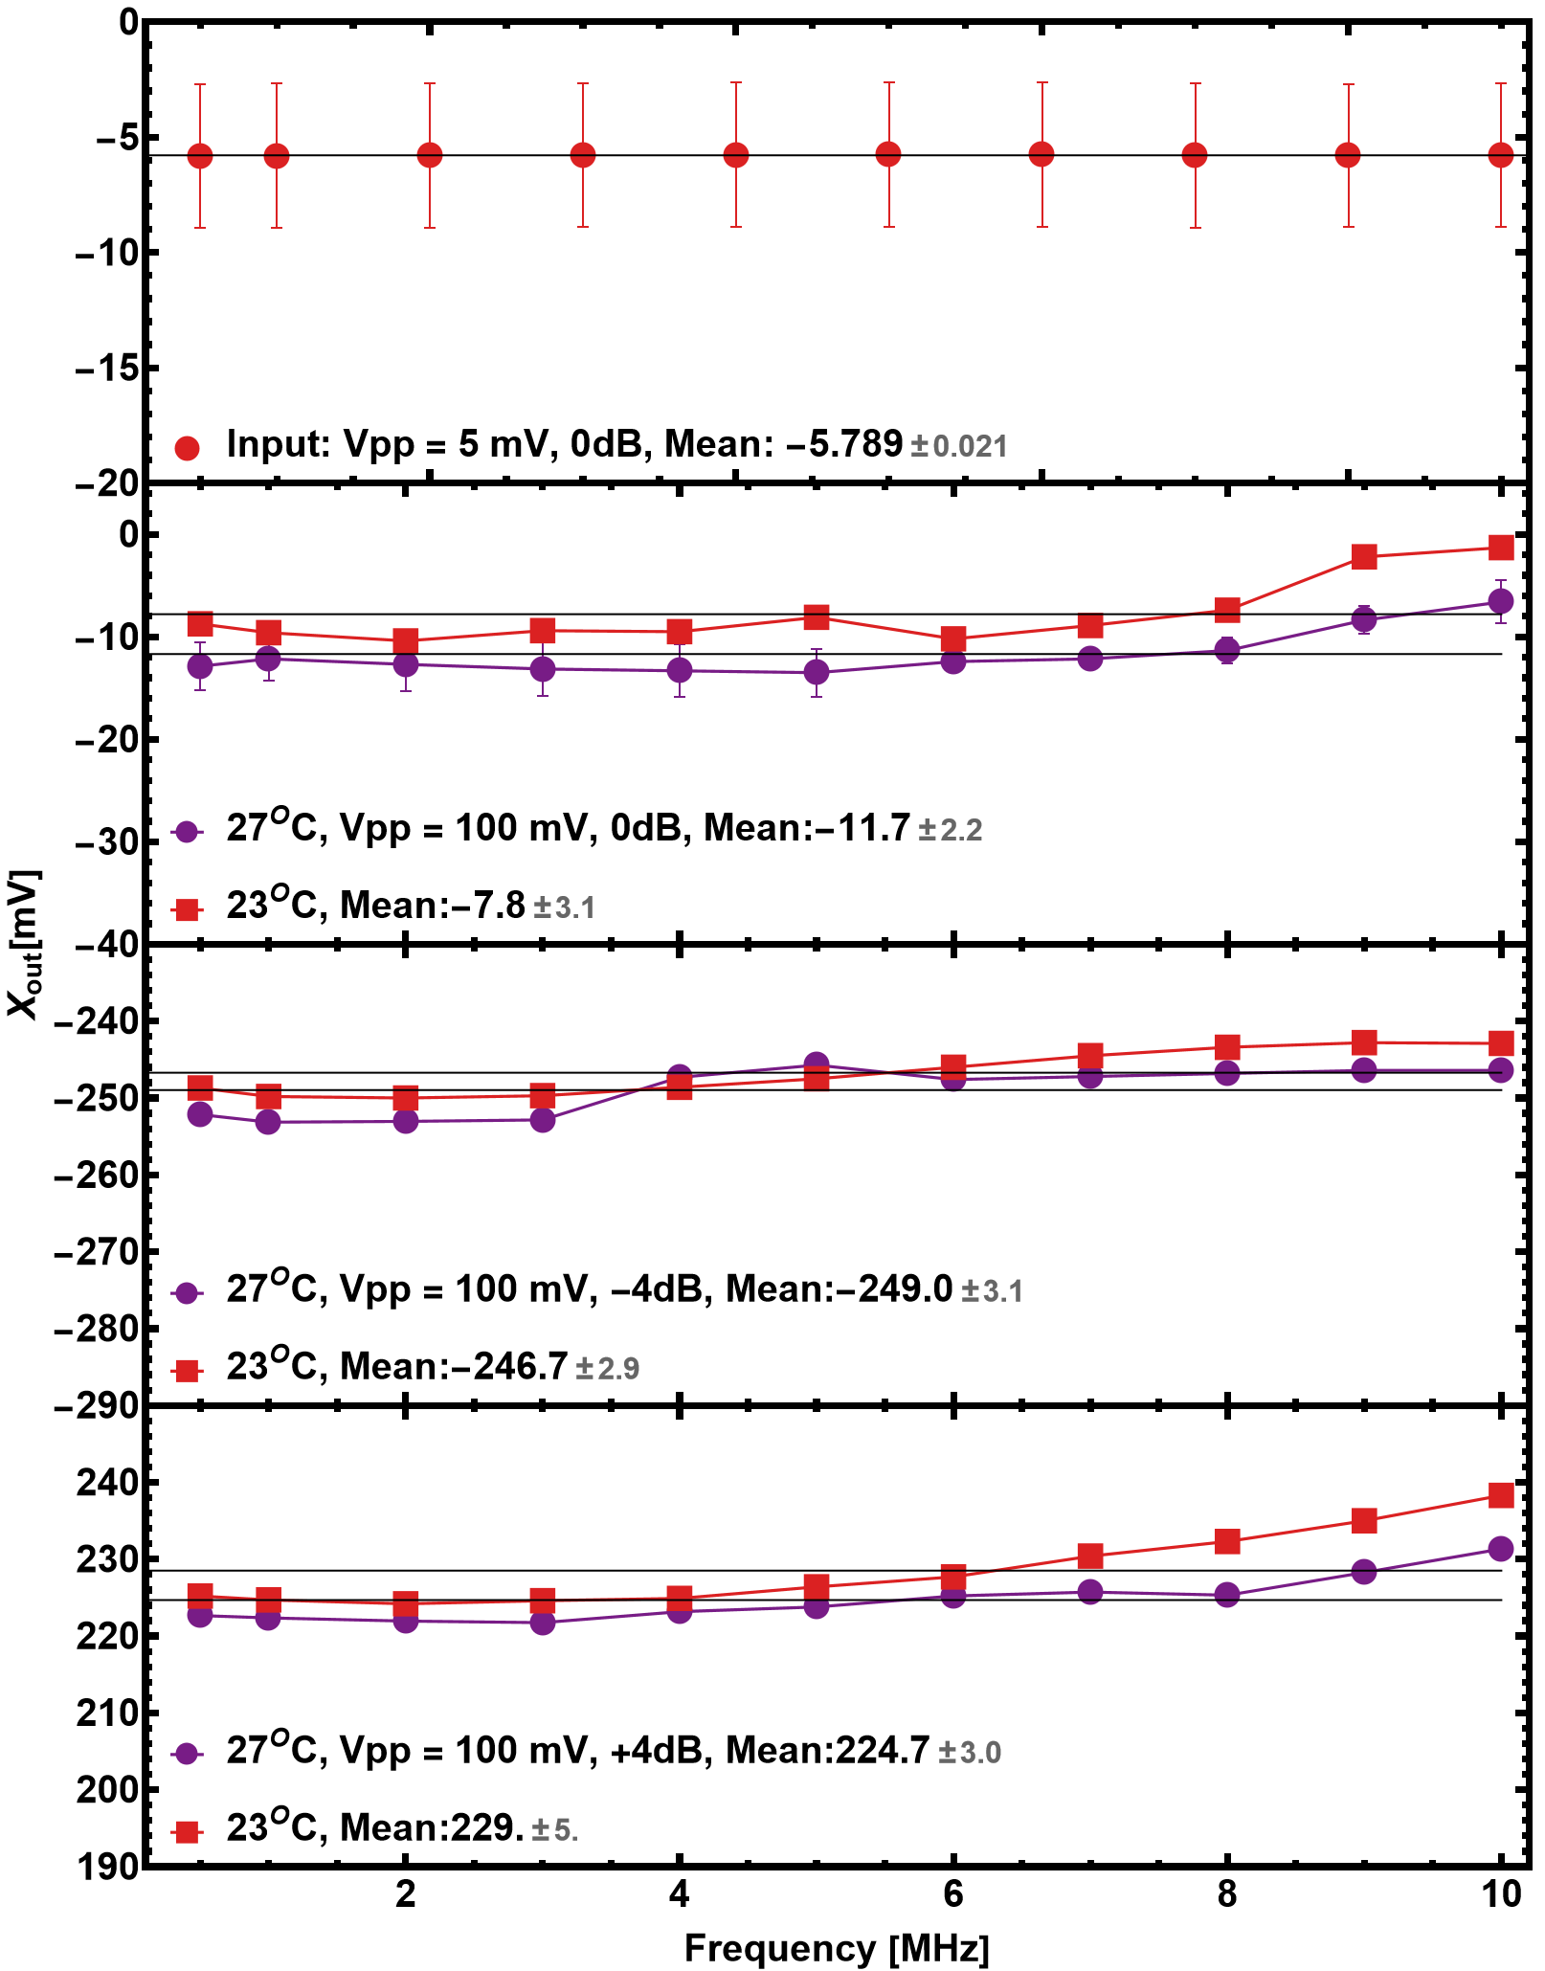
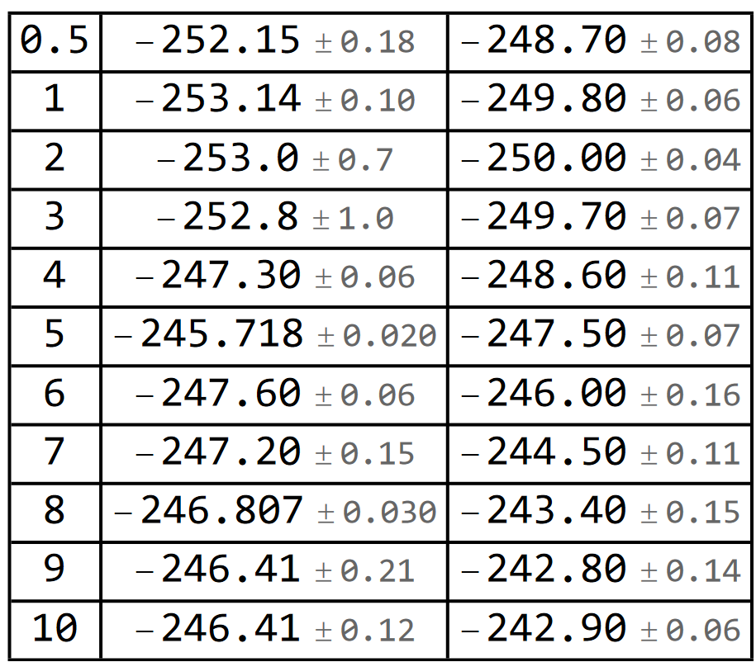
Bergoz-BB Frequency dependence Check
Bergoz-BB have a BW of 10 MHz
So, it should be independent of the signal up to 10 MHz
Data was obtained
Vpp=5 mV, Frequency 0.5 MHz to 10 MHz @ 27 °C
Vpp=100 mV, Frequency 0.5 MHz to 10 MHz @ 27^{O}C and 23^{O}C, Log(V_{a}/V_{c}) = -4 dB
Vpp=100 mV, Frequency 0.5 MHz to 10 MHz @ 27^{O}C and 23^{O}C, Log(V_{a}/V_{c}) = +4 dB
R.Yang: 0dB, -4 dB, +4dB are misleading
Abs. error to position.
Frq [MHz]
X_{out}@27^{O}
X_{out}@23^{O}
The room temperature was adjusted with the air conditioner.

Slide 16
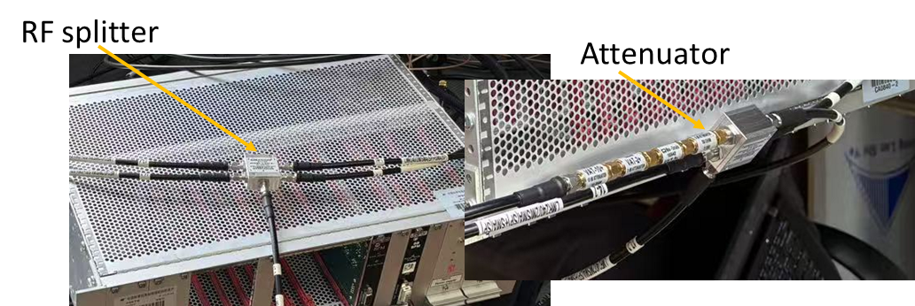
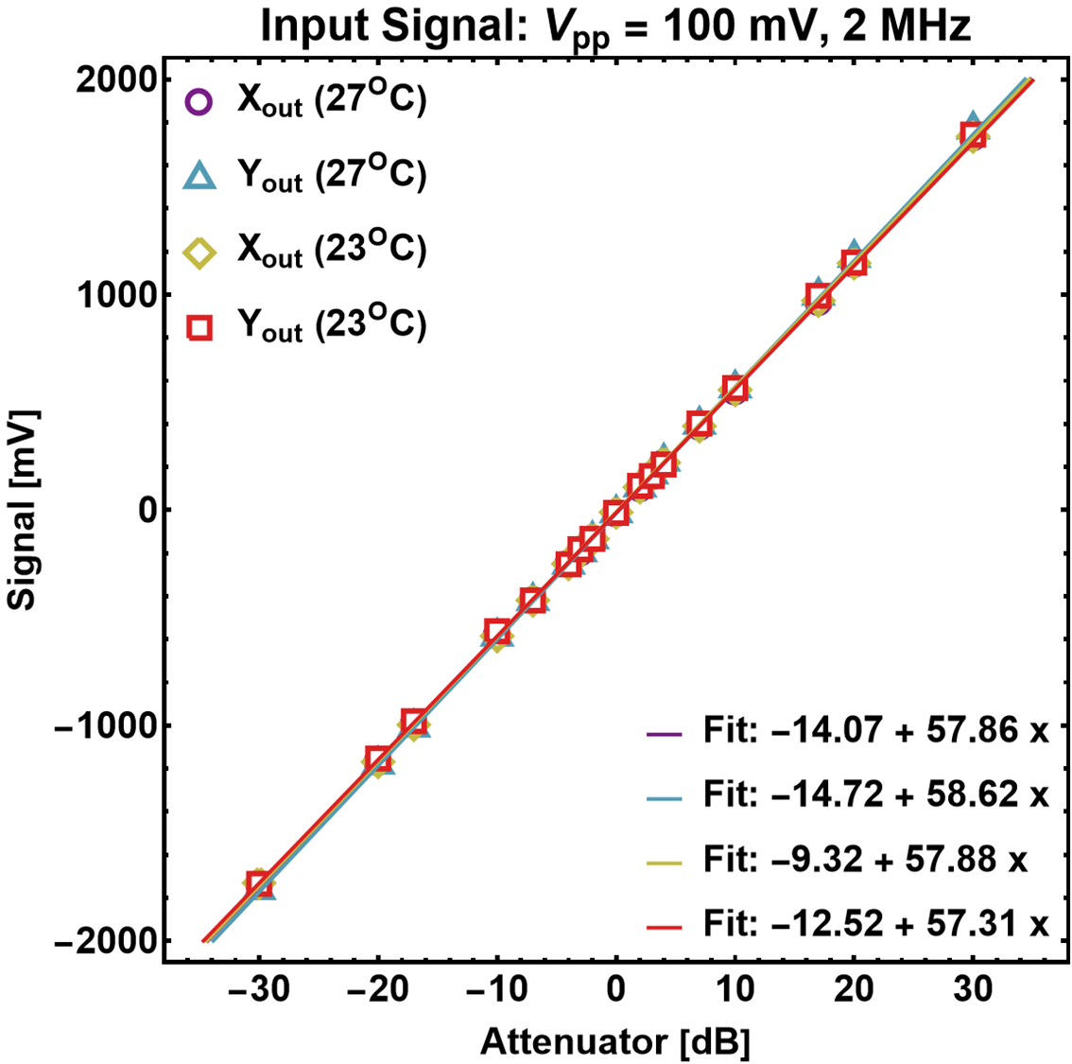
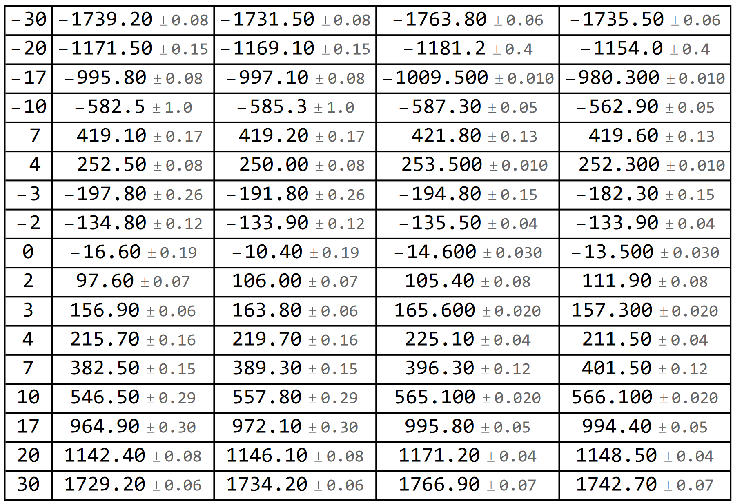
Bergoz-BB Linearity Check
R.YANG: Conclusion of this page
Att. [dB]
X_{out}@27^{O}
X_{out}@23^{O}
Y_{out}@27^{O}
Y_{out}@23^{O}
Log(V_{a}/V_{c}) or Log(V_{b}/V_{d})

Slide 17
Re-calibration of the BPM

Slide 18
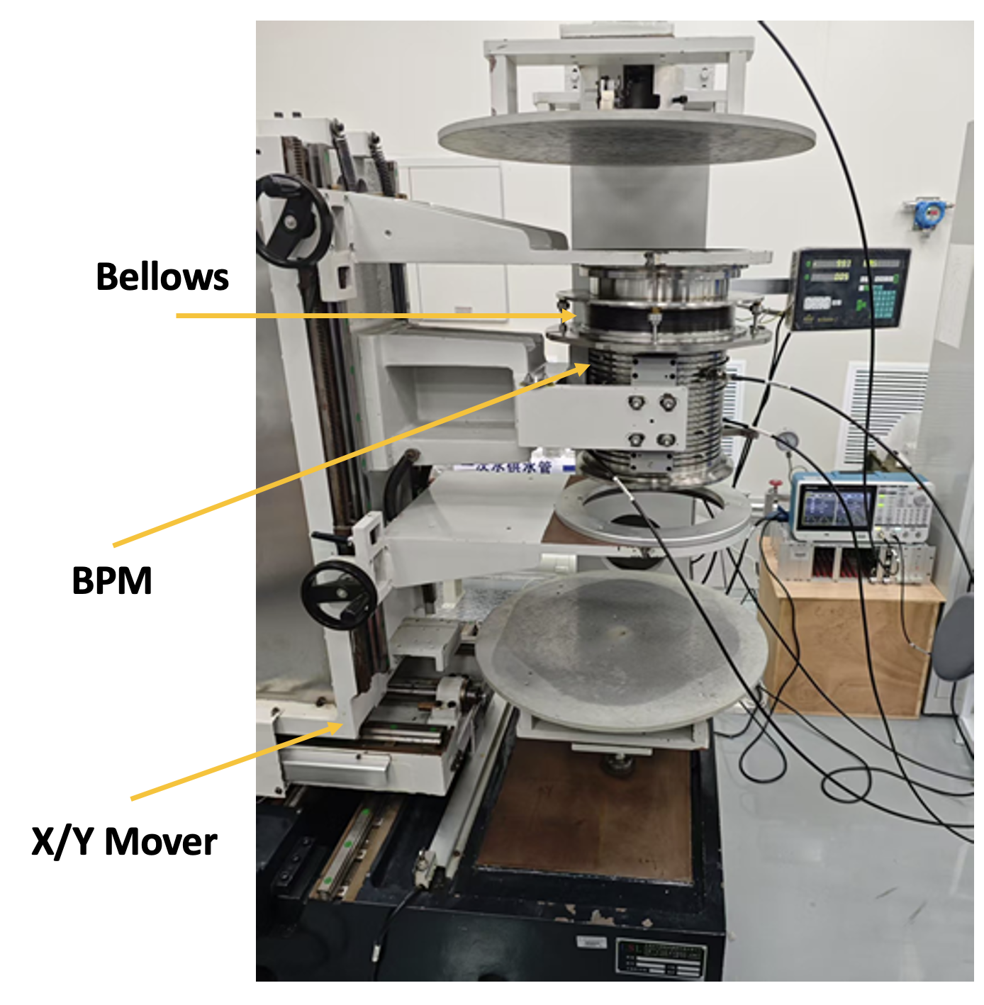
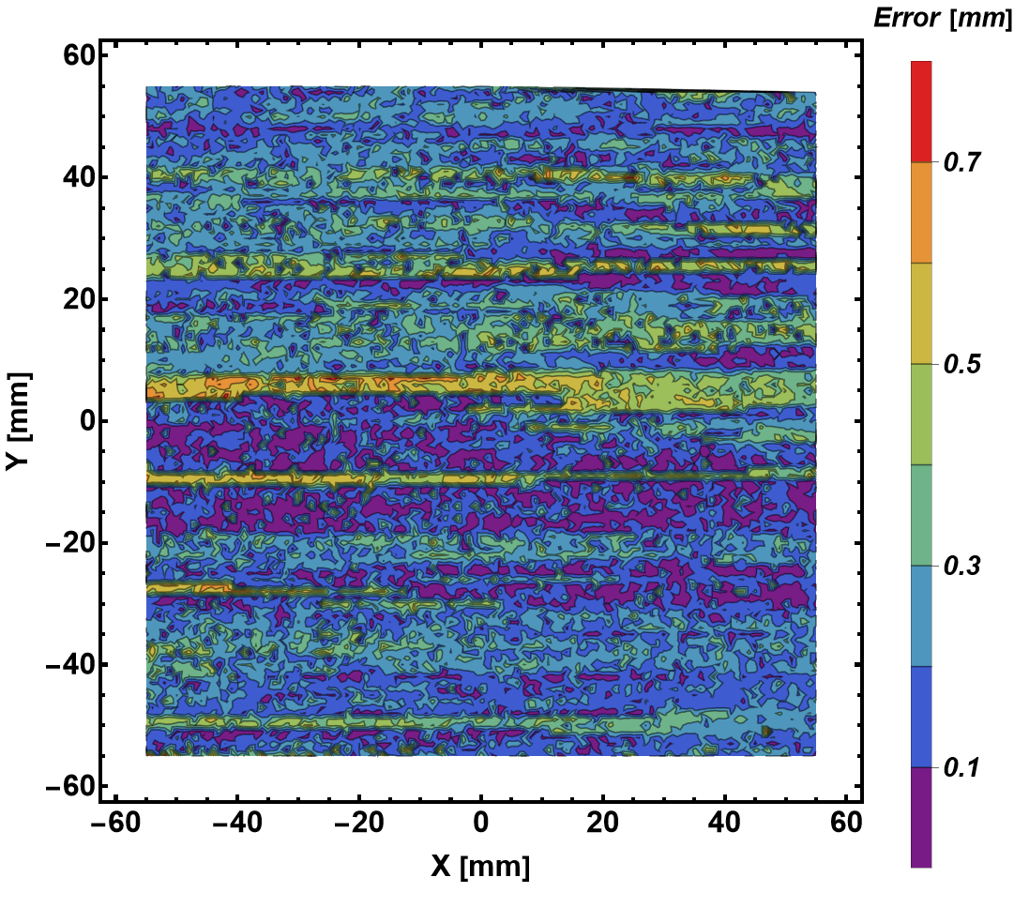
Repeatability of the calibration system
Step size: 1 mm
Frequency: 1 MHz
Repeat 17 Times
C_{00,x} [mm] | C_{00,y} [mm] | C_{10,x} [mm] | C_{01,y} [mm]
$$3.23±0.06$$ | $$5.95±0.19$$ | $$135.74±0.07$$ | $$136.20±0.30$$
Conclusion:
The random error induced uncertainty of the mapping coef. is <3.2%.

Slide 19
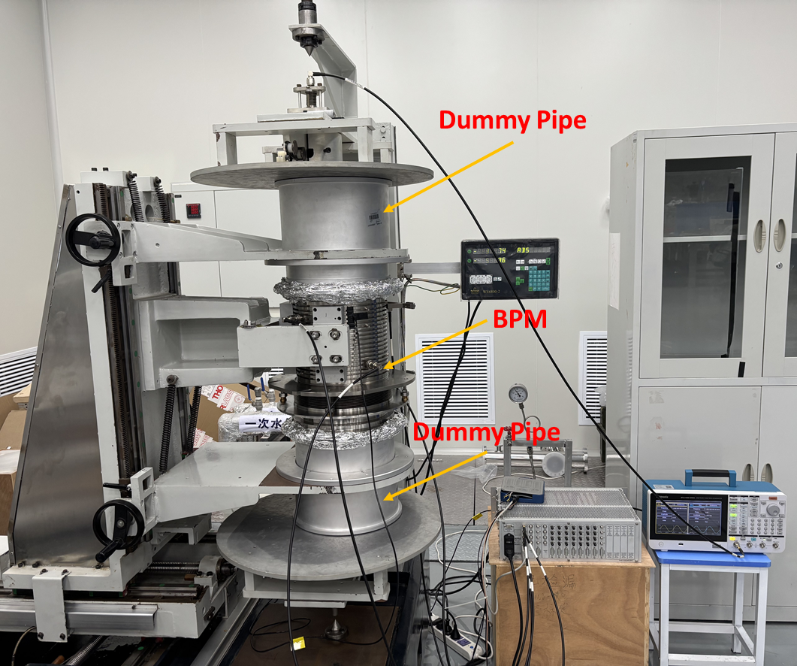
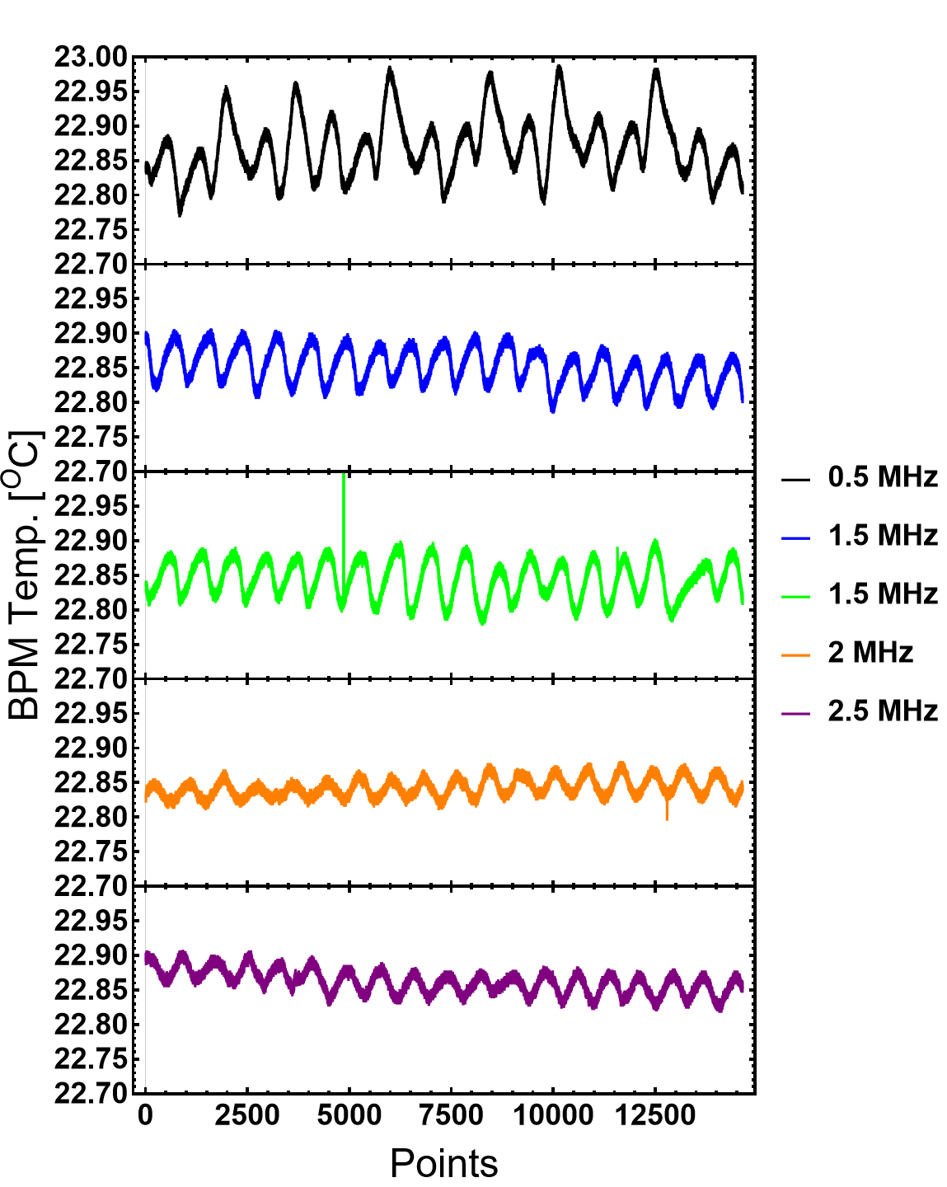
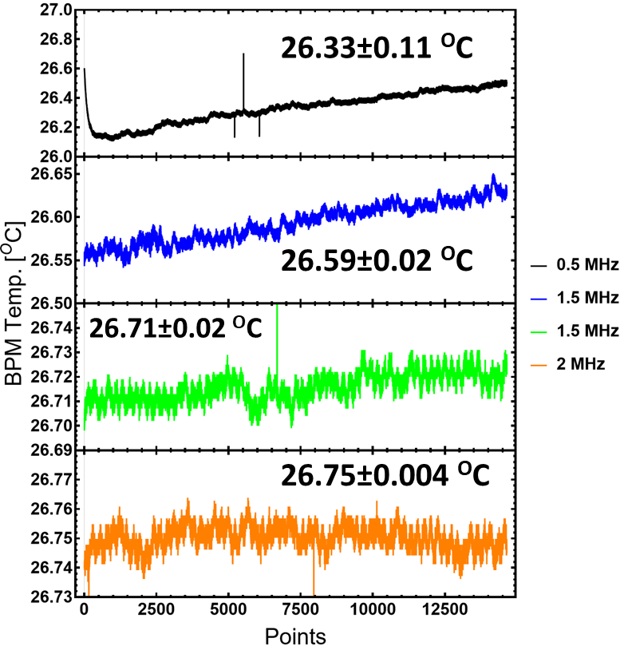
Calibration system: more details
1, dummy pipe (old) were added to the upper and bottom sides
2, Room temperature was change from 23 ºC to 27 ºC (maximum!)
Input to Electronics: 1~2 mV

Slide 20
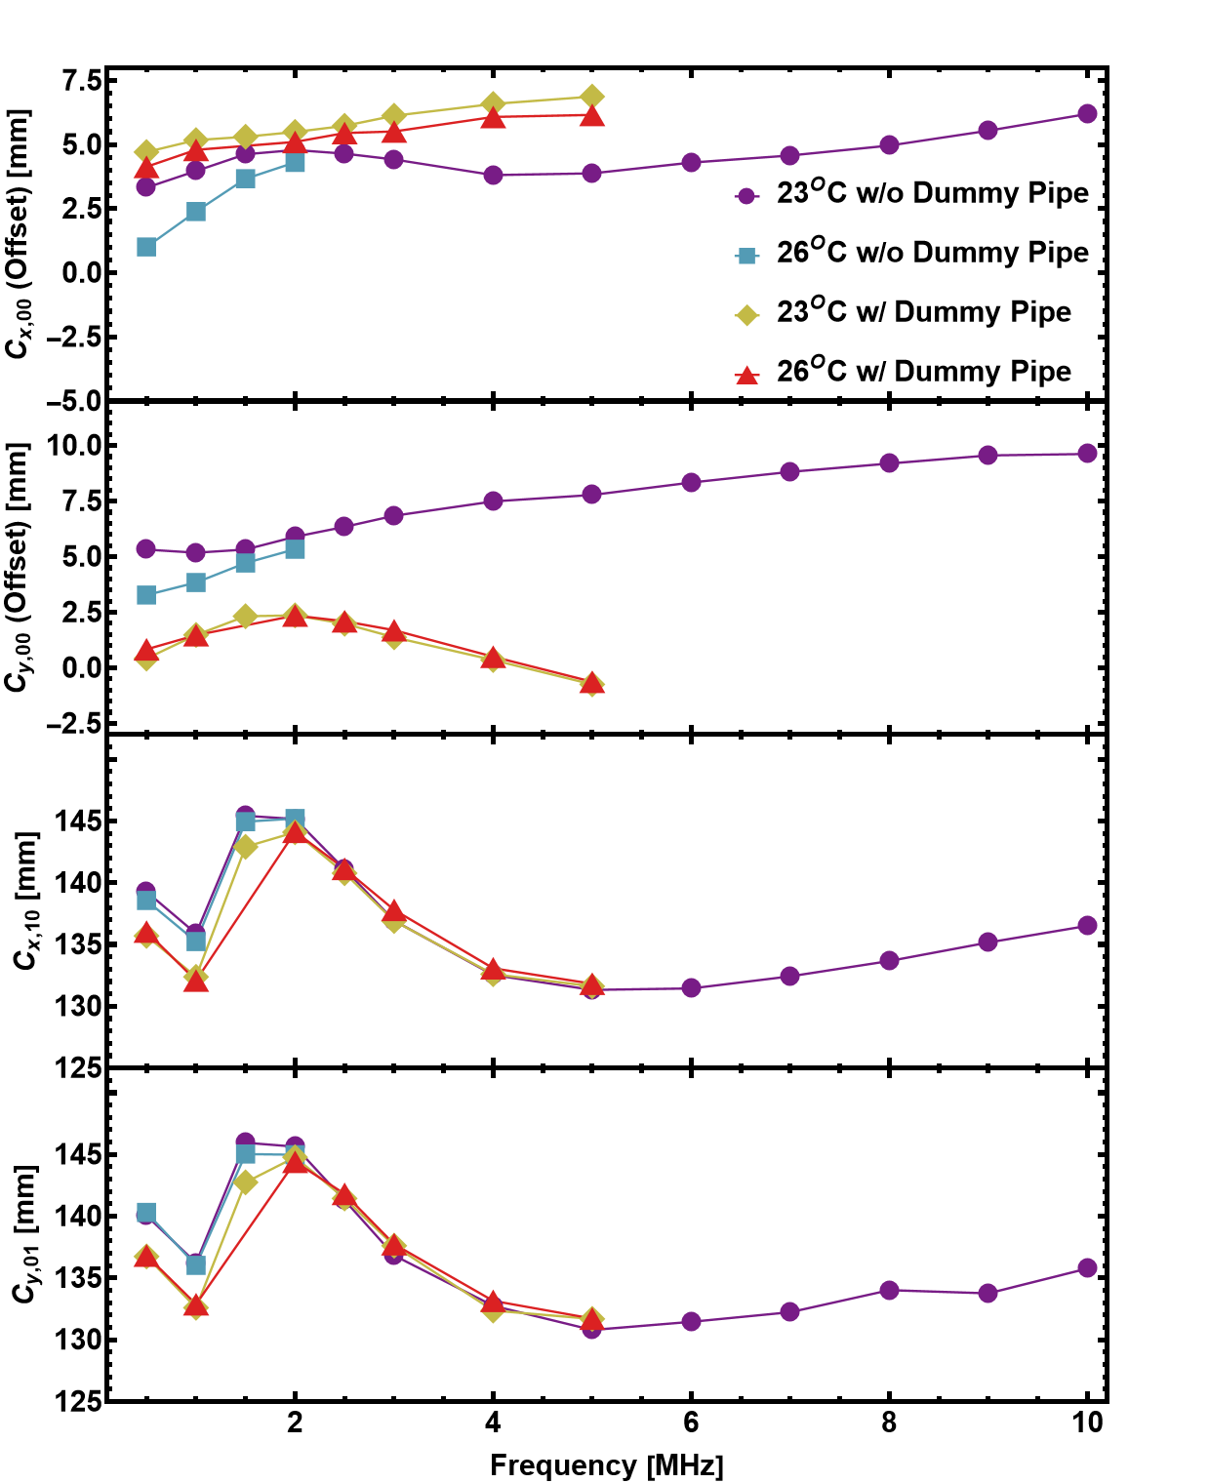
Wire Mapping: Frequency Dependence
* w/ 3rd order Polynomial Fit
Strong frequency dependence is observed
Offset(y) varies from 5.5 to 10 mm in Freq. range 0.5 to 10 MHz
The offset varies largely with and without dummy pipe
The offset variation with temperature change (w/o dummy pipe) is large. Offset variation with temperature change (w/ dummy pipe) is small

Slide 21
Summary
CST simulations has been carried out to estimate the Edge Effect
The error is ?mm to ? mm within the measurement range from 0 mm to ±55 mm
The wire mapping of spare BPM has been carried out
Wire mapping without dummy pipe
Room Temperature 23^{O}
Frequency variation 0.5 MHz to 10 MHz
Room Temperature 27^{O}
Frequency variation 0.5 MHz to 2 MHz
Wire mapping with dummy pipe
Room Temperature 23^{O}
Frequency variation 0.5 MHz to 5 MHz
Room Temperature 27^{O}
Frequency variation 0.5 MHz to 5 MHz
Only Sim.
Exp. In future
Mapping
Exp.
Mapping
Exp.
Known
Probably Error w/ and w/o Dummy Pipe: About 2.5 mm/3.7 results in additional offset @ r=0 mm

Slide 22
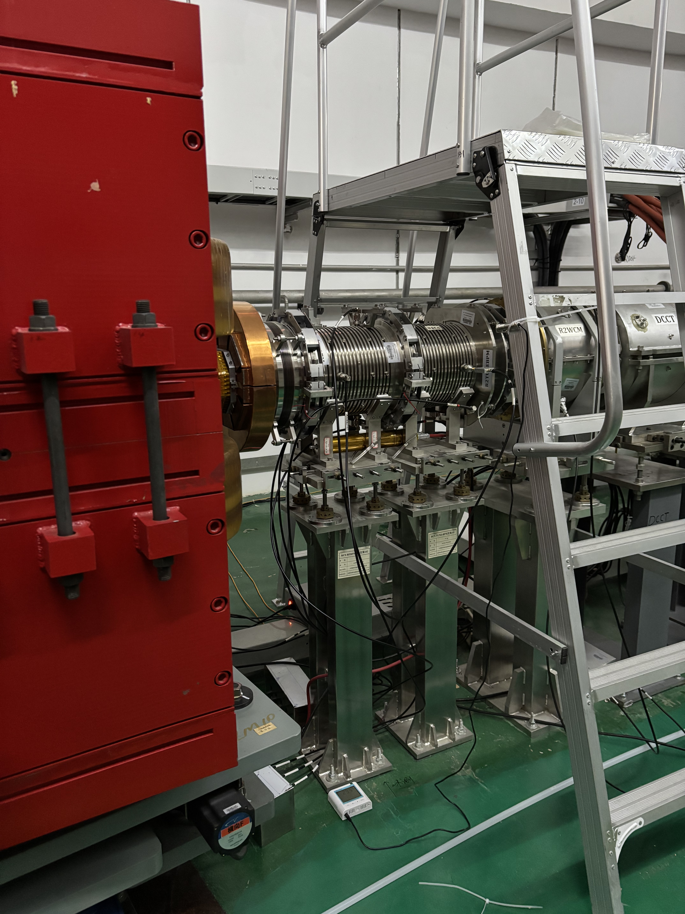
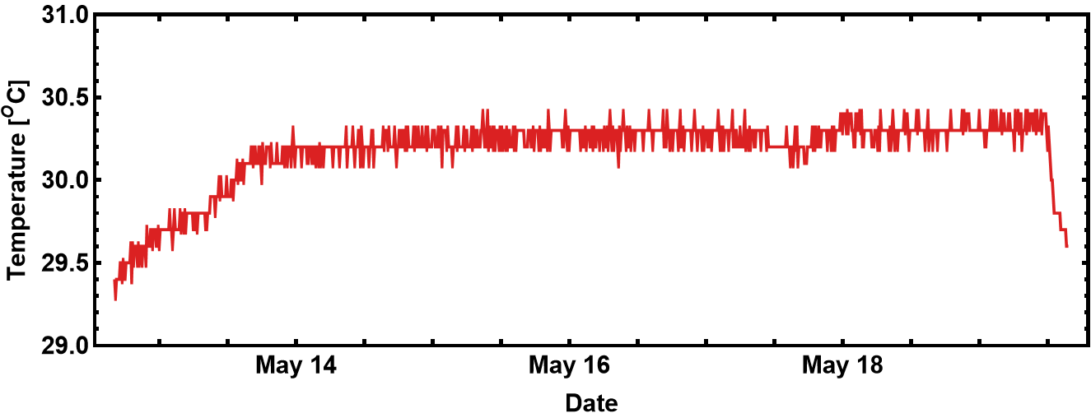
Bending Magnet
BPM
sensor
Real BPM Temperature in Tunnel
30.26±0.07 ^{O}C
Beam ON
Temperature sensor Readout

Slide 23
Highlights from 29/05/2025 RCS BPM meeting
A remote discussion meeting with T. Toyama and K. Satou of J-PARC/KEK (29/05/2025)
Some highlights of the discussion
Comment 1#: CST simulation with open boundy might include additional undesired artifical effects/errors. Therefore, simulations with dummy pipe is recommanded. The appropriate length of the dummy pipe should be checked via simulation and comparison of the results. => A length of the dummy pipe being >3*BPM diameter has been recommanded by senior master; but, Toyama-san think L>1*diam. Might also work. It should be confirmed through comparisons.
Q6: Did you check the capacitance matrix terms in lab.? A6: Not yet, but it could be done. Recommendation: use a two-port VNA and a 50 Ohm terminator; The lower frequency range is more important, i.e., determine the C_ij value in a lower freq. (<1 MHz at JPARC , Toyama-san)
Q9: which dummy pipe length is favoured for the calibration system in lab.? (R. Yang) A9: Same troubles in J-PARC’s BPM calibration (varying BPM apertures). No clear norm. The 3*Diam. is assessed by senior master through static calculation (formula), and it is very rough. (Toyama-san) => We should use a longer one

Slide 24
Highlights from 29/05/2025 RCS BPM meeting
Some highlights of the discussion
Q7: Mapping with VNA at JPARC. A7: we use a 5-port VNA Recommendation:
Generator – Transformer at wire input – Wire: the transformer should be optimized to minimize the reflection; in the case of mis-matched impedance, the reflection RF signal will cause extra EM field distortion inside the BPM body, it does deform the waveform
Consider to use a RF power amplifier
might be 200-300 Ohm characteristics impedance of the (wire-BPM, the calibration system)
In Toyama-san’s mapping work, some problems were observed in the early phase, and the reason was found to be the mis-match between wire and coax. cable

Slide 25
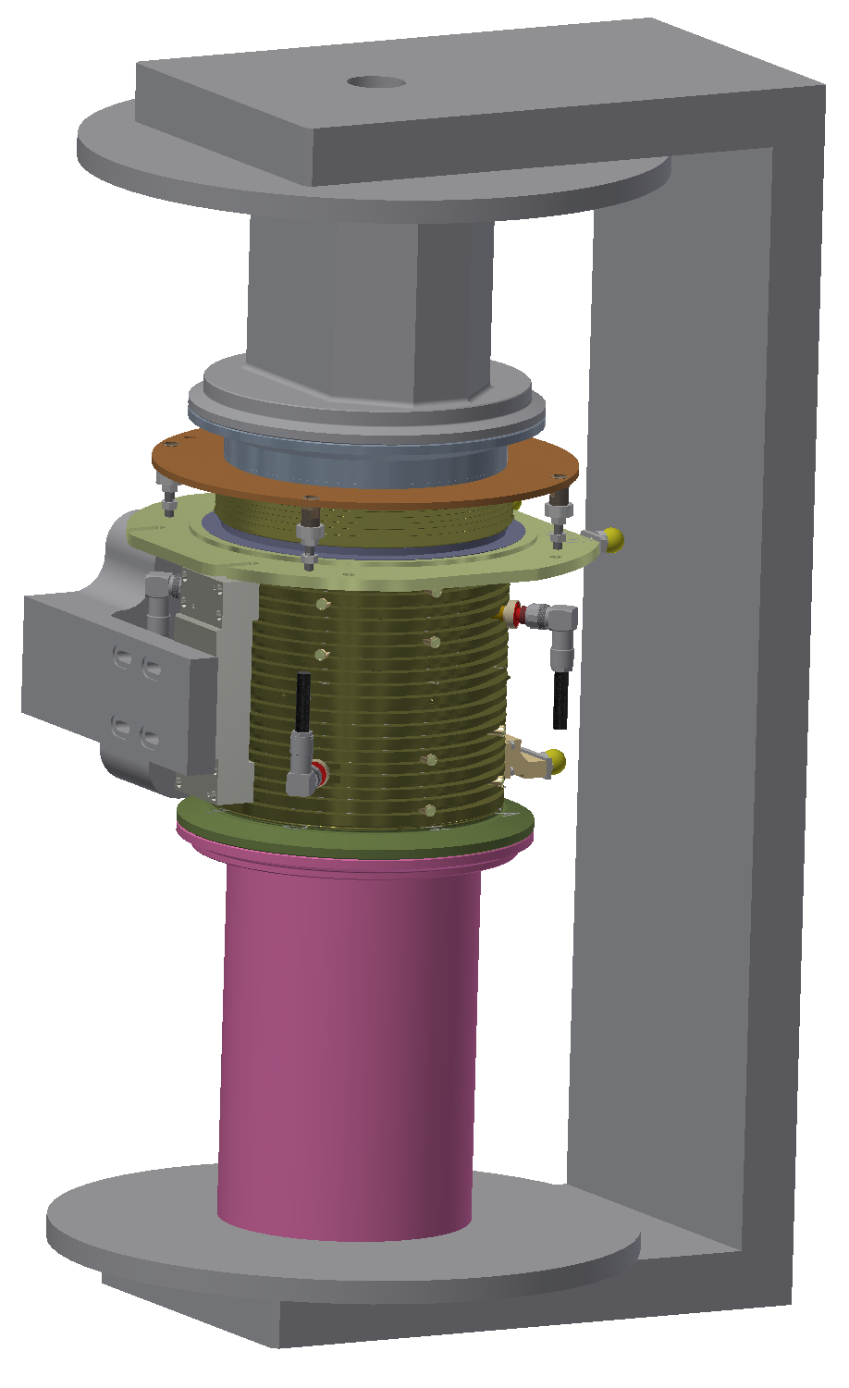
Future Works
Wire Mapping with realistic pipe (preparing)
Upgrade of the BPM calibration system
A longer dummy pipe (defined in simu.)
Controlled room temperature (up to 30 ºC)
Frequency of interest: 0-10 MHz
Fasten the calibration process w/ VNA
Try to understand the real cause of strong frequency dependence
Is it due to cross coupling among electrodes?
Or Transfer Impedance?

Slide 26
Back up

Slide 27
Analysis Method
In case of non rotated electrodes
X = c_{x}Log[A/C], Y = c_{y}Log[B/D]
X and Y_{r} come directly come from Bergoz-BB electronics,
c_{x} and c_{y} are calibration constant
Since the electrodes are 45^{O} rotated
X = c_{x} [Log(A/C) . cos(α) – Log(B/D) . sin(α)], Y = c_{y} [Log(A/C) . sin(α) + Log(B/D) . cos(α)]
sin(α)= cos(α)=1/sqrt(2)
In our case 3rd order polynomial is applied

