Slide 1
Beam Intensities
Beam Power [kW] | DCCT → ppb | Pulse Width [μs]
170 | 11.7×10¹² | 575
85 | 4.17×10¹² | 100
40 | 6.2×10¹² | 275
10 | 1.54×10¹² | 80
5 | 0.7×10¹² | 49
1 | 0.17×10¹² | 49
0.5 | 0.08×10¹² | 30
All simulations have fixed initial bunch length and RMS size

Slide 2
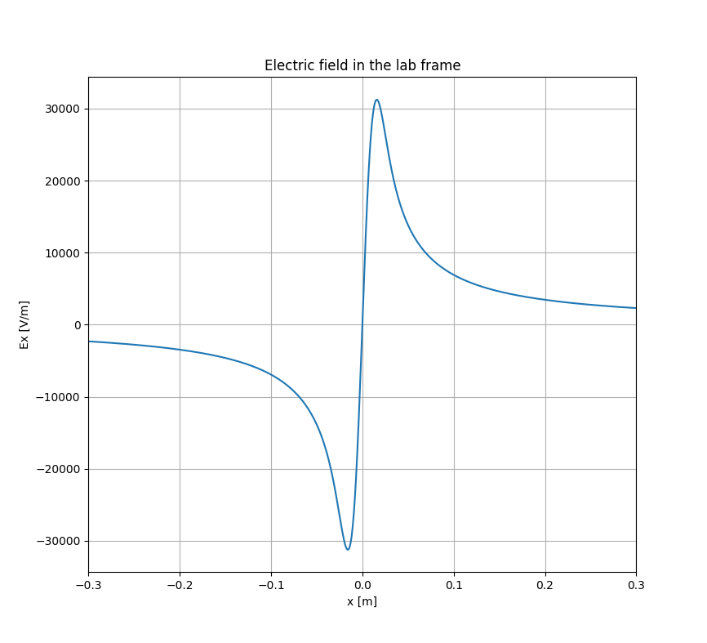
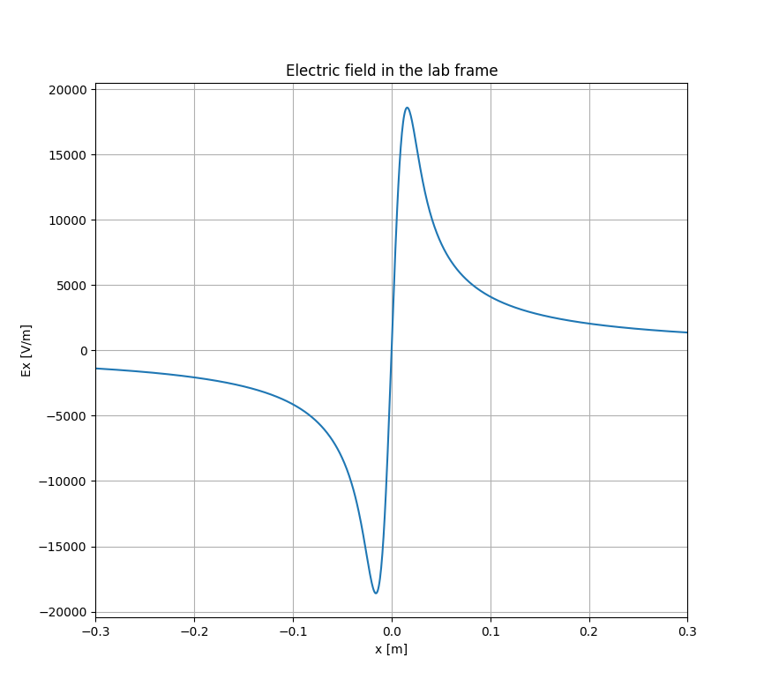
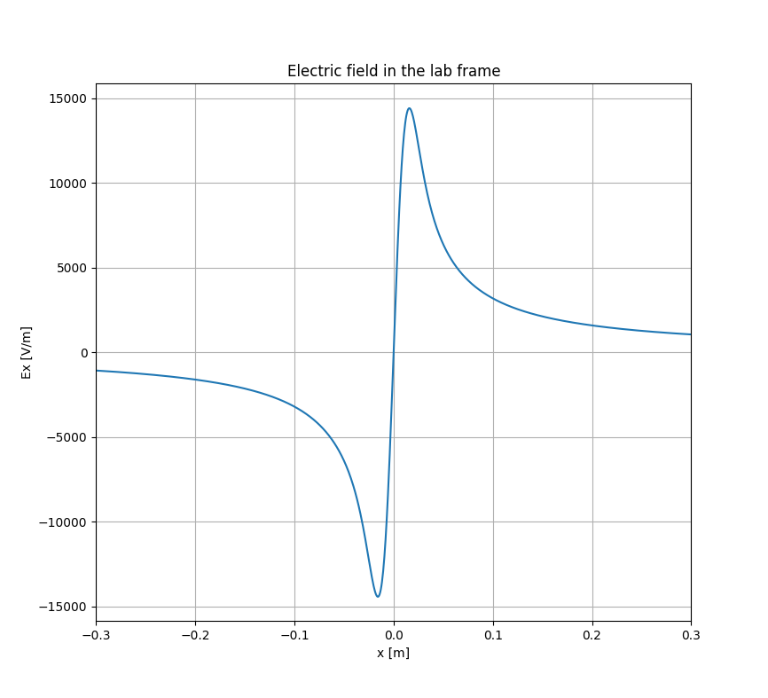
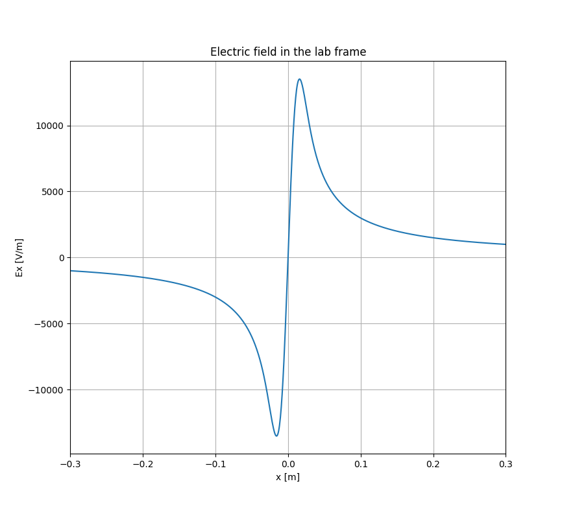
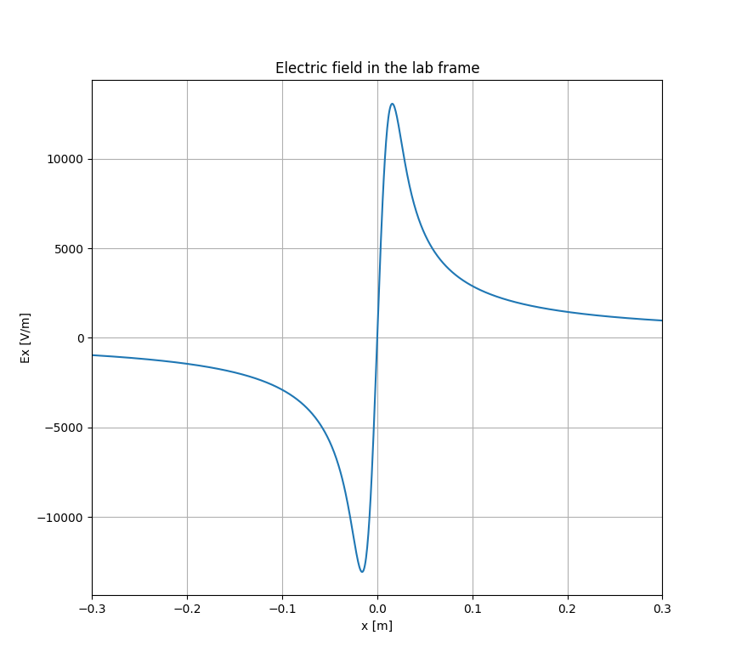





170 kW, 3$σ_{z}$=500 ns, 80 MeV
170 kW, 3$σ_{z}$=500 ns, 300 MeV
170 kW, 3$σ_{z}$=500 ns, 800 MeV
170 kW, 3$σ_{z}$=500 ns, 1.2 GeV
170 kW, 3$σ_{z}$=500 ns, 1.6 GeV
As the beam energy increases, the electric field in the beam space decreases
As the beam power increases, the electric field in the beam itself increases

Slide 3
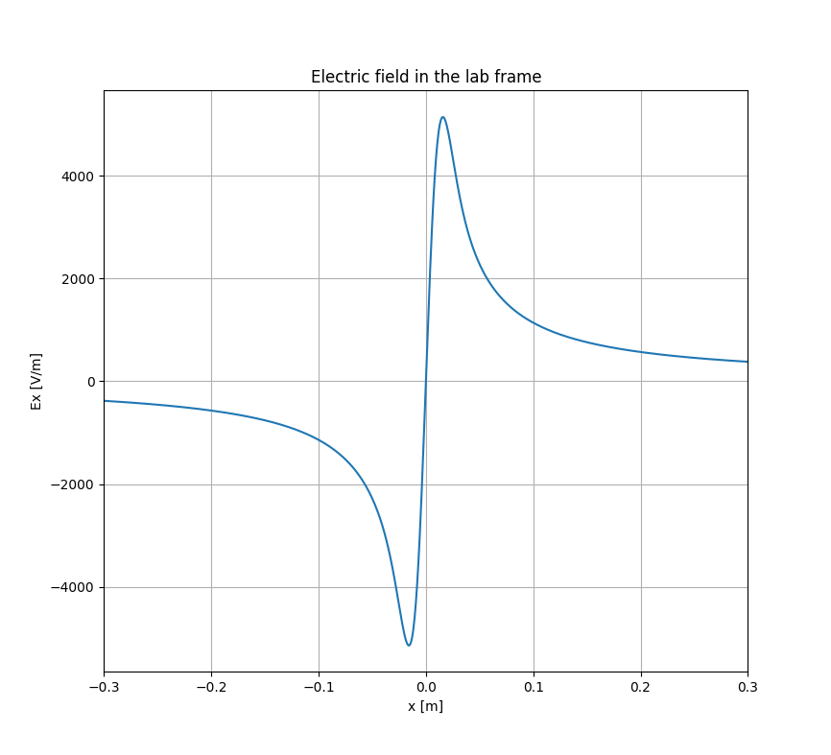
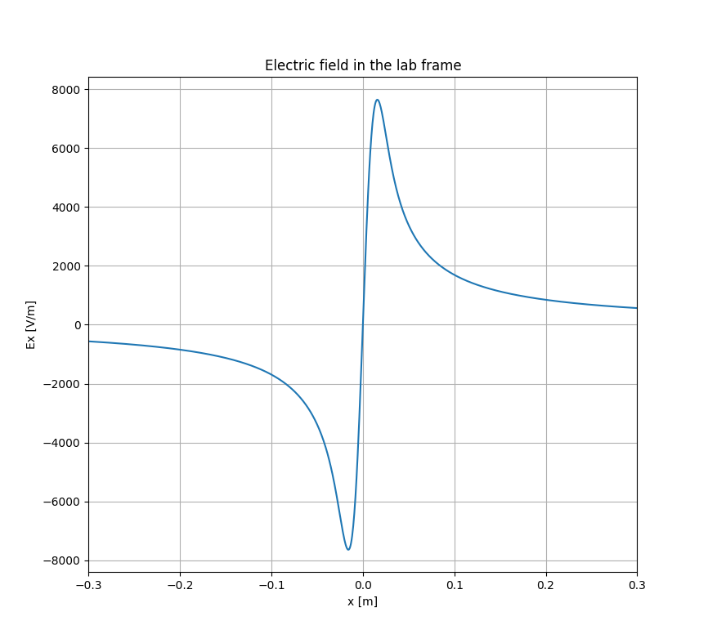

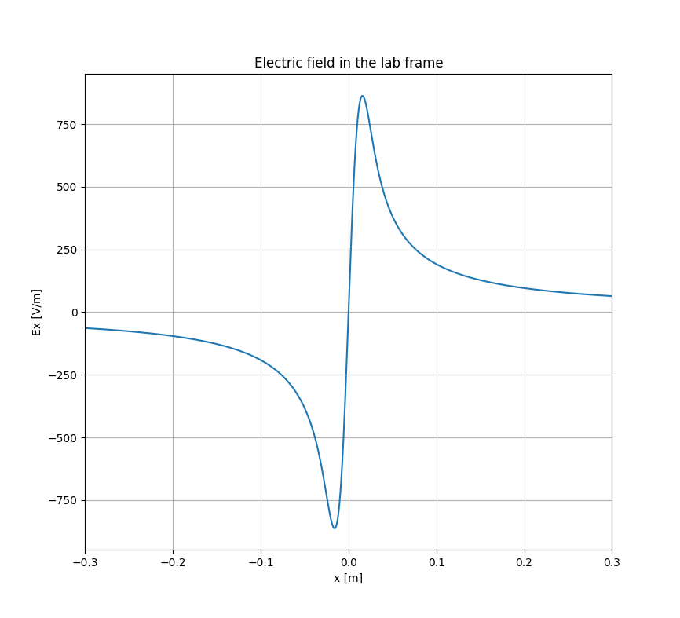
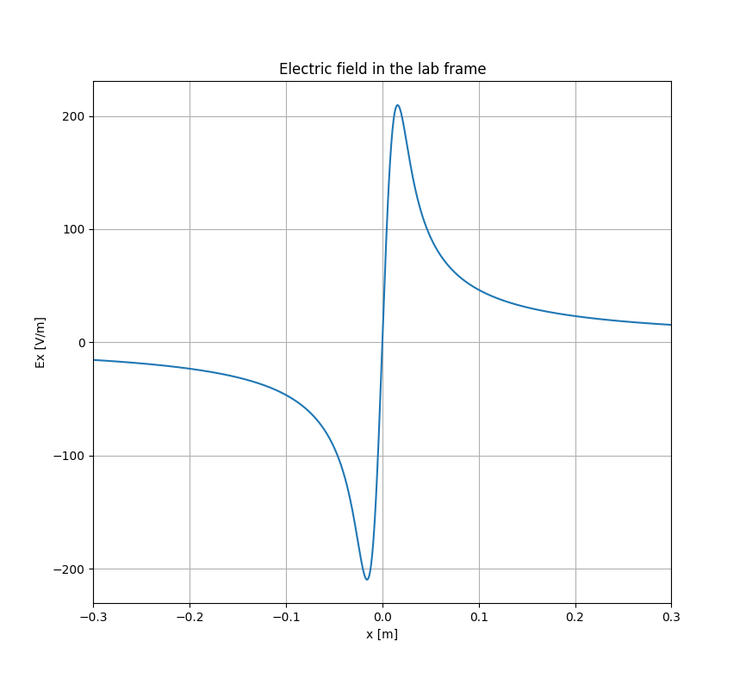






170 kW, 3$σ_{z}$=500 ns, 80 MeV
85 kW, 3$σ_{z}$=500 ns, 80 MeV
40 kW, 3$σ_{z}$=500 ns, 80 MeV
10 kW, 3$σ_{z}$=500 ns, 80 MeV
5 kW, 3$σ_{z}$=500 ns, 80 MeV
1 kW, 3$σ_{z}$=500 ns, 80 MeV

Slide 4

170 kW, 3$σ_{z}$=500 ns, w/o magnetic field

Slide 5

80 MeV, 3$σ_{z}$=500 ns, w/o magnetic field

Slide 6

170kW, 3$σ_{z}$=500ns, $σ_{x}$=10mm,
  100Gs magnetic field can achieve suppression when E=80MeV
170 kW, 80 MeV, 3$σ_{z}$=500 ns, w/ magnetic field

Slide 7



$$\vec{B}$$
$$\vec{E}$$
Quadratic Spline Interpolation
$$S_{i}\left(x\right)=a_{i}{(x−x_{i})}^{2}+b_{i}\left(x−x_{i}\right)+c_{i}$$
and same as increasing beam energy

Slide 8
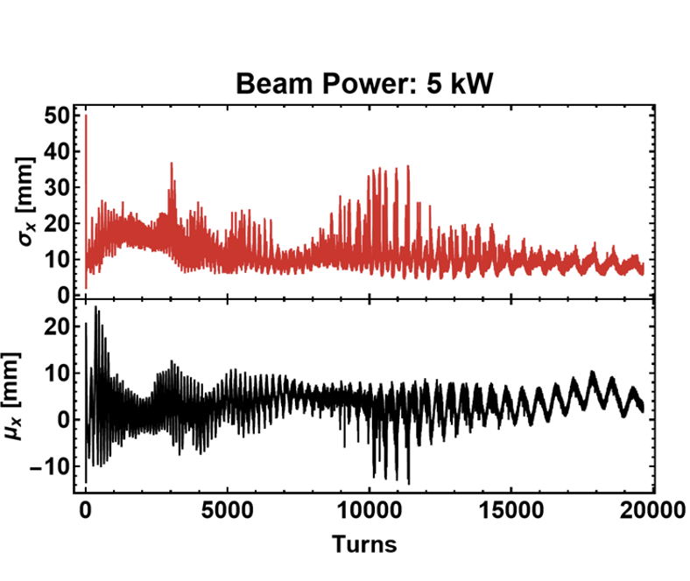
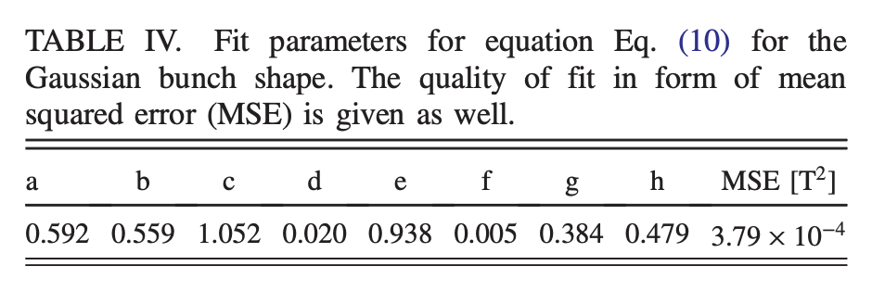
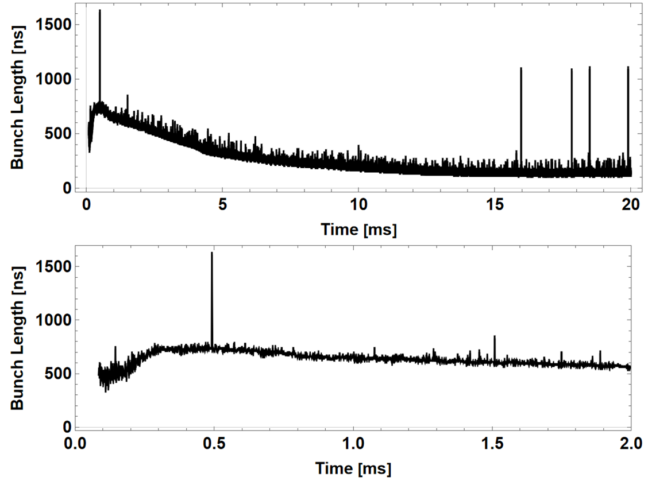
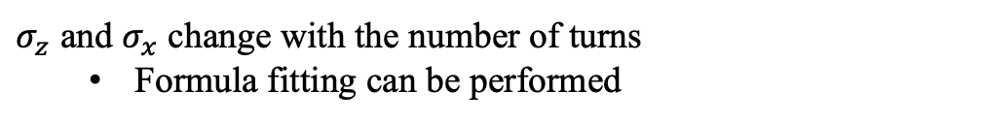

$σ_{z}$ and $σ_{x}$ change with the number of turns
  Formula fitting can be performed
SC
Initial velocity
$B_{min}=\frac{N_{a}}{σ_{z}^{b}σ_{x}^{c}τ^{g}}∙d+\frac{f}{σ_{x}^{e}τ^{h}}$ $τ=\frac{σ_{m}}{σ_{t}}−1$
Dominik Vilsmeier. Space-charge distortion of transverse profiles measured by electron-based Ionization Profile Monitors and correction methods. DOI: 10.1103/PhysRevAccelBeams.22.052801

