Slide 1
Fast Luminosity Monitor
Transient Simulation with deviated hit
Wang Yilun (Nanjing University) Zhang Jialiang (Nanjing University)
Zhang Xiaoxu (Nanjing University) Zhang Lei (Nanjing University)
Liu Shuxian (Nanjing University)

Slide 2
Contents
Introduction
Geometry & Meshing
Doping & I-V Characteristic Curve
Transient Simulation
Conclusion

Slide 3
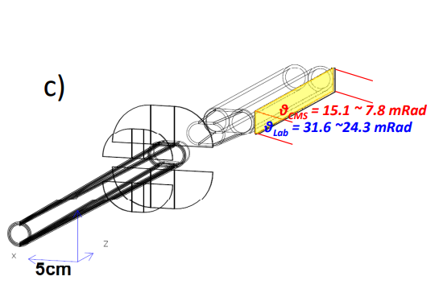
Introduction
Fast Luminosity Monitor is used to give bunch luminosity at CEPC
Integrated event rates along z-position can help monitoring z-position at IP
Polar angle $θ\sim 10 mrad$, highest radiation field at CEPC
Detect small angle Bhabha events
Electron showers generated in the copper beam pipe
Diamond is used for detector
Single crystal Chemical Vapor Deposition (sCVD), reducing defect densities
High carrier mobility : $2000\sim 2800 {cm}^{2}V^{−1}s^{−1}$
Wide bandgap, low dark noise : $5.47 eV$
Strong covalent bonds, high radiation hardness
Notes:
首先是介绍，在CEPC上，快速亮度探测器用于测量每个束团的亮度，为束流的校准提供信息。快速亮度探测器位于质心系下theta约为10毫弧度位置，探测小角度Bhabha散射粒子在铜束流管上产生的簇射。使用sCVD金刚石作为探测器的主要材料，其具有高载流子迁移率，和较宽的能隙，并具有很强的共价键，抗辐照能力较好

Slide 4
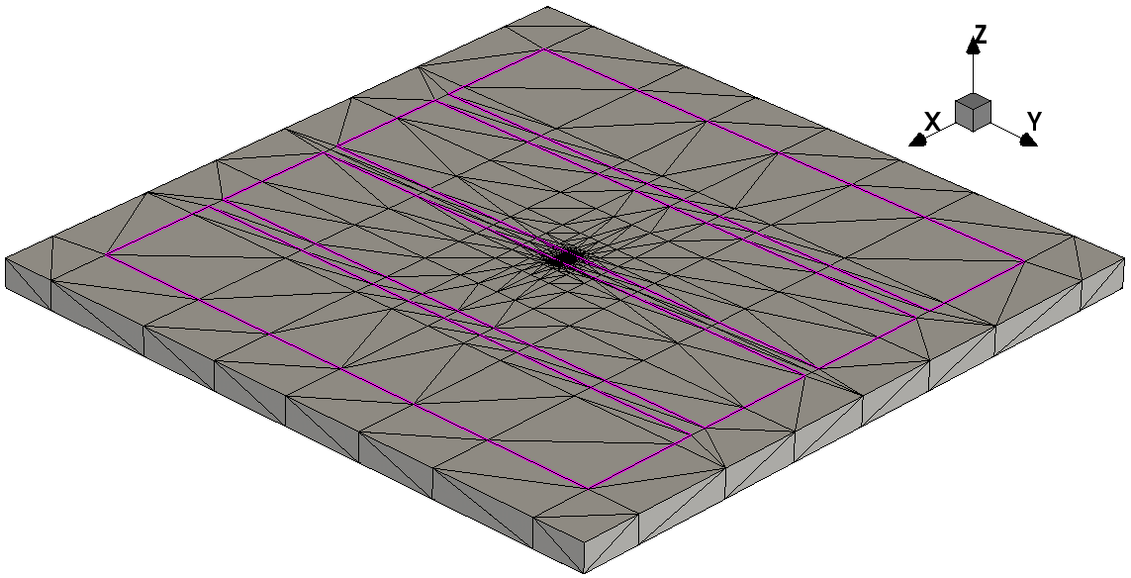
Geometry
Same as the 4-strip diamond, $6000×6000×260 μm (x−y−z)$
4 electrodes on front side, each $1100×5000 μm (x−y)$
One electrode on back side, $5000×5000 μm (x−y)$
All electrodes are ohmic contact
Notes:
用于模拟粒子击中的模型和实物相同，大小为 6000*6000um，厚度260um。顶面为4个1100*5000um的电极，底面为一个5000*5000um的电极，电极均为欧姆接触

Slide 5
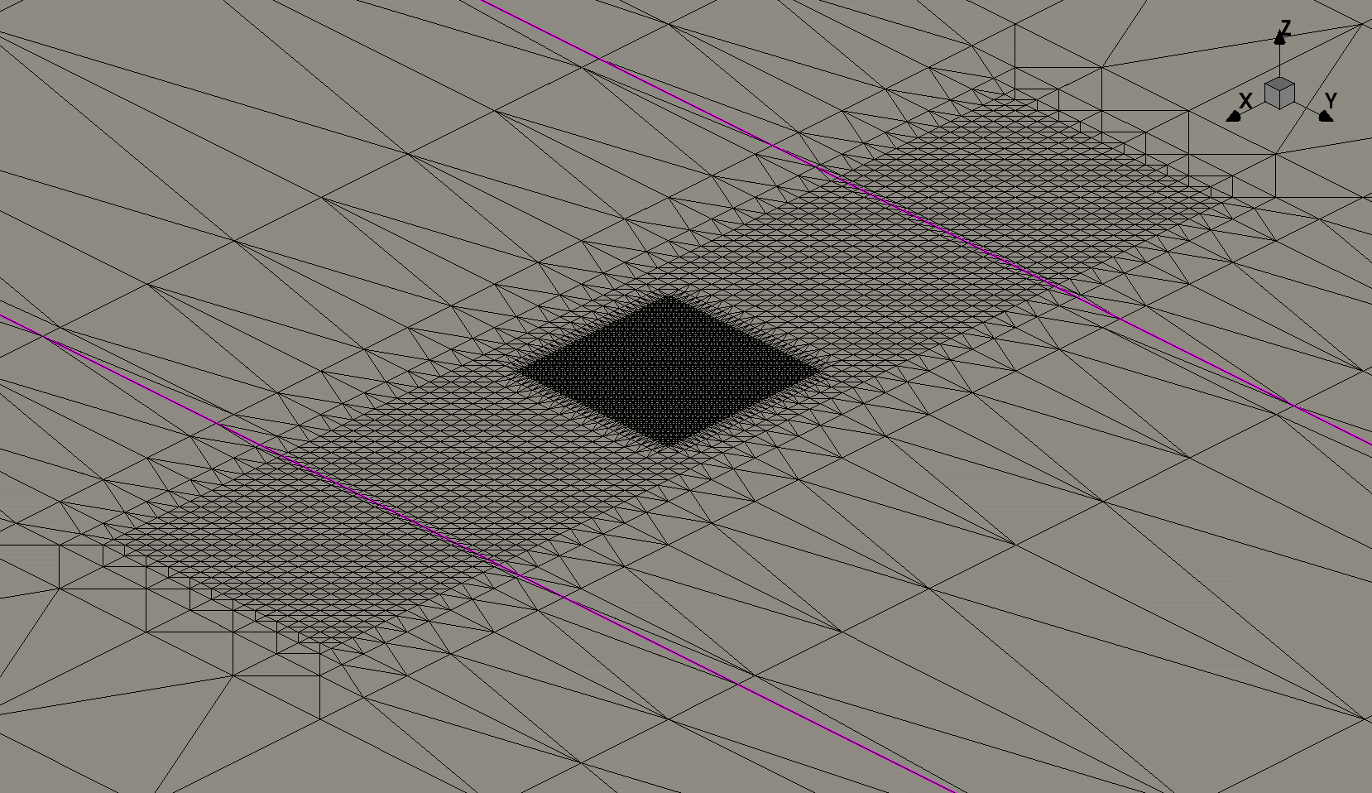
Meshing
Meshing focus on the center of detector
Smaller mesh around hit position
Region 1 $\left(x−y−z\right) (μm)$
$2×2×2 \sim 5×5×10$
$2×2×0.5 \sim 5×5×2$ around electrode
Region 2 $\left(x−y−z\right) (μm)$
$0.5×0.5×1 \sim 1×1×4$
$0.5×0.5×0.5 \sim 1×1×1$ around electrode
Region 2
Region 1
Notes:
将网格设置在探测器中心区域，粒子击中位置的区域2网格密度最高，为了使电荷漂移计算更为准确，较外围的区域1也做了细化，区域1网格大小为2*2*2um到5*5*10um，靠近电极5um的区域为2*2*0.5~5*5*2um，区域2网格大小为0.5*0.5*1um到1*1*4um，靠近电极处减小为0.5*0.5*0.5~1*1*1um。区域1之外的区域网格由软件自动完成

Slide 6
Physics
Physics {
EffectiveIntrinsicDensity( OldSlotboom ) # doping bandgap narrowing effect
Mobility(
-ConstantMobility # do not use ConstantMobility model
DopingDep
HighFieldSaturation( Eparallel ) # Removed to match experiment results
Enormal # Removed, no effect
)
Recombination(
SRH( DopingDep ) # doping dependent Shorkley-Read-Hall recombination
Avalanche
)
HeavyIon(
Direction = (0,0,1)
Location = (0,0,-260)
Time = 1e-9
Length = 520
Wt_hi = 1
LET_f = 5.767e-6
Gaussian
PicoCoulomb
)
}
Notes:
这是使用的物理模型，有掺杂禁带变窄模型，迁移率模型，迁移率模型中关闭固定迁移率模型，使用依赖掺杂浓度的迁移率模型。然后是依赖掺杂浓度的SRH复合和雪崩击穿模型。为了符合实验结果，去掉了高场饱和模型，另外去掉了界面散射模型，因其对结果没有影响

Slide 7
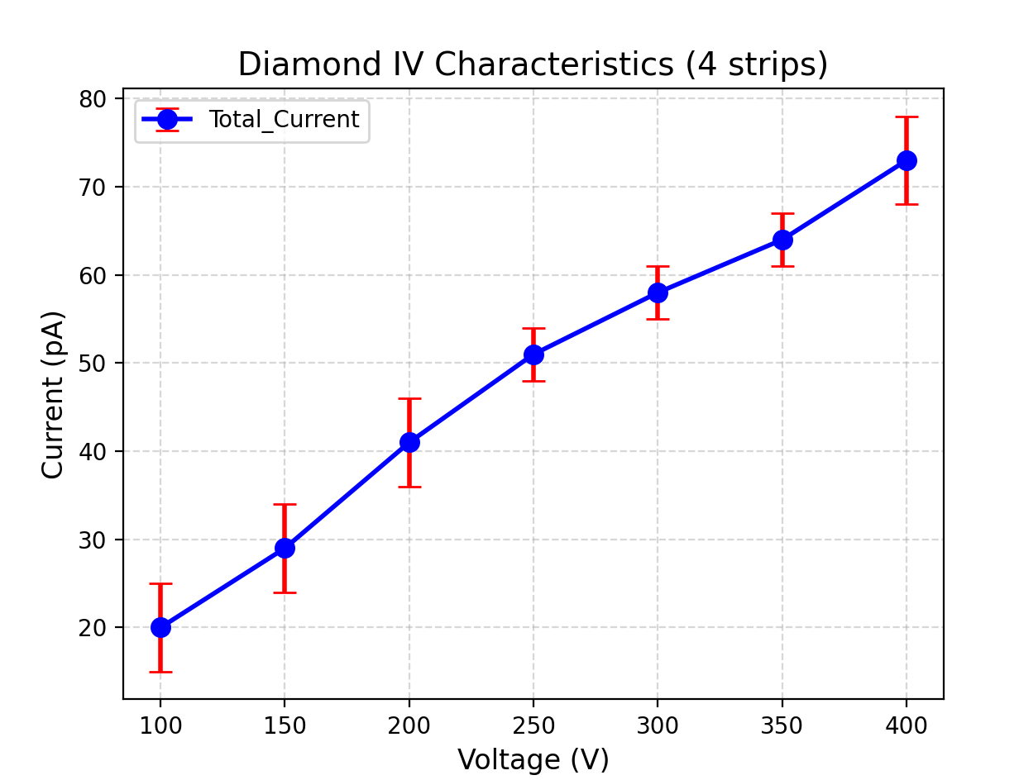
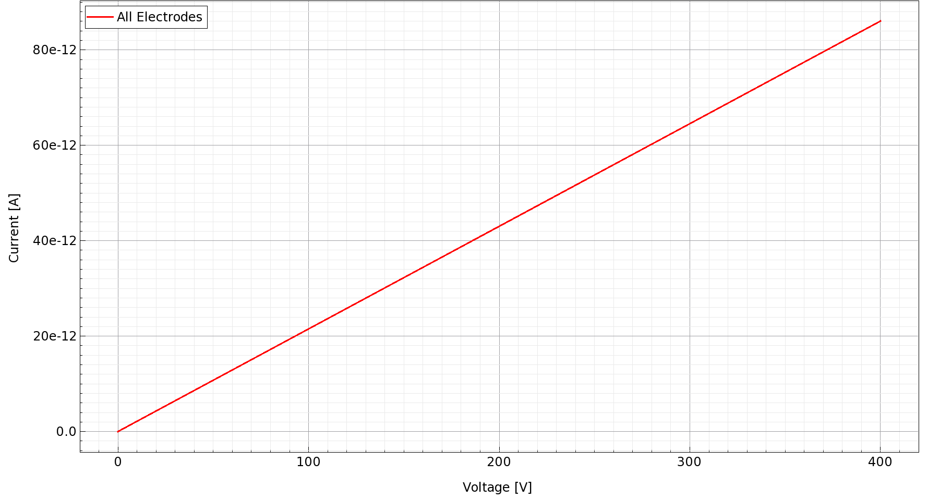
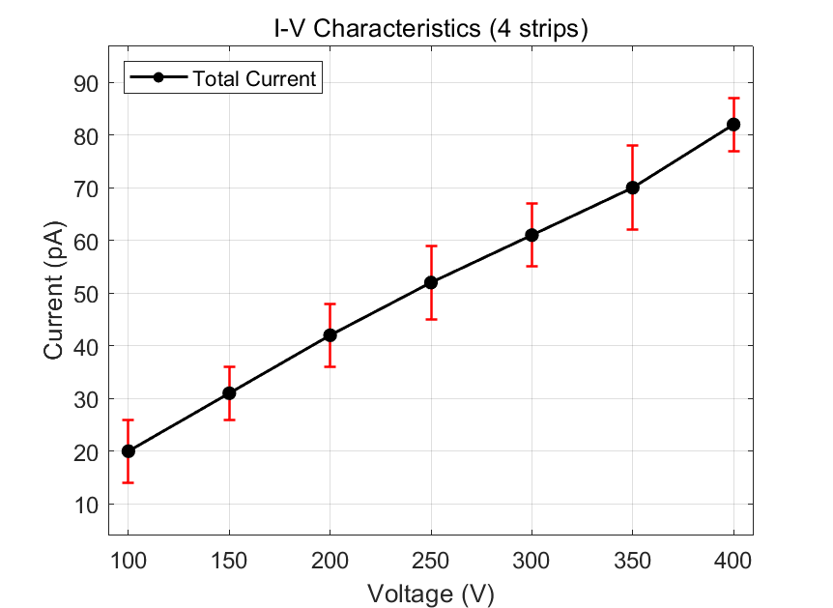
Doping & I-V Characteristic Curve
During CVD process, Boron and Nitrogen are common impurities
Add $45 {cm}^{−3}$ Boron Active Concentration to match experiment result
Notes:
当掺杂浓度设置为45/cm3时，左图模拟结果符合右侧的实验结果

Slide 8
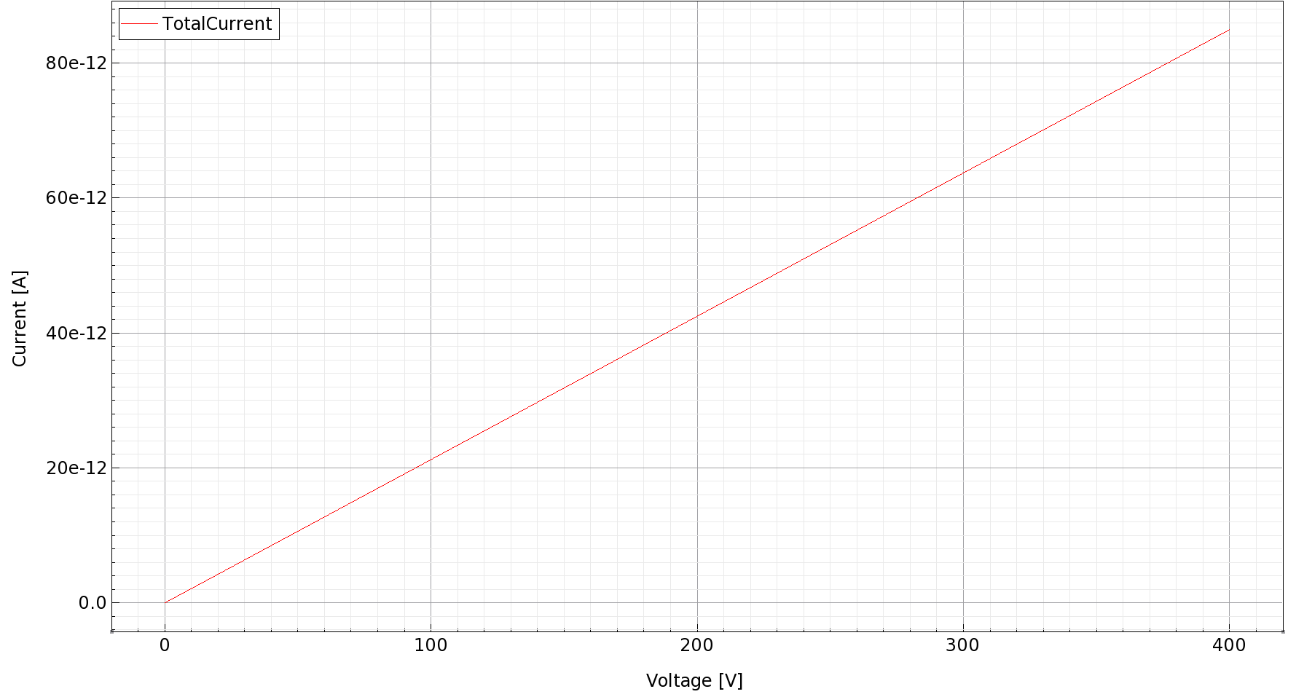
Doping & I-V Characteristic Curve
Instead of changing the “ActiveBoronConcentration” from ${10}^{10}$ to $45 {cm}^{−3}$,
Adding traps can arrive at the same results
Experiment uses pCVD diamond
Notes:
实验结果可能由于多晶金刚石中的缺陷导致，而非低至45/cm3的掺杂浓度，因此，在保持10^10掺杂浓度的情况下，增加缺陷，也可以达到相同的效果。

Slide 9
Physics with Traps
Physics {
EffectiveIntrinsicDensity( OldSlotboom ) # doping bandgap narrowing effect
Mobility(
-ConstantMobility # do not use ConstantMobility model
DopingDep
HighFieldSaturation( Eparallel ) # Removed to match experiment results
Enormal # Removed, no effect
)
Recombination(
SRH( DopingDep ) # doping dependent Shorkley-Read-Hall recombination
Avalanche
)
Traps(
( Donor Level fromCondBand EnergyMid=0.05 Conc=1.65e10 eXsection=1e-13 hXsection=1e-18 )
( Donor Level fromCondBand EnergyMid=1.0 Conc=1.65e10 eXsection=1e-15 hXsection=1e-18 )
( Acceptor Level fromCondBand EnergyMid=2.2 Conc=1.65e10 eXsection=5e-16 hXsection=1e-13 )
)
HeavyIon(...)
}
Notes:
这是使加入缺陷后的物理模型，加入了三种缺陷，浓度为1.65*10^10，由于两种方式效果相同，且使用缺陷模拟时间更长，因此目前采用直接改变掺杂浓度的方式

Slide 10
Transient Simulation

Slide 11
Transient Simulation - Physics
Physics {
EffectiveIntrinsicDensity( OldSlotboom )
Mobility(
-ConstantMobility
DopingDep
)
Recombination(
SRH( DopingDep )
Avalanche
)
HeavyIon(
Direction = (0,0,1)
Location = (@x0@,0,-260)
Time = 1e-9
Length = 520
Wt_hi = 1
LET_f = 5.767e-6
Gaussian
PicoCoulomb
)
}
Electrode 2
Electrode 3
(parameter)
Notes:
瞬态模拟的物理模型中，将粒子击中位置的x坐标设为参数，使粒子击中位置偏离中心，向x轴正方向移动一定距离，离电极3更近，离电极2较远

Slide 12
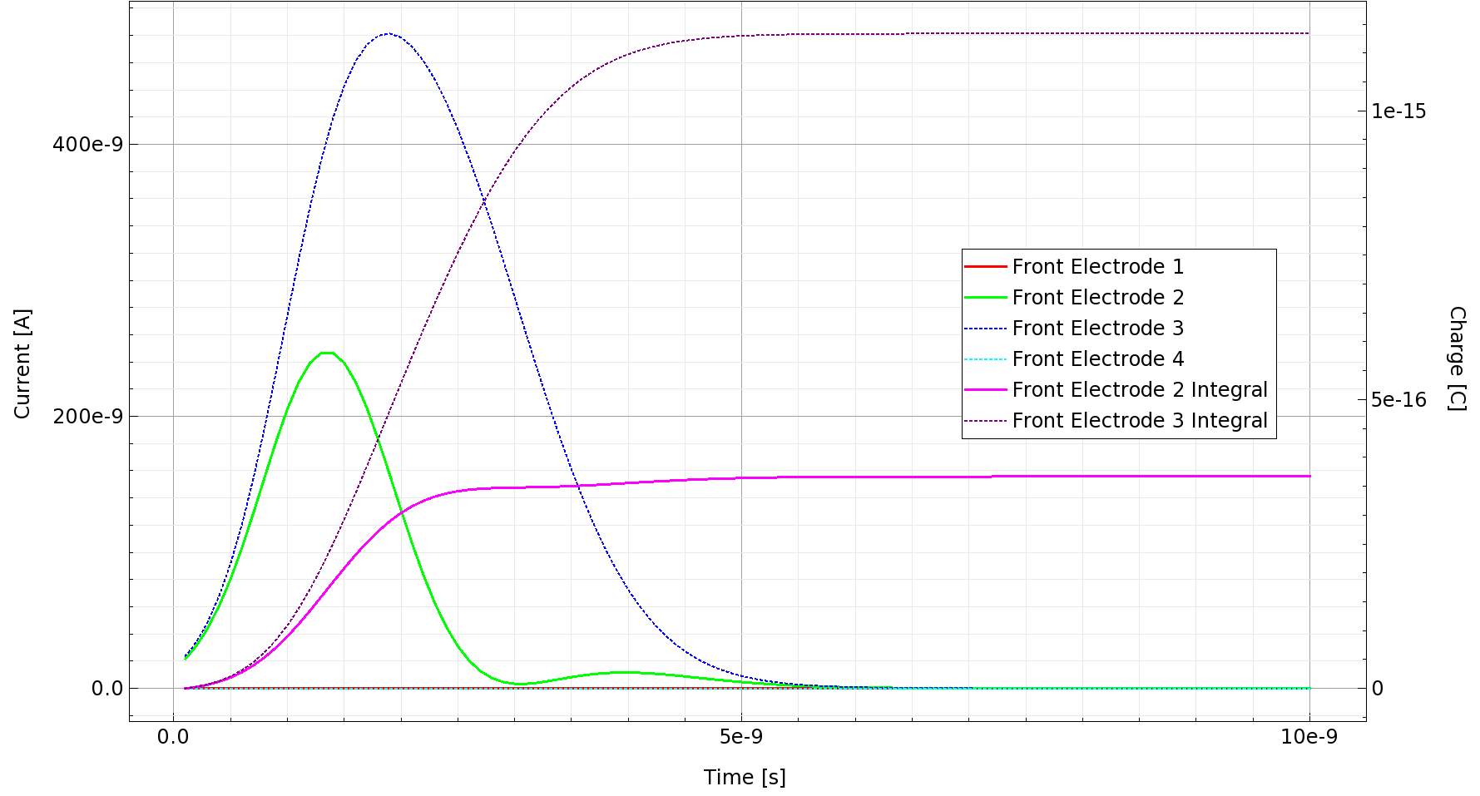
200 V, 2 um
Notes:
这是电压为200V，粒子击中位置偏移2um时的电流曲线，最下面两条几乎水平的线为靠边缘的两个电极，在左侧有峰值的曲线为中间两个电极，而一直上升后趋于平缓的是对中间两电极电流的积分，也就是收集到的电荷

Slide 13
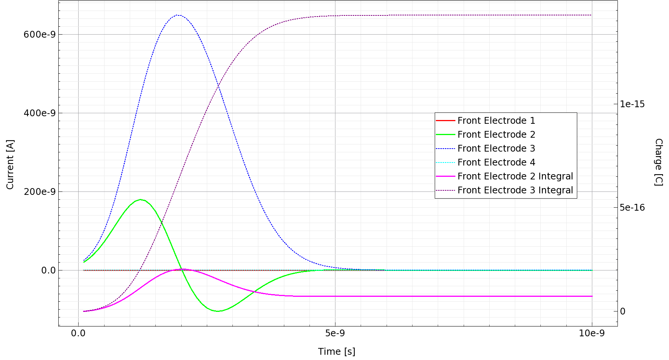
200 V, 5 um
Notes:
这是击中位置偏移5um时结果，电压依然为200V，可以看出这时离击中位置较远的电极2只能接收到很少电荷

Slide 14
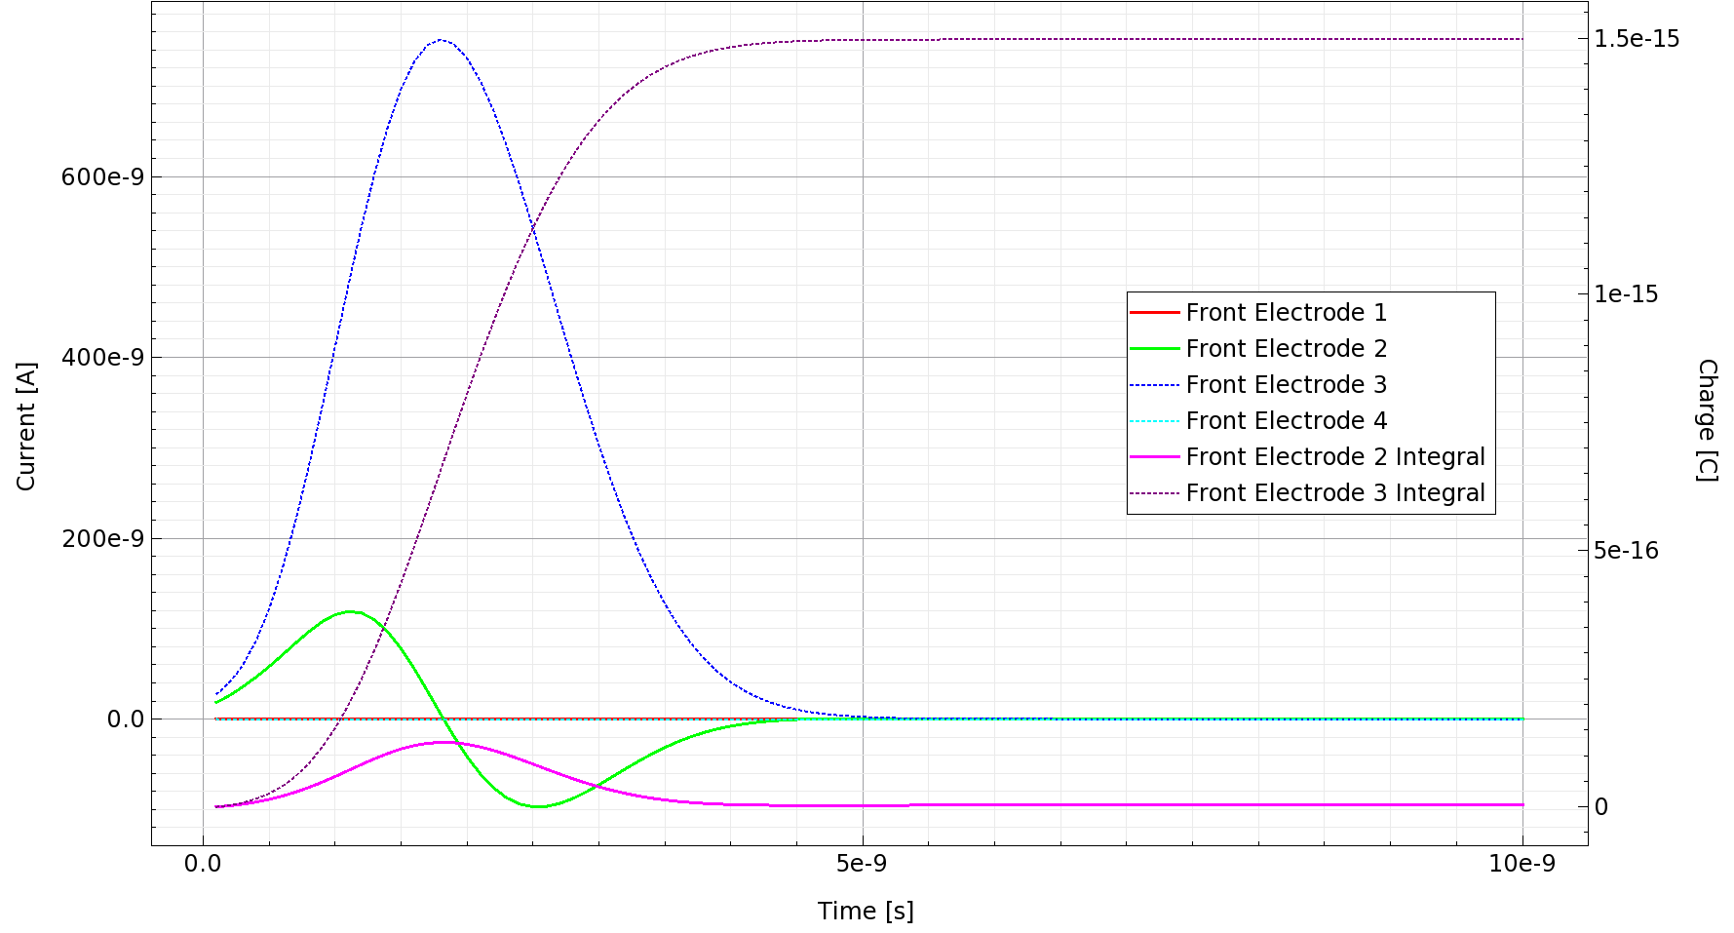
200 V, 10 um
Notes:
这是击中位置偏移10um时结果，这时离击中位置较远的电极2几乎收不到电荷

Slide 15
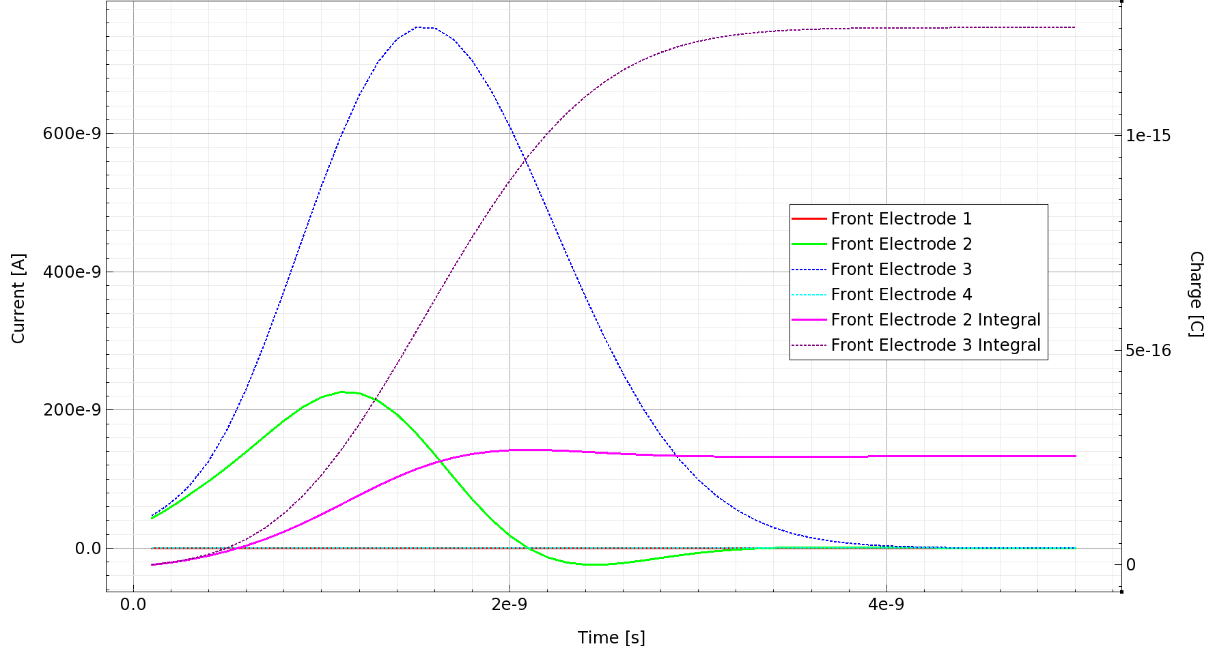
400 V, 2 um
Notes:
这是电压为400V，偏移距离2um时粒子击中的电流曲线，模拟时间从10ns改为5ns，相比200V时，两电极收集电荷之差更大一些

Slide 16
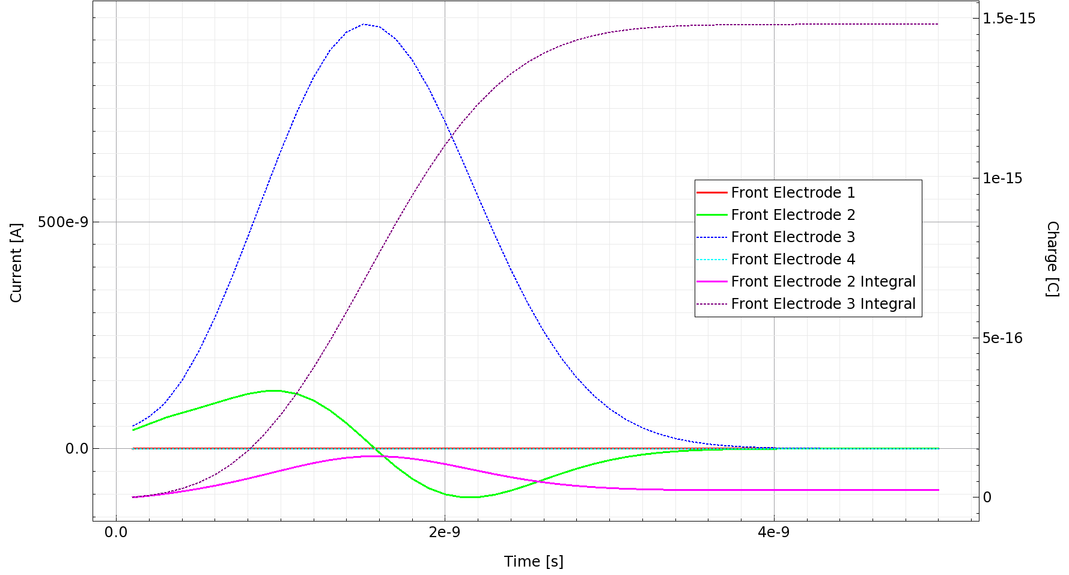
400 V, 5 um
偏离中心 5 um 时，距离较远的电极几乎收不到电荷
Notes:
这是400V，偏移5um时的结果

Slide 17
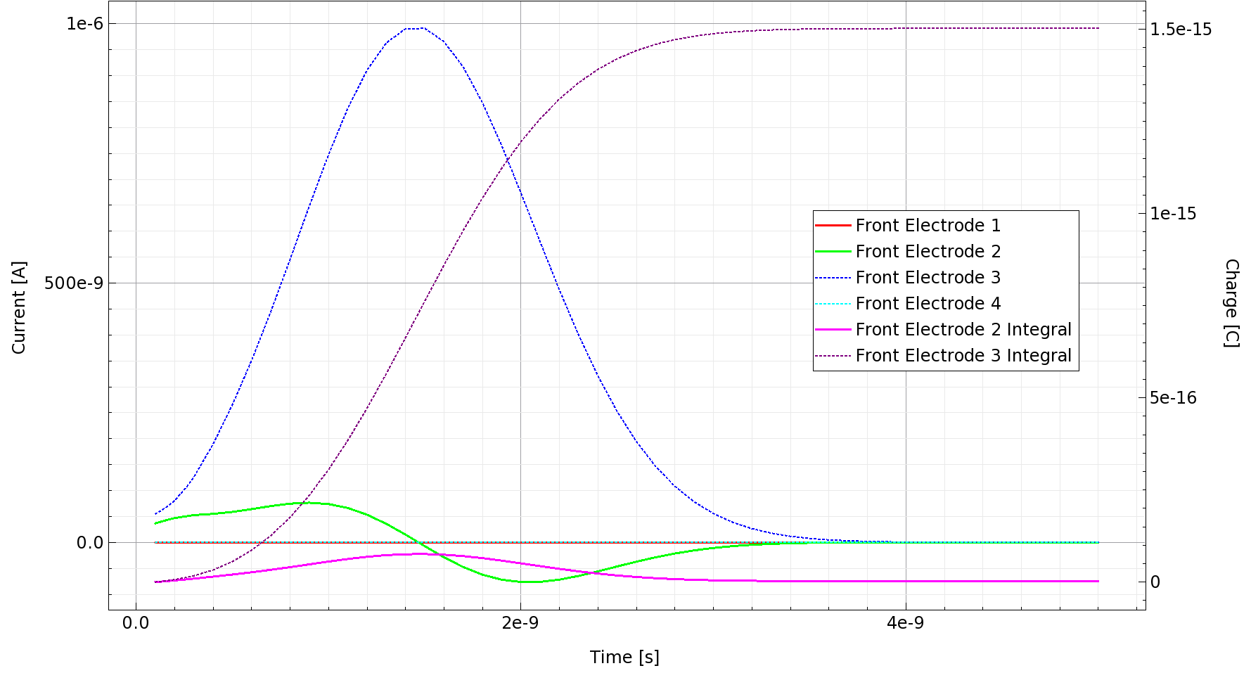
400 V, 10 um
Notes:
400V，偏移10um时的结果

Slide 18
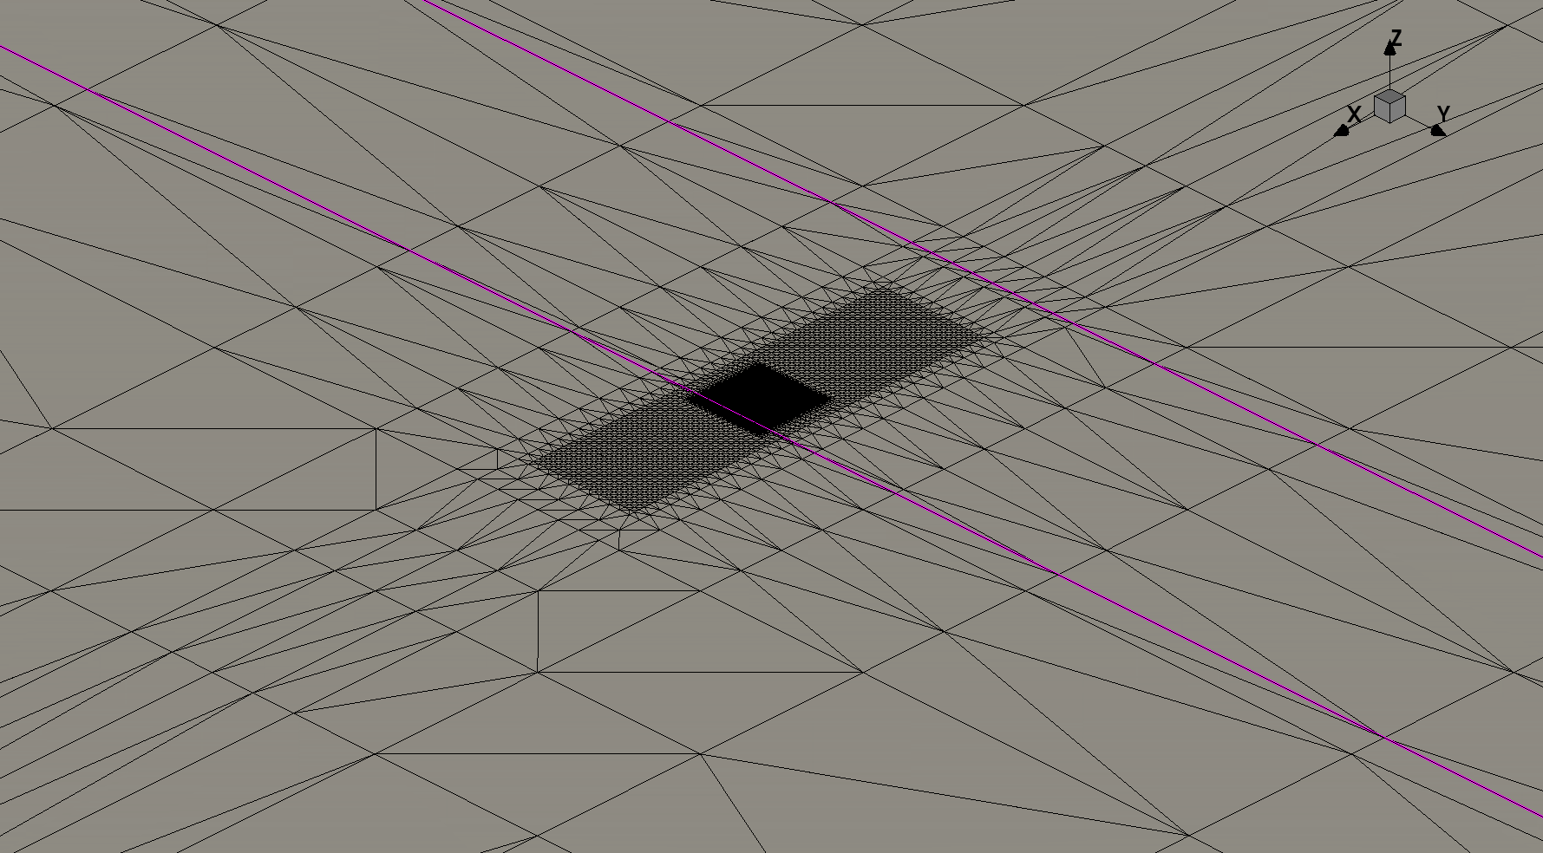
For further hits, shifting mesh to cover the hit position is required
Otherwise, the total charge ionized will be wrong
The picture below shows the mesh centered at $x=60um$
Notes:
计算更远位置的击中时，需要改变网格密集区域的位置，否则计算出的电离总电荷会出错。图为将网格中心移动至x=60um

Slide 19
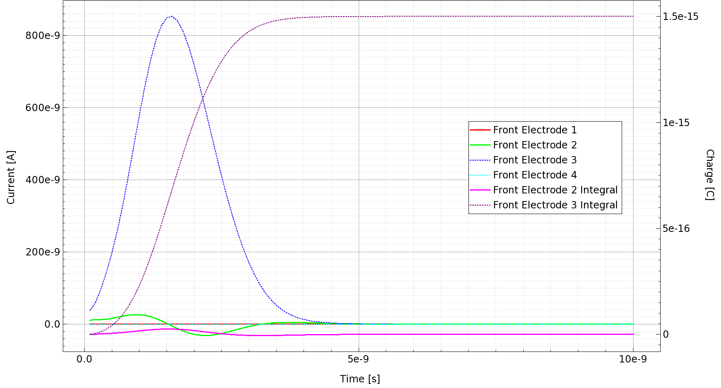
200 V, 30 um
Notes:
这是200V,偏移30um的结果

Slide 20
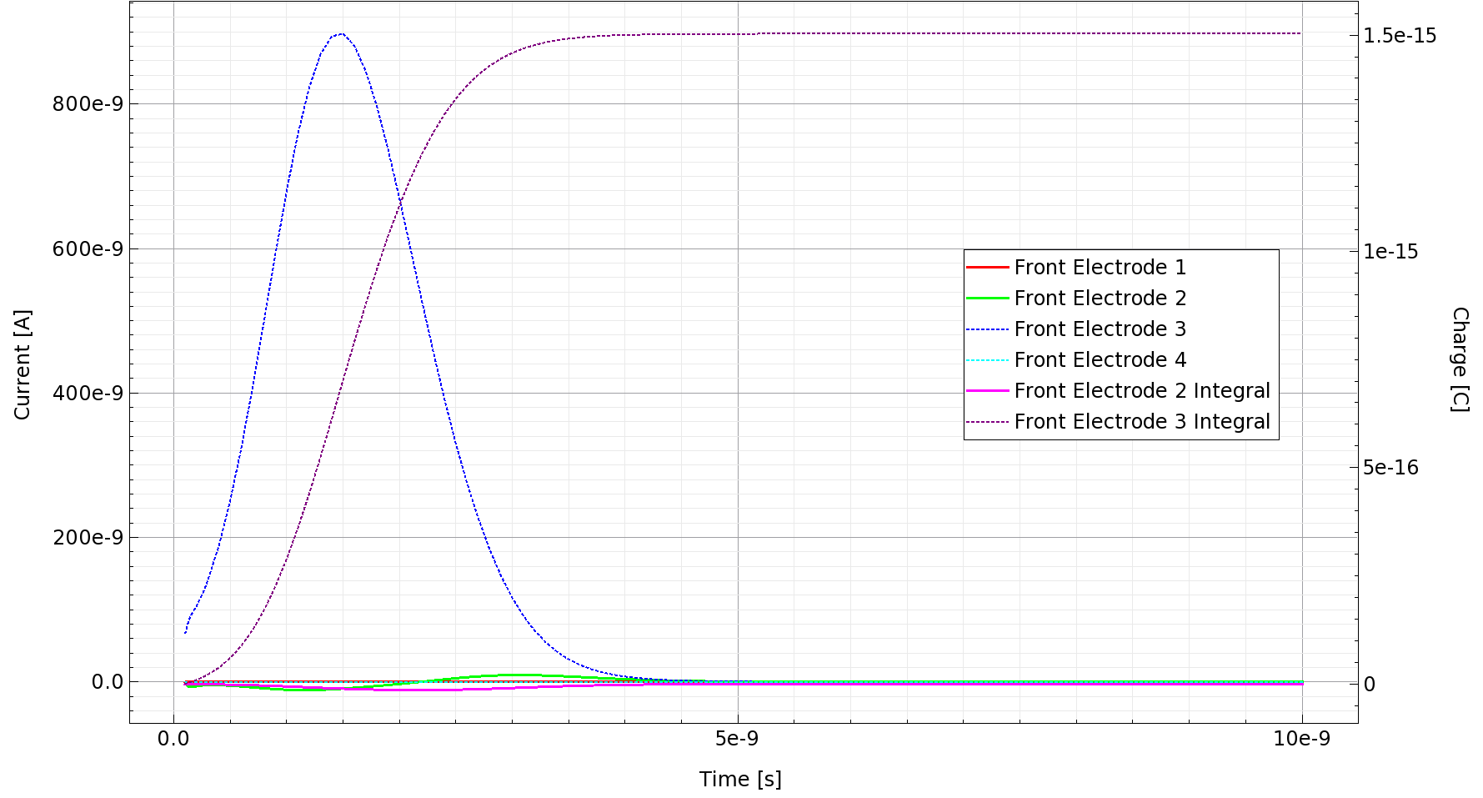
200 V, 60 um
Notes:
200V,偏移60um的结果

Slide 21
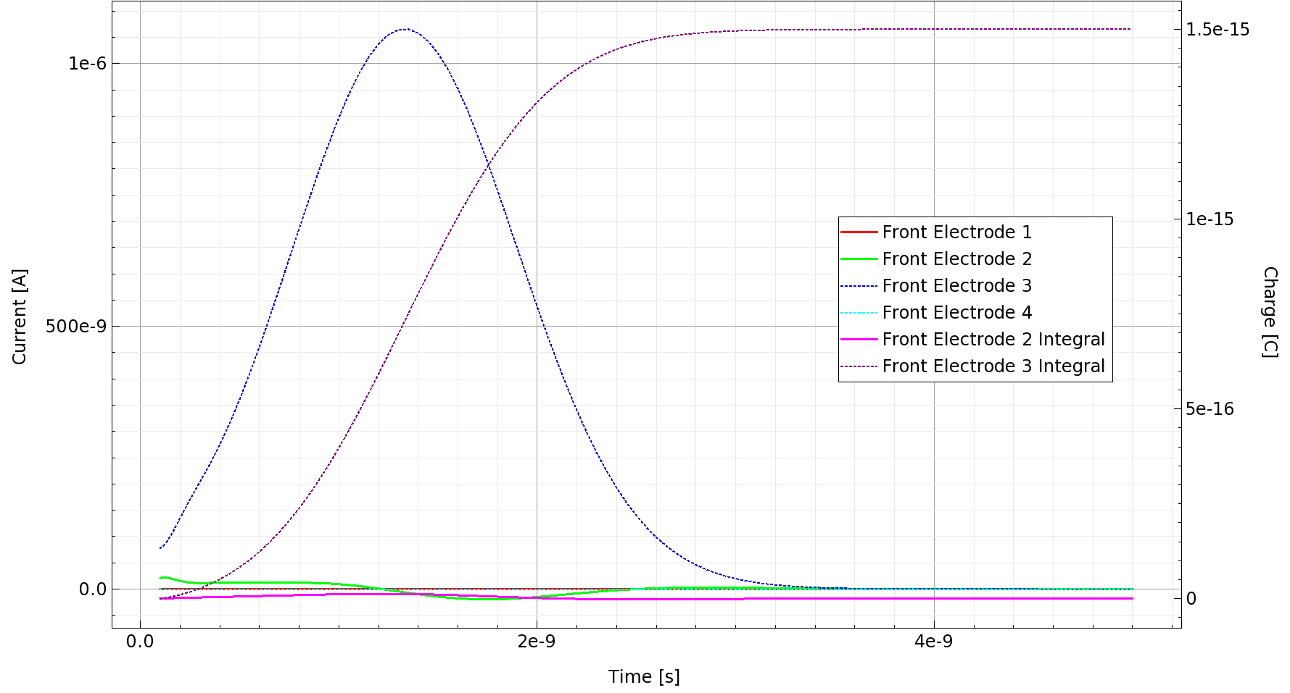
400 V, 30 um
Notes:
400V,偏移30um

Slide 22
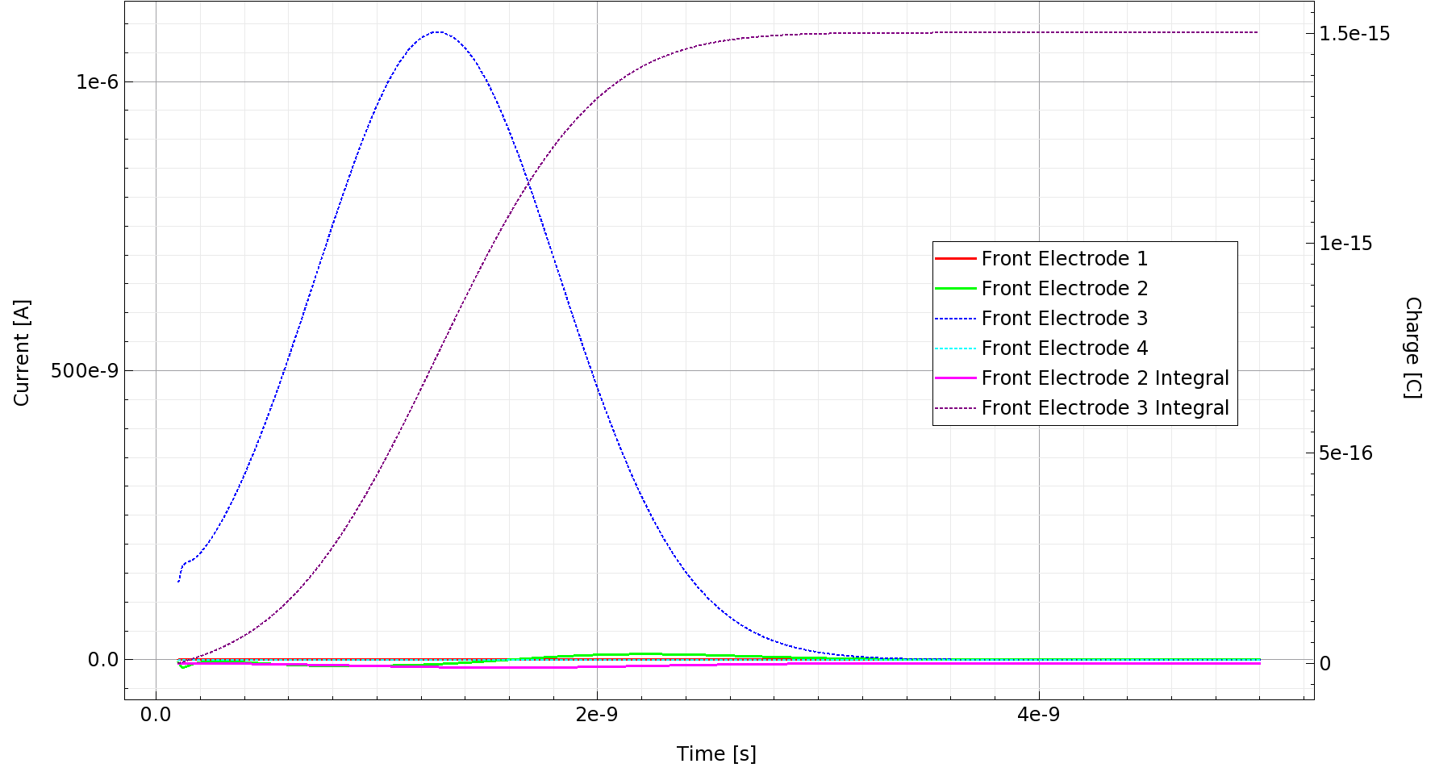
400 V, 60 um
Notes:
最后是400V,偏移60um

Slide 23
Conclusion
Fast luminosity monitor uses sCVD diamond, for its high carrier mobility, wide bandgap and high radiation hardness
The geometry of the diamond is built, same as the real device
Either doping be set to $45 {cm}^{−3}$, or ${10}^{10} {cm}^{−3}$ with traps, to reach the same IV results as experiment
Transient simulations of particle hitting the detector with different deviations are performed, the signal produced is drawn
Notes:
总结，快速亮度探测器以气相沉积金刚石为材料，因其具有高载流子迁移率，宽能带和高抗辐照能力。构建了探测器的几何结构，与实物相同。将掺杂设置为45/cm3,或是掺杂为10^10并加入缺陷，可以得到跟实验相同的IV曲线结果。对偏离中心不同距离粒子击中进行了瞬态模拟，绘制了信号的曲线。

