Slide 1
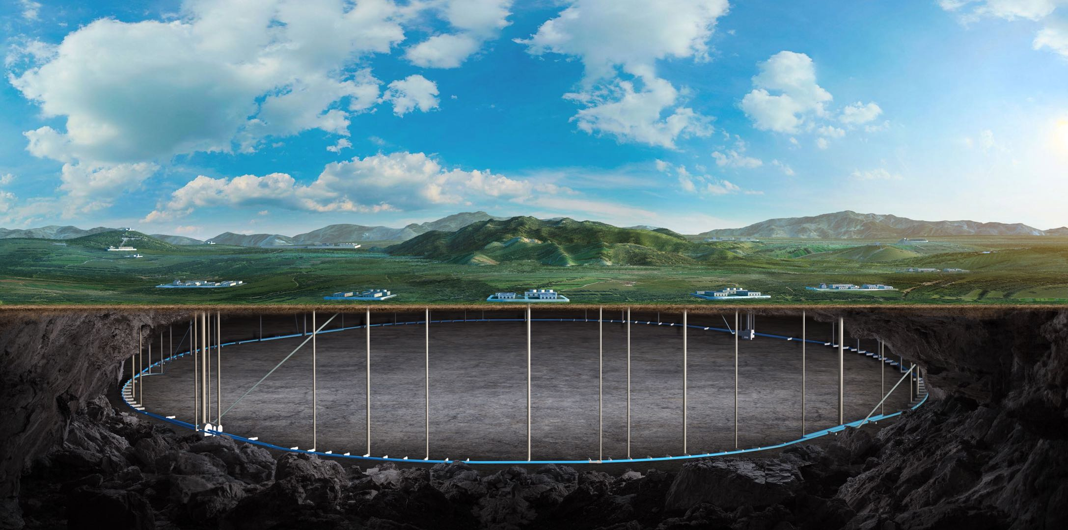
CEPC vertex Detector
Zhijun Liang

Slide 2
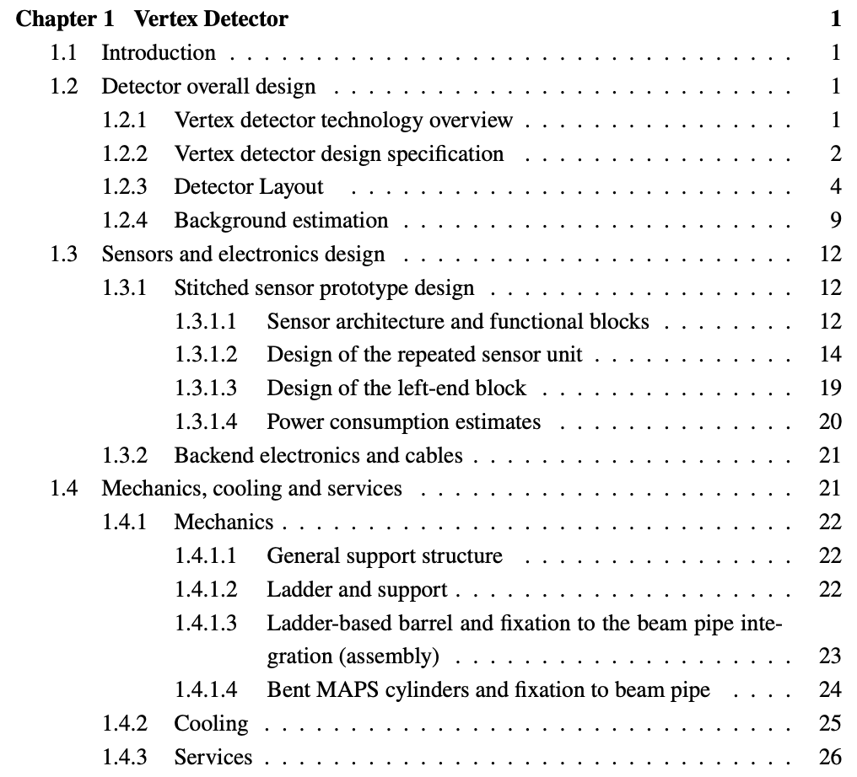
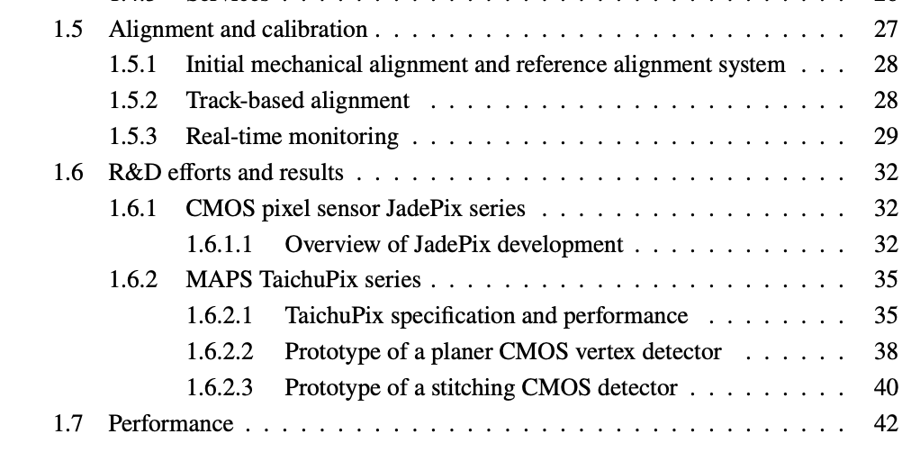
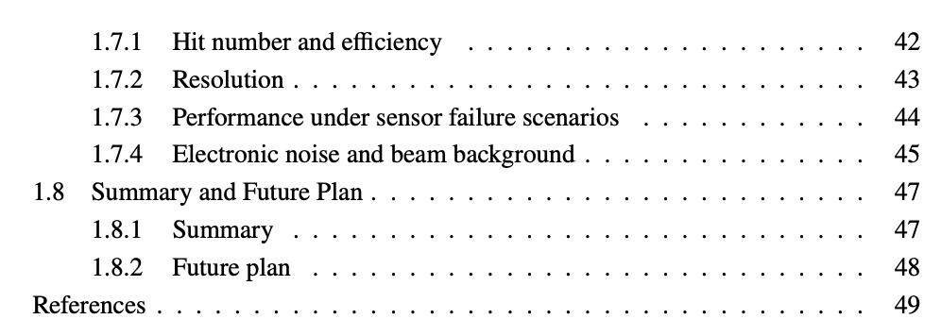
Structure update
Structure is re-arranged, adding introduction and summary

Slide 3
Table and figure format
All front size in table has been fixed. Significant figures adjusted
Plan for this week
Refine the structure of the chapter
Remake some of the figure with small front size

