Slide 1
CSNS RCS Diagonal Cut-Plane BPM: Accuracy vs. Calibration
M. A. Rehman
On behalf of the CSNS Beam Instrumentation group
Many thanks to CSNS Alignment & Survey, Mechanical, PS group
2025-06-03

Slide 2
Content
Reveal the Edge Effect in RCS BPM
  The EM field of the beam is distorted in the vicinity of the edges of the BPM [1]
    J-PARC MR also reported a similar issue [2, 3]
  Simulations
    CST simulations to reveal the edge effect
Calibration of the BPM with wire mapping
    Frequency Dependence
    Wire Mapping without Dummy pipe
    Wire Mapping with Dummy pipe
    Temperature influence on BPM
[1] J. H. Cupérus, NIM145 (1977) 233-243
[2] T. Toyama, IPAC10 MOPE012
[3] T. Toyama, OHO School 2009 (Japanese)
[4] K. Satou, OHO School 2020 (Japanese)

Slide 3
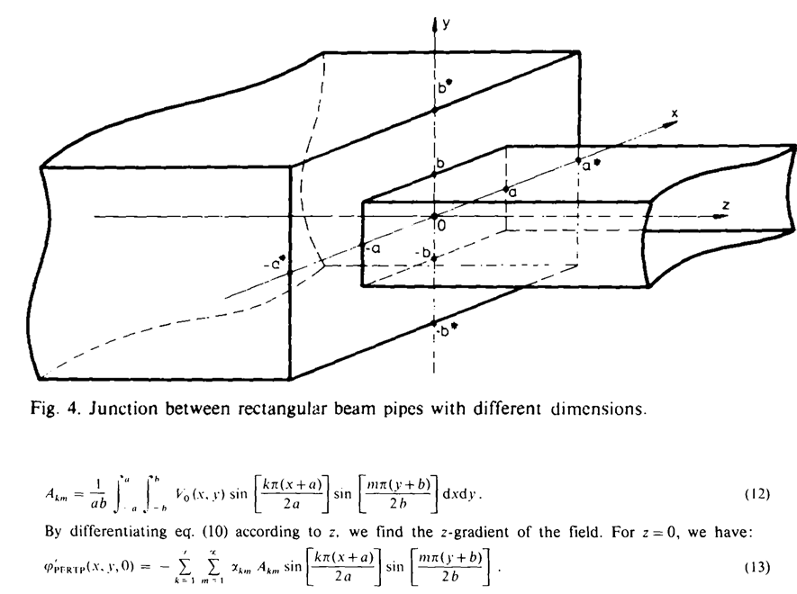
What is the Edge Effect in BPM?
If the beam pipe and BPM cross sections/shapes are different
  The EM field of the beam is distorted in the vicinity of the edges of the BPM
Design a BPM in such a way as to prevent the edge effect
    Guard rings in an upstream and downstream direction
    The longitudinal space is limited!
Wire Mapping
    The wire is a constant-potential surface
    For the beam, the potential along its length depends on the charge of the beam and the cross-section of the beam pipe
    Underestimate the edge effect
Mapping with Beam [only one at ANL ZGS (J. R. Simanton, 1969)]!
  Expensive and difficult to realize the installation
Analytical formulae
  Less accurate, valid only for simple geometries
FEM simulations (CST)
  Wake field solver line charge only→ few weeks!
  PIC solver beam transverse cross-section→ few months
J. H. Cupérus, NIM145 (1977) 233-243

Slide 4
CST Simulations

Slide 5
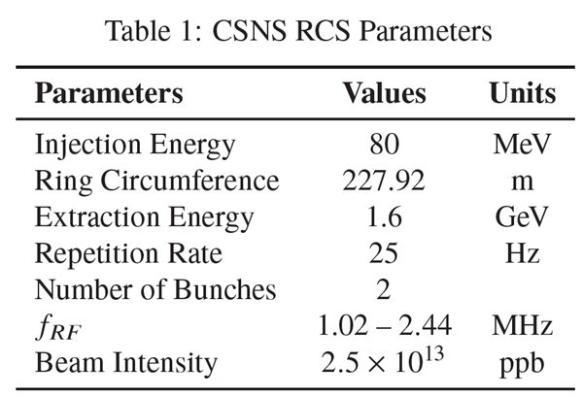

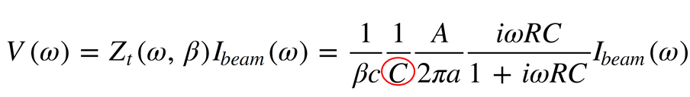
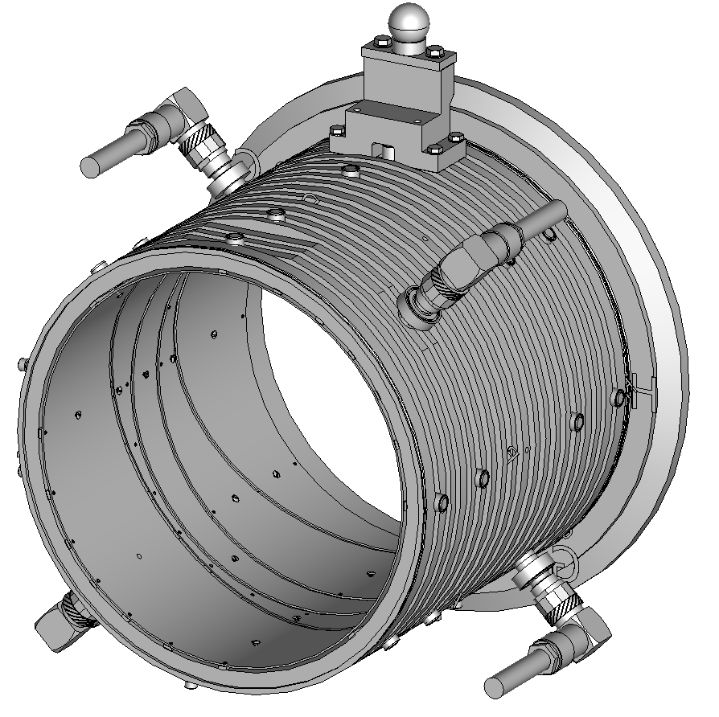
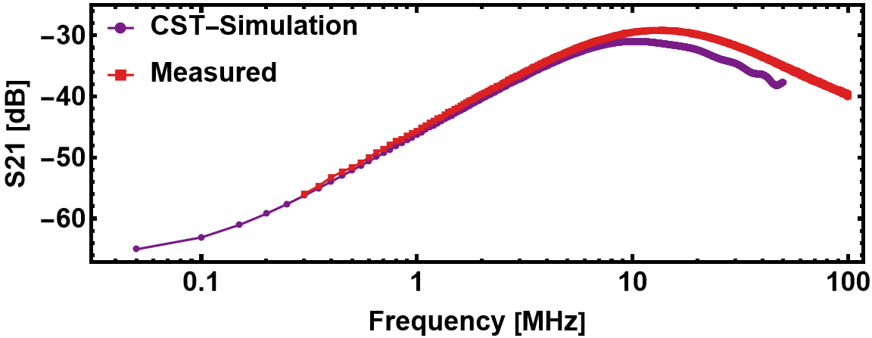
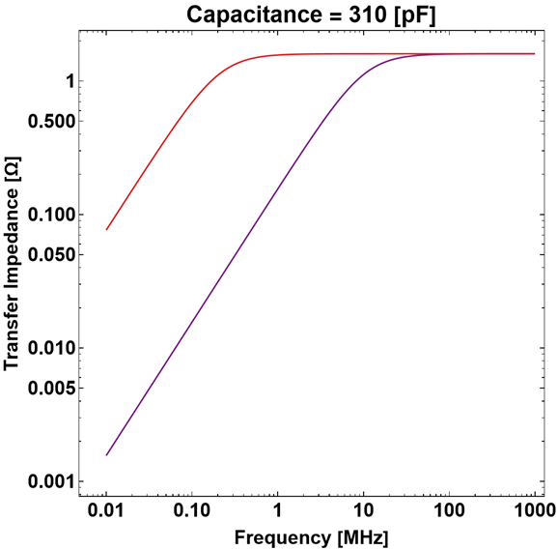
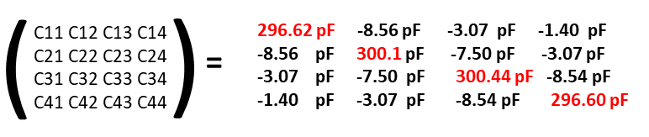

CSNS RCS BPM Structure
32 Diagonal cut BPMs are instrumented in RCS
Several of them are placed inside steering magnet (limited space)
  Rib structure on body to prevent eddy current
BPMs are 45^{O} rotated for convenient access to attach cables
Diagonal Cut-plane BPM
(Prof. Taoguang Xu)
Corrector
Magnet
B
Electrode Isolation
Transfer Impedance
BPM
A
D
Capacitance Matrix
C

Slide 6
CST Simulations
Only BPM
  Bunch charge 1 µC, Bunch Length 7000 mm/1σ (24 ns/1σ ), β = 1
    ¼ Region, 0 to x/y:60 mm, with 10 mm step
BPM with Upstream Bending Magnet Pipe (Exaggerated Condition)
  Bunch charge 1 µC, Bunch Length 7000 mm, β = 1
    ¼ Region, 0 to x:60 mm, y: 40 mm, with 10 mm step
BPM with Upstream Bellows and Bending Magnet Pipe (Realistic)
  Bunch charge 1 µC, Bunch Length 7000 mm, β = 1
    ¼ Region, 0 to x:60 mm, y: 40 mm, with 10 mm step

Slide 7
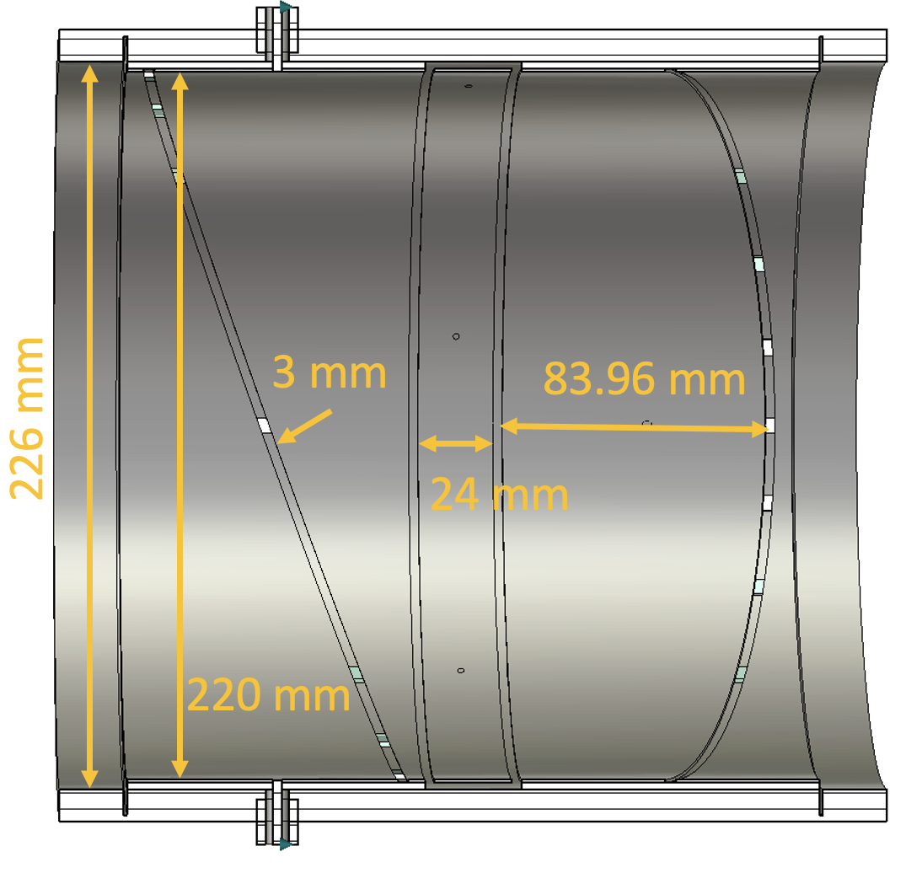
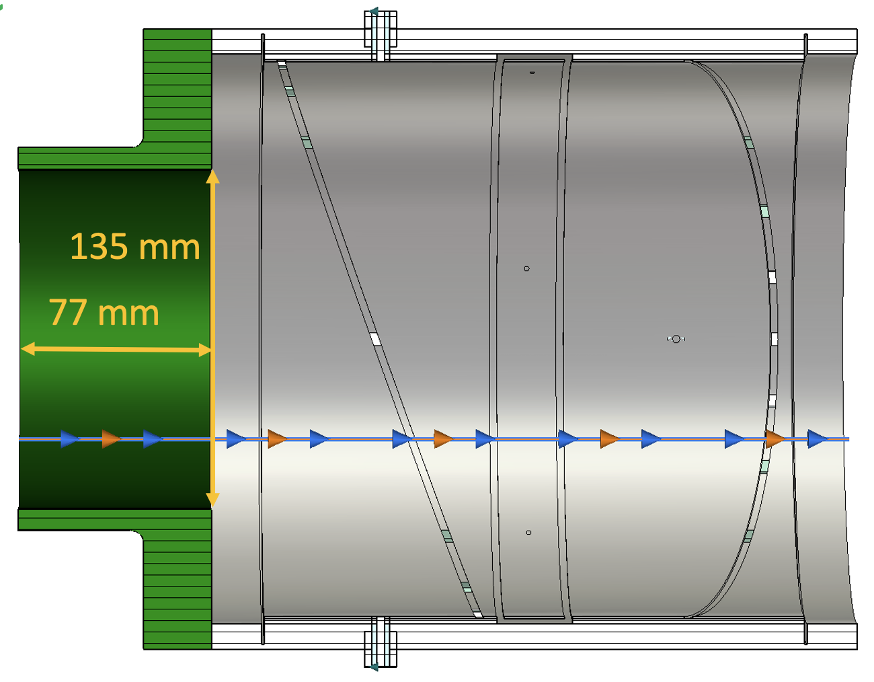
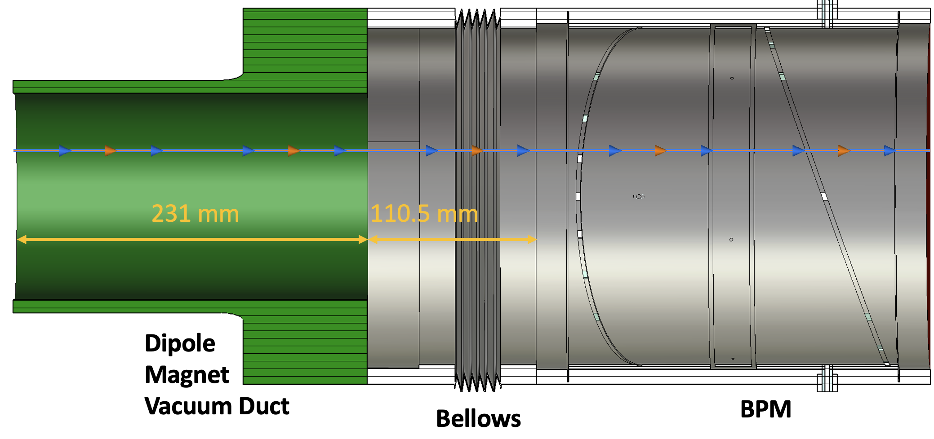
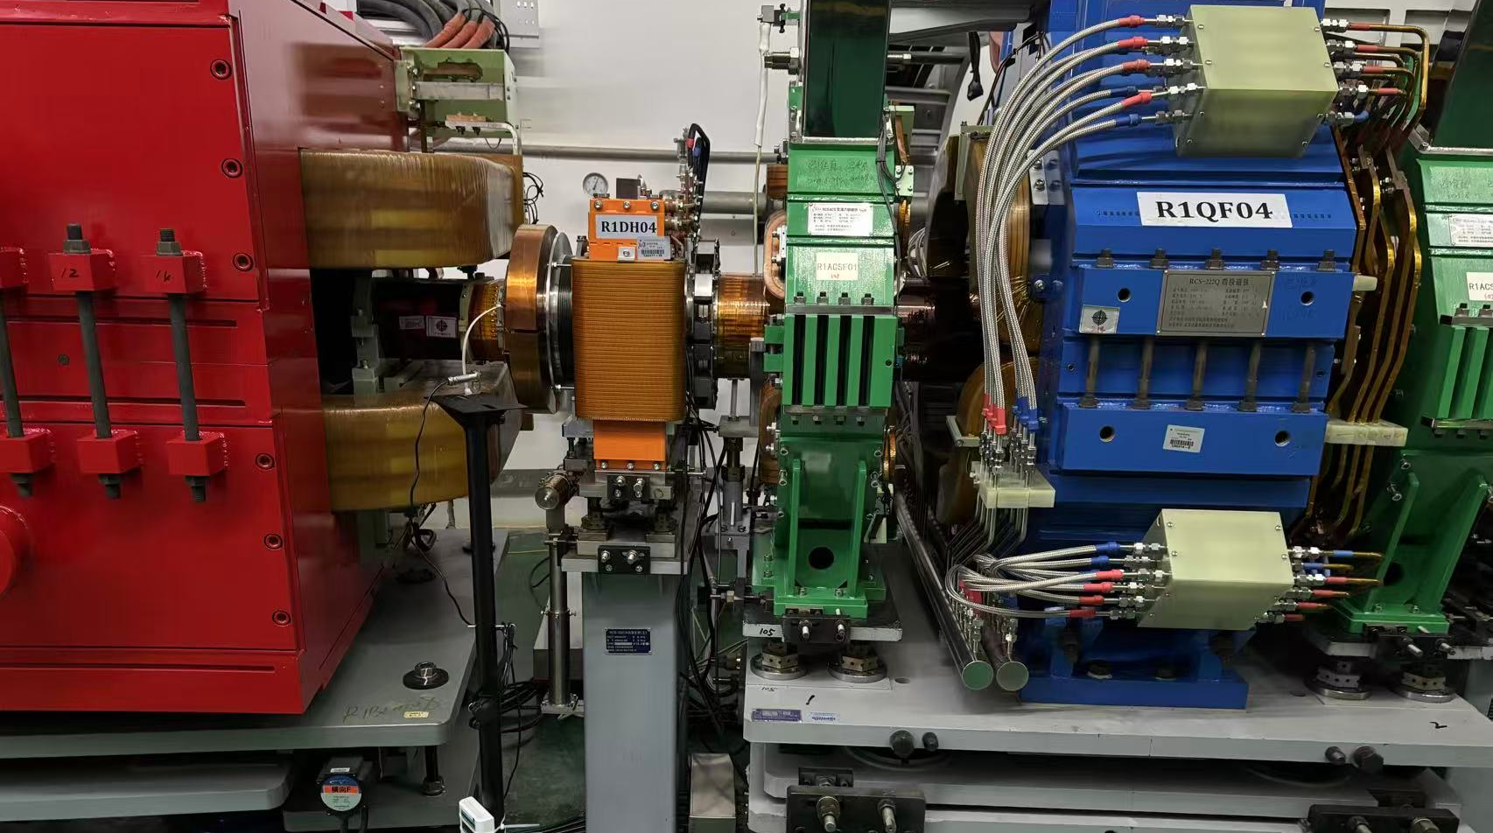
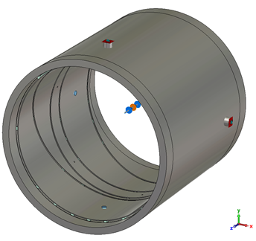
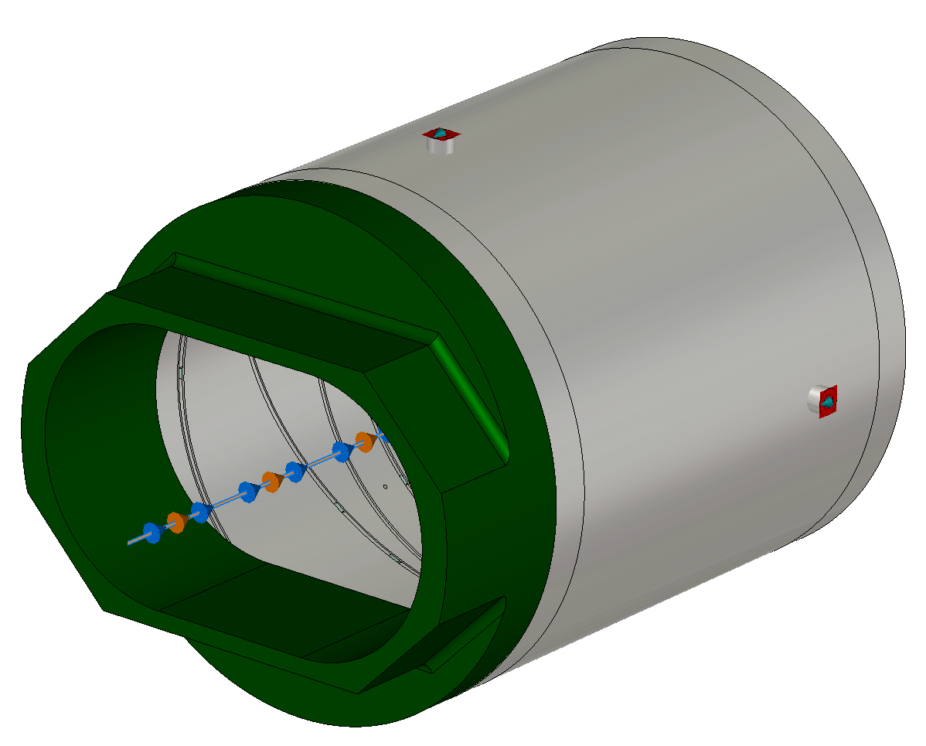
CST Simulated Models: Three Scenarios
Scenario 3: BPM + Realistic pipe
(R1BPM04 case)
Scenario 1: only BPM
Scenario 2: BPM + short pipe
218 mm

Slide 8
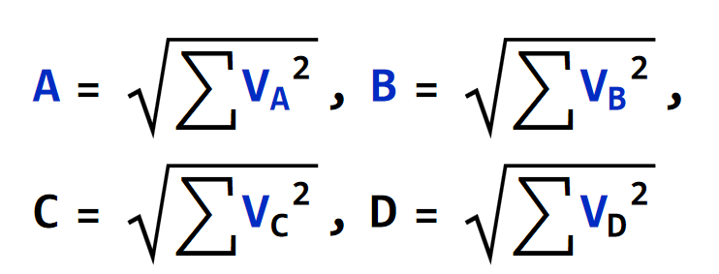
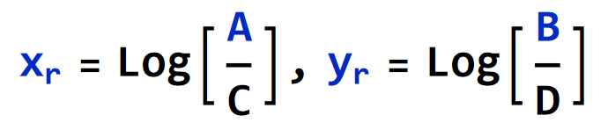
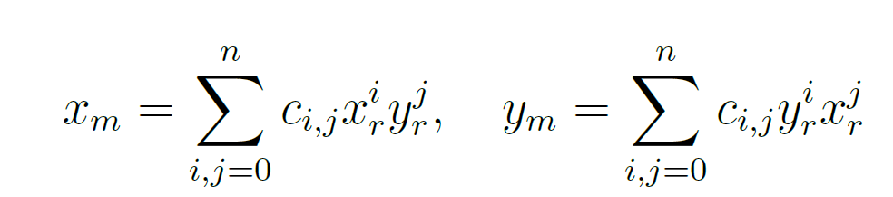
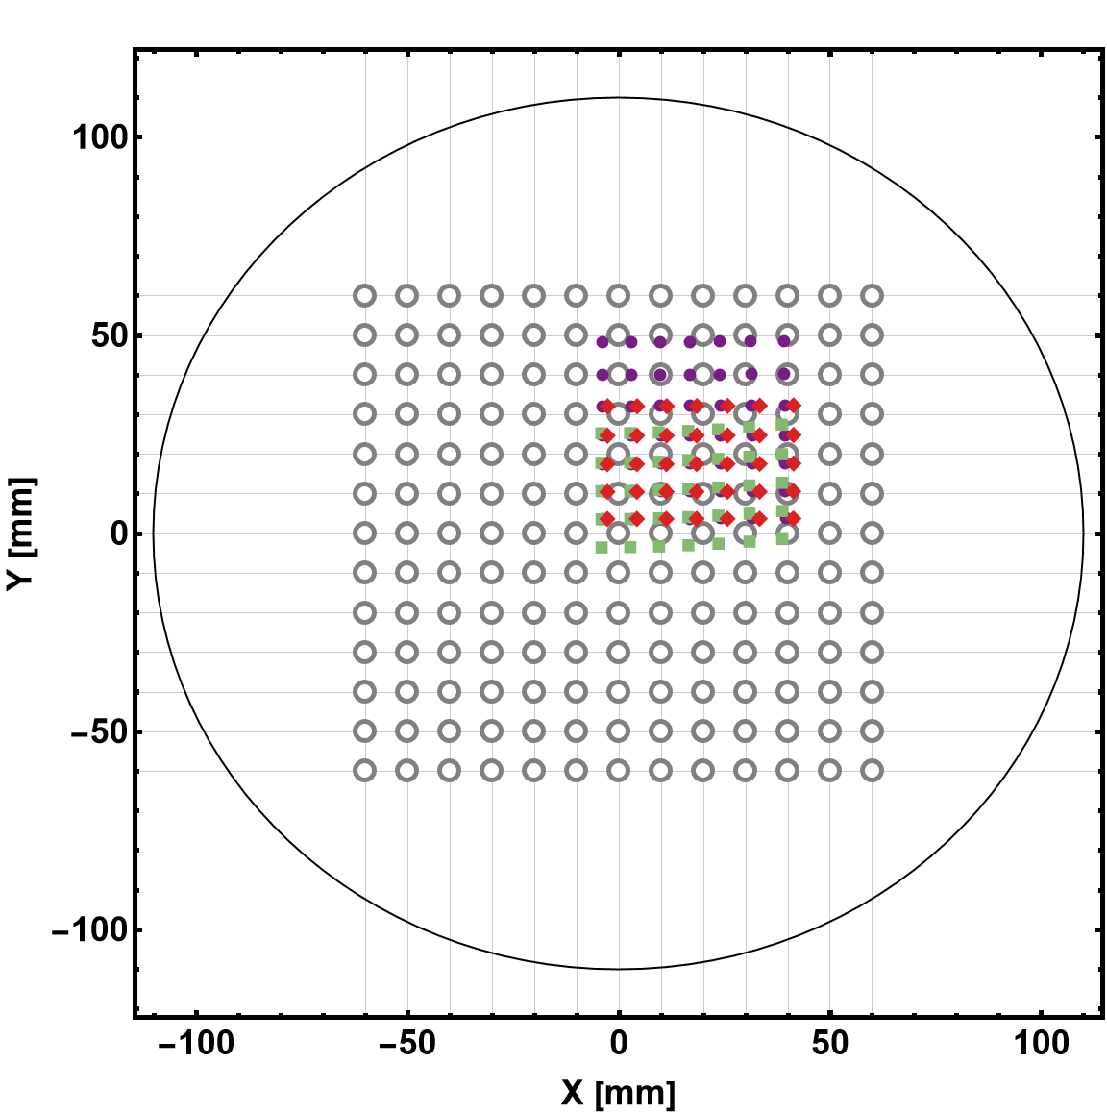
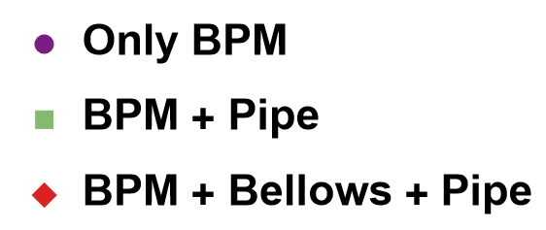
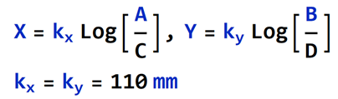
Evaluation of position map in simulation
To find offset and calibration constant polynomial fit
Findings
Transverse offsets are nearly symmetric for Only BPM case
Offset for Horizontal and Vertical plane are asymmetric for BPM + Pipe and BPM + Bellows + Pipe
The Offset and calibration constants differ for all three scenarios due to Edge effect
If edge effect is considered
  Errors to sudden change can be prevented
  Ignored → Results in wrong position measurement
3rd Order Polynomial was used
 | C_{00,x} [mm] | C_{00,y} [mm] | C_{10,x} [mm] | C_{01,y} [mm]
Senario1 | 5.45 | -5.42 | 161.30 | 161.73
Senario2 | 6.05 | 4.88 | 162.11 | 155.02
Senario3 | 3.94 | -5.54 | 157.91 | 165.11

Slide 9


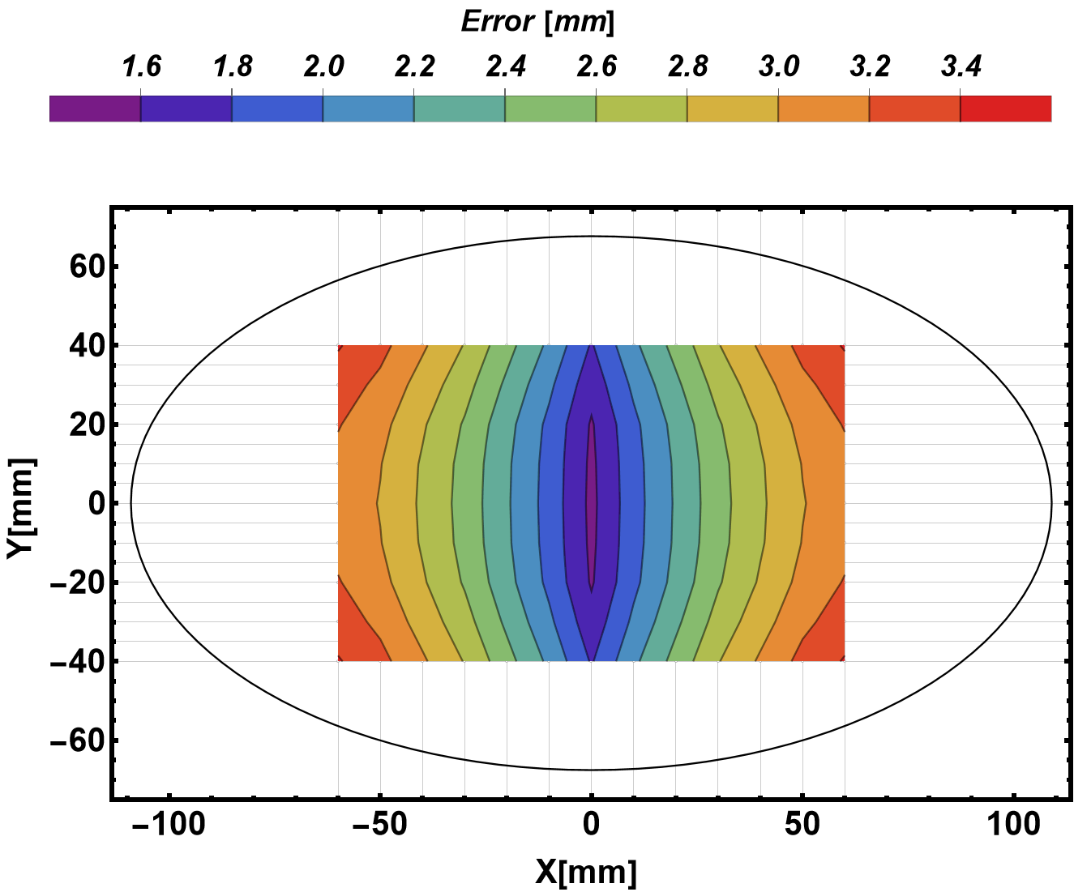
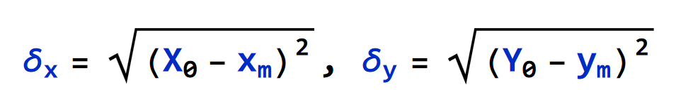
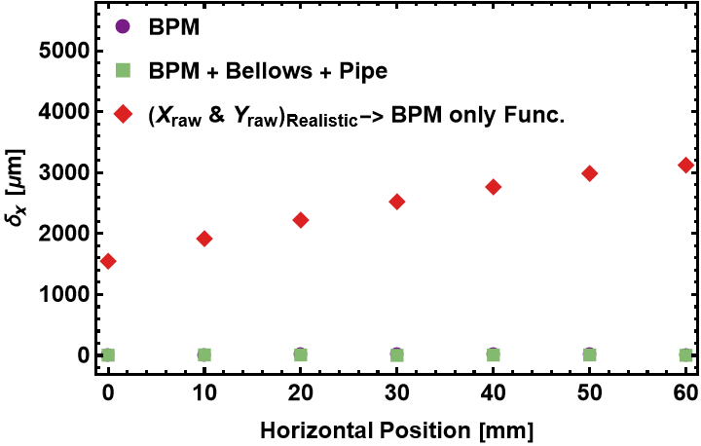
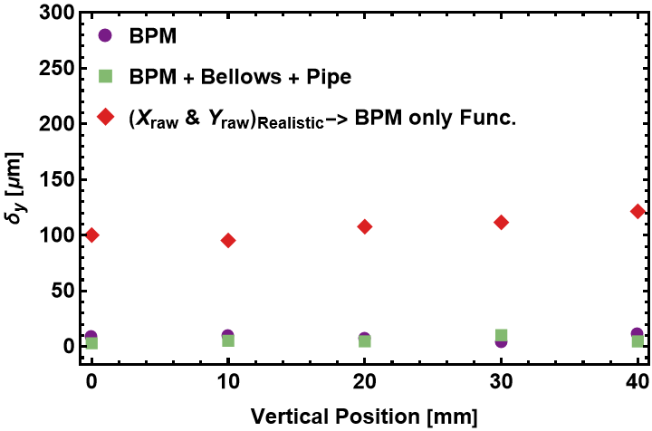
Errors Due to Edge Effect
The mapping function obtained from the wire mapping ignores the BM pipe!
To estimate these errors in the CST Simulation
  Let’s consider the X_{raw} = Log[A/C] and Y_{raw} = Log[B/D] from the case BPM + Bellows + Pipe
  But the Fitting function from the BPM only
The accuracy error is 1.6 mm to 2.2 mm within the measurement range of 0 mm to ±10 mm

Slide 10
BPM calibration in lab.
Many thanks to the Alignment and Survey Group (J. Liang, T. Wang)

Slide 11
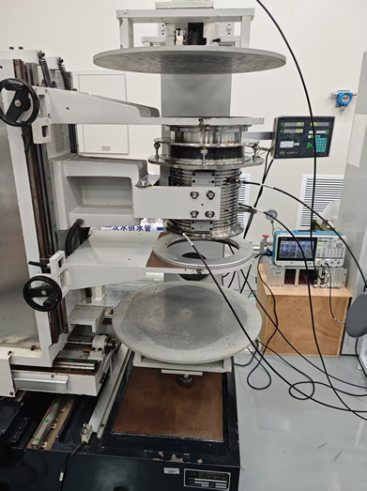
Calibration system in D1
BPM and wire (Molybdenum: Ø_{d}=100 µm) aligned with accuracy of 100 µm (Measured)
Transverse mover precision is 5 µm (Measured)
Transverse mapping range is ±60 mm
Tektronix signal generator (AFG31000)
  Sine Wave, V_{pp}=5 V, Frequency = 1-10 MHz (Varied)
Bergoz-BB Electronics
  Dynamic range: -70 dBm to +5 dBm
  BW: 10 MHz
  ADC Bit: NI Digitizer 16-bit
A thermocouple to monitor temperature
Bellows
BPM
X/Y Mover

Slide 12
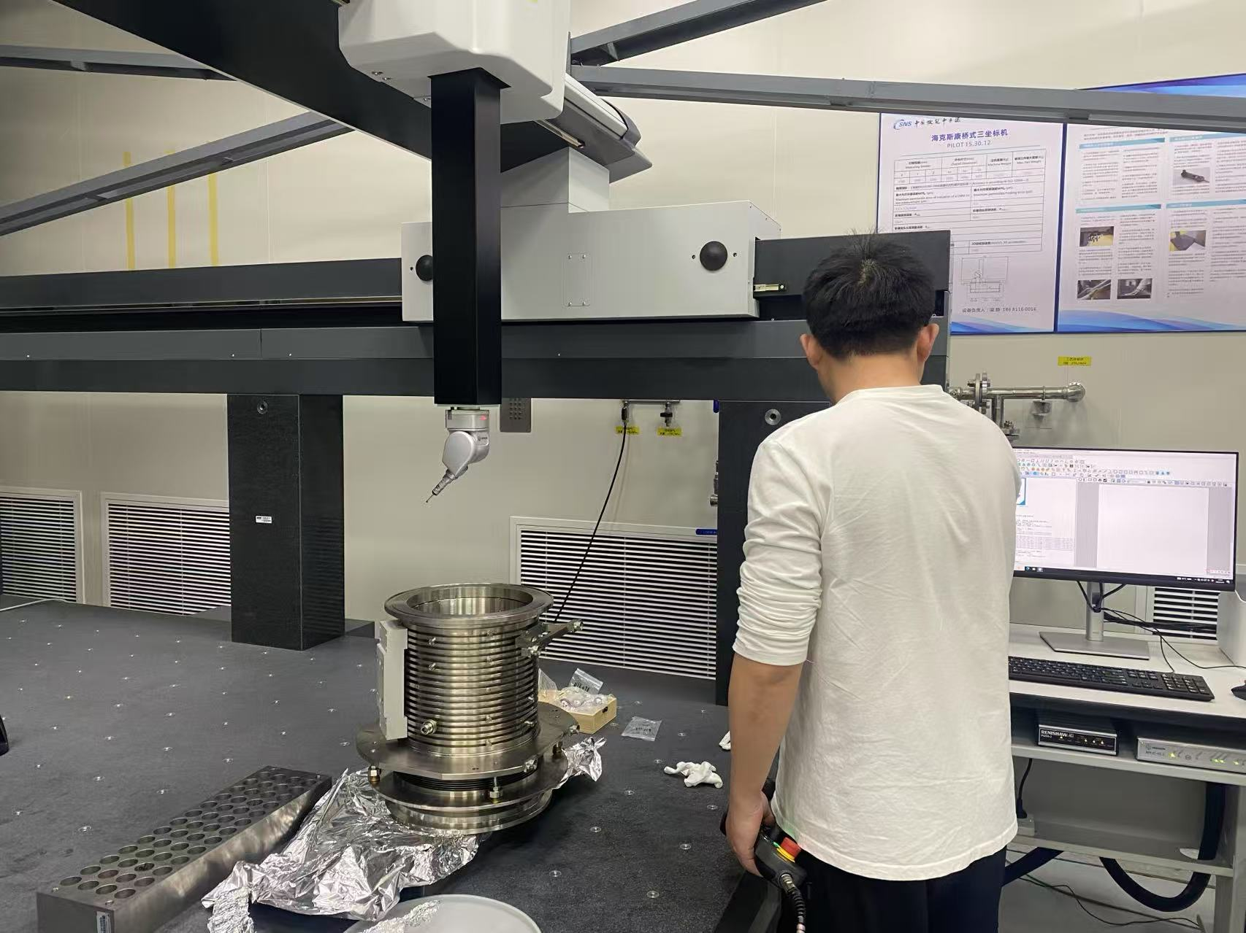
Survey of the calibration system (1)
1.First Measure Coordinate of BPM
  Coordinate Measuring Machine（CMM）
  Brand: HEXAGON
  Model: PILOT 15.30.12
The Coordinates of BPM were measured with the accuracy of better than 10 µm.
error | BPM calibration 01-BPM calibration 02
 | X/mm | Y/mm | Z/mm
F1 error | -0.004 | 0.005 | -0.003
F2 error | 0.012 | -0.007 | 0.030
F3 error | 0.057 | -0.040 | 0.010
F4 error | 0.057 | -0.039 | 0.013
error | BPM calibration 04-BPM calibration 03
 | X/mm | Y/mm | Z/mm
F1 error | 0.003 | 0.003 | -0.002
F2 error | 0.030 | -0.016 | -0.015
F3 error | 0.004 | -0.001 | 0.002
F4 error | 0.002 | -0.002 | -0.004
error | BPM calibration 04-BPM calibration 01
 | X/mm | Y/mm | Z/mm
F1 error | 0.007 | 0.013 | -0.001
F2 error | 0.012 | 0.002 | -0.001
F3 error | 0.013 | -0.006 | 0.003
F4 error | 0.007 | -0.006 | -0.002
BPM calibration 01 |  |  |  |  | BPM calibration 02
point name | X/mm | Y/mm | Z/mm |  | point name | X/mm | Y/mm | Z/mm
F1 | -88.214 | 185.064 | 244.628 |  | F1 | -88.218 | 185.070 | 244.626
F2 | -88.026 | 190.152 | 51.868 |  | F2 | -88.014 | 190.145 | 51.897
F3 | 87.936 | 189.844 | 51.456 |  | F3 | 87.993 | 189.804 | 51.465
F4 | 87.988 | 185.130 | 244.477 |  | F4 | 88.045 | 185.090 | 244.490
BPM calibration 03 |  |  |  |  | BPM calibration 04
point name | X/mm | Y/mm | Z/mm |  | point name | X/mm | Y/mm | Z/mm
F1 | -88.211 | 185.074 | 244.630 |  | F1 | -88.207 | 185.077 | 244.628
F2 | -88.044 | 190.170 | 51.882 |  | F2 | -88.014 | 190.154 | 51.866
F3 | 87.944 | 189.838 | 51.457 |  | F3 | 87.948 | 189.838 | 51.459
F4 | 87.993 | 185.126 | 244.479 |  | F4 | 87.995 | 185.123 | 244.475

Slide 13
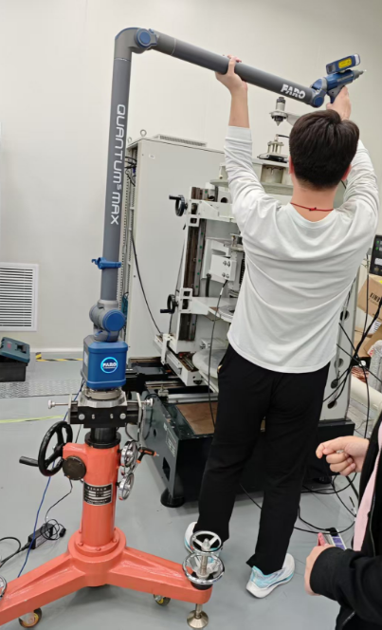

Survey of the calibration system (2)
The horizontal/vertical mover precision is about than 5 µm/ 15 µm
Laser Scanner
Brand: FARO
Model: S730
X axis
error(forward-goning)
max | 0.03mm
min | -0.012mm
RMS | 0.006mm
error(reverse-goning)
max | 0.008mm
min | -0.042mm
RMS | 0.005mm
Y axis
error(forward-goning)
max | 0.022mm
min | -0.045mm
RMS | 0.017mm
error(reverse-goning)
max | 0.025mm
min | -0.065mm
RMS | 0.016mm

Slide 14
Survey of the calibration system (3)
Laser Scanner
Brand: FARO
Model: S730
The Wire and BPM were aligned with the accuracy better than 100 µm.
Error of BPM Center and Wire Position
Test 01 | X(mm) | Y(mm) |  | Test 02 | X(mm) | Y(mm)
Top Flange center of BPM-Wire | 0.018 | 0.038 |  | Top Flange certer of BPM-Wire | -0.079 | 0.02
Bottom Flange center of BPM-Wire | -0.005 | 0.014 |  | Bottom Flange certer of BPM-Wire | -0.052 | 0.011
Test 03 | X(mm) | Y(mm)
Top Flange center of BPM-Wire | -0.066 | 0.072
Bottom Flange center of BPM-Wire | -0.088 | -0.018

Slide 15
Test of the BPM electronics

Slide 16
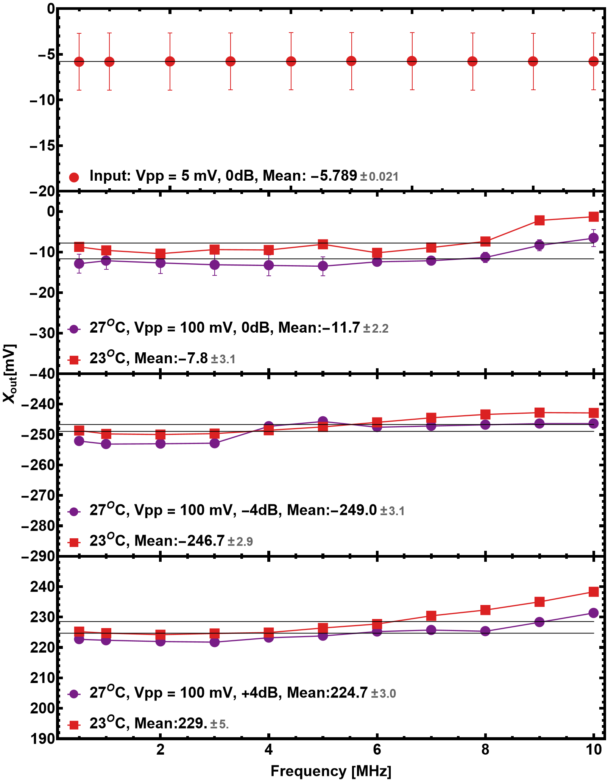
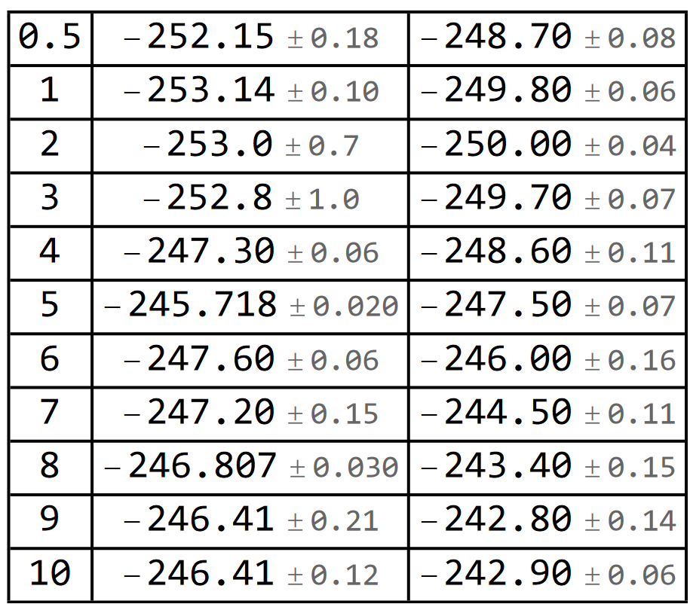
Bergoz-BB Frequency dependence Check
Bergoz-BB have a BW of 10 MHz
  So, it should be independent of the signal up to 10 MHz
Data was obtained
  Vpp=5 mV, Frequency 0.5 MHz to 10 MHz @ 27 °C
  Vpp=100 mV, Frequency 0.5 MHz to 10 MHz @ 27^{O}C and 23^{O}C, Log(V_{a}/V_{c}) = -4 dB
  Vpp=100 mV, Frequency 0.5 MHz to 10 MHz @ 27^{O}C and 23^{O}C, Log(V_{a}/V_{c}) = +4 dB
Frq [MHz]
X_{out}@27^{O}
X_{out}@23^{O}
The room temperature was adjusted with the air conditioner.

Slide 17

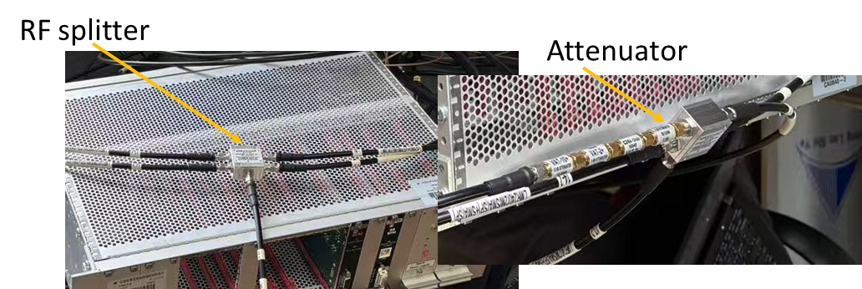
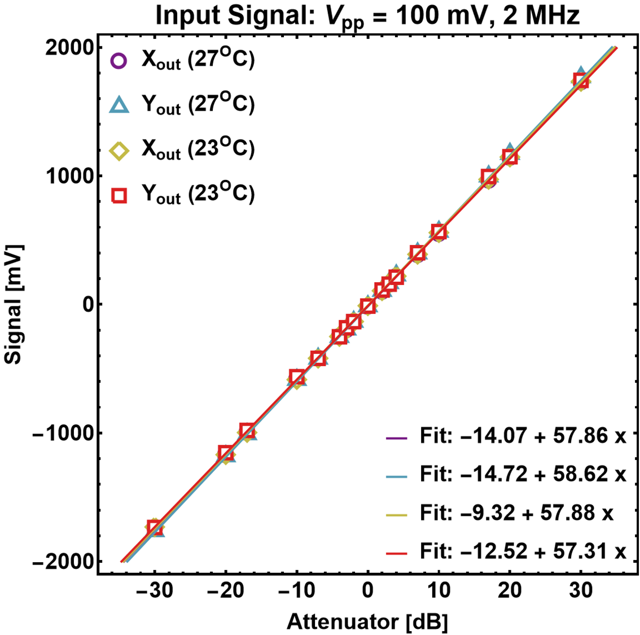
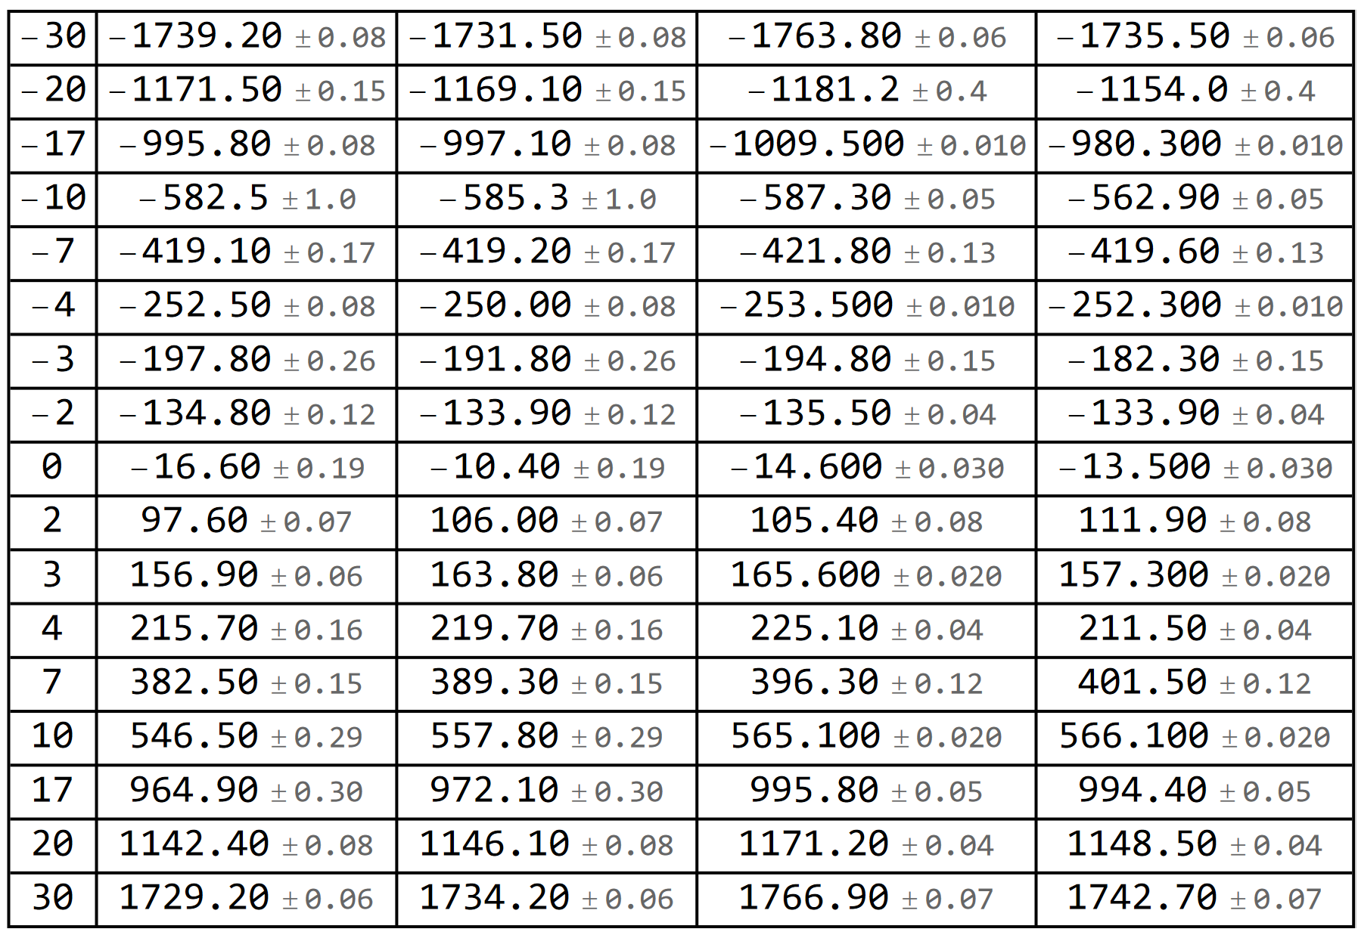
Bergoz-BB Linearity Check
Finding:
The temperature influence (23^{O}C-27^{O}C) on electronics is less than 0.5%
The electronics output is linear within desired range of measurement
Att. [dB]
X_{out}@27^{O}
X_{out}@23^{O}
Y_{out}@27^{O}
Y_{out}@23^{O}
Log(V_{a}/V_{c}) or Log(V_{b}/V_{d})

Slide 18
Re-calibration of the BPM

Slide 19
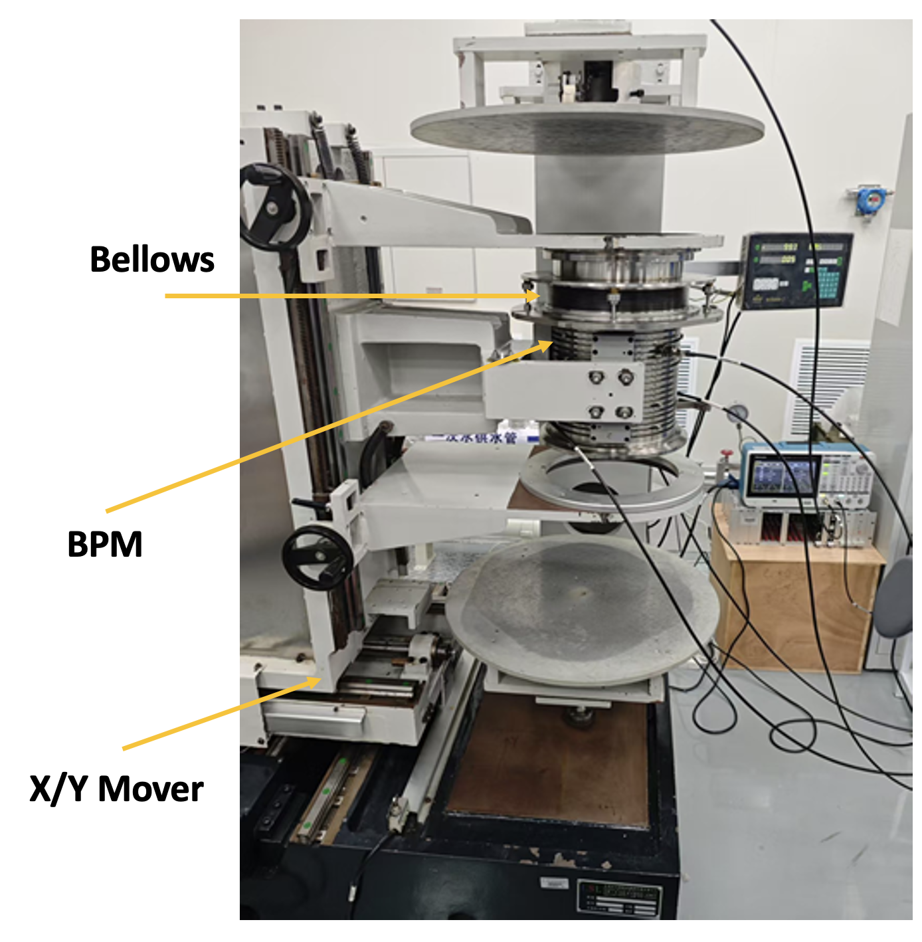
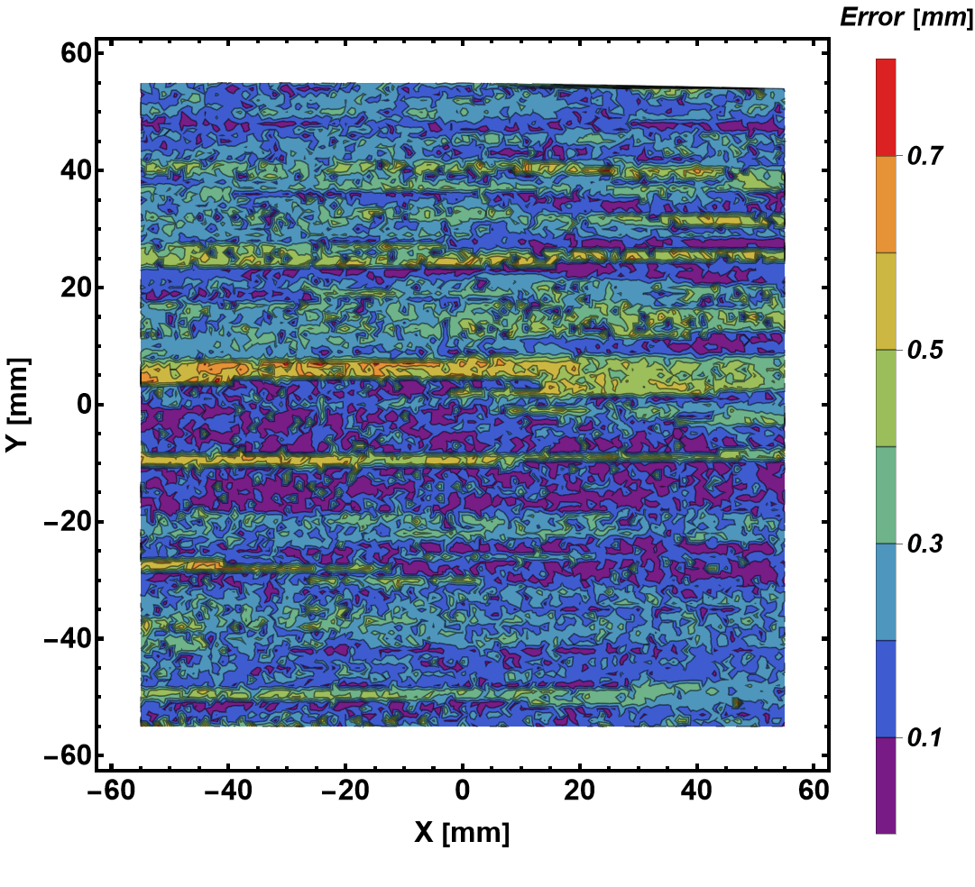
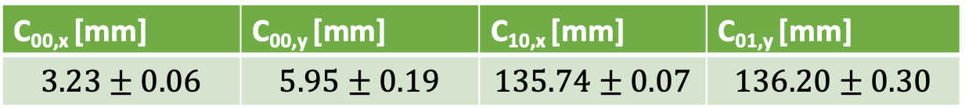
Repeatability of the calibration system
Step size: 1 mm
Frequency: 1 MHz
Repeat 17 Times
C_{00,x} [mm] | C_{00,y} [mm] | C_{10,x} [mm] | C_{01,y} [mm]
$$3.23±0.06$$ | $$5.95±0.19$$ | $$135.74±0.07$$ | $$136.20±0.30$$
Finding:
The random error induced uncertainty of the mapping coef. is <3.2%.

Slide 20
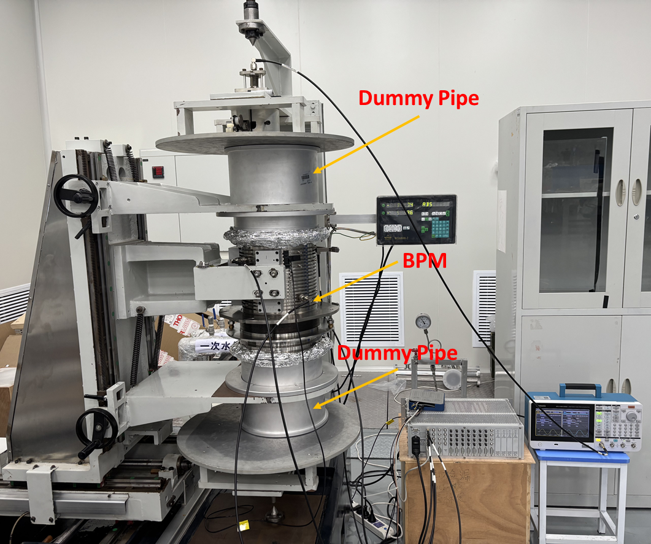
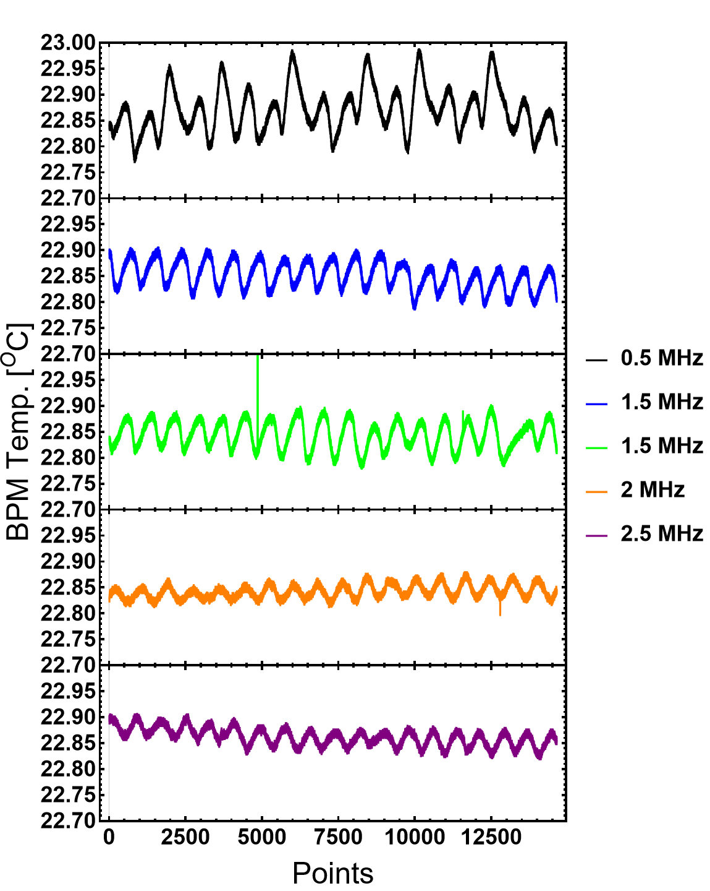
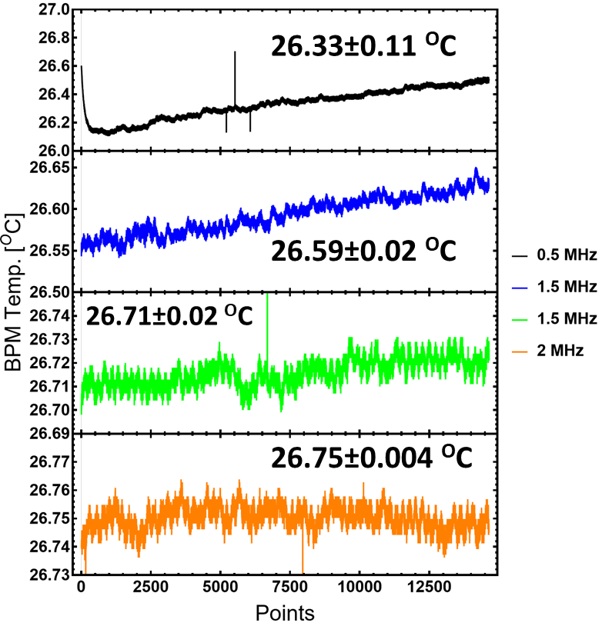
Calibration system: more details
1, dummy pipe (old) were added to the upper and bottom sides
2, Room temperature was change from 23 ºC to 27 ºC (maximum!)
Input to Electronics: 1~2 mV

Slide 21
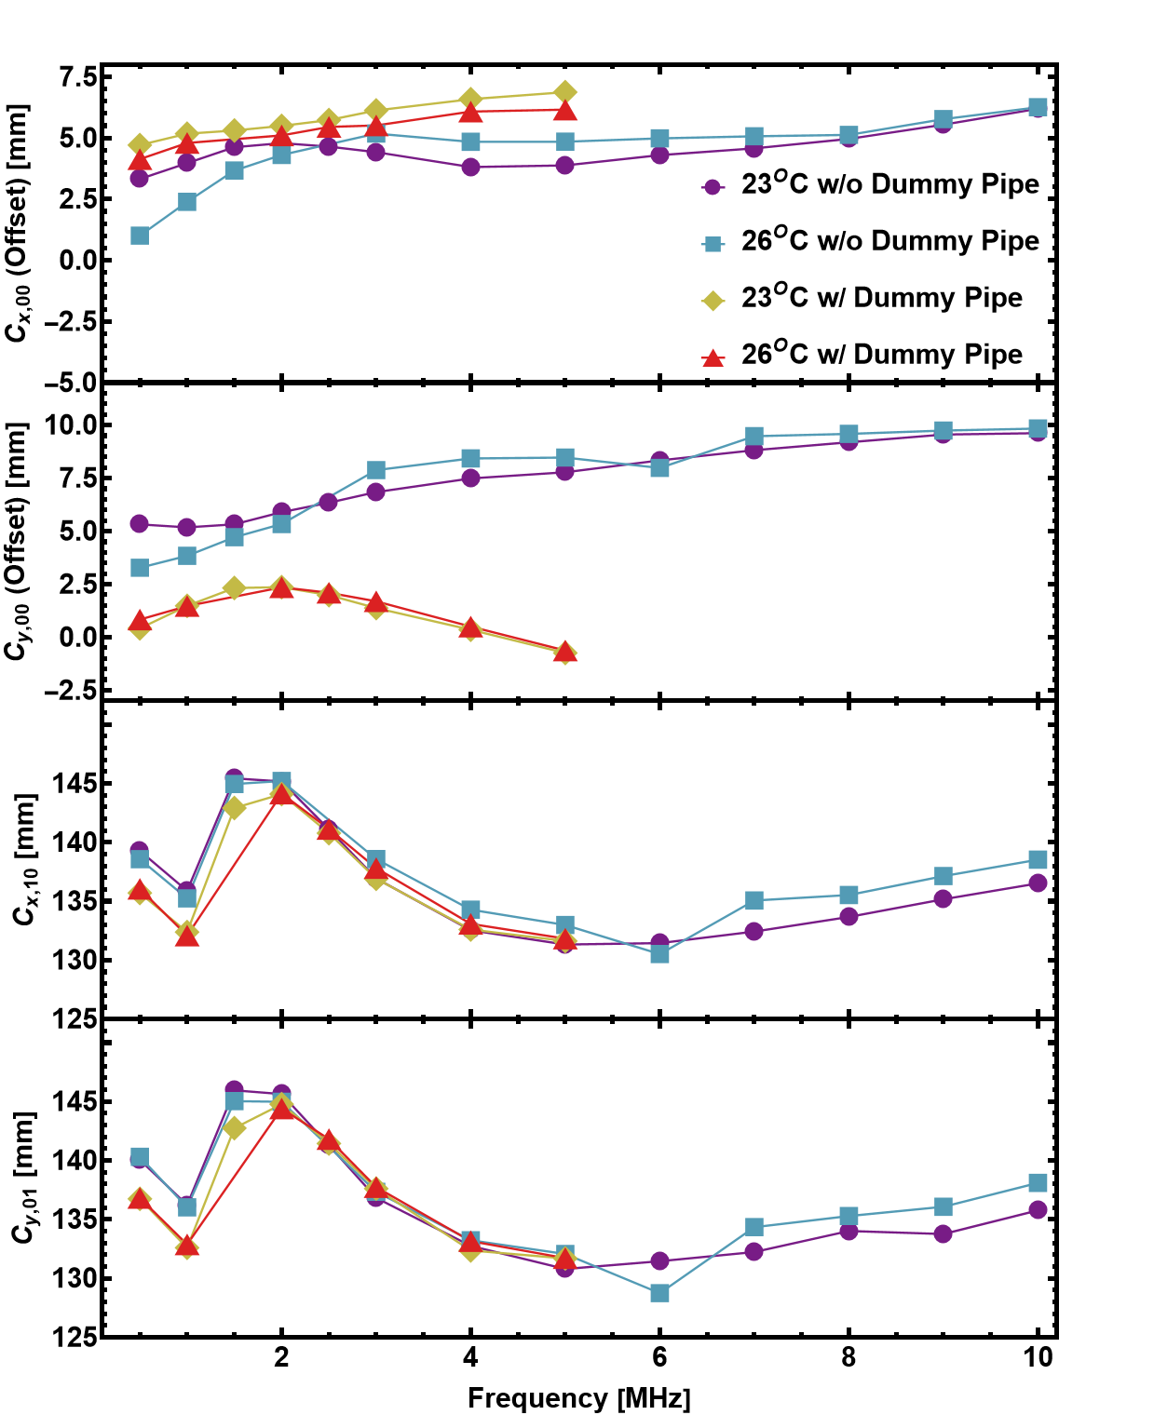
Wire Mapping: Frequency Dependence
With 3rd order Polynomial Fit
Strong frequency dependence is observed
Offset(y) varies from 5.5 to 10 mm in Freq. range 0.5 to 10 MHz
The offset varies largely with and without dummy pipe
The offset variation with temperature change (w/o dummy pipe) is large. Offset variation with temperature change (w/ dummy pipe) is small

Slide 22
Summary
CST simulations has been carried out to estimate the Edge Effect
  The error is 1.6 mm to 2.2 mm within the measurement range from 0 mm to ±10 mm
The wire mapping of spare BPM has been carried out
  Wire mapping without dummy pipe
    Room Temperature 23^{O}
      Frequency variation 0.5 MHz to 10 MHz
    Room Temperature 27^{O}
      Frequency variation 0.5 MHz to 2 MHz
  Wire mapping with dummy pipe
    Room Temperature 23^{O}
      Frequency variation 0.5 MHz to 5 MHz
    Room Temperature 27^{O}
      Frequency variation 0.5 MHz to 5 MHz
Only Sim.
Exp. In future
Mapping
Exp.
Mapping
Exp.
Known
Probably Error w/ and w/o Dummy Pipe: About 2.7 mm / 3.7 results in additional offset @ r=0 mm

Slide 23
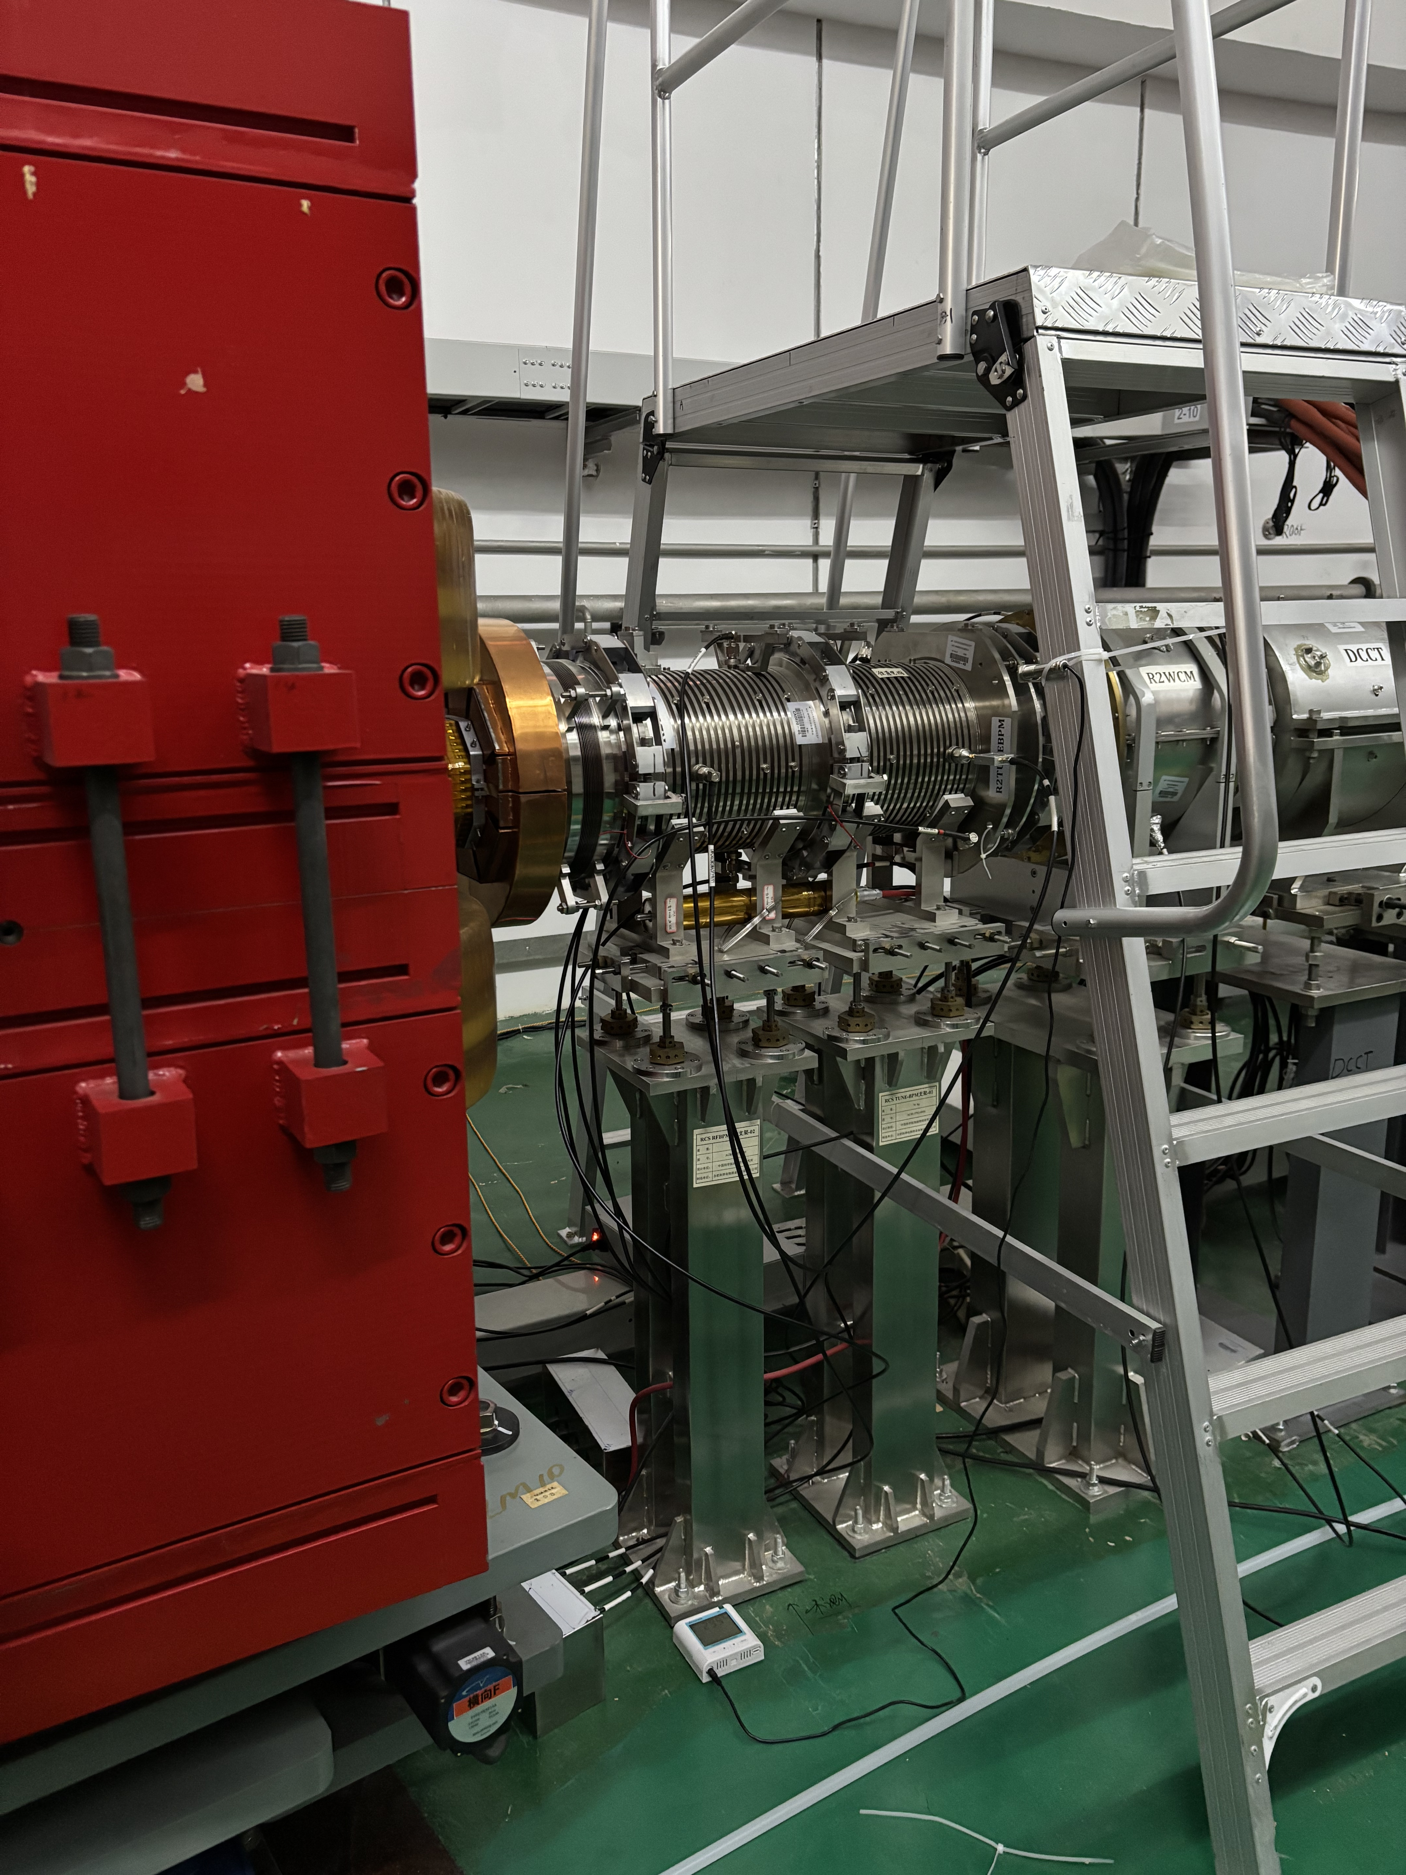
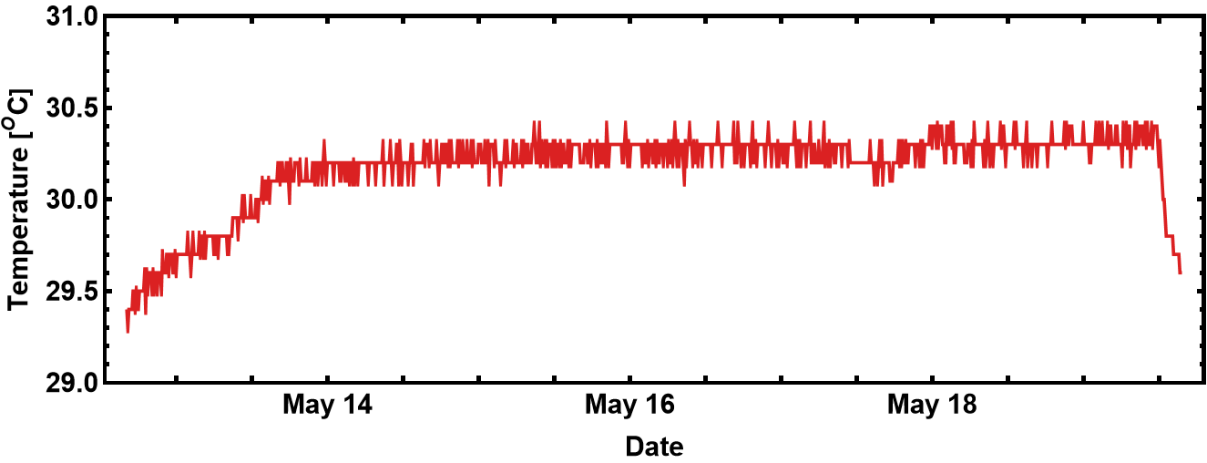
Bending Magnet
BPM
sensor
Real BPM Temperature in Tunnel
30.26±0.07 ^{O}C
Beam ON
2025
2025
2025
Temperature sensor Readout

Slide 24
Highlights from 29/05/2025 RCS BPM meeting
A remote discussion meeting with Prof. T. Toyama and Prof. K. Satou of J-PARC/KEK (29/05/2025)
Some highlights of the discussion
  Comment 1#: CST simulation with Electrical Boundary might include additional undesired effects/errors. Therefore, simulations with dummy pipe is recommended. The appropriate length of the dummy pipe should be checked via simulation and comparison of the results
    A length of the dummy pipe being >3*BPM diameter has been recommended by senior master
    But, Toyama-san think L>1*diam. Might also work. It should be confirmed through comparisons
  Q6: Did you check the capacitance matrix terms in lab.?
  A6: Not yet, but it could be done.
  Recommendation: use a two-port VNA and a 50 Ohm terminator; The lower frequency range is more important, i.e., determine the C_ij value in a lower freq. (<1 MHz at JPARC , Toyama-san)
  Q9: which dummy pipe length is favoured for the calibration system in lab.? (R. Yang)
  A9: Same troubles in J-PARC’s BPM calibration (varying BPM apertures). No clear norm. The 3*Diam. is assessed by senior master through static calculation (formula), and it is very rough. (Toyama-san)
  => We should use a longer one

Slide 25
Highlights from 29/05/2025 RCS BPM meeting
Some highlights of the discussion
  Q7: Mapping with VNA at JPARC
  A7: we use a 5-port VNA
  Recommendation:
    Generator – Transformer at wire input – Wire: the transformer should be optimized to minimize the reflection; in the case of mis-matched impedance, the reflection RF signal will cause extra EM field distortion inside the BPM body, it does deform the waveform
    Consider to use a RF power amplifier
    might be 200-300 Ohm characteristics impedance of the (wire-BPM, the calibration system)
    In Toyama-san’s mapping work, some problems were observed in the early phase, and the reason was found to be the mis-match between wire and coax. cable

Slide 26
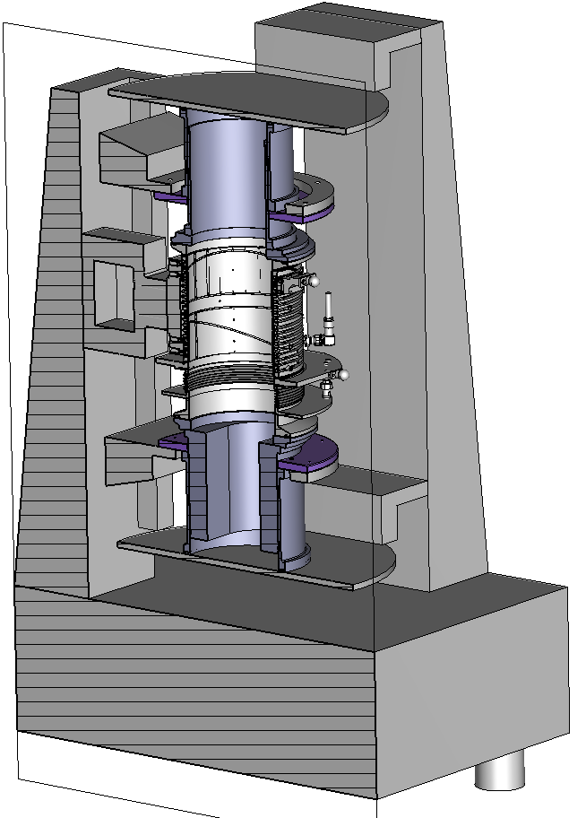
Future Works
Wire Mapping with realistic pipe (preparing)
Upgrade of the BPM calibration system
  A longer dummy pipe (As defined in simu.)
  Controlled room temperature (up to 30ºC)
  Fasten the calibration process w/ VNA
    Frequency of interest: 0-10 MHz
Try to understand the real cause of strong frequency dependence
  Is it due to cross coupling among electrodes?
  Transfer Impedance?
  Calibration System?
Thank you very much!!!

Slide 27
Back up

Slide 28
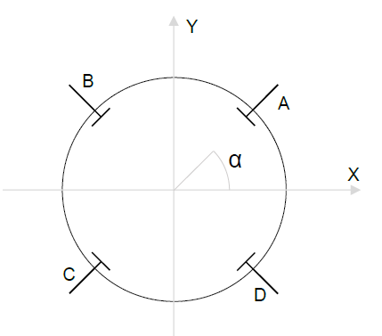
Analysis Method
In case of non rotated electrodes
  X = c_{x}Log[A/C], Y = c_{y}Log[B/D]
  X and Y_{r} come directly come from Bergoz-BB electronics,
  c_{x} and c_{y} are calibration constant
Since the electrodes are 45^{O} rotated
  X = c_{x} [Log(A/C) . cos(α) – Log(B/D) . sin(α)], Y = c_{y} [Log(A/C) . sin(α) + Log(B/D) . cos(α)]
  sin(α)= cos(α)=1/sqrt(2)
In our case 3rd order polynomial is applied

Slide 29

