Slide 1




Effect of Soft-Hard Correlations on R_{AA} as a Function of Centrality
W. A. Horowitz
University of Cape Town
OIST TSVP
Mar 24, 2026
Based, in part, on
Faraday and WAH, JHEP 11 (2025) 019 [arXiv:2505.14568]
Faraday, Bert, Brand, Vogelsang, WAH, arXiv:2512.17832 [hep-ph]
Bert, Faraday, and WAH, arXiv:2603.XXXXX [hep-ph]

Slide 2
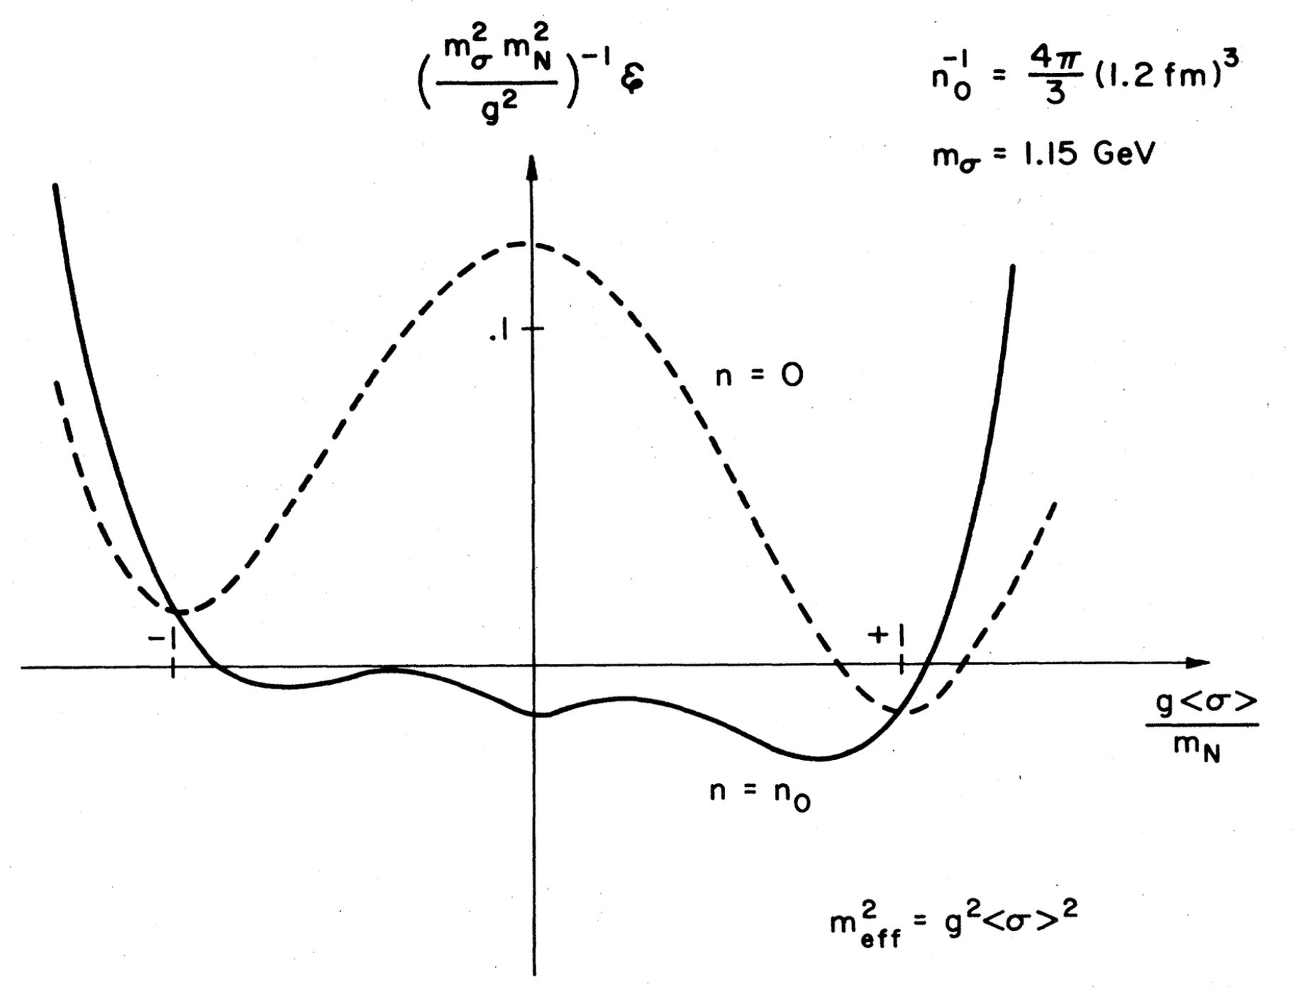
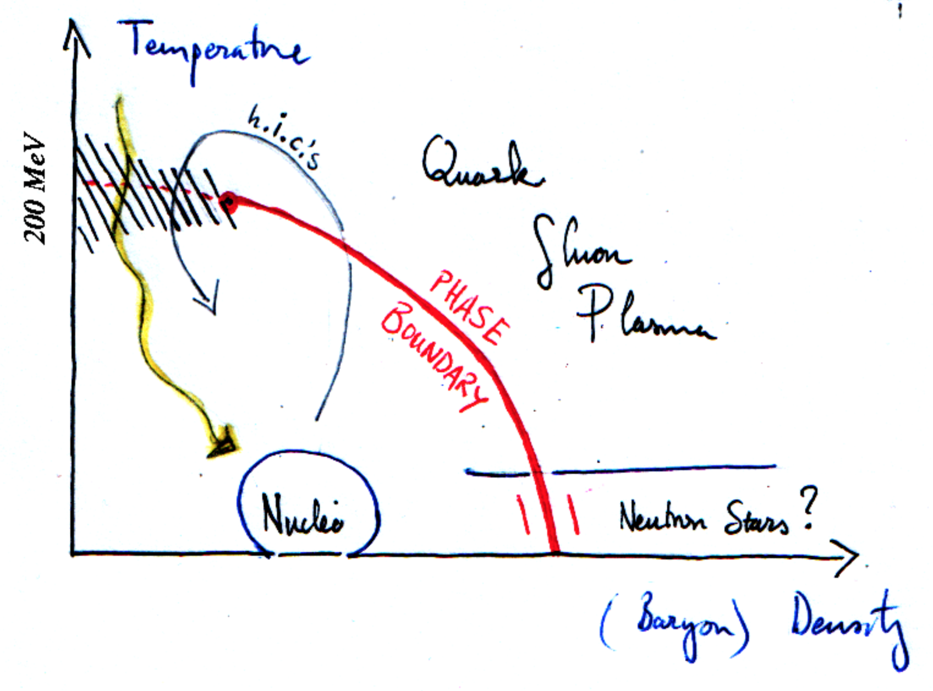
The Big Old Question in HIC
Pre-RHIC: Can we form a plasma of abnormal nuclear matter?
TD Lee, Rev. Mod. Phys. 47, 267 (1975)

Slide 3
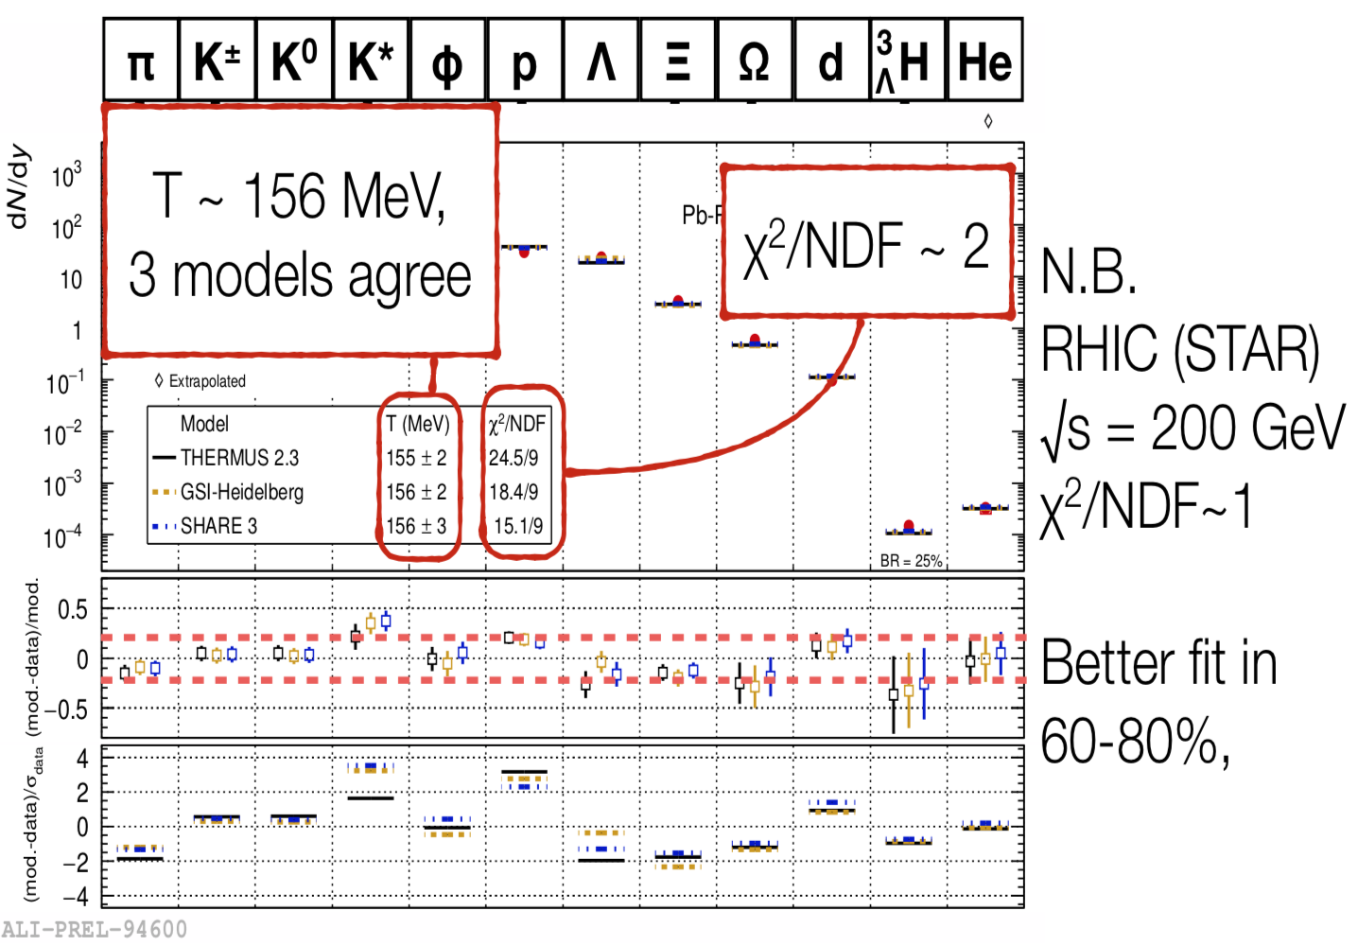

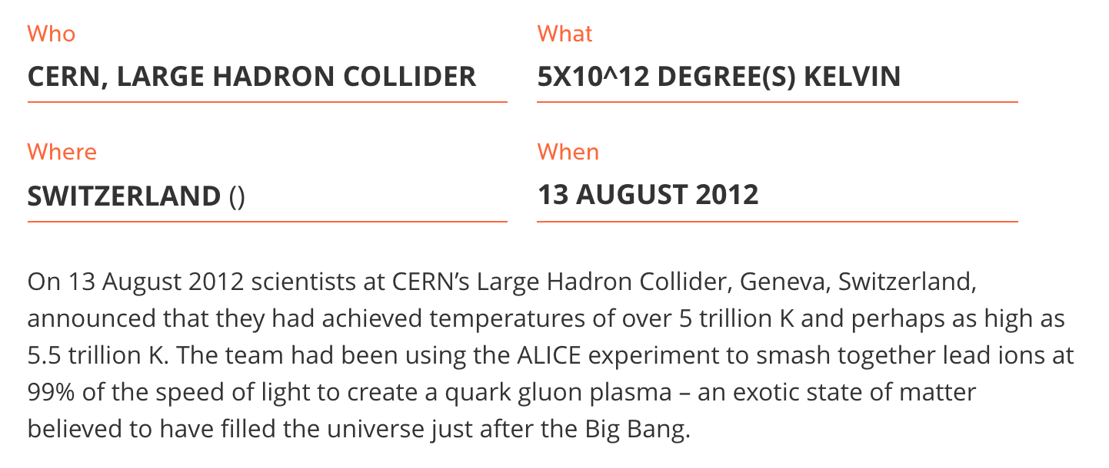
New State of Matter Found in AA:
Species abundancies => hottest temperatures ever measured
J Cleymans, HEPP2018
http://www.guinnessworldrecords.com/world-records/highest-man-made-temperature
Notes:
Experimental measurement => theoretical interpretation

Slide 4
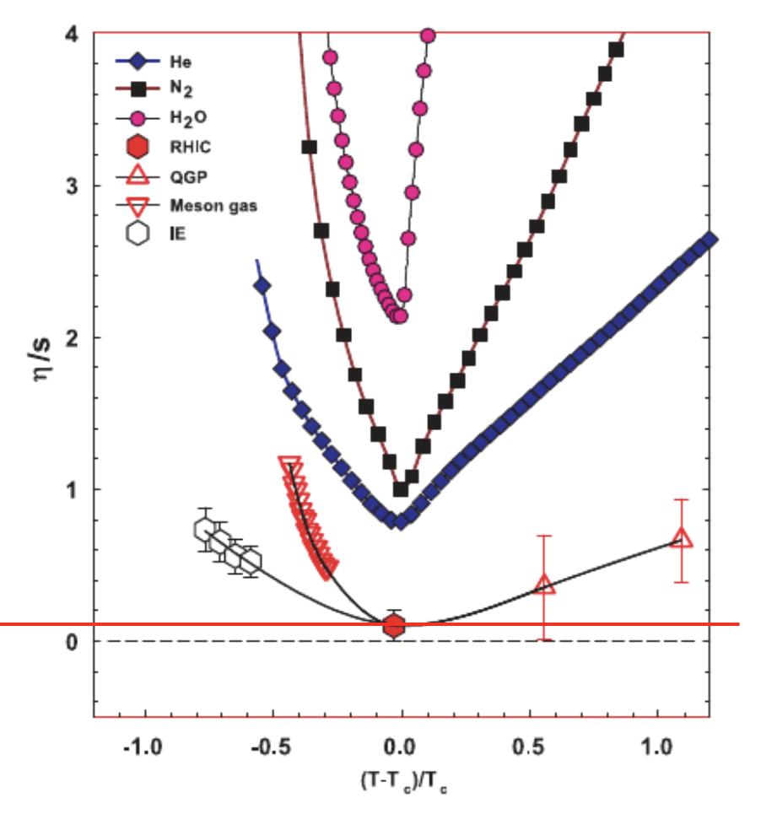
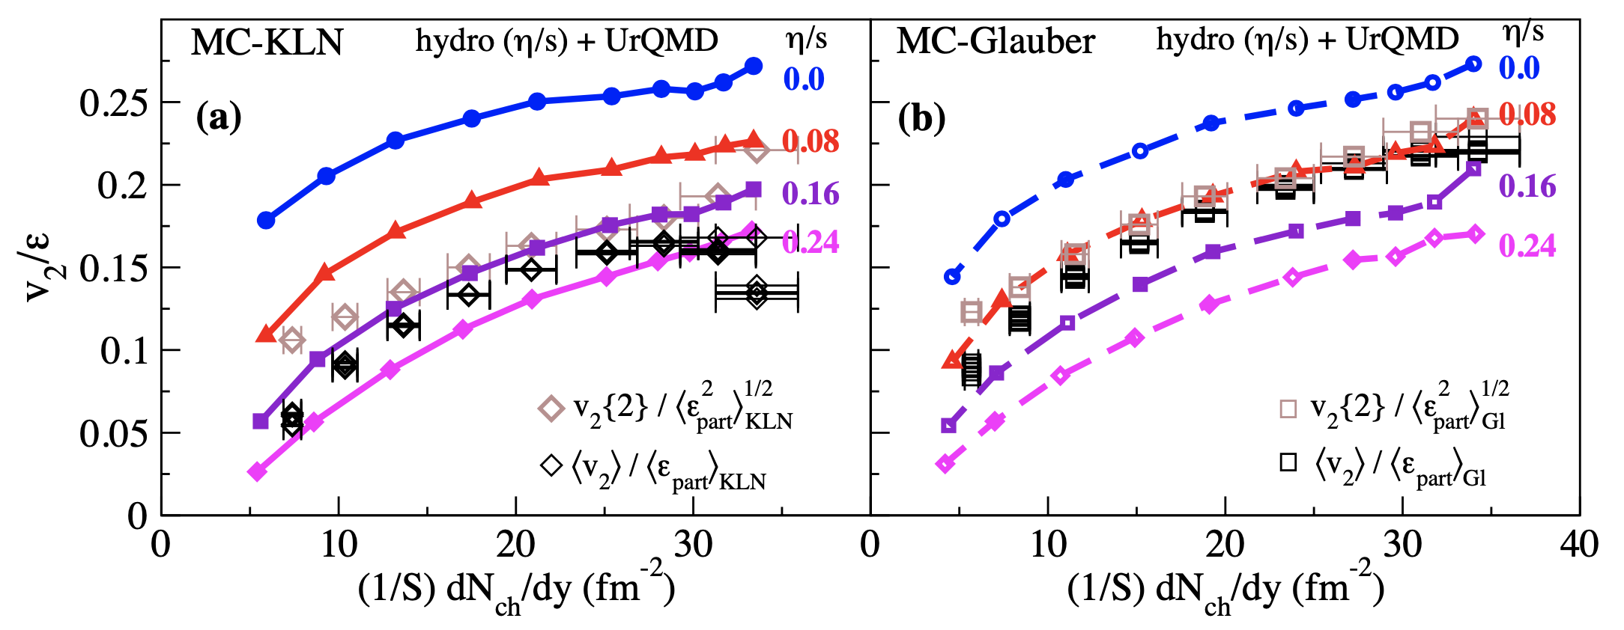
New State of Matter Found in AA:
Particle correlations => hydrodynamic flow of perfect fluid
STAR Data
Song et al, PRL106 (2011)

Slide 5
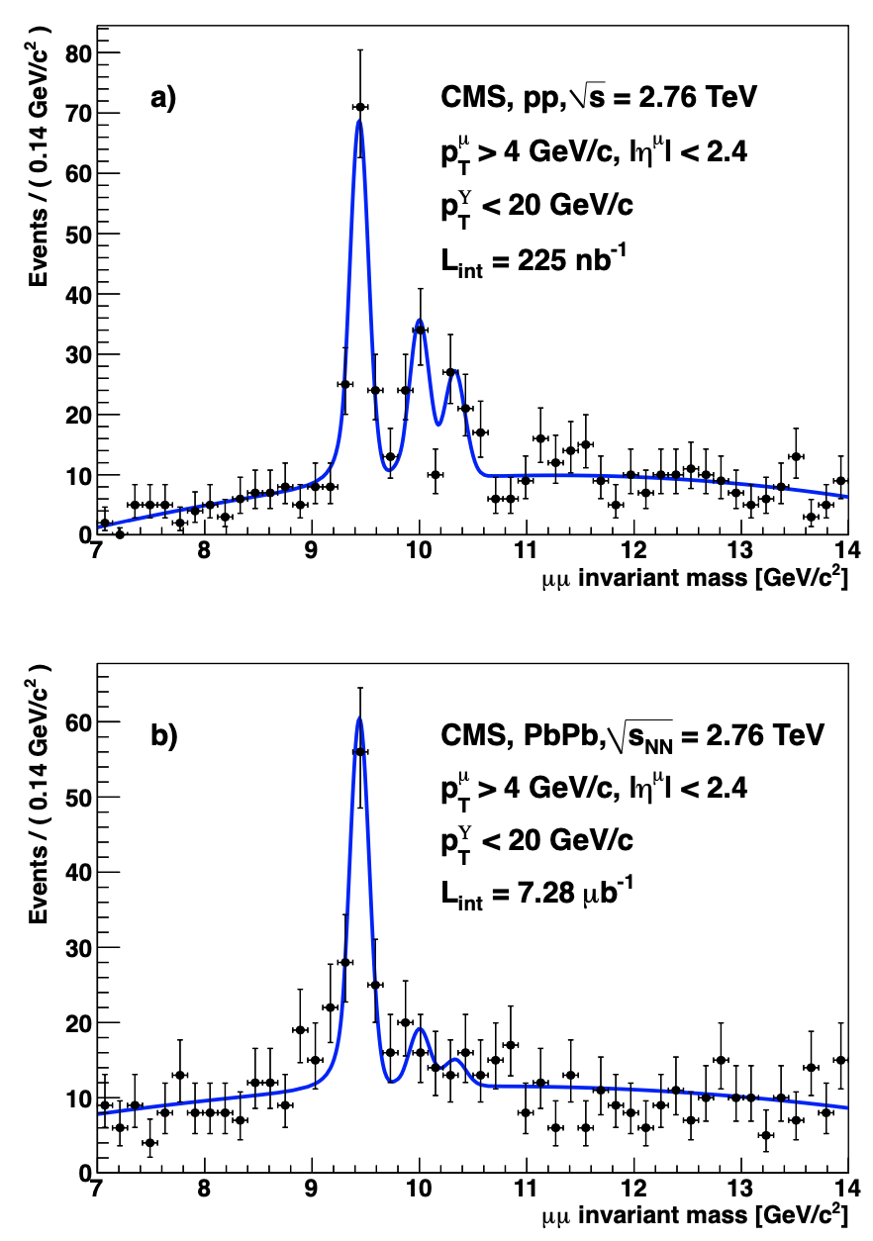
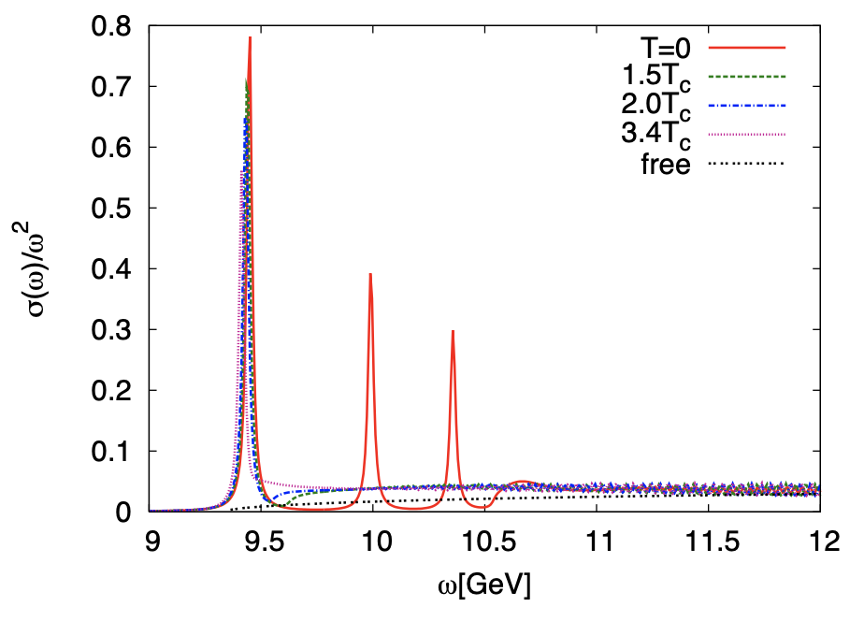
New State of Matter in AA:
Quarkonia melting => deconfined plasma
CMS, PRL107 (2011)
Mócsy and Petreczky, PRL99 (2007)

Slide 6
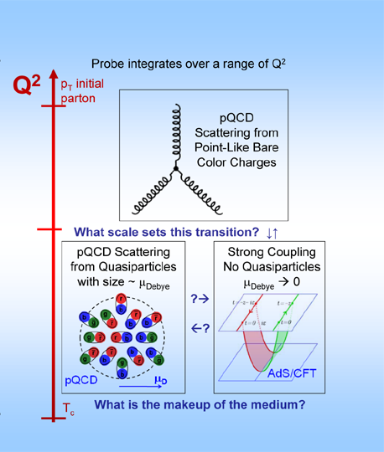
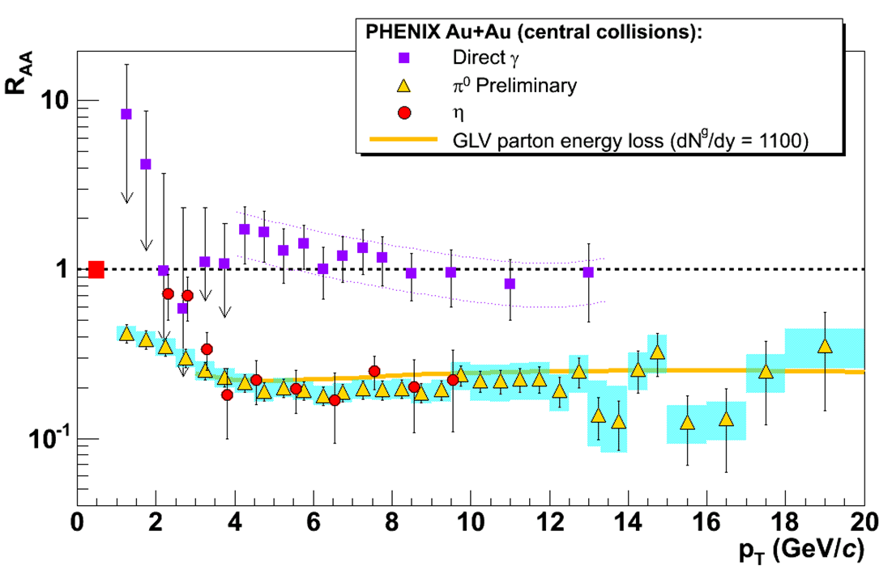
New State of Matter in AA:
Particle suppression: final state energy loss to medium
Y. Akiba for the PHENIX collaboration, hep-ex/0510008
  Consistency: R_{AA}(η)~R_{AA}(π)
  Null Control: R_{AA}(γ)~1
  GLV Prediction: Theory~Data for reasonable fixed L~5 fm and dN_{g}/dy~dN_{π}/dy
Notes:
Conclusion: QGP formation in AA collisions

Slide 7
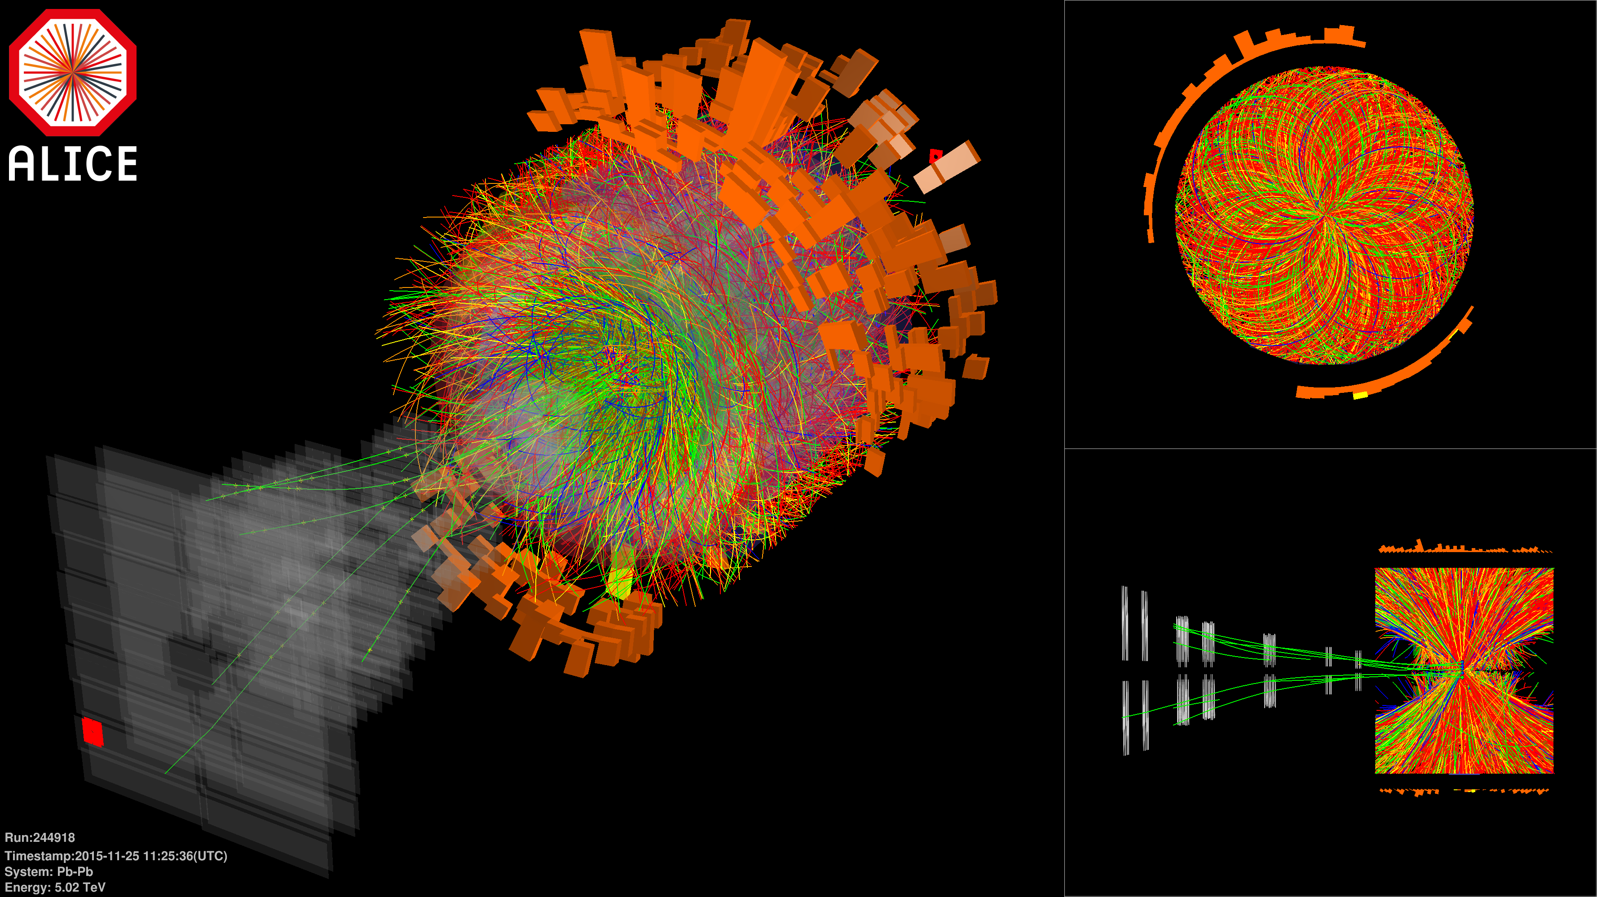
The Big New Question in Physics
How small can you go?
  How large a system and how many particles are needed for a phase of matter?
    Naively, need infinite size and infinite number
    Slightly less naively, order Avogadro’s number:
    6 x 10²³
    Central AA => O(15,000)
Notes:
Does size really matter?

Slide 8
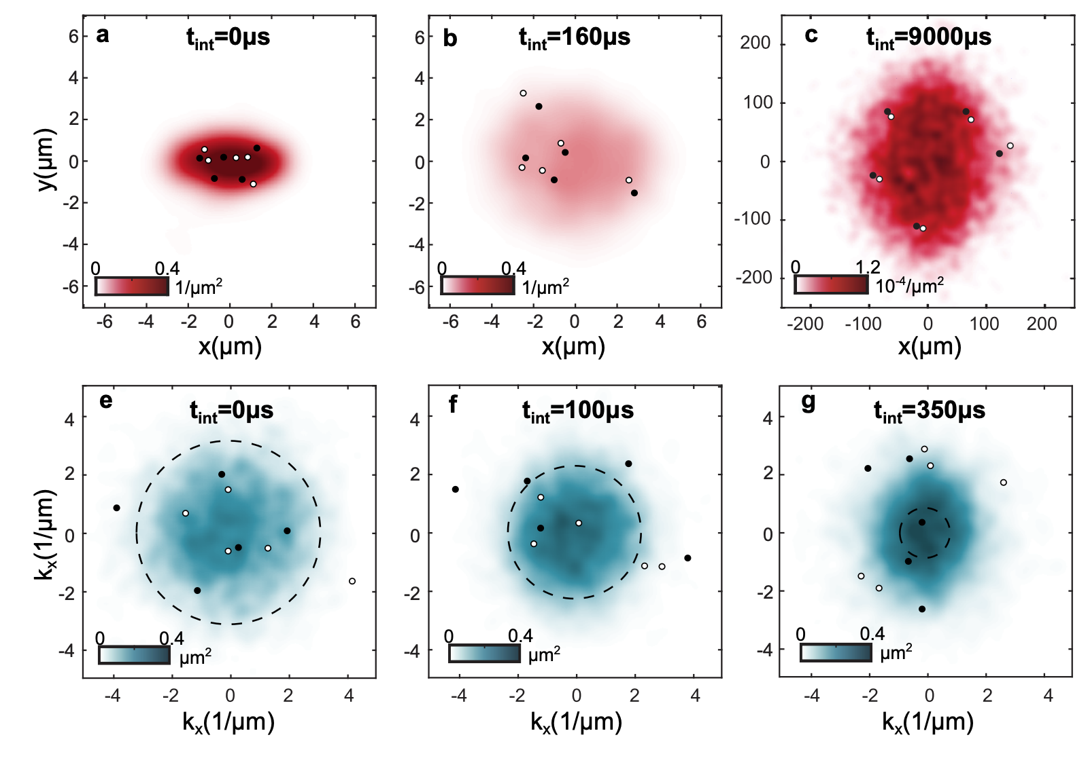
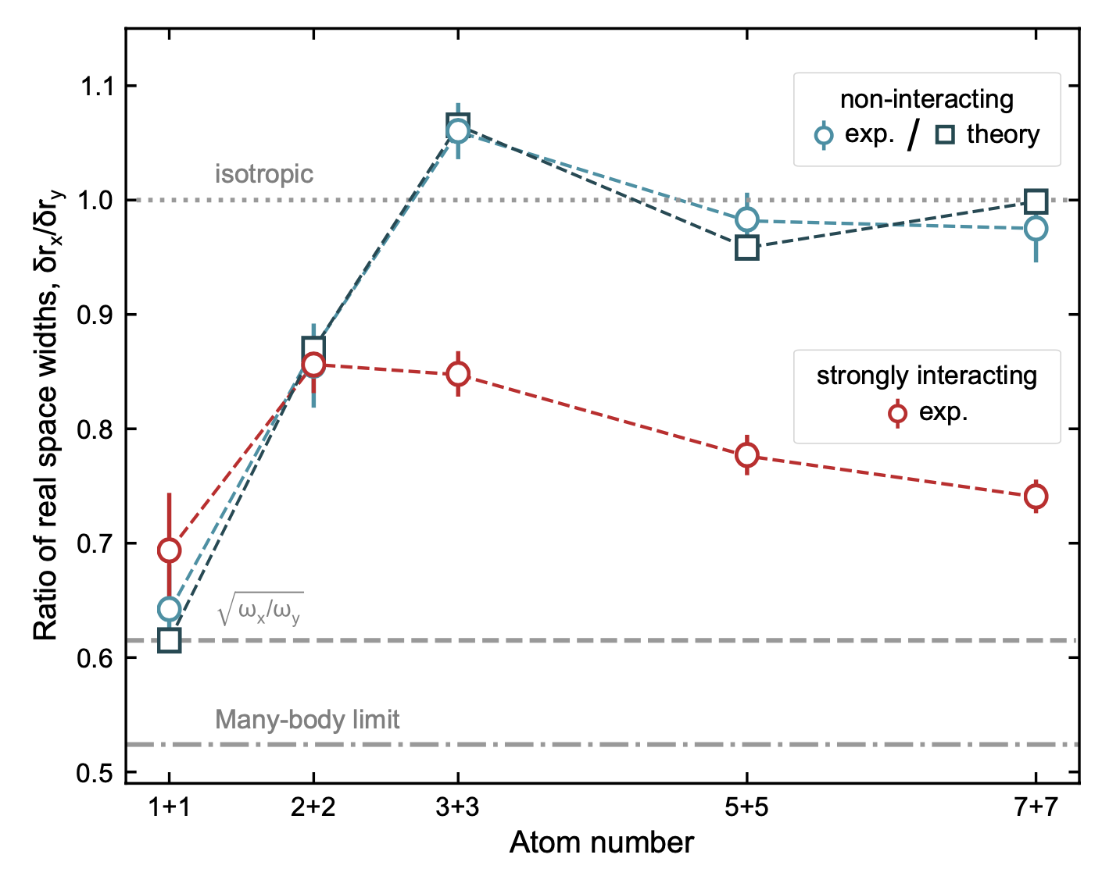
Does Size Really Matter?
From AMO, the answer is yes, but also shockingly small: ~2μm and 6 particles
What is the smallest droplet of QGP matter that can be formed and measured?
Brandstetter et al., Nature Phys 21, p 52–56 (2025)

Slide 9
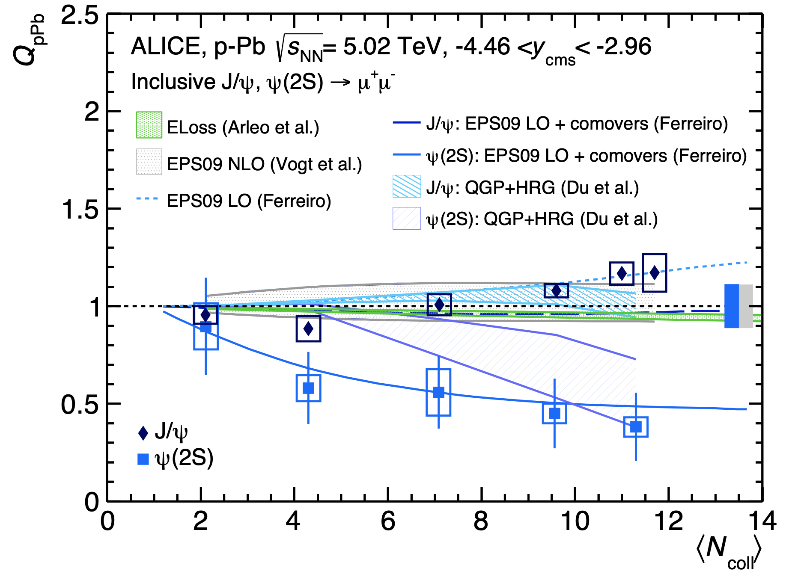
New State of Matter in Small Systems?
Quarkonium suppression
ALICE, JHEP 06 (2016)

Slide 10
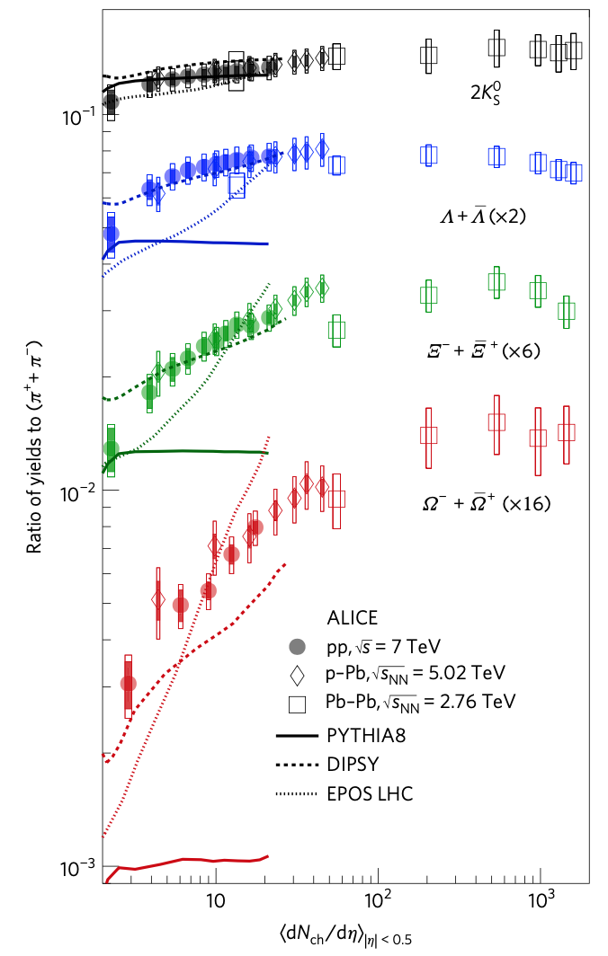
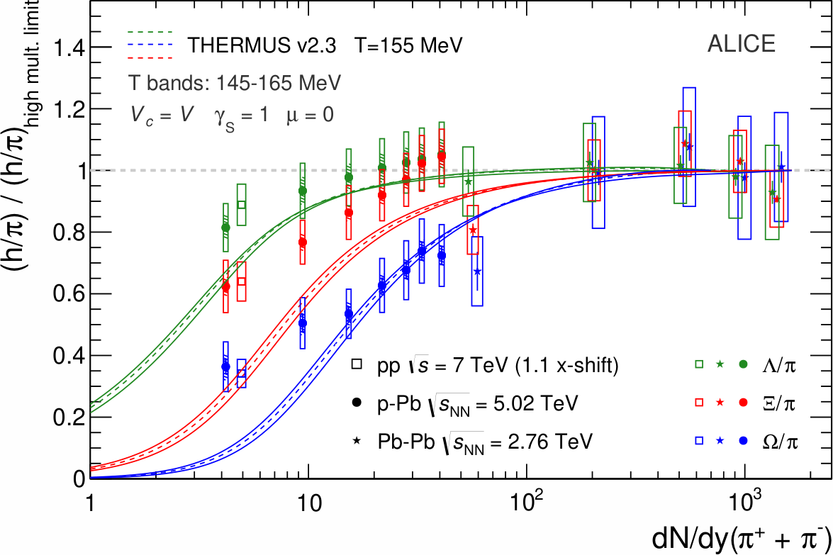
New State of Matter in Small Systems?
Strangeness
enhanced
ALICE, PLB 758 (2016) 389-401
ALICE, Nature Physics (2017)

Slide 11
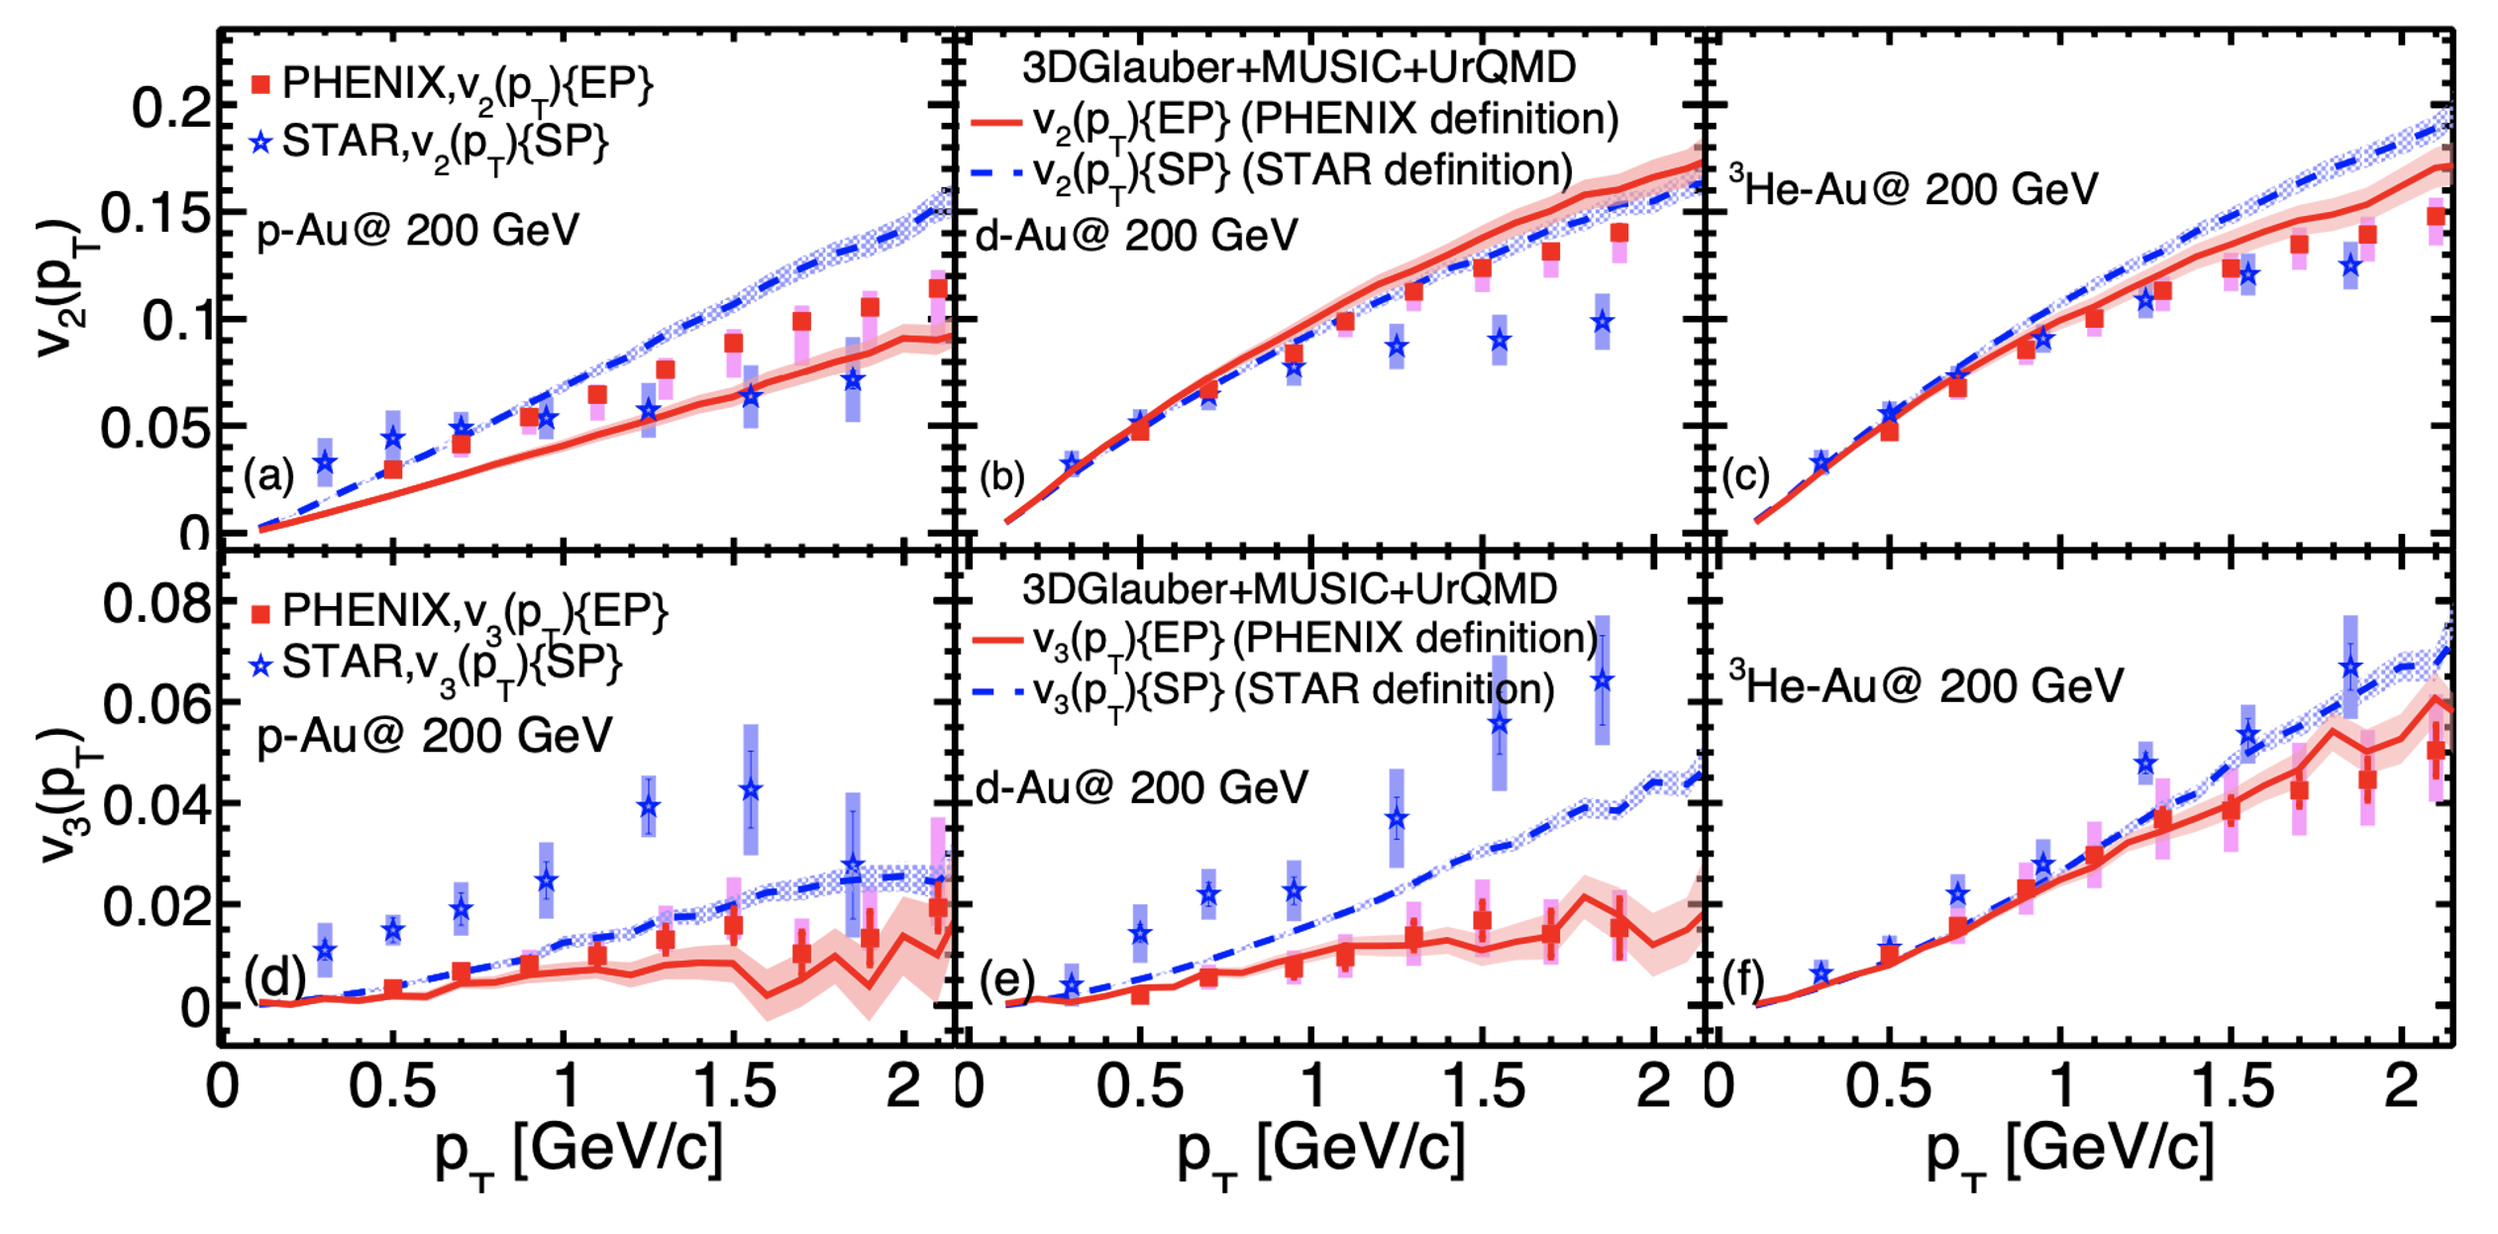
New State of Matter in Small Systems?
Flow observed
Zhao et al, PRC107 (2023) and Schenke SQM2024

Slide 12
Energy Loss in More Detail
Show results from “Cape Town Model”
  pQCD-based collisional + radiative energy loss
    BT/HTL elastic energy loss
    DGLV inelastic energy loss
  Sophisticated geometry
    MUSIC 2+1D viscous hydro
    For v₂, e-loss through event-by-event hydro
  Single free parameter, effective coupling
    Fixed once to 0-50% PbPb collisions via rigorous statistical analysis

Slide 13
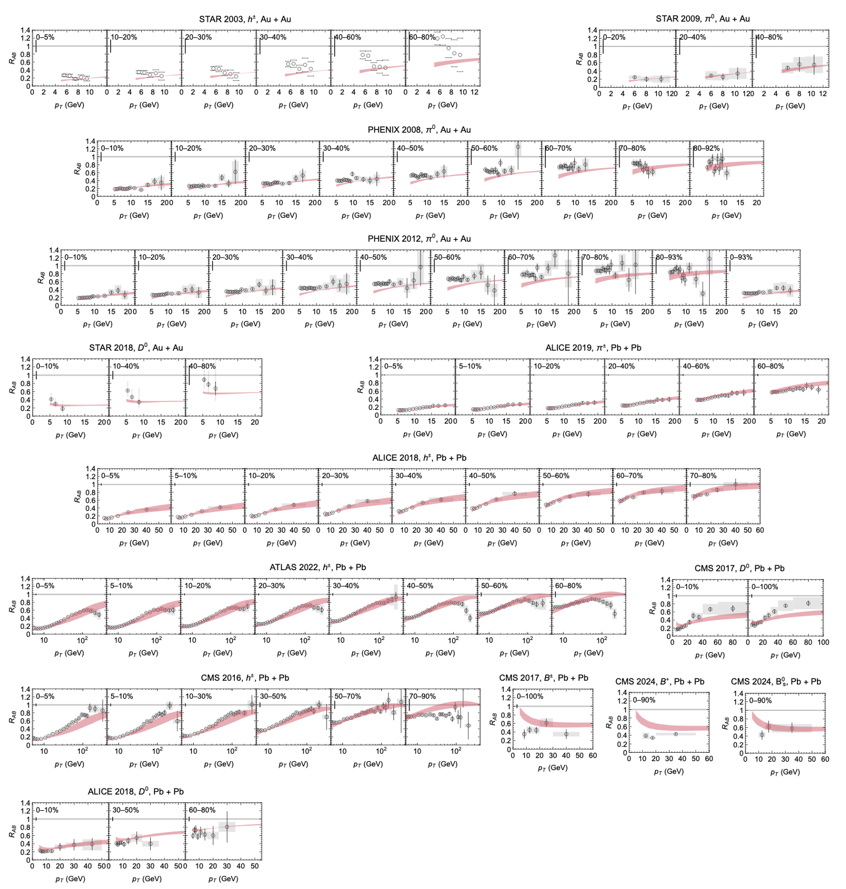
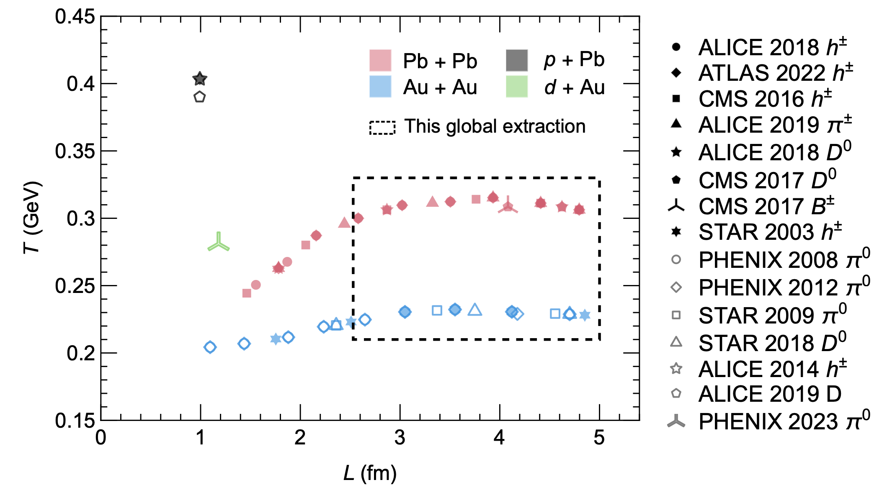
New State of Matter in AA:
Particle suppression: quantitative description
  Fit single parameter in central & semi-central collisions
Faraday and WAH, JHEP (2025)
Notes:
Conclusion: QGP formation in AA collisions

Slide 14
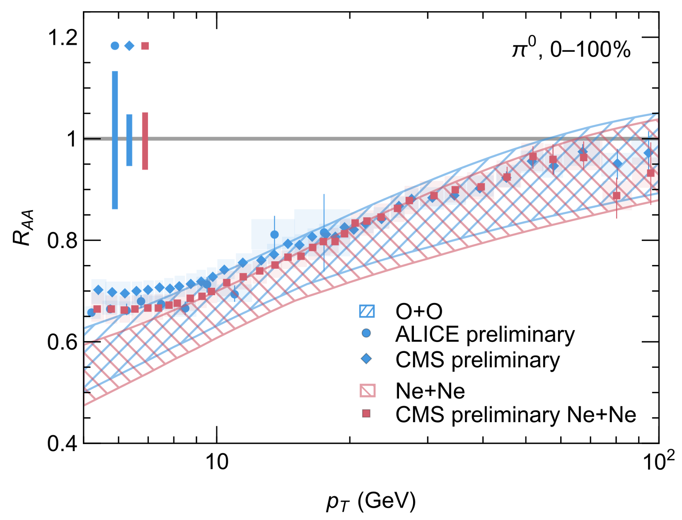
New State of Matter in Small Systems?
Final state energy loss seen in OO and NeNe!
Based on Faraday and WAH, JHEP (2025)

Slide 15
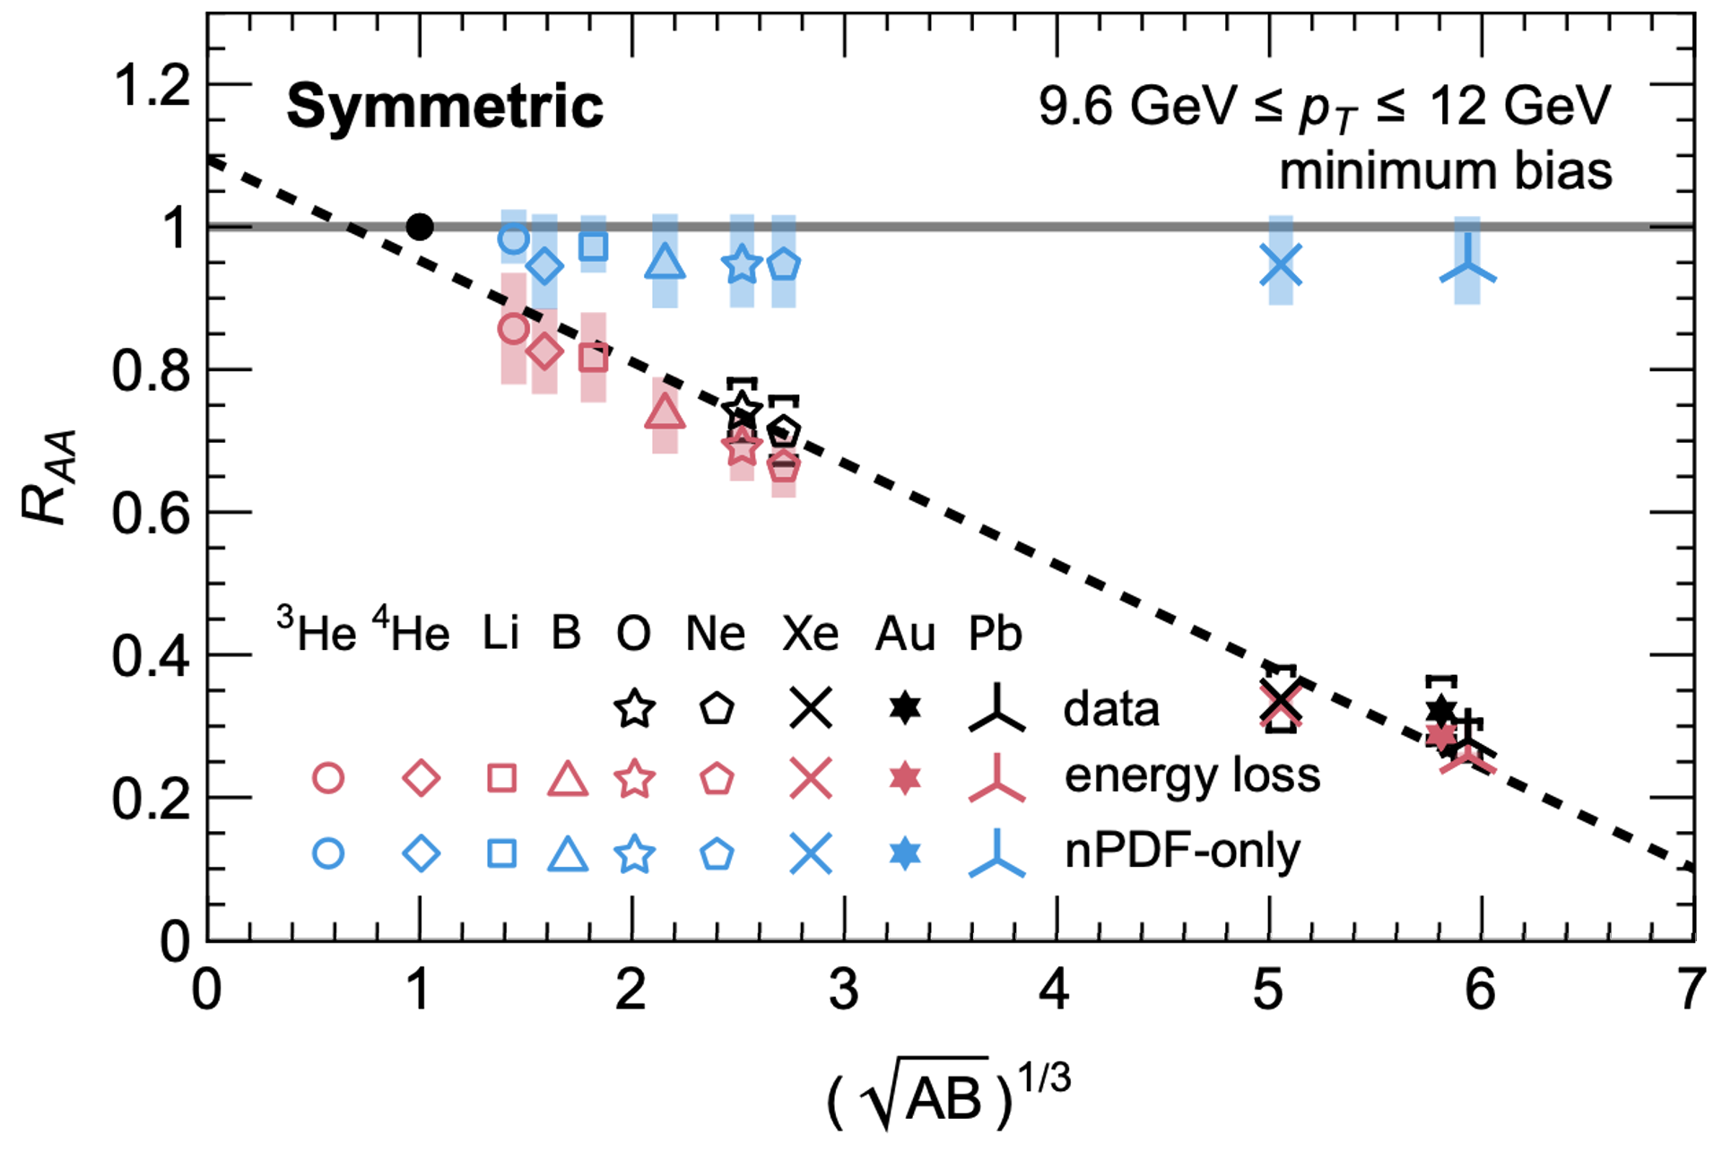
Even Smaller Systems?
Predictions for potential discovery of final state energy loss in min-bias ⁶Li⁶Li
Faraday et al., arXiv:2512.17832 [hep-ph]

Slide 16
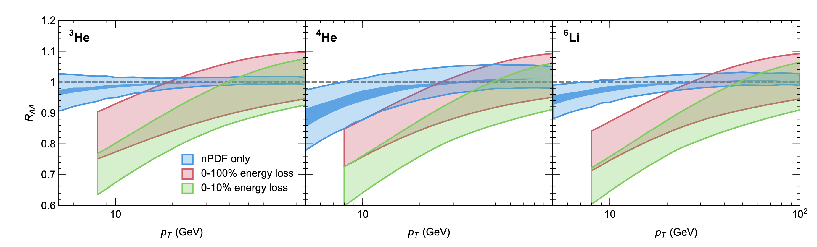
Greater Potential for Central Small Systems
Central small systems: Eloss observable in ³He³He (!)
Faraday et al., arXiv:2512.17832 [hep-ph]

Slide 17
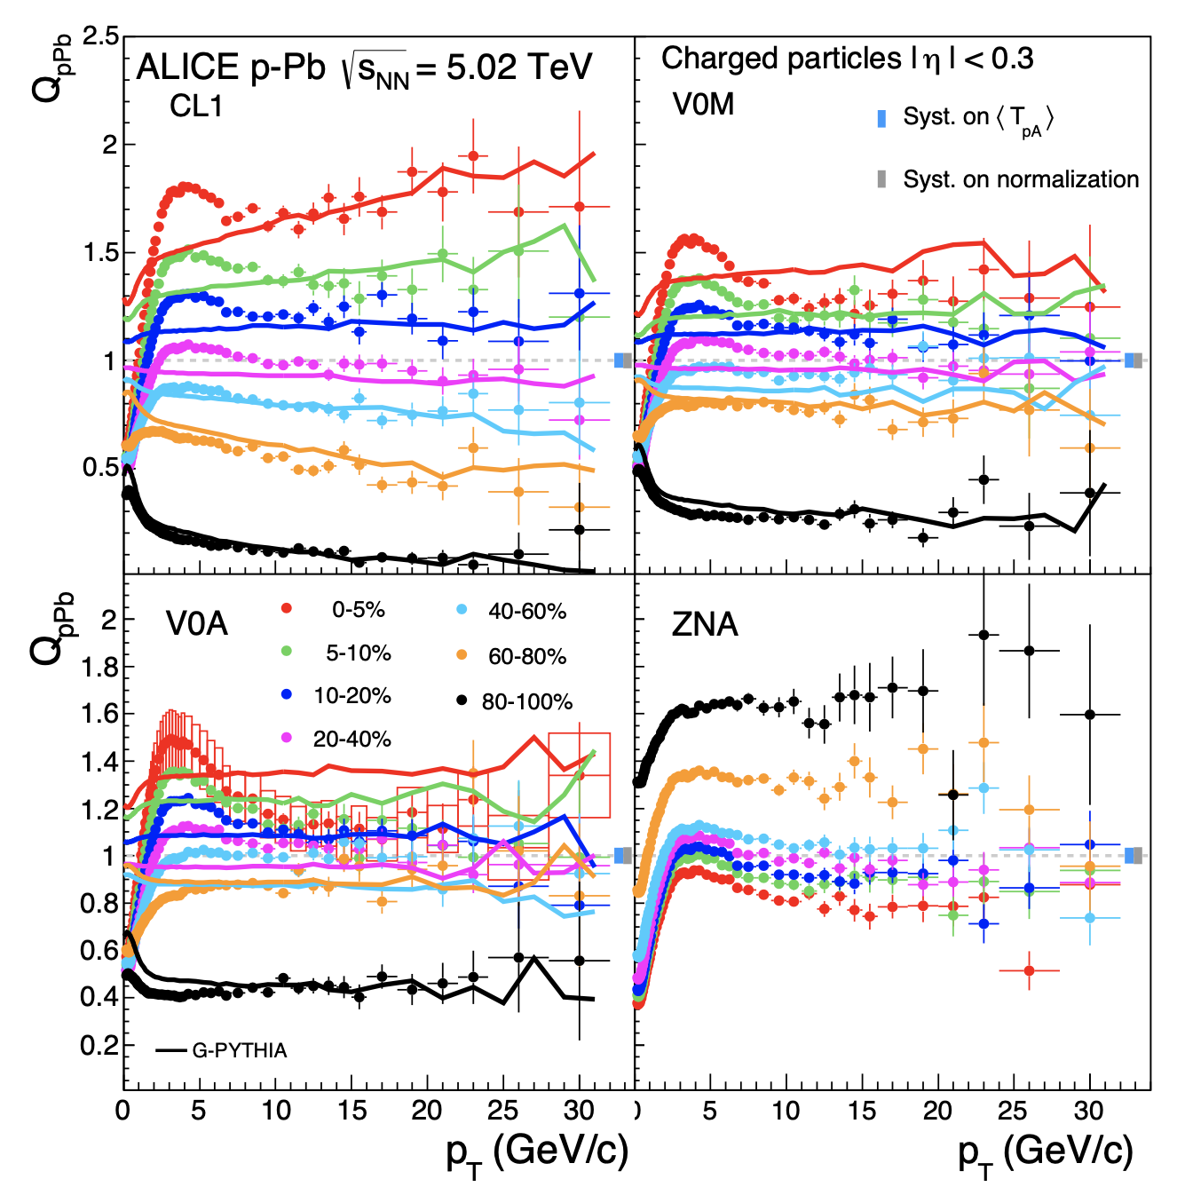
Centrality Tricky in Small Systems
Depending on selection procedure, completely different trends emerge
ALICE, PRC 91 (2015) 6, 064905

Slide 18
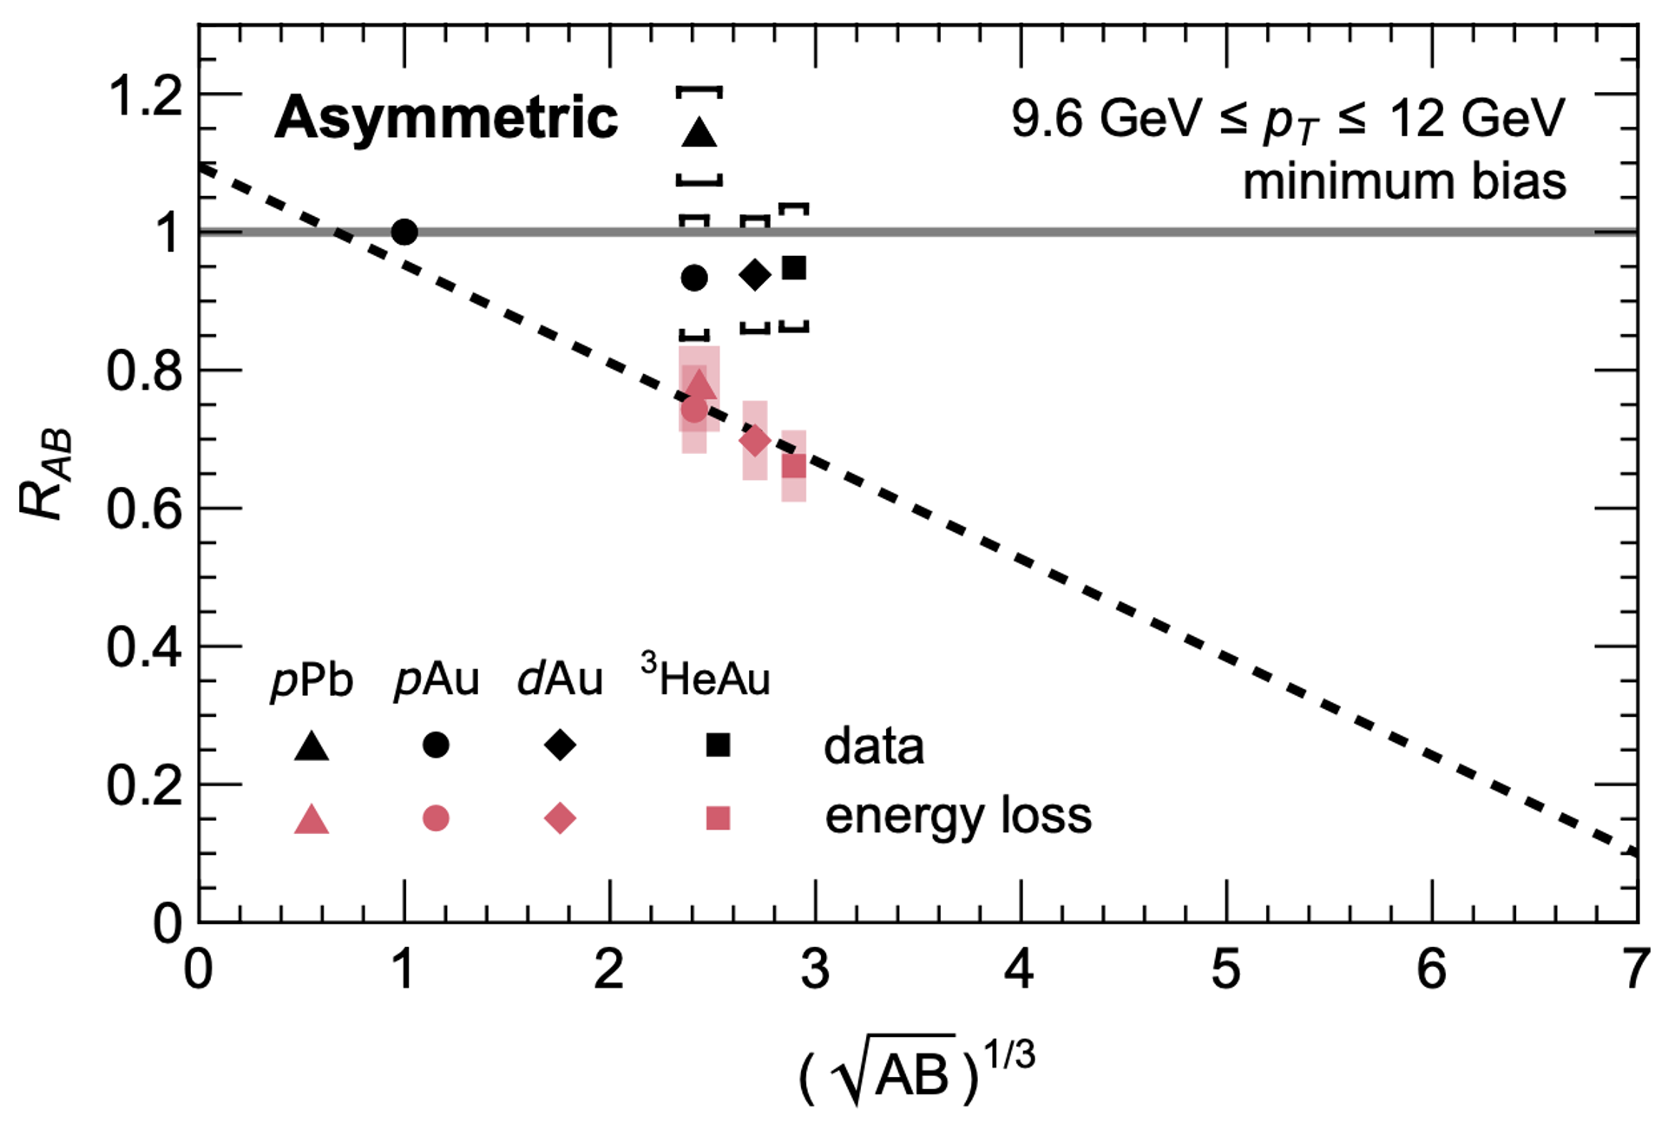
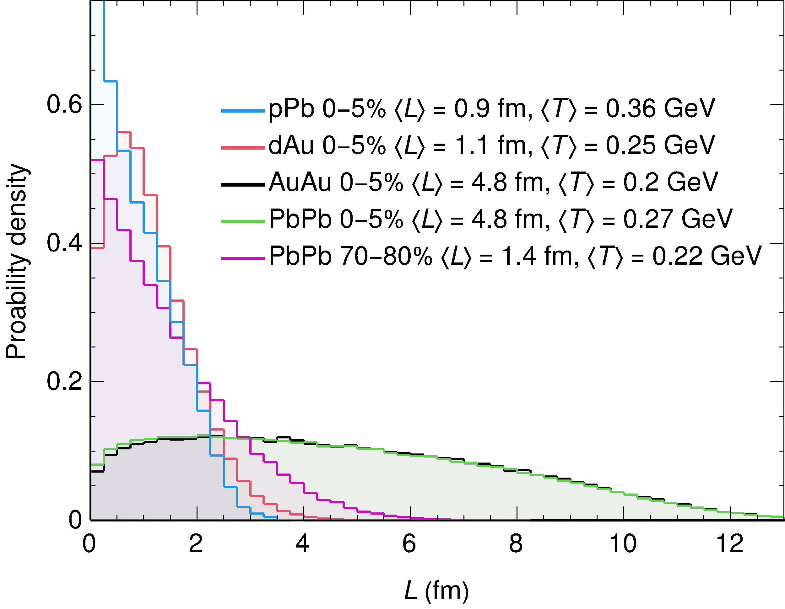
What about Asymmetric Systems?
Energy loss much more complicated and less well understood, even in min bias
  Eloss in asymmetric systems is the current open question
Faraday et al., arXiv:2512.17832 [hep-ph]

Slide 19
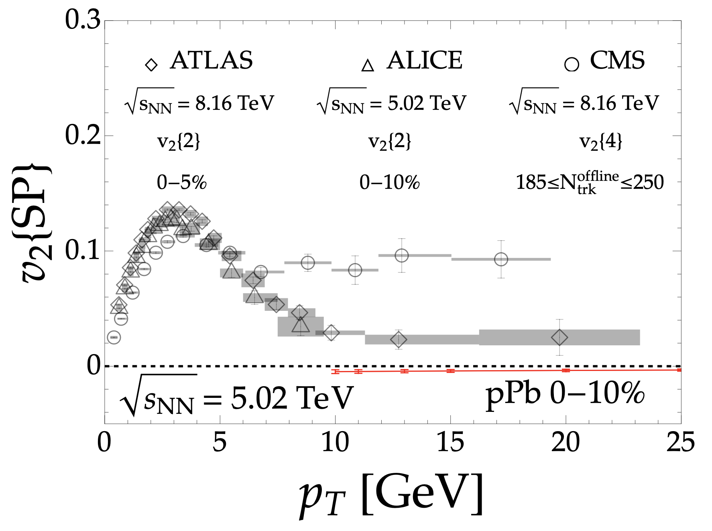
Anisotropy in Asymmetric Systems
v₂ in pPb even more confusing, experimentally and theoretically:
Bert, Faraday, and WAH, arXiv:2603.XXXXX

Slide 20
Role of Soft/Hard Correlations
Soft/hard correlations are crucial for insight into small collision systems:
  High-p_{T} v₂ experimentally measured via soft/hard correlations
  Possible initial state correlations between soft/hard production
Significant need to better theoretical and experimental control over these correlations

Slide 21
Hard/Soft Correlations in v₂
Theory

Slide 22
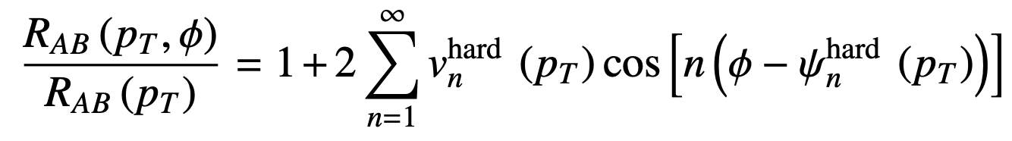
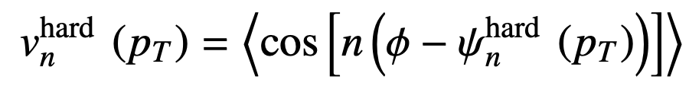
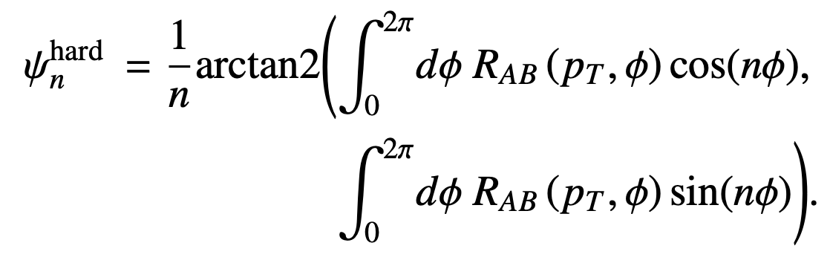
Anisotropy Calculations
Theoretical v₂:

Slide 23
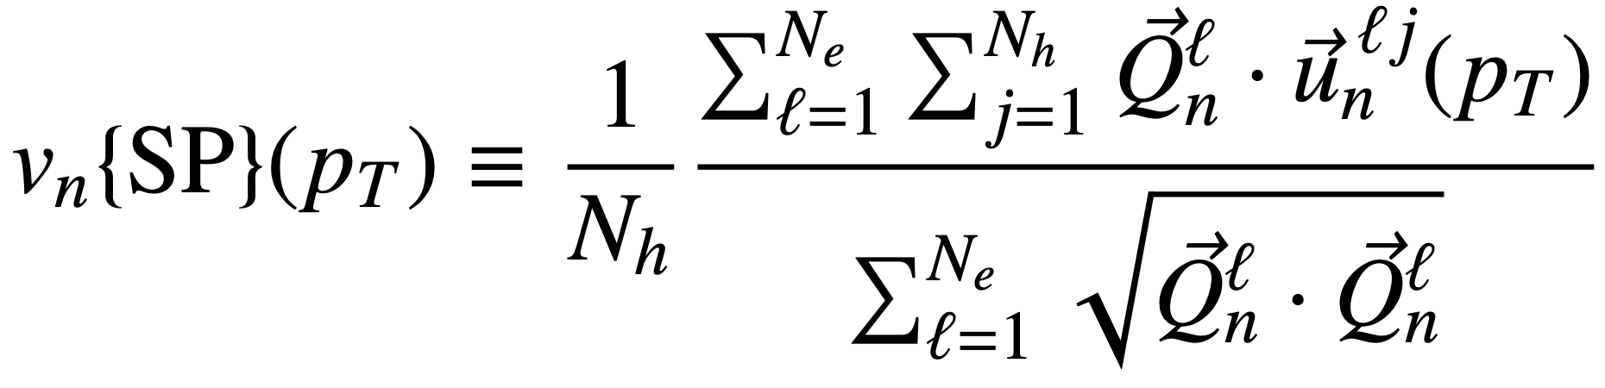
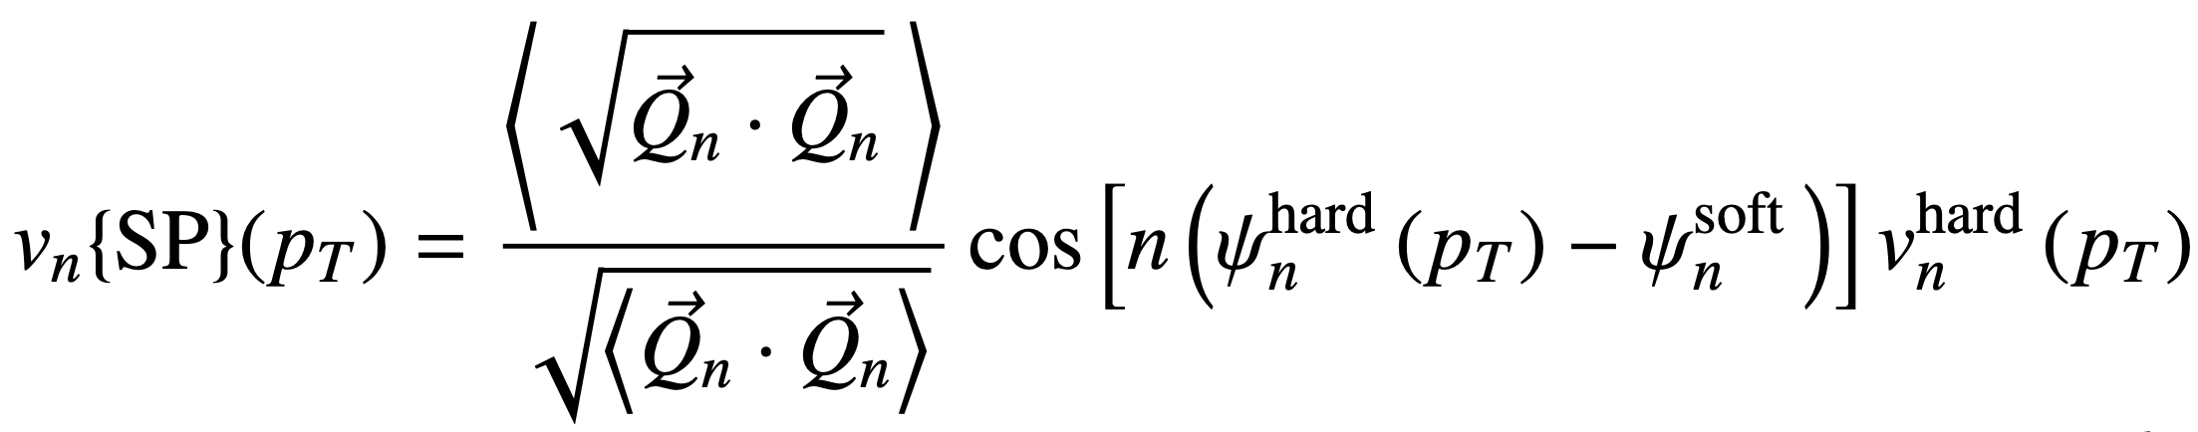
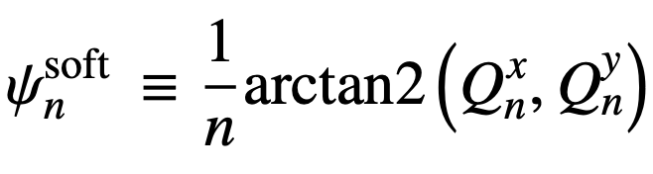
Anisotropy Measurements
Compare to scalar product v₂:
  In absence of non-flow, 2 particle cumulant (usual experimental method) and scalar product v₂ are identical

Slide 24
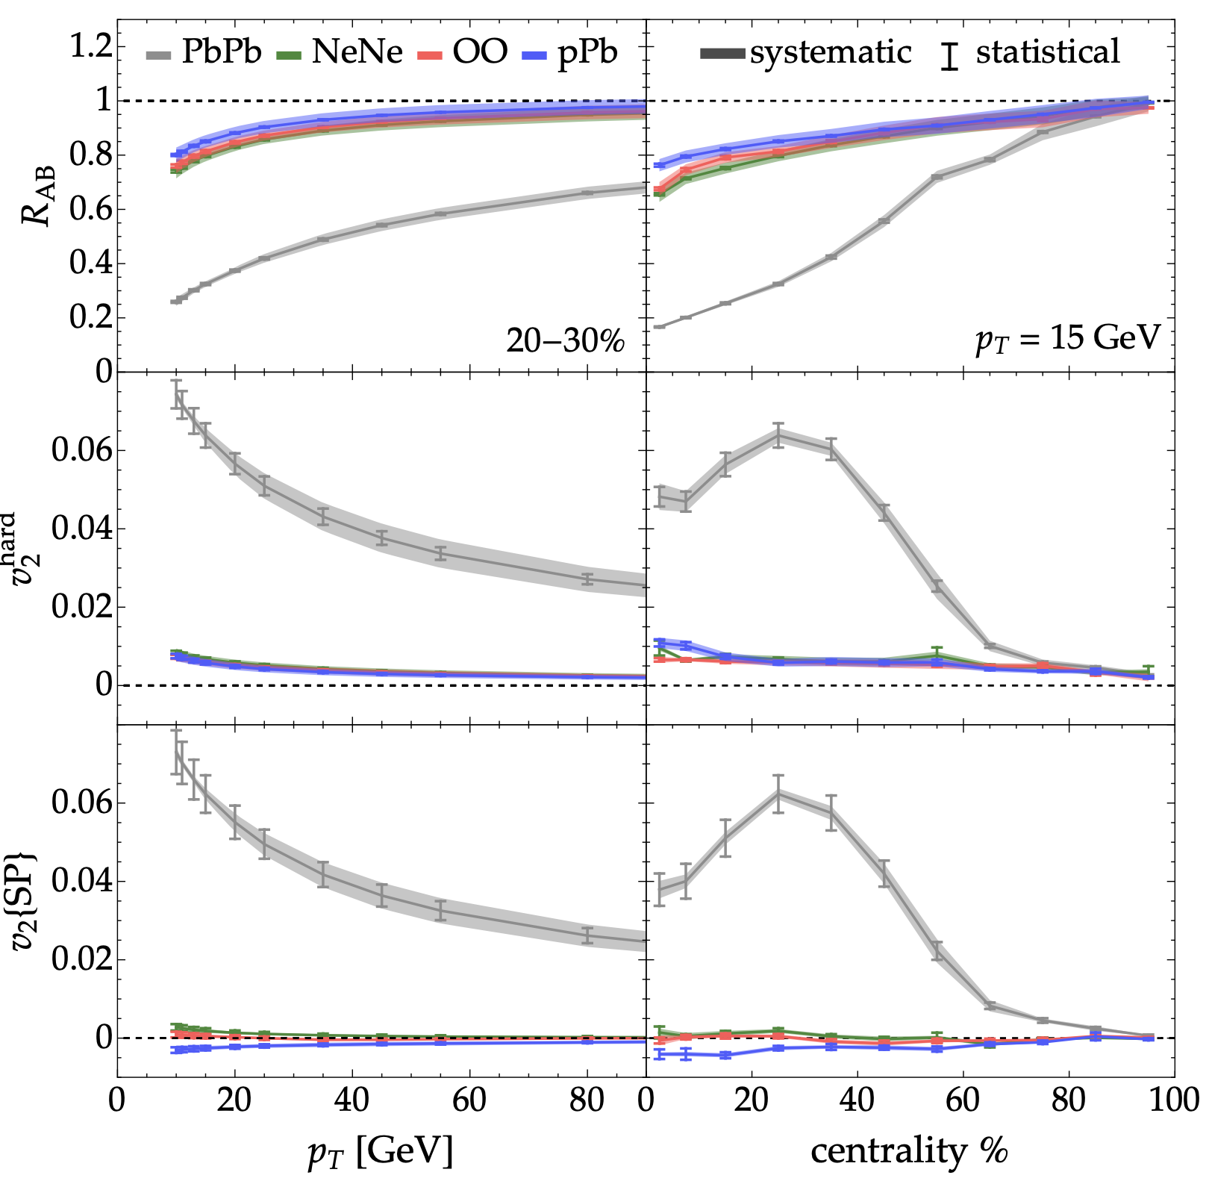
Energy Loss Predicts No v₂ in Small Systems
Very little theory v₂
  Could be model dependent
Measured v₂ = 0
  Robust prediction?
Bert, Faraday, and WAH, arXiv:2603.XXXXX

Slide 25
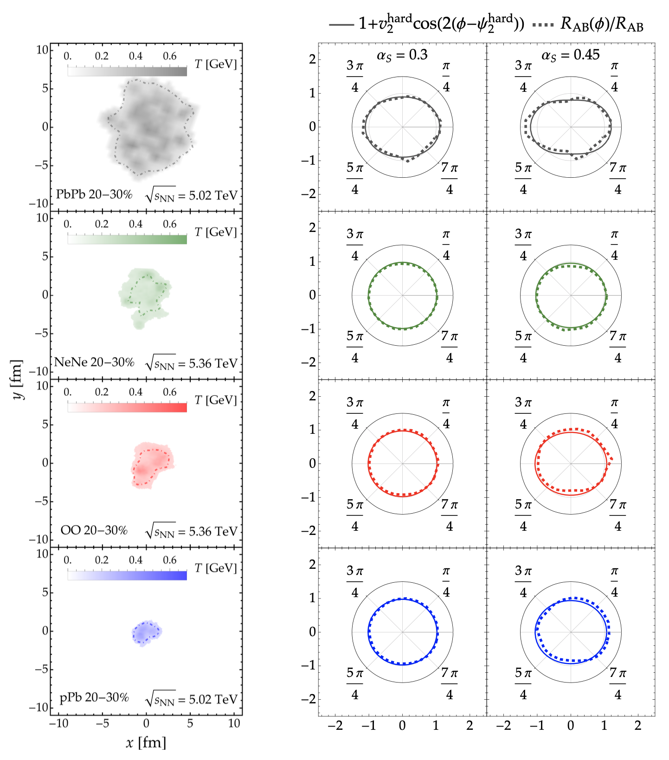
E-loss Doesn’t Translate
Small systems don’t yield v₂
  Increasing coupling doesn’t increase
  theory v₂
  Too small for E-loss to build up anisotropy?
Bert, Faraday, and WAH, arXiv:2603.XXXXX

Slide 26
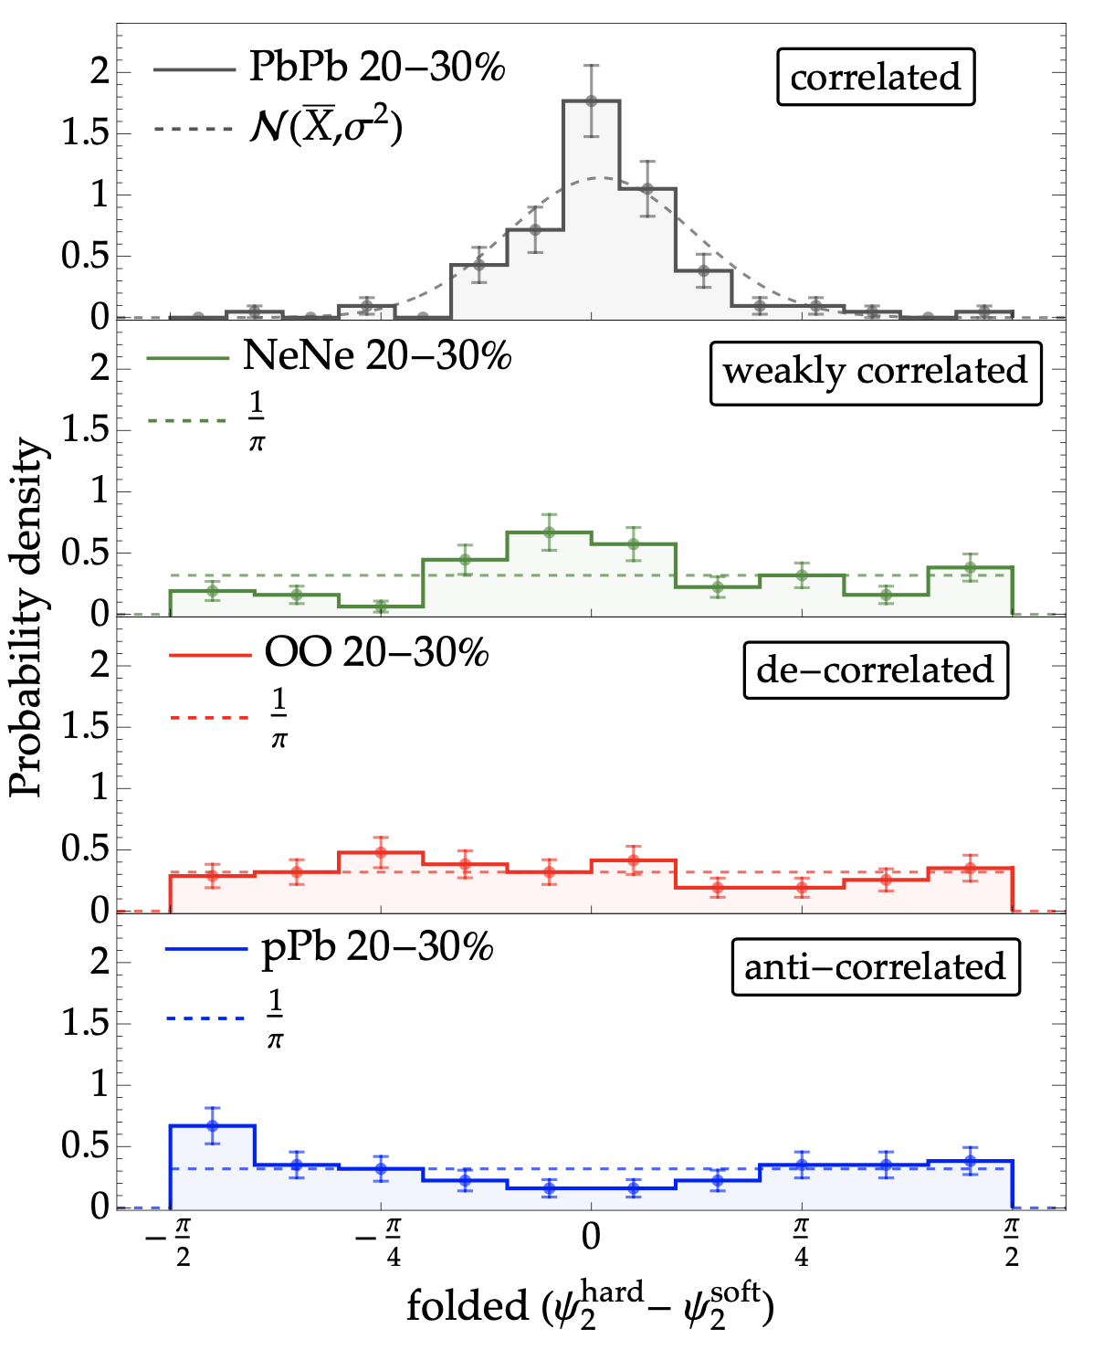
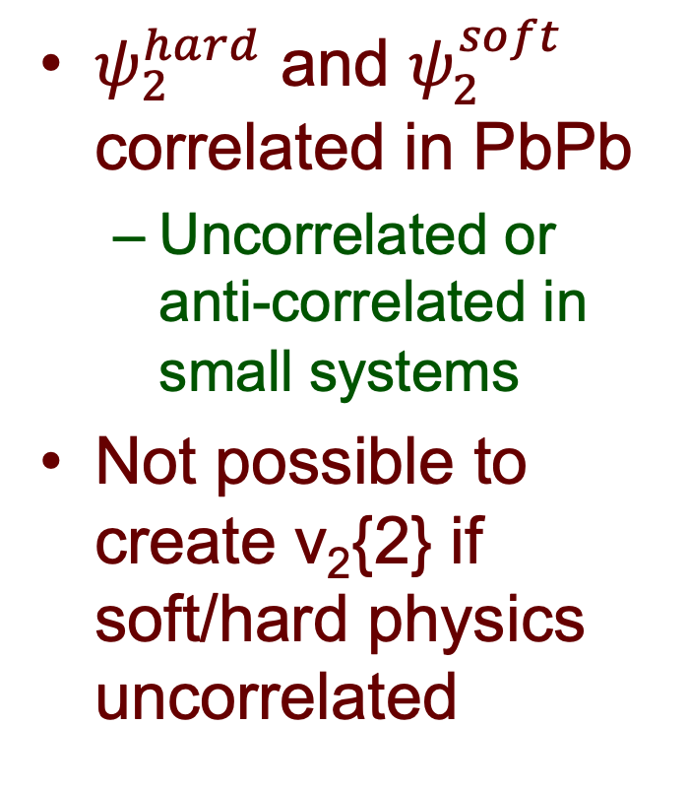
Soft and Hard Planes Decorrelate
$ψ_{2}^{hard}$ and $ψ_{2}^{soft}$ correlated in PbPb
  Uncorrelated or anti-correlated in small systems
Not possible to create v₂{2} if soft/hard physics uncorrelated
Bert, Faraday, and WAH, arXiv:2603.XXXXX

Slide 27
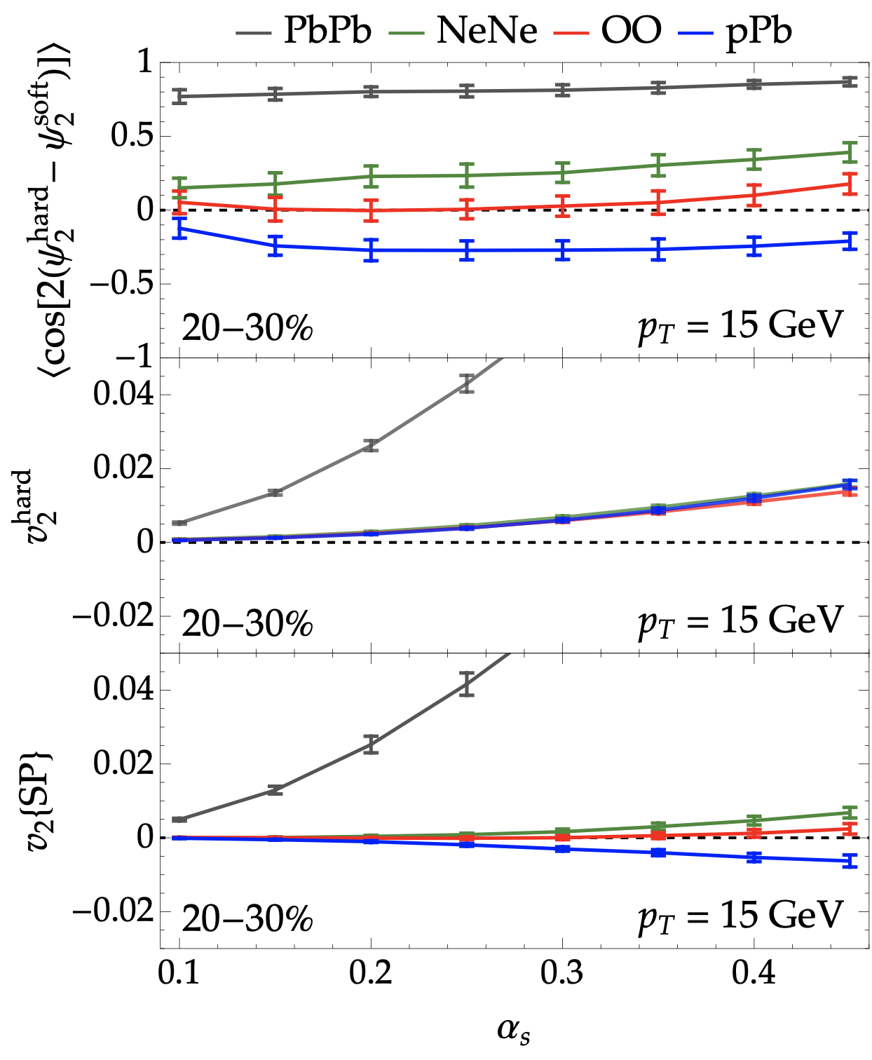
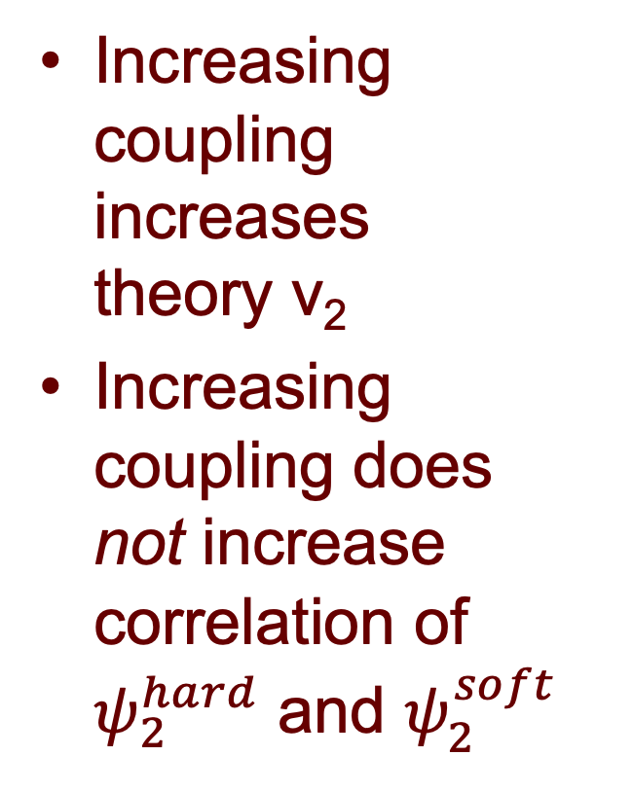
Decorrelation Due to Small v₂? No!
Increasing coupling increases
theory v₂
Increasing coupling does
not increase correlation of $ψ_{2}^{hard}$ and $ψ_{2}^{soft}$
Bert, Faraday, and WAH, arXiv:2603.XXXXX

Slide 28
Hard/Soft Correlations in v₂
Measurement (Briefly)

Slide 29
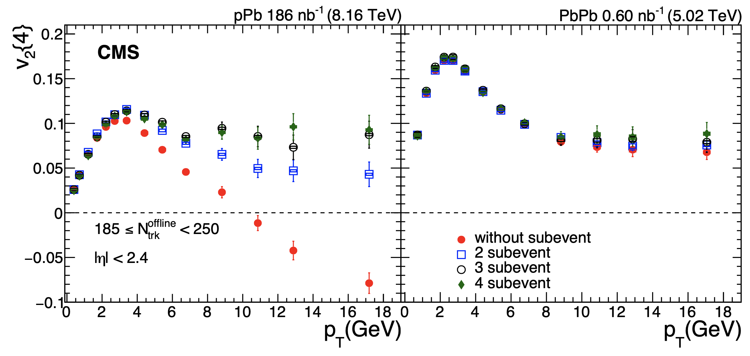
More Soft/Hard Correlations
Measured pPb v2{4} depends strongly on number of subevents
  Large non-flow contribution in pPb not under control in v2{2} of ALICE and ATLAS?
CMS, PRL 135, 071903
Notes:
V2 measurement under control in PbPb
V2 measurement stabilizes between 3 and 4 subevents, suggesting nonflow under control then

Slide 30
Hard/Soft Correlations in Production

Slide 31
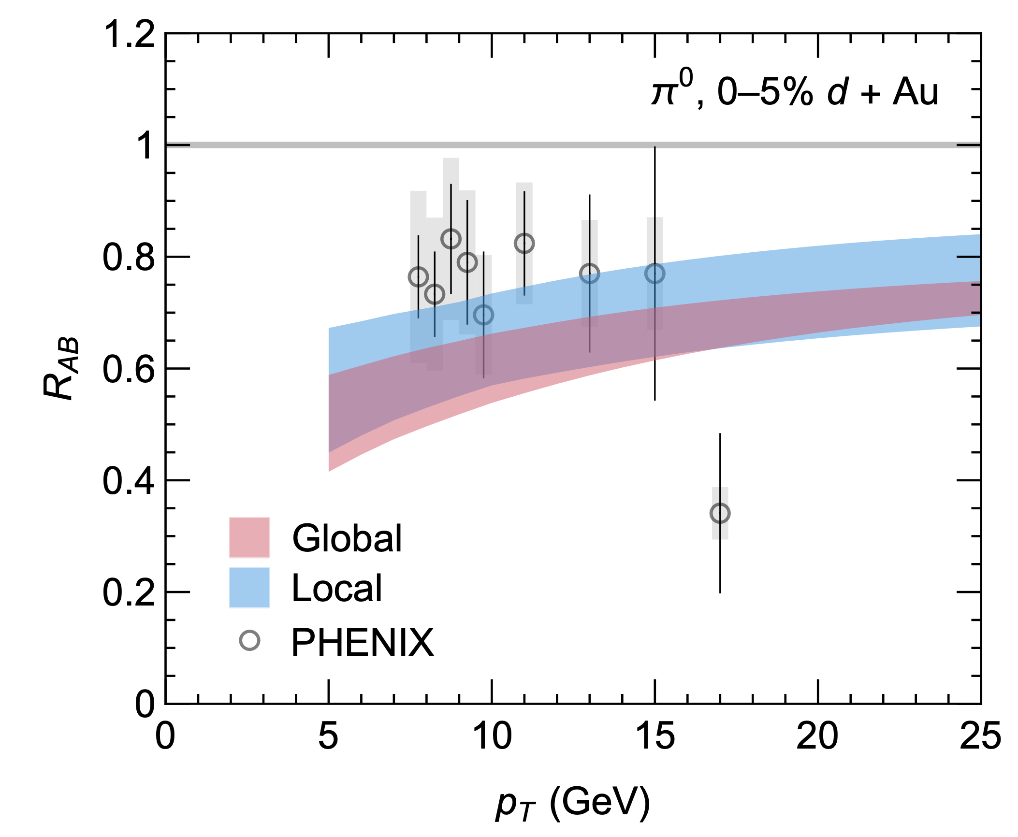
Soft/Hard Initial State Production: RHIC
PHENIX R_{dAu} normalized by photons is suppressed, similar to E-loss
  Suggestive of importance of hard/soft correlation production in p/d+A collisions
    Perhaps not surprising: p generates hard and soft particles
Faraday and WAH, JHEP (2025)

Slide 32
Soft/Hard Initial State Correlations
Conflicting theories:
  Energy conservation: high-p_{T} parton => less soft matter
    Less soft matter => event categorized as more peripheral
  Hot spots in nuclei: high-p_{T} parton => more soft matter
    High-p_{T} parton => more central event
    Cold spot => fewer high-p_{T} partons than expected in peripheral events

Slide 33
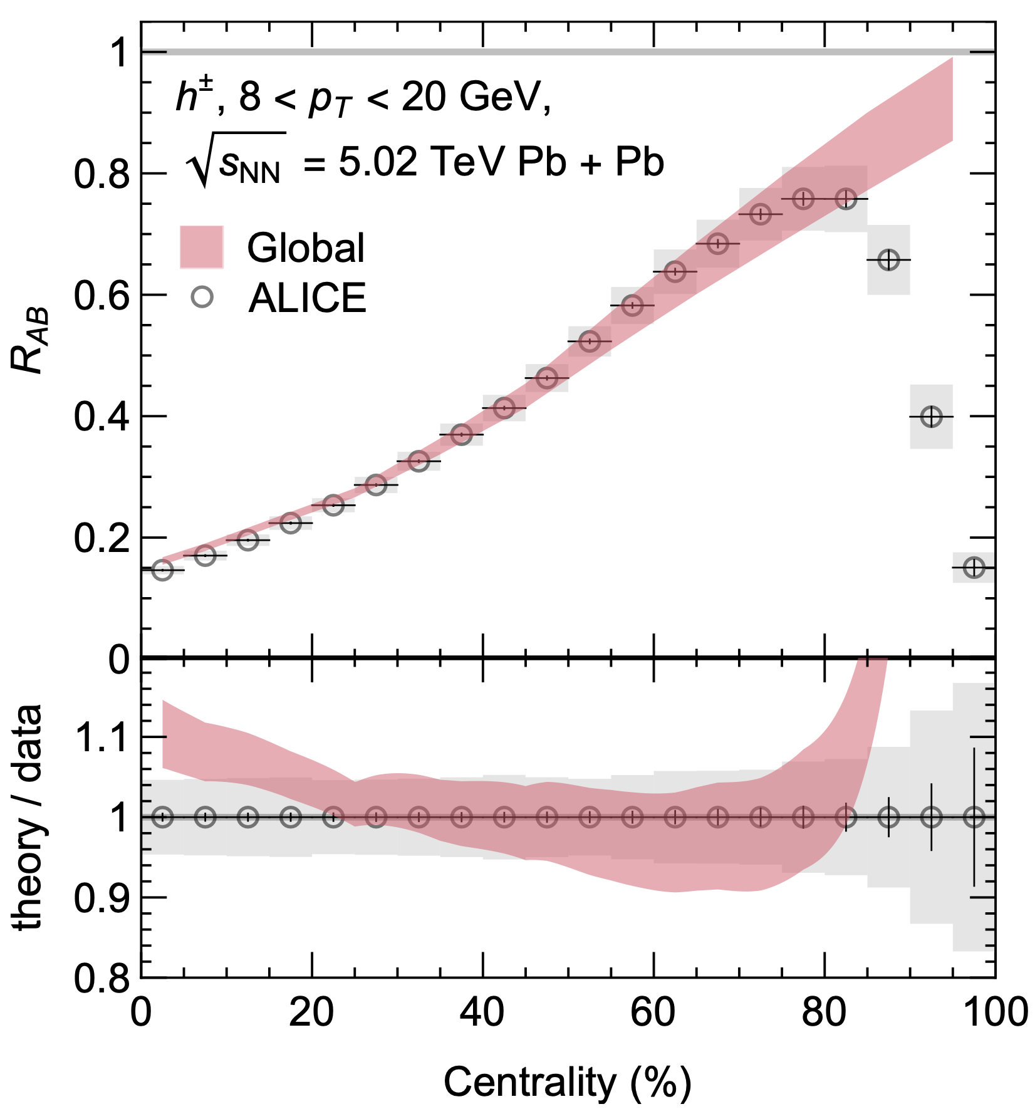
AA Centrality Dependence
Energy conservation idea hard to believe for sqrt(s) ~ TeV’s
Centrality dependence of R_{PbPb} clearly indicates hot/cold spot physics is correct
Faraday and WAH, JHEP (2025)

Slide 34
Summary
QGP formed in central AA
  Large low-p_{T} v₂, strangeness enhancement, quarkonium suppression
  High-p_{T} particle suppression and anisotropy described by pQCD energy loss
Signs of QGP formation in smallest systems
  Large low-p_{T} v₂, strangeness enhancement, quarkonium suppression
  High-p_{T} picture less clear

Slide 35
High-p_{T} in Small Systems
Asymmetric Small Systems are a Mess:
  ATLAS and CMS see min bias R_{pA} > 0;
  ALICE sees R_{pA} < 0
    pQCD (Eloss in general?) predicts R_{pA} < 0
  ALICE and ATLAS agree v₂{2} > 0
  CMS v₂{4} ~ v₂^{PbPb} (!!) ~ 4x v₂^{ALICE/ATLAS}, should be less sensitive to non-flow
    Energy loss predicts v₂ = 0 (!!)
Hard/soft correlations in p/d+A likely very important

Slide 36
Outlook (I)
Possibility for v₂{2} measurement between two hard particles?
  Avoids soft/hard decorrelation
What is the heavy quark v₂ in small systems?
  If v₂ is independent of quark mass, then clearly v₂ isn’t sourced from energy loss
Any chance of electroweak v₂ in small systems?
  Avoids final state energy loss
  Non-zero electroweak v₂??

Slide 37
Outlook (II)
ALICE/ATLAS confirmation of CMS
v₂{4} ~ 4 x v₂{2}_{ALICE/ATLAS}?
v₂ in OO and NeNe extremely interesting
  If v₂ ~ 0, then E-loss in symmetric small systems is consistent
    Suggestive that asymmetric small systems are uniquely different from symmetric systems
  If v₂ > 0, then origin of large v₂ in p Pb likely also present in OO

Slide 38
Outlook (III)
How Small Can We Go?
  pQCD E-loss true prediction for min bias
  R_{OO} and R_{NeNe}
    Prediction of measurable suppression in
    min bias ⁶Li⁶Li
Can we measure E-loss in pp collisions??
  11/12’s of LHC data is pp…
  Control of soft/hard correlations will be key

Slide 39
Bonus Slides

Slide 40
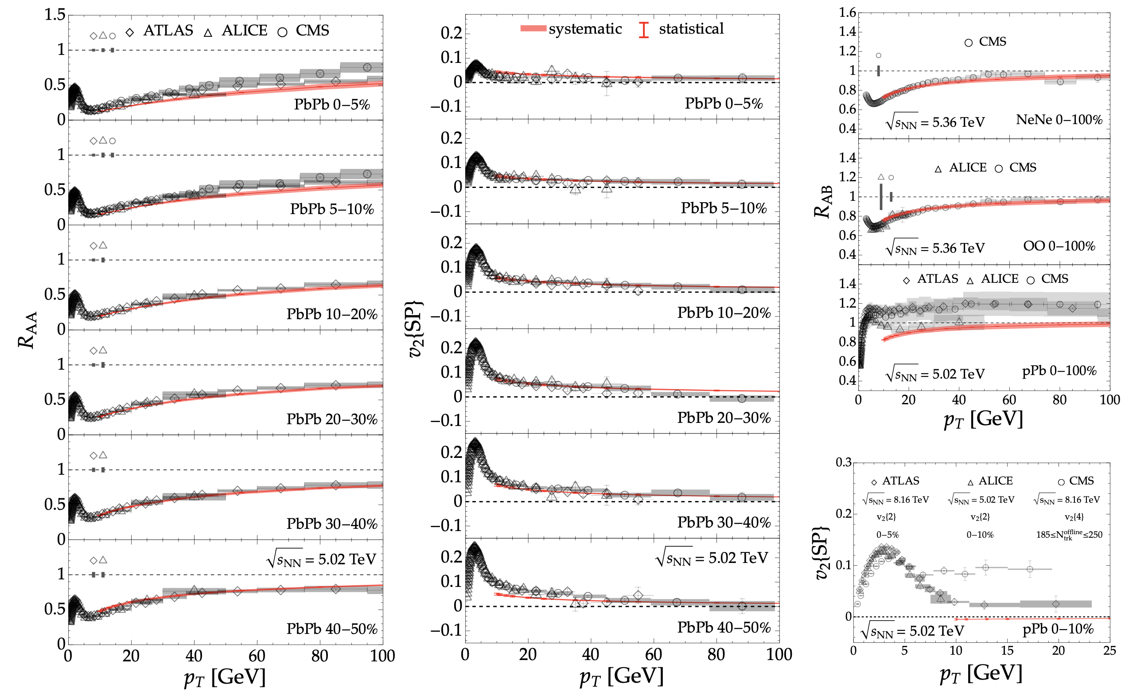
Anisotropy in Asymmetric Systems
v₂ in pPb even more confusing:
Bert, Faraday, and WAH, arXiv:2603.XXXXX

Slide 41
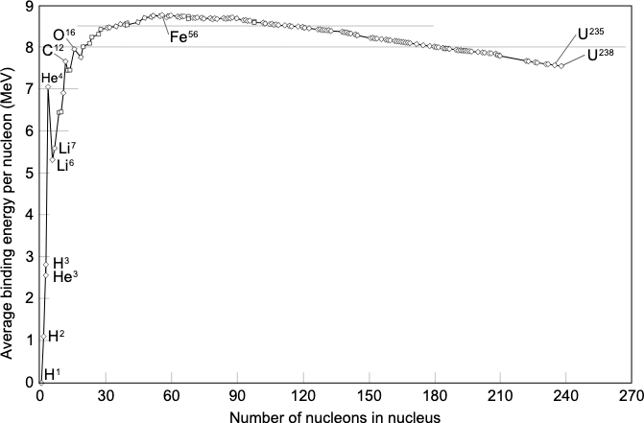
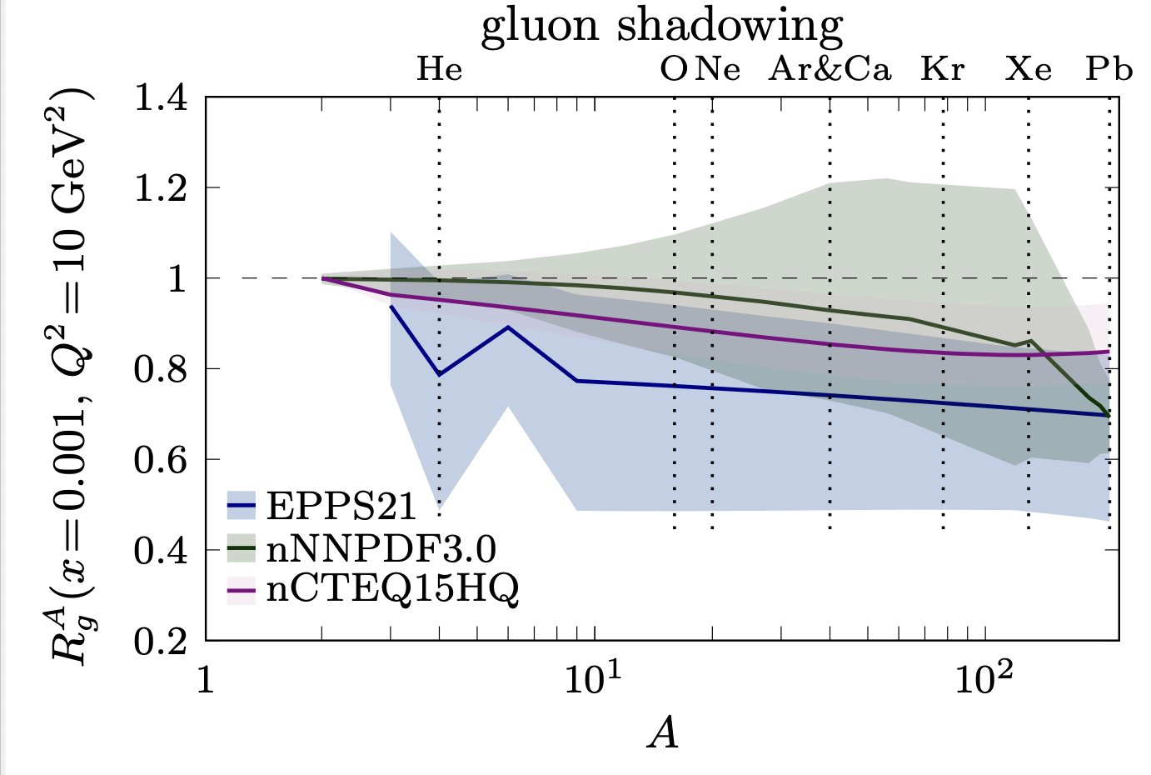
3-He and 6-Li
Why do 6-Li and 3-He have significantly smaller nPDF suppression and uncertainties than their neighbors?
6-Li
3-He

