Slide 1
Length of Chapters
Vertex section is asked to reduced from 52 pages to less than 40 pages
Timeline:
Updated draft by next Tuesday (June 10th )
Final draft by next Friday (for printed version shown in CEPC workshop)

Slide 2
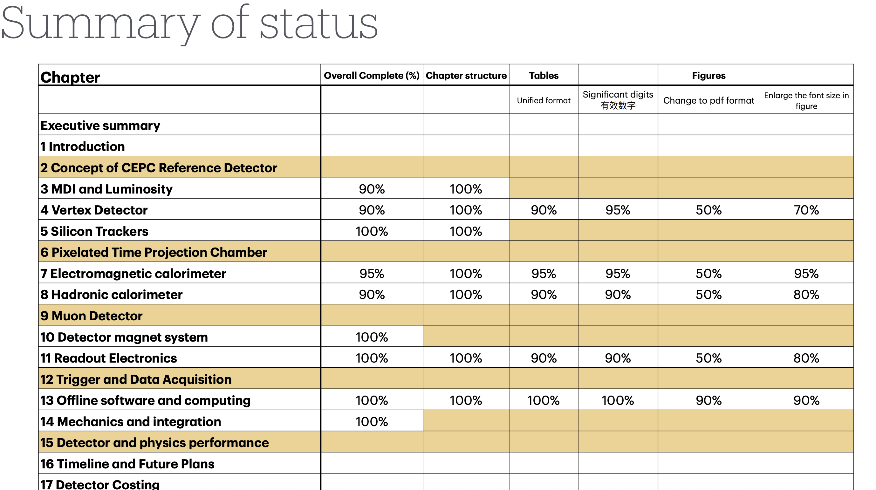
Three major problems:
Poor quality
Small font
Plot style
These figures need to be redrawn and exported as PDF or high quality PNG

Slide 3
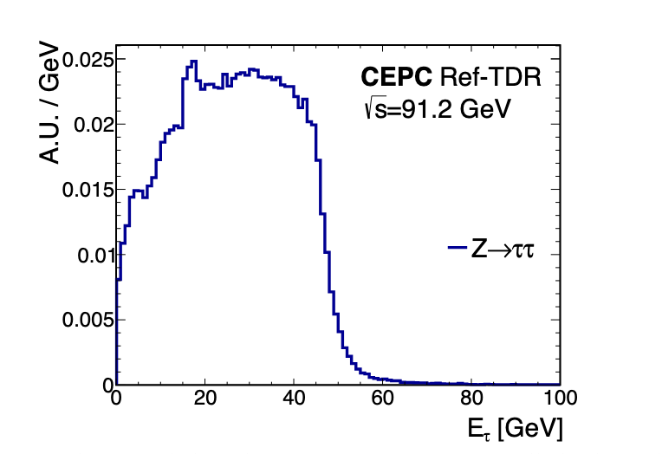
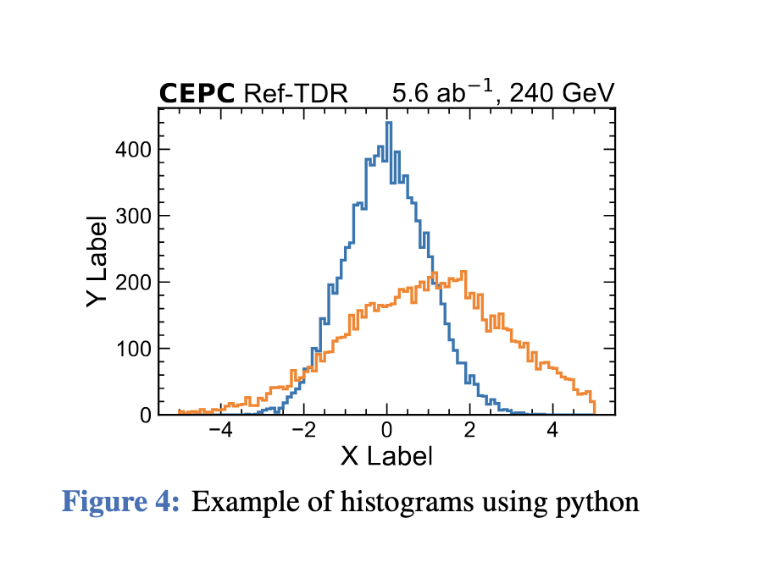
Python and ROOT example can be found in:
https://latex.ihep.ac.cn/read/sgqpscdqjdpp#4933c4
The plot macro can be found in:
https://indico.ihep.ac.cn/event/26316/#21-scripts-and-examples-of-fig

Slide 4
Detector overall design

Slide 5
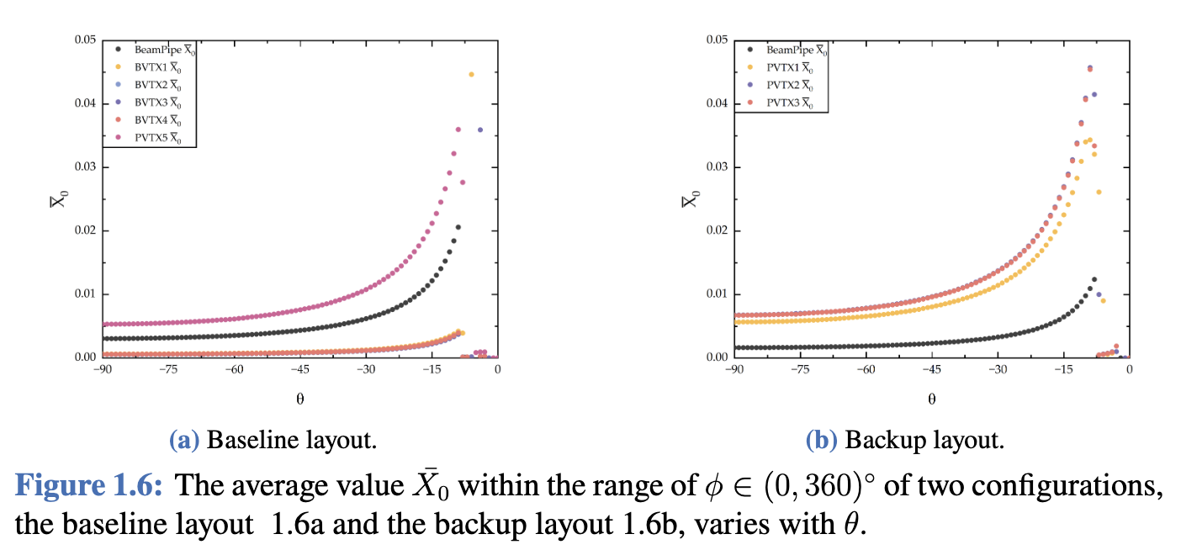
Small font
Plot style

Slide 6
Sensor and electronics

Slide 7
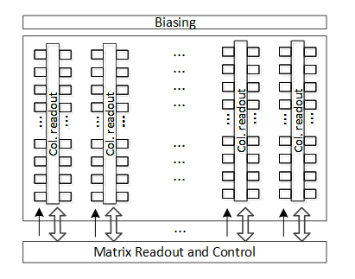
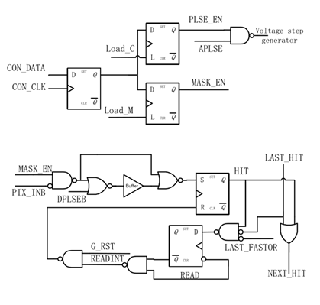
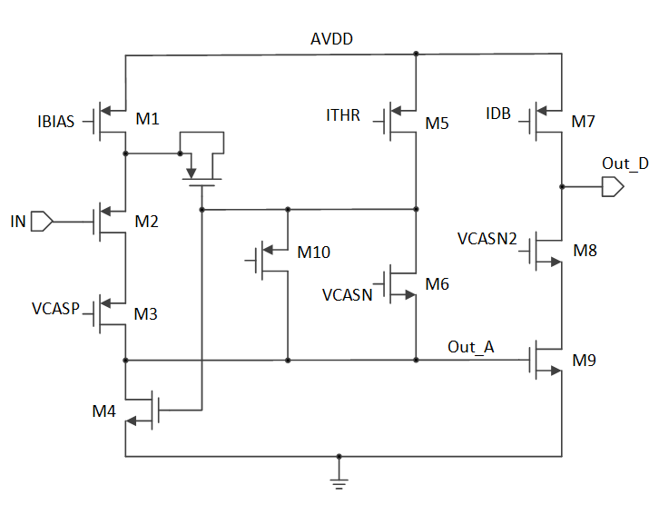
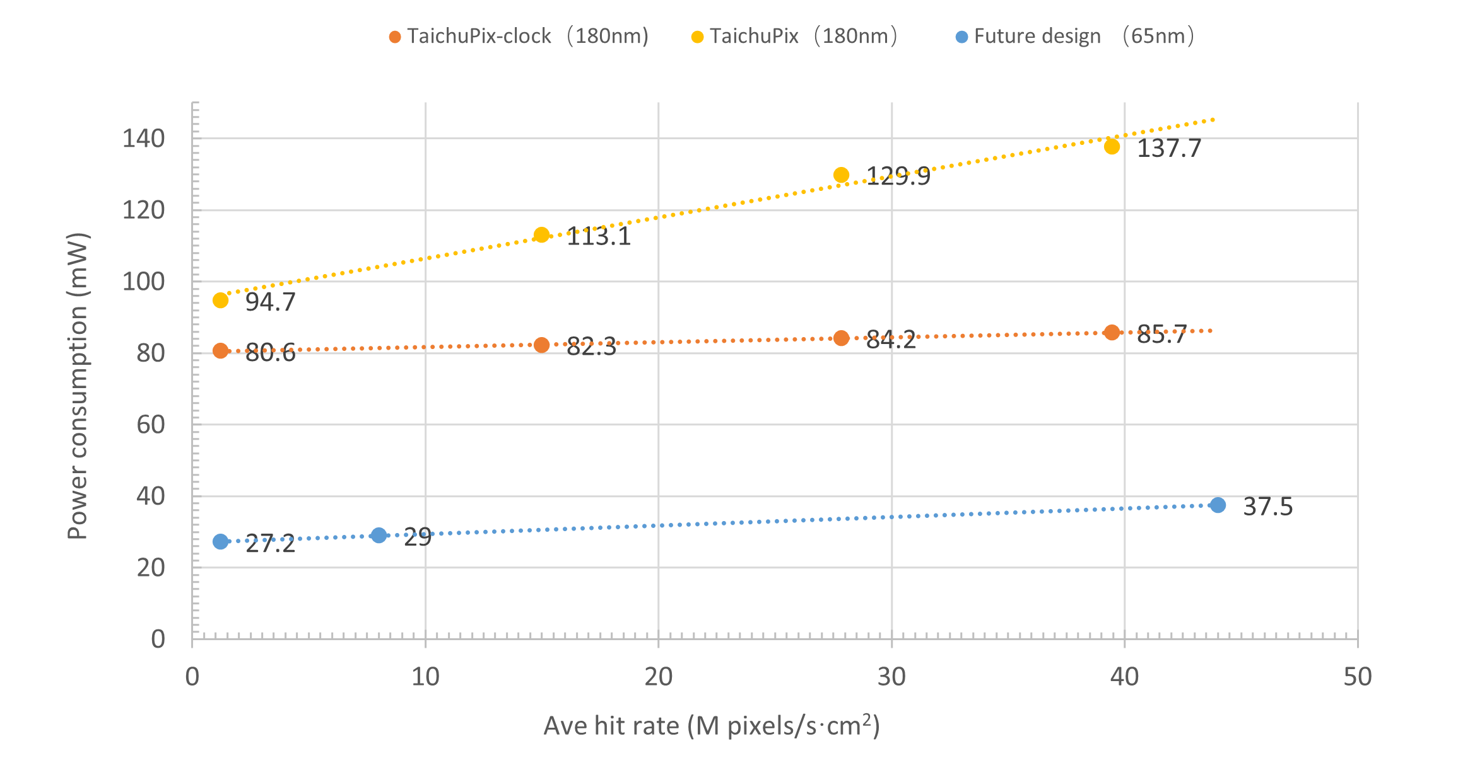
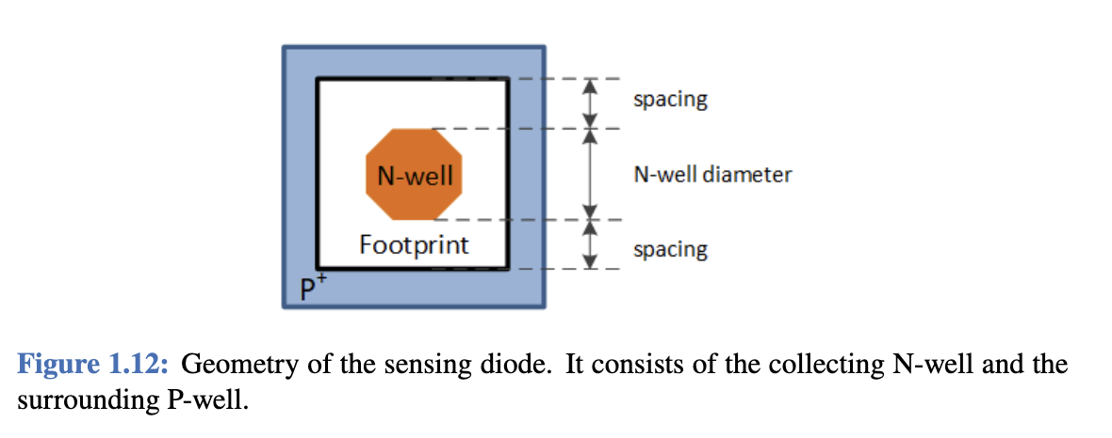
Quality issue
Quality issue
Architecture_SensroBlock.png
InPixel_Logic.png
Pixel_FE.png
Quality issue
Small font
Quality issue
Evaluation_of_required_power_consumption.pdf

Slide 8
Mechanics, cooling and services

Slide 9
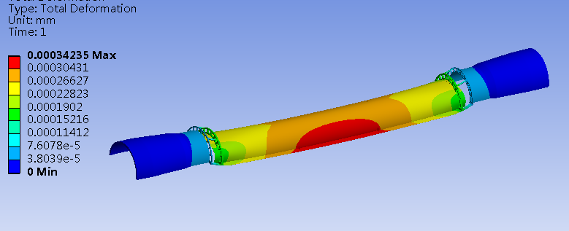
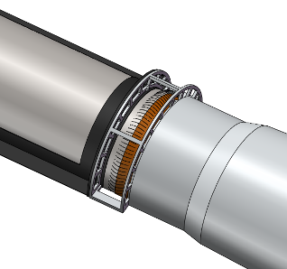
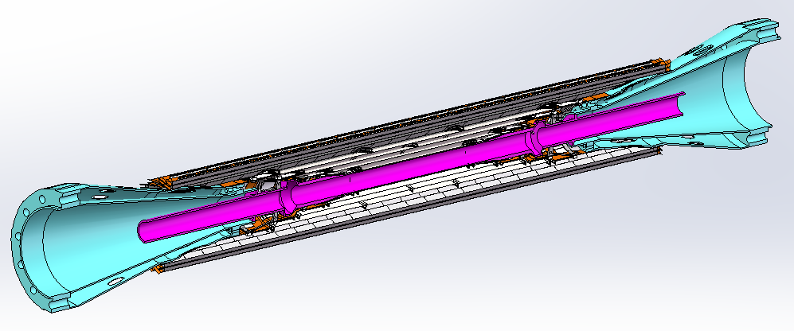
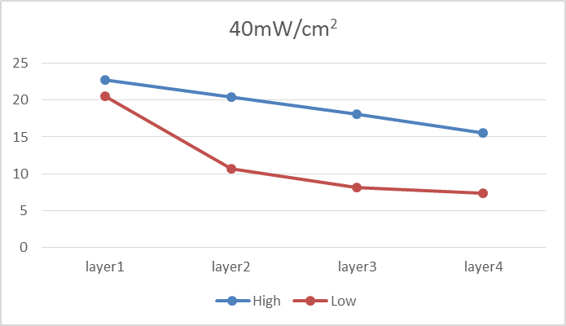
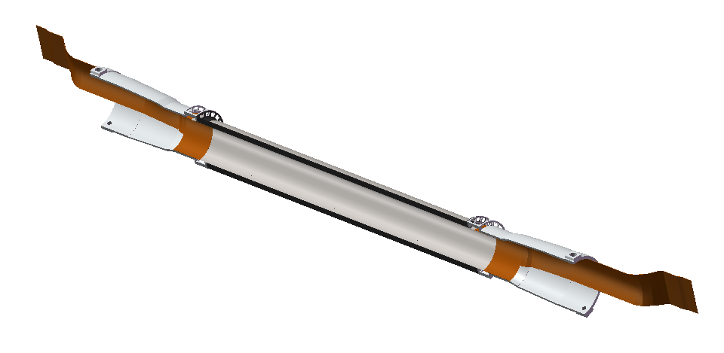
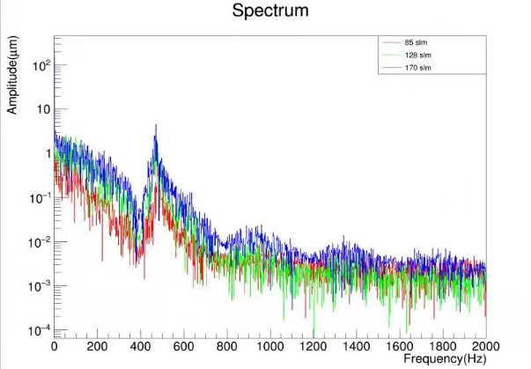
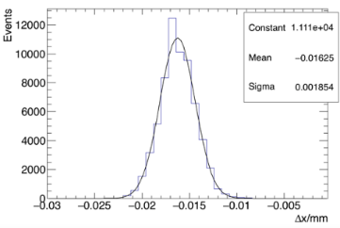
Quality issue
Quality issue
Quality issue
Quality issue
Quality issue
Plot style
Quality issue
Plot style
Small font
Plot style

Slide 10
Alignment and calibration

Slide 11
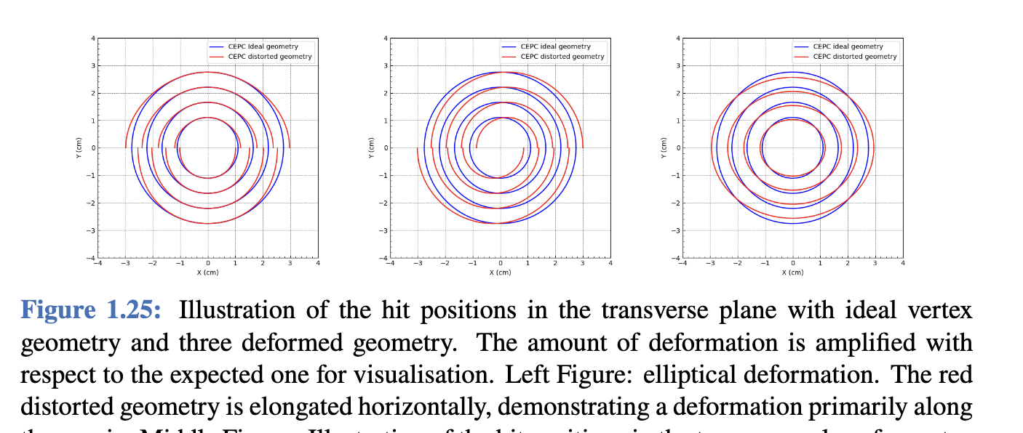
Small font
Plot style

Slide 12
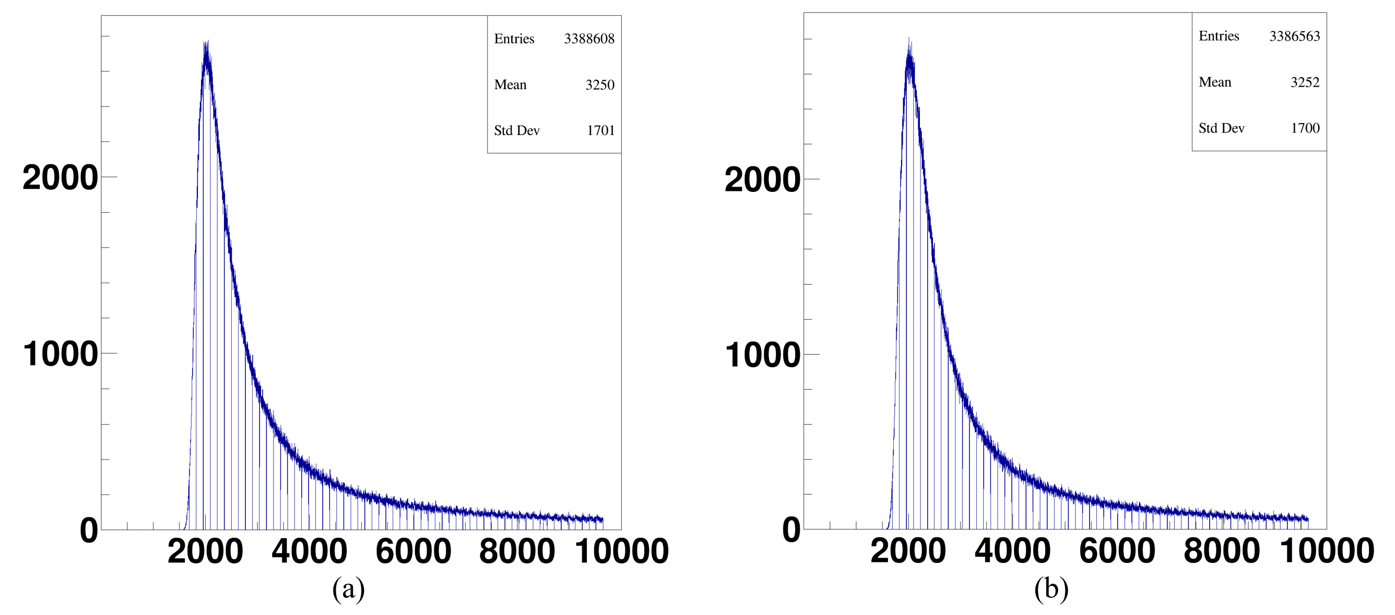
Poor quality
TDRlasersys.jpg
Small font
Small font
Plot style
Plot style
laser_pixel_id.png

Slide 13
R & D efforts and results

Slide 14
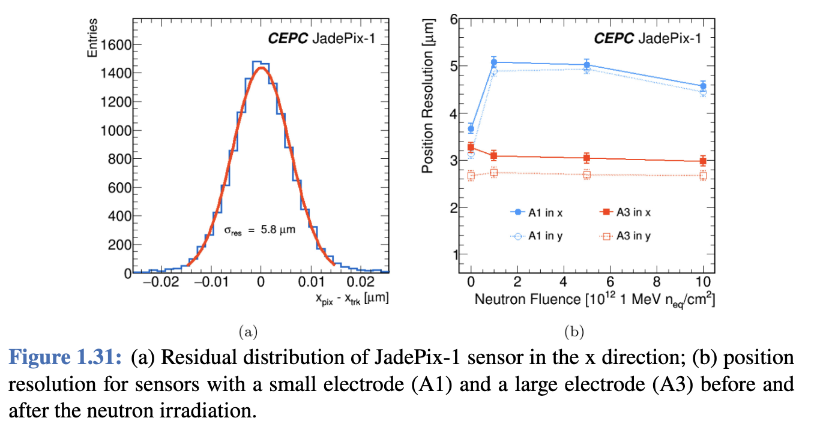
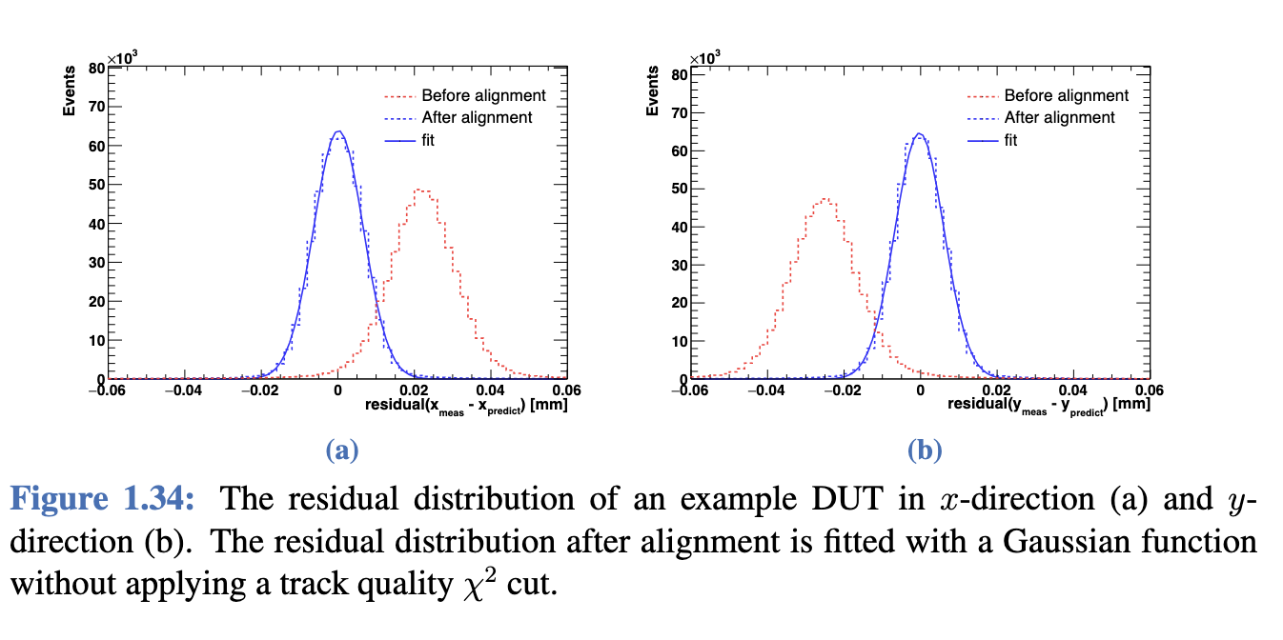
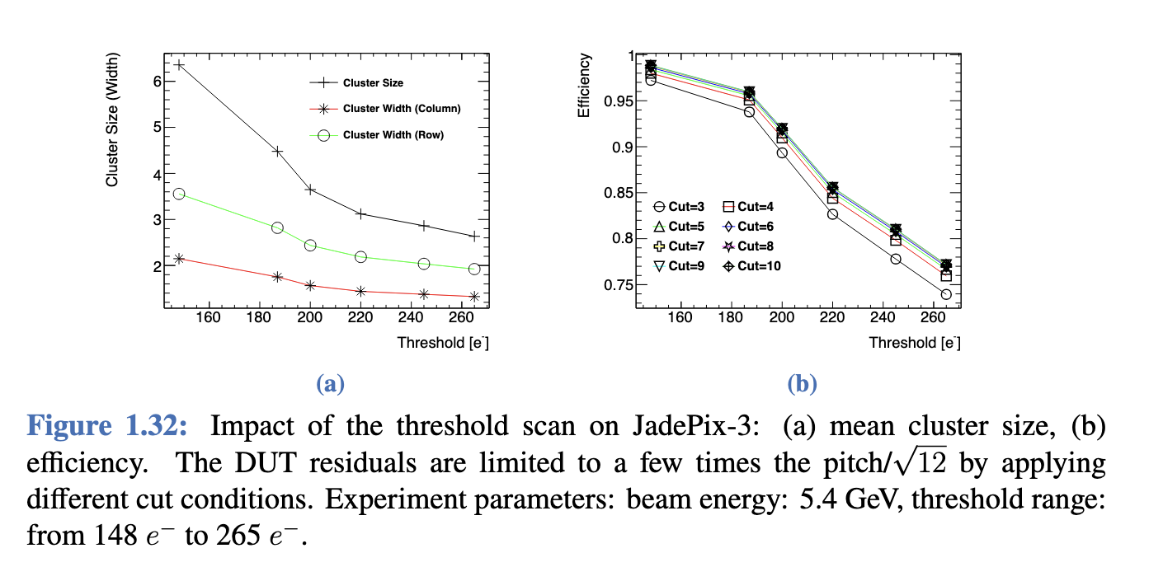
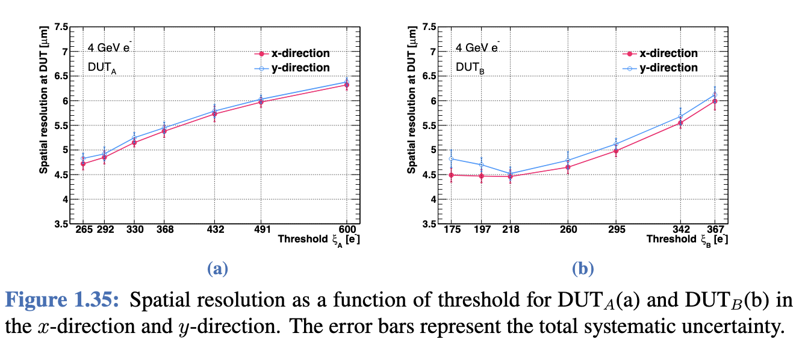
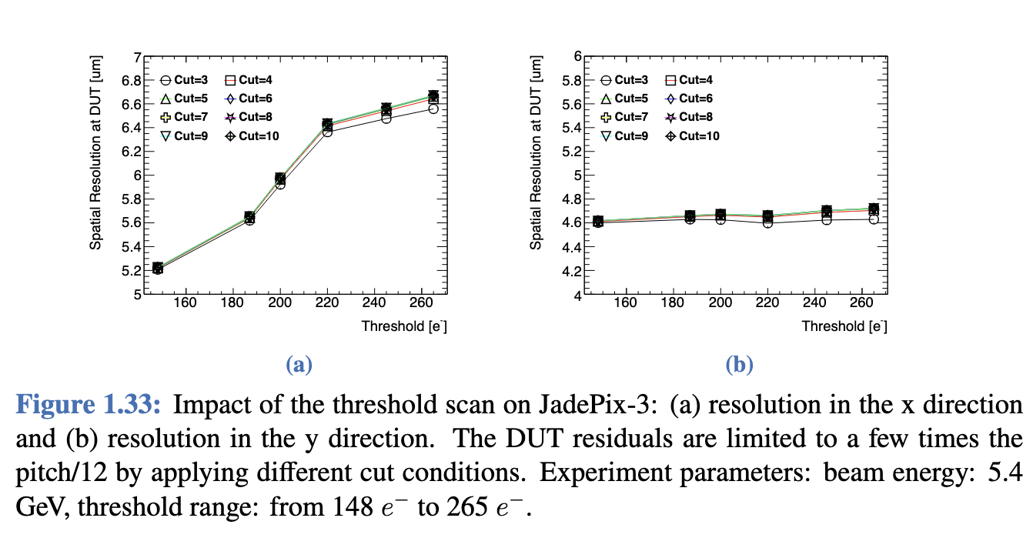
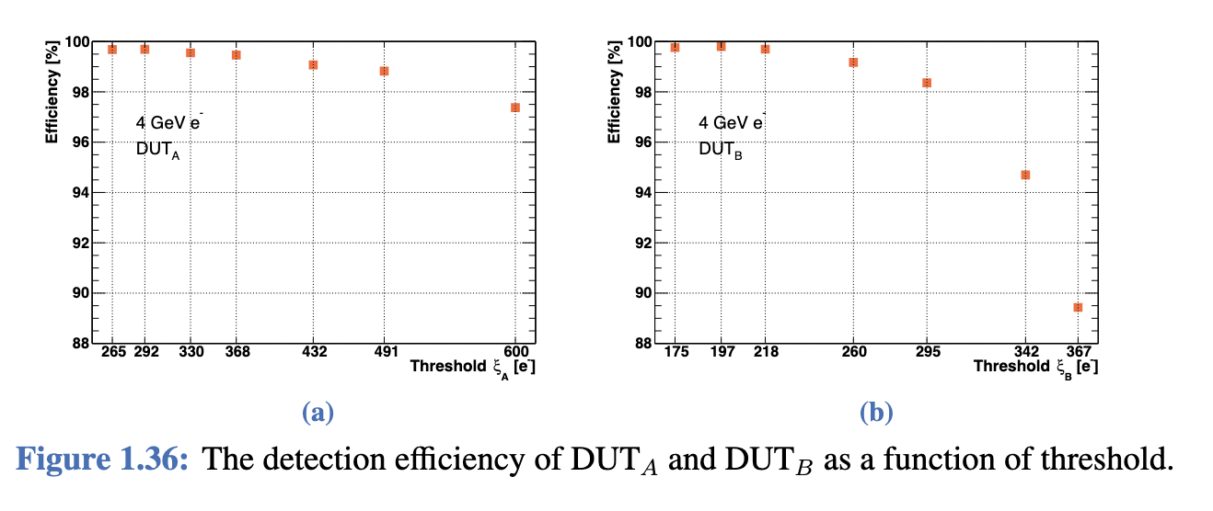
All these figures have plot style issue, but should be fine for they are figures from published papers.

Slide 15
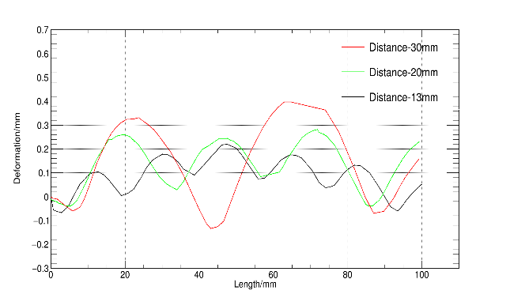
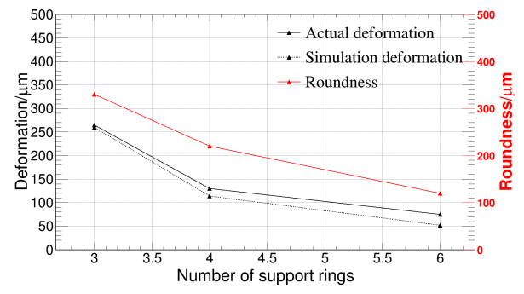
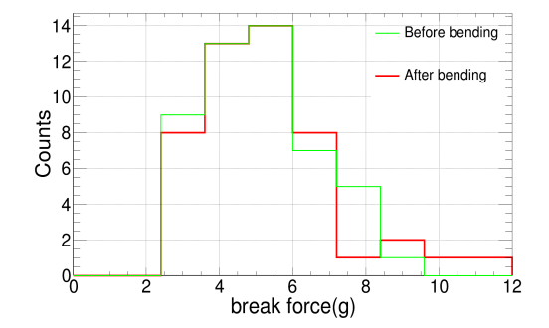
Quality issue
Plot style
Plot style
Quality issue
Quality issue
Plot style

Slide 16
Performance

Slide 17
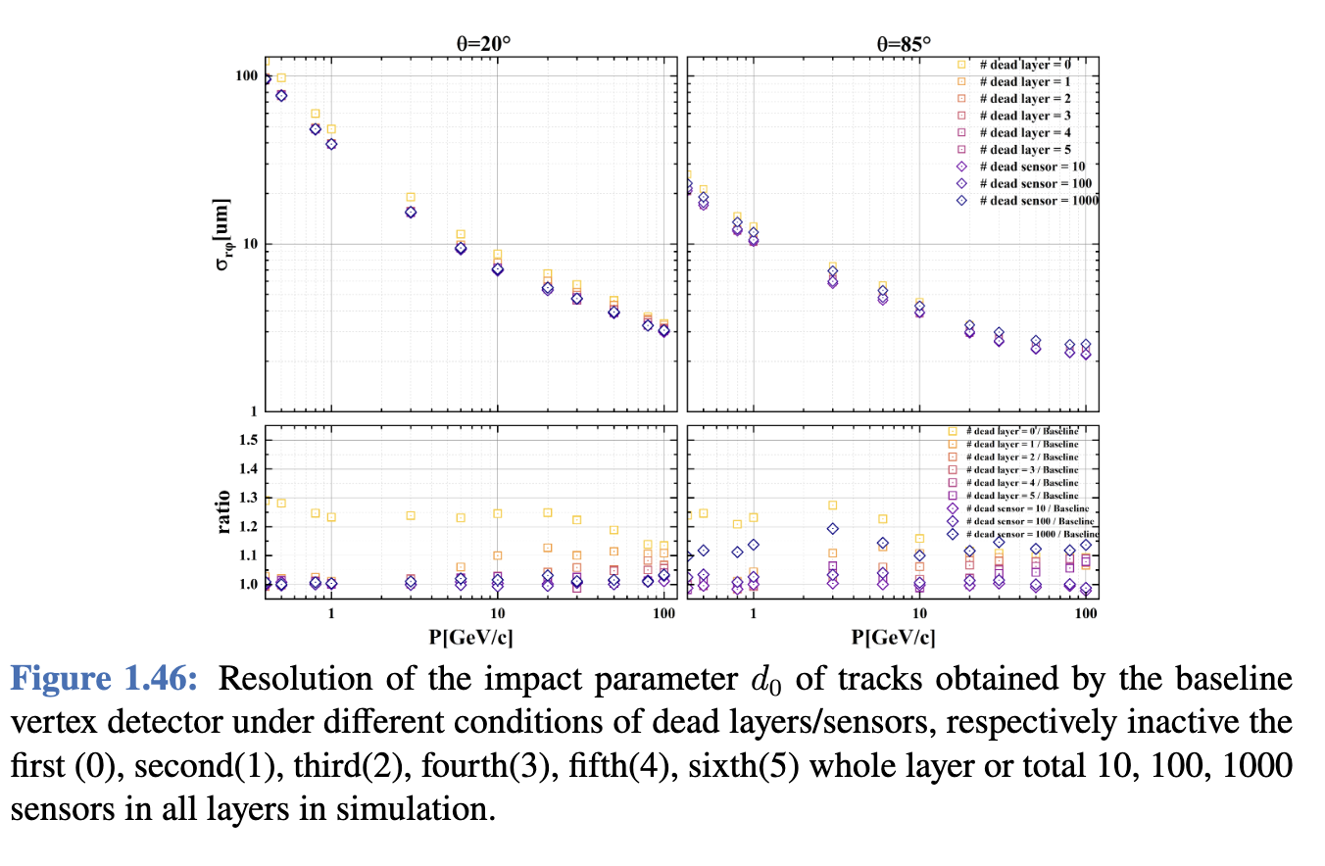
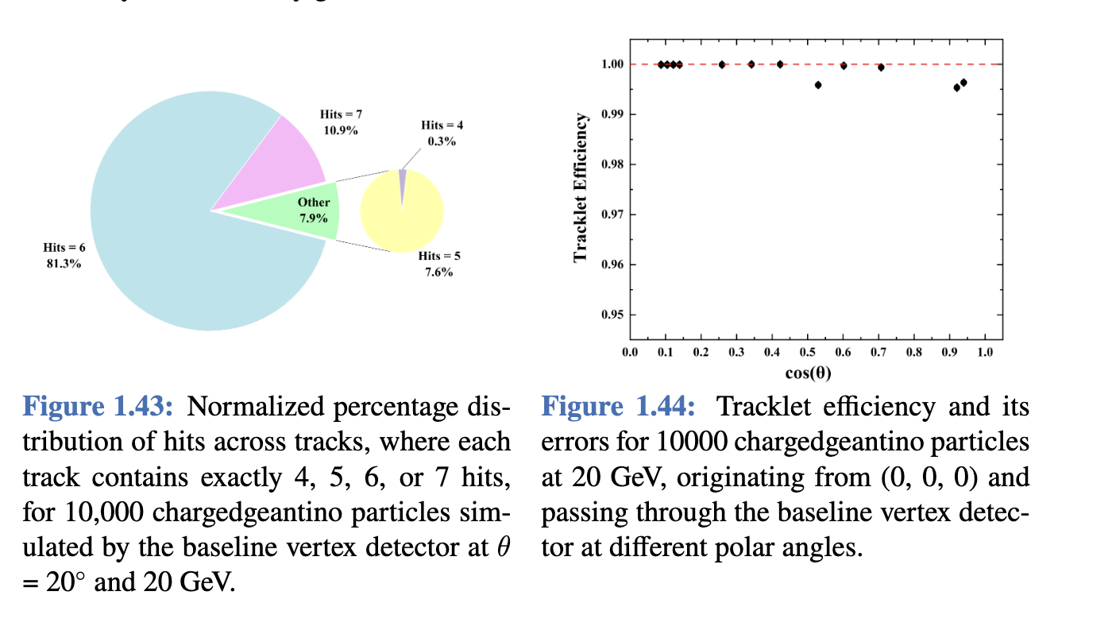
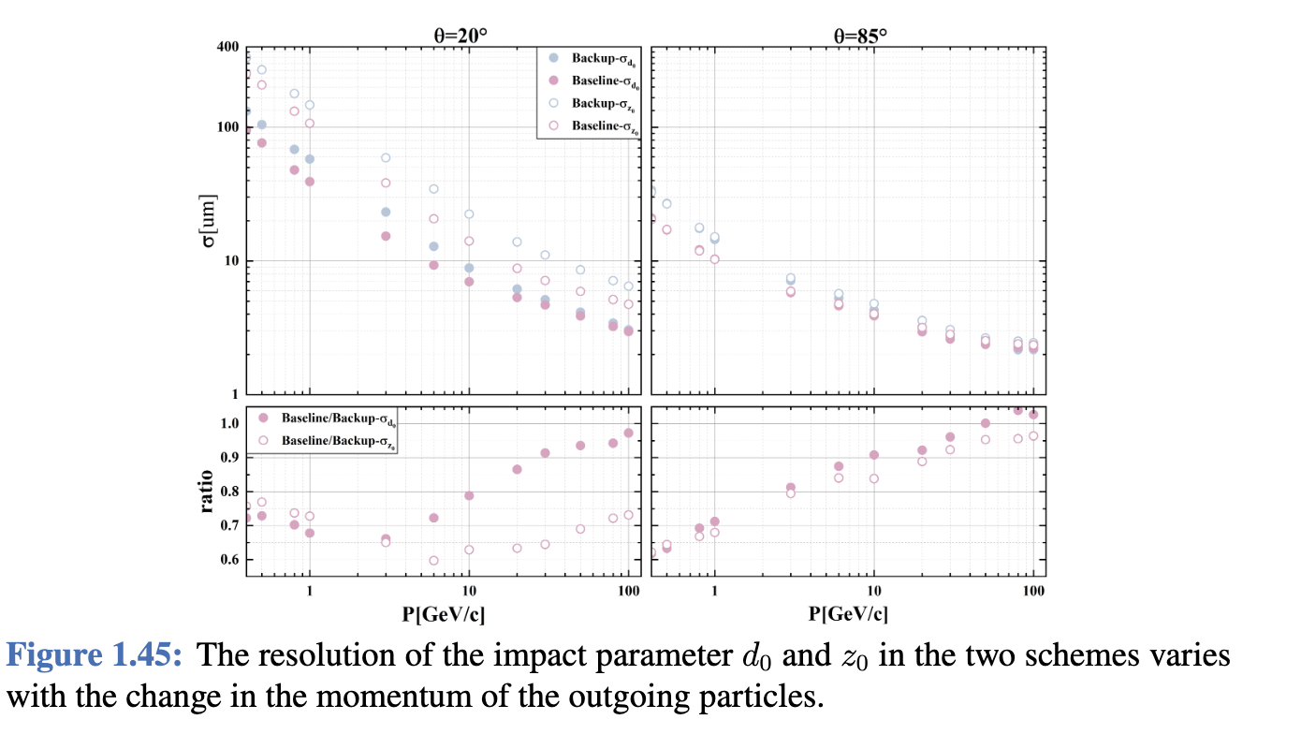
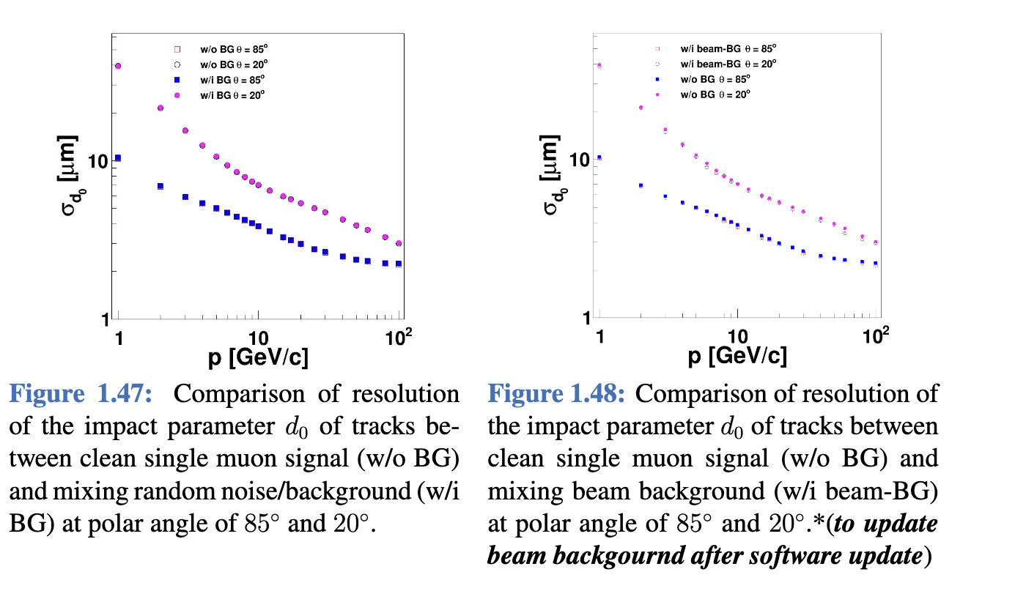
Plot style
Plot style
Plot style
Plot style

Slide 18
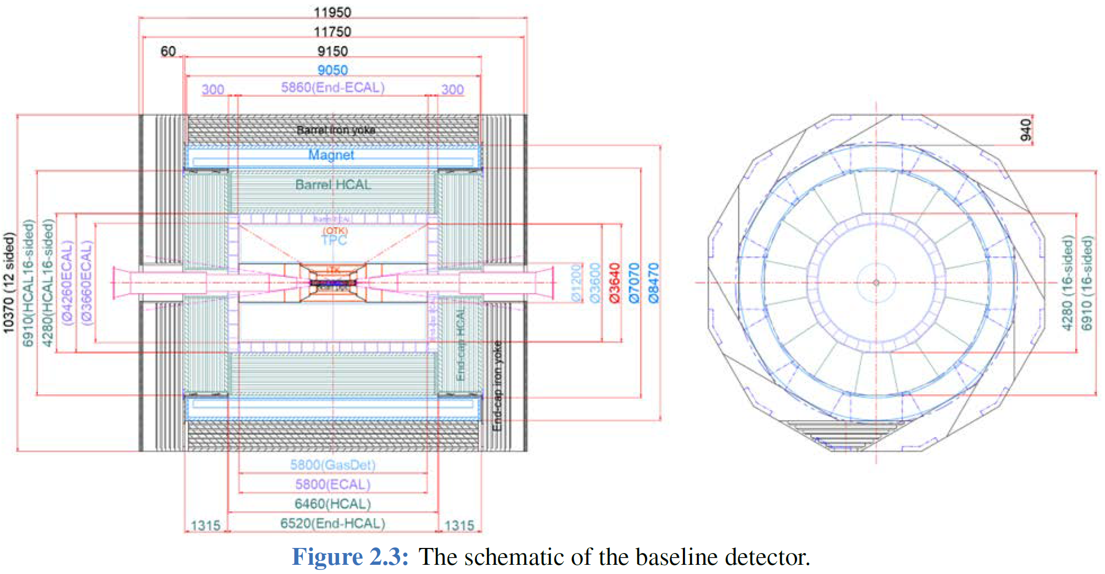
Additionally, we may need an overall layout figure with:
More detailed parameters
More clear structure
Like this but more detailed explanation

