Slide 1

Neutrino physics at CEPC
Yongchao Zhang (张永超)
Southeast University
第十一届中国LHC物理会议（CLHCP2025） Oct 30, 2025, Xinxiang

Slide 2
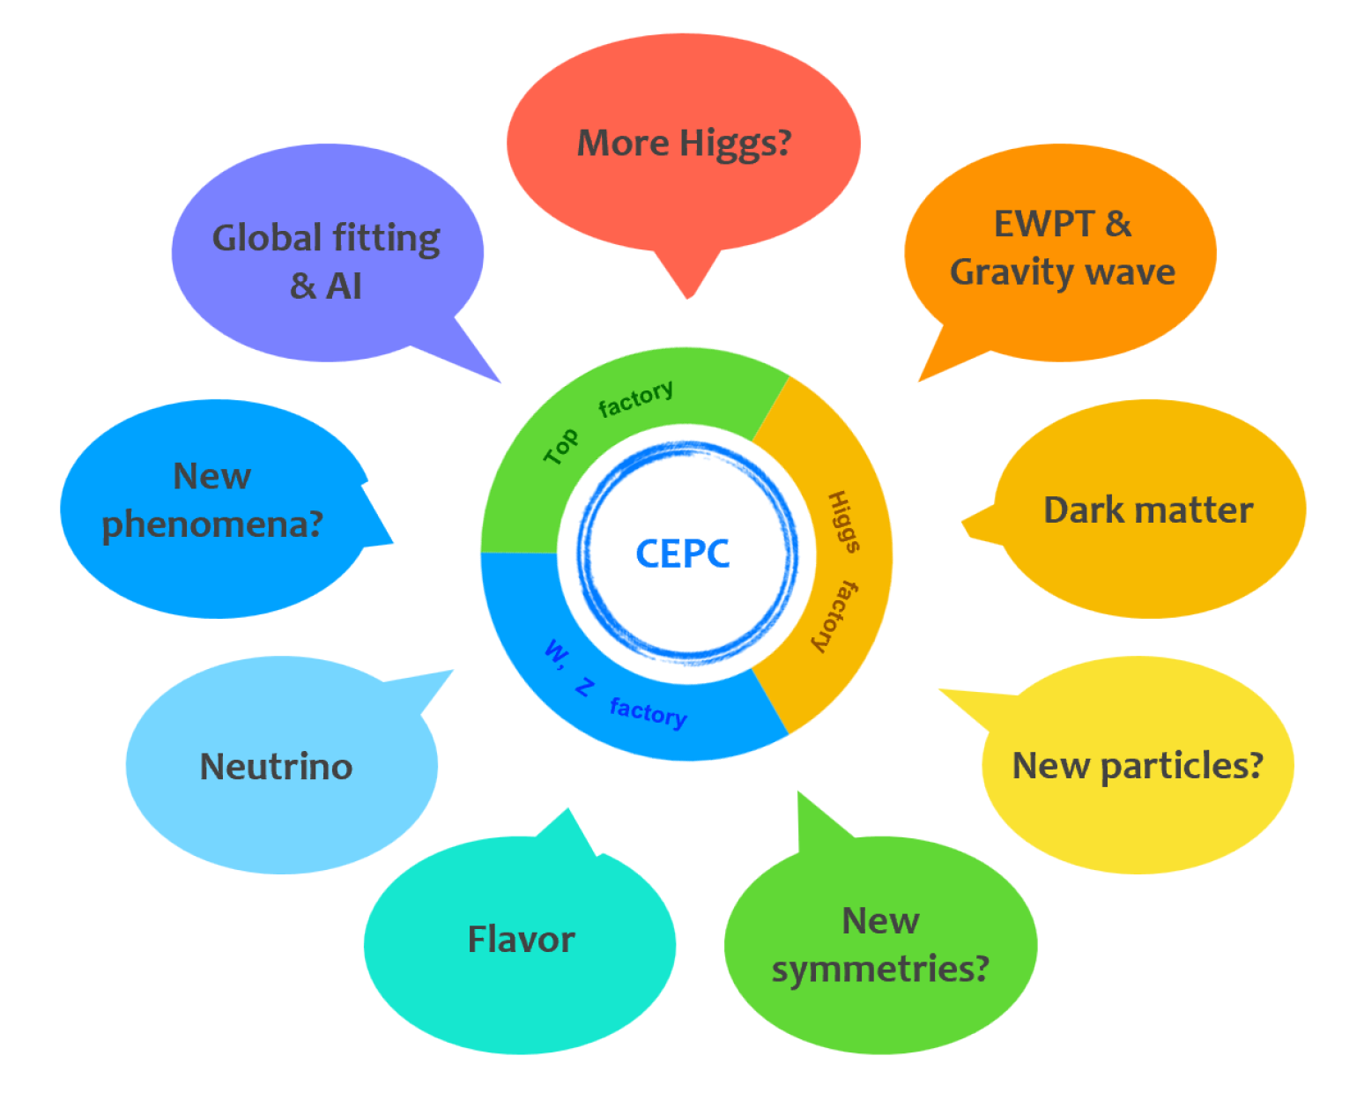
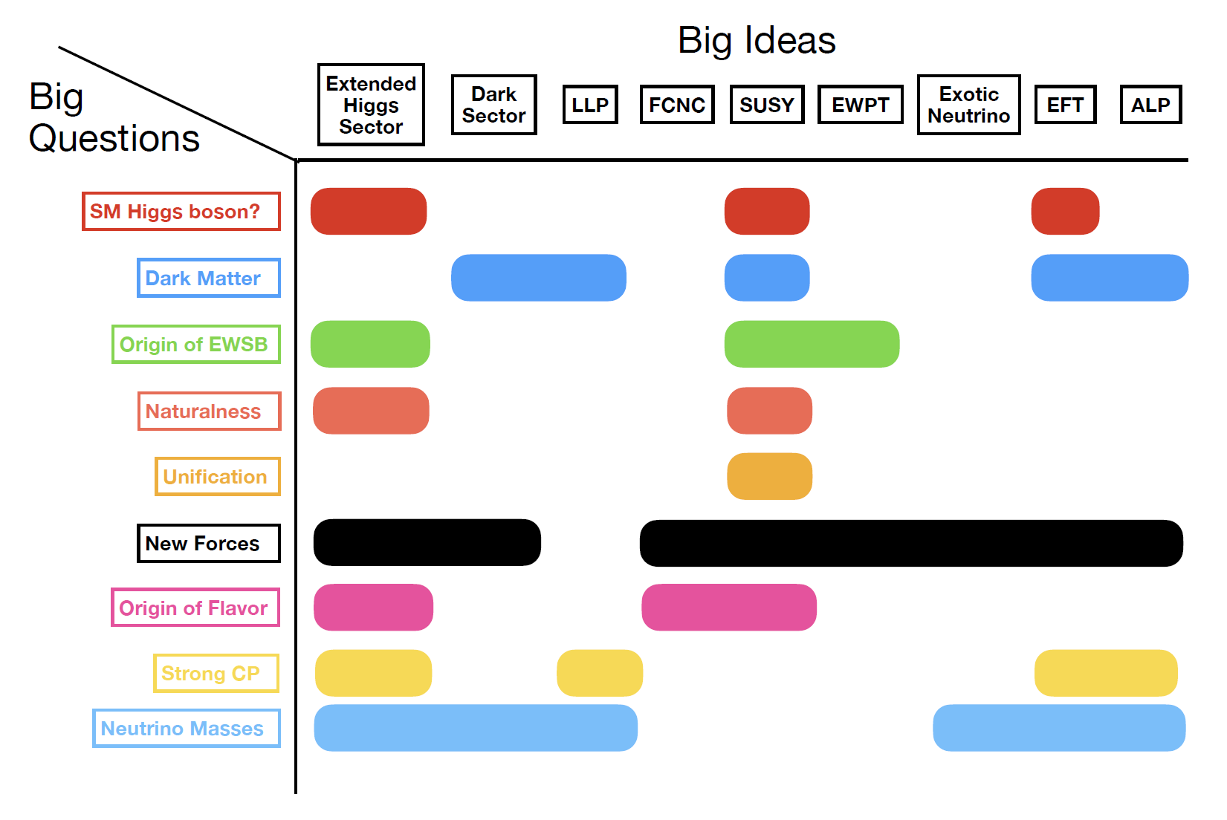
CEPC BSM White Paper
topics
questions & ideas

Slide 3
Outline
Neutrino Physics
Motivations
A. Prospects of heavy neutrinos (N)
1. N at main detectors
2. N at far detectors
3. SM Higgs decay h → NN
4. Prospects of N in U(1) models
5. Prospects of N in the LRSM
B. Non-standard neutrino interactions
C. Active-sterile neutrino transition magnetic moments
D. Neutral and doubly-charged scalars in seesaw models
E. Connection to Leptogenesis and Dark Matter
F. Summary

Slide 4
Motivations
𝜈 physics: neutrino masses & oscillation.
Smoking-gun signals @ CEPC: associated with neutrino physics e.g. Lepton Number Violation (LNV), Lepton Flavor Violation (LFV).
Strong connections to DM & baryon asymmetry e.g. leptogenesis.

Slide 5
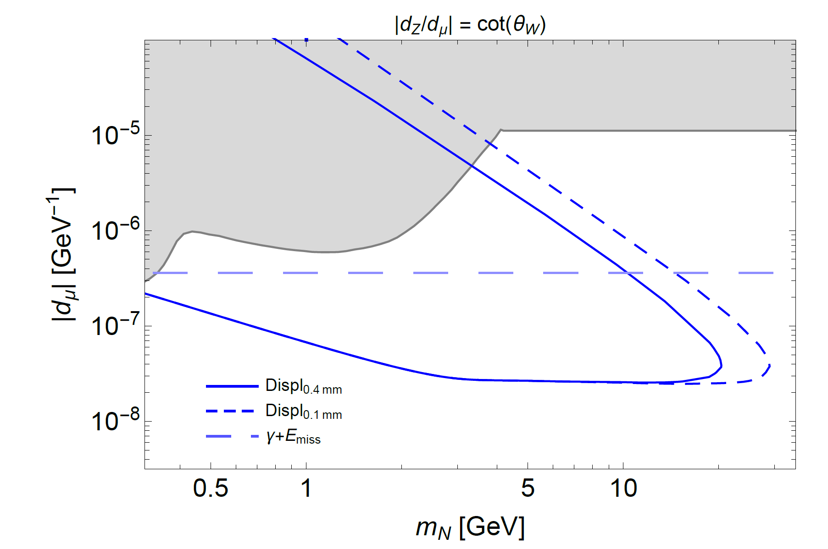
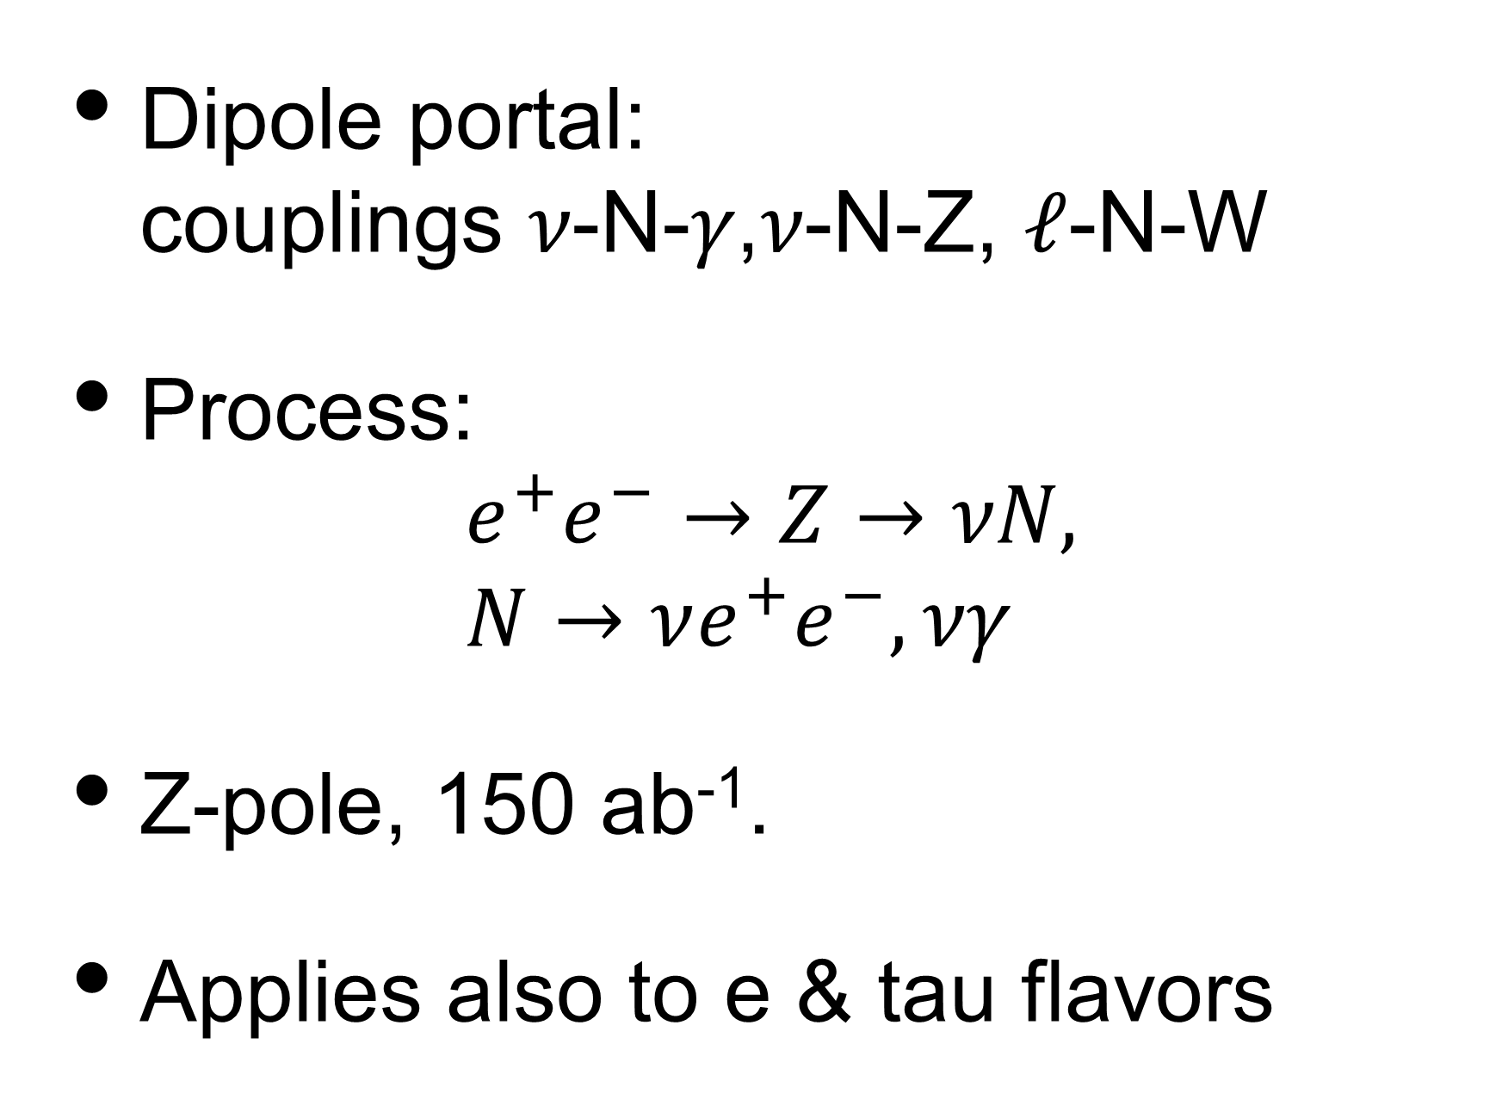
A.1 N @ main detector
Ovchynnikov & Jing-Yu Zhu, 2301.08592
Dipole portal: couplings 𝜈-N-𝛾,𝜈-N-Z, 𝓁-N-W
Process: $e^{+}e^{−}→Z→\text{ν}N,$ $N→\text{ν}e^{+}e^{−},\text{νγ}$
Z-pole, 150 ab⁻¹.
Applies also to e & tau flavors

Slide 6
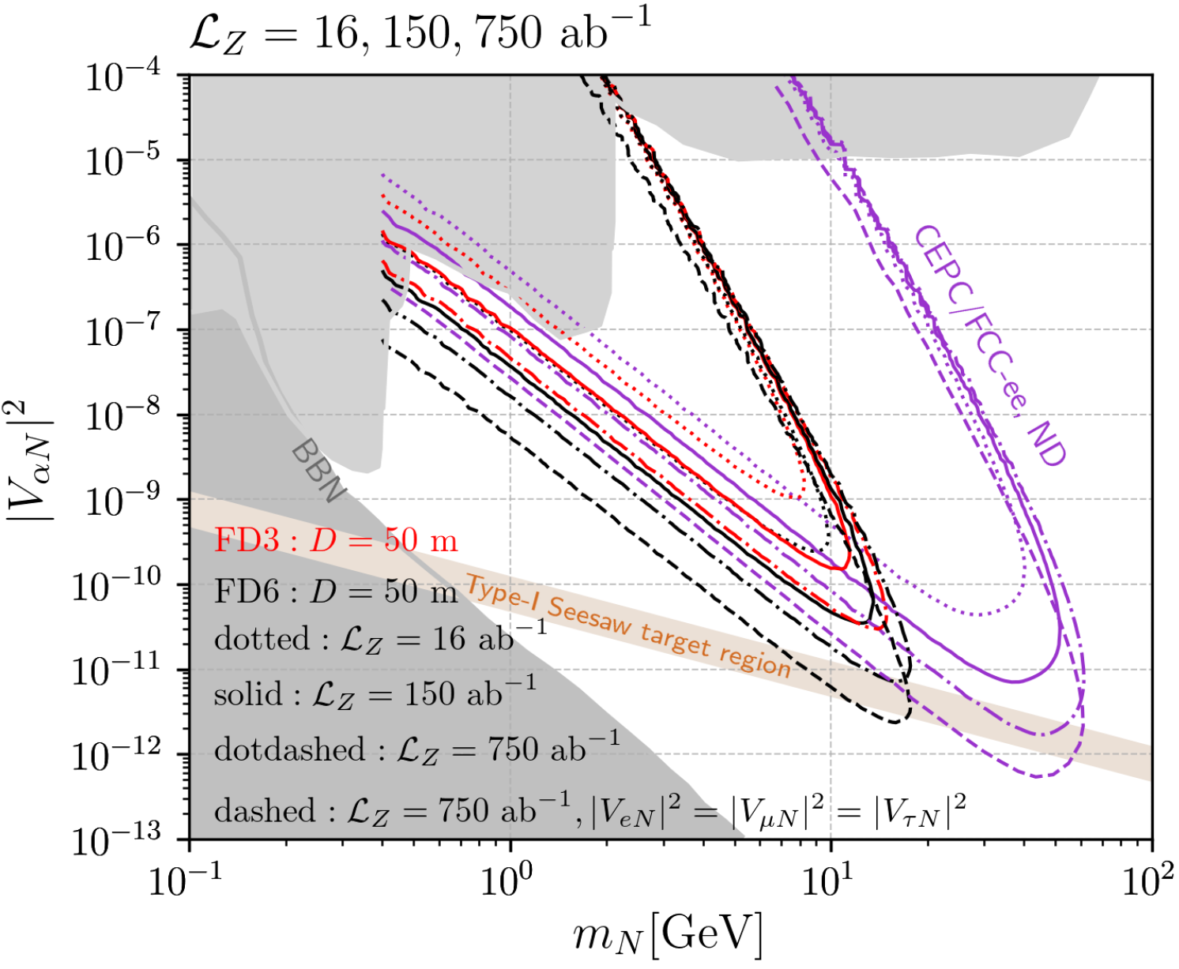
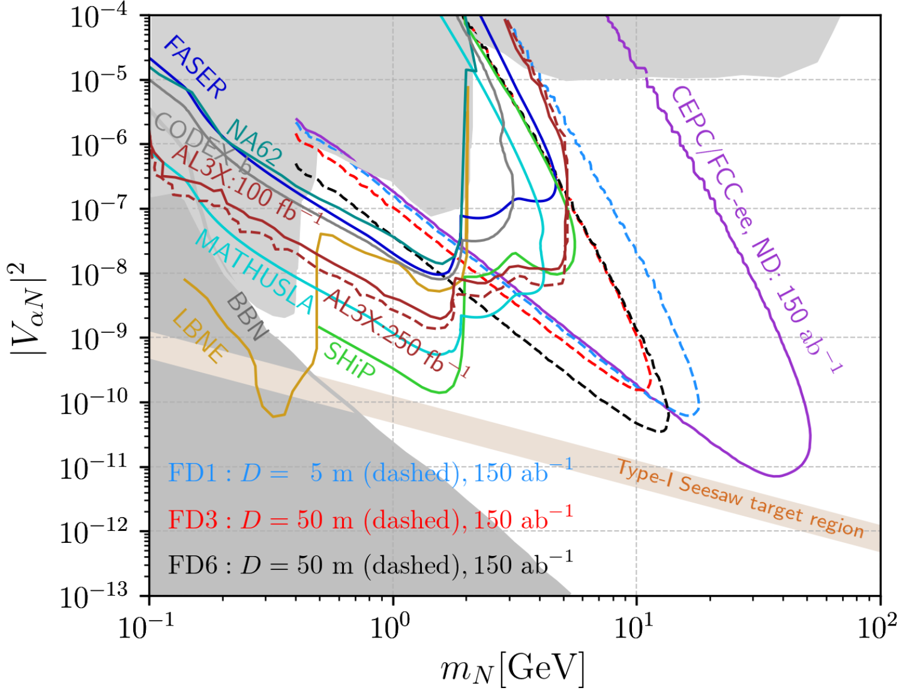


A.2 N @ far detectors
Zeren S. Wang and Kechen Wang, 1911.06576
$$Z→\text{ν}N$$
$$Z→\text{ν}N$$

Slide 7
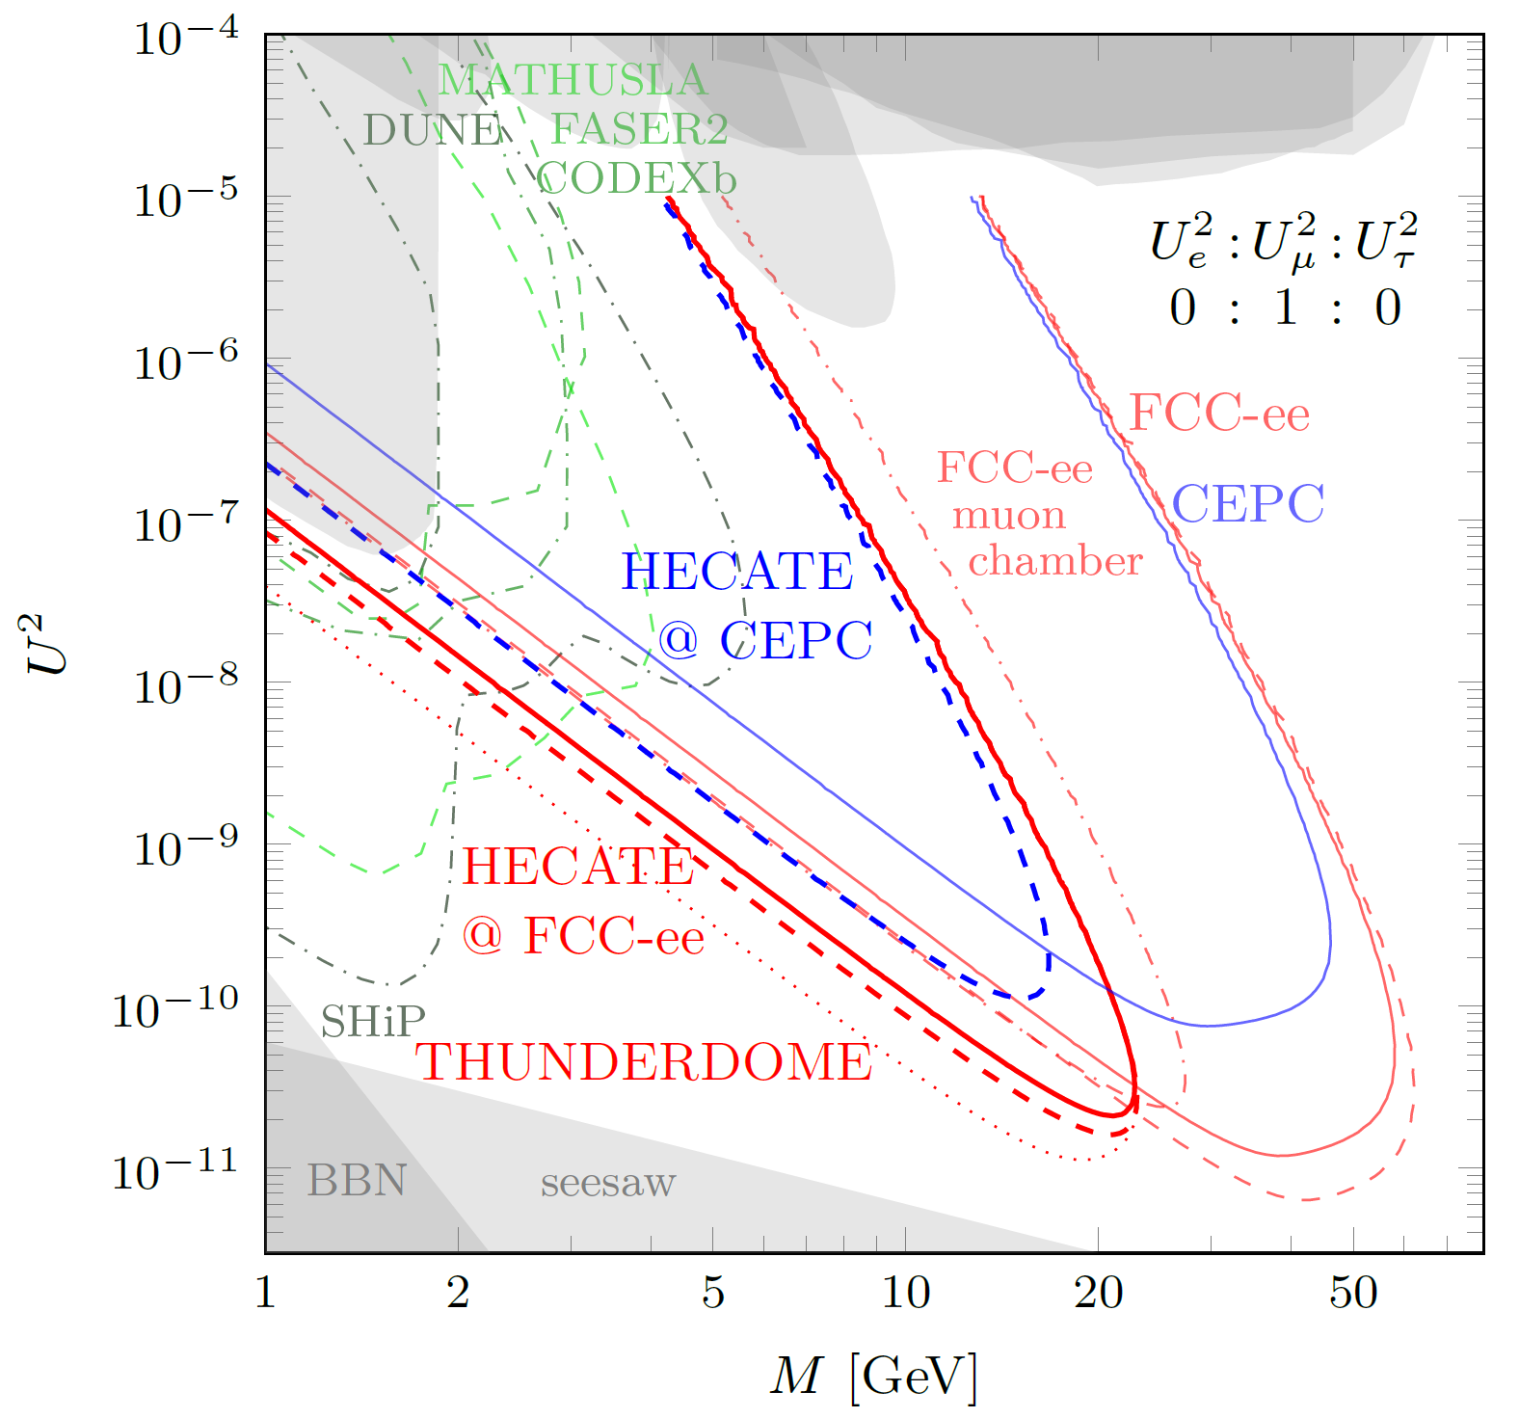

A.2 Heavy neutrinos at far detectors
Chrzaszcz, Drewes & Hajer, 2011.01005
At Z-pole
Main detector: L0= 5 mm, L1=1.22 m;
Muon chamber: L0 = 1.22 m, L1 = 4 m;
HECATE: L0 = 4 m, L1 = 15/25 m.
The difference of CEPC & FCC-ee lines is mainly due to Z numbers: 3.5 × 10¹¹ vs 2.5×10¹²
$$Z→\text{ν}N$$

Slide 8
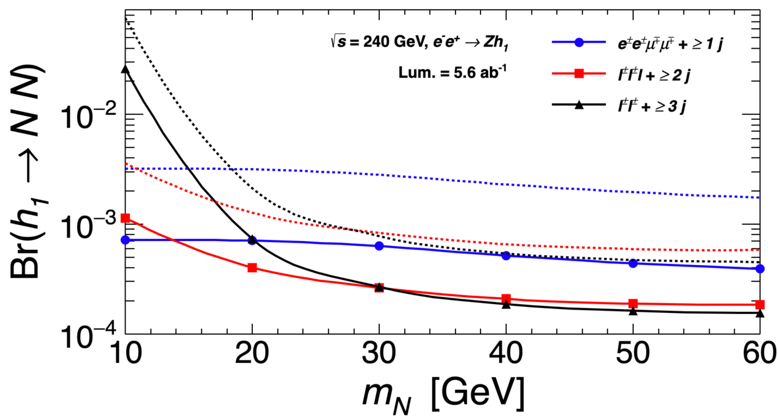
A.3 SM Higgs decay h → NN
WARNING: LNV ≠ N
Yu Gao and Kechen Wang, 2102.12826
LNV!

Slide 9
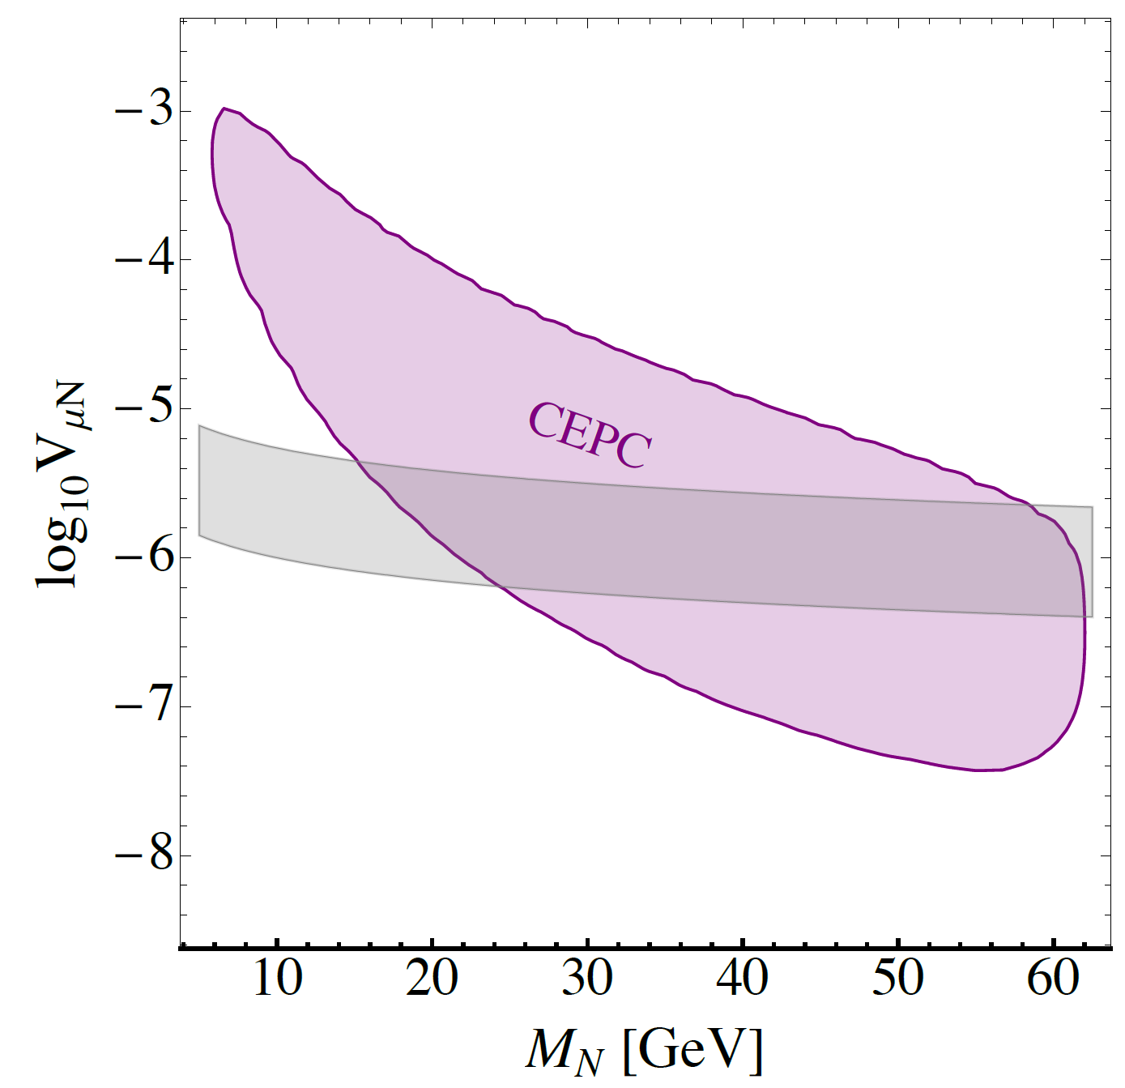
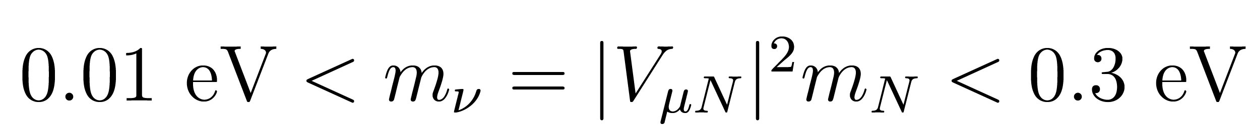
A.3 SM Higgs decay h → NN
Deppisch, Wei Liu & Mitra, 1804.04075
Based on U(1)_{B-L} model
With neutrino mixing, N decays via N → lqq, llν
Lumi = 20 ab⁻¹
Higgs-BSM mixing = 0.3.
Gray band: interesting range:
DV signal of N

Slide 10
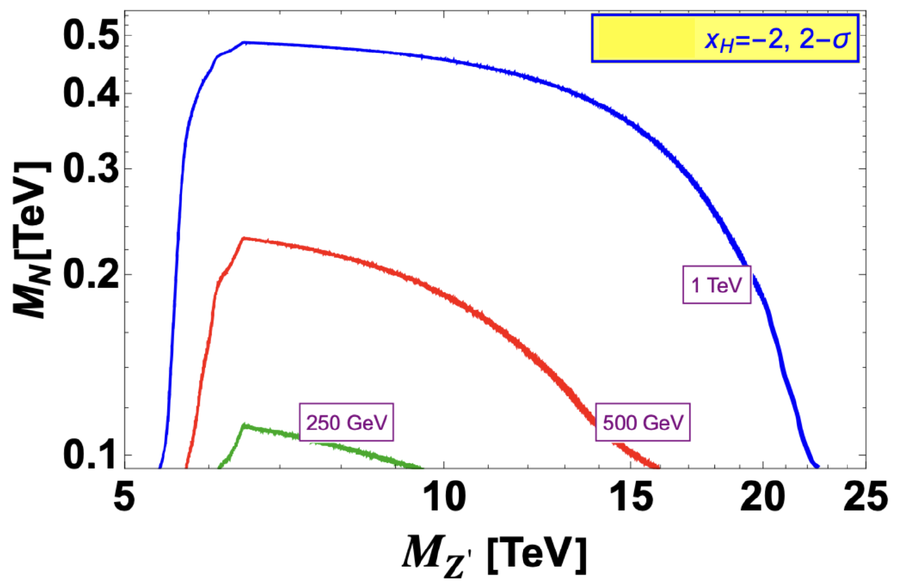
A.4 Prospects of N in U(1) models
e+ e- → Z’* → NN
BR (Z ’→ NN) depending on x_{H}.
Lumi = 2, 4 & 8 ab⁻¹.
Das, Mandal, Nomura & Shil, 2202.13358

Slide 11
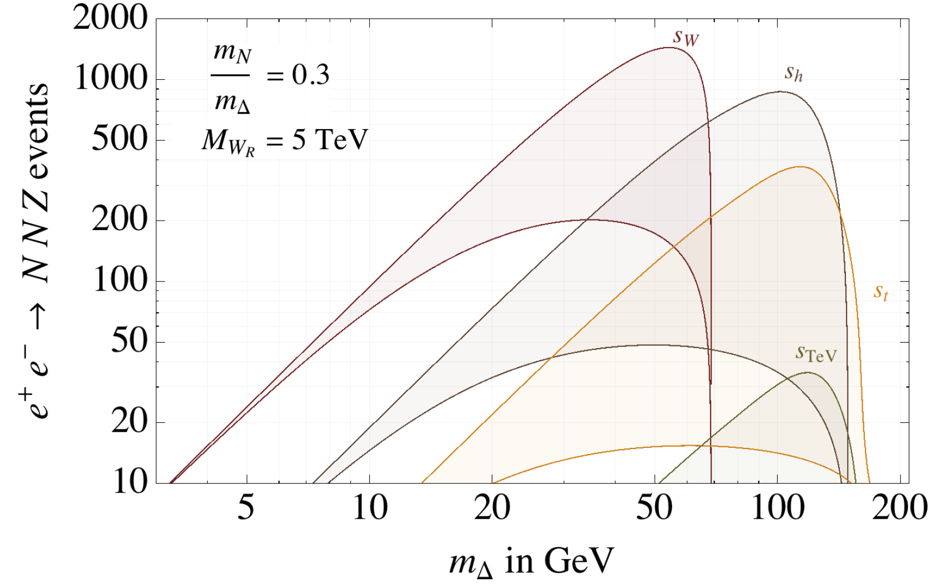
A.5 Prospects of N in LRSM
e+ e- → Z Δ, Δ→ NN
Assumptions: m_{N} = m_{Δ}/3, lumi = 1 ab⁻¹.
The shaded regions: sin θ ∈ (0.01, 0.1).
Nemevsek, Nesti & Vasquez, 1612.06840

Slide 12
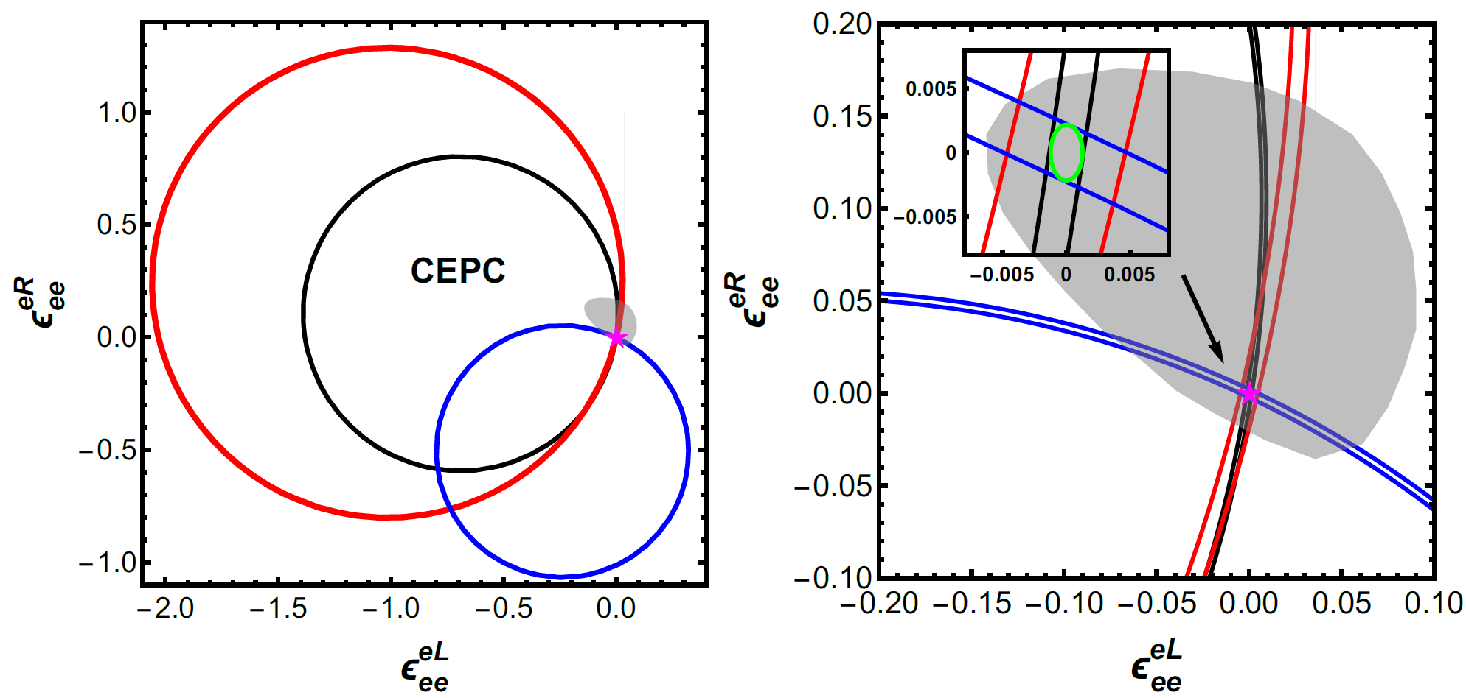
B. Non-standard neutrino interactions (NSIs)
Jiajun Liao and Yu Zhang, 2105.11215
Black: 240 GeV, 5.6 ab-1;
Red: 160 GeV, 2.6 ab−1;
Blue: 91.2 GeV, 16 ab-1;
Green: combined.
Gray region: allowed by LEP, CHARM, LSND & reactor data.

Slide 13
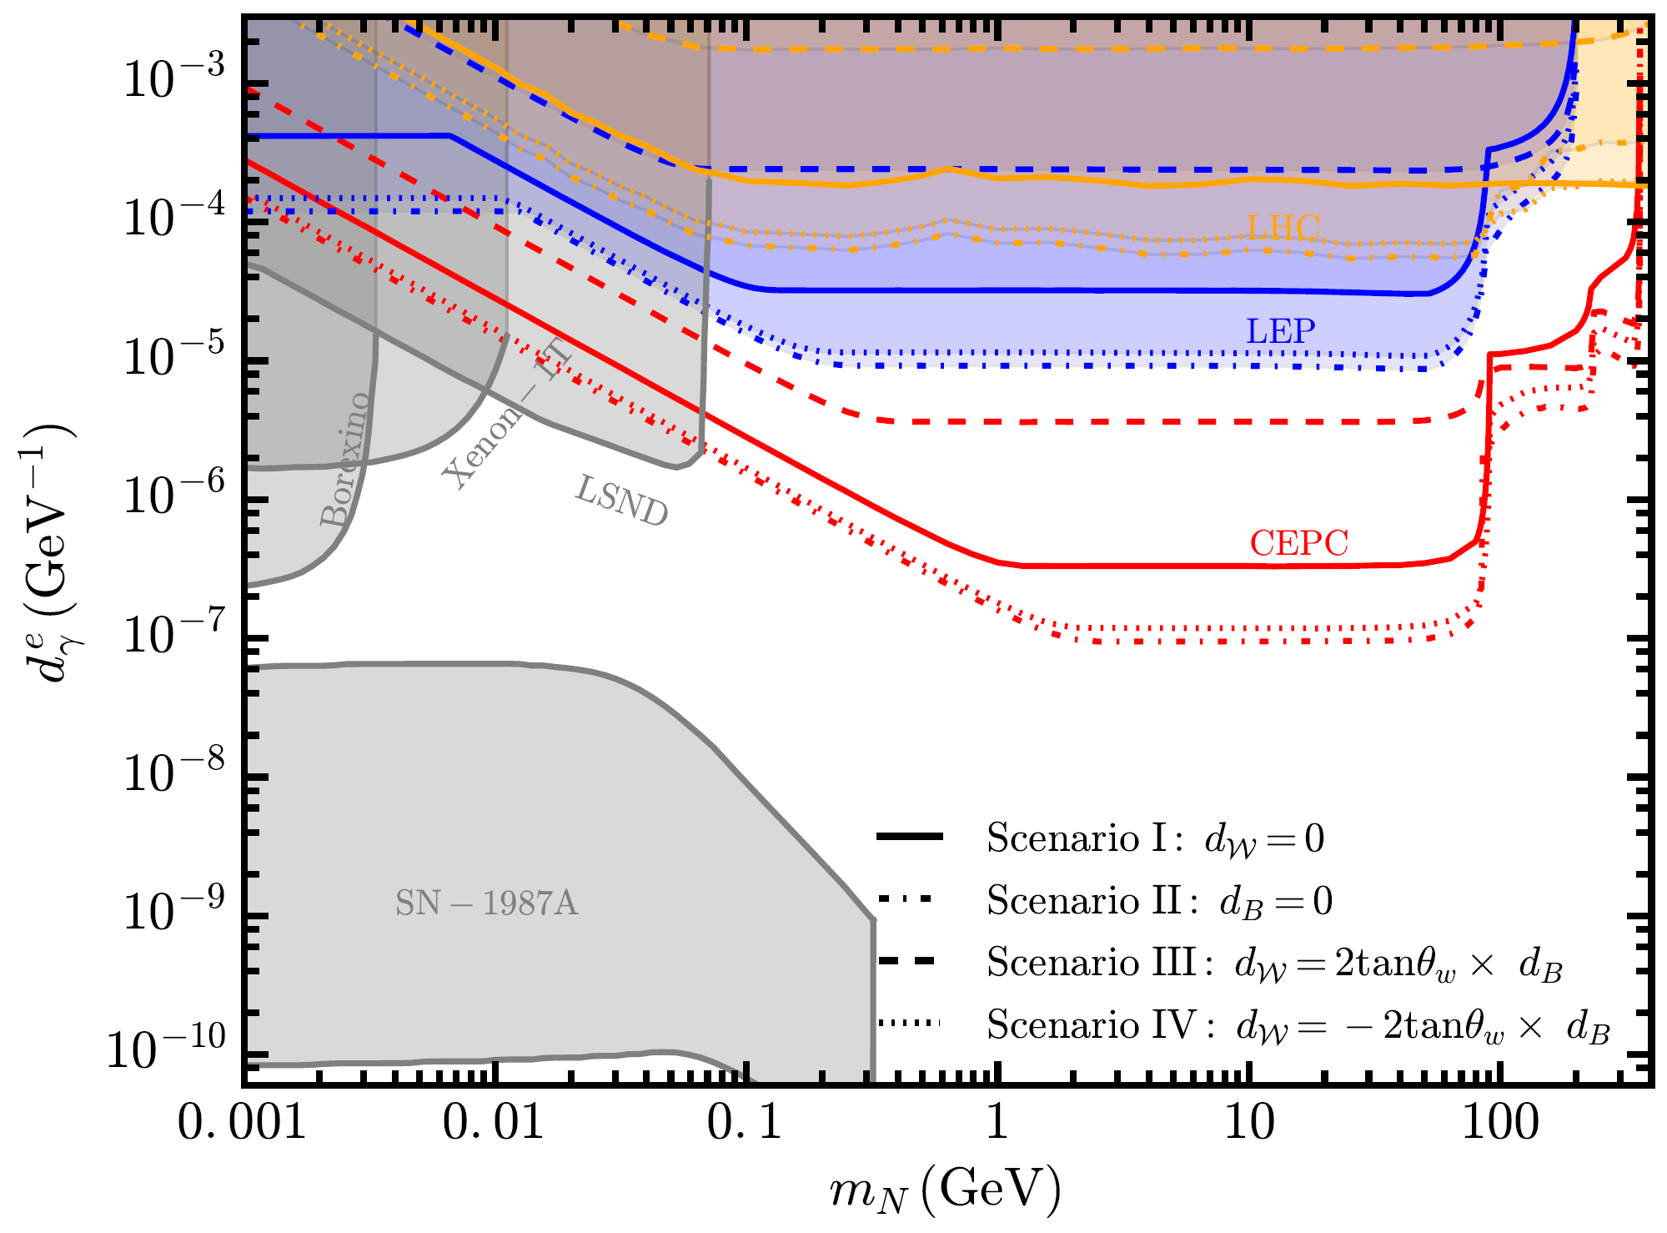
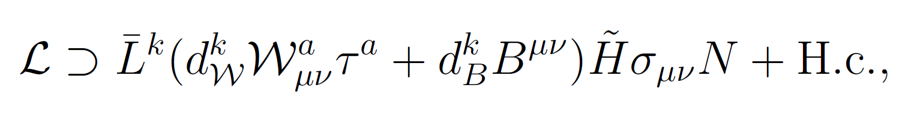
C. Active-sterile neutrino transition magnetic moments
Yu Zhang & Wei Liu, 2301.06050
Active-sterile neutrino transition magnetic moments
e+ e- → Nν, N→νγ
Combination of 4 running modes: 20 ab−1 @ Higgs-mode, 6 ab−1 @ WW-mode, 100 ab−1 @ Z-mode, 1 ab−1 @ ttbar-mode

Slide 14
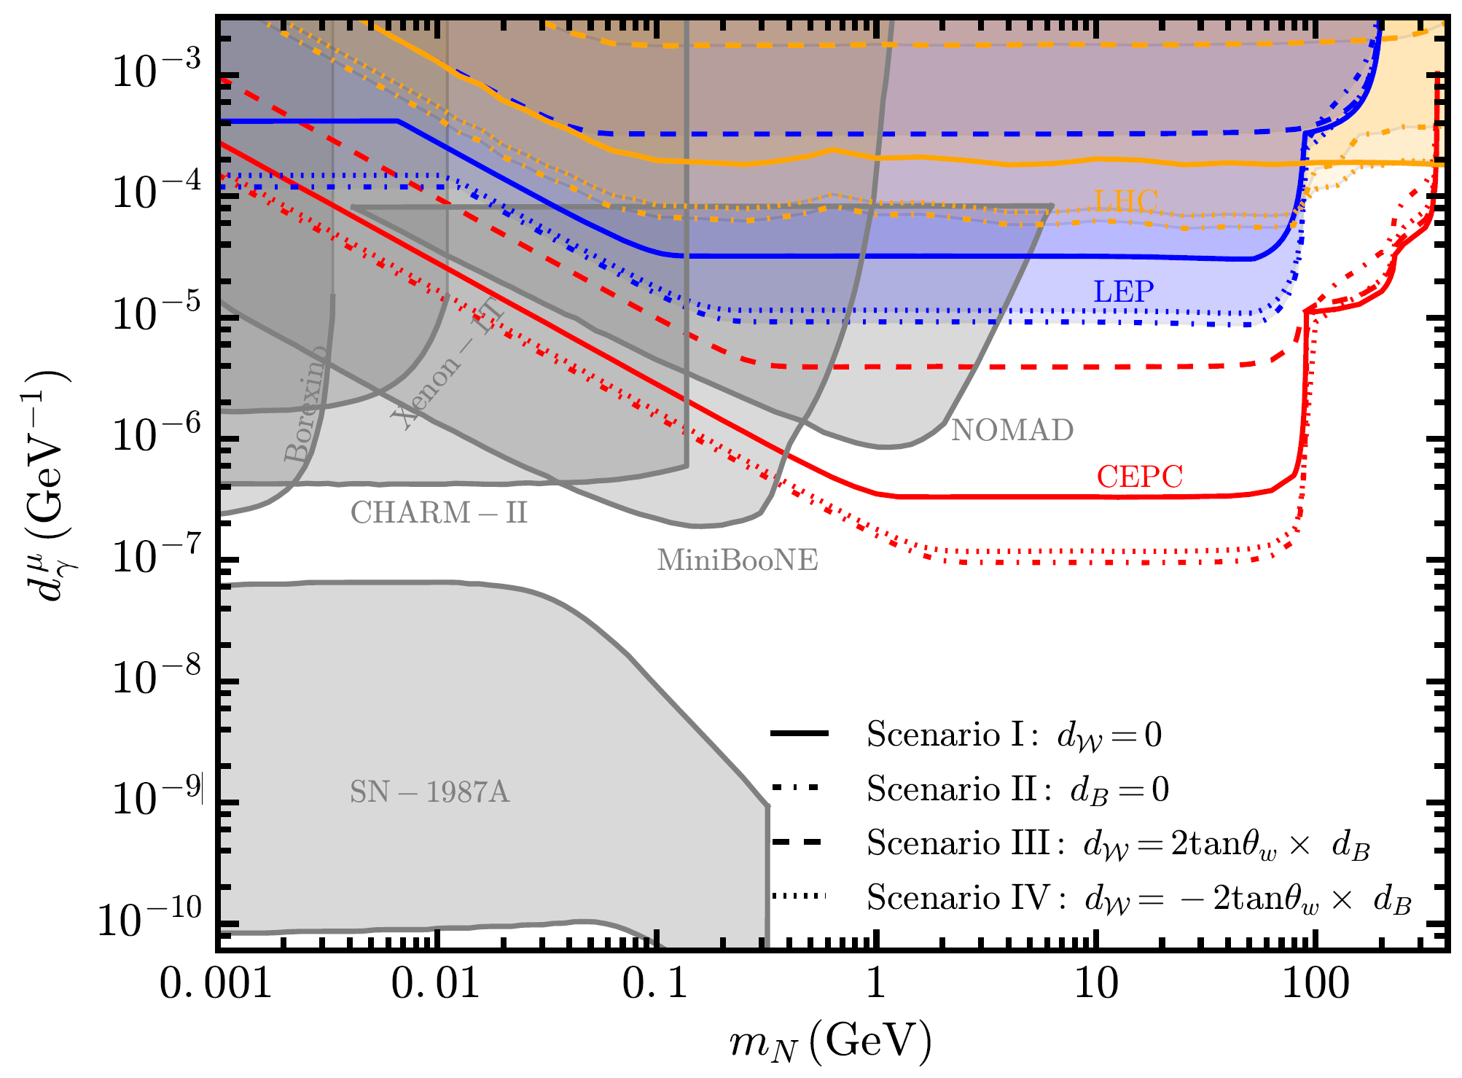
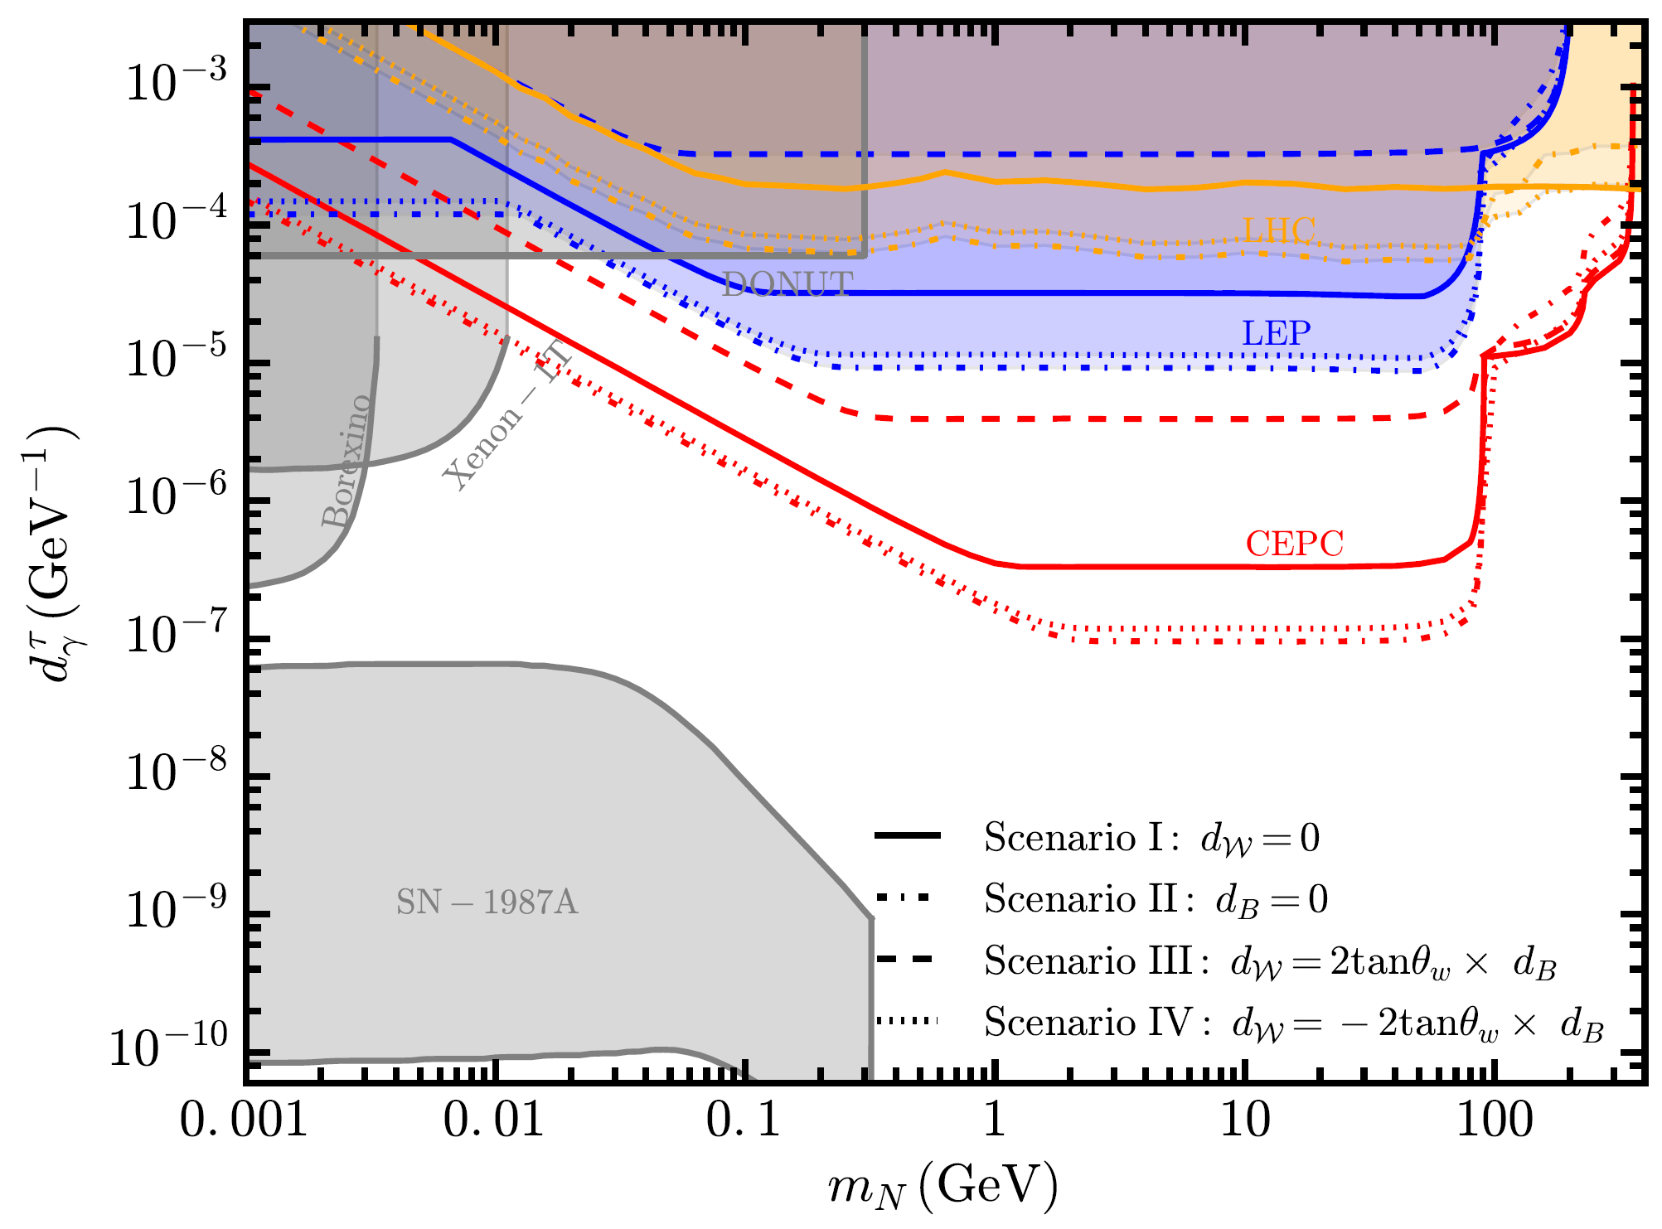
C. Active-sterile neutrino transition magnetic moments
Yu Zhang & Wei Liu, 2301.06050

Slide 15
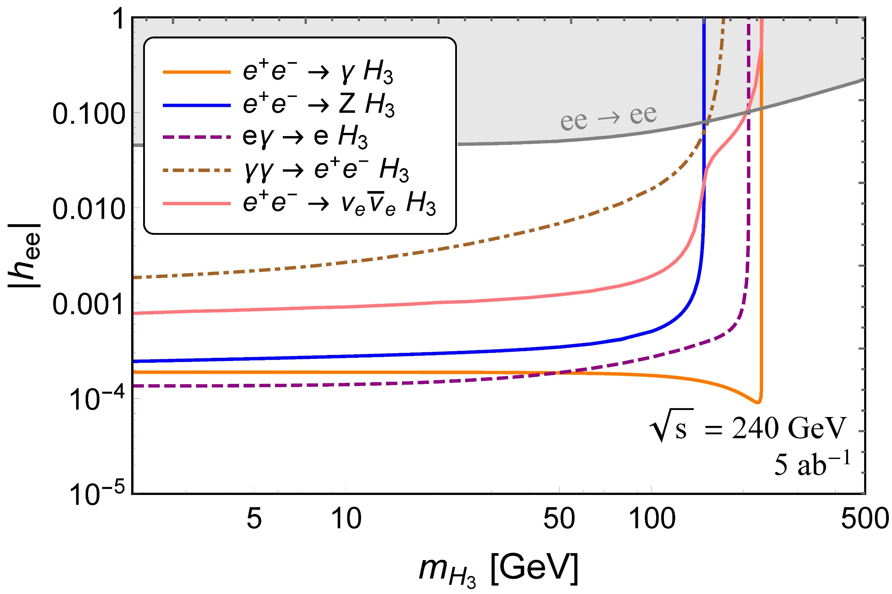
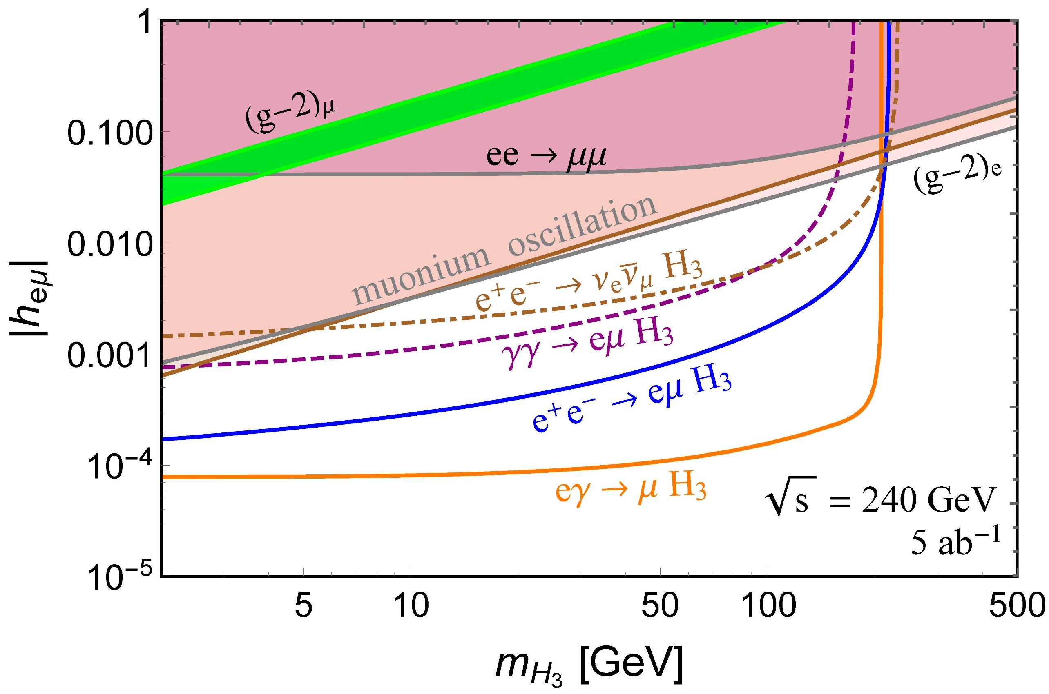
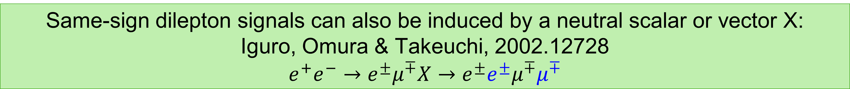
D. Neutral scalar in seesaw models
Dev, Mohapatra & YCZ, 1711.08430; 1803.11167
Same-sign dilepton signals can also be induced by a neutral scalar or vector X: Iguro, Omura & Takeuchi, 2002.12728 $$e^{+}e^{−}→e^{±}μ^{∓}X→e^{±}e^{±}μ^{∓}μ^{∓}$$

Slide 16
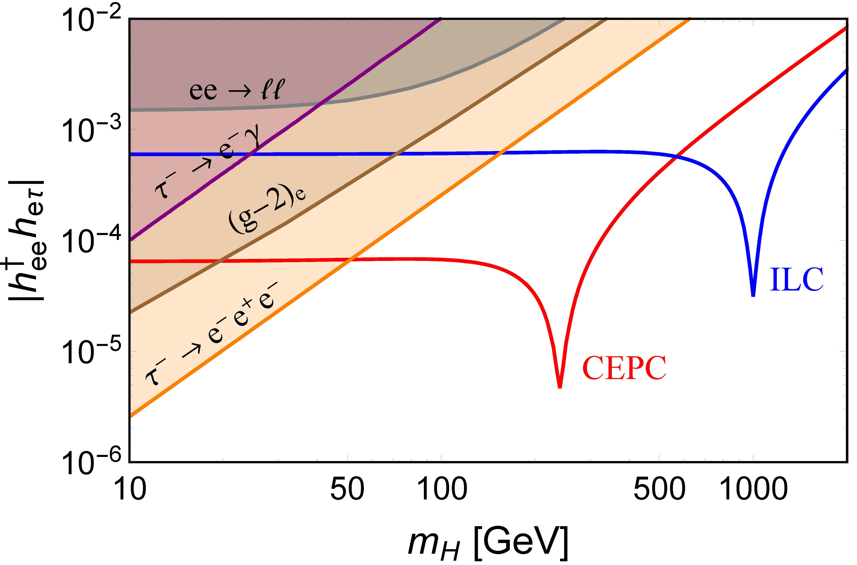
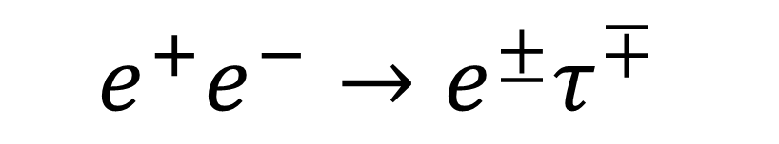
D. Neutral scalar in seesaw models
Dev, Mohapatra & YCZ, 1711.08430; 1803.11167
$$e^{+}e^{−}→e^{±}τ^{∓}$$

Slide 17
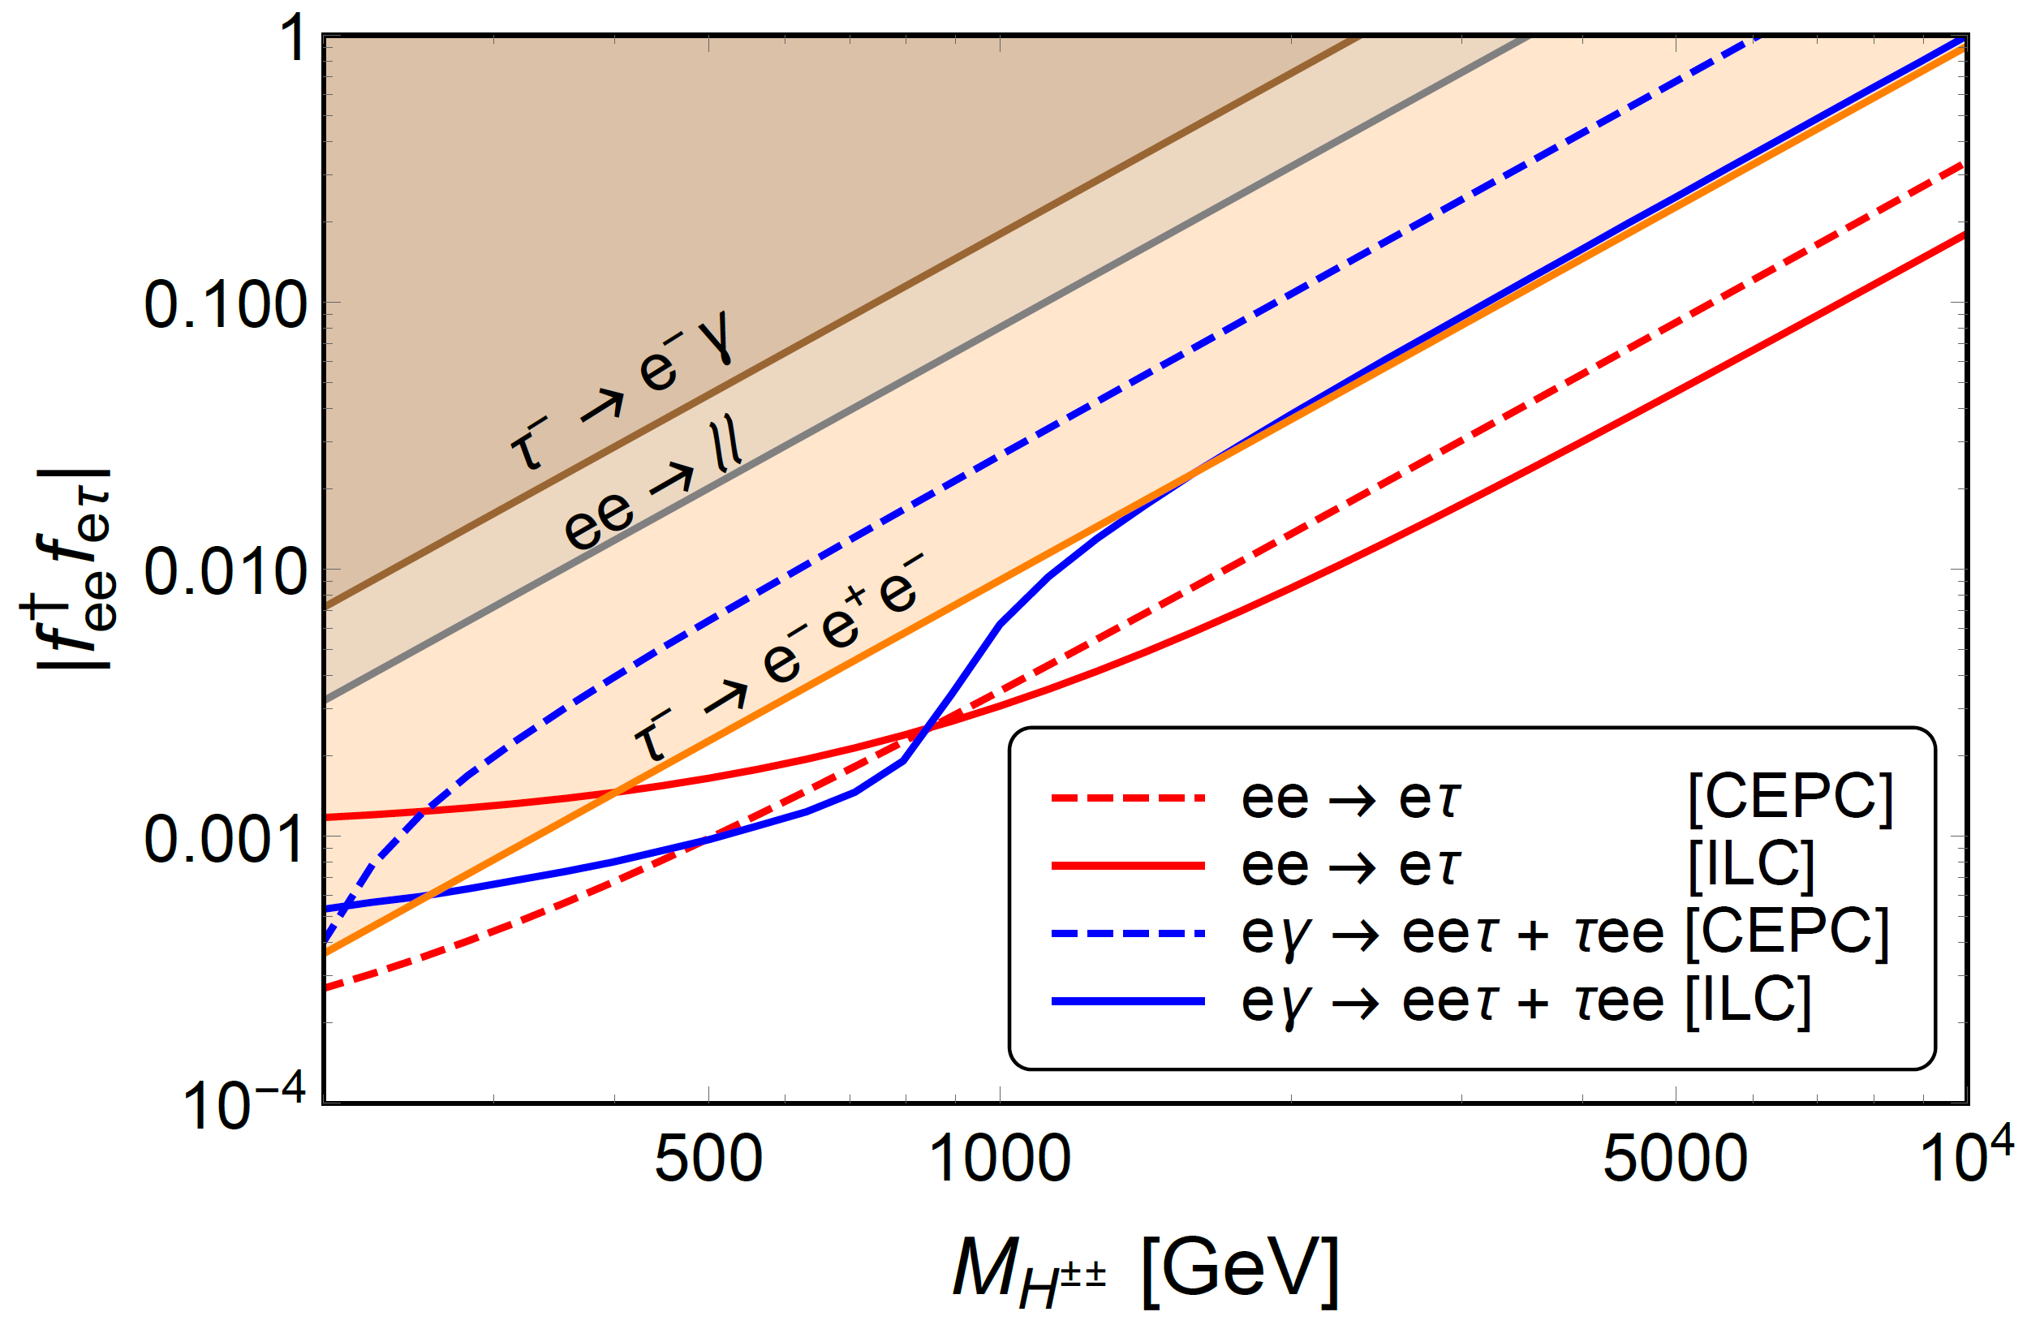
D. Doubly-charged scalars in seesaw models
Dev, Mohapatra & YCZ, 1711.08430; 1803.11167

Slide 18
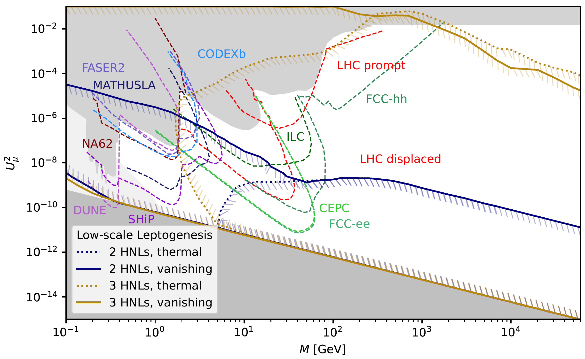
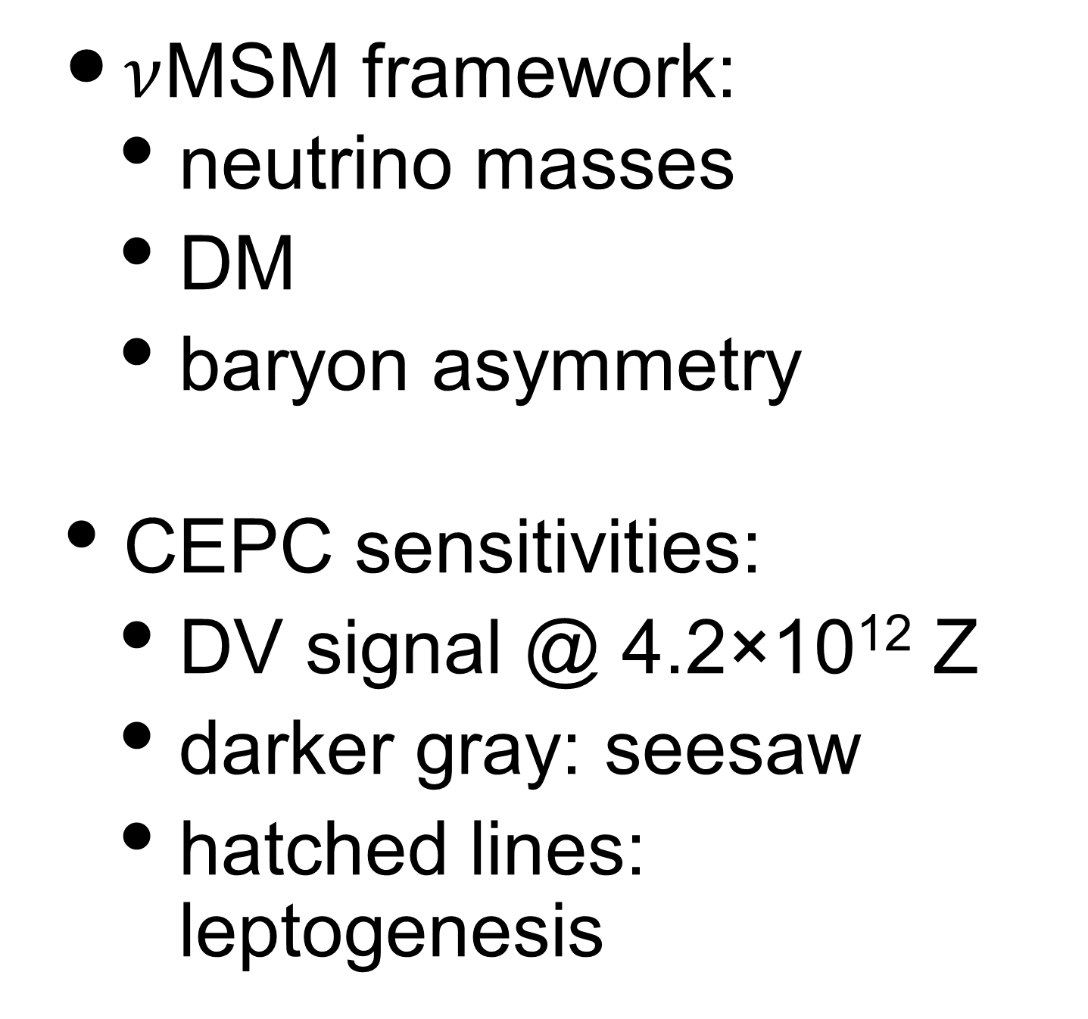
E. Connection to Leptogenesis and Dark Matter
Abdullahi et al., 2203.08039
$\text{ν}$MSM framework:
neutrino masses
DM
baryon asymmetry
CEPC sensitivities:
DV signal @ 4.2×10¹² Z
darker gray: seesaw
hatched lines: leptogenesis

Slide 19
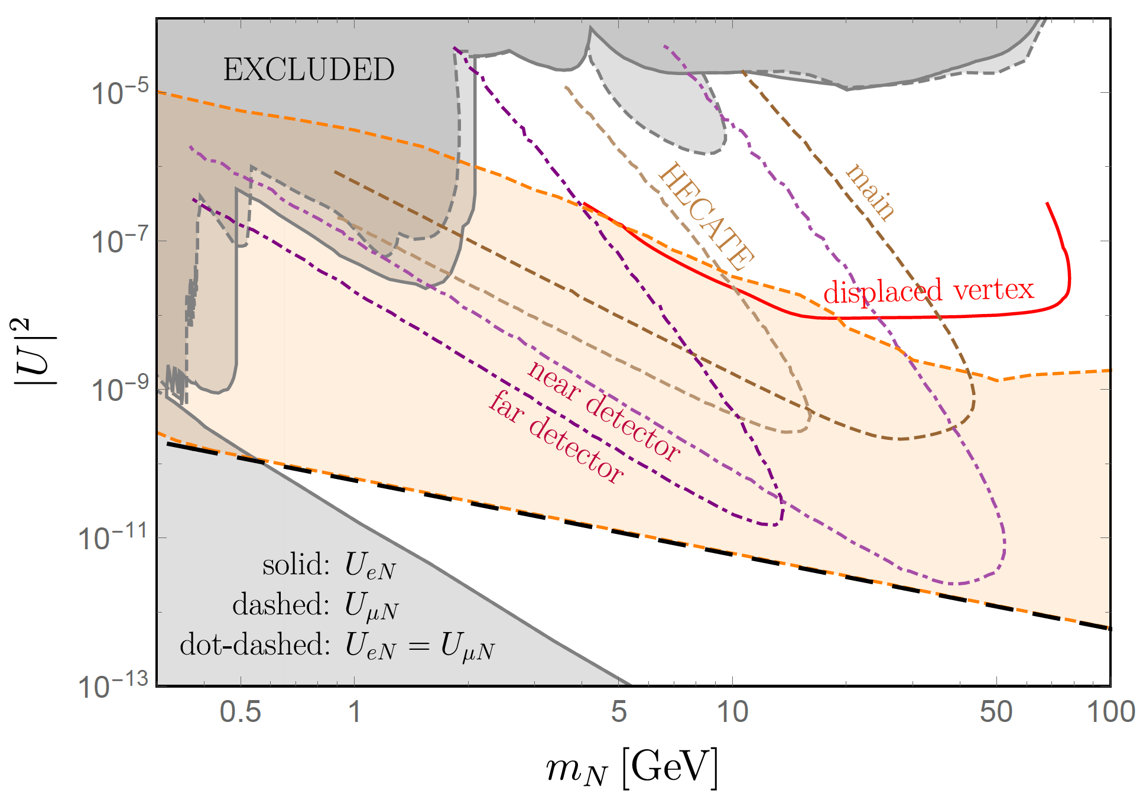
F. Summary
long dashed black line: seesaw mechanism; shaded orange region: leptogenesis mechanism
Main signals of N: displaced vertices?
Unique signatures of N: LNV? LFV?
Implications of N signals: neutrino mass origin, DM & baryon asymmetry?

Slide 20
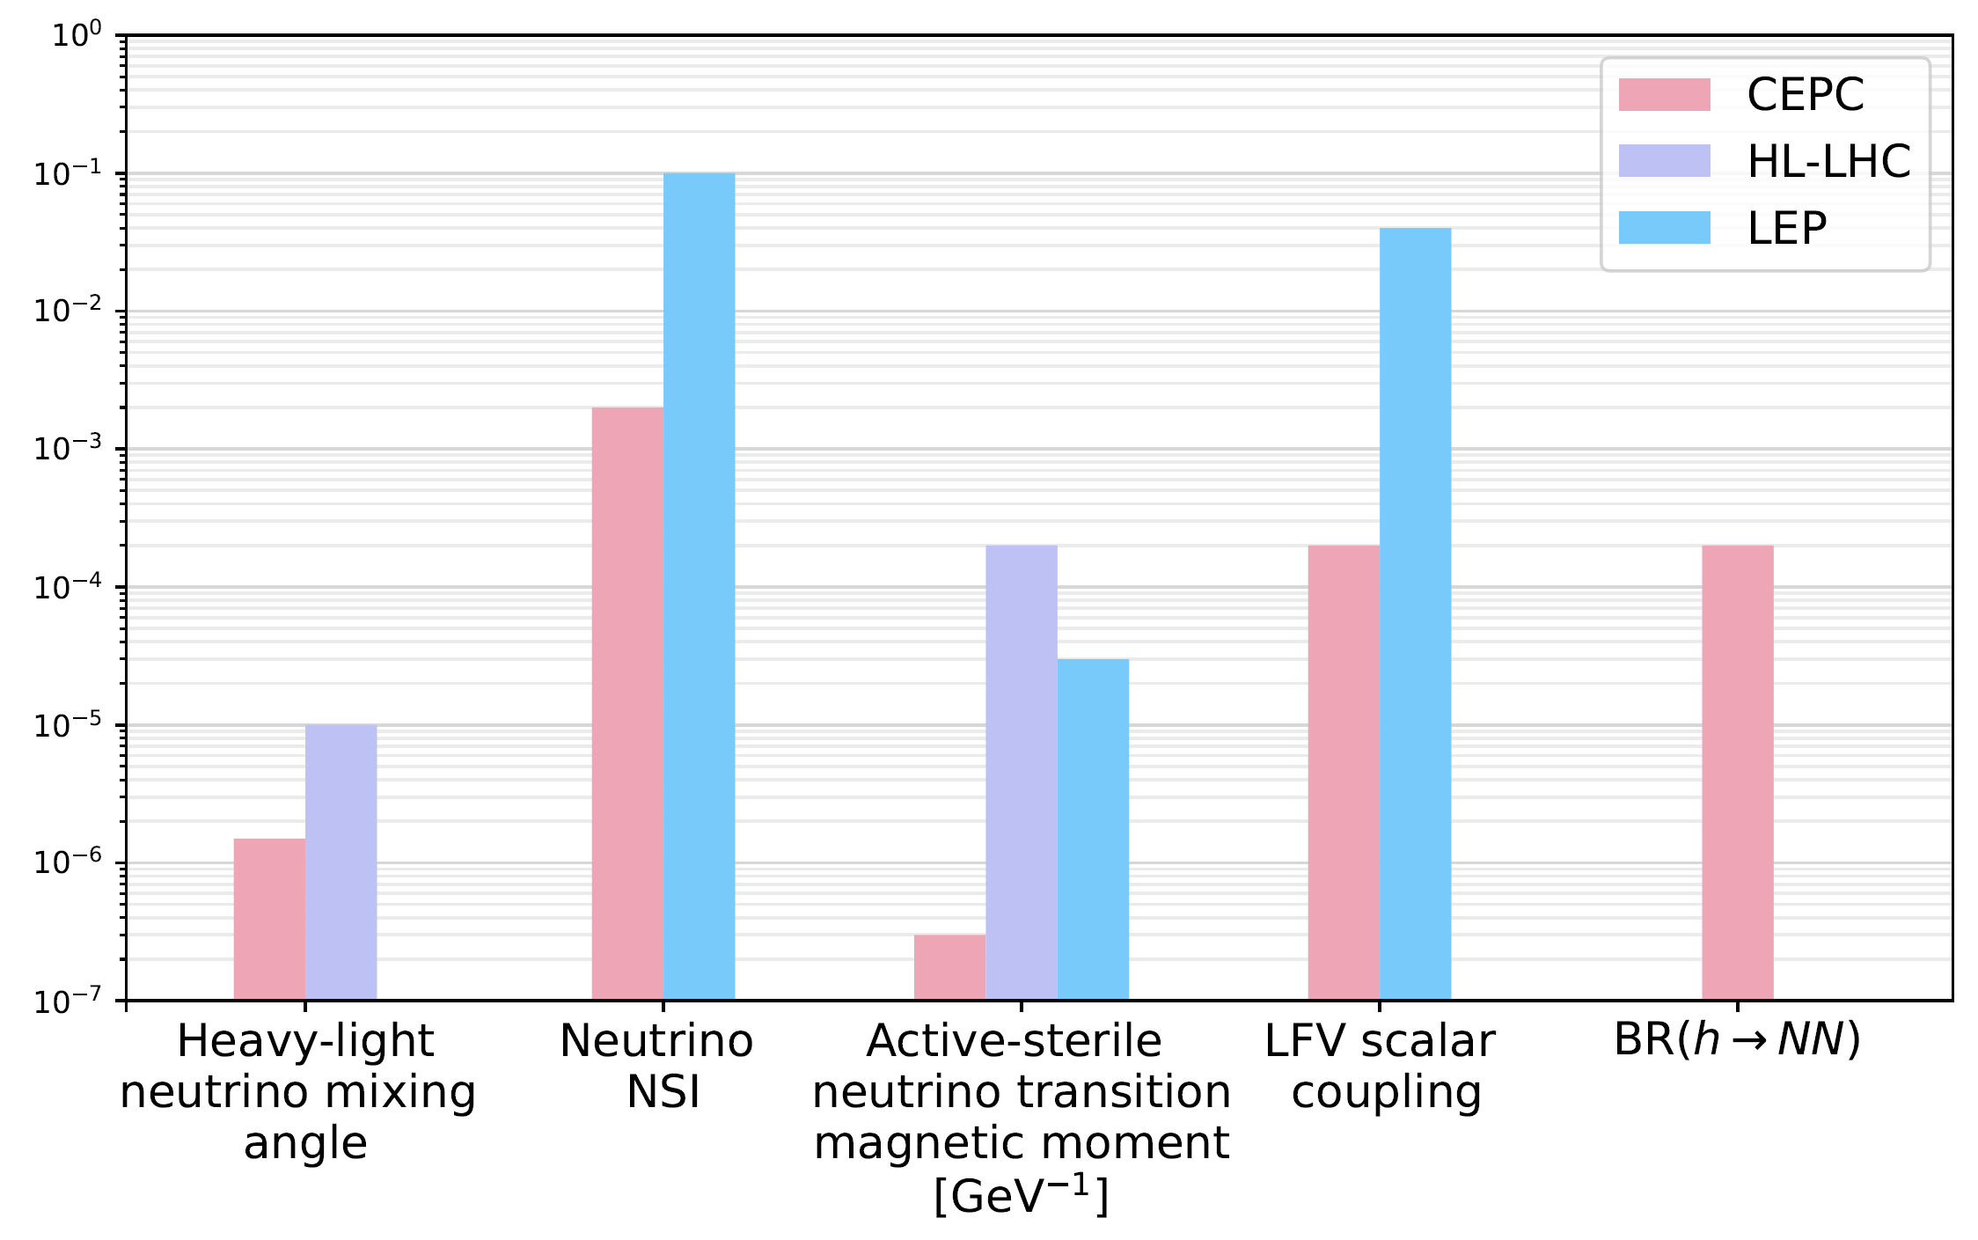
F. Summary

Slide 21
Conclusion
CEPC can have sensitivities to rich neutrino physics scenarios, e.g.
heavy neutrinos
non-standard neutrino interactions
active-sterile neutrino transition magnetic moments
neutral and doubly-charged scalars in seesaw models
connection of neutrino models to DM & leptogenesis
In general, neutrino-relevant signals may behave like rare processes, e.g. the LFV or LNV events or displaced vertices.
CEPC provides a clean environment to search for such signals.
Let us pray for Step 1: 𝜈 signals Step 2: better understanding of 𝜈, DM & more!
Thank you!

