Slide 1
Simulation studies for LHCb ECAL upgrade
Chenjia Zhang
Peking University

Slide 2

Content
Introduction
Single module study
Spill over effect
Physics benchmark study
$D^{0}→π^{+}π^{−}π^{0}$ decay channel

Slide 3
Introduction

Slide 4
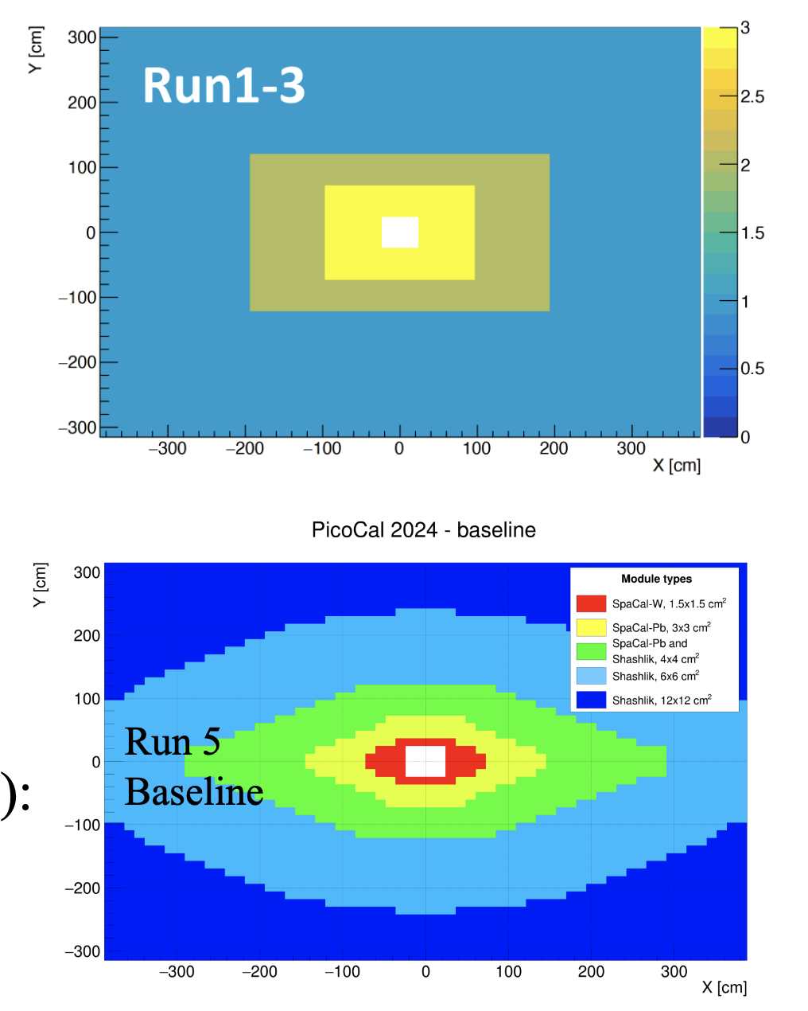
LHCb Upgrade II
Run 1-3: 4×4/6×6/12×12 cm² Shashlik
Run 5 Baseline of Upgrade II:
Innermost: 1.5×1.5 cm² SpaCal-W + GAGG fibers
Longitudinal segmentation: front and back sections
Rotated (3+3) for best energy resolution
Timing capability
Second inner: 3×3 cm² SpaCal-Pb + Poly fibers
Outer: 4×4/6×6/12×12 cm² Shashlik

Slide 5
LHCb Upgrade II
Run 1-3: 4×4/6×6/12×12 cm² Shashlik
Run 5 Baseline of Upgrade II:
Innermost: 1.5×1.5 cm² SpaCal-W + GAGG fibers
Longitudinal segmentation: front and back sections
Rotated (3+3) for best energy resolution
Timing capability
Second inner: 3×3 cm² SpaCal-Pb + Poly fibers
Outer: 4×4/6×6/12×12 cm² Shashlik
Back
z
Seperation point
Front
100 mm
y
4 mm
50 mm
x

Slide 6
LHCb Upgrade II
Run 1-3: 4×4/6×6/12×12 cm² Shashlik
Run 5 Baseline of Upgrade II:
Innermost: 1.5×1.5 cm² SpaCal-W + GAGG fibers
Longitudinal segmentation: front and back sections
Rotated (3+3) for best energy resolution
Timing capability
Second inner: 3×3 cm² SpaCal-Pb + Poly fibers
Outer: 4×4/6×6/12×12 cm² Shashlik

Slide 7
Single module study (SpaCal-W + GAGG )

Slide 8
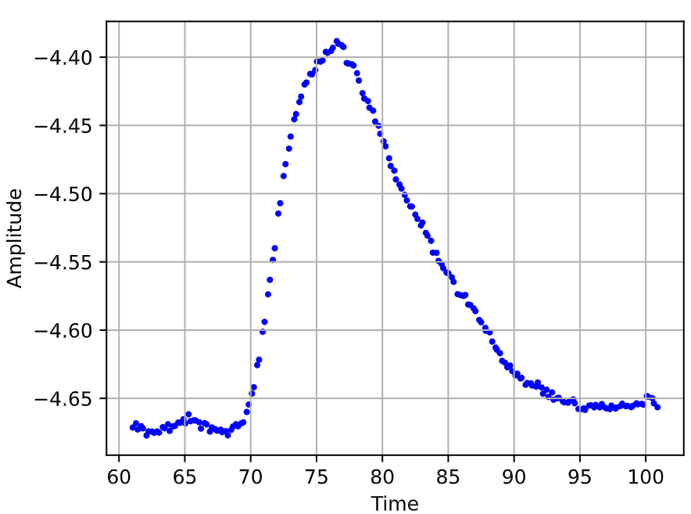
Spill over effect
25 ns
Pulse shape for each event
With 25 ns window
Bunch gap

Slide 9
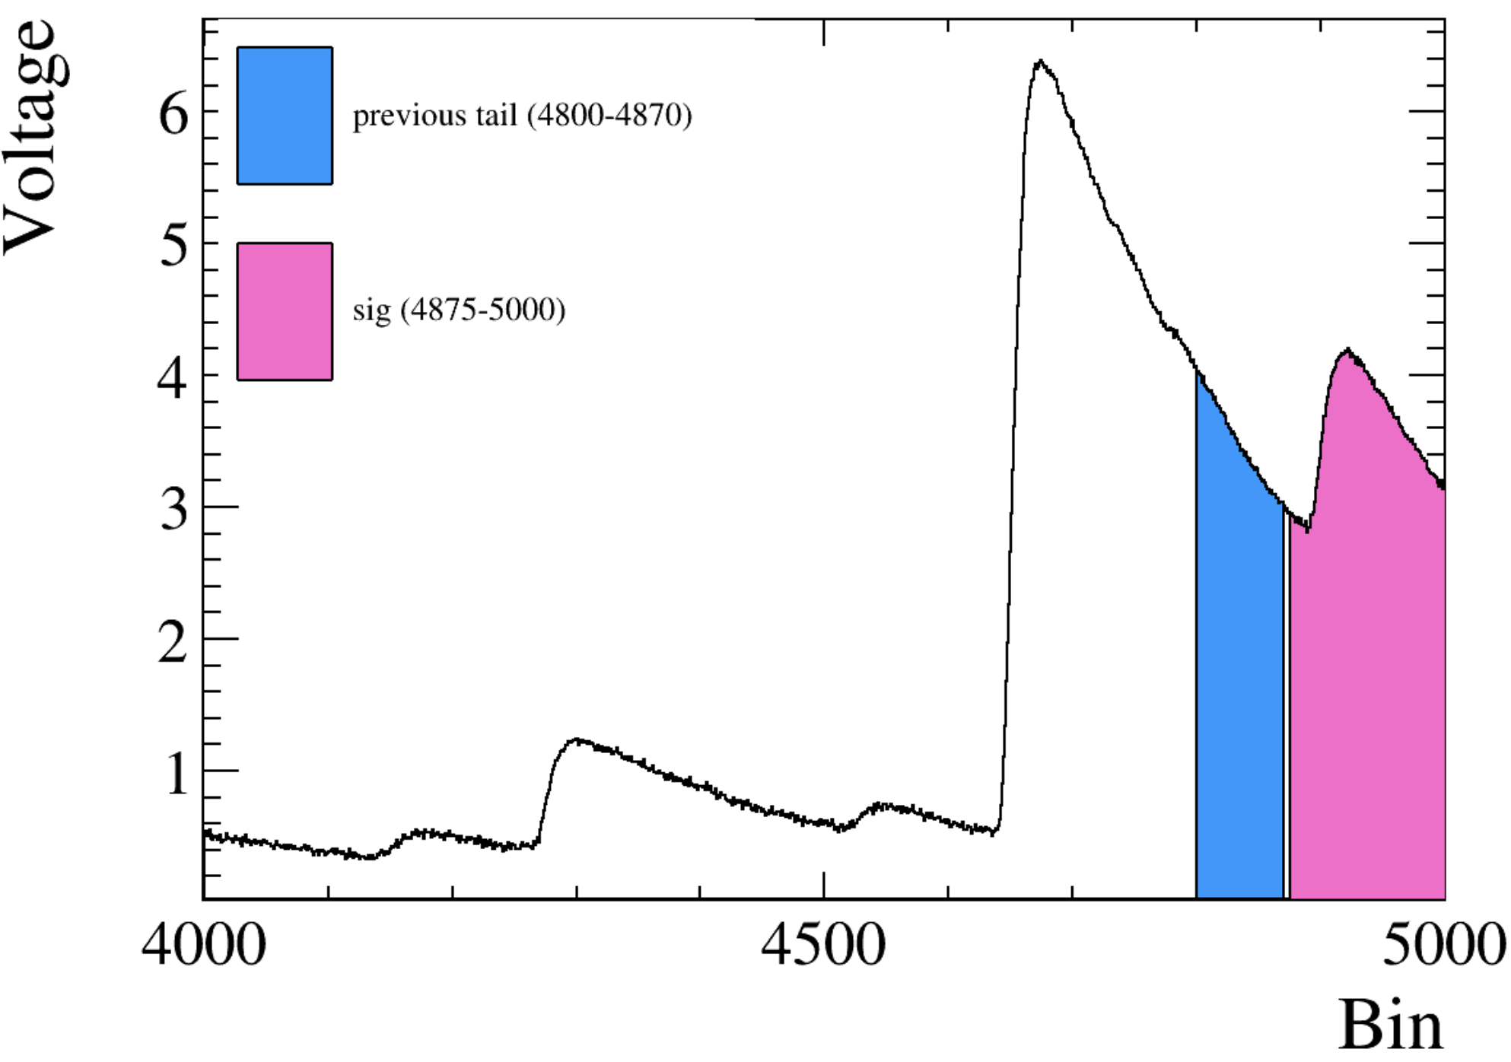
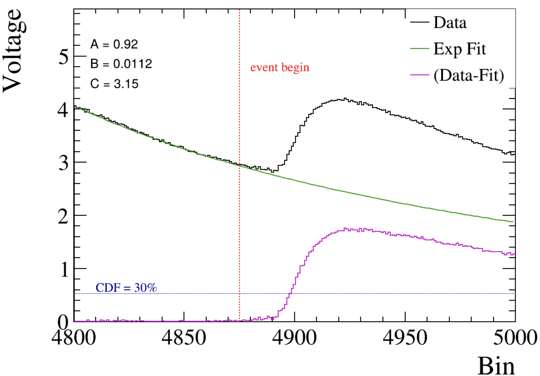
Spill over effect
Spill Over
True pulse = tail from previous events + current event
Signal peak

Slide 10
Spill over effect
How to mitigate this effect?
Faster crystal (shorter decay time)
Background subtraction
Etc.

Slide 11
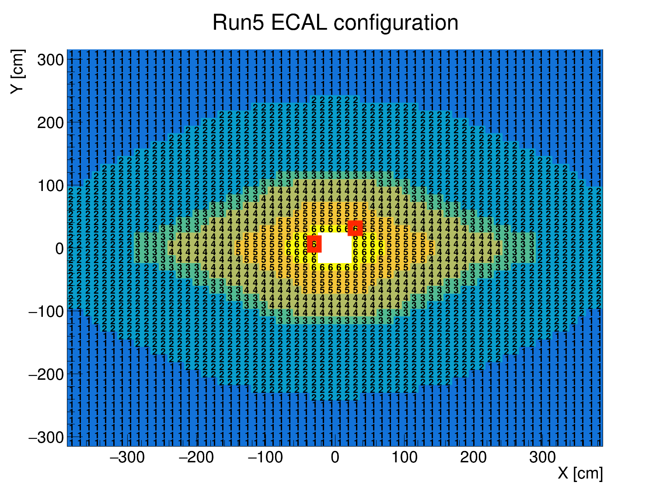


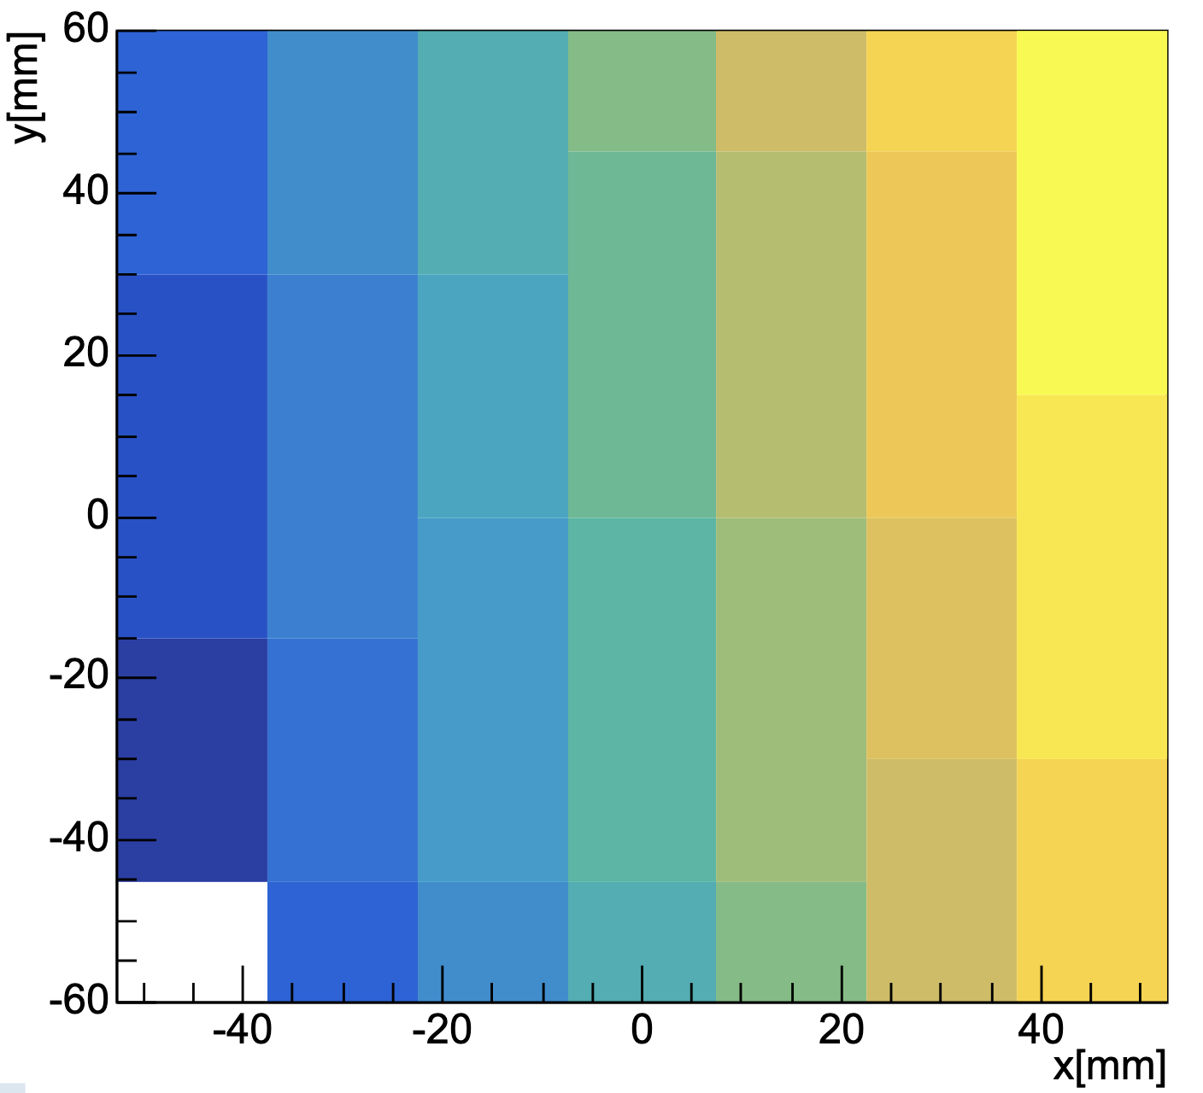
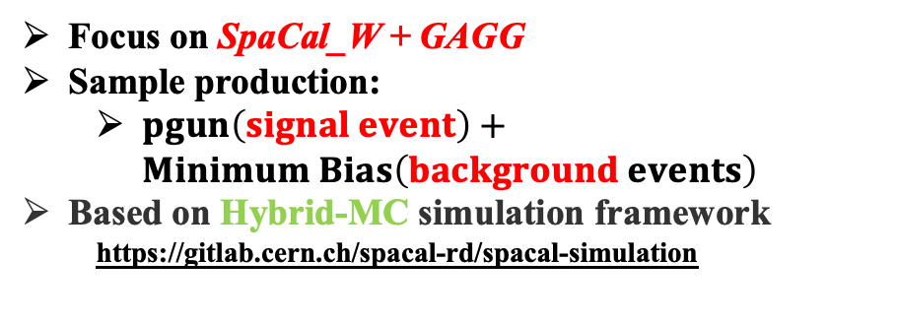
Spill over effect
One module was selected
Focus on SpaCal_W + GAGG
Sample production:
$pgun\left(signal event\right)+Minimum Bias\left(background events\right)$
Based on Hybrid-MC simulation framework
https://gitlab.cern.ch/spacal-rd/spacal-simulation
Photons were shot at this cell
(1-100 GeV)
Central cell used for timing;
3 × 3 cell cluster used for energy
Cell map in this module

Slide 12

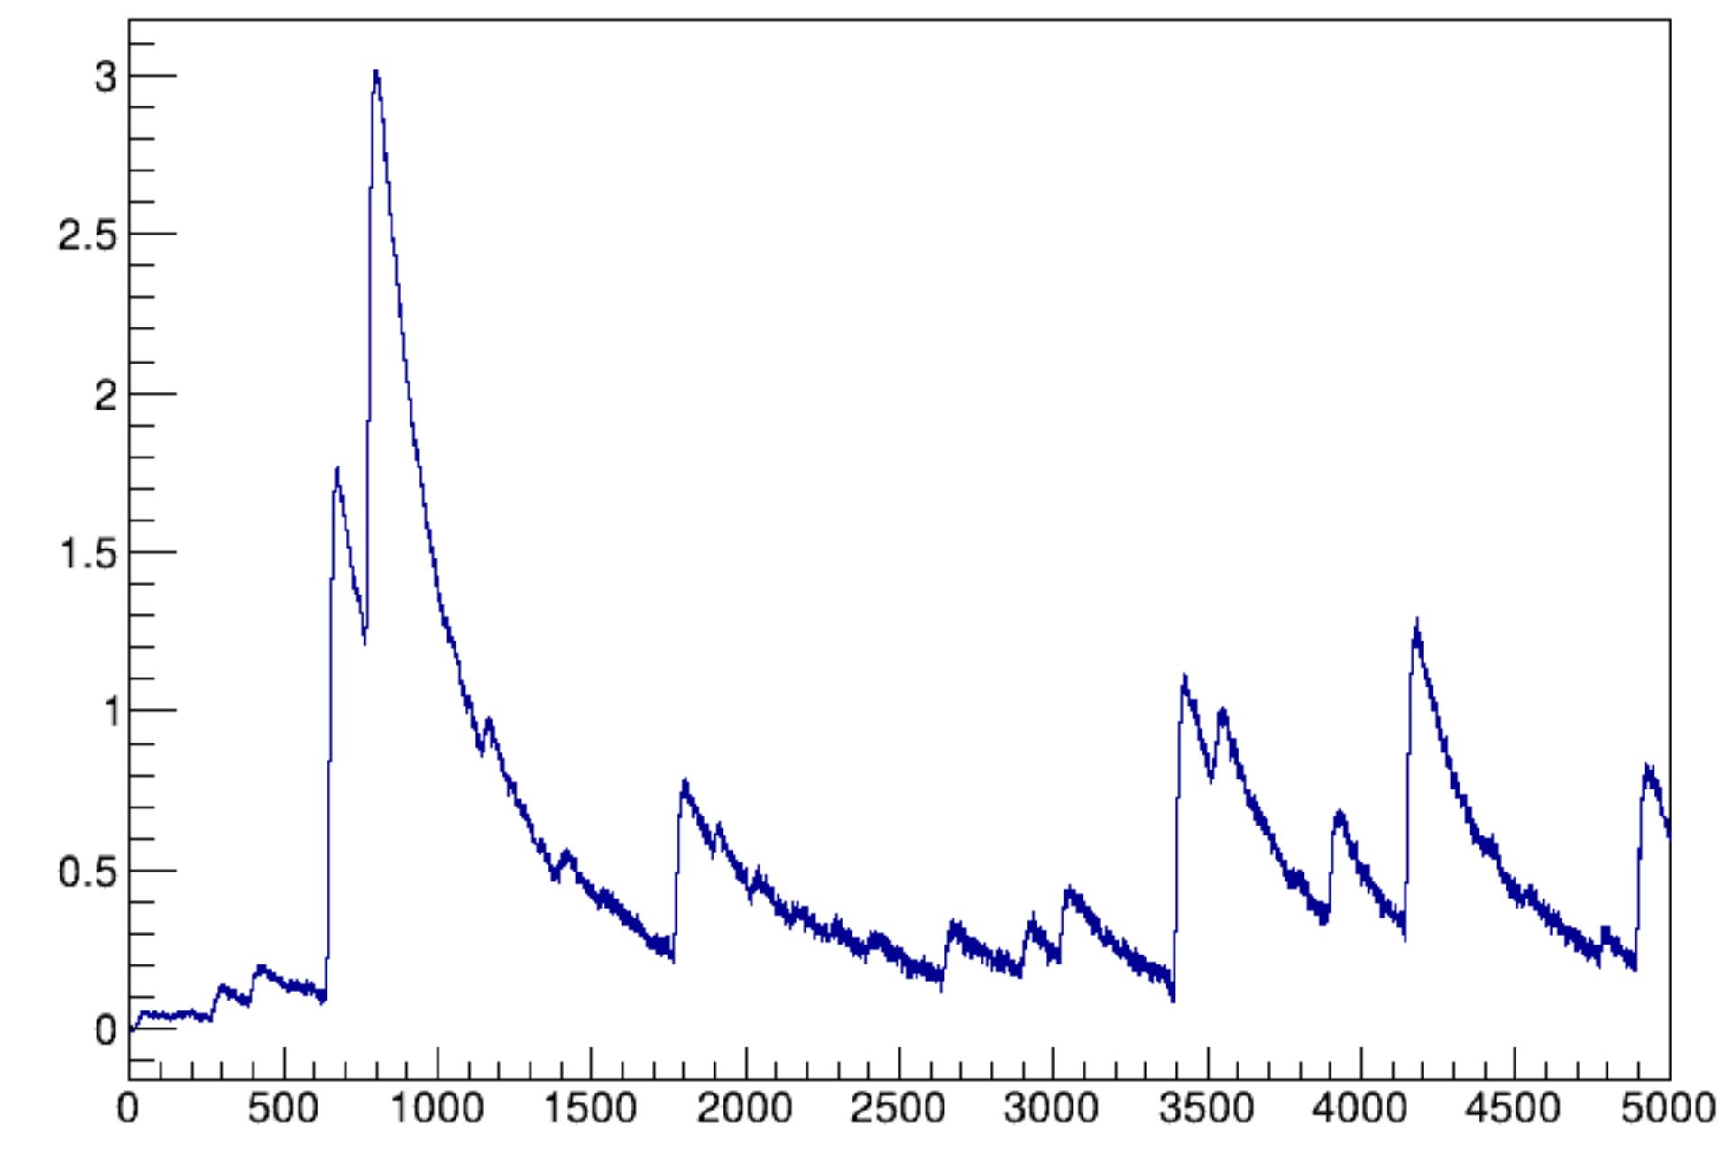
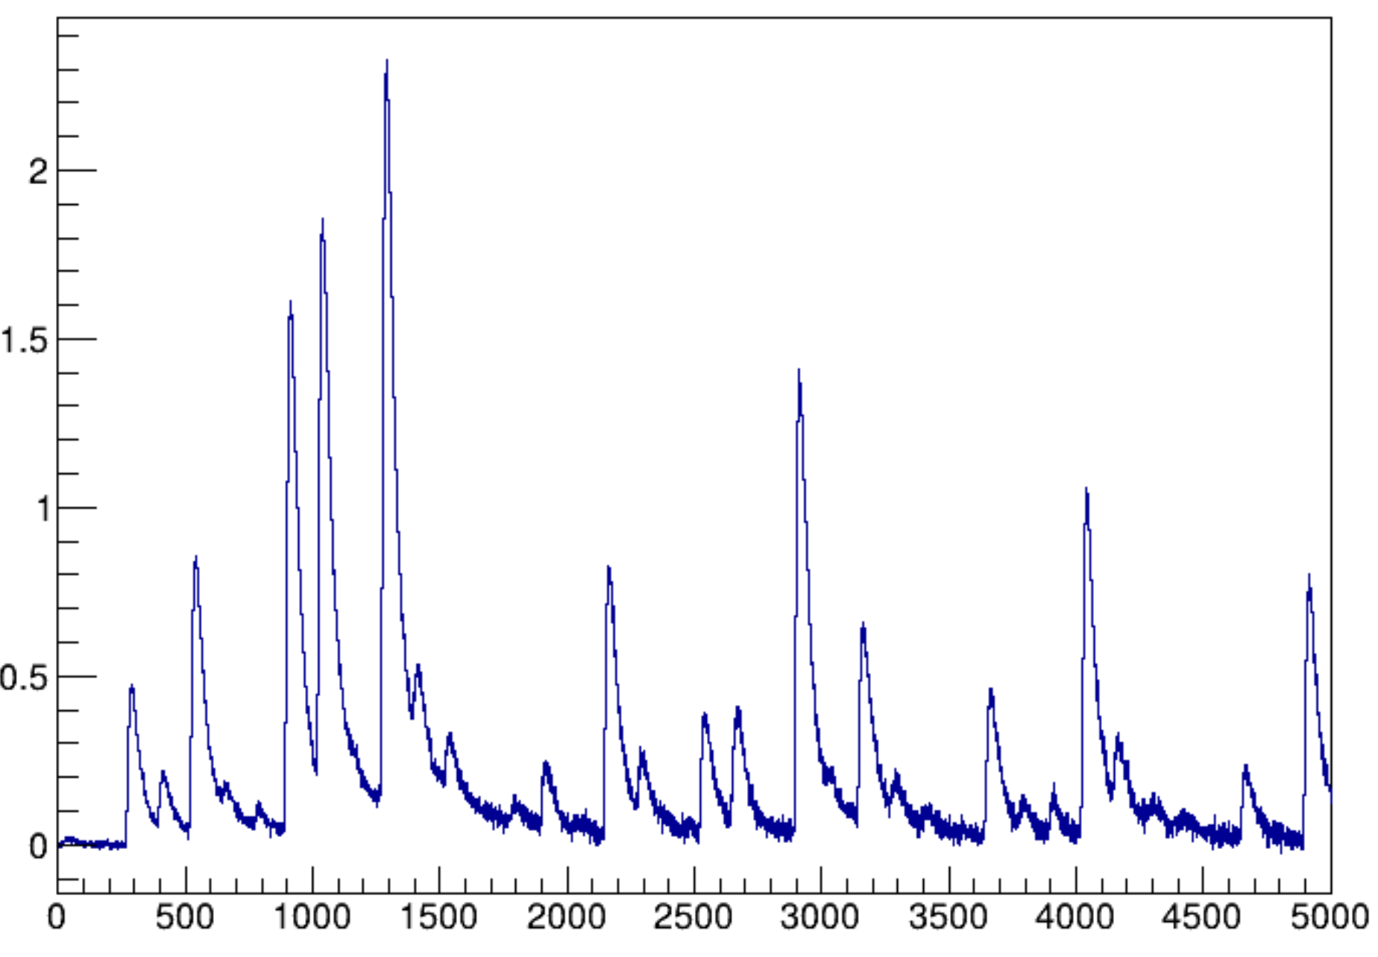
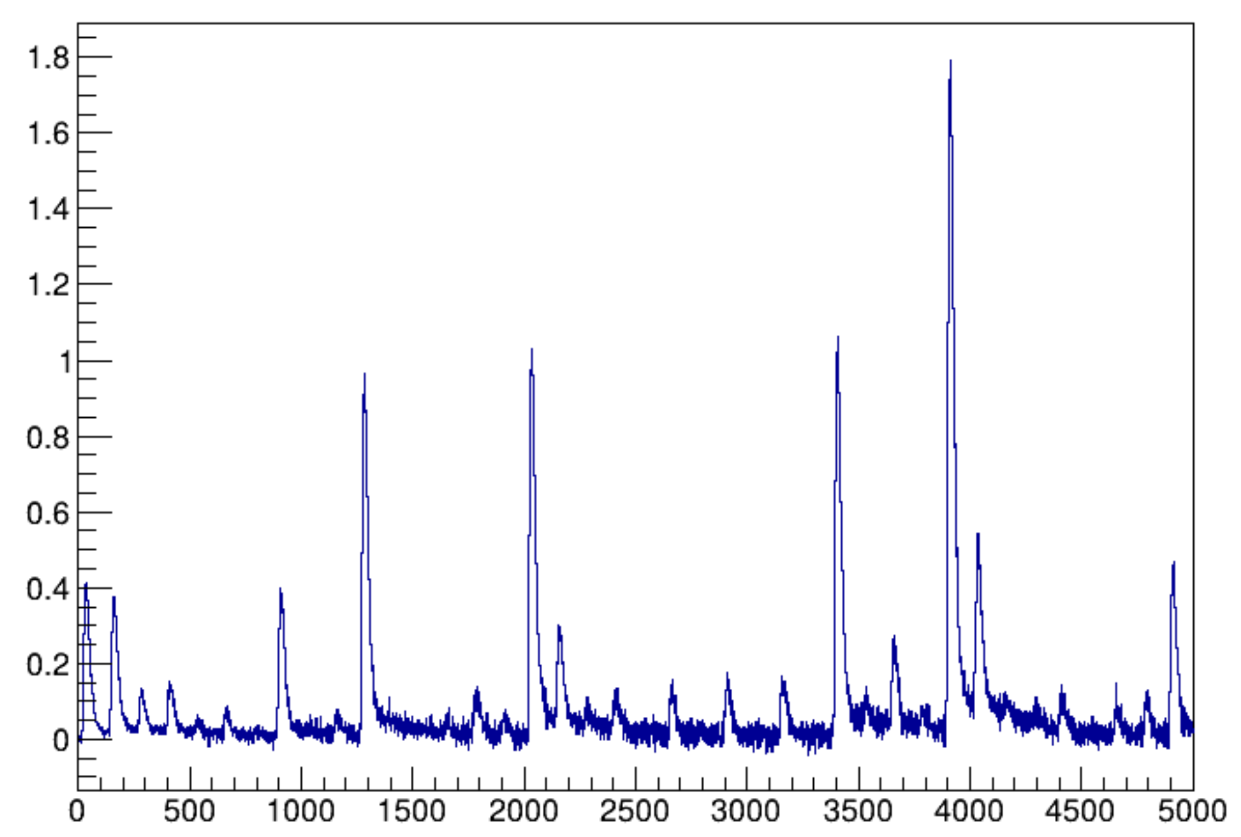



Influence of crystal
Chain of events made of 40 bunch crossing separated by 25 ns (39 MB + 1 pgun)
Taking E = 10GeV as example.
Signal peak
Signal peak
Signal peak
Bin(0.2ns)
Bin(0.2ns)
Bin(0.2ns)
$$τ_{deff}=56.4 ns$$
$$τ_{deff}=10 ns$$
$$τ_{deff}=4 ns$$

Slide 13
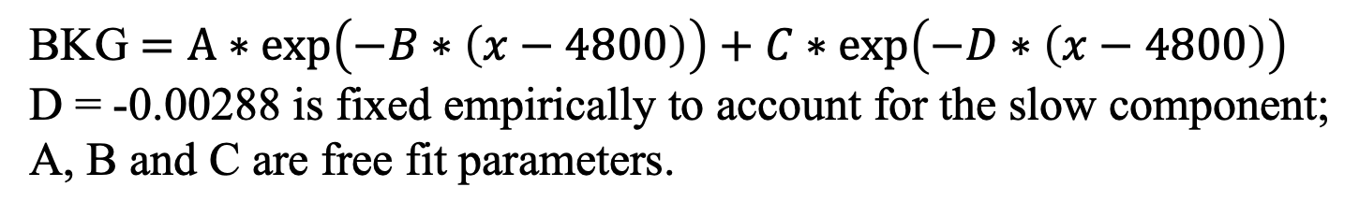
Background subtraction
Method1(flat subtracrtion): baseline level taken as average of 6 points before event begin
Method2(exp subtraction):
BKG $=A∗\exp\left(−B∗\left(x−4800\right)\right)+C∗\exp\left(−D∗\left(x−4800\right)\right)$
D = -0.00288 is fixed empirically to account for the slow component;
A, B and C are free fit parameters.

Slide 14
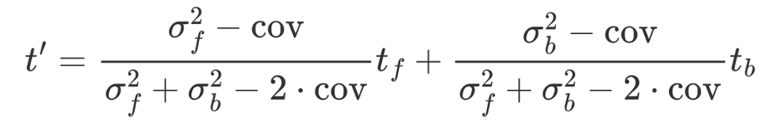
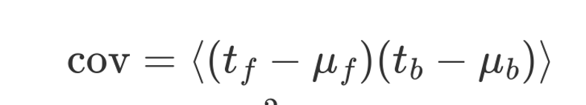
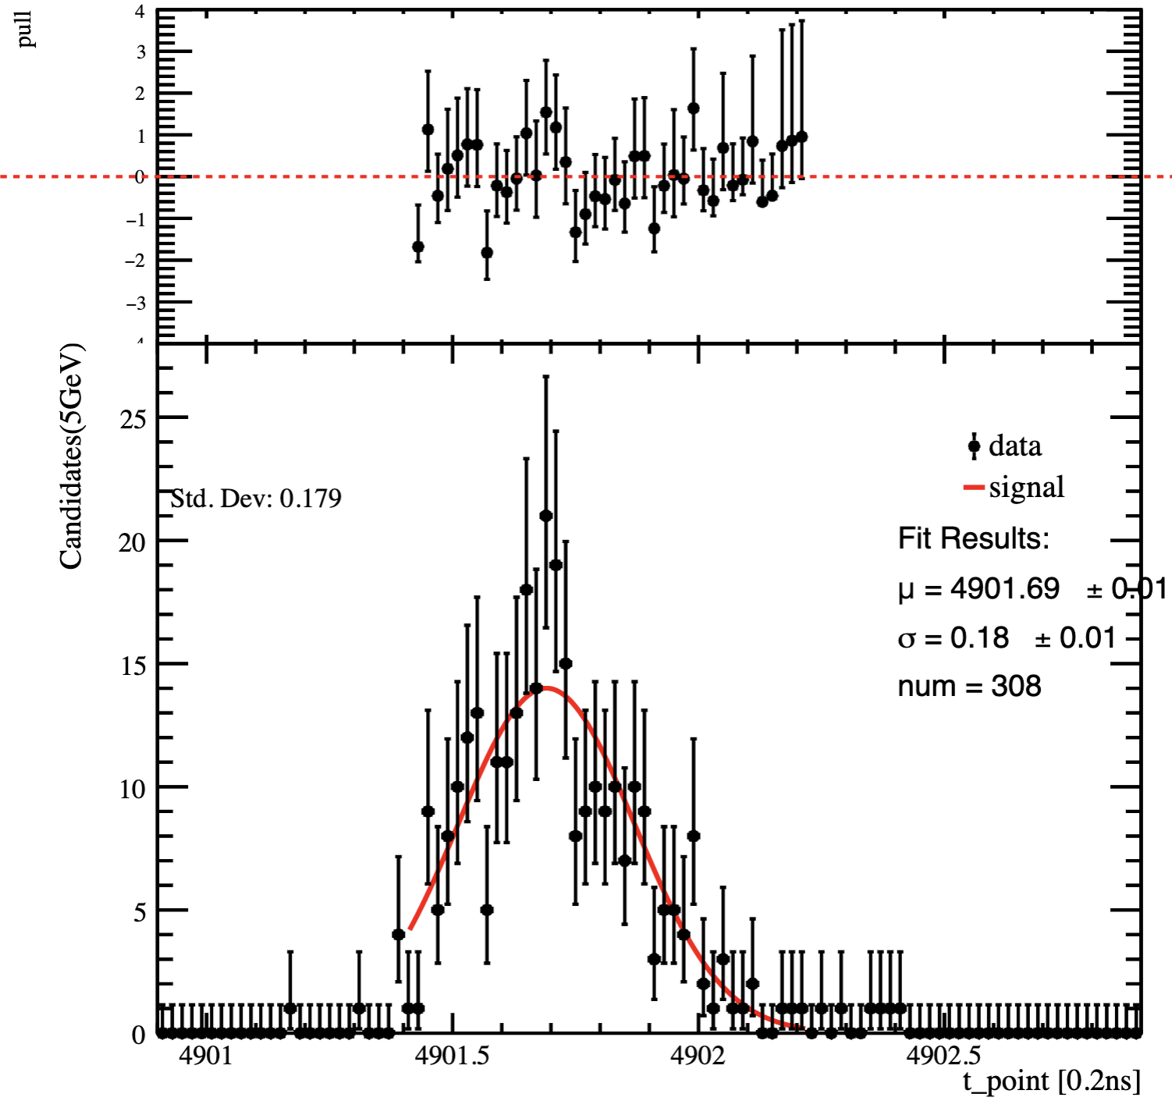
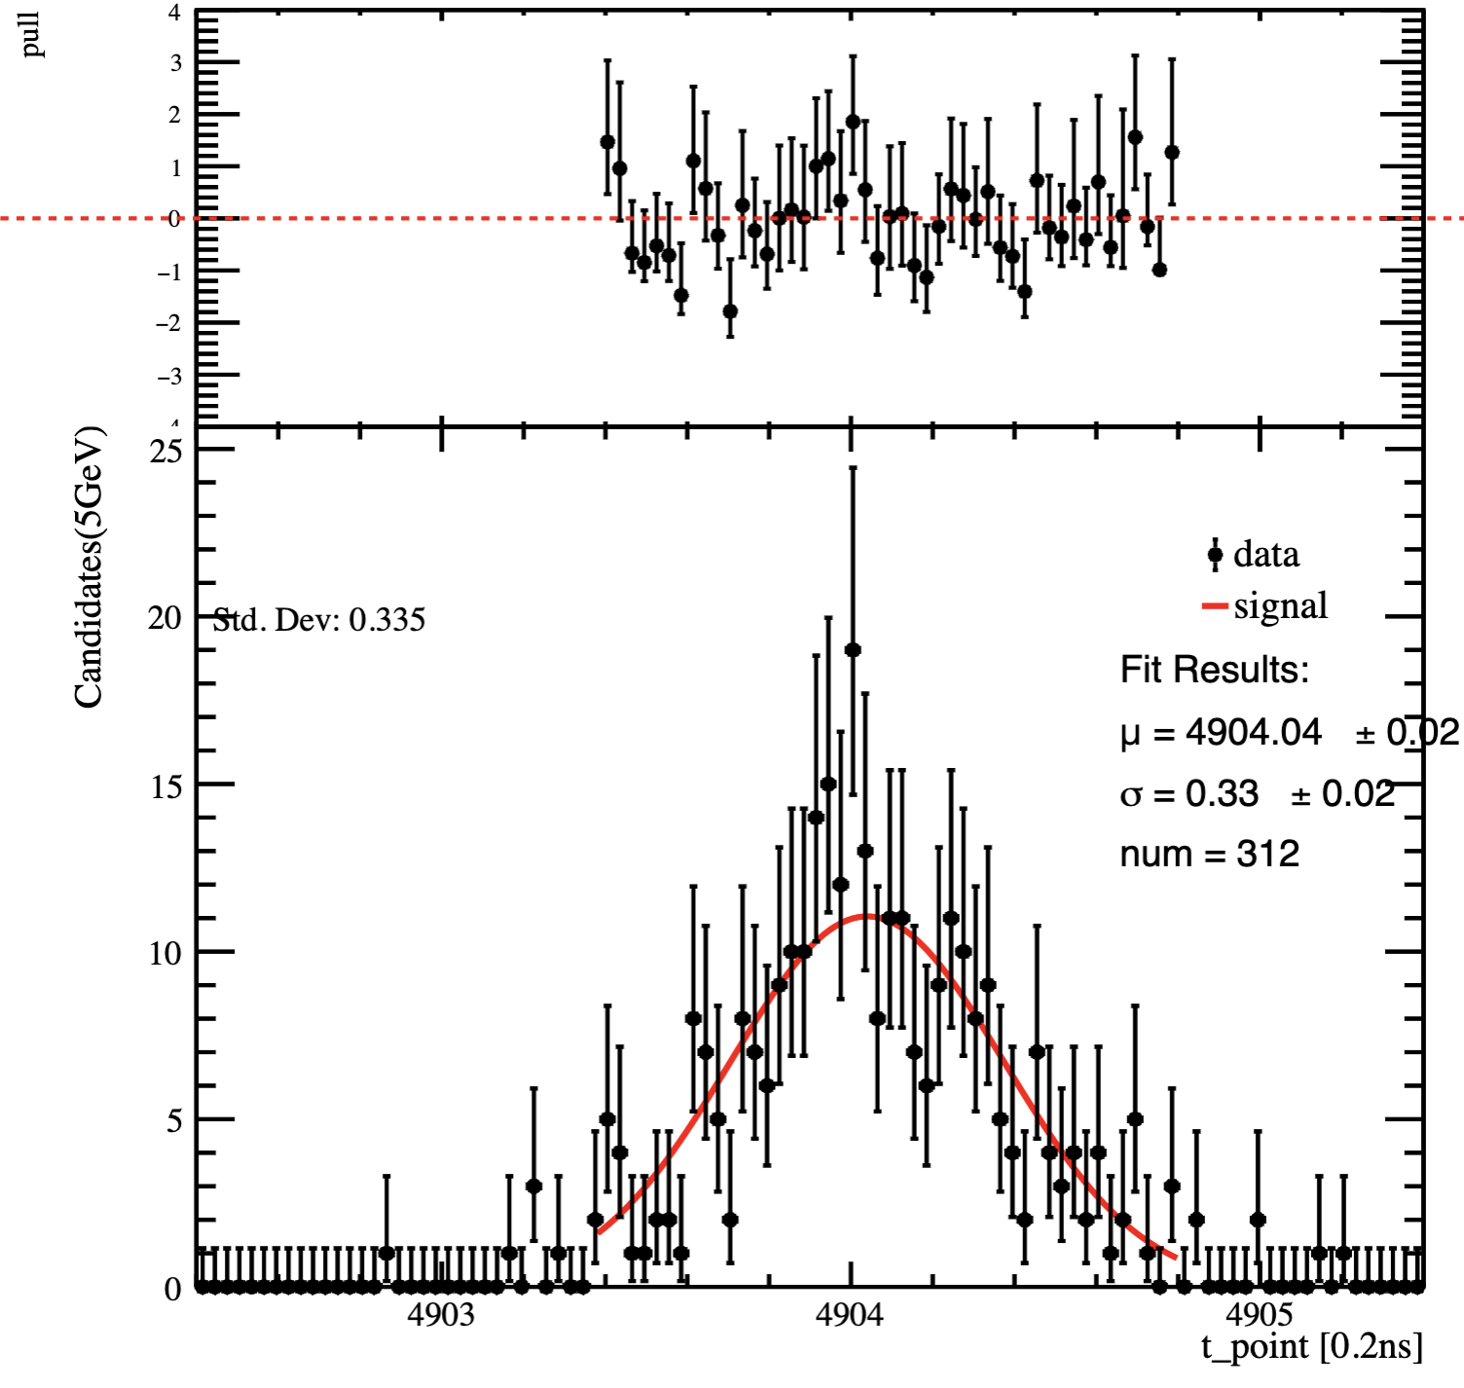
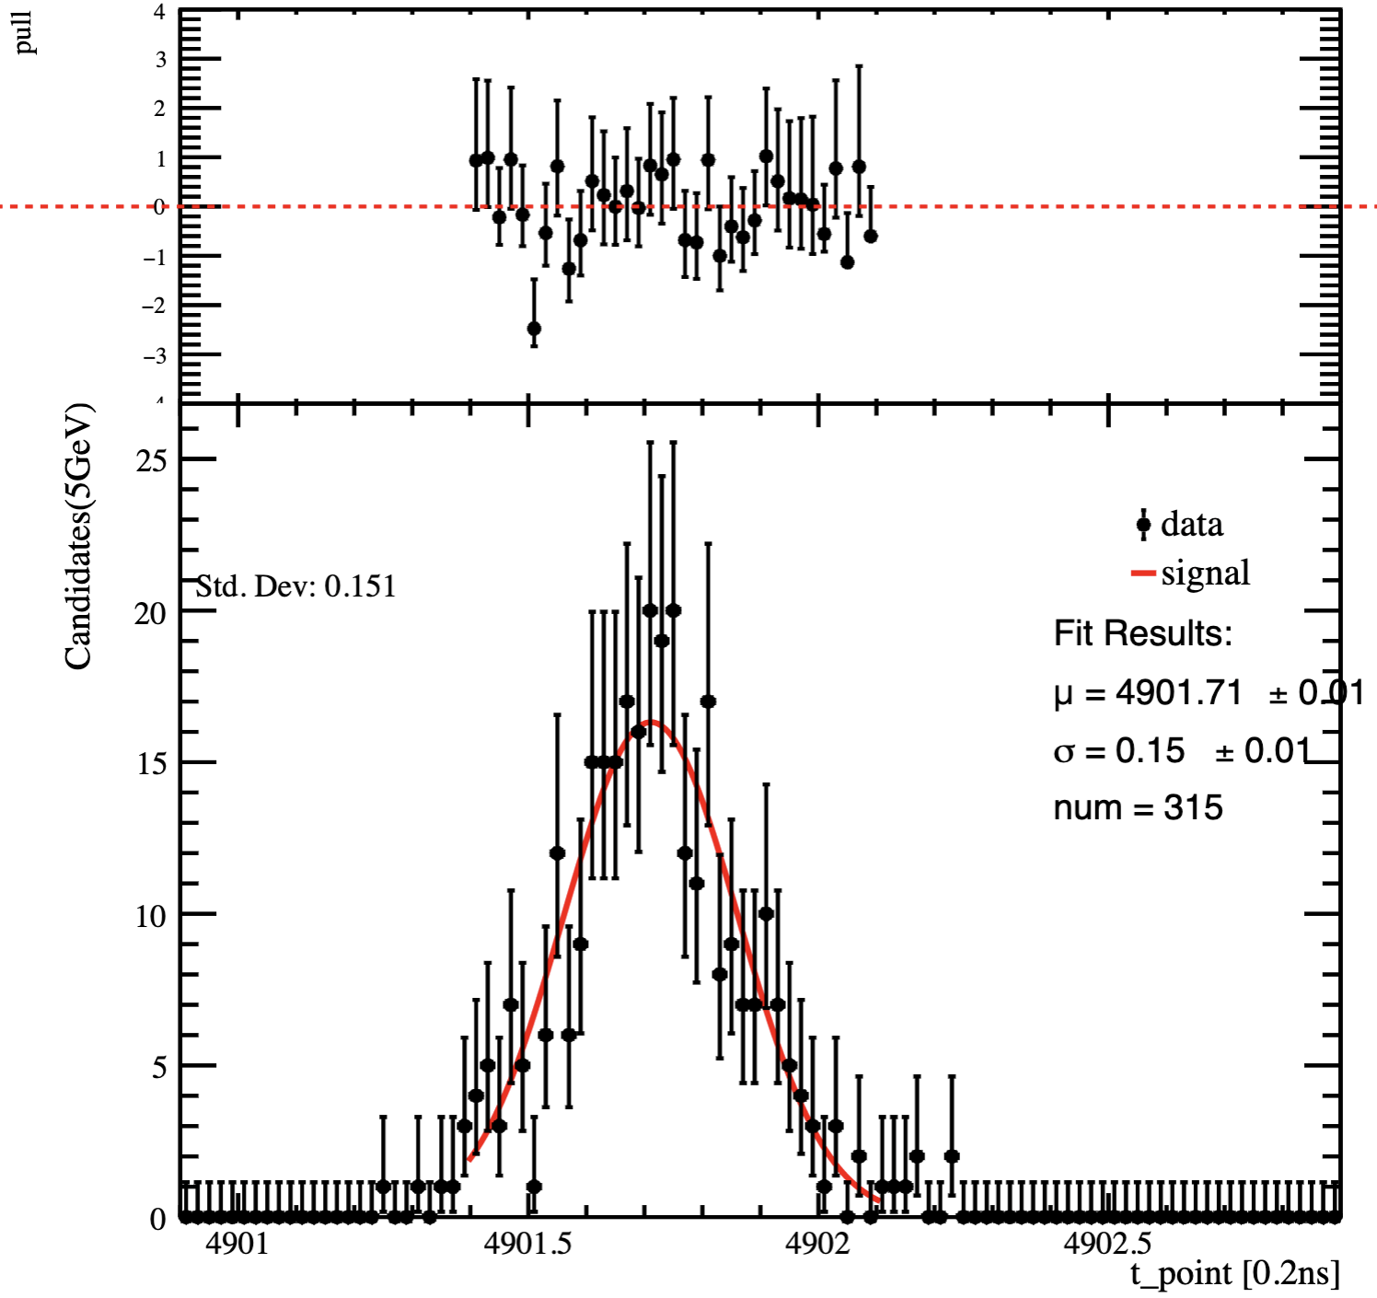
Time resolution
Time from the front and back sides was combined as follows:
Time distribution (t_{front})
Time distribution (t_{back})

Slide 15
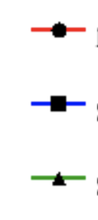
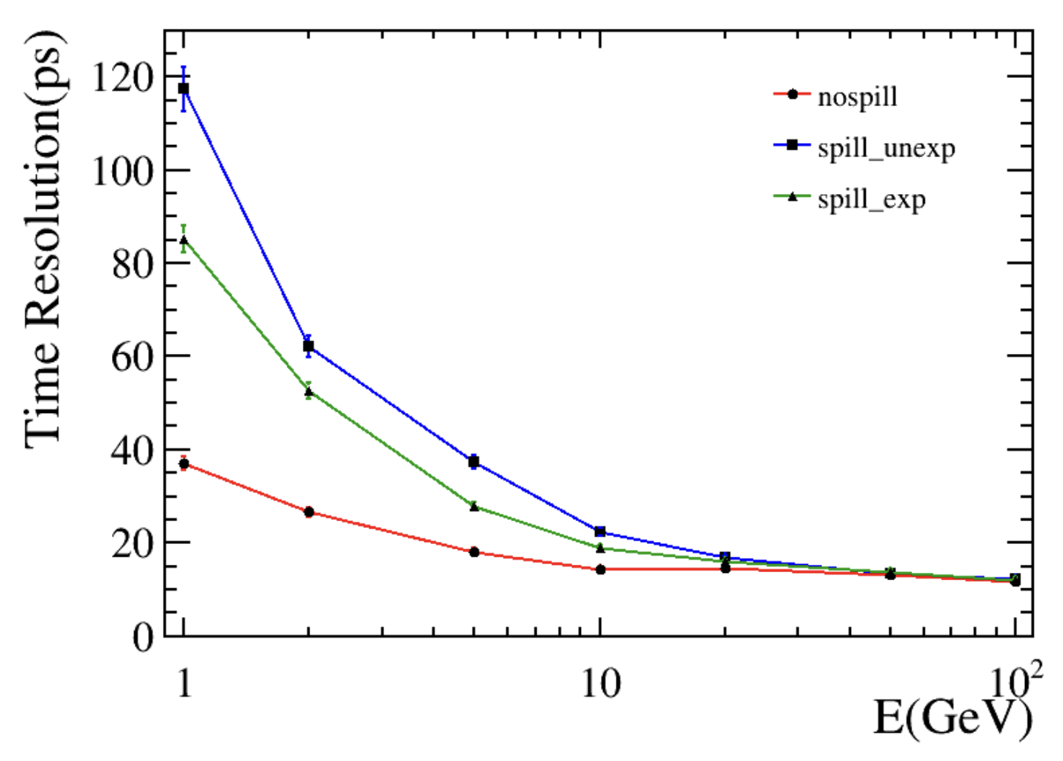
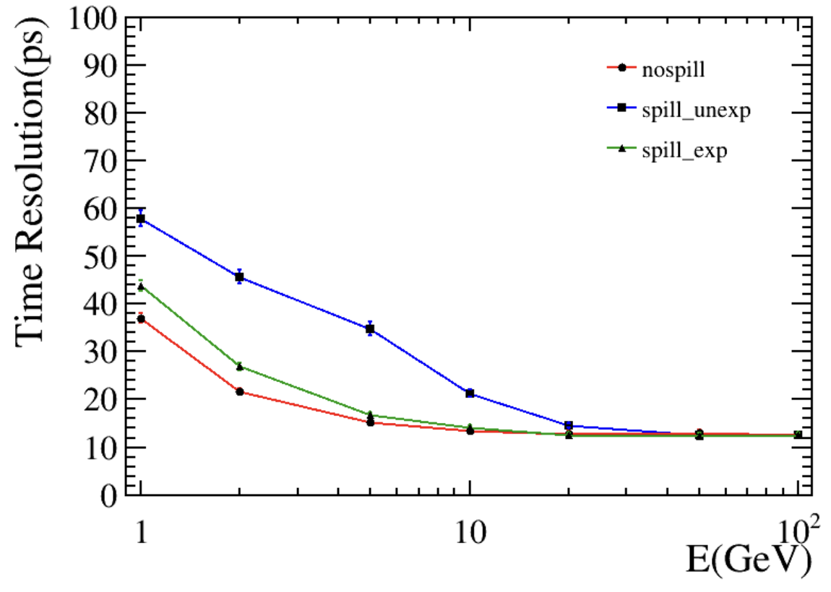
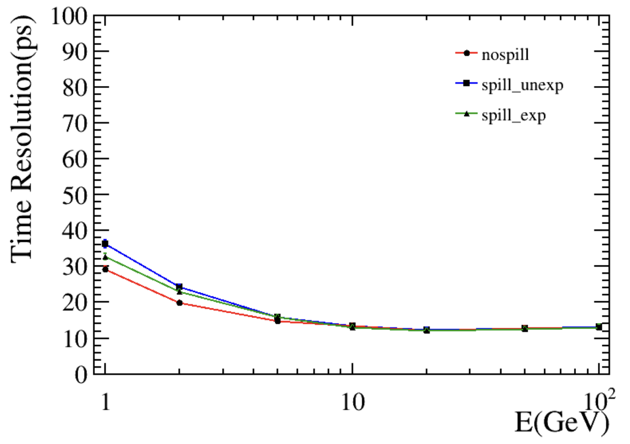
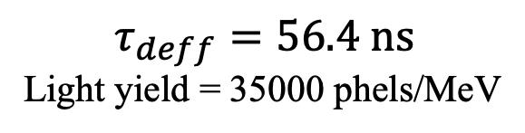
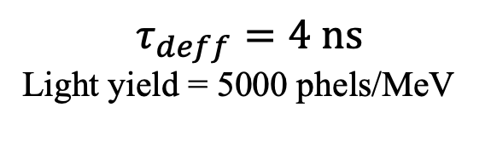
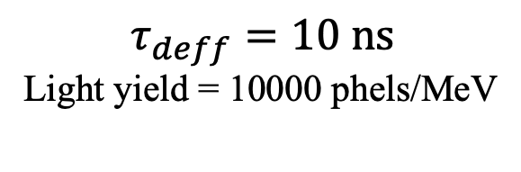
Time resolution
No Spill
Decay time of crystals play important role in time resolution
Exp subtraction has better performance than flat subtraction
Flat subtraction
Exp subtraction
$$τ_{deff}=56.4 ns$$
Light yield = 35000 phels/MeV
$$τ_{deff}=10 ns$$
Light yield = 10000 phels/MeV
$$τ_{deff}=4 ns$$
Light yield = 5000 phels/MeV

Slide 16
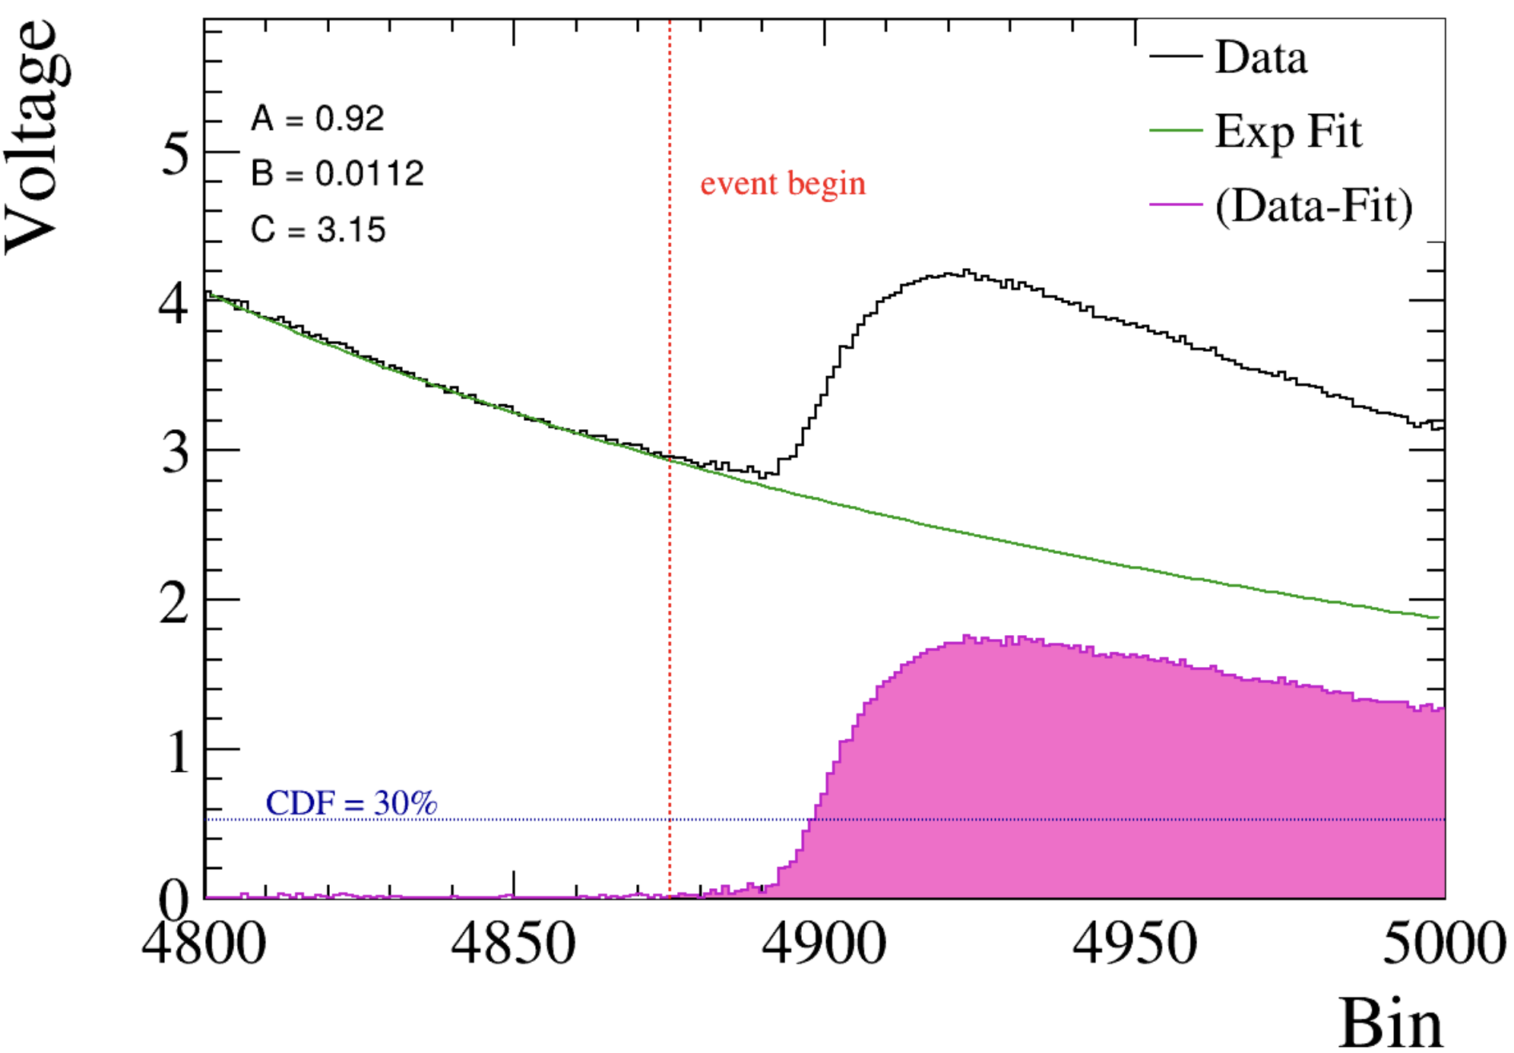
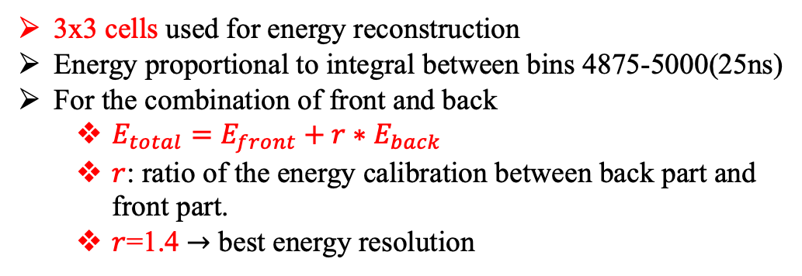
Energy resolution
Photons were shot at this cell
3 × 3 cells used for energy measurement
Cell map in this module
3x3 cells used for energy reconstruction
Energy proportional to integral between bins 4875-5000(25ns)
For the combination of front and back
$E_{total}=E_{front}+r∗E_{back}$
$r$: ratio of the energy calibration between back part and front part.
$r$=1.4 $→$ best energy resolution
Signal yield

Slide 17
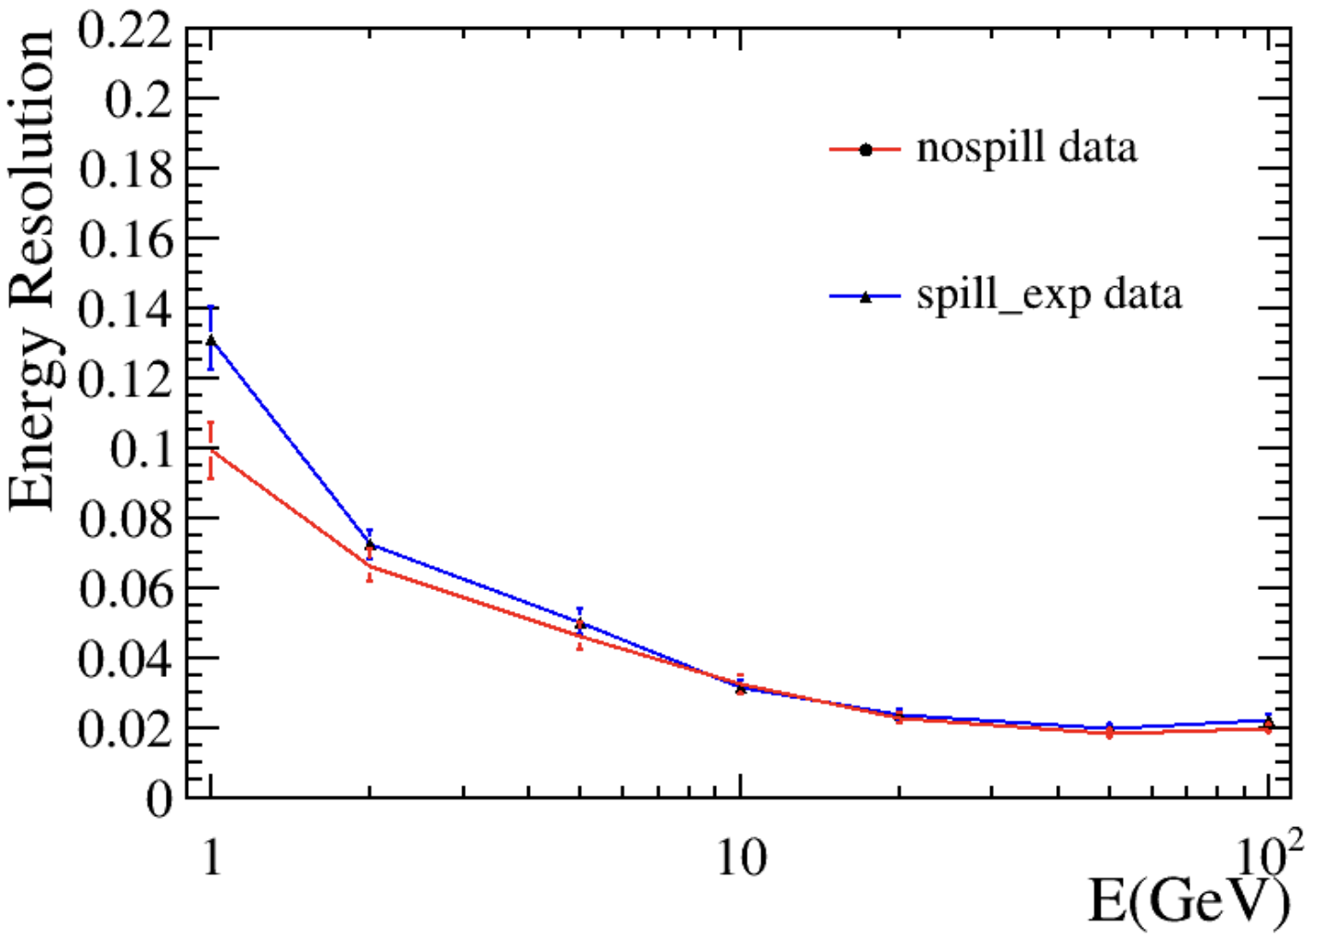
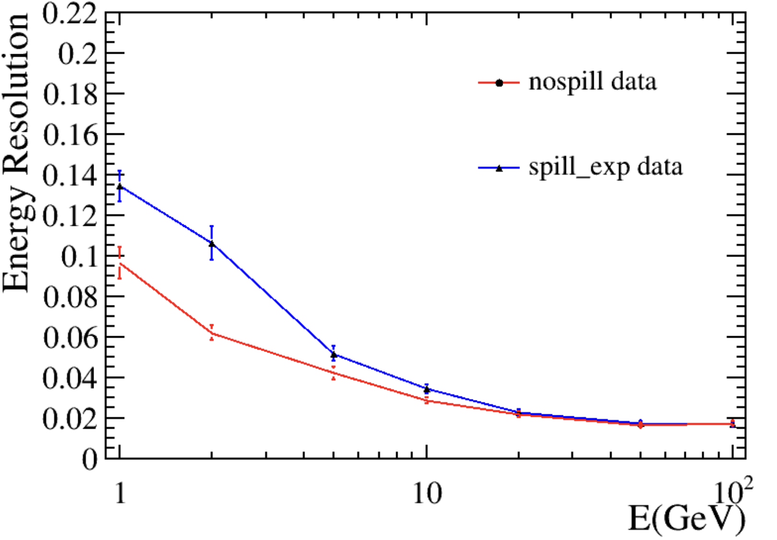
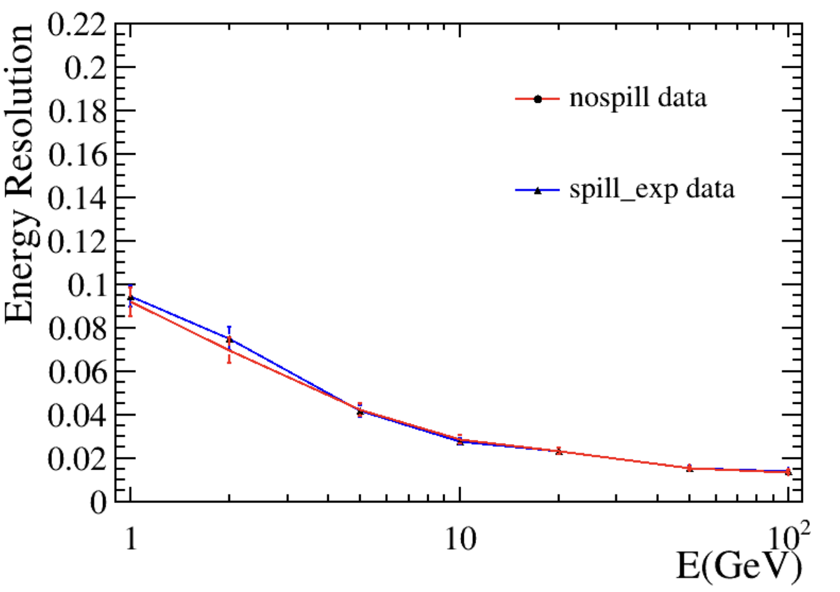
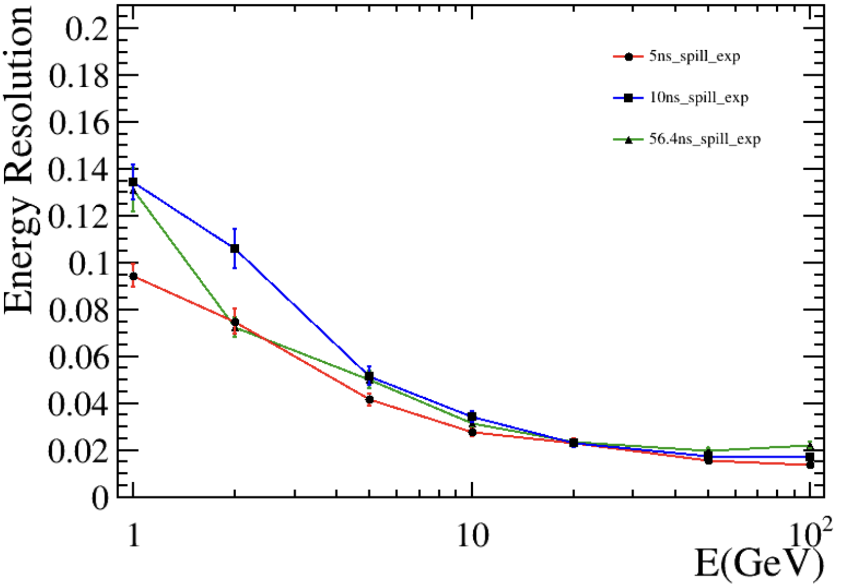
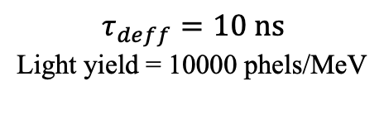
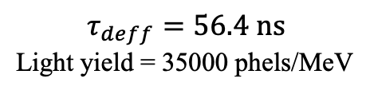
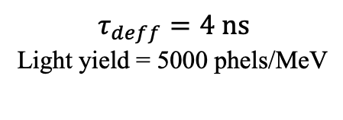
Energy resolution
$$τ_{deff}=56.4 ns$$
Light yield = 35000 phels/MeV
$$τ_{deff}=10 ns$$
Light yield = 10000 phels/MeV
$$τ_{deff}=4 ns$$
Light yield = 5000 phels/MeV
Worst performance at 10 ns decay time
Possibly related to light yield?
Influence negligible above 10 GeV

Slide 18
Physics benchmark study

Slide 19
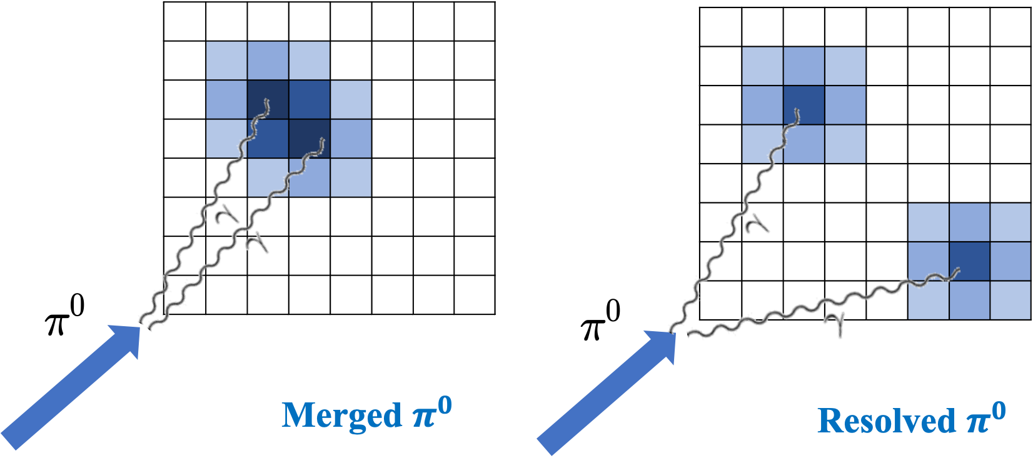

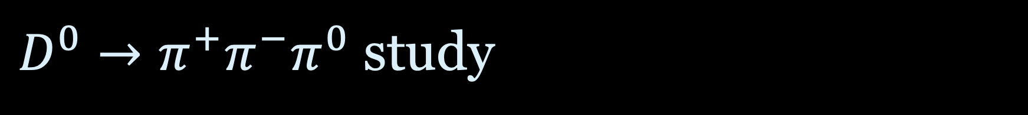


$D^{0}→π^{+}π^{−}π^{0}$ study
$D^{∗}→D^{0}π$
$π^{+}π^{−}π^{0}$
$γγ$

Slide 20
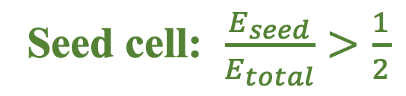
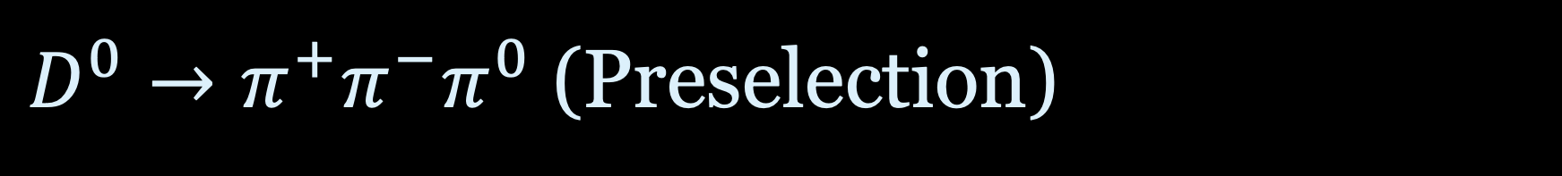
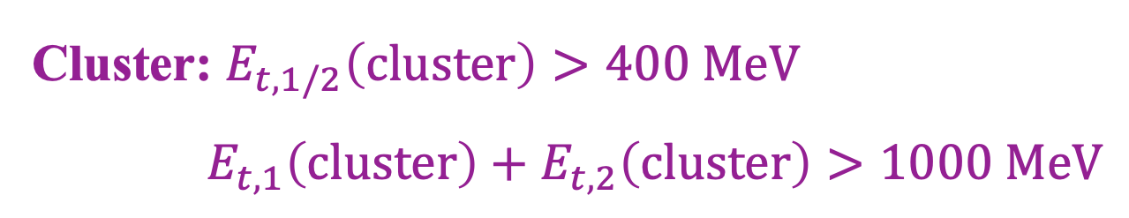
$D^{0}→π^{+}π^{−}π^{0}$ (Preselection)
Seed cell: $\frac{E_{seed}}{E_{total}}>\frac{1}{2}$
Cluster: $E_{t,1/2}\left(cluster\right)>400 MeV$
$E_{t,1}\left(cluster\right)+E_{t,2}\left(cluster\right)>1000 MeV$

Slide 21
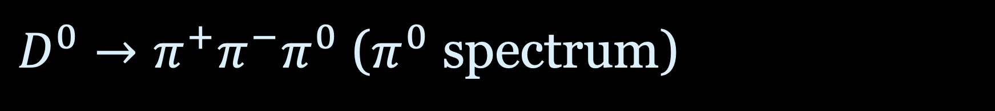
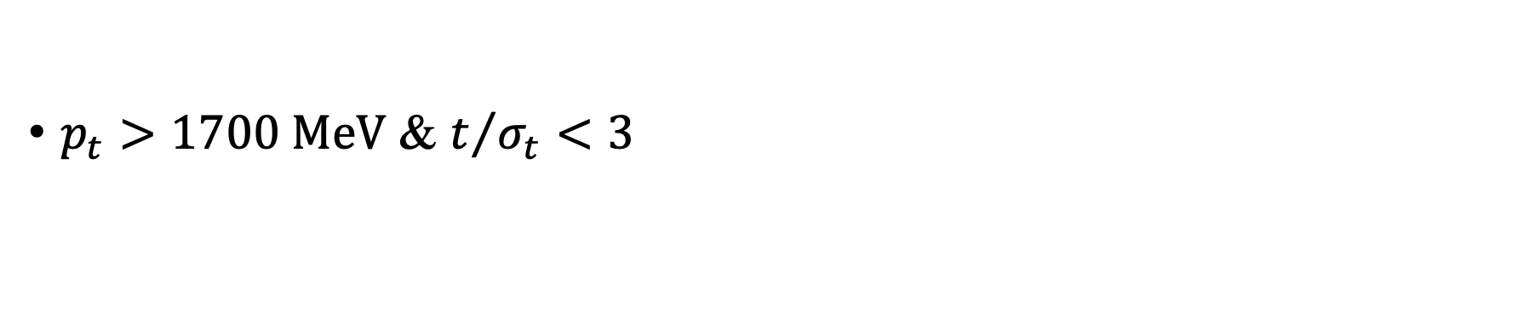
$D^{0}→π^{+}π^{−}π^{0}$ ($π^{0}$ spectrum)
$p_{t}>1700 MeV$ & $t/{σ_{t}}<3$

Slide 22
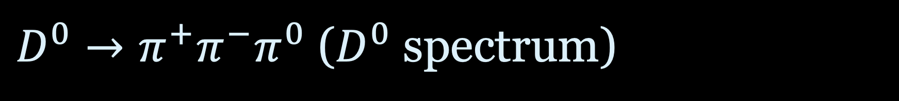
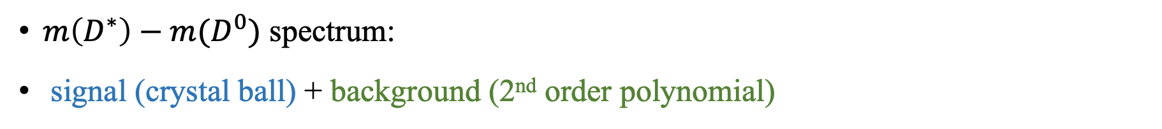

$D^{0}→π^{+}π^{−}π^{0}$ ($D^{0}$ spectrum)
$m\left(D^{∗}\right)−m(D^{0})$ spectrum:
signal (crystal ball) + background (2nd order polynomial)
S(Number of signals)
B(Number of backgrounds)
$Efficiency≡\frac{S}{N_{truth,total} }$
$Significance≡\frac{S}{\sqrt{S}+B}$

Slide 23
Conclusion

Slide 24
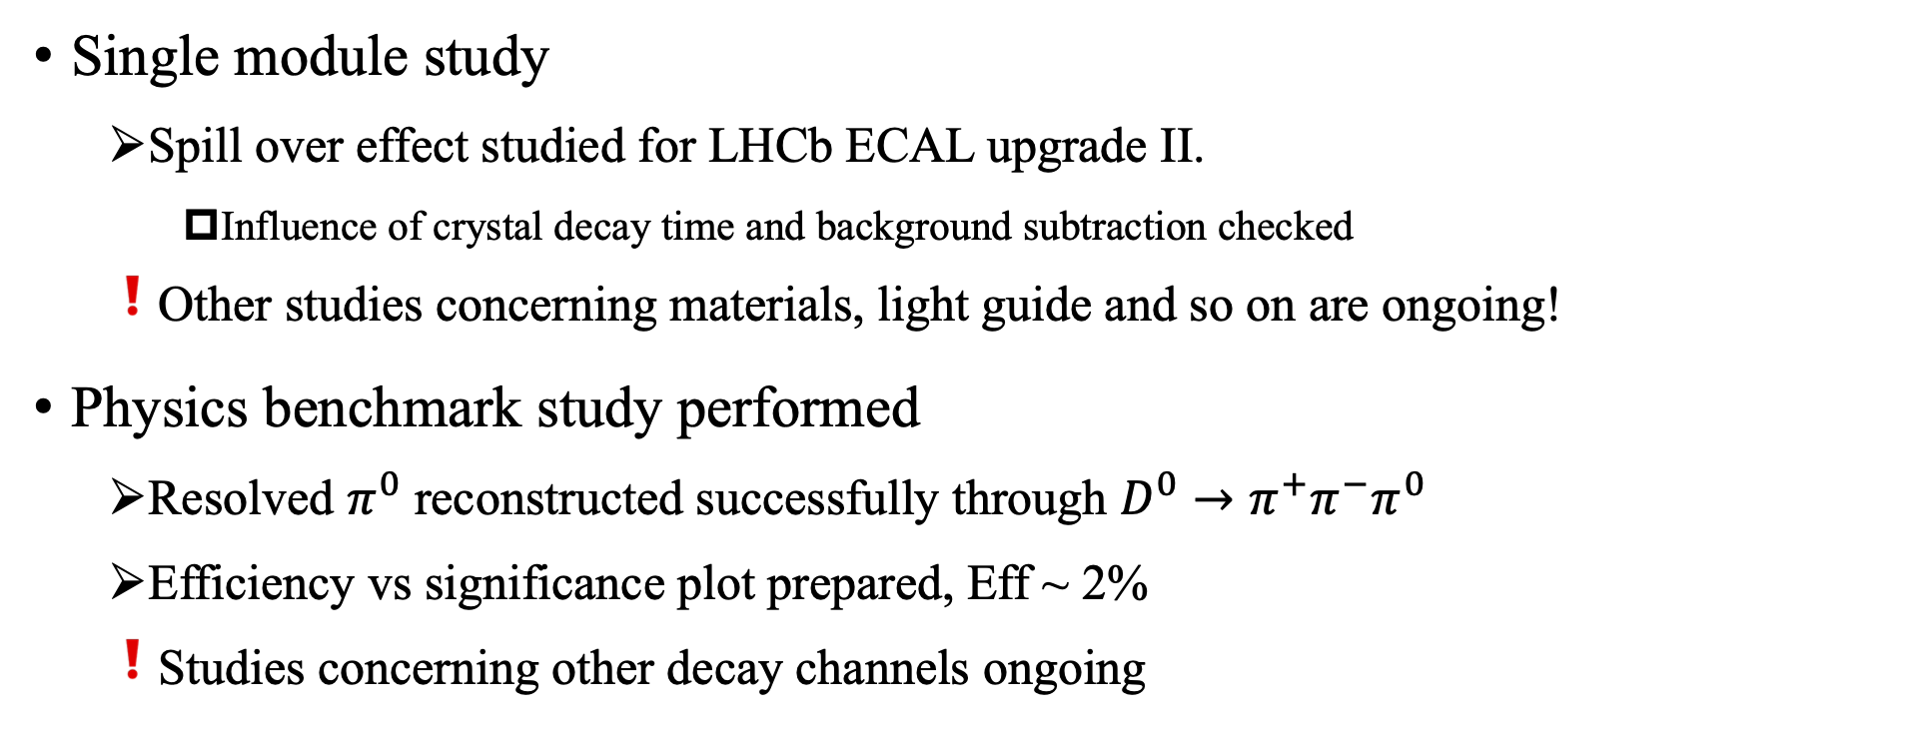
Conclusion
Single module study
Spill over effect studied for LHCb ECAL upgrade II.
Influence of crystal decay time and background subtraction checked
Other studies concerning materials, light guide and so on are ongoing!
Physics benchmark study performed
Resolved $π^{0}$ reconstructed successfully through $D^{0}→π^{+}π^{−}π^{0}$
Efficiency vs significance plot prepared, Eff ~ 2%
Studies concerning other decay channels ongoing

