Slide 1



IHEP Site Report
Yan Xiaofei
On Behalf of IHEP Computing Center
2025-11-01

Slide 2
Outline
1
Overview of NGI_CHINA
2
Overview of IHEP-CC
3
Grid Site at IHEP-CC
4
A solution to Access Storage of Grid T2/T3
5
A solution to Access Storage of Grid T2/T3
6
Summary

Slide 3
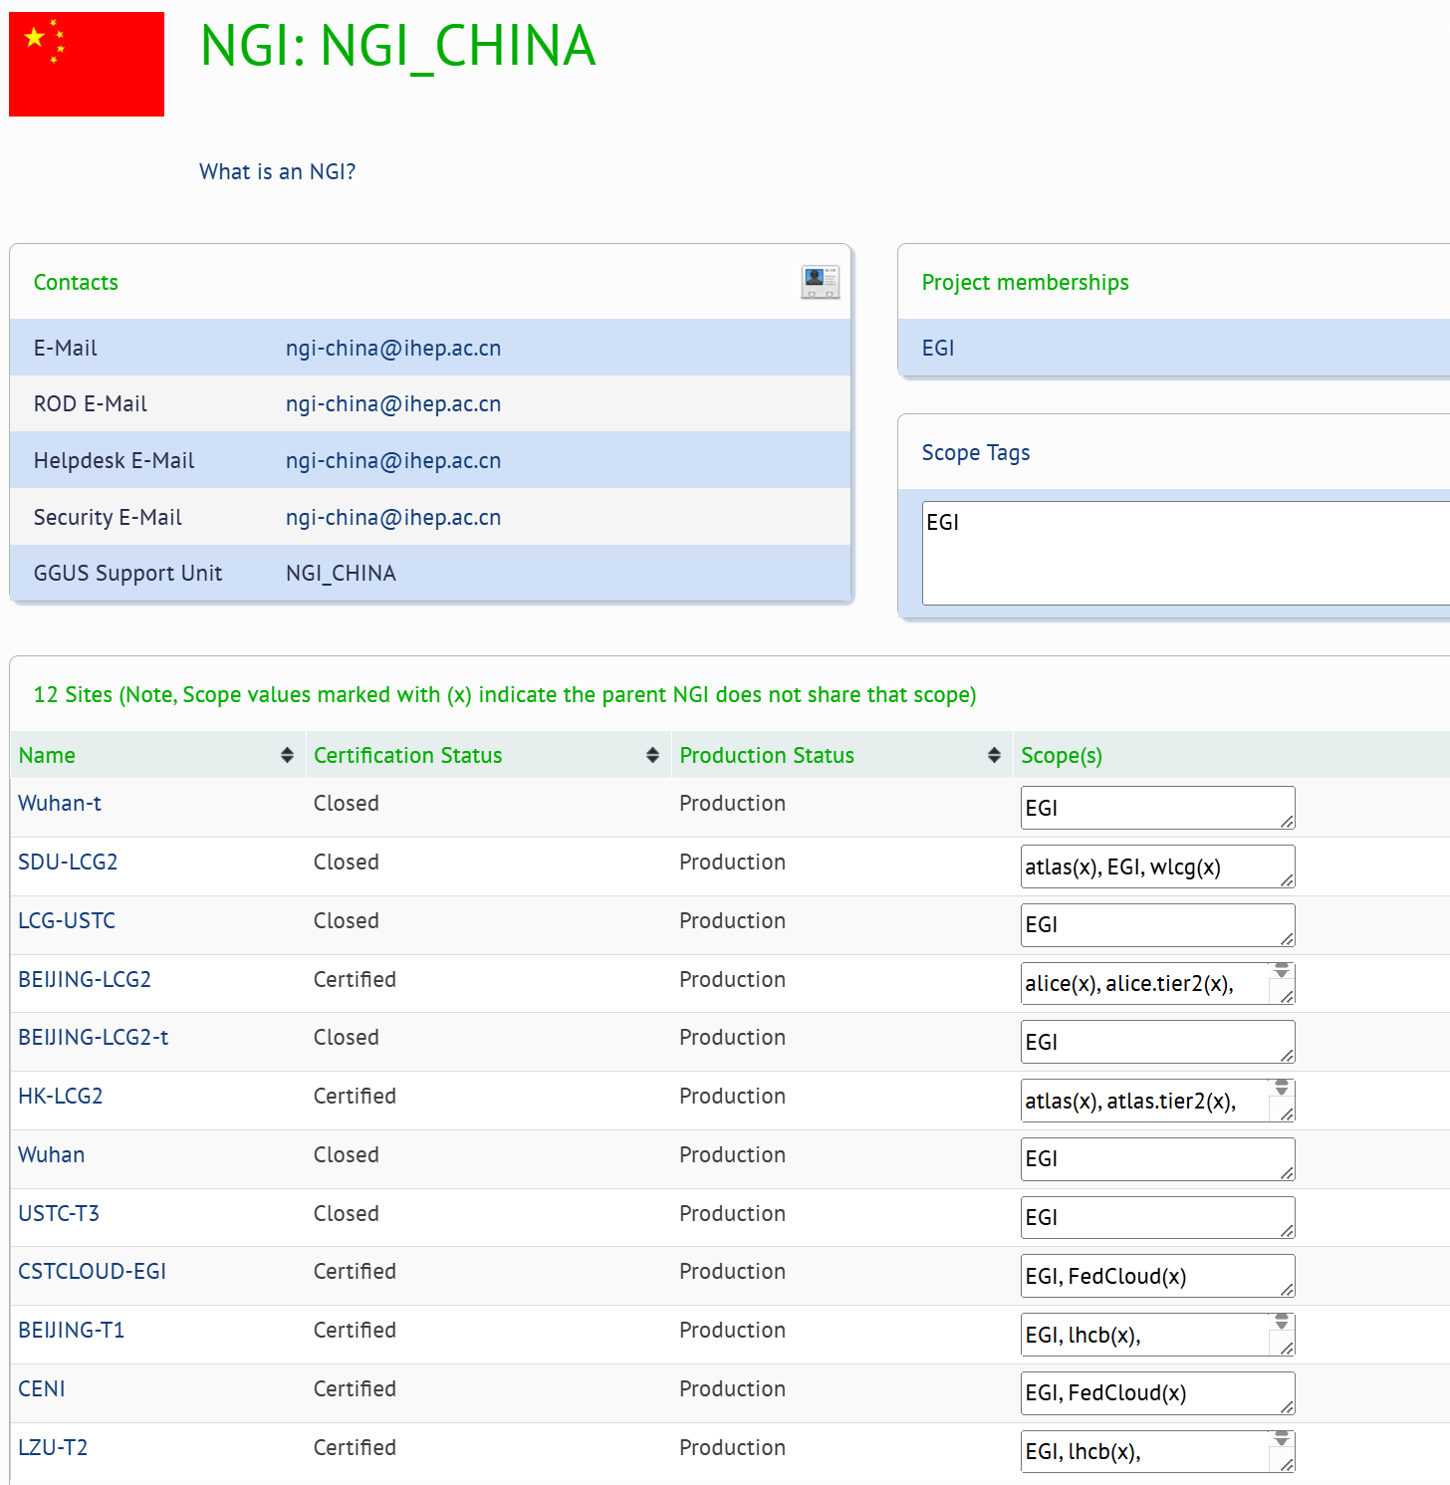
NGI_CHINA
National Grid Initiatives or Infrastructures
Set up by individual countries to manage the computing resources.
Reginal operation center of EGI & WLCG
Central of the China LHC computing.
Contributes a number of sites to the grid infrastructure.
BEIJING-T1
BEIJING-LCG2
LZU-T2
CSTCLOUD-EGI
CENI
HK-LCG2
Others were deprecated
Support For Tier1 & Tier2 daily operations
Yearly review of all resources

Slide 4
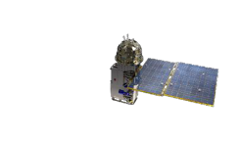
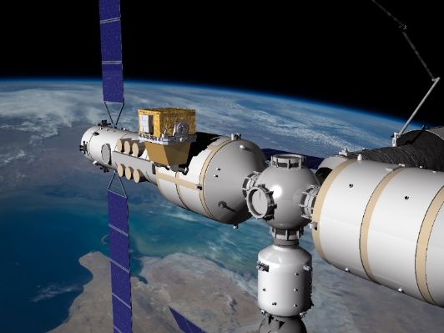









Overview of IHEP Computing Center
Herd
IHEP CC at main compus of IHEP :
Local cluster: HTC,HPC
Grid site
CSNS at Dongguan
Local cluster: HPC
HEPS at Huairou of Beijing: to be ready
Interactive
Local cluster: slurm
Remote sites:
Cluster running for Exp.
Network
WAN Bandwidth: 100 Gbps
IHEPCC-HEPS: 100Gbps
IHEPCC-CSNS: 20G
HXMT
Gecam
BEPCII/BESIII
BSRF
HEPS
AliCPT
AS𝛾
LHAASO
CSNS
JUNO
Daya Bay
Notes:
Let’s begin with the overview of IHEP computing center.
The center is equipped with 58,000 CPU cores and 250 GPU cards, which serve more than ten different experiments.
The resources include HTC cluster, HPC cluster and Distributed computing sites.
Considering the high growth rate of data generation, new raw space of storage was added both for disk and tape.
Now the total disk storage reached 120PB and tape storage increased to 100PB.
In terms of network capabilities, our infrastructure is equipped to handle high data throughput:
We support both IPv4 and IPv6 dual stack configurations.
Ethernet, InfiniBand (IB), and RDMA over Converged Ethernet (ROCE) protocols are all supported, ensuring flexibility and high-speed data access.
Our WideAreaNetwork bandwidth reaches 100 Gbps
opportunity

Slide 5
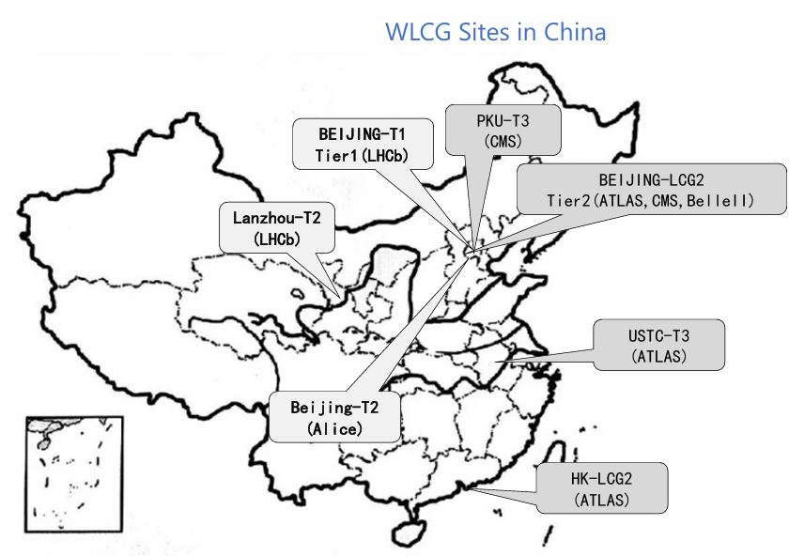
Grid Sites - Statistics
Tier 1
Beijing T1 for LHCb
Tier 2
IHEP sites for ATLAS, ALICE, BELLEII, CMS
IHEP Tier 1 Site resources
IHEP Tier 2 Site resources

Slide 6
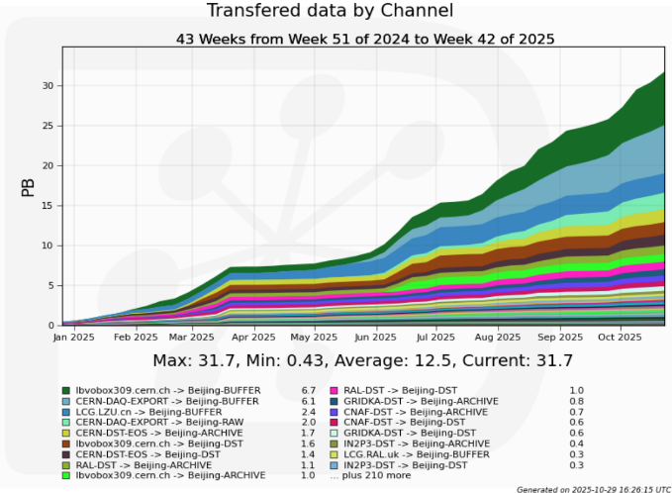
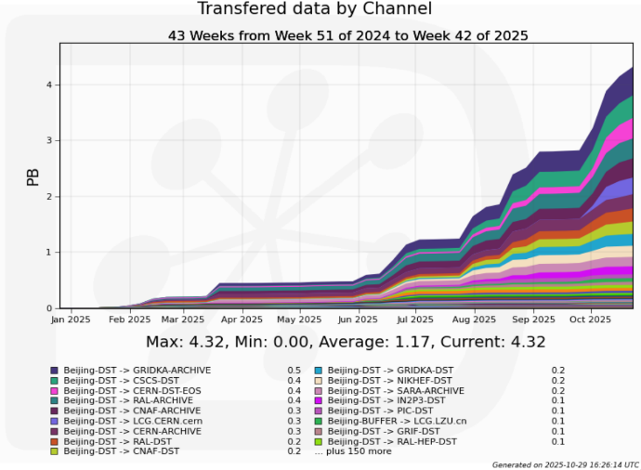
Grid Sites - LHCb Beijing Tier-1 Site
Complete the resource expansion at the end of 2024
The resources provided for LHCb Beijing Tier-1
Computing: 40 worker nodes (Intel & AMD) with 3216 CPU cores
Disk storage: 12.5 PB
Tape storage:
6 drivers (IBM) and 2 drivers more than last report
22.3 PB (10 PB more than last report)
Data Volume of Write out
Data Volume of Write In
Notes:
Since the last report, we have expanded our LHCb Tier 1 resource,
We added 6.5PB of disk storage and 7.5PB of tape storage, and there are also 2 tape drivers will be added in this month.

Slide 7
Grid Sites - Tier-2 Site at IHEP
CPU: 4608 cores with ~129k HS23
ALICE T2: 1152 Cores 32.4k HS23
ATLAS T2: 1728 Cores 48.6k HS23
CMS T2: 1728 Cores 48.6k HS23
Disk Storage: 3.54 PB
ALICE T2: 0.84 PB
ATLAS T2: 1 PB
CMS T2: 1.7 PB
ATLAS Beijing T2 resource upgraded in 2024
replaced old resources provisioned in 2011 and 2015.
8k HS23, 400 TB for ATLAS.
8k HS23, 600 TB for CMS.
Upgrades has been done in 2024.
Add 48.6k HS23 and 1.12 PB for ATLAS.
Add 48.6k HS23 and 1.12 PB for CMS.

Slide 8
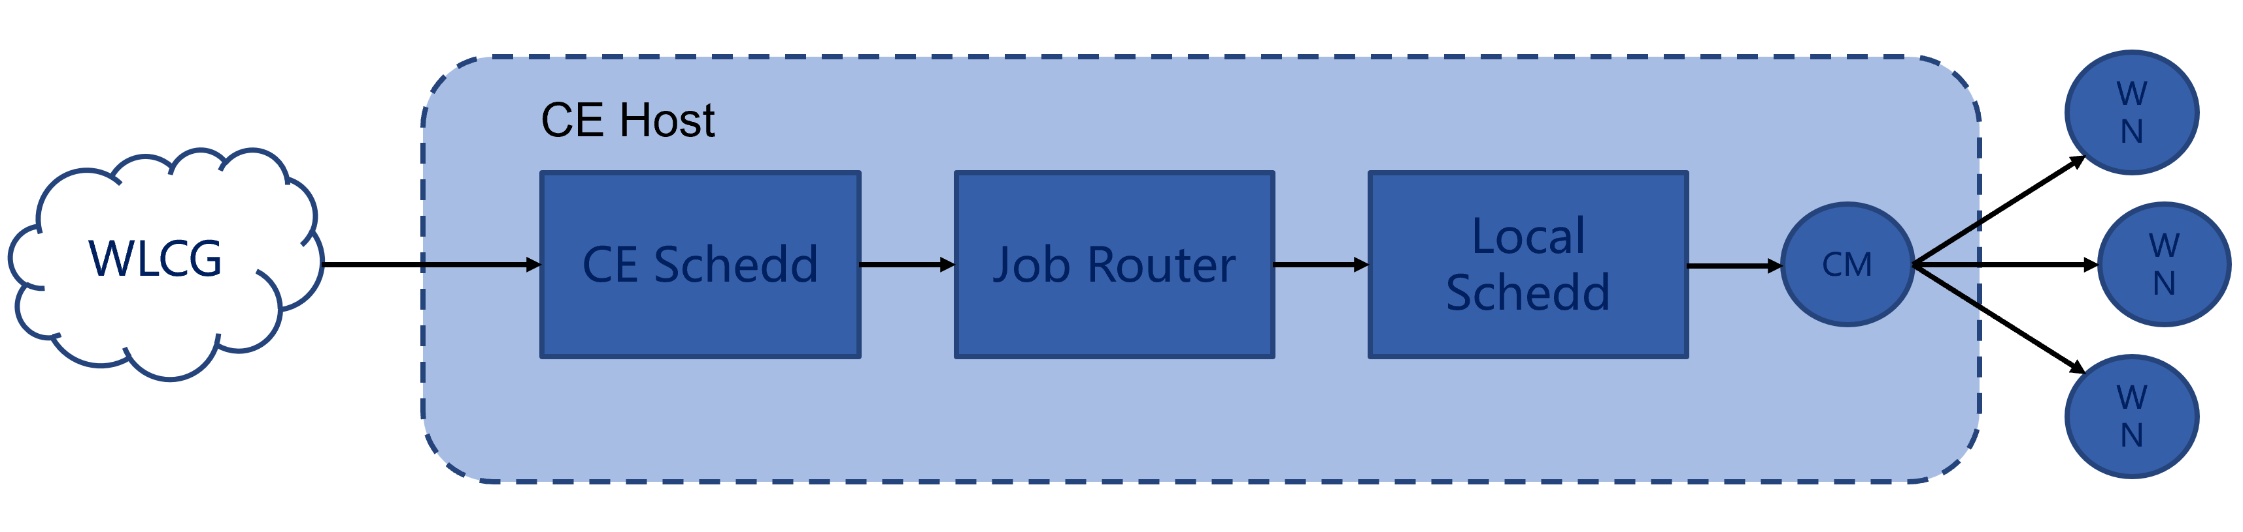
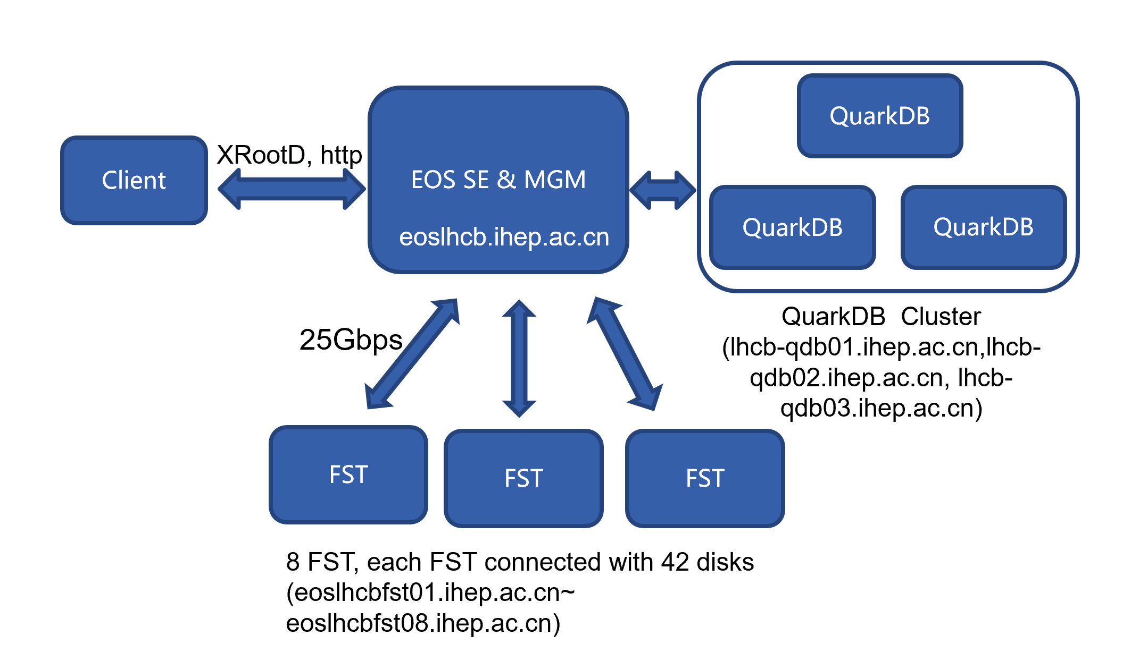
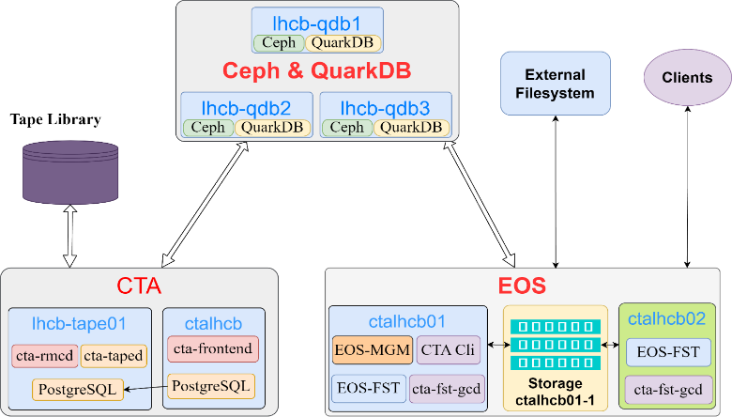
Site Operations
OS upgraded
Upgrade from CentOS 7.9 to AlmaLinux 9.4 in 2024
Upgrade to AlmaLinux 9.6 in May 2025 for CVE-2025-21756
Upgrade to latest kernel version for CVE-2025-38352
All Tier-1 and Tier-2 sites are using the same middleware technologies
Managed by foreman + puppet system.

Slide 9
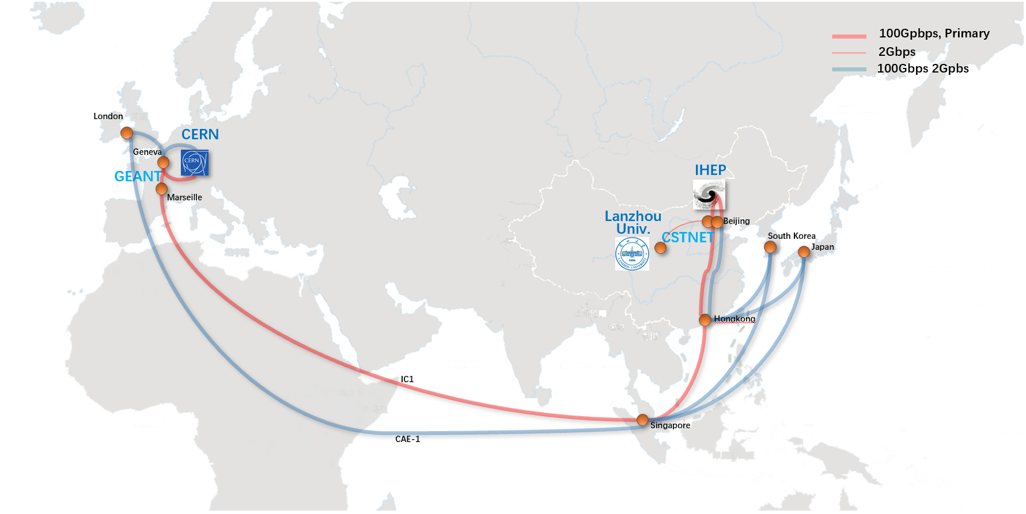
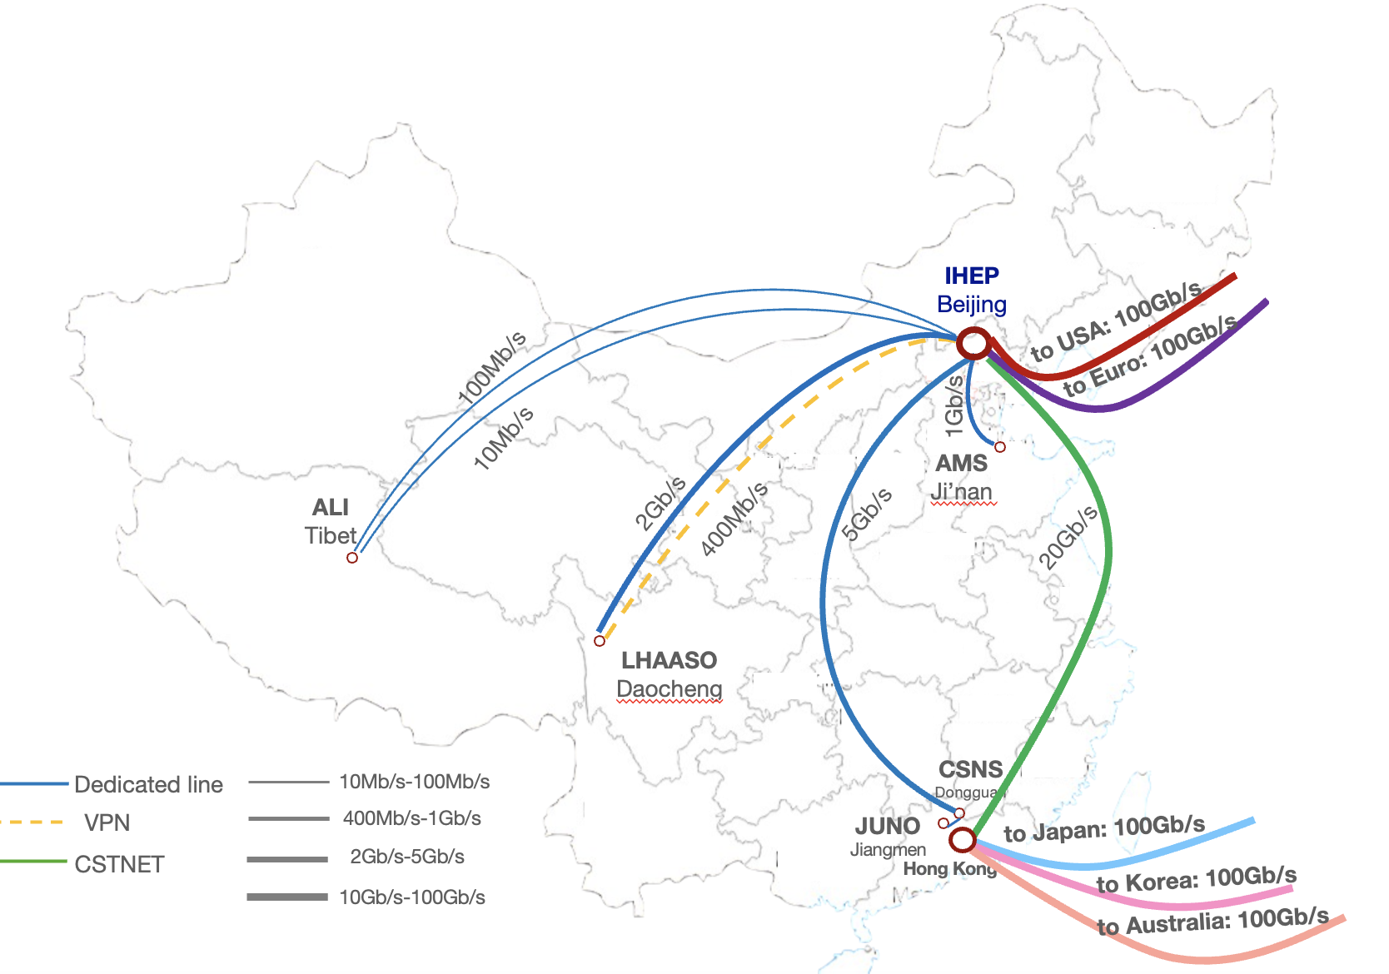
International Network of IHEP
International network link upgraded to 100Gbps in 2023
With the help from CSTNET, GEANT and CERN
The data transfer test showed the peak performance between IHEP and Europe reach to 50Gbps
LHCOPN for Tier 1
LHCONE for Tier 2
Dedicated links between IHEP and domestic remote sites
HEPS-IHEP: 100 Gbps
CSNS-IHEP: 20 Gbps
Lanzhou Univ-IHEP: 2 Gbps
…..

Slide 10

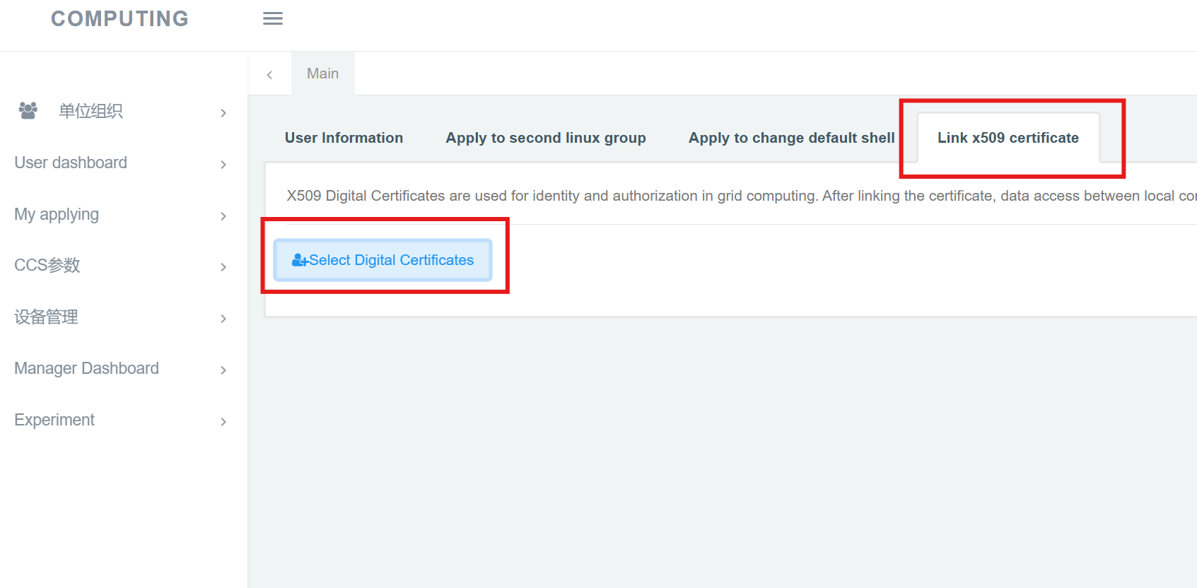



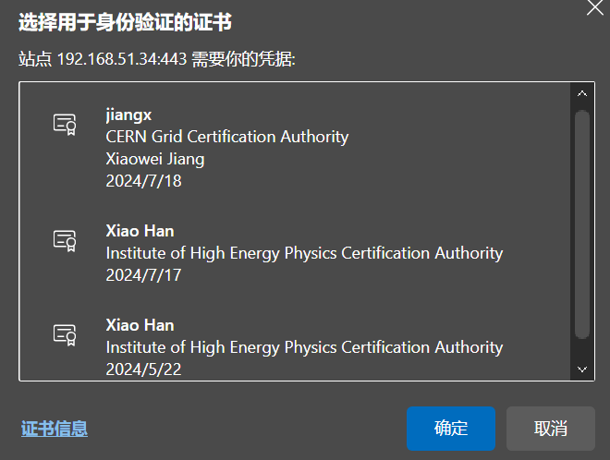


Solution for T2/T3 SE access
T2 jobs access T3 SE
1. upload certificate to browser
2. Register at ccsinfo.ihep.ac.cn
3. Submit jobs by WLCG command
1
2
$ voms-proxy-init
$ WLCG command
3
T3 jobs access T2 SE
1. Upload cert to login node
2. Submit jobs with cert proxy
$ voms-proxy-init
$ cp /tmp/x509up_u${UID} $HOME/
$ hep_sub … -cert x509 –in $HOME/x509up_u${UID}
lxlogin.ihep.ac.cn

Slide 11







Solution for T2/T3 SE access
JOBs
JOBs
WLCG
hep_sub +
hep_sub
T2
T3
SE
SE
Mapping by
CCS
AFS user

Slide 12
Resource Transition Between DCI and Local Clusters at IHEP
Motivation
IHEP has been running grid site and local cluster separately and serving more than 10 HEP Exp.
Run the grid site as the IHEP JUNO DCI
A large HTC local cluster shared among multiple Exp. including JUNO, BES, DYW etc.
Job slots quota of each Exp. is depended on the resource contributed by the Exp
The job slots utilization of IHEP DCI and local cluster fluctuates frequently
Example: the DCI experiences heavy usage while the cluster remains idle, and vice versa
Switch additional JUNO job slots between DCI and local cluster
Provides more resource to the peak usage needed by the grid site/local cluster
Promote the overall job slots utilization of IHEP JUNO computing platform

Slide 13
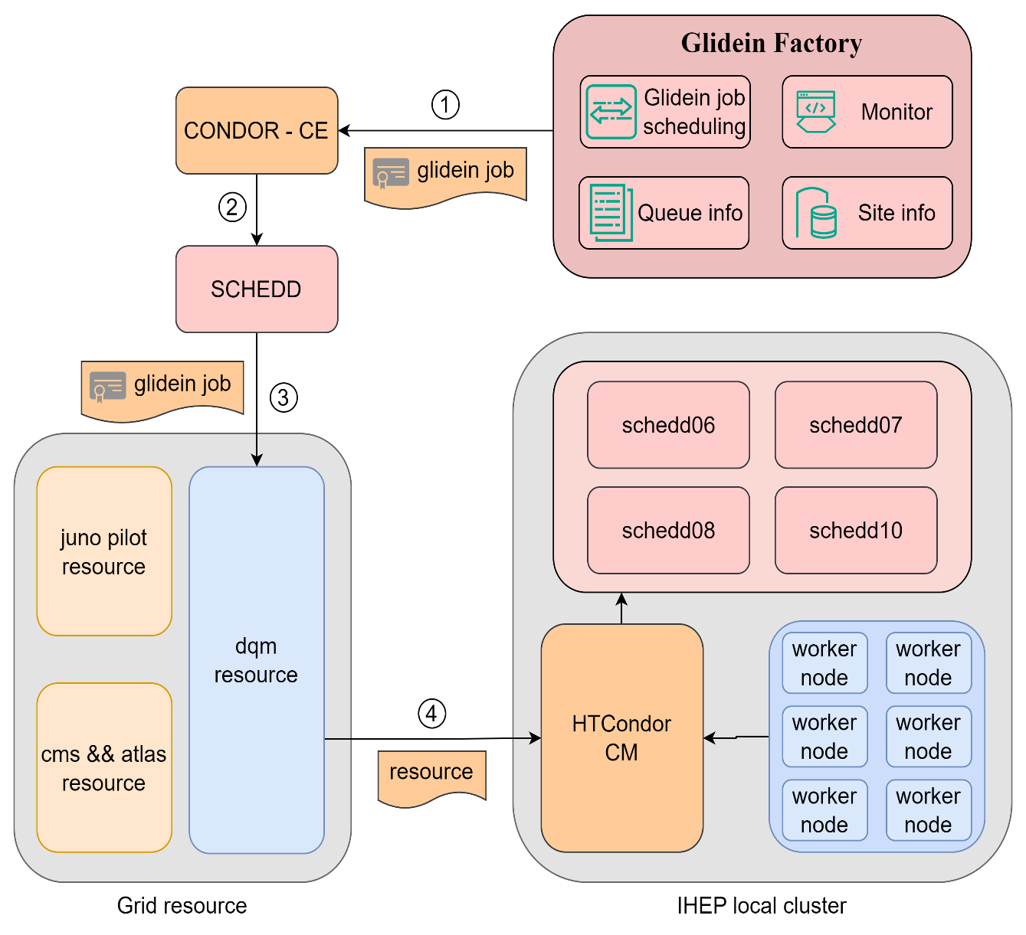
Workflow of Resource Transition
Create a “glidein job”
It contains the details and configuration information of the scheme for connecting Grid nodes to the IHEP local cluster
Submit a grid job to run the “glidein job” to CE
CE will configure relevant parameters for the glidein job
Set the requirement attributes of the job
Run the glidein job on the grid worker nodes
Start a computing service for IHEP local cluster
Ensure environmental consistency through containers
Report the resource to local pool
Local cluster jobs can be scheduled to glidein job slots running on grid nodes

Slide 14
Summary
IHEP-CC has been running NGI_CHINA and all 4 LHC grid sites with close cooperation of Chinese LHC phycists
NGI_CHINA start at 2014
LHCb T1 and Alice T2 in production in 2024
Atlas and CMS grid sites have been running since 2006
IHEP-CC has been doing best to support LHC computing
Apply funds to upgrade ATLAS/CMS grid site
Help Lanzhou Univ. to build and maintain the LHCb grid site
Provides more functions for the LHC physcists.
A solution to access T2/T3 storage based on Exp. Requirement
Resource Transition Between Grid and Local Clusters
More functions would be added
Contact persons from IHEP-CC for each Exp.
Alice: Ran Du (duran@ihep.ac.cn)
ATLAS: Xiaofei Yan (yanxf@ihep.ac.cn)
CMS: Xuantong Zhang (zhangxuantong@ihep.ac.cn)
LHCb: Xiaowei Jiang (jiangxw@ihep.ac.cn)
Thanks!
Q&A

Slide 15
Thanks

