Slide 1
Status of ALICE Computing
Qiye Shou, Fudan University
Ran Du, Xiao Han, Computing Center, IHEP
2025-Nov-01

Slide 2
Outline
The China ALICE group
The ALICE Tier2 Site at IHEP
Summary

Slide 3
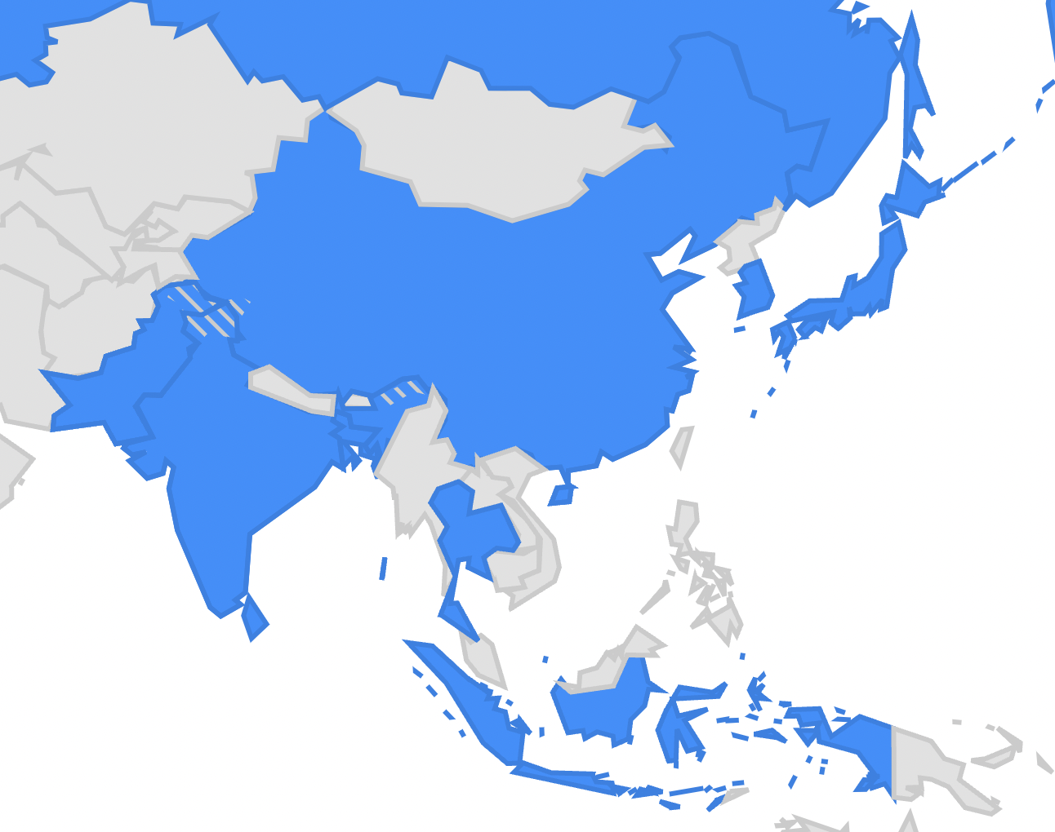
The China ALICE Group
China
7 (5+2) institutes
101(98+3) members
Central China Normal University (Wuhan)
also a member of LHCb
China University of Geosciences (Wuhan)
China Institute of Atomic Energy (Beijing)
Fudan University (Shanghai)
also a member of CMS
University of Science and Technology of China (Hefei)
also a member of ATLAS, CMS
Two new associate members
University of Chinese Academy of Sciences
Shandong University
Beijing
Hefei
Qingdao
Wuhan
Shanghai
ALICE general introduction: Zhongbao Yin’s talk on Thu (link)

Slide 4
The China ALICE T2
Since late 2023, a new ALICE T2 has been established in IHEP, Beijing, where the clusters of the other 3 LHC experiments are also located
Up to now, 2.8% (15 M&O) obligation, corresponding to:
CPU: 42,897.2 HS23 ( 30,000.0 HS23 pledged in 2025)
Disk: 5,018.7 TB ( 840.0 TB pledged in 2025)
Disk resources will be invested/increased in 2025-2026

Slide 5
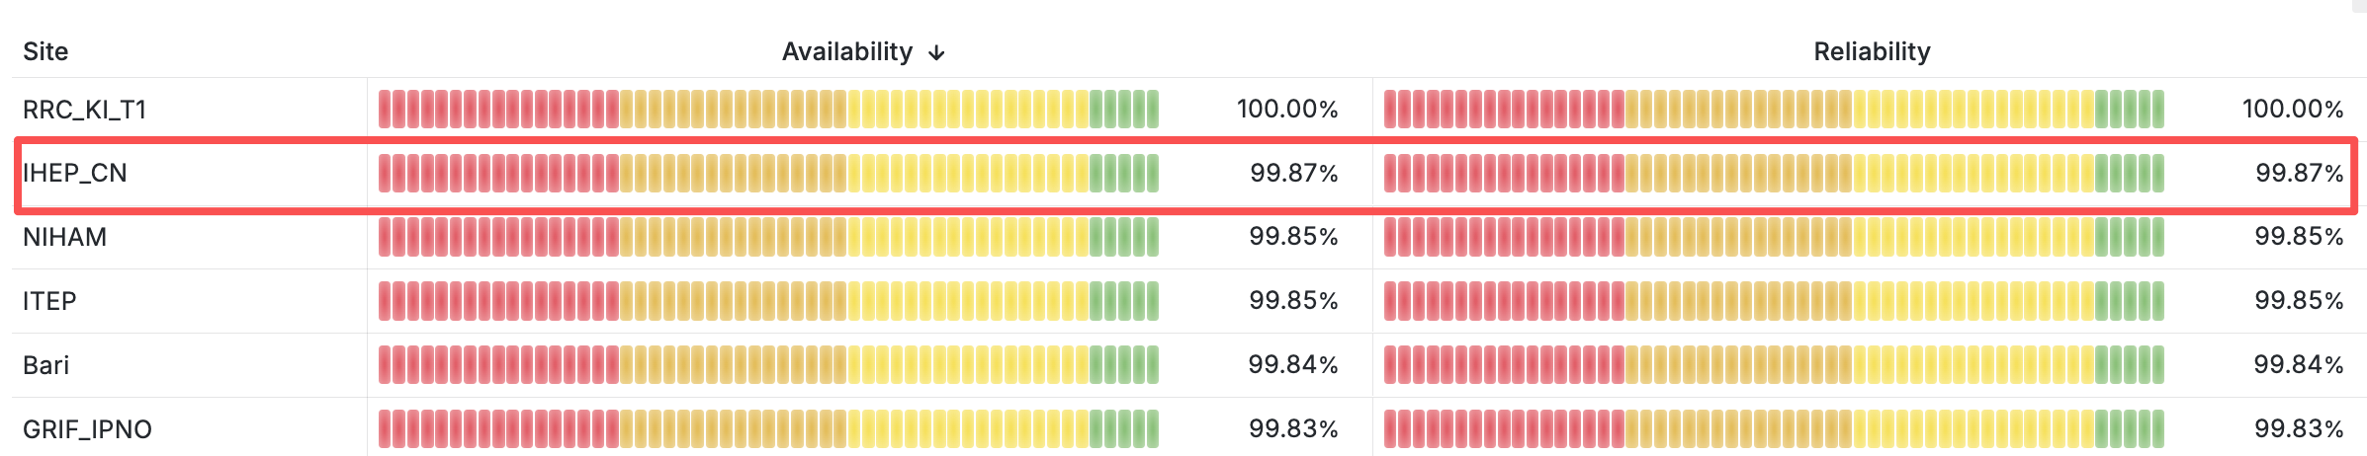
Alice Tier2 Site at IHEP – Site Information
The first large-scale ALICE Tier2 site in China, in full production since Oct. 2024
Resources are provided by Fudan University
Site management by IHEP, site rank( 2/49 ) since Oct. 2024
Computing Element | Storage Element | OS
HTCondor CE | EOS SE | AlmaLinux 9.4
CPU Cores | Disk Storage
1152, AMD | 800 TB

Slide 6
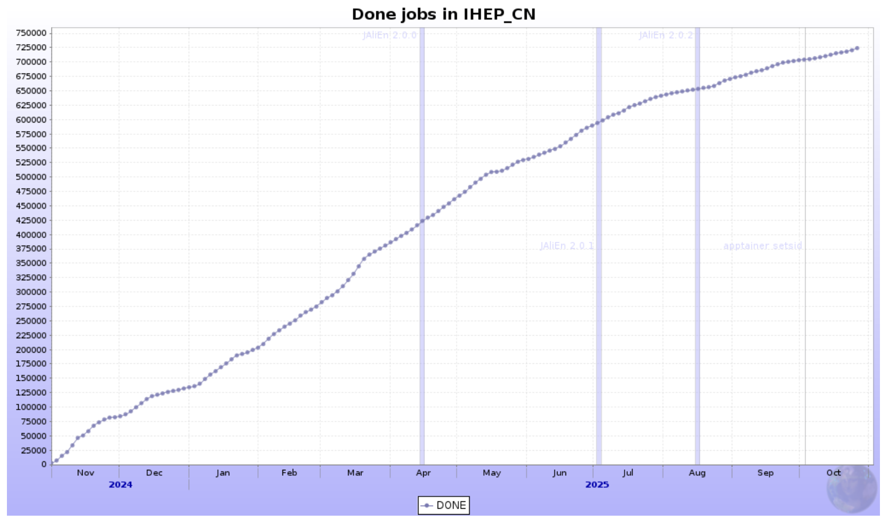
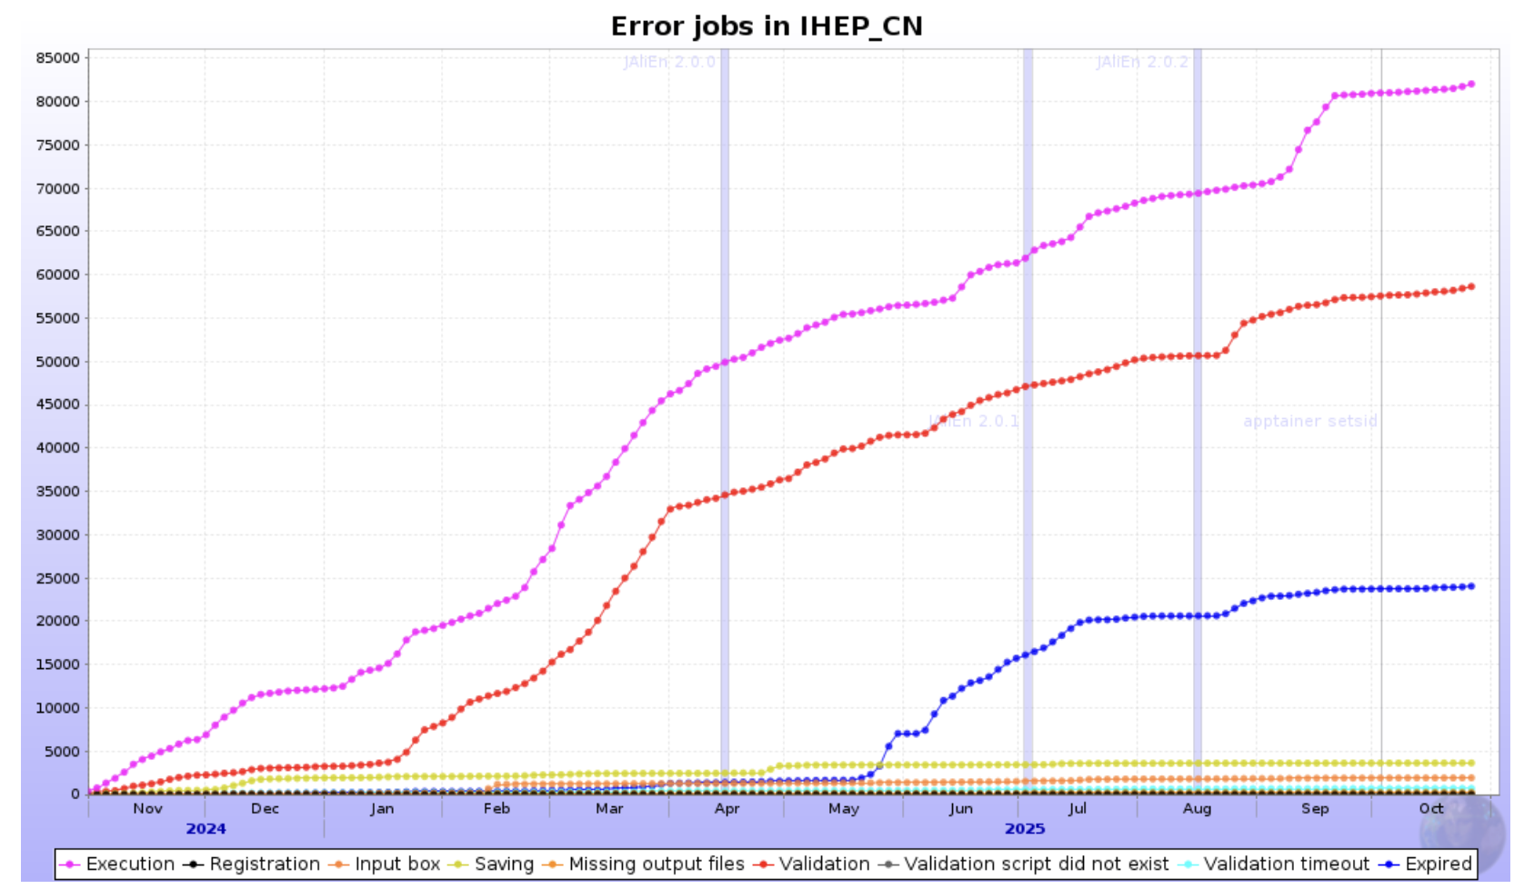
Alice Tier2 Site at IHEP - Jobs
724,203 jobs are done, ratio of success reaches 80.89%

Slide 7
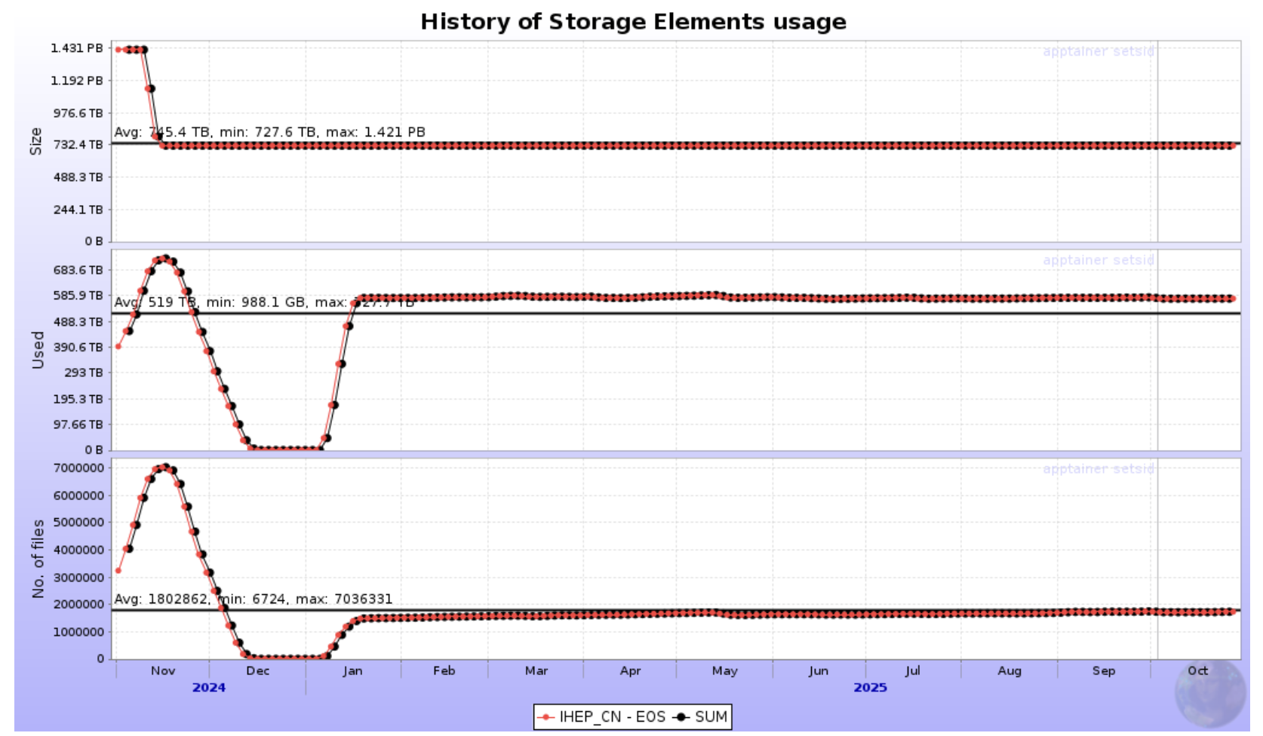
Alice Tier2 Site at IHEP - Storage
727.6 TB storage space used with 1,735,196 files

Slide 8
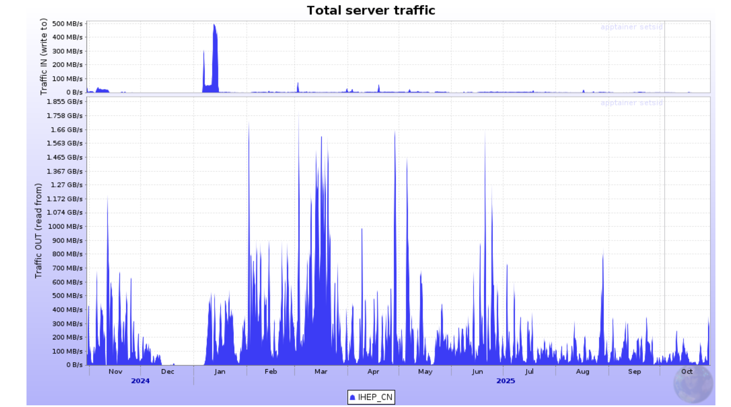
Alice Tier2 Site at IHEP – Data Transfer
262.3 TB downloaded with max throughput 3.7 GB/s
6.8 PB uploaded with max throughput 12.2 GB/s

Slide 9
Summary
Alice China Group has added two new partner institutions.
The Alice IHEP site is operated in an orderly and stable manner.
It is planned to expand storage resources according to the MOU in 2026.

Slide 10
Thanks & Questions

Slide 11
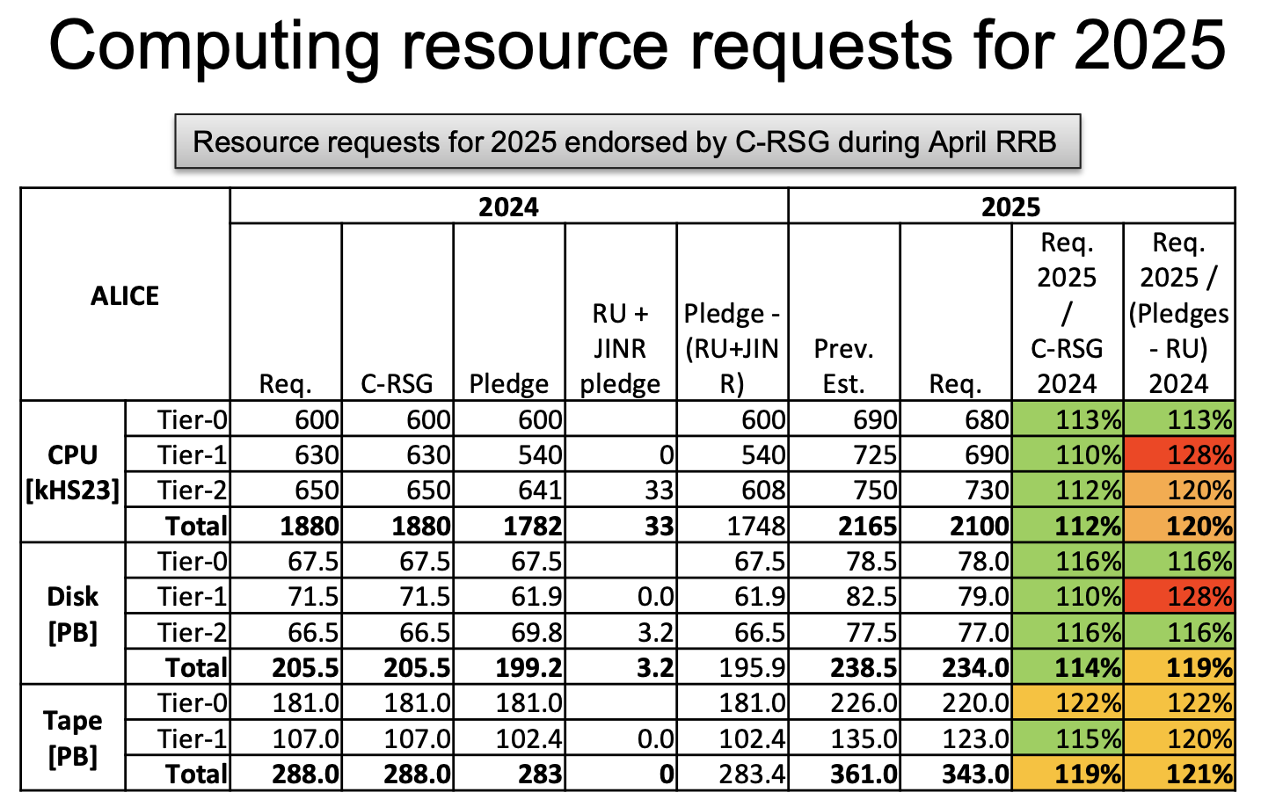
Backup: ALICE computing resource plan

