Slide 1


Observation of a family of all-charm tetraquarks at CMS
Speaker
Yilin Zhou (Fudan University & Nanjing Normal University)
Xinxiang, October 31, 2025
Yilin Zhou
CLHCP 2025
1

Slide 2
Outline
Introduction
𝐽/𝜓𝐽/𝜓 updated result
Summary

Slide 3
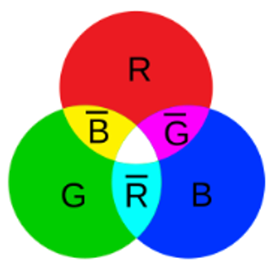
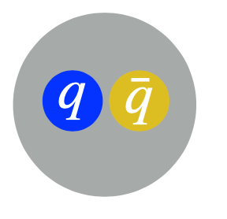
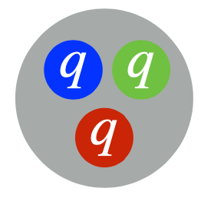
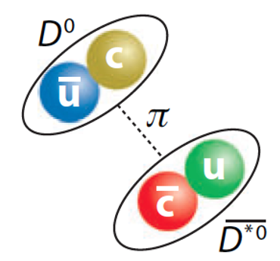

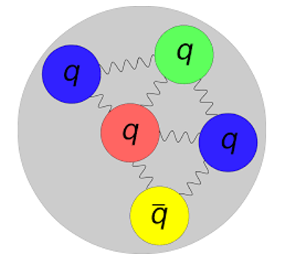
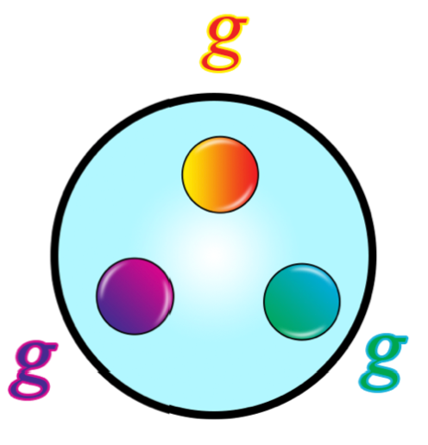
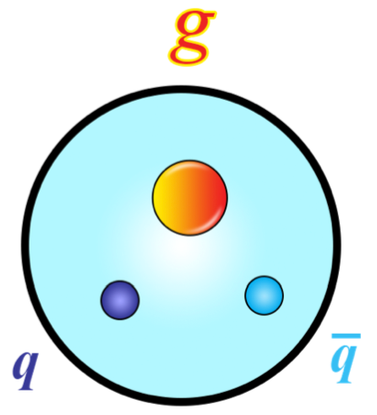
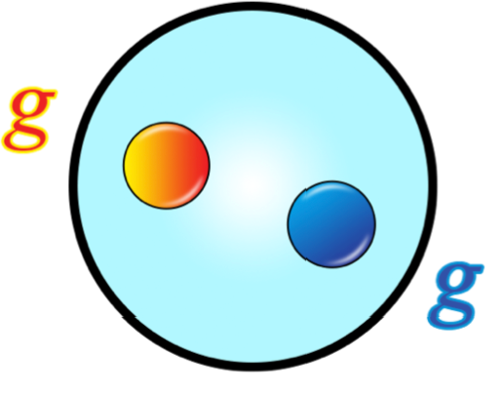
The quark model
Classical quark model
“Exotic” hadron
Color Charge
Meson
Baryon
Molecule
Diquark-antidiquark
> 60 years of classical quark model
tetraquark
pentaquark
Experimentally tested at high energies; asymptotic freedom →Nobel Prize 2004
Success of Conventional Hadrons at low energies: non-perturbative quark model (confinement) →Nobel Prize 1969
Exotic hadrons (Non-Conventional), no definitive conclusion yet
– currently a hot topic
Glueball
Hybrid
Exotic Hadrons

Slide 4
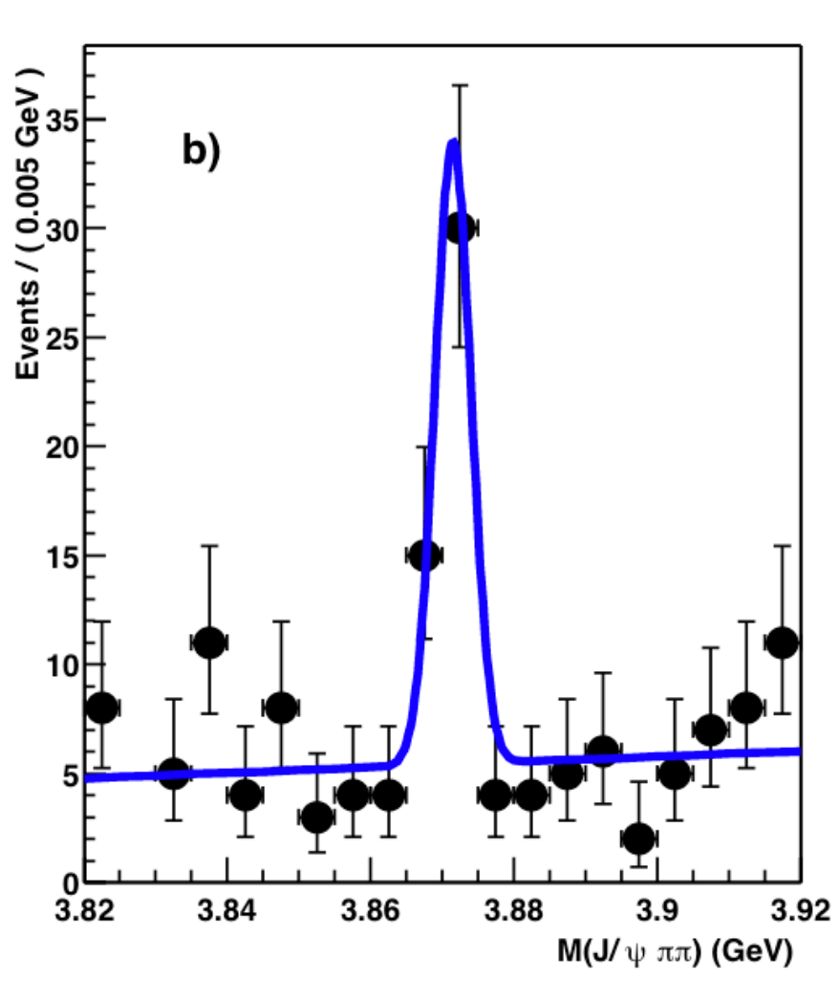
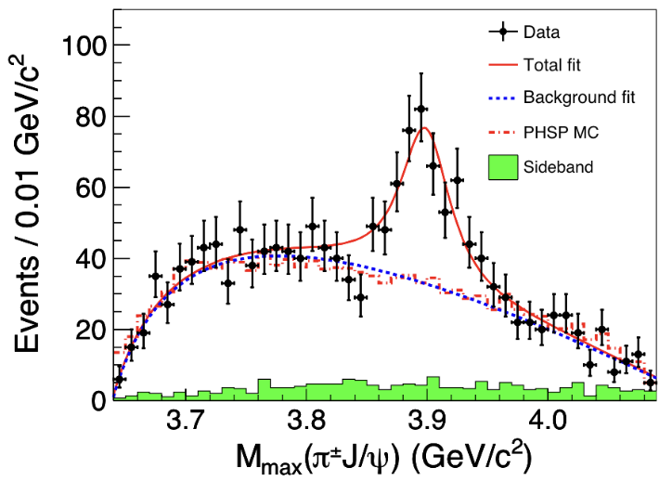


Heavy-Flavor Exotic Hadron States (XYZ Particles)
X(3872) [$uc\overline{u}\overline{c}$]
$$Z_{c}^{+}(3900)$$
24 exotic hadrons at LHC
Belle
Light exotics likely exist, but light-meson sector too messy for clear identification
Heavy-flavor exotics: larger quark mass relative to $Λ_{QCD}$, theoretical treatments more reliable
X(3872), kicked off a boom in (heavy-flavor) exotic hadron, dozens of XYZ found
Zc(3900), carries charge and couples to charmonium
Fully-heavy exotic hadrons, promising and accessible for theoretical exploration
Exotic Hadrons
Notes:
Nonperturbative multi-body systems make theoretical modeling a challenge.
Nature of XYZ remain a mystery, looking for experimental input

Slide 5
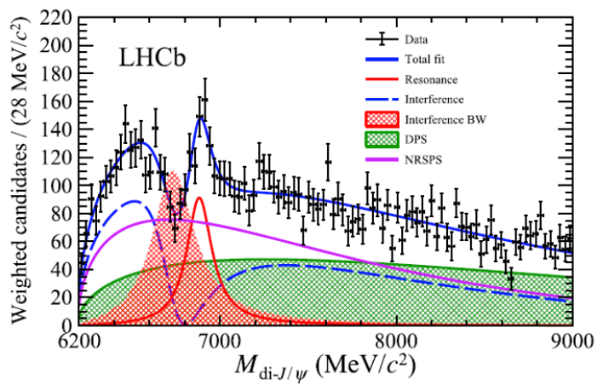
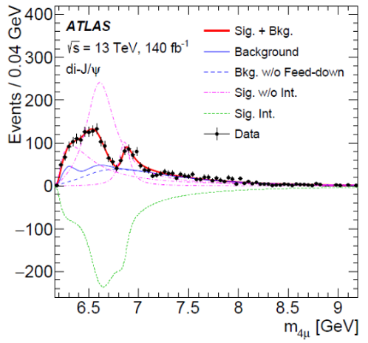
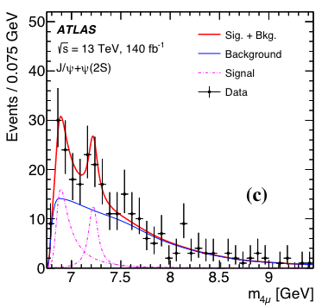
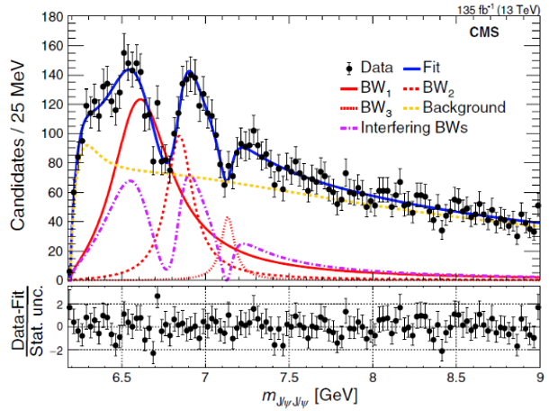
Status of of all-charm tetraquark
LHCb
ATLAS
CMS
Sci. Bull., 65(23):1983, 2020
Phys. Rev. Lett., 131(15):151902, 2023
Phys. Rev. Lett., 132(11):111901, 2024
ALL exp observe X(6900)
+ additional structure
Hump @ 6.6 GeV: Different modeling
Hint @ 7.2 GeV: LHCb not consider; ATLAS 3σ hint in $J/ψψ(2S)$
CMS first observed X(6600) & evidence of X(7100)
All exp use interference, but in diff ways
Exotic Hadrons

Slide 6
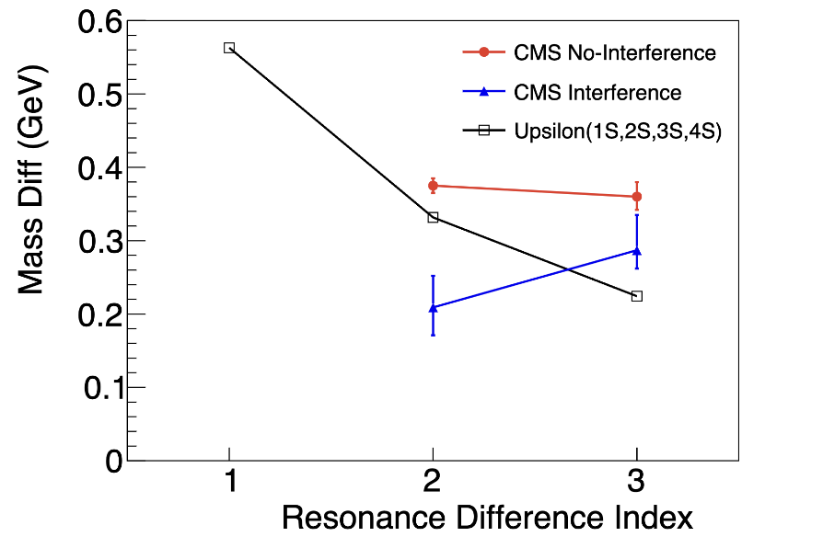
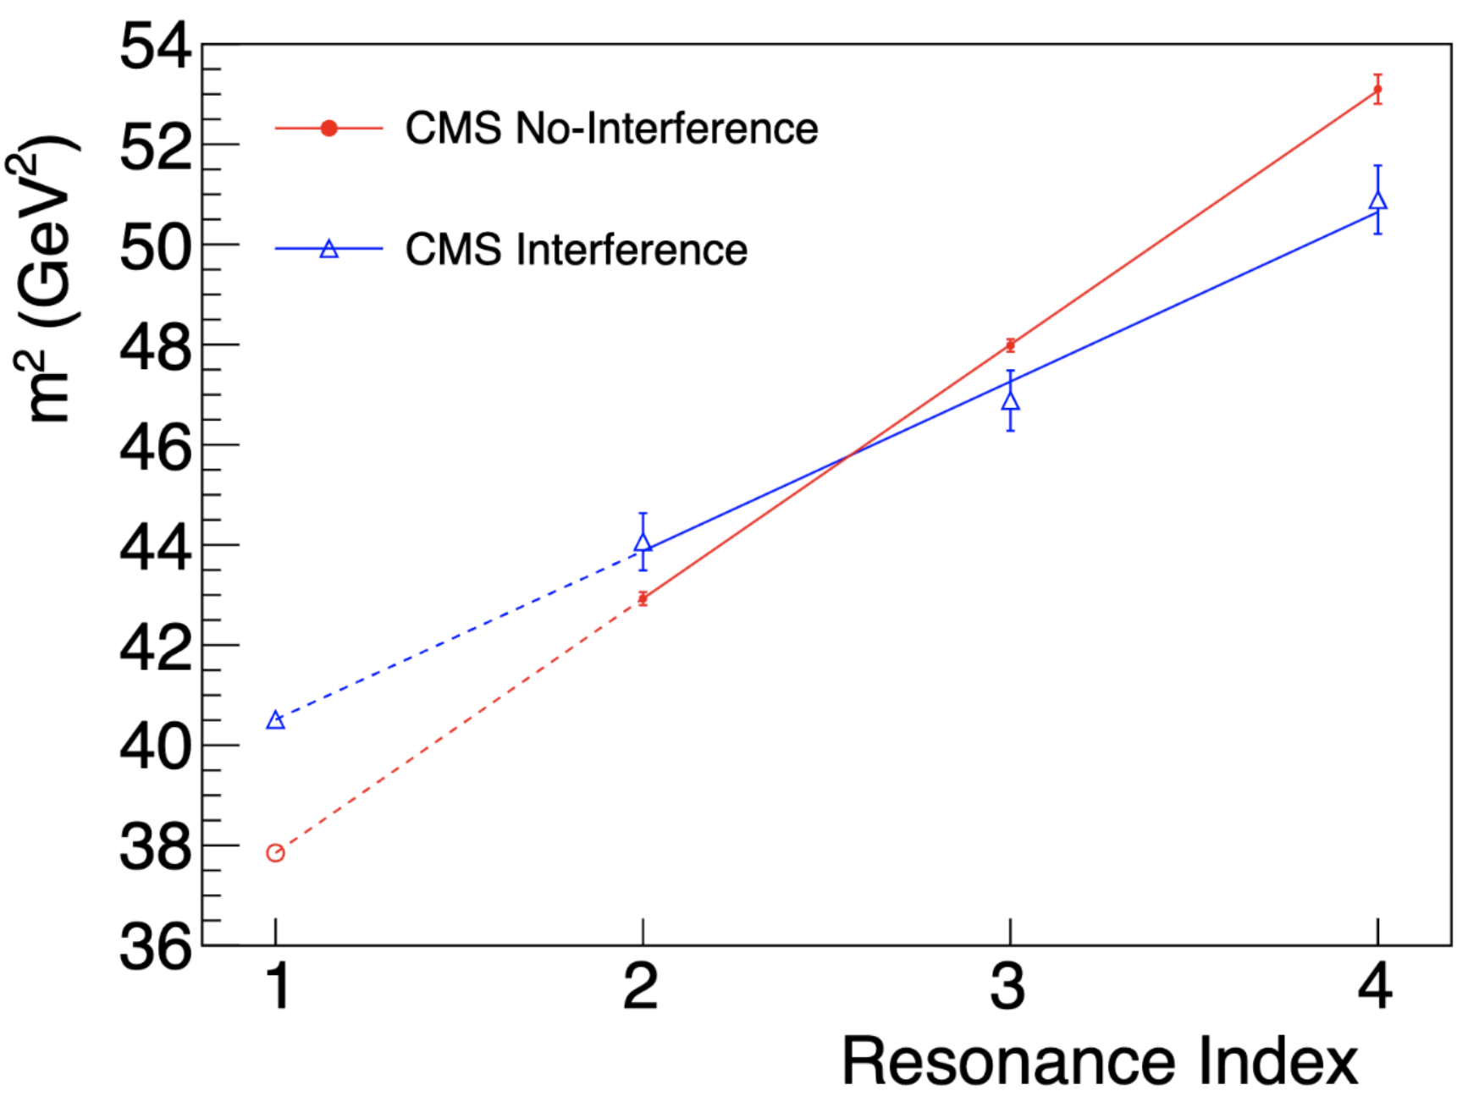
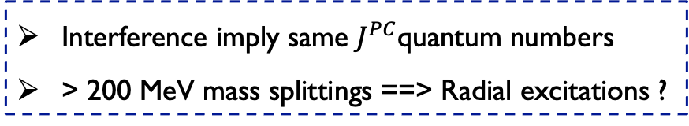


CMS Run 2 Result
CMS Run 2 mass spectrum
CMS Run 2 Regge plot
Phys. Rev. Lett., 132(11):111901, 2024
Run II
$Υ$ Family
Res. Diff Indices:
1: Y(2s)-Y(1s)
2: Y(3s)-Y(2s), X(6900)-X(6600)
3: Y(4s)-Y(3s), X(7100)-X(6900)
Chinese Phys. Lett. 41 111201
Run 2 result:
X(7100): 4.7σ
Interference < 4σ
Interference imply same $J^{PC}$quantum numbers
> 200 MeV mass splittings ==> Radial excitations ?
With 3.6X statistics:
ALL states over 5σ ?
Interference over 5σ ?
Cornell Model:
$V\left(r\right)=−\frac{4}{3}\frac{α_{s}}{r}+ σr$ + …
A radial FAMILY of all-charm tetraquark states with same $J^{PC} ?$
Exotic Hadrons

Slide 7
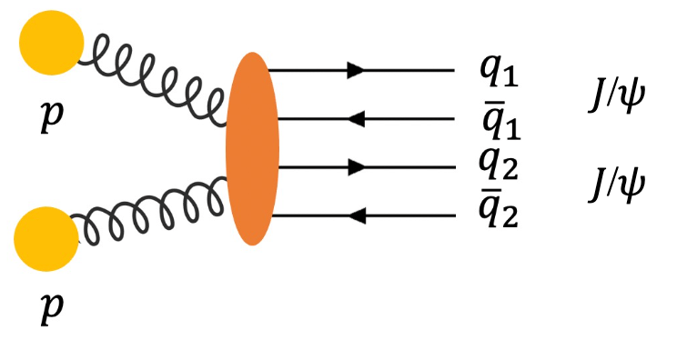
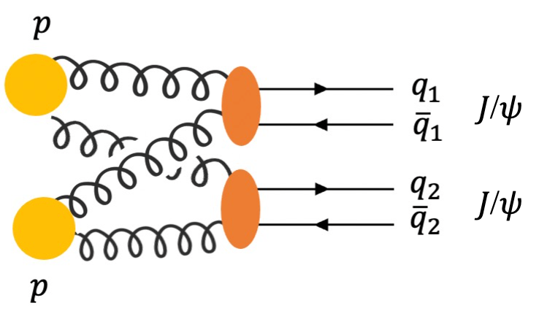

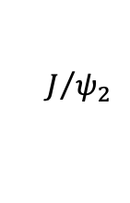
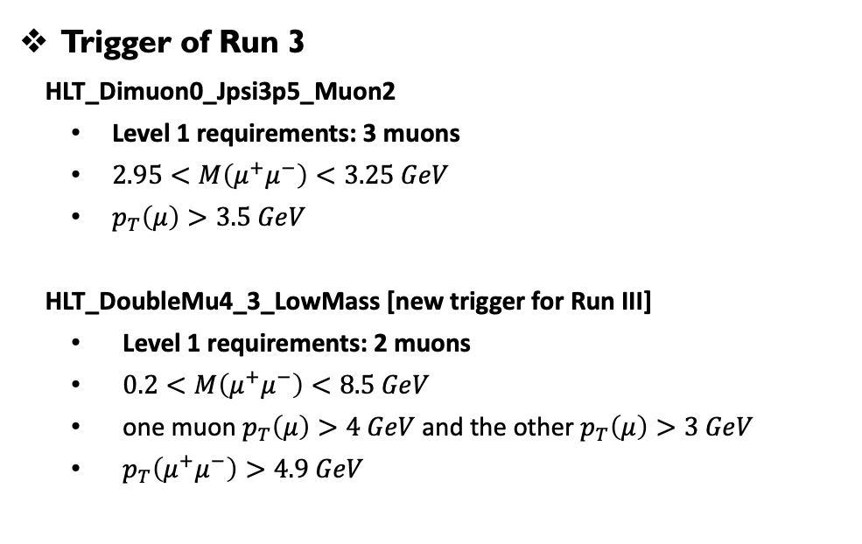

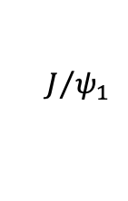





𝐽/𝜓𝐽/𝜓: Datasets, MC, trigger, and event selection
Data samples [315 fb⁻¹]
Run 2: 135 fb⁻¹ data taken in 2016, 2017 and 2018.
Run 3: 180 fb⁻¹ data taken in 2022, 2023 and 2024.
Trigger of Run 3
HLT_Dimuon0_Jpsi3p5_Muon2
Level 1 requirements: 3 muons
$2.95<M\left(μ^{+}μ^{−}\right)<3.25 GeV$
$p_{T}\left(μ\right)>3.5 GeV$
HLT_DoubleMu4_3_LowMass [new trigger for Run III]
Level 1 requirements: 2 muons
$0.2<M\left(μ^{+}μ^{−}\right)<8.5 GeV$
one muon $p_{T}\left(μ\right)>4 GeV$ and the other $p_{T}\left(μ\right)>3 GeV$
$p_{T}\left(μ^{+}μ^{−}\right)>4.9 GeV$
Signal and Background simulated events:
Signal $X→J/ψJ/ψ→μ^{+}μ^{−}μ^{+}μ^{−}$by JHUGen
NRSPS, DPS by Pythia8 or event-mixing
Feeddown by Pythia8: $X\left(6900\right)→J/ψψ(2S)→J/ψJ/ψ+anything$
$$μ_{1}^{+}$$
$$J/{ψ_{1}}$$
$$X$$
$$μ_{2}^{−}$$
$$μ_{3}^{+}$$
$$μ_{4}^{−}$$
$$J/{ψ_{2}}$$
Compared to only Dimuon trigger, LowMass trigger increase 30% $J/ψJ/ψ$ statistics
Event selection of Run 3
Follow PRL cuts + A new trigger for Run 3
SPS
DPS
Feeddown from X(7100) in systematics
𝐽/𝜓𝐽/𝜓 updated result

Slide 8
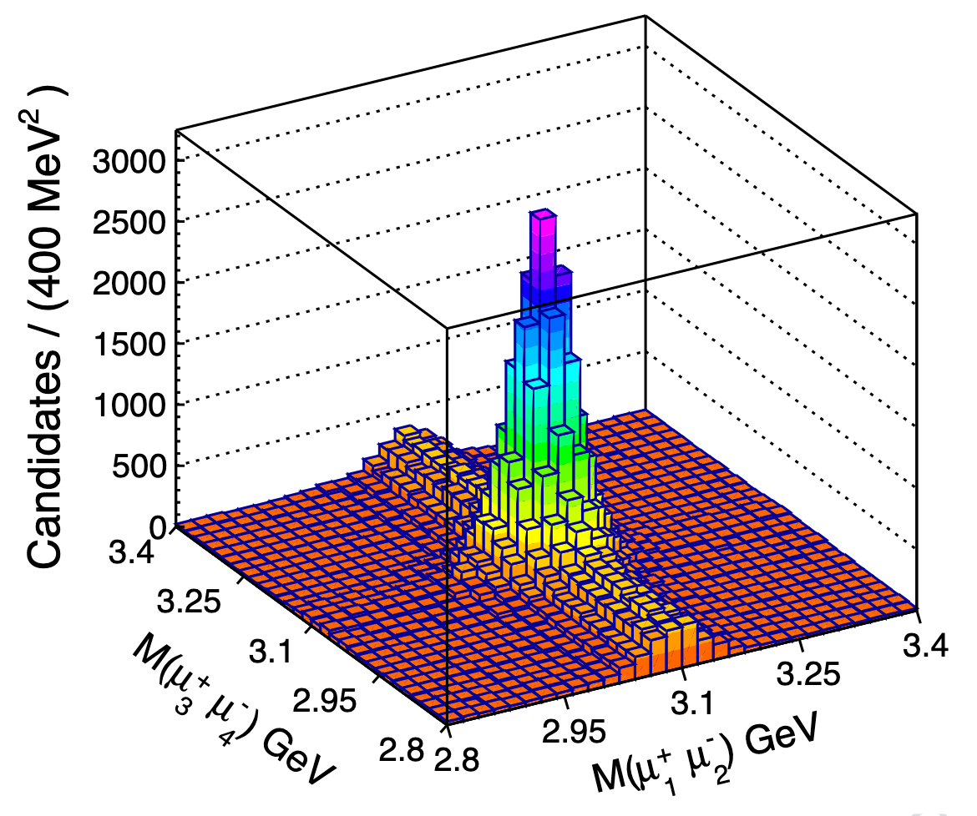


𝐽/𝜓𝐽/𝜓: Statistics of CMS Run 2+3
2D distributions of double-dimuon masses
𝐽/𝜓 signal: Double Crystal Ball
non-resonant μ⁺μ⁻: 1st-order Chebyshev polynomial
Luminosity
Run 2: 135 fb⁻¹
Run 3: 180 fb⁻¹
$J/ψJ/ψ$ yield
Run 2 ~12622 ± 165
Run 3 ~31802 ± 476
$J/ψJ/ψ$ yield per unit luminosity
Run 2 ~93 events / fb⁻¹
Run 3 ~177 events / fb⁻¹
Run 2+3 $J/ψJ/ψ$ yield is 3.6X of Run 2
Run 2+3 luminosity is 2.3X of Run 2
Baseline mass variable
– invariant mass of two constrained J/ψ candidates
𝐽/𝜓𝐽/𝜓 updated result

Slide 9
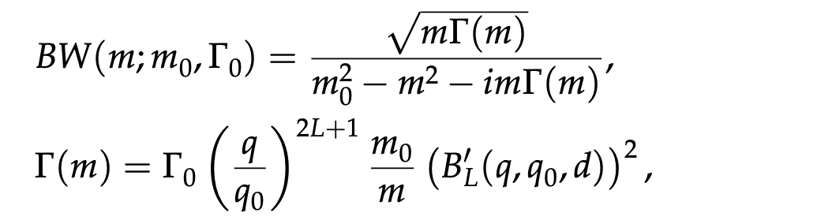
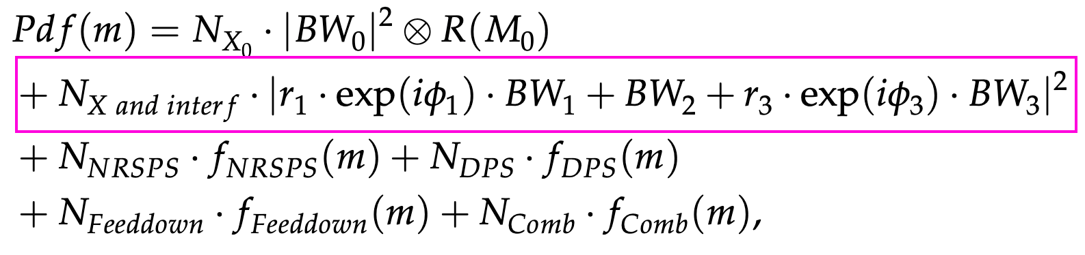
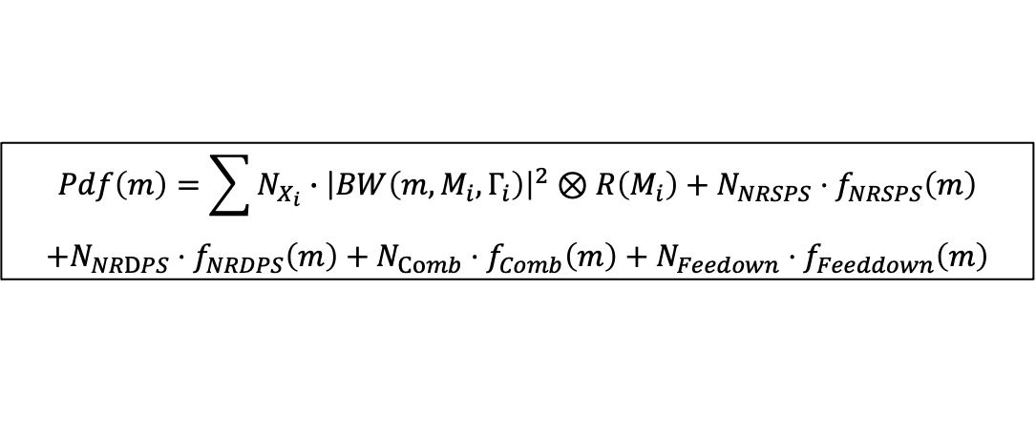
𝐽/𝜓𝐽/𝜓: Signal and Background models
Signal shape: Relativistic Breit-Wigner
Background component:
NRSPS + NRDPS + Comb + Feeddown + BW0
Non-interference model:
Signal-hypothesis: NRSPS+NRDPS+Comb+Feeddown+BW0+BW1+BW2+BW3
$$Pdf\left(m\right)=\sum{N_{X_{i}}∙{\left|BW\left(m,M_{i},Γ_{i}\right)\right|}^{2}⊗R\left(M_{i}\right)}+N_{NRSPS}⋅f_{NRSPS}\left(m\right)$$
$$+N_{NRDPS}⋅f_{NRDPS}\left(m\right)+N_{Comb}⋅f_{Comb}\left(m\right)+N_{Feedown}⋅f_{Feeddown}\left(m\right)$$
Interference model:
Signal-hypothesis: NRSPS+NRDPS+Comb+Feeddown+BW0+BW123 Interf. Term
𝐽/𝜓𝐽/𝜓 updated result

Slide 10
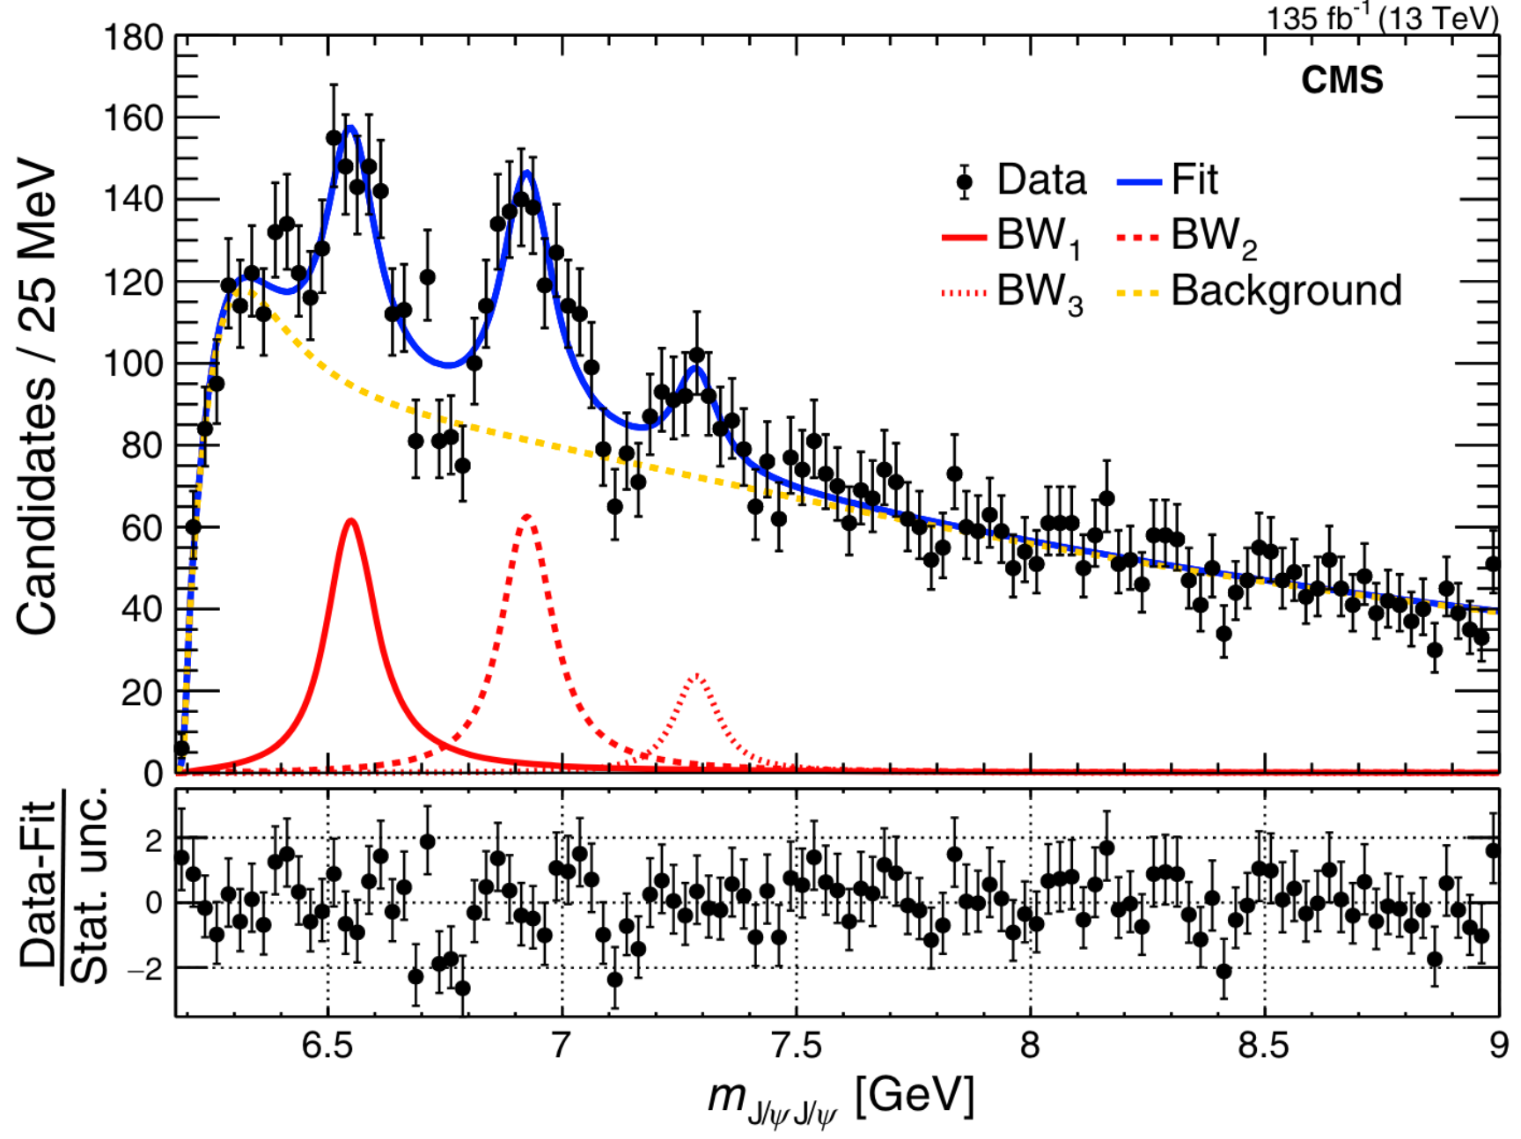
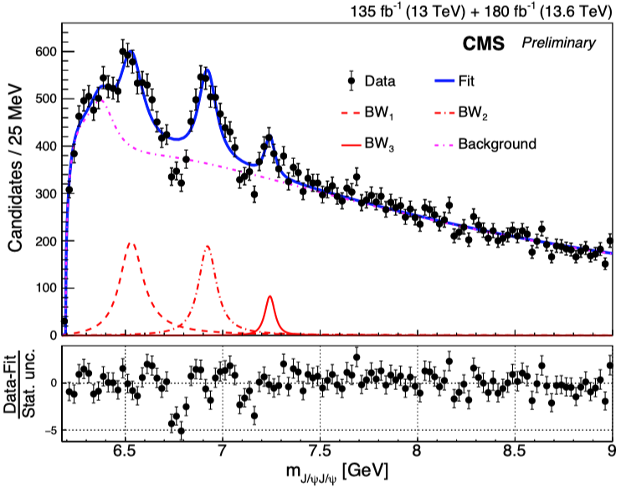
𝐽/𝜓𝐽/𝜓: Run 2+3 noninterference fit result
CMS Run 2 noninterference fit result
CMS Run 2+3 noninterference fit result
Run 2 No-Interf
Run 2+3 No-Interf
Dips poorly described — no-Interf. model no longer sufficient !
Let’s now look at the fit results including interference
𝐽/𝜓𝐽/𝜓 updated result

Slide 11
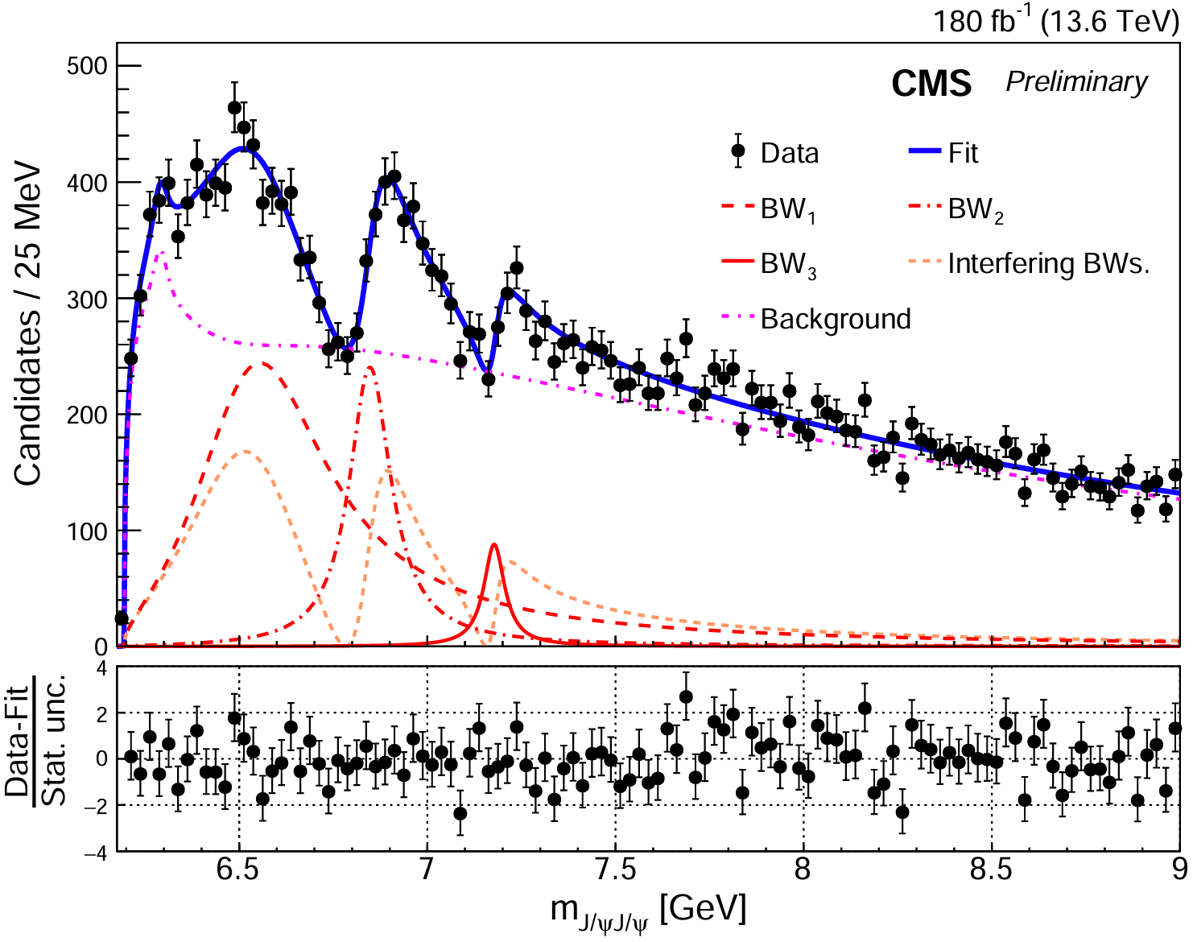
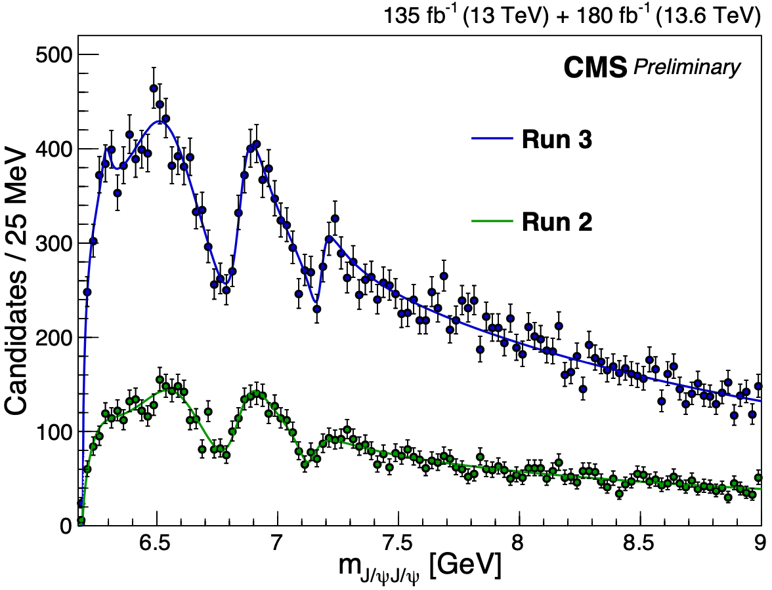
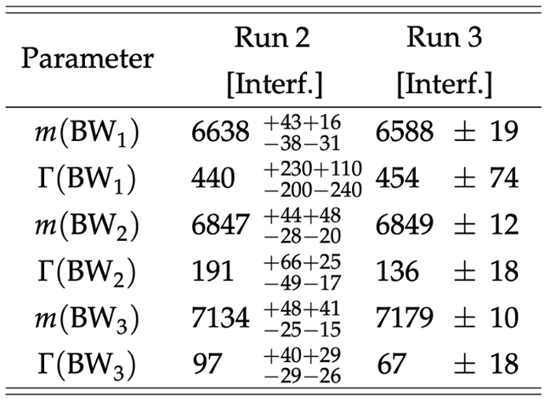
𝐽/𝜓𝐽/𝜓: Run 3 interference fit result
CMS Run 3 interference fit result
12.7σ
12.9σ
6.3σ
Dip1: 8.4σ
Dip2: 5.1σ
Confirm Run II results with Run III data only
All states and dips above 5σ !
---with better precision!
---already achieve our goals!
𝐽/𝜓𝐽/𝜓 updated result

Slide 12
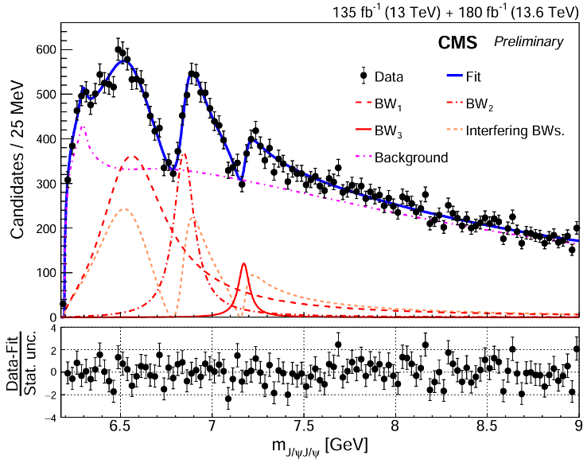
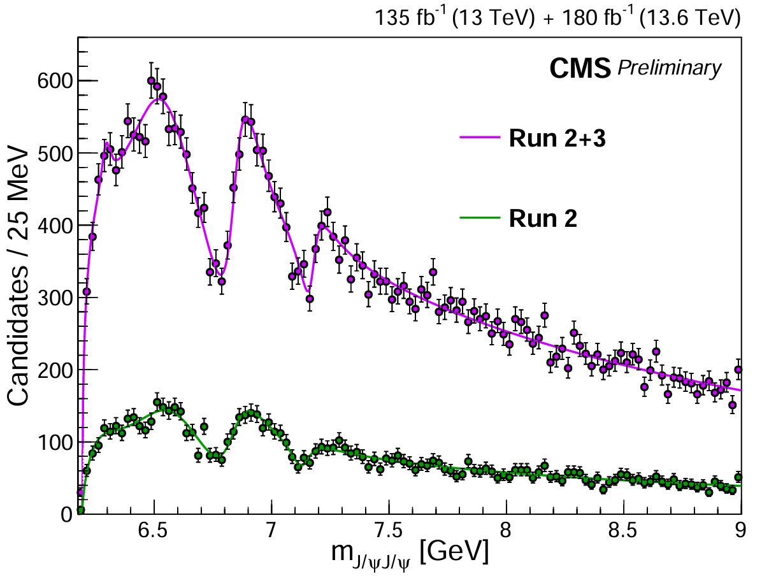
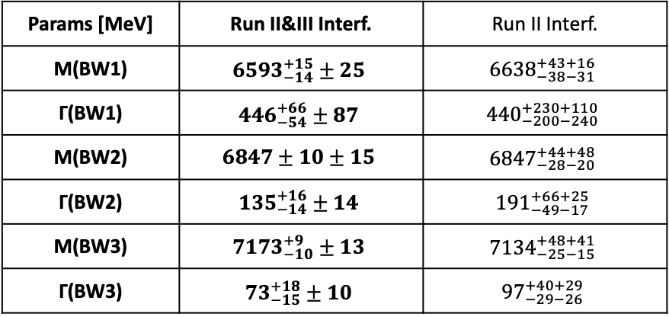
𝐽/𝜓𝐽/𝜓: Run 2+3 interference fit result
CMS Run 2+3 interference fit result
15σ
17σ
8σ
Dip1: 10σ
Dip2: 7σ
VS. Run II result:
Statistical uncertainty reduced by a factor of 3
Systematic uncertainty reduced by about a factor of 2
All states and dips well above 5σ !
Quantum interference among structures validated!
With improved precision, large mass splittings persist
𝐽/𝜓𝐽/𝜓 updated result

Slide 13
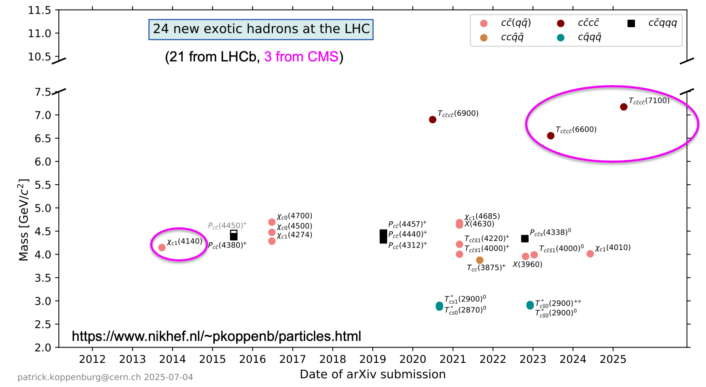
Summary
Summary

Slide 14
Summary
A family of all-charm tetraquarks
X(6600), X(6900), and X(7100) well above 5σ
Quantum interference among structures validated well above 5σ
Large mass splittings, more precisely
==> Multiple states makes comparisons possible
Studied 𝐽/𝜓𝜓(2S) channel with Run2+3 data (see plenary talk by Jingqing Zhang and Liangliang’s poster)
==> States have common $J^{PC}$
Measurement of spin-parity reveals their J^{PC} = 2⁺⁺ (Details in poster by Xining Wang)
==> radial family of states
CMS is painting a coherent picture of all-charm tetraquark structures!
THANKS!
Summary

Slide 15
BACKUP
Yilin Zhou
15

Slide 16
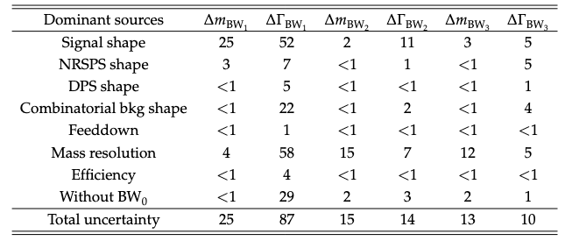
𝐽/𝜓𝐽/𝜓 Run II & III interference fit result
CMS Run 2+3
15σ
17σ
8σ
Dip1: 10σ
Dip2: 7σ
BACKUP

Slide 17
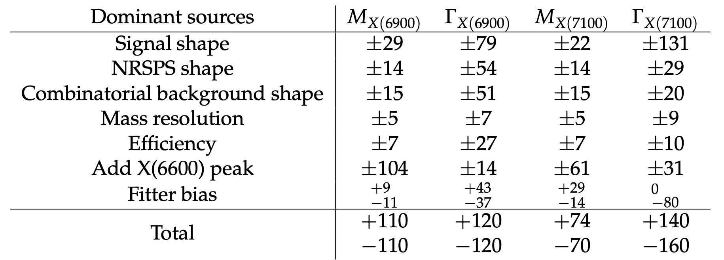
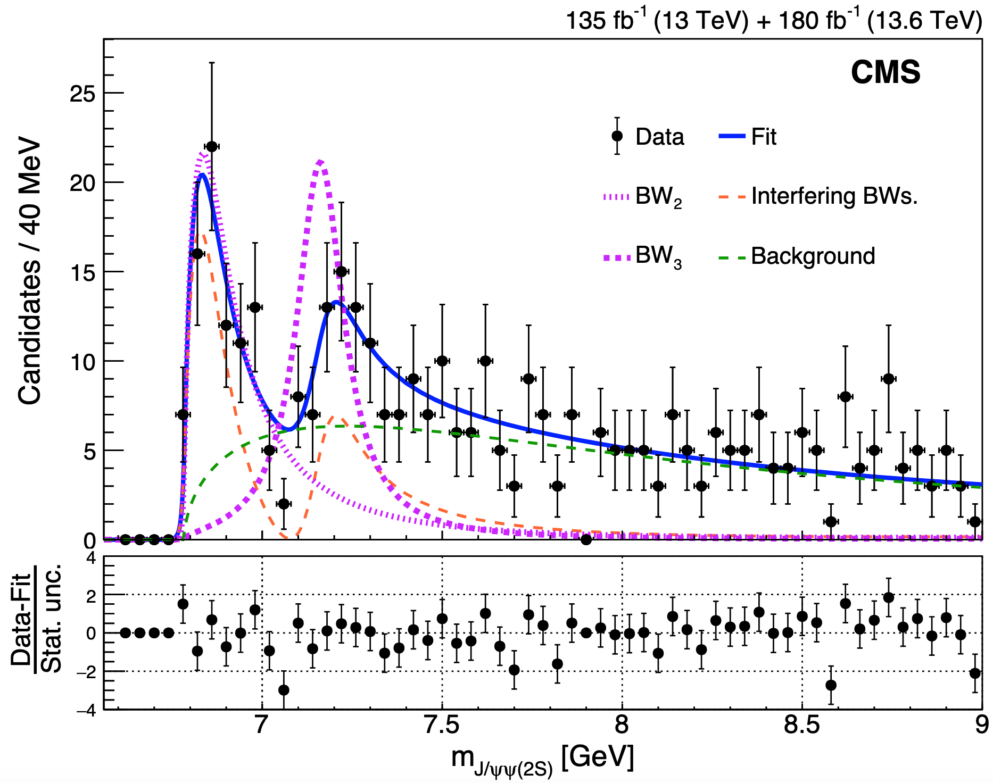

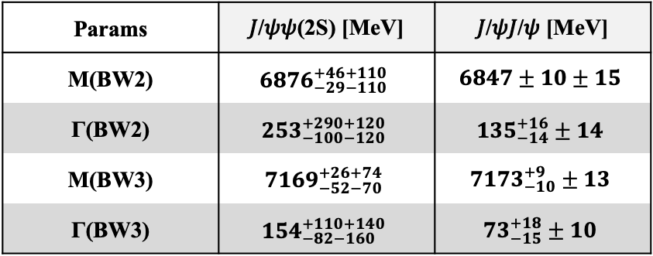
𝐽/𝜓𝜓(2S) Run II & III interference fit result
CMS Run 2+3
Params | 𝐽/𝜓𝜓(2S) [MeV] | 𝐽/𝜓𝐽/𝜓 [MeV]
M(BW2) | $${6876}_{−29−110}^{+46+110}$$ | $$6847±10±15$$
Γ(BW2) | $${253}_{−100−120}^{+290+120}$$ | $${135}_{−14}^{+16}±14$$
M(BW3) | $${7169}_{−52−70}^{+26+74}$$ | $${7173}_{−10}^{+9}±13$$
Γ(BW3) | $${154}_{−82−160}^{+110+140}$$ | $${73}_{−15}^{+18}±10$$
Significance of X(6900) = 7.9σ
Significance of X(7100) = 4.0σ
ATLAS only claim X(6900) 4.7σ in 𝐽/𝜓𝜓(𝟐𝐒) channel
𝐽/𝜓𝜓(2S) result

