Slide 1




Progress of the HL-LHC accelerator and contribution from China
Qingjin Xu, IHEP-CAS
For the HL-LHC MCBRD Magnet Team
The 11th China LHC Physics Conference (CLHCP2025), Xinxiang, 1 November 2025

Slide 2
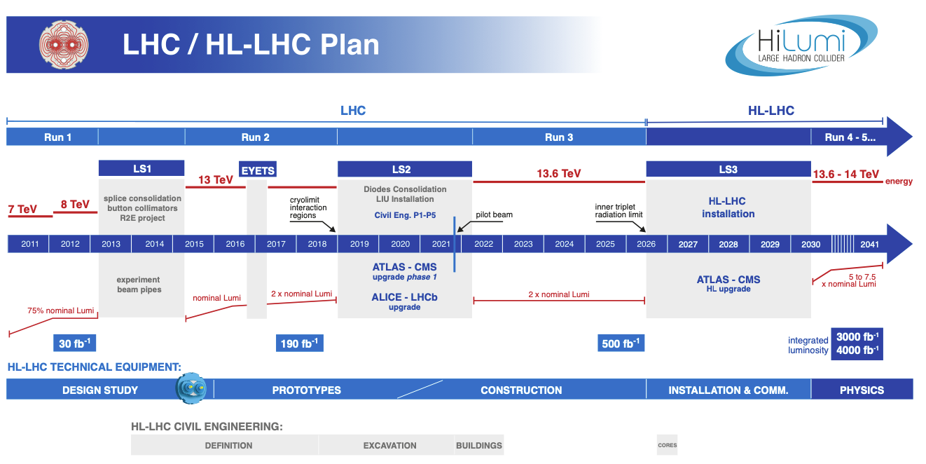
EU funded HiLumi
Design Study
Approval of
HL-LHC Project
We are here
HL-LHC Operation
Run3 operation

Slide 3
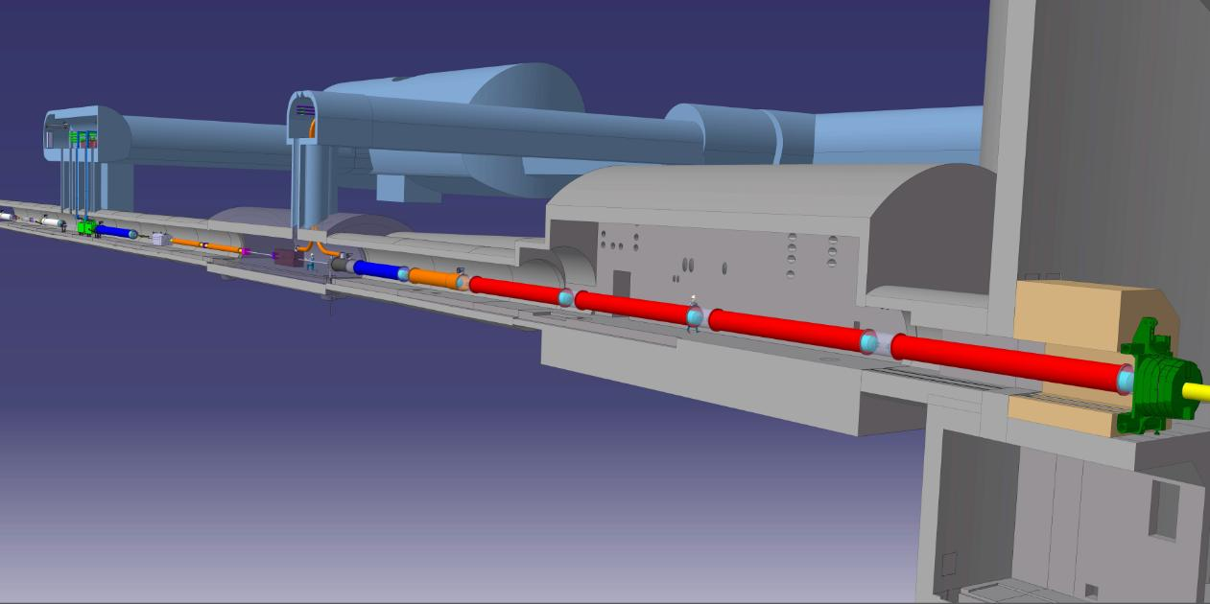







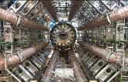


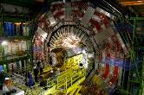
The Insertion Region (up to Q4)
Connection to LHC (UL)
Service gallery (UR)
UA Gallery
Service cavern
SC Links
Q4
Collimators
D2
Crab cavities
D1
CP
Q3
TAXN
DFM
DFX
Q2b
Q2a
Q1
TAXS
O. Brüning @ HL-LHC Annual meeting in Geneva, 29th September 2025

Slide 4
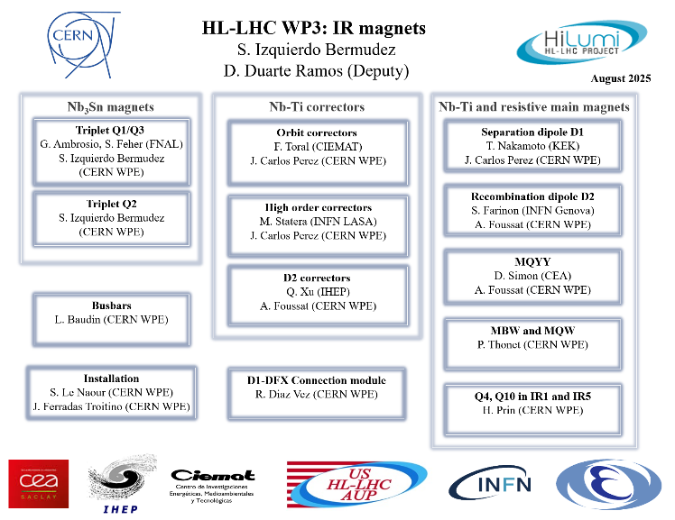
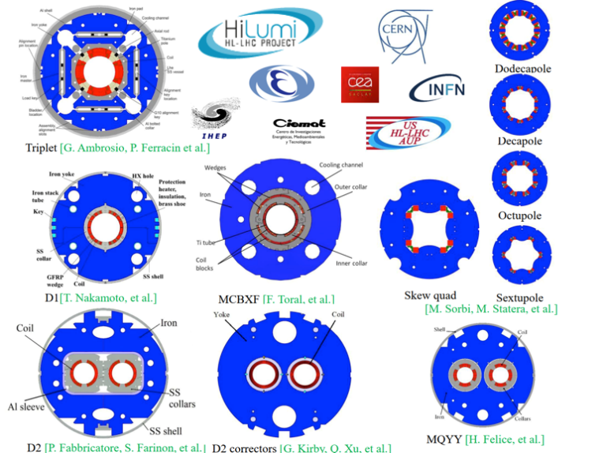
WP3 Scope
Susana Izquierdo Bermudez @ HL-LHC Annual meeting in Geneva, 29th September 2025

Slide 5
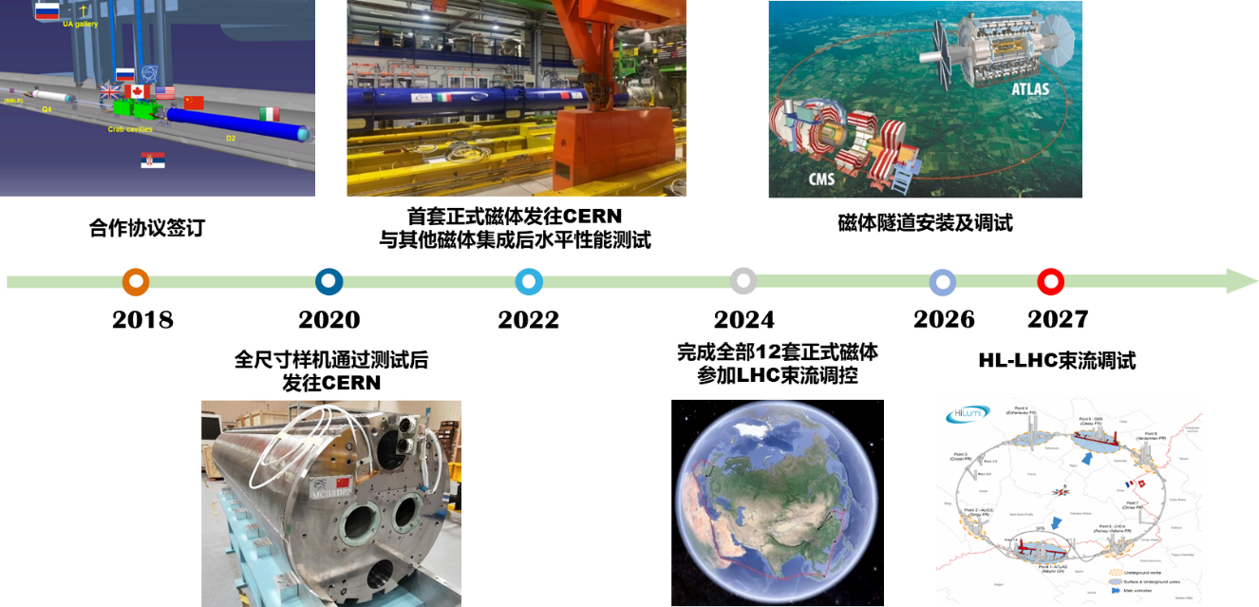
Time Schedule

Slide 6
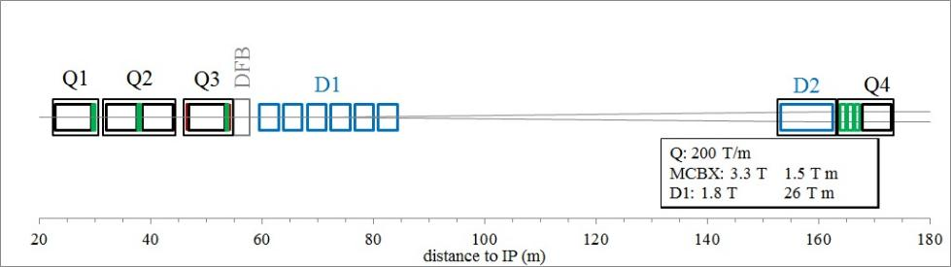

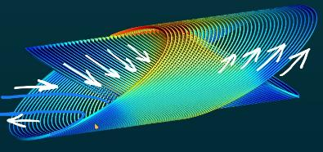
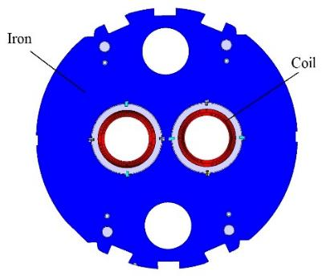
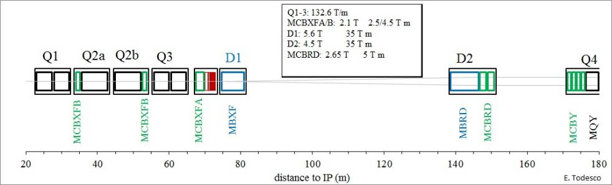
MCBRD: the HL-LHC D2 orbit correctors, 12+1 units, providing a 5 Tm integrated field in two apertures, vertical in one and horizontal in the other.
The first application of the CCT magnets in an accelerator
LHC 2008-2022
E. Todesco
HL-LHC 2026-2035

Slide 7



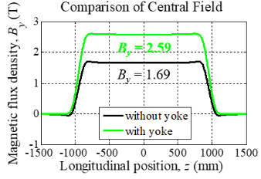


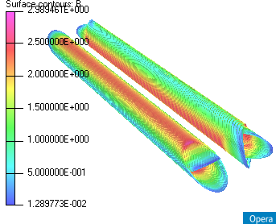
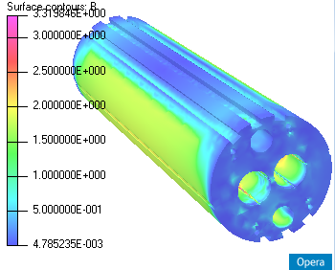
Main Design Parameters
Items | Values
CCT skew angle | 30°
No. of turns per layer | 365
Slot size in former (mm) | 2×5 (10 NbTi wires connected in series)
Spacing per turn | 5.222
Inside/Outside diameter of the former (mm) | Inner former:105.35/119.35 Inner former:120.80/134.85
Inside diameter of the groove/slot(mm) | 1st layer: 109.15/119.15 2nd layer: 124.65/134.65
Reference radius (mm) | 35
Diameter of aperture (mm) | 105
Current (A) | 395
Cooling hole
Hole for tie rod
Hole for fixing pin
Aperture
Yoke alignment
CCT Coils
Ø 614 mm
Items | Values
Diameter of yoke (mm) | 614
Thickness of yoke lamination (mm) | 5.8
Diameter of aperture (mm) | 167
Position of aperture (mm) | 94.19
Yoke key slot(mm) | 8(3.01) ×6
Diameter of cooling hole (mm) | 110
Position of cooling hole (mm) | 205

Slide 8
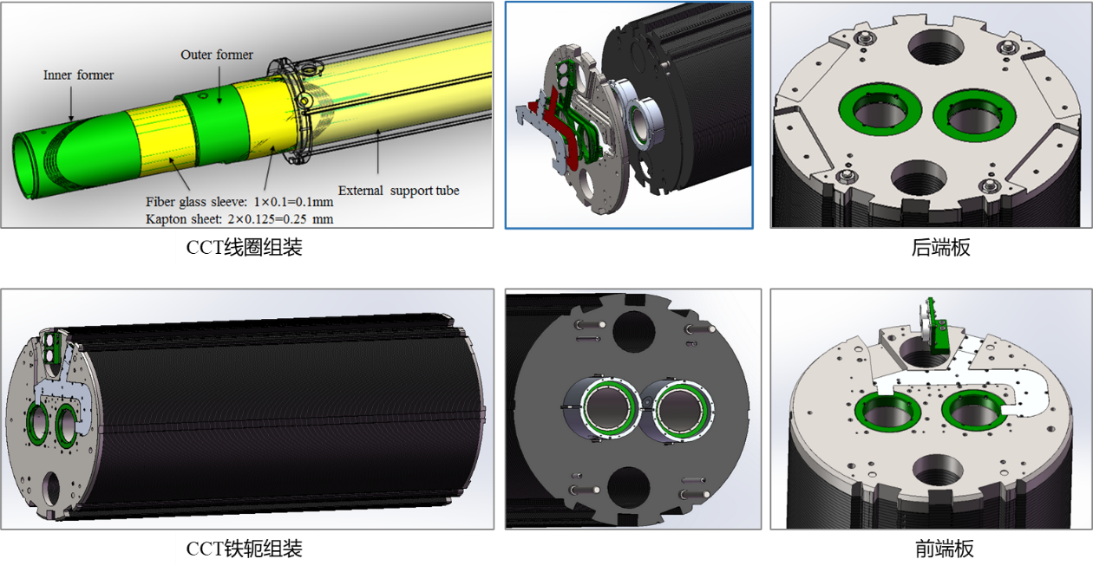
Mechanical Structure
双层超导线圈+外支撑筒，共用轭铁结构

Slide 9
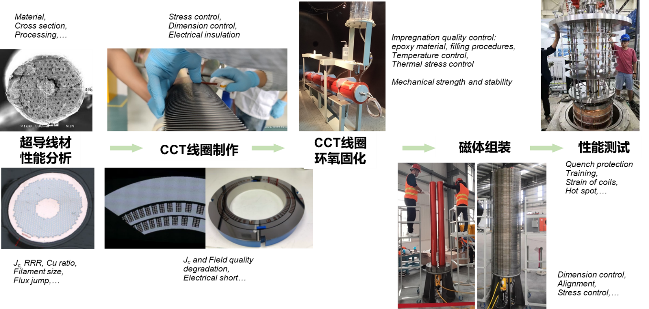
Development Scheme
HL-LHC CCT磁体：从超导线材到线圈、磁体，实现核心部件完全国产化

Slide 10
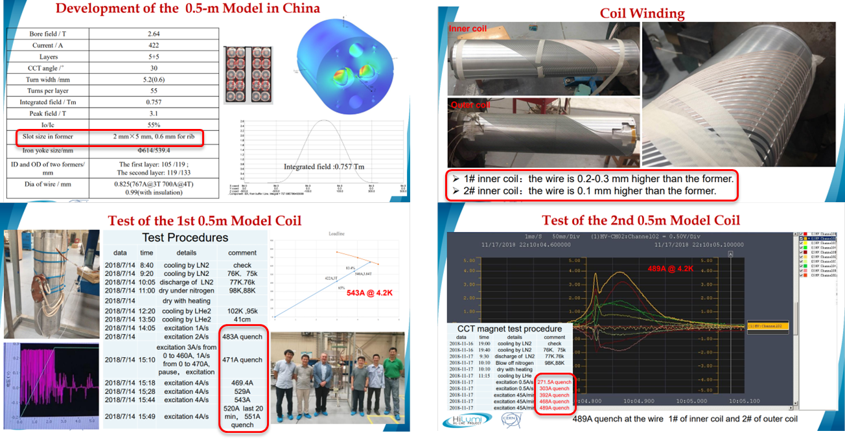
Development of Subscale CCT Coils
2018年完成两台缩尺线圈样机研制，性能远超设计指标

Slide 11
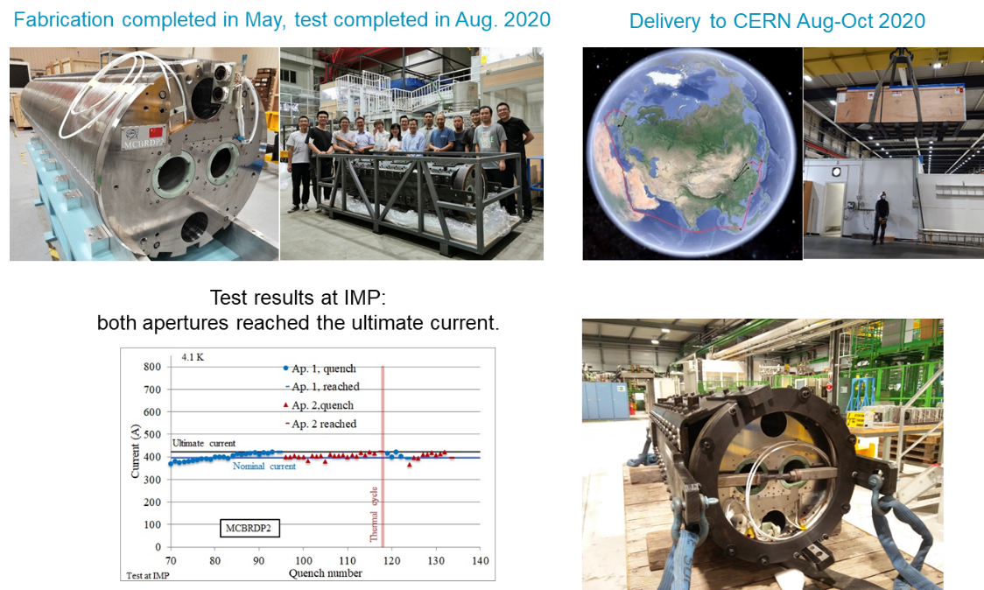
Development of Full-scale Prototype
2020年完成国内首台全尺寸磁体样机研制，性能达到设计指标

Slide 12
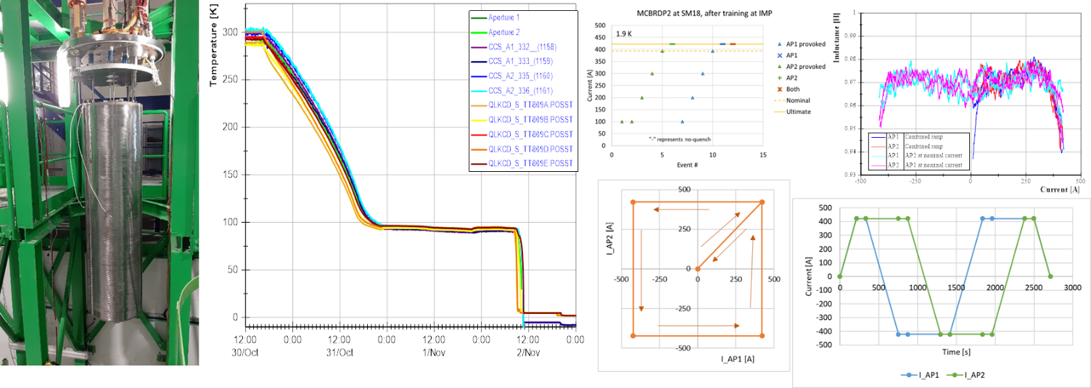
Development of Full-scale Prototype
国内首台全尺寸磁体样机，CERN确认性能达到设计指标
CERN性能复测：场强、场质量及长时间运行稳定性均达到要求
“Each aperture, individually and combined, arrived to ultimate current without quench”
“Operation range test checked without quench”

Slide 13
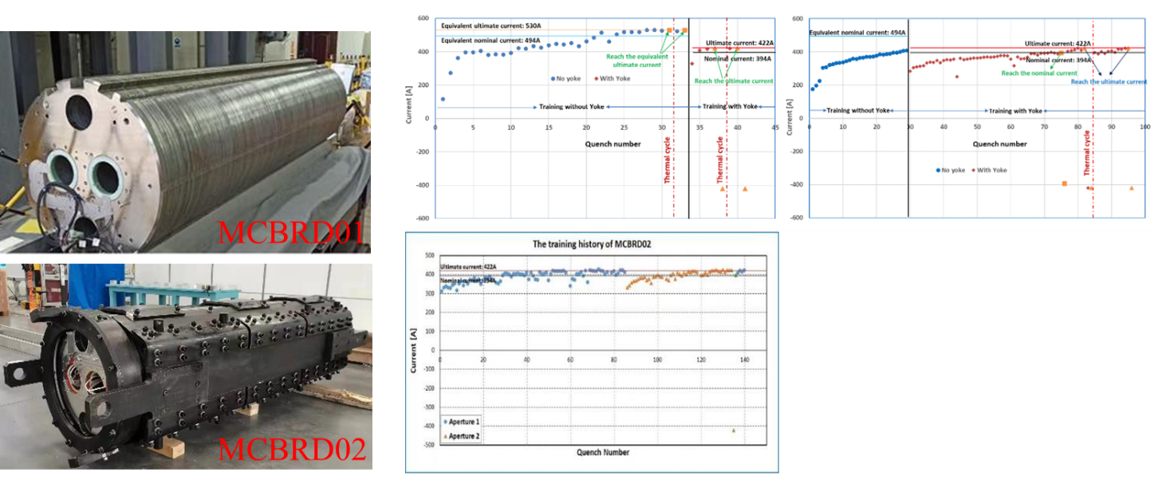
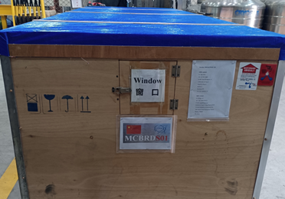
Mass Production
首套量产CCT磁体性能达标，2021年10月运往欧洲；2025年底前完成所有磁体交付

Slide 14
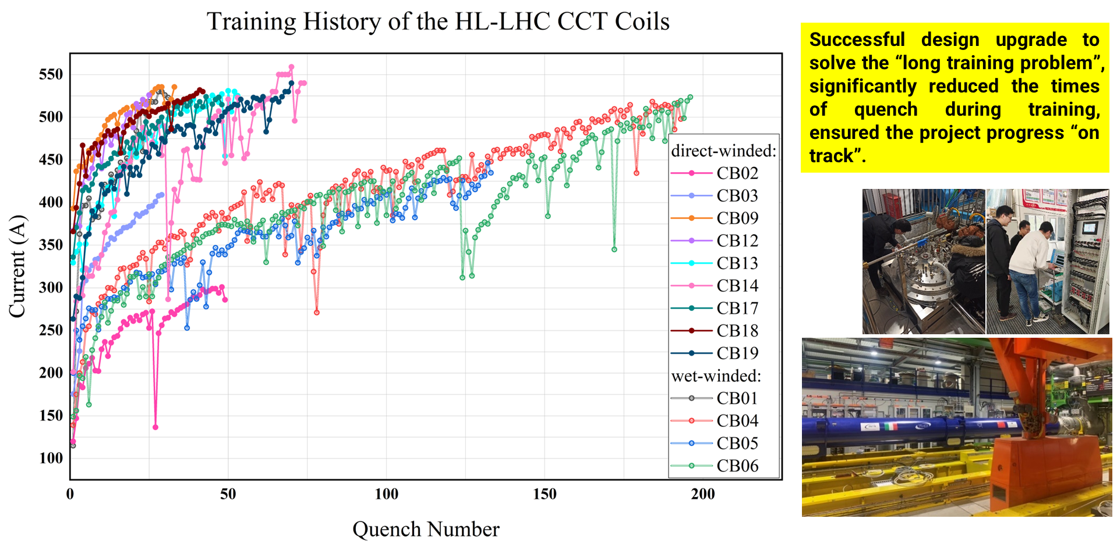
Problems and Solutions During Mass Production

Slide 15
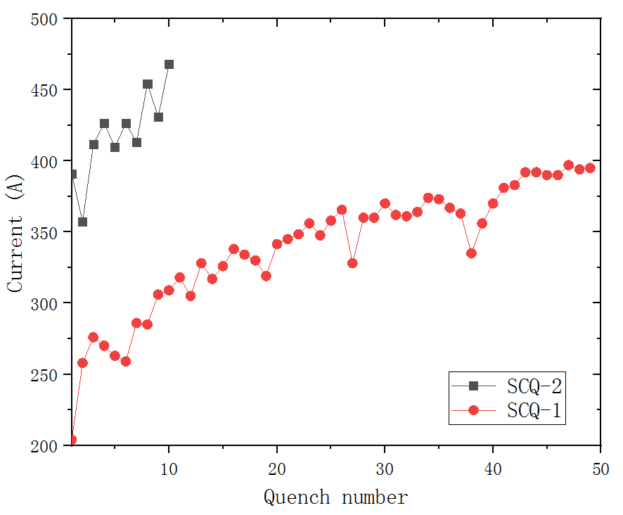
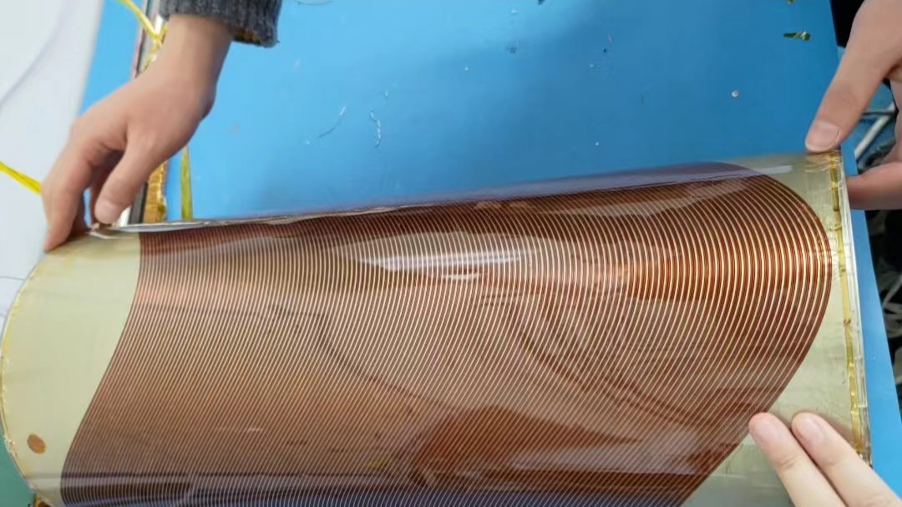
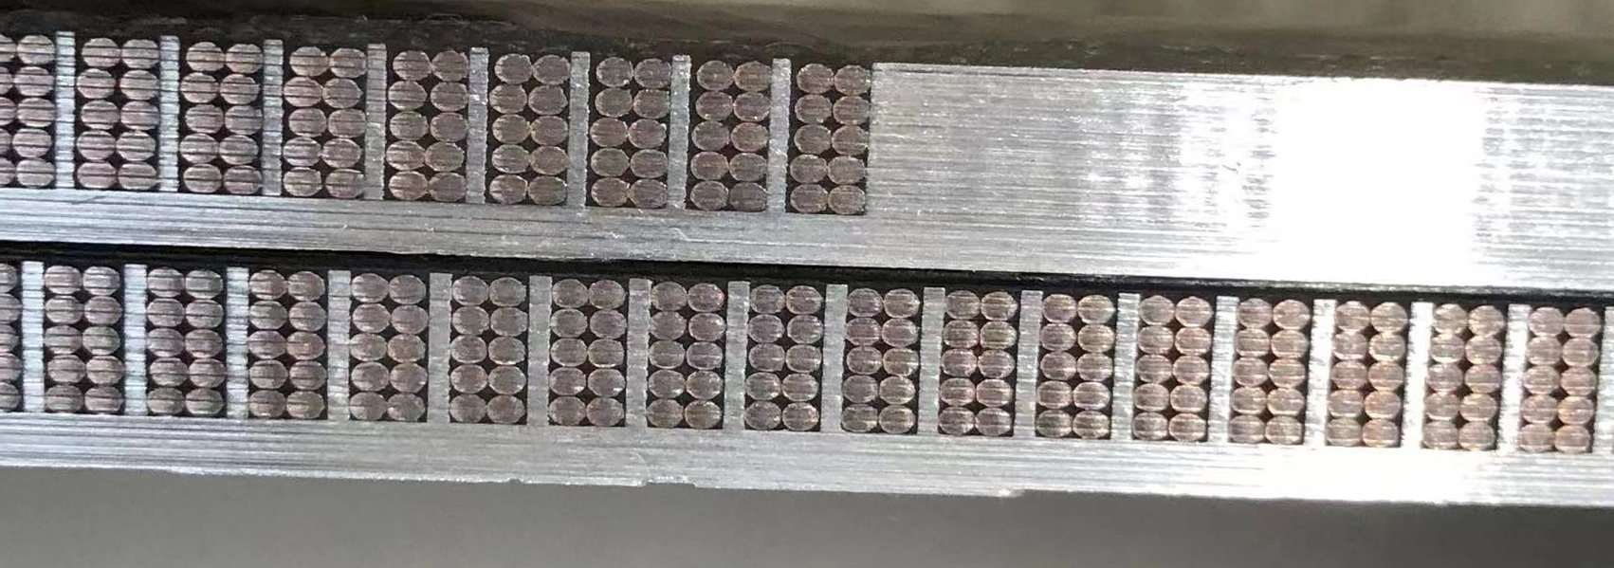
Problems and Solutions During Mass Production
“long training”问题解决方案CCT四极线圈验证，确认了解决方案的有效性及普适性
Performance of SCQ-CCT coils
Well impregnated magnet SCQ-1 experienced long training
With the modified channel size, the training performance of SCQ-2 significantly improved.

Slide 16
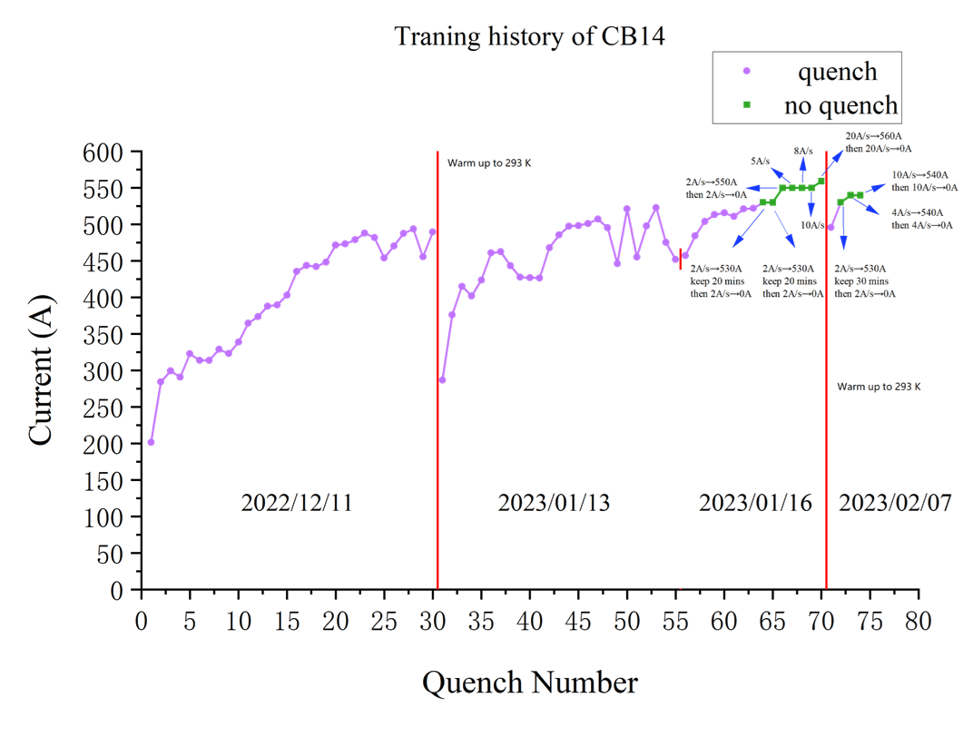
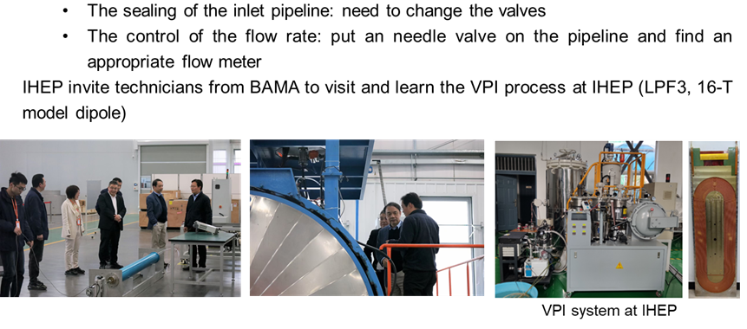
Problems and Solutions During Mass Production
解决了CCT超导线圈“detraining”问题
参照高能所高场超导磁体VPI经验，全面升级八马VPI系统
注胶速度、温度控制；质量管控等

Slide 17
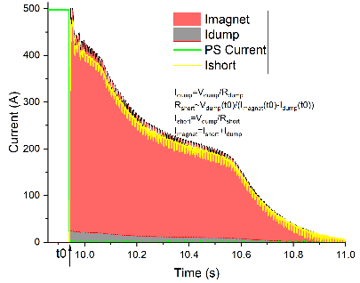
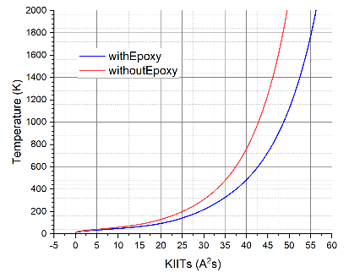
Issues about CB25: the failed quench protection (2025.04)
Problems and Solutions During Mass Production
Measured and estimated current components in the last training test. QI is about 58 KIITs.
Estimated relation between hot spot temperature and KIITs for the WST NbTi wire used in MCBRD coils.
Resistances later measured at room temperature
A short-circuit to the dump resistor was created during the last test for CB25, resulted into a very slow discharge.
Unfortunately, CB25 is confirmed damaged.
Coil sections | Resistance
A1-EE14/EE15 | 73.7 Ω
EE14/EE15-EE17 | 76.9 Ω (V.S. ~98Ω)
EE17-B10 | 0.27 MΩ (V.S. ~74Ω)
A1-B10 | 0.27 MΩ (V.S. ~246 Ω)

Slide 18

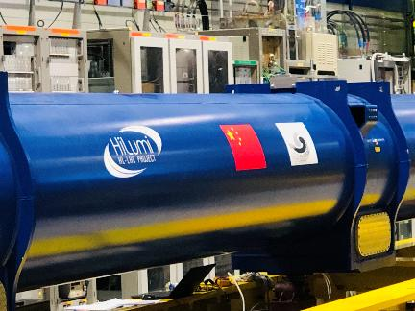
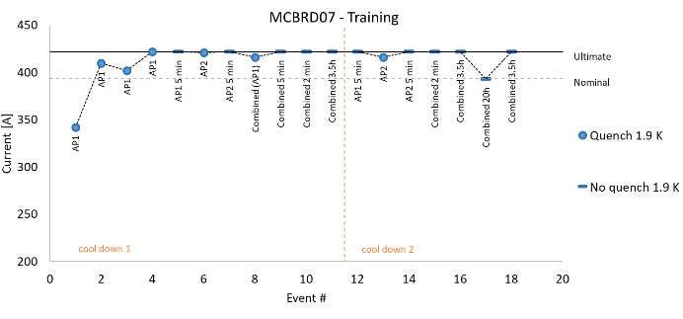
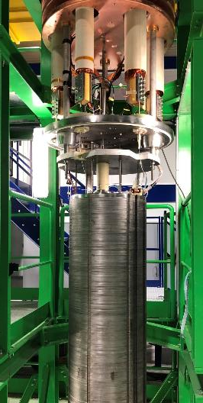
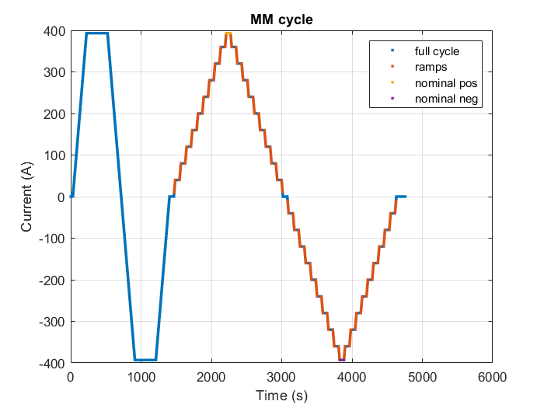
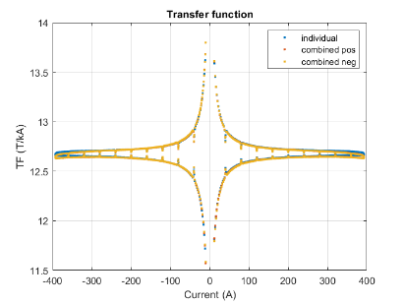
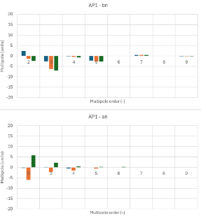
Performance Testing at CERN
All the delivered magnets have been successfully tested at CERN.
All the tested magnets reached the design target: field strength, field quality, operating stability…
MCBRD under test at CERN

Slide 19



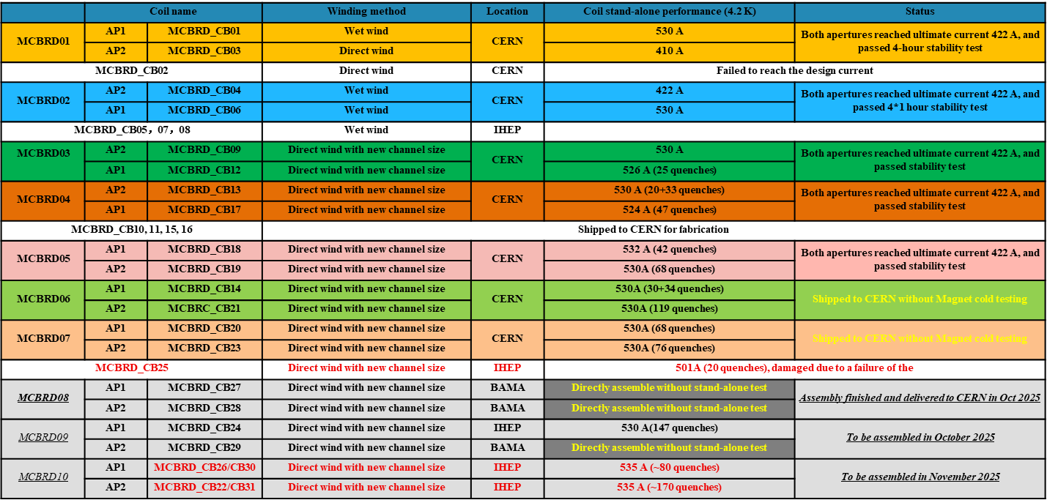
Status of HL-LHC CCT Magnets
1(prototype)+8(series magnets)+2 (components) have been delivered to CERN
The rest of 2 series magnets to be completed and delivered to CERN by the end of 2025
Two more back-up coils to be completed and delivered by April 2026

Slide 20

Summary
China provides 12+1 sets of CCT superconducting magnets for the HL-LHC project, helping to increase the luminosity by 5 times
For the 1st time the CCT superconducting magnets are adopted for an operating accelerator, and for the 1st time China contributed to the LHC accelerator
During mass production, effective and universal solutions have been developed to solve the problems of "long training“ and “de-training”, which make possible large-scale application of CCT magnets in future while ensuring the progress of the HL-LHC project
Delivery of all magnets is expected to be completed by 2025
Continuous collaboration with CERN on HFM is expected after HL-LHC construction
Thanks for your attention!

