Slide 1
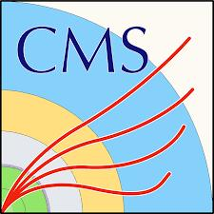

ETL LGAD Characterization at USTC
Chengjun Yu, Zhan Zhang,Xiang Zhao, Beikun Fan, Nan Lu,De Zhang
University of Science and Technology of China
2025.10.30

Slide 2
Outline
1.Introduction of the ETL project
2.Our test environment
3.Measurements about test structures
4.Measurements about a part of sensors
5.Summary
Notes:
liquid&Semiconductor cooling

Slide 3
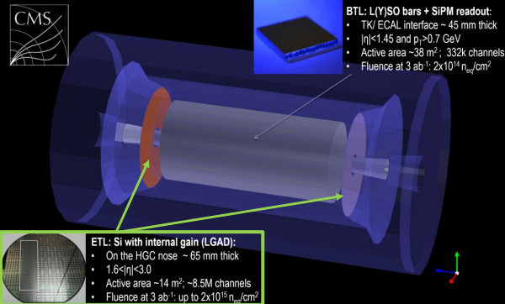
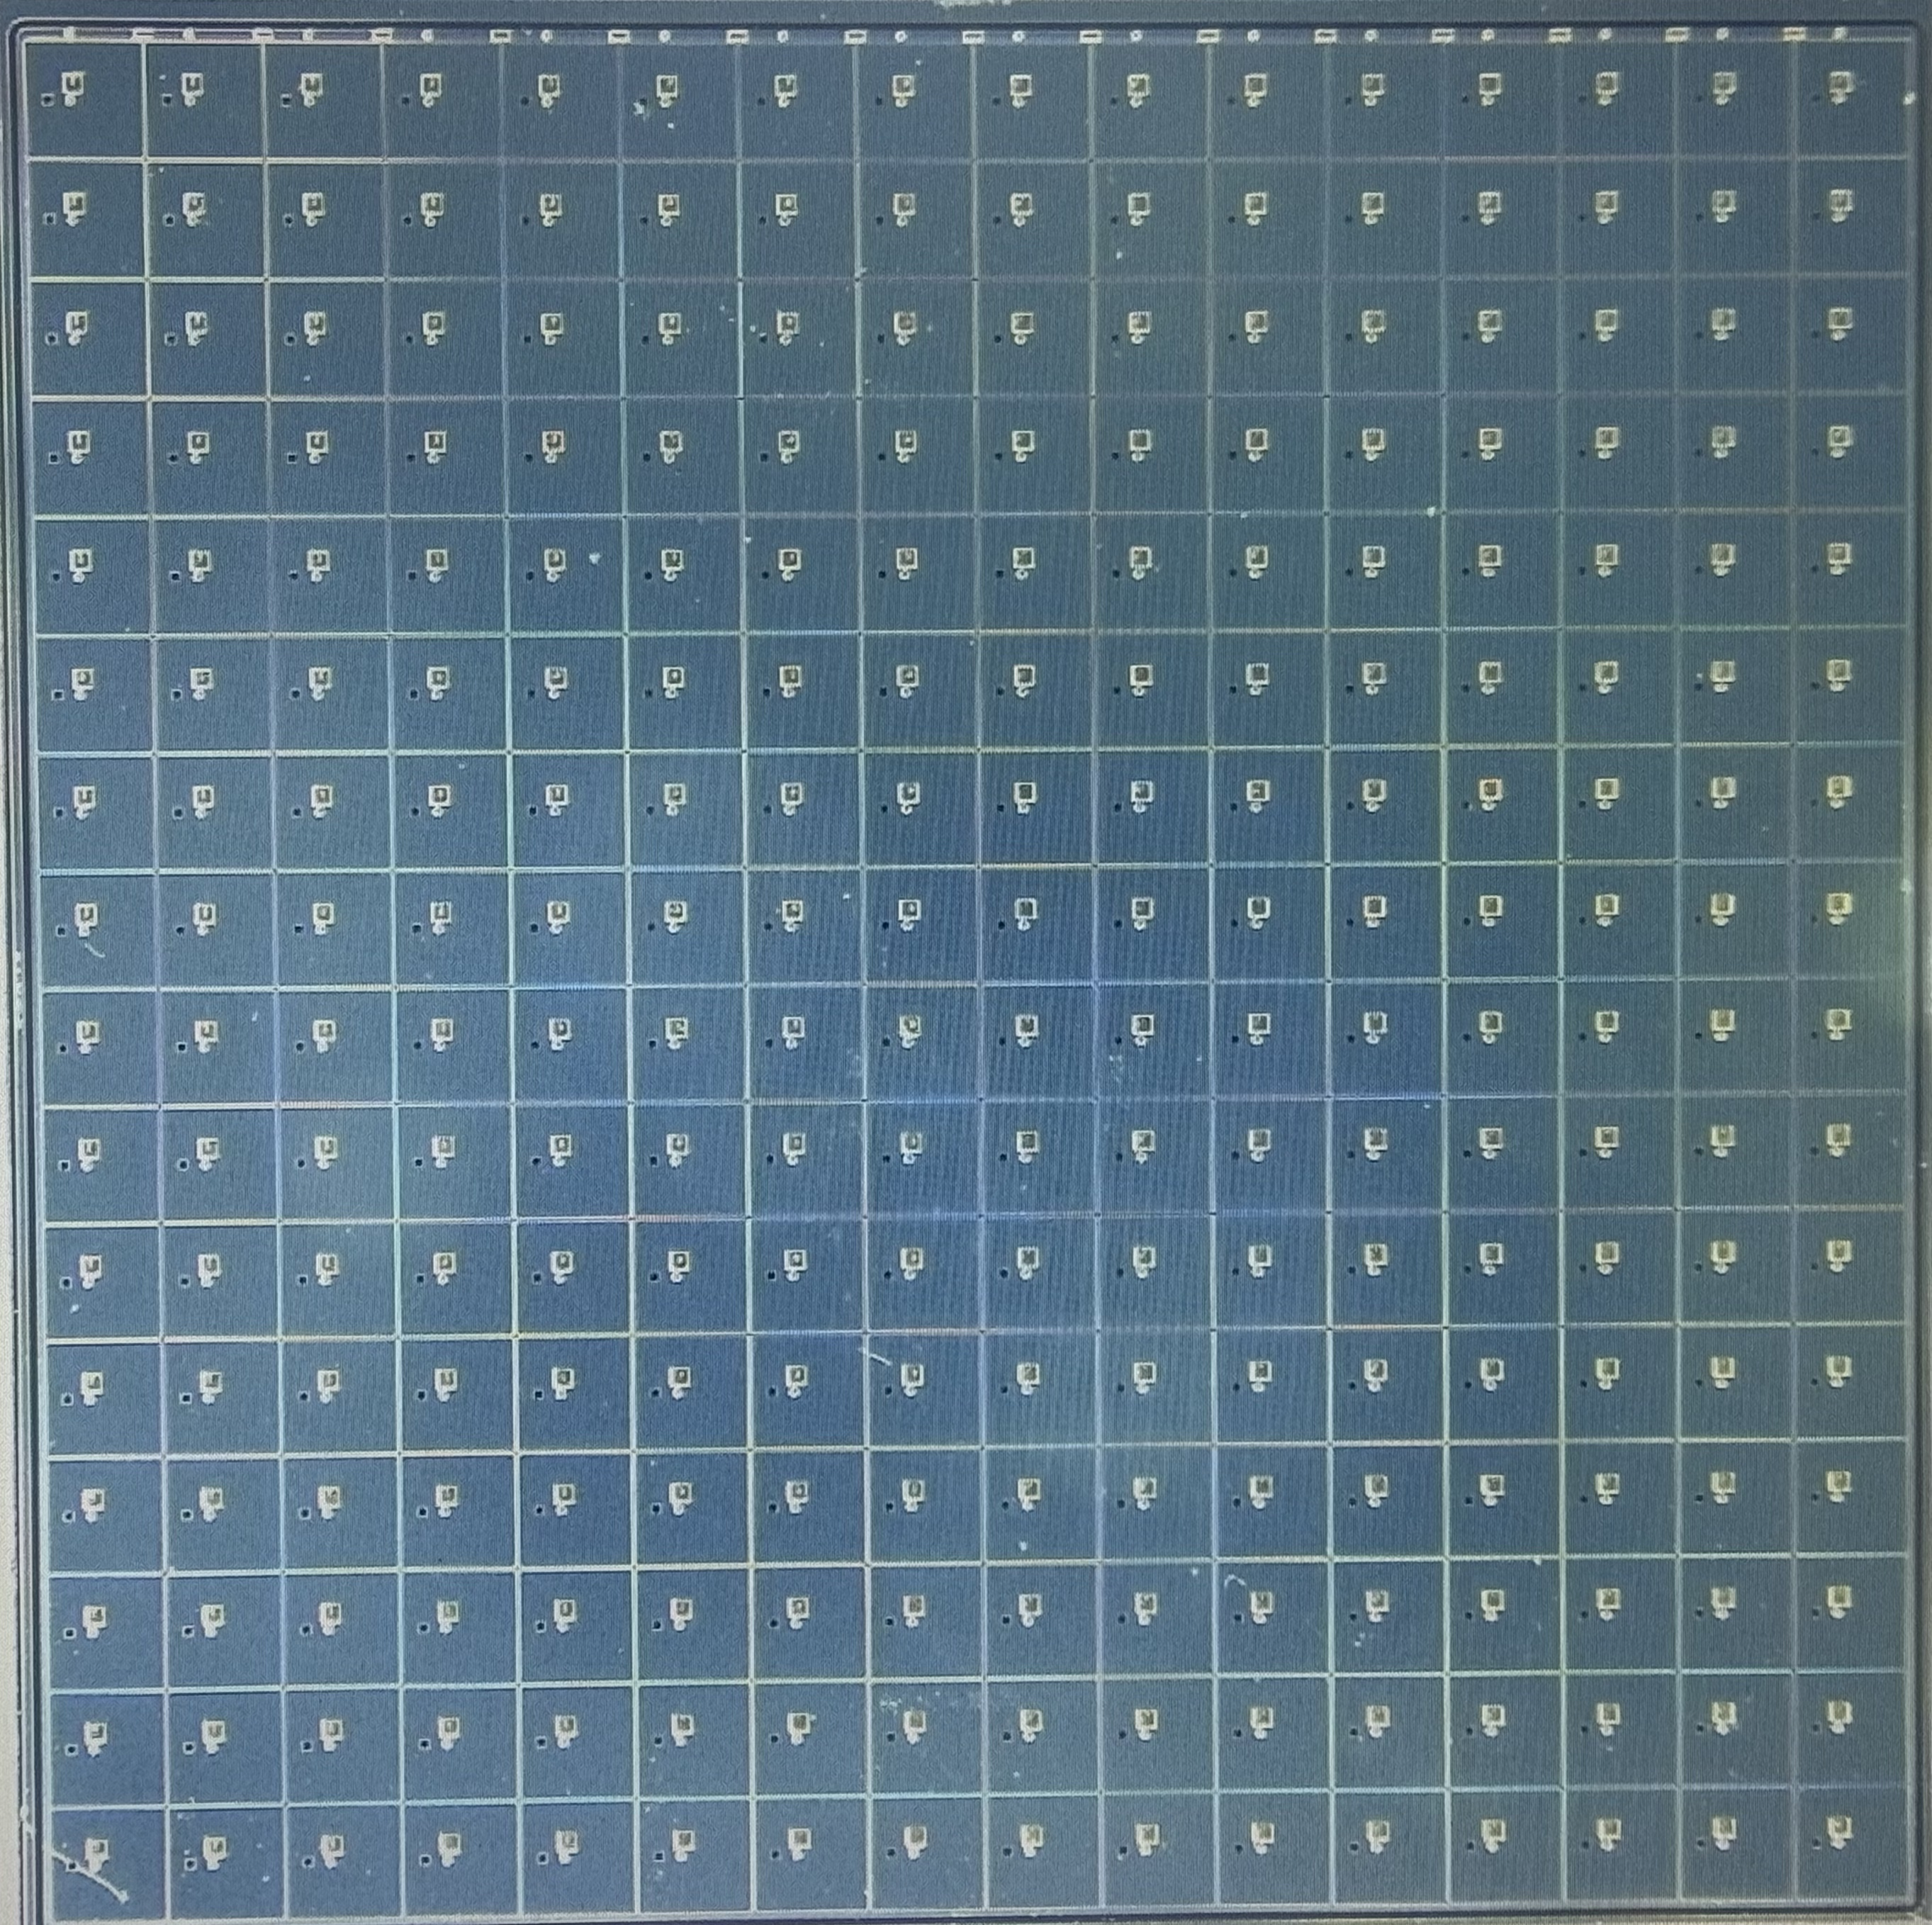
Introduction of the ETL Project
MIP Timing Detector (MTD) have two section:Barrel section and Endcap section
The Endcap Timing Layer (ETL) will employ Low-Gain Avalanche Diodes (LGADs) to address the severe challenges in event reconstruction.
LGADs are an important development in silicon detector technology, with advantages such as excellent time resolution and signal - to - noise ratio.
Notes:
liquid&Semiconductor cooling

Slide 4
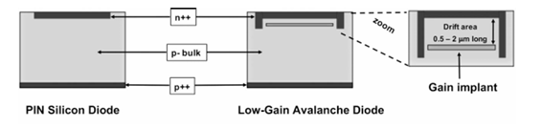
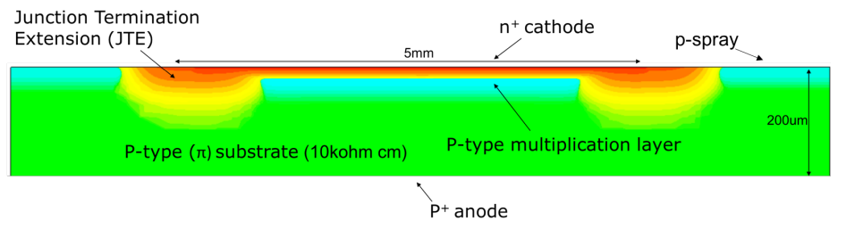
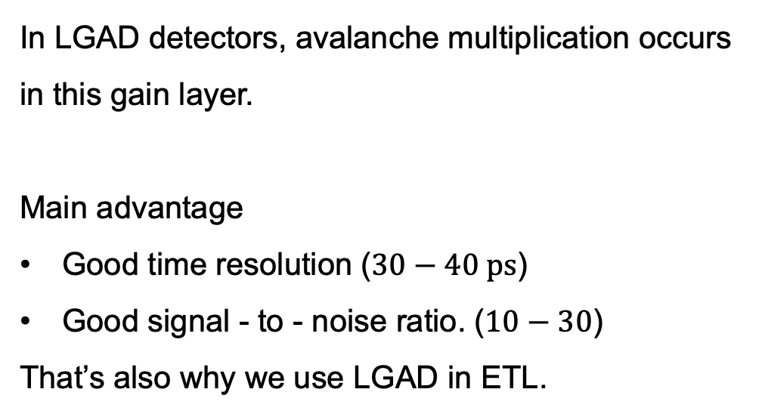
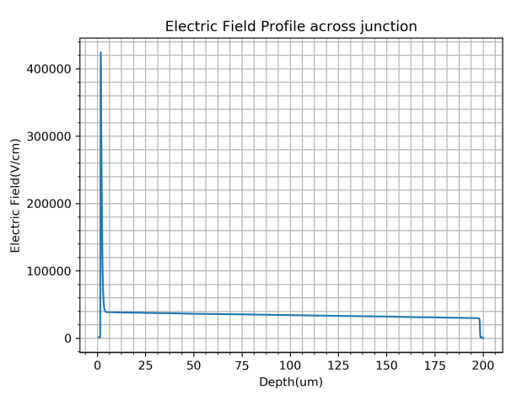
Low-Gain Avalanche Diodes (LGADs)
JINST 13 (2018) C03014
Notes:
liquid&Semiconductor cooling

Slide 5
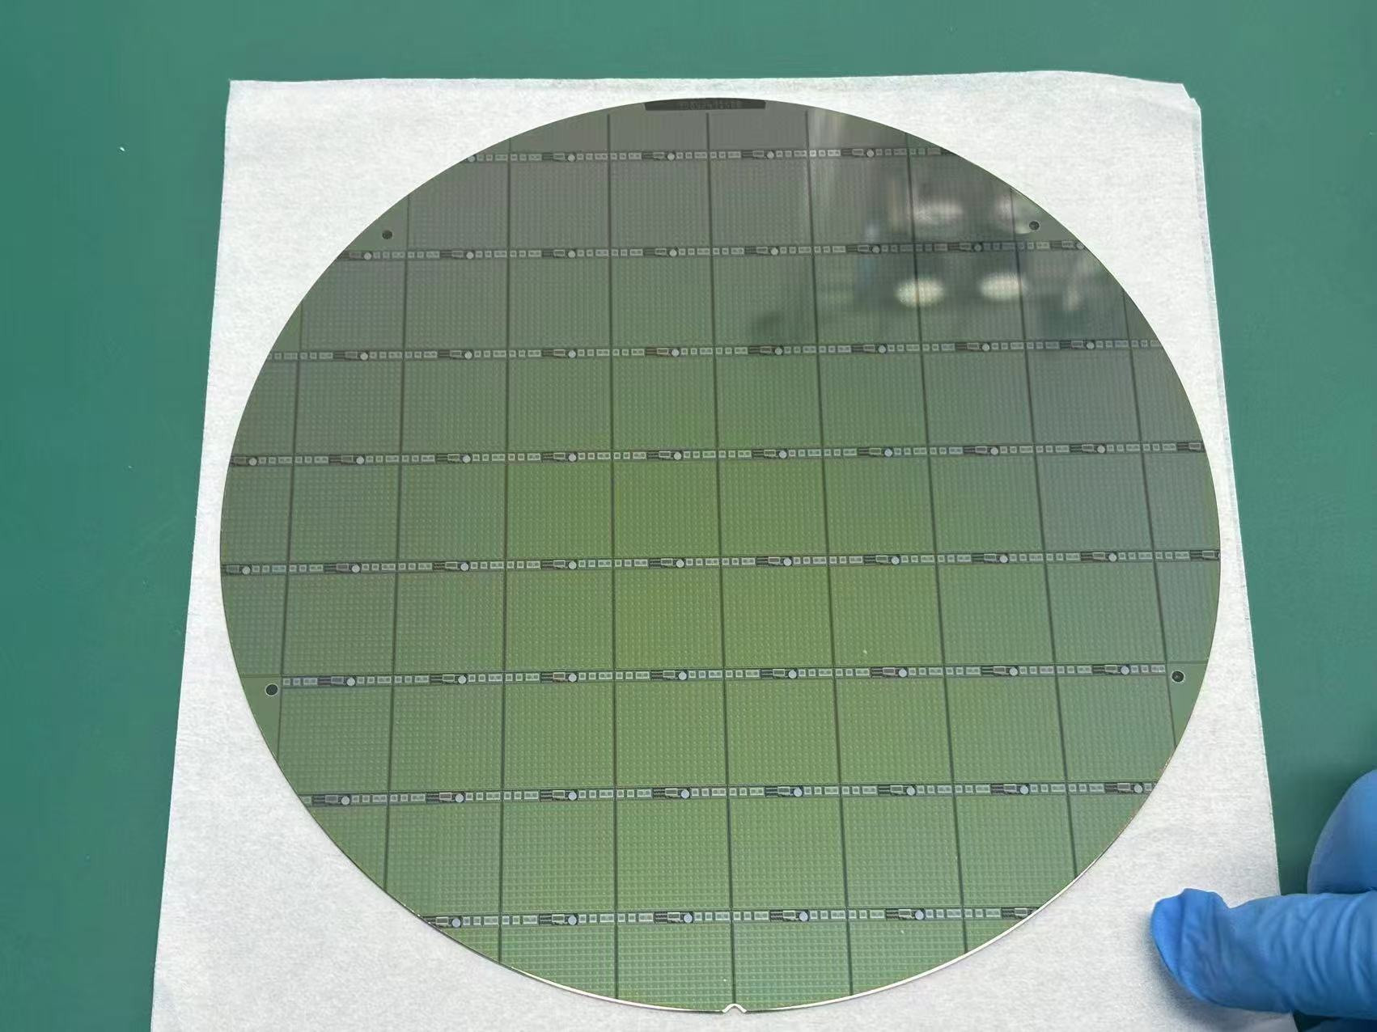
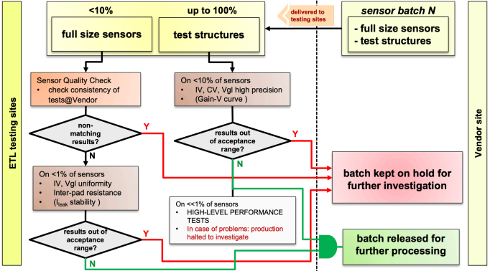
We tested the sensor and test structure
In order to understand quality and inspect quality,we need test some sensors and all test structrues.We also test them.
FBK-LFoundry Wafer13
Notes:
liquid&Semiconductor cooling

Slide 6
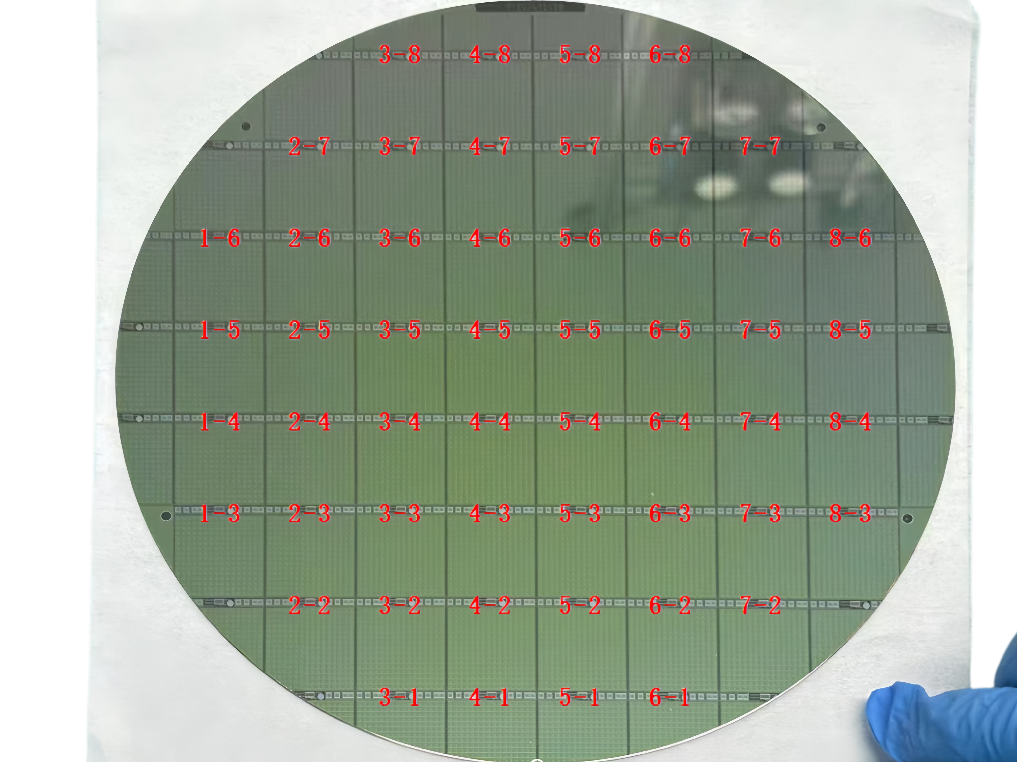
We name the sensor and test structures
Wafer 13
Early-stage non-uniform wafer
Coding of test structures
Notes:
liquid&Semiconductor cooling

Slide 7
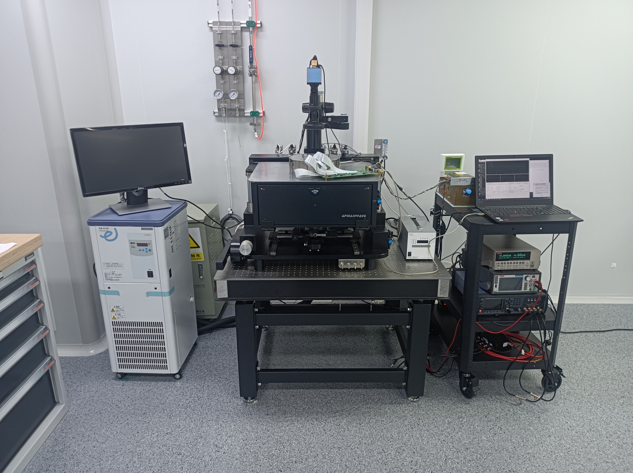
Our test environment at USTC
Chamber temperature and humidity monitor
PC for data acquisition
Peltier system
Keithley 6482
(pico-ammeter）
Keithley 2470
(HV source meter)
Microscope
Monitor for probing
Low temperature probe station
Low temperature circulator
Notes:
liquid&Semiconductor cooling

Slide 8
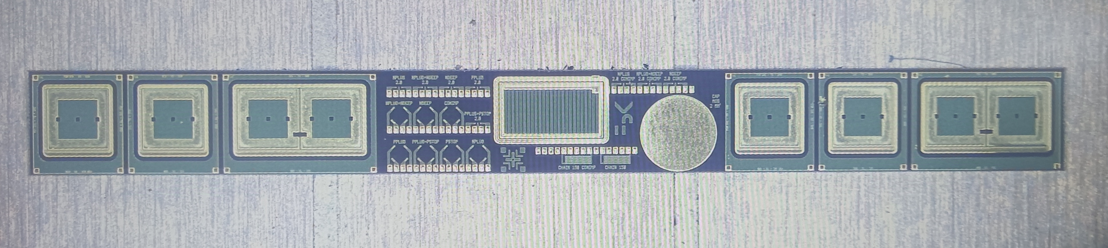
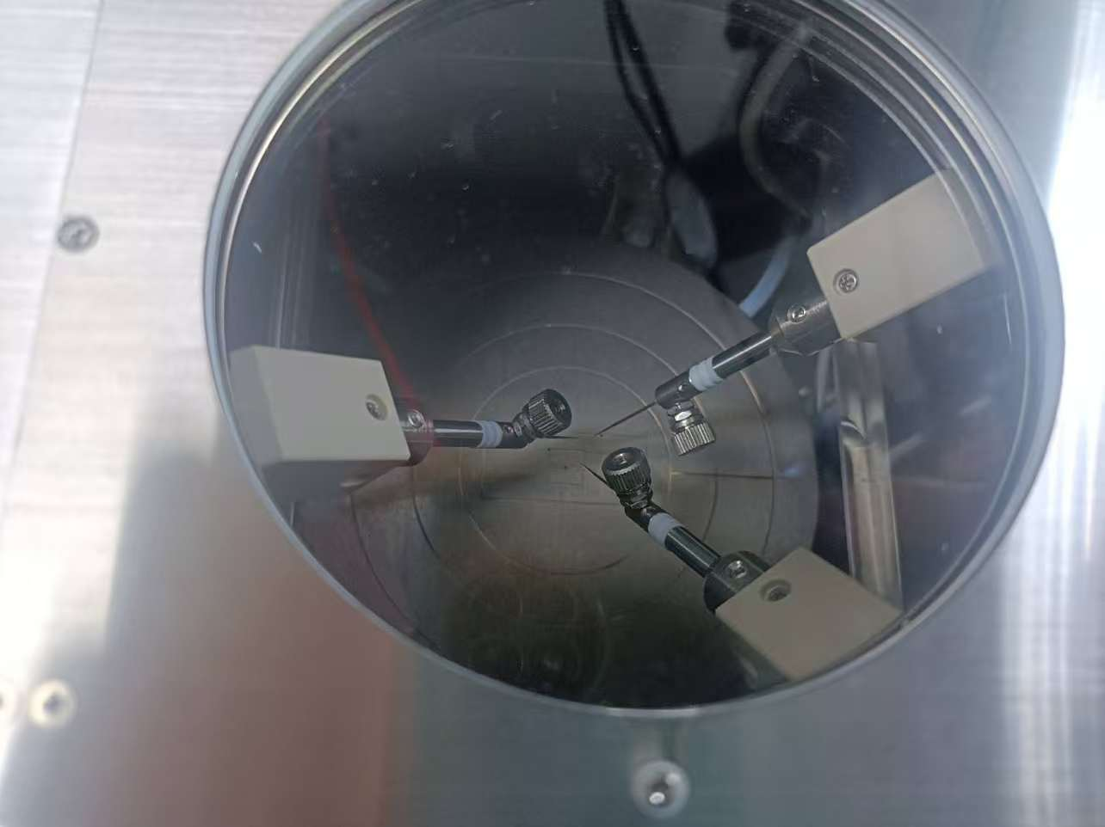
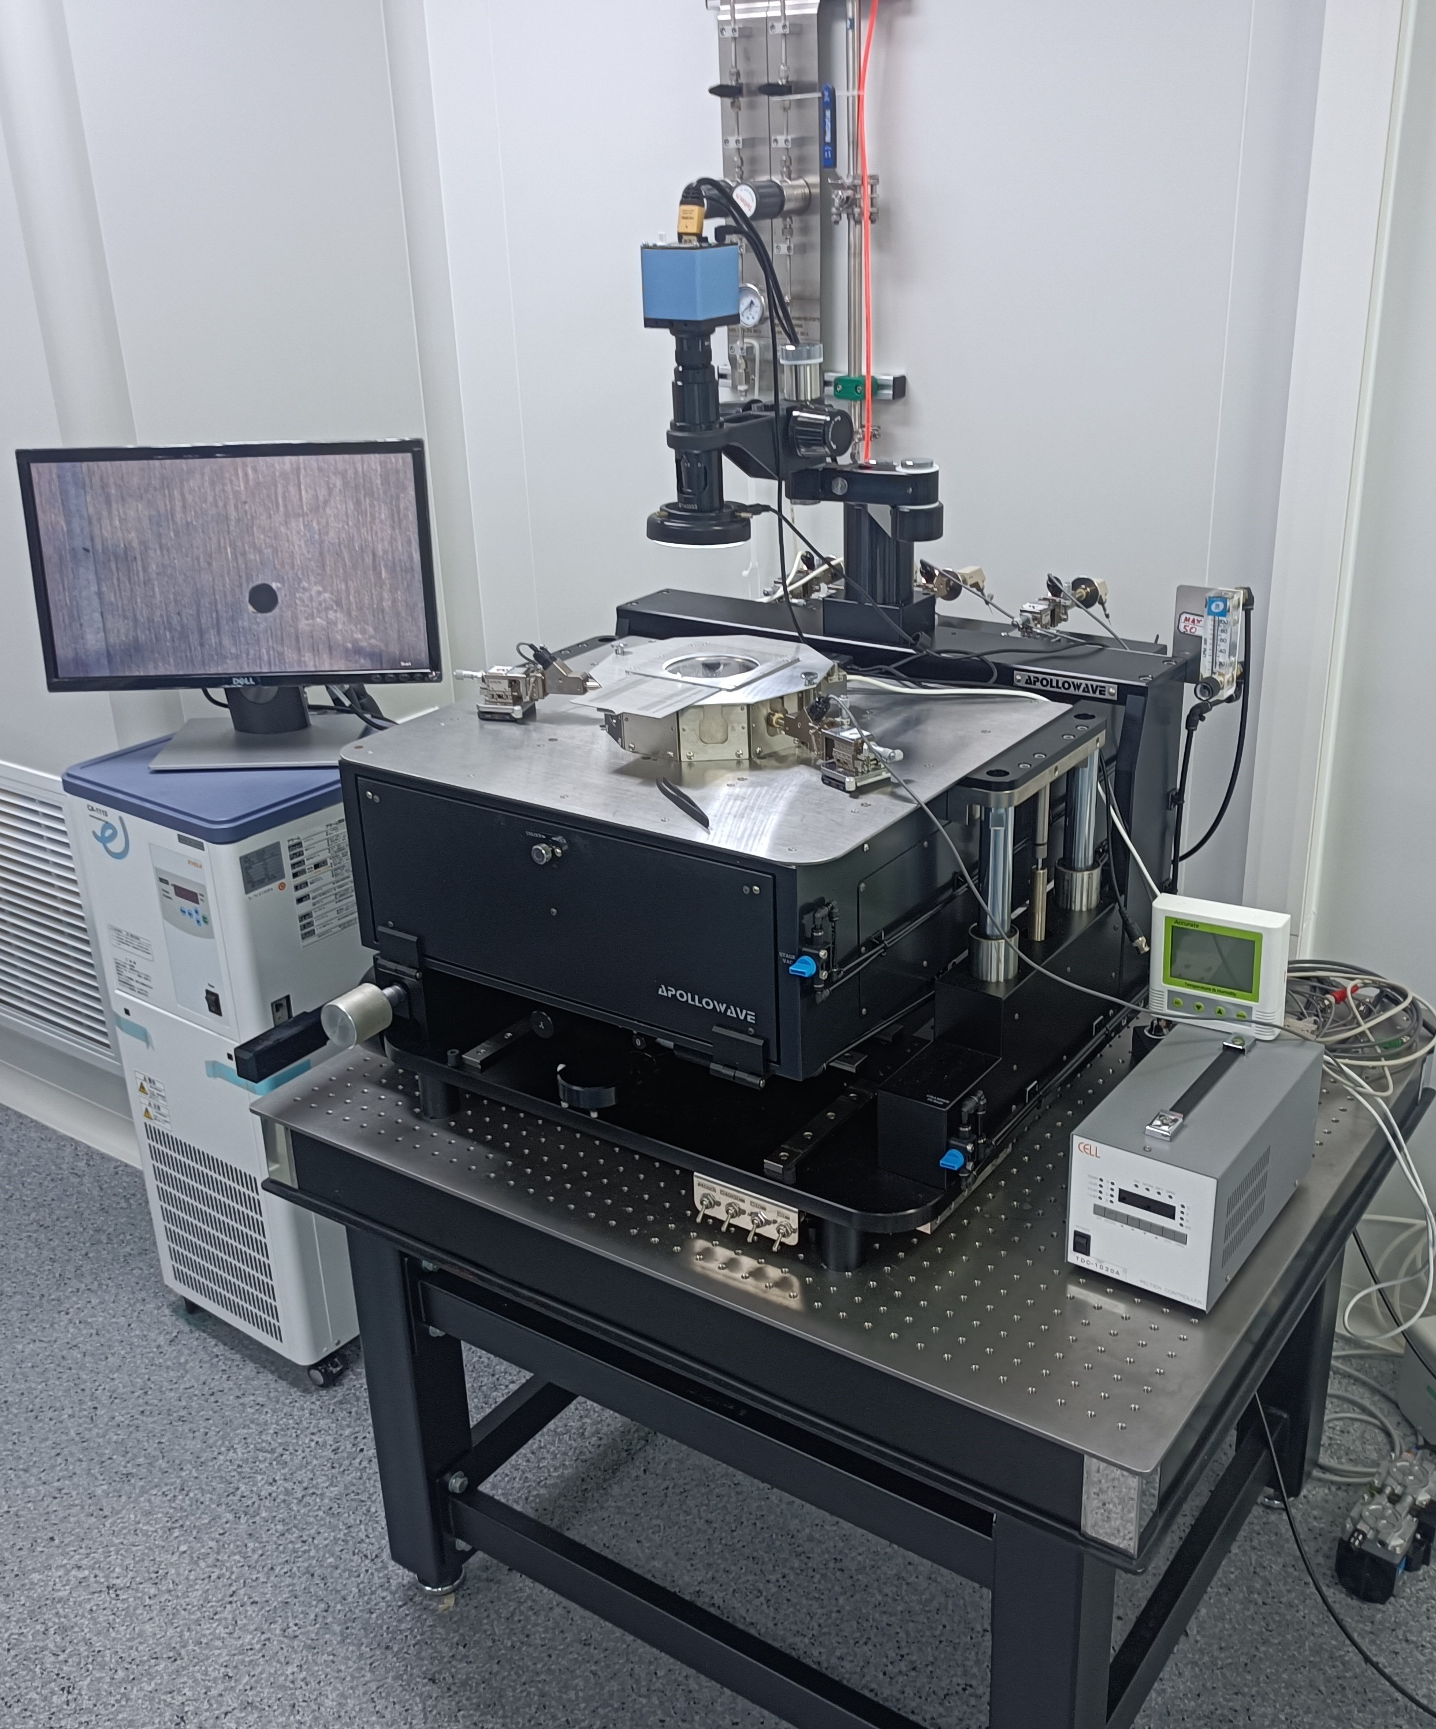
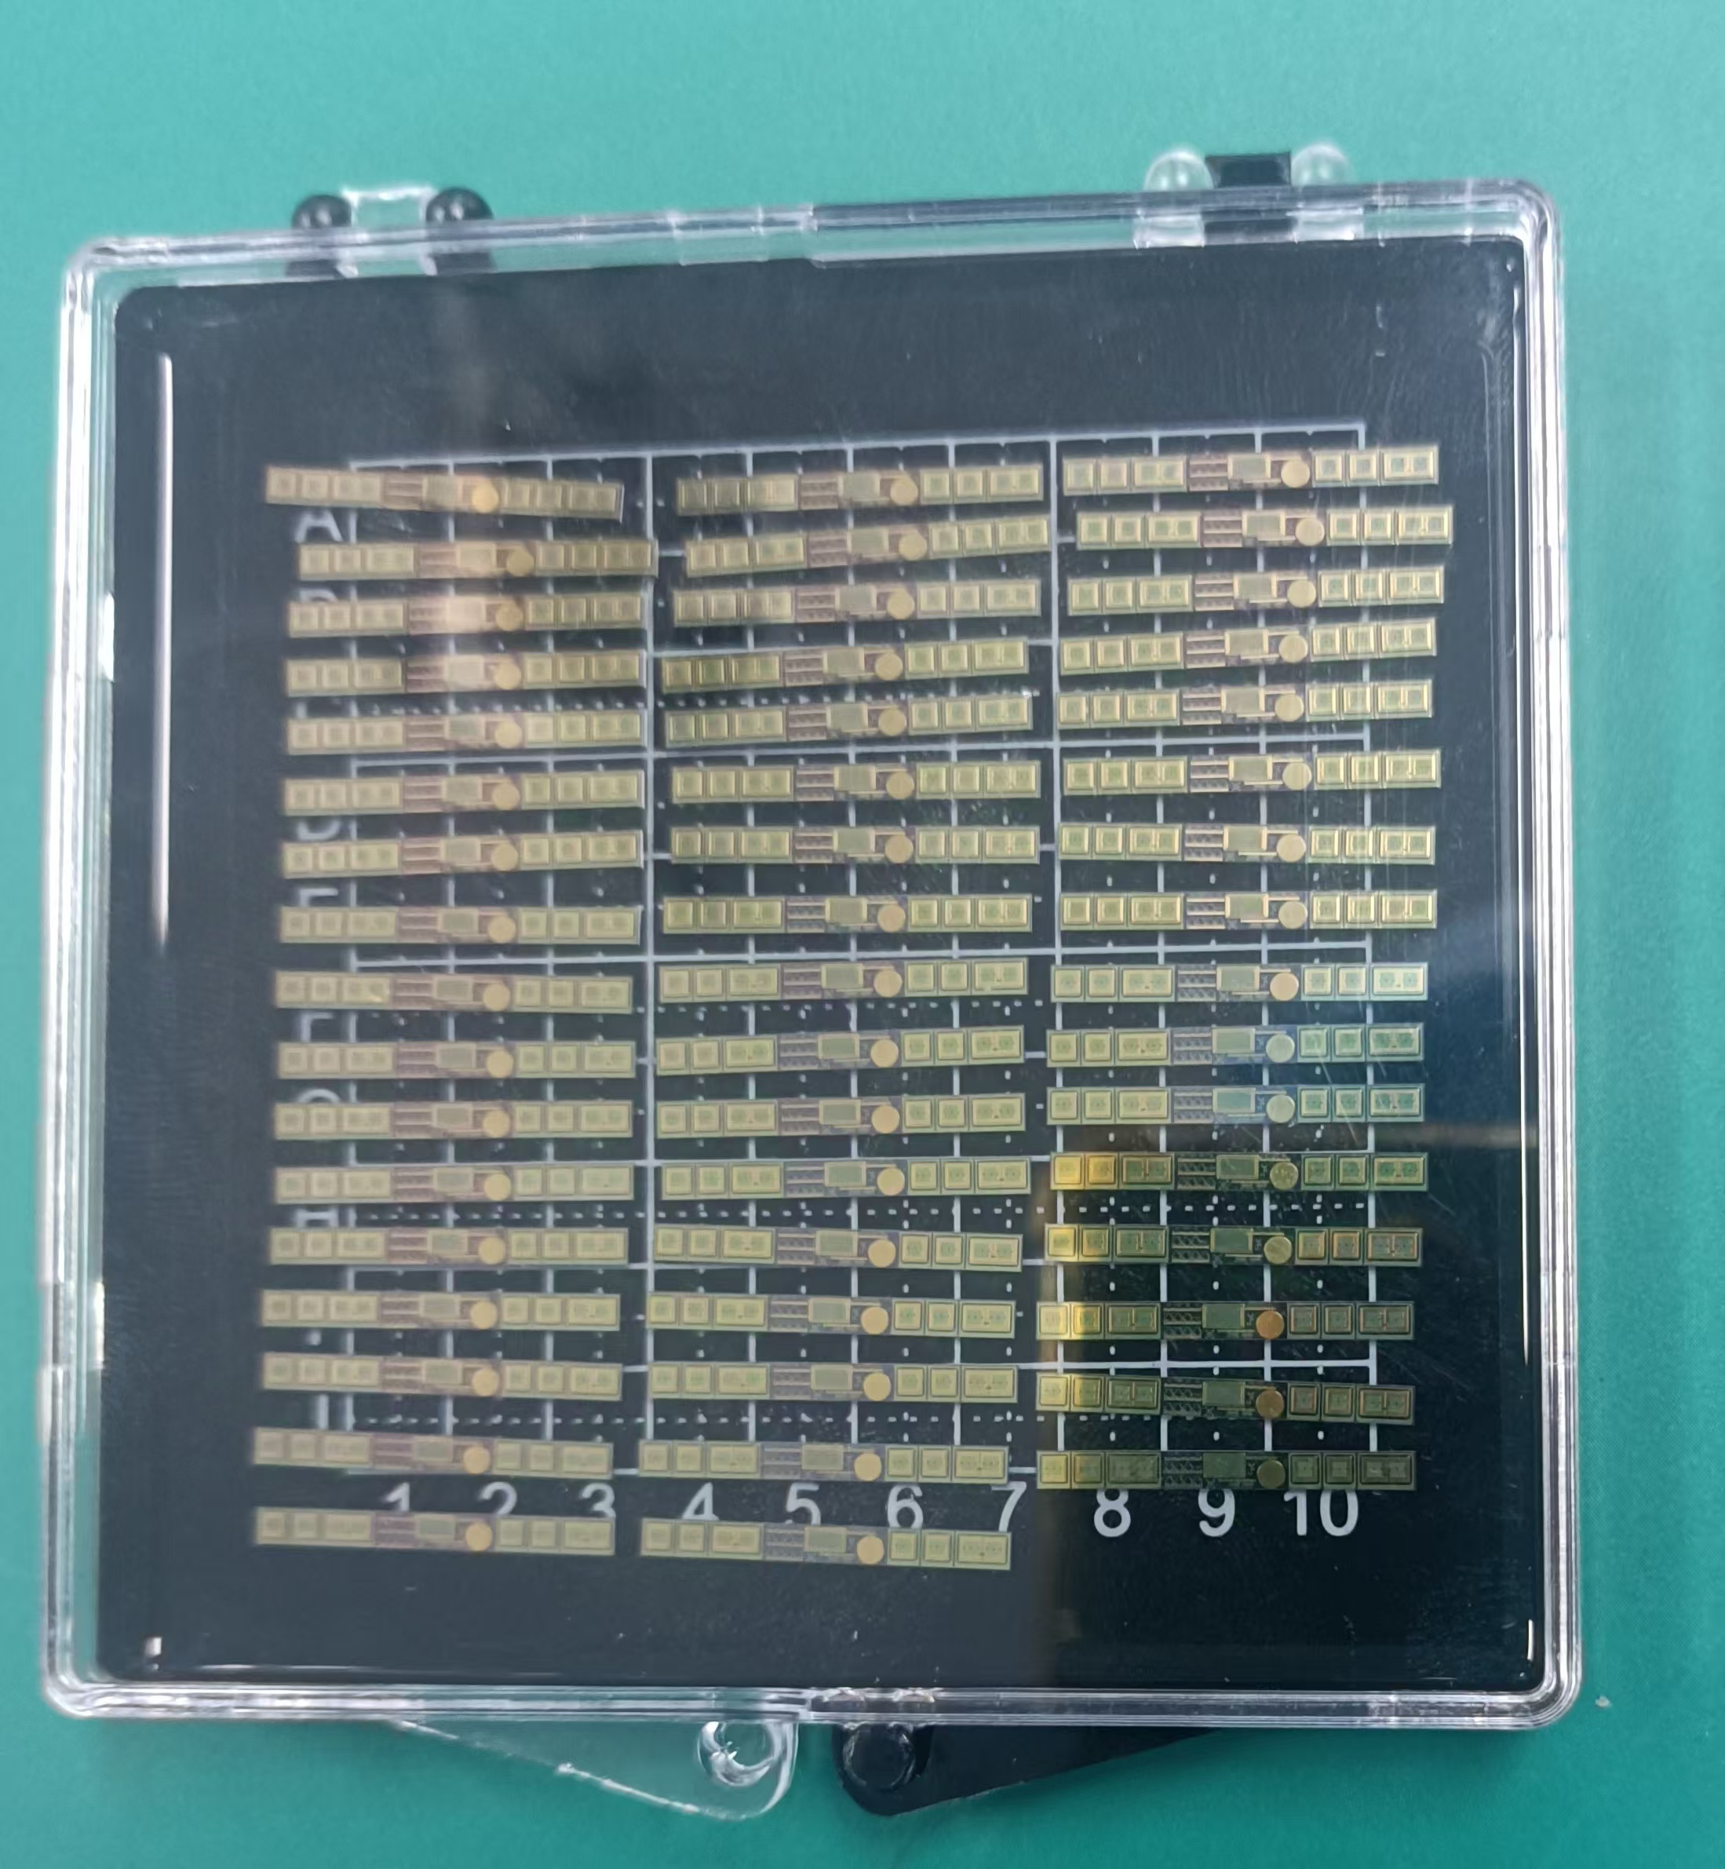
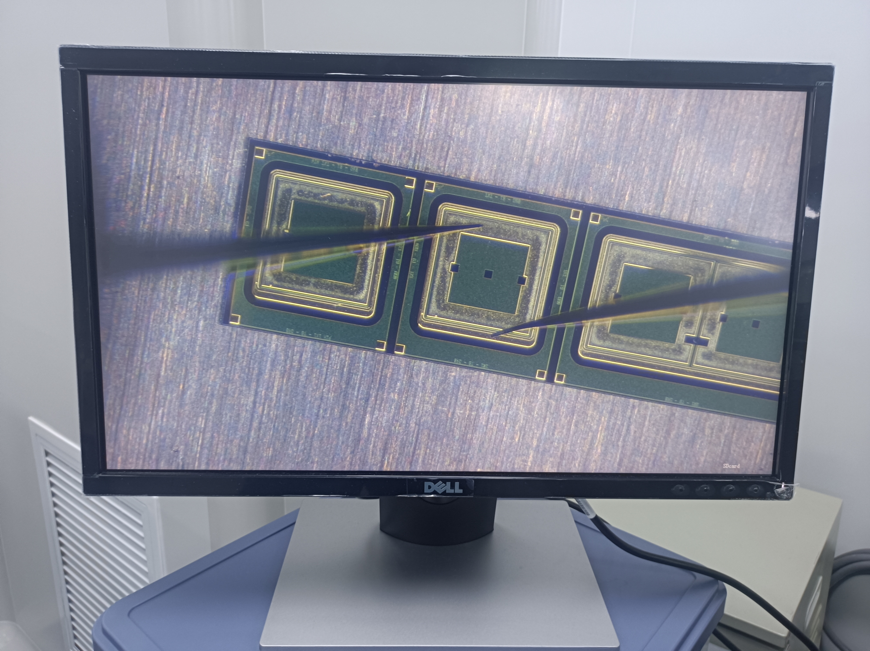
We test the test structure by probe
52 test structrues on W13
Notes:
liquid&Semiconductor cooling

Slide 9
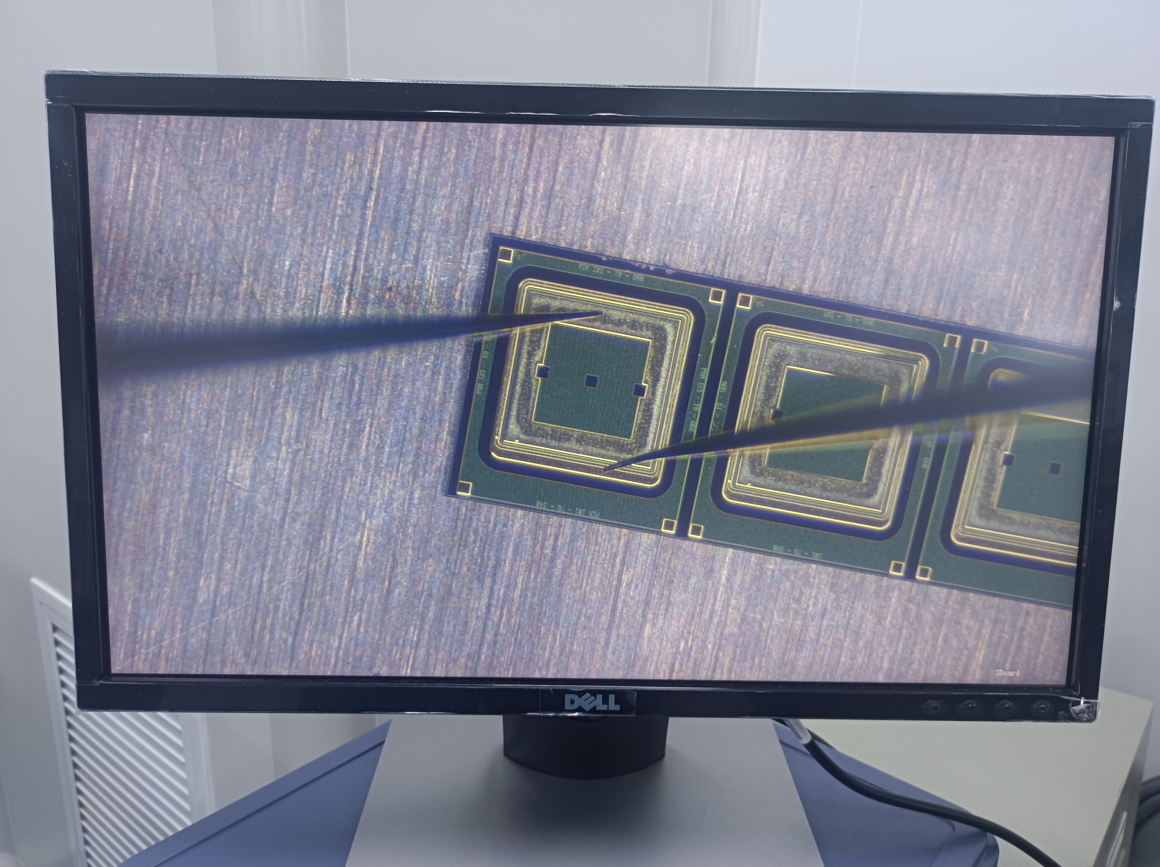
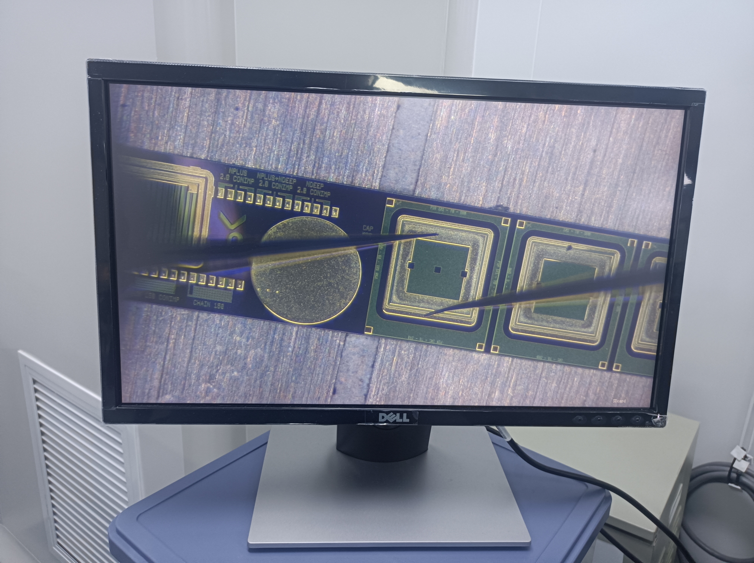
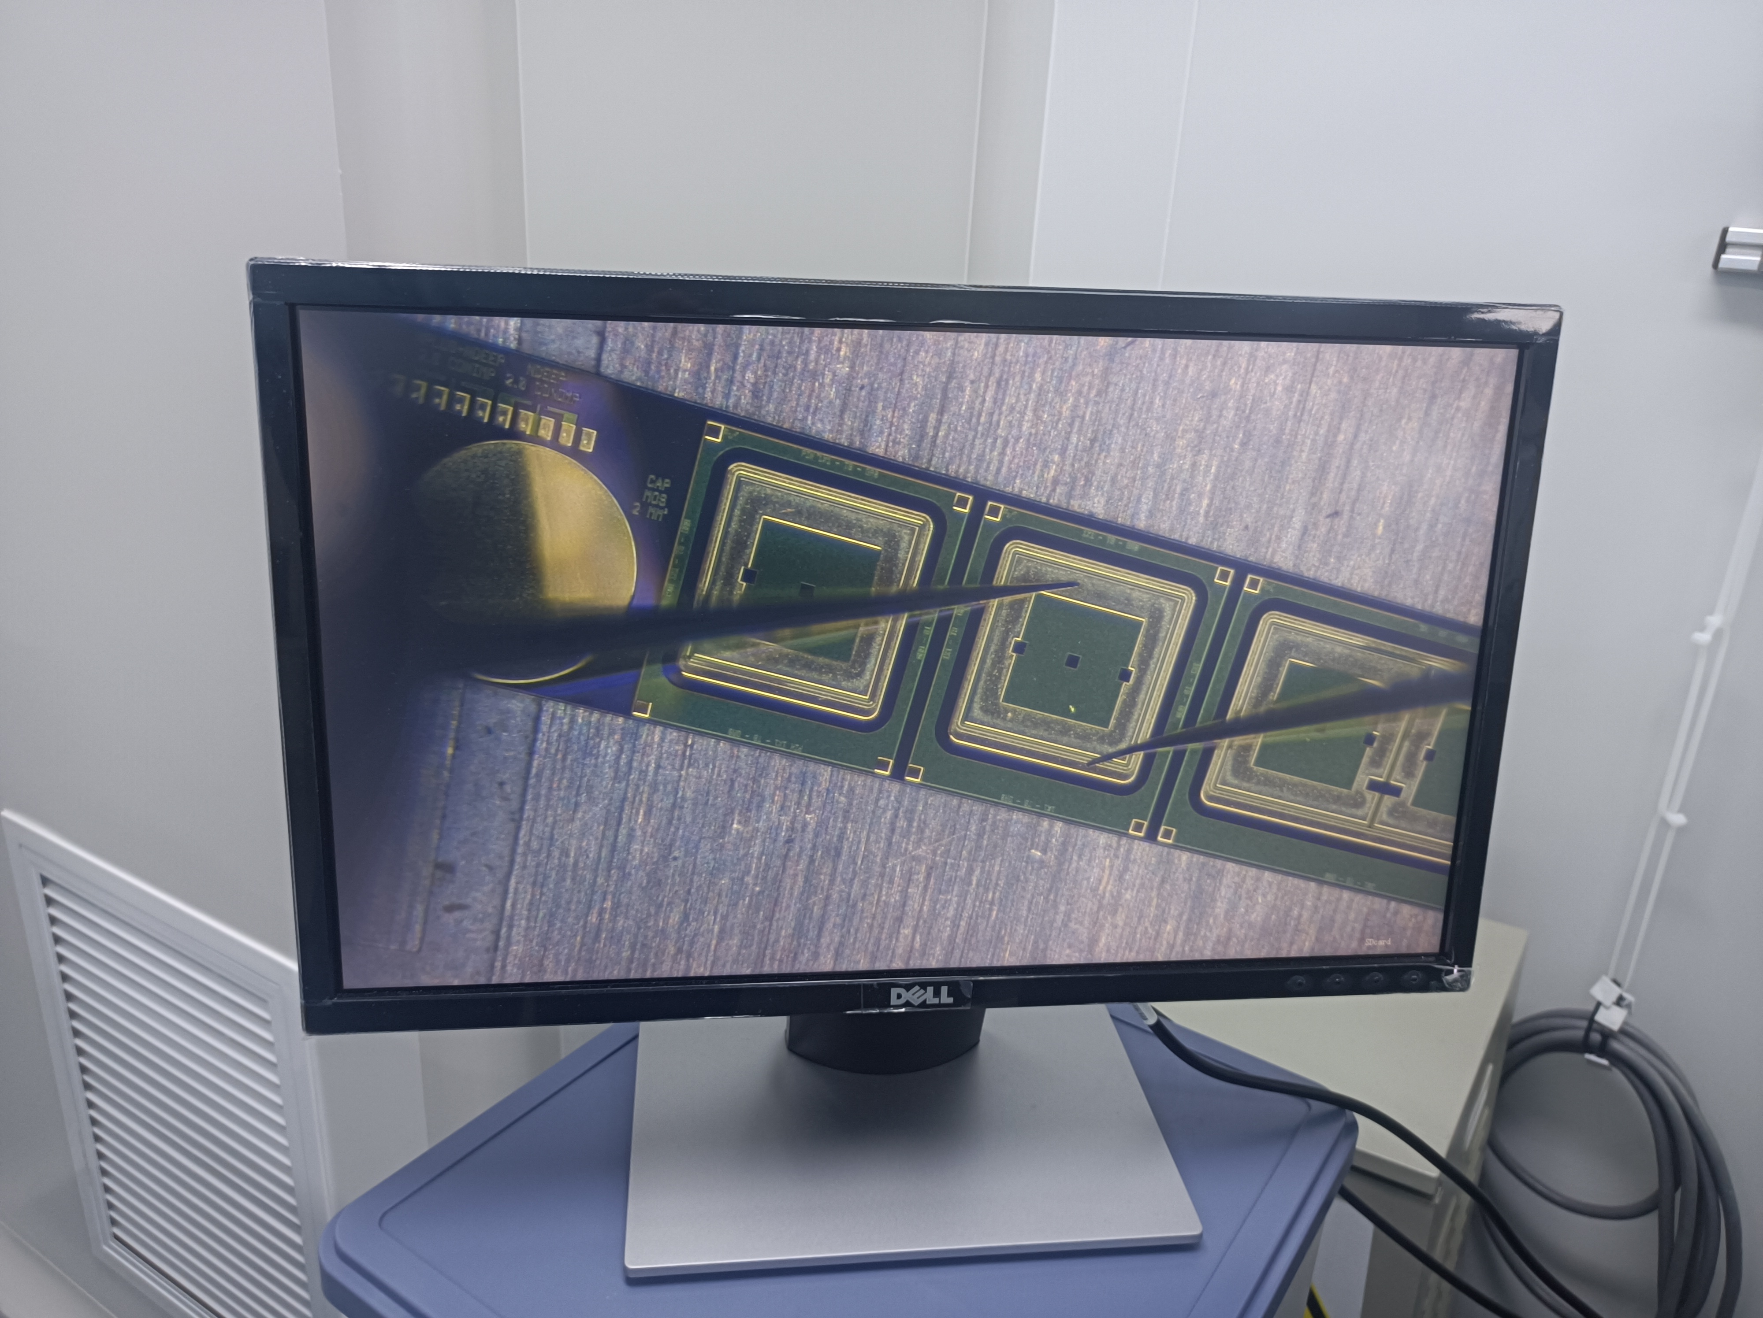
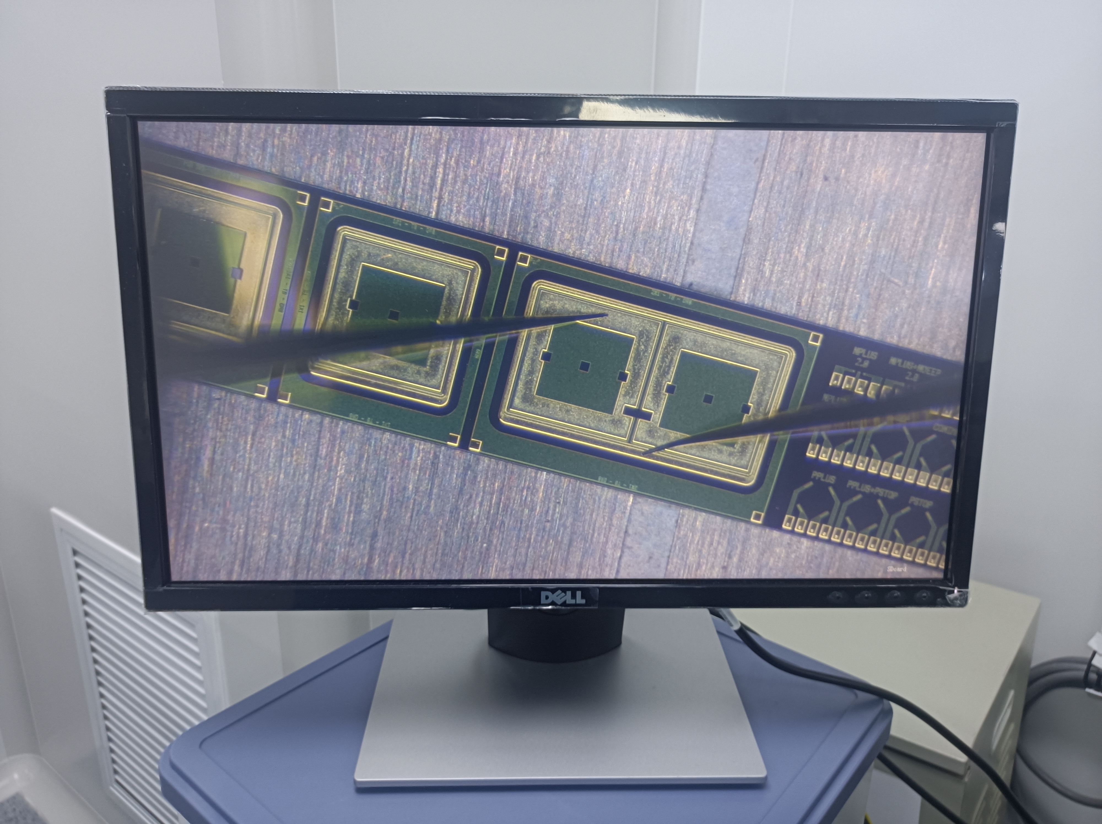
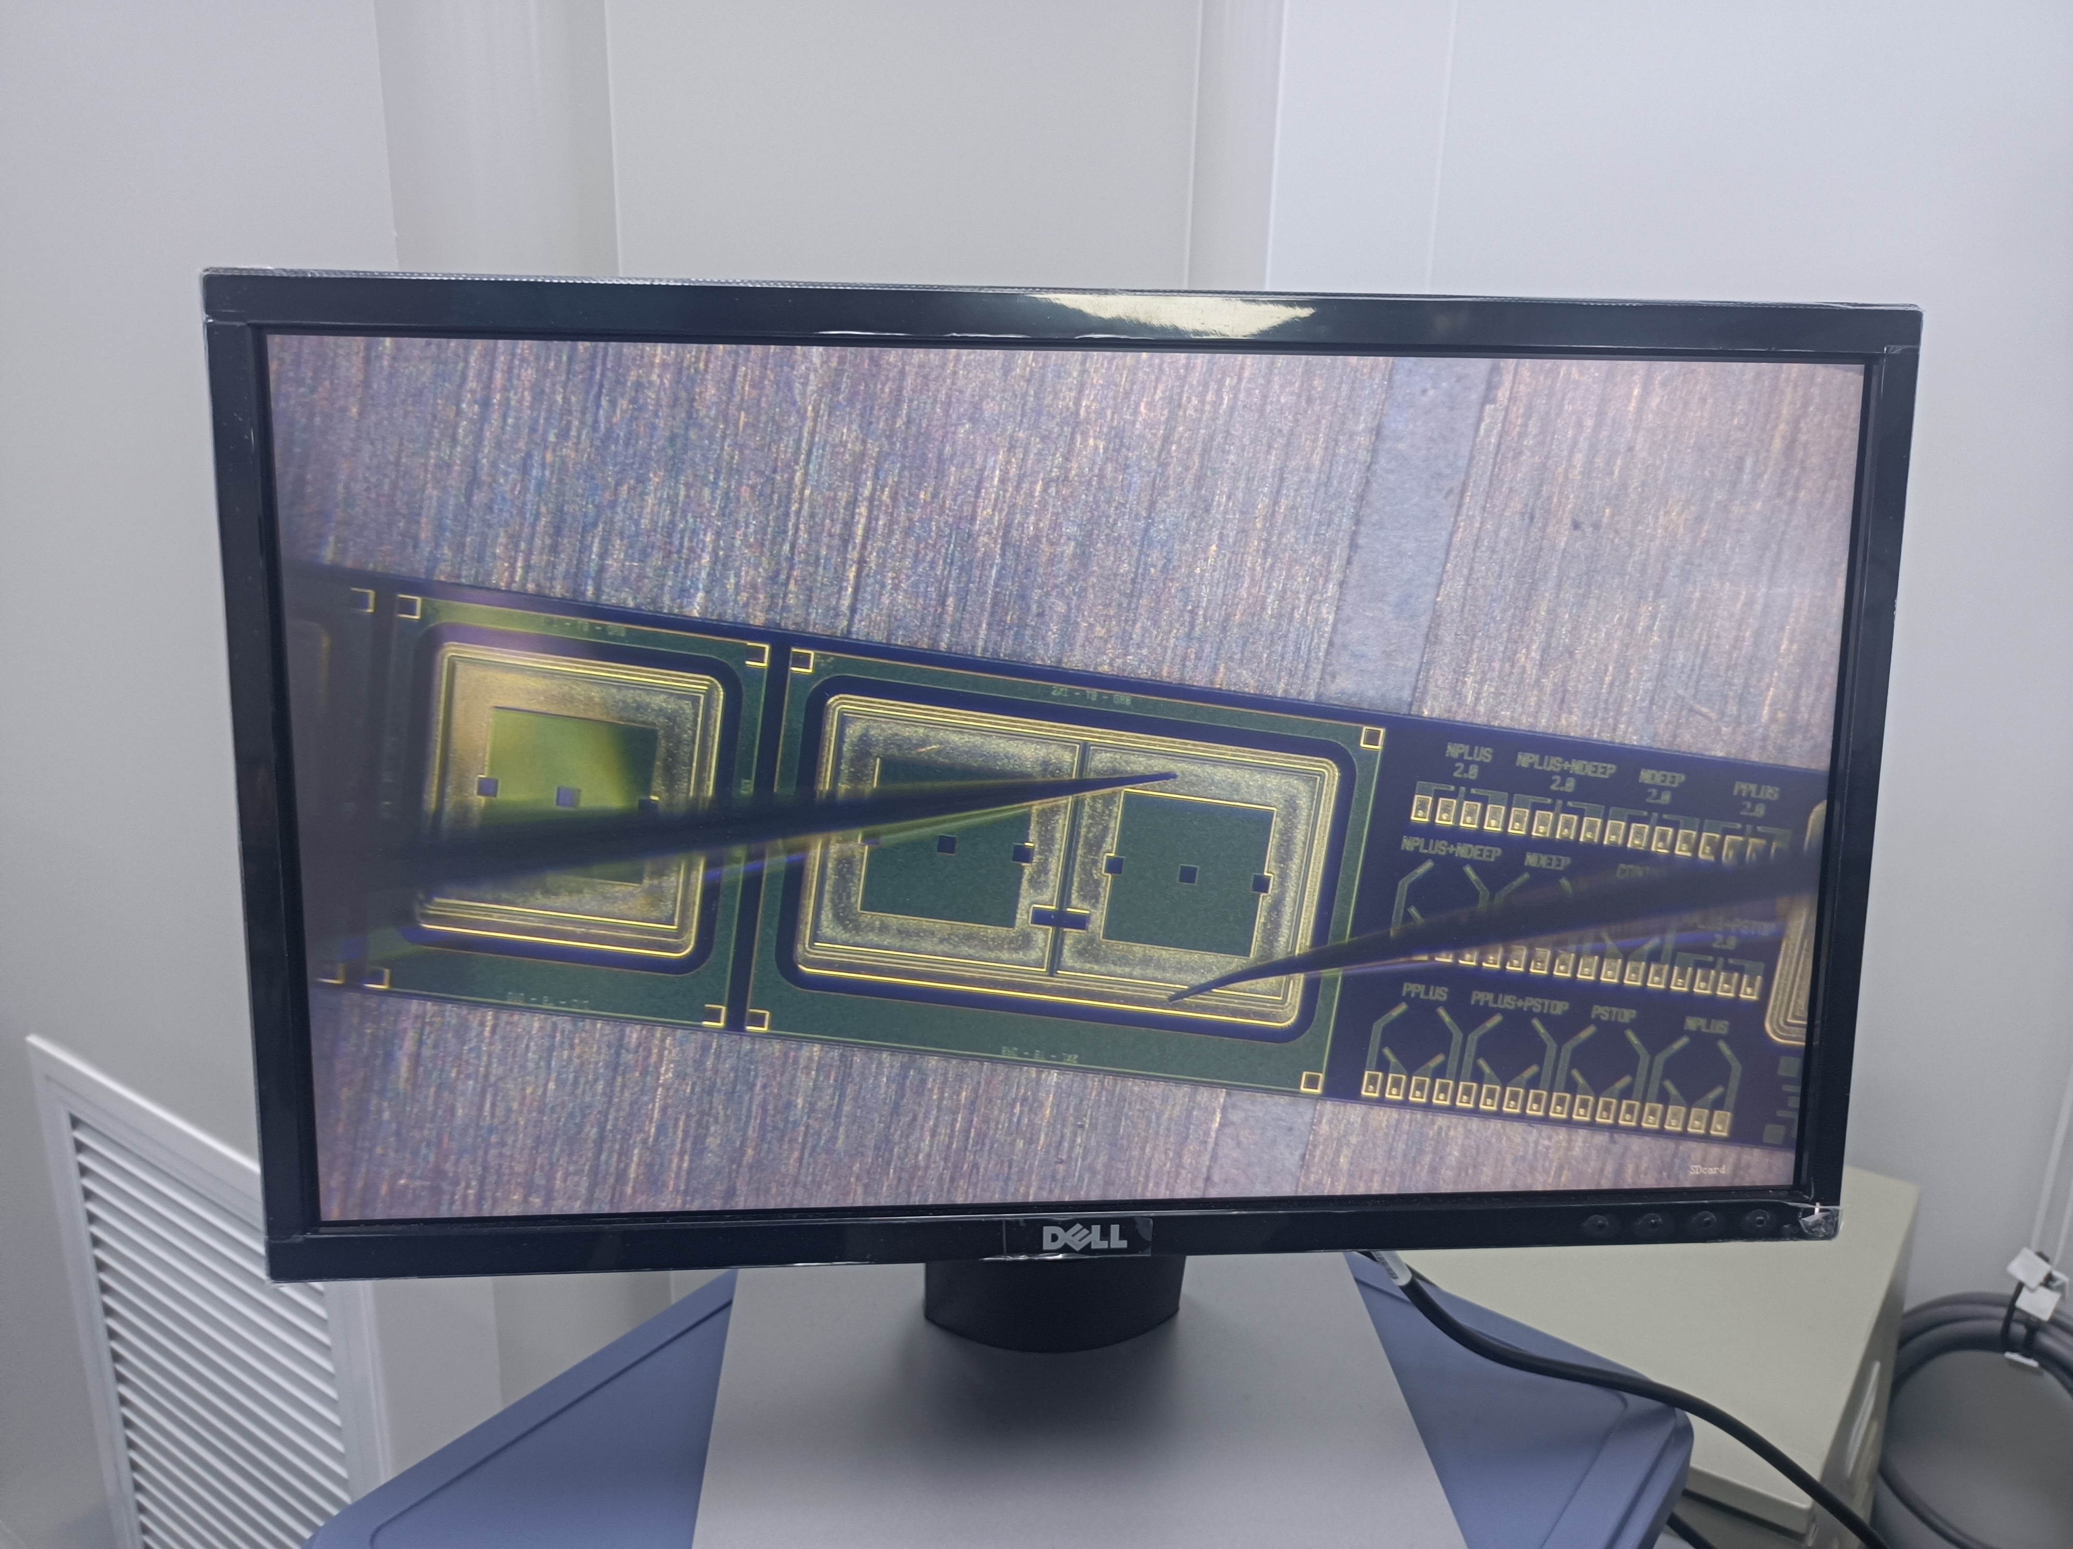
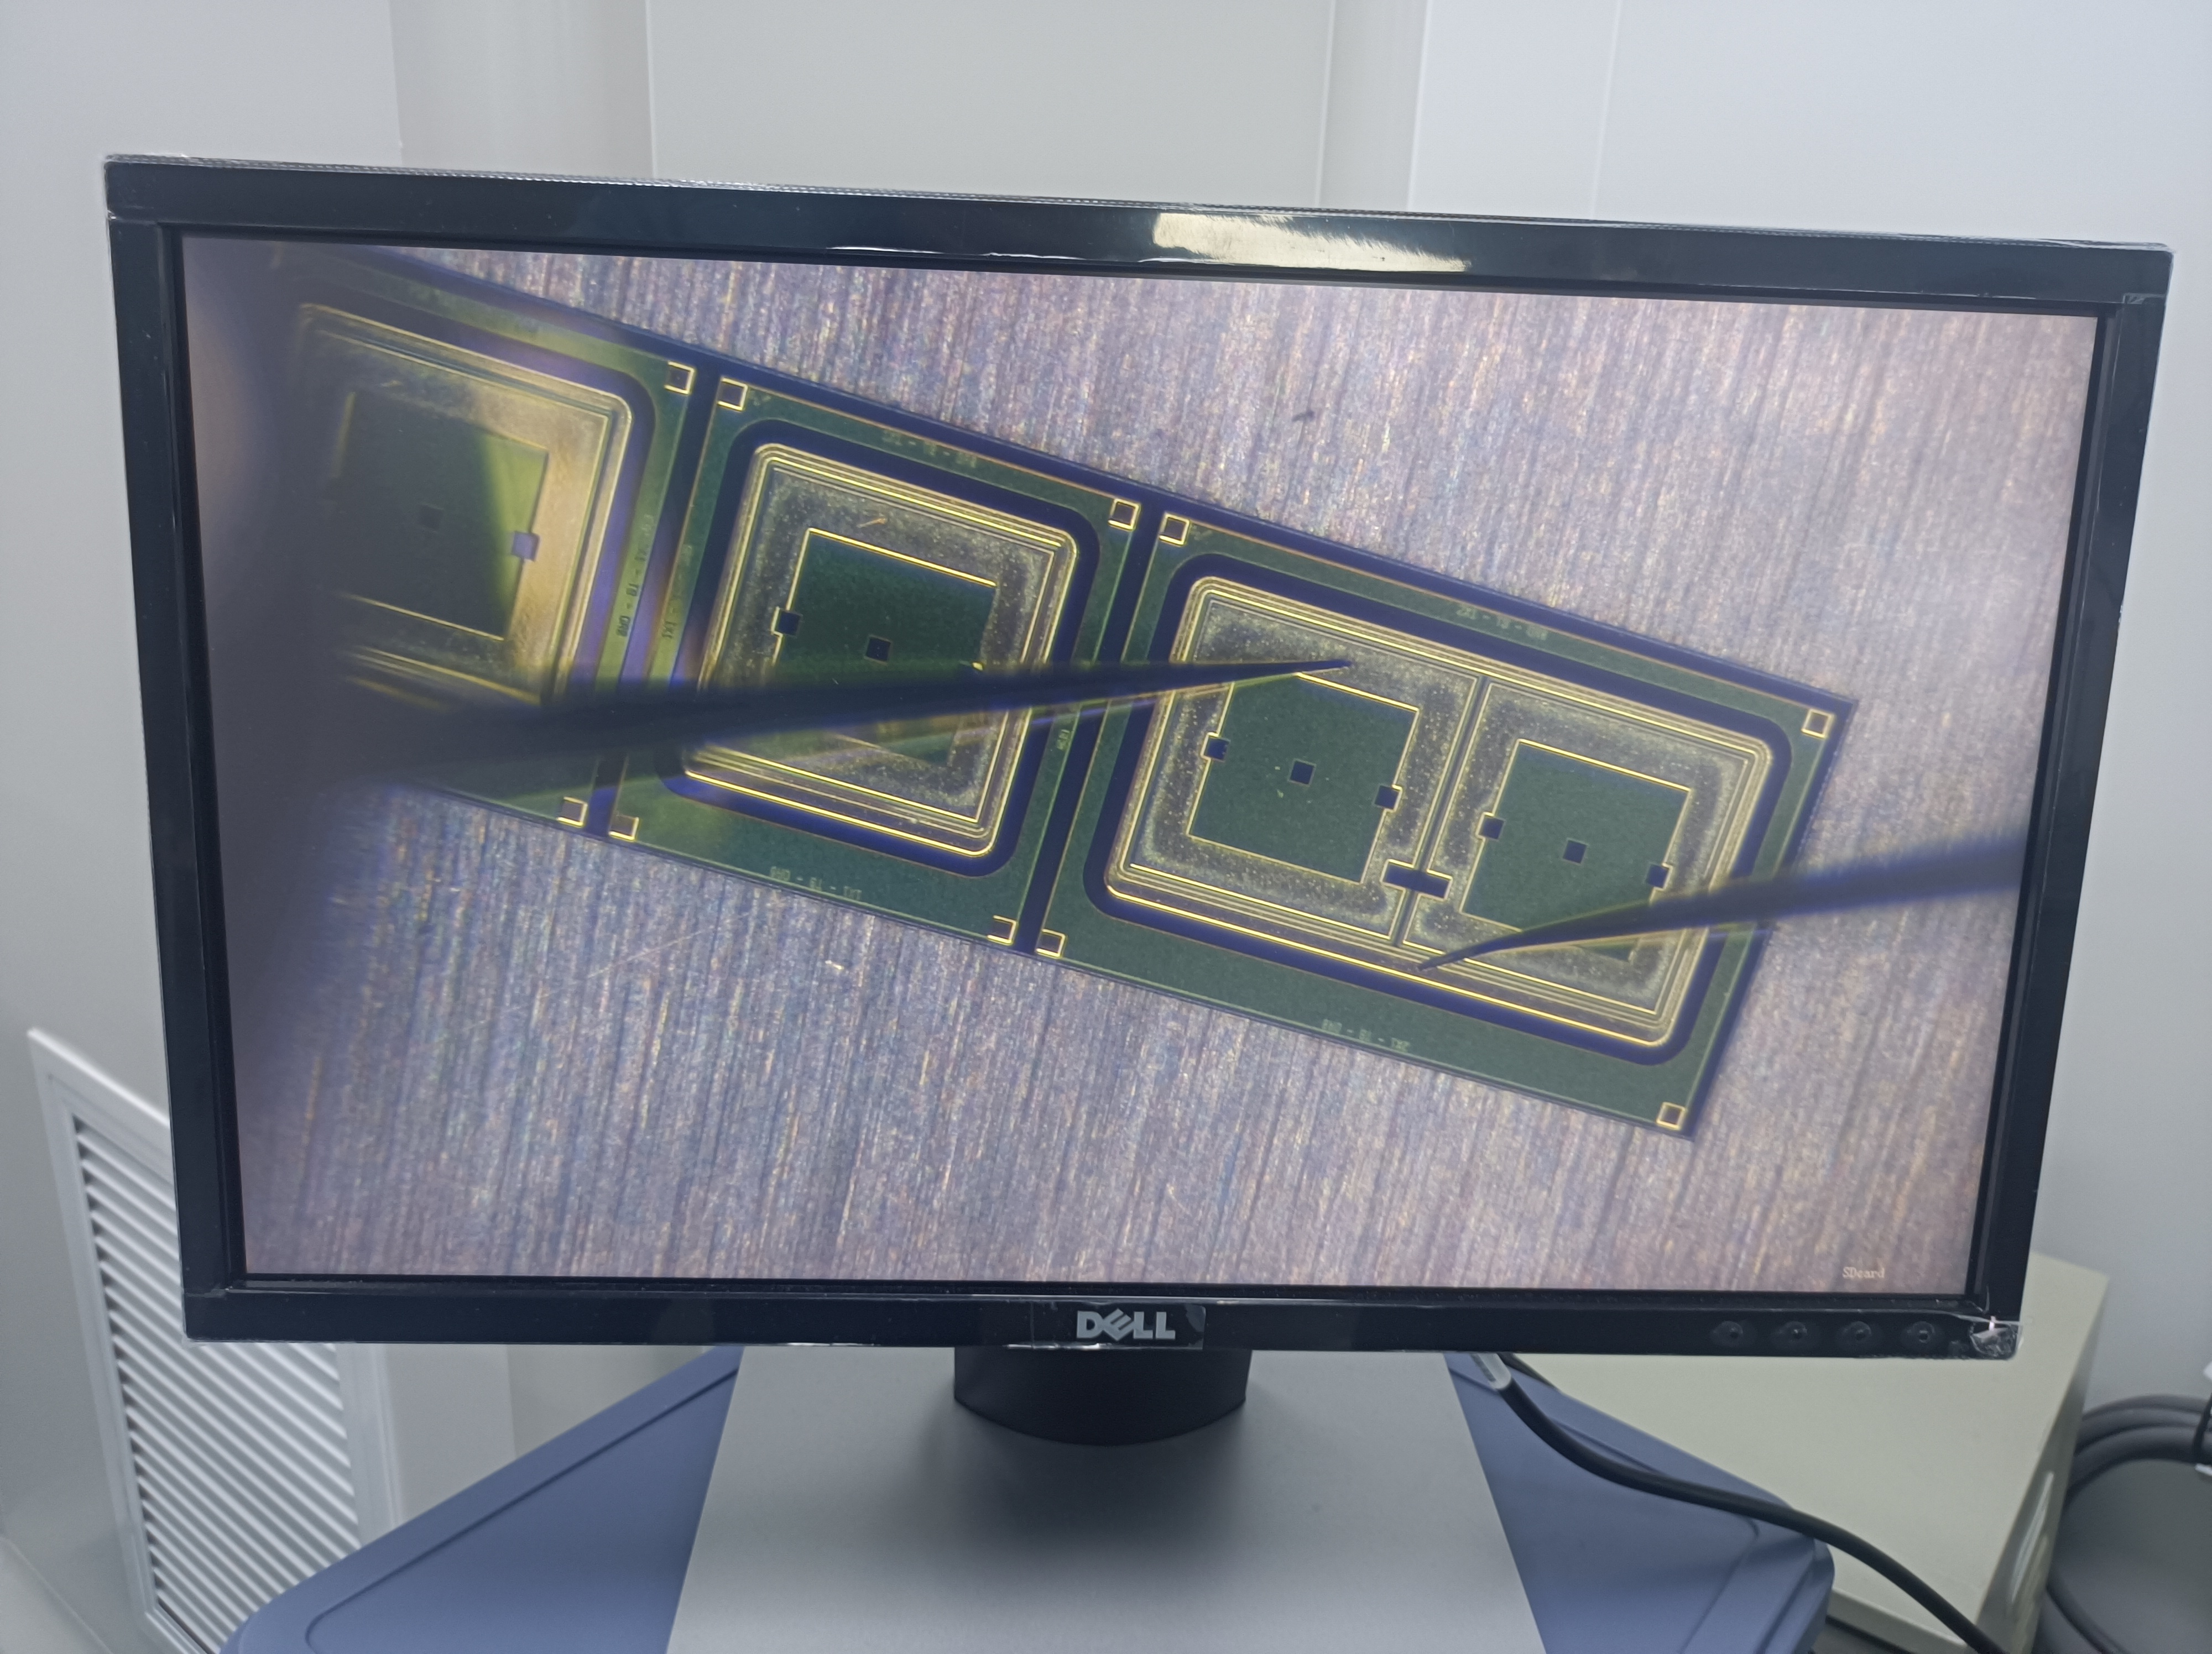
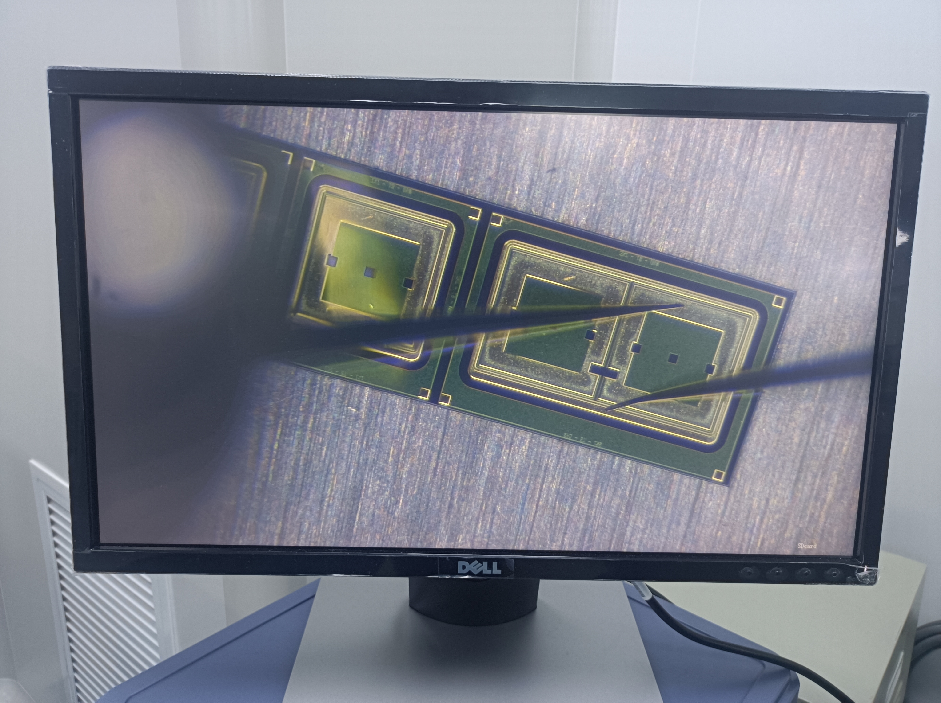
Eight pads of each test structure were also named
A01
A02
A03
A04
B01
B02
B03
B04
Each test structure include the following structures:
● a single-pad PIN diode.(A01，B01)
● a single-pad LGAD（A02,B02）, a 1×2 LGAD array(A03,A04,B03,B04)
● Van der Pauw structures,
● gated diodes and MOS capacitors,
● Any additional structures deemed necessary by the Contractor for their process control.
Notes:
liquid&Semiconductor cooling

Slide 10
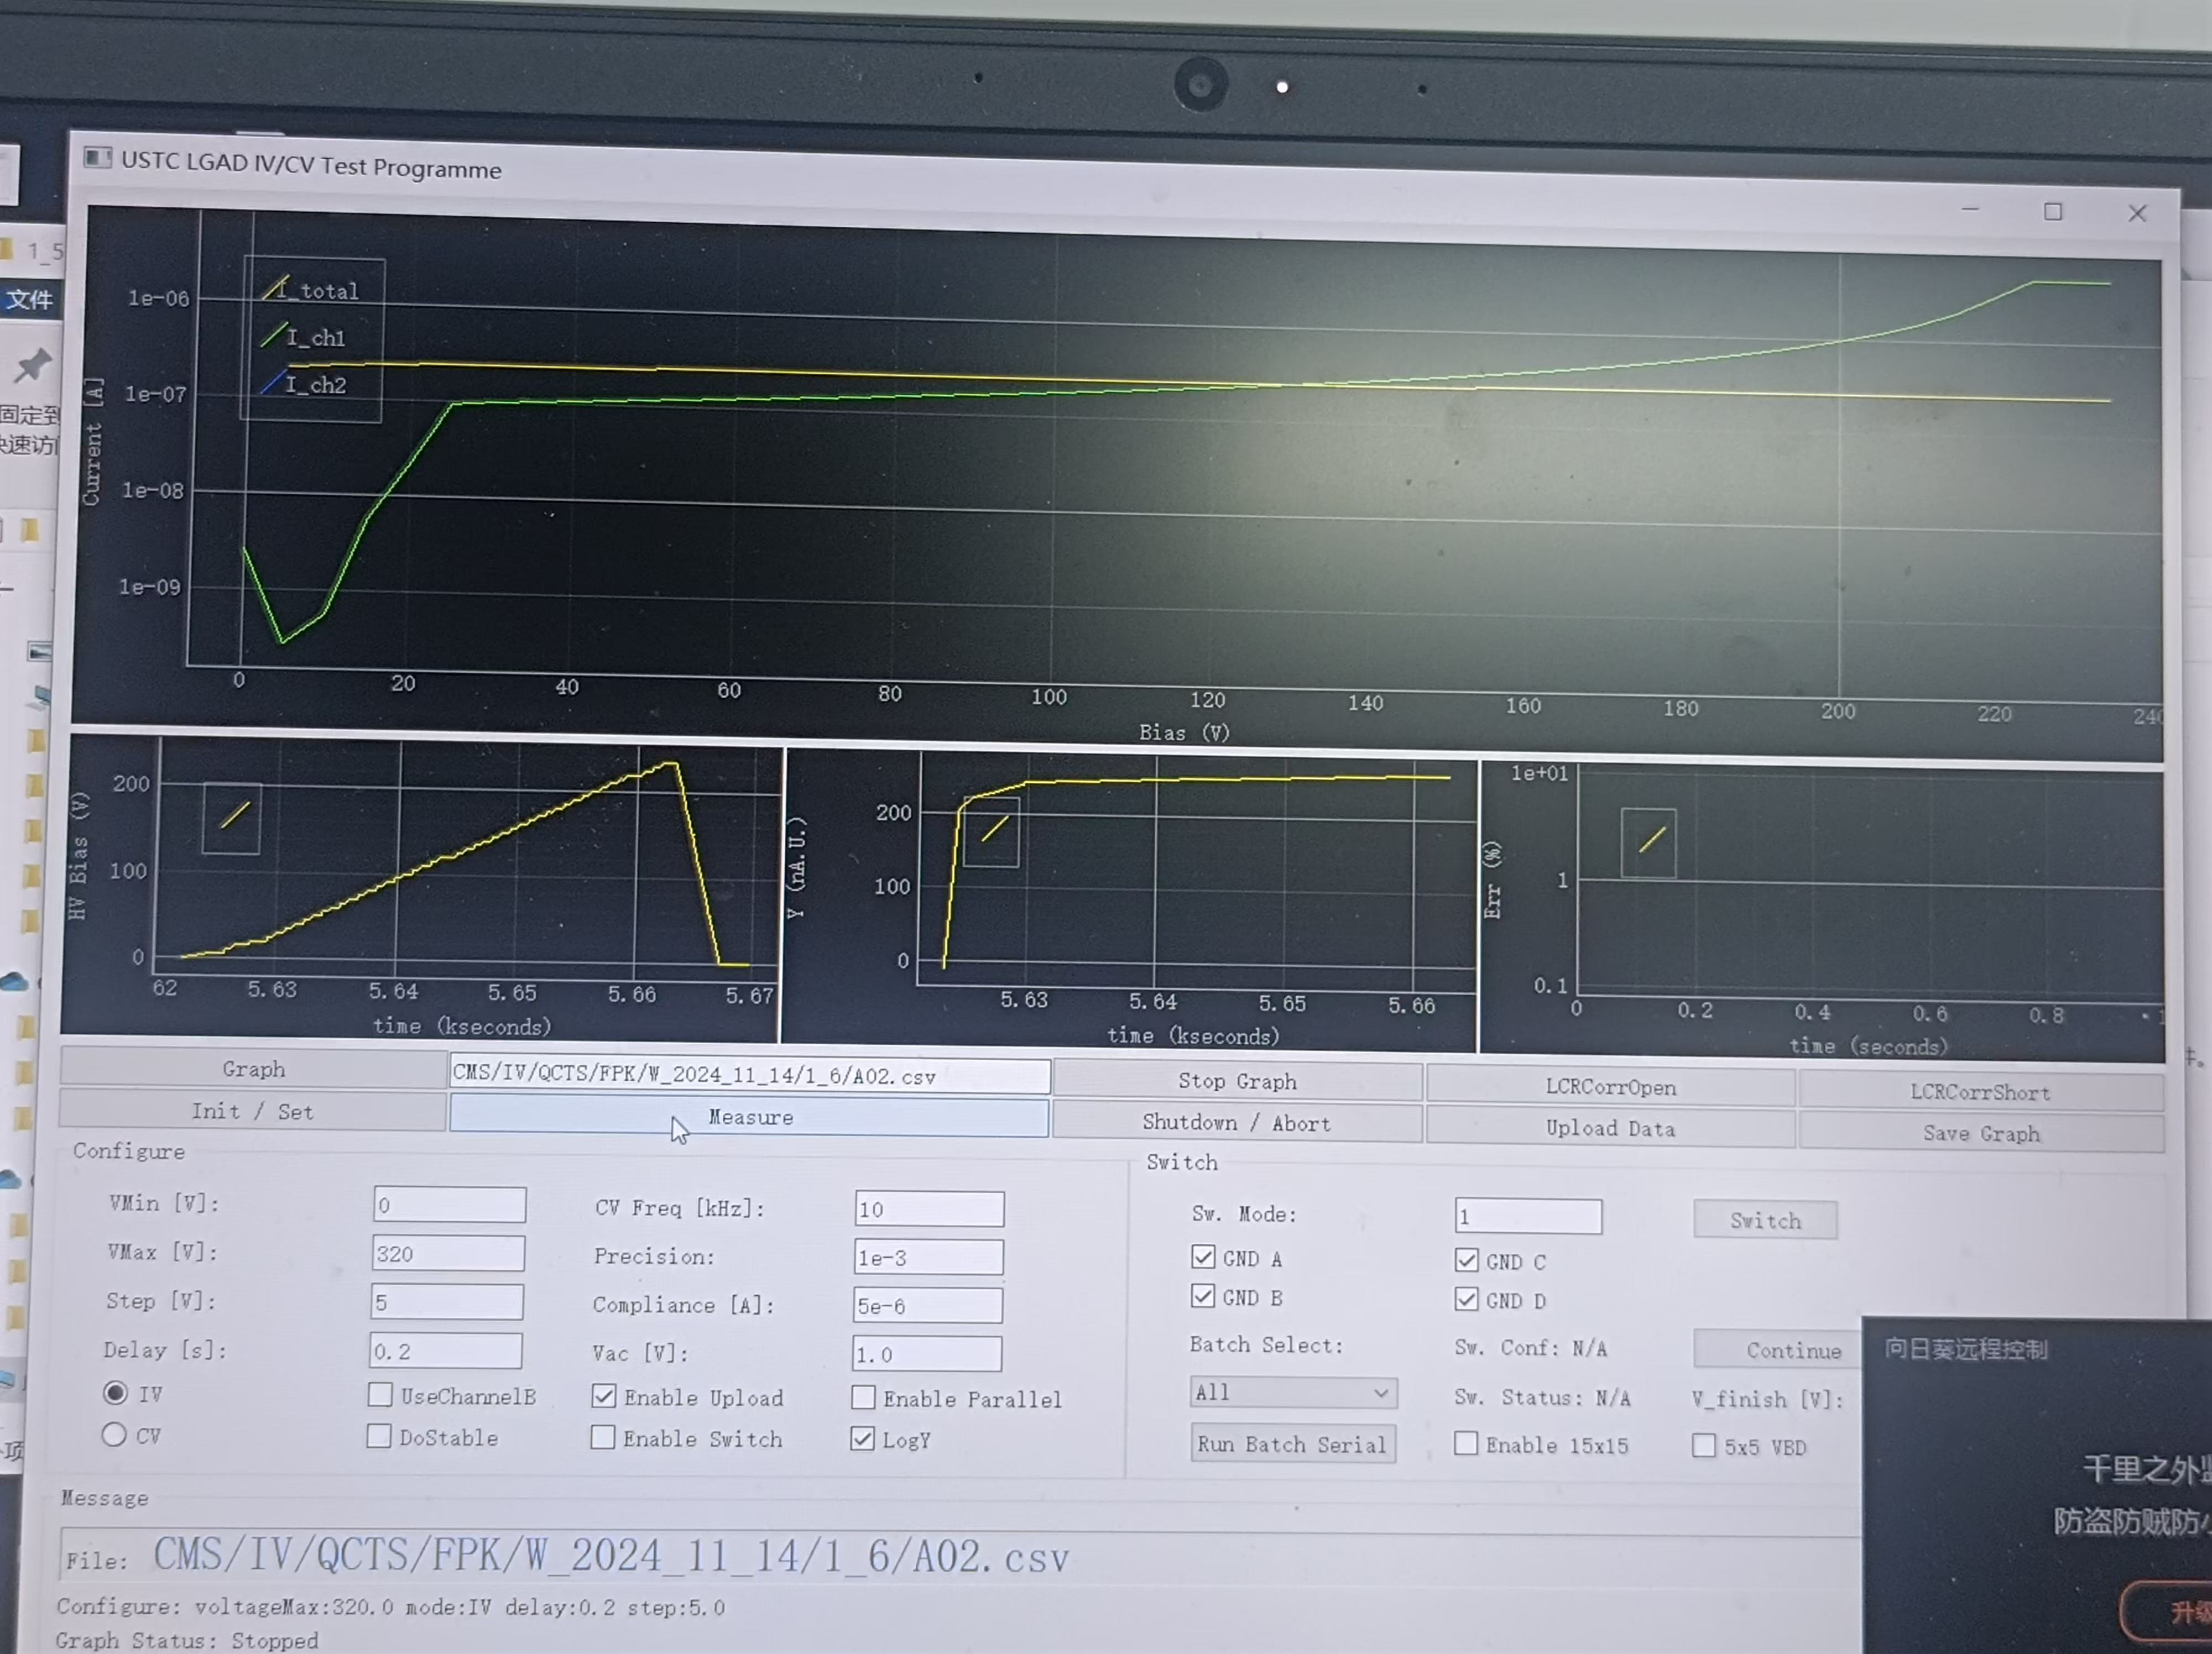
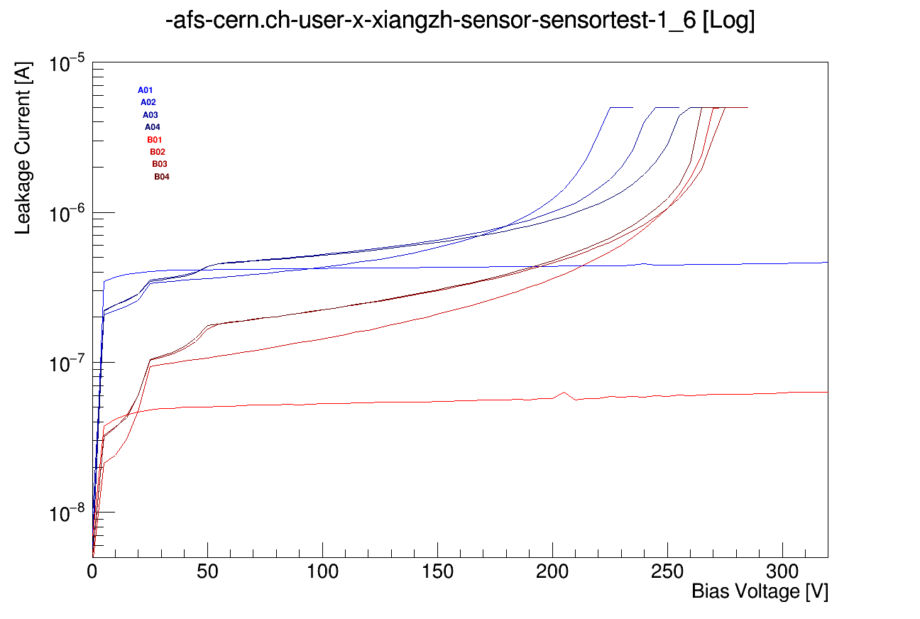
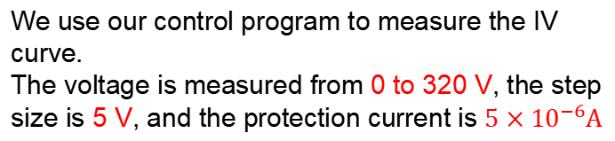
Read the IV curve of a single pad
Their breakdown voltage can be known from the csv file (read by the control program) or the IV curve that we measured.
A2:225V A3:245V A4:260V B2:275V B3:275V B4:265V
Notes:
liquid&Semiconductor cooling

Slide 11
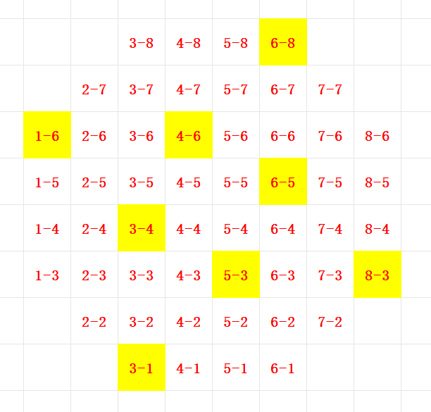
Chose eight structures evenly to show the IV curve
There are 52 test structures, so there will be 52 IV curves,which will not be displayed one by one. We chose eight structures evenly:
Outer ring: 1_6 6_8 8_3 3-1
Inner ring : 3_4 4_6 6_5 5_3
Notes:
liquid&Semiconductor cooling

Slide 12
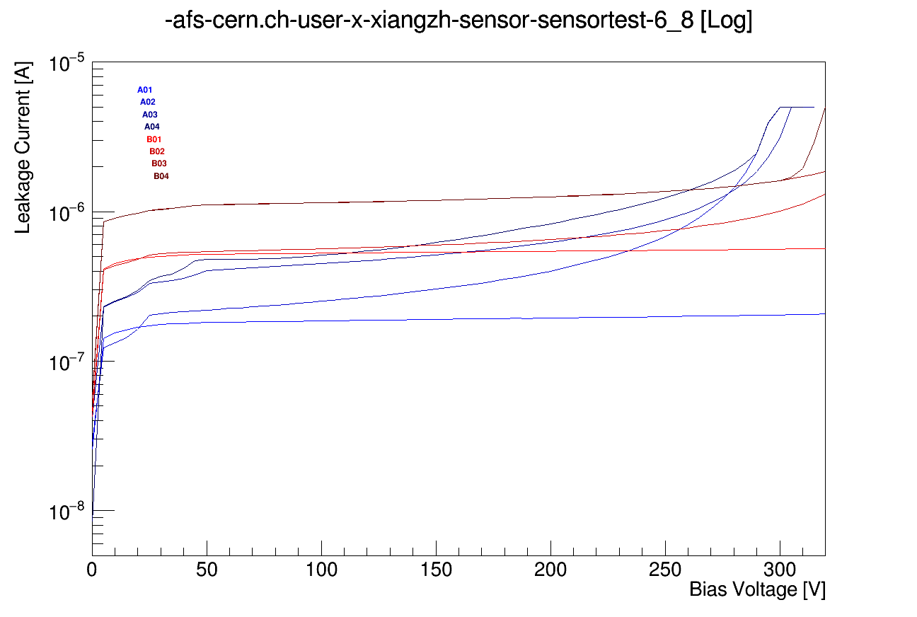
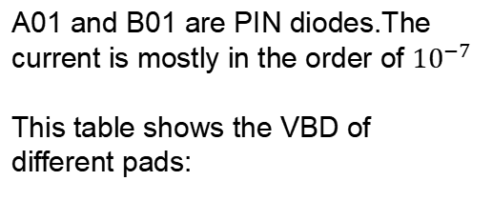
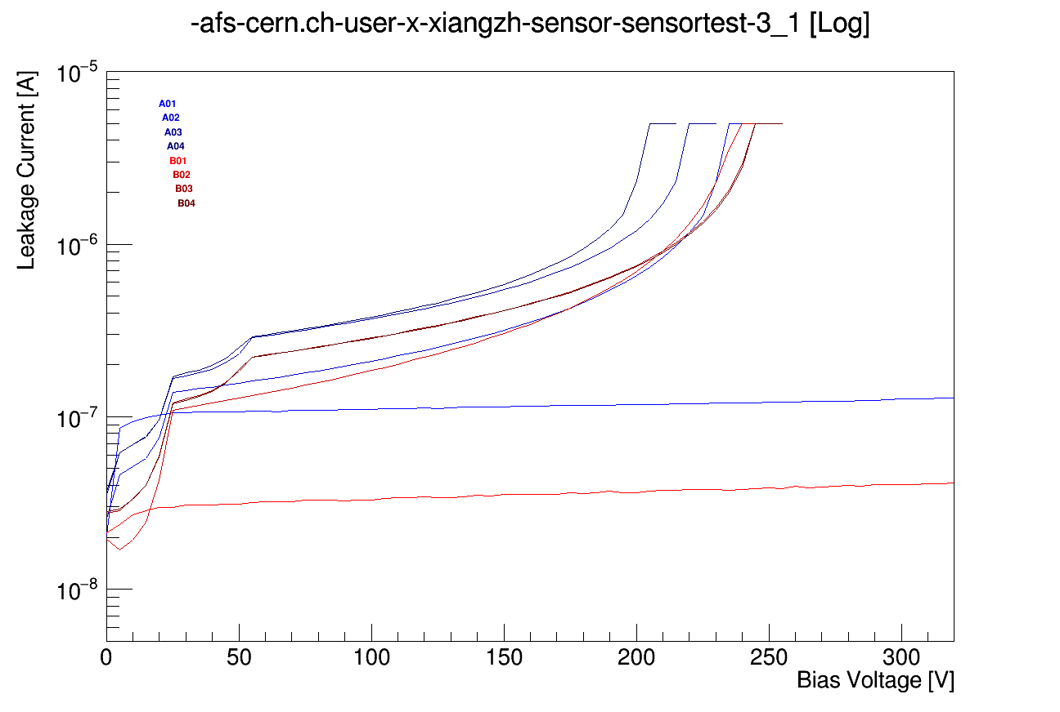
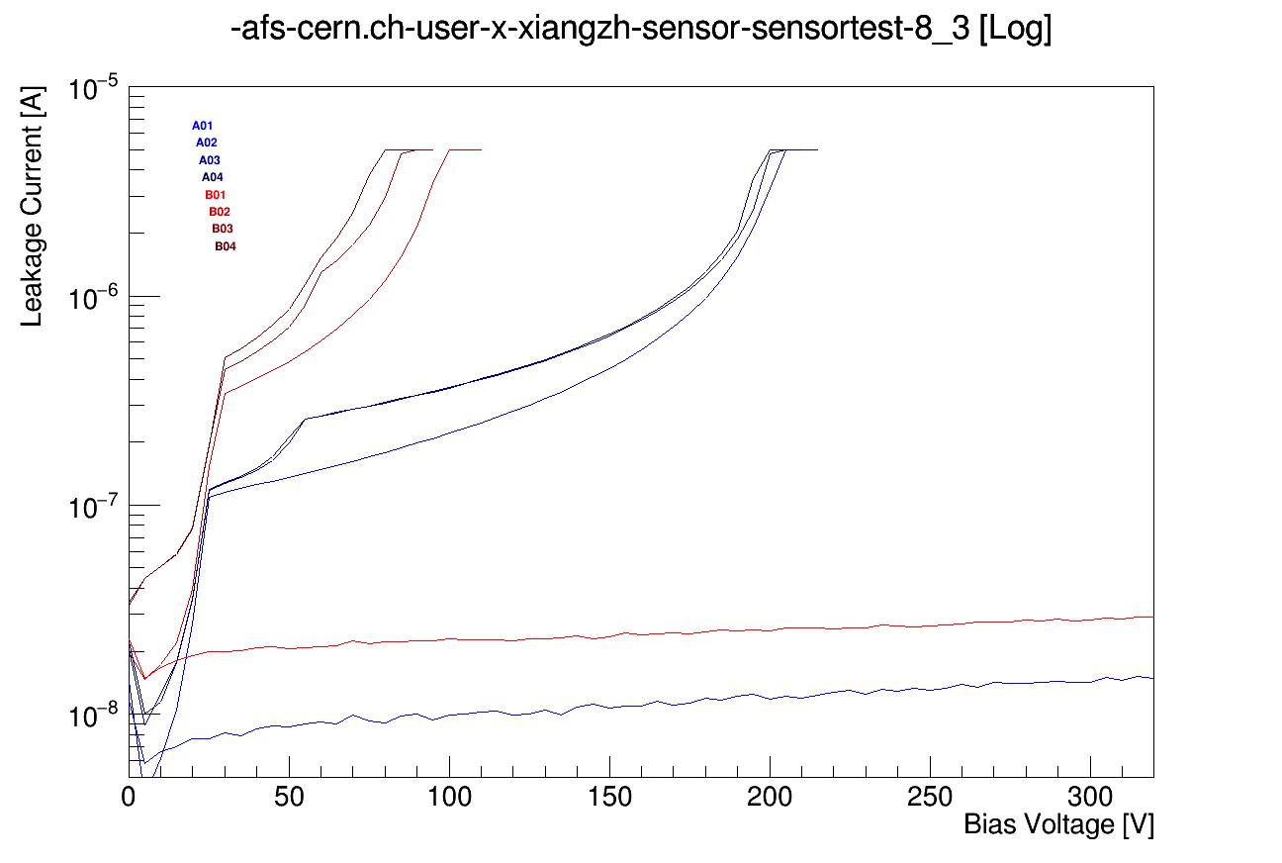
Outer ring
 | A02 | A03 | A04 | B02 | B03 | B03
1.6 | 225 | 245 | 260 | 275 | 275 | 265
3.1 | 235 | 220 | 205 | 240 | 245 | 245
6.8 | 300 | 305 | 300 | 320 | 320 | 320
8.3 | 205 | 205 | 200 | 100 | 90 | 80
As mentioned earlier, this is an early-stage non-uniform wafer.
Notes:
liquid&Semiconductor cooling

Slide 13
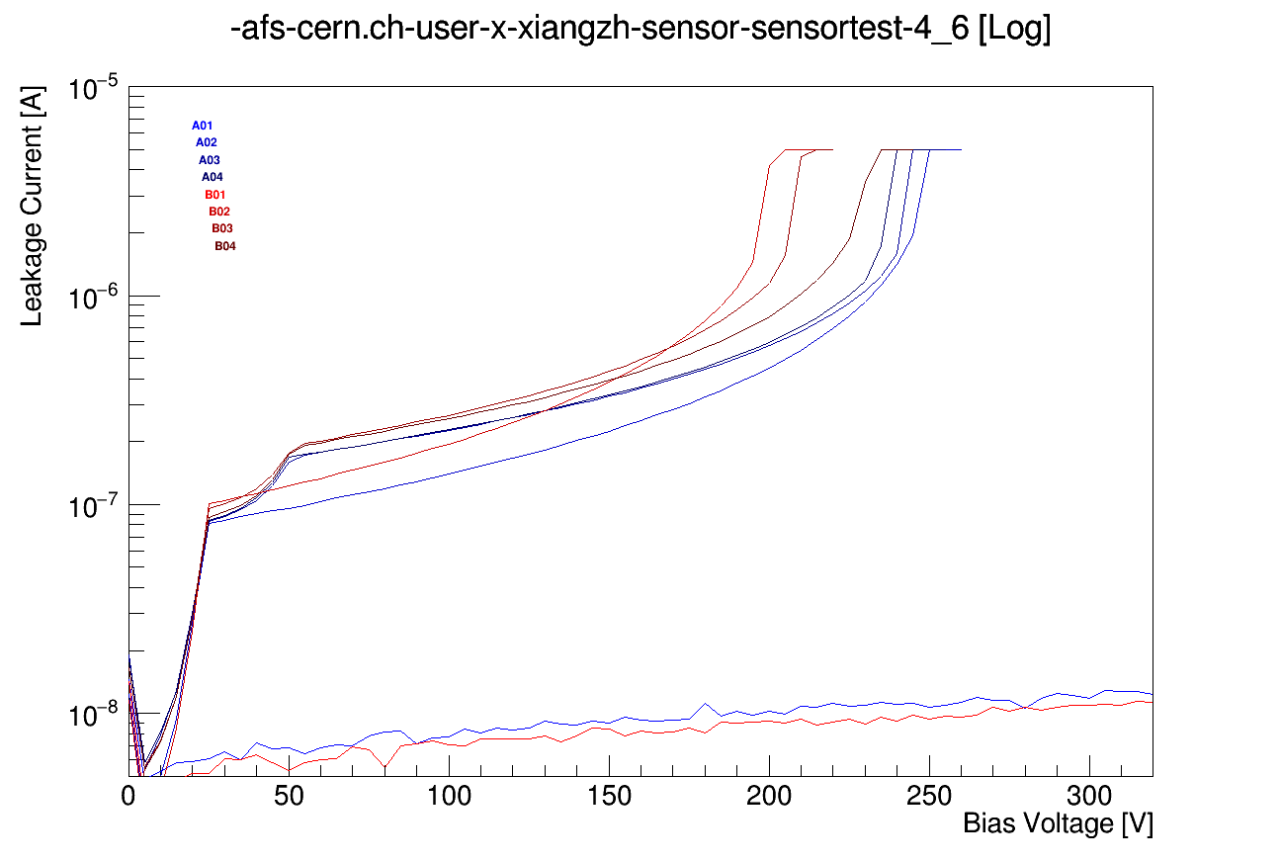
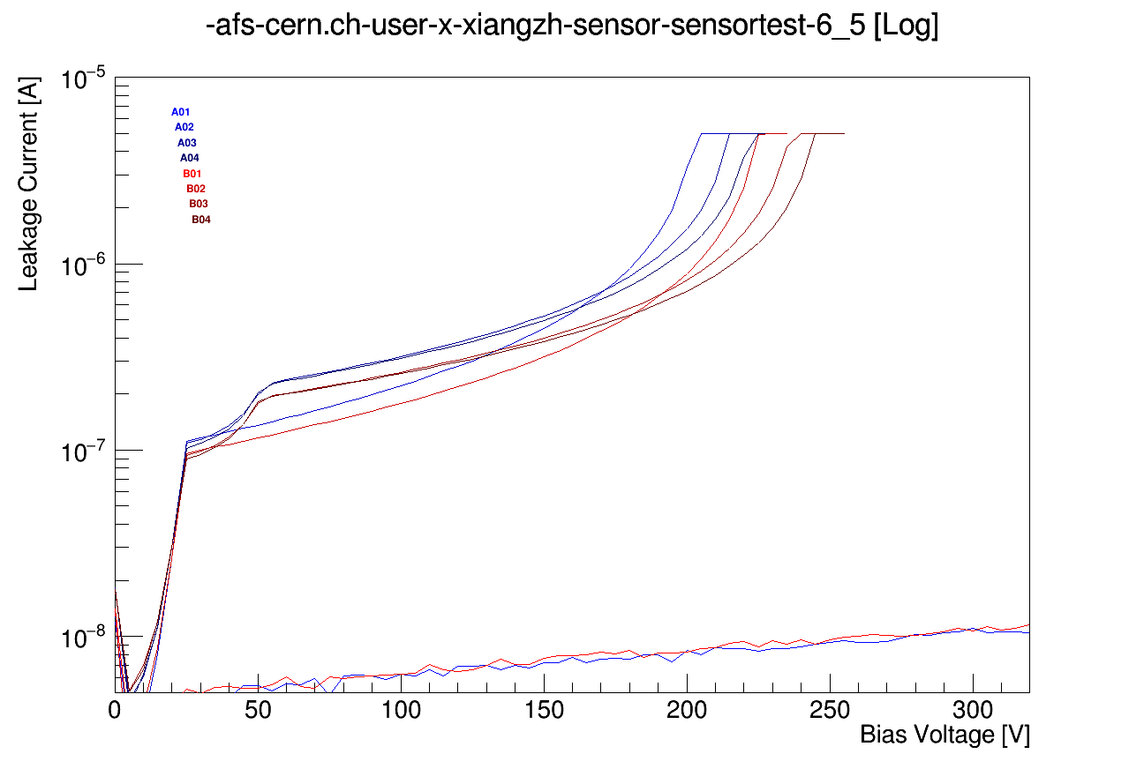
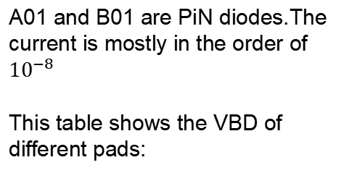
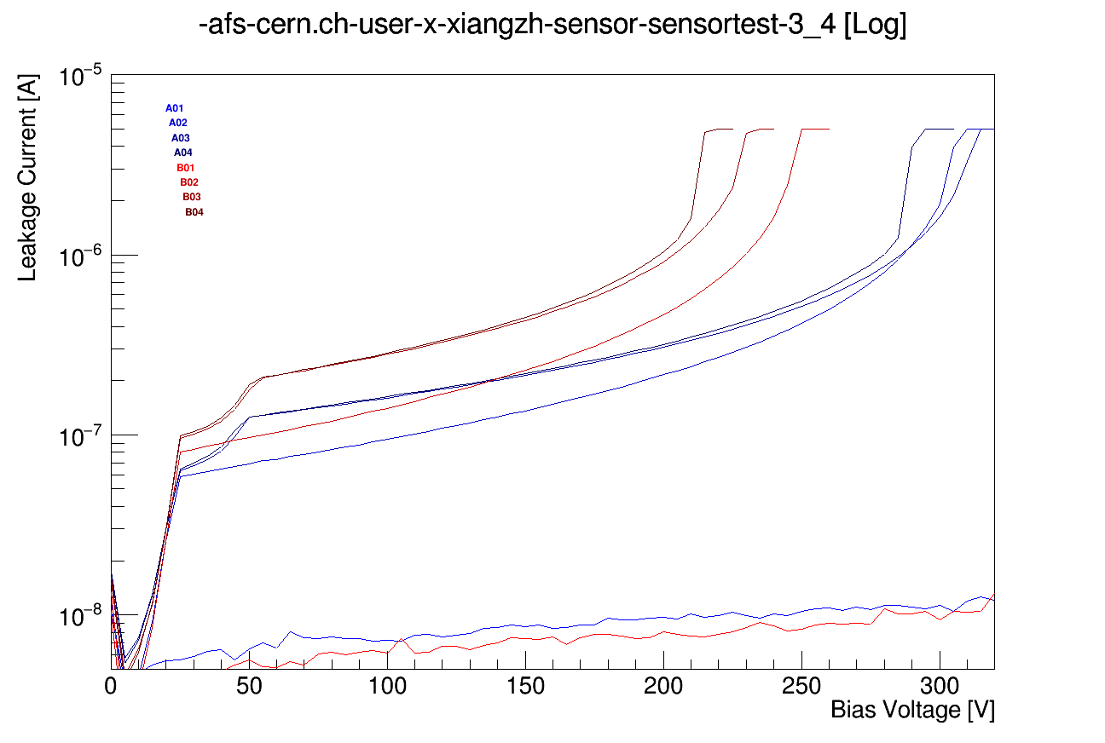
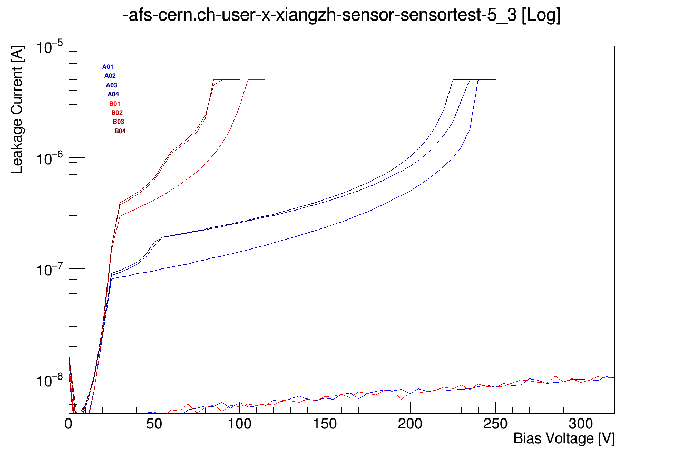
Inner ring
 | A02 | A03 | A04 | B02 | B03 | B03
3.4 | 310 | 315 | 295 | 250 | 235 | 220
4.6 | 250 | 250 | 240 | 205 | 215 | 235
5.3 | 240 | 225 | 225 | 105 | 85 | 90
6.5 | 205 | 215 | 225 | 230 | 240 | 245
In order to visualize the VBD of the test structure on this entire wafer, we use different colors to describe the size of the VBD.
Notes:
liquid&Semiconductor cooling

Slide 14
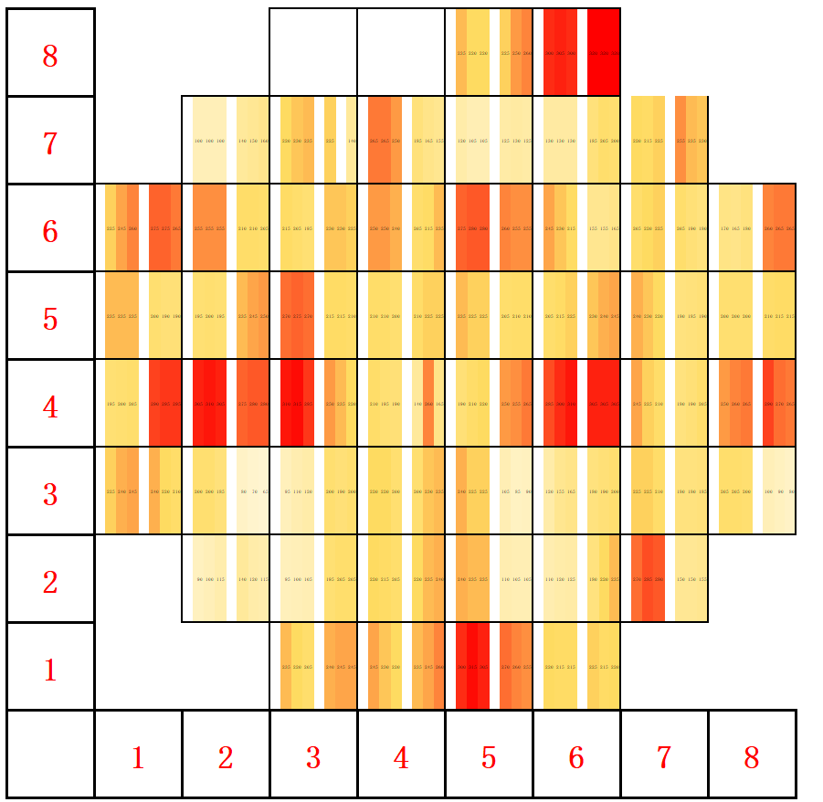
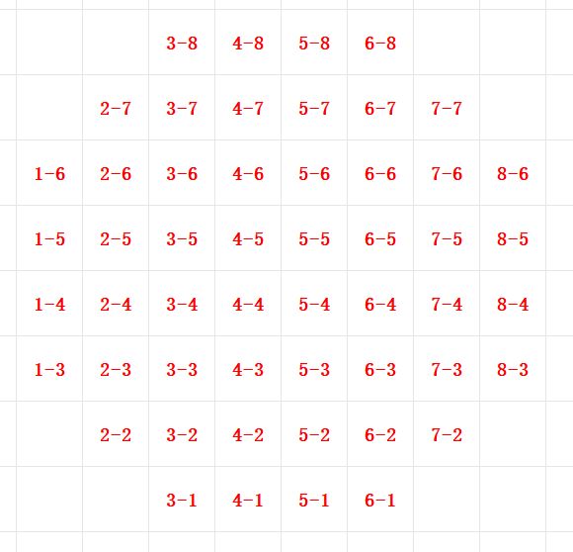
VBD for all test structures
0 100 200 300
Early-stage non-uniform wafer.
Notes:
liquid&Semiconductor cooling

Slide 15
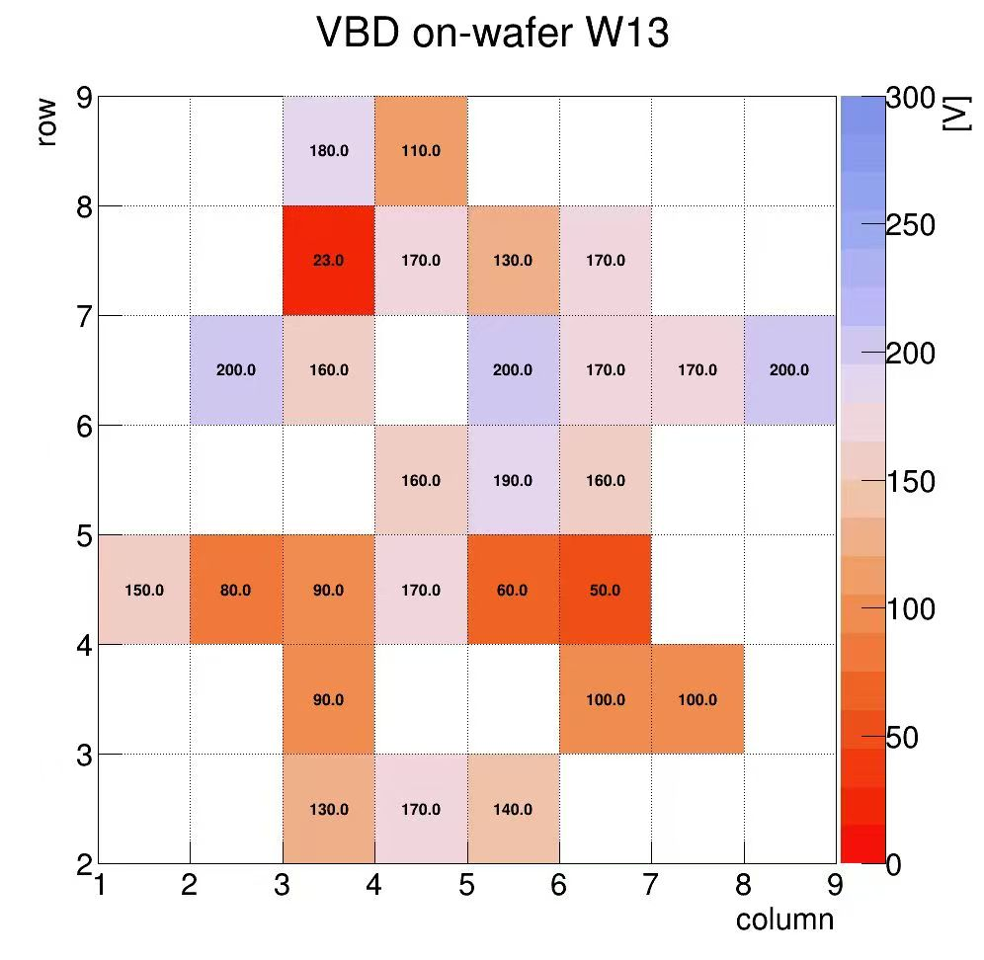
The green area is small and the red area is large
VBD from manufactory
Notes:
liquid&Semiconductor cooling

Slide 16
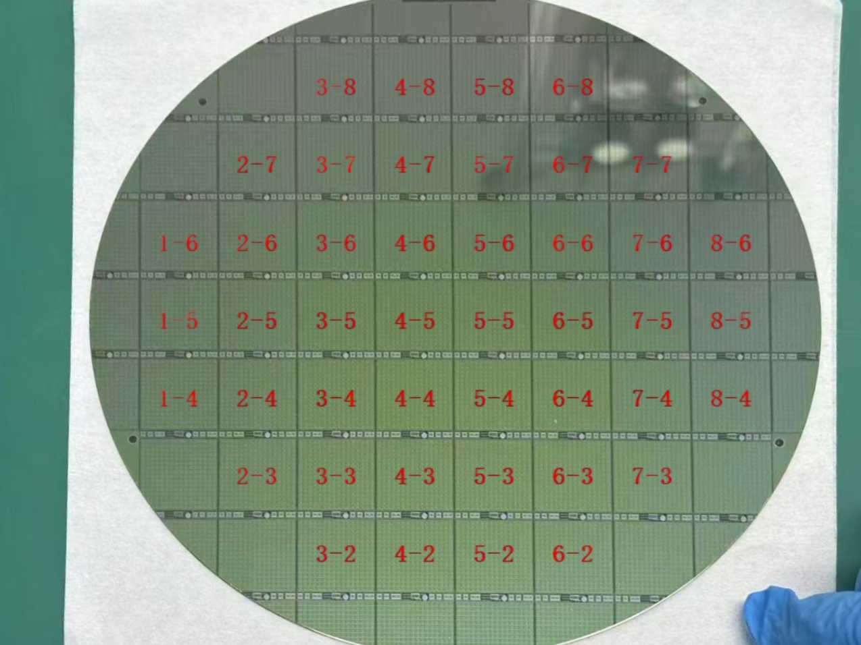
We name the sensor and test structures
Wafer 13
Coding of sensor
Notes:
liquid&Semiconductor cooling

Slide 17
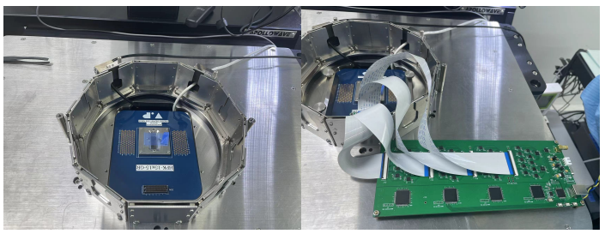
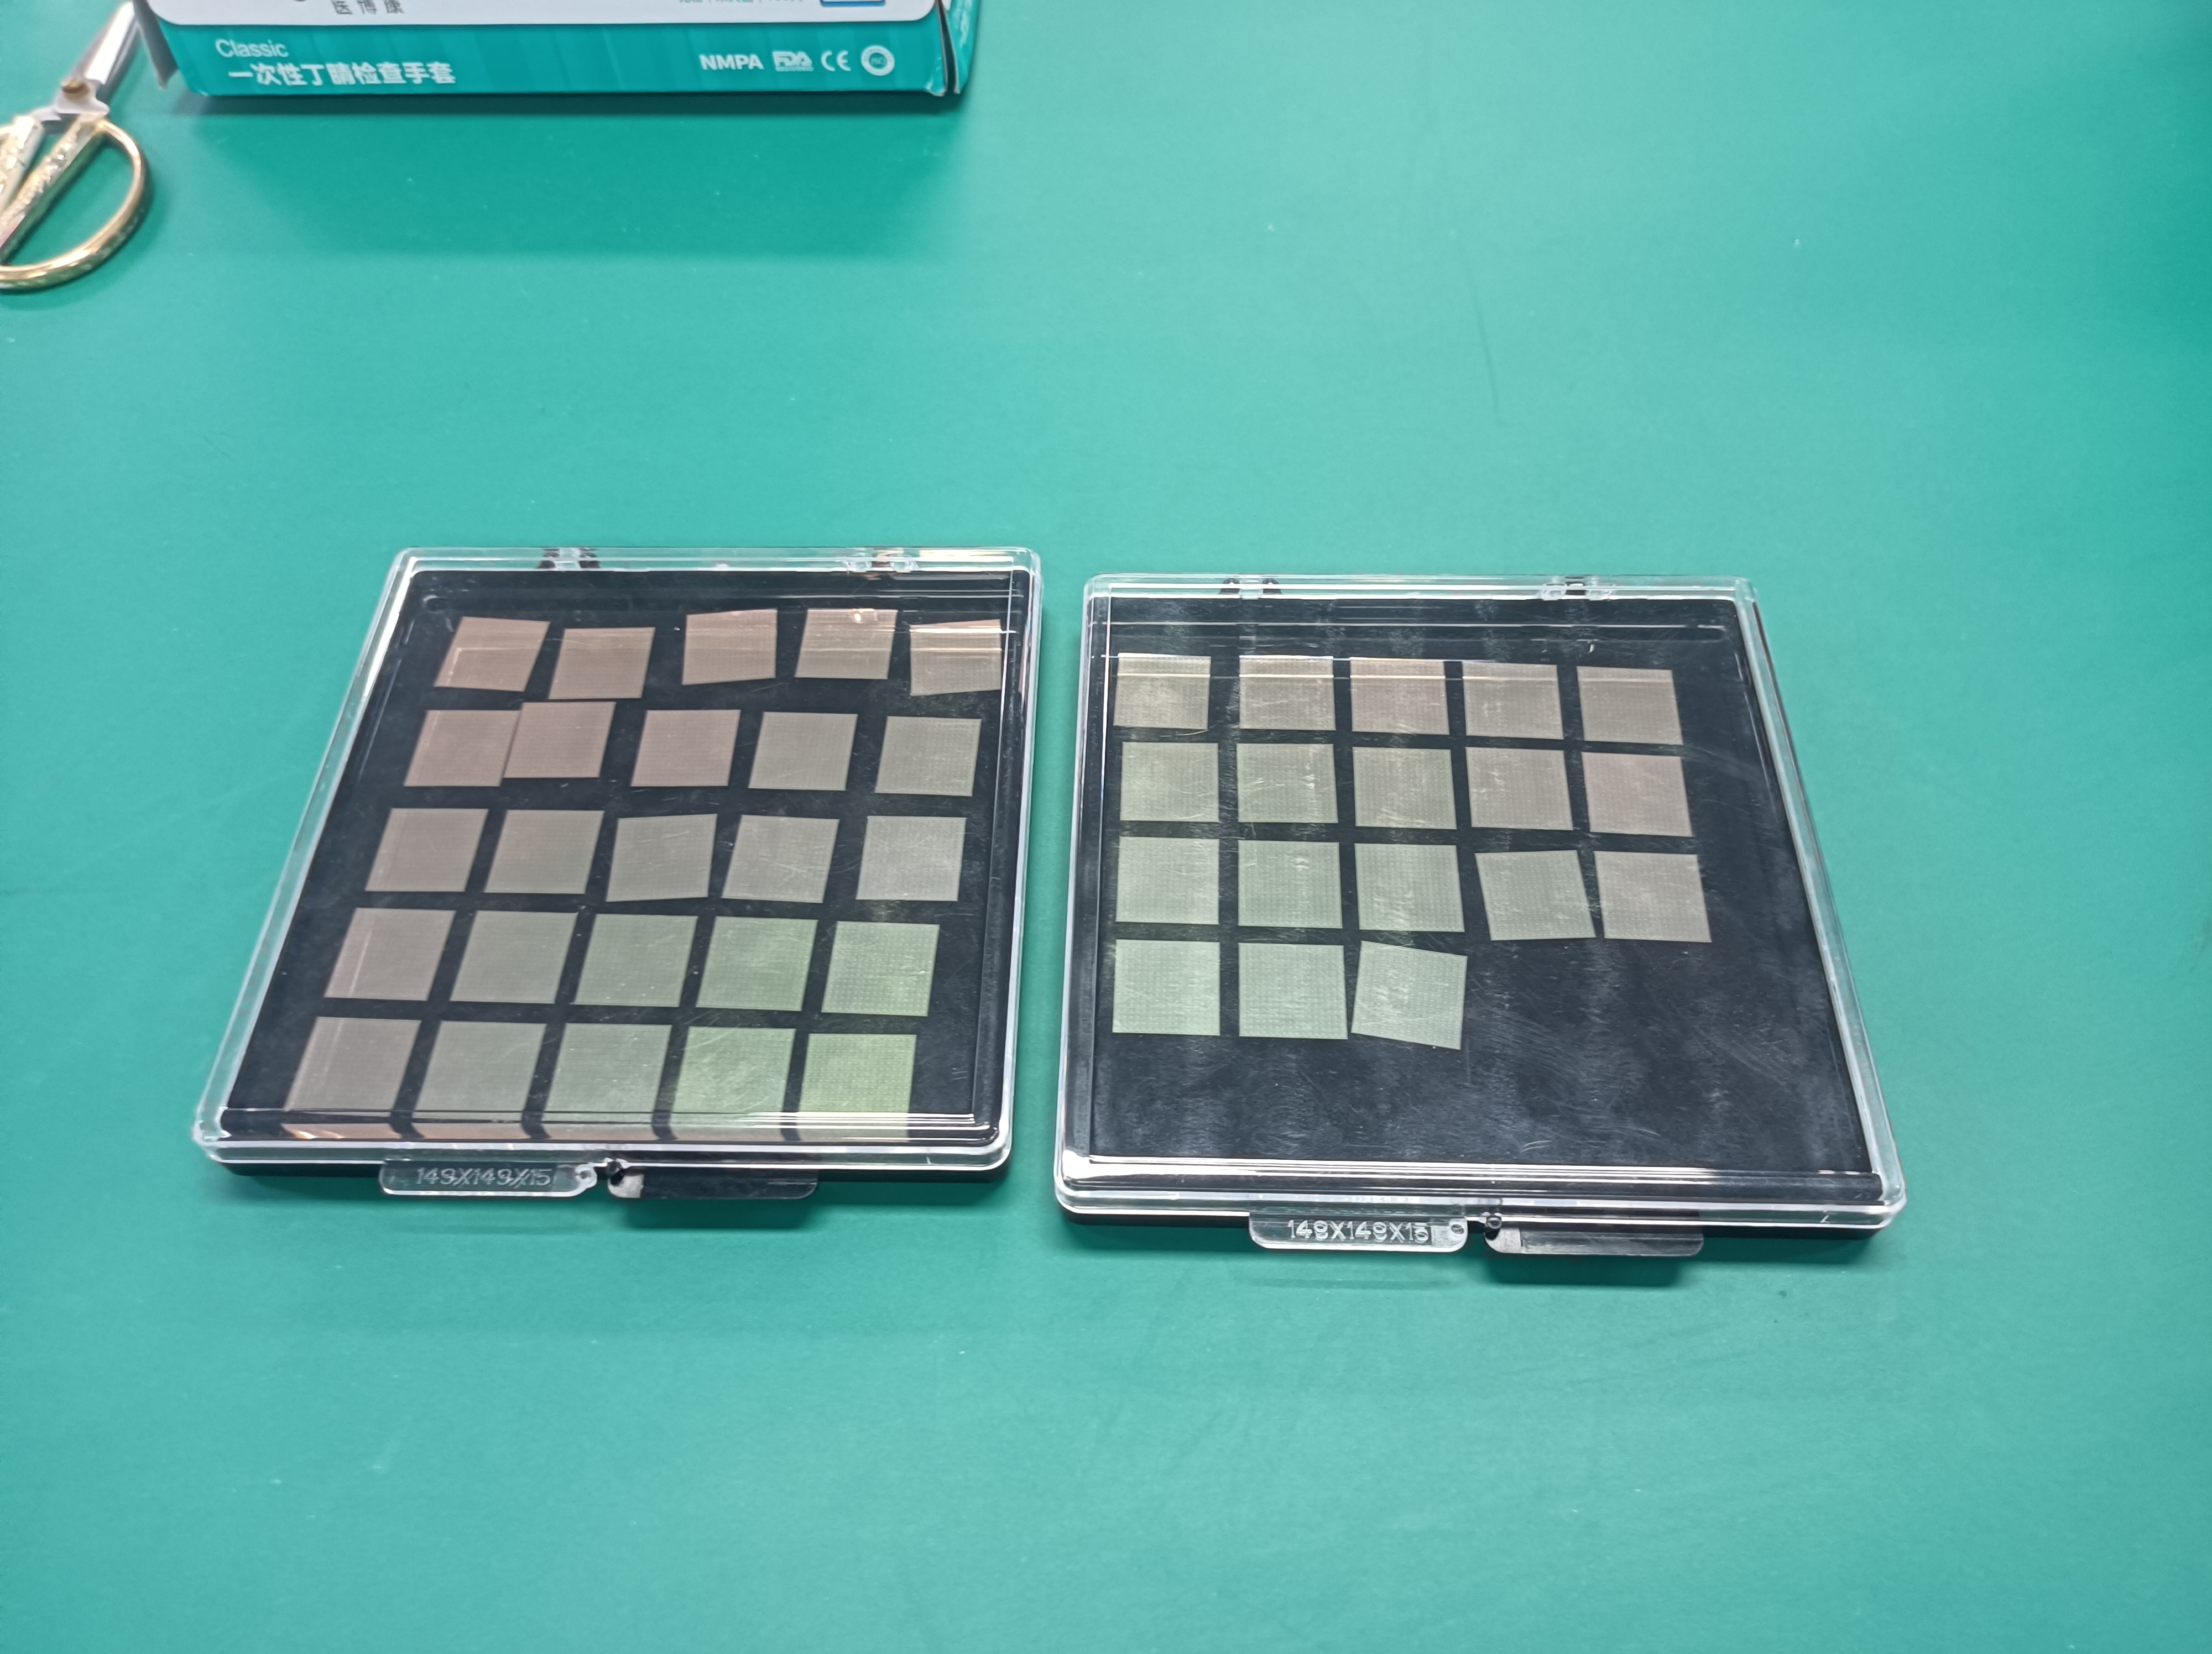
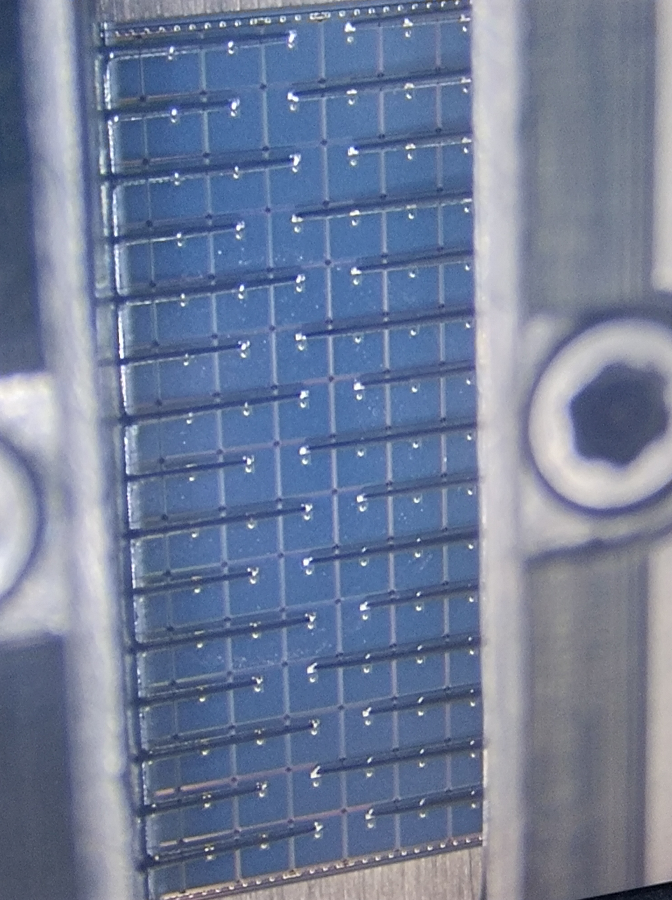
We test the sensor by probe card
probe card
switch matrix
16×16
44 sensors on W13
Notes:
liquid&Semiconductor cooling

Slide 18
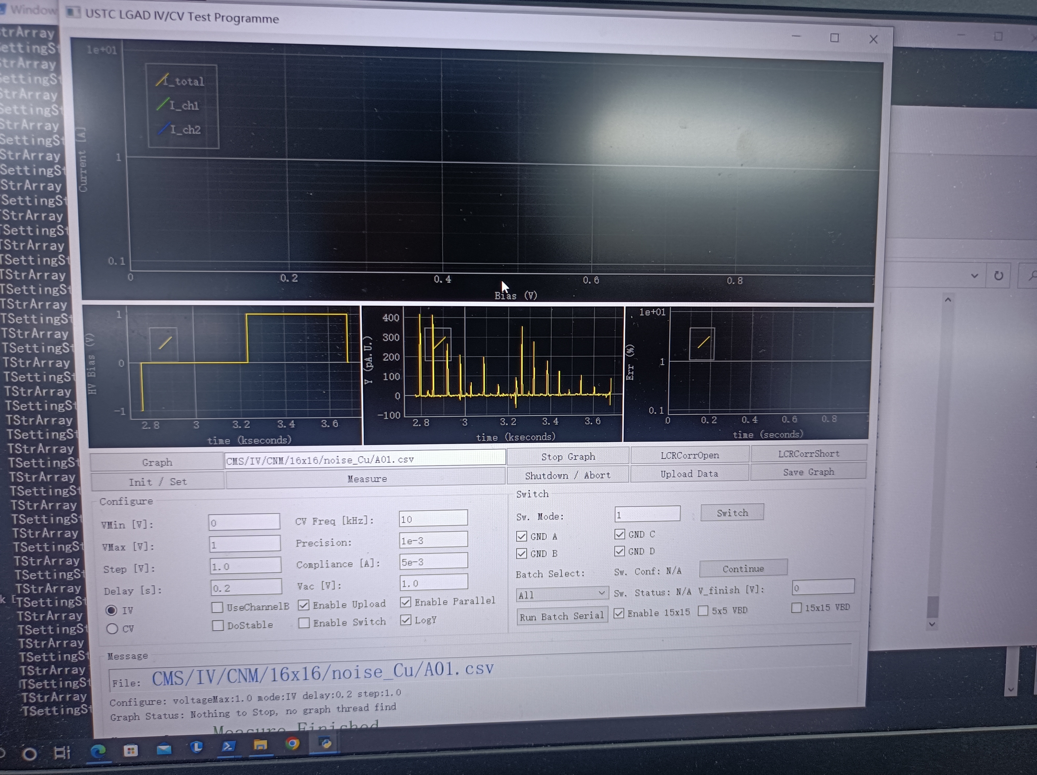
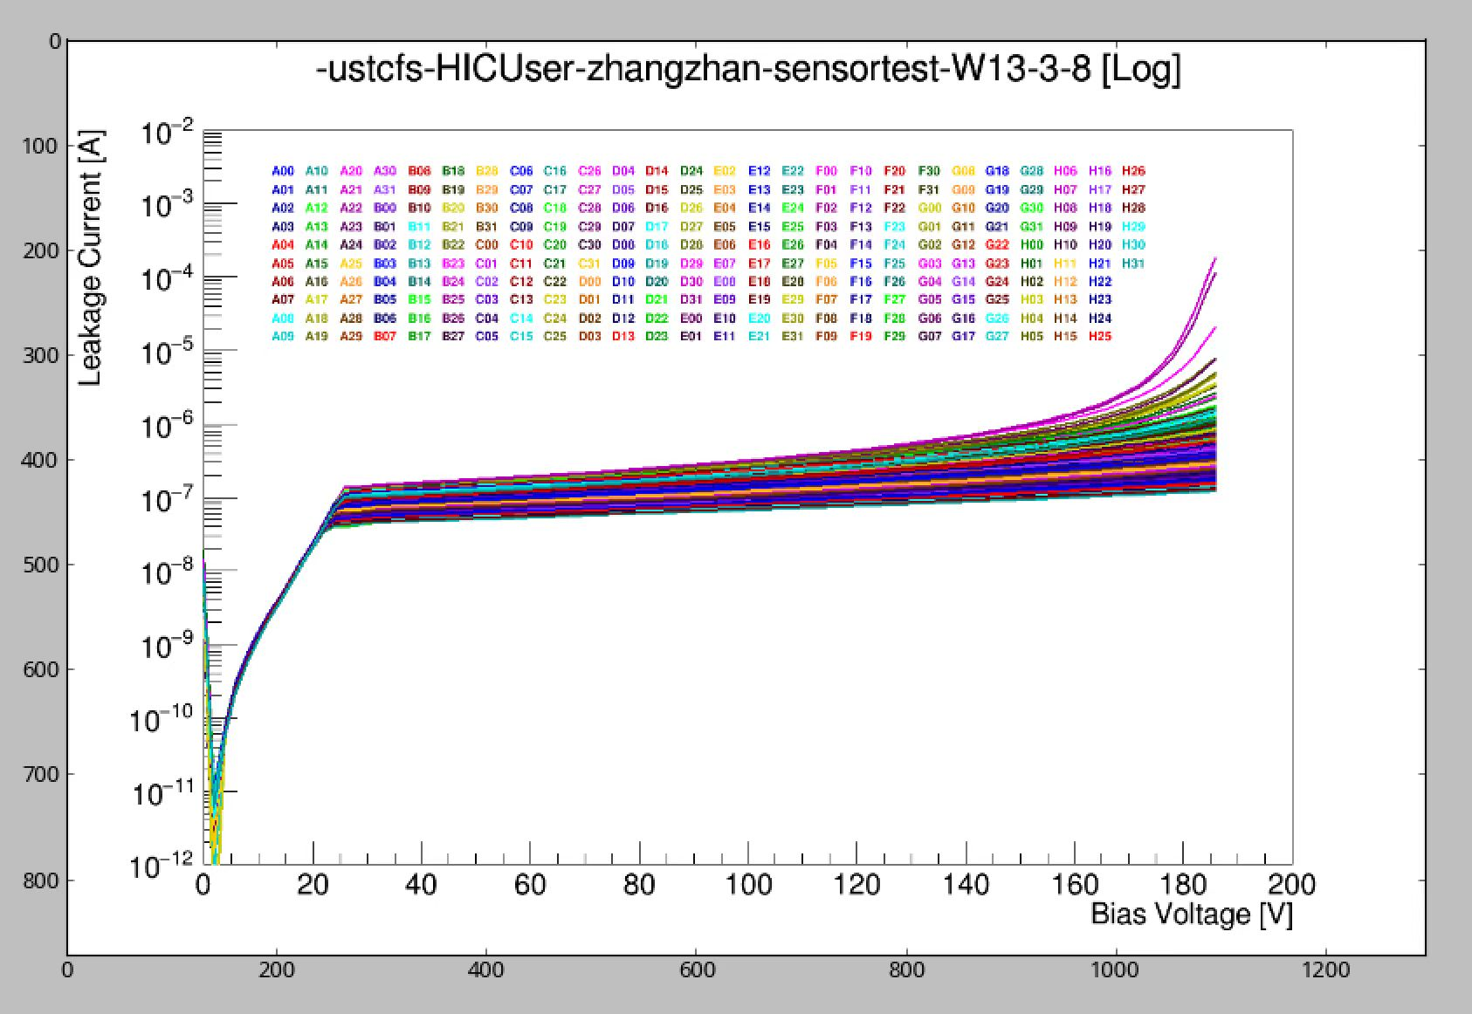
Read the IV curve of sensor
We've measured 1-4 3-8 4-7 5-5
Notes:
liquid&Semiconductor cooling

Slide 19
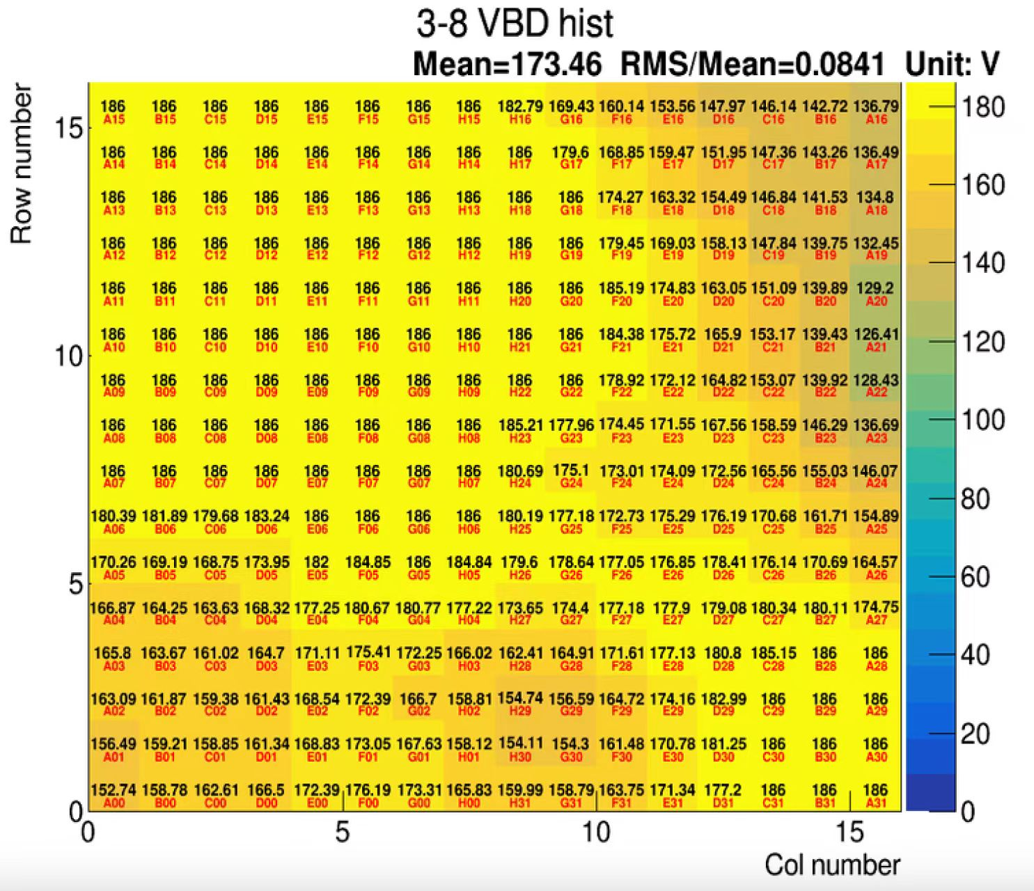
W13 3-8
The VBD ranges from 126V to 186V, and the maximum VBD is 186V (It is also the most).
Notes:
liquid&Semiconductor cooling

Slide 20
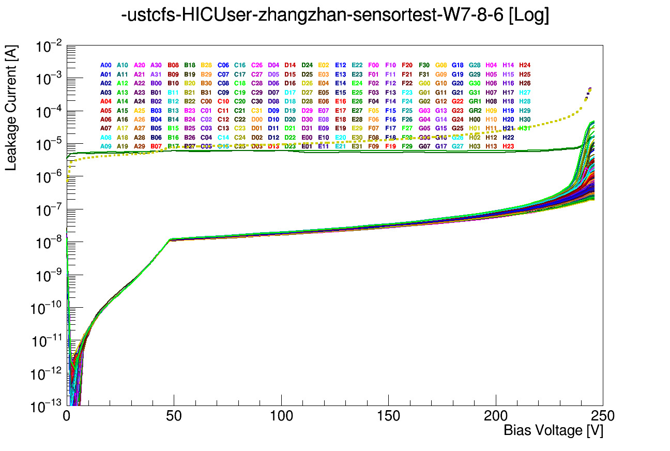
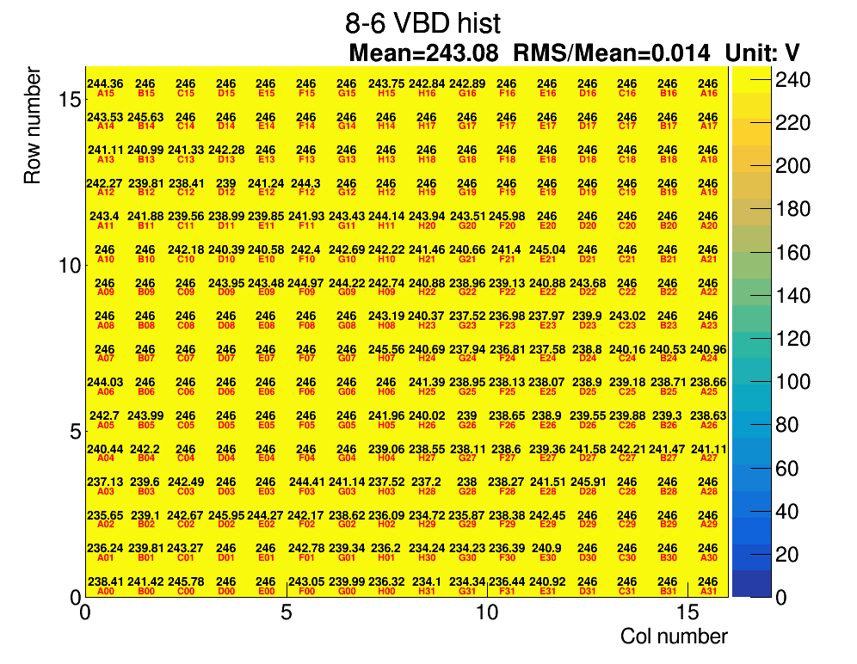
Full-size testing of FBK-LFoundry W7 (8-6)
They basically breakdown at the same voltage. W7 8-6 is a higher-quality sensor.
Notes:
liquid&Semiconductor cooling

Slide 21
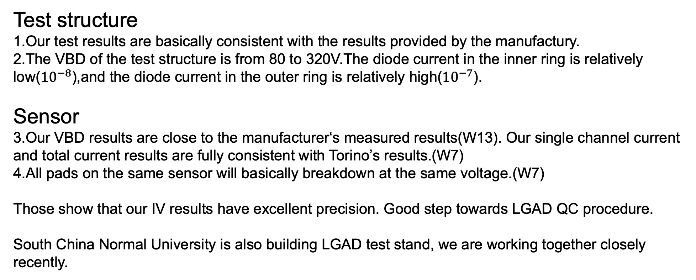
Summary
Thanks!
Notes:
liquid&Semiconductor cooling

Slide 22
Thanks!

Slide 23
Others
Notes:
liquid&Semiconductor cooling

