Slide 1
A FPGA-based DAQ system for RPC cosmic ray test
Jiaxuan Li
On behalf of USTC RPC lab
Nov 1st, 2025

Slide 2
Outline
Introduction
FPGA-based DAQ system design
Performance of the TDC with the signal generator
DAQ test with RPC detector
Summary

Slide 3
Introduction
2025 CLHCP

Slide 4
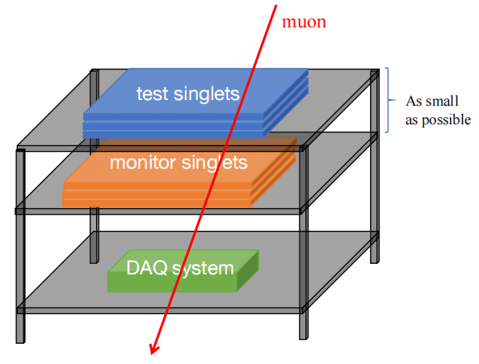
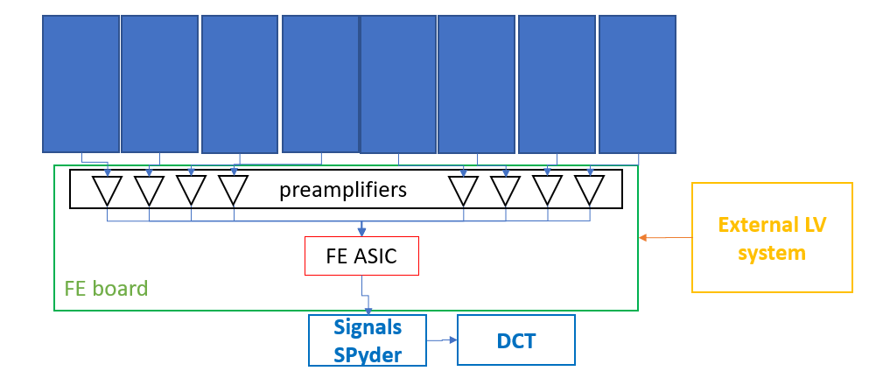
Introduction
Phase II upgrade: next-generation Resistive Plate Chambers
< 300 ps time resolution
1 cm spatial resolution
> 95% detection efficiency
Cosmic ray test in RPC production
monitor singlets
test singlets
Advantages
monitor singlets are very close together → a better triggering rate (try to accept all hit angles)
can operate the test singlets easliy
DAQ design goals
144 channels per board
TDC function with 100 ps time resolution
three trigger modes: external/self/master-slave

Slide 5
FPGA-based DAQ system design
2025 CLHCP

Slide 6
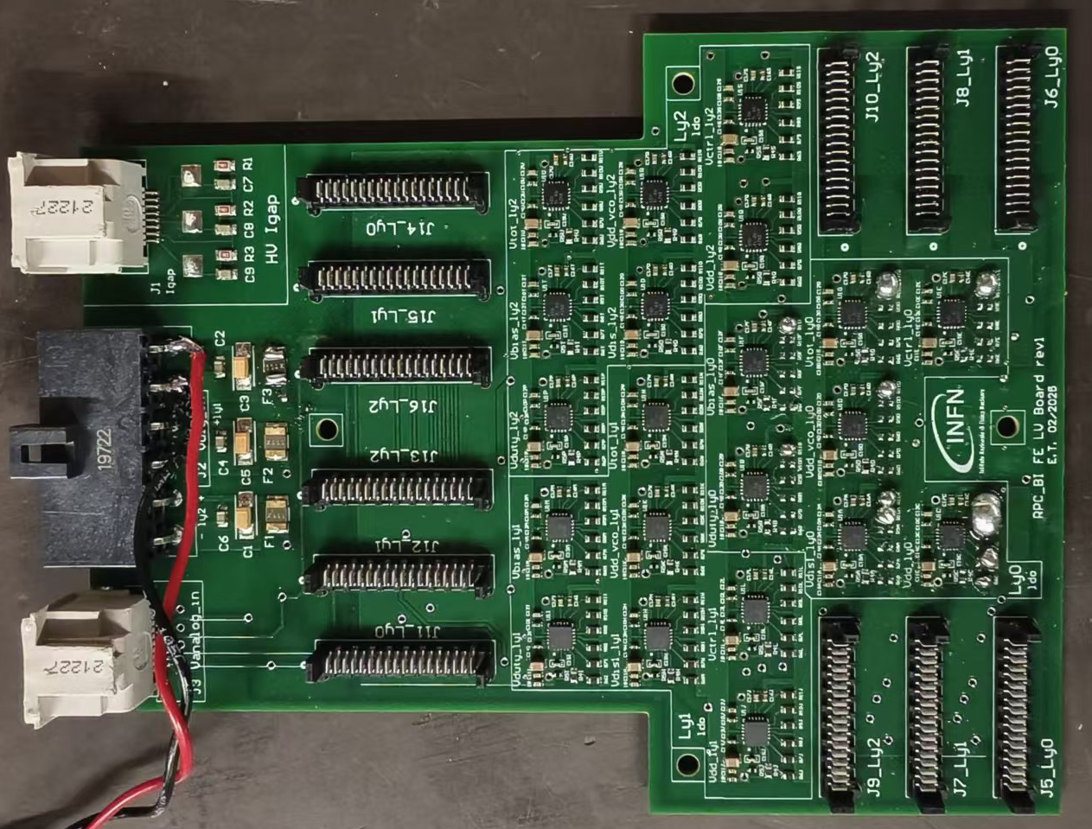
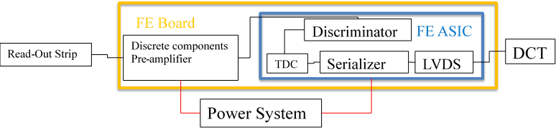
Overall signals system
DAQ:
Located or directly on the chamber or maximum at 3.5m distance, connected with 18 FEBs.
Signals ‘’spyder’’ board
Front-end board
Backup solution: without TDC
Amplifier and discriminator
20 pins connect with spyder board
68 pins cables
Differential BC_clock cable
Signals ‘’spyder’’ board
The Signals ‘’spyder’’ board is an adaptor board with 4 connectors.
Located directly within the service boxes of the detector
It couples in a single 68 pins cable the signals of 3 FEBs of a readout panel column
20 pins cables
FEBs eta1 layer 0
FEBs eta1 layer 1
Low voltage board
FEBs eta1 layer 2
Low voltage board
Power supply for FE
Vth / Vdigital / Vamp / Vpol
PC software
TDC data transmission
Online monitor

Slide 7
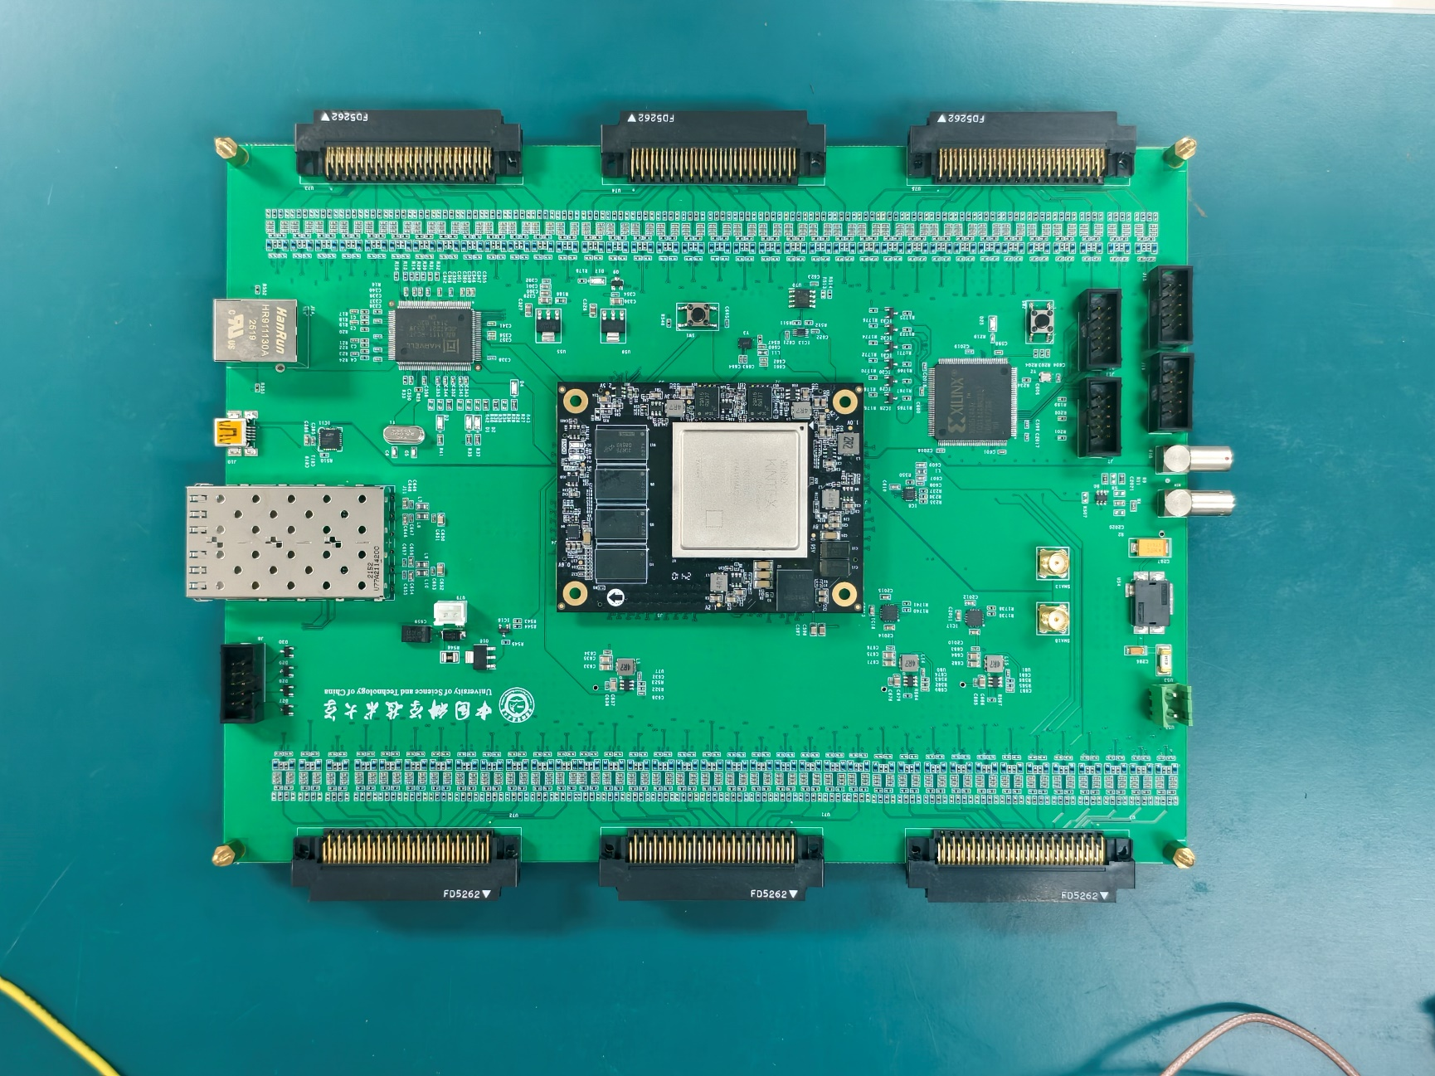
DAQ hardware design
Receive data from FE board
18 FE boards = 144 channels in total.
Integrates 144 channels polarization circuitry. Capable of receiving signals from baseline or backup FE
Xilinx KINTEX UltraScale: XCKU060
Central processing and control Manchester decoder or TDC
JTAG
Clock buffer
40 MHz LVDS clock output from FPGA.
Split into 2 channels,
then further distributed into 18 channels.
SFP
UART
CPLD:XC95144XL
Processes 18 fast_or signals from FE board.
Ethernet
Other
Temperature sensor, SMA, buttons, fan, cascading signals between two boards, and etc.

Slide 8
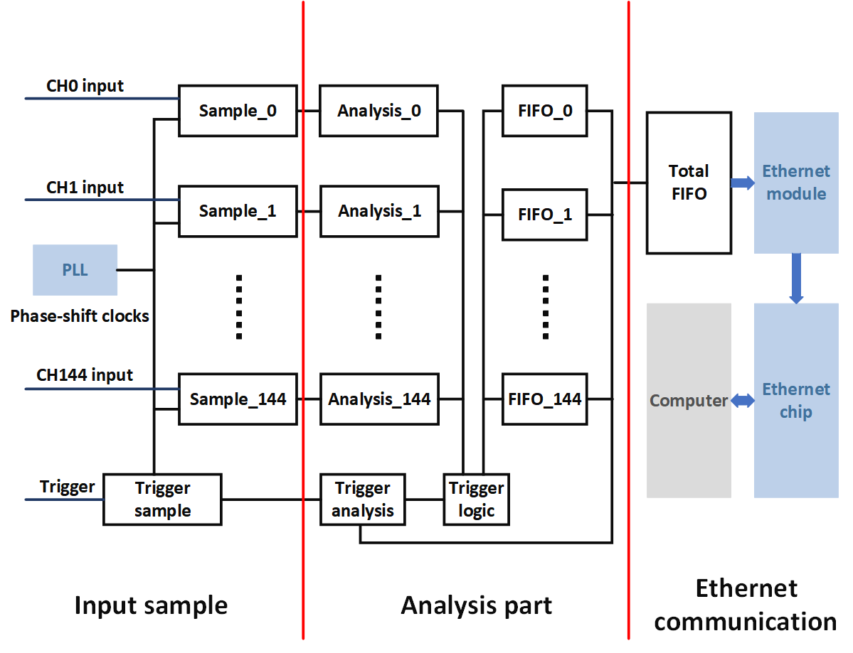
TDC principle diagram
Input sample part
Phase shift sampling clock: 500MHz
8 bit thermometer code
Analysis part
8 bit → 3 bit fine count
Analyze edges
Trigger logic
External/self/master-slave
Ethernet communication part
Transfer the data to the total FIFO
Gigabit Ethernet

Slide 9
Performance of the TDC with the signal generator
2025 CLHCP

Slide 10
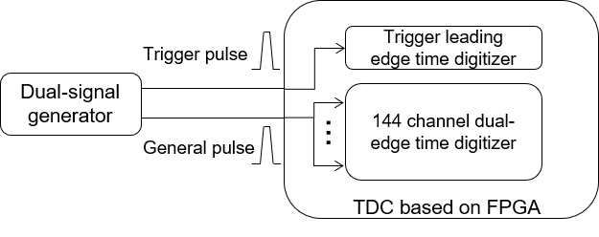
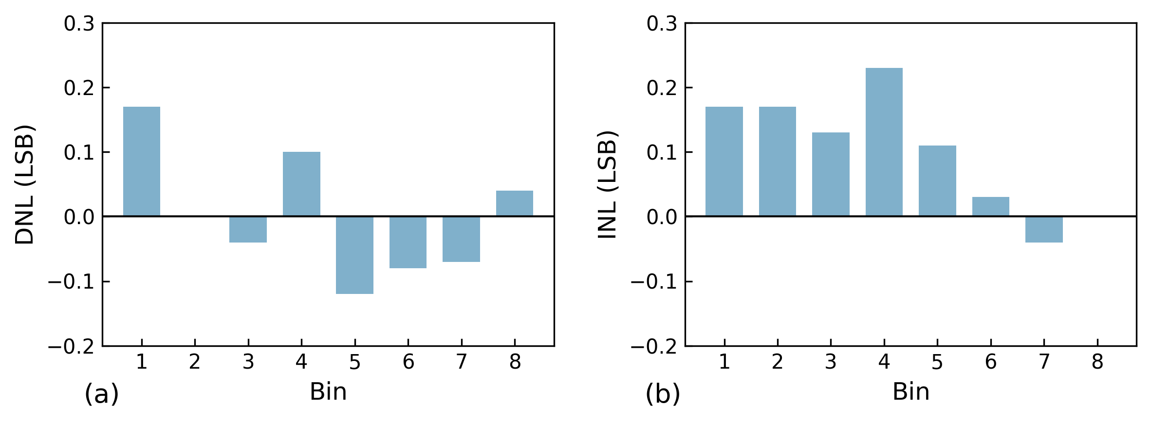
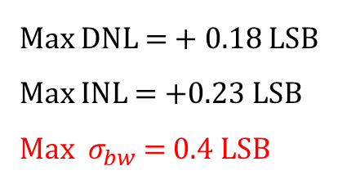
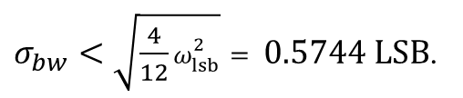
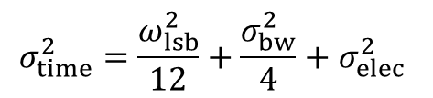
Performance: DNL & INL
Test setup
Two pulse signals as trigger and stop
Standard deviation is the time resolution
Test results: DNL & INL
General Pulse Width: 2 – 21 ns Trigger delay: 400 ns
$$σ_{time}^{2}=\frac{ω_{lsb}^{2}}{12}+\frac{σ_{bw}^{2}}{4}+σ_{elec}^{2}$$
$σ_{bw}<\sqrt{\frac{4}{12}ω_{lsb}^{2}}= 0.5744 LSB$.
Max DNL = + 0.18 LSB
Max INL = +0.23 LSB
Max $σ_{bw}$ = 0.4 LSB
Result: The impact of bin width variation on resolution is non-dominant compared to quantization error, indicating that the linearity performance of the TDC is well within acceptable limits.

Slide 11
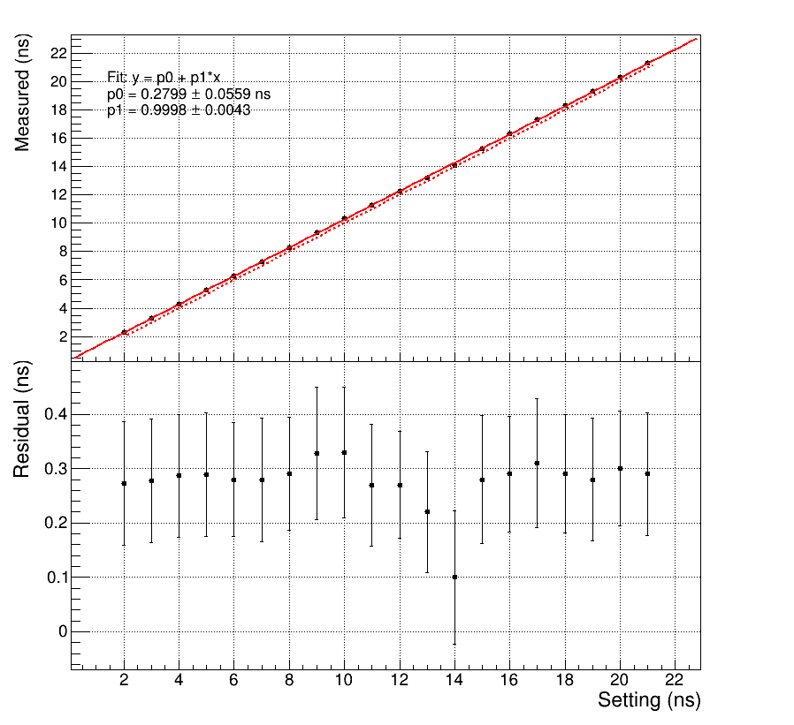
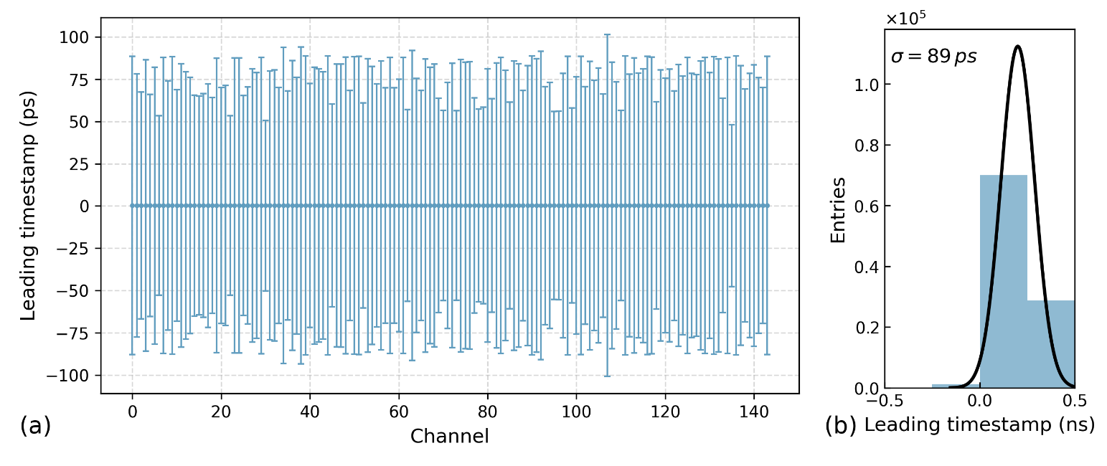
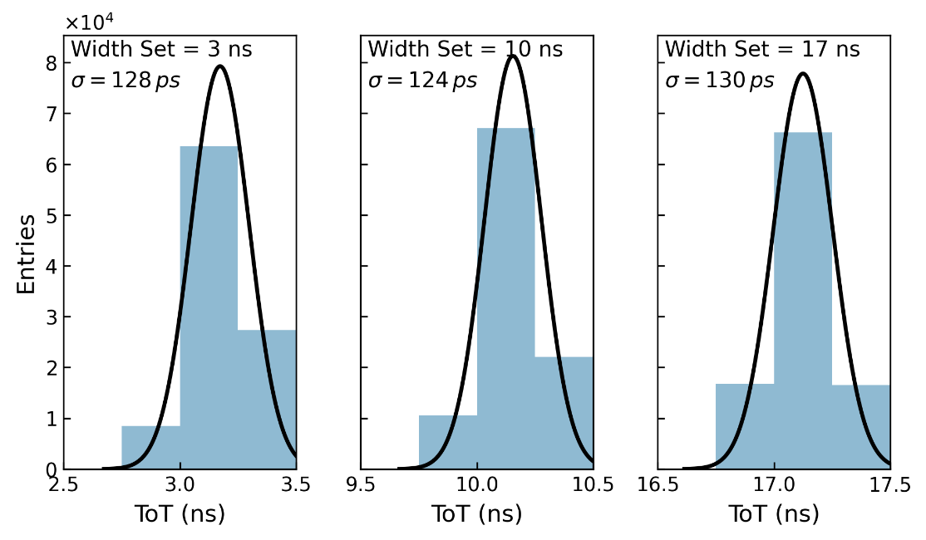
Performance: time resolution
Test results: time resolution
(c)
Each channel’s mean value shows uniformity after applying the correction.
All channels achieved a time resolution of 89 ps.
FPGA-based TDC attains sub-100 ps time precision and 2 ns dead time over 144 channels.
(d)

Slide 12
DAQ test with RPC detector
2025 CLHCP

Slide 13
Performance with RPC detector: setup
ch 0 - 7
ch 48 - 55
ch 72 - 79
BIL
BIS
HV = 5400V
​​Trigger System: three scintillators operate in coincidence to generate the external trigger signal.
RPC Configuration utilizes two RPCs:
​​BIS:​​ standard RPC
​​BIL:​​ implements eta-eta readout​​

Slide 14
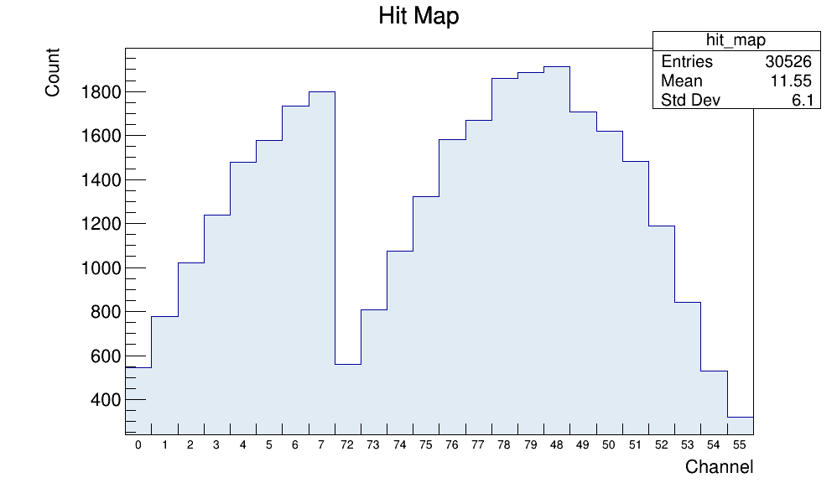
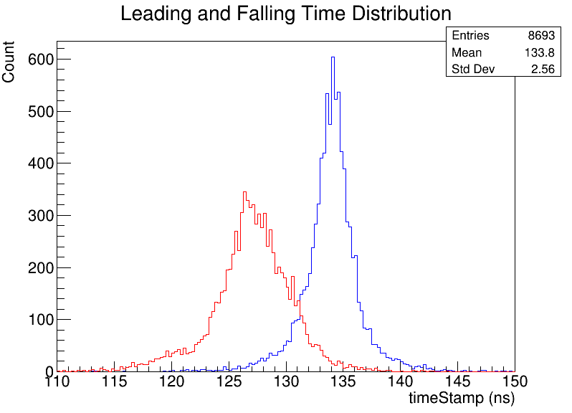
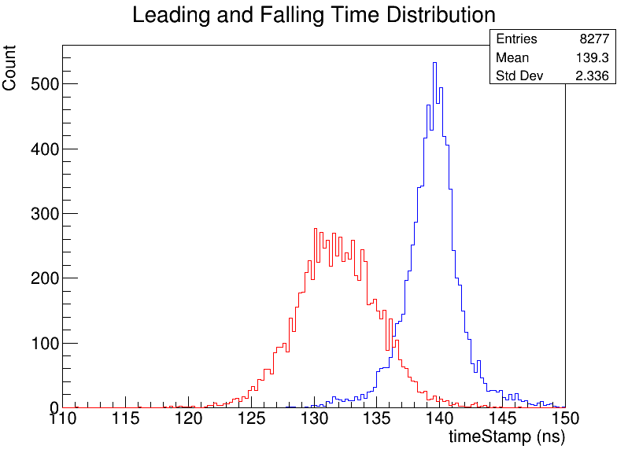
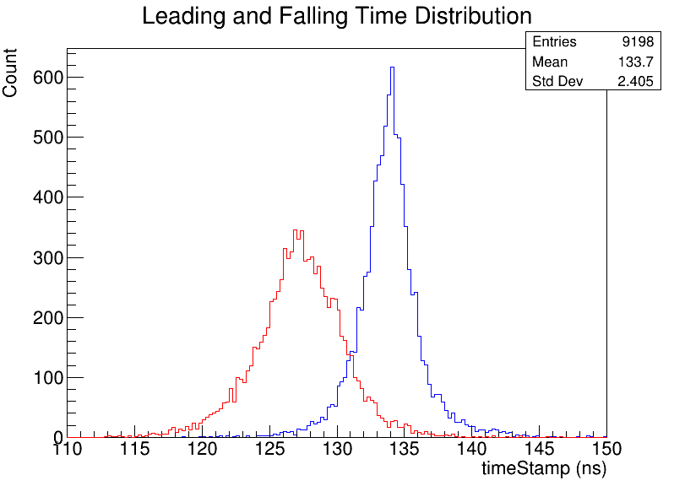
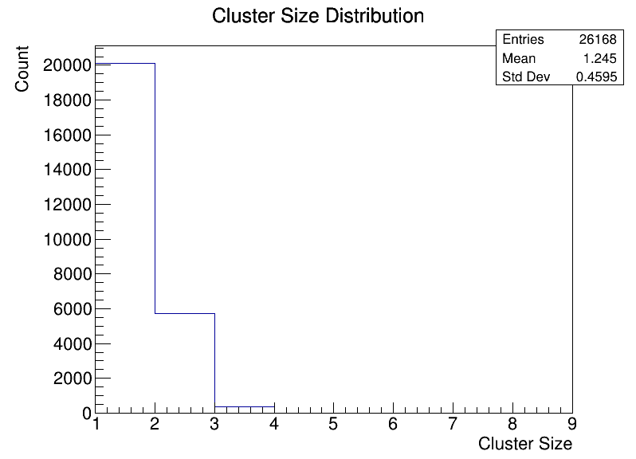
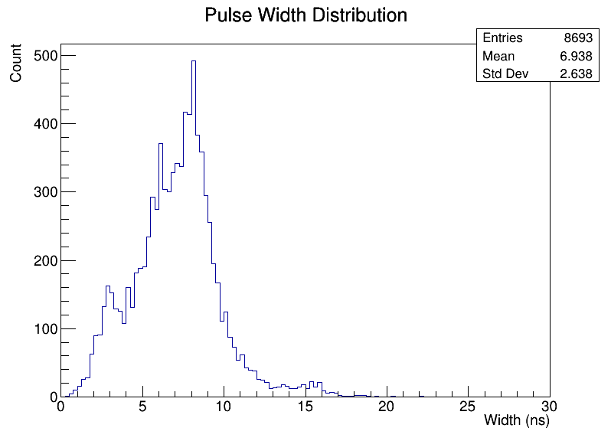
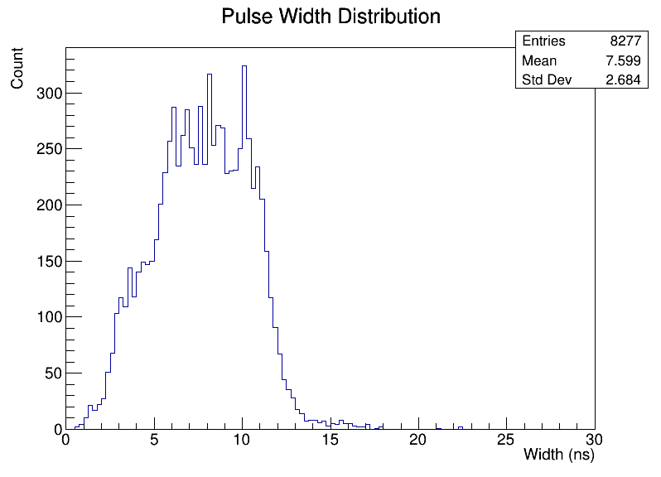
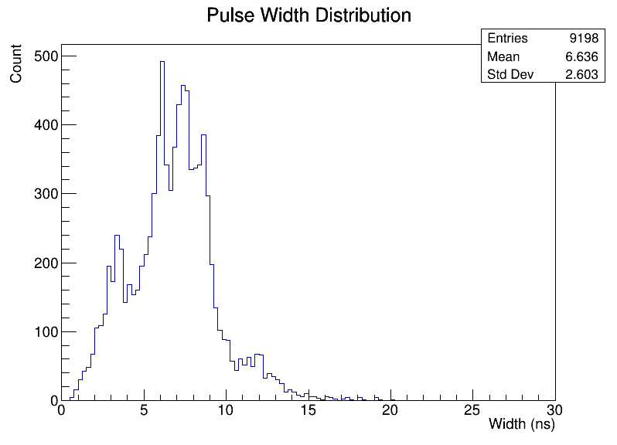
Performance with RPC detector: results
ch 0-7
ch 48-55
ch 72-79
Hit map matches the setup, with scintillators placed at the indicated positions.
Leading time resolution are less than 100ps.
Pulse widths are 5–10 ns and the cluster-size mean is 1.24.

Slide 15
Summary
2025 CLHCP

Slide 16
Summary
DAQ module: TDC key functions have been verified.
Readout system: full-chain test completed.
Next step:
Establish a cosmic-ray test platform
Verify 3 trigger modes
High-V efficiency curve

Slide 17
Back up
2025 CLHCP

Slide 18
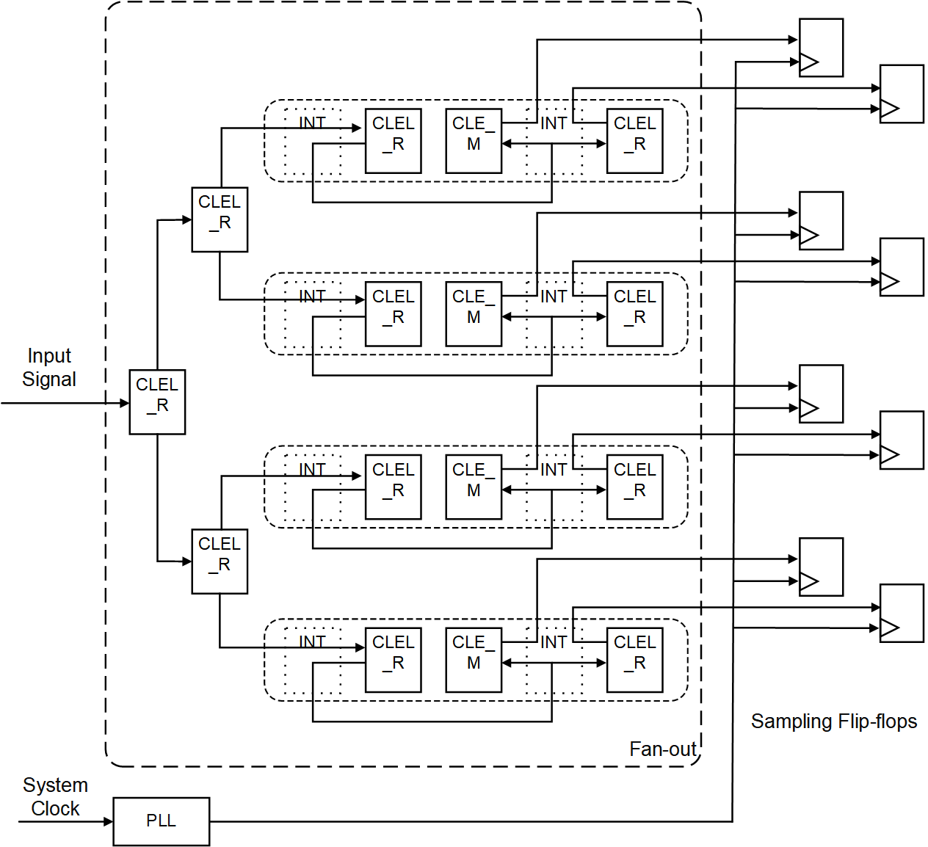
Architecture of data sampling
A pulse signal following fan-out is captured simultaneously by eight flip-flops driven by eight uniform phase-shifted clocks.
Flip-flops | First Level Fan-out Delay (ps) | Second Level Fan-out Delay (ps) | Third Level Fan-out Delay (ps) | Total Delay (ps)
1 | 305 | 239 | 370 | 914
2 | 305 | 239 | 363 | 907
3 | 305 | 140 | 403 | 848
4 | 305 | 140 | 365 | 810
5 | 268 | 189 | 370 | 827
6 | 268 | 189 | 404 | 861
7 | 268 | 294 | 403 | 965
8 | 268 | 294 | 365 | 927
Table 1. Path delays from signal input to flip-flops

Slide 19
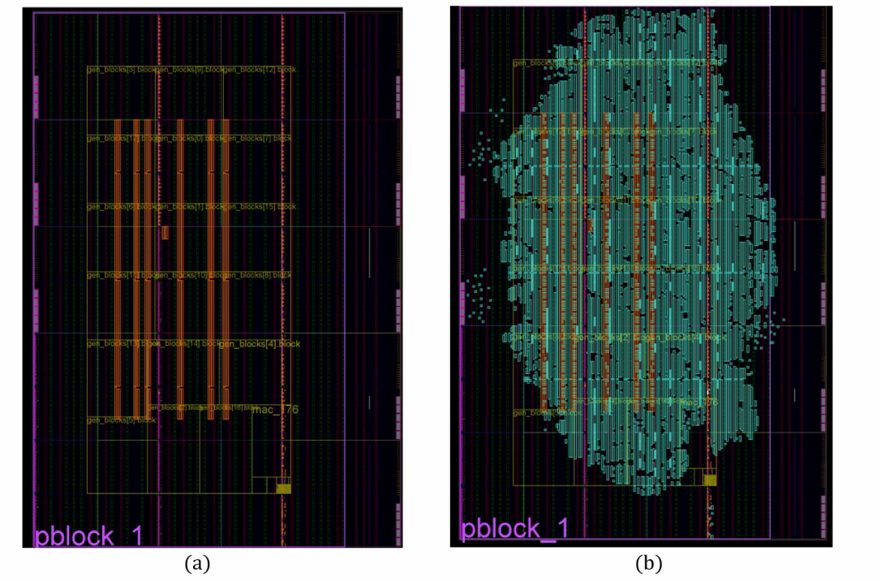
Post-synthesis and implementation
Resource | Utilization | Available | Utilization %
LUT | 51497 | 331680 | 15.53
LUTRAM | 312 | 146880 | 0.21
FF | 122876 | 663360 | 18.52
BRAM | 166 | 1080 | 15.37
IO | 319 | 520 | 61.35
BUFG | 14 | 624 | 2.24
MMCM | 2 | 12 | 16.67
Table 2. The summary of resource utilization.

Slide 20
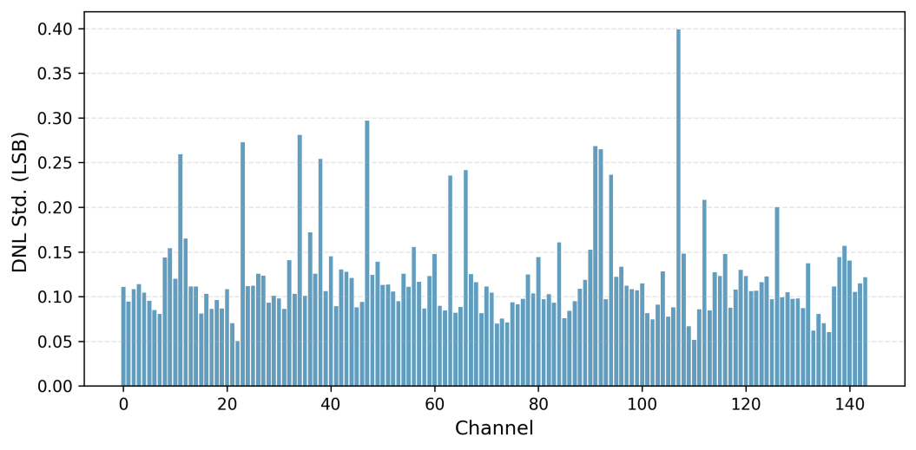
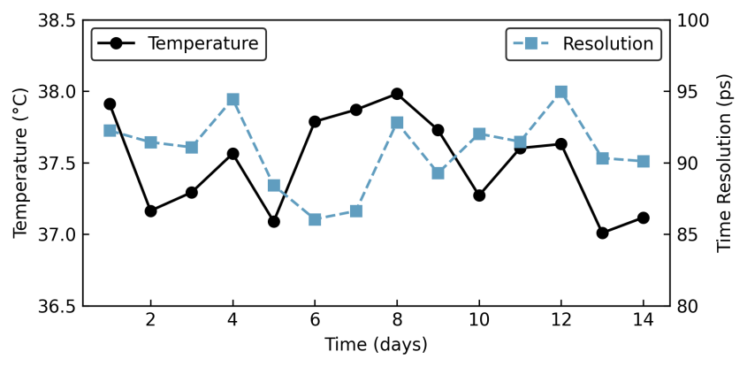
Result
The standard deviations of the time bin width for each TDC channel.
Temperature and time resolution over 14-day continuous operation.

Slide 21
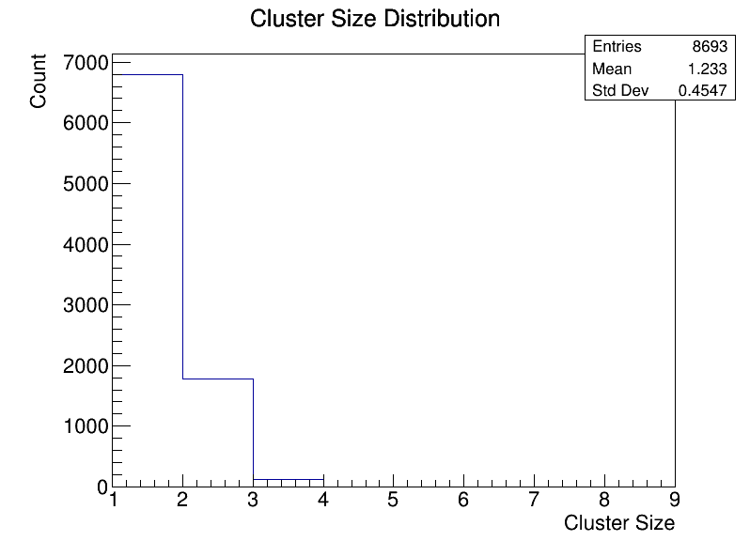
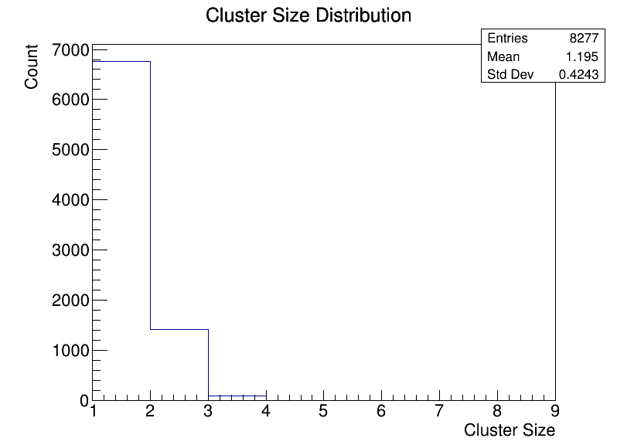
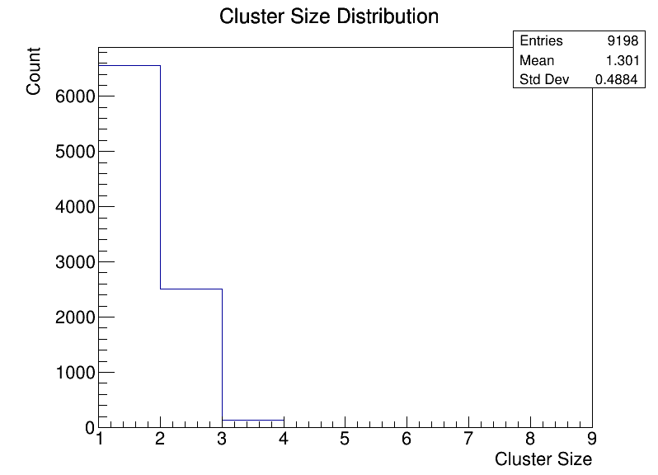
Cluster size
ch 0-7
ch 48-55
ch 72-79

