Slide 1



R&D on the fast GAGG for LHCb upgrade II
Xiong Xiao, Jingjing Qu, Pengfei Han, Yuchong Ding*
on behalf of the ECAL China Group
The 26th Research Institute of China Electronics Technology Group Corporation (SIPAT)
Henan Normal University October 31, 2025

Slide 2
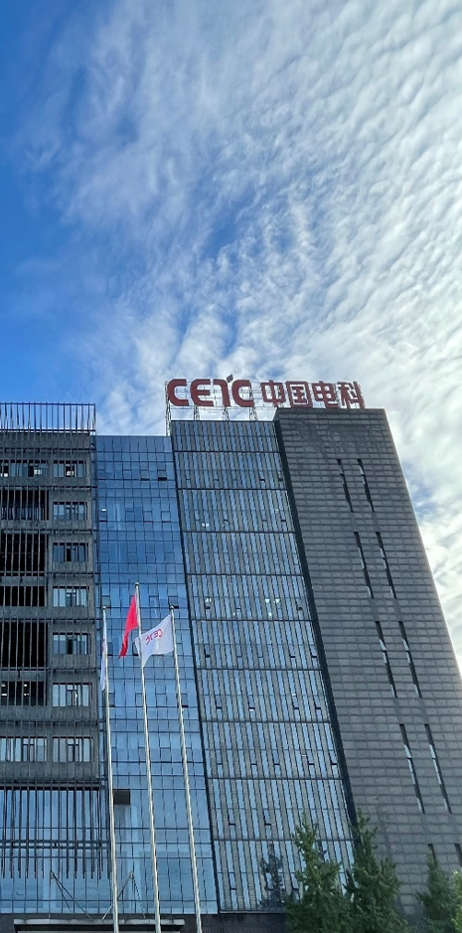
Outline
1. Background
2. Crystal Growth and Characterization
3. Beam Testing Results
4. Conclusions and Next Work

Slide 3
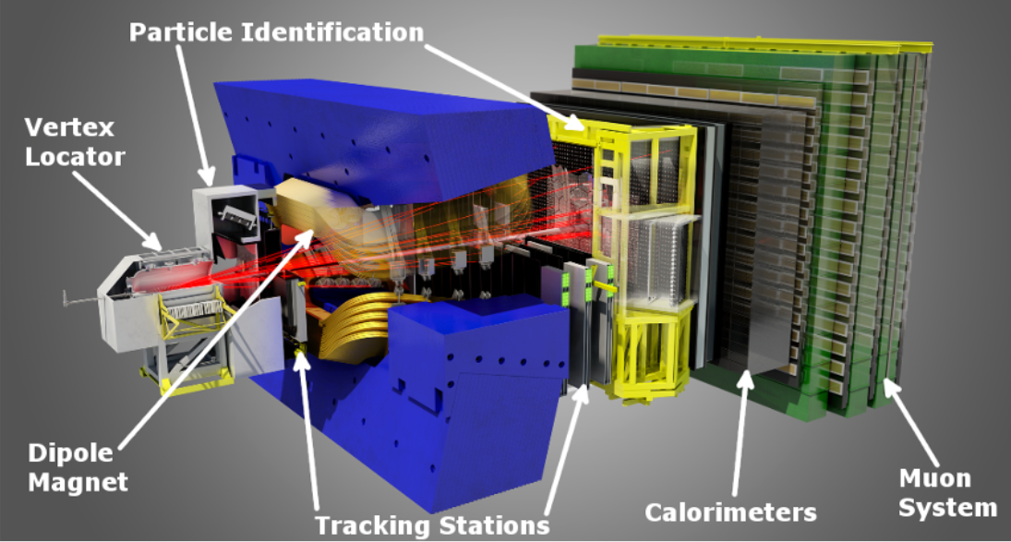
1.Background: ECAL at LHCb
The LHCb experiment is designed for heavy flavor physics at the LHC.
Electromagnetic calorimeter (ECAL)
is a key component of LHCb
ECAL is crucial for key physics goals of LHCb, such as:
  CP violation
  Lepton flavour universality

Slide 4
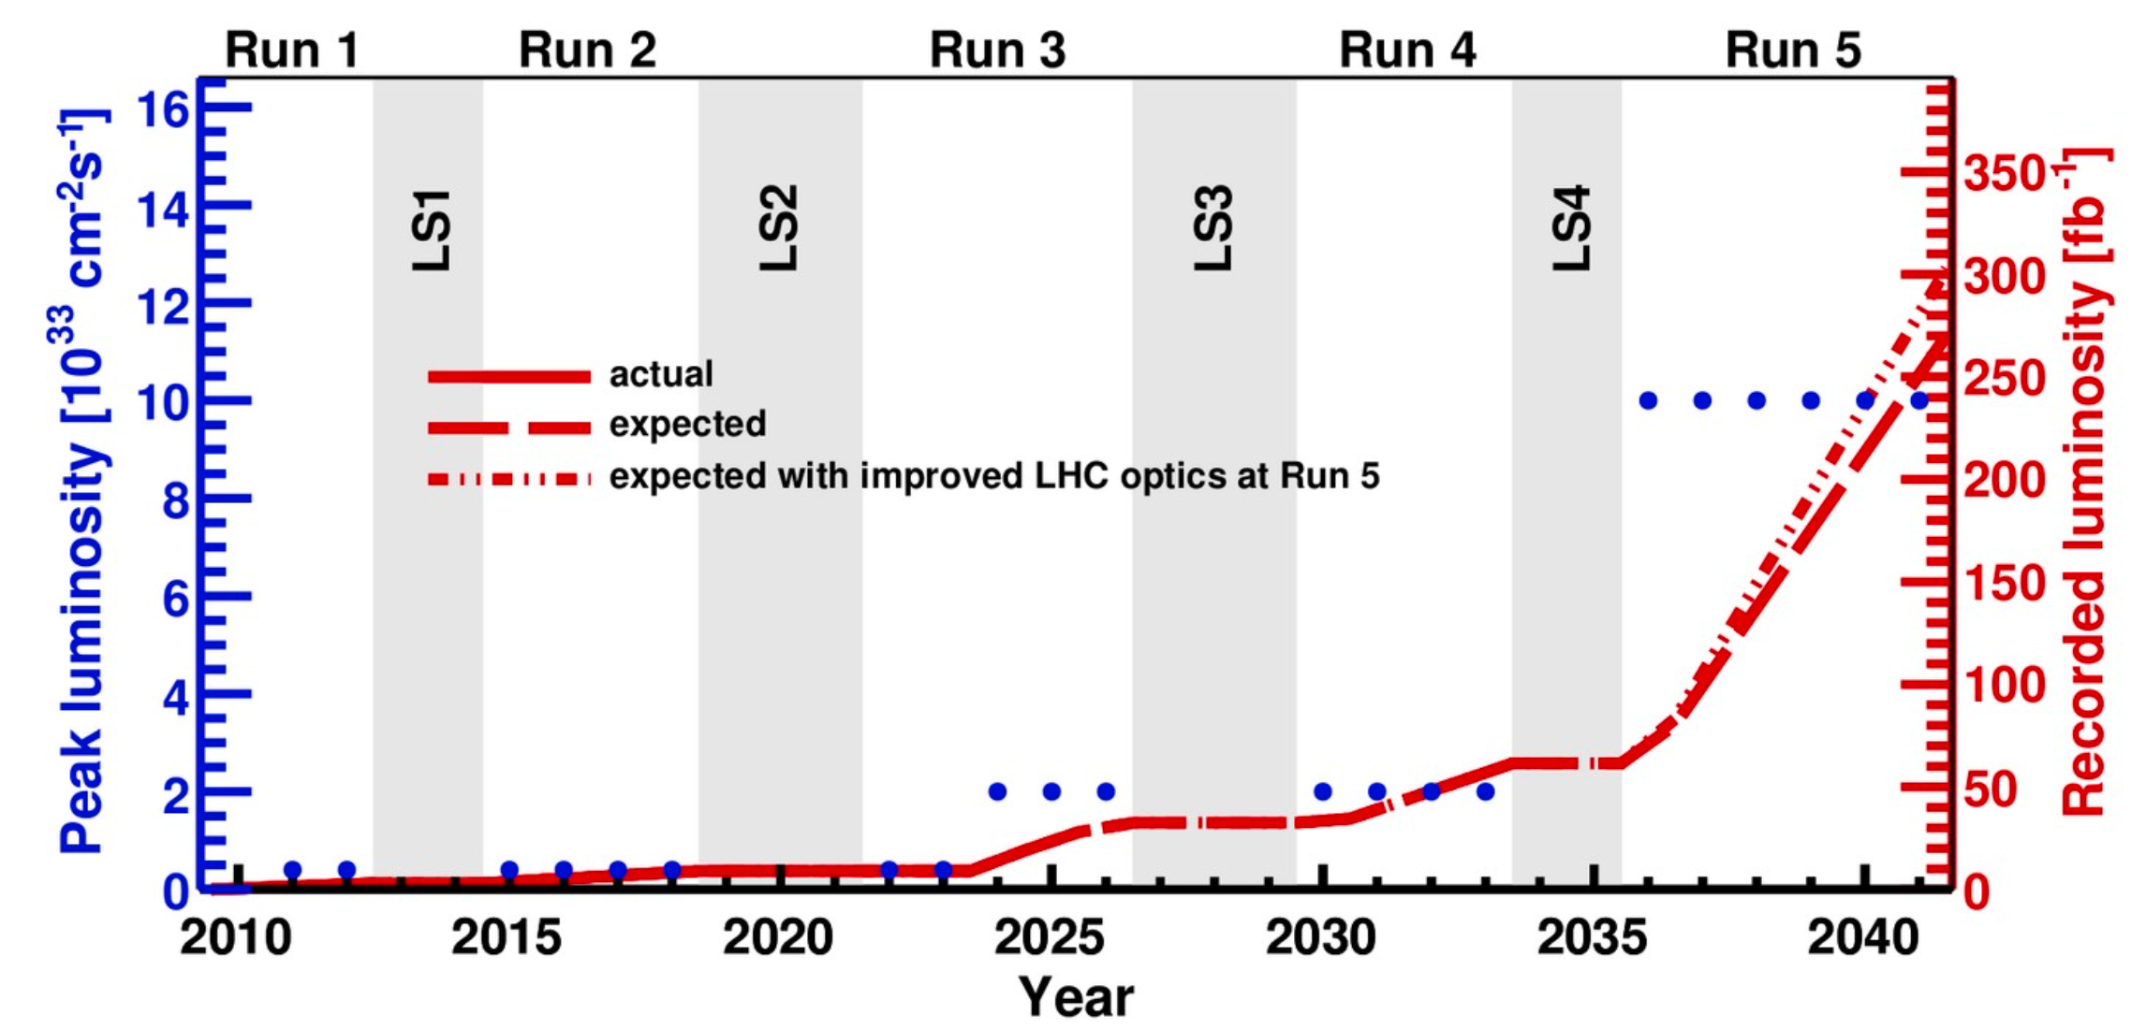
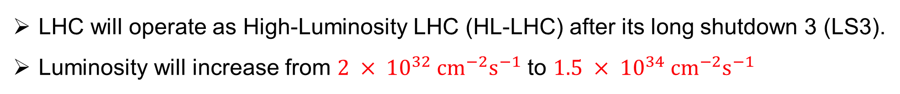
1.Background: Motivation to LHCb ECAL upgrade
LHC will operate as High-Luminosity LHC (HL-LHC) after its long shutdown 3 (LS3).
Luminosity will increase from $2 × 10^{32} cm^{−2}s^{−1}$ to $1.5 × 10^{34} cm^{−2}s^{−1}$
Challenges to LHCb ECAL:
  Higher occupancy
  Higher radiation dose
We are here
An upgrade of the ECAL is essential!

Slide 5
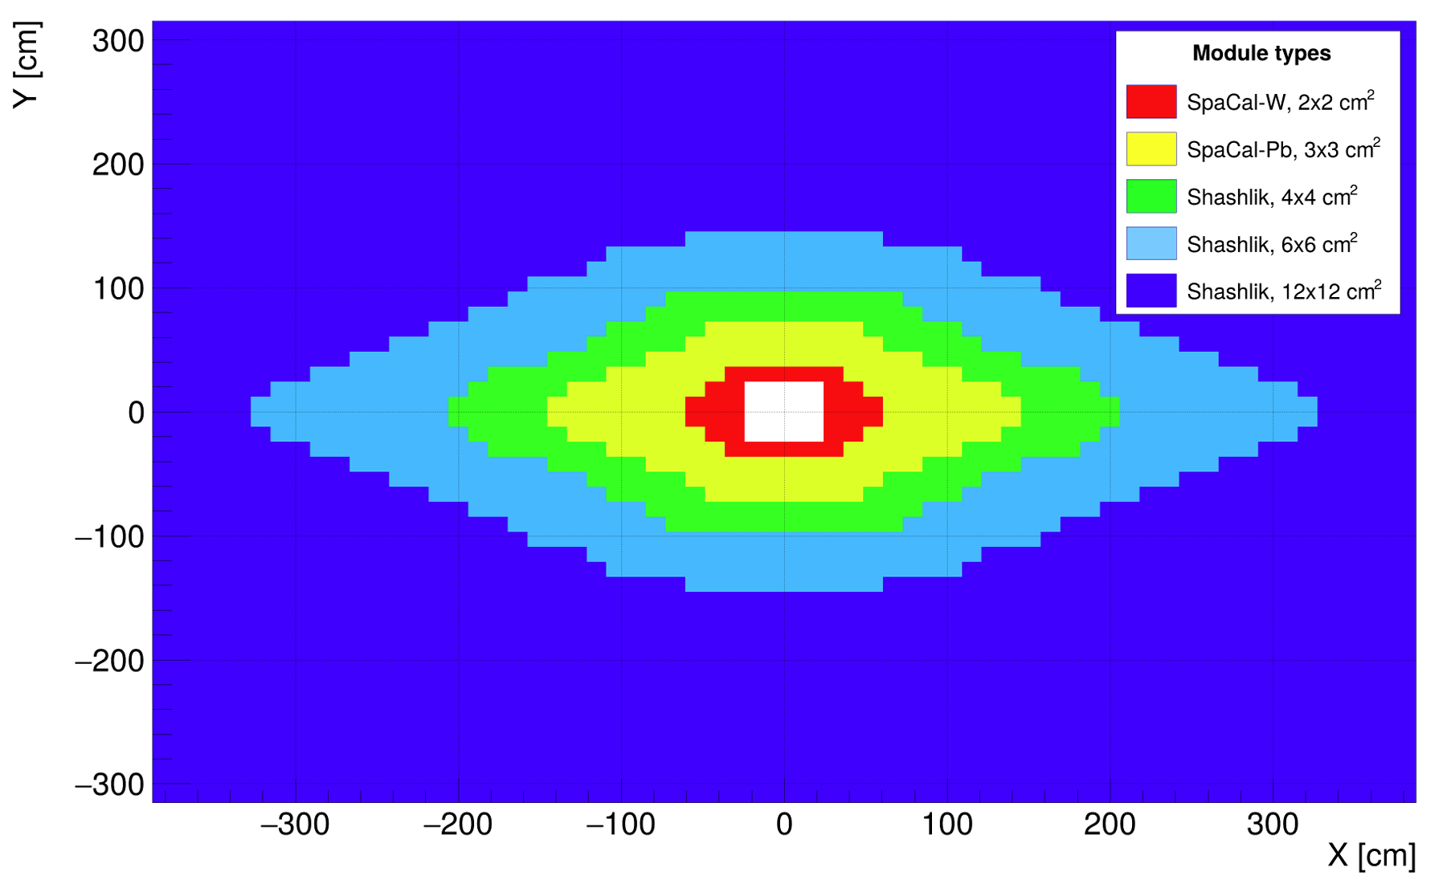
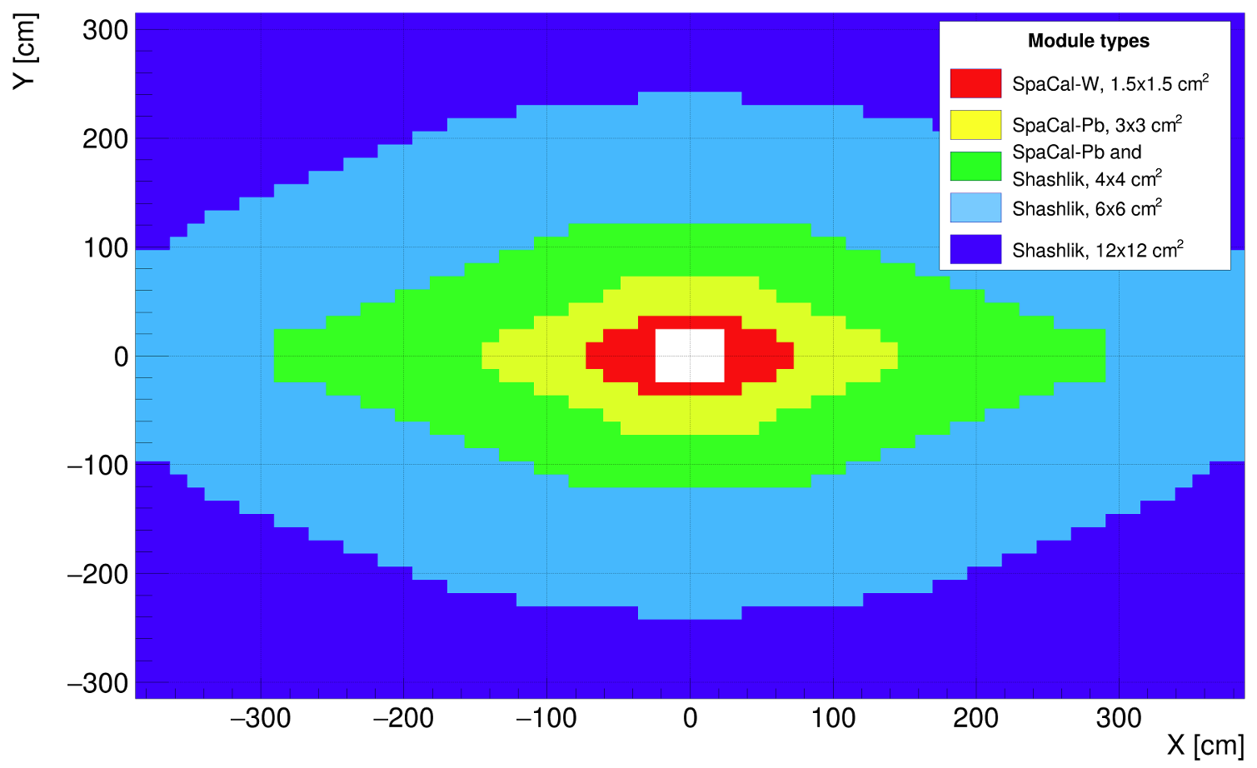
1.Background: LHCb ECAL upgrade plan
ECAL upgrade is planned in two phases:
LS3 enhancement (2026 – 2029)
Upgrade II (2034 – 2035)
SpaCal-W with GAGG fibre

Slide 6
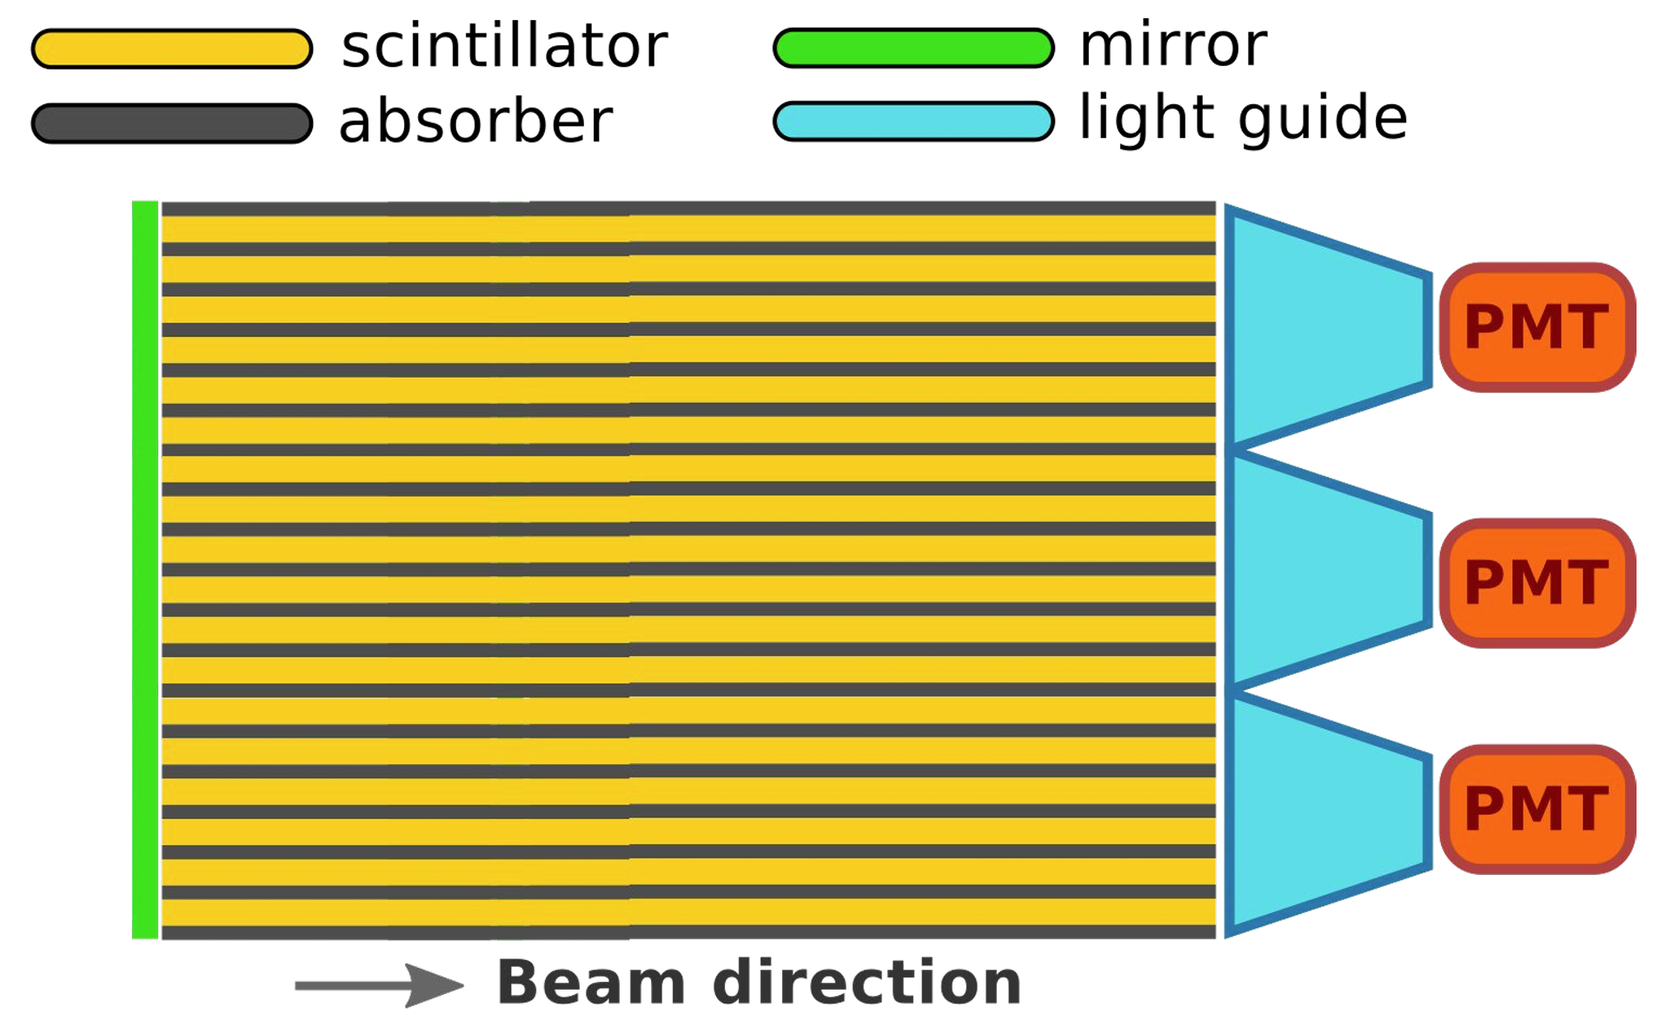
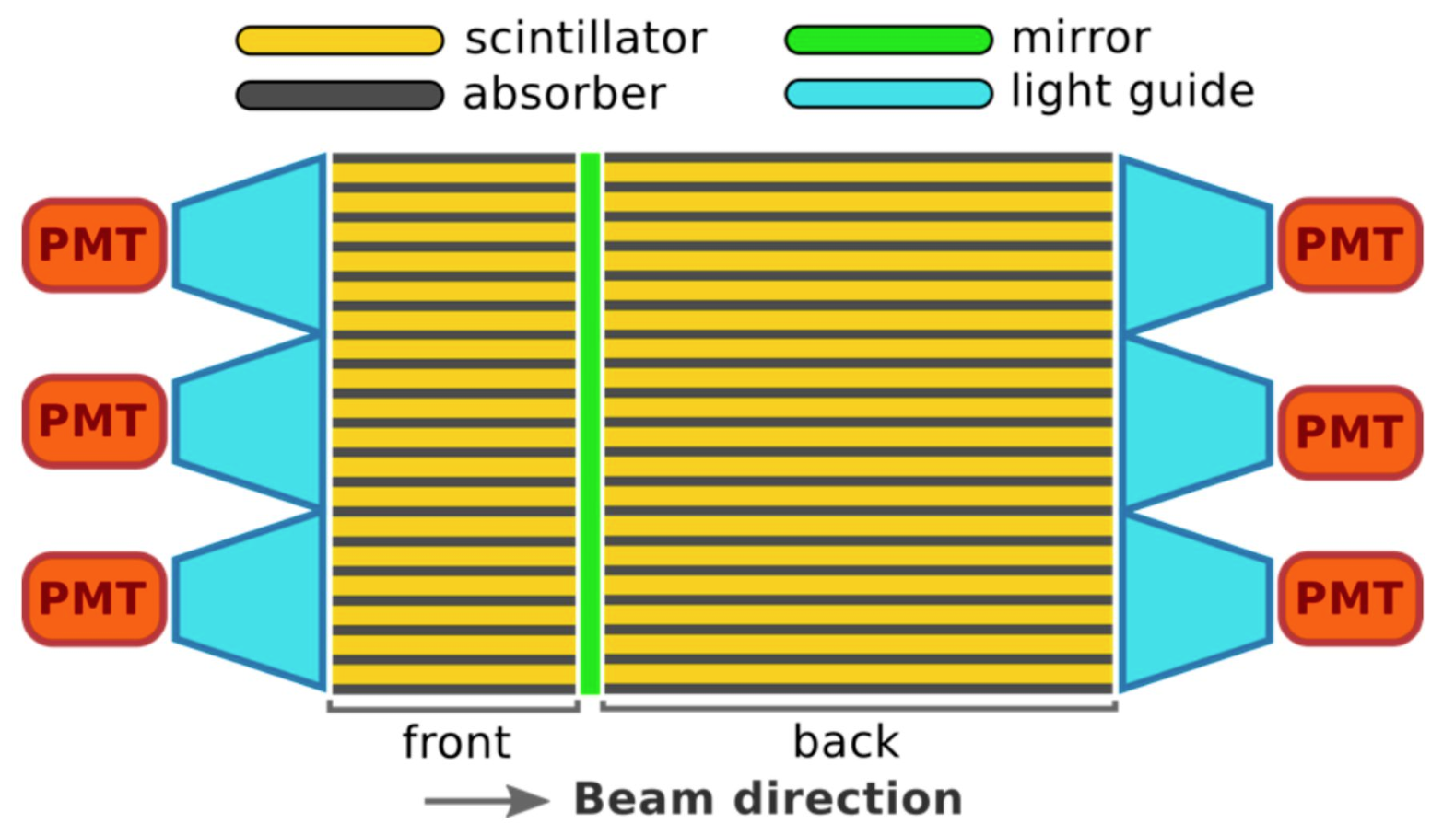
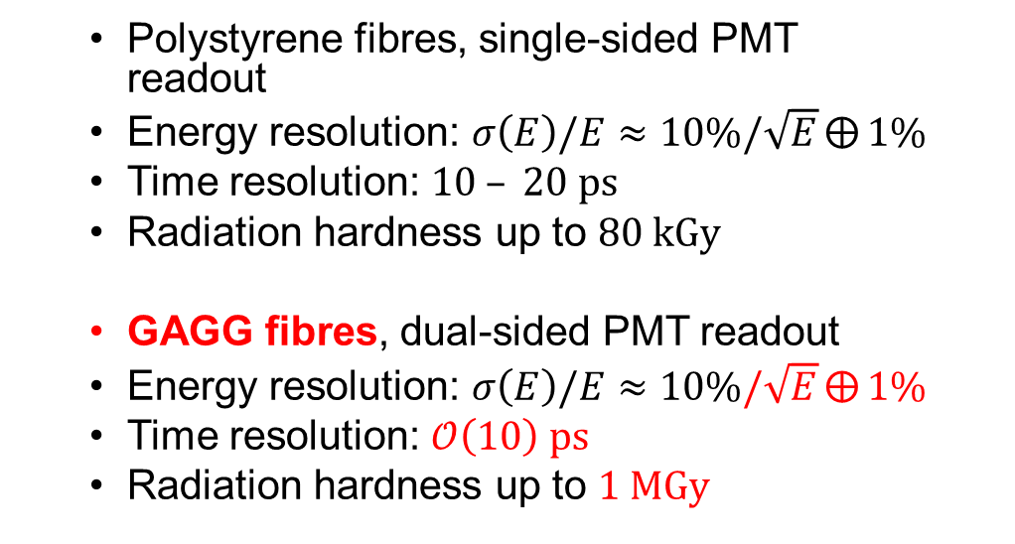
1.Background: SpaCal-W modules for LHCb ECAL upgrade
For both upgrade phases, the innermost modules of LHCb ECAL will be replaced
with spaghetti calorimeter (SpaCal) modules with tungsten (W) absorbers
  Polystyrene fibres, single-sided PMT readout
  Energy resolution: $σ\left(E\right)/E≈10\%/\sqrt{E}⨁{1\%}$
  Time resolution: $10 – 20 ps$
  Radiation hardness up to $80 kGy$
  GAGG fibres, dual-sided PMT readout
  Energy resolution: $σ\left(E\right)/E≈10\%/\sqrt{E}⨁{1\%}$
  Time resolution: $𝒪\left(10\right) ps$
  Radiation hardness up to $1 MGy$
LS3 enhancement
(2026 – 2029)
Upgrade II
(2034 – 2035)

Slide 7
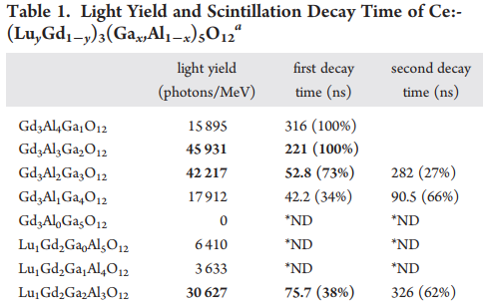
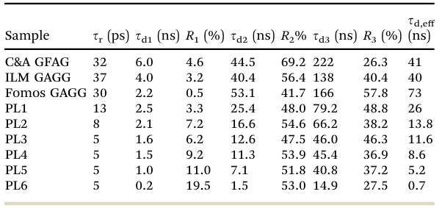
1.Background: Requirements of GAGG scintillator
GAGG scintillator is the most promising material, but current commercial GAGG has scintillation decay time > 40 ns.
L. Y. ~ 45,000 MeV⁻¹
𝜏_{𝑑,𝑒𝑓𝑓} ＞ 40 ns
ρ ~ 6.67 g/cm³
Z_{eff} ~ 54
Material Advances, 2022, 3, 6842
*Kei Kamada, Takanori Endo, Kusuke Tsutumi, et al. Cryst. Growth Des. 2011, 11, 4484–4490.
R&D to produce large-size and homogeneous fast GAGG:
  Decay time < 10 ns
  Size > Φ50 mm × 110mm

Slide 8
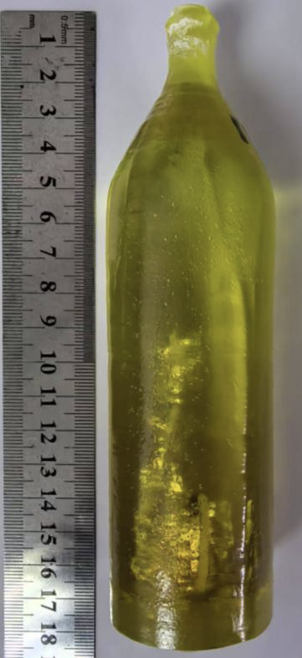
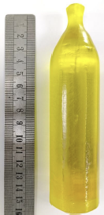
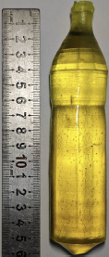
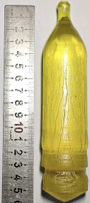
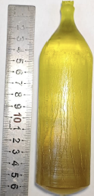
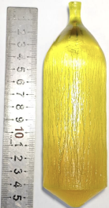
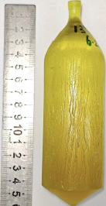
2.Crystal Growth and Characterization: Stage goals
2024.01
2024.12
Results of GAGG in 2024: 𝜏_{𝑑,𝑒𝑓𝑓} ~ 20 ns, Size ~ Φ42mm×100mm
R&D stage goals of 2025: 𝜏_{𝑑,𝑒𝑓𝑓} ≤ 15 ns, Size ≥ Φ45mm×110mm
Abbreviations: 𝜏_{𝑑,𝑒𝑓𝑓} (Decay Time), size (ingot size)

Slide 9
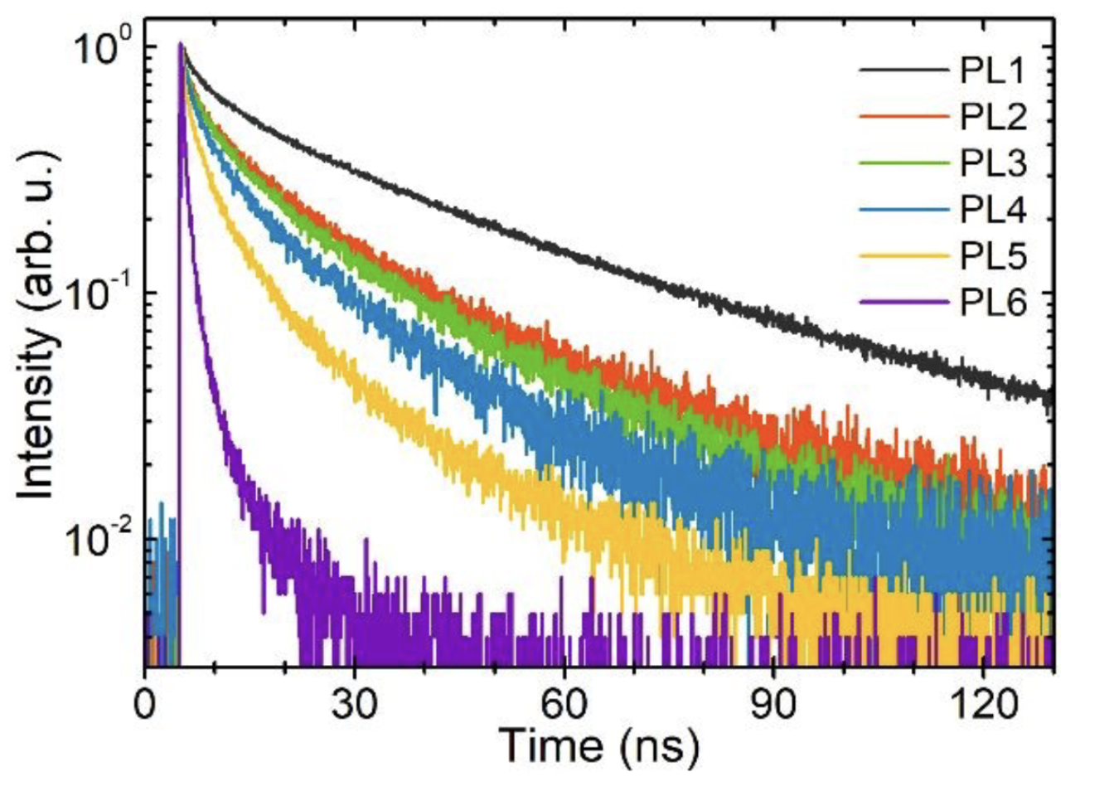
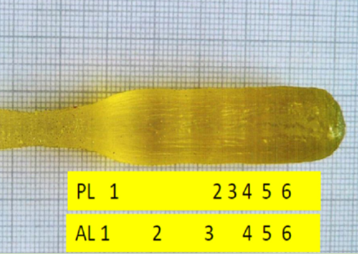

2.Crystal Growth and Characterization: Accelerate the decay
How to accelerate the decay time ? The effect of scintillation quenching
Non-radiative Recombination Centers
Increase Mg ions Doping Concentration
Material Advances, 2022, 3, 6842
The concentration of Mg²⁺ ions becomes higher and higher from sample PL1 to PL6

Slide 10
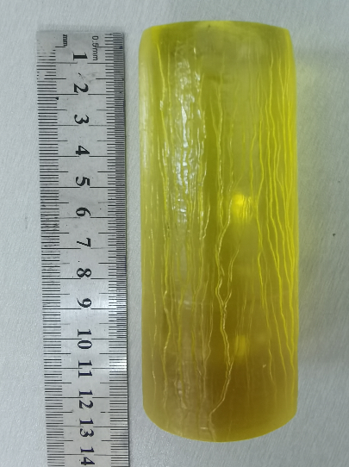
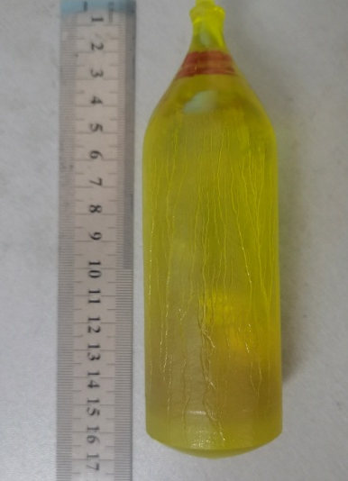
2.Crystal Growth and Characterization: Crystal improvement
The fastest decay time of GAGG reached ~5 ns.
Inclusions
Cracks & Inclusions existed.
Only a length of ~50 mm is usable.
Inclusions
Crack
Φ42 mm×100 mm

Slide 11
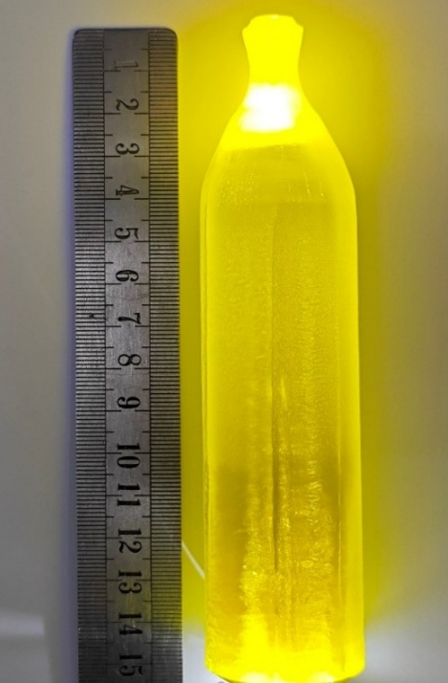
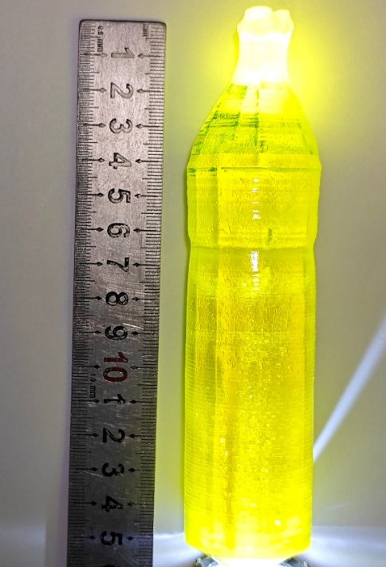
2.Crystal Growth and Characterization: Crystal improvement
Improve the crystal quality: ① by decreasing the crystal diameter
The crystal shape has defects.
Cannot cut optical fiber with dimensions of
1mm x 1mm x 100mm.
Φ35 mm×110 mm

Slide 12
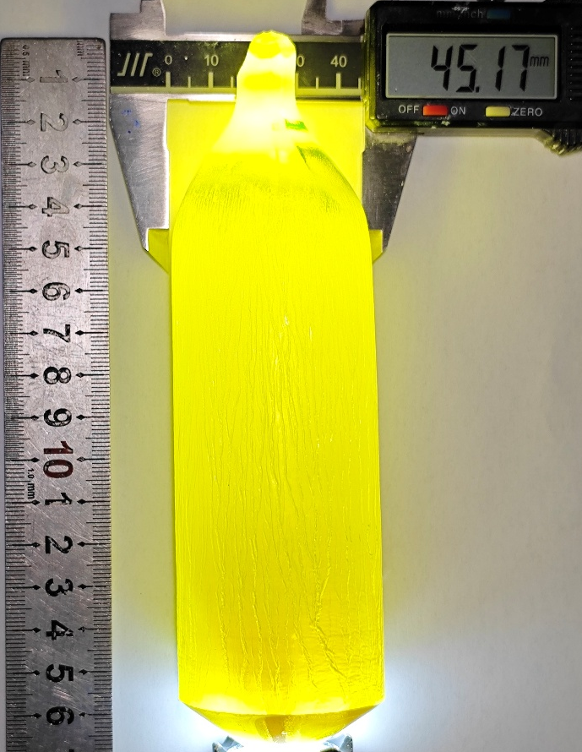
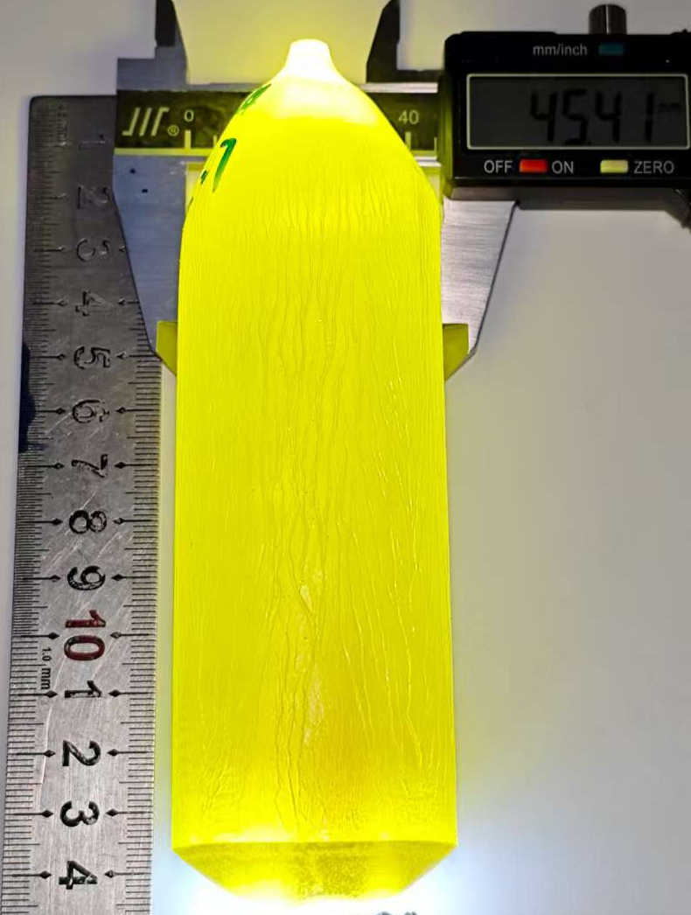
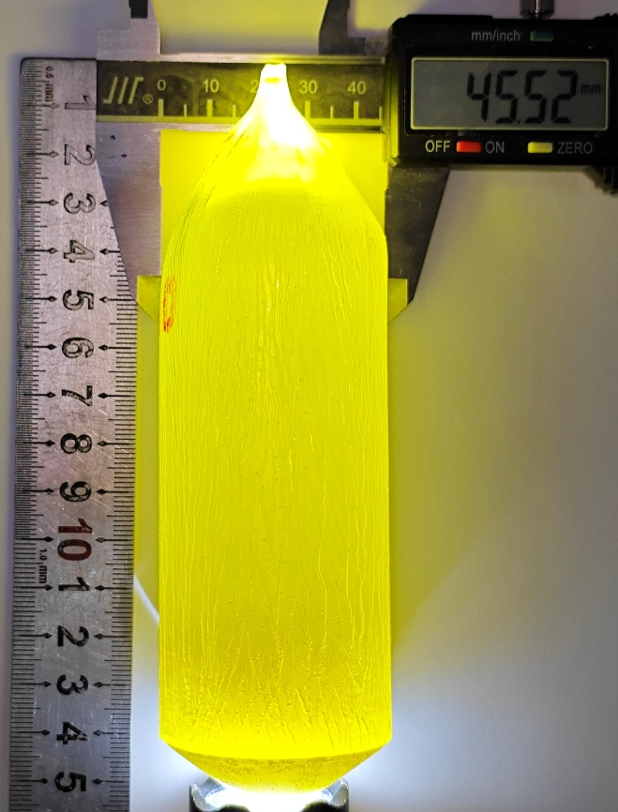
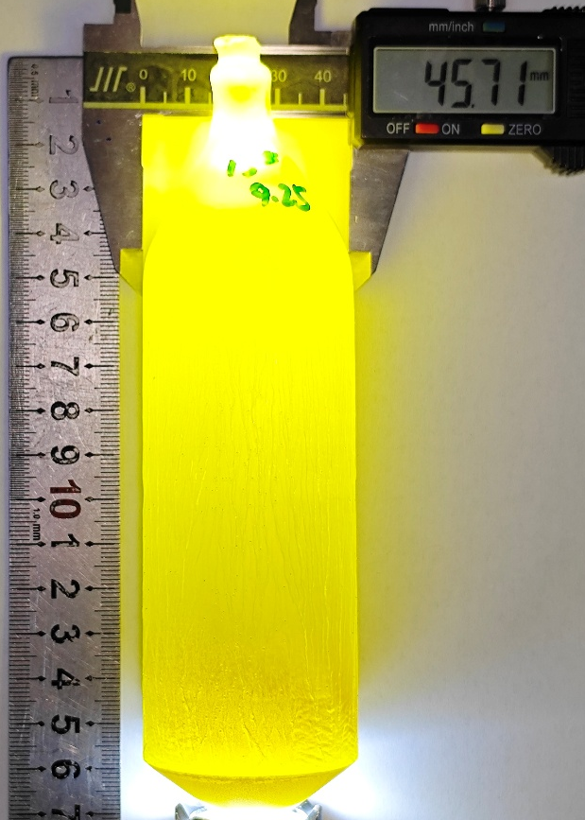
2.Crystal Growth and Characterization: Crystal improvement
Improve the crystal quality: ② by optimizing thermal filed of the crystal growth system
Φ45 mm×110 mm 𝜏_{𝑑,𝑒𝑓𝑓} ＜ 15 ns

Slide 13
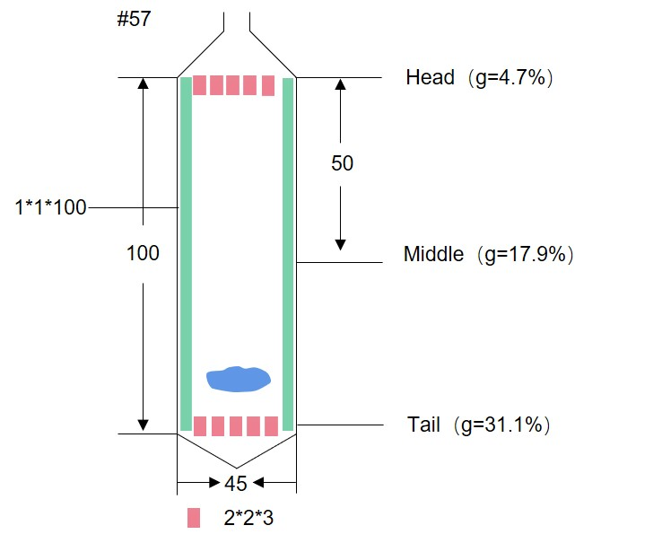
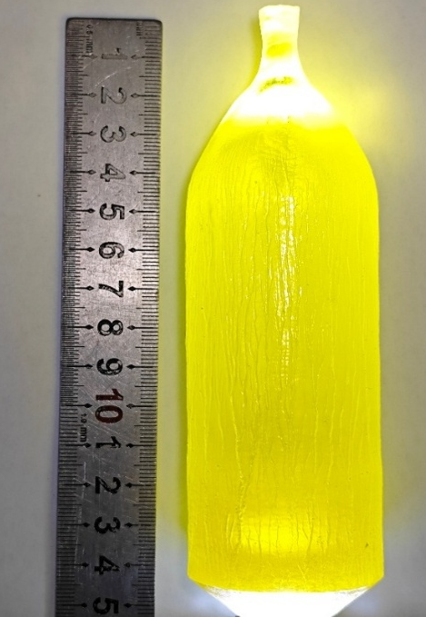
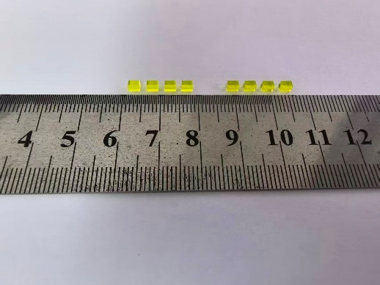
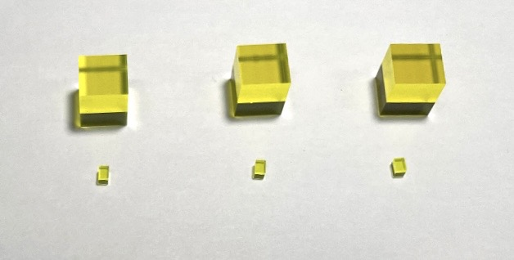
2.Crystal Growth and Characterization: Sample Prepare
#57
top
middle
tail
GAGG samples
Definition of sample positions from an ingot
Ingot and sample pictures
We have produced 22 ingots and take samples from them during 2025
  Sample size: 2 mm×2 mm×3 mm
  Surface treatment: polished with all sides
  Fiber produce: 1mm x 1mm x 100mm

Slide 14
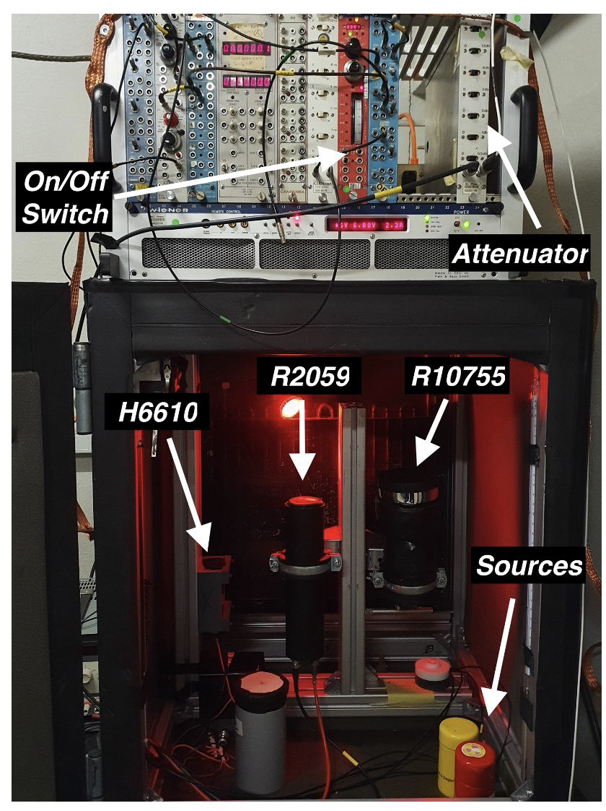
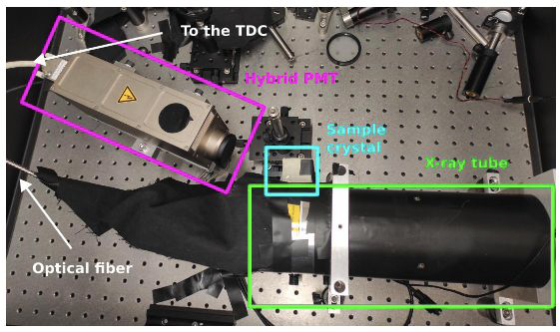
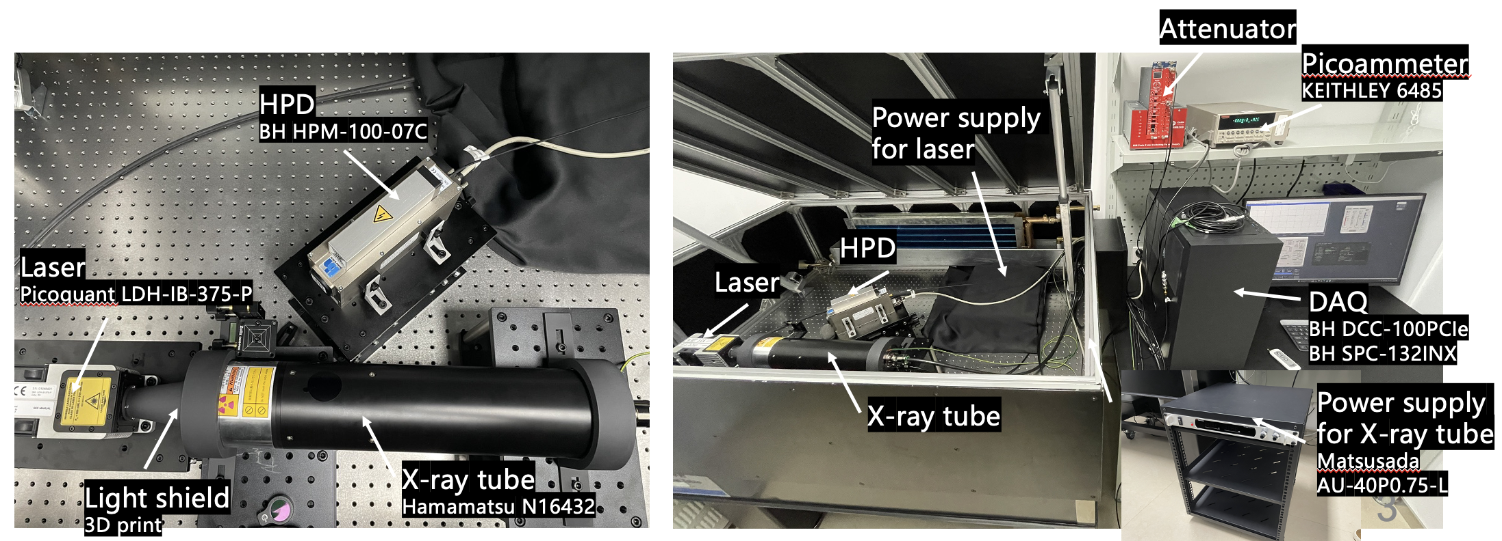
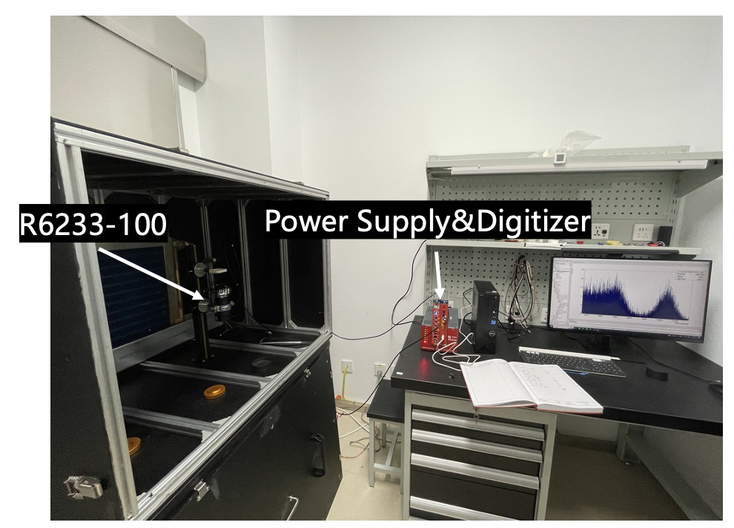
2.Crystal Growth and Characterization: Test Systems
CERN
Light yield
Decay time (TCSPC with X-ray)
Dual testing ensures both R&D efficiency and the reliability of test results, the test results from PKU are consistent with those from CERN.
Light yield
Decay time (TCSPC with X-ray)
PKU

Slide 15
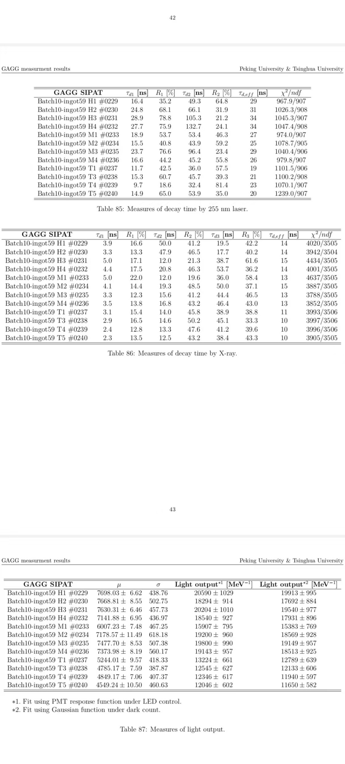
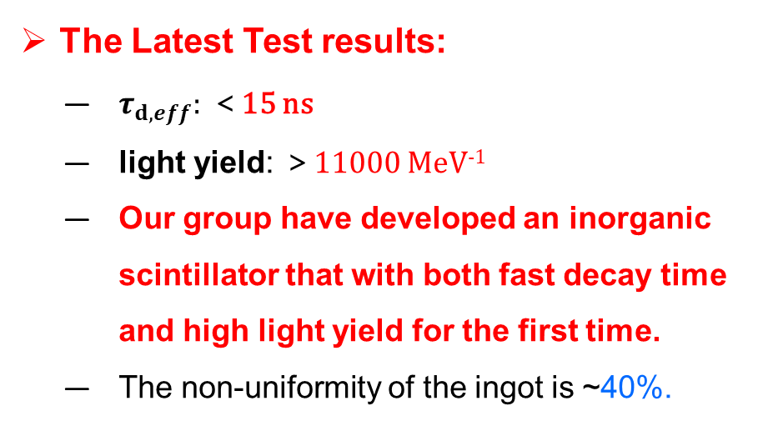
2.Crystal Growth and Characterization: L.Y. & Decay time
$τ_{d,eff}$ and L.Y. for SIPAT GAGG samples from #59 ingot
The Latest Test results:
  $τ_{d,eff}:$ ＜15 ns
  light yield: ＞11000 MeV⁻¹
  Our group have developed an inorganic scintillator that with both fast decay time and high light yield for the first time.
  The non-uniformity of the ingot is ~40%.

Slide 16
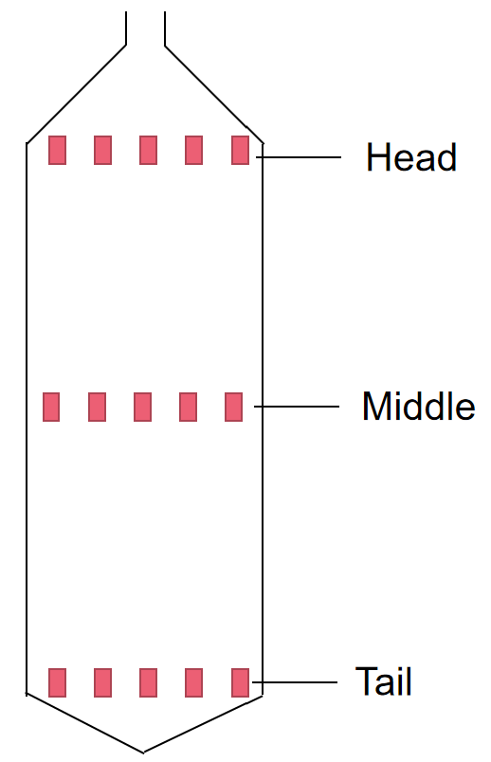
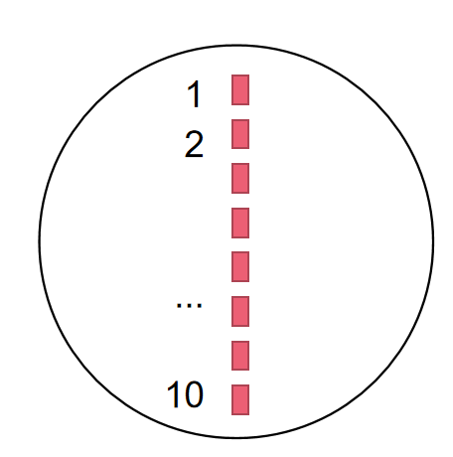

2.Crystal Growth and Characterization: Annealing Experiment
Annealing in air atmosphere
Sample part |  | Light yield^{*3}（photon/MeV） | τ_{d,eff}（ns）^{*3}
Top | Before annealing^{*1} | 16,456.25 | 12.50
 | After annealing^{*2} | 20,302.33 | 14.33
 | Increase rate | +23.37% | +14.64%
Middle | Before annealing | 14,234.00 | 10.25
 | After annealing | 19,139.66 | 15.33
 | Increase rate | +34.46% | +49.59%
Tail | Before annealing | 13,447.00 | 10.25
 | After annealing | 16,029.33 | 12.00
 | Increase rate | +19.20% | +17.07%
#52
Sample H1-H3/M1-M3/T1-T3
annealing in air atmosphere
*1 average value of sample 1-3
*2 average value of sample 4-10
*3 measured by PKU and THU
After annealing in air atmosphere, the light yield was increased, the non-uniformity is ~20%is
While the decay time became longer

Slide 17
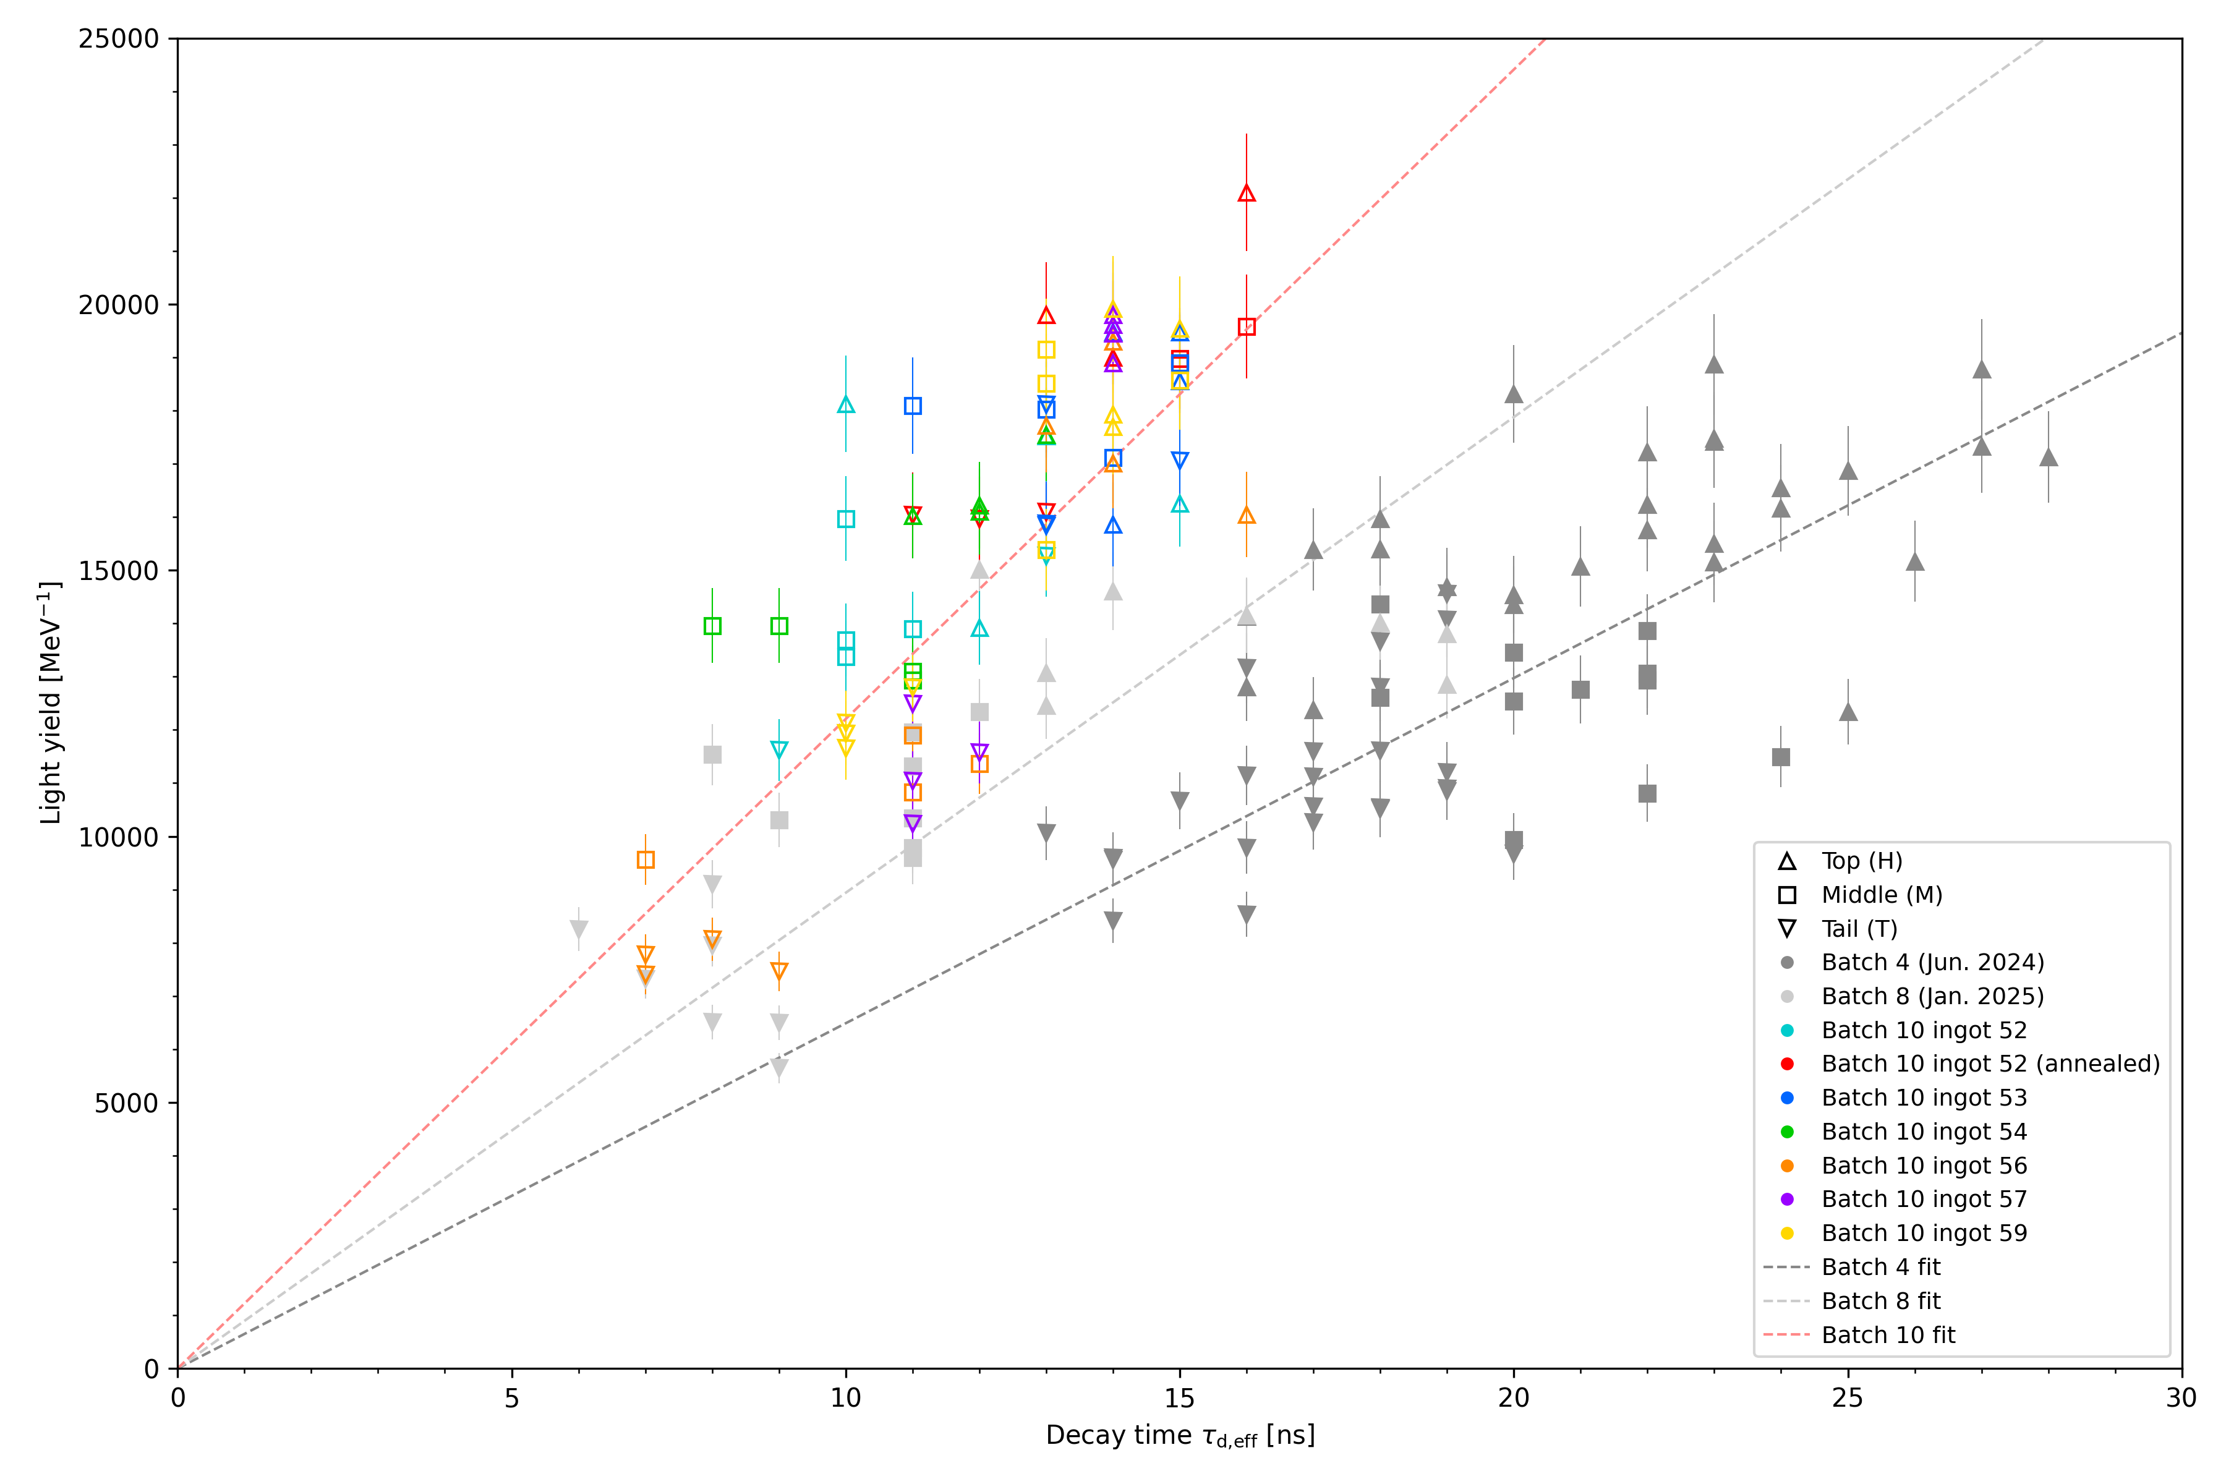
2.Crystal Growth and Characterization: L.Y. & Decay time
Correlation of $τ_{d,eff}$ and L.Y. for SIAPT GAGG samples
By increasing the Mg²⁺ doping level to quench the scintillation
  Ingot in Nov. 2024:
  𝜏_{𝑑,𝑒𝑓𝑓} ~ 24 ns for top samples and 𝜏_{𝑑,𝑒𝑓𝑓} ~ 12 ns for tail samples
  Ingot in Jun. 2025:
  𝜏_{𝑑,𝑒𝑓𝑓} reached ~ 10 ns for tail samples with light yield ~11000 MeV⁻¹
2024
2025
Latest batch delivered in June & July 2025
10 ns
Note: the $τ_{d,eff}$is measured with X-ray, and the light yield is calculated with Gaussian fitting.

Slide 18
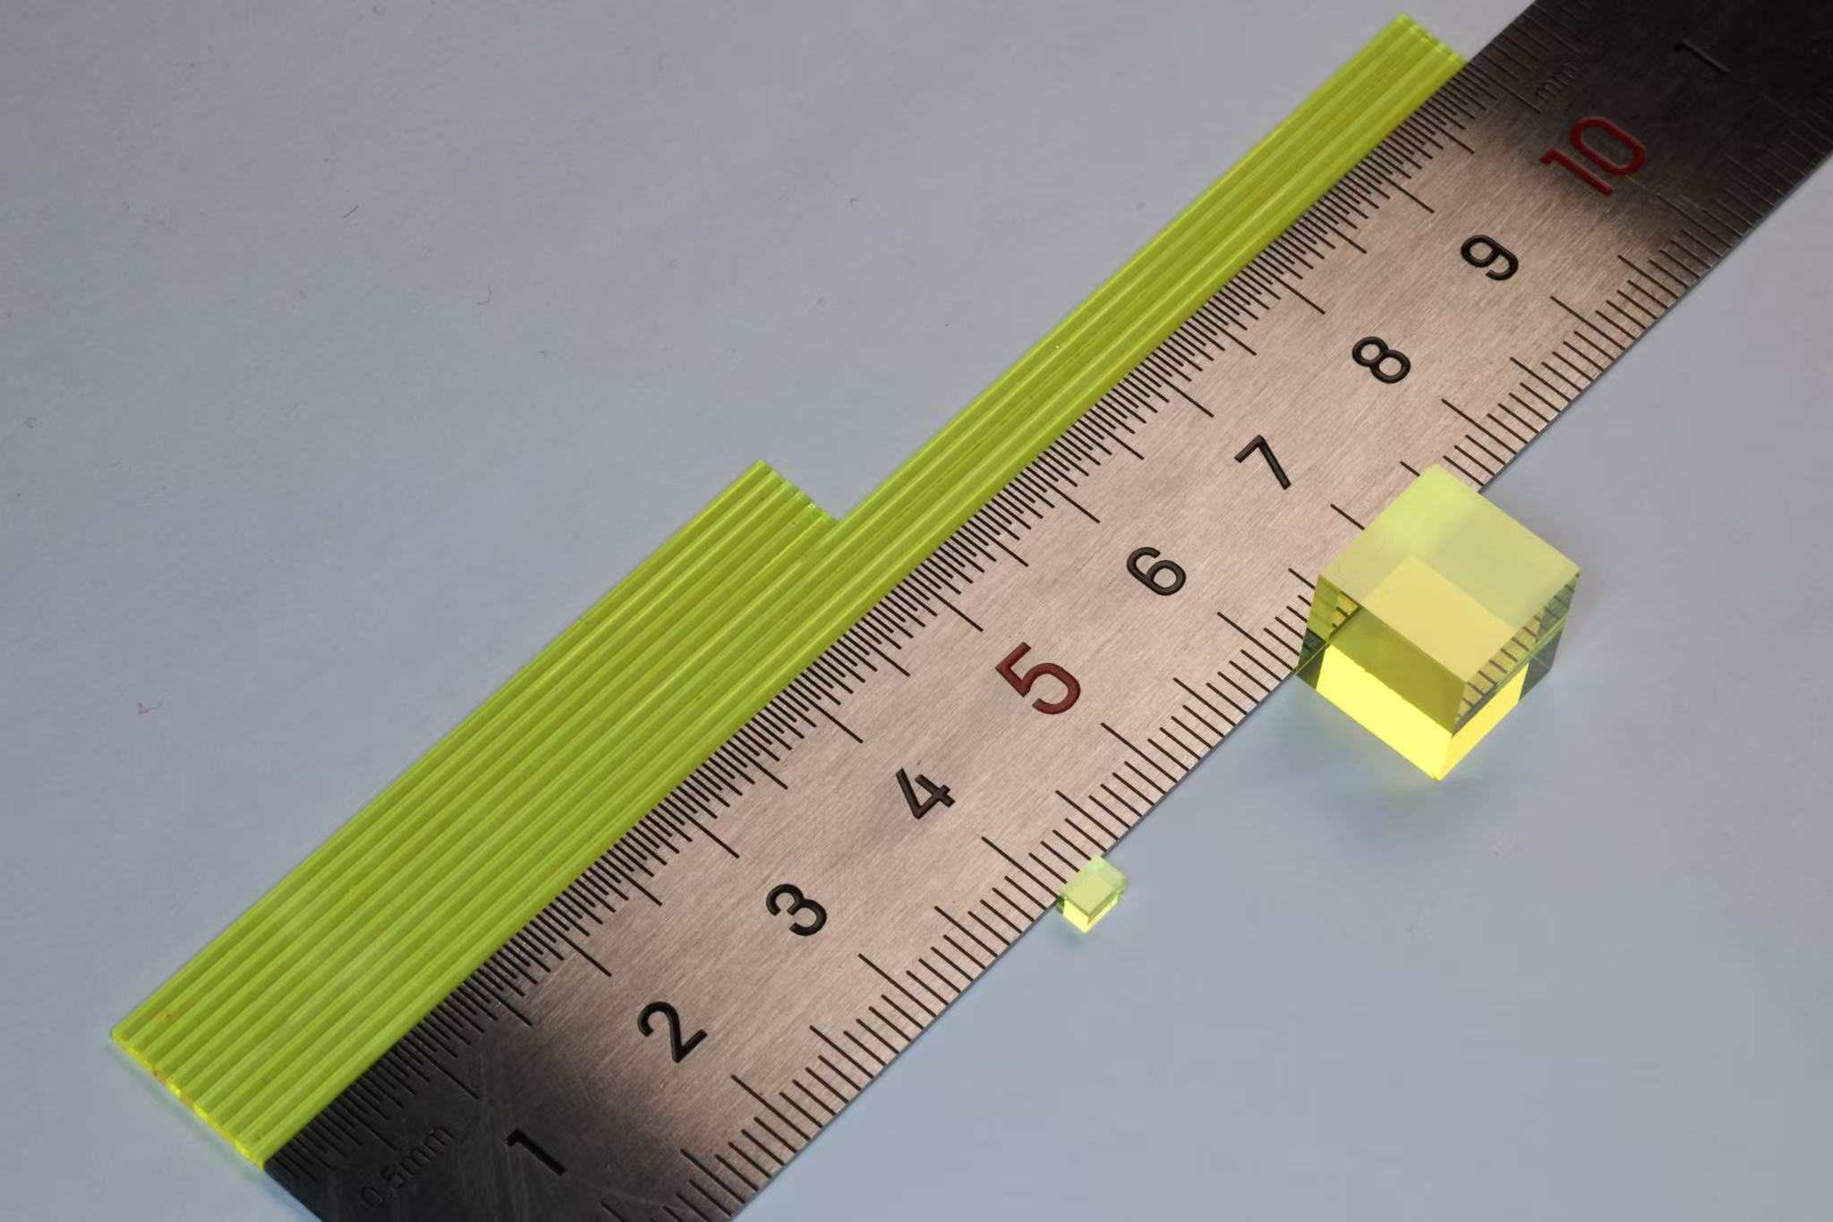
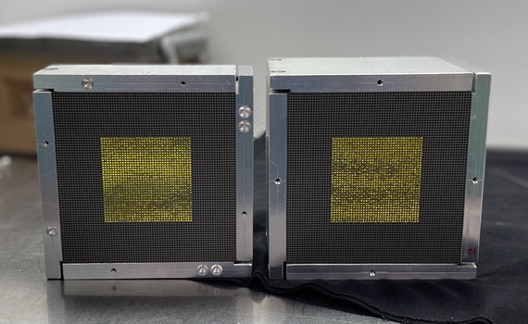
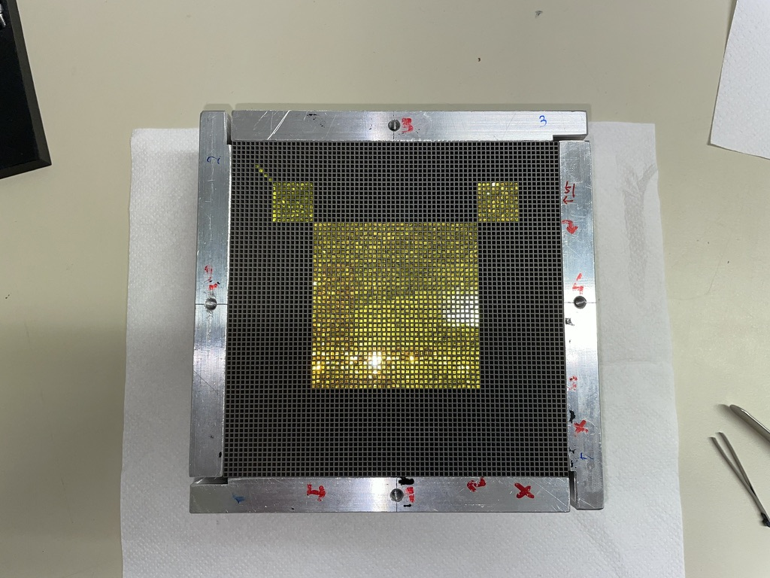
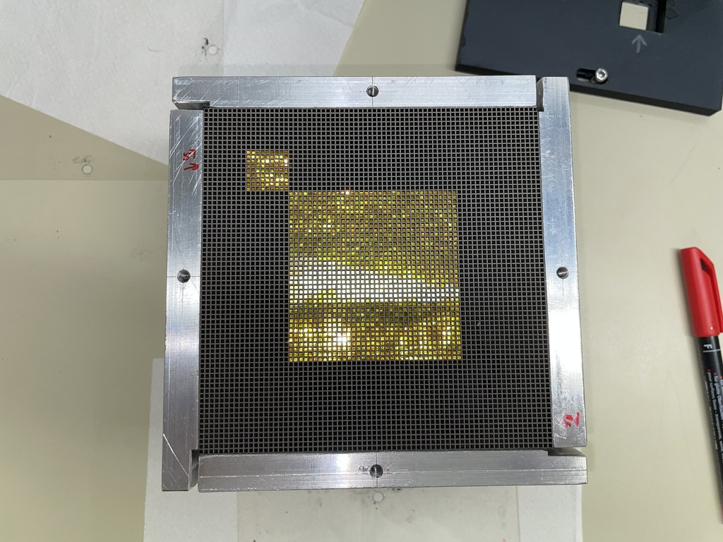
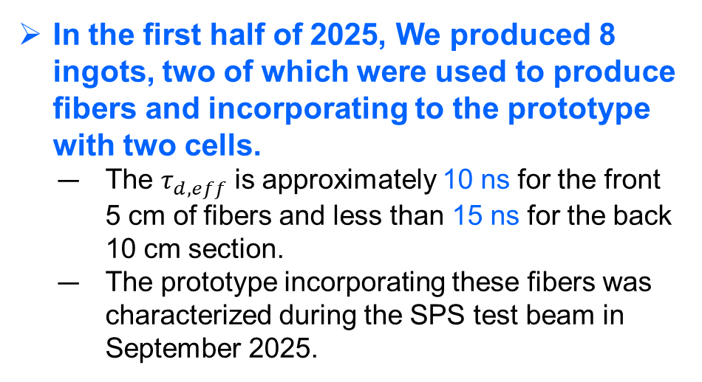
3.Beam Testing Results: The SpaCal-W prototype
In the first half of 2025, We produced 8 ingots, two of which were used to produce fibers and incorporating to the prototype with two cells.
  The $τ_{d,eff}$is approximately 10 ns for the front 5 cm of fibers and less than 15 ns for the back 10 cm section.
  The prototype incorporating these fibers was characterized during the SPS test beam in September 2025.
GAGG fibres
front
back
front
back
SpaCal-W Prototype
SpaCal-W Prototype with two cells incorporating fibers from new batches

Slide 19
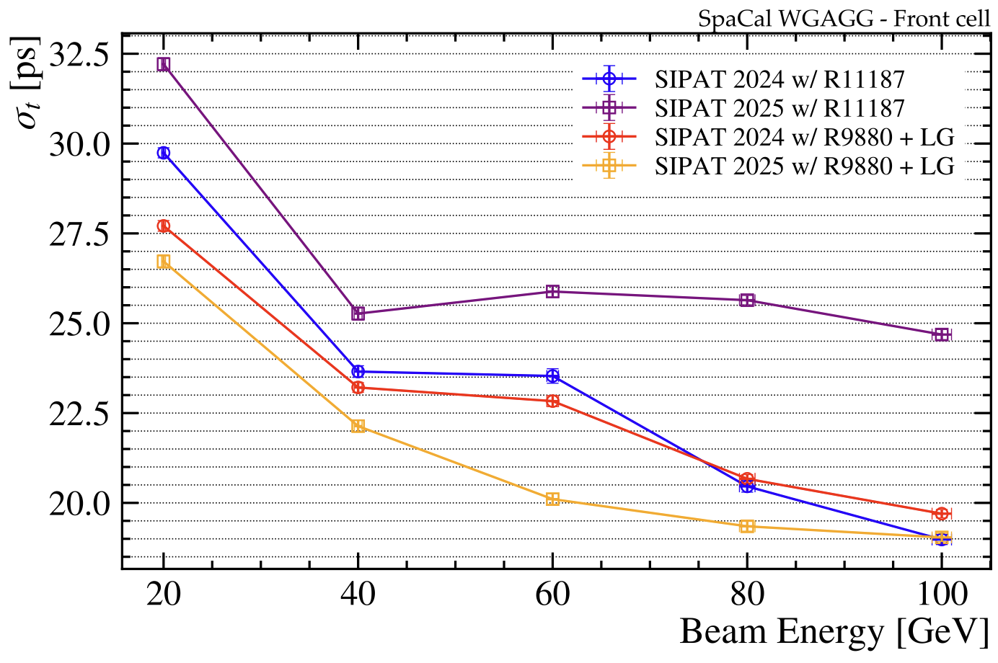
3.Beam Testing Results: Time resolution
Time resolution for prototype
Time resolution at 3°+3°:
Front only:
  Improvement of time resolution, as expected from measurements done in the lab.
  With R9880U: below 20 ps after 60 GeV
Front & Back:
  The analysis is still ongoing!
Preliminary

Slide 20
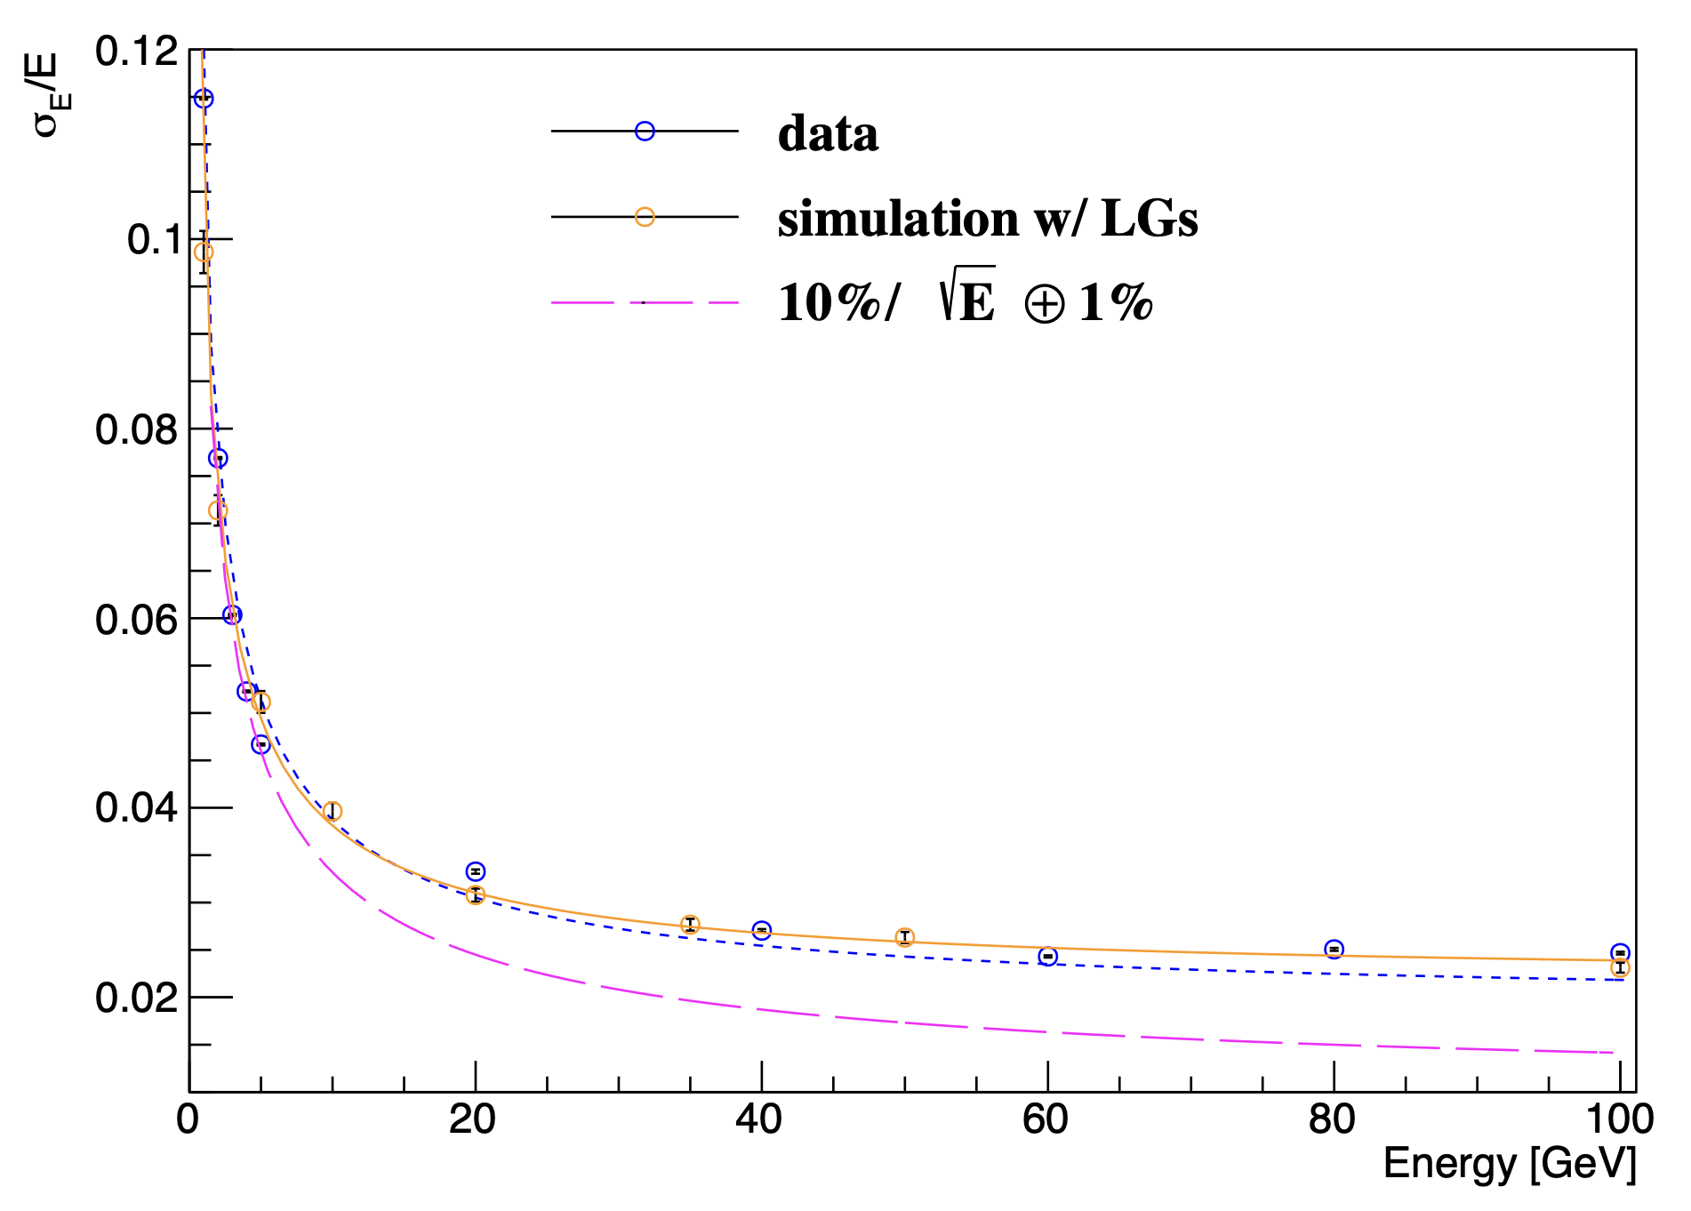
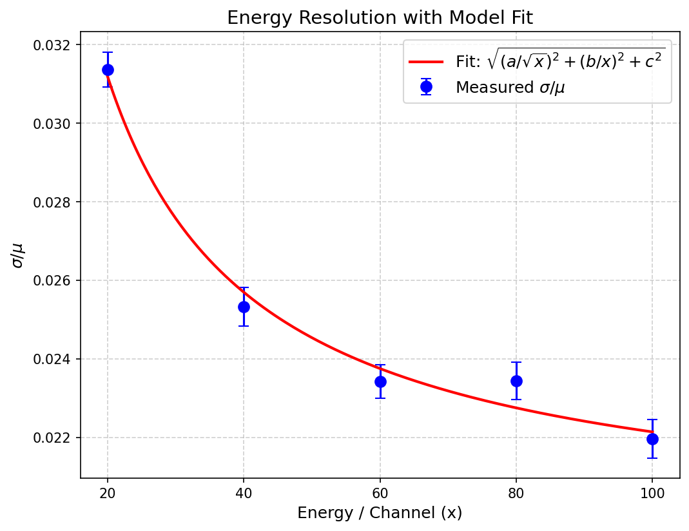
3.Beam Testing Results: Energy resolution
2024
2025
Energy resolution for prototype
Energy resolution for prototype
Preliminary
Preliminary
Energy resolution at 3°+3°: (4x4 cells)
  Sampling term: 10.6±0.2 %
  Constant term: ~2 %
Energy resolution at 3°+3°: (4x4 cells)
  Sampling term: 10. 2 %
  Constant term: ~2 %

Slide 21
4.Conclusions and Next Work
Conclusions:
  The stage goals have been reached in 2025, 𝜏_{𝑑,𝑒𝑓𝑓} ≤ 15 ns, Size ≥ Φ45 mm×110 mm.
  GAGG Crystals with a decay time of less than 15 ns can be grown stably, meet the requirements of optical fibers and applicable to other fields.
  With beam test at 2025, the time resolution improved significantly (＜20 ps).
Next work:
  Improve the inhomogeneity of the ingot to ≤20%.
  Increase the ingot size at least to reach Φ50 mm×110 mm, to increase the yield of fibers.
  Furtherly accelerate the decay time to sub-10 ns for entire ingot.

Slide 22
Acknowledgments
The crystals were characterized by both Zhenwei Yang's group at PKU and Etiennette's group at CERN.
Ming Zeng’s group at THU provided valuable technical advice and student support.
Beam testing was conducted at both CERN and DESY, with thanks to the LHCb ECAL Upgrade II group.

Slide 23
Thanks for Your Attention!

