Slide 1



CuW baseplate R&D and production
Hao Zhu (IHEP)
On behalf of Chinese HGCal Group
Oct 31rd, 2025
CLHCP 2025, Xinxiang

Slide 2
Outline:
CuW baseplate introduction & production status
Irradiation test, peel test, mechanics study, heat flow study and specs inspection for IHEP baseplates
Future production plan

Slide 3
CuW baseplate introduction & production status

Slide 4
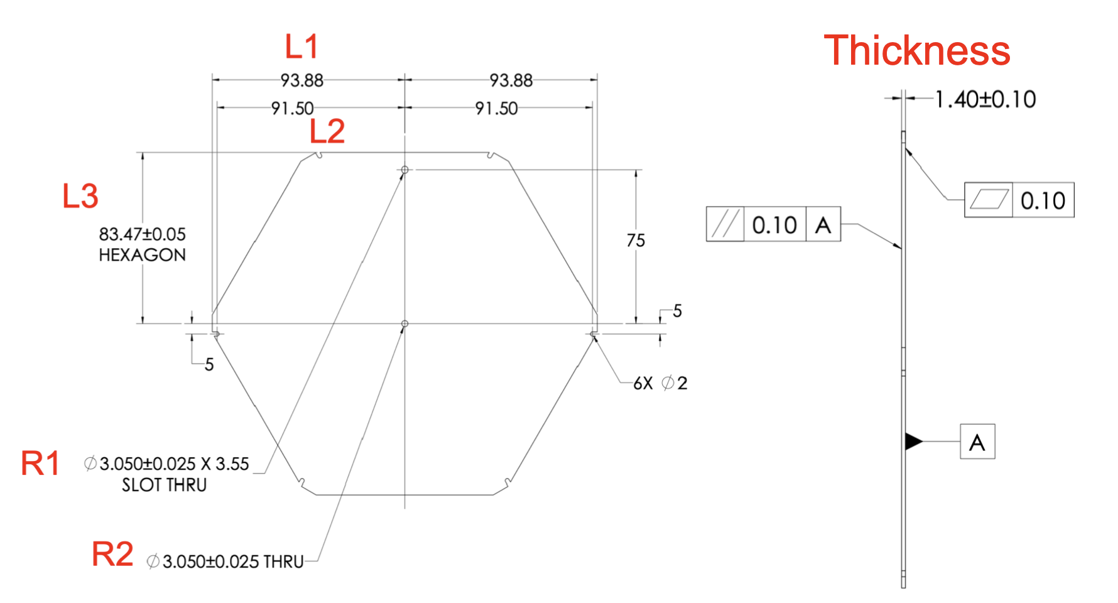
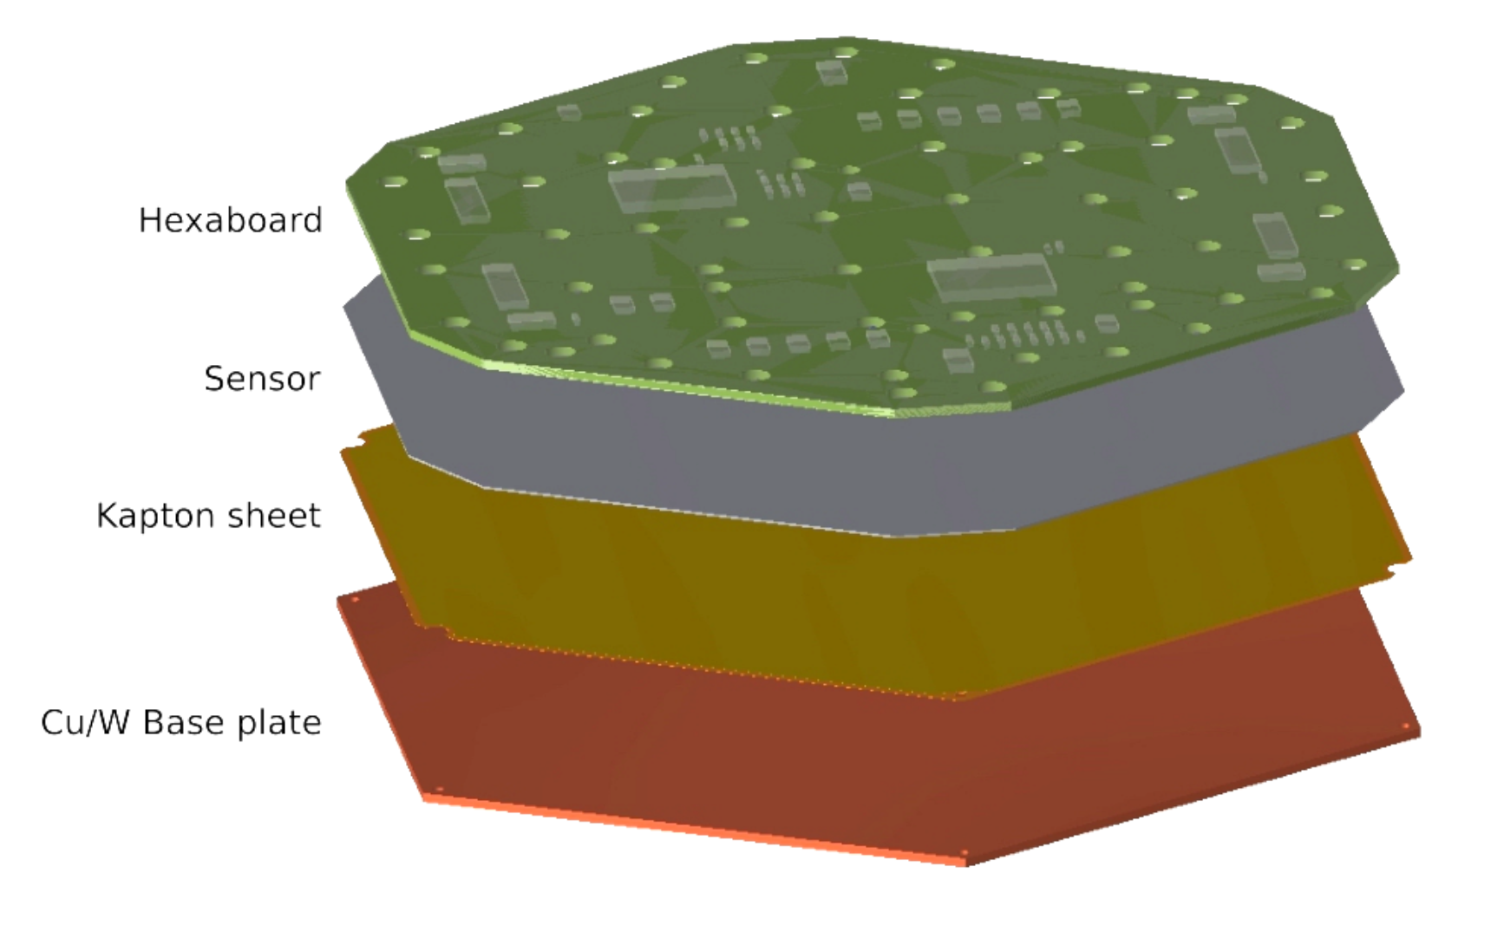
CuW baseplate introduction
CuW baseplate in HGCal: will be used in ECal; insulation layer, absorber, thermal conductive layer, sensor protection, noise shelding, supporting.
2 Kapton assembly process(bonding Kapton and CuW): KIT plan, IHEP plan.
First time Chinese entities participate and will produce the largest area(~90%) of CuW baseplates.
Brought in orders worth over 10 million RMB for China’s precision machining industry.
Participating entities: IHEP, THU, ZJU, FDU, NNU.
Complete CuW baseplate
Complete HGCal module
CuW baseplate design

Slide 5
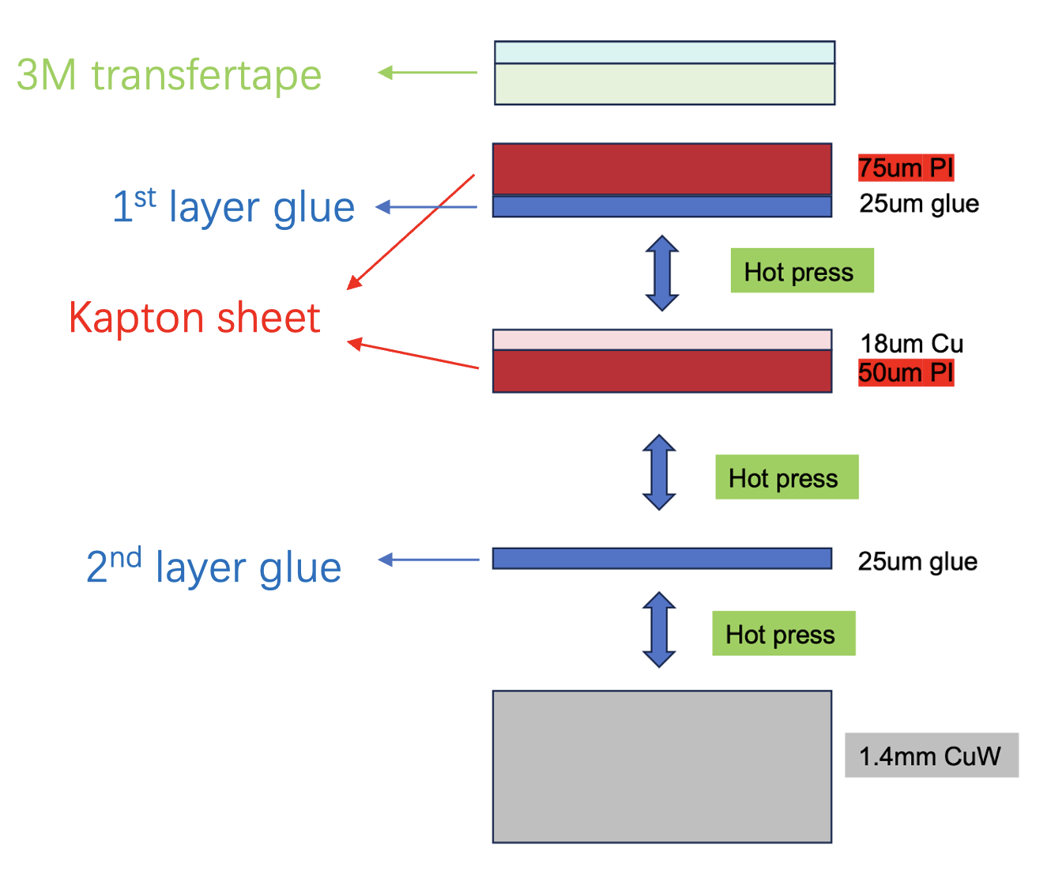
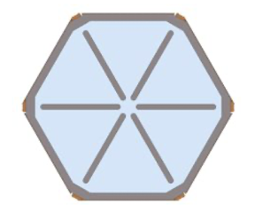
Introduction of KIT plan and IHEP plan
IHEP Kapton assembly process
Using hot melt adhesive to bond different layers.
Glue fully covers entire CuW baseplate.
Layers bonded together by hot pressing process.
Will cover most of the production work
KIT Kapton assembly process
Hybrid attachment with 3M glue and epoxy.
Using gantry in KIT’s lab to dispense glue on CuW baseplate.
Use partially-overlapping glue dispensing pattern.
Laminate using pressure.
Will take on production partially
KIT plan’s glue pattern
p.s. KIT plan will be modified soon.

Slide 6
Comparison & advantage
 | KIT plan | IHEP plan | IHEP plan’s advantage
Glue dispensing pattern | Partially-overlapping glue dispensing pattern. | Fully-overlapping glue dispensing pattern. | Have larger glue coverage area.
Bonding method | Laminate using pressure. | Hot pressing process. | Better mechanism performance.
Production method | Laboratory production. | Industrial production. | Capable for mass production.
All kinds of test | Irradiation test, lack of mechanical test. | Irradiation test, peel test, mechanical test, etc. | Passed all tests so far.

Slide 7
CuW baseplate production status
3 batches small batch trial production
of CuW baseplate produced(81 in total):
1st batch,10 CuW baseplates, 2022.09
Mainly for all kinds of tests.
2nd batch,41 CuW baseplates, 2023.09
13 send to NTU for module assembly.
13 send to UCSB for module assembly.
15 @IHEP for module assembly and test.
3rd batch,30 CuW baseplates, 2024.07
7 send to NTU for module assembly.
2 send to CERN for irradiation test and peel test.
8 for IHEP’s pre-production modules.
10 for IHEP’s pre-series modules.
Full scale production(plan around 12000):
Pre-batch 1200 bare CuW ready and tested/labeled, next batch 2500 bare CuW have just done manufacture
Extra 100 bare CuW for KIT ready and tested/labeled, have shipped to CERN.
So far, IHEP has produced the most CuW baseplates used for module assembly and testing.

Slide 8
Irradiation test, peel test, mechanics study, heat flow study and specs inspection for IHEP baseplates

Slide 9
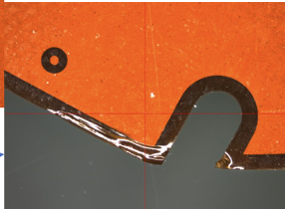
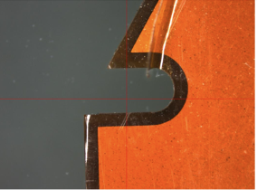
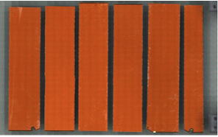
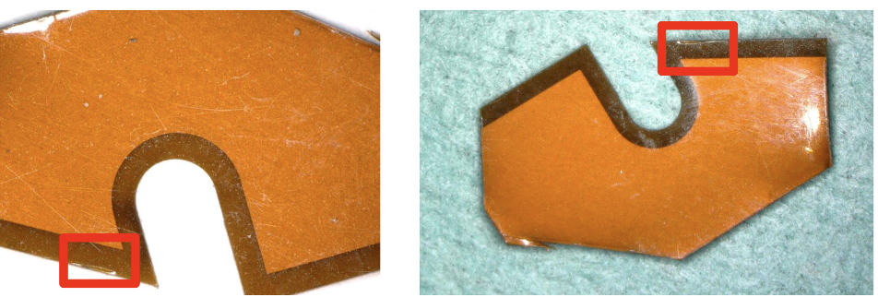
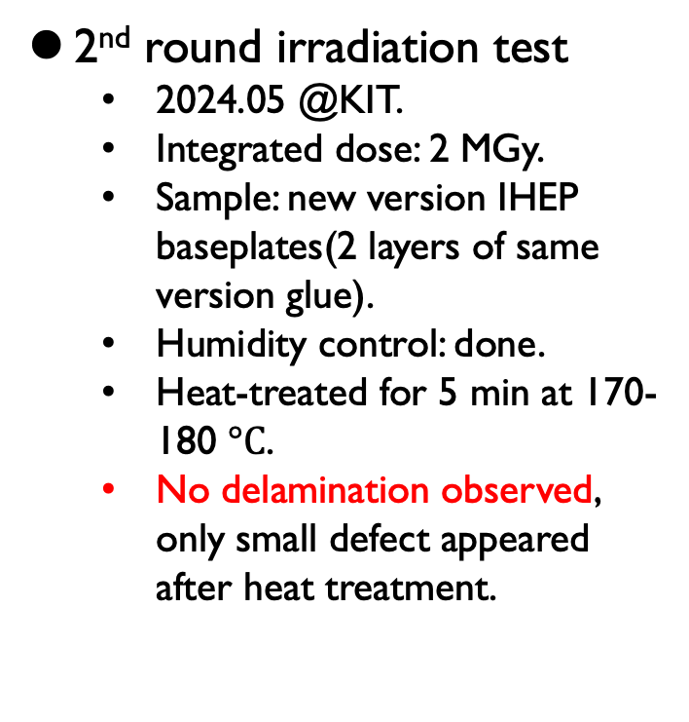
Irradiation test
IHEP produced CuW baseplates have undergone 3 rounds of irradiation test and part of peel test.
1st round irradiation test
2024.05 @CIEMAT.
Integrated dose: 2 MGy.
Sample: old version IHEP baseplates(2 layers of different version glue).
High humidity(~80/90%)
Delamination discovered.
2nd round irradiation test
2024.05 @KIT.
Integrated dose: 2 MGy.
Sample: new version IHEP baseplates(2 layers of same version glue).
Humidity control: done.
Heat-treated for 5 min at 170-180 $°C$.
No delamination observed, only small defect appeared after heat treatment.
3rd round irradiation test
2024.09 @CIEMAT.
Integrated dose: 0.5 MGy, 1 MGy, 1~2 MGy.
Sample: new version IHEP baseplates(2 layers of same version glue).
Humidity control: done.
No delamination observed.

Slide 10
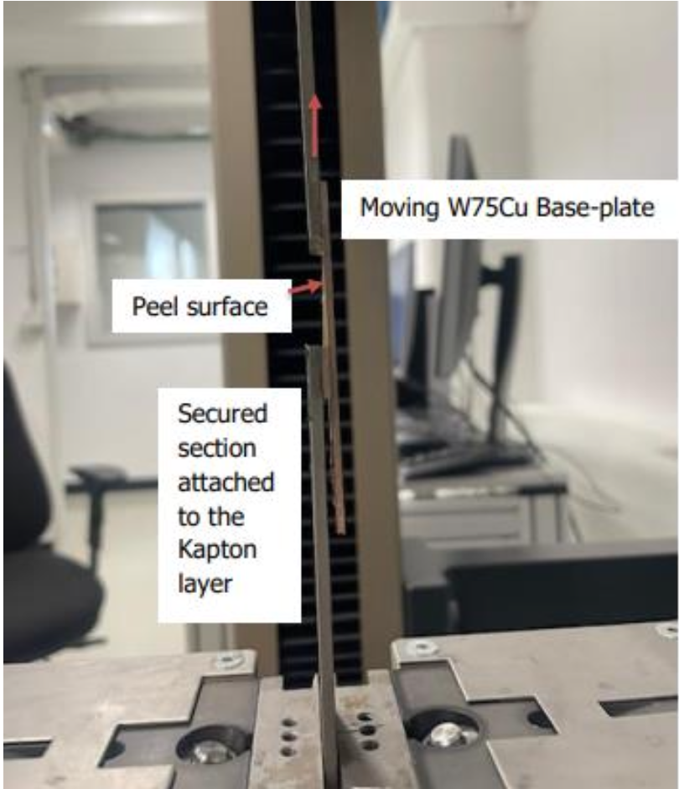
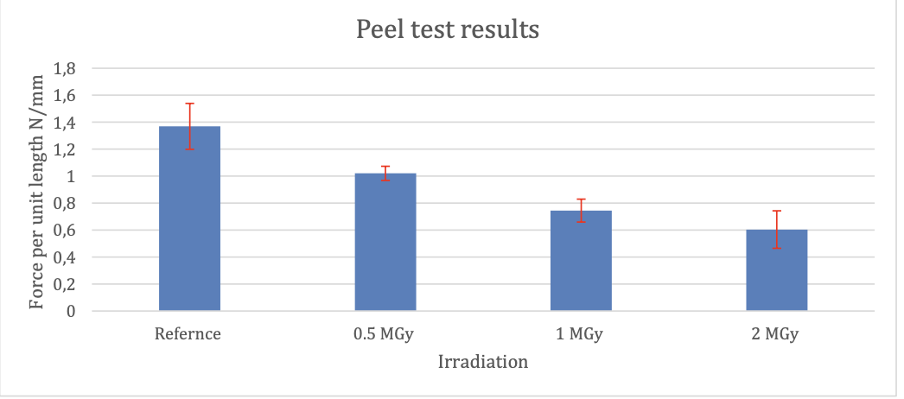
Peel test
Motivation: evaluate whether irradiation caused significant degradation to adhesive.
Using mechanical testing machine, test adhesive performance of 2nd layer glue.
Sample: unirradiated reference sample, irradiated by 0.5 MGy, 1 MGy, 2 MGy samples.
Results: samples showed a steady decline in peel strength with the increase in accumulated doses. 2 MGy sample showed significant peeling after test.
Although irradiation can affect peel strength, the test results meet the requirements(glue specifications: < 0.5 N/mm when irradiation dose = 2 MGy).
Glue specs

Slide 11
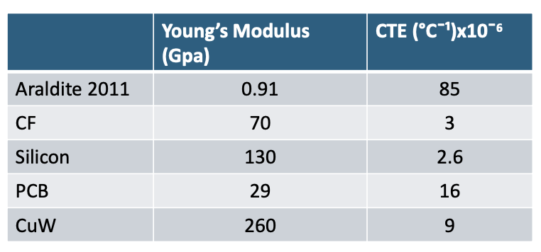
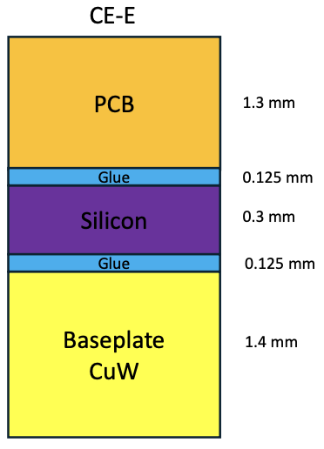
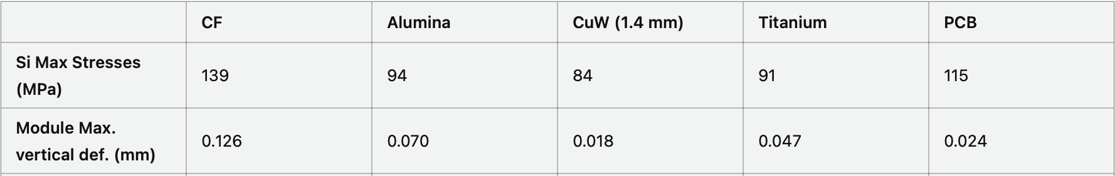
Mechanics study
Conducted by CERN
Motivation: when module cool down from room temperature to -35 °𝐶, stress is generated in Silicon sensor.
Silicon Yield stress ~ 350 MPa, CuW baseplate’s Si max stress is 84 MPa, so it’s safety in simulation.
In the temperature cycling tests conducted by NTU and KIT so far, no module damage has been found.
Material properties:
Complete module:
Simulation results:

Slide 12
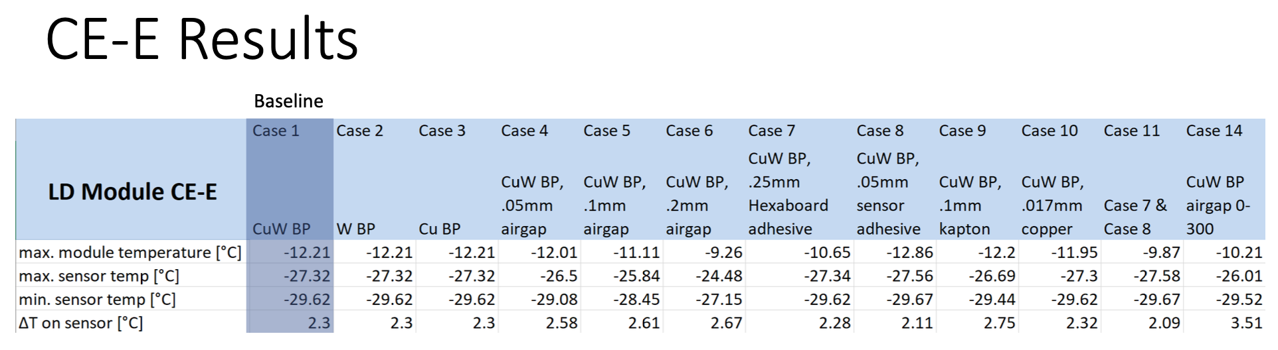
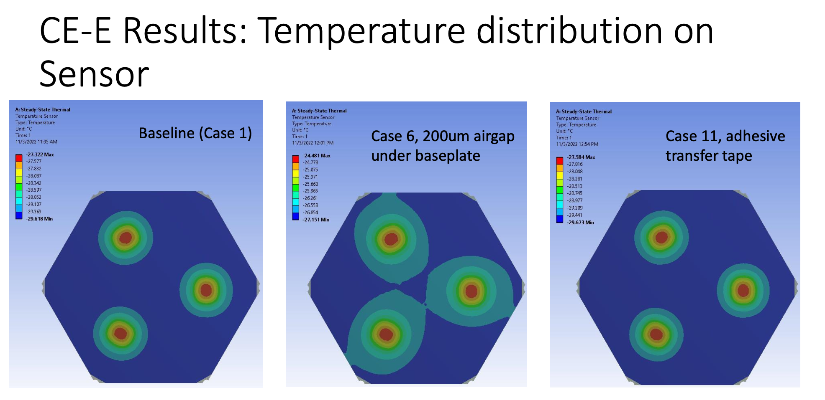
Heat flow study
Conducted by UCSB
Steady state thermal simulation of heat flow through the module.
Determine sensor temperature and temperature gradient, using different airgaps and materials.
Better flatness, smaller airgap, temperature distribution is more uniform.
All cases’ max/min temperature and temperature gradient performed well. It will not cause damage to the Silicon sensor.

Slide 13
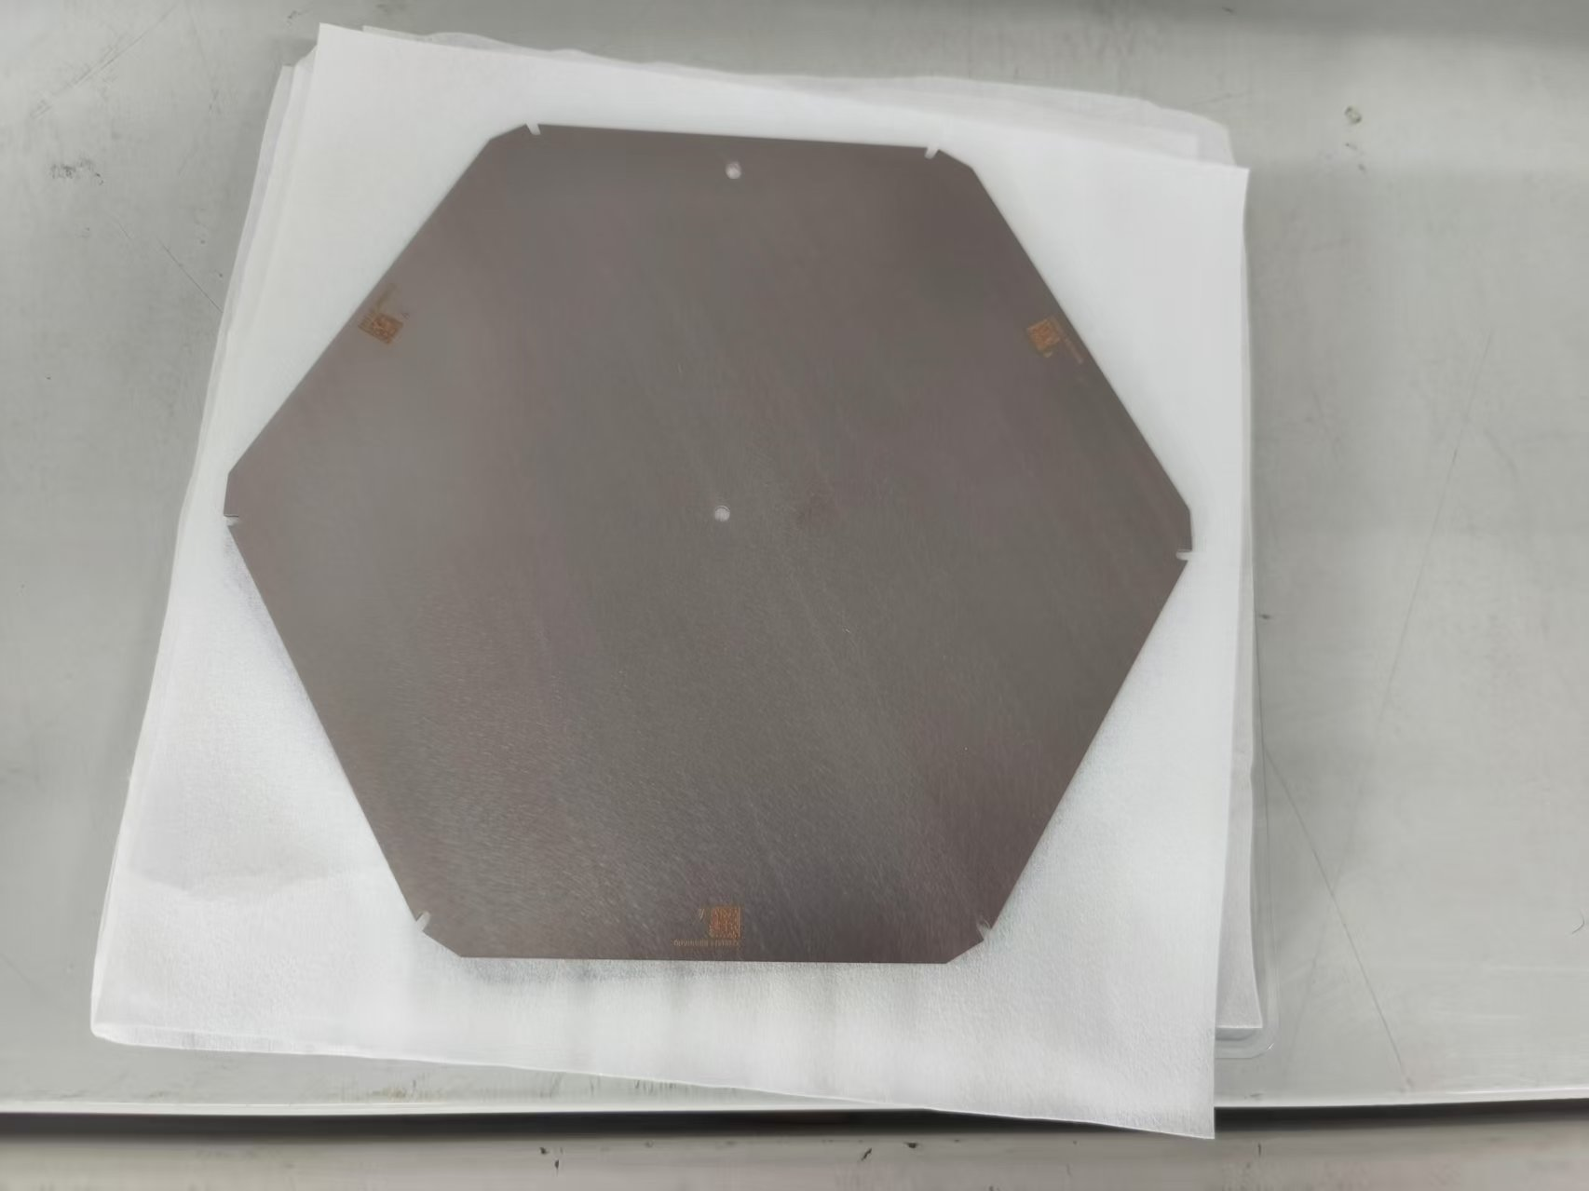
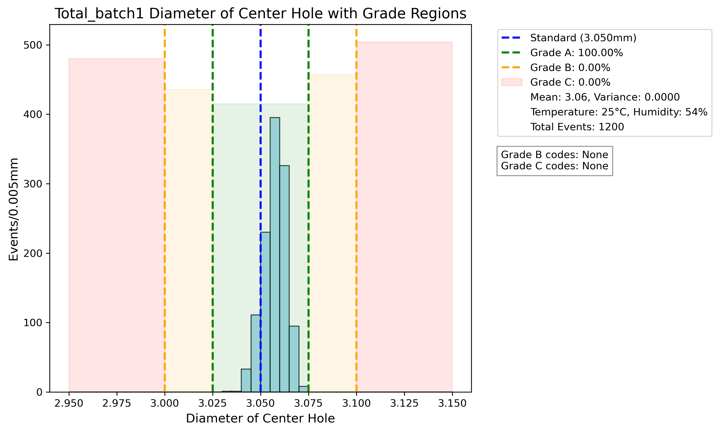
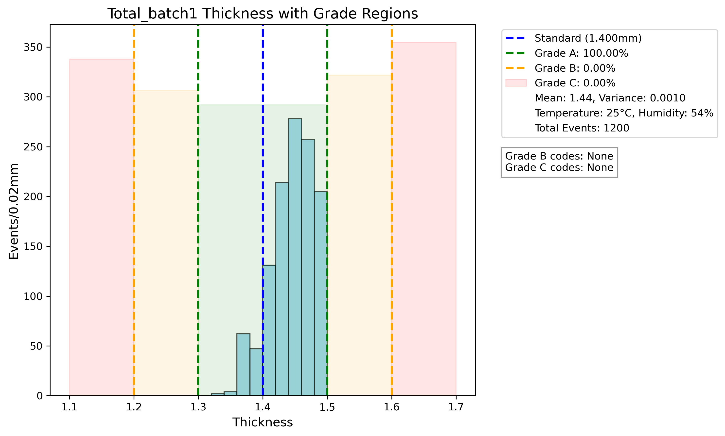
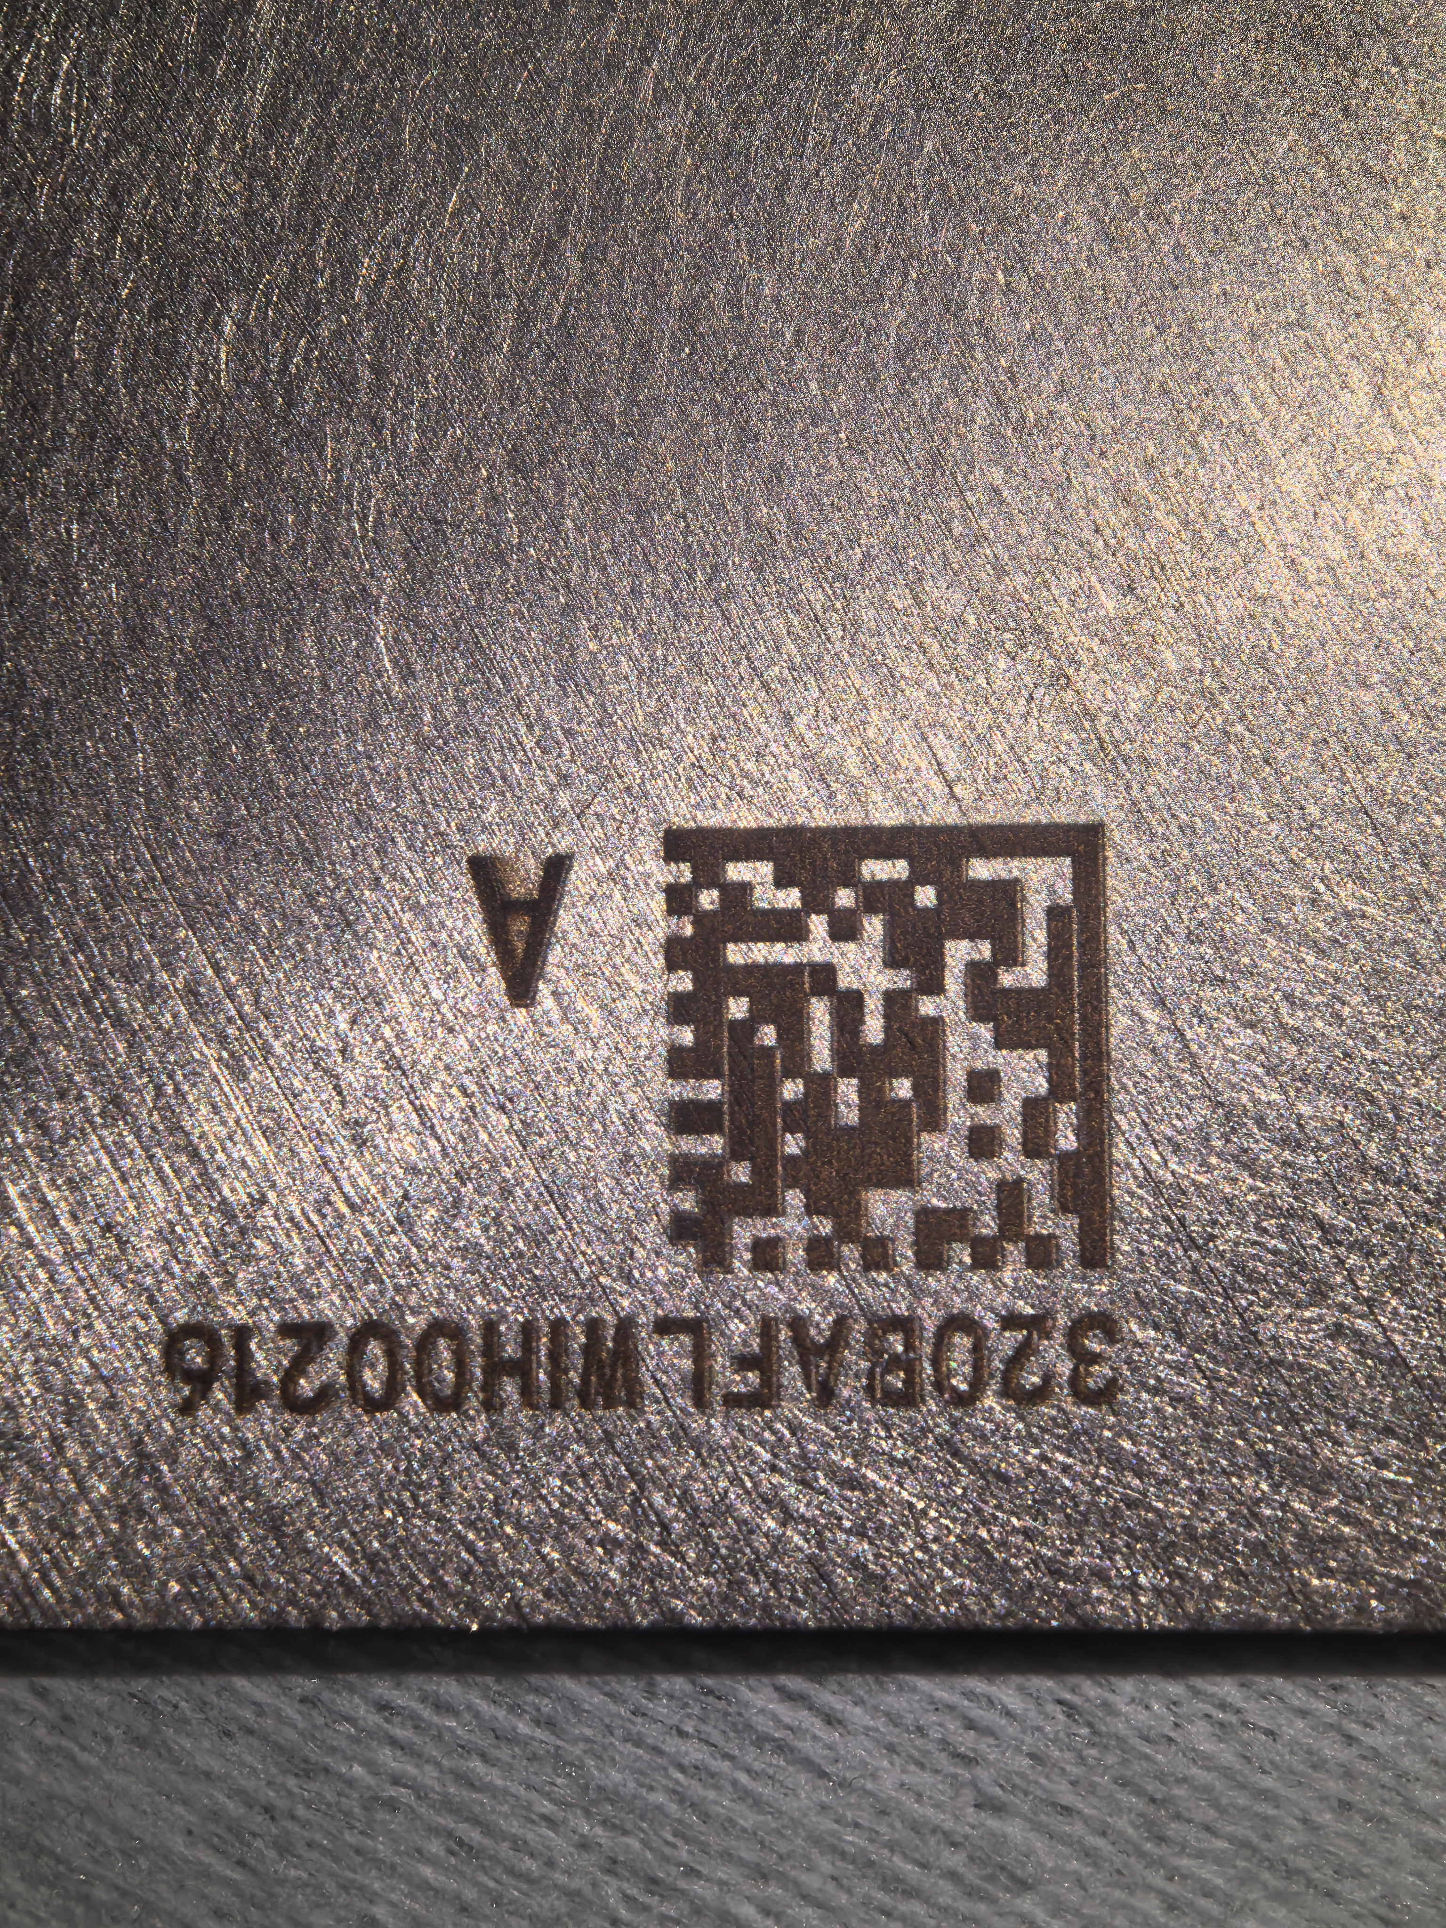
CuW baseplate specification inspection
CuW baseplate company measured all specifications in CuW baseplate design, for all 1200 pre-batch baseplates. (Also measured all extra 100 baseplates for KIT)
All 1200+100 CuW baseplates passed Grade A.
All specifications are tested by Vision Measuring Machine, accuracy ~ 0.002mm.
QR code print is just before the measure process, so surface A/B are random. We always measure surface A.
Thickness and diameter of center hole distribution. Other specification details in backup.

Slide 14
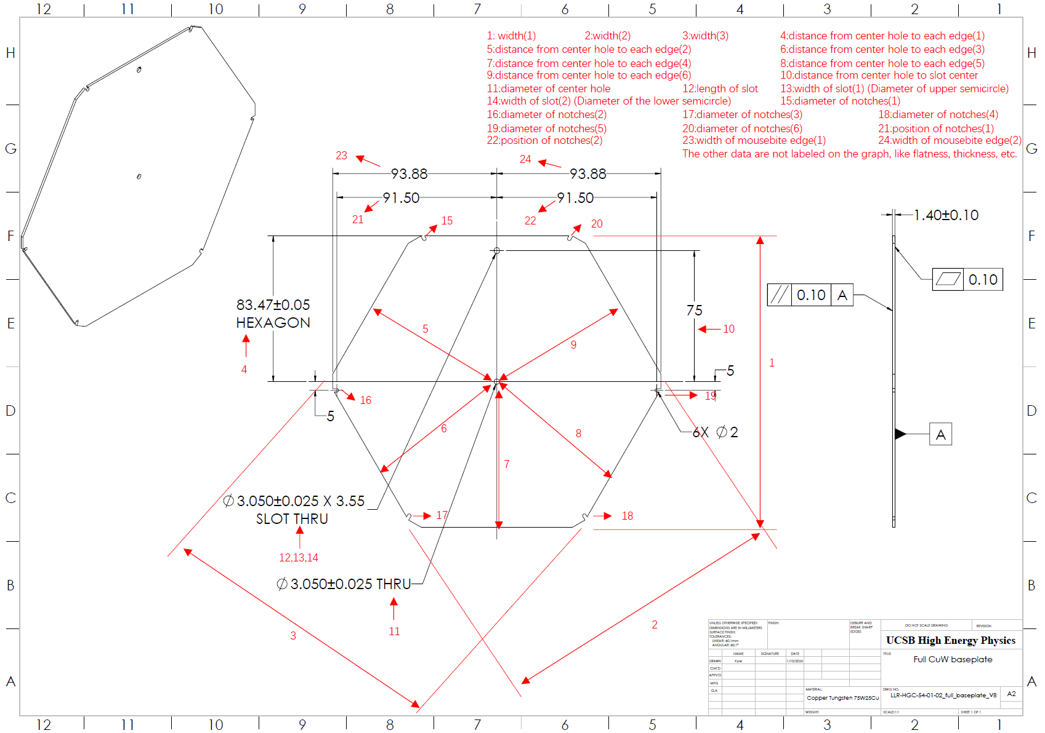
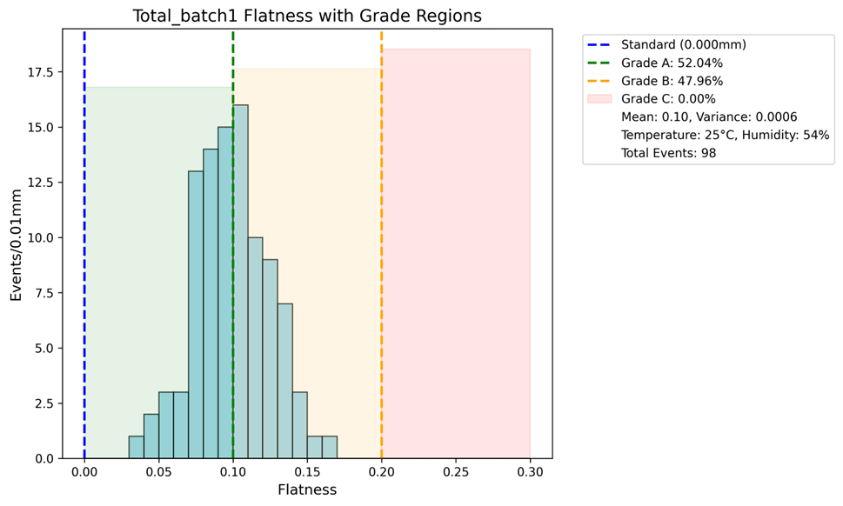
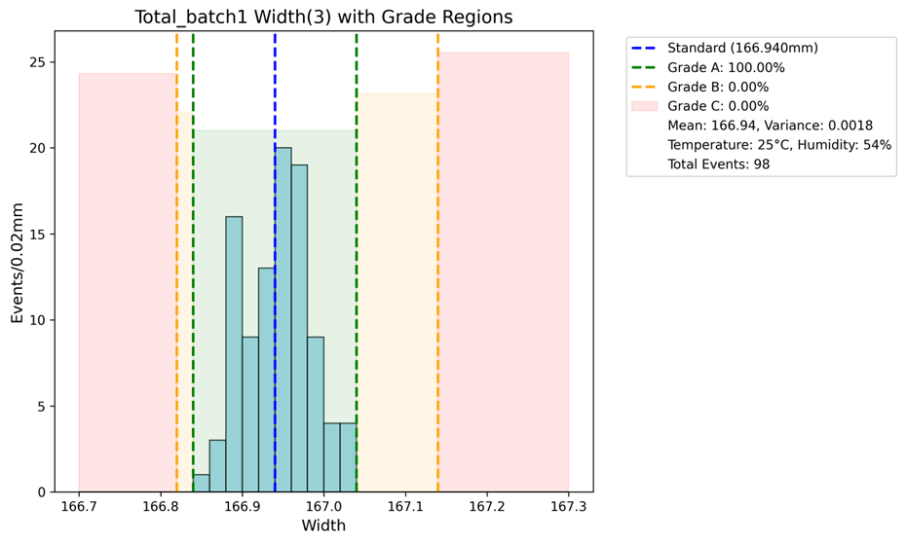
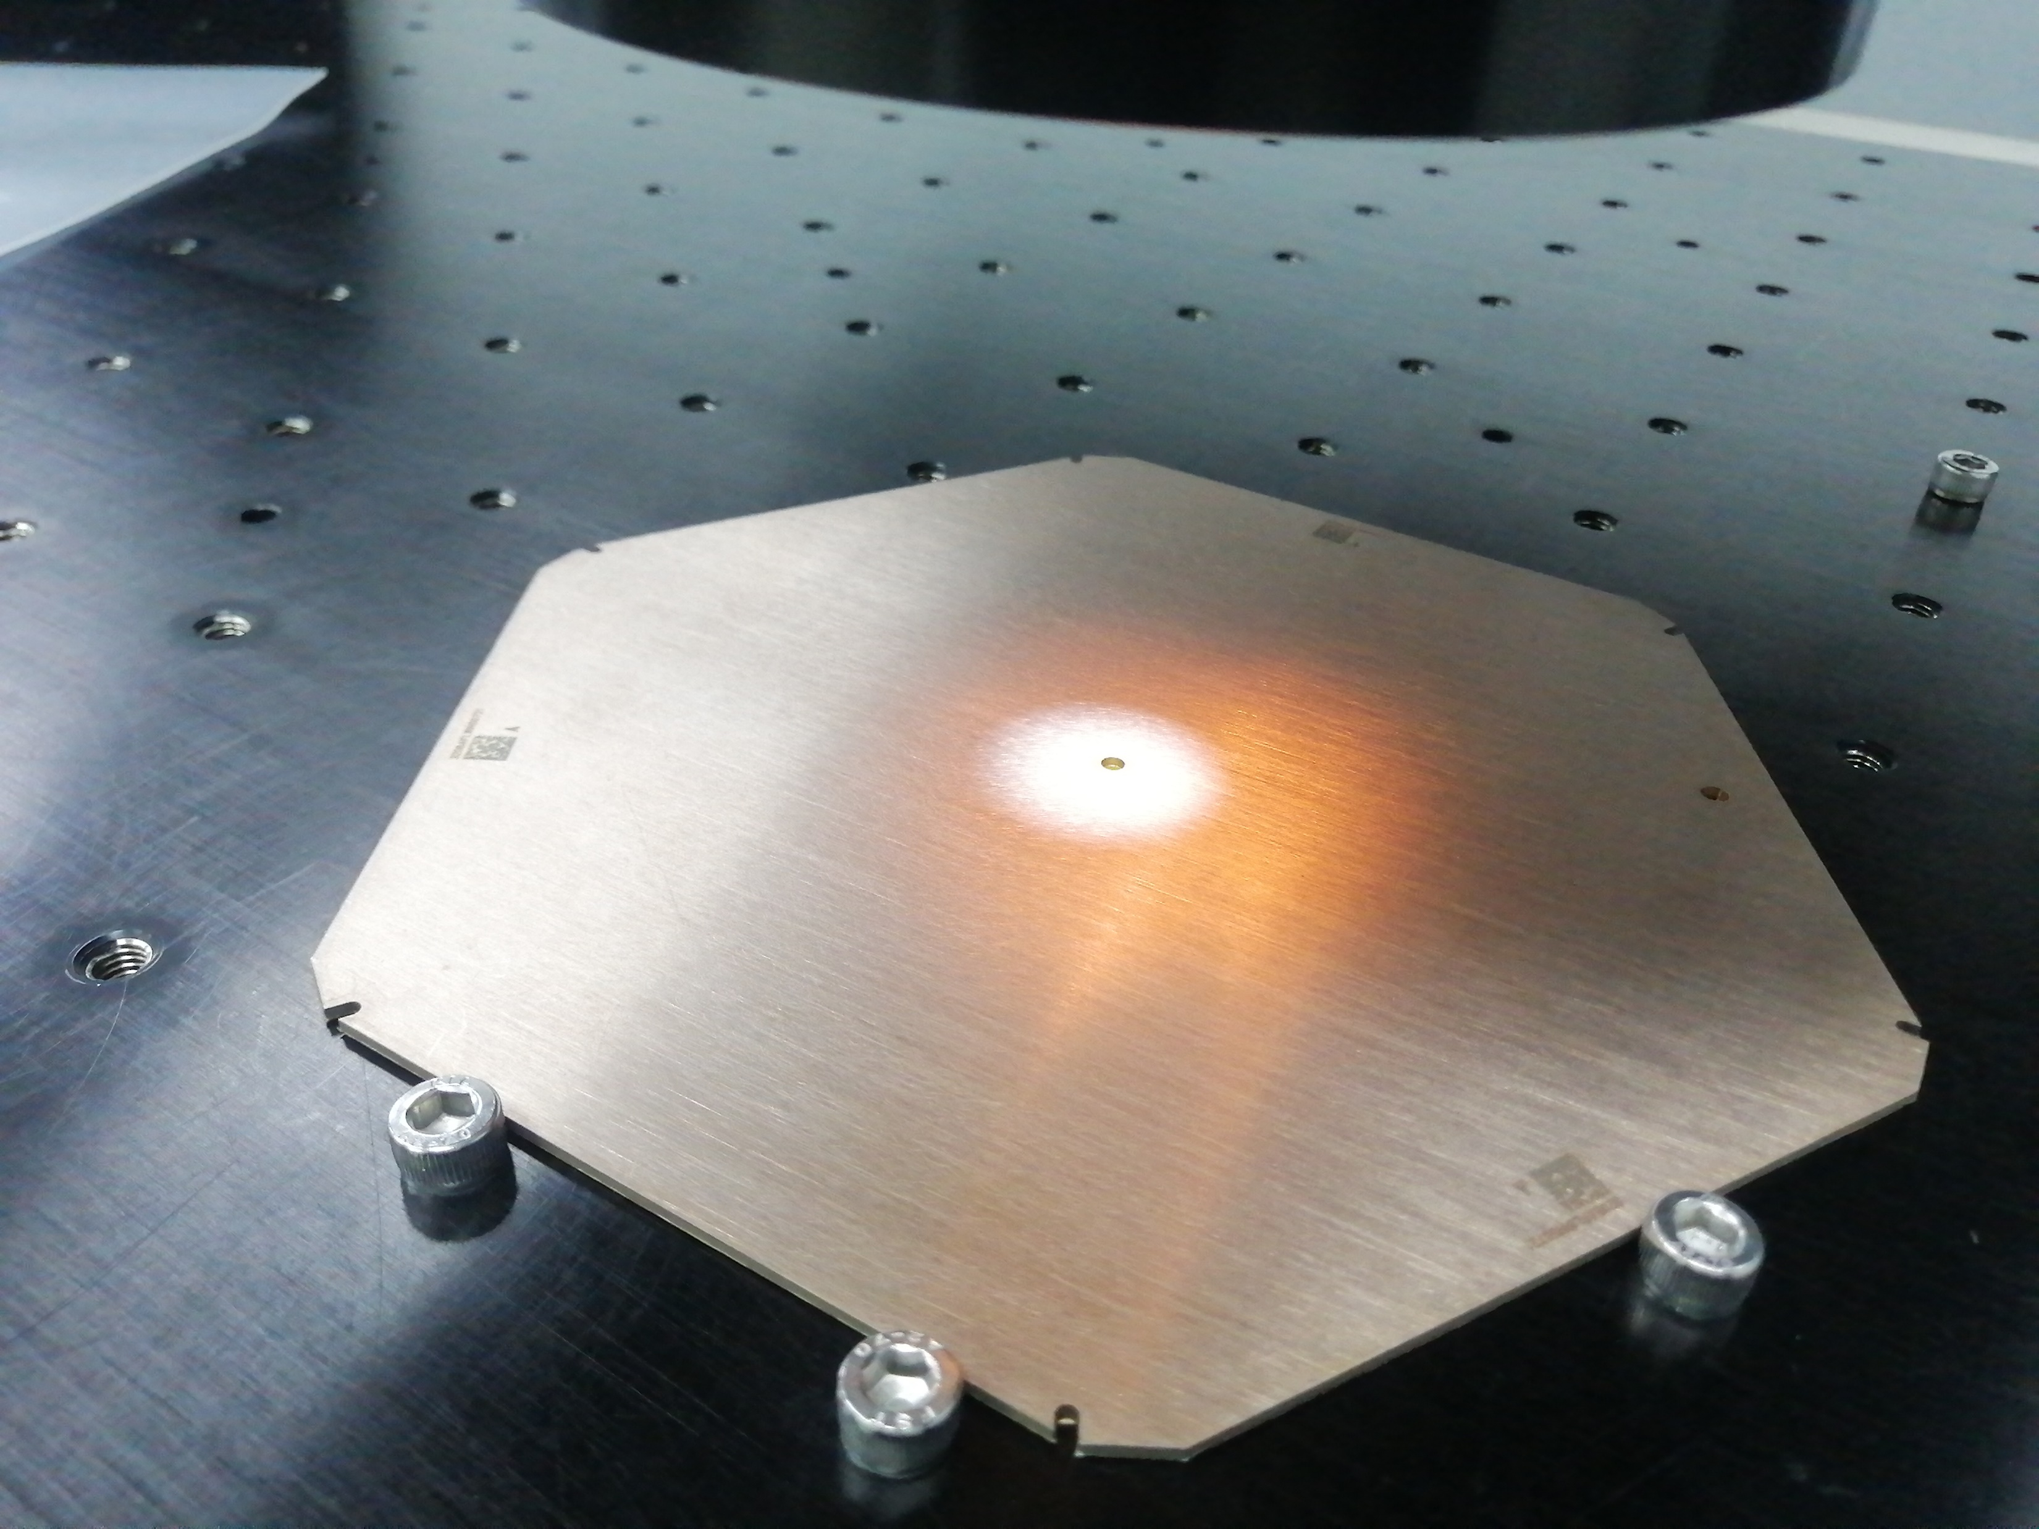
CuW baseplate spot check
Random select 98 CuW baseplates from all 1200 pre-batch baseplates sent to IHEP.
Measured specifications in CuW baseplate using OGP as cross-check to CuW baseplate company’s result.
Result shows most specification can still reach a high Grade A percentage compare to baseplate factory result*(degradation mainly due to lamination process, plan to fix next)
Flatness and distance from center to edge distribution.
Other specification details in backup.
*Detail are listed in backup, PPT page31

Slide 15
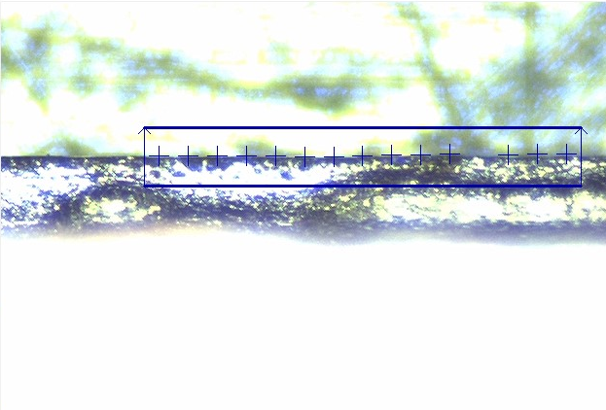
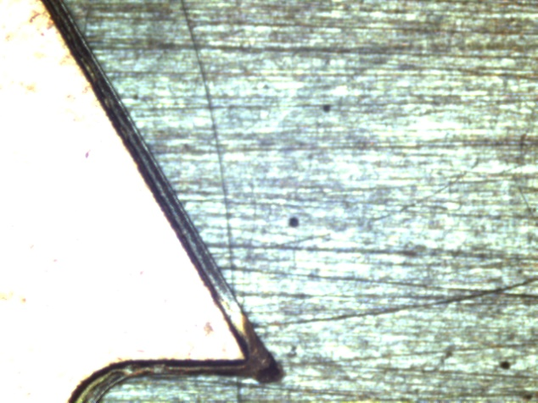
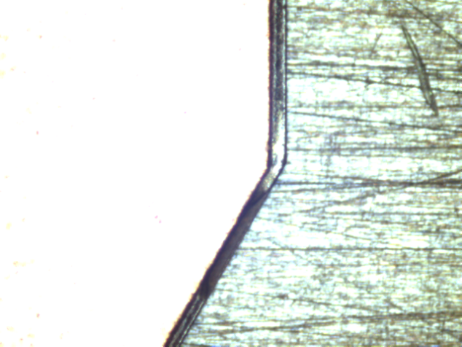
CuW baseplate kapton boundary check
Exam the Kapton boundary by locate the position and record pictures at two end points
For all 98 baseplates, none of CuW baseplate edge exceed the Kapton boundary and mostly are well aligned
measurement pictures to locate the kapton boundary
Exam pictures for end point of kapton boundary

Slide 16
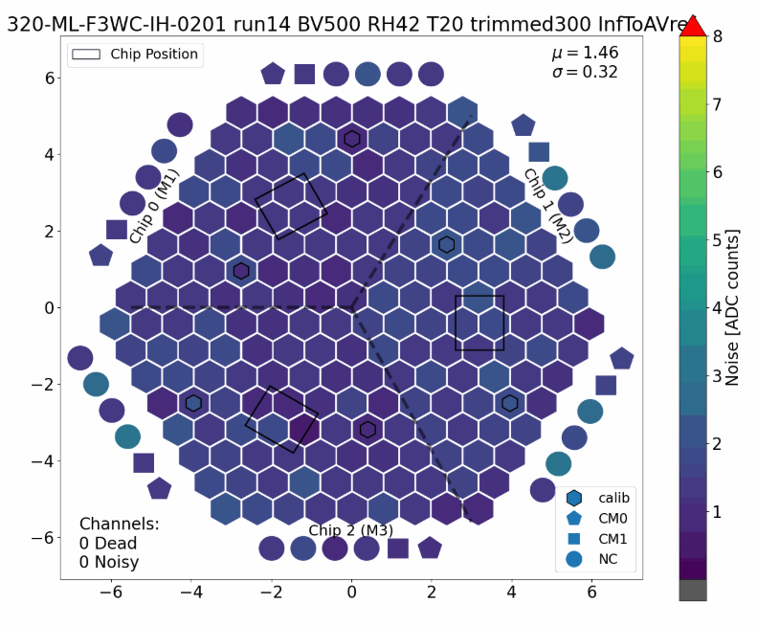
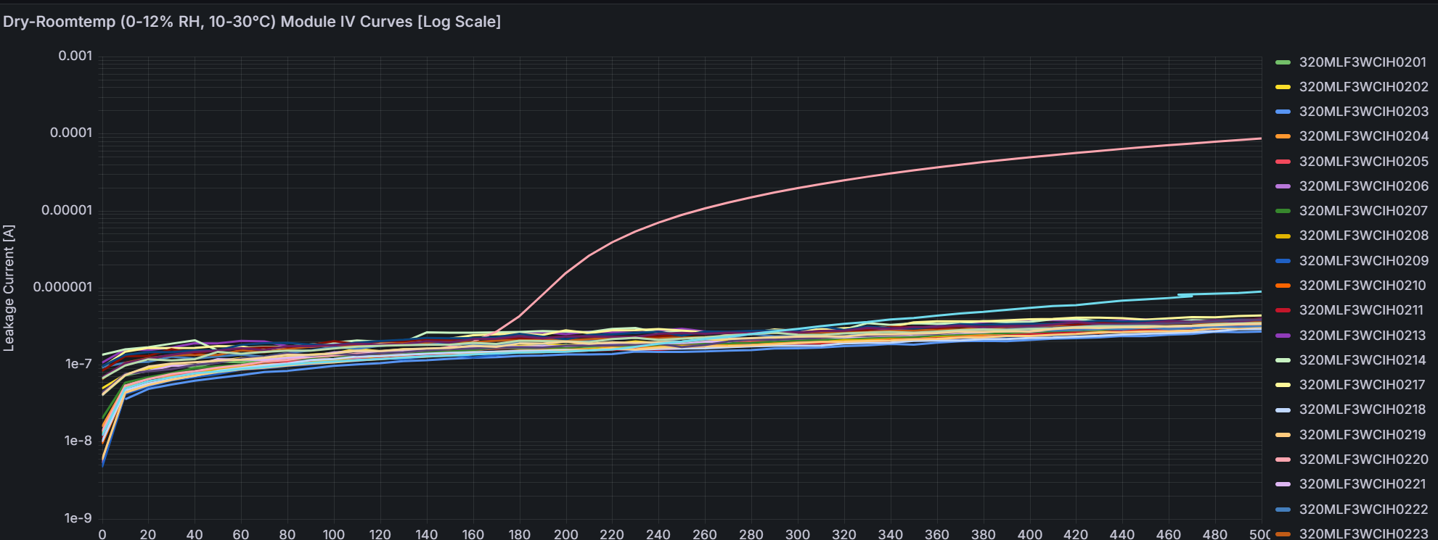
New modules performace with new baseplate
For now 28 modules has assembled with new IHEP produced CuW baseplates
Electronics test shows all completed modules meet the standard as good noise and good IV
noise channel result for one baseplate,
good noise require noisy+dead+unbound channels ≤ 4
I-V result for all 28 modules, good IV require I_{500V}<100μA
Notes:
which show new modules with new IHEP baseplate performed well

Slide 17
Future production plan

Slide 18
Production plan & contract status
Production plan:
Pre-batch 1200 bare CuW ready and tested/labeled at July 2025, next batch 2500 bare CuW have just done manufacture, and for shipment:
200LD plan to ship to CMU
200LD plan to ship to TTU
199HD plan to ship to NTU&UCSB
100LD ship to TIFR
468LD for IHEP pre-prodution
Extra 100 bare CuW for KIT now at IHEP.
Have sent to CERN.
Contract status:
CERN’s K-contract: CERN’s K-contract has been signed, November 2024.
Industrial production contract:
The production contract with CuW baseplate factory signed at February 2025, and contract with Kapton factory signed at May 2025
Future Plan
Nov. 2025 | Mar. 2026 | Jun. 2026 | Sept. 2026 | Dec. 2026
2500 (1500LD +1000HD) | 2500 | 2500 | 1300 | 2500

Slide 19
Summary

Slide 20
Summary
CuW baseplate introduction & production status:
2 Kapton assembly process : IHEP, KIT.
So far, IHEP has produced the most CuW baseplates used for module assembly and testing.
Irradiation test, Mechanics study, Heat flow study, peel test & specs inspection:
Irradiation test: No delamination observed.
Peel test: test results satisfy our requirements.
Mechanics study: Silicon Yield stress ~ 350 MPa CuW baseplate’s Si max stress is 84 MPa , it’s safety for Silicon sensor.
Heat flow study: Heat flow and temperature gradient perform well, it will not cause damage to the Silicon sensor.
IHEP CuW baseplates have passed all tests so far.
Specification inspection: all 1300 IHEP CuW baseplates specifications passed Grade A.
Spot check shows most specification can still reach a high Grade A percentage
Future production plan:
IHEP will produce most of CuW baseplates(~90%).
CERN’s K-contract signed, the production contract with CuW baseplate factory and Kapton factory have signed too

Slide 21
Thanks

Slide 22
Backup

Slide 23
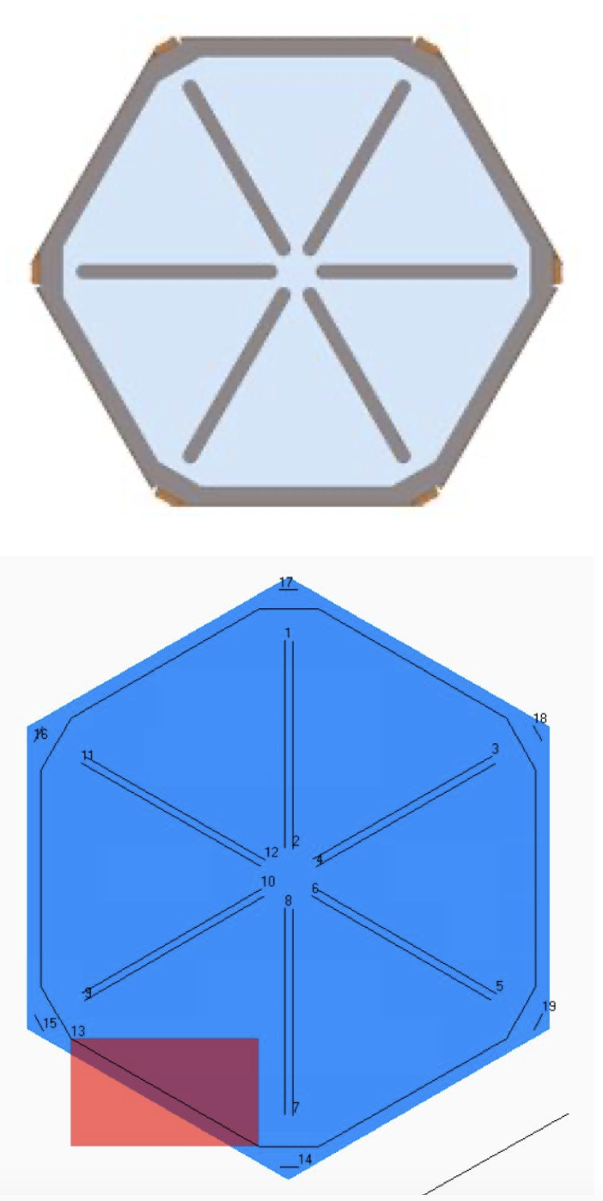
CuW Baseplate production status
KIT Kapton assembly process:
Hybrid attachment with 3M F9460PC tape (top image, blue area) and Araldite 2011 epoxy (grey).
Using PreciFluid volumetric glue dispenser and our Tracker lab’s 3-axis gantry.
Glue application pattern consists of 2 lines of glue in each cutout, dodecagon following the shape of the tape, and a line in each corner.
After lamination, put in book press overnight to cure.

Slide 24
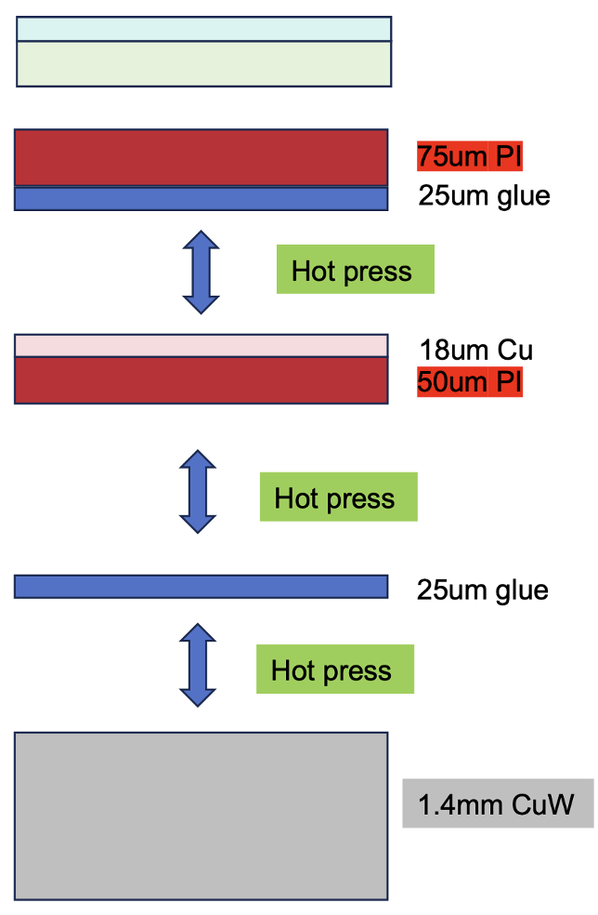
CuW Baseplate production status
IHEP Kapton assembly process :
Optional: 50 um 3M transfertape + protection paper for hybrid sensor gluing.
Coverlay: Taihong MHK3025 (100um= 75um PI + 25um glue), made of a polyimide film, one side or both sides of which is coated with a prescribed adhesive and then overlaid with polyimide film.
Bottom layer: Panasonic R-F777 (18 um Cu+50 um PI).
Pure adhesive: HaynerTaiXing Electronics HC25 (25um), epoxy adhesive, melts when heated.
Kapton and CuW are bonded together through a hot pressing process at a temperature of approximately 180℃.

Slide 25
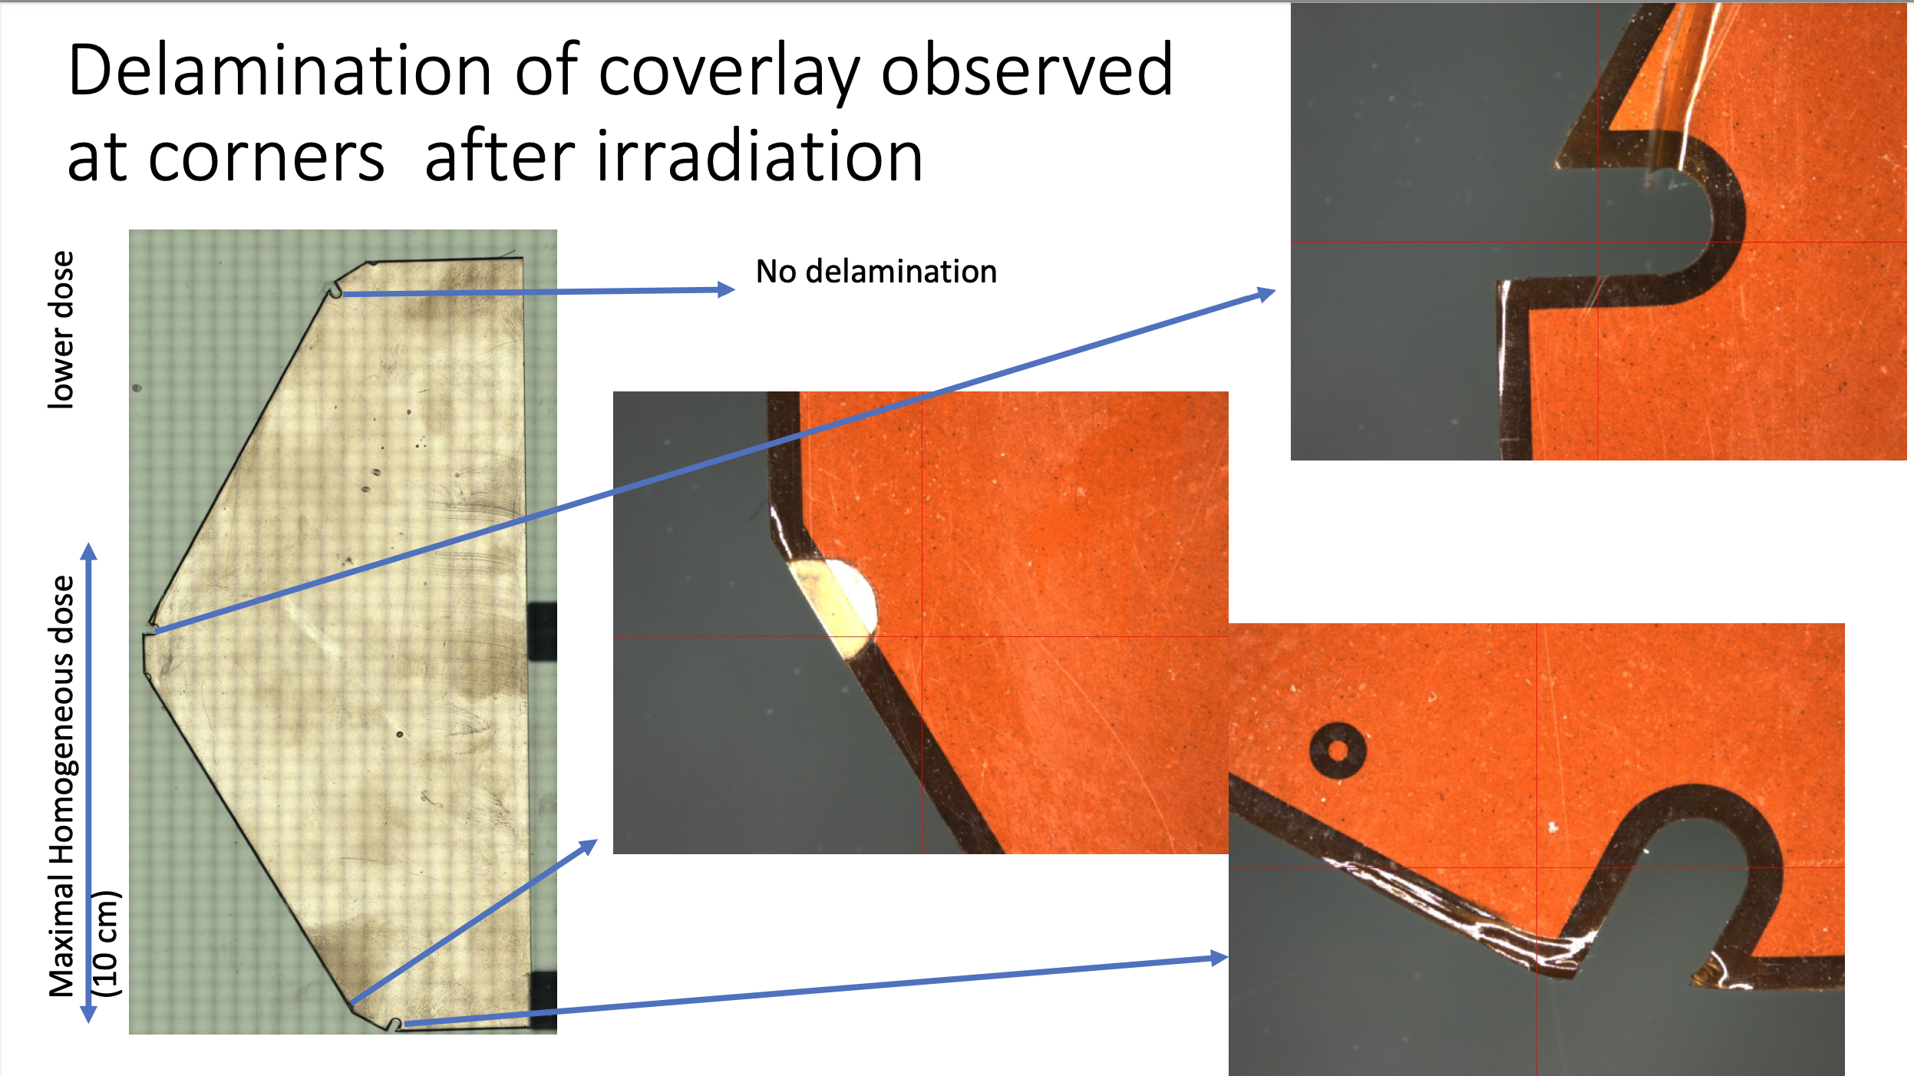
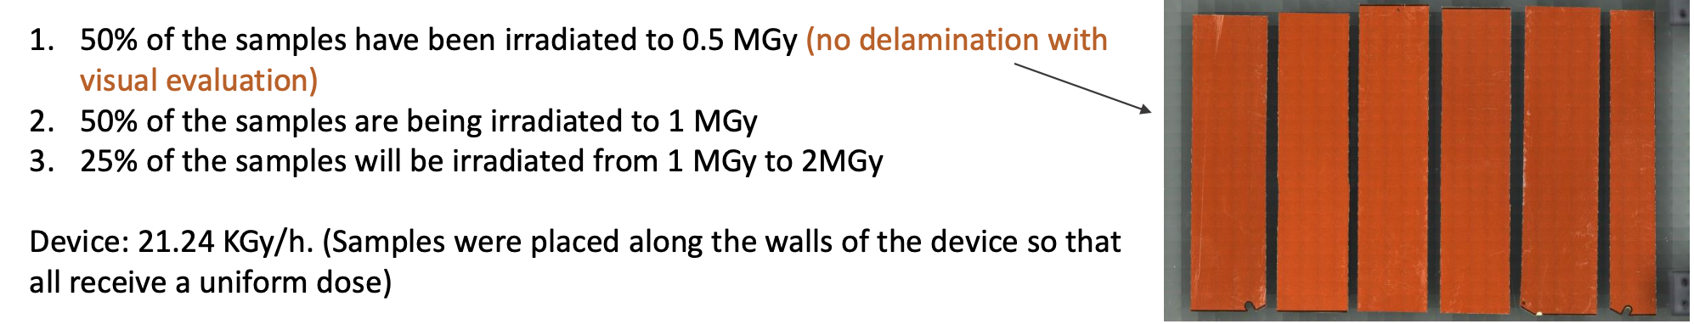
Irradiation test
Irradiation test @CIEMAT: May 2024 and Sept 2024
1st test in May. 2024:
2 MGy over 10 days and 15 h, ~ 8 kGy/h
Integrated dose is homogeneous in the bottom 10 cm of the plate, gradually decreases
Due to High humidity (80/90 %), delamination of coverlay observed
2nd test in Sept. 2024:
Humidity control: done
Irradiated to 0.5MGy,1MGy, 1~2MGy
No delamination observed
Peel test will be done @CERN

Slide 26
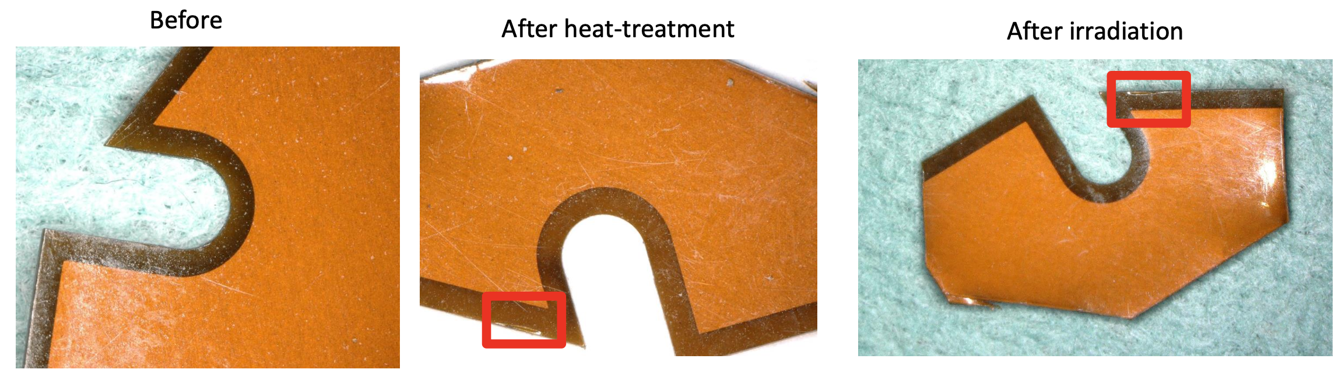
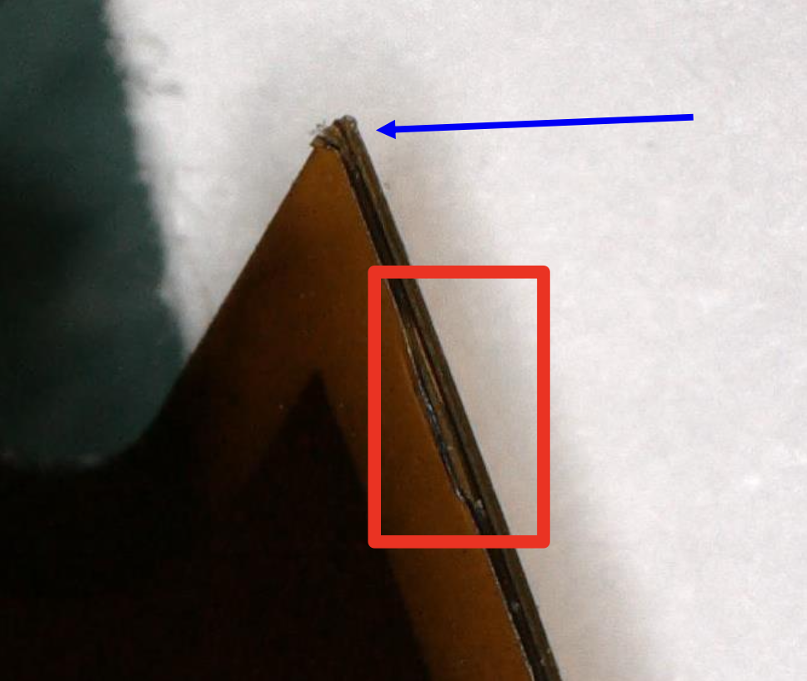
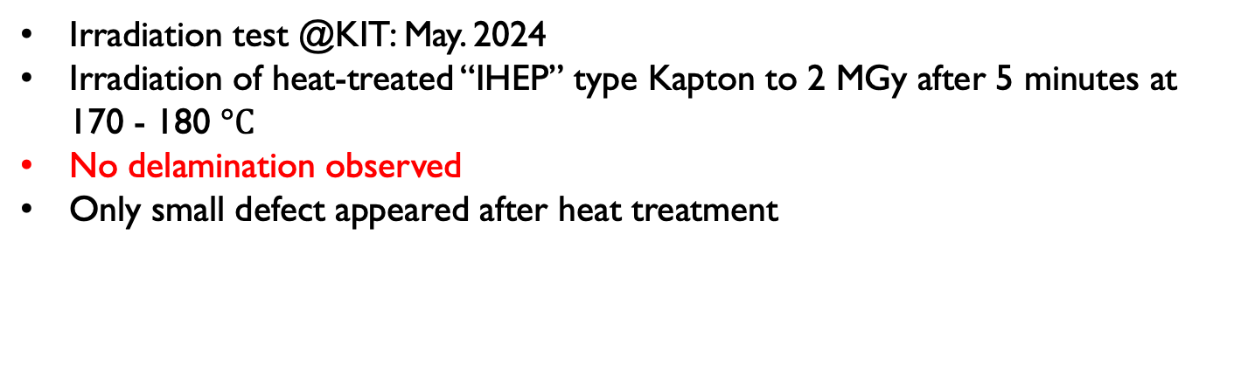
Irradiation test
Irradiation test @KIT: May. 2024
Irradiation of heat-treated “IHEP” type Kapton to 2 MGy after 5 minutes at 170 - 180 $°C$
No delamination observed
Only small defect appeared after heat treatment

Slide 27
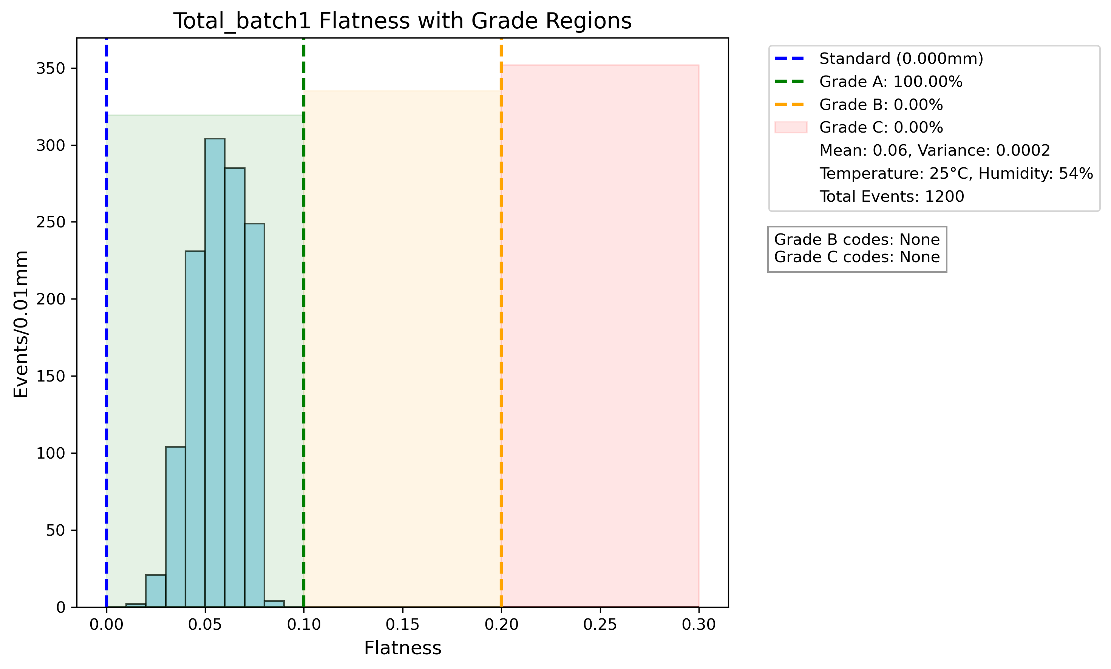
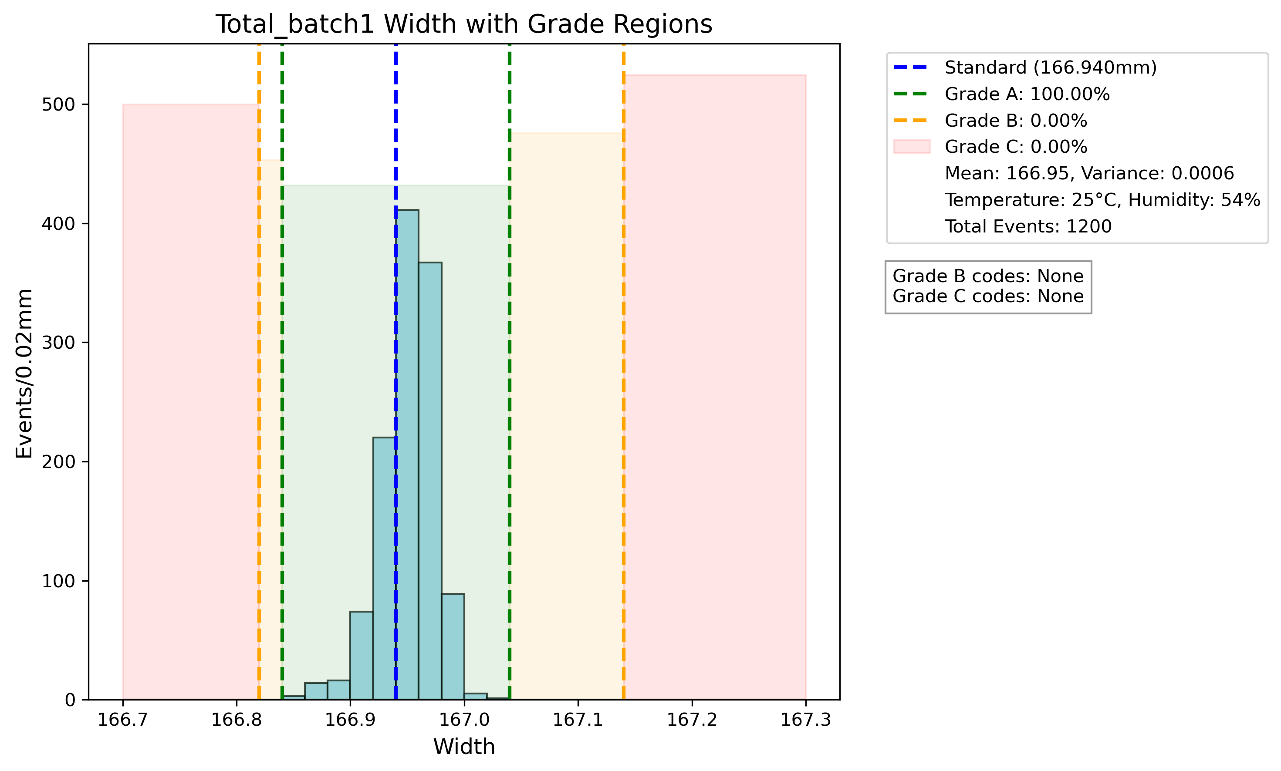
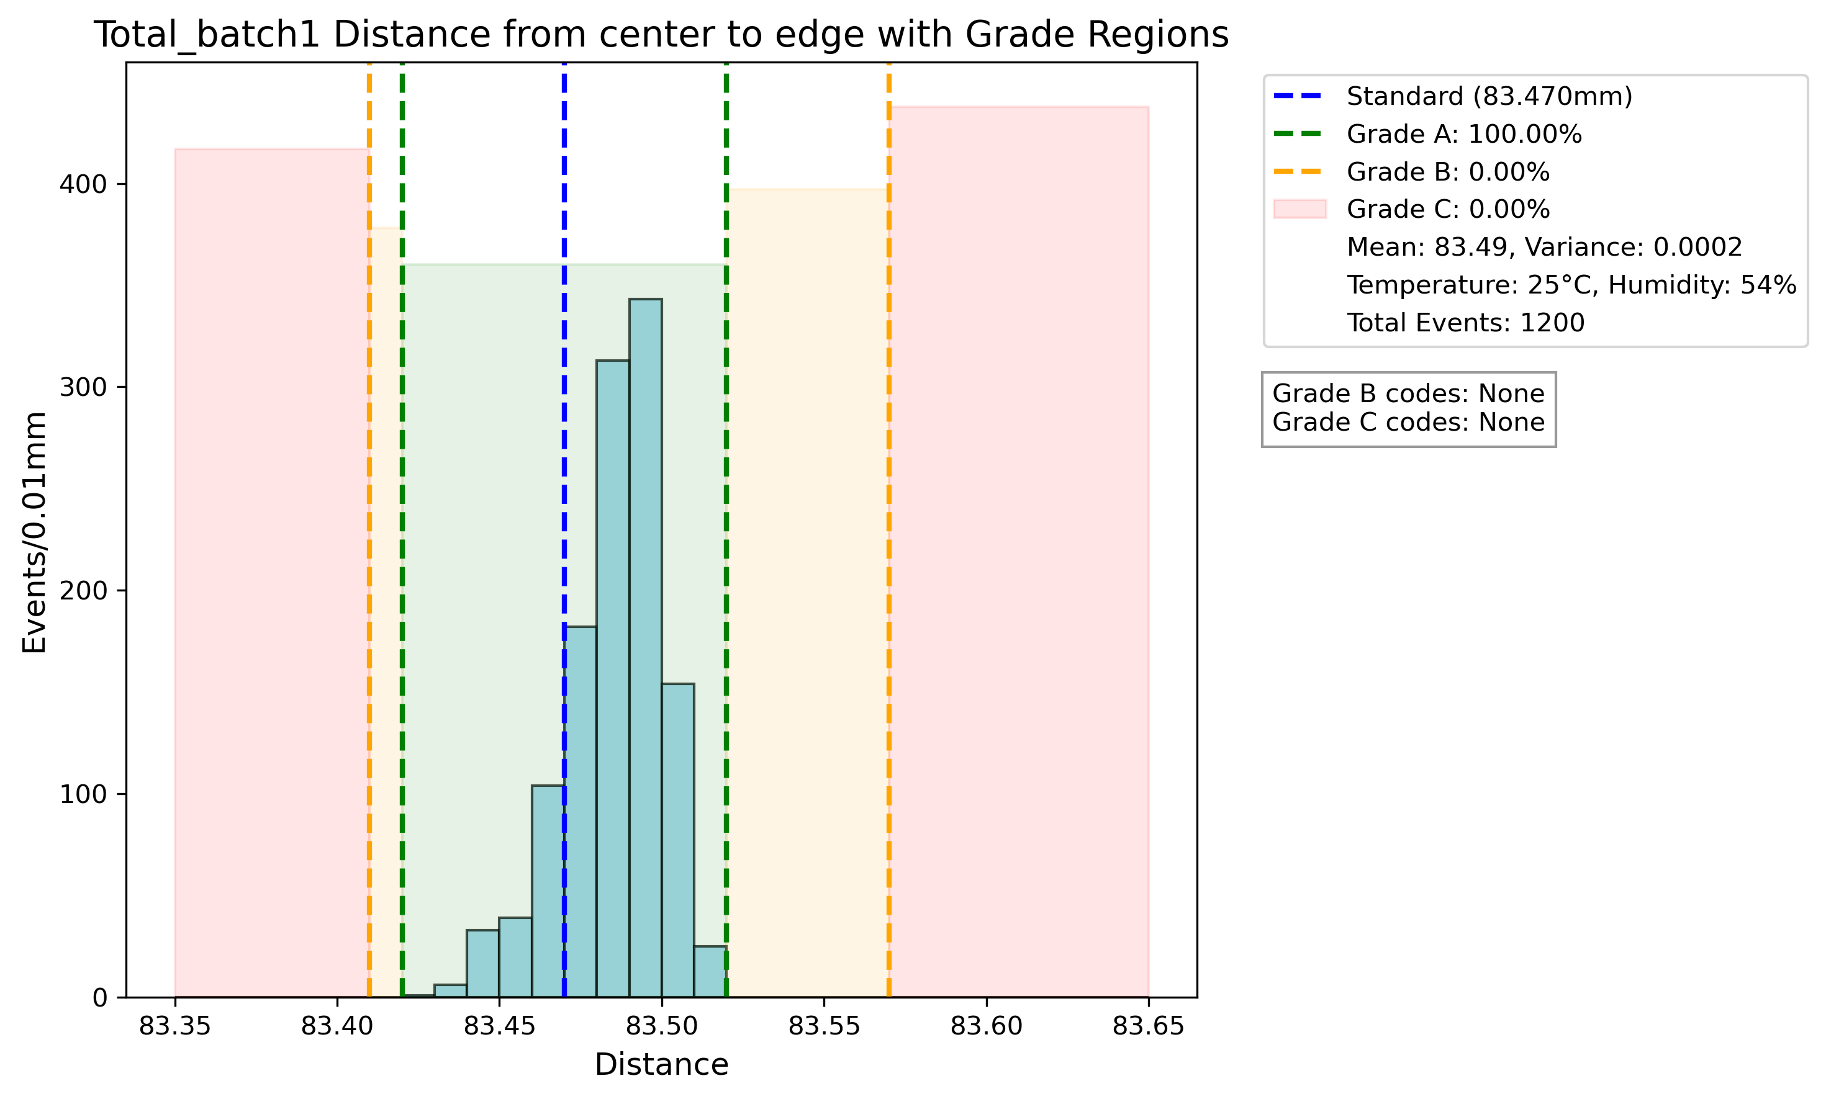

Slide 28
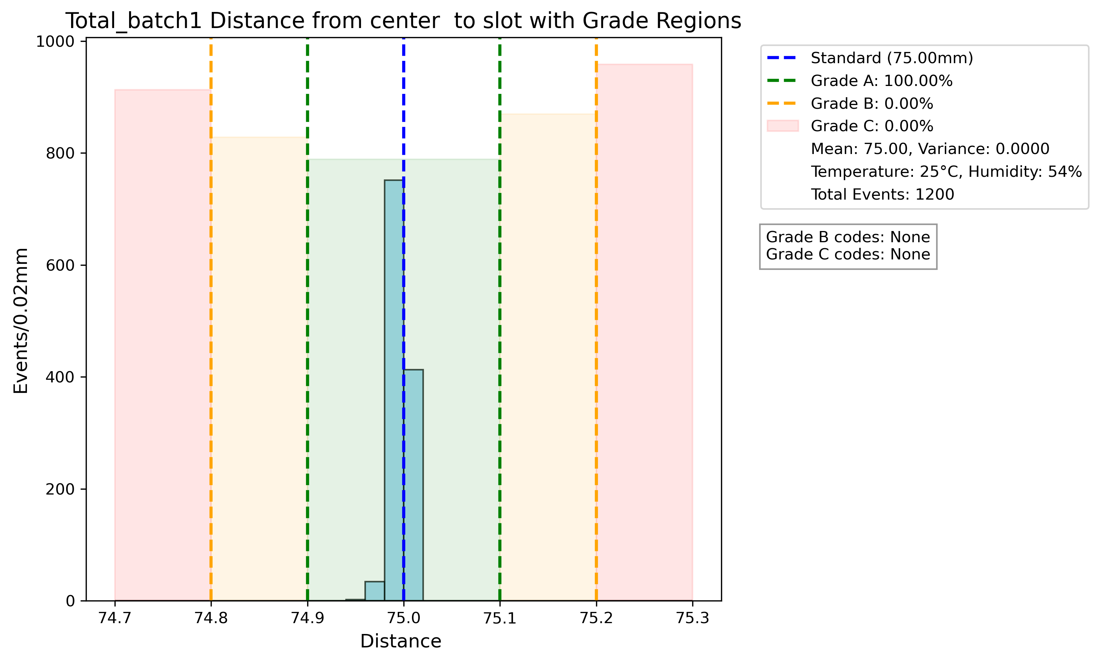
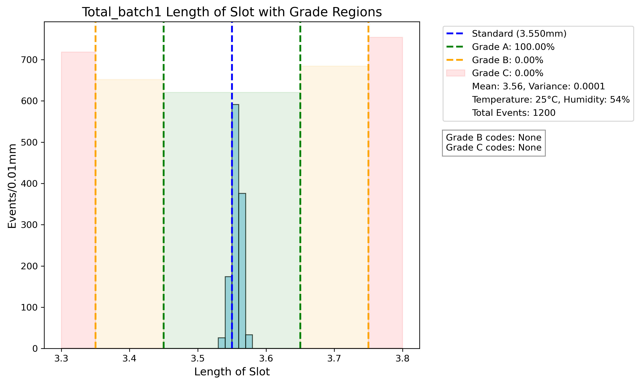
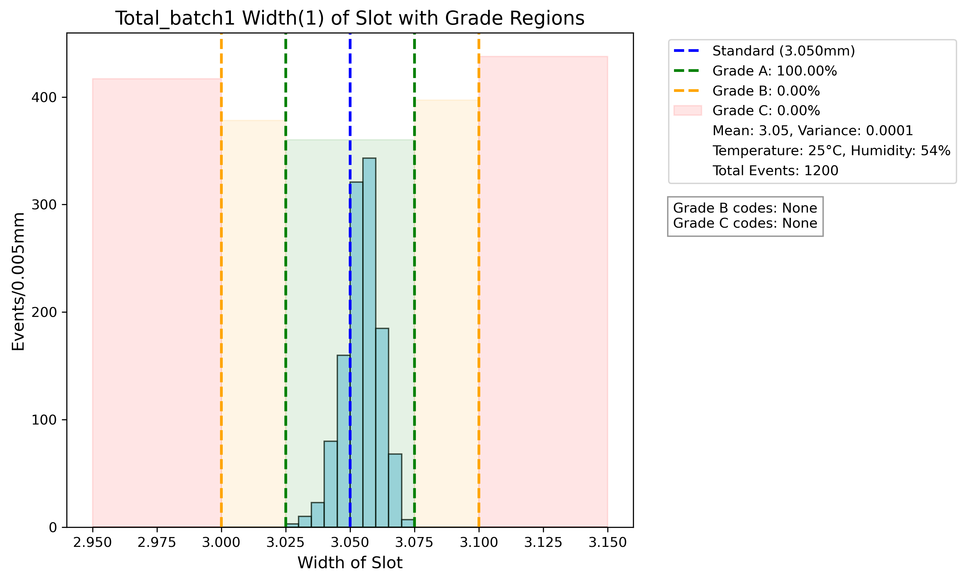

Slide 29
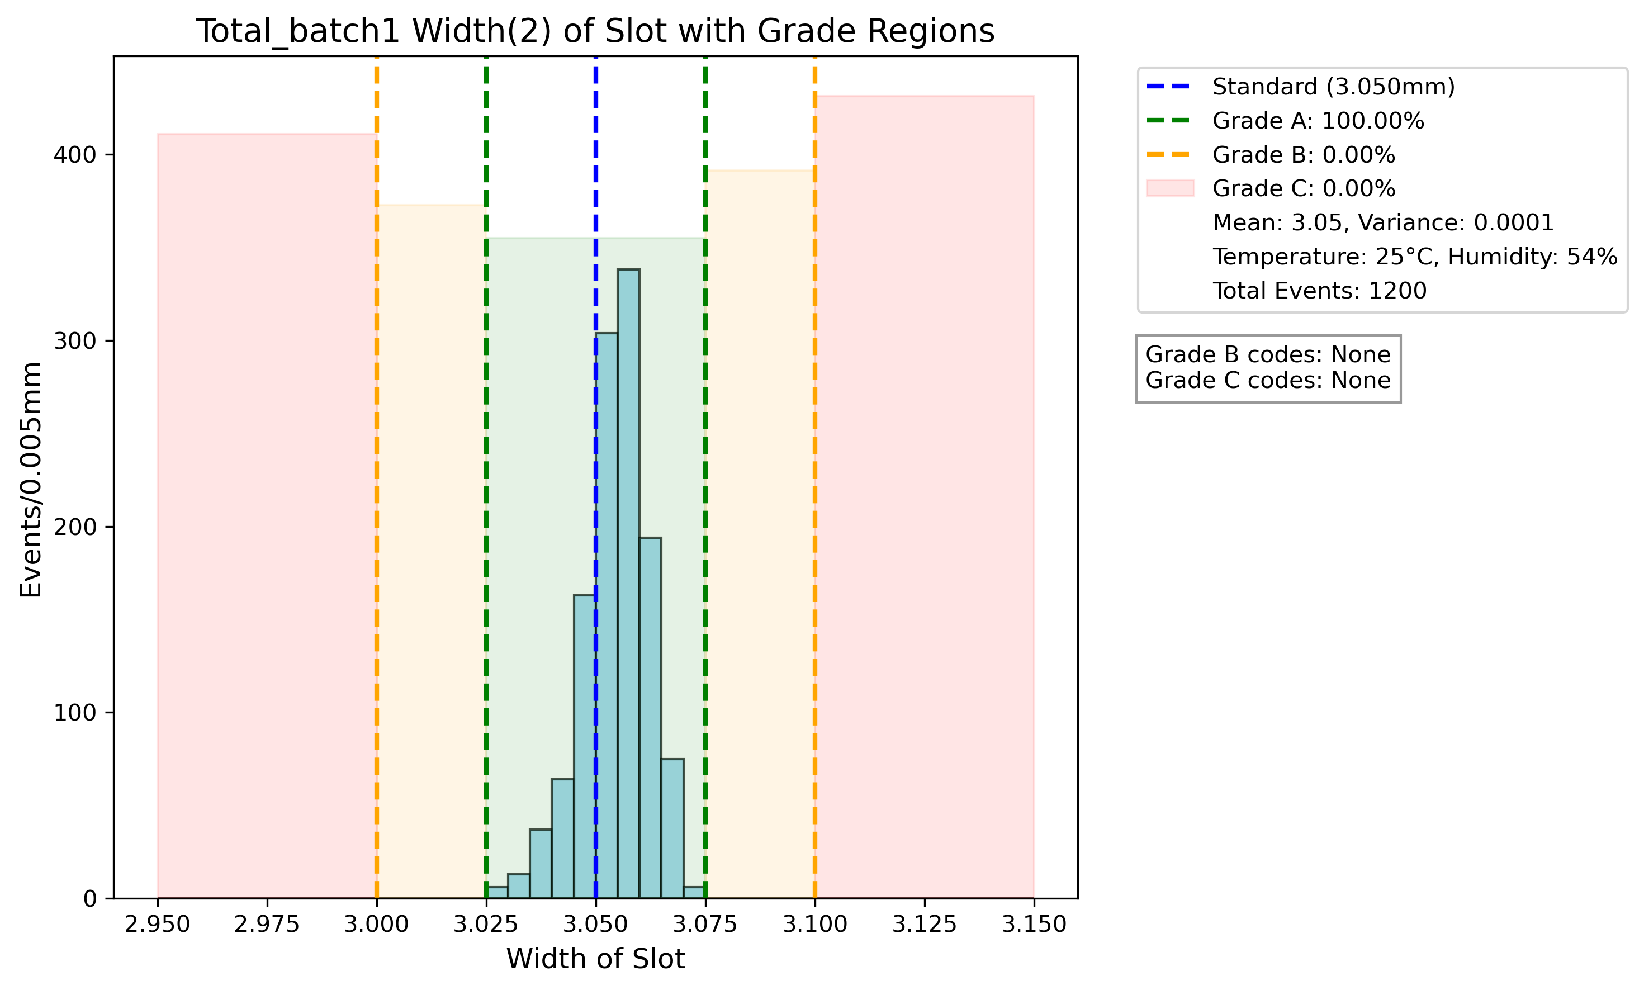
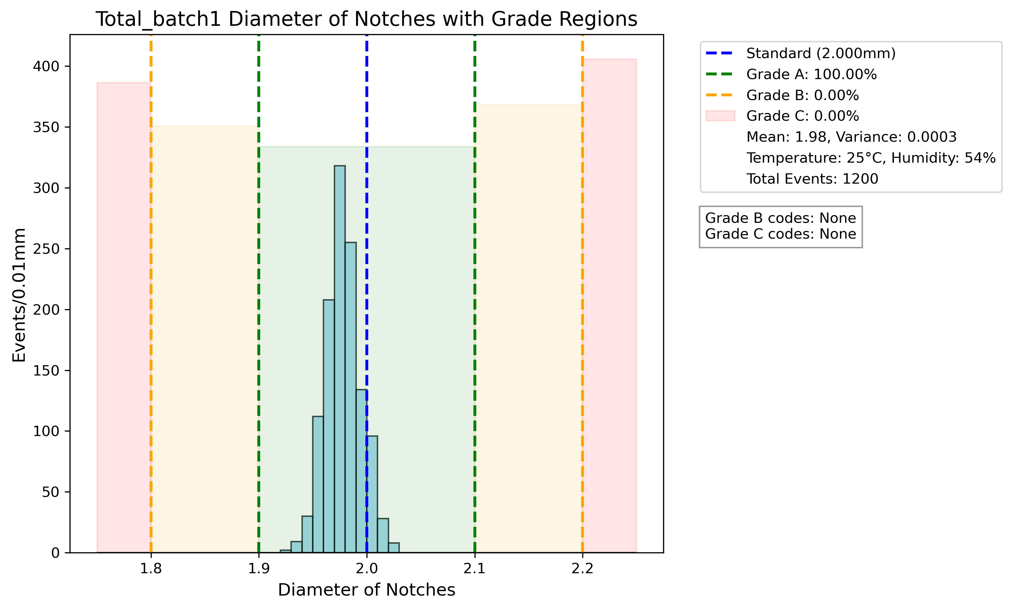
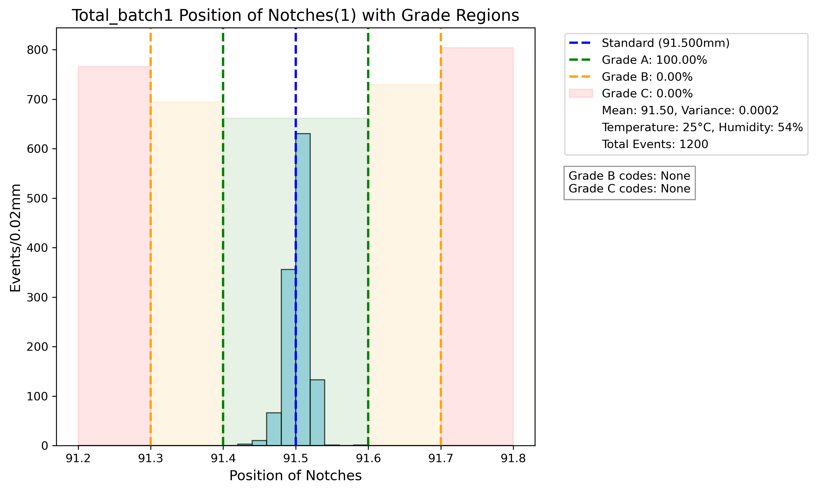
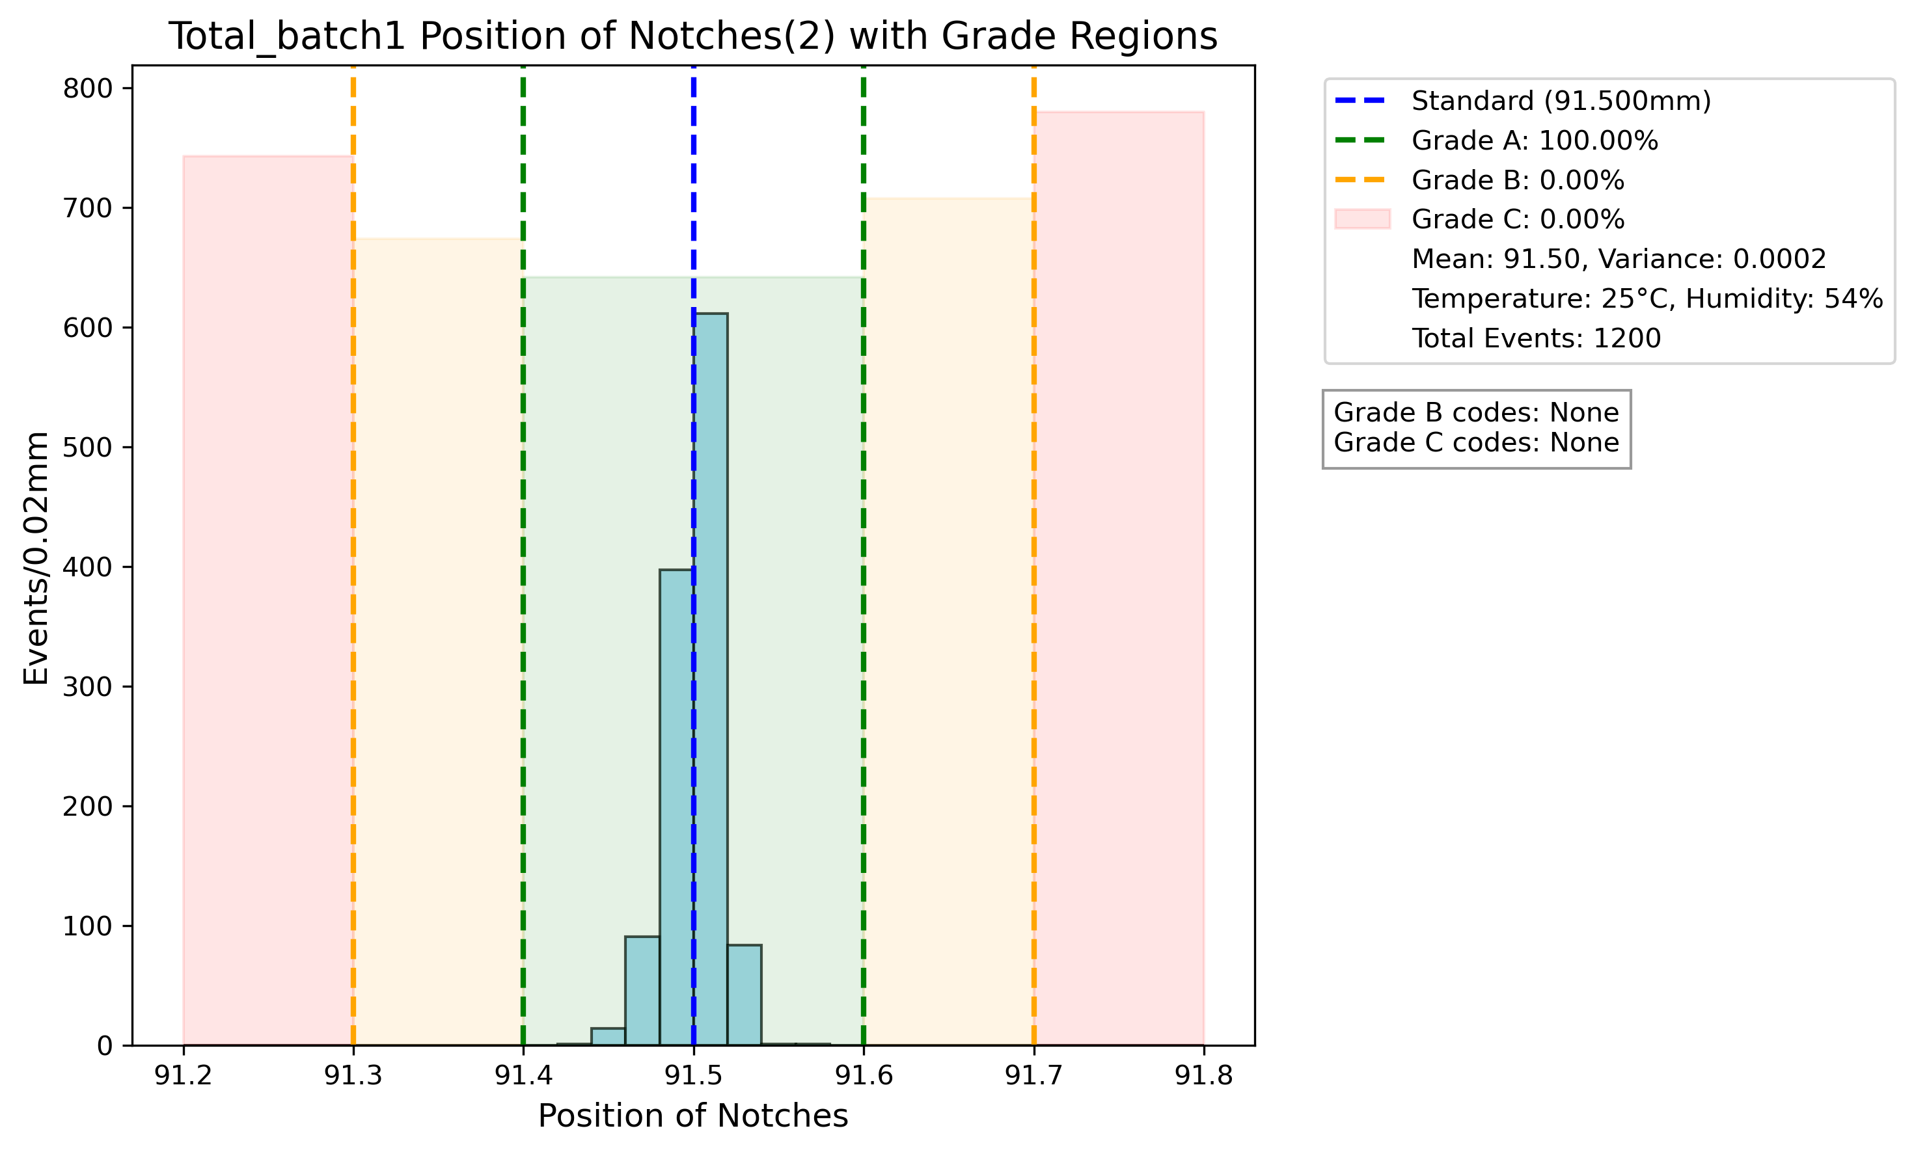

Slide 30
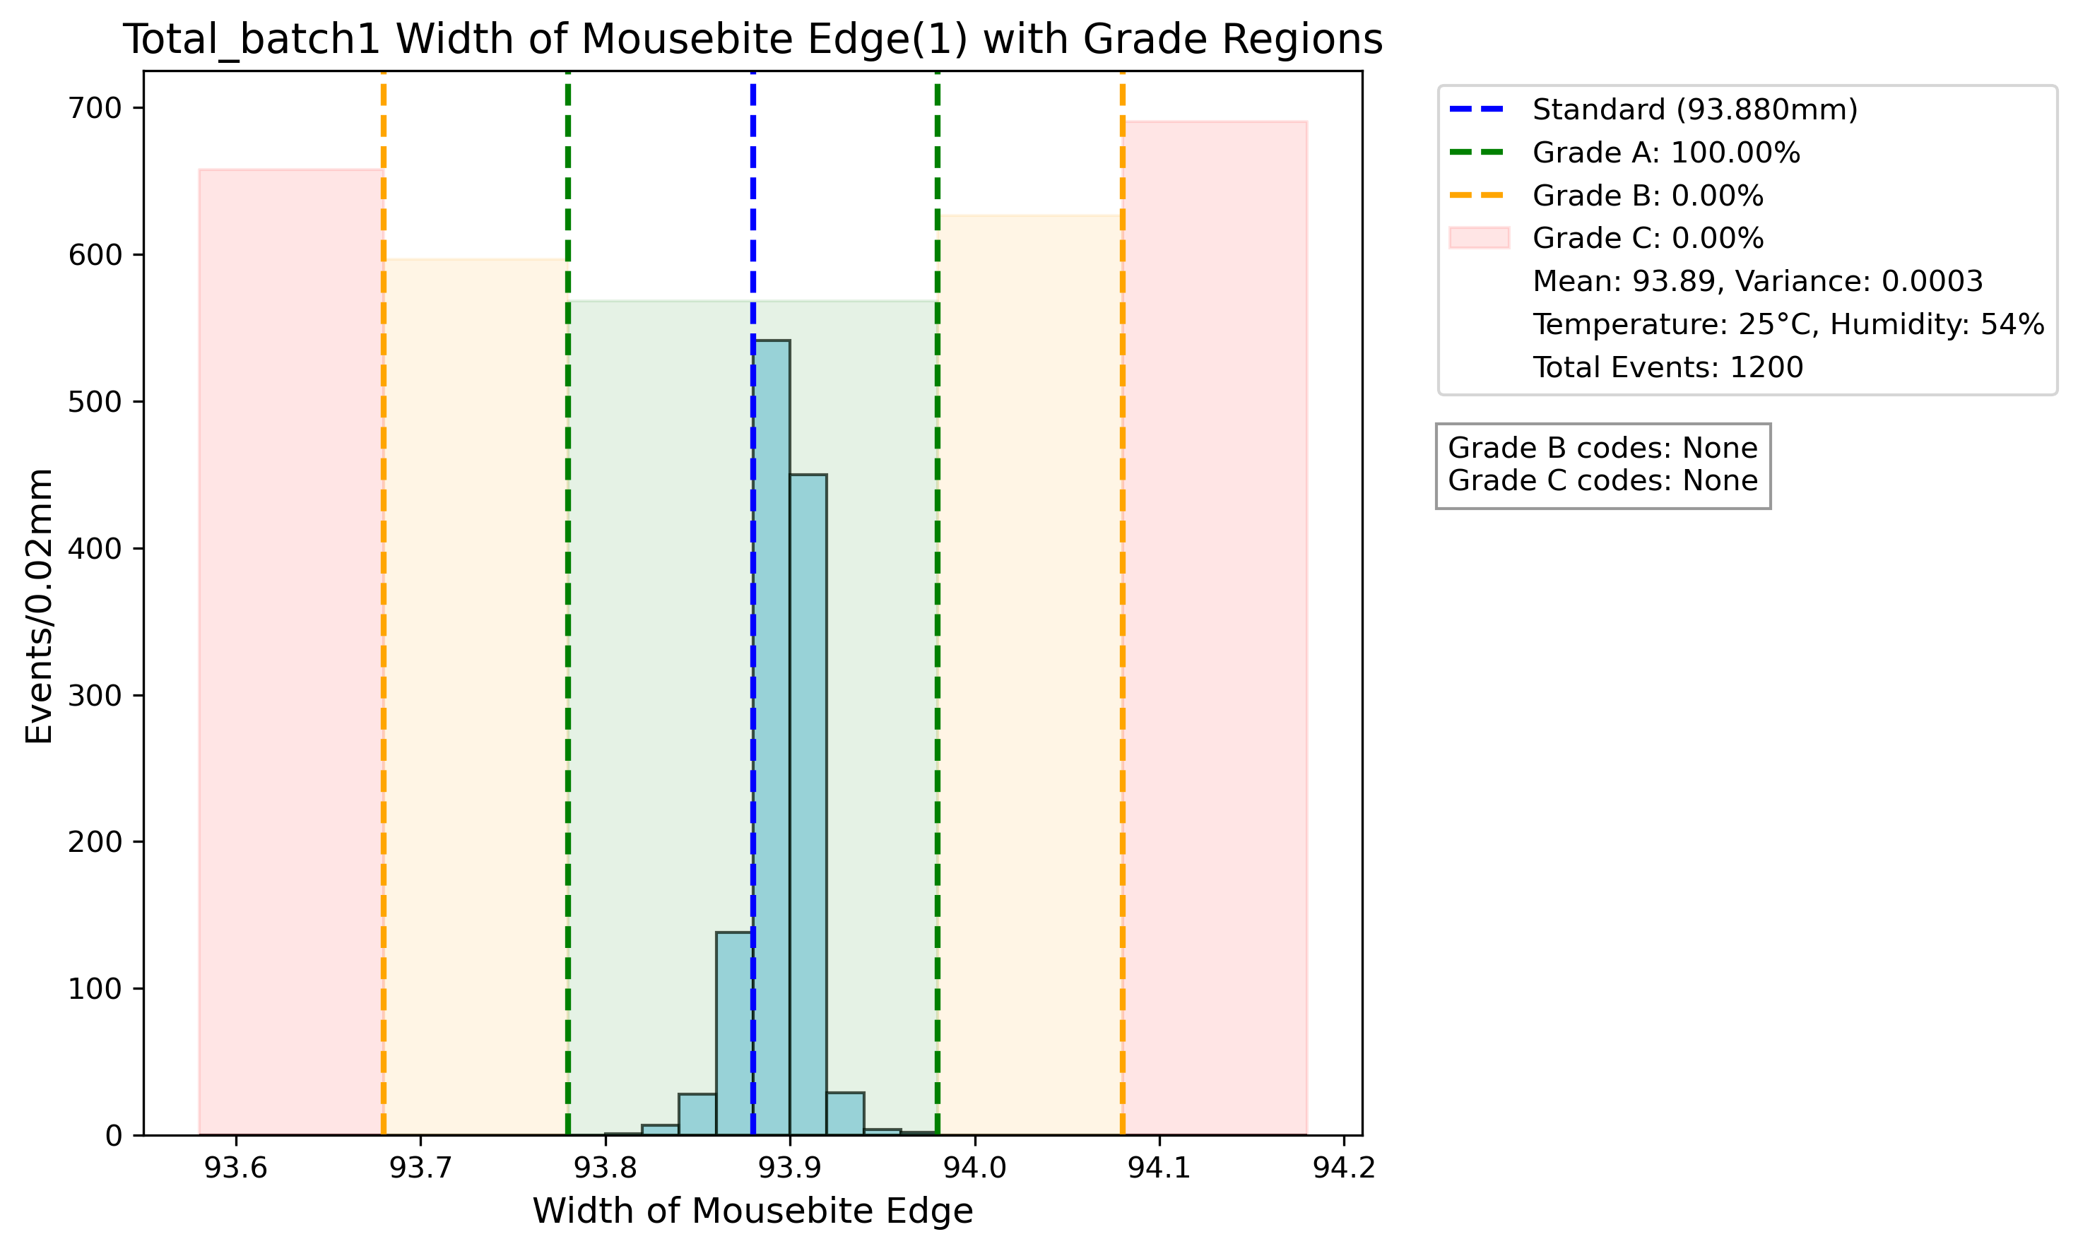
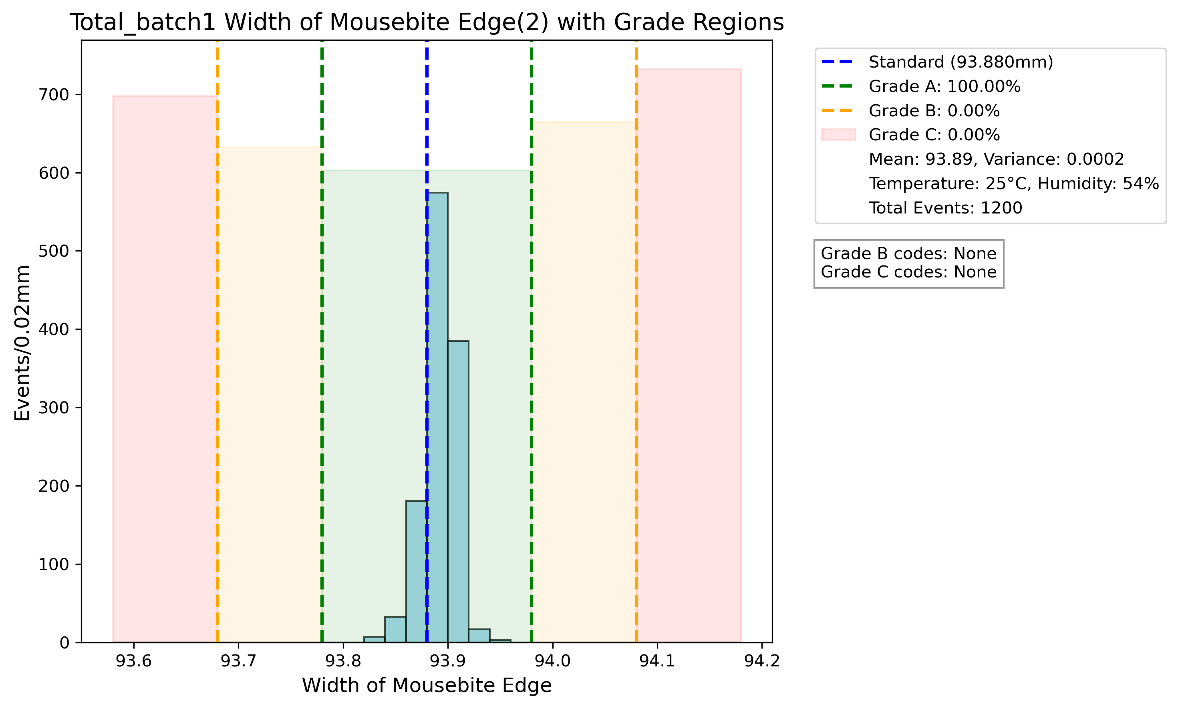

Slide 31
Summary table for IHEP measured result
Variables | Grade A | Grade B | Grade C | Possible reason
Length of Slot | 93.90% | 3.66% | 2.44% | Part of the reason is our OGP use light mainly from top side, for holes with a rough edge when manufacturing it will be hard to identify outline and cause inaccuracy
Diameter of Center Hole | 67.07% | 28.05% | 4.88%
Width of Slot | 59.76% | 29.27% | 10.98%
Flatness | 52.04% | 47.96% | 0% | Mainly due to the process to paste Kapton to CuW, which creates tension and causes flatness become worse
distance from center to edge | 83.67% | 12.24% | 4.08% | Same error caused by OGP recognition, which bring deviation to center position and influence this distance value
distance from edge to opposite edge | 100% | 0% | 0%

Slide 32
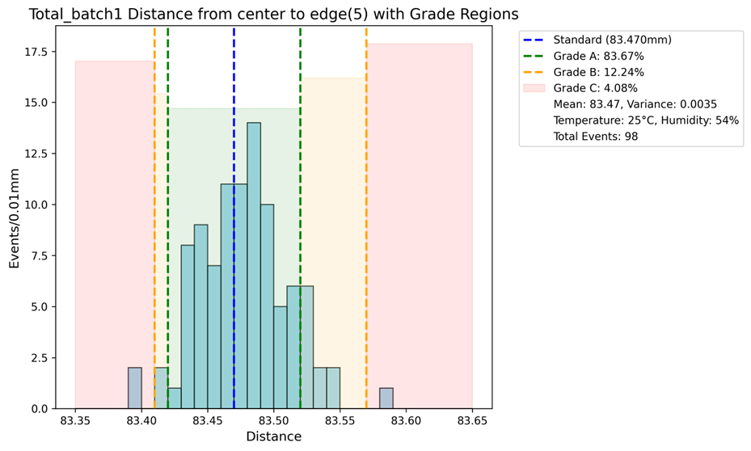
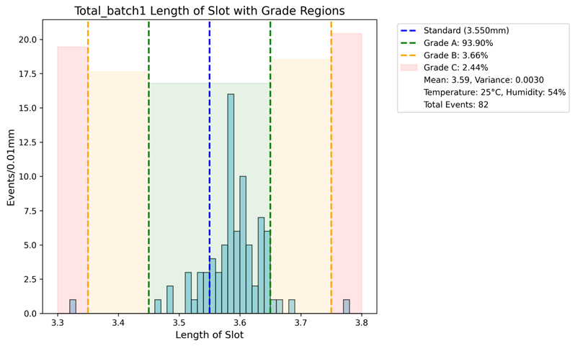



Slide 33

Production plan
Factory’s production capacity：
~4 months producing 4000 CuW baseplates
6~8 months producing 17000 CuW baseplates
Most of the CuW baseplates(~90%) will be produced using the IHEP method.

