Slide 1
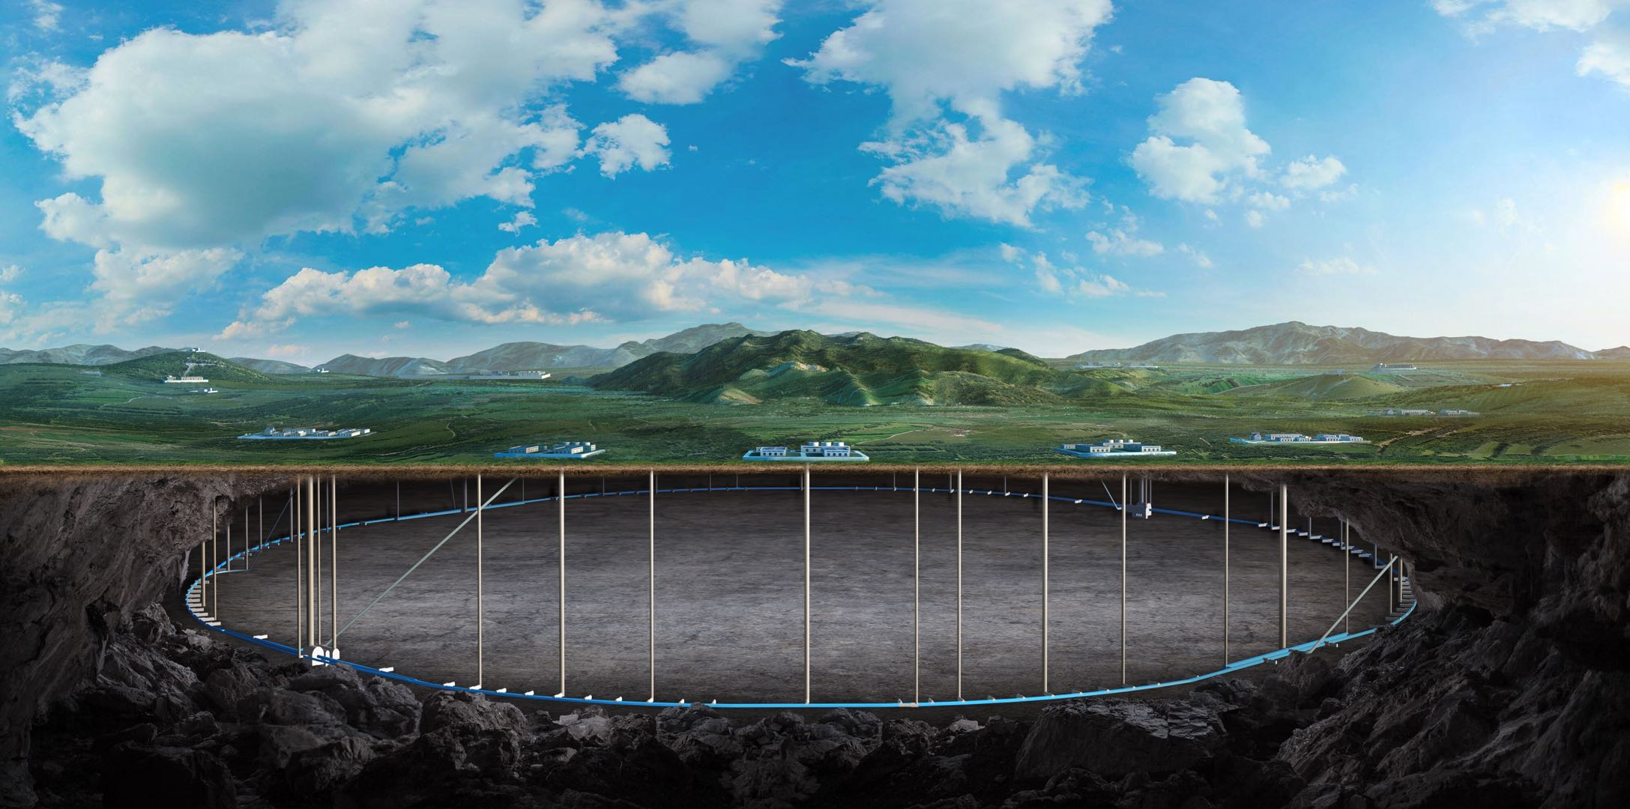

Circular Electron Positron Collider
Recent progress on CEPC Accelerator studies
段哲
On behalf of the CEPC Accelerator Study Group
Institute of High Energy Physics, CAS
Courtesy of Jie Gao, Dou Wang, Yuan Zhang, Dazhang Li, Yingshun Zhu for their help in preparing the slides.
See Jie Gao’s plenary talk “Overview of the CEPC Project” at 10:30 Nov 2nd (Sunday)
30 Oct - 02 Nov, 2025, CLHC 2025, email: zhe.duan@ihep.ac.cn

Slide 2
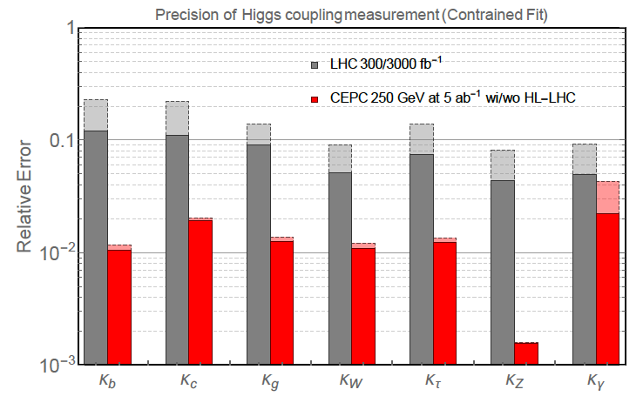
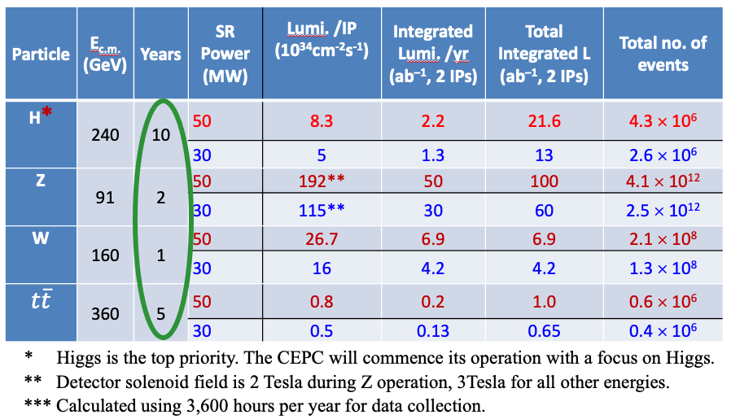
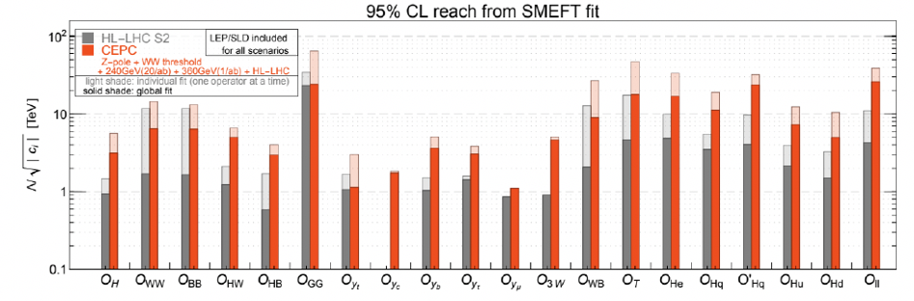
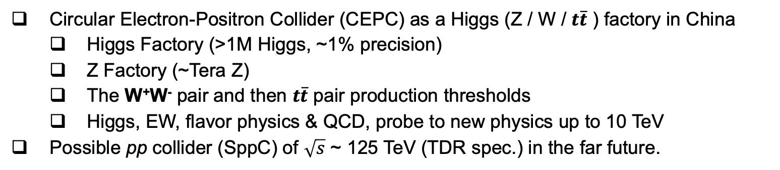
A brief introduction of CEPC
Circular Electron-Positron Collider (CEPC) as a Higgs (Z / W / $t\overline{t}$ ) factory in China
Higgs Factory (>1M Higgs, ~1% precision)
Z Factory (~Tera Z)
The W⁺W⁻ pair and then $t\overline{t}$ pair production thresholds
Higgs, EW, flavor physics & QCD, probe to new physics up to 10 TeV
Possible pp collider (SppC) of $\sqrt{s}$ ~ 125 TeV (TDR spec.) in the far future.
CEPC Operation Plan and Goals
Anticipated accuracy on Higgs properties at CEPC versus at LHC/HL-LHC
Covered energy scales of NP

Slide 3
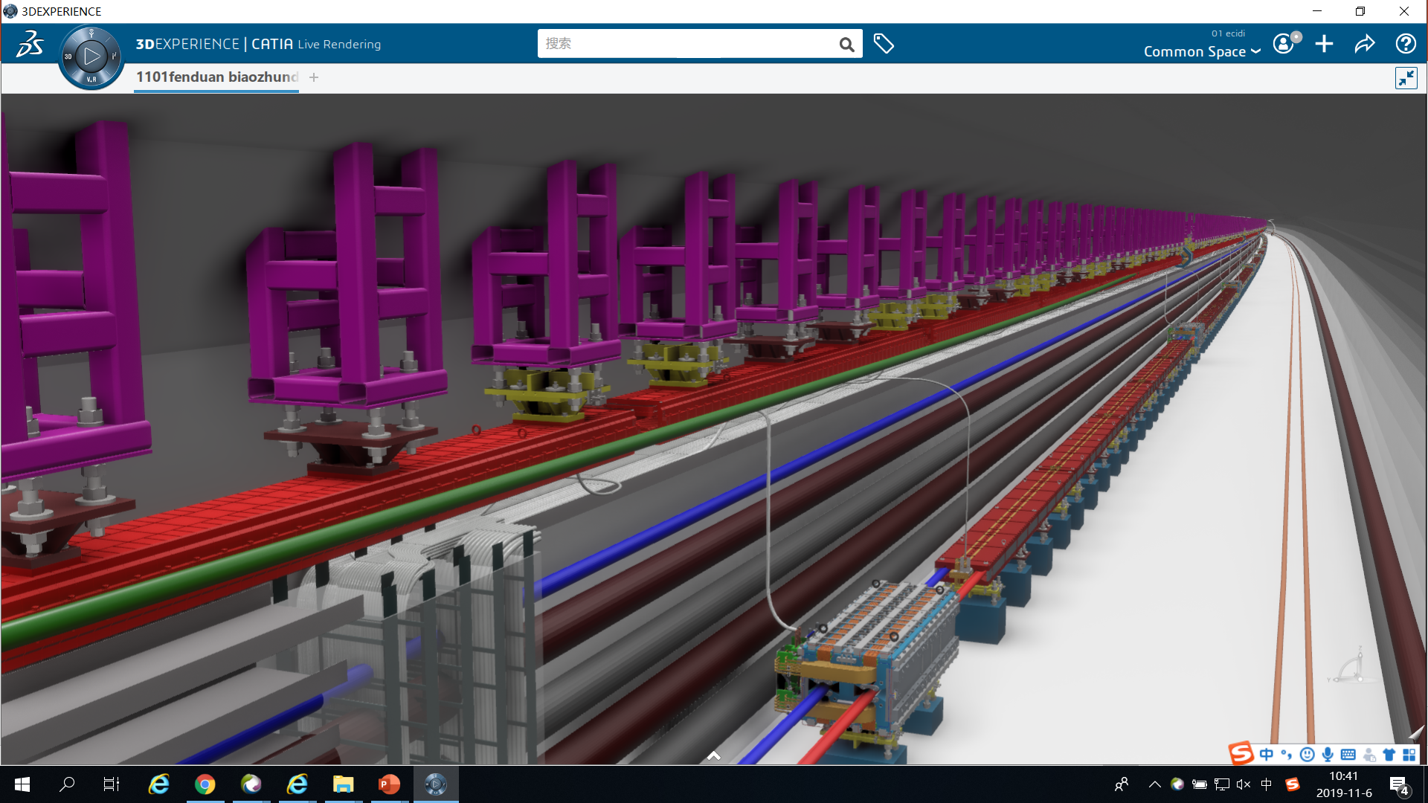
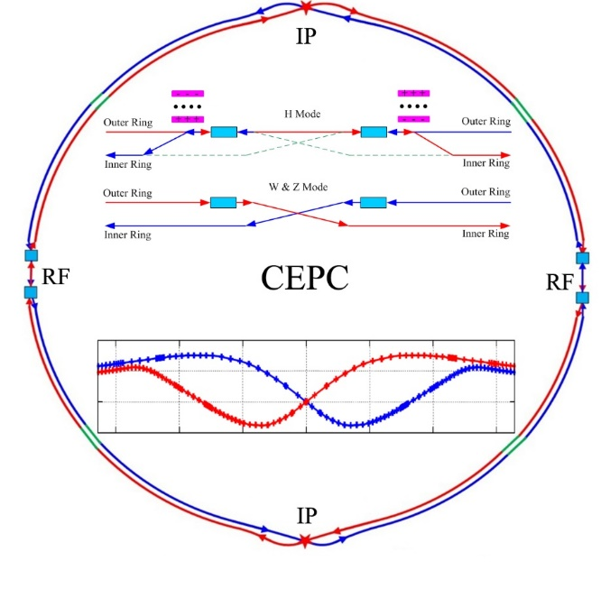
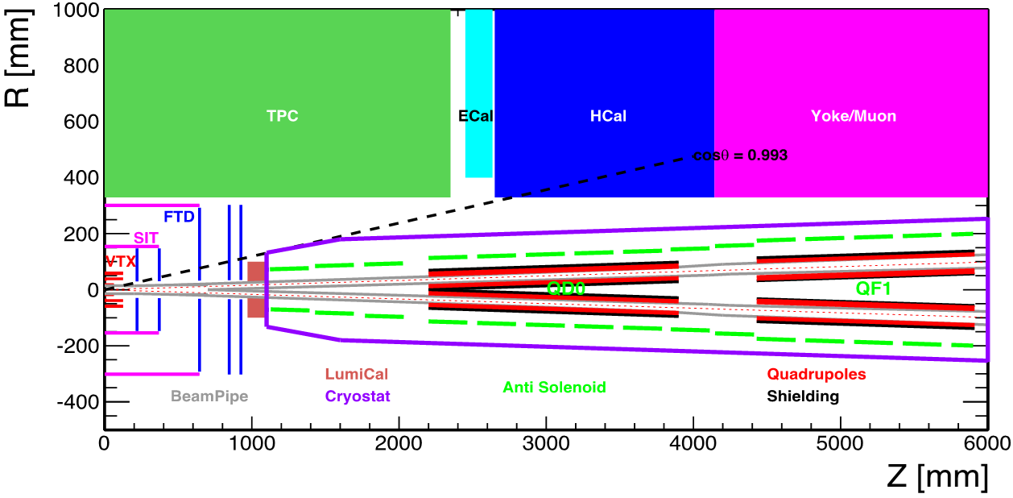
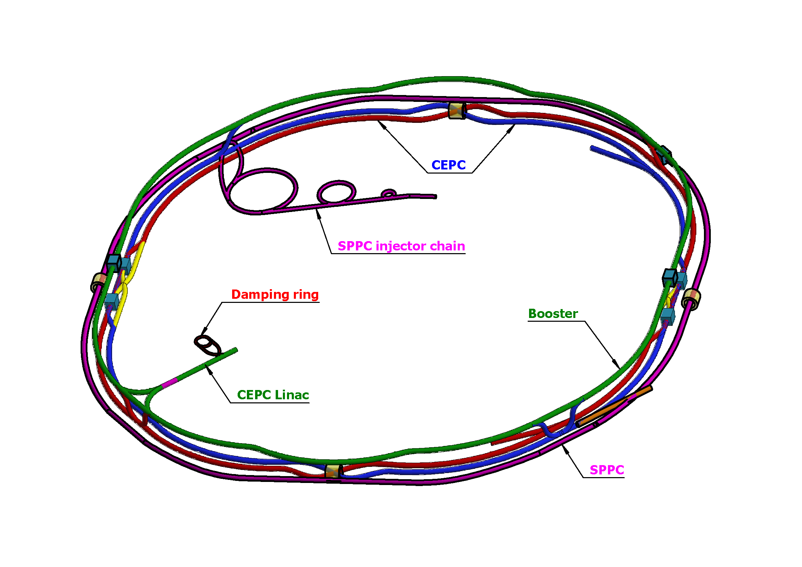
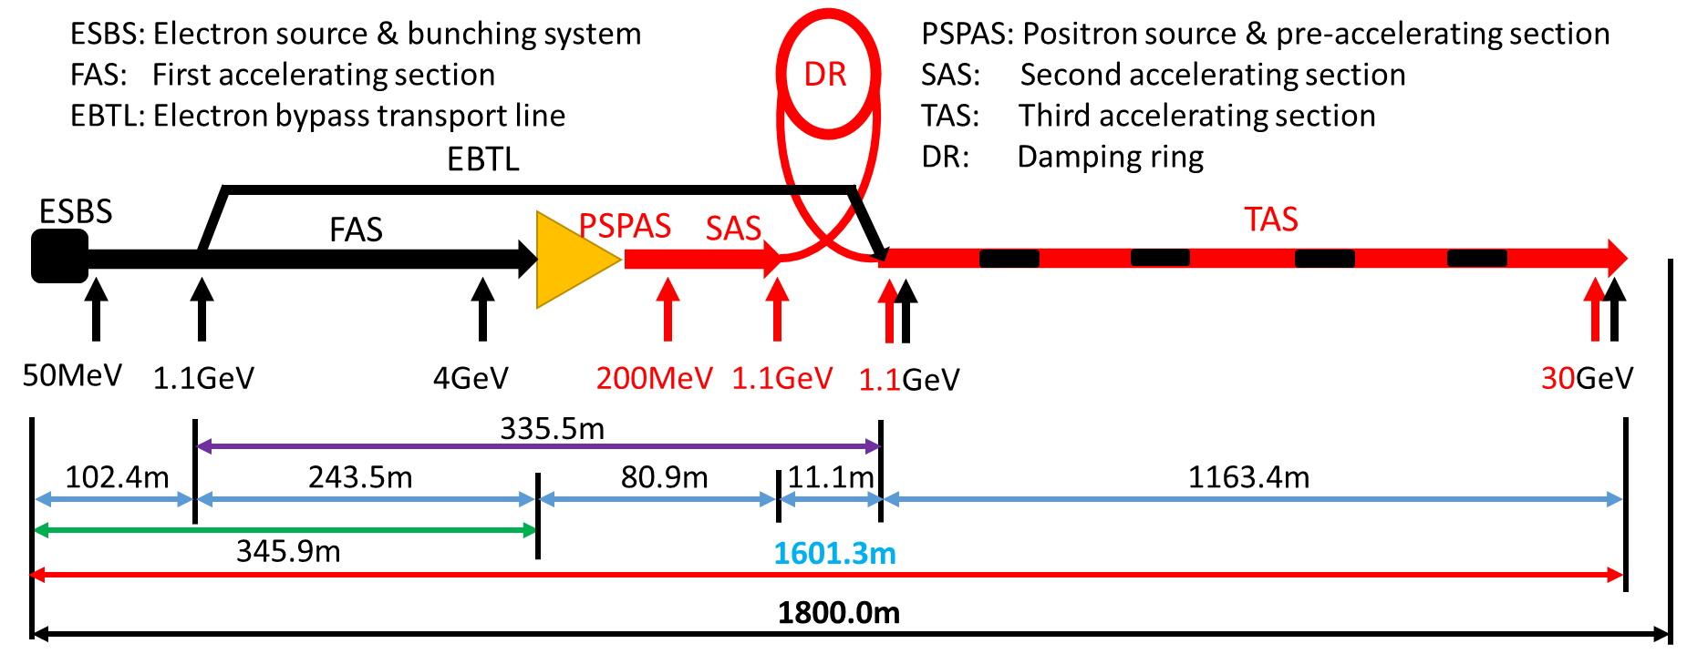
Accelerator Considerations in TDR
Circular collider: Higher luminosity than a linear collider
100km circumference: Optimal total cost
Shared tunnel: Compatible design for CEPC and SppC
Seamless switchable operation: Higgs/W/Z/(ttbar)
Accelerator complex comprised of a 30 GeV Linac, a 100 km booster and a double-ring e+/e- collider with two IPs
High energy & high flux synchrotron light source provides γ-ray up to 300 MeV, critical for multi-disciplinary sciences
Common tunnel for booster/collider & SppC
H/tt-bar
W and Z
Machine Detector Interface
CEPC Collider Ring
Accelerator Complex
Seamless mode switch for Higgs/Z/W/(ttbar)
Baseline: 100 km, 30 MW; Upgradable to 50 MW, High Lumi Z, ttbar
S+C-band 30 GeV linac
3

Slide 4


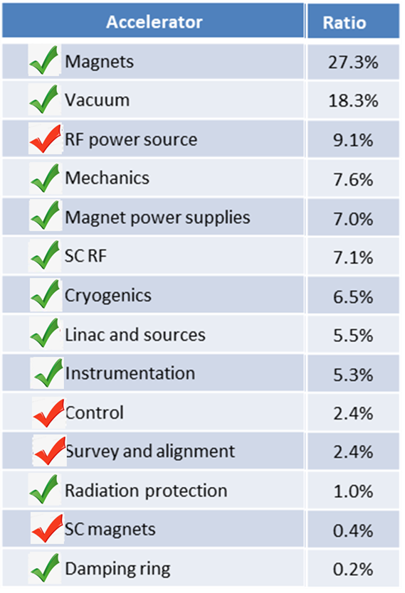
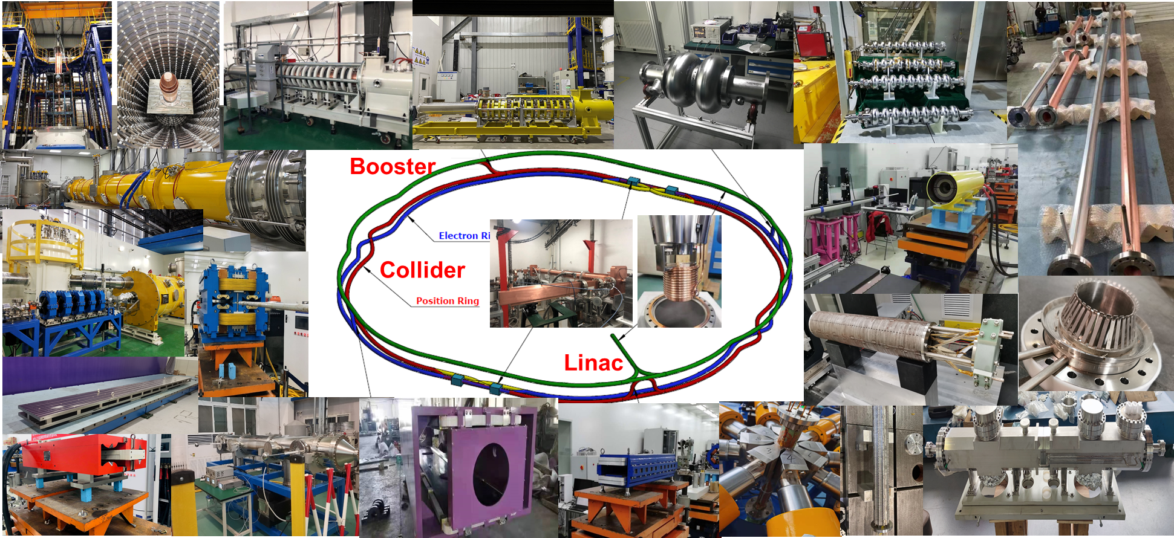
Hardware R&D progress in the TDR
Specification Met
Prototype Manufactured
Fraction
representative Key Technologies for the CEPC
Key technology R&D spans all component lists in CEPC TDR
4

Slide 5
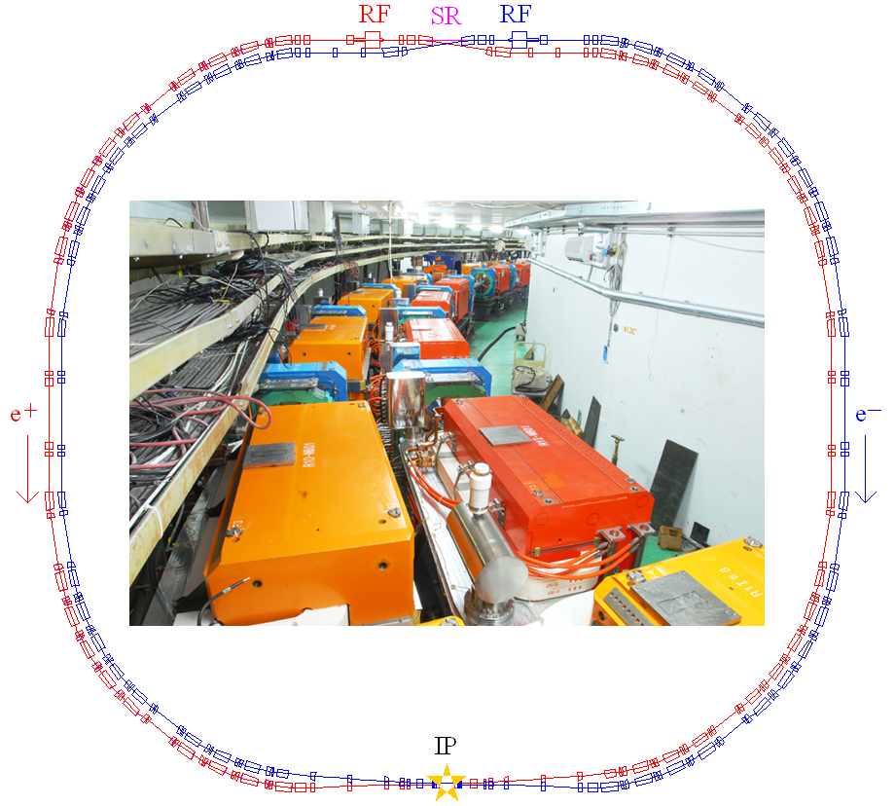
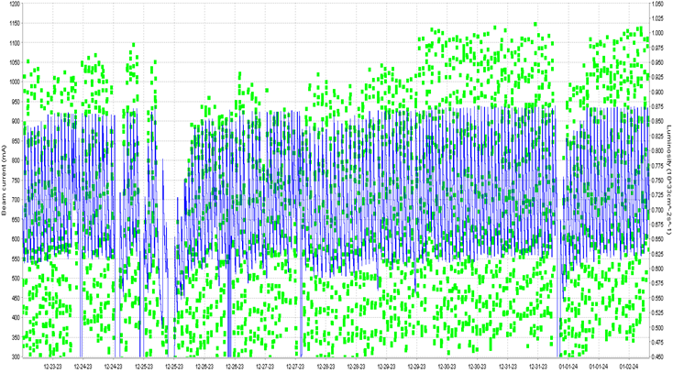
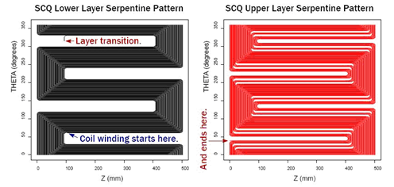
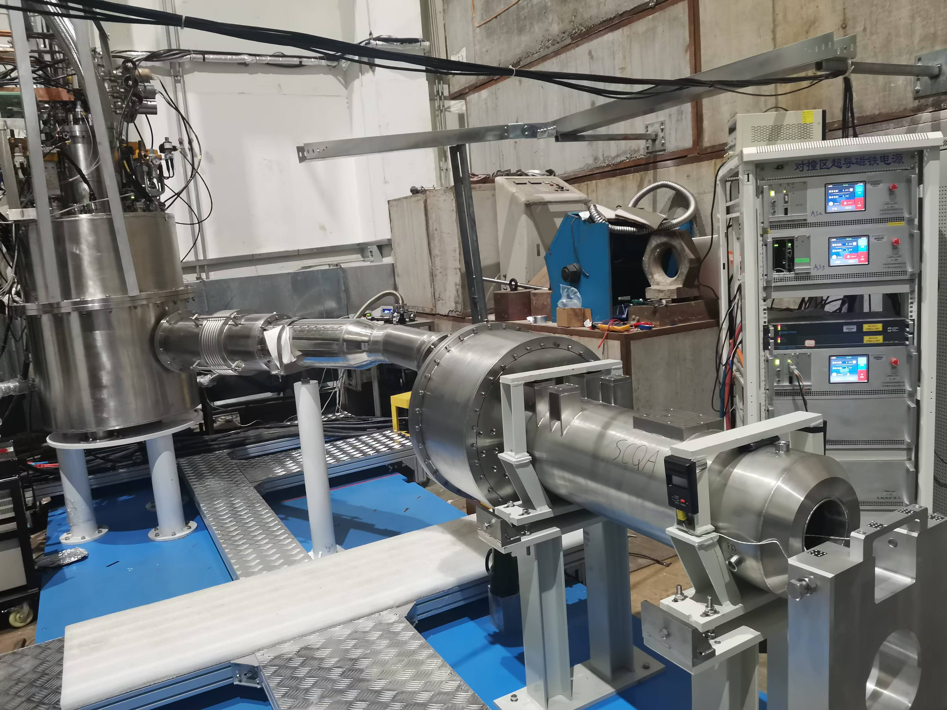
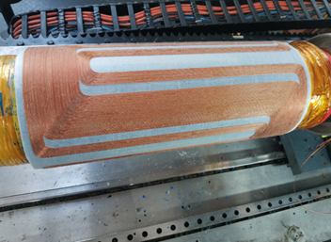
Key technologies demonstrated in BEPCII
BEPCII has achieved a peak luminosity > 1.0×10³³cm⁻²s⁻¹ & stable operation of ~1A beam current in 2023, mastering key technologies of high intensity, high luminosity e+e- collider
BEPCII has been upgraded in 2024-2025, to achieve 3X increase of luminosity at 2.35 GeV, and energy reach up to 2.8 GeV
Home-developed superconducting final focus quadrupoles in routine operation
1.0×10³³cm⁻²s⁻¹
BEPC Il luminosity design goal attained routinely in 2023
Home-developed Superducting quadrupole with serpentine coils

Slide 6
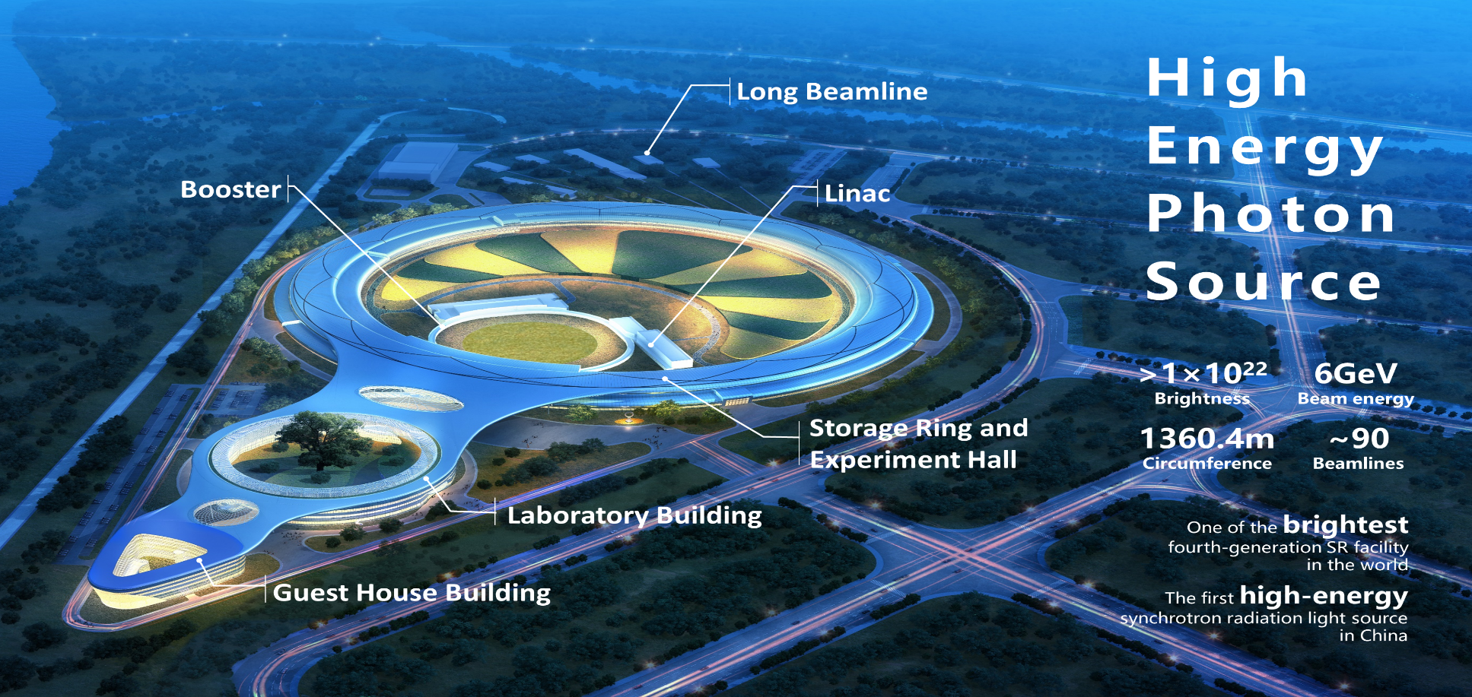
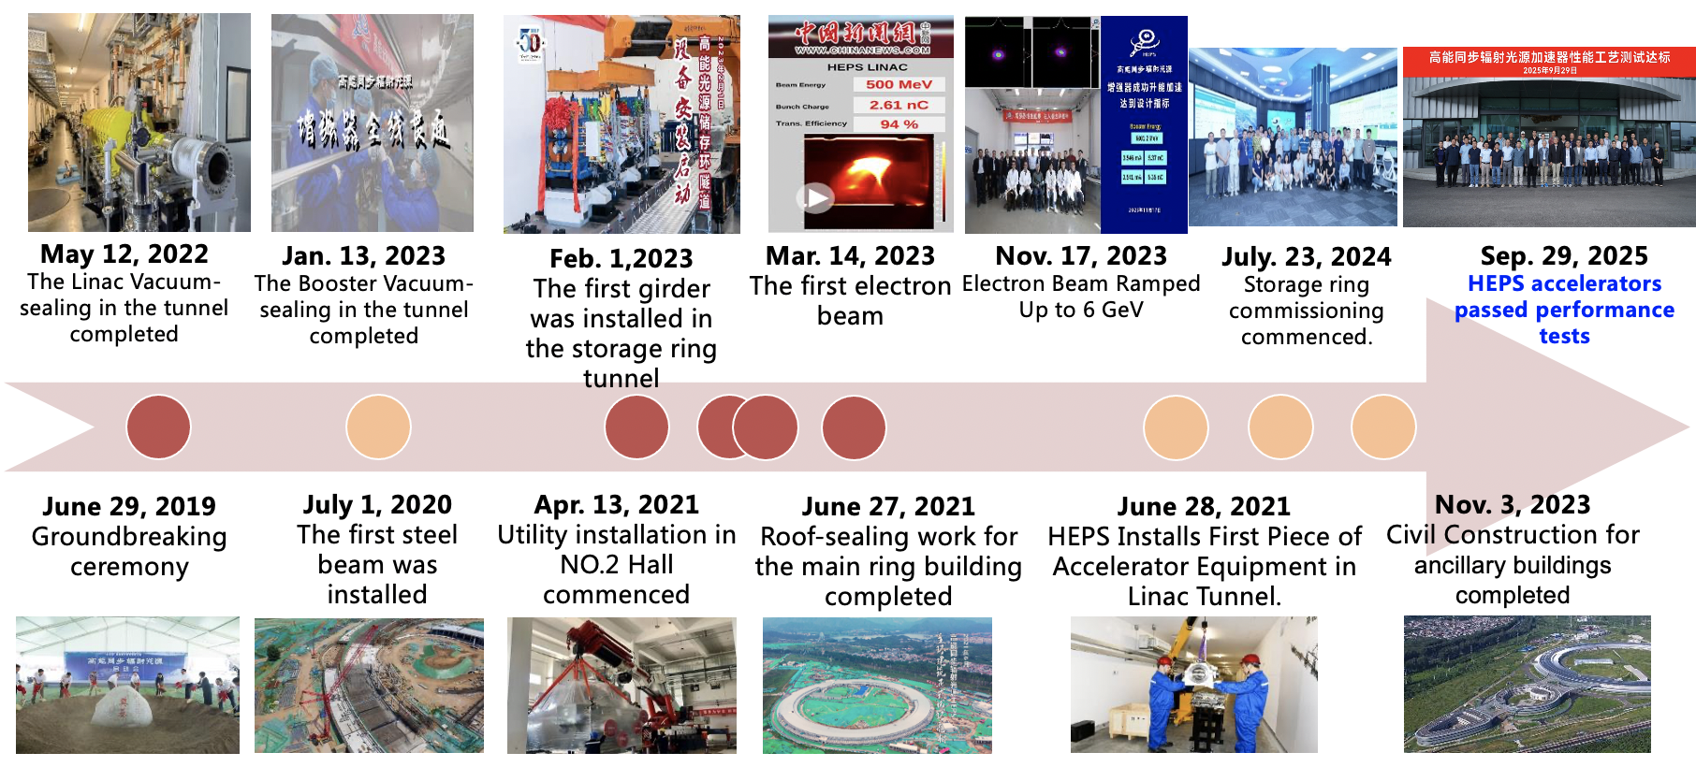
Successful commissioning of High Energy Photon Source
Passed the performance acceptance organized by CAS yesterday, with high peer appraisal https://mp.weixin.qq.com/template/article/1761783531/index.html
Relevance to CEPC
Demonstration of many shared key technologies
A team trained with rich experiences in design, construction and commissioning of state of the art accelerator facility

Slide 7
CEPC Accelerator EDR
Accelerator physics study
Design
Refinery of accelerator design & key parameters with engineering considerations
Beam loss mechanism and management
MDI
Research
Simulation code development: APES
Combined influence of various effects: beam-beam, impedance, SR, ion effects, space-charge, nonlinearity, polarization
Beam commissioning and luminosity tuning procedures
Collaborative studies on SuperKEKB
injection, beam-beam, instability etc
Key technology R&D
More prototypes
SRF
Klystron
More detailed design and planning
MDI
Control and Timing
Alignment and Installation Plan
Tunnel Mockup for installation
Mass production preparation
Magnets’ Automatic Production Lines
Massive Production Line of NEG Coating Vacuum Chamber
Experimental studies for advanced accelerator physics topics
Plasma wakefield accelerator test facility @ BEPCII
Polarized beam

Slide 8
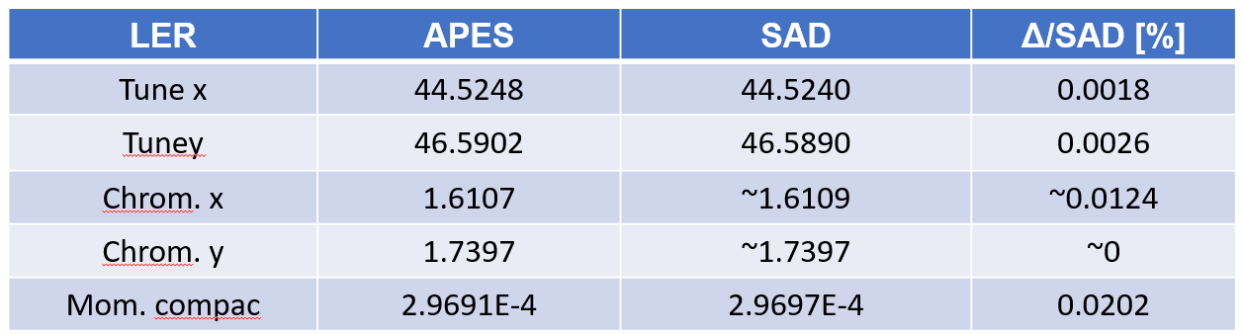
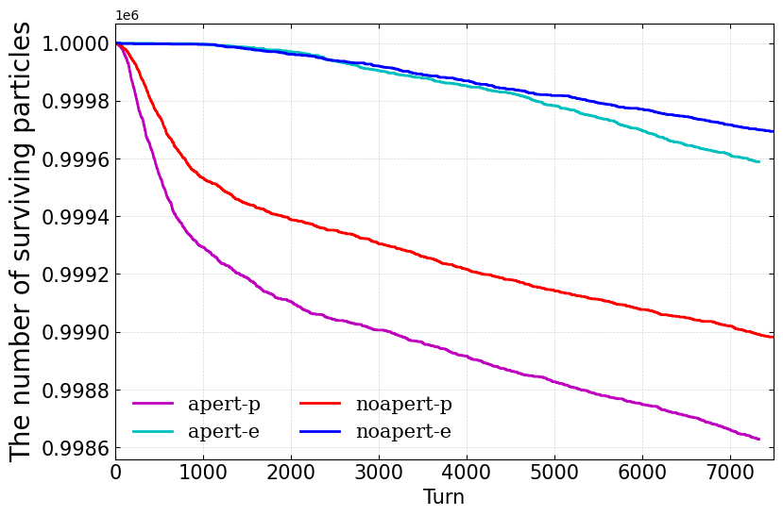
Accelerator Physics Emulation Studio （APES）
Modeling of SuperKEKB
To meet the requirements of beam dynamics study in CEPC
Flexible modeling of complicated accelerators
Self-consistent simulation of combined effects
Application of new IT technology: GPU acceleration etc
Weibin Liu et al., IPAC24.
Yuan Zhang, CEPC workshop, Jun.16-19 2025,Barcelona.
Online Commission
Simulation of Swap-out injection (Higgs)
- with element-by-element tracking and beam-beam
Machine Modeling
Detector Background
Optics function
Single Particle Dynamics
Combined Effects
Analysis of Nonlinear Dynamics
Spin
Analysis
of Collective Instability
More accurate, powerful and faster
8
Zhiyuan Li etal., NIMA 1064 (2024) 169386

Slide 9
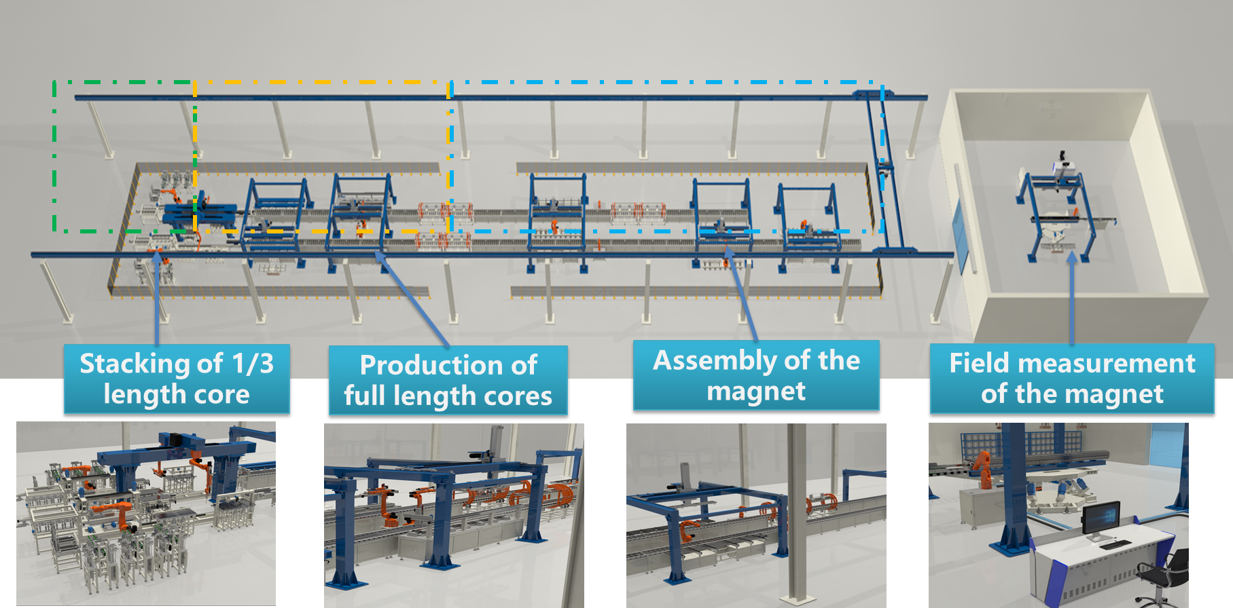
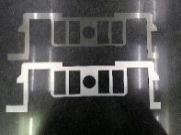
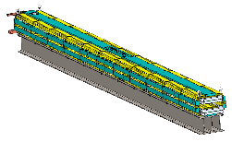
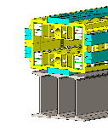
CEPC Booster automatic production line
~15000 dipole magnets in the CEPC booster
4 booster magnets fabricated per day
3 production lines with 5 years
Thanks for your attention
Status： construction started, the first workstation to be completed in 2025

Slide 10
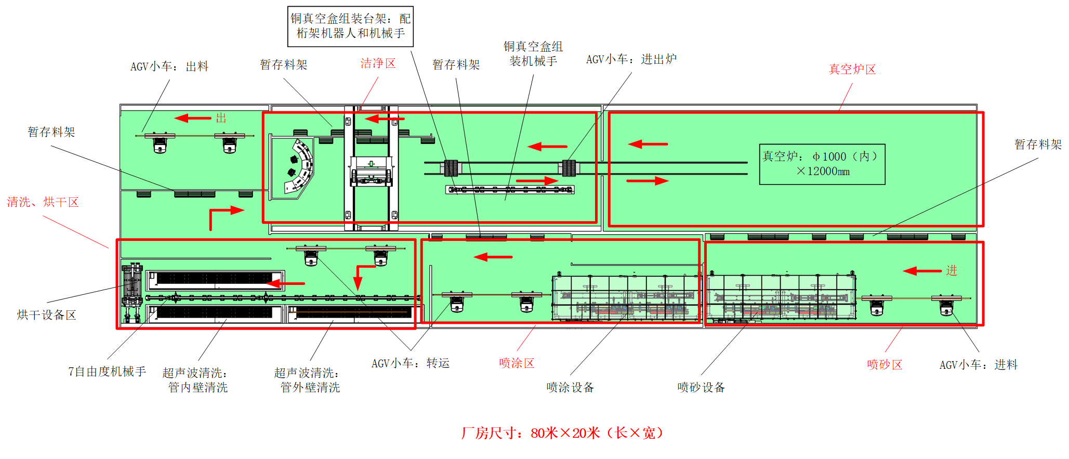
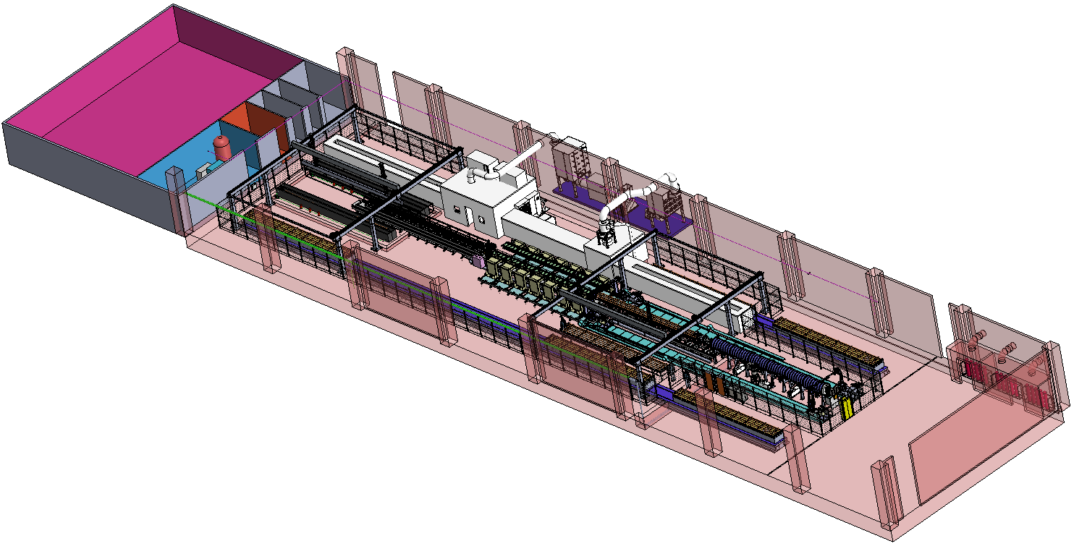
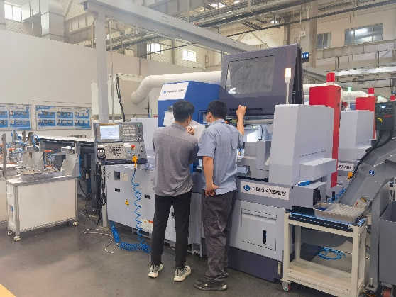
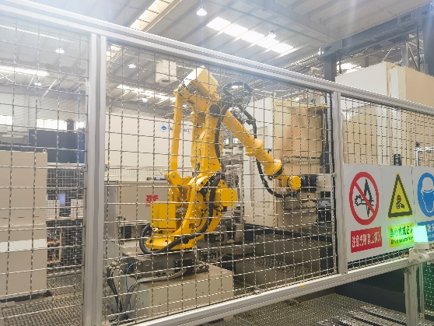
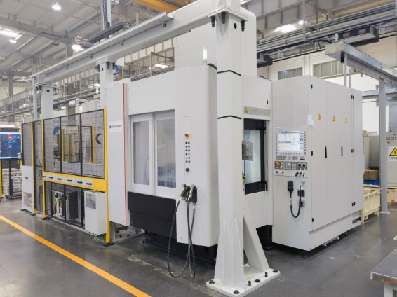
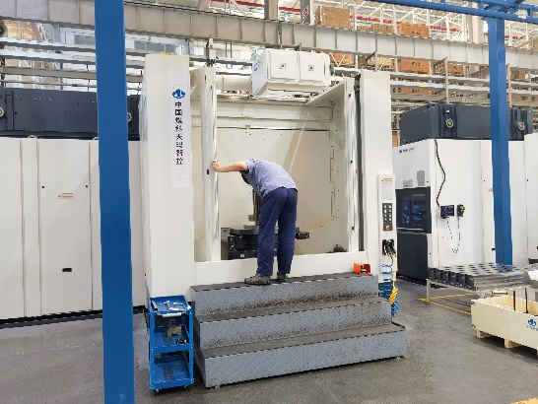
CEPC vacuum chamber NEG coating automiatc production line
total length of vacuum chamber ~ 190km in CEPC collider rings
Assembling for NEG coating
NEG coating
5年完成真空盒制造
Cleaning
Spraying heating film
兼顾NEG镀膜和喷涂
Layout of production line
Thanks for your attention
Status：construction started, commissioning scheduled in 2026

Slide 11
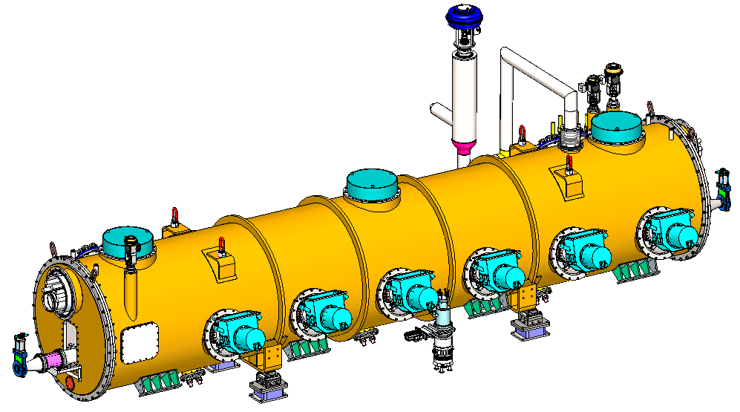
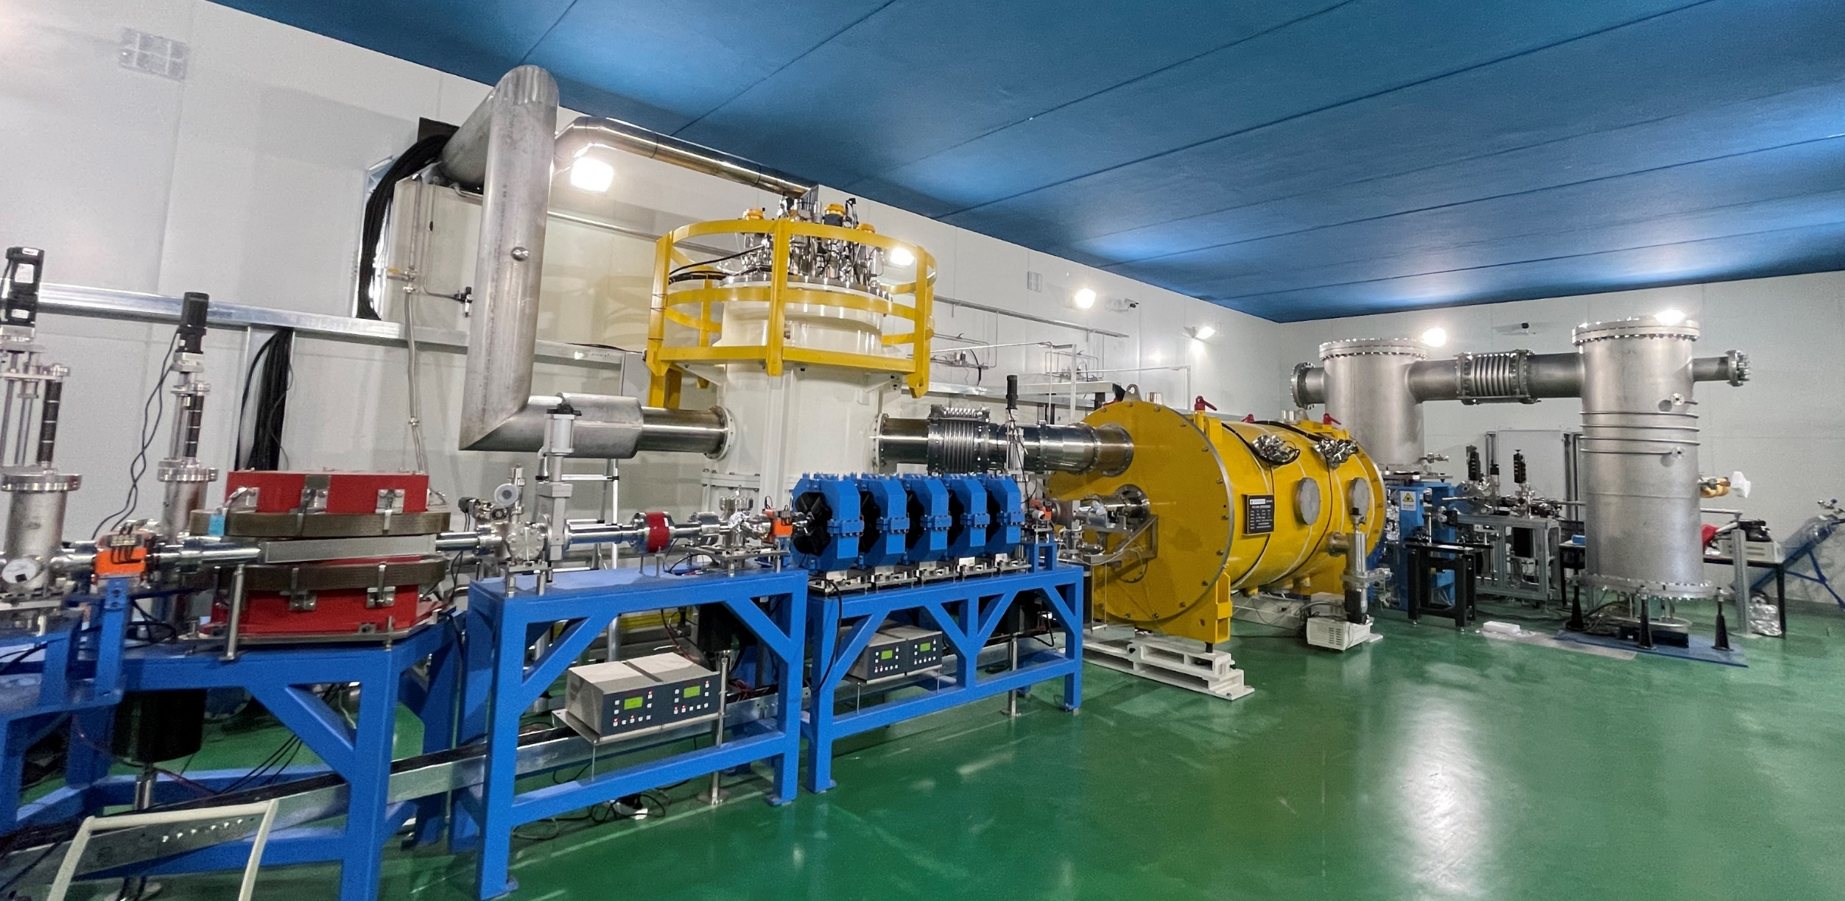
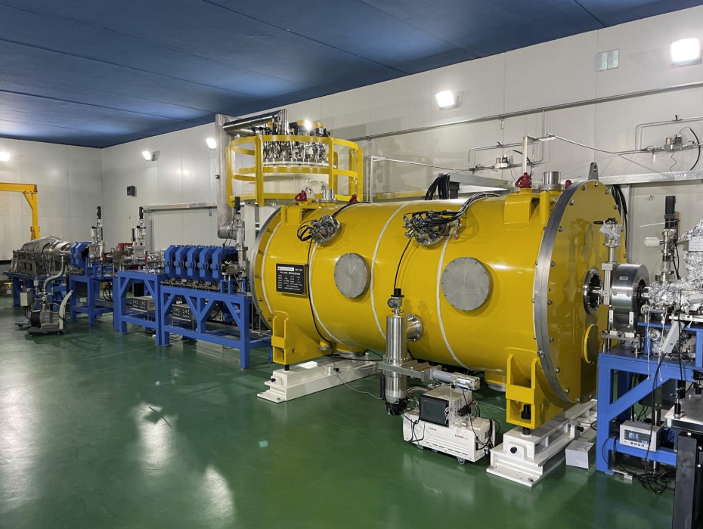
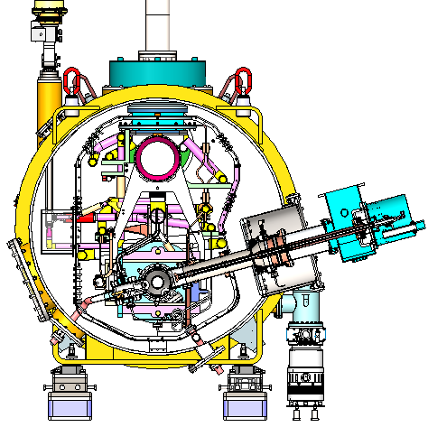
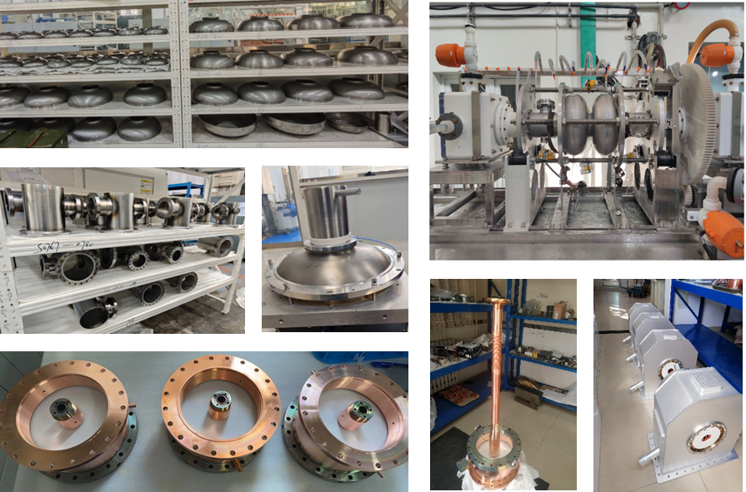
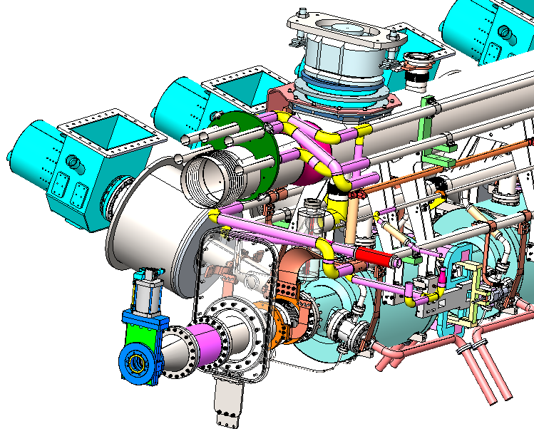
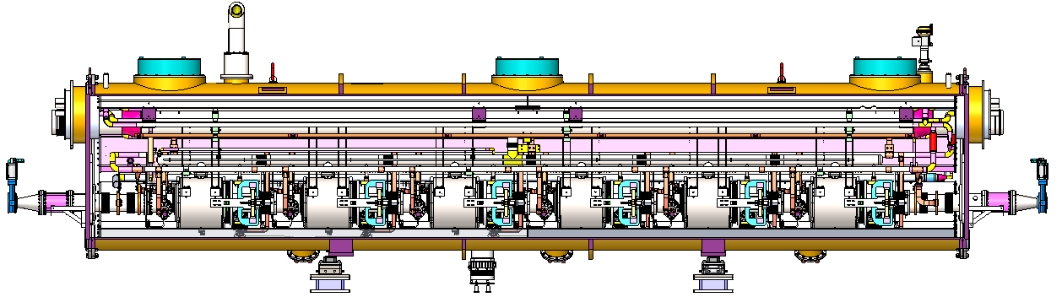
CEPC 650MHz full-size cryomodule prototype
mid-temp backing→ high Q, high gradient
CEPC collider ring 650MHz 2*cell short test module has been completed in TDR phase
低温、机械设计考虑CEPC自身要求
The collider Higgs mode for 30 MW SR power per beam will use 32 units of 11 m-long cryomodules each contain six 650 MHz 2-cell cavities, a full size 650 MHz cryomodule will be developed in EDR

Slide 12
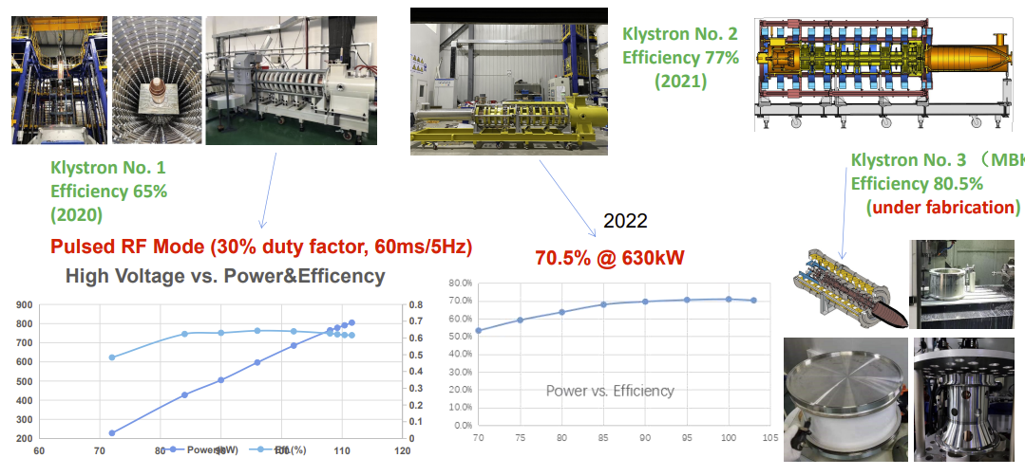
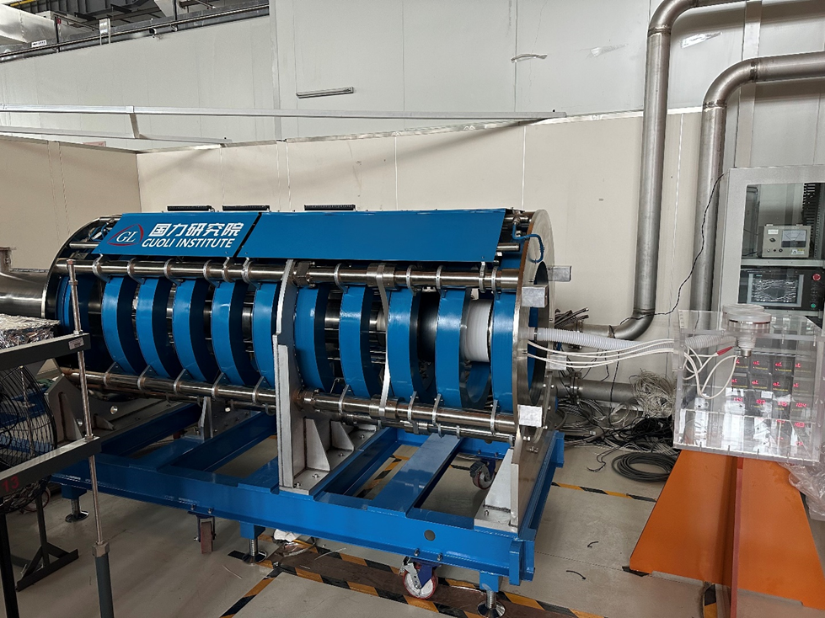
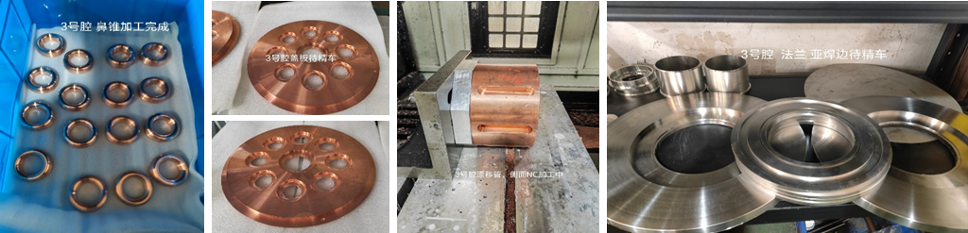
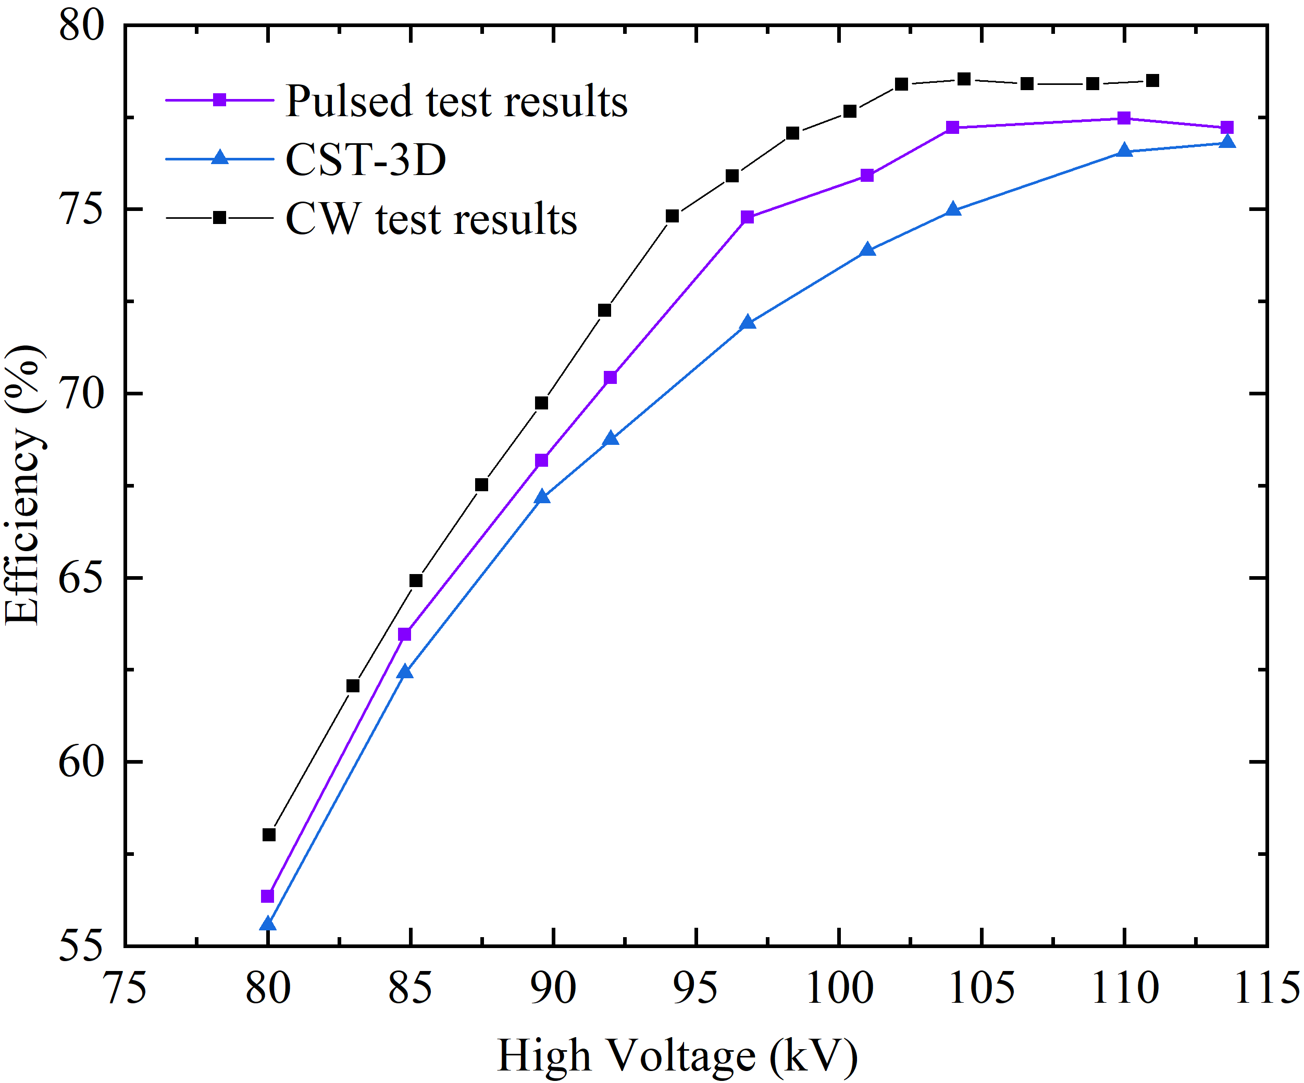
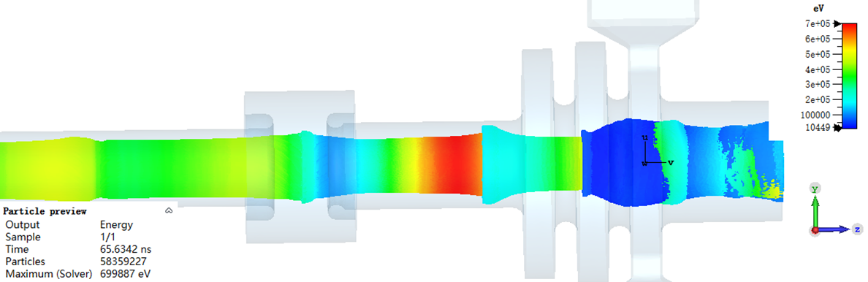
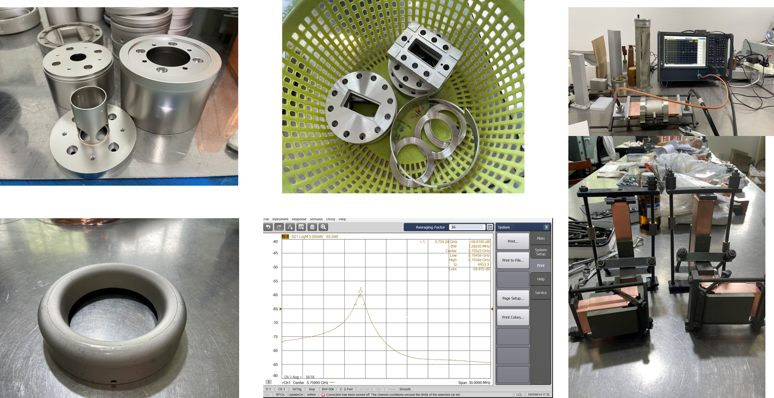
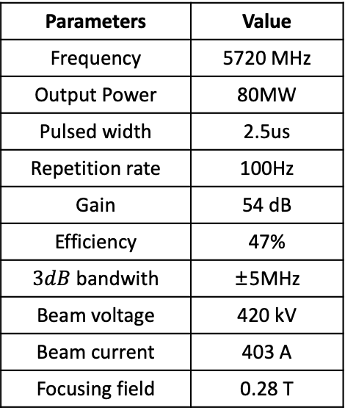
CEPC high efficiency klystron
Klystron R&D
Parameters | Value
Frequency | 5720 MHz
Output Power | 80MW
Pulsed width | 2.5us
Repetition rate | 100Hz
Gain | 54 dB
Efficiency | 47%
$3dB$ bandwith | ±5MHz
Beam voltage | 420 kV
Beam current | 403 A
Focusing field | 0.28 T
78.5%@803kW CW in 2024
in Fabrication.
C band 5720MHz 80MW Klystron
CEPC collider ring 650MHz klystron development in TDR/EDR phase
C band 5720MHz 80MW
Klystron design completed
Technical assessment has been done
on August 12, 2024, construction
started , high-power test starts soon
1拖4

Slide 13
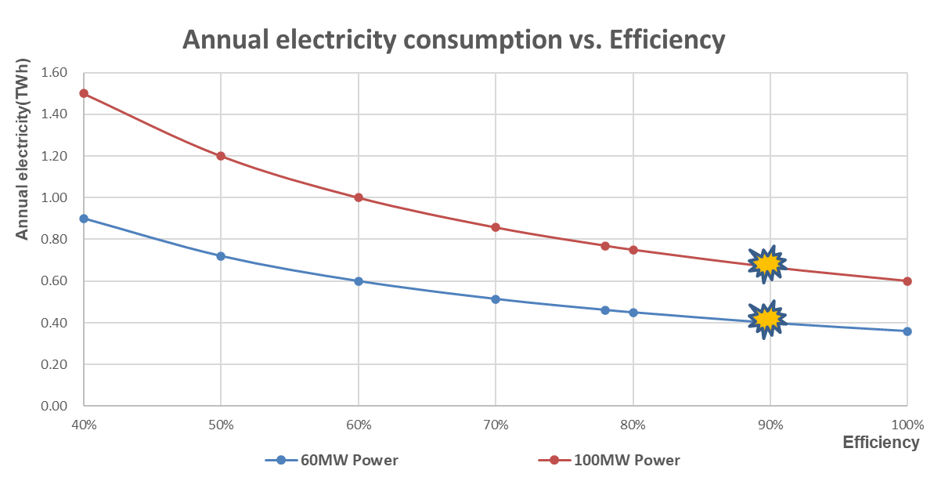
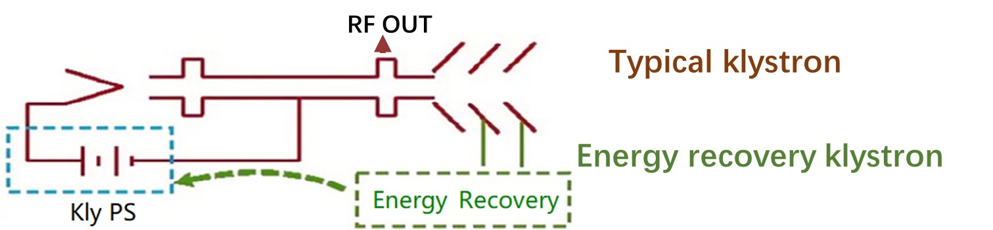
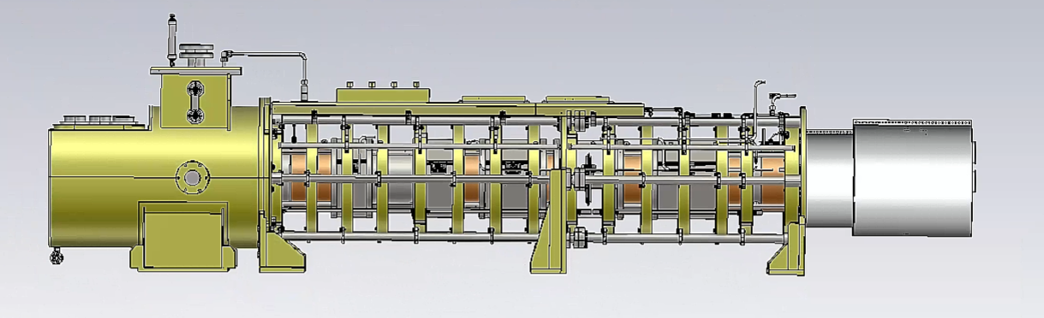
CEPC 650MHz energy recovery klystron R&D
Parameter | Value
Operating frequency | 650 MHz
Beam Voltage | 113 kV
Efficiency | 77.5%
Output power | 800 kW
Beam perveance | 0.25 μP
Beam current | 9.5A
Efficiency (one-stage depressed collector) | 85%
4200mm
The 4th Klystron (Energy recovery, one stage) ：machining will start soon

Slide 14
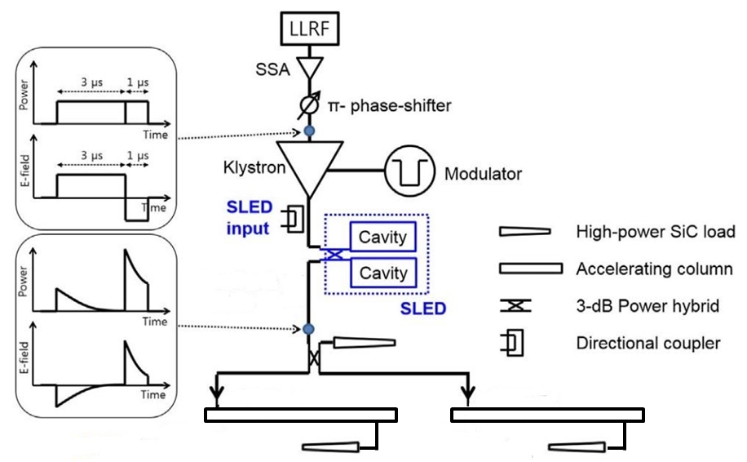
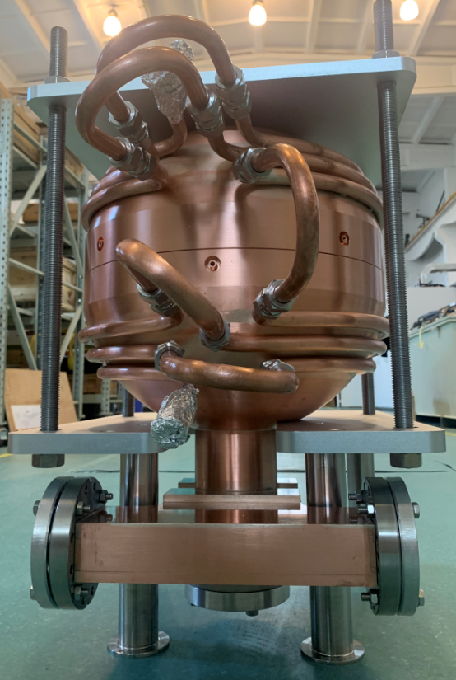








CEPC C-band microwave beam test platform
CEPC EDR will establish the C-band test bench and test the components. With pulsed compressor, waveguides, directional couplers, loads, bend and straight waveguides, etc. as a basic unit of CEPC C-band linac
The C-band test bench is equipped with a CEPC 5720MHz 80MW power source
The CEPC C-band test bench will be completed in 2026
Waveguide taper
BJ48
End cavity
Match section
Regular section
C band 5720MHz 80MW Klystron design completed, and fabrication will be completed in 2025
Cavity shape
The deformation caused by temperature variation
CEPC C-band linac test platform will be completed in 2026

Slide 15








CEPC tunnel model and installation verification
Booster magnets installation
Collider ring magnets supports
A 60 m long tunnel mockup, including parts of arc section and part of RF section
Demonstrate alignment and installation procedure, highlighting the installation of the booster on the roof
Plan：to be completed in 2026

Slide 16

Green technology and sustainability study
HEPS experiences
solar panel of 10 MW -> 10% saving
permanent dipole magnet: 5.6M kWh saving/yr
Cooling water for heating 13 MW@42ºC
CEPC approach
High Q SRF: 60M kWh saving/yr
High E klystron (80%): 160M kWh saving/yr
shared coils in dual aperture magnets
liquid helium recovery system
permanent magnets in damping ring/transfer lines
CEPC carbon footprint study
lowest carbon emission/Higgs
Publication: Dou Wang; Jie Gao; Yuhui Li; Jinshu Huang; Song Jin; Manqi Ruan; Mingshui Chen; Shanzhen Chen,
"The carbon footprint and CO2 reduction optimization of CEPC“, RDMT, https://doi.org/10.1007/s41605-025-00535-7 (2025).

Slide 17






Plasma-based Acceleration: >10³ increase in E_{acc}
RF cavity：< 100MeV/m
Drive Beam:
laser pulse
e- bunch
proton beam
…………
Table-top X/γ sources
High Energy colliders
Plasma：1-100 GeV/m
HEDP platforms
SACLA, 750 m, 8 GeV
ANL
BNL
SACLA, 750 m, 8 GeV
THU/IHEP
DESY
LBNL, 20 cm, 7.8 GeV
SLAC
CERN
THU/SINAP
LNF
High power laser facilities (2020)

Slide 18

CEPC Plasma injector study
Replace the 100km booster by a PWFA accelerator, promising significant cost reduction
Key issues identified for experimental justification

Slide 19



PWFA test facility @BEPCII

Slide 20





Timeline and progress

Slide 21

Beam polarization study
Motivation
Precision beam energy calibration @ Z, W (~100keV), w/ resonant depolarization
Longitudinal polarization at Z-pole and beyond, for weaking mixing angle measurement, CPV etc.
Design
Polarized beam injector
~70% longitudinal polarization at Z-pole
Potential to attain polarization at Higgs
W. Xia et al., Investigation of spin rotators in CEPC at the Z-pole,
Radiat. Det. Tech. Meth. 6:490 (2022).
T. Chen, Z. Duan, D. H. Ji, D. Wang, Phys. Rev. Accel. Beams, 26, 051003 (2023).

Slide 22


Polarization R&D in the EDR phase
CEPC requirements, R&D items,
and required experiment demonstration
R&D, beam tests, and foreseen experimental demonstration at IHEP accelerator facilities
These activities will set the basis for polarized beam applications @ CEPC.

Slide 23




Compton polarimeter @ BEPCII
CEPC vertex detector prototype
Laser optics & detector layout
Attempt first beam polarization measurement before end of 2025
Resonant Depolarization experiment in 2026

Slide 24




Other polarization R&D
Polarized electron source
First superlattice GaAs cathode under test @ JGU Mainz
Beam test of the polarized e- beamline in 2027
Superconducting solenoid spin rotator under design.
E- longitudinal polarization @ BEPCII under study.
Polarized e- source beamline
YBCO superconducting solenoid
e- longitudinal polarization scheme for BEPCII

Slide 25

Other CEPC Accelerator EDR Activities

Slide 26
Summary
CEPC accelerators are in the phase of Engineering Design Report
Some R&D highlights are reviewed
Experiences of BEPCII & HEPS set steady basis for the success of CEPC
Thank you for your attention!

