Slide 1
Status of RPC Muon trigger detector for ATLAS Phase-II upgrade
Yongjie Sun
On behalf of the ATLAS China Muon team
University of Science and Technology of China
CLHCP 2025, Nov. 1st, Xinxiang

Slide 2
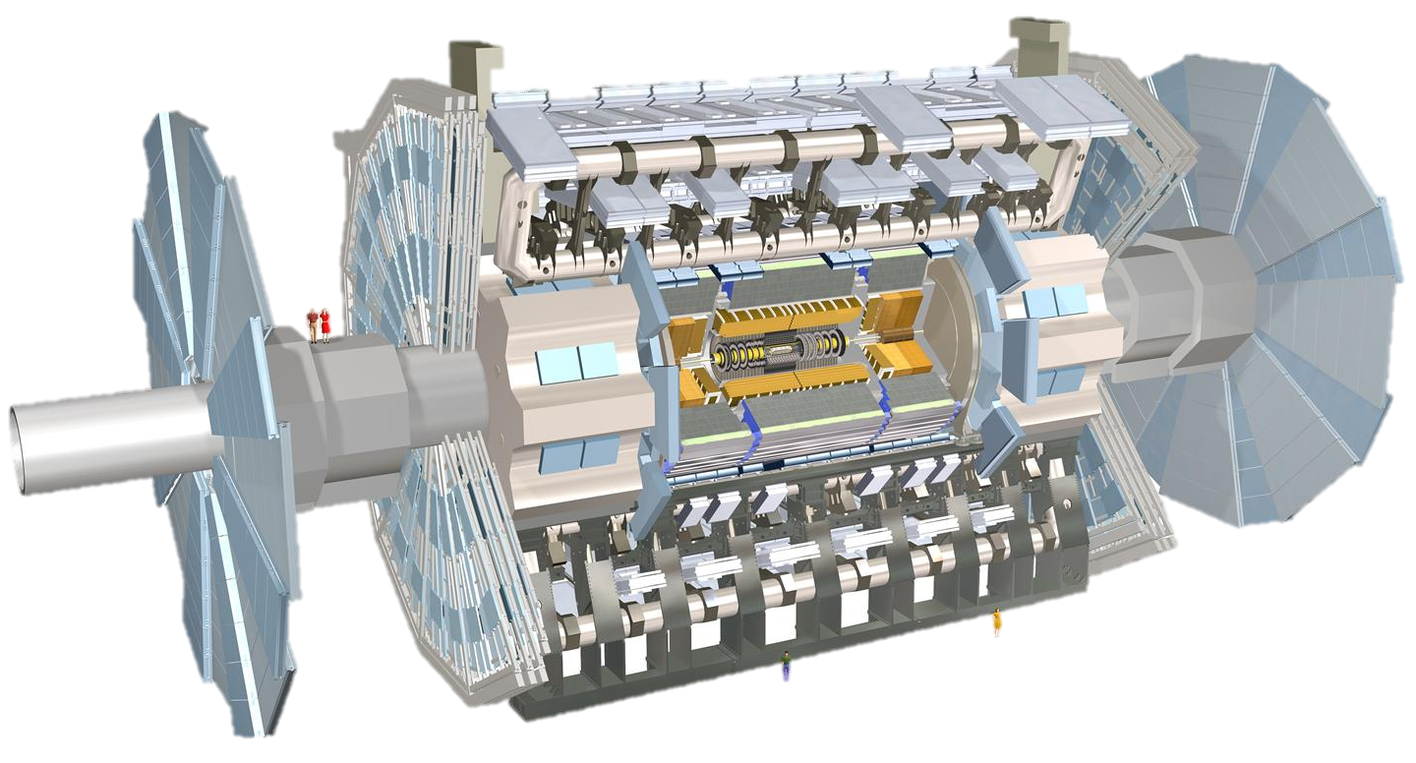
Upgrade of the ATLAS detector
Phase-I upgrade
New Small Wheel (NSW)
Phase-II upgrade
Silicon Inner Tracking system
Main goals:
Higher radiation hardness/rate capability
Higher spatial/time resolution
Faster response time
Higher data acquisition rate
Phase-II upgrade
Trigger and Data Acquisition - TDAQ
Phase-II upgrade
High Granularity Timing Detector HGTD
Phase-II upgrade
Thin-gap RPC (barrel muon trigger, very crucial for physics) ,
sMDT, electronics

Slide 3
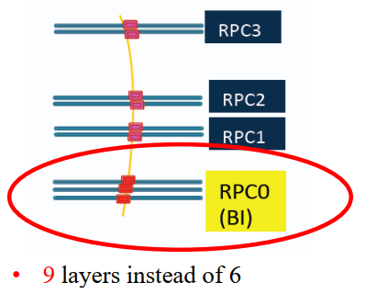
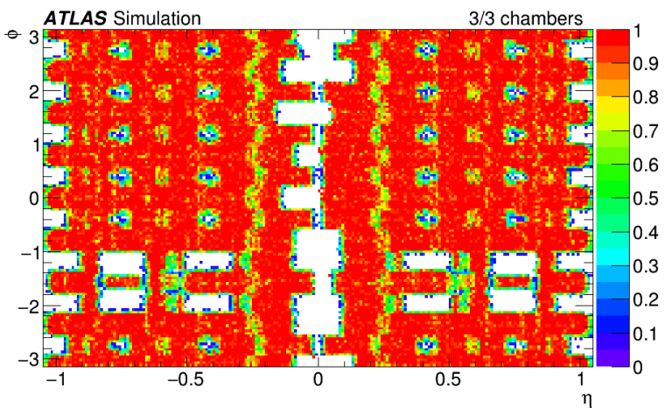
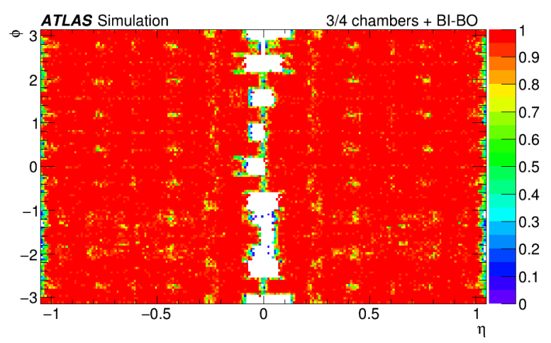
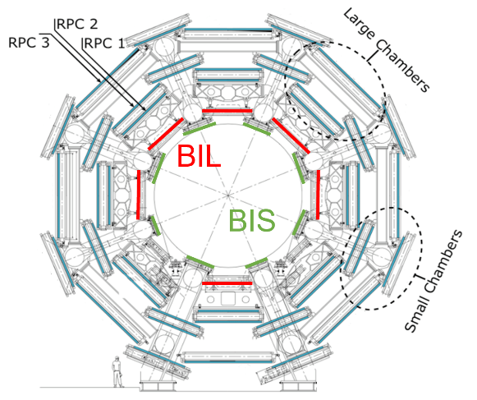
Muon RPC upgrade for Phase-II
Limitations of current RPC system
  Rate capability: ~ 100 Hz/cm²
  Lifetime: 10 years @ LHC → lower efficiency
  The acceptance holes due to support structures
Phase-II upgrade for HL-LHC
  Three layers of RPC in BI region
  Thin-gap design with higher rate capability and longevity
  Fix most of the acceptance holes
  Increase redundancy and flexibility
678 singlets，1054m² effective area
~70,000 electronics channels
触发效率：70% ➔ 90%
BOMBOR

Slide 4
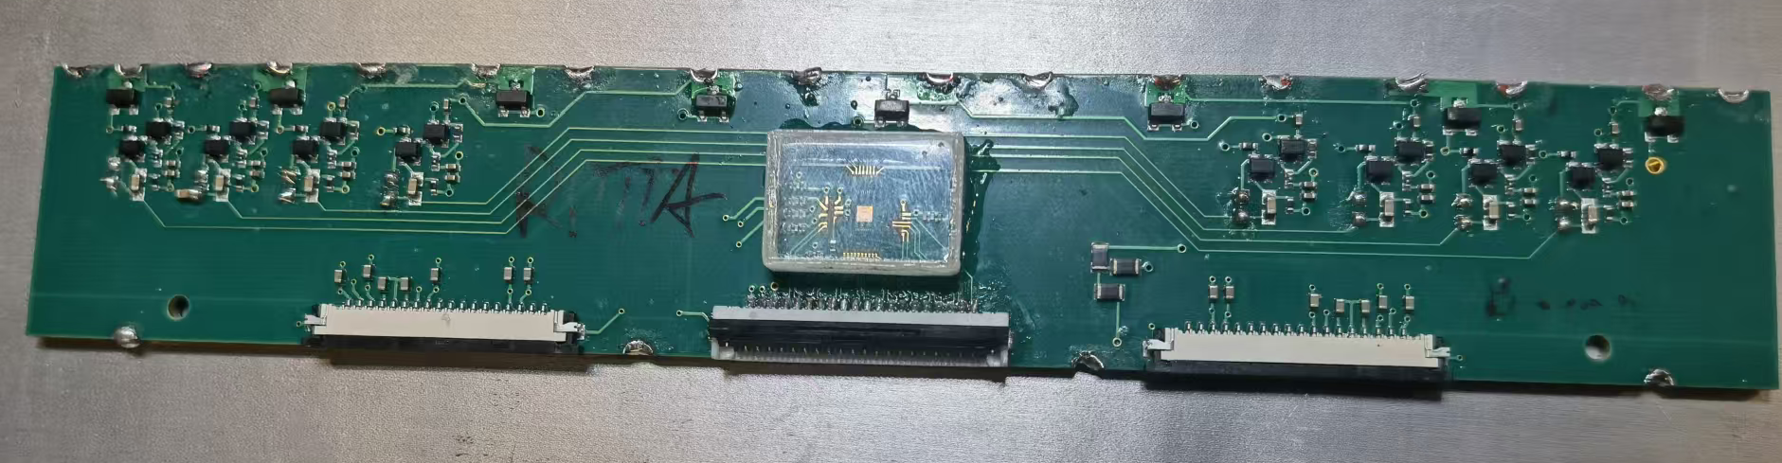
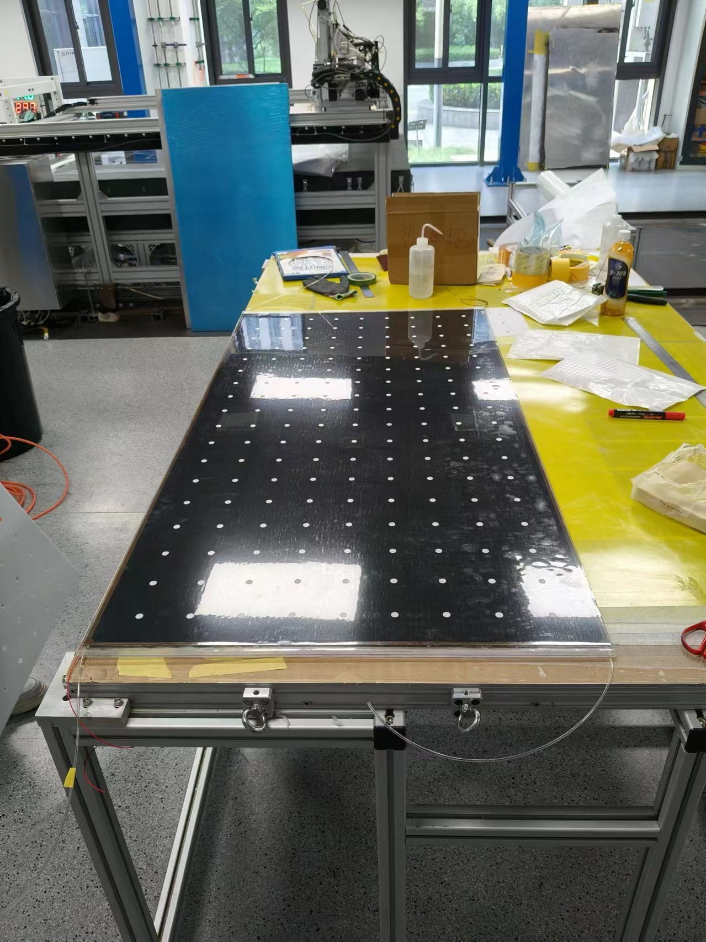
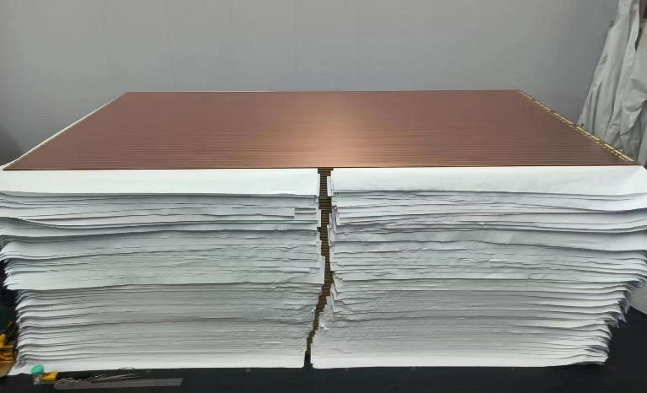
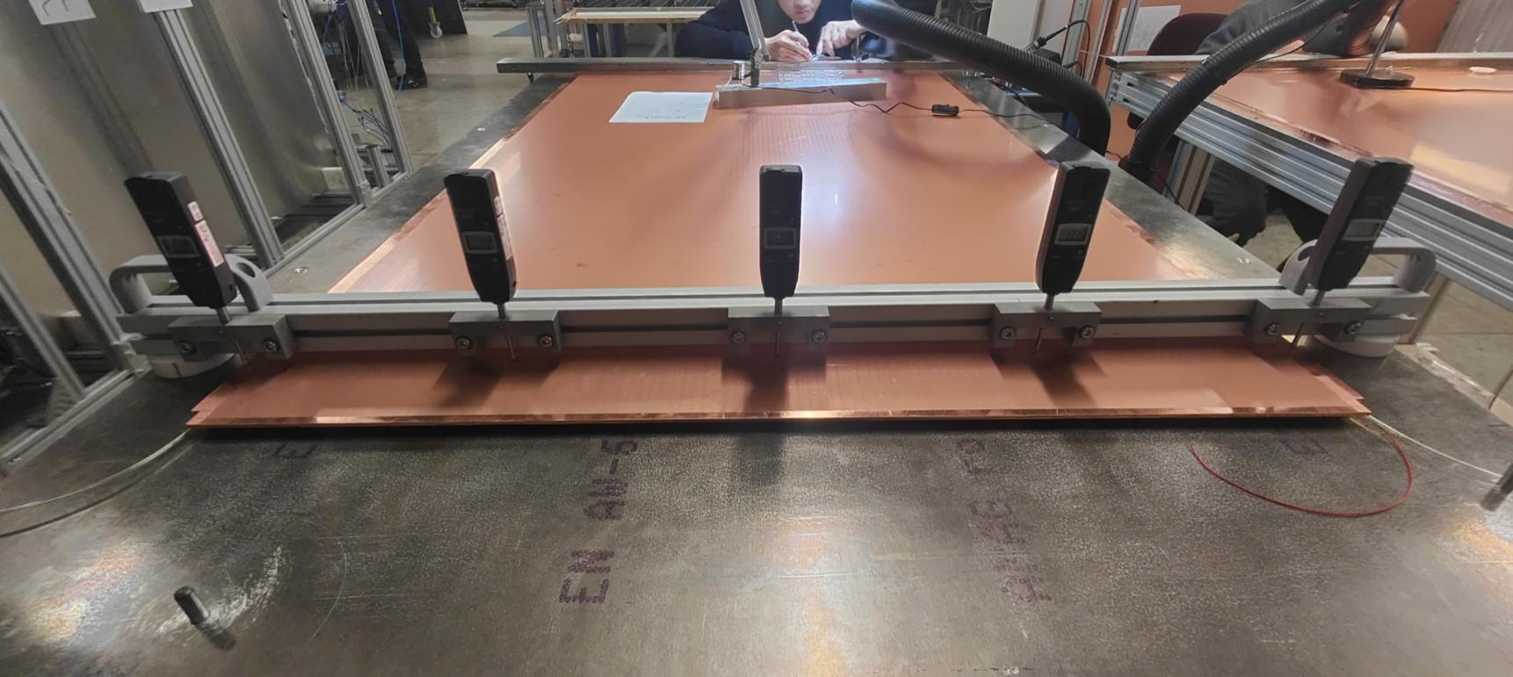
The contribution from China
~50% of the detector components and related assembly and QA/QC
Cover full chain of RPC production
  288 BIS singlets and readout panel
  120 BOMBOR singlets and readout panel
  72 RPC gas gaps
  5000 FE boards
  LV and HV power supply
FE board
Readout panel
Gas gap
singlet

Slide 5
Technical scheme of thin-gap RPC detector
Thinner bakelite:
  Less voltage drop in bakelite → improve the rate capability, larger induced signals
Thinner gas gap:
  Less charge produced per event → improve rate capability and longevity
New generation FE electronic:
  Higher amplification factor and high S/N ratio to compensate the lost gas amplification.
Honeycomb readout panel
  Better mechanics flatness and hardness → better signal transmission and spatial resolution.
Specifications：
  Rate：>1 kHz/cm²
  Longevity：>10y@HL-LHC
  Spatial resolution：<1 cm
  Time resolution：~ 0.5 ns
Low ε_{r} filler
Bakelite: 2 mm→1.5 mm
Gap size: 2 mm→1 mm
Readout panel
Copper strip/GND
Bakelite electrode
Gas gap
Notes:
高能物理实验中的首次大面积应用

Slide 6
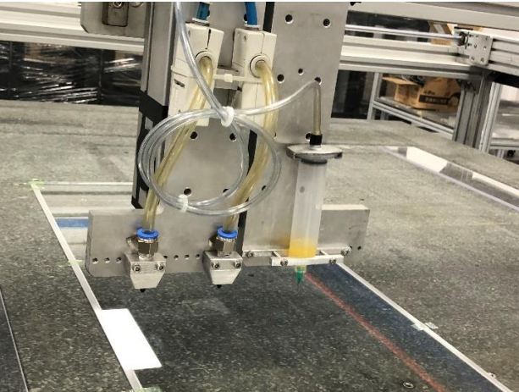
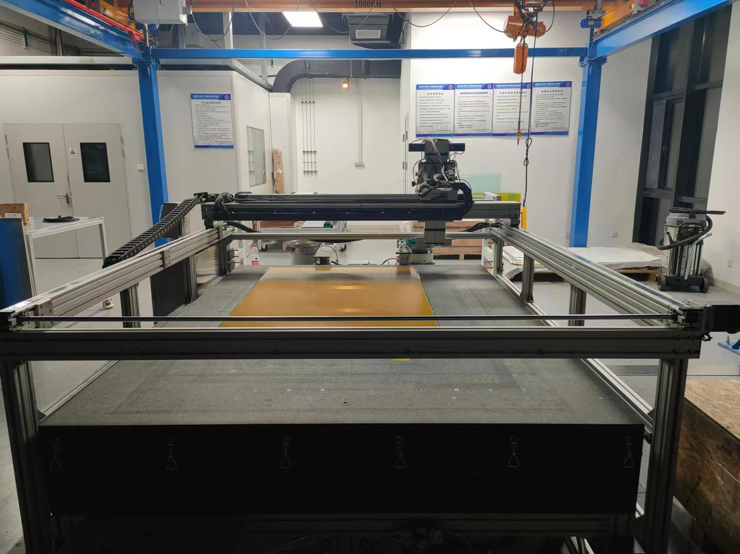
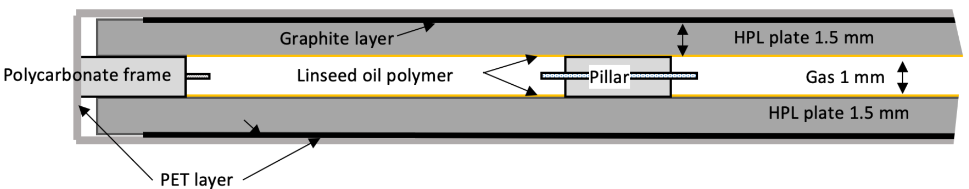
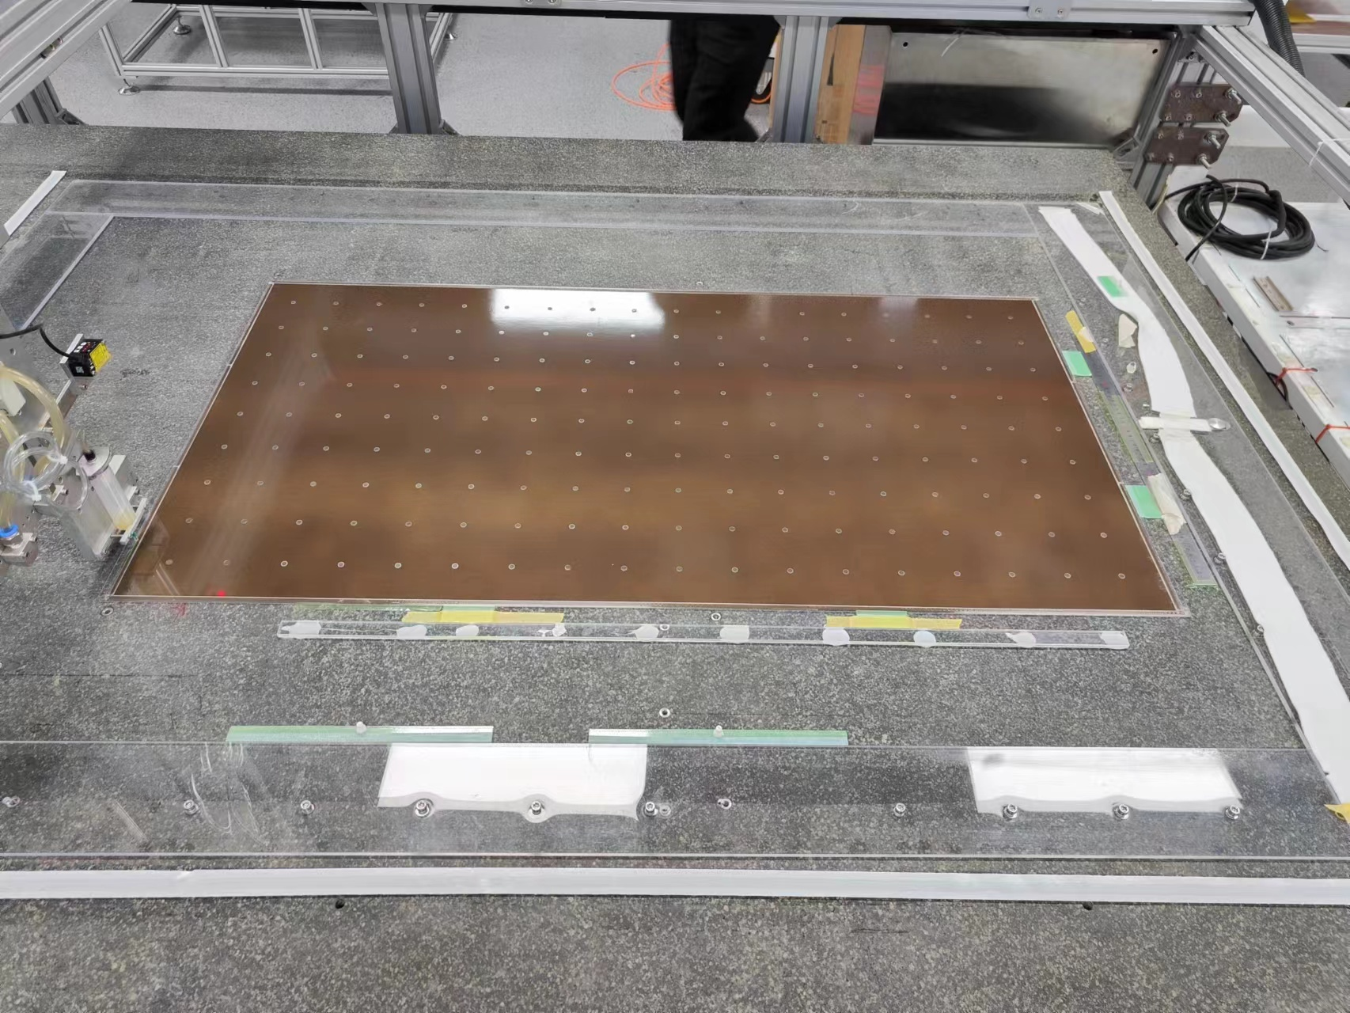
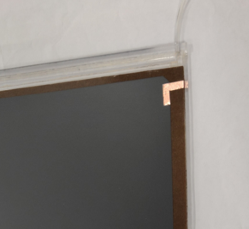
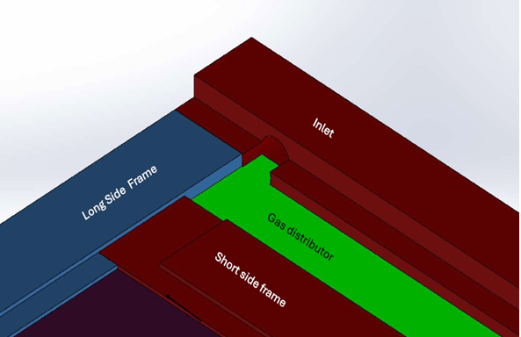
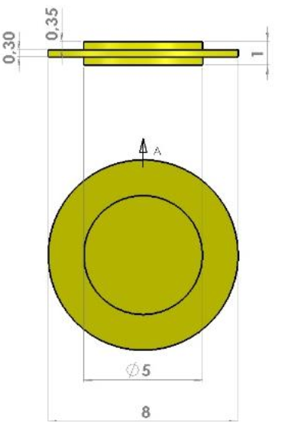
Gas gap production
Full production chain established in China
Automatic distribution gantry
  Spacer positioning, glue drop/line distribution
Precision machining of spacers, bars
  Customized process and tooling for strict uniformity and tolerance
Gas tight, linseed oiling, graphite painting, thermal laminating
6 gaps under aging test at GIF++
Spacers placed
HV electrode

Slide 7
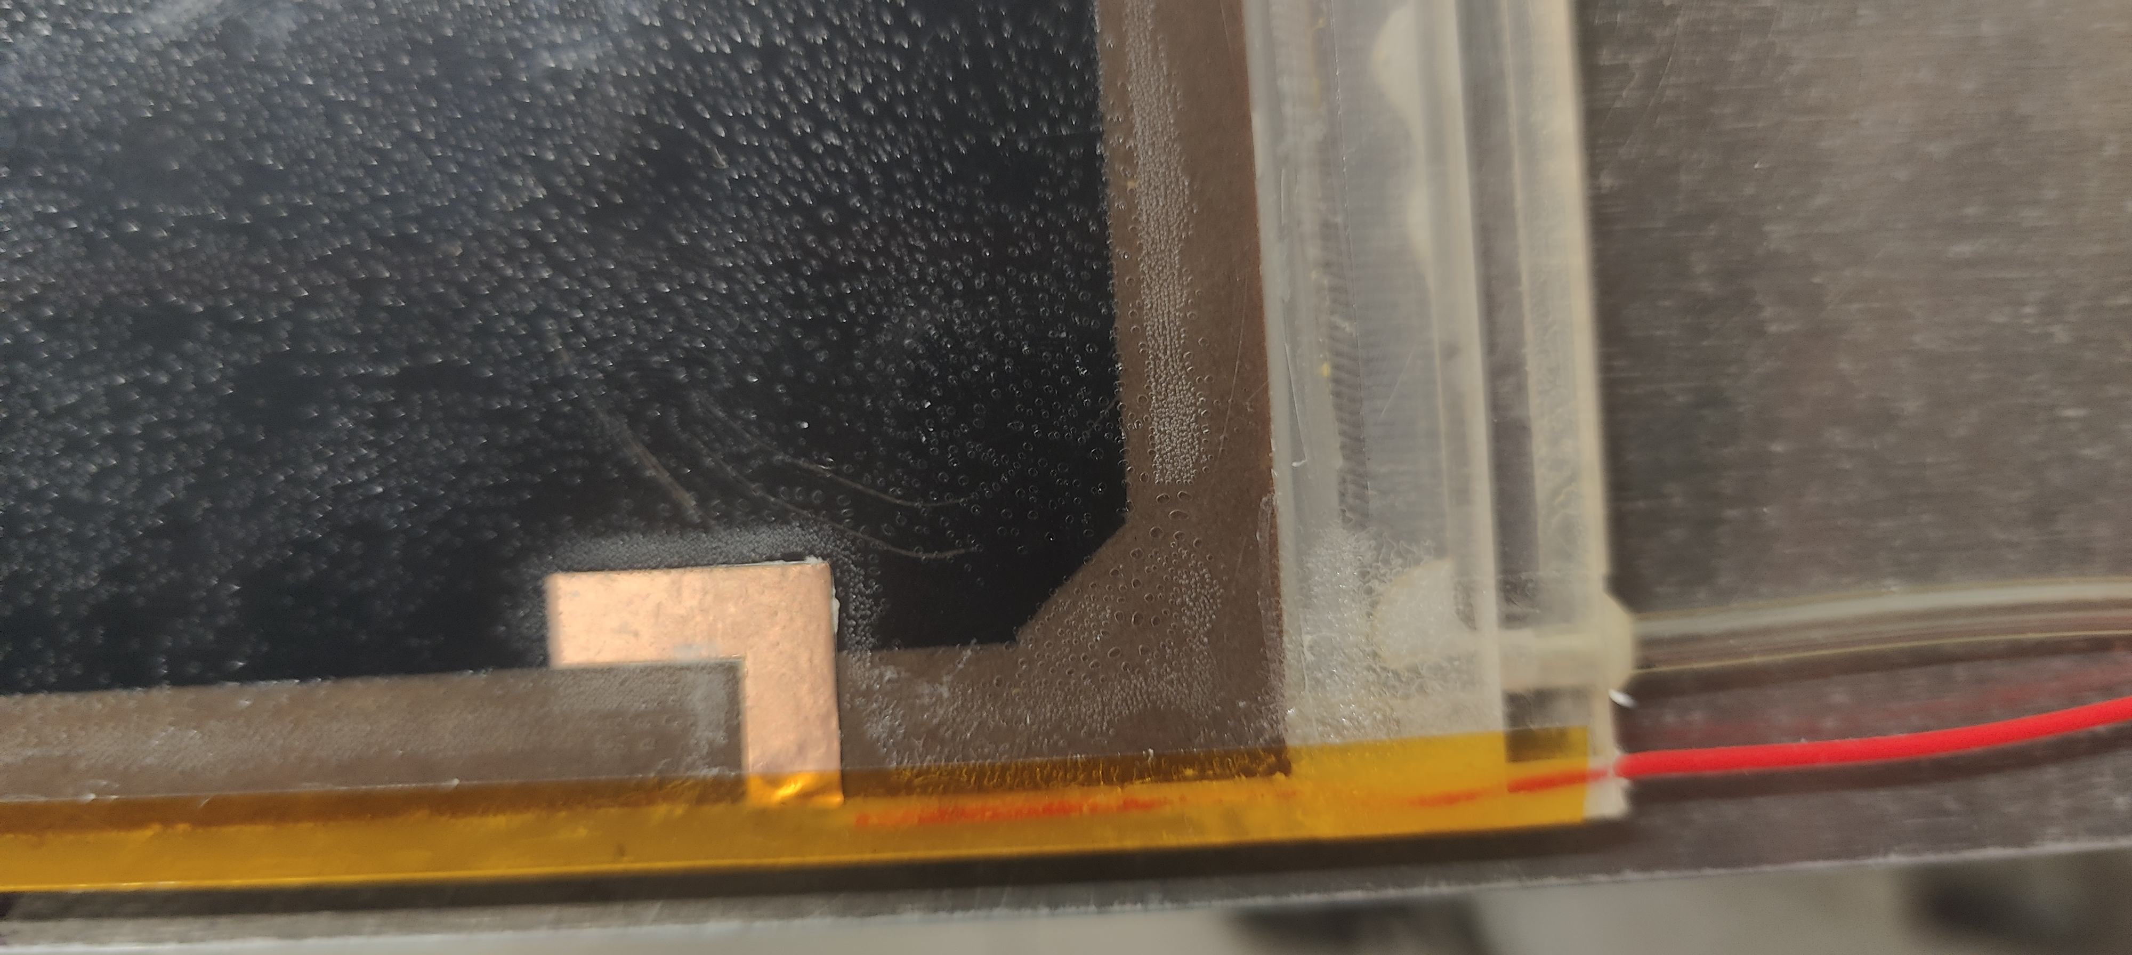
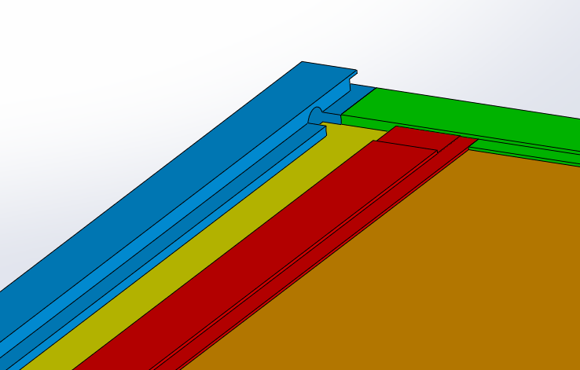

Profit the mass production in Italy company
  Gas leak problem
The early production of ~160 gas gaps suffered gas leak problem
Weak point addressed based on the experience in our prototype production
Problem solved with mechanical modifications
Hole + slot with steps
PET
1.4mm
4.5mm
3.1mm
2.0 mm
0.7mm
1.0mm
Policarbonate
Hole
Slot

Slide 8
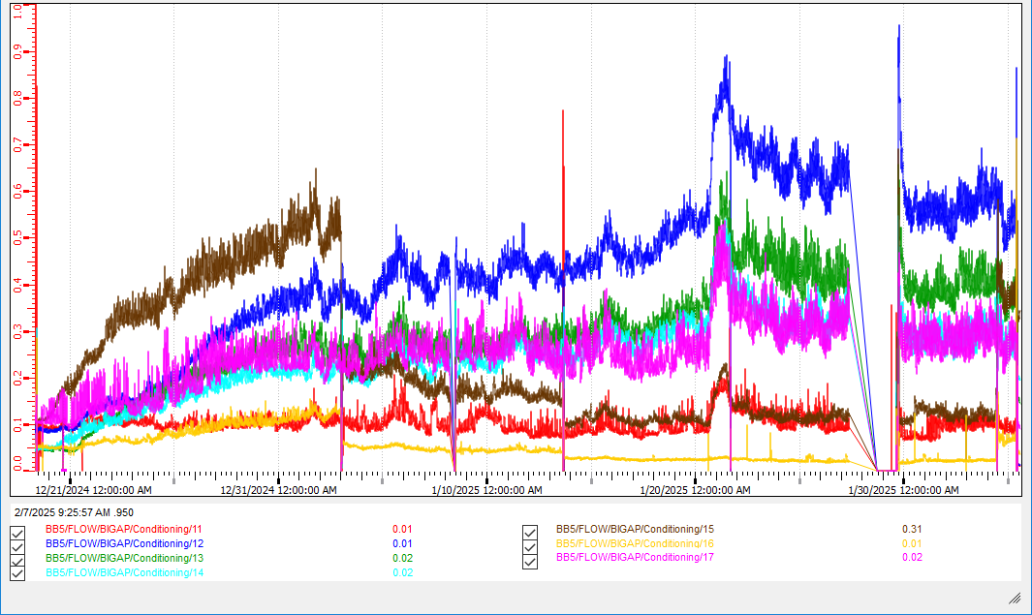
Profit the mass production in Italy company
  The drift current problem
More than half of ~290 gas gaps (till Sep. 2025) were tested with drifting current
Many measures taken to improve the quality.
  Pre-wash before oiling, extend drying time, Ar training, improve gluing quality … Most based on our experience
The recent batch has a yield of 15/16

Slide 9
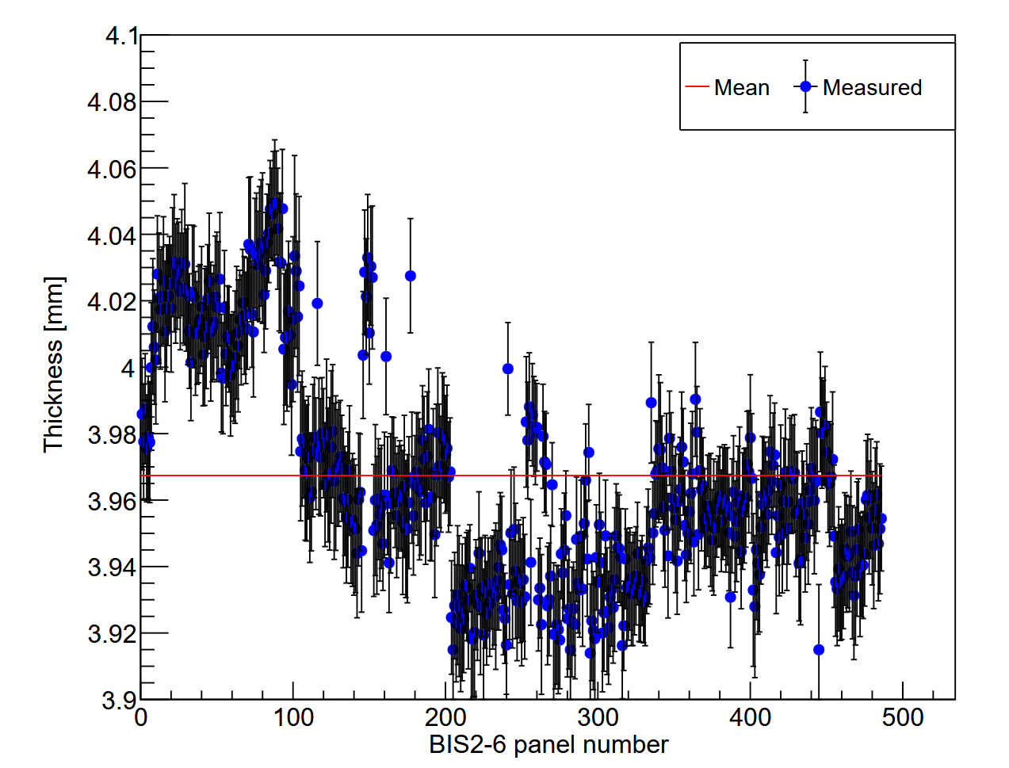
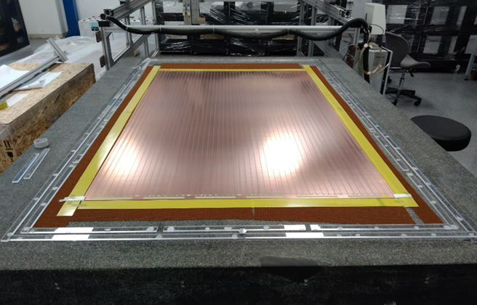
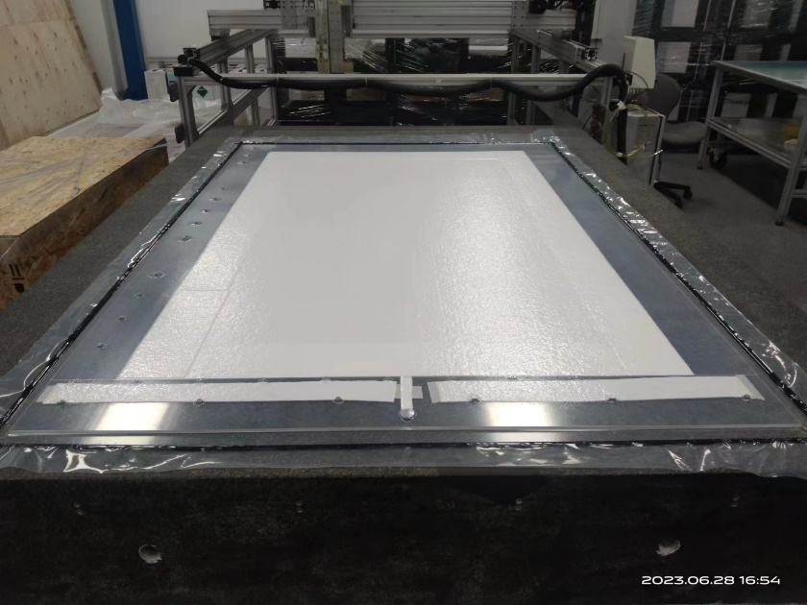
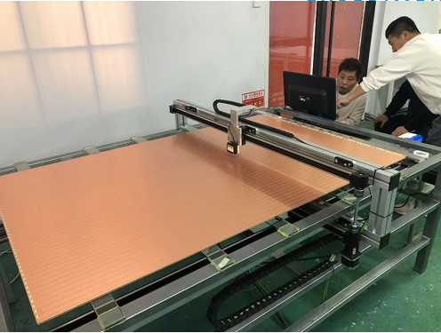
Readout panel production
  All BIS panels produced and qualified
The sole manufactory for large size PCB
The vacuum bag method for honeycomb panel production
The automatic scan system for panel qualification
All 576 BIS panels qualified
1.7m
1.1m
Large size PCB
Vacuum bag pressing
Automatic thickness scan

Slide 10
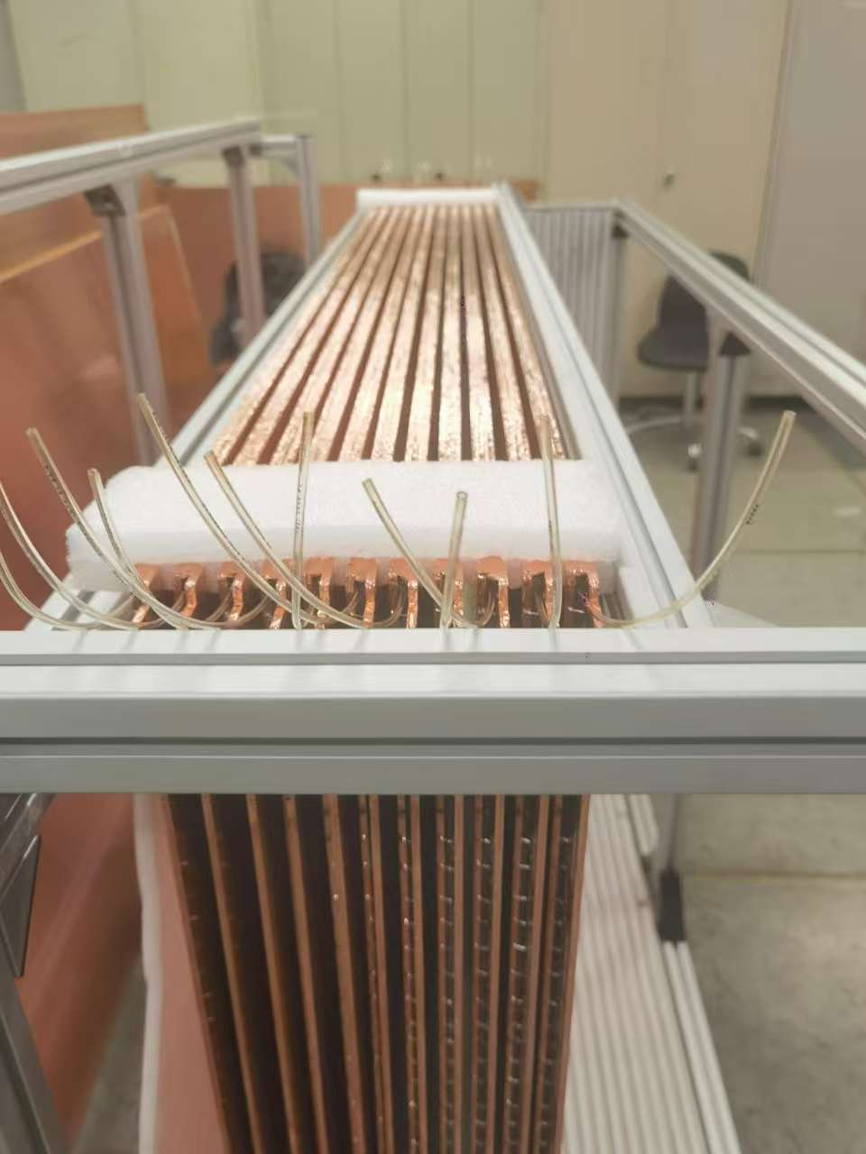
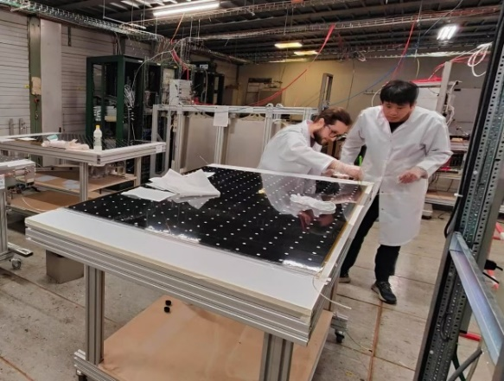
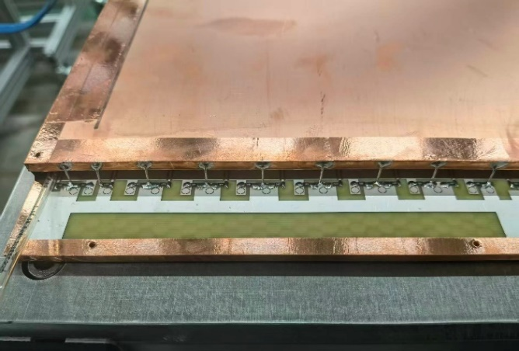
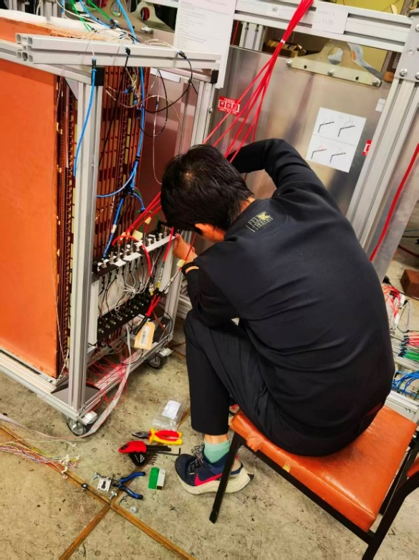
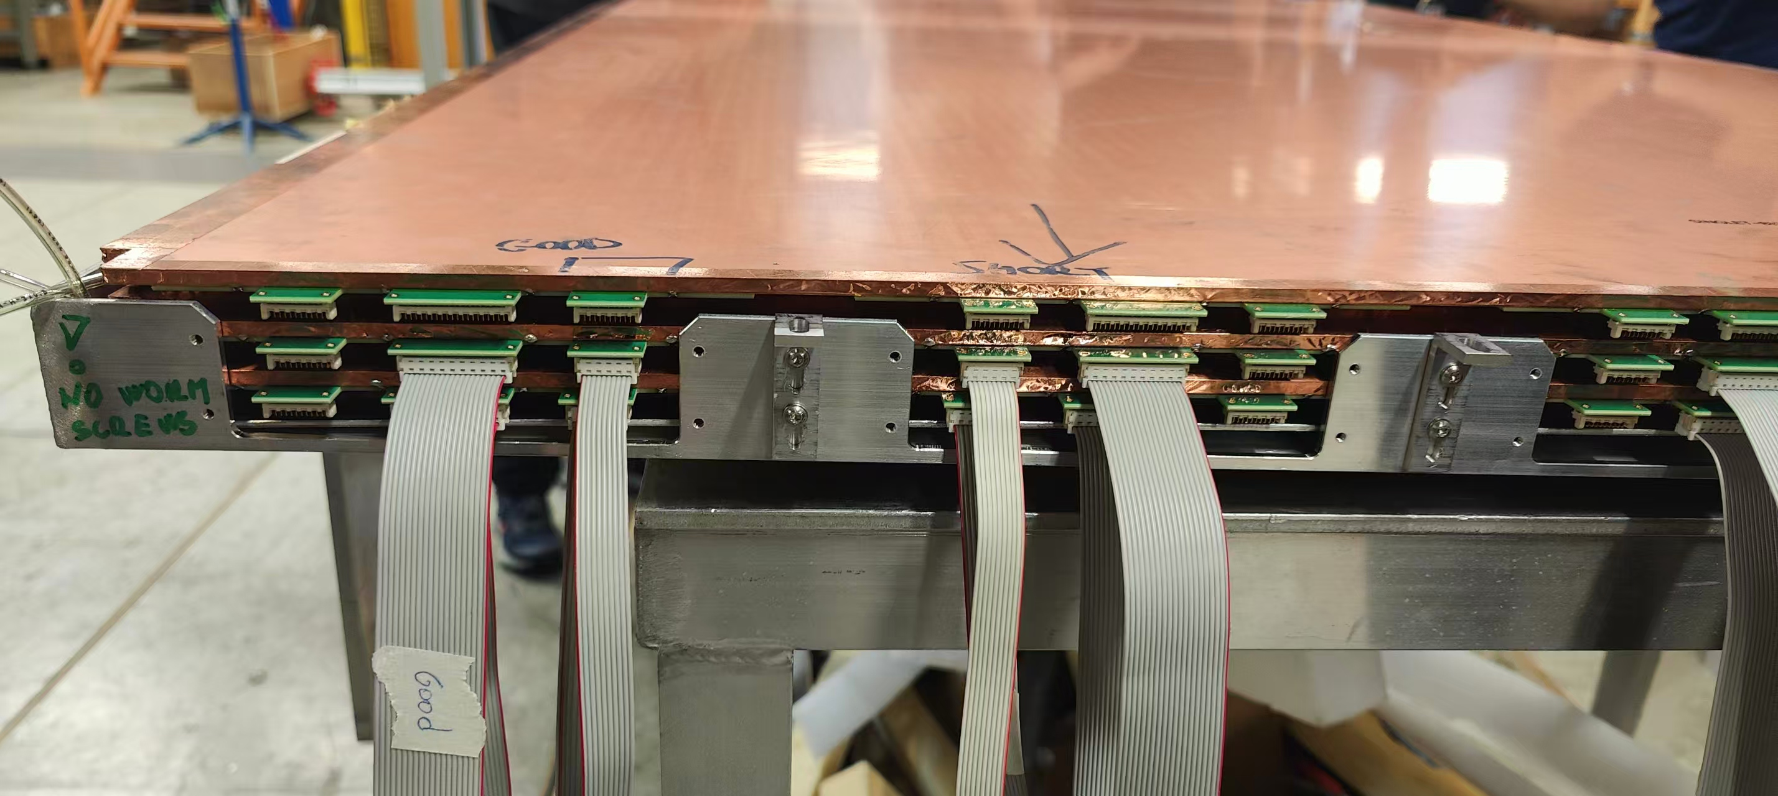
The singlet assembly at CERN
  Assembly and QA/QC procedures established
Participate the joint singlet assembly training at CERN
21 BIS singlet assembled in July 2025
QA/QC procedures applied and qualified
Gas-tight refurbish
Singlet finishing
Dimensions and thickness checks
Triplet prototyping
HV test

Slide 11
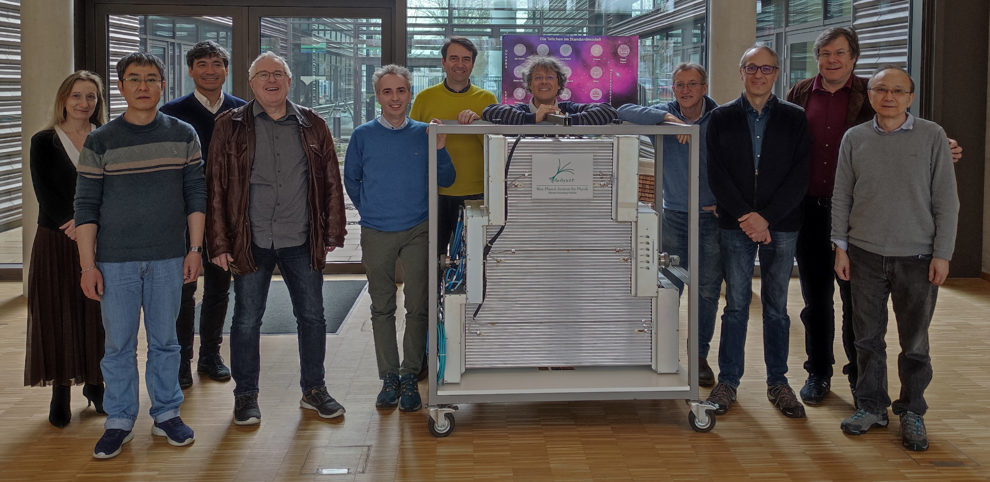
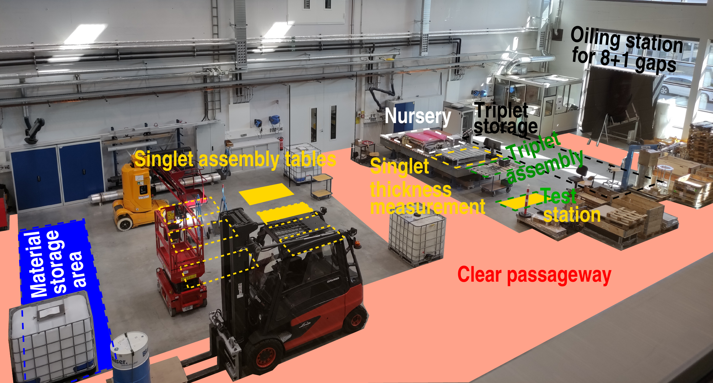
BIS singlet production line in MPI
USTC on the US. “entities list”, singlet assembly can not carry out in USTC
Multiple solutions discussed together with upgrade management.
Warmly welcome from MPI with strong support promised
After on-site discussion in April, the cooperation decided
  MPI takes care of all the necessary facilities, tools, gas, HV system
  China team sets up the production line together with a cosmic ray test station

Slide 12
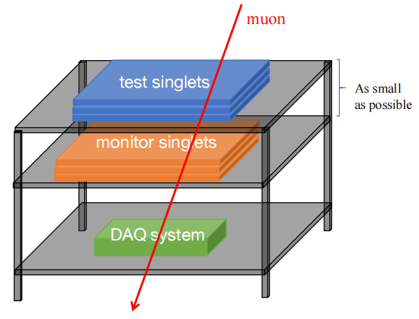
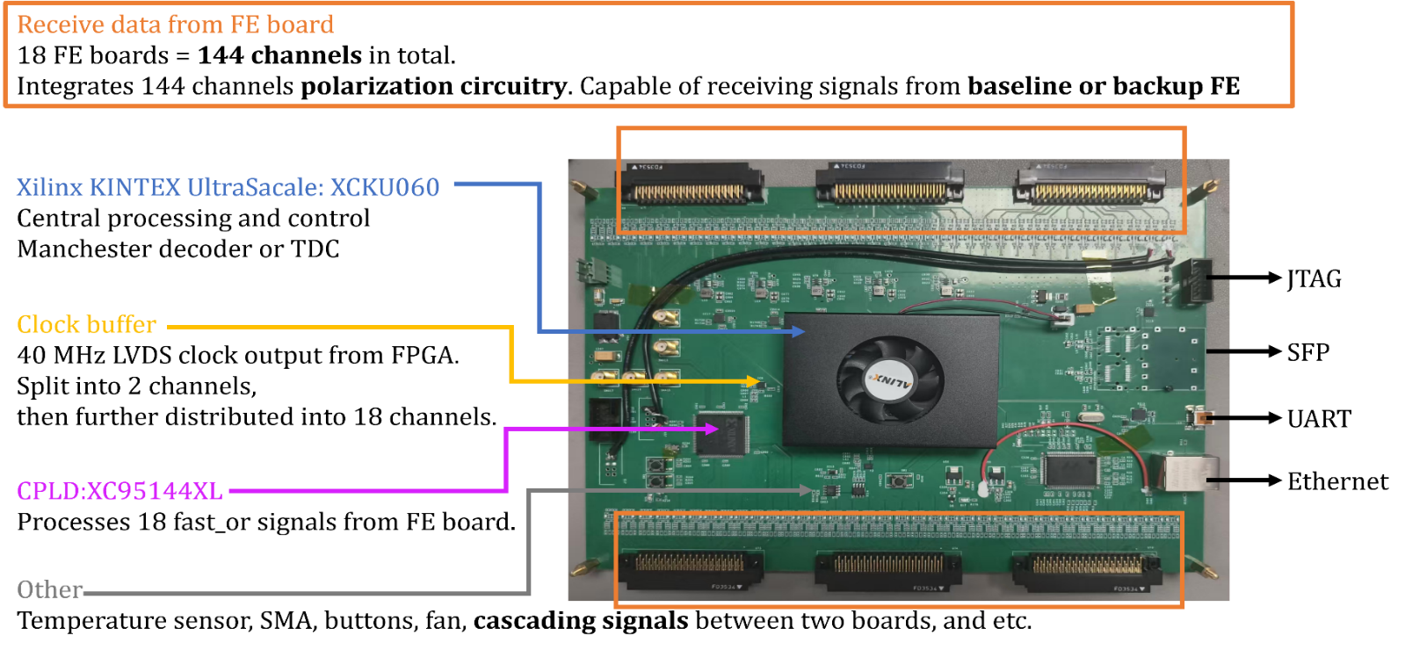
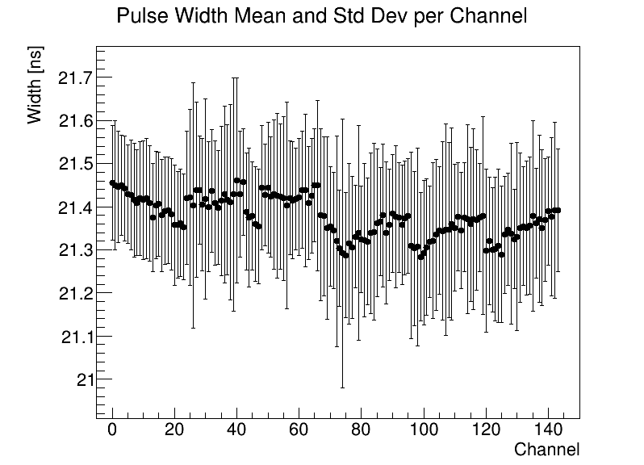
FPGA-based TDC system
  A crucial solution for performance test in mass production
288 channels capacity sufficient for one test station
100 ps time resolution on leading and trailing edge
Flexible trigger mode：external/self/master-slave
Broad potential application field

Slide 13
The delays and solutions
Delay of the gas gap production in GTE
  The gas leak problem
  ➔Solved by mechanical optimization
  ➔Produced leak gap: all refurbished
  Drifting current problem
  ➔Improved by multiple optimization in production
  ➔Produced drifting gaps: re-oiling, Ar-training, etc. on going
Delay of the electronics system
  Supports from other institutions injected
  Several pre-productions in China
  The situation improved a lot to catch up with the plan

Slide 14
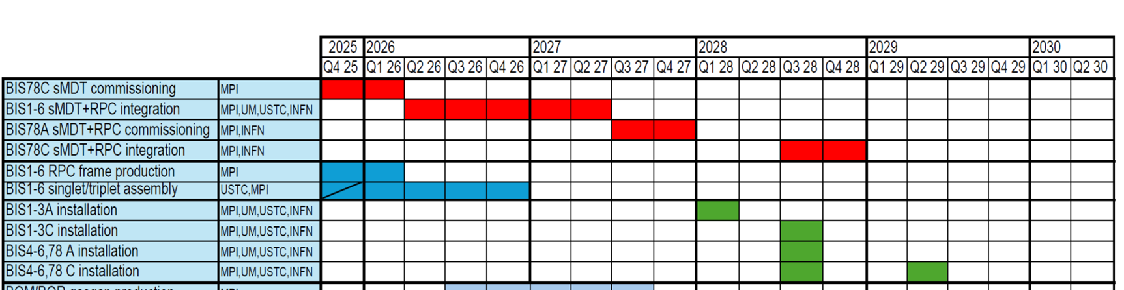
The plan
RPC gas gap production: preparing the material
BIS singlet assembly：
  2025.11-2025.12：setting up the production line in MPI
  2026.1-2026.6：BIS singlet assembly in MPI
BIS singlet qualification：
  2025.11-2025.12：setting up the cosmic test station in MPI
  2026.1-2026.12：BIS singlet qualification test
Join the installation and commissioning

Slide 15
Summary
Huge efforts towards the mass production in 2025, especially with main issues addressed and solved.
The main progresses
  RPC gas gap prototypes produced with all manufacture procedures
  Finished the BIS readout panel production and qualification
  Established the singlet assembly and qualification procedures
  Developed the read out system for performance test station
Close cooperation with all the sub-tasks and institutions, making the project progress smoothly and successfully.
Thanks!

Slide 16
backup
backup

