Slide 1
CGEM Cluster Plots of Run 85756
Jiajv Wang, Linghui Wu, Liangliang Wang
WuHan University, Institute of High Energy Physics
June 9, 2025

Slide 3
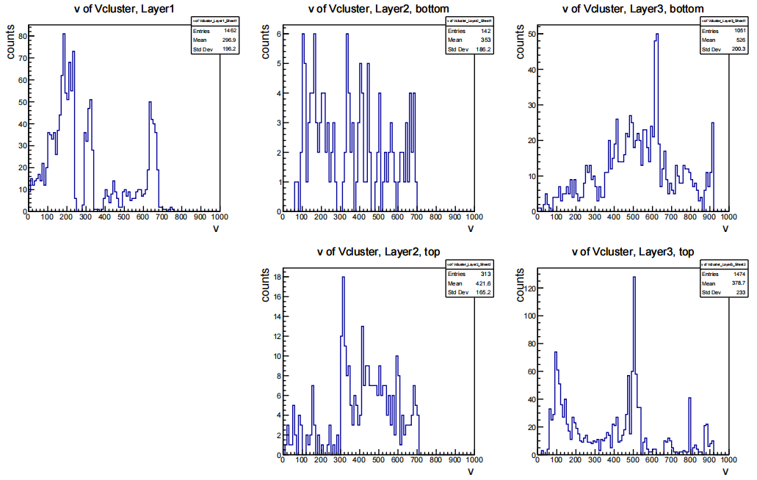

Slide 4
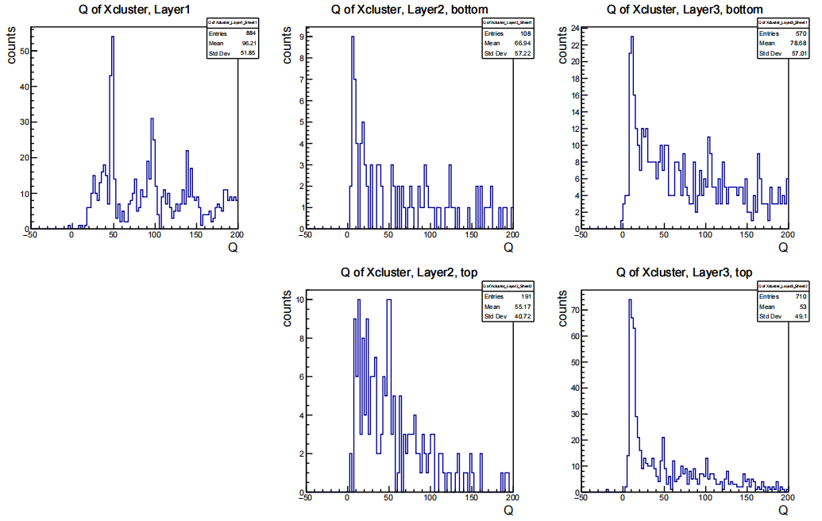

Slide 5
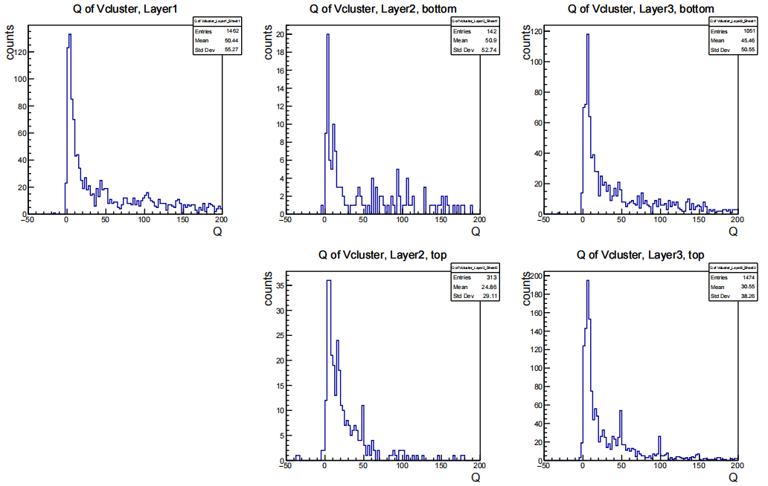

Slide 6
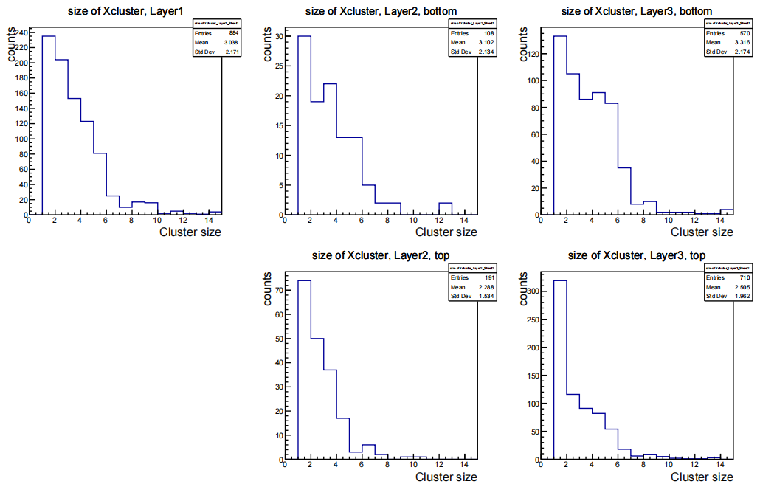

Slide 7
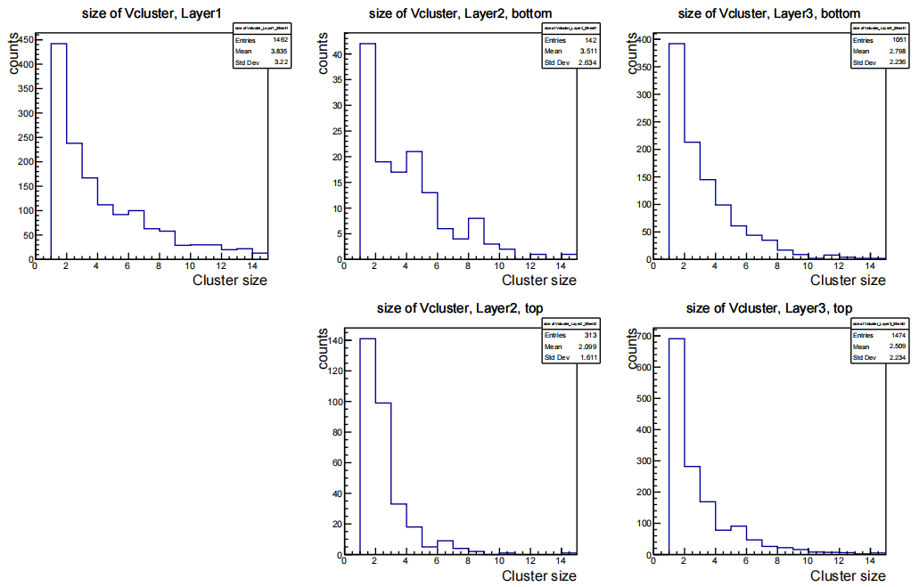

Slide 8
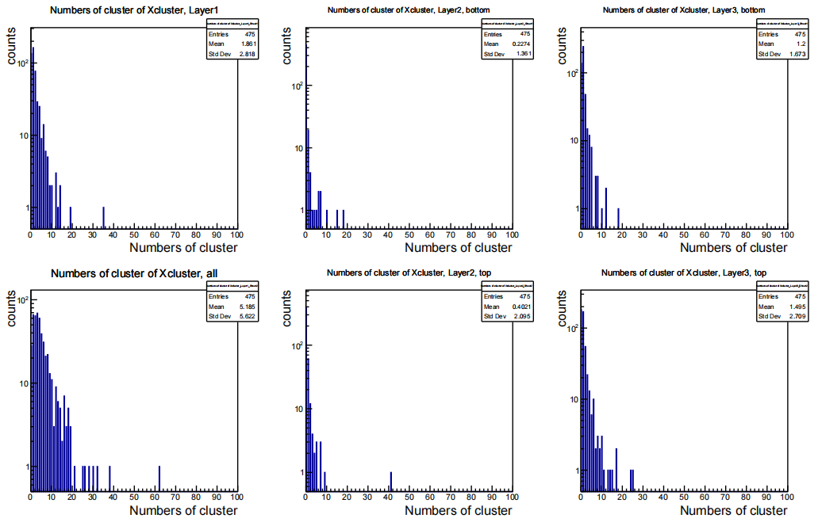

Slide 9
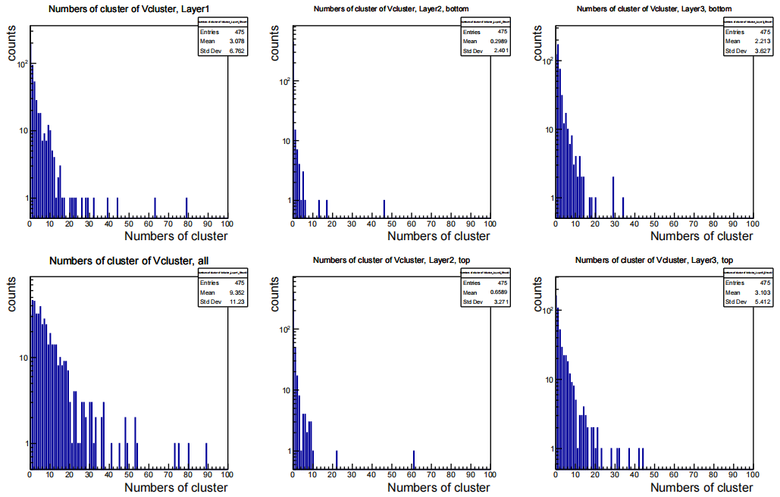

Slide 10
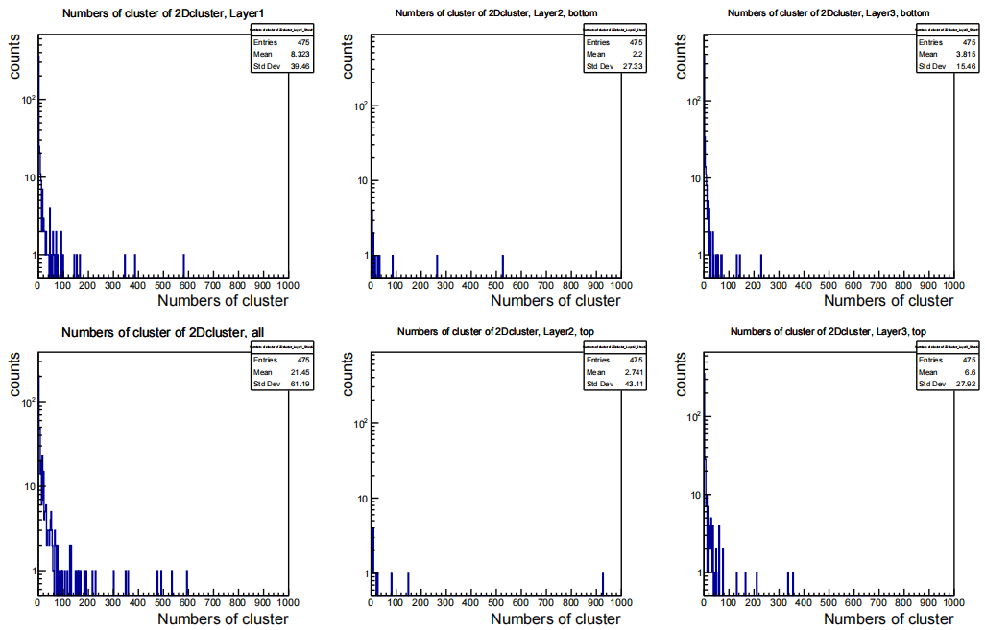

Slide 11
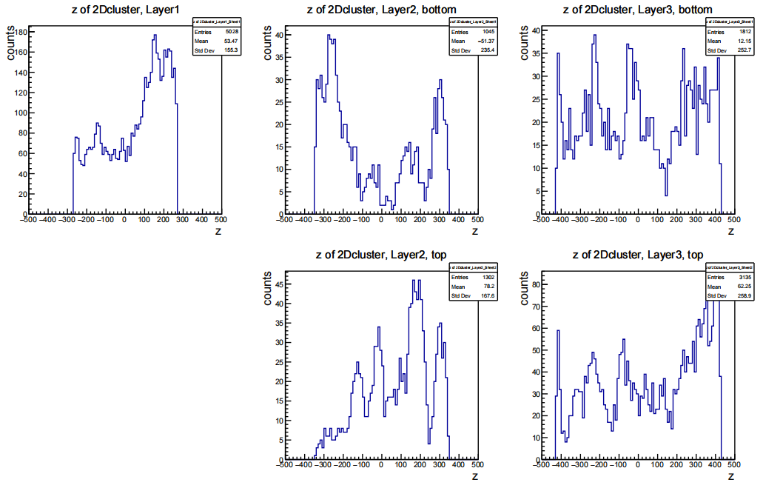

Slide 12
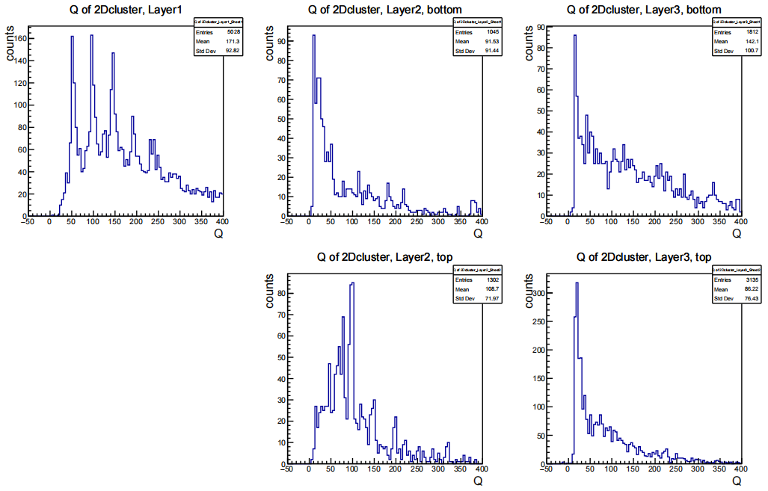

Slide 18
Summary
A certain number of dead channel observed.
Further validation ongoing.

