Slide 1
CGEM data taking with beam
Mingyi Dong
2025-06-9

Slide 2
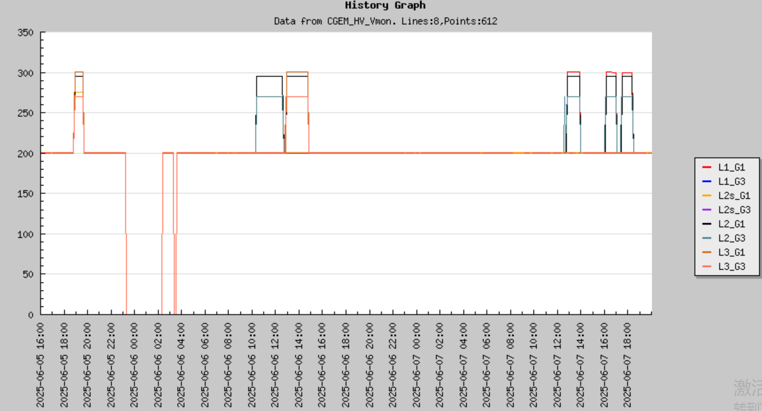
CGEM data taking with beam
From June 5 to 7
Nominal HV: Run 85756 (L1,L2,L2s, L3), 85764 (L1, L2), 85765(L1, L2, L3), 85776(L1,L2), 85777(L1, L2), 85778(L1, L2)

Slide 3
Check results
Run No | start | stop | BESIII event number | CGEM uniq trigger number | CGEM Last trigger number | CGEM check error | Nominal HV
85756 | 2025.6.5 18:57 | 19:33 | 1519318 | 1621224/1224613 | 1621224/1224613 | No | L1, L2, L2s, L3
85764 | 2025.6.6 10:24 | 12:34 | 4249673 | 4335952 | 4335952 | No | L1, L2
85765 | 2025.6.6 12:56 | 14:42 | 3649511 | 1004546/ 3642902 | 1004546/ 3642902 | No | L1, L2, L3
85776 | 2025.6.7 12:54 | 13:58 | 2168719 | 2168719 | 2168719 | No | L1,L2
85777 | 2025.6.7 16:08 | 17:03 | 2152803 | 2152785/2152802 | 2152785/2152802 | No | L1,L2
85778 | 2025.6.7 17:29 | 18:22 | 2121445 |  |  | No | L1,L2
85763 | 2025.6.6 8:45 | 10:04 | 2780004 | 2780003 | 2780003 | No | None
85753 | 2025.6.5 14:51 | 15:04 | 590399 | 590398 | 590398 | No | None
85754 | 2025.6.5 14:19 | 18:21 | 2894945 | 2943325 | 2943325 | No | None
Communication errors between FEBs and GEMROCs can result in packet loss

