Slide 1
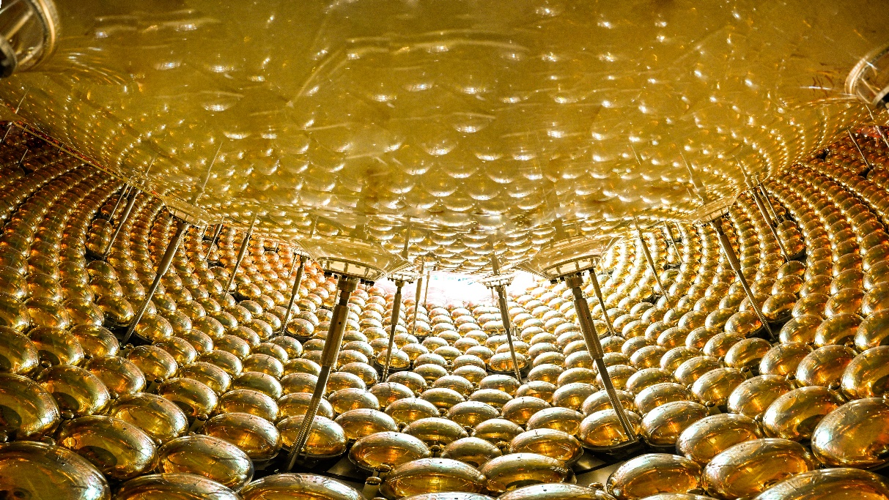
JUNO DAQ 的设计与实现
季筱璐
On behalf of JUNO DAQ Group
长春，2025.8.27
第二十一届全国科学计算与信息化会议

Slide 2
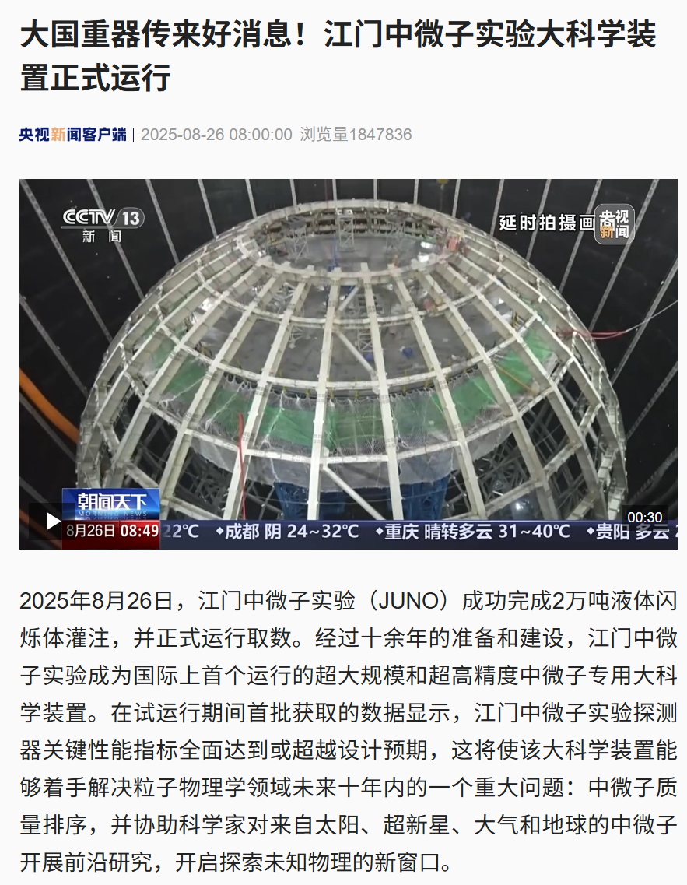
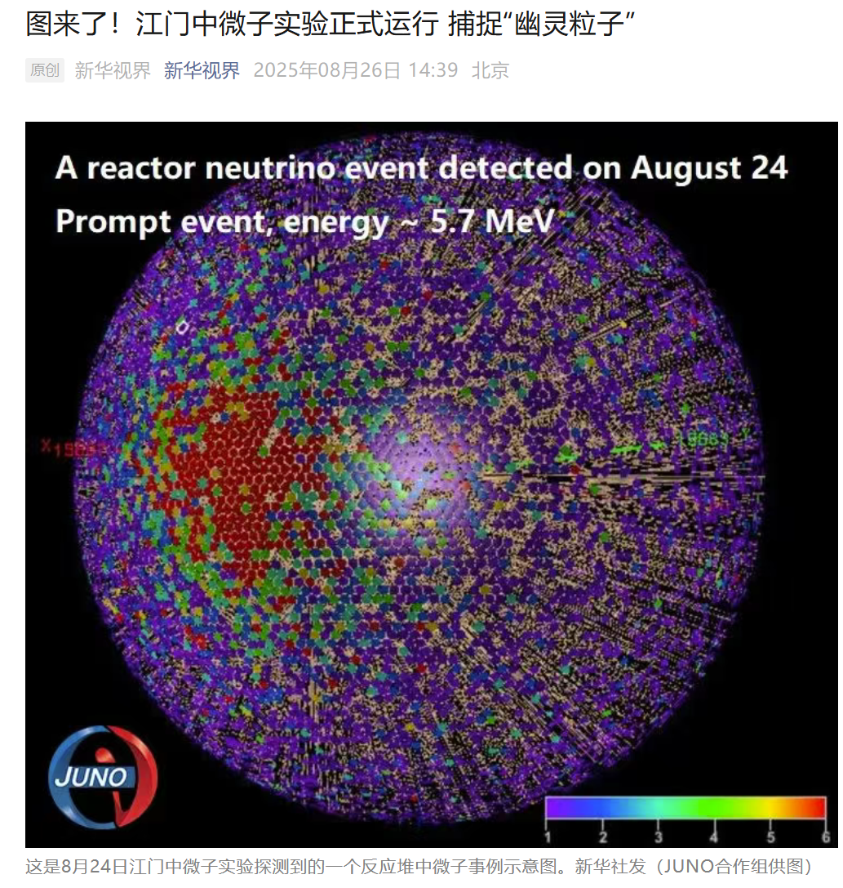
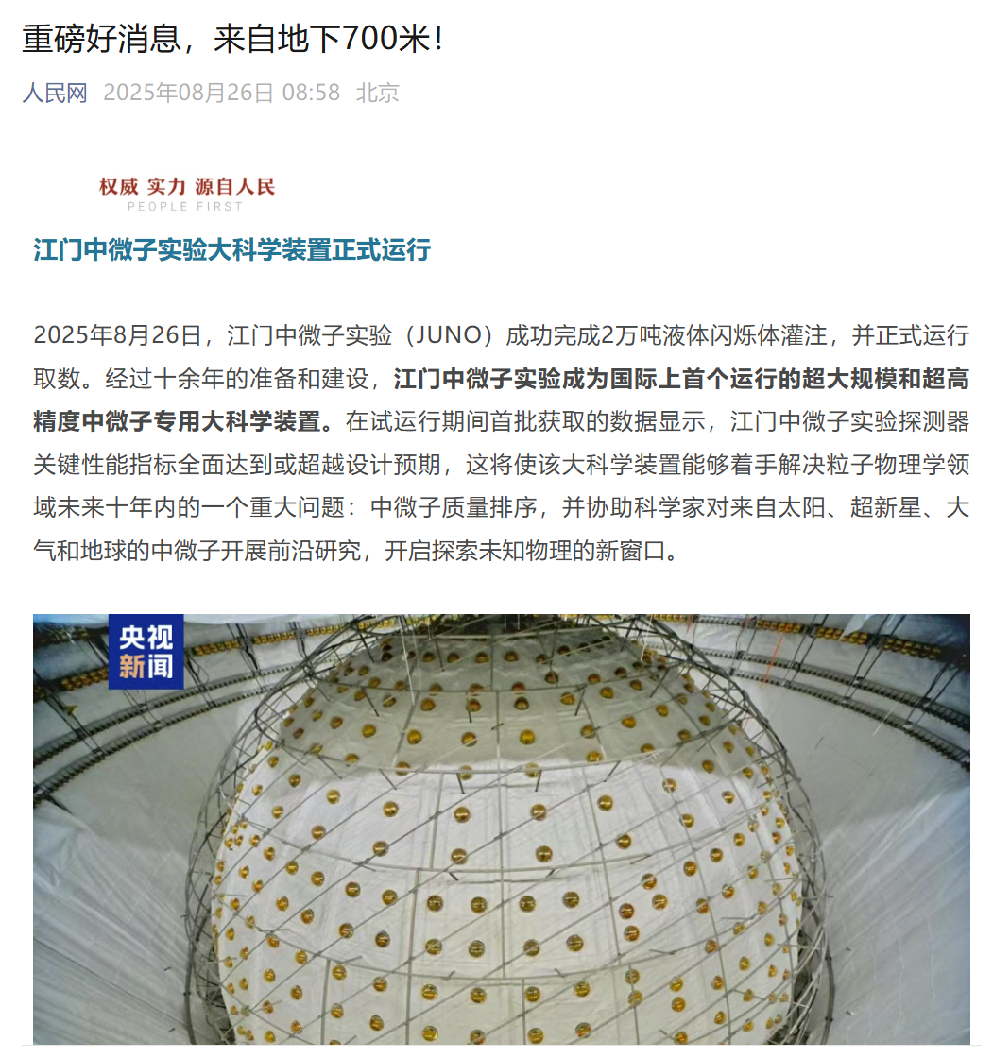
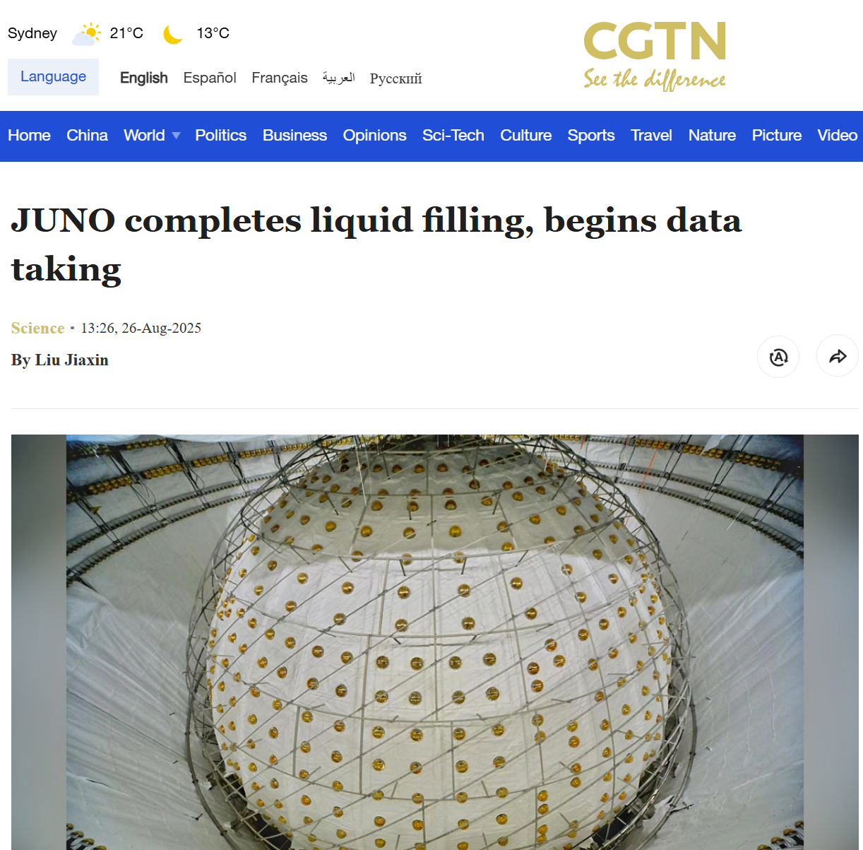
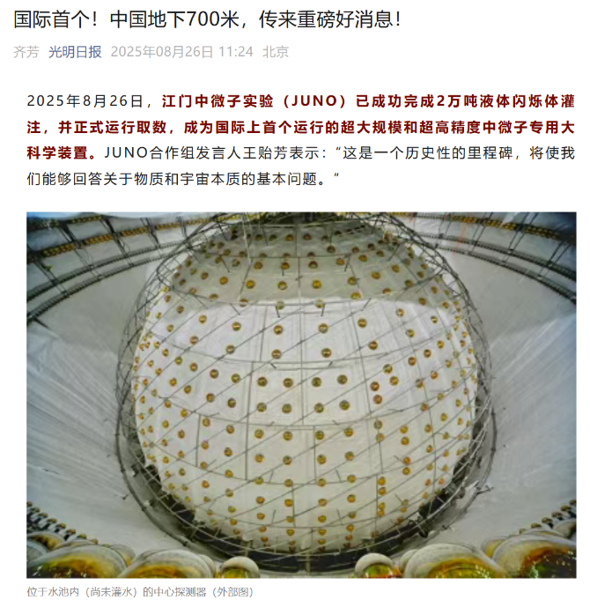
2025.8.26 8:00 正式开始物理运行

Slide 3

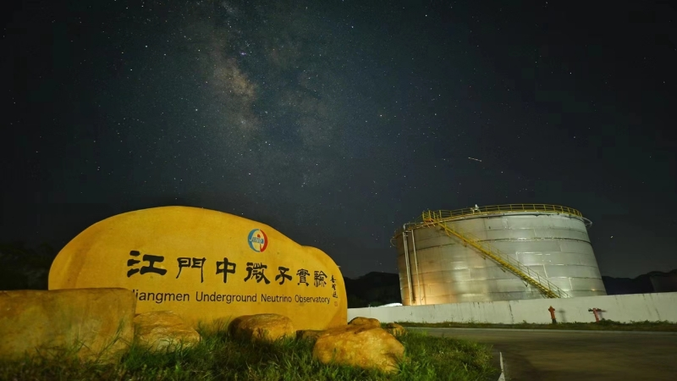
Outline
JUNO实验背景介绍
JUNO DAQ硬件部署
JUNO DAQ软件设计与研发
总结

Slide 4
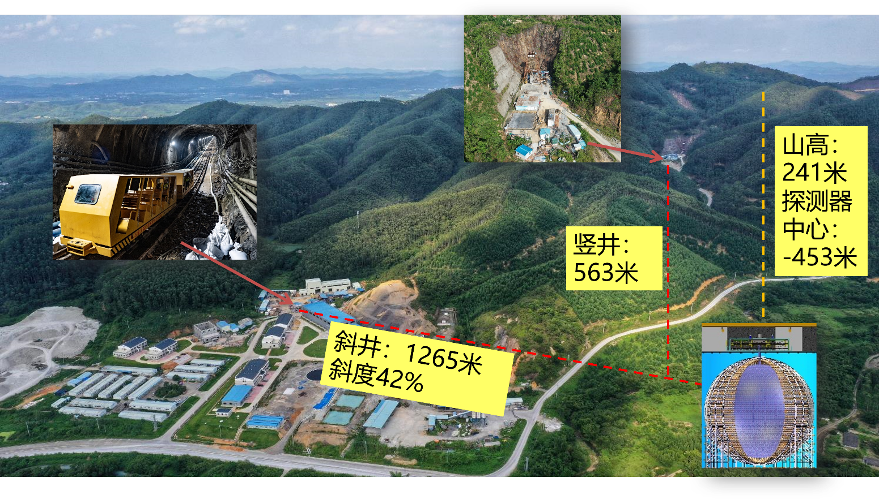
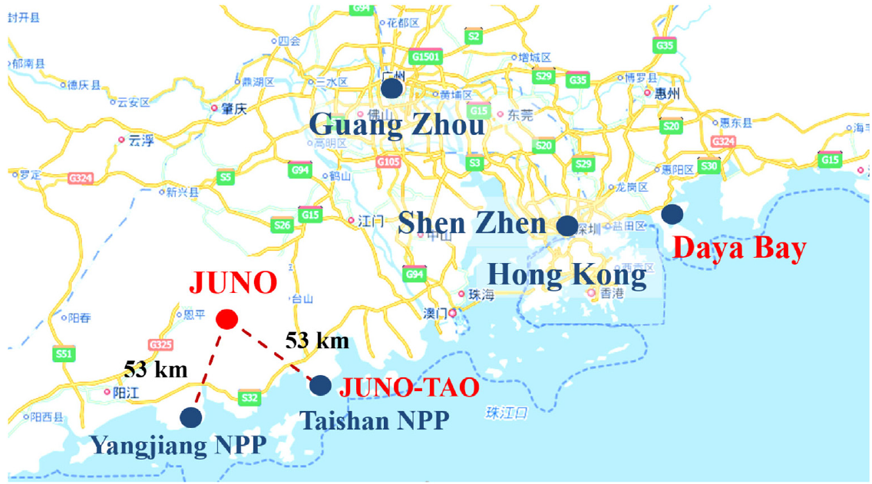
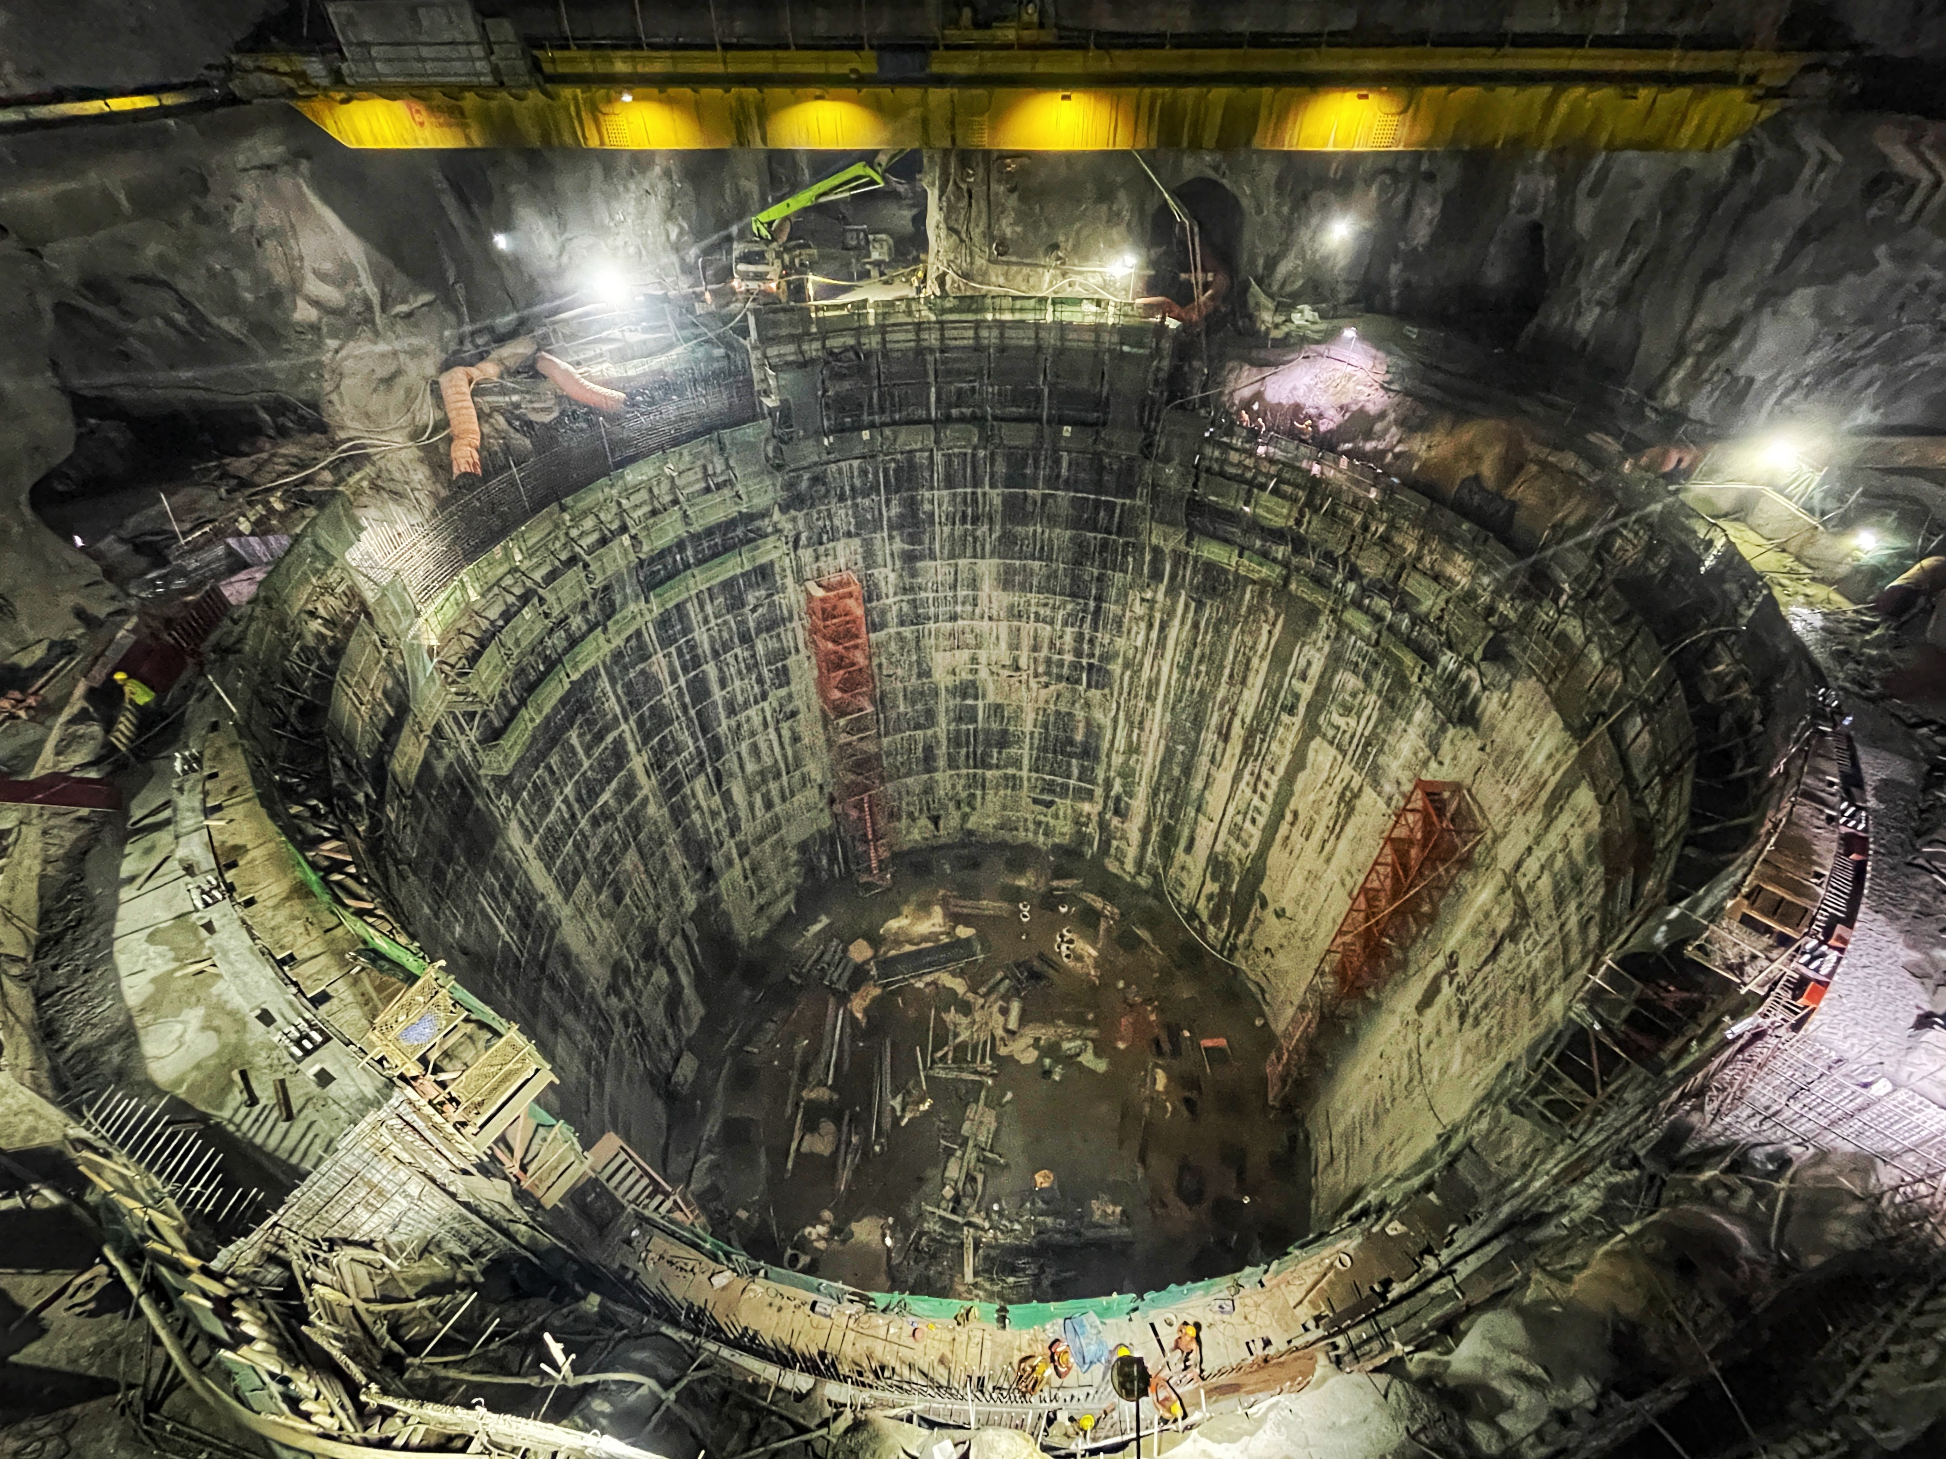
JUNO
Jiangmen Underground Neutrino Observatory
国际最大地下单体实验厅
跨度 > 50 m
• Location optimized for neutrino mass ordering
• 700 m underground to suppress muon-induced background
44 m巨型水池

Slide 5
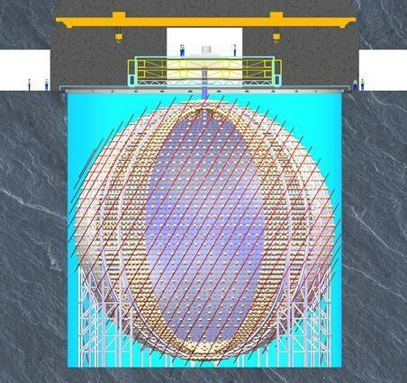
JUNO Detector Design
Two-layers structure for simplicity and cost: stainless steel frame + Acrylic tank
Water as VETO and Buffer(instead of oil) ➔ radiopurity control of water
Calibration
VETO system
Top Tracker: plastic scintillator
Water + 2400 20’’ PMT
Earth Magnetic Field shielding coils
Central detector
Steel structure
Acrylic sphere + 20kt Liquid scintillator
17612 20” PMT
25600 3’’ PMT
AS: ID35.4m
SSS: ID40.1m
44m
arXiv:1508.07166
Prog. Part. Nucl. Phys. 123(2022), 103927
43.5m

Slide 6
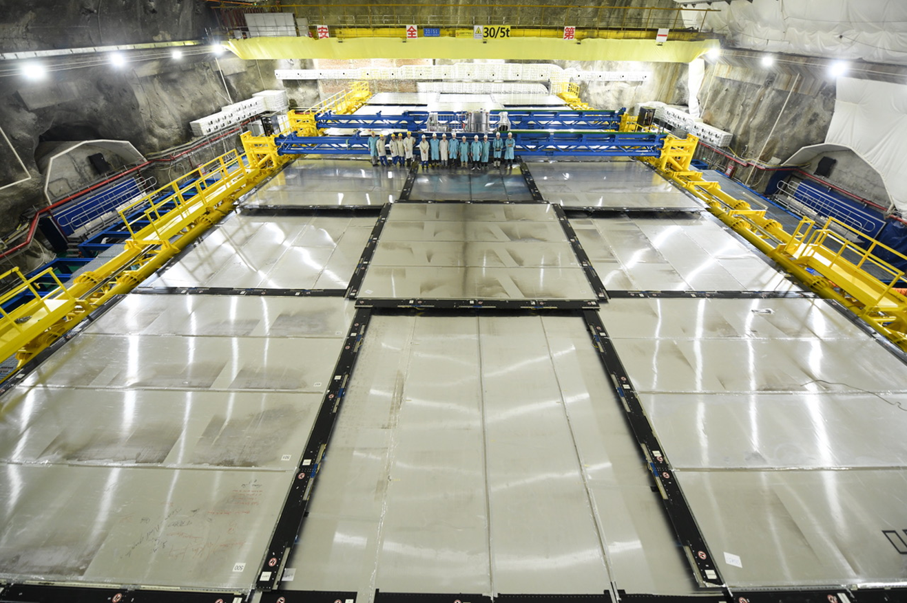
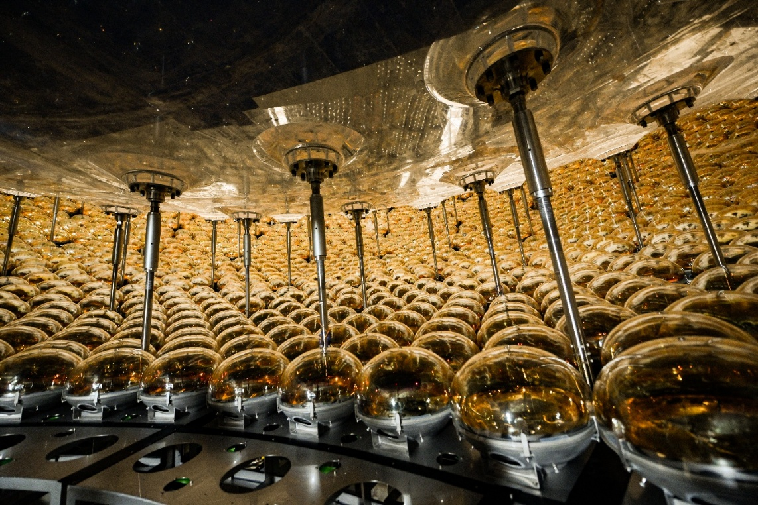
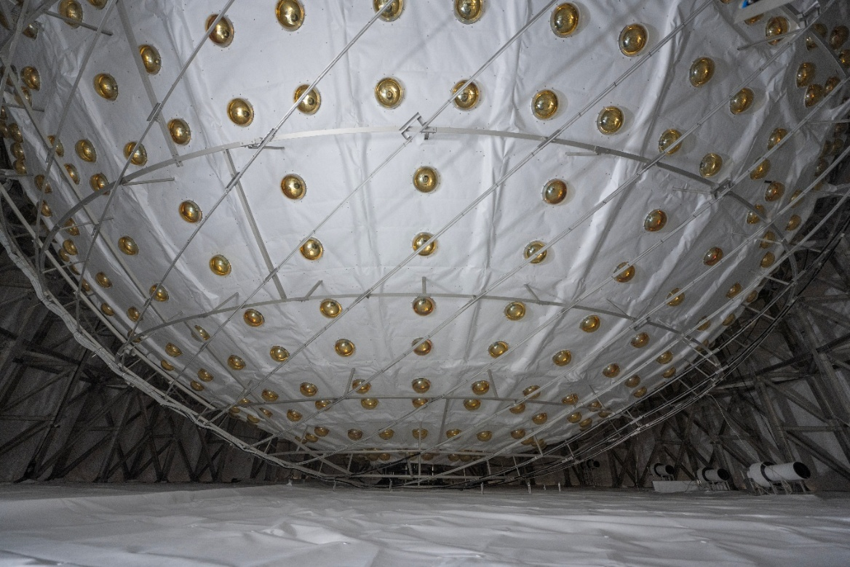
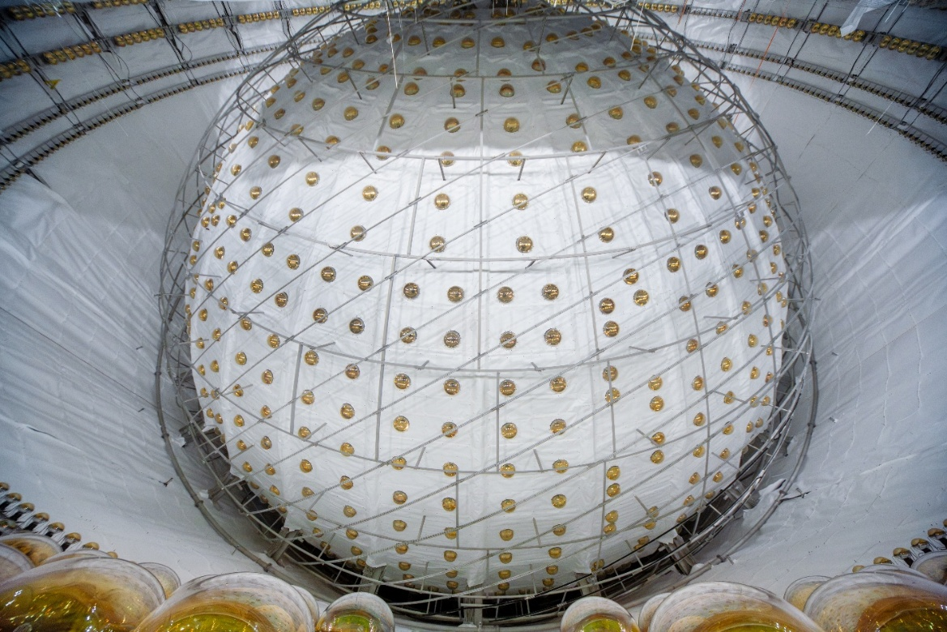

Slide 7
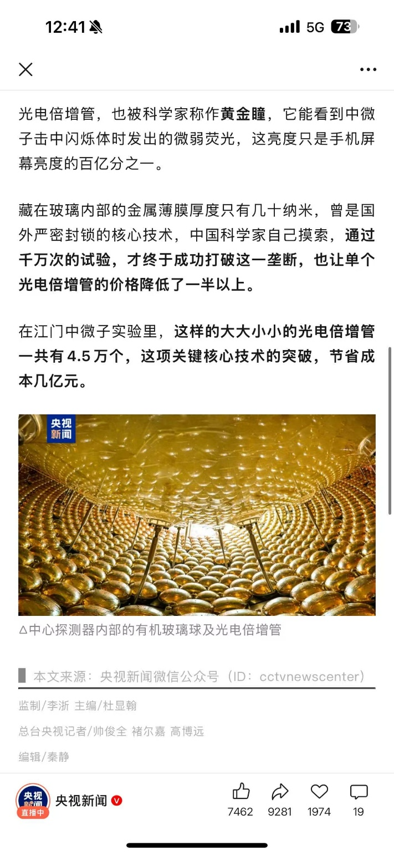

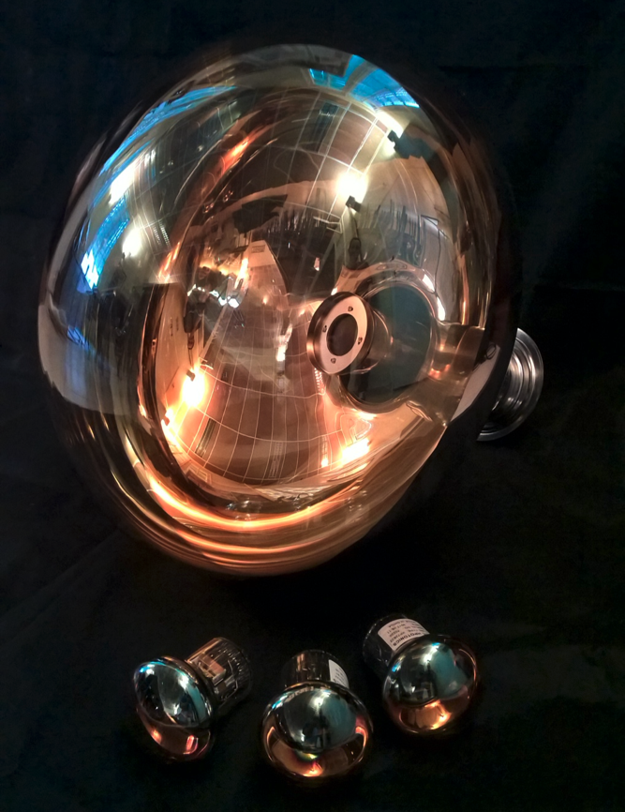
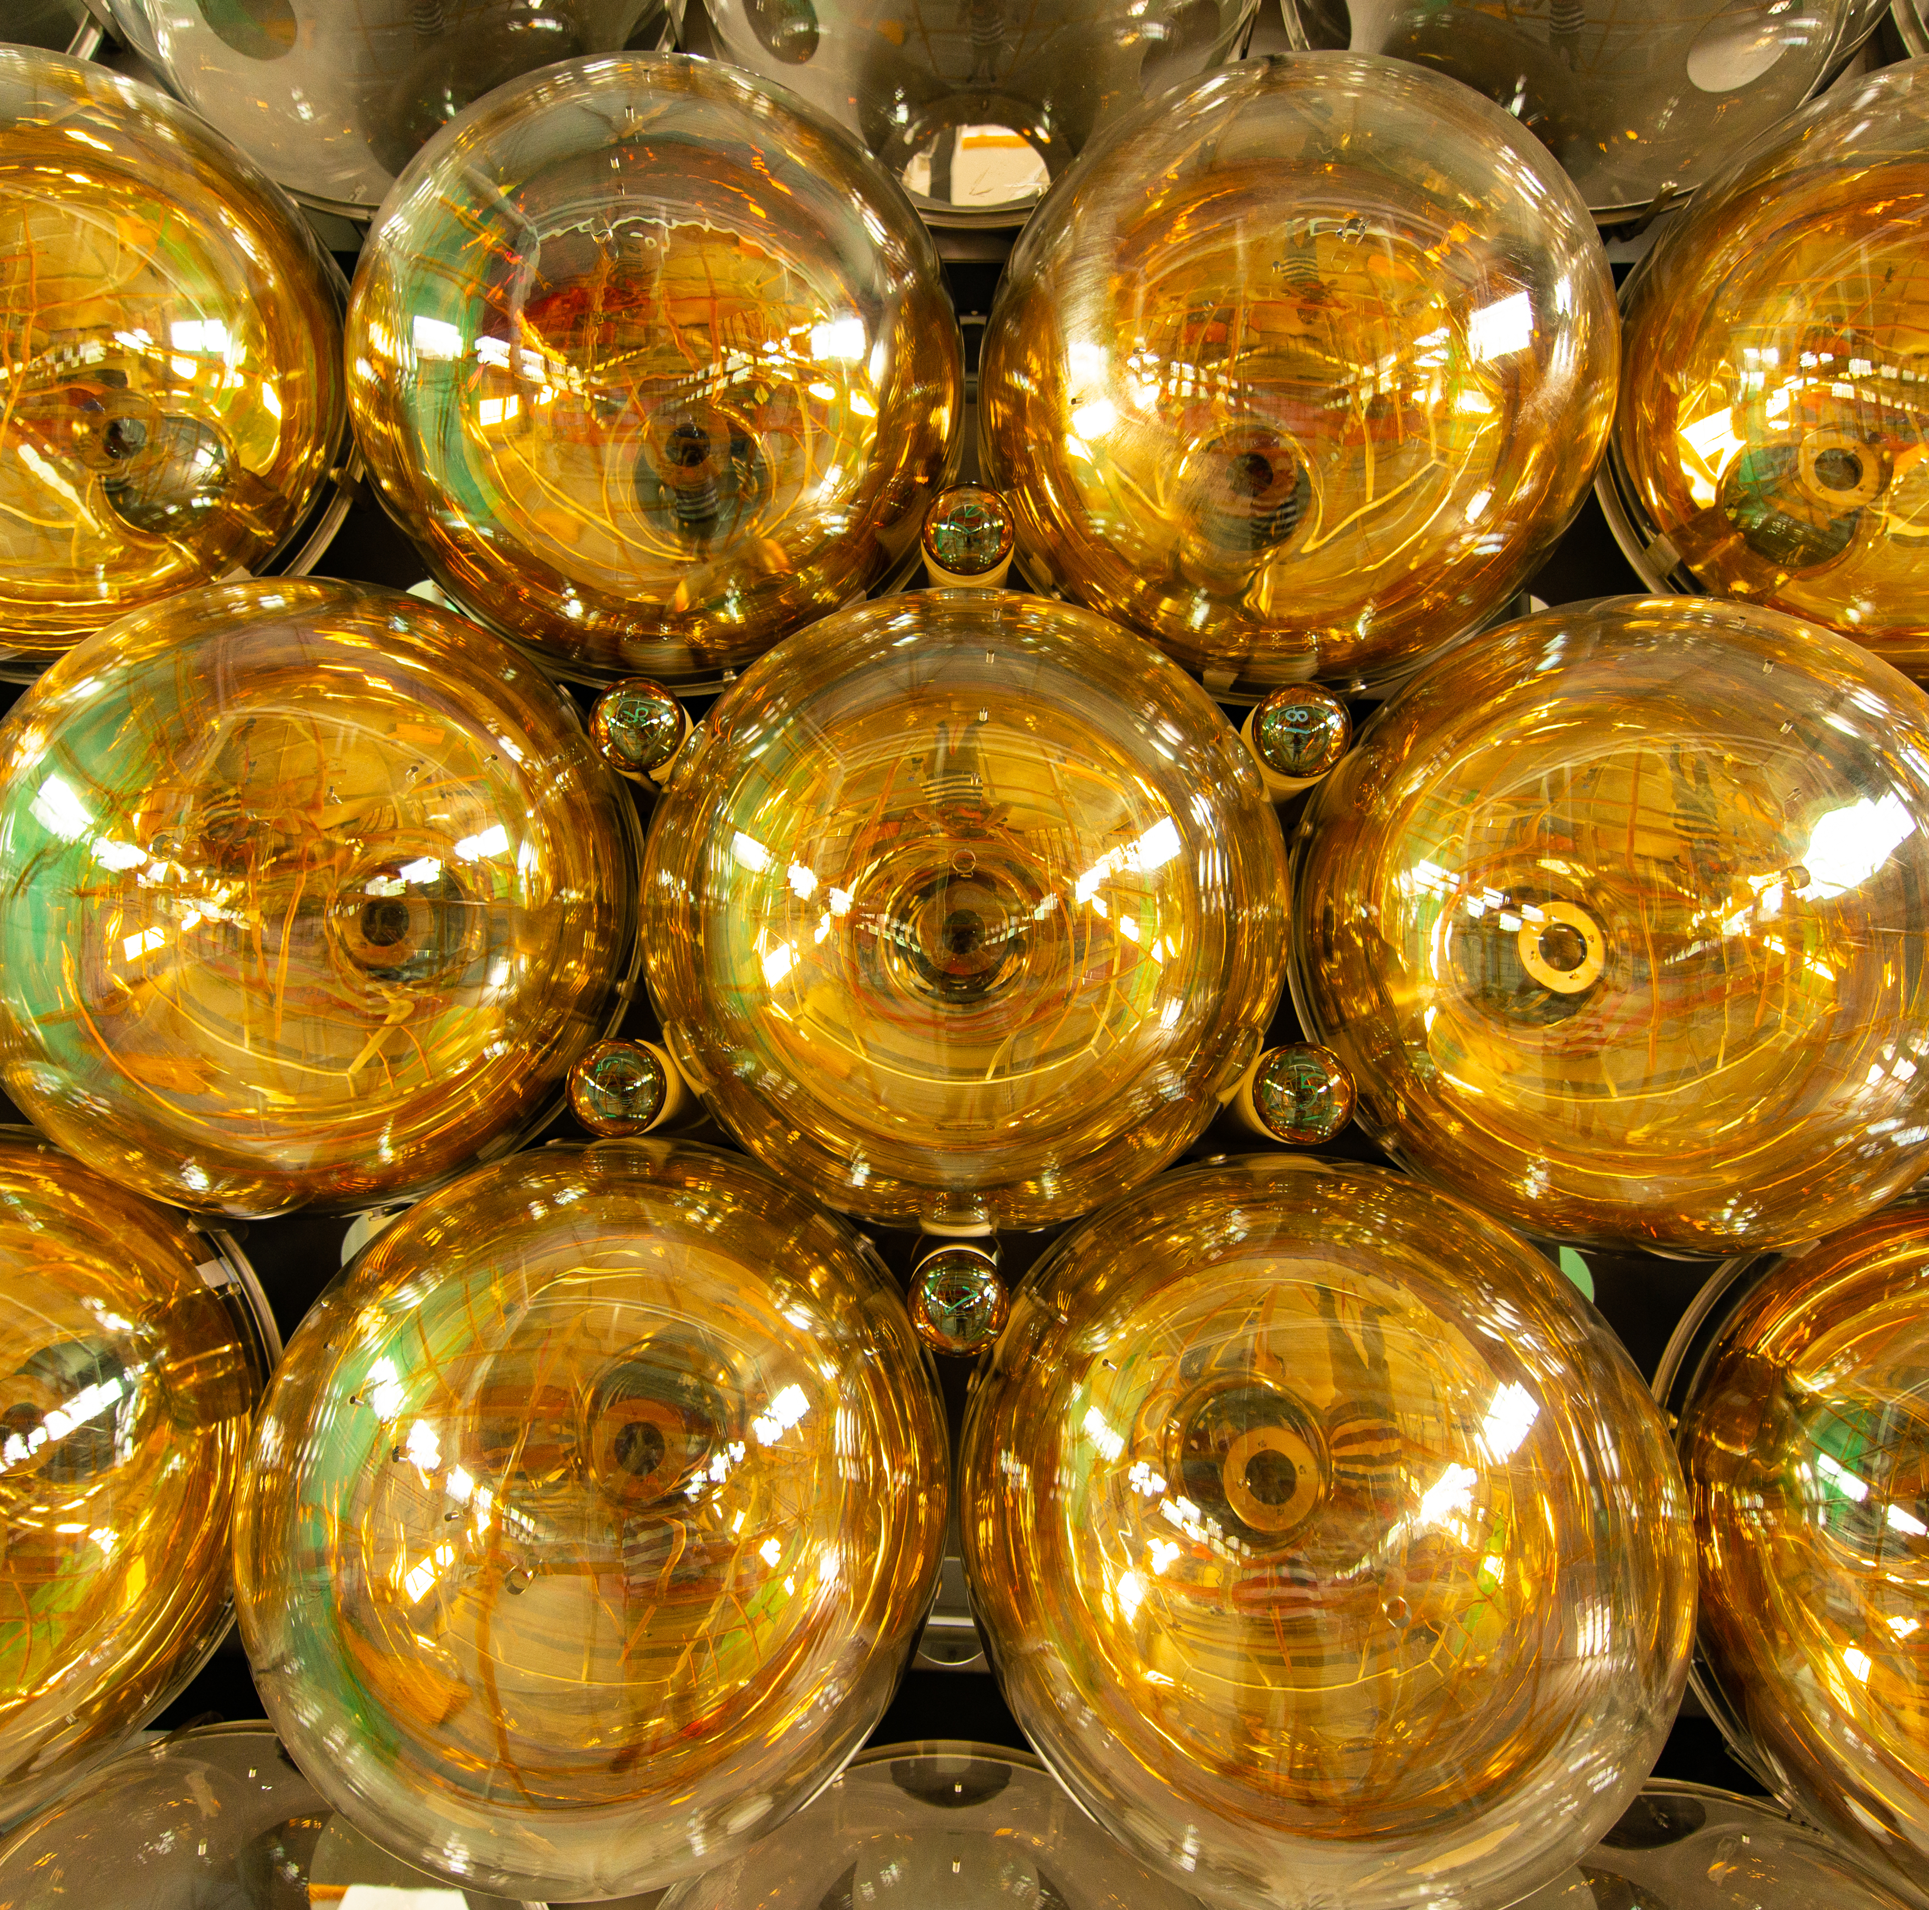
探测器的眼睛：光电倍增管
国内团队自主研发新型50厘米直径PMT
共45600支光电倍增管，通过光电效应探测微弱的光

Slide 8
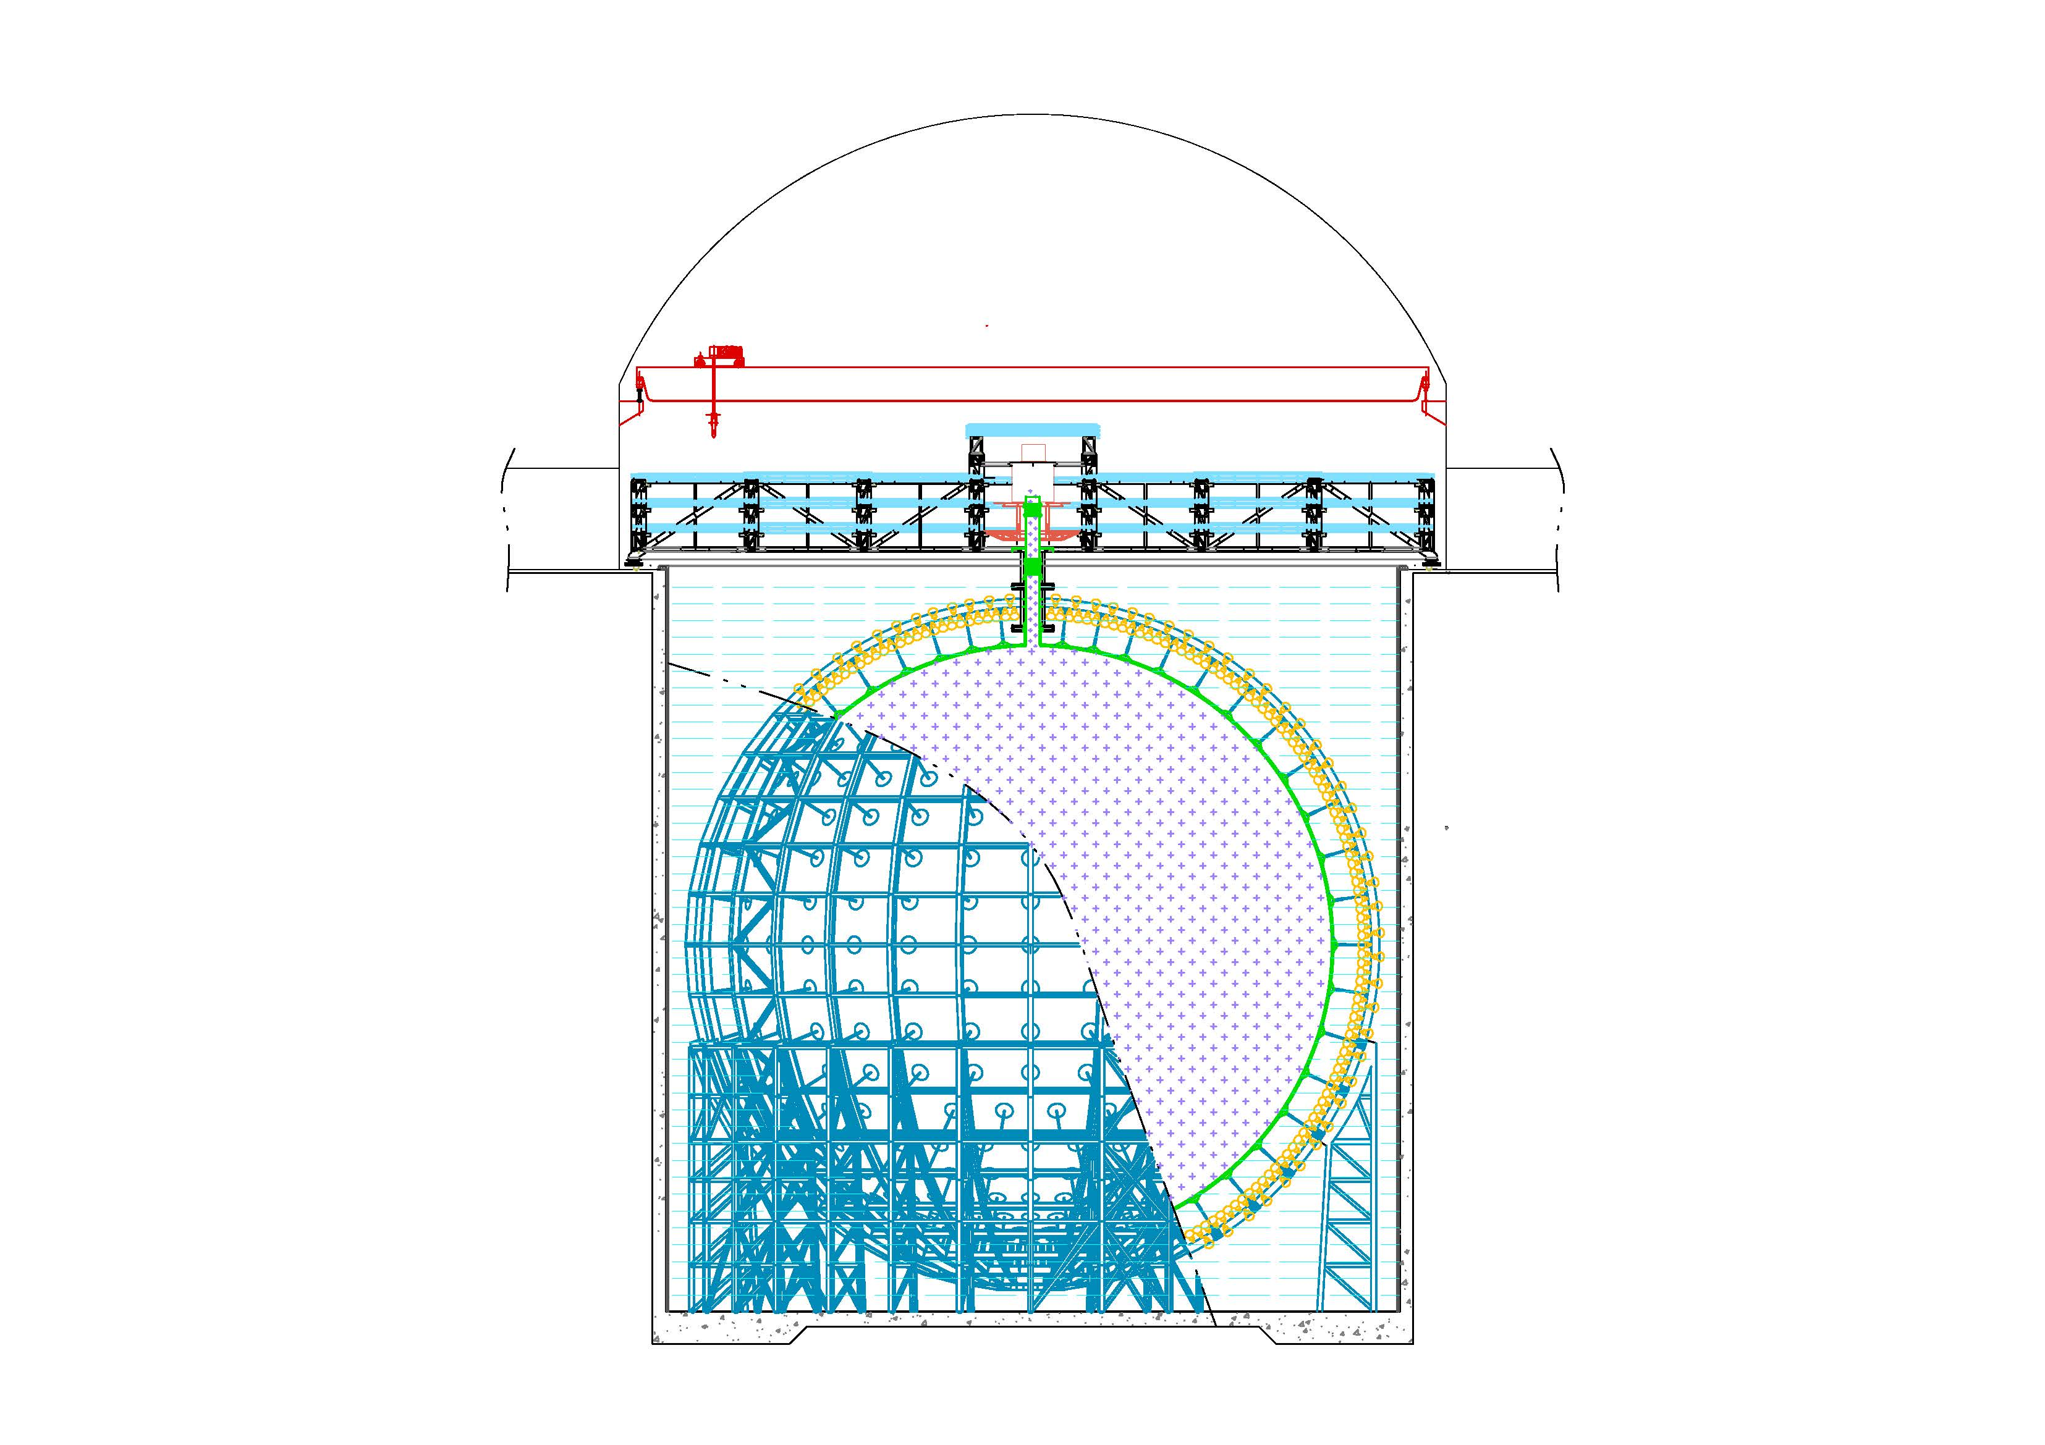
JUNO Detectors‘ Readout
Top Tracker (TT)
Local DAQ, merged to global DAQ before storage
Water Cherenkov Detector (WCD)
2,400 20-inch PMTs
LPMT: 1 GS/s waveform readout with global trigger + trigger-less T/Q data
SPMT: trigger-less readout of T/Q
LPMT readout
Same as CD
Central Detector (CD)
17,612 20-inch PMTs (LPMT) and 25,600 3-inch PMTs (SPMT)

Slide 9
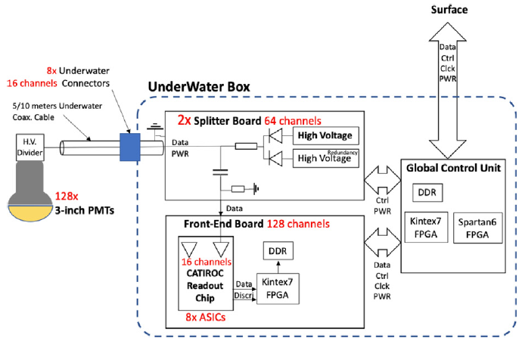
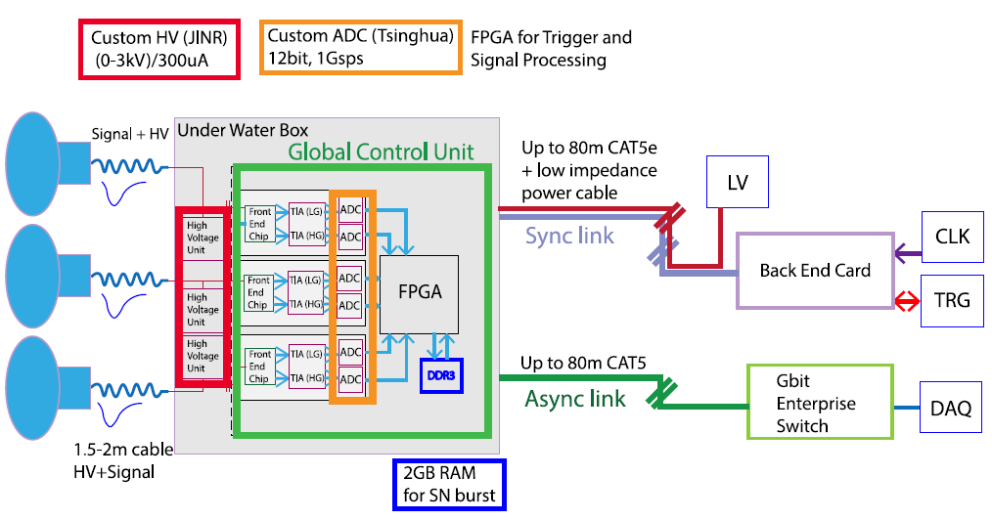
JUNO DAQ Highlights
  3 channels/UWB for LPMTs of CD and WCD : ~6800 UWBs
  18000 * 1GHz sample * 2 Bytes *1 us window *1 kHz trigger rate = 36 GB/s
  trigger-less TQ data rate: 18000 * 30 kHz dark rate * 16 Bytes = ~ 9 GB/s
  128 channels/UWB for SPMTs: 200 UWBs
  500 Hz dark rate * 25600 * 30 Bytes = 375 MB/s
Large PMT electronics scheme
Small PMT electronics scheme
  > 40 GByte/s triggered waveform data and trigger-less time and charge data
  ~7000 readout links with interface: 1 Gbps Ethernet + TCP protocol
  Process events via Online Event Classification to reduce data rate by ∼ 500 times

Slide 10
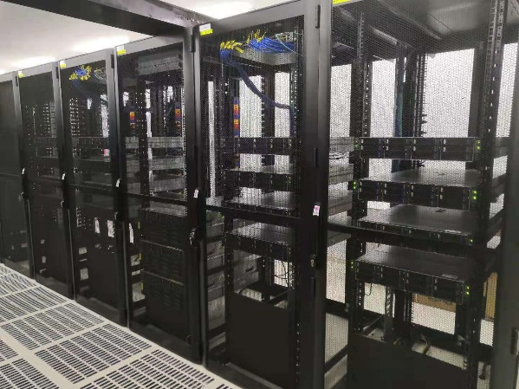
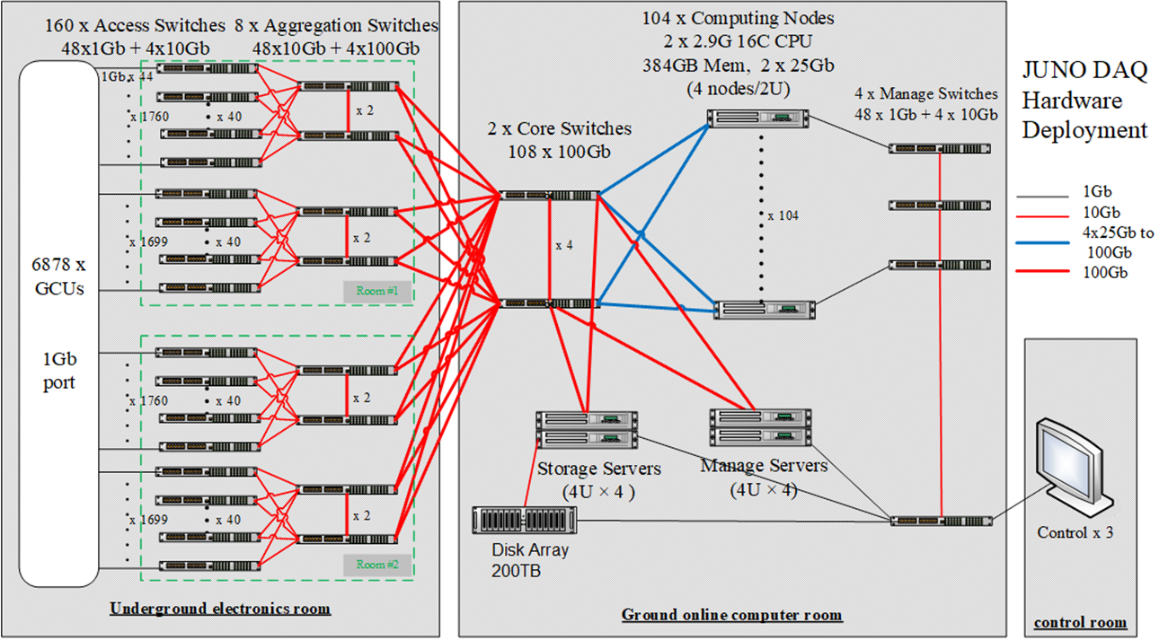
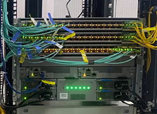
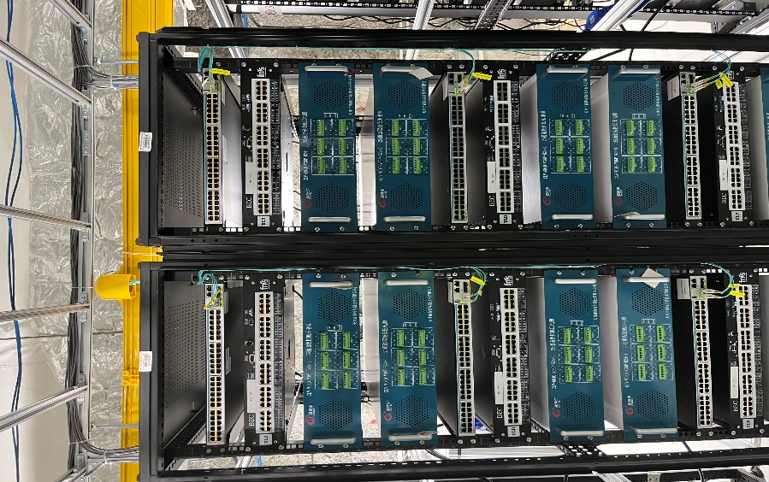
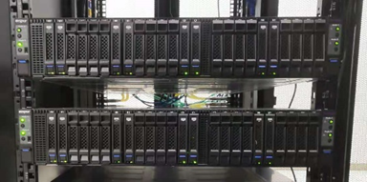
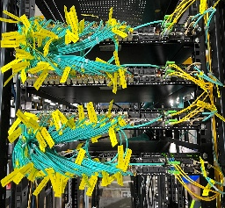
Hardware Implementation
All onsite devices deployed & running for over 2 years
Network dual redundancy design to avoid single point of failure
Total CPU cores: 3328
Computing node：
CPU: Intel(R) Xeon(R) Gold 6226R CPU(16 cores) @ 2.90 GHz x 2
Memory: 384 GB
Network: 2x25 Gb/s uplink

Slide 11
Software Framework
异构流式DAQ框架Radar
heteRogeneous Architecture of Data Acquisition and pRocessing
Version | Deployment | Data rate | Trigger mode | Key updates
V1 | LHAASO | ~ 5 GB/s | SW Only | - Baseline implementation
V2 | JUNO | ~ 50 GB/s | Hybrid | Containerized Partial HA New DP workflow
V3 (Dev) | CEPC detector (Future) | ~ TB/s | Default HW + Possible SW | Heterogeneous processing Full HA

Slide 12
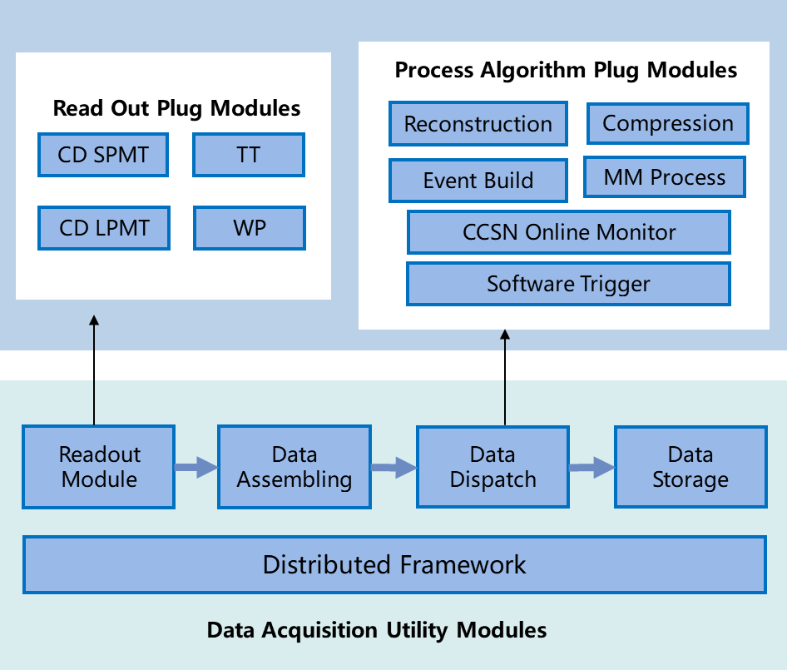




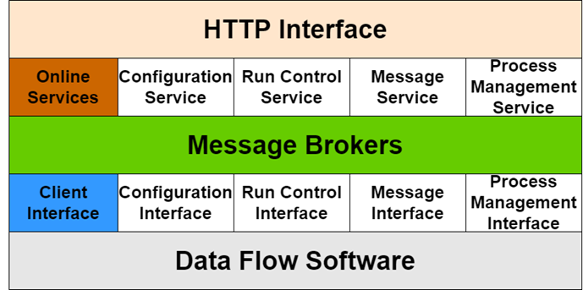

Software Architecture
Radar : general-purpose distributed framework
Transport layer – ZeroMQ
Services – Kafka / ZooKeeper based
Two core software:
  Data flow: process data streams
  Online: management and services
Data Flow Software
Online Software

Slide 13
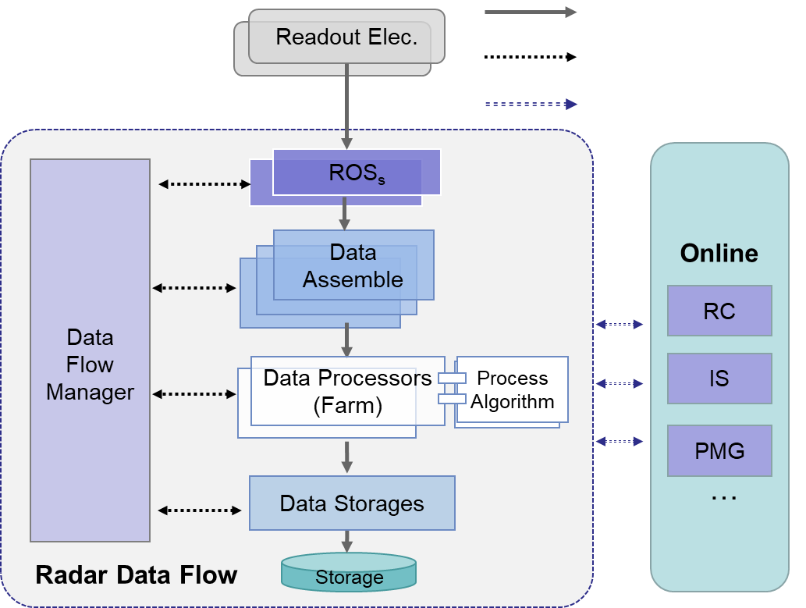
Data Flow Software
Radar data flow
Lightweight structure
ROS + DA + DP + DS
Plug-in modules design
Integrate customized readout / processing modules
ROS: ReadOut System
DA: Data Assemble
DP: Data Processor
DS: Data storage
Chen, Chao, et al. "Design and Development of JUNO DAQ Data Flow Software.“
IEEE Transactions on Nuclear Science (2024).

Slide 14
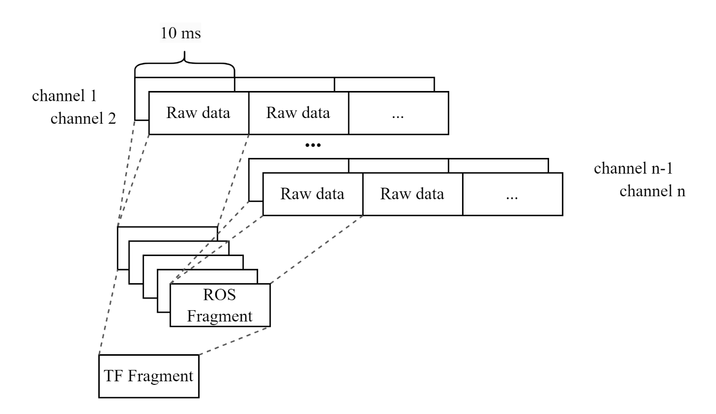
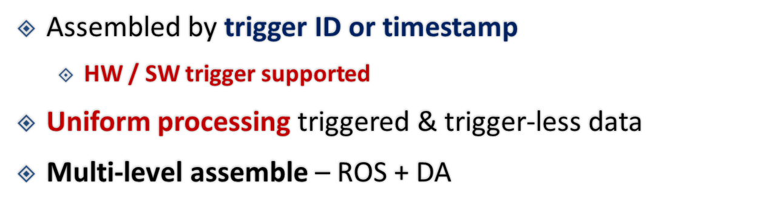
Data Readout & Assemble
Readout Elec.
基于时间切片
DFM message
Readout Elec.
Raw data stream
Raw data
DFM
ROS_{s}
ROS Fragments
ROS₁
DA_{s}
高触发率场景
  Muon事例
  局部PMT打火
  超新星事例
Timed Fragment
固定间隔的时间片可能导致单个时间片过大
@ 1 kHz: 17612 * 10 * 2048 Bytes = ~360 MB
10 kHz
3.6 GB
1 MHz
360 GB

Slide 15
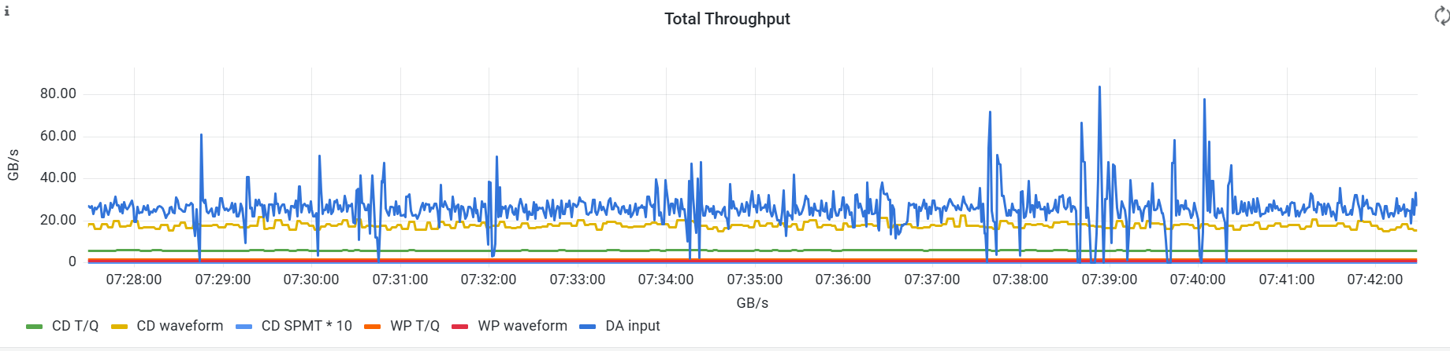
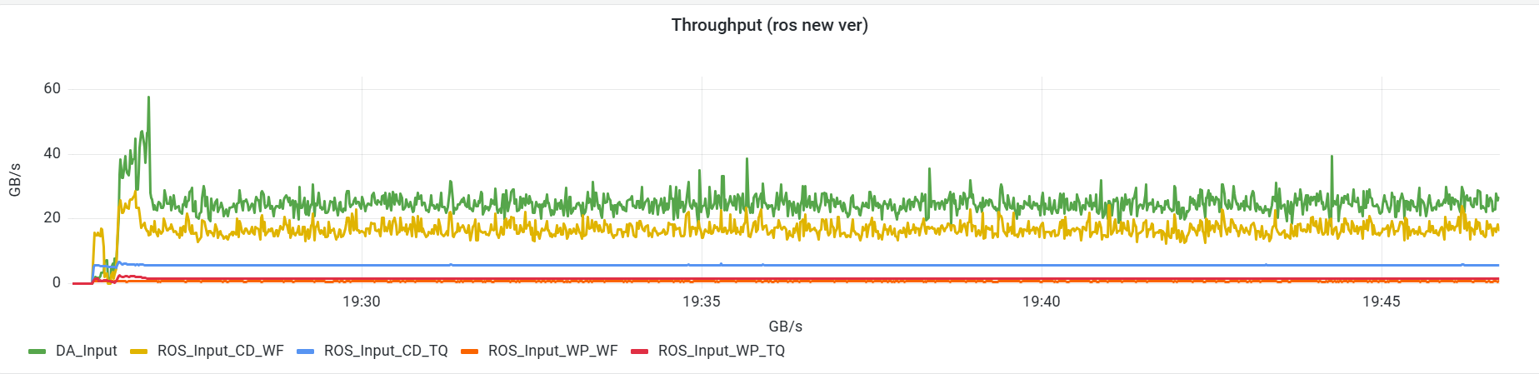
读出模块升级
定长时间片→不定长时间片
升级前
时间片管理模块TFM
分布式的读出模块
获取全局事例时间信息
集中、灵活的时间分片
升级后
陈超，“JUNO DAQ数据流读出模块的升级与实现”
https://indico.ihep.ac.cn/event/26373/contributions/198315/

Slide 16
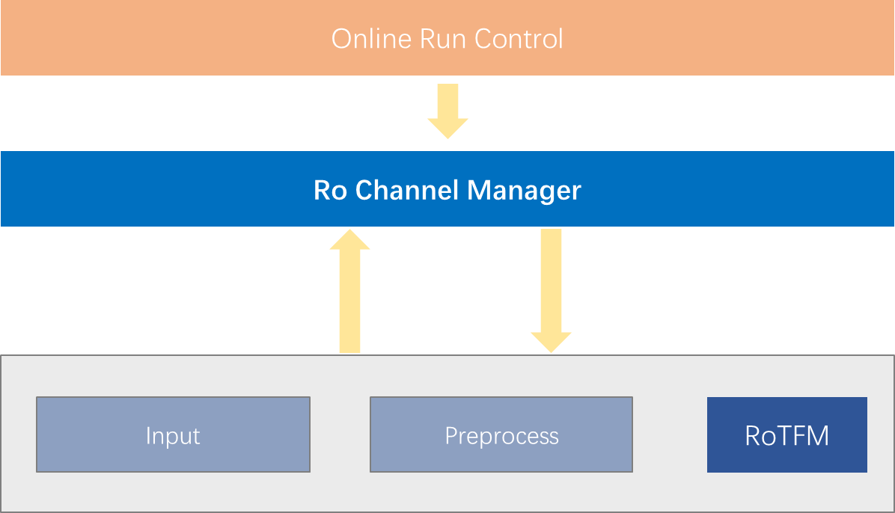
读出级通道管理组件
通道信息>6万路 -> 实现动态的通道增加与删除，从源头解决问题
读出软件内的高可用功能设计→支持不间断运行
采用事件总线的设计
  事件处理器异步执行通道的禁用/启用
  对外接口：消息传递+通道管理函数注册
管理全局的通道状态信息
内外一致的调用接口
  对内：自动 + 对外：手动

Slide 17
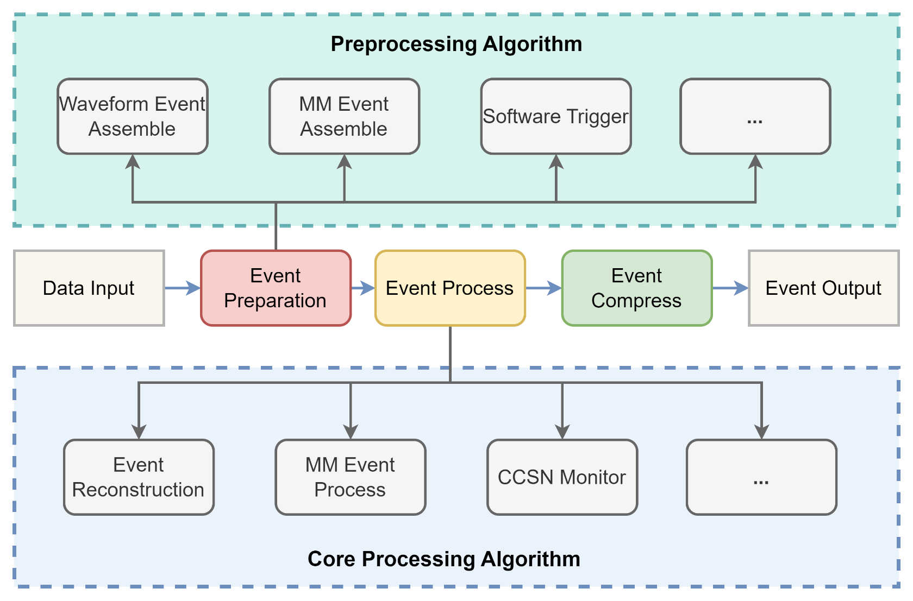
在线数据处理
Data processing is flexible, configurable
Customized alg.
Multi-stage data processing:
Data preparation / preprocessing
Core event processing
Parallel processing
Interface provided
Plugin algorithm deployment
Customized alg.
CCSN: Core Collapse SuperNova
MM: Multi-Messenger

Slide 18

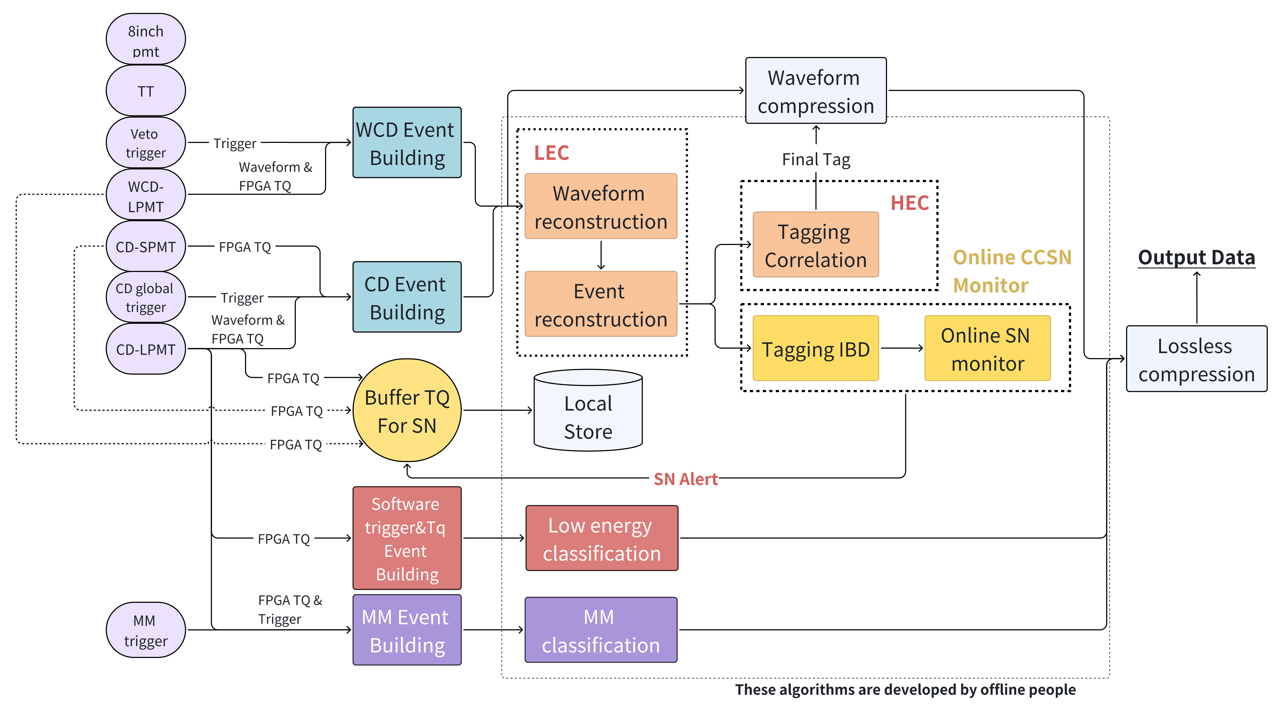
在线处理软件实现
JUNO在线软件核心业务流
1. 波形事例组装
2. 在线事例鉴别
4. 软件触发
3. 超新星预警
5. 多信使事例组装

Slide 19
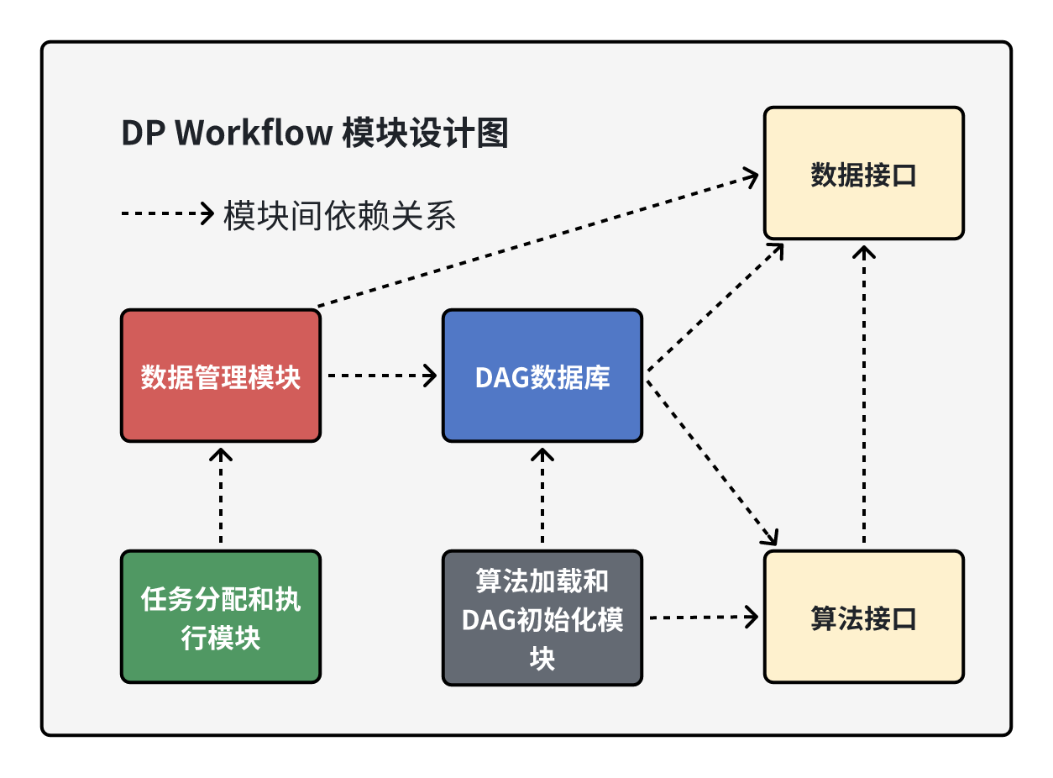
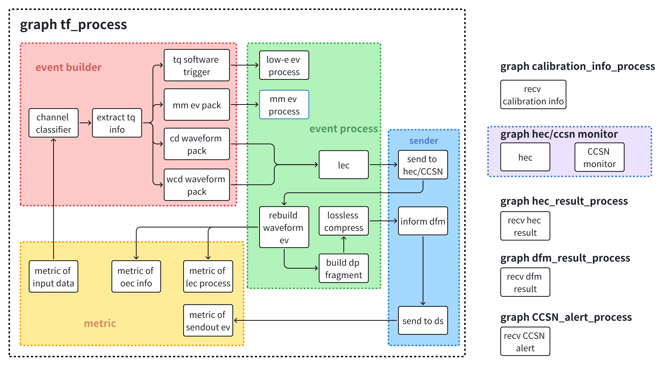
数据处理框架（DP workflow）
传统的流水线处理模式，存在流程固化、资源僵化、管理和扩展性受限的挑战，难以应对愈加复杂的在线处理
张叙，“JUNO在线数据处理软件框架”
https://indico.ihep.ac.cn/event/26373/contributions/198304/
利用有向无环图DAG架构，数据流驱动+自动化任务编排
核心优势
自动化处理
高效并行
灵活可扩展
异构任务兼容
DAG：复杂异构系统的“万能粘合剂”，将异构任务转化为统一模型实现自动调度
在线事例处理软件业务函数图
7种业务图、25个业务处理算法
基于DAG实现自动化调度，为在线数据处理提供灵活高效的解决方案

Slide 20
在线事例鉴别Online Event Classification
Data Assemblers
High Level Event Classification
Raw data stream
~ 40 GB/s
OEC
Including two levels:
Distributed parallel computing (LEC)
Global serialized computing (HEC)
1. Full channel data
2. LEC result
3. Event type
Data Processers
Low Level Event Classification
OEC
OEC Adaptor
4. Compressed data
Event Compress
…
Data Storages
Data to storage
~ 60 MB/s
Interlayer between DAQ and offline
— Reuse offline software online
JUNO OEC Processing
raw data
Storage
message
OEC based on online reconstruction – suppress waveform data
Offline code directly embedded, making development and deployment easier

Slide 21
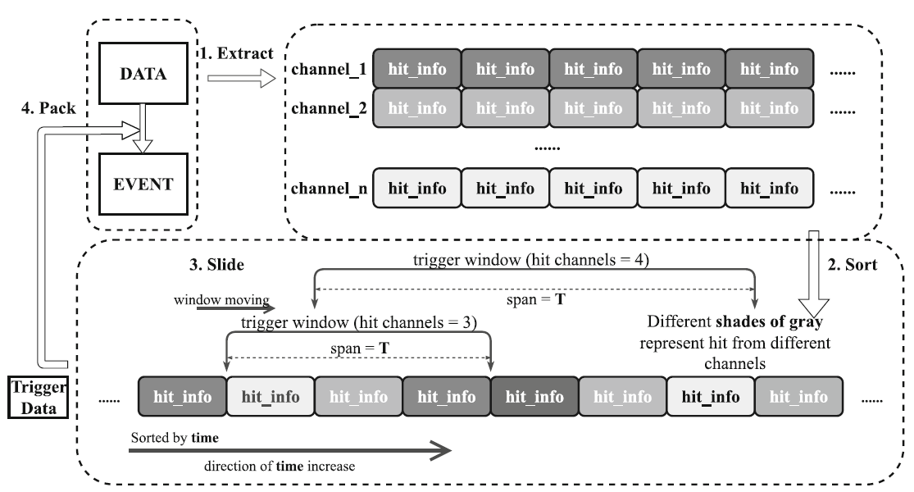
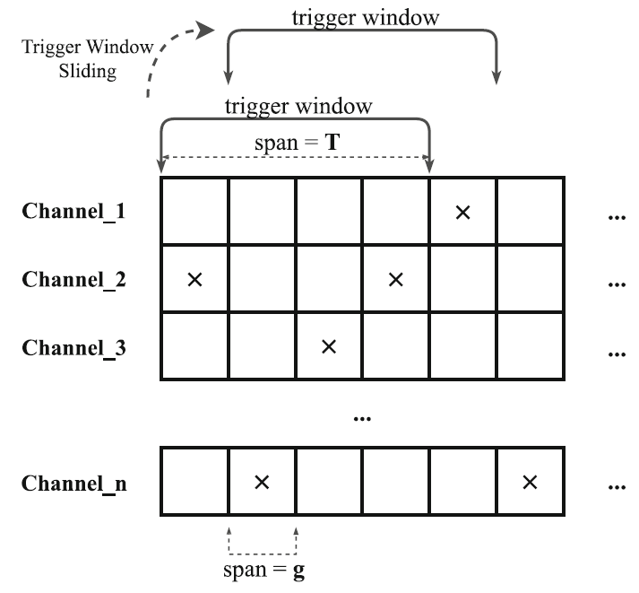
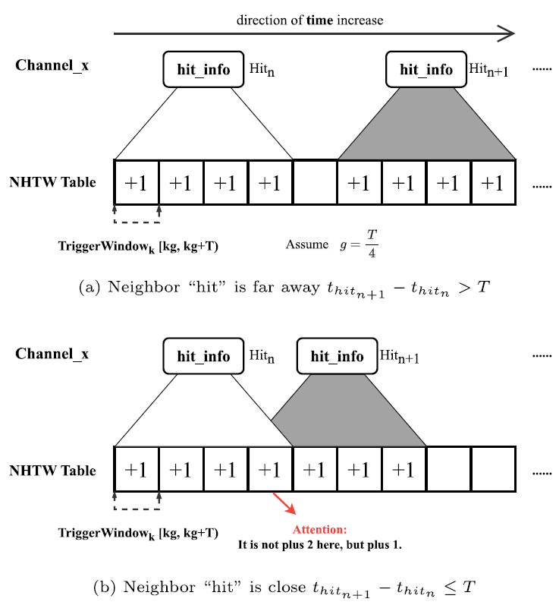
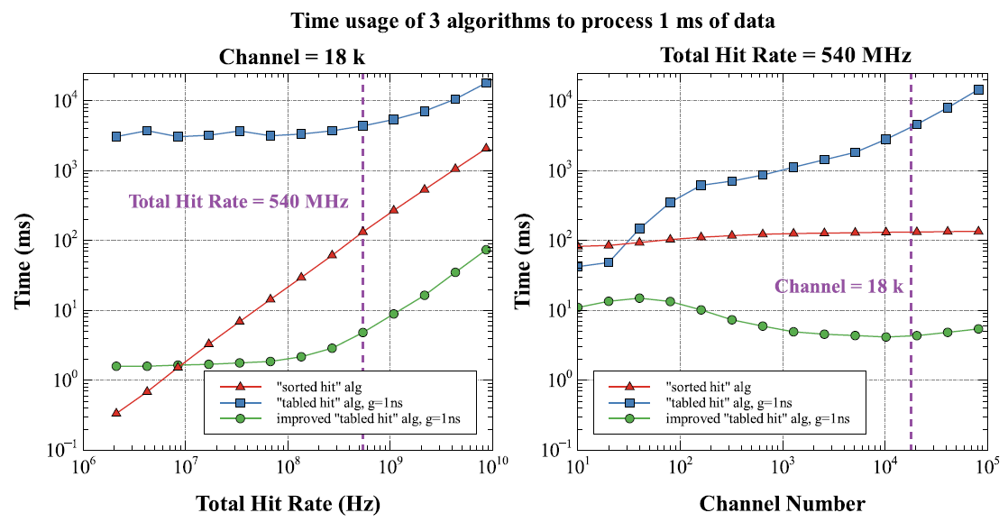
软件触发算法
JUNO基于填表的算法
LHAASO 基于排序的nPMT算法
为JUNO开发了一种新的n-PMT软件触发算法
→CPU使用率降低一个量级
Peng, Yu, et al. "A multiplicity software trigger algorithm for JUNO.“
Radiation Detection Technology and Methods (2025): 1-9.
21

Slide 22
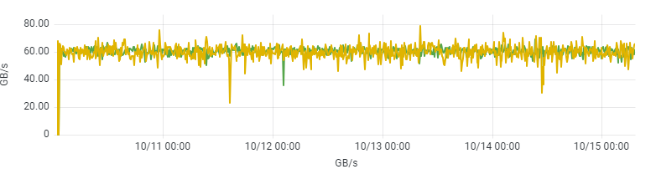
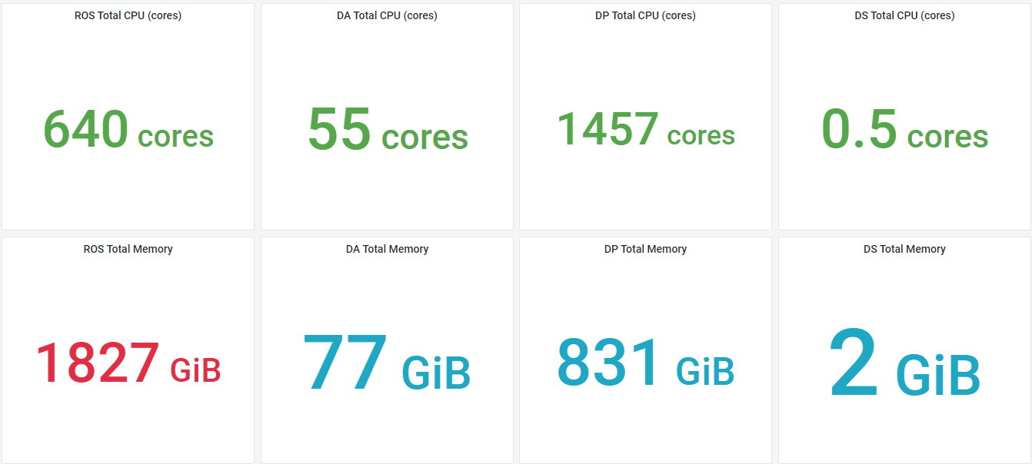
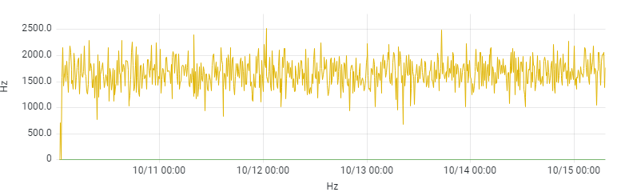


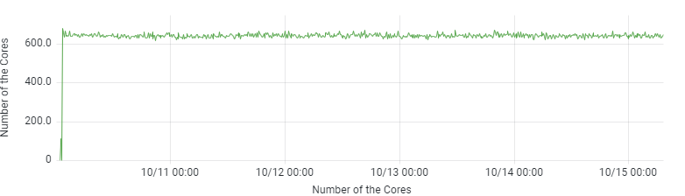
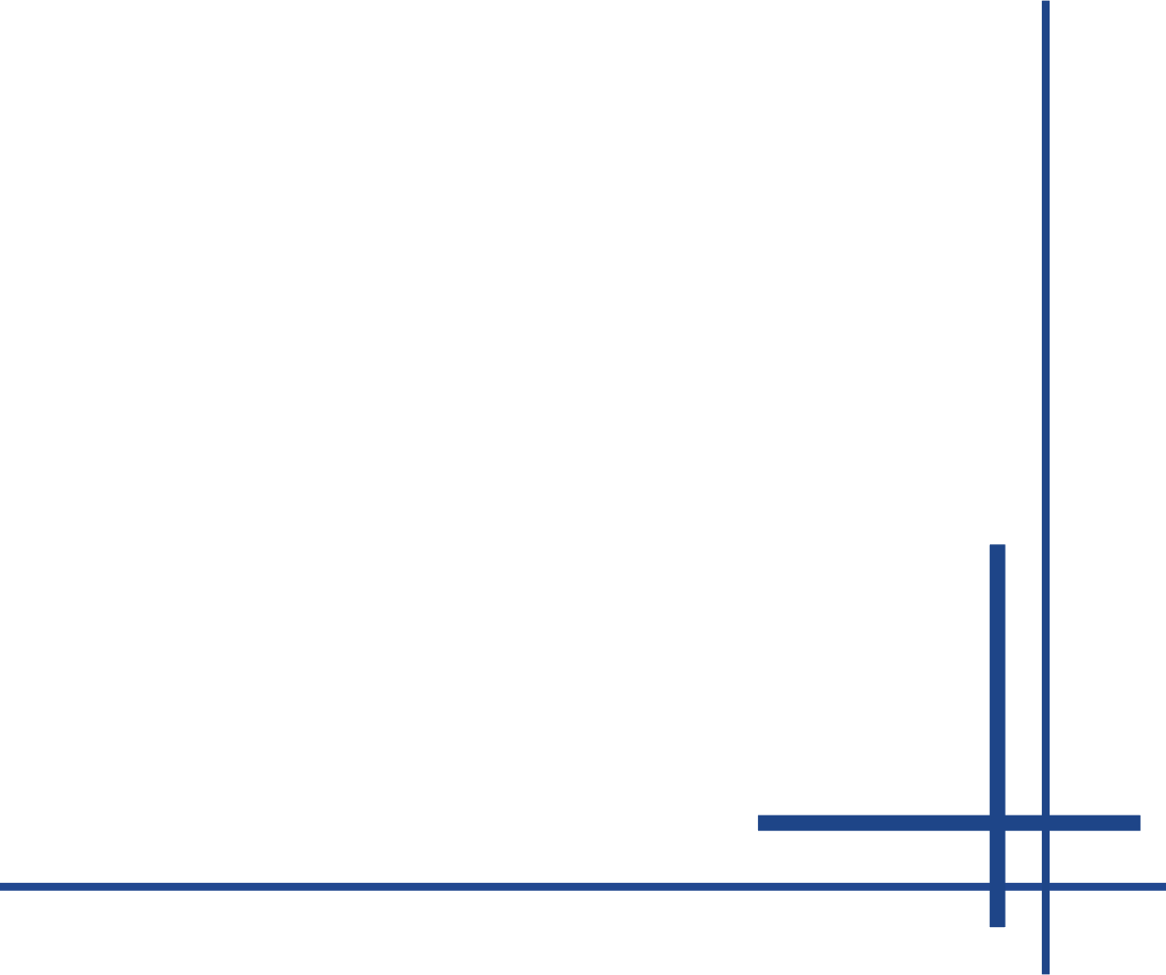
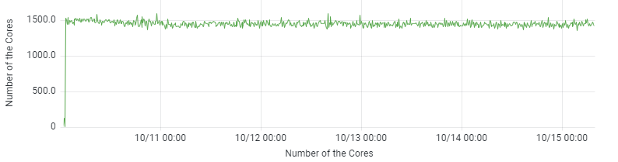
性能研究—模拟测试
60GB/s 读出节点吞吐
1600Hz 波形事例率
基于蒙卡产生的模拟事例数据
带OEC基础算法的完整数据流
现场集群测试吞吐达到 60GB/s
  60% margin
使用计算节点数: 55
全部读出进程 CPU 占用率
全部数据处理进程CPU占用率

Slide 23
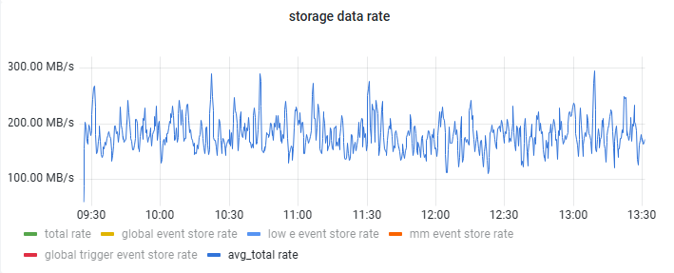




性能研究—现场实测
存盘数据率 < 200GB/s
总吞吐达到40GB/s（run 6483, 2025.6.15）
存盘性能 > 500GB/s （run 5791-5811，2025.5.15）
CD触发率约1kHz
1.5kHz ~60GB/s稳定运行

Slide 24
Online Software Overview
provide management, interfaces and services
Online Software | HTTP Interface
 | Online Service | Configuration Service | Run Control Service | Message Service | Process Management Service
 | Message Brokers
 | Client Interface | Configuration Interface | Run Control Interface | Message Interface | Process Management Interface
Data Flow Software
Microservices architecture
Kafka / ZooKeeper based services
Kubernetes-Managed Containers → Orchestrated Operations
Failover mechanism design based on Kubernetes
Feature-rich interface design
30 years running for JUNO lifetime
Reliable for supernova detection

Slide 25

Online Software Architecture
Centralized messaging topology → message brokers decouple online - data flow
Microservices architecture → Independent & Loosely-Coupled Services
Layered component design – interface, message, online services and supervisor
HTTP interface layer: provide external interfaces
Layer scheduler, for global management
Interlayer between data flow and message brokers
Message data transfer
Major online services modules
Wu, Yinhui, et al. "The Online Software of JUNO Data Acquisition System.“
IEEE Transactions on Nuclear Science (2024).
Notes:
整体软件采用集中式消息拓扑微服务架构[6]，保证服务的独立性互不干扰，在线软件分为“配置服务”、“消息服务”、“Runt控制服务”和“进程管理服务”四个主要模块。在线软件和数据流软件的分层架构，隔离数据流和在线软件。在线软件分为四层，分别为接口层负责向第三方软件和数据流软件提供接口；服务层由在线软件的四个服务组成;消息代理用于在数据流软件和在线软件之间传输数据；监管层负责全面监控数据流运行状态和在线软件状态，提供全局的控制为整个DAQ系统提供更可靠的保障

Slide 26

Online HA Design & Implementation
Failure Detection
Heartbeat Detection
Inter-Process: Based on ZooKeeper
Inter-Node: Based on ICMP Protocol
Failover
Redundancy + Master-Slave Election
Takeover scheme based on Kubernetes
Solutions for rapid restart of services
Anomaly detection and recovery fully implemented
Services recovered within seconds, ensuring overall reliability

Slide 27

DAQ在线监控平台
面向繁多、分散的数据来源，构建实时、全面、准确的监控平台
持久化存储数据，提供便捷高效的数据访问
提供便捷的操作界面
提供友好的监测页面
前后端高效协同
平衡实时性与资源消耗
处理监测数据的采集，分析，告警
统一控制数据流软件
吴寅慧，“JUNO DAQ在线监控系统及智能化研究”
https://indico.ihep.ac.cn/event/26373/contributions/198327/

Slide 28

JUNO DAQ Console GUI
Run control
Detector info
Total throughput monitoring
PMT&Elec info
Data flow apps status

Slide 29





可视化监测 — DAQ
数据流进程资源占用状态
175台交换机网络端口状态
数据流运行状态
109台节点集群服务状态

Slide 30



可视化监测 — 探测器
DCR统计分布
单通道DCR监测
三维PMT计数率等状态监测

Slide 31




可视化监测 — 电子学
电子学配置相关
电子学缓冲区监测
电子学(GCU)运行状态监测
触发率监测

Slide 32




移动端监测软件
    面向移动端的轻量级、可定制的实时监测报警软件
石源，“JUNO DAQ移动端监测软件的实现”
https://indico.ihep.ac.cn/event/26373/contributions/198320/

Slide 33






通用在线数据质量可视化系统(ROBOT)
Zhang, Shuihan, et al. "A ROOT-based General Online Data Visualization System."
IEEE Transactions on Nuclear Science (2024).
Architecture design
Configuration file demo
Applications
支撑JUNO DAQ全部约十万张在线直方图显示
Integration scheme
System implementation
张水涵，“SPMT DAQ系统的研究与实现”
https://indico.ihep.ac.cn/event/26373/contributions/198310/

Slide 34





数据质量可视化监测
事例组装监测
事例筛选算法性能监测
在整个联调、液闪灌装过程中发挥了重要作用
触发状态监测
SPMT数据质量监测

Slide 35


基于机器学习的自动异常检测
More real-time and automatic monitoring, ensure the experiment efficiency
Realtime anomaly detection system
  Unsupervised Model: Autoencoder
  Supervised Model: Neural Network
  Model training & optimization
  Integrated & tested with Radar
Next: Multi-model for scenarios
Architecture of Anomaly Detection Methods
Model | Recall | Prec.
Autoencoder | ~97% | ~88%
Neural Network | ~99% | ~99%
Deployment Strategy
* Test done at JUNO, with SPMT ADC SPE
Provided a solution for real-time anomaly detection, has been validated in DAQ workflow
张水涵，“SPMT DAQ系统的研究与实现”
https://indico.ihep.ac.cn/event/26373/contributions/198310/

Slide 36

试运行情况
2月至今，连续试运行半年
边取数边升级，持续无缝切换，保障取数时间

Slide 37
总结
完成核心开发与部署​​
基于Radar平台完成全部核心软件功能开发
系统实现全容器化运行
完成全部四万多路PMT及近七千路电子学通道集成
​性能与可靠性​​
性能满足实验要求，并保留>50%余量
硬件与软件设计充分考虑稳定性与可靠性
​运行​​
全系统6个月试运行，昨日转入正式运行
提供全面的实时监测
尝试智能化运维方案
系统持续迭代升级完善中。。。
助力JUNO早日取得重要物理成果

Slide 38

Thanks!
DAQ member (19)
  Staffs (5)
    Kejun Zhu
    Fei Li
    Xiaolu Ji
    Minhao Gu
    Tingxuan Zeng (2018 Ph.D.)
  Ph.D. students (7)
    Jin Li (2019)
    Zezhong Yu (2023)
    Yu Peng(2024)
    Shuihan Zhang (2025)
    Chao Chen
    Yinhui Wu
    Xu Zhang
  Master students (7)
    Tong Zhou (2021)
    Daibin Luo (2022)
    Xiaozhao Jiang (2024)
    Wenxi Pei (2025)
    Xiangyi Mu
    Yuan Shi
    Hao Wang
New Year's Eve of the Spring Festival in 2025

