Slide 1
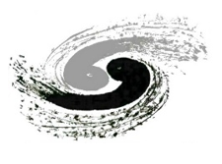



https://indico.ihep.ac.cn/event/25730/
Achieving 10⁻⁴ luminosity
with LumiCal @ CEPC
2025.04.21
S. Hou
LumiCal group (weekly meetings, onging 2yrs)
TDR design accomplished, aim for 10⁻⁴
Goal: IP BPM, Radiative Bahbha, Survey monitoring
Prototyping: Diamond, Tracking multi-scattering
forward LYSO, BPM @BES III
高能所 IHEP: MDI, beam-pipe, mechanics: Haoyu Shi, Quan JI, Longyan He, …
BPM: Jun He, …
AC LGAD: Mei Zhao, …
物理所 AS： Generator, GEANT: Suen Hou
吉林大学： Generator, BESIII BPM: Weiming Song, Jiading Gong
南京大学： Generator, GEANT4: Lei Zhang, Renjie Ma, Yilun Wang
Diamond, LYSO: Jialiang Zhang, …
Si tracking: Changhua Hao, Yuhui Miao, Xingyang Sun, Ligang Xia
LumiCal : IHEP: Xiao Cai , Sheng Dong, Jingzhou Zhao, Jie Zhang
prototype : NJU: Lie Zhang, Liangliang Han, Zhenwu Ge

Slide 2
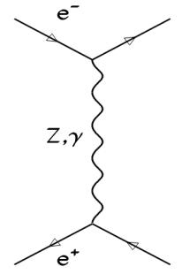
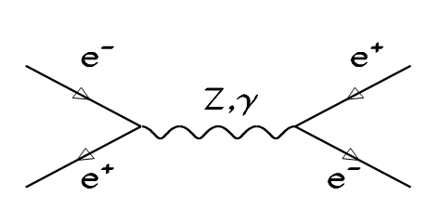
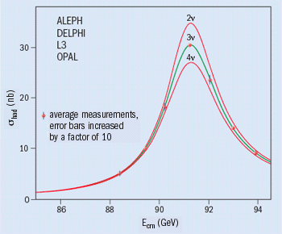



SM LEP to CEPC
SM Z-lineshape e⁺e⁻ → Z → qq‾
QED Luminosity by Bhabha e⁺e⁻ → e⁺e⁻
LEP: 17 Million Z (4 IP)
L= 4.3 10³¹/cm²s (E=46GeV)
= 1x10³²/cm²s (E=100 GeV)
CEPC Z-pole : 2x10¹² events
L~ 10³⁶/cm²s (Z-pole)
dL/L < 10⁻⁴
➔
N_{ν} = 2.9840 ± 0.0082
Bhabha generator
was BHLUMI 4.04 ➔ still BHLUMI ??
S. Jadach [CPC 101 (1997) 229]
2020 systematic 0.037%
[PLB 803 (2020) 135319]
Hardronic correction to reach 0.01%
M_{Z} = 91187.5 ± 2.1 MeV 2.3 × 10⁻⁵
G_{Z} = 2495.2 ± 2.3 MeV 1‰
N_{ν} = 2.9840 ± 0.0082
Precision luminosity 3‰
Framework of YFS exponentiation
e⁺e⁻ → e⁺e⁻ nγ
predict nγ Poisson photons (not confirmed)
2 November 2005

Slide 3
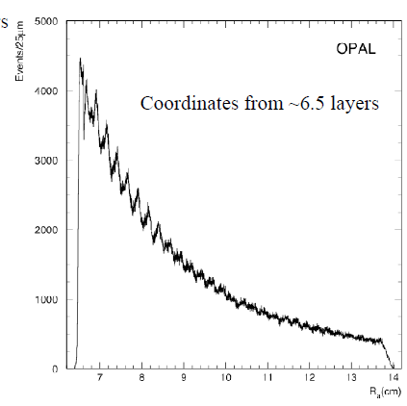
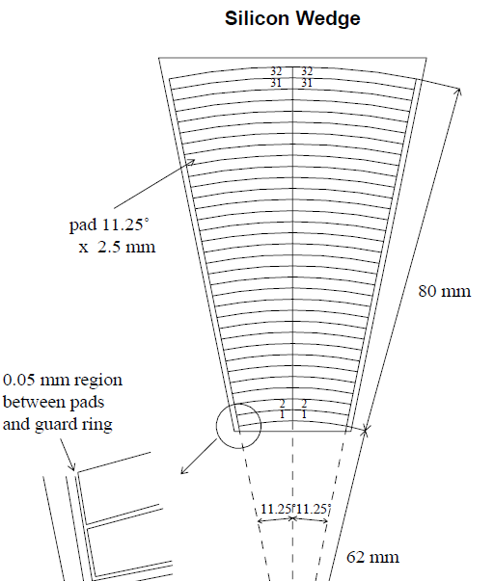
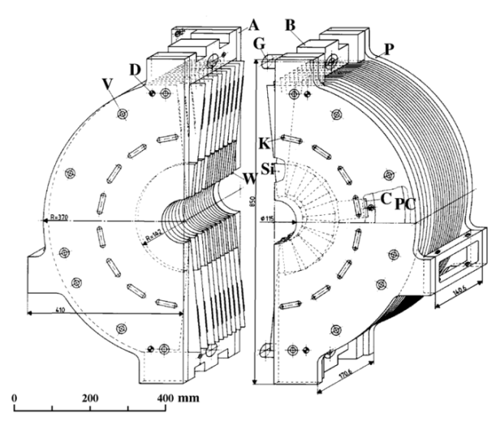
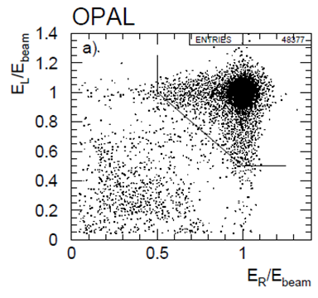
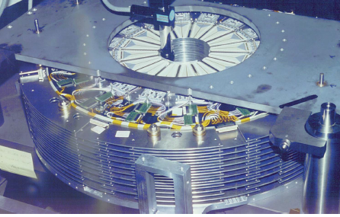
LEP luminosity achieved
Bhabha events
Not calibrated
Si pad 2.5mm pitch
EPJC 14 (2000) 373
OPAL precision
σ_{Bhabha} 79 nb
Expt 3.4x10⁻⁴
Theo 5.4x10⁻⁴
6.2 – 14.2 cm,
θ = 25 – 58 mrad

Slide 4
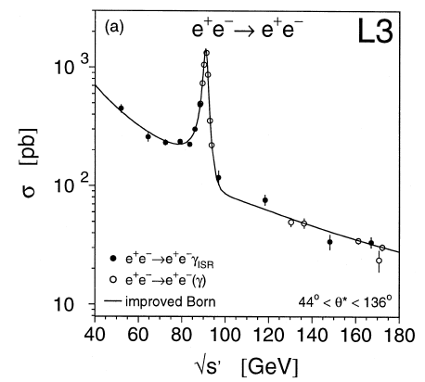
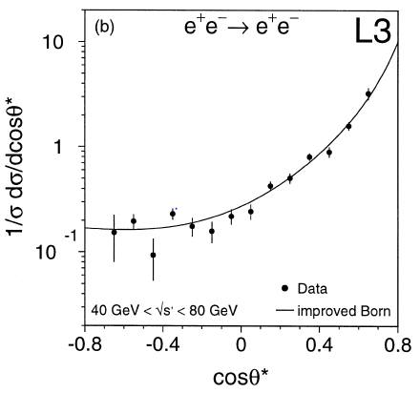
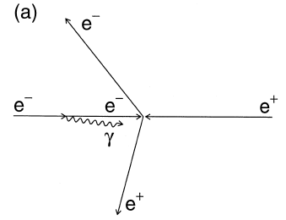
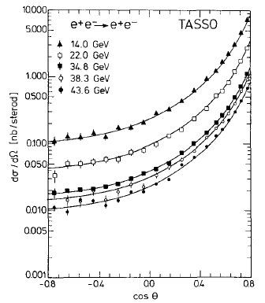
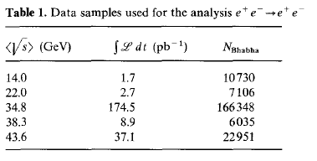
Radiative Bhabha expt results (only @LEP)
L3 radiative Bhabha with ISR
Systematic error at ~1% level
e⁺e⁻ → e⁺e⁻ (γ)
√s= 50 ~ 170 GeV, 232 pb⁻¹, 2856 event
[PLB 439, 1998, 183]
TASSO Bhabha
Systematic error ~3%
√s = 12 ~ 47 GeV
[ ZPC 37, 1988, 171]

Slide 5
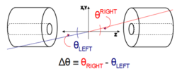
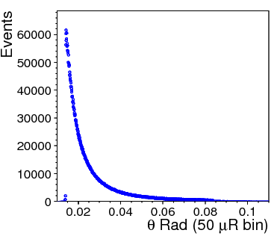
Bhabha event counting to 10⁻⁴
Luminosity L is derived by
Bhabha detected for
a pair of back-back electrons,
precision θ of e,e(γ) in fiducial region
e⁺e⁻ → e⁺e⁻(nγ)
Bhabha enter of mass
θ distribution
detector spatial resolution
count Bhabha
in Fiducial region
δL/L ~ 2 δθ/θ_{min}
δL/L = 10⁻⁴
at z = ±1000 mm, θ_{min} = 20 mRad
→ δθ = 1 μRad, or dr = 1 μm
error due to offset on Z
→ 50 μm on Z eq. dr = δz x θ = 1 μm
Luminosity systematics due to
event counting in/out fiducial edge
offset on the mean of θ_{min}

Slide 6
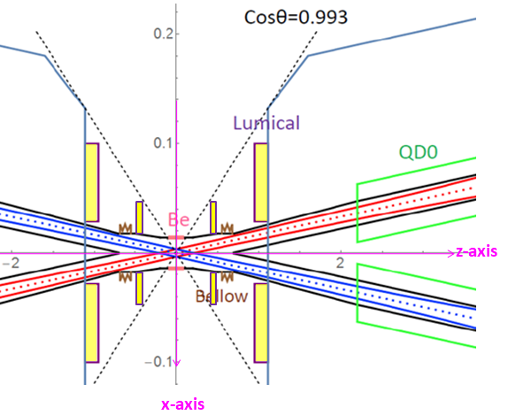
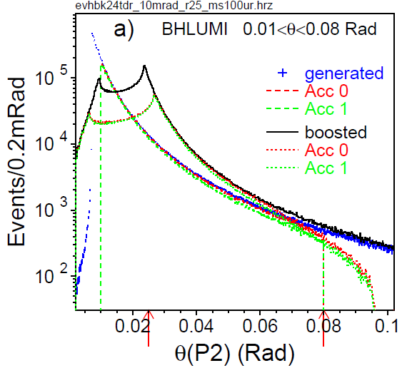
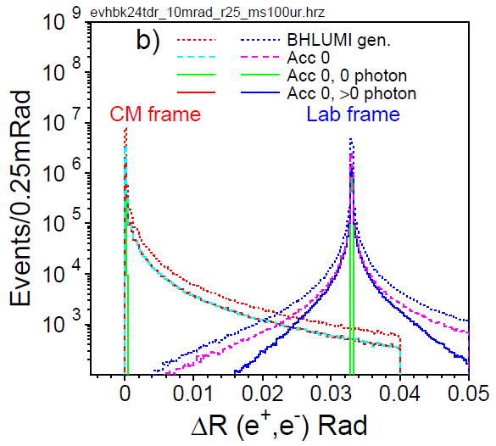
QED BHLUMI e⁺e⁻ → e⁺e⁻(nγ) at CEPC
BHLUMI demo.f cuts
ACC 0 CMS 10 mRad < θ(e±) < 80 mRad
ACC 1 .and. s’(P2,Q2)/s(P1,Q1) >0.5
Beam crossing, 33 mRad
Boost in x direct
e⁺, e⁻ offset by 33 mRad
10 M events generated for 10 – 80 mRad,
θ(e±) distributed from 7 mRad
ACC0 = 47.9 %
ACC1 = 45.9 %
θ(e±) shown
for CMS
and boosted
of all generated
events with 0 photos
Show δ back-back distribution

Slide 7
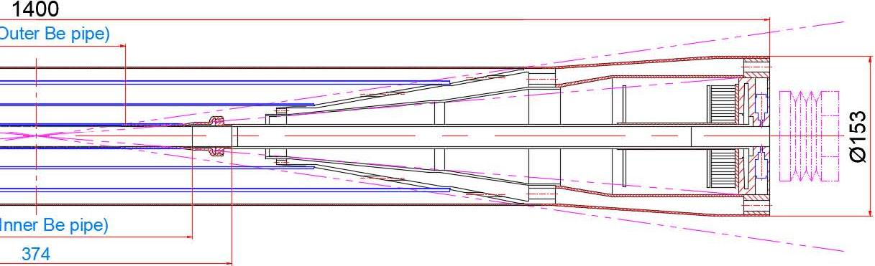

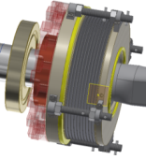
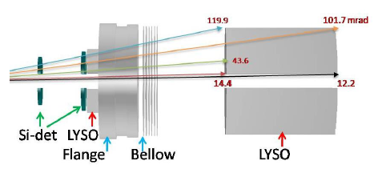
CEPC LumiCal design
Front LumiCal volume
L=2x10³⁶/cm²s¹ @Z-pole,
ø 20 mm racetrack,
beam-crossing 33 mRad
IP bunch :
σ_{x} σ_{y} σ_{z} = 6 μm, 35 nm, 9 mm
Bunch crossing: 23 ns
before Flange z = 560~700 mm
Low-mass beampipe window:
Be 1mm thick
traversing @22 mRad traversing L= 45 mm,
= 0.13 X₀ (Be), 0.50 X₀ (Al)
Two Si-wafers for e± impact θ
2X₀ LYSO = 23 mm
behind Bellow z= 900~1100 mm
Flange+Bellow : ~60 mm, 4.3 X₀
13X₀ LYSO 150 mm
Flange Bellow
w. BPM
1mm Be
Flange
Bellow

Slide 8
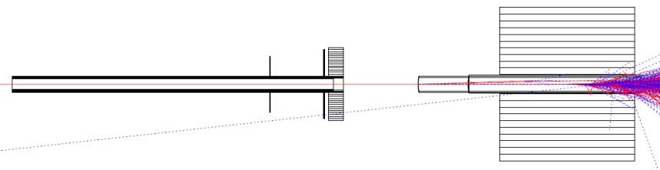
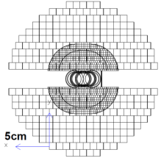
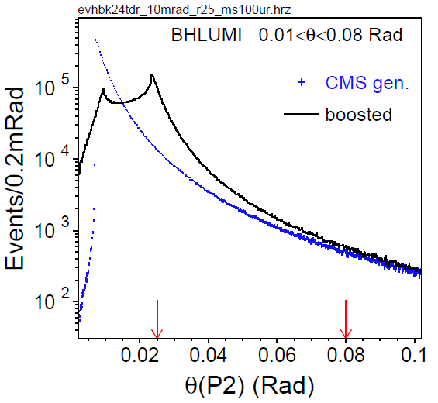
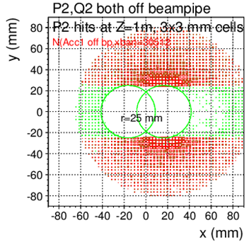
LumiCal acceptance, racetrack beampipe
BHLUMI event distribution
detecting back-to-back e⁺, e⁻ pair
@|z|=1000mm
Θ > 25mRad outside pipe centers
|y|>25 mm
Events in shaded area
counted for Xsec
Pair of P2,Q2 detected
@|z|=1000mm
region |y|<25 mm
10% to r=80 mR full covered
e⁺, e⁻ back-to-back symmetric
to out-going pipe center
LumiCal acceptance at |z|=1000mm, with RaceTrack pipe r=10mm
ONE e⁺ or e⁻ detected |  | e⁺, e⁻ back-to-back detected
θ>25 mRad | θ>25mR & |y|>25mm | θ>25 mRad | θ>25mR & |y|>25mm
133.5 nb | 81.8 nb | 85.4 nb | 78.0 nb

Slide 9
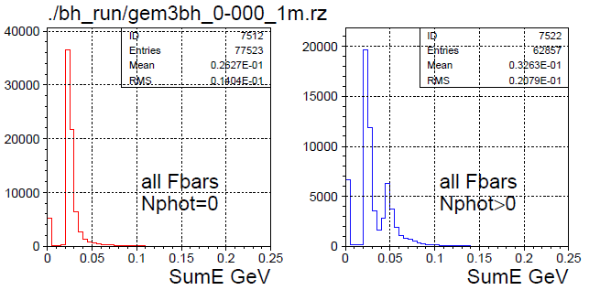
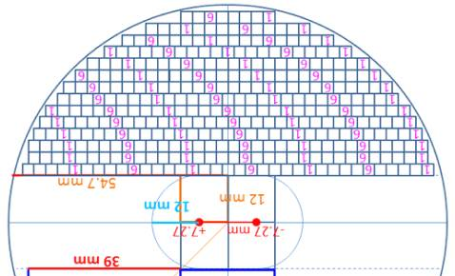
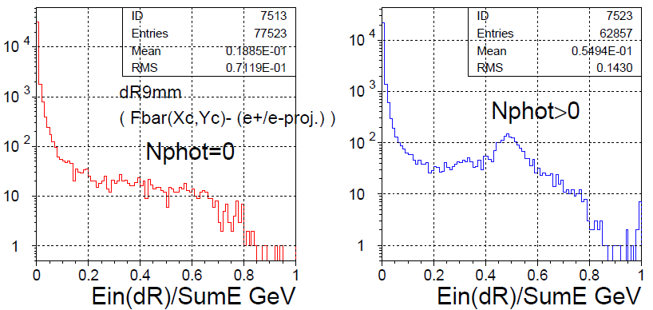
Front 2X₀ LYSO, on radiative e,γ
2X₀ LYSO
@ z=647mm
Bhabha hits on LYSO, |y|>12mm
Incident particles are e±,(γ)
GEANT sum dE/dx in each LYSO bars
3x3mm², 23 mm long, 2X₀
Deviation to e± truth (impact hit >E_{b}/2)
mostly < 0.2mm
Hit distributions in a Bar
distributed due to Bhabha θ, w./w.o. photon
BHLUMI events, GEANT simulation
Nγ=0 Nγ>0
sumE
sum dE/dx all LYSO bars (a plane)
e± one track : sumE min. 20 MeV
(e± + FSRγ) : two MIPs, sumE x2
sumE(R<9mm)/sumE
Nγ=0 Nγ>0

Slide 10
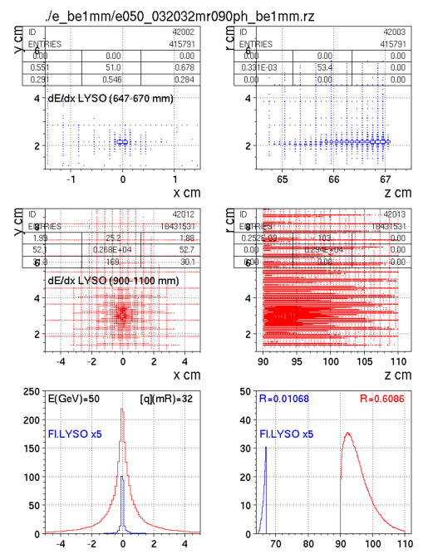
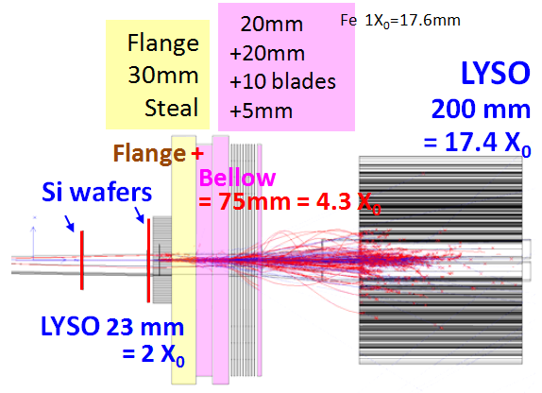
GEANT LumiCal electron shower
50 GeV electron @ θ = 32 mRad, φ=90º
2X0 LYSO + 4.3X0 Flange,Bellow
+ 17X0 LYSO
Shower deposition, by Sum(dE/dx)
in front LYSO: ~1.0 %
in back LYSO: ~ 61 %
2X₀
LYSO
y
x z
17X₀
LYSO
y
x z
deposit in Z
dis. in X
X cm z cm

Slide 11
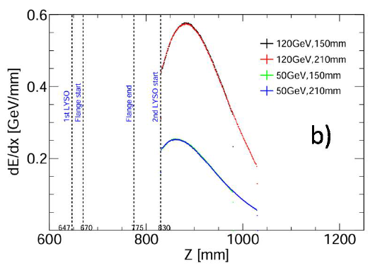
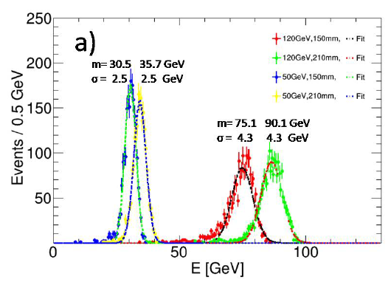
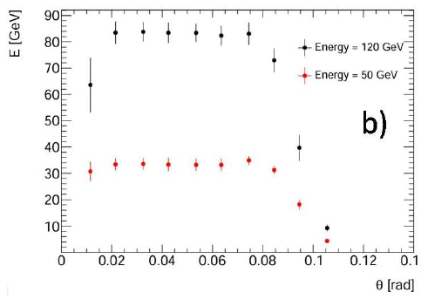
LumiCal electron LYSO, 5% resolution
马仁杰
王翊伦
孙行阳
LYSO length vs E resolution
150 mm, 13 X₀, 210 mm, 18 X₀
Electron energies 50 GeV, 120 GeV
150, 13 X₀ LYSO sufficient
50GeV: RMS 2.5 GeV
120GeV: RMS 4.3 GeV
dE/dx in long LYSO
Sum dE/dx in long LYSO
Acceptance

Slide 12
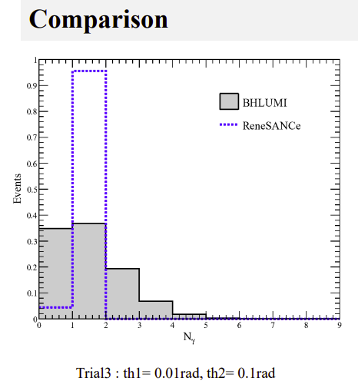
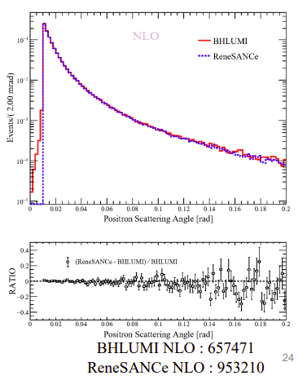
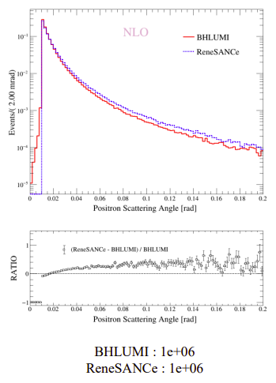
Challenge: QED α²L² shall be measured
Jiading Gong
Renjie Ma
Compare
BHLUMI: YFS exponentiation e⁺e⁻ → e⁺e⁻(nγ)
ReneSANCe: NLO calculation e⁺e⁻ → e⁺e⁻(γ)
# photons
Differ very much
eγ opening angle
Consistent
e± theta angle
NLO 0γ discrepency
BHLUMI E(γ)>5MeV
Event final states | BHLUMI generated
e⁺e⁻ | 36.4%
e⁺(e⁻γ) or (e⁺γ)e⁻ | 47.8%
(e⁺γ)(e⁻γ), | 15.8%

Slide 13
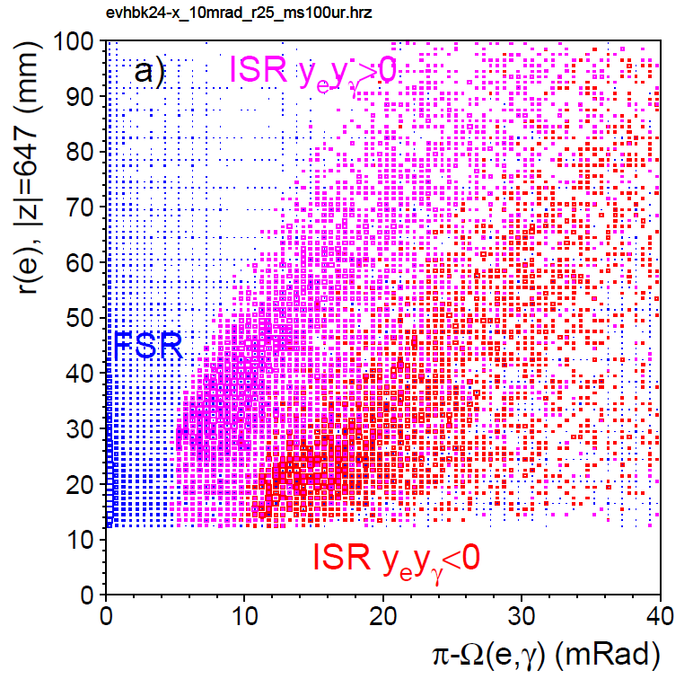

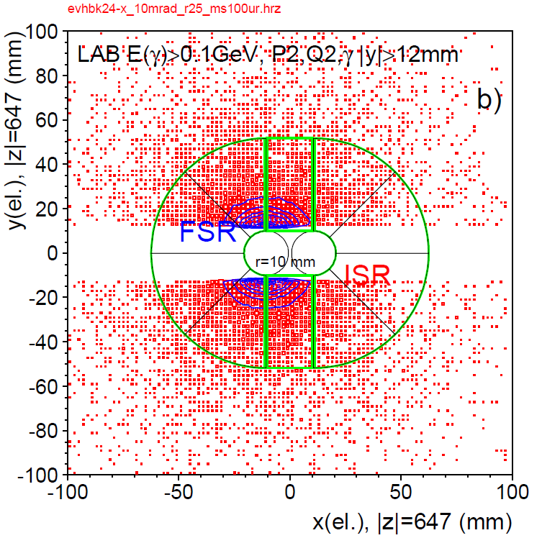
Detecting photons in e⁺e⁻ → e⁺e⁻(nγ)
γ to nearest electron
Bhabha events in LumiCal acceptance
e⁺,e⁻,γ : |y|>12 mm at LYSO front face ±z=647mm
±z Hemispheres | BHLUMI generated | & P2,Q2 |y|>12mm
e± | 60.3 % | 3.87 %
e± γ | 39.7 %* | 3.16 %
*ISR 20.3%, FSR 19.4%
Detectable Bhabha, e⁺,e⁻,γ : |y|>12 mm
±z Hemispheres | P2,Q2 |y|>12mm | & E(γ)>0.1GeV |y(γ)|>12mm
e± | 55.1 % | 14.7 %
e± γ | 44.9 % | ISR 0.89 % FSR 13.8 % FSR 2.96%*
⬅ ??
γ distribution
*FSR Ω(e±,γ) > 5 mRad

Slide 14
Challenge: 10⁻⁴ on Bhabha e⁺e⁻ → e⁺e⁻(nγ)
Bhabha electron θ (set by 2 points ) : IP – Si.hit
Requirement: 1 μRad on mean of θ
IP by BPM (beam position monitor) on beam current
x,y by BPM, z by timing
LumiCal Si-wafer position mounted on Flanges
reference to “beam center” at Flanges
→ 1. construction survey to sub-micron
2. monitoring on Flanges z position

Slide 15
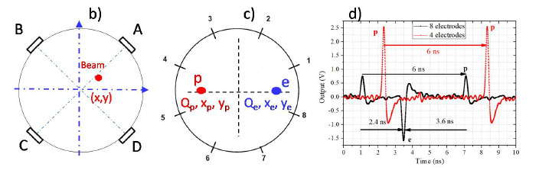
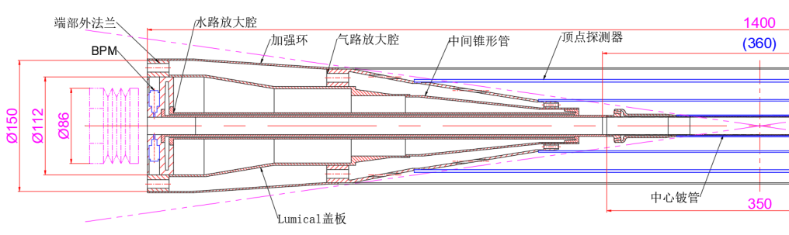
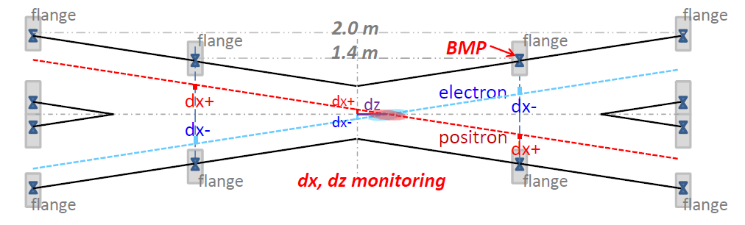
Survey/monitoring, for Beam IP position
Beam Probe Monitor BPM , IP x,y to 1 μm
Position monitoring, Flange dx,dy ~1 μm, dz~ 50 μm
CEPC WS2023
Jun He
LumiCal 监测
1. 法藍 dx,dy 1 μm, dz 50 μm
2. 电子束流 dx,dy 1 μm
BPM

Slide 16
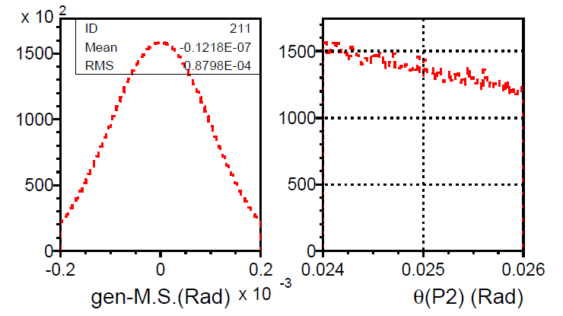
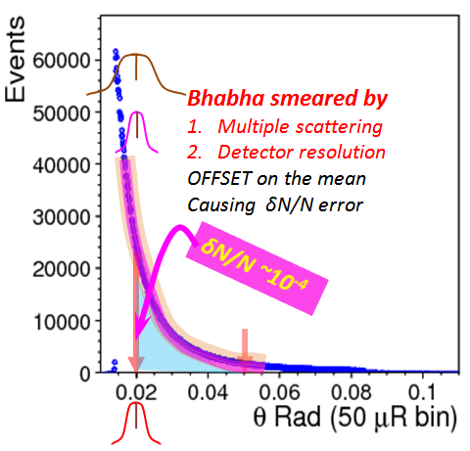
multiple scattering, against 10⁻⁴
BHLUMI scattered e⁺, e⁻
Multi. Scatt. smearing 100 μRad
θ’= θ ∙ σ (100μR), φ’= φ ∙ σ(100μR)
δN/N due to σ(100μR) smearing
δN = deviation due to Multi.Scatt.
effect is Gaussian, Symmetric
at θ_{min}= 25 mRad, slope of Bbhabha
in neiboring 100 μRad bins to 25mR
δN(@25mR)/N(25-80 mR) < 10⁻⁴
Θ =25 mRad
10⁻⁴ is determined
1. Multi.Scatt. distribution
2. survey of the mean position
(shift of the arrow)

Slide 17
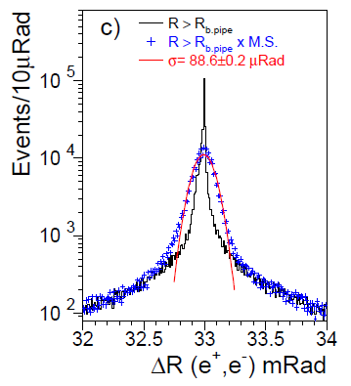
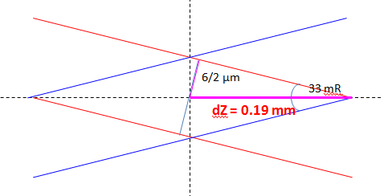
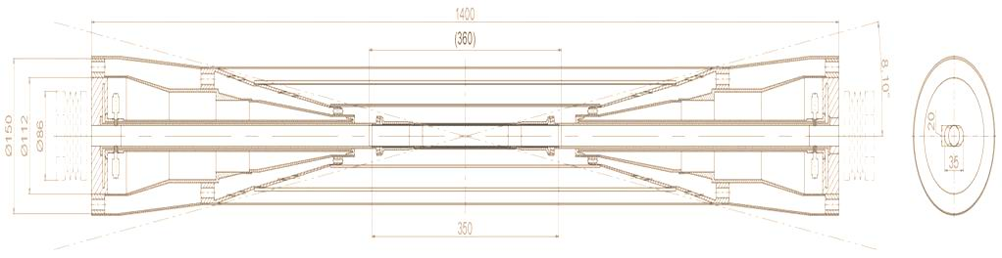
e⁺, e⁻ back-back, calibrate survey, if narrow
Bunch size σ_{x} = 6 μm, σ_{y} = .035 μm _{z} = 9 mm
IP spot, 33mRad Xing
σ_{x} = 6 μm, σ_{z} = 380 μm
Z → e⁺, e⁻ at θ= 30 mRad
smearing at @z=560mm
smeared width σ(θ) = 24 μRad
back-to-back σ(Ω) = 21 μRad
e⁺, e⁻ back-back
BHLUMI scattered e⁺, e⁻
θ , φ smeared 100 μR
IP collision spot
e⁺
e⁻
Si position detector
LYSO

Slide 18
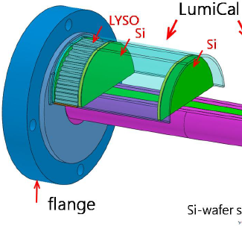
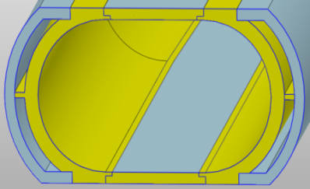
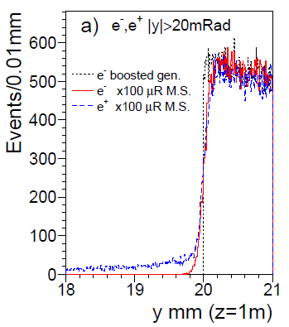

Electron hits on 1st Si-wafer
1 mm Be thin pipe window
33 mm = 0.09 X₀ traversing @ 30mR
IP (σ_{x},σ_{z}) = (6,380 μm)
50 GeV e⁺, e⁻
@ (θ= ± 30 mRad, φ = 1.0, 1.0+π Rad)
Si wafer @z=560mm
|x|<6.0 mm σ(θ) = 54 μR (1mm Be)
|x|>6.0 mm σ(θ) = 95 μR (1m Al pipe)
back-back Op.Ang σ(Ω) = 137 μR
Al Be
Low-mass
window
Multiple scattering at edge
BHLUMI 100 μR smearing
Both z sizes but on e- side
e± GEANT hit – gen. |x|>6 hit – gen. |x|<6

Slide 19



LumiCal detector/electronics options
2D Si-strip
Si-wafers for electron impact position
Strip detector 50 or 100 μm pitch, 2D x,y
AC LGAD, 2D long coupling layer
Readout: (LGAD) tracker readout, fast and pileup ID
Calorimetry, LYSO rad-hard bars
2 X₀ (3x3x23mm3) position, e/γ etc
13 X0 (10x10x150 mm3) Ebeam electron ID
Readout: SiPM + ECAL front-end, trigger and pileup ID
LumiCal trigger
Single side, long LYSO E> Ebeam/2
Coincidence +z,-z E> Ebeam/2,
event rate @L=10³⁶ 0.003 /b.c.
but Pileup ~10⁻⁴ shall be identified
AC LGAD
TCAD

Slide 20


Bhabha event pile-up rate @Z-pole
Z-pole (2021 design) L_{max}/IP = 115 x 10³⁴/cm²s
Bhabha both e⁺, e⁻ detected, X-sec = 100 nb
Event rate = (246x10⁻³³) x (115 x 10³⁴) /sec = 115 kHz
Event rate / 25 ns bunch crossing = 0.003 events /b.c.
Pile-up: per b.c., @adjacent cell in peak region
Pile-up Fraction = 0.018*6cells/2sides = 0.054
Pile-up event rate = 0.003*0.054 = 1.6 x 10⁻⁴
c.f. LEP
L= 1x10³²
X-sec= 100nb
Rate= 10 Hz
⬅ too high
50 GeV e- shower on 3x3 mm² cells
event fraction /(cell of 3x3mm²)
maximum at beampipe edge = 0.018
LYSO signal overlap
25 ns

Slide 21





Multiple Scattering, test beam
Changhua Hao,
Yuhui Miao,
Xingyang Sun,
Ligang Xia,
Lei Zhang
南京大学─紫金山天文台 Si-strip station
Cosmic ray Muon, > 1 GeV filtered
6 sets (x,y) 200 μm pitch, VA readout
GEANT 30 mm Pb muon scattering
30 mm Pb
journal.pone.0144679
Cosmic Muon energy
1 GeV muon 2 GeV muon

Slide 22




Prototyping, forward LYSO @BES III
BES III forward, between beam pipes, stack total length 120mm
LYSO crystals 3x5 bars (9x10mm² frontface)
SiPM frontend, to VME DAQ

Slide 23




GEANT LYSO @BES III
BES III forward, between beam pipes
Electron impact position analysis
Position by Center-of-Gravity
Calibrated for correction
Center of gravity
LYSO dE/dx
GEANT 1 GeV electron passing
1.45 cm Cu beam pipe materials
Calibrated position

Slide 24



Diamond fast beam monitor
LumiCal LYSO bar
Before Quadrupole
Beam monitoring
Bhabha electrons of
~10 mRad (CMS)
~25 mRad (Lab 33 mRad beam crossing)
front of Quadrupole |z|= 855~1110 mm
diamond slab, on sides of beampipe
differing event rates on +z, -z sides
for IP offset
Diamond
θ_{CMS} = 15.1 ~ 7.8 mRad
θ_{Lab} = 31.6 ~24.3 mRad

Slide 25



50 GeV electron on diamond
50 GeV electrons at CMS 9 ~ 12 mRad, Lab 25.5 ~ 28.5 mRad
3 mm thick Cu beampipe (~300 mm traversing)
dE/step of charged tracks (>100 keV) in diamond
dE/steps in z profile
Diamond slab covering 8~15 mRad
X-sec order of ~100 nb
dE/steps in y profile
Event rate @Z, L=1x10³⁶/cm²s
= (100x10⁻³³) x (1 x 10³⁶) /s = ~100 kHz

Slide 26








Producing diamond pads
Jialiang Zhang
Wang Yilun
Two prototype microstrip diamond sensor
successfully fabricated
Pitch of 1.0 mm on 10 mm×10 mm
Pitch of 1.35 mm on 6 mm×6 mm diamond
TCAD simulation
Post-litho development
I-V Curve
Perpendicular electron hit
at pad center
Test PCBs
preparation

Slide 27
Backup

Slide 29
Small-angle Bhabha scattering
an almost pure QED process. Differential cross section can be written as:
e⁺
α
e⁺
γ
e⁻
α
e⁻
Z interference correction
Born term for t-channel single γ exchange
s-channel γ exchange correction
Photonic radiative corrections
α₀ ≅ 1/137.036
Effective coupling factorized
experimentally: high data statistics, very high purity
This process and method advocated by Arbuzov et al., Eur.Phys.J.C 34(2004)267

Slide 30

Small-angle Bhabha scattering
BHLUMI MC (S.Jadach et al.) calculates the photonic radiative corrections up to O(α²L²) where L = ln ( |t| / m_{e}² ) – 1 is the Large Logarithm
Higher order terms partially included through YFS exponentiation
Many existing calculations have been widely cross-checked with BHLUMI to decrease the theoretical error on the determination of Luminosity at LEP, reduced down to 0.054% (0.040% due to Vacuum Polarization)
Size of the photonic radiative corrections (w.r.t. Born = 1)
First incomplete terms
O(α²L)
O(α³L³)

Slide 31

Small-angle Bhabha scattering in OPAL
E_{L} R_{L} ϕ_{L}
E_{R} R_{R} ϕ_{R}
e⁺
IP
γ
z
6.2 cm
14.2 cm
2.5 m
e⁻
SW - Left
SW - Right
2 cylindrical calorimeters encircling the beam pipe
at ± 2.5 m from the Interaction Point
19 Silicon layers
18 Tungsten layers
Total Depth 22 X₀
(14 cm)
Each detector layer divided
into 16 overlapping wedges
Sensitive radius: 6.2 – 14.2 cm, corresponding to scattering angle of 25 – 58 mrad from the beam line

