Slide 1
Weekly Report
Minghao Li 2025.06.10

Slide 2
$$ψ\left(3686\right)→pK^{−}\overline{Λ}+c.c.$$
Uncertainty due to background is estimated by removing it from PWA, the difference of center value is taken to be its uncertainty.
 | mass(MeV/c²) | Width(MeV/c²)
Before | 2149 | 173
Now | 2196 | 204
difference | 47 | 31
Through the output file, we can see the mass and width of X(2085). We found that the differences in mass and width were 47 MeV and 31 MeV respectively.

Slide 3
$$ψ\left(3686\right)→pK^{−}\overline{Λ}+c.c.$$
Uncertainty of $Λ$ mass window is estimated by enlarging or narrowing mass window by 1 MeV/c², the maximum difference between obtained center value is taken to be its uncertainty.
 | mass(MeV/c²) | Width(MeV/c²)
Before | 2149 | 173
Now | 2190 | 207
difference | 41 | 34
Through the output file, we can see the mass and width of X(2085). We found that the differences in mass and width were 41 MeV and 34 MeV respectively.

Slide 4
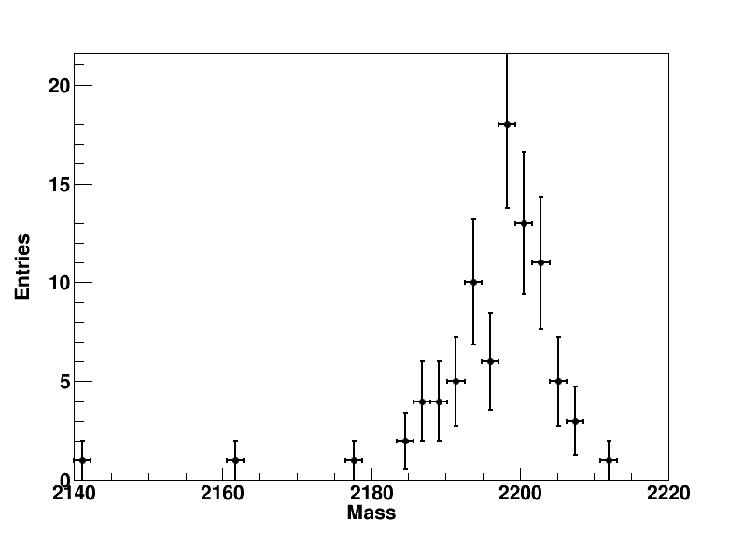
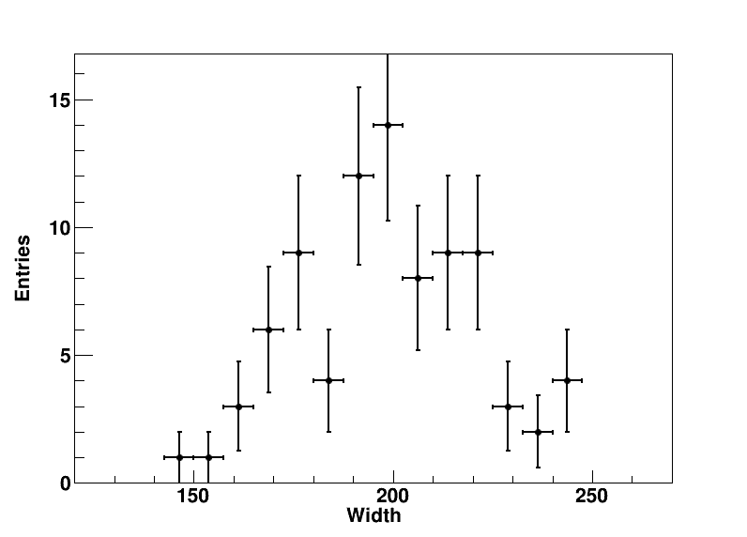
$$ψ\left(3686\right)→pK^{−}\overline{Λ}+c.c.$$
Uncertainty of quoted mass and width of the other fifteen resonance states besides X(2085). In estimation, mass and width of those resonance states are replaced by new ones, which are randomly sampled according to the Gaussian distribution. New mass and width of X(2085) is obtained with smeared Breit-Wigner shape and the difference between center value is taken as its uncertainty.
Through the picture, we can see the mass and width distribution of X(2085).

Slide 5
$$ψ\left(3686\right)→pK^{−}\overline{Λ}+c.c.$$
Uncertainty of quoted mass and width of the other fifteen resonance states besides X(2085). In estimation, mass and width of those resonance states are replaced by new ones, which are randomly sampled according to the Gaussian distribution. New mass and width of X(2085) is obtained with smeared Breit-Wigner shape and the difference between center value is taken as its uncertainty.
 | mass(MeV/c²) | Width(MeV/c²)
Before | 2149 | 173
Now | 2196 | 195
difference | 47 | 22
Through the fitting, we found that the differences in mass and width were 47 MeV and 22 MeV respectively.

Slide 6
$$ψ\left(3686\right)→pK^{−}\overline{Λ}+c.c.$$
Uncertainty due to background is estimated by removing it from PWA, the difference of center value is taken to be its uncertainty.
Through Professor Ping‘s discussion, we use the event box for fitting, found that the fitting was successful. We have get the preliminary results of the systematic uncertainty by Boxfill method. Currently, there is still under work.

