Slide 1
Observation of ferroelectric domains

Slide 2

Phase transformation
Temperature rise: $T↑$
Ferroelectric phase
Paraelectric phase
Example:
ice
water
Experiment aim: Observe the complex ferroelectric domains during the phase transition process

Slide 3

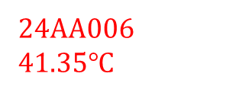



24AA006
41.35$℃$
24AA006
41.35$℃$
5×
10×
铁电畴区域
Ferroelectric
铁电畴区域
Ferroelectric
Phase transition
process
Phase transition direction
无铁电畴区域
Paraelectric
无铁电畴区域
Paraelectric
24AA006
41.35$℃$
24AA006
41.35$℃$
50×
100×
铁电畴区域
Ferroelectric
铁电畴区域
Ferroelectric
无铁电畴区域
Paraelectric
无铁电畴区域
Paraelectric

Slide 4
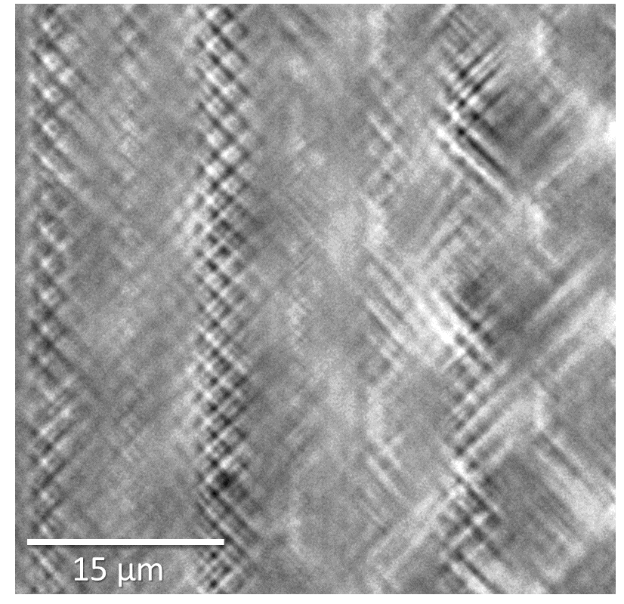

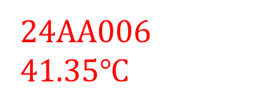
Observation of complex ferroelectric domains
Pro Xin
24AA006
41.35$℃$
JHW
100×

