Slide 1
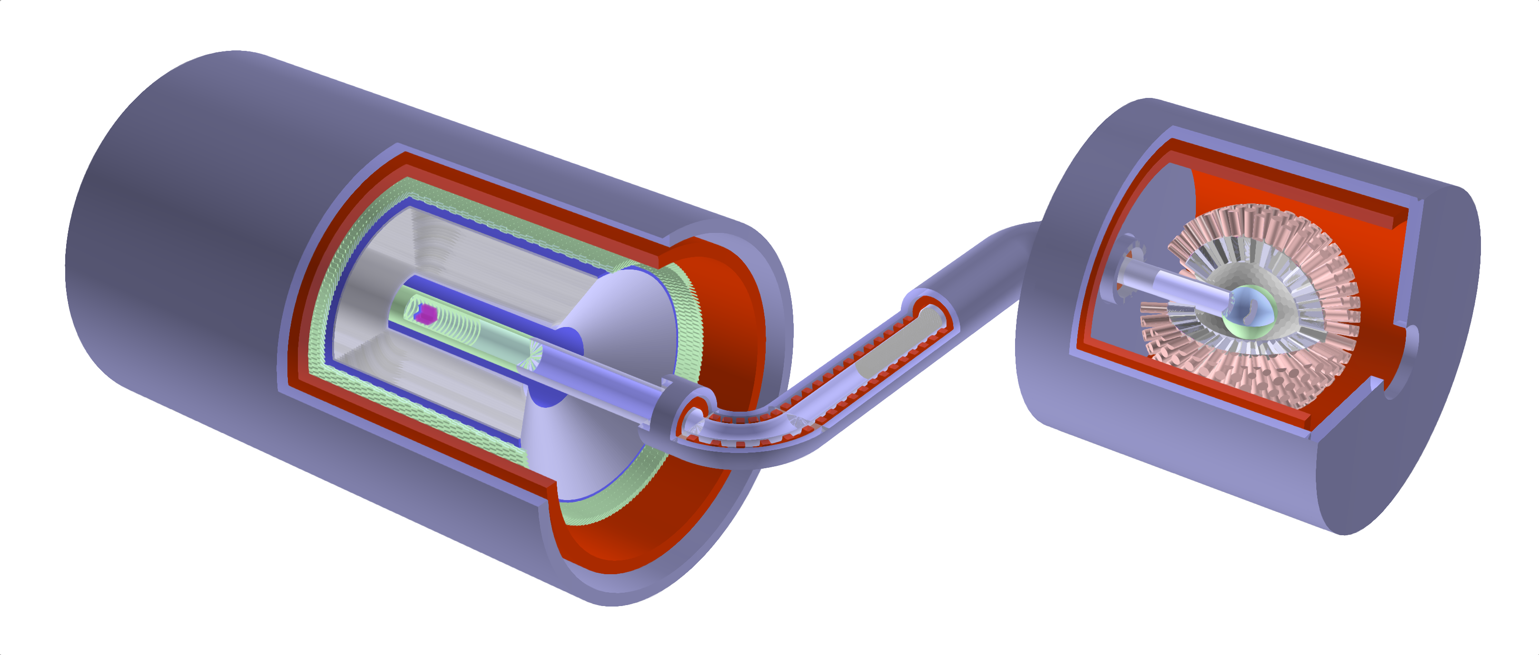
Progress of the Muonium-to-Antimuonium Conversion Experiment (MACE)
Zhichao Wang (王志超) on behalf of the MACE working group
wangzhch29@mail2.sysu.edu.cn
第七届粒子物理天问论坛，2025，武汉
2025-09-20
Ai-Yu Bai, Hanjie Cai, Chang-Lin Chen, Siyuan Chen, Xurong Chen, Yu Chen, Weibin Cheng, Ling-Yun Dai, Rui-Rui Fan, Li Gong, Zihao Guo, Yuan He, Zhilong Hou, Yinyuan Huang, Huan Jia, Hao Jiang, Han-Tao Jing, Xiaoshen Kang, Kim-Siang Khaw, Hai-Bo Li, Jincheng Li, Yang Li, Shulin Liu, Guihao Lu, Han Miao, Yunsong Ning, Jianwei Niu, Huaxing Peng, Alexey A. Petrov, Yuanshuai Qin, Mingchen Sun, Jian Tang, Jing-Yu Tang, Ye Tian, Rong Wang, Xiaodong Wang, Zhichao Wang, Chen Wu, Tian-Yu Xing, Weizhi Xiong, Yu Xu, Baojun Yan, De-Liang Yao, Tao Yu, Ye Yuan, Yi Yuan, Jian Zhang, Yao Zhang, Yongchao Zhang, Zhilv Zhang, Guang Zhao, Shihan Zhao
(MACE working group)
[arXiv:2410.18817] Conceptual Design of the Muonium-to-Antimuonium Conversion Experiment (MACE), accepted by Nuclear Science and Techniques

Slide 2

Contents
Motivations
MACE conceptual design
Proposal of MACE Phase-I
MACE offline software
Summary

Slide 3
Contents
Motivations
MACE conceptual design
Proposal of MACE Phase-I
MACE offline software
Summary

Slide 4
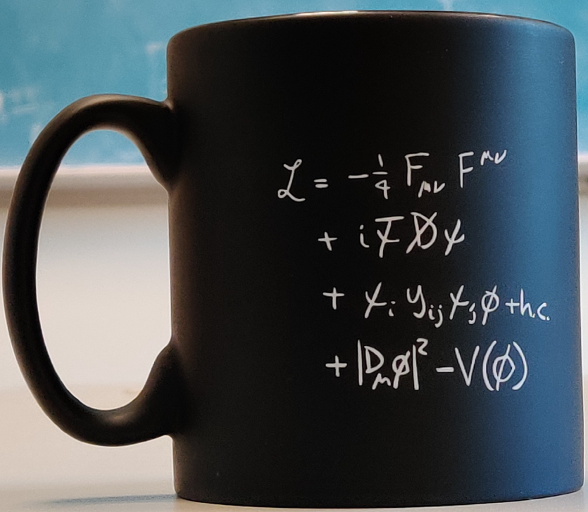
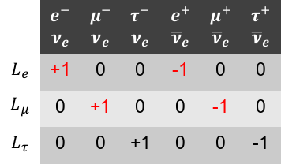
Symmetries of SM
The Standard Model (SM) gauge symmetry:
The absence of right-handed neutrino leads to lepton flavor symmetry:
Lepton flavor is always conserved in the Standard Model, however…
QCD
Electroweak
Baryon number conservation
Lepton flavor conservation
 | $$e^{−}$$ $$ν_{e}$$ | $$μ^{−}$$ $$ν_{e}$$ | $$τ^{−}$$ $$ν_{e}$$ | $$e^{+}$$ $${\overline{ν}}_{e}$$ | $$μ^{+}$$ $${\overline{ν}}_{e}$$ | $$τ^{+}$$ $${\overline{ν}}_{e}$$
$$L_{e}$$ | +1 | 0 | 0 | -1 | 0 | 0
$$L_{μ}$$ | 0 | +1 | 0 | 0 | -1 | 0
$$L_{τ}$$ | 0 | 0 | +1 | 0 | 0 | -1

Slide 5

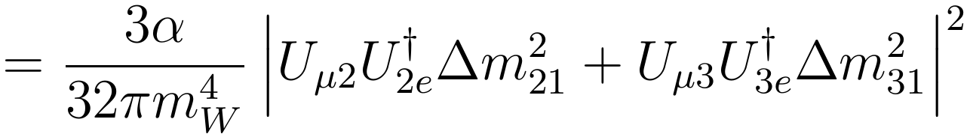










Charged lepton flavor violation (cLFV): a portal of new physics
    Lepton flavor is not conserved in the real world.
      Neutrinos have mass and mixing.
      So cLFV should exist, but it hasn't been seen yet...
    Many new physics model beyond SM predict scalable cLFV.
    cLFV is forbidden in SM, free of SM background.
    A clear evidence of new physic if observed!
Why muon?
Lightest massive unstable charged lepton.
Reasonably long 2.2-μs lifetime.
Almost free from QCD corrections.
MACE (China)
$$M \underset{→}{ } \overline{M} (μ^{+}e^{−}→μ^{−}e^{+})$$
MEGII (PSI)
$$μ^{+}→e^{+}γ$$
Mu3e (PSI)
$$μ^{+}→e^{+}e^{−}e^{+}$$
Mu2e (Fermilab)
$$μ^{−}N→e^{−}N$$
COMET (J-PARC)
$$μ^{−}N→e^{−}N$$

Slide 6
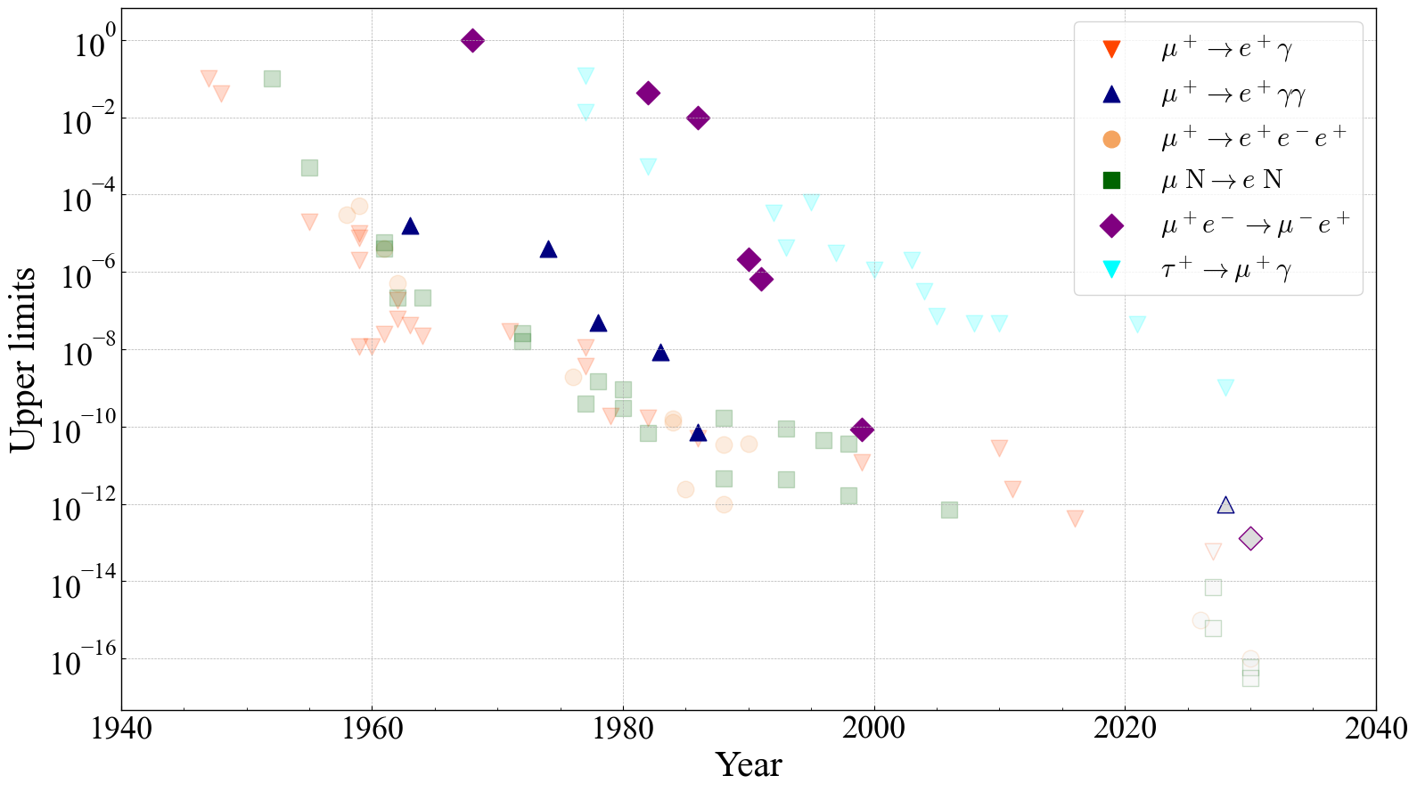


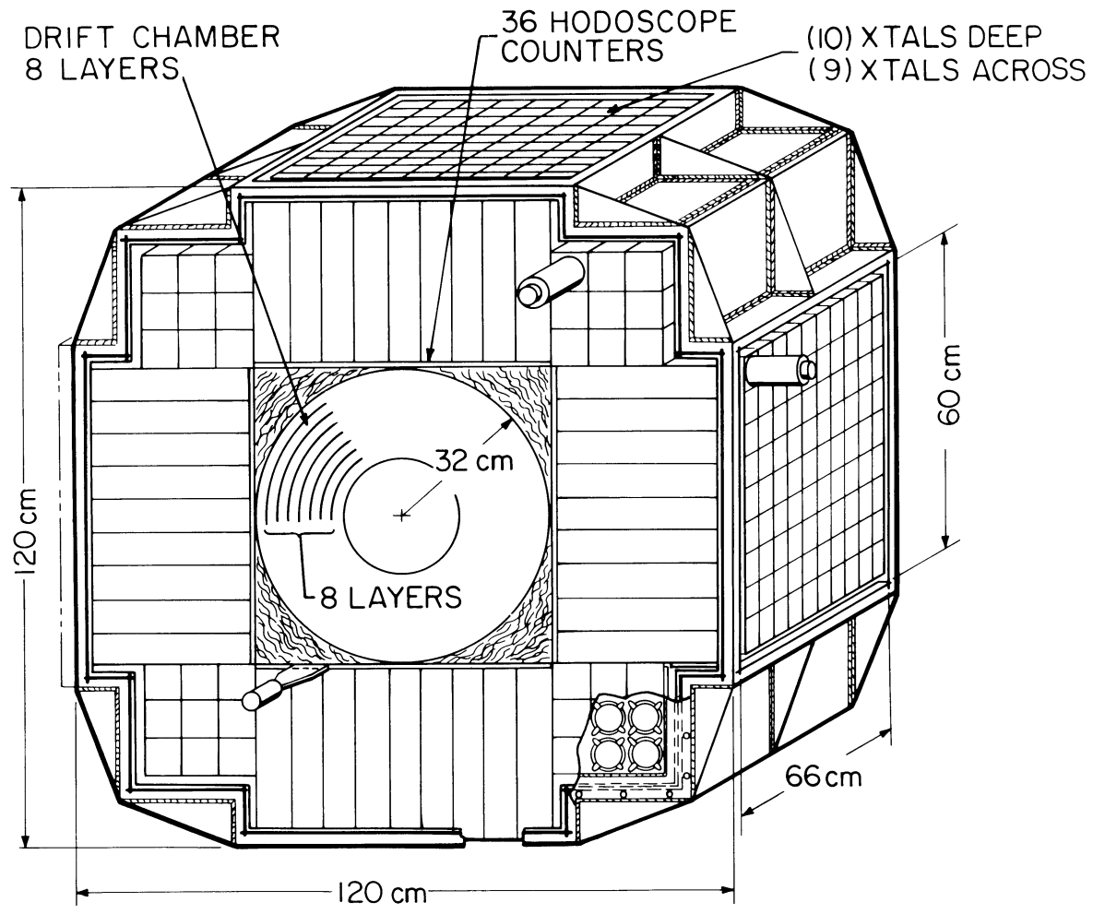
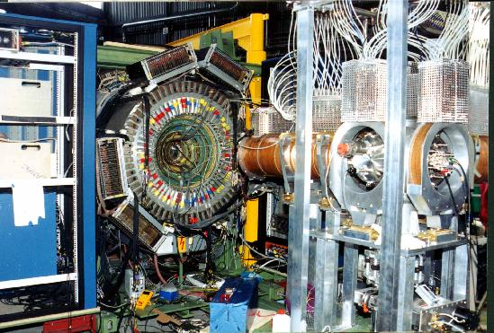








1940s till now: a cLFV odyssey
Towards new muon cLFV experiments
Construction of intense muon beamlines in China
Development of particle detection technology
MACE
MEGII
COMET
$𝓞\left({10}^{−13}\right)$ sensitivity!
Mu3e
Mu2e
Crystal Box, 1986
$$ℬℛ<7.2×{10}^{−11}$$
MACS, 1999
$$P_{M→\overline{M}}<8.3×{10}^{−11}$$
MEGII
(PSI)
$$μ^{+}→e^{+}γ$$
Mu3e
(PSI)
$$μ^{+}→e^{+}e^{−}e^{+}$$
Mu2e (Fermilab)
$$μ^{−}N→e^{−}N$$
COMET
(J-PARC)
$$μ^{−}N→e^{−}N$$
MACE (China)
$$M \underset{→}{ } \overline{M} (μ^{+}e^{−}→μ^{−}e^{+})$$
Notes:
The figure above shows the reported charged lepton flavor violation searching in the history
We aim at sensitivity
Decay and conversion
Improvement compared to

Slide 7
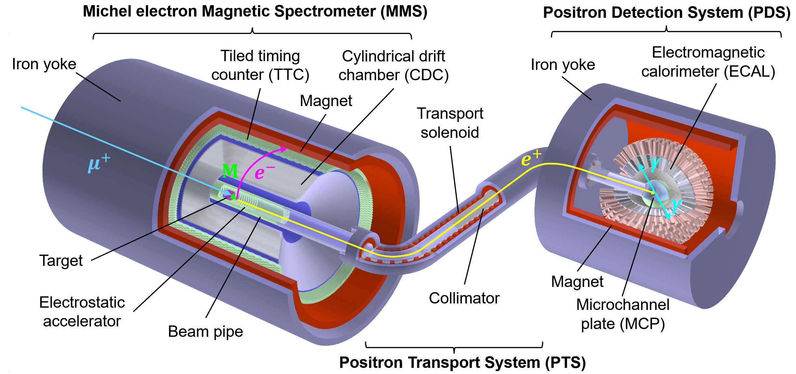
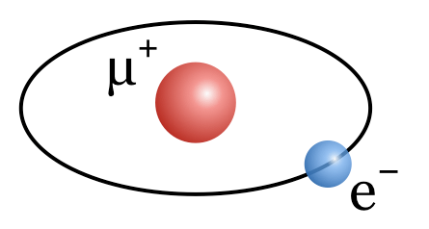
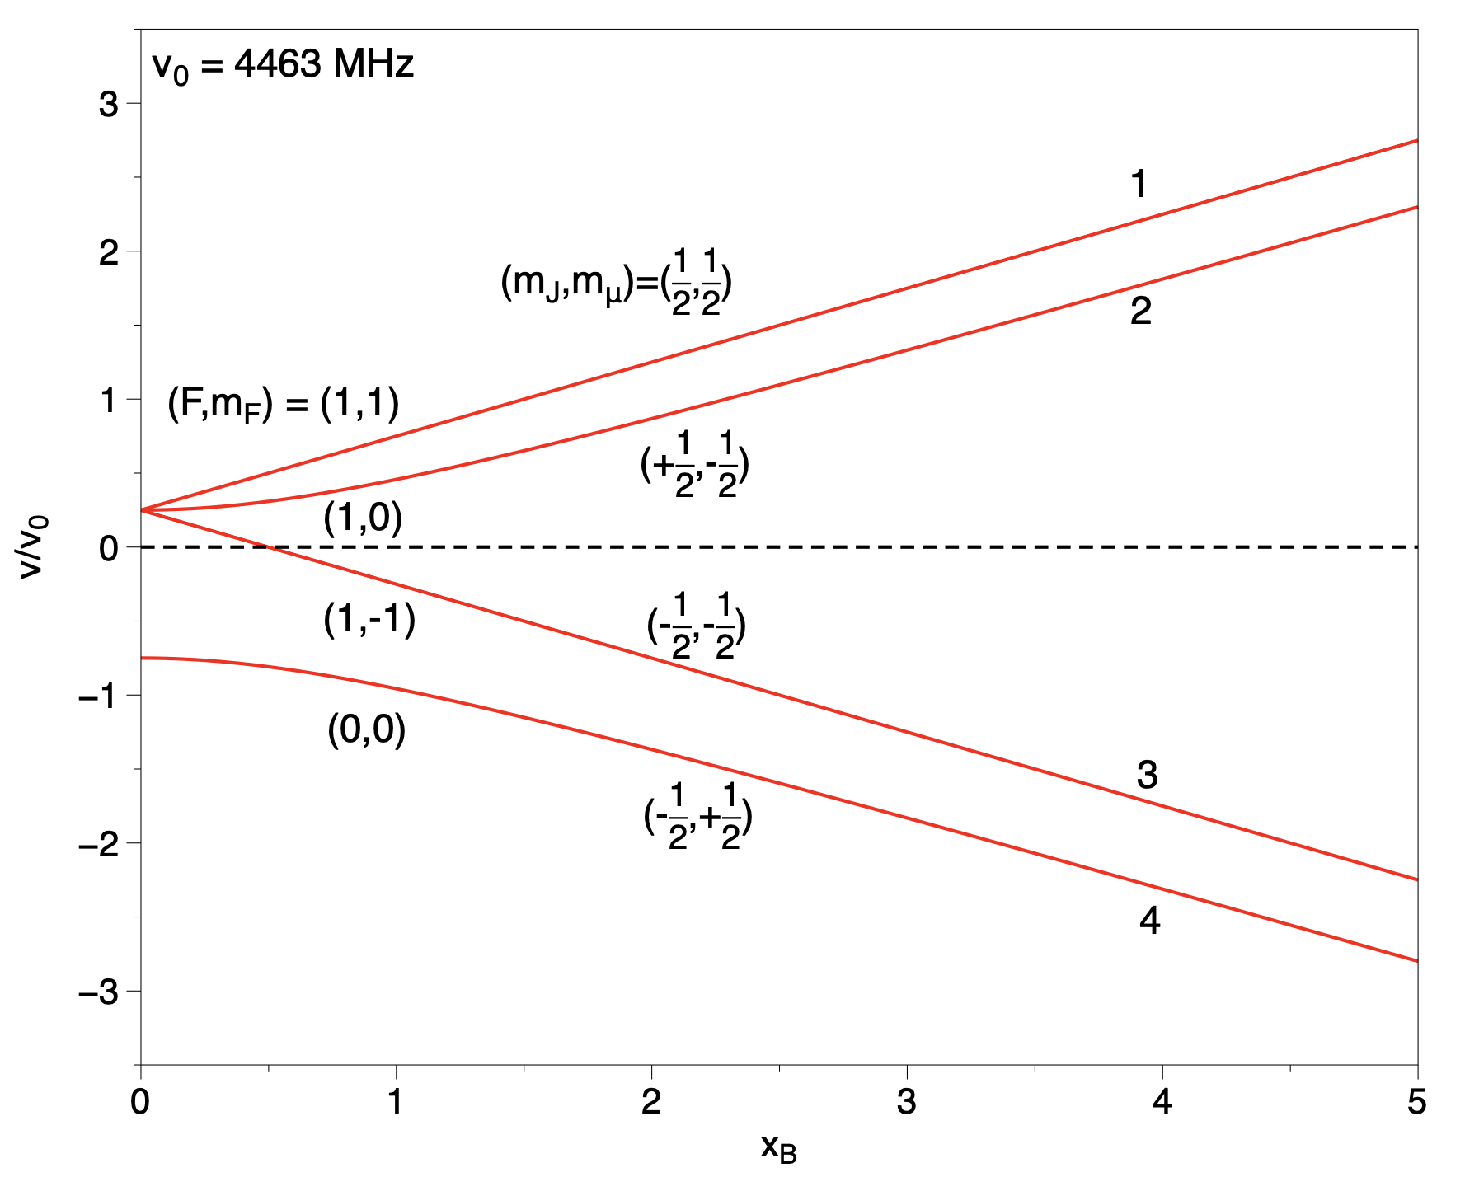
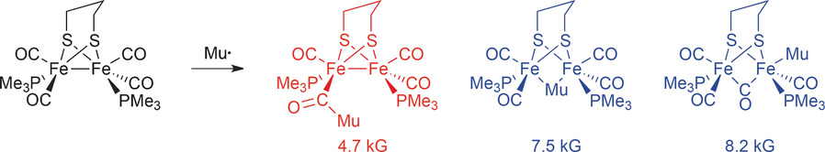
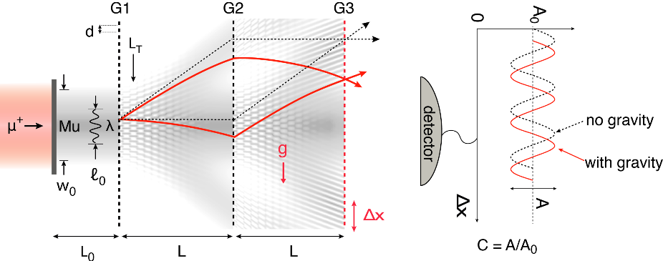
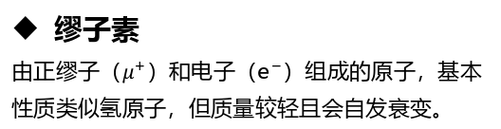

Muonium science and application
缪子素
由正缪子（$μ^{+}）$和电子（$e^{−}）$组成的原子，基本性质类似氢原子，但质量较轻且会自发衰变。
缪子素在前沿科学研究中有重要价值
缪子素是精确检验基础物理定律的重要体系
  精确测量缪子素能级 → 精确检验量子电动力学
  寻找正反缪子素转化过程 → 寻找超越标准模型的新物理
  测量缪子素重力 → 研究反物质重力及检验广义相对论
缪子素是交叉学科前沿的重要窗口
  缪子素自旋谱学 → 研究材料内禀磁学性质
  缪子素化学 → 研究化学反应机理
缪子素示意图
正反缪子素转化实验
Ai-Yu Bai et al (MACE working group). Conceptual Design of the Muonium-to-Antimuonium Conversion Experiment (MACE). arXiv: 2410.18817, 2024.
缪子素研究铁氢酶催化机理
Joseph A. Wright. Muonium Chemistry at Diiron Subsite Analogues of [FeFe]-Hydrogenase. Angewandte Chemie International Edition, 55, 47, 14471, 2016
缪子素 $1S$ 态的 Breit-Rabi 能级
Tanaka K S, Iwasaki M, Kamigaito O, et al. PTEP, 2021, 2021(5): 053C01.
缪子素是前沿科学研究的理想探针
缪子素重力测量实验
Anna Soter and Andreas Knecht, Development of a cold atomic muonium beam for next generation atomic physics and gravity experiments, SciPost Phys.Proc. 5, 031, 2021

Slide 8
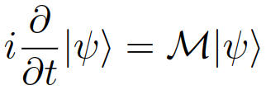

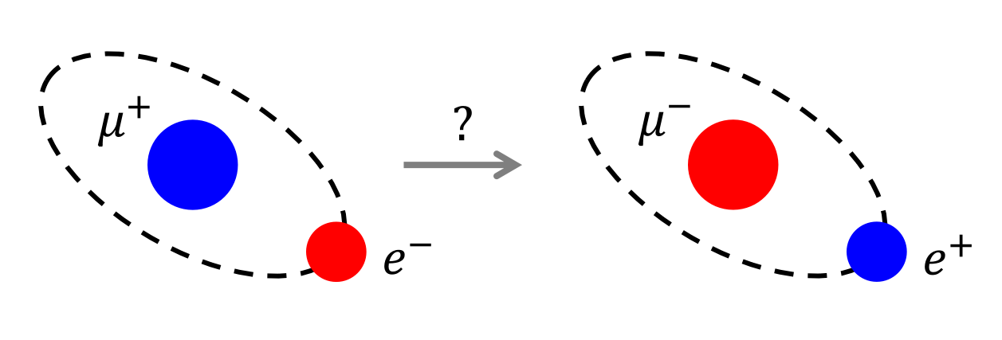
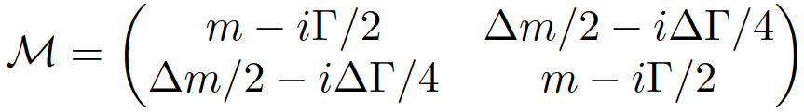
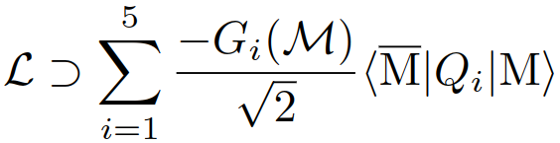

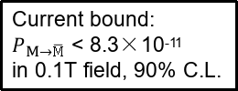




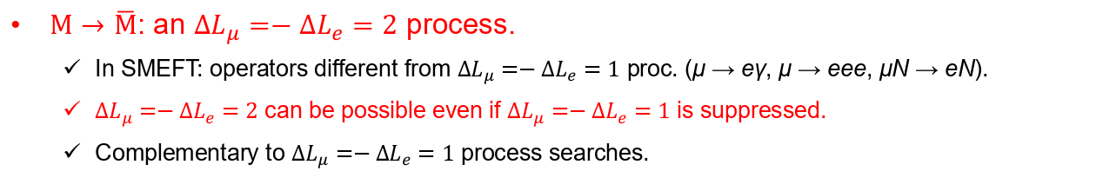
Muonium conversion: a cLFV process
Muonium ($M=μ^{+}e^{−}$): a leptonic isotope of hydrogen.
$M$-$\overline{M}$ mixing: an phenomenological possibility leads to $M$-to-$\overline{M}$ conversion.
$e^{−}$
$${\overline{ν}}_{e}$$
$e^{+}$
Muonium
Antimuonium
$$ν_{μ}$$
$M→\overline{M}$: an $∆L_{μ}=−∆L_{e}=2$ process.
  In SMEFT: operators different from $∆L_{μ}=−∆L_{e}=1$ proc. (μ → eγ, μ → eee, μN → eN).
  $∆L_{μ}=−∆L_{e}=2$ can be possible even if $∆L_{μ}=−∆L_{e}=1$ is suppressed.
  Complementary to $∆L_{μ}=−∆L_{e}=1$ process searches.
Current bound:
$P_{M→\overline{M}}$ < 8.3×10⁻¹¹
in 0.1T field, 90% C.L.
L. Willmann et al., Phys. Rev. Lett. 82 (1999), 49-52.
Julian Heeck and Mikheil Sokhashvili. Lepton flavor violation by two units. Phys. Lett. B, 852:138621, 2024.
T. Fukuyama, Y. Mimura, and Yuichi Uesaka, Phys. Rev. D 105, 015026 (2022). (arXiv: 2108.10736)

Slide 9
Contents
Motivations
MACE conceptual design
Proposal of MACE Phase-I
MACE offline software
Summary

Slide 10

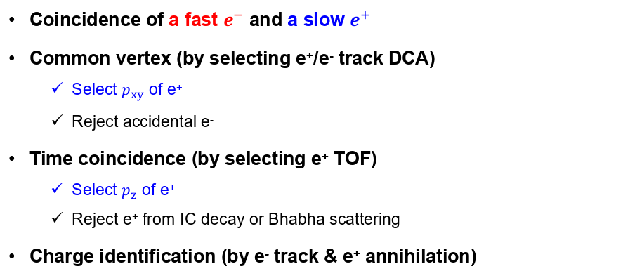


Signal and background
Signal:
fast $e^{−}$ + slow $e^{+}$
1. Internal conv. (IC) decay
$μ^{+}→e^{+}e^{−}e^{+}{\overline{ν}}_{μ}ν_{e}$
2. Final state scattering
$M→e^{+}{\overline{ν}}_{μ}ν_{e}e^{−}$
3. Accidental bkg.
Scattering/conv. e⁻
Misreconstruction
Cosmic ray, etc.
e⁻ (26MeV avg.)
e⁻
e⁻
e⁻
μ⁺
e⁺
e⁺
e⁺
e⁺
(13.5eV avg.)
μ⁺
μ⁺
μ⁺
M
M
e⁺ (miss)
ν
ν
Target
ν
ν
ν
ν
ν
ν
Coincidence of a fast $e^{−}$ and a slow $e^{+}$
Common vertex (by selecting e⁺/e⁻ track DCA)
  Select $p_{xy}$ of e⁺
  Reject accidental e⁻
Time coincidence (by selecting e⁺ TOF)
  Select $p_{z}$ of e⁺
  Reject e⁺ from IC decay or Bhabha scattering
Charge identification (by e⁻ track & e⁺ annihilation)
Excellent vertex resolution
  e⁺/e⁻ spatial resolution
  Precise e⁺ transport in EM field
Excellent time resolution
  e⁺/e⁻ time resolution

Slide 11
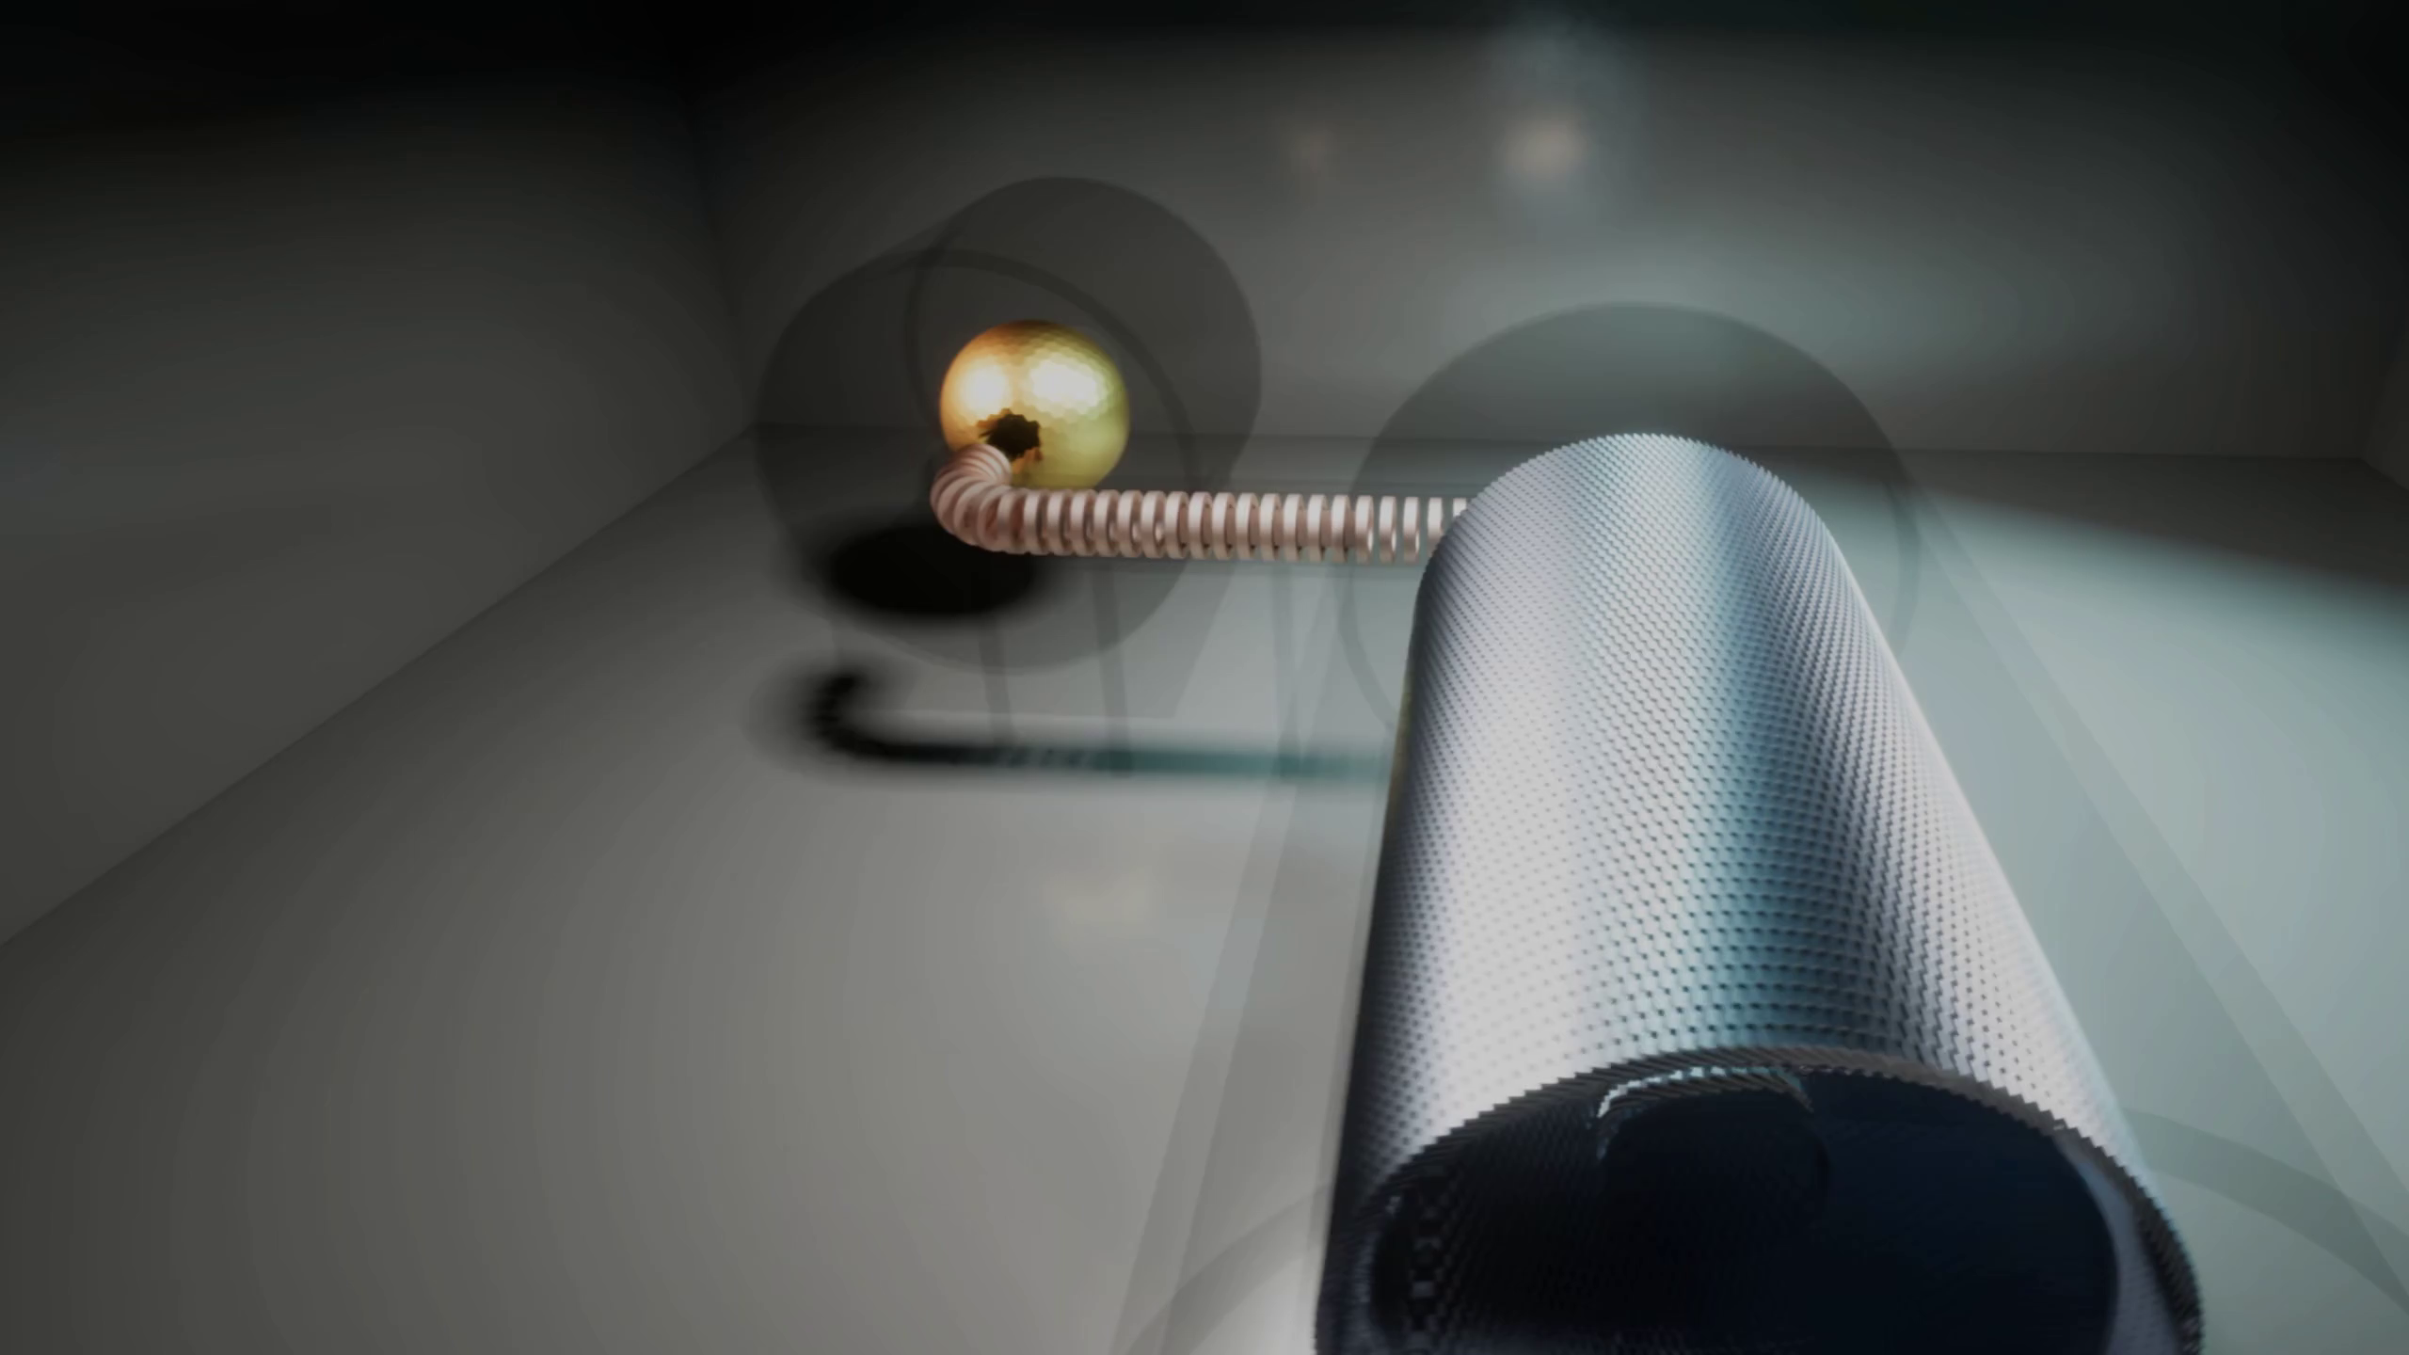
Conceptual design of MACE detector system

Slide 12
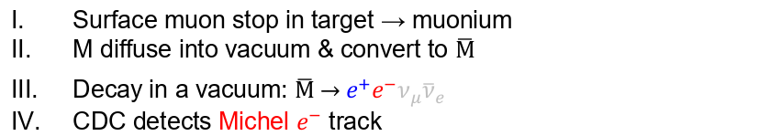
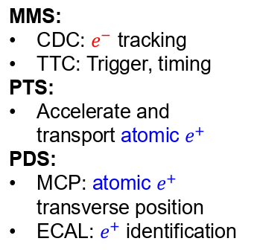
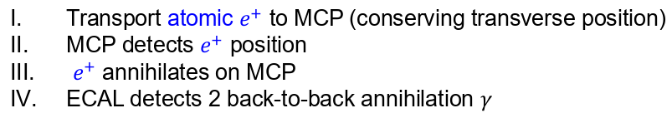


Conceptual design of MACE detector system
MMS:
CDC: $e^{−}$ tracking
TTC: Trigger, timing
PTS:
Accelerate and transport atomic $e^{+}$
PDS:
MCP: atomic $e^{+}$ transverse position
ECAL: $e^{+}$ identification
Triple coincidence:
MMS + MCP + ECAL
Michel $e^{−}$
Atomic $e^{+}$
Surface muon stop in target → muonium
M diffuse into vacuum & convert to $\overline{M}$
Decay in a vacuum: $\overline{M} \underset{→}{ } e^{+}e^{−}ν_{μ}{\overline{ν}}_{e}$
CDC detects Michel $e^{−}$ track
Transport atomic $e^{+}$ to MCP (conserving transverse position)
MCP detects $e^{+}$ position
$e^{+}$ annihilates on MCP
ECAL detects 2 back-to-back annihilation $γ$

Slide 13

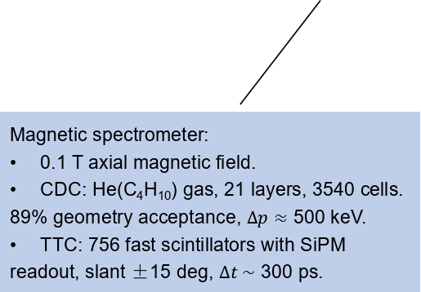
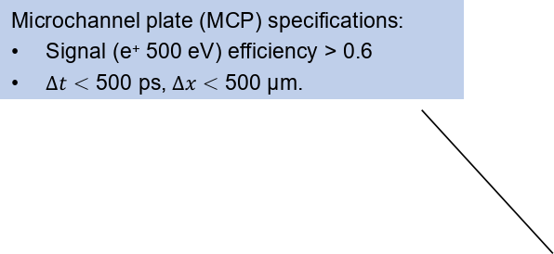
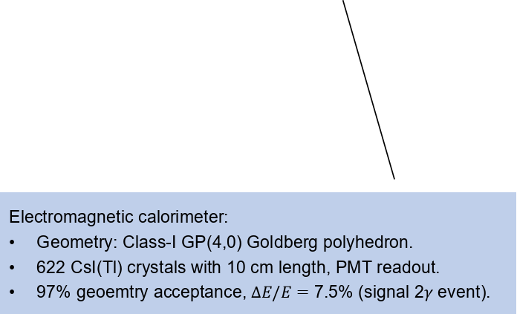
Detector Specifications and Implementation
Muonium target:
Silica aerogel with perforation surface.
Goal: 4% muonium yield in a vacuum.
Microchannel plate (MCP) specifications:
Signal (e⁺ 500 eV) efficiency > 0.6
$∆t<$ 500 ps, $∆x<$ 500 μm.
0.2 mm
1.15 mm
Positron transport system:
500 V electrostatic accelerator & 0.1 T transport solenoid & brass foil collimator.
Signal e⁺ position error 100 μm.
Magnetic spectrometer:
  0.1 T axial magnetic field.
  CDC: He(C₄H₁₀) gas, 21 layers, 3540 cells. 89% geometry acceptance, $∆p≈$ 500 keV.
  TTC: 756 fast scintillators with SiPM readout, slant ±15 deg, $∆t \sim$ 300 ps.
Electromagnetic calorimeter:
Geometry: Class-I GP(4,0) Goldberg polyhedron.
622 CsI(Tl) crystals with 10 cm length, PMT readout.
97% geoemtry acceptance, $∆E/E=$ 7.5% (signal 2$γ$ event).

Slide 14
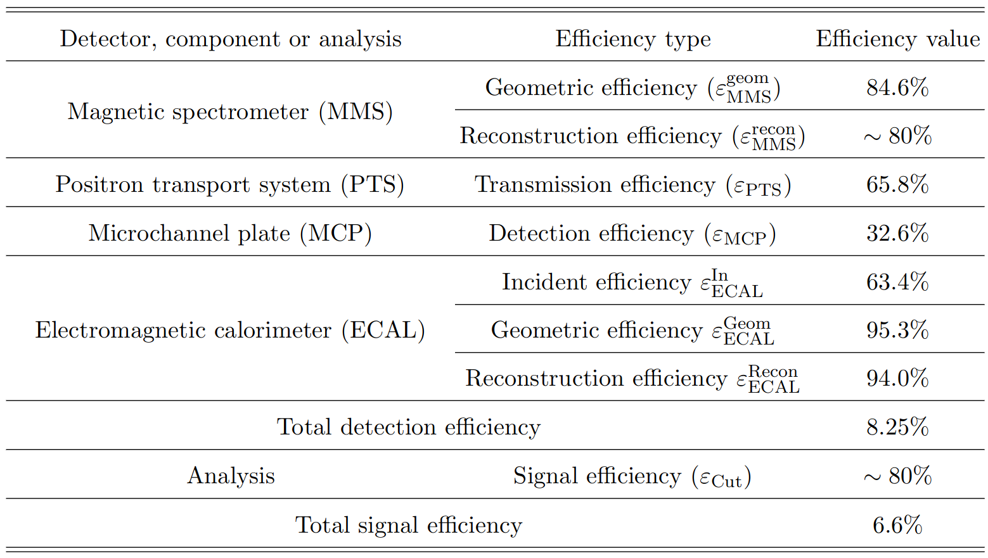
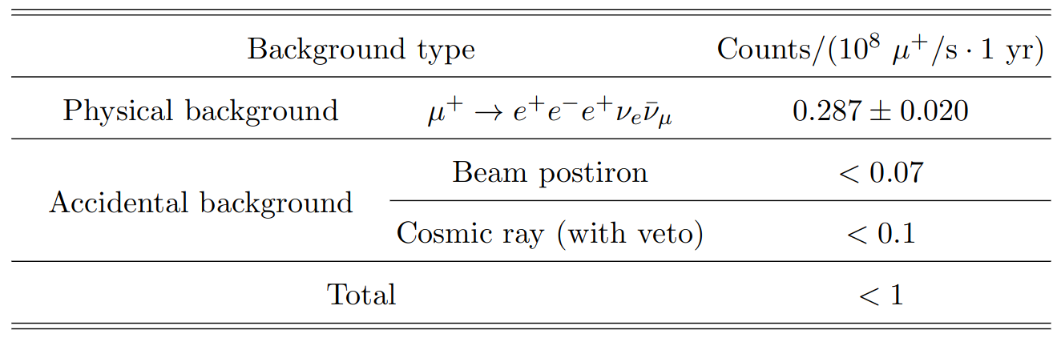
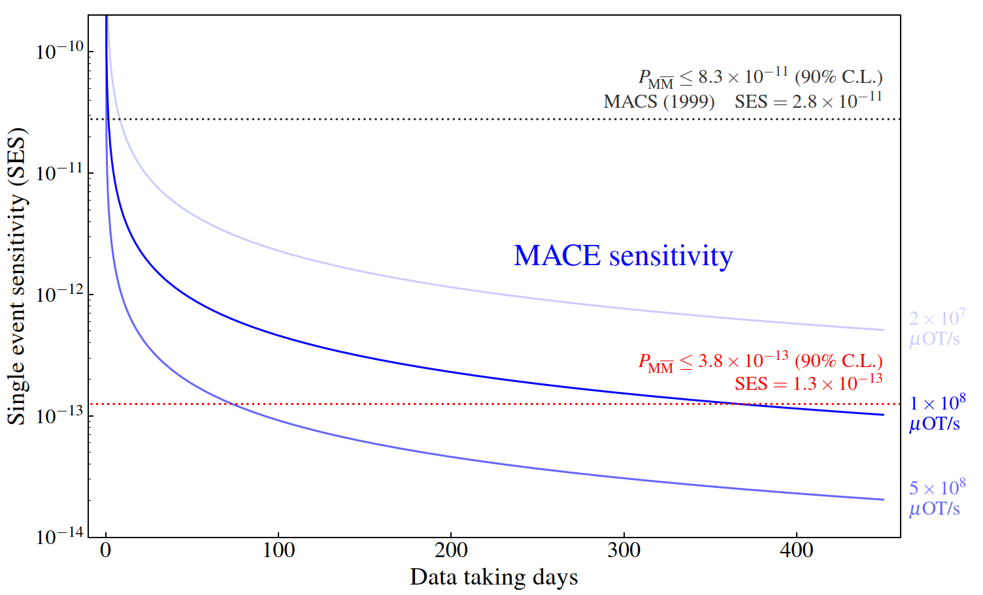
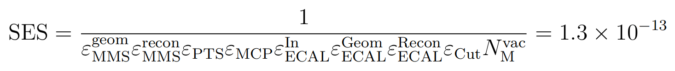
Sensitivity estimation
Summary of simulation results:
$𝒪\left({10}^{−13}\right)$ single event sensitivity is expected:
Notes:
We estimated the sensitivity of MACE by detailed simulations
Left side table: each type of backgrounds and their levels
Right side table: the detailed efficiency of each subdetectors
For the muonium to antimuonium conversion, we can expect a single event sensitivity of

Slide 15
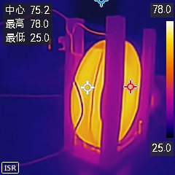
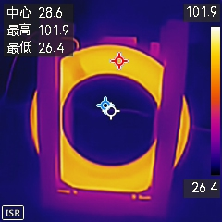
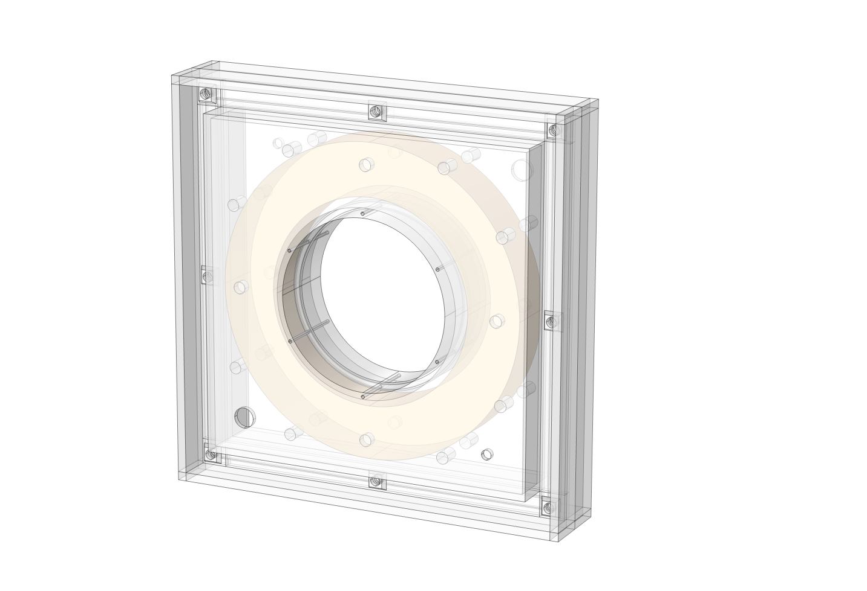
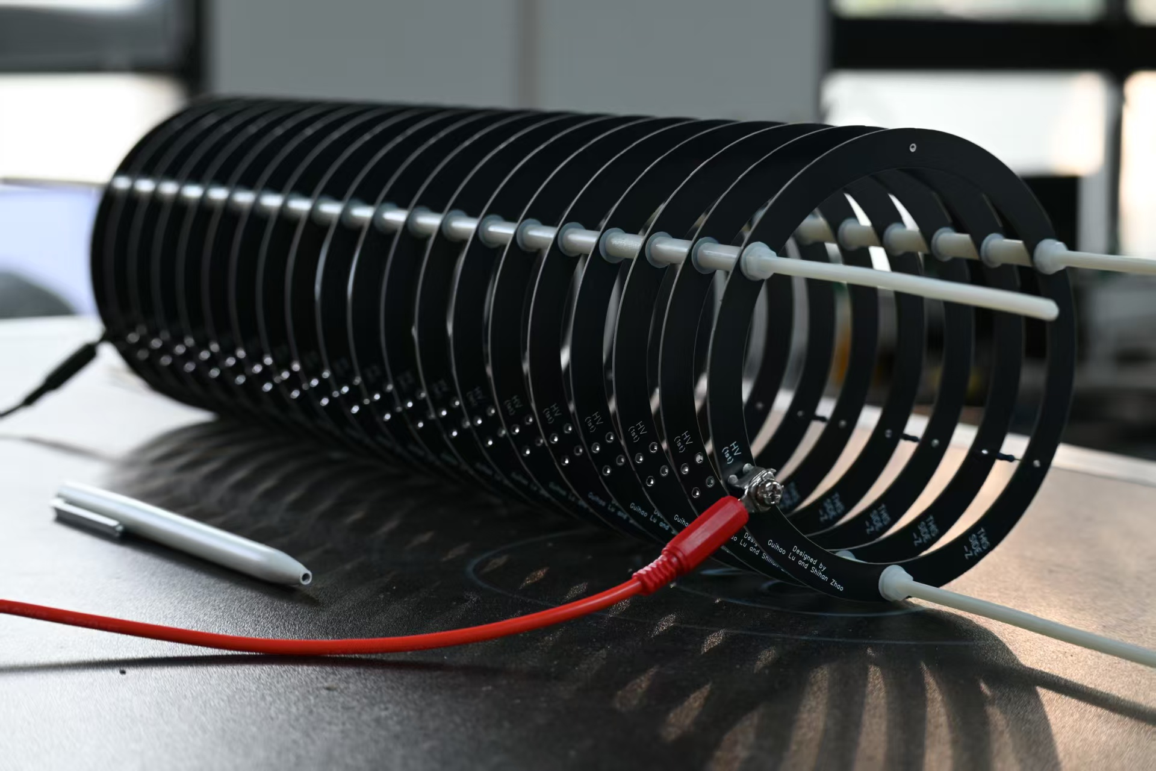
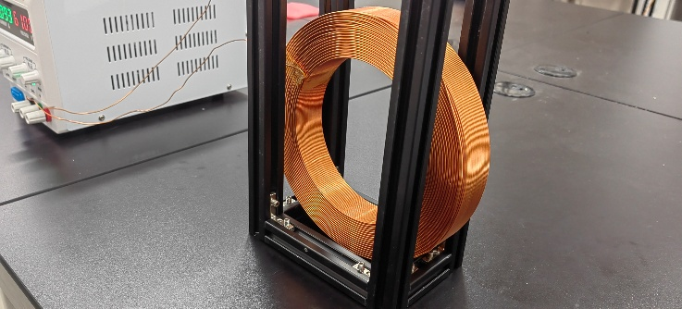
PTS prototyping progress
PTS validation
  Testing with TS solenoids and accelerator module
Credit: Guihao Lu
Detector Chamber
Ionization Vacuum Gauge
Venting Valve
Validation
prototype
Particle Source
Roughing Valve
Accelerator module prototype
  Multi-layer PCB
  High voltage > 2 kV
Thermocouple Vacuum Gauge
High Vacuum Gate Valve
Dry Mechanical Pump
Foreline Valve
Molecular Pump

Slide 16
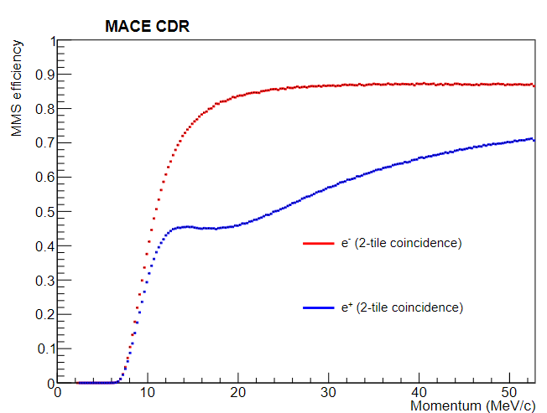
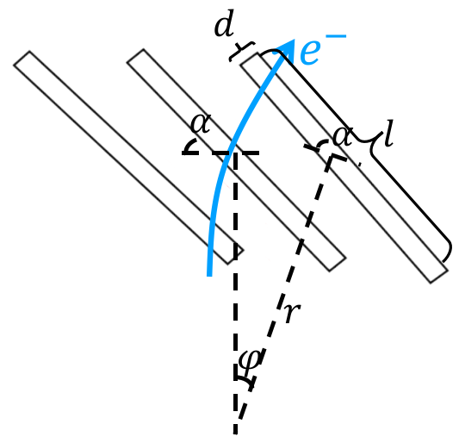
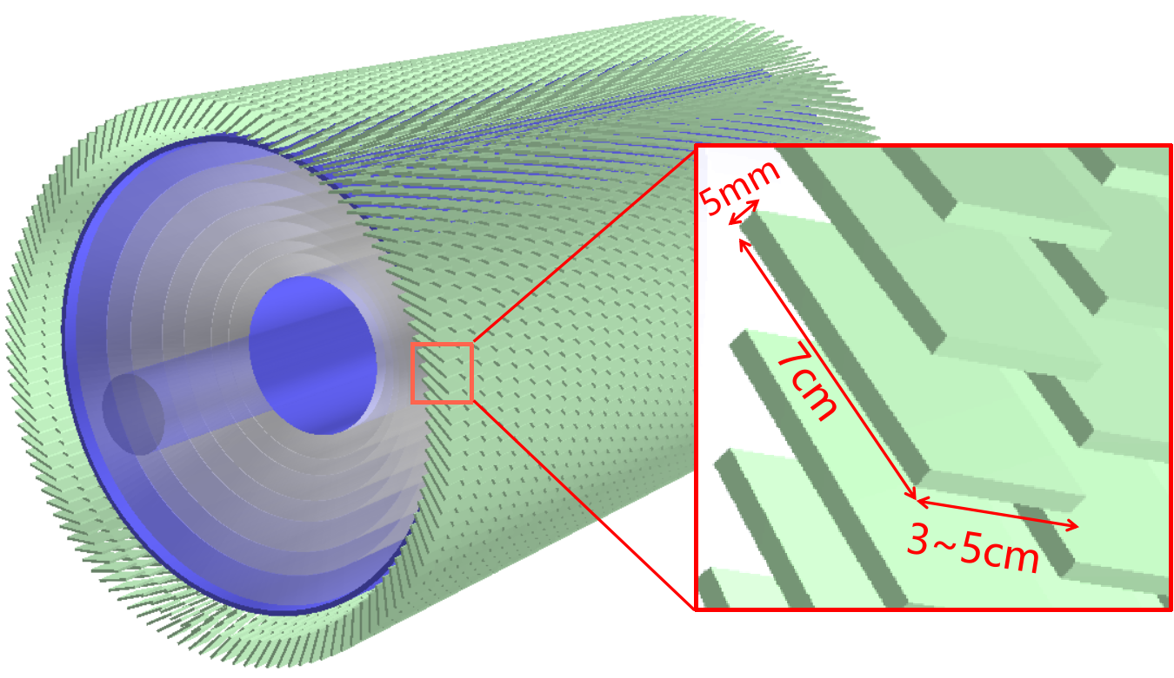
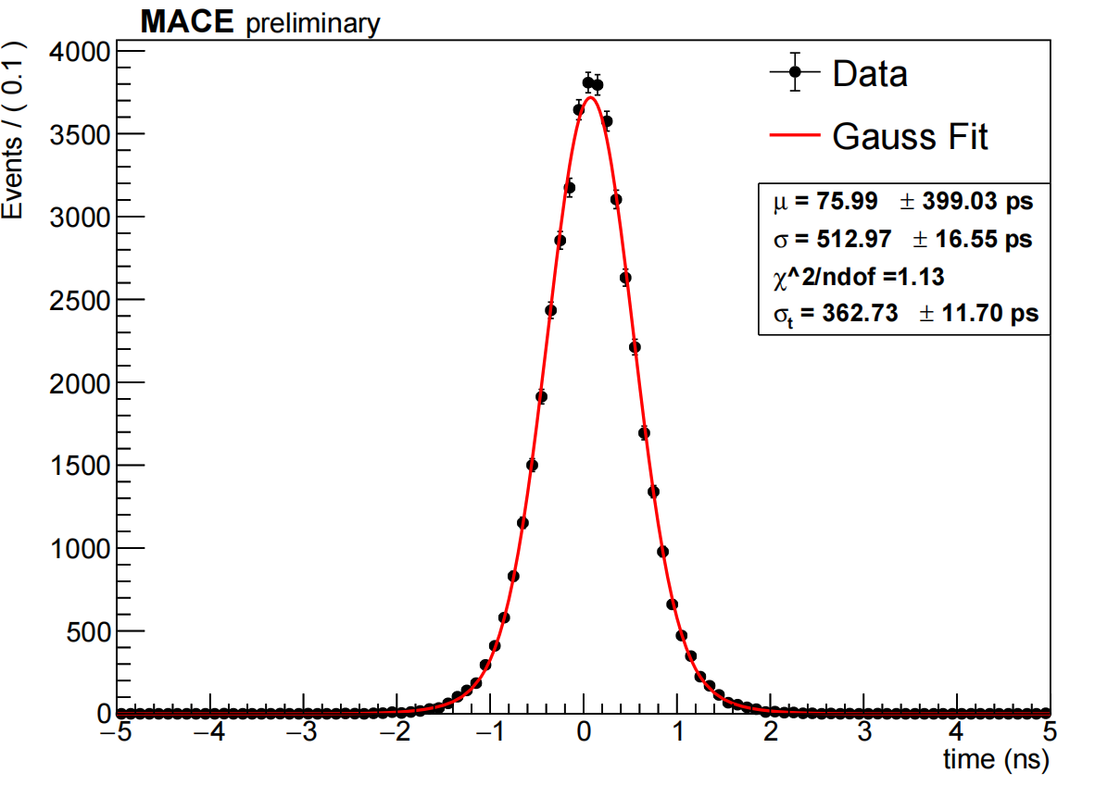
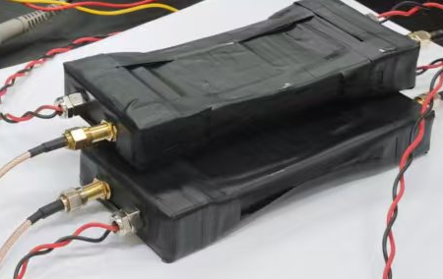
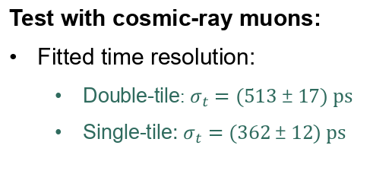
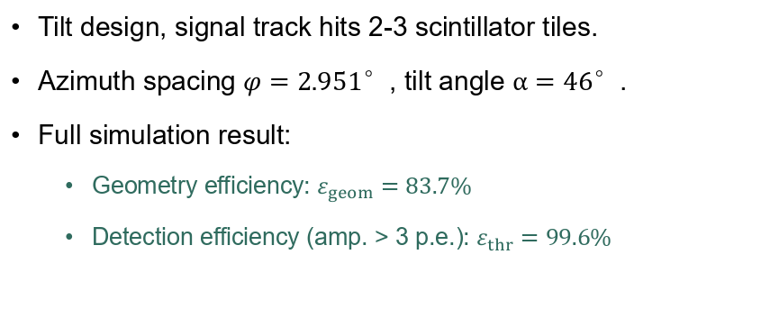
Tiled timing counter (TTC)
Tilt design, signal track hits 2-3 scintillator tiles.
Azimuth spacing $φ=2.951°$, tilt angle $α=46°$.
Full simulation result:
  Geometry efficiency: $ε_{geom}=83.7\%$
  Detection efficiency (amp. > 3 p.e.): $ε_{thr}=99.6\%$
Test with cosmic-ray muons:
Fitted time resolution:
  Double-tile: $σ_{t}=(513±17) ps$
  Single-tile: $σ_{t}=(362±12) ps$
Credit: Hao Jiang

Slide 17
Contents
Motivations
MACE conceptual design
Proposal of MACE Phase-I
MACE offline software
Summary

Slide 18
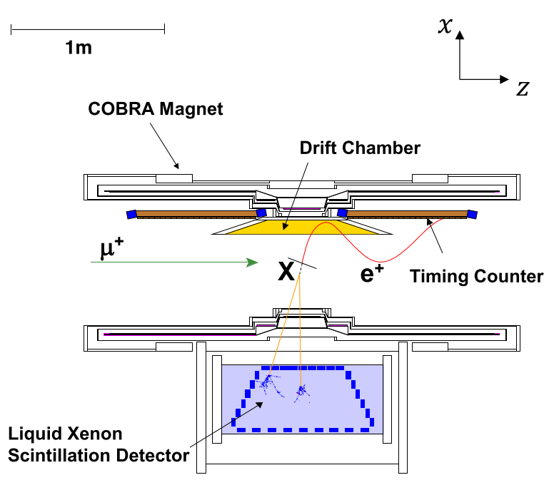
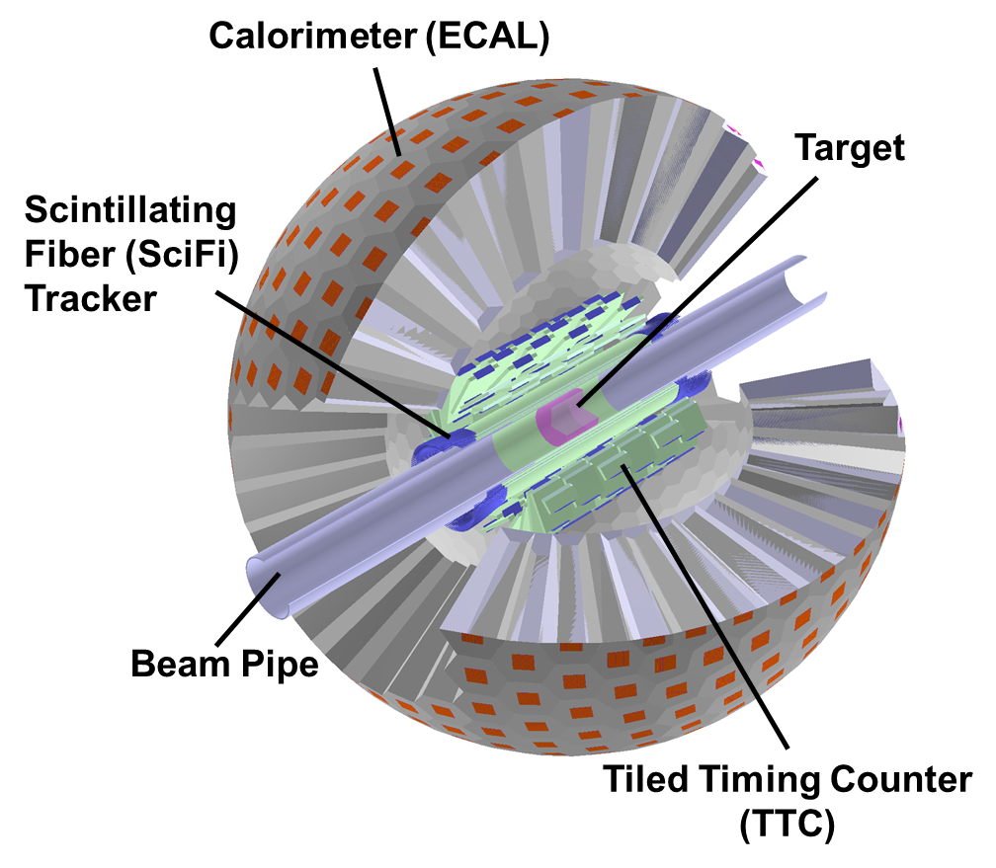
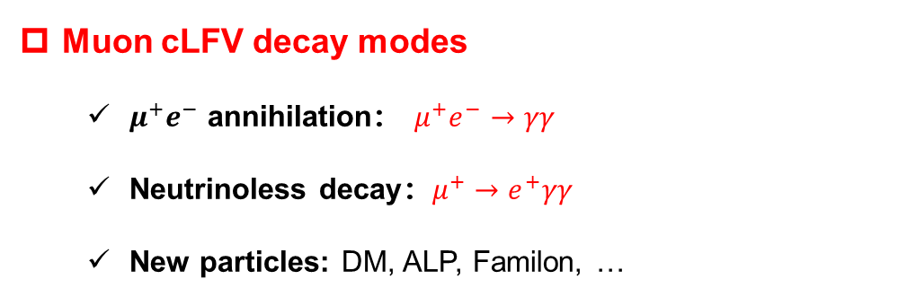
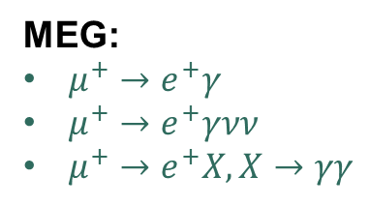
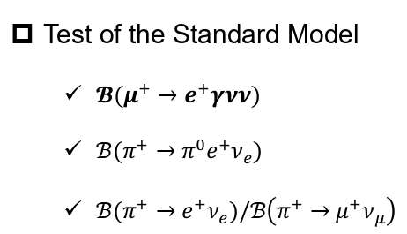

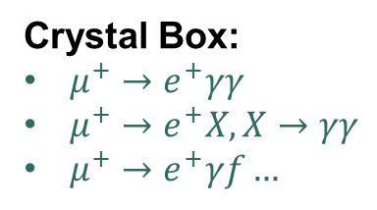

Proposal of MACE Phase-I
Muon cLFV decay modes
  $μ^{+}e^{−}$ annihilation： $μ^{+}e^{−}→γγ$
  Neutrinoless decay：$μ^{+}→e^{+}γγ$
  New particles: DM, ALP, Familon, …
$𝒪\left({10}^{−5}\right)$, 1959
$𝒪({10}^{−11})$, 1988
Crystal Box、MEG
PRL, 1959, 3: 288-291
PRD 38 (1988) 2077
EPJC 80 (2020) 9, 858
Crystal Box:
$μ^{+}→e^{+}γγ$
$μ^{+}→e^{+}X, X→γγ$
$μ^{+}→e^{+}γf…$
MEG:
$μ^{+}→e^{+}γ$
$μ^{+}→e^{+}γνν$
$μ^{+}→e^{+}X, X→γγ$
Test of the Standard Model
  $𝓑(μ^{+}→e^{+}γνν)$
  $ℬ(π^{+}→π^{0}e^{+}ν_{e})$
  ${ℬ(π}^{+}→e^{+}ν_{e})/ℬ\left(π^{+}→μ^{+}ν_{μ}\right)$
$𝒪\left({10}^{−8}\right), E_{e}>45, E_{γ}>40$ MeV, 2016
$𝒪({10}^{−8})$, 2004
$𝒪({10}^{−4})$, 2015
EPJC 76 (2016) 3, 108
Int.J.Mod.Phys.A 20 (2005) 472-481
PRL. 115 (2015) 7, 071801
arXiv:2203.01981
PIONEER CDR, 2022
MACE Phase-I

Slide 19

MACE Phase-I detector
Phase-I requirements：
High-intensity muon beam —— improvement of statistics
Detectors with fast response —— “pileup” rejection
$e^{+}$ tracking and timing, $e^{+}/γ$ discrimination
High acceptance and granularity, good resolution
Challenge：
No magnetic field applied.
High background rate.

Slide 20











Sensitivity estimation of $μ^{+}→e^{+}γγ$
Signal:
Triple coplanar tracks
$e^{+}$ and two $γ$s
Background:
Double radiative muon decay
Calculated by McMule
SciPost Phys. 9, 027 (2020)
$$γ$$
$$γ$$
$$e^{+}$$
$$μ^{+}$$
$$e^{+}$$
$$μ^{+}$$
$$ν_{e}$$
$${\overline{ν}}_{μ}$$
$$γ$$
$$γ$$
Event selection criteria:
Time coincidence
One track in tracker, two tracks in ECAL
Select missing energy
$$s_{up}=\frac{1}{2}F_{χ^{2}}^{−1}\left[1−α, 2\left(n_{obs}+1\right)\right]−b$$
$$n_{obs}=b$$
$$ℬ\left(μ→eγγ\right)<\frac{s_{up}}{ε_{signal}Φ_{μ}T}$$
BR upper limit estimation: $4×{10}^{−13}$ (90% C.L.)
$𝒪({10}^{−11})$ in 1988
PRD 38 (1988) 2077

Slide 21



Sensitivity estimation of $M→γγ$
Signal: Double collinear 53 MeV gamma-rays
γ
No response in Tracker
Double tracks reconstructed by ECAL
μ⁺
M
γ
Target
Background: Accidental coincidence of “pileup” positrons
$$s_{up}=\frac{1}{2}F_{χ^{2}}^{−1}\left[1−α, 2\left(n_{obs}+1\right)\right]−b$$
$$n_{obs}=b$$
e+
Positron → gamma misidentification
Two accidental coincidence misidentified tracks at same vertex
μ⁺
μ⁺
M
$$ℬ\left(M→γγ\right)<\frac{s_{up}}{ε_{signal}Y_{M}Φ_{μ}T}$$
Target
e+
BR upper limit estimation: $2×{10}^{−13}$ (90% C.L.)
More background simulations and refined data analyses to be updated!
$𝒪({10}^{−5})$ in 1959
PRL, 1959, 3: 288-291

Slide 22
Contents
Motivations
MACE conceptual design
Proposal of MACE Phase-I
MACE offline software
Summary

Slide 23

MACE offline software
Experiment design stage: simulation-guided detector design optimization.
Engineering stage: detector alignment and detector-response simulation.
Data-taking stage: bridges experimental data to physics results.
Tasks:
  Event generation
  Simulation: detector, DAQ…
  Reconstruction & analysis
  Visualization: event, track, detector geometry…
Software quality control:
  Framework and architecture
  Continuous integration
  Validation

Slide 24

Software Architecture
Mustard framework:
  A modern, distributed, high-performance architecture for particle physics experiments.
High-performance design:
  Distributed executor for simulation and analysis.
  Based on C++20, template-rich design for zero-overhead abstraction and flexibility.
Key components:
  Distributed computing framework
  Unified geometry interfaces
  High-level data model abstractions and IO
  Utilities for simulation, reconstruction, analysis...

Slide 25


Continuous Integration
Challenges in Parallel Development
  Merge conflicts
  Tedious code review
  Hidden risks
Practice of Continuous Integration
  Frequently integrate code into a shared repository.
  Each integration is verified via automated builds and tests.
CI/CD
  Configure pipeline via config file.
  Runners execute automated test scripts.

Slide 26


Regression test
Expectation
In terms of performance:
previously developed ≈ newly tested
For MACE offline software:
Output data maintains homogeneity.
Test elements
Benchmark: $h_{test}$
Histograms drawn from the output data.
Reference: $h_{ref}$
Histograms run by the stable version (with larger data volume 10×tested).
Performance indicator: homogeneity
Chi2test p-value.
time line

Slide 27
Contents
Motivations
MACE conceptual design
Recent progress and prototyping
MACE offline software
Summary

Slide 28


Breakthrough point for fundamental research
The latest result was obtained by MACS in 1999, with a muon flux of $8×{10}^{6}μ^{+}/s$.
Requirement: China domestic accelerator muon source to provide ${10}^{8}μ^{+}/s$ surface muon.
Over 20 years, significant advances in detector technology.
China’s accelerator and particle detection technology have made great strides.
The new generation of experiments is expected to improve sensitivity by over two orders of magnitude compared to the 1999 PSI results!
Acknowledgements:
We express our gratitude to Yoshitaka Kuno, Klaus Jungmann, Lorenzo Calibbi, Ce Zhang, Tsutomu Mibe, Yuichi Uesaka, Yu Bao, Ningqiang Song and
many other colleagues for their insights and expertise during discussions. We also appreciate the professional and constructive comments provided by Xin Chen, Kim-Siang Khaw, Teng Li, Yi Liao, Yong Liu and Xiang Xiao in reviewing the MACE conceptual design report.
Thanks!
28

Slide 30




New physic sensitivity (SMEFT)
Standard Model effective field theory (SMEFT) Lagrangian:
Five dim-6 operators contribute to muonium mixing:
Well complement to high-energy frontier.

Slide 31







Muonium production target
Intensity of in-vacuum muonium source: $I_{M}^{vac}=I_{beam}Y_{μ→M}$
$Y_{μ→M}$ can be improved by utilizing porous materials, ideally perforated silica aerogel.
A simulation method is developed to accurately simulate muonium production and diffusion.
The simulation is validated by muonium yield data measured in TRIUMF.
Optimize $Y_{μ→M}$ in perforated bulk target by scanning parameters, it can achieve
  Max $Y_{μ→M}={N_{M}^{vac}}/{N_{μ}^{total}}=1.134\%$, with 2mm hole depth, $p_{beam}=28 MeV/c$ and $\frac{σ_{p_{beam}}}{p_{beam}}=2.5\%$.
J. Beare et al., PTEP. 2020, 123C01 (2020)
2 times larger than the yield in 1999
$${N_{M}^{vac}}/{N_{μ}^{beam}}$$
$${N_{M}^{vac}}/{N_{μ}^{beam}}$$
$${N_{M}^{vac}}/{N_{M}^{total}}$$
$${N_{M}^{vac}}/{N_{M}^{total}}$$
Zhao, Shihan, and Jian Tang. "Optimization of muonium yield in perforated silica aerogel." Physical Review D 109.7 (2024): 072012.

Slide 32




Muonium production target
Proposed design: Tilted single-layer silica aerogel.
Improves the muon emmision efficiency while keeping the muon stopping power.
$$d$$
$$d_{eff}=d\sec{α}$$
Simulation in progress.

Slide 33


Positron transport system
The component of positron transport system (PTS)
  I. Electrostatic accelerator
  II. Solenoid system
  1. MMS solenoid
  2. TS solenoid
  3. ECAL solenoid
PTS performance
I. Transmission efficiency: 65.8%.
II. Flight time: 322 ns.
III. Flight time FWHM: 6.9 ns.
IV. Spatial resolution: 0.088 mm $×$ 0.102 mm
Suppress the IC decay bkg. by a level of ${10}^{−7}$
Lu, Guihao, et al. "Positron Transport System for Muonium-to-Antimuonium Conversion Experiment." arXiv preprint arXiv:2508.07922 (2025).

Slide 34








Tracker System
Precise timing and tracking ability
Low material budget
Low cost
$e^{+}/γ$ discrimination
  High active area
  High $e^{+}$ detection efficiency
  Low $γ$ detection efficiency
Plastic scintillators
Credit: Yinyuan Huang
SciFi baseline design:
Crossing fiber arrangement
2360 channels
Single-end readout by SiPM
Spatial resolution ~1 mm
Timing resolution ~800 ps
$ε_{Recon}≈80\%$
$ε_{e}=96\%$
$ε_{γ}=3\%$
325.4 mm
$$e^{+}$$

Slide 35





Tracker System
Tiled timing counter (TTC)
  108 tiles of plastic scintillator in total
  Double-end readout by SiPM
  Good timing resolution, ~$𝒪\left(100\right)$ ps
  Providing timing information to ECAL, e/γ discrimination
$$e^{+}$$
Plastic scintillator
ECAL
SciFi
PCB
TTC
Credit: Hao Jiang

Slide 36




Electromagnetic Calorimeter
Design scheme：
High acceptance and granularity
Symmetrical structure
Class-I GP(8,0) Goldberg polyhedron
Crystal scintillators coupled with SiPM arrays
PEN detector
pCsI + PMT
MACE ECAL
pCsI + SiPM
LYSO
30000 ph/MeV
40 ns
Radiation hard
Not hygroscopic
Emits at 420 nm
CNY ￥300/cm³
BGO
8000 ph/MeV
300 ns
Not hygroscopic
Emits at 480 nm
CNY ￥100/cm³
Pure CsI
3500 ph/MeV
40 ns
Slight hygroscopic
Emits at 310 nm
Adopted by Mu2e and PIBETA
CNY ￥30/cm³
Baseline design
NUV SiPM readout
Sensors 19 (2019) 2, 308

Slide 37

Key components
Distributed executor & scheduler
  Based on Message Passing Interface (MPI)
  Pure message passing model (nice speedup and reduced technical complexity).
Event Data Model
  Statically typed data model built by C++ template metaprogramming.
  Interface enables:
    Compile-time type checking.
    Zero-overhead tuple mapping.
    Consistency with actual data object.
Detector Geometry & Field
Separates human-readable parameters (Description) from detailed geometry construction (Definition).
Supports reusable EM field definitions and interpolation from field maps.
Unifies interface for simulation and reconstruction processes

