Slide 1

Measurements of Higgs boson Mass in the μμH final state at 240 GeV in CEPC Reference detector
Approval Talk
Yuji Li, Chenguang Zhang, Mingshui Chen

Slide 2

Motivations
The recoil mass method in μμH final state leverages the high-momentum resolution of muon detectors in CEPC to infer the Higgs mass by measuring the four-momentum of the accompanying Z boson.
The method reduces dependencies on direct Higgs decay mode, provides a clean channel unaffected by Higgs decay branching fraction uncertainties, which allows model-independent measurements on Higgs properties.
The mass uncertainties will be given in a value ~5GeV, which is much smaller comparing the uncertainties from LHC, enhancing the sensitivity to New Physics Beyond the SM
The results will give a good performance test on CEPC tracking system, and PID software for muon objects.

Slide 3
Datasets
Lumi = 20000fb-1
Name | FinalStates | Cross sections[fb]
zz_l0mumu | mumu+vtauvtau | 19.38
4mu | mumu+mumu | 15.56
sze_l0mu | mumu+ee | 845.81
sznu_l0mumu | mumu+veve | 43.42
sl0mu_down | mumu+(bb, ss, dd) | 136.14
sl0mu_up | mumu+(uu,cc) | 87.39
zzorww_ll | mumu+vmuvmu | 221.1
2fermion | mumu(isr) | 5332.71
mmHX | mumu+H(incl.) | 6.77
The name is using the same conventions in the CEPC sample generation.

Slide 4

Event Selection
Muon Selection:
PID 90%WP (XGBoost based BDT has been applied)
20 < p < 80
Best Muon Pair Selection:
The nearest inv. mass to Z pdg mass.
120<recoil mass<140
Missing EZ < 50
E(μμ)< 110, 20<p(μμ)< 60, 50< m(μμ)< 120

Slide 5
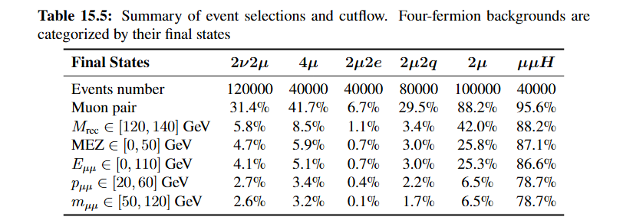
Cutflow
Nearly 80% signal events are kept in our selection, and the backgrounds are suppressed under 5%.
2mu events has been pre-selected with GEN-filter in sample production, and the filter efficiency is 2.69%

Slide 6
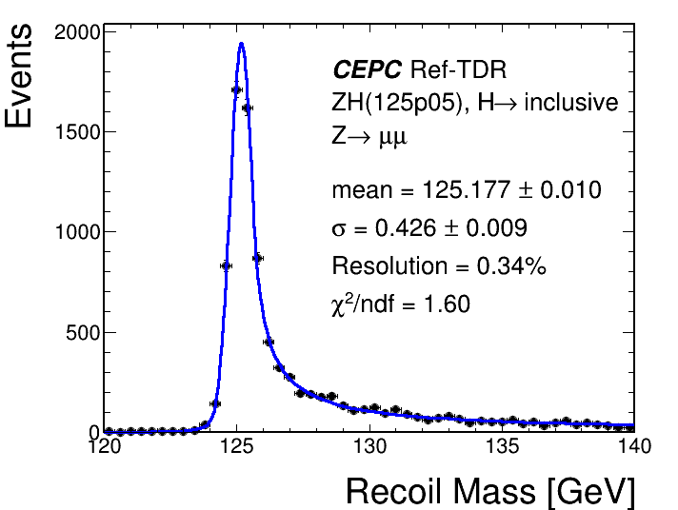
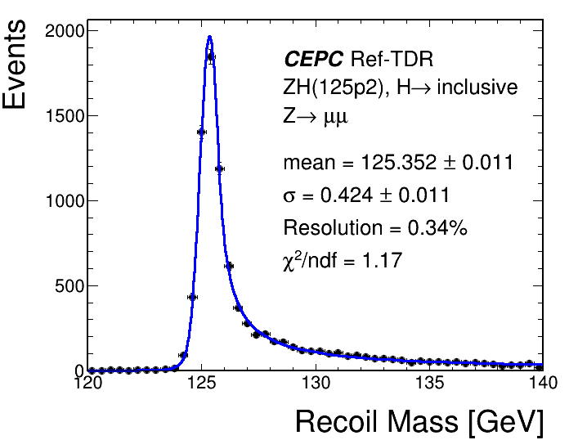
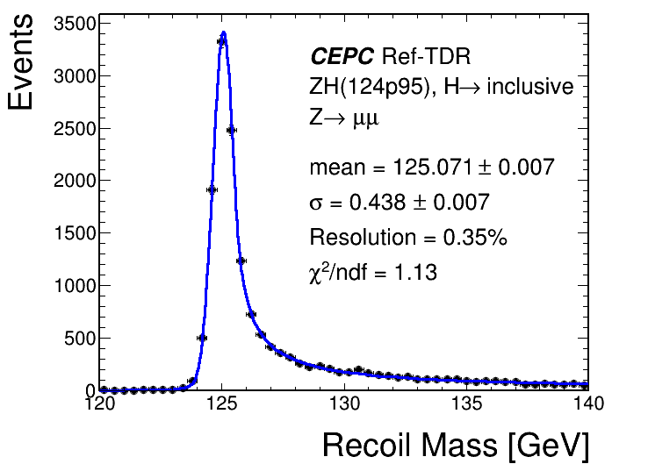
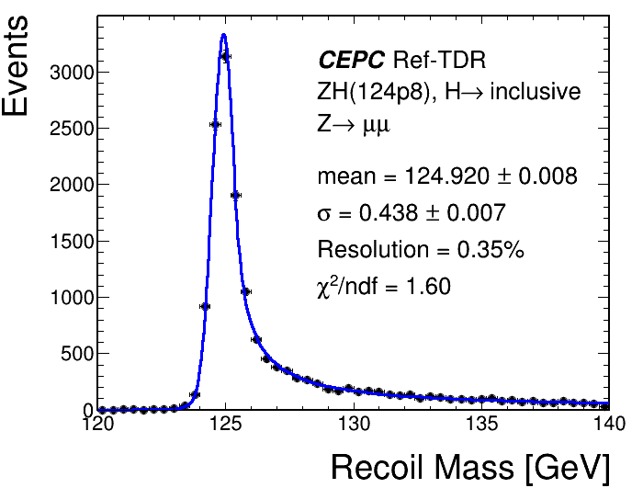
Signal Modeling
Mean and Sigma in DCB function in signal model will be parameterized as a linear function of mH.
Finally, we will extract mH with its error from S+B fitting.

Slide 7
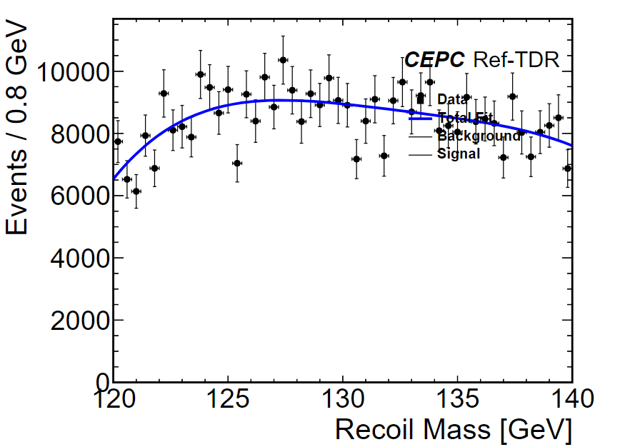
BKG Modeling
The shape of bkgs can be described by a Chebychev Polynomial.
Best Fit params:
c0 = 0.0475084
c1 = -0.123529
c2 = 0.0414444
c3 = -0.0237697

Slide 8
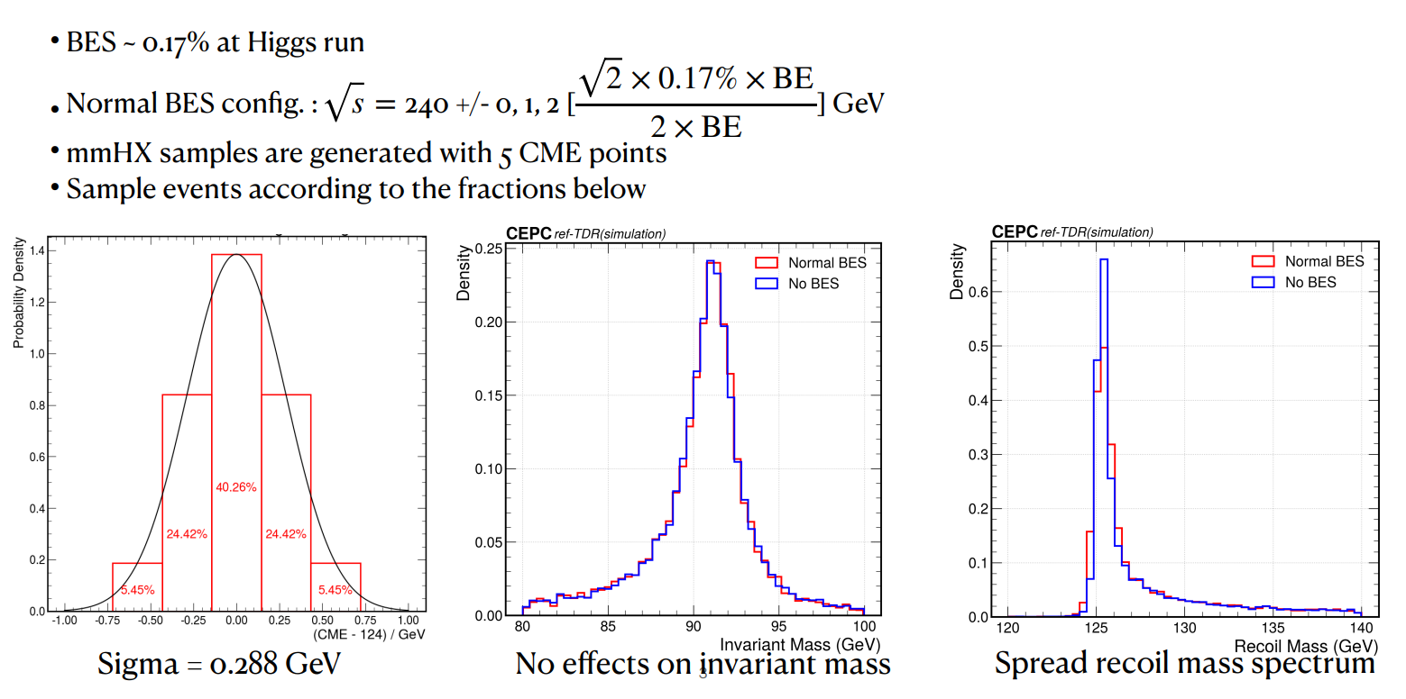
Systematic Uncertainty: Beam Energy Spread(1MeV)

Slide 9
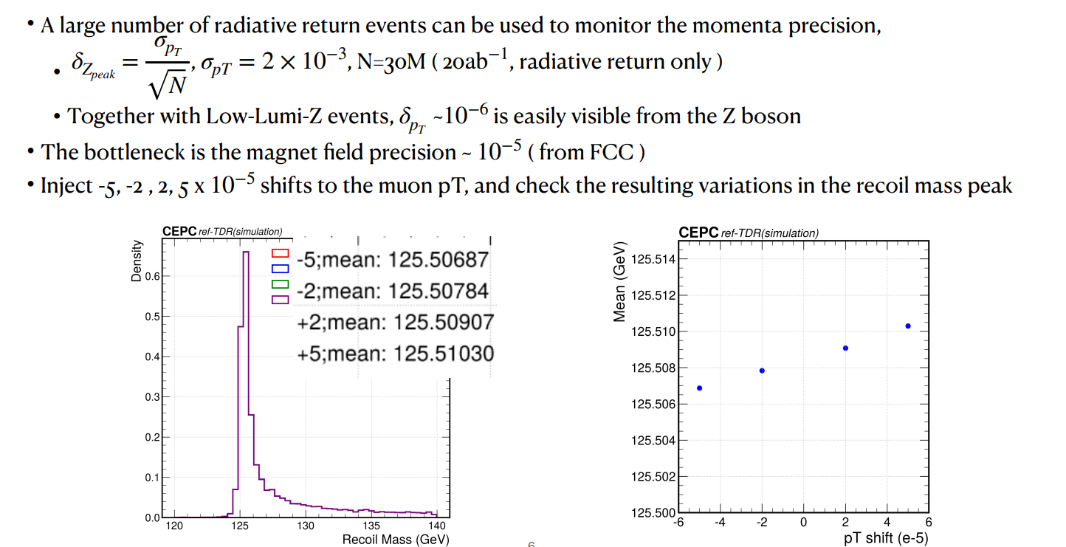
Systematic Uncertainty: Lepton Scale(2MeV)

Slide 10
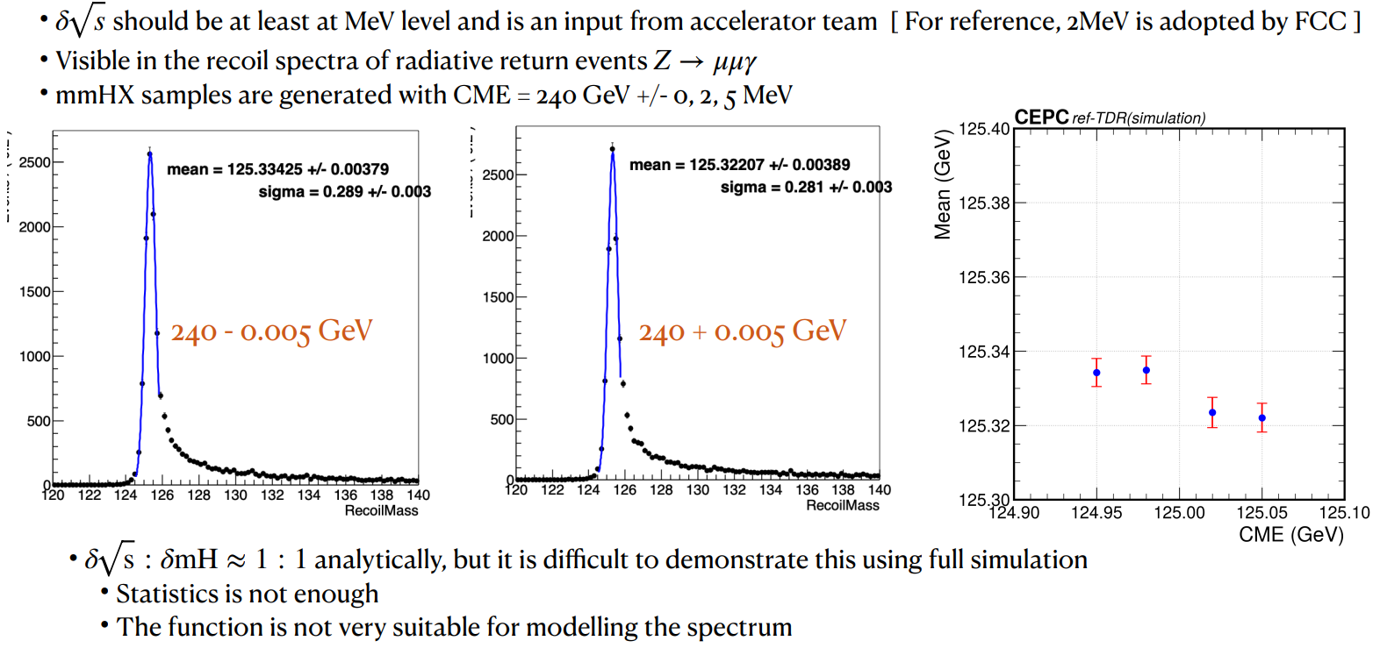
Systematic Uncertainty: Centre-of-mass Energy(2MeV)

Slide 11
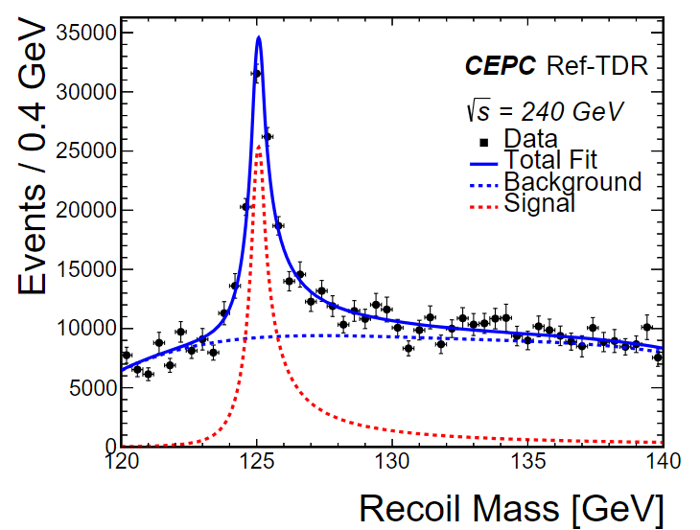
Final results
The distribution of recoil mass has been rescaled to 20ab-1, for the full planned CEPC luminosity.
The statistic uncertainty can be extracted from toyMC generated by post-fitted S+B model.
The sysmatic uncertainty includes beam energy spreading, centre-of-mass scale, lepton scale, which are considered as nuisance params.
mH = 125 GeV ± 3.2 MeV(stat.) ± 2.5MeV(sys.)

Slide 12
Summary
The final results has been shown as the most precise measurement on mH with a model-dependent method in CEPC, with a total uncertainty of 4.1MeV
This results can be taken as a probe of the quality of muon detection for now, which means we can expect higher precision as the improvement of the CEPC tracker and muon system performance.
We can combine this study with eeH final state in future study, and then the statistic uncertainty of mH can be reduced.
For now the systematic variance are performed with MC simulation, but the impacts collected from real data should be checked when we start the CEPC physics run.

Slide 13
Thanks!

Slide 14
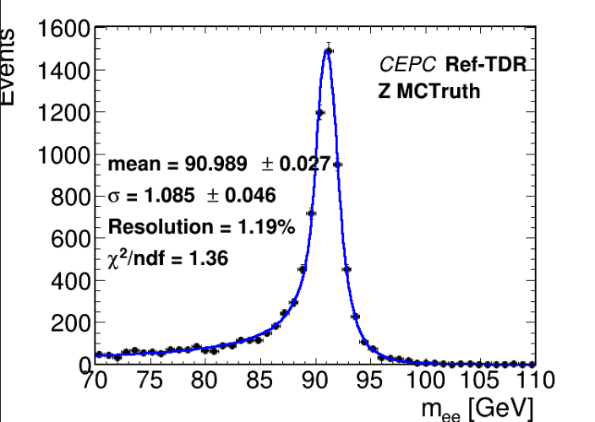
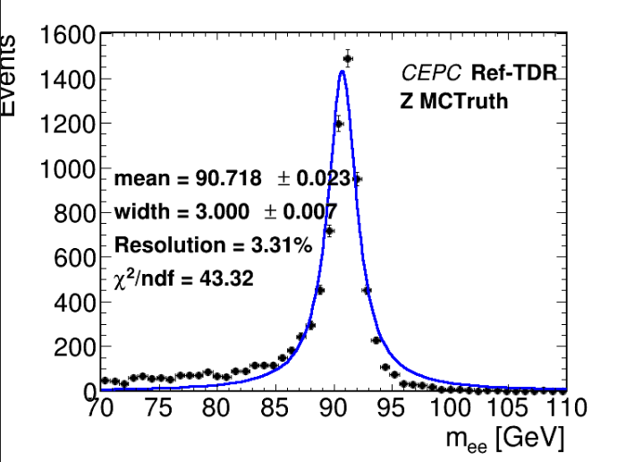
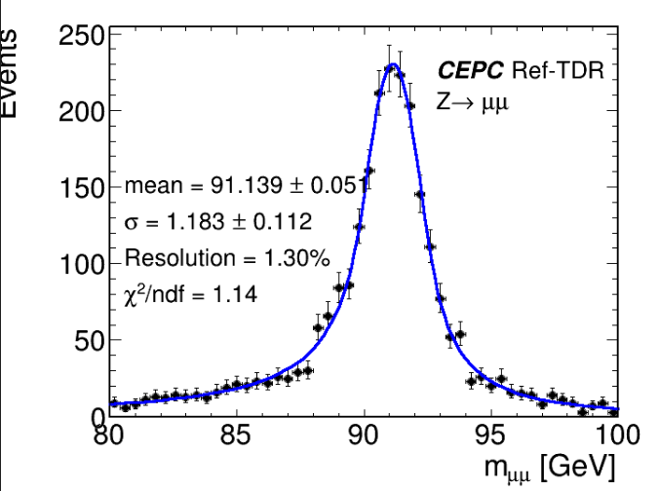
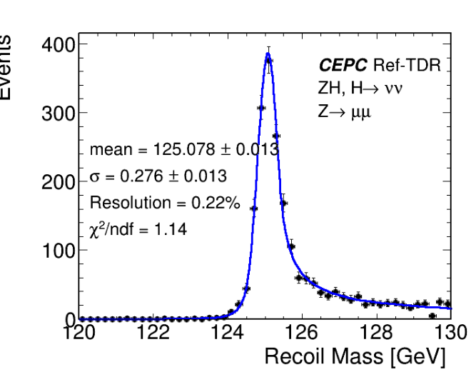
Backup
BW checking

Slide 15
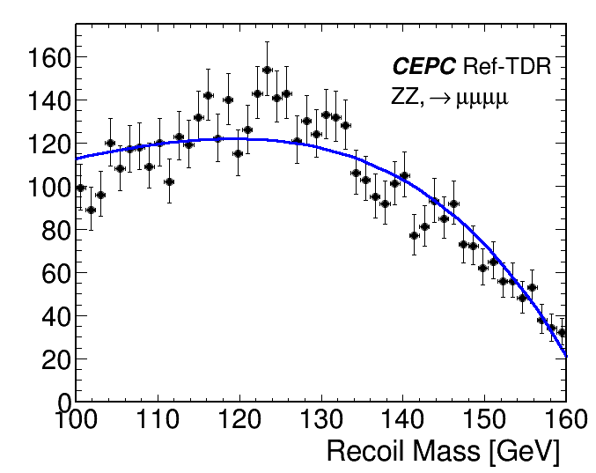
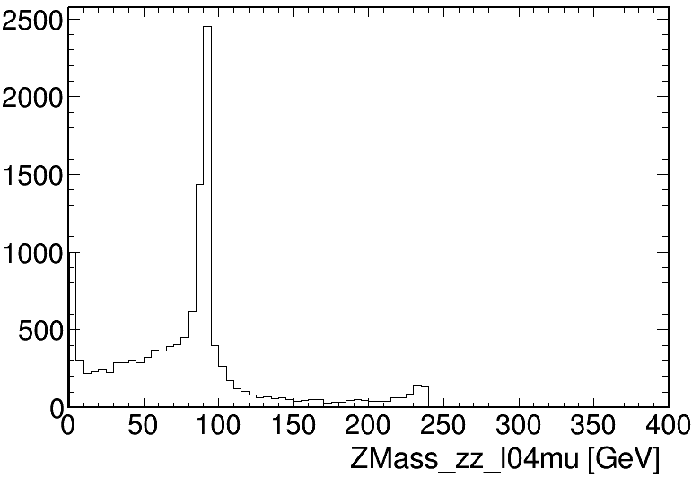
BKG Samples: eeToZZ4L
Fitted by polynomial

Slide 16
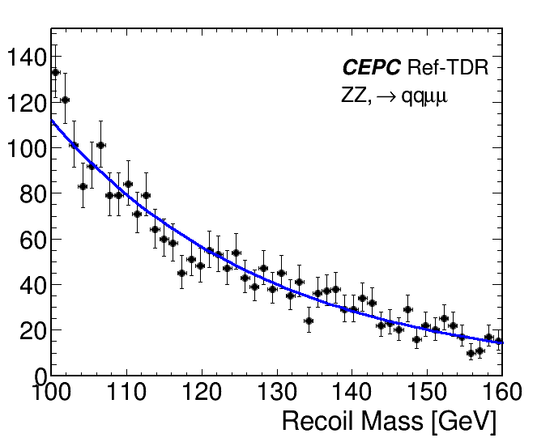
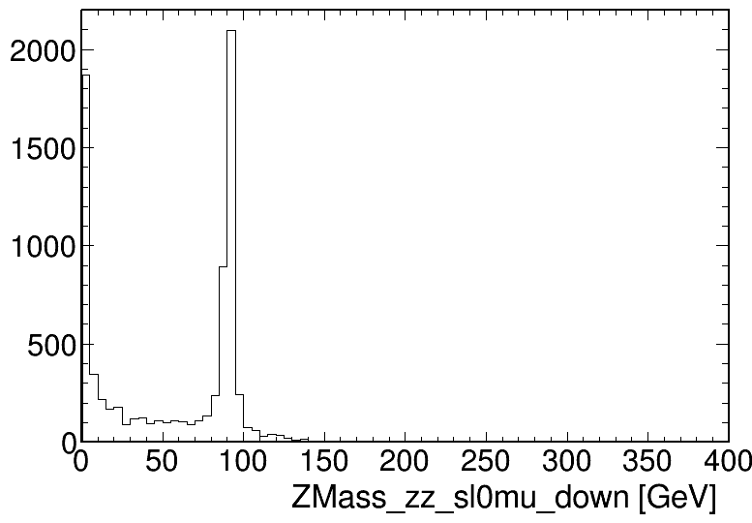
BKG Samples: eeToZZTo2l2q
Fitted by exponential

Slide 17
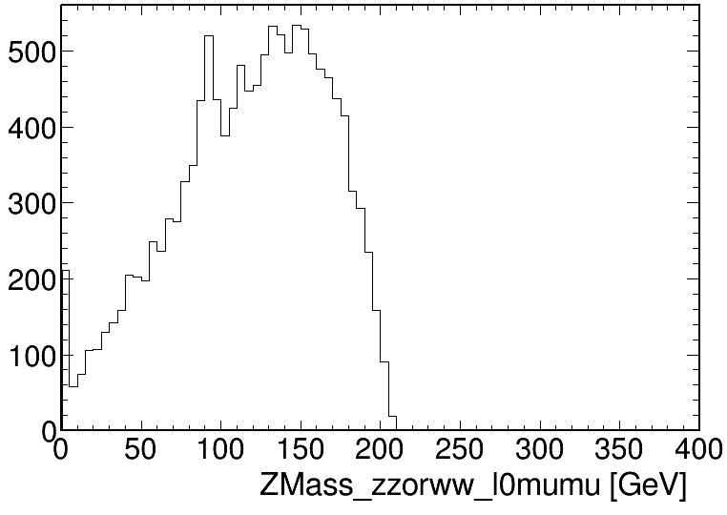
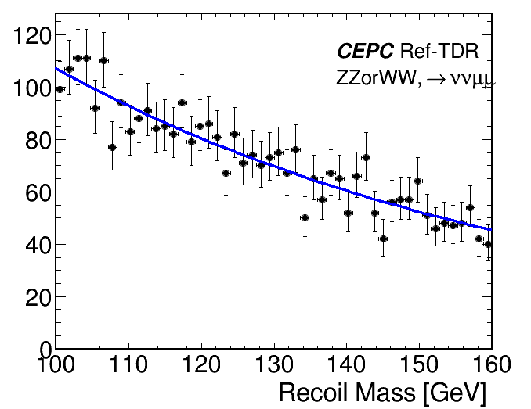
BKG Samples: eeToZZ(WW)To2l2nu
Fitted by exponential

Slide 18
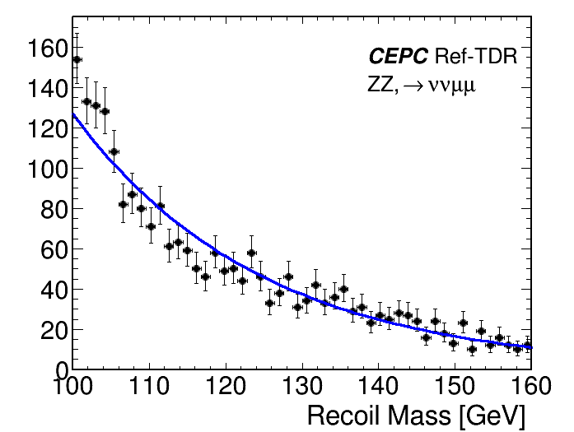
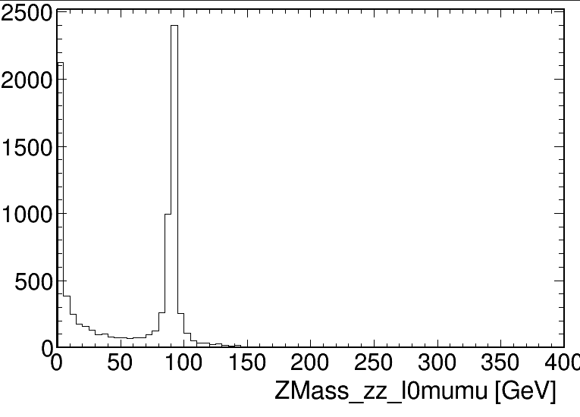
BKG Samples: eeToZZTo2l2nu
Fitted by exponential

