Slide 1
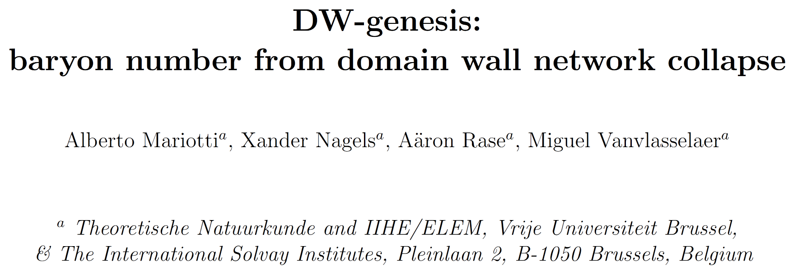
2411.13494
DianWei Wang
2025.05.29

Slide 2
$U\left(1\right)$ symmetry breaking
axion potential induced by dark $SU\left(N\right)$
Domain walls form at temperature

Slide 3
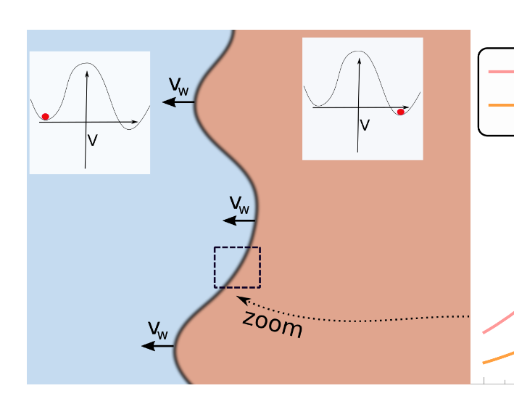
a moving domain wall
surface tension
DW domination (must avoid)
annihilation temperature
DW net work must annihilate before dominate

Slide 4
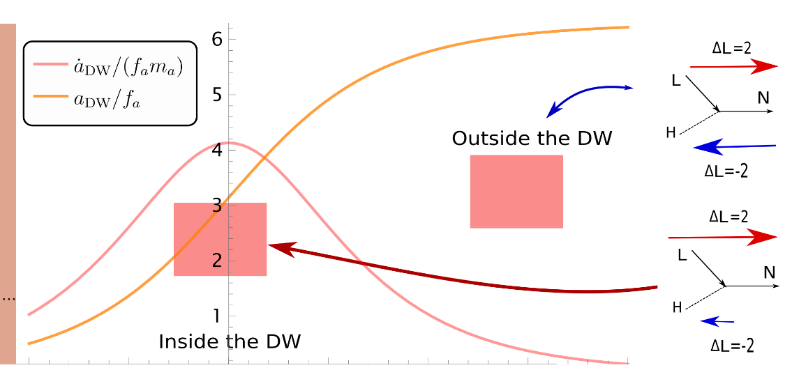
$\dot{a}$ is equivalent to $μ$
bias induced motion, otherwise the asymmetry cancels out
$X$ is NOT conserved
Boltzmann Equation (schematic)
further require kinetic equilibrium within DW
(necessary for BE)

Slide 5
minimal model – only couple to left hand lepton
full version
Majorana RHN – L violation
after chiral rotation – eliminate $∂_{μ}a$ term
Boltzmann equation – for $n_{L}$
using paramtrisation
$ξ_{L}$ describes the deviation from $f^{eq}$

Slide 6
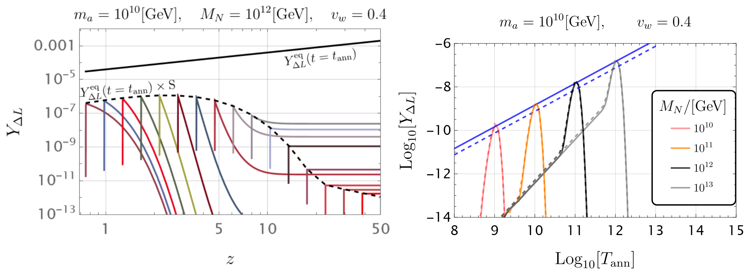
Boltzmann equation – for $Y_{ΔL}$

Slide 7
Boltzmann equation – for $Y_{ΔL}$
$Y_{ΔL}^{eq}$ has never
been reached
peak: $T_{ann}≈1.5T_{dec}$
flat:
decay/scattering
decouple at $t_{dec}$
suppression:
decouple too late
jump: wall pass at $t_{ann}$
slope:
decouple too early

Slide 8
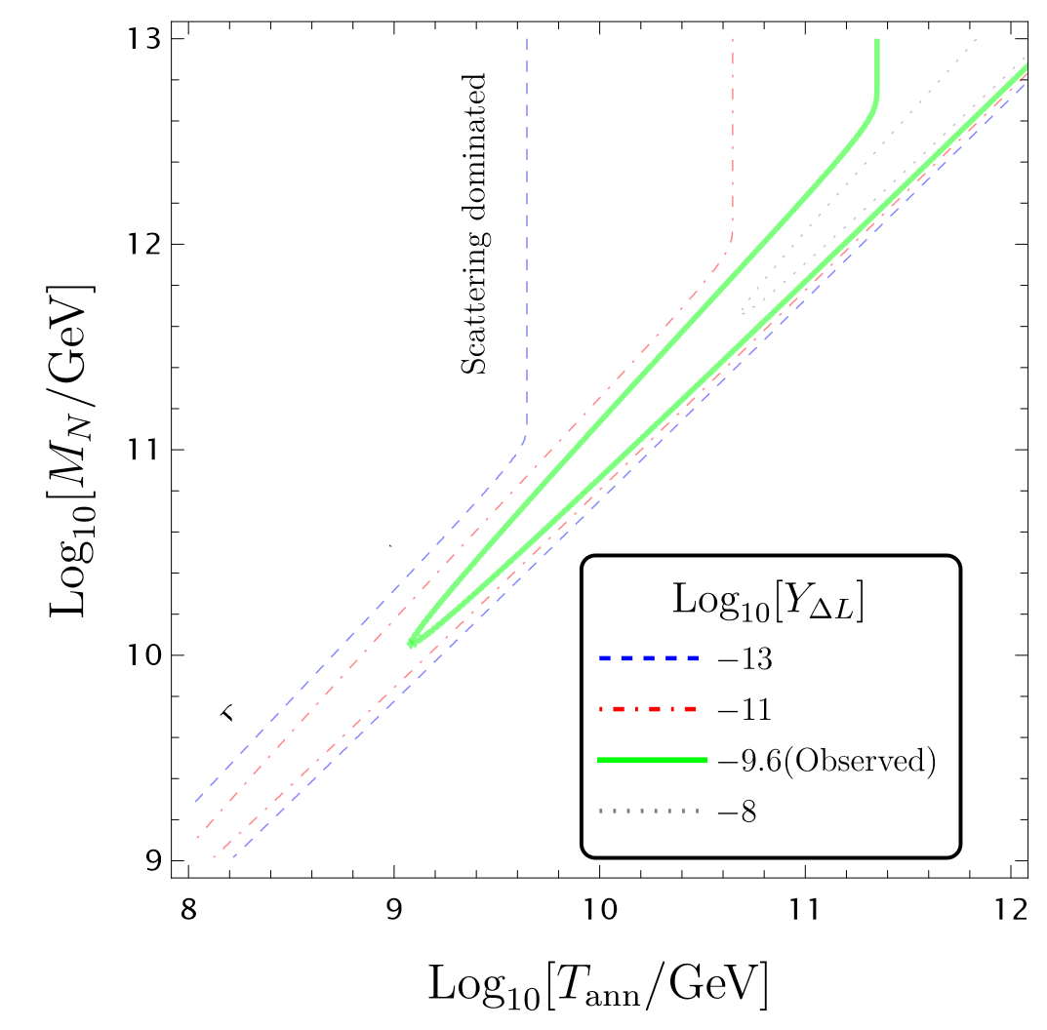
parameter space

Slide 9
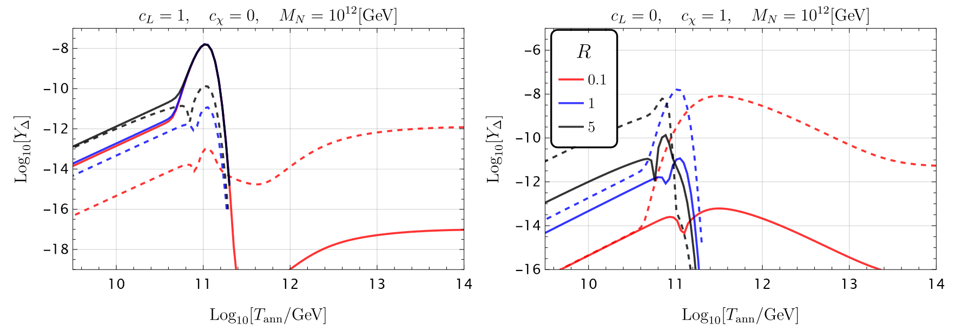
cogenesis
solid: lepton
dashed: dark matter

Slide 10
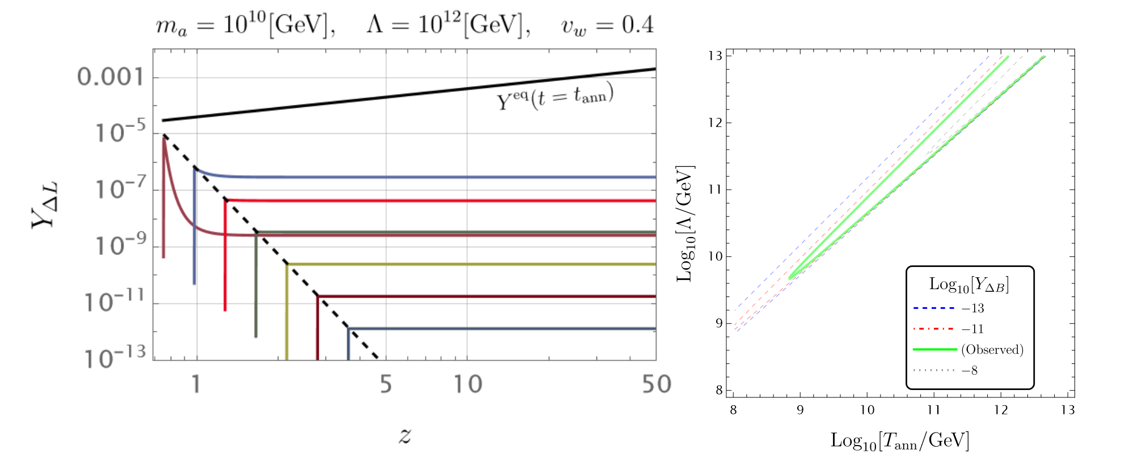
baryogenesis

Slide 11
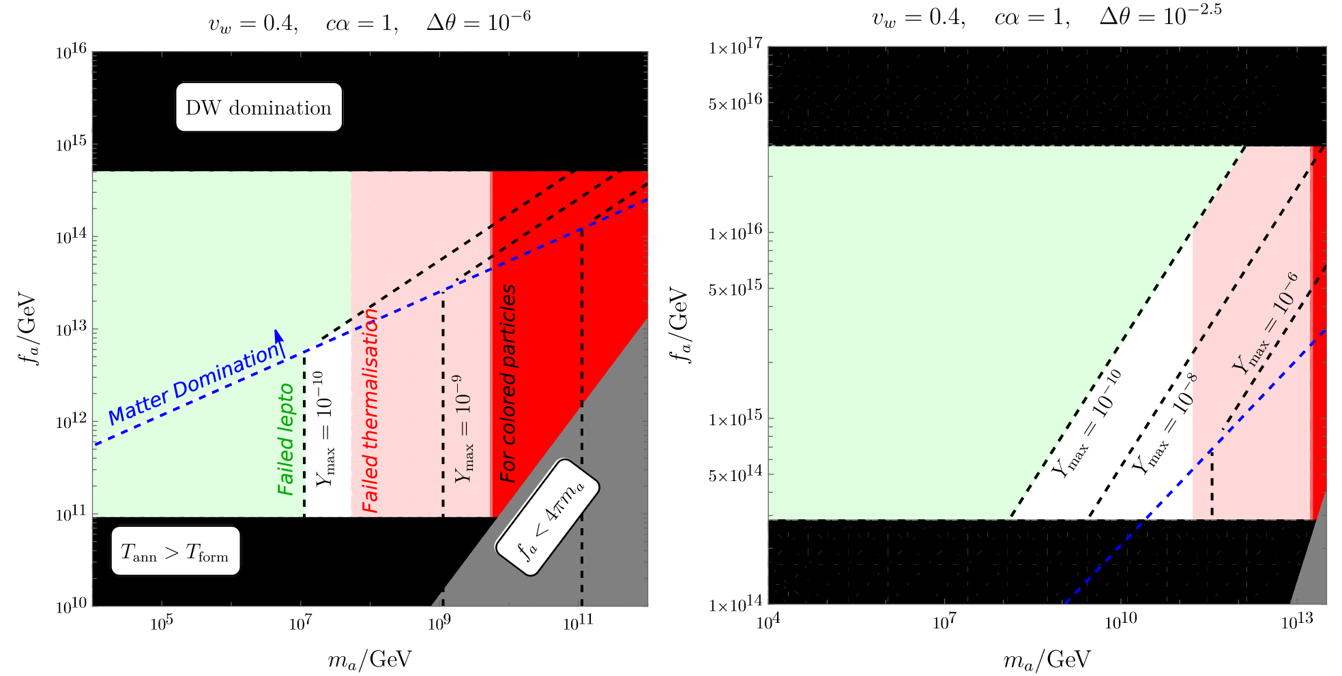
parameter space $\left(m_{a},f_{a}\right)$

Slide 12
parameter space $\left(m_{a},f_{a}\right)$

Slide 13
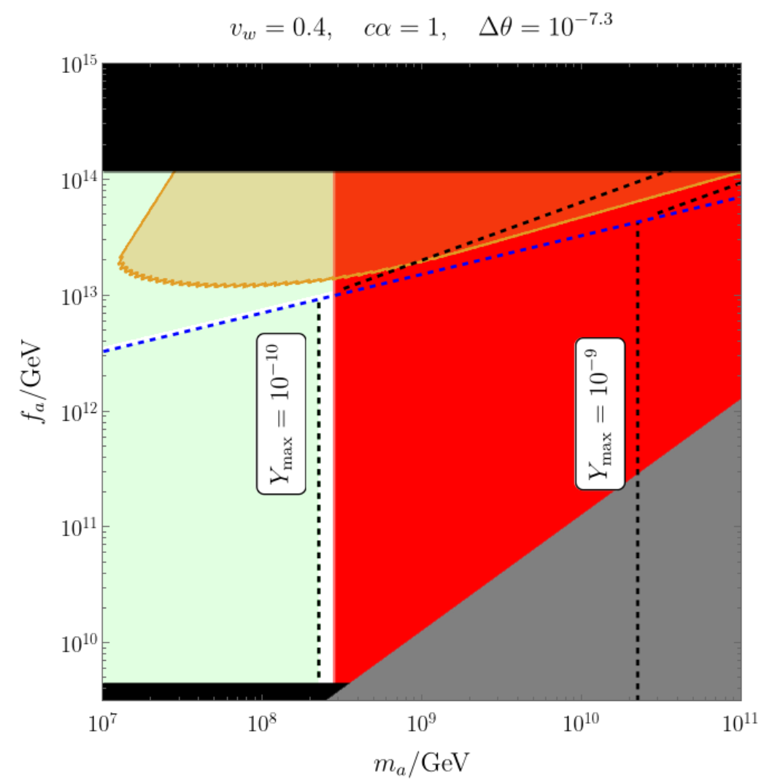
gravitational waves
Detectable GWs from DWs and successful
DW-genesis appear are mutually in tension
heavy QCD axion $Δθ≲{10}^{−10}$
DW-genesis axion cannot be heavy QCD axion

Slide 14
Thanks for your listening!
Dian-Wei Wang
2025.05.29

