Slide 1
Double strangeness Ξ production as a probe of nuclear equation of state at high densities
Gao-Chan Yong,Zhi-Gang Xiao, Yuan Gao, and Zi-Wei Lin
arXiv:2105.10284v3 [nucl-th] 13 Jul 2021
Mean-field update in the JAM microscopic transport model: Mean-field effects on collective flow in high-energy heavy-ion collisions at sNN = 2-20 GeV energies
Yasushi Nara and Akira Ohnishi
arXiv:2109.07594v3 [nucl-th] 9 Mar 2022

Slide 2
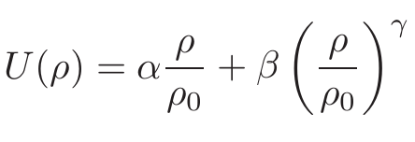
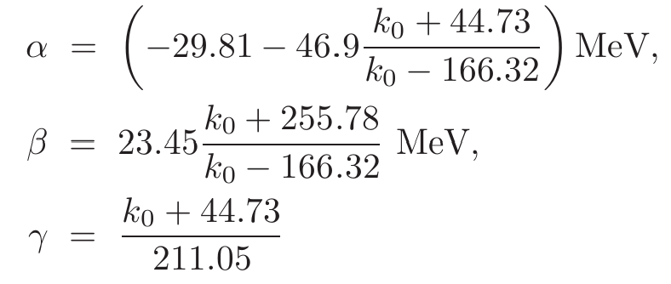
In AMPT-HC,
Single nucleon mean-field potential
using the density-dependent form
The total potential energy V
(Skyrme parametrization)
reproduce the binding energy E/A, the saturation density $ρ_{0}$
And nuclear incompressibility K=
=380MeV(hard)or 210MeV(soft).

Slide 3
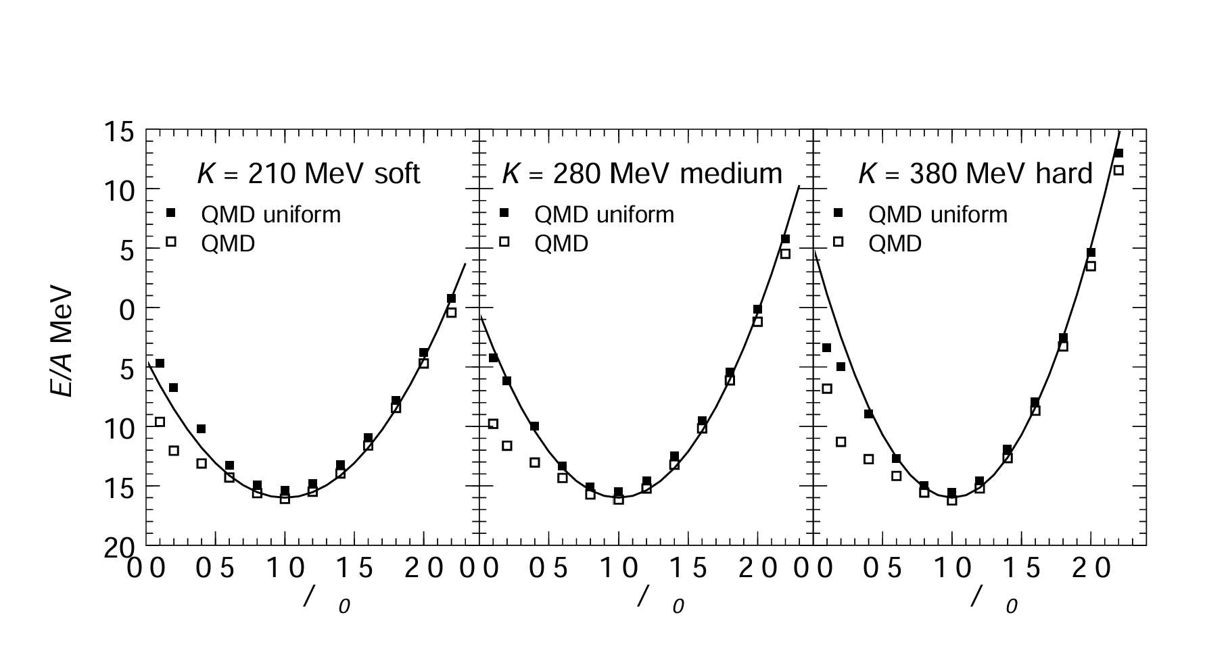
Toshiki Maruyama, Koji Niita, Kazuhiro Oyamatsu, Tomoyuki Maruyama arXiv:nucl-th/9705039v1 23 May 1997

Slide 4
In JAM2, Nonrelativistic potential
total potential energy V
The single-particle potential is
From Yukawa force ?

Slide 5
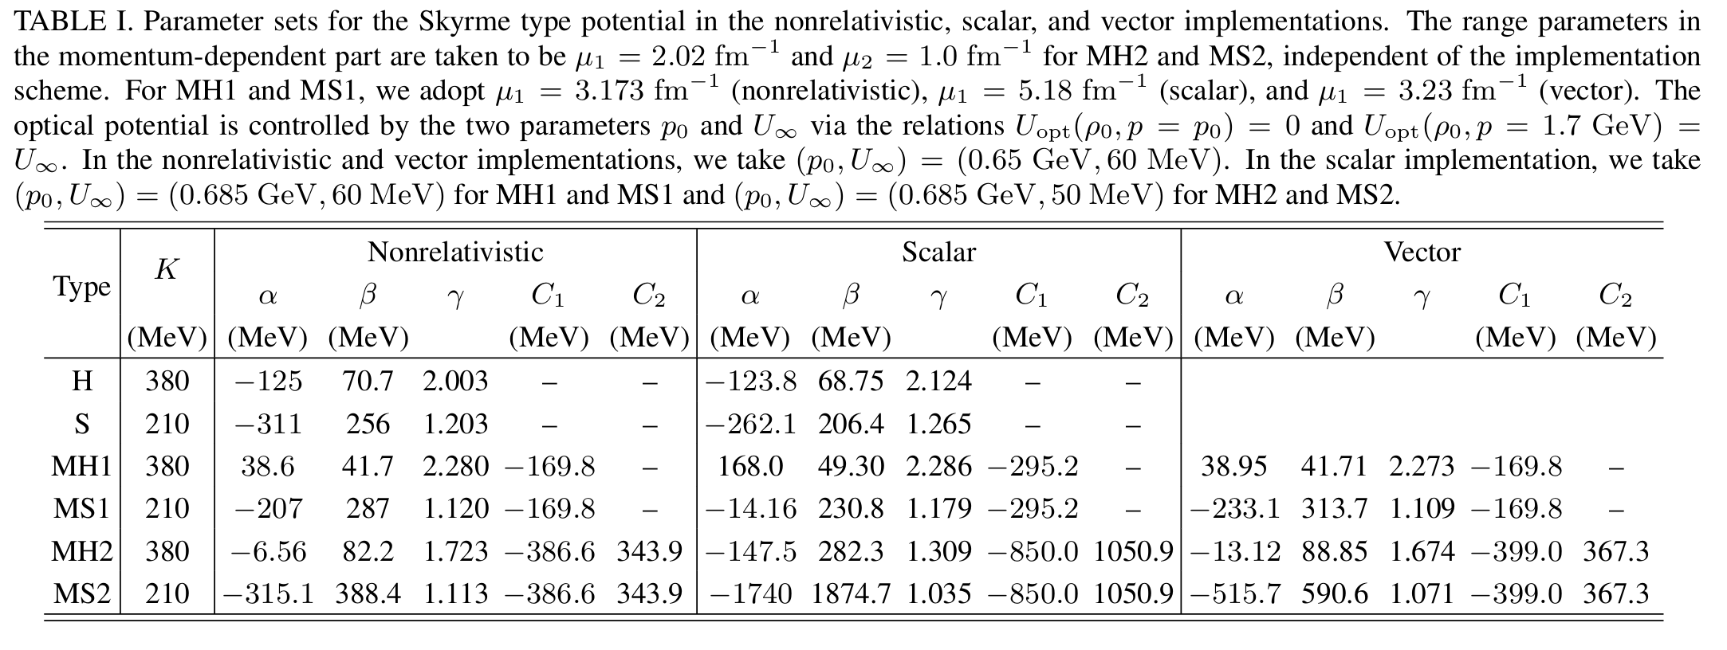

Slide 6
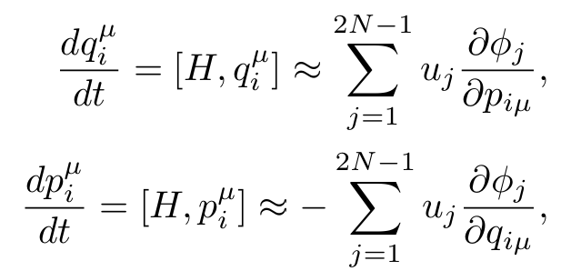
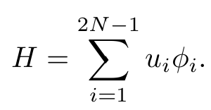

Slide 7
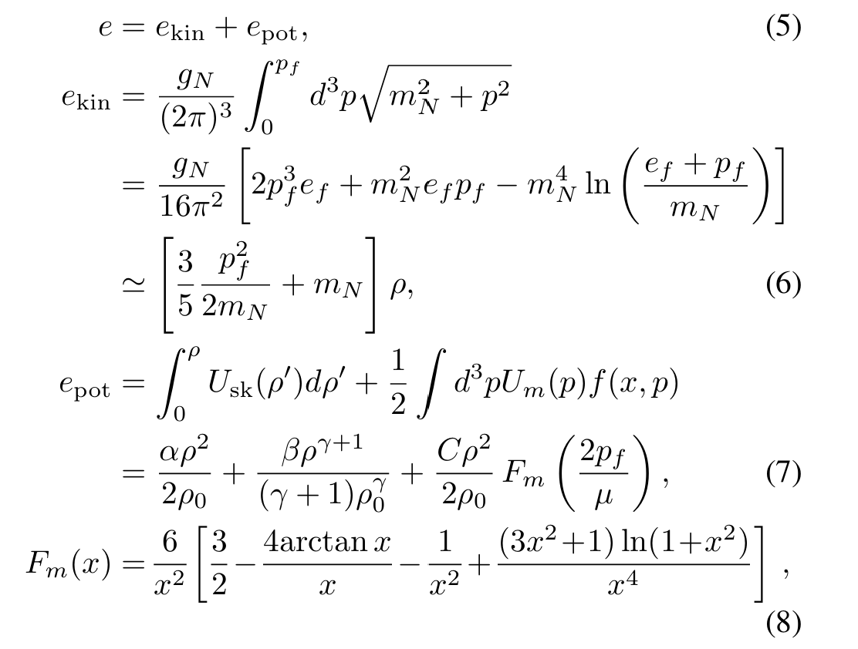
At the saturation density and T=0,
where
Fermi momentum
pressure

Slide 8
The nuclear incompressibility K is defined by the second derivative of the energy density with respect to the baryon density:

Slide 9
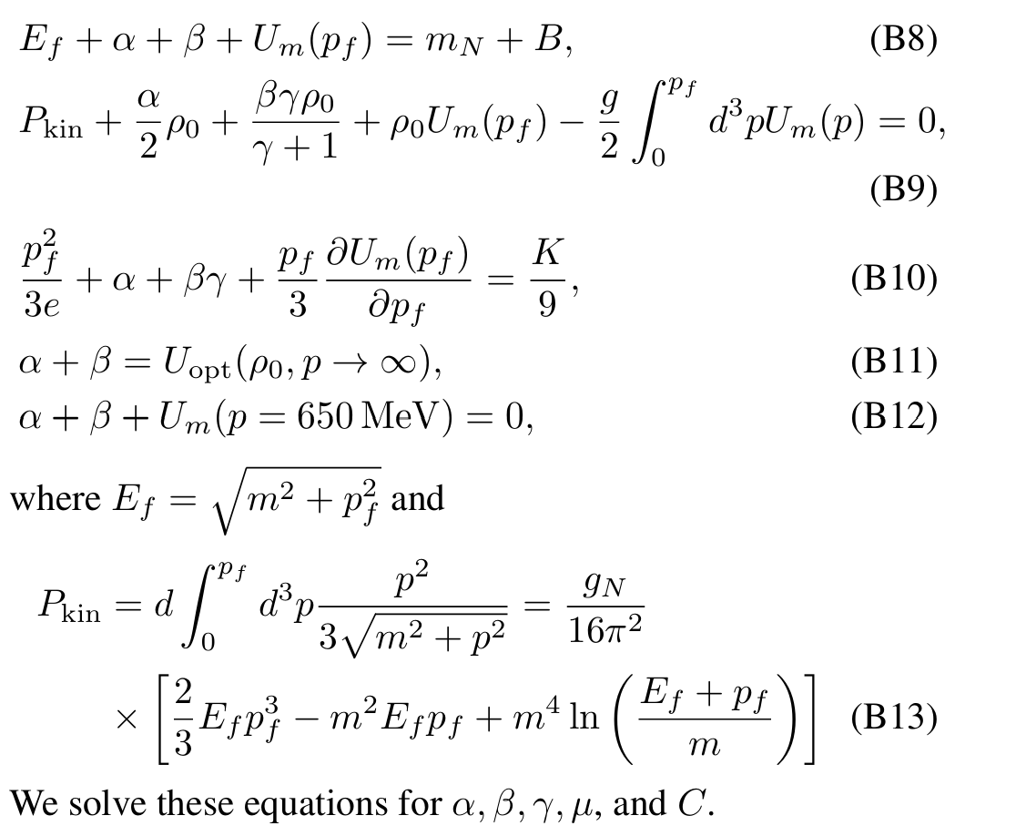

Slide 10
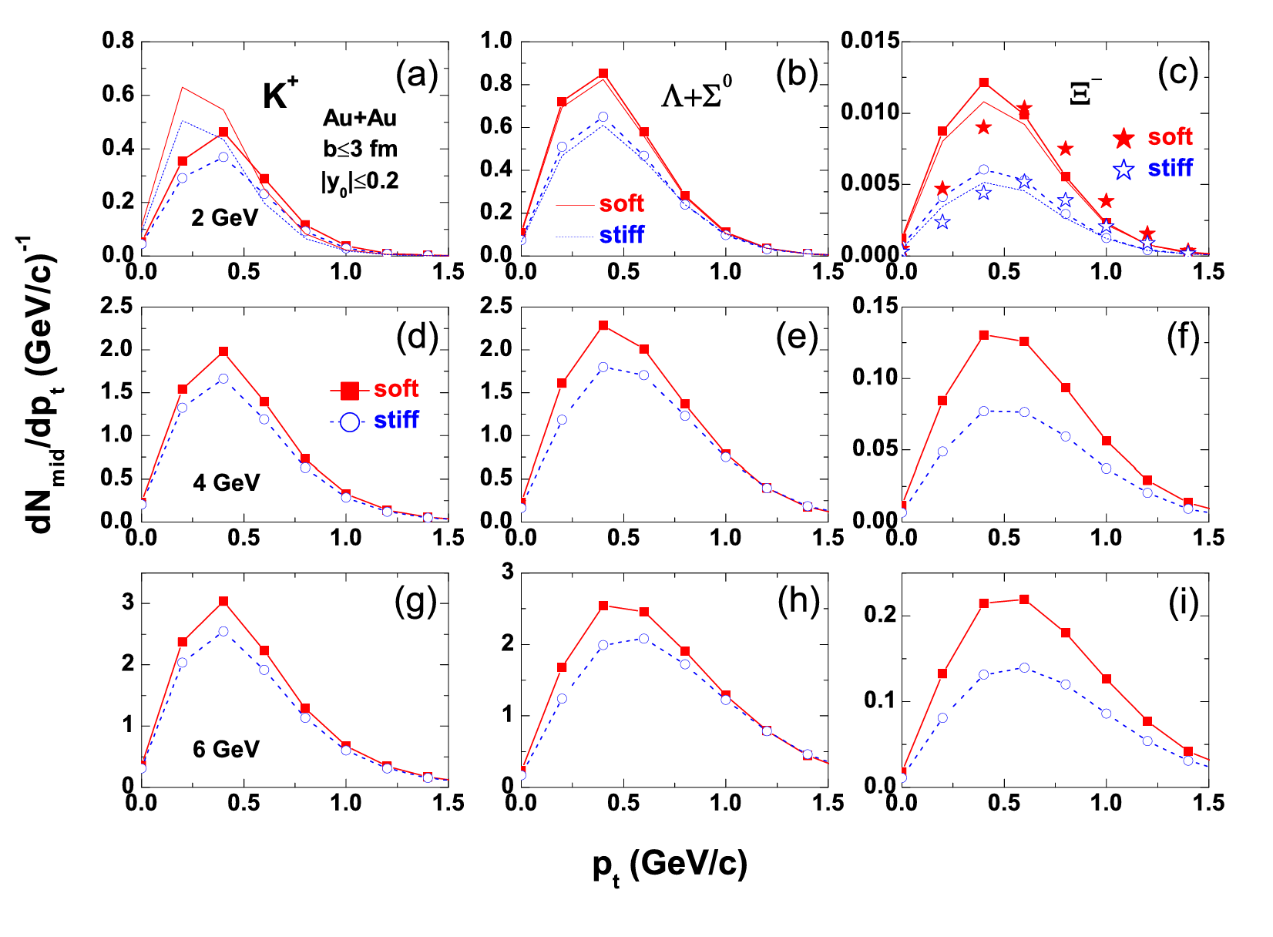
In AMPT-HC,
Transverse momentum distributions
changed by mean-field

Slide 11
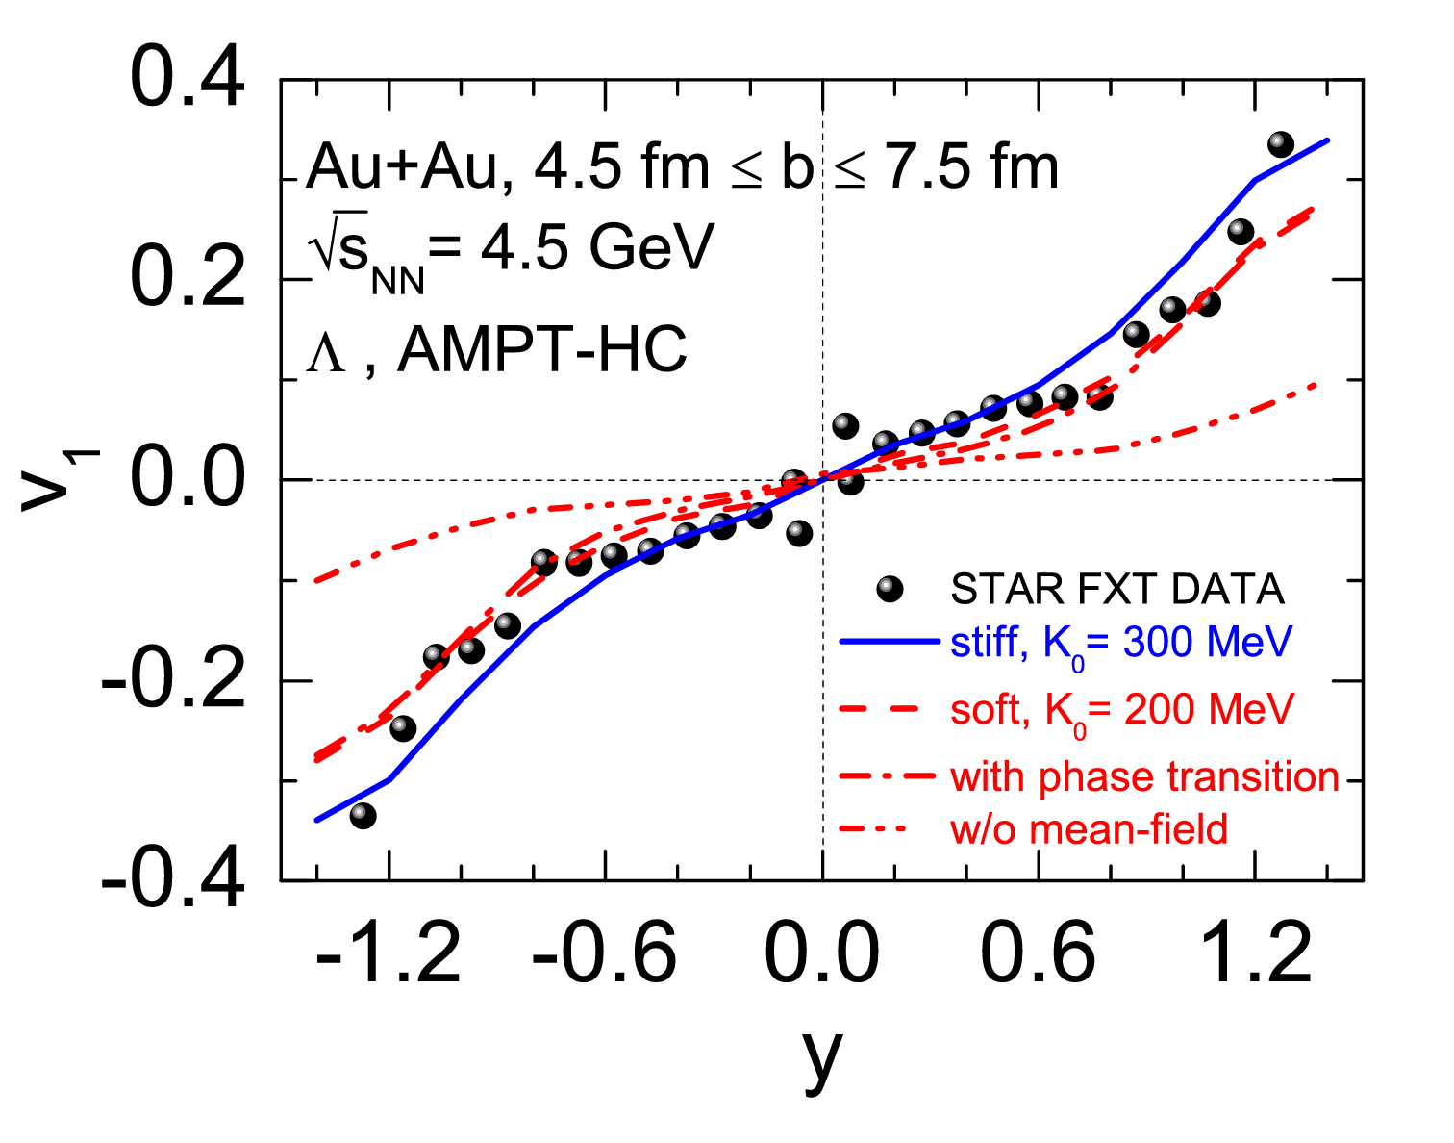
In AMPT-HC,
Rapidity dependence of the directed flow v1 of Λ

Slide 12
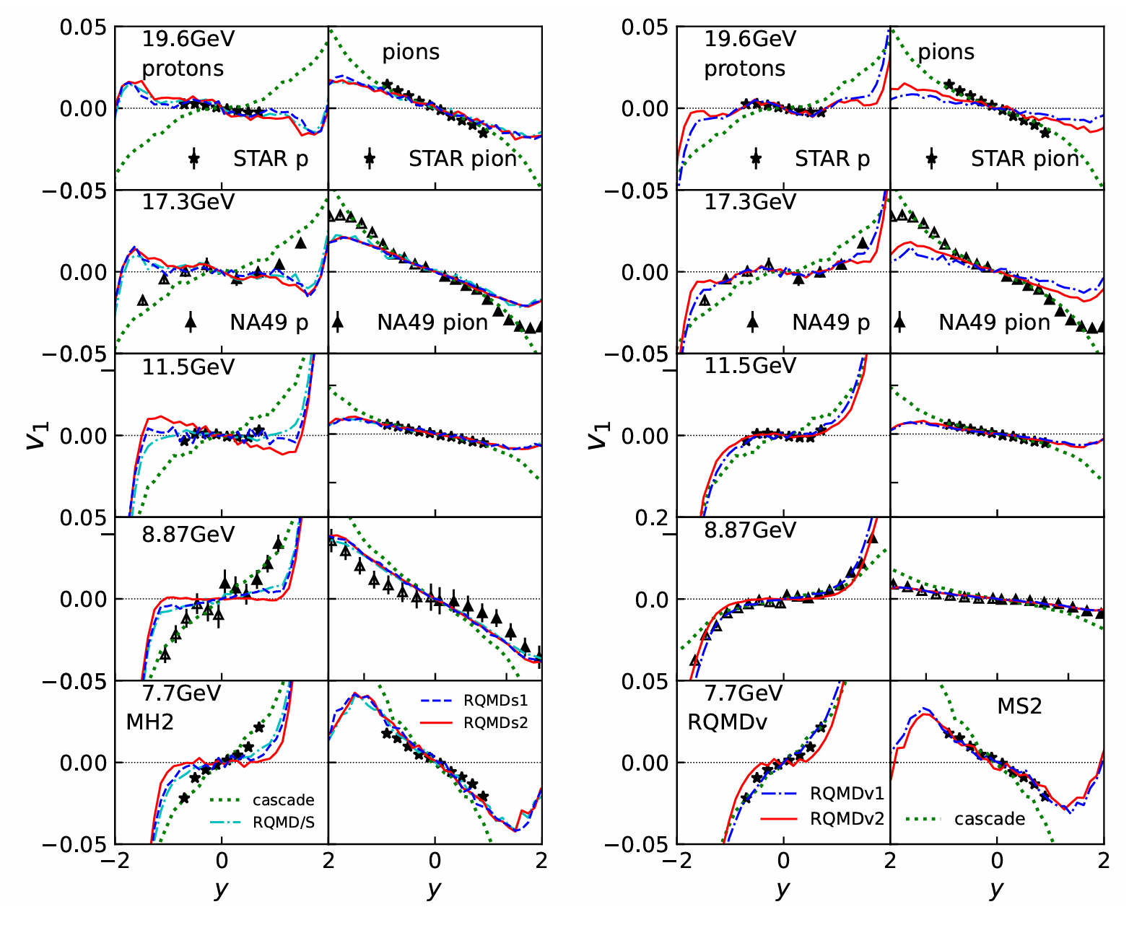
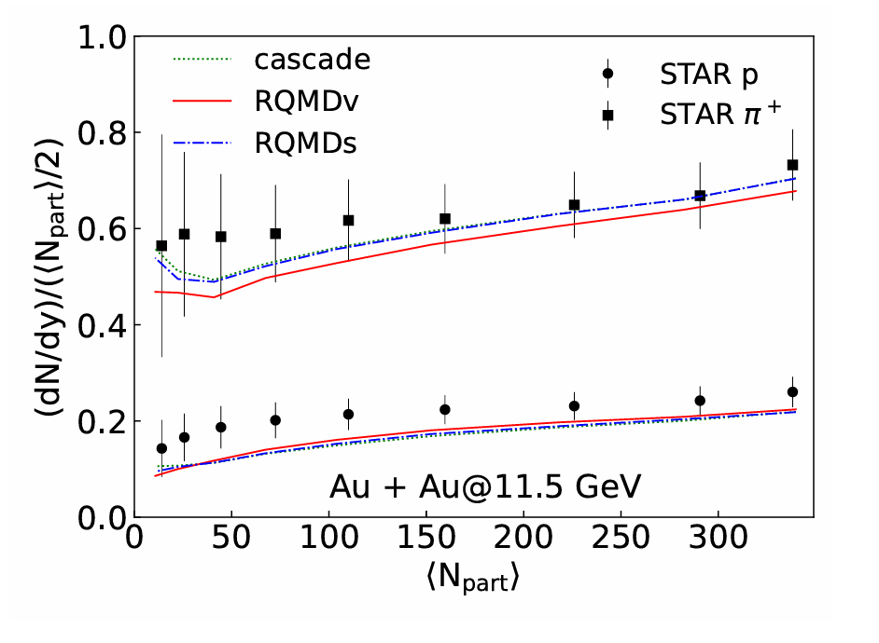
In JAM2

Slide 13
A Guide to microscopic models for intermediate-energy heavy ion collisions
G.F. Bertsch(Michigan State U.), S. Das Gupta(McGill U.) Phys.Rept. 160 (1988) 189-233
A transport equation which contains both the mean field and hard collisions is called the Boltzmann— Uehling—Uhlenbeck (BUU) equation. It has also been called the Vlasov—Uehling—Uhlenbeck equation ,the Boltzmann—Nordheim equation or the Landau—Vlasov equation .
We can define the mean field potential that a nucleon feels as a function of the density. A reasonable parametrization (often called the Skyrme parametrization) is

Slide 14
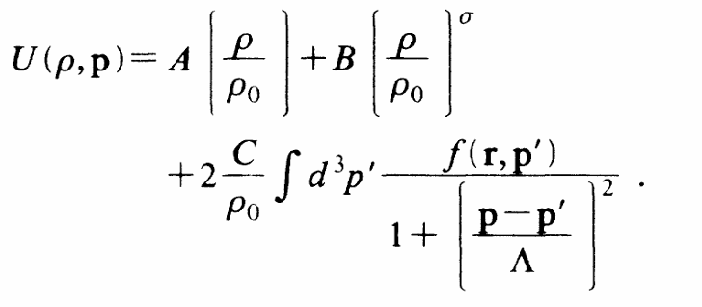
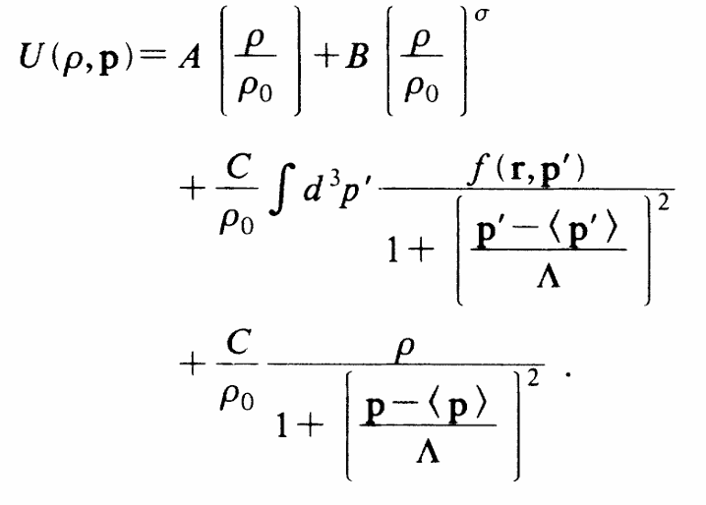
Transverse momenta, nuclear equation of state, and momentum-dependent interactions in heavy-ion collision
C. Gale, G.M. Welke, M. Prakash, S.J.Lee, and S.Das Gupta
Phys. Rev. C 41, 1545
soft BKD/ hard BKD
Yukawa interaction (MDYI)
used by Gale, Bertsch, and Das Gupta (GBD)

Slide 15
ON THE ORIGIN OF THE FLOW ANGLE IN HIGH-ENERGY COLLISIONS OF HEAVY NUCLEI
Bernd SCHIJRMANN and Winfried ZWERMANN
For the average nuclear potential they use
Importance of Momentum-Dependent Interactions for the Extraction of the Nuclear Equation of State from High-Energy Heavy-Ion Collisions
J. Aichelin, A. Rosenhauer, G. Peilert, H. Stoecker, and W. Greiner
The mean potential field can be cast into a form which explicitly shows the density dependence of the interaction in infinite nuclear matter at T =0:

