Slide 1
A New State of Matter between the Hadronic Phase and the Quark-Gluon Plasma?
Yuki Fujimoto, Kenji Fukushima, Yoshimasa Hidaka, Larry McLerran
arXiv:2506.00237

Slide 2
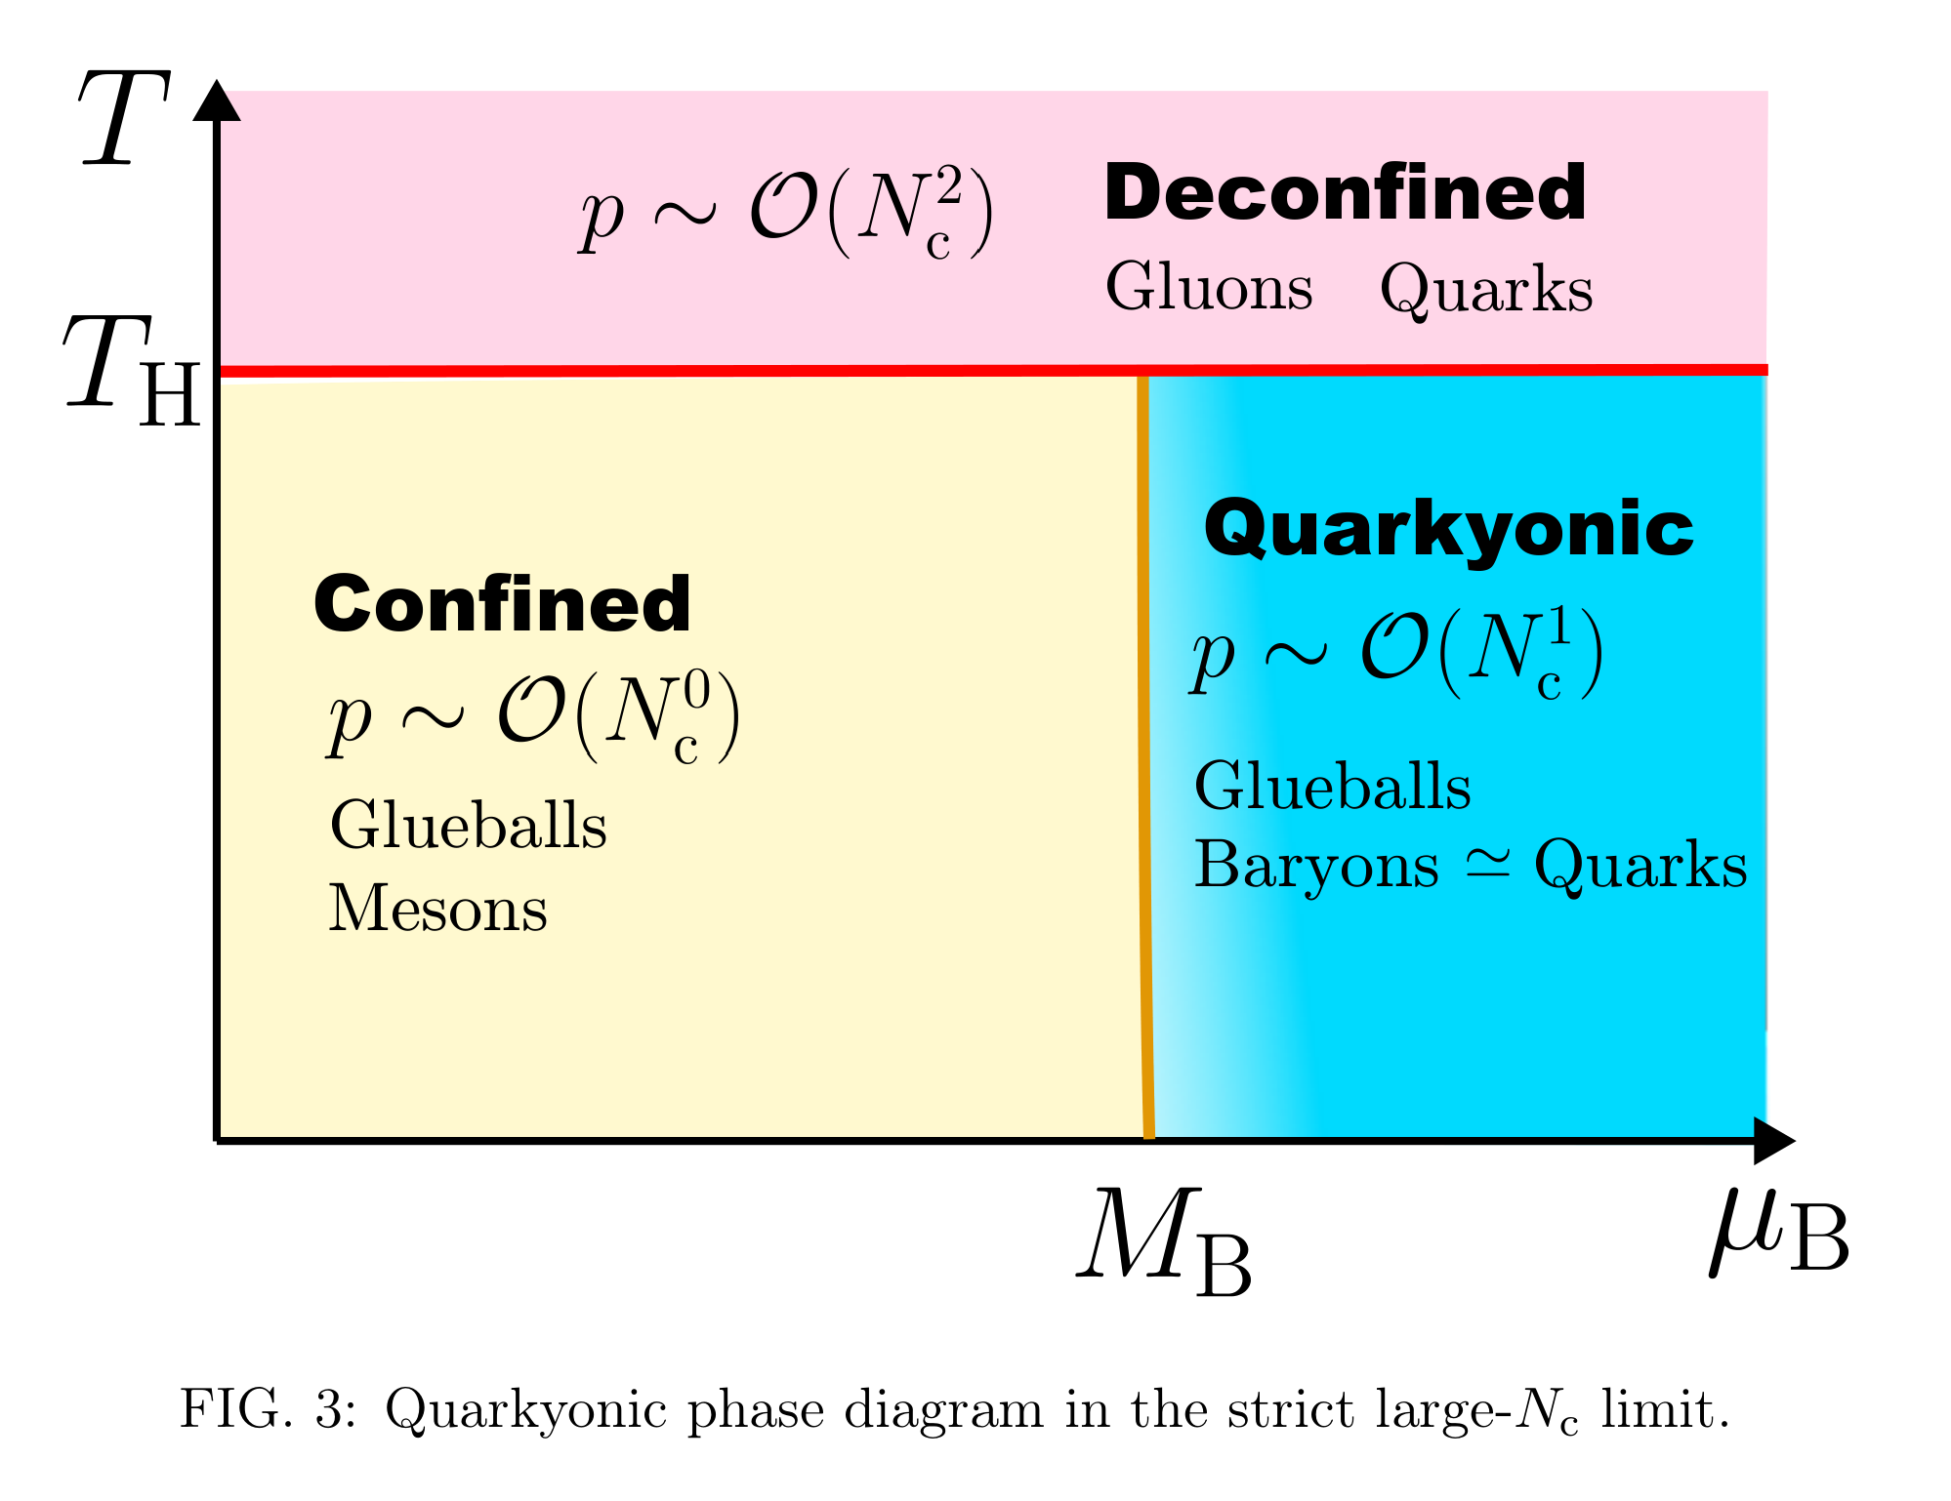
The onset of Quarkyonic Matter at T ≃ 0 lies at a baryon chemical potential, µB, close to the baryon mass, MB.

Slide 3
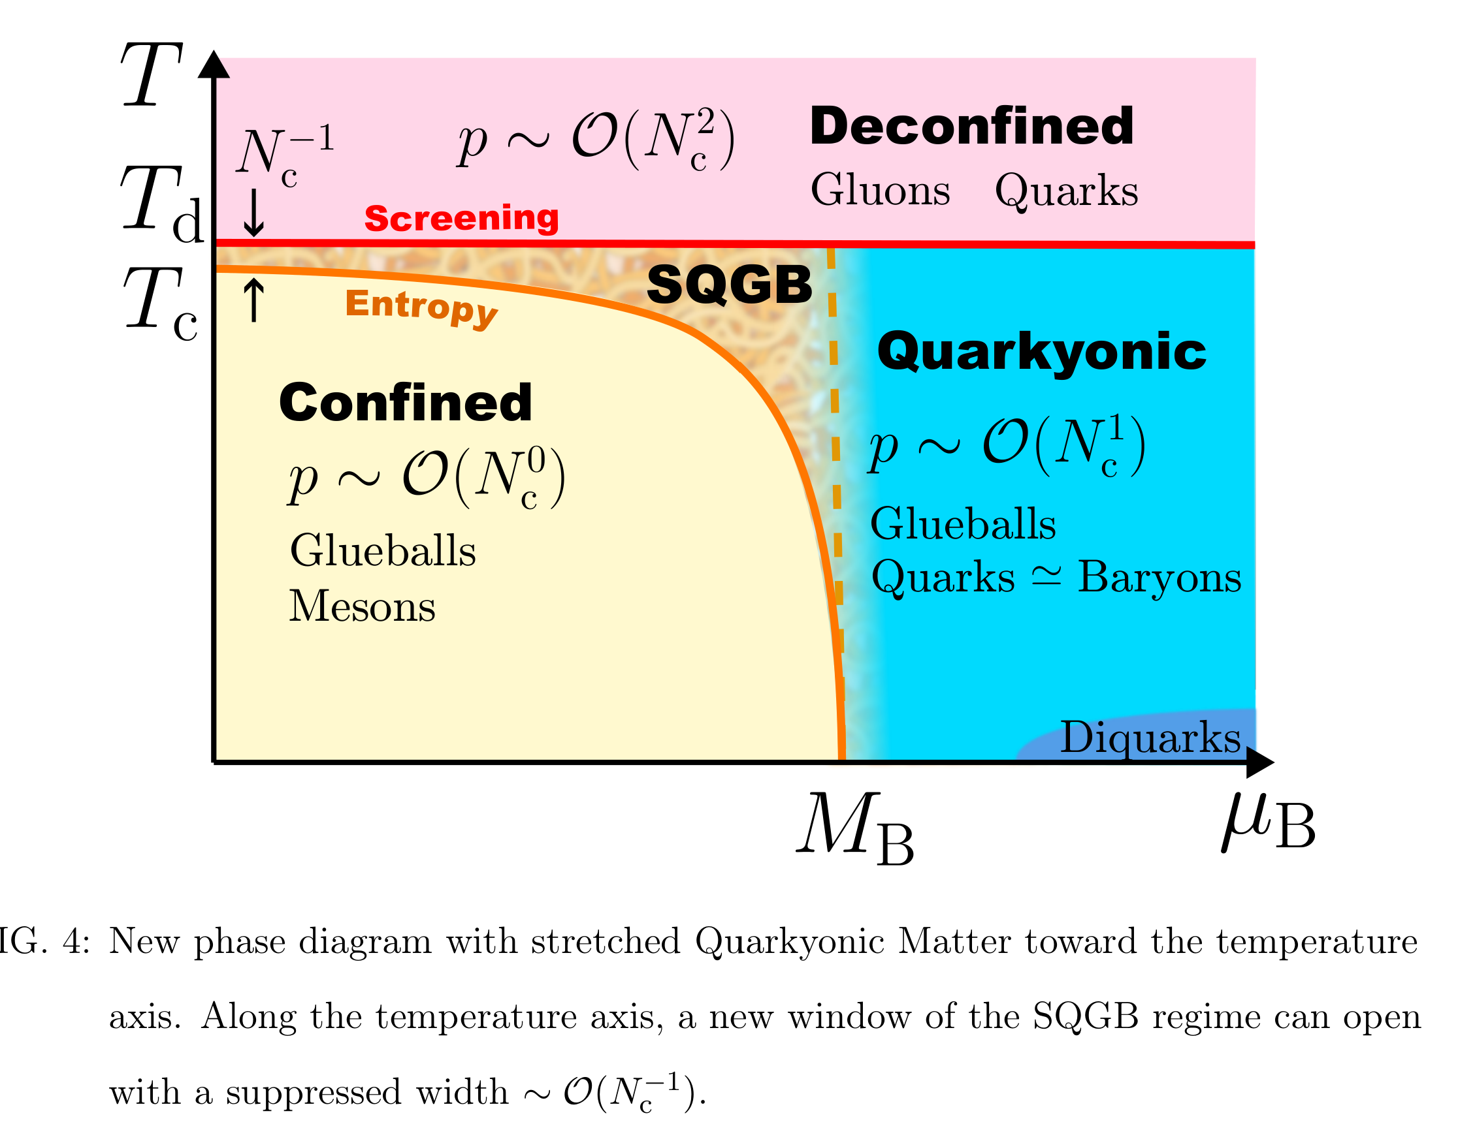
Although thermal degrees of freedom in Quarkyonic Matter and the SQGB seem similar, the SQGB presumably has restored chiral symmetry, while chiral symmetry is weakly broken in Quarkyonic Matter. Although naive arguments would also suggest chiral symmetry restoration in Quarkyonic Matter, interactions on the Fermi
surface generate spatially inhomogeneous condensate that locally breaks chiral symmetry

Slide 4
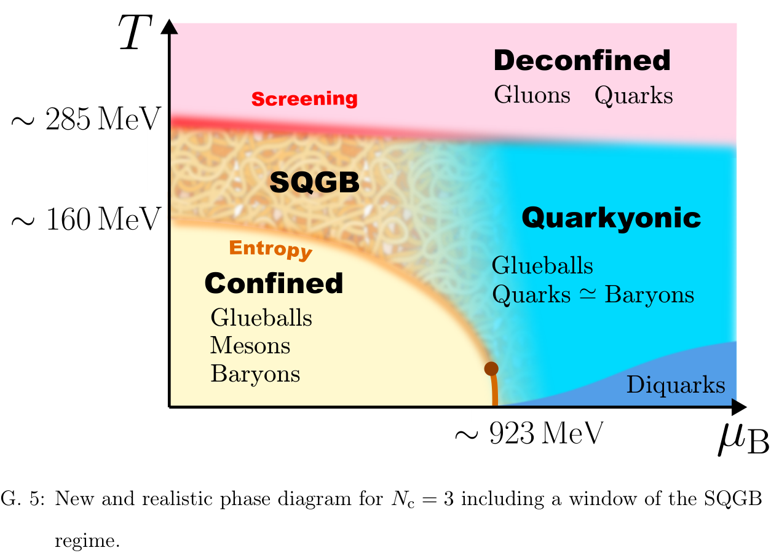
pseudo-critical temperature
The curvature
computed in the lattice-QCD simulation

Slide 5
The temperature upper bound of the SQGB phase
Is given by the screening argument based on the thermal screening mass
gluon loops
quark loops
When is comparable to the QCD scale or larger, the confining interaction is
not long-ranged anymore due to screening, and thus the deconfinement sets in.

Slide 6
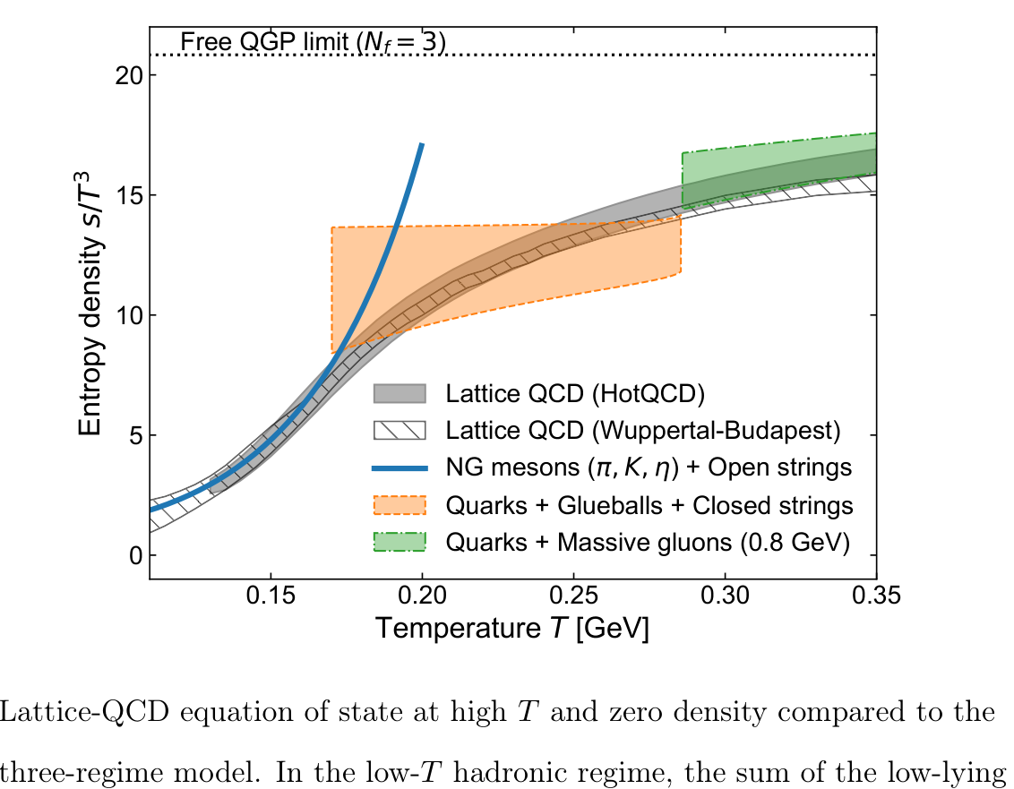

Slide 7
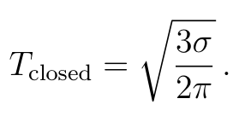
the spectrum as a function of the mass

Slide 9
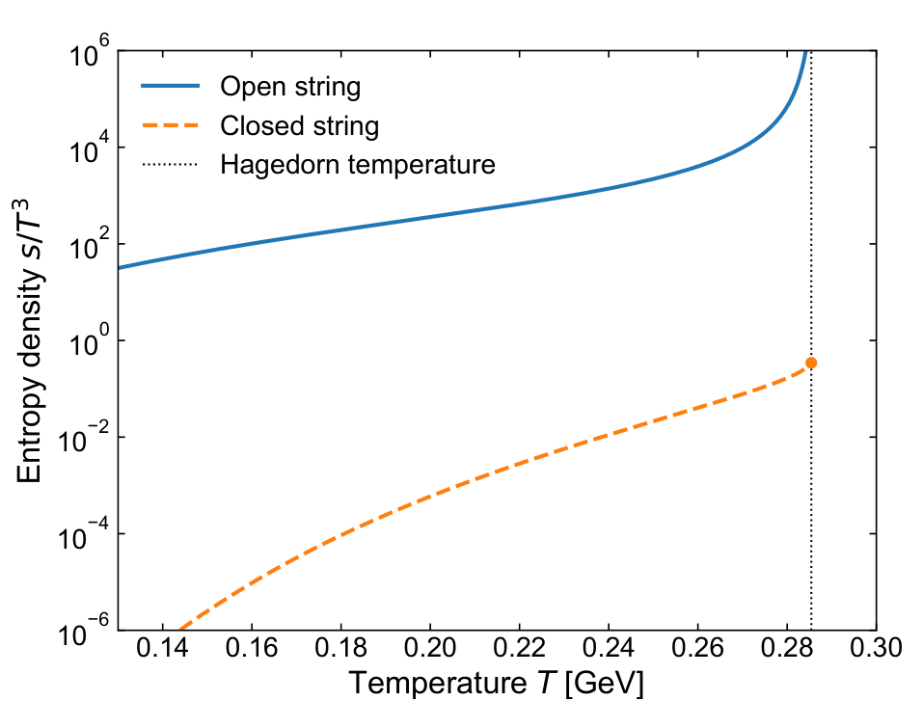
the closed strings corresponding to the glueballs
remains finite at T = TH.
The open strings corresponding
to the meson resonance gas
diverges at T = TH.

Slide 10
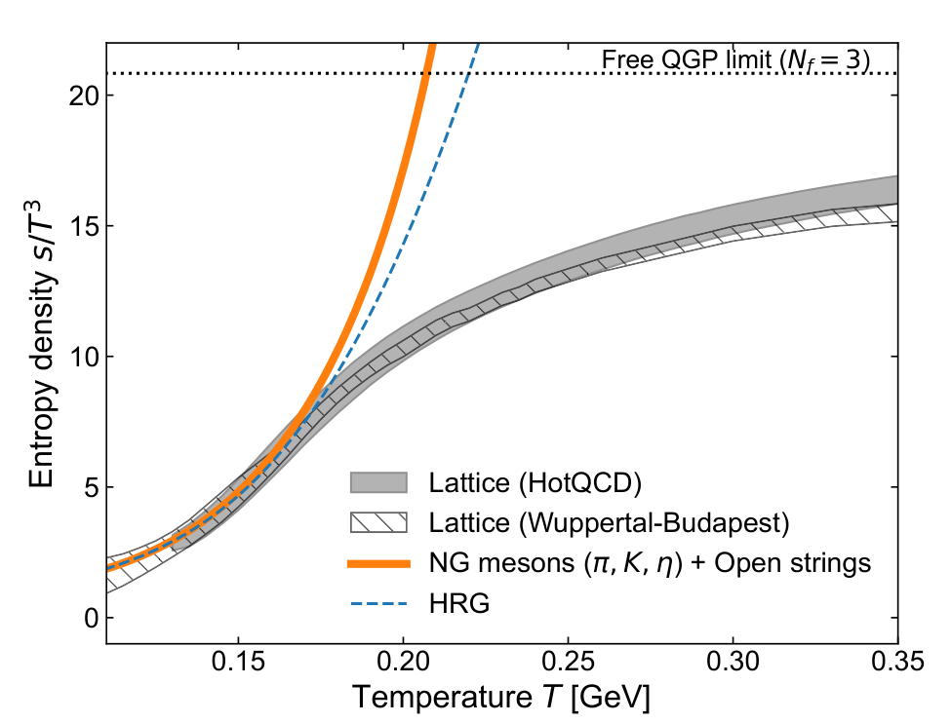
matches well with the lattice-QCD data and the HRG equation of state

Slide 11
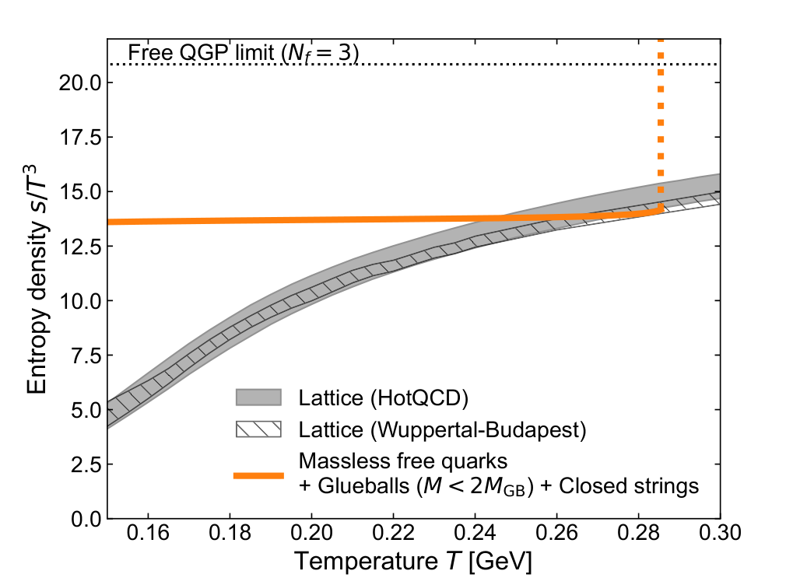
Comparison of the entropy density between the lattice-QCD data and the gas of
massless free quarks and light glueballs as well as heavy glueballs that obey the
closed-string spectrum.

Slide 12
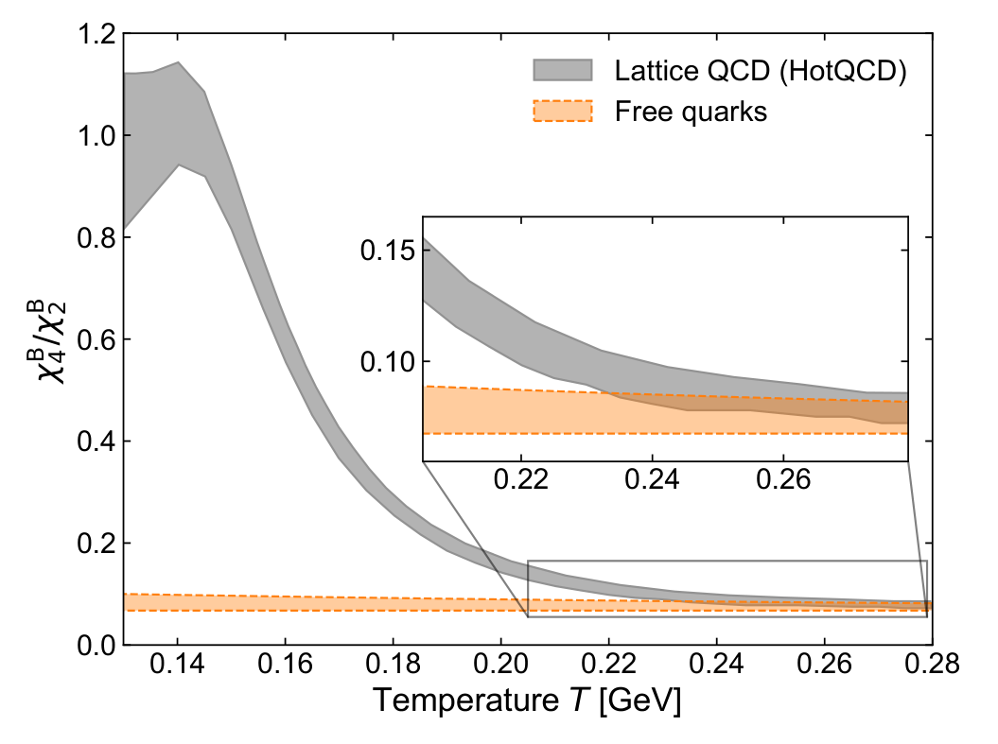

Slide 13
