Slide 1
2025/07/07
组会

Slide 2
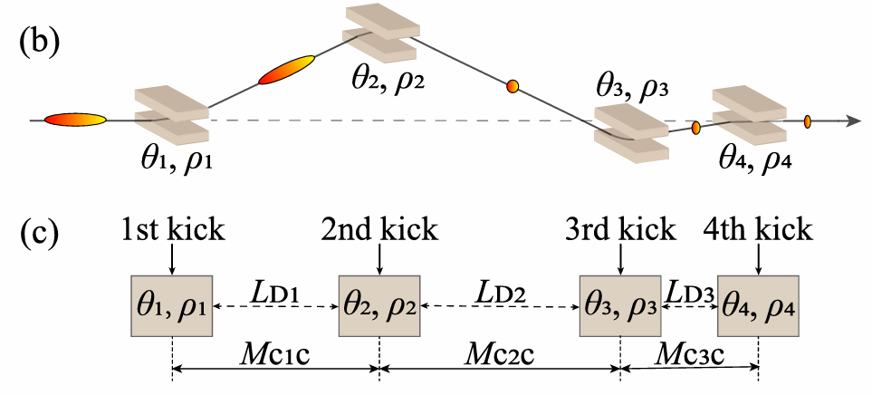
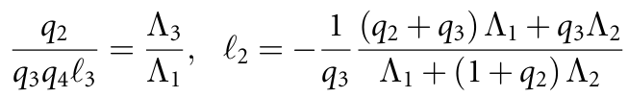
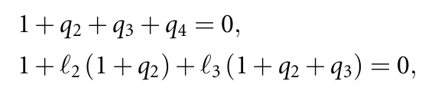
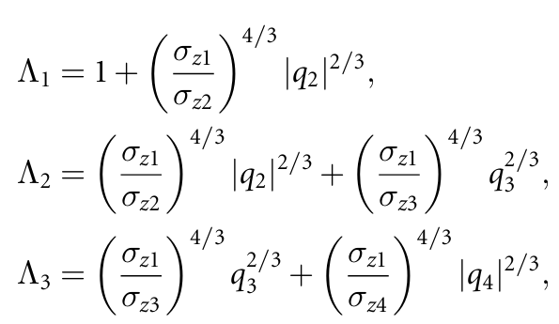

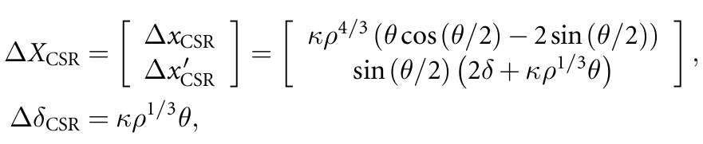
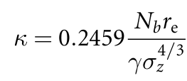
S-chicane
F Zeng et al. New J. Phys. 27 (2025) 063801
1. 消色散条件（R51=0，R52=0）：
3. S-chicane参数：
省略掉了含有磁铁长度的项
2. 抑制发射度增长条件：
point-kick model
计算$ΔX_{CSR}$时不考虑CSR引起的束流能量变化$Δγ$

Slide 3
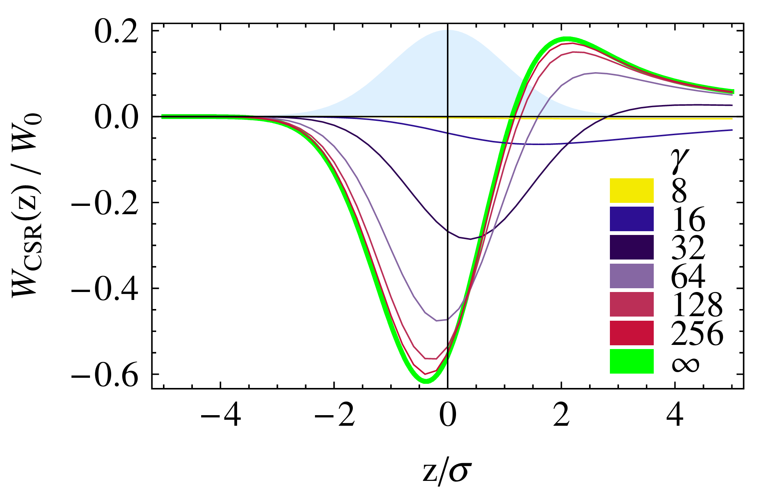
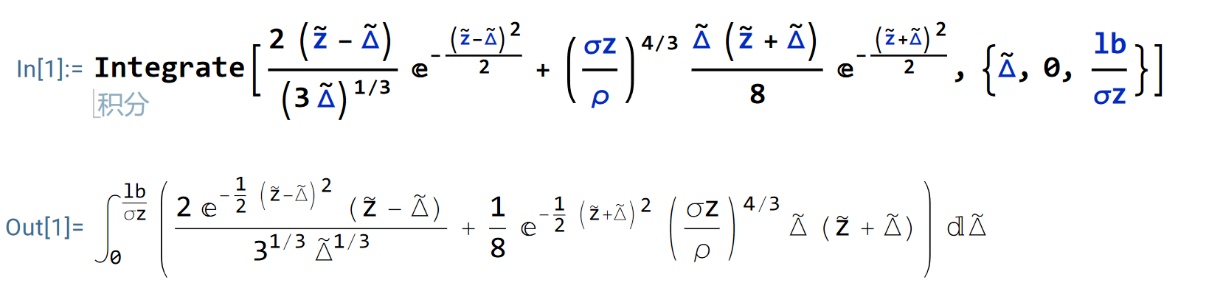
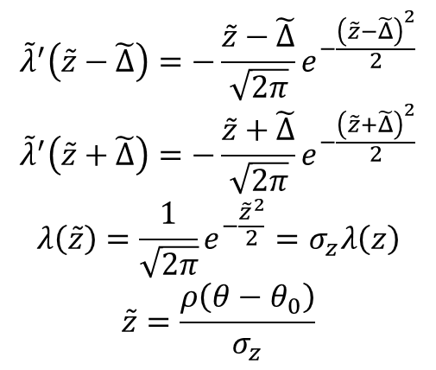
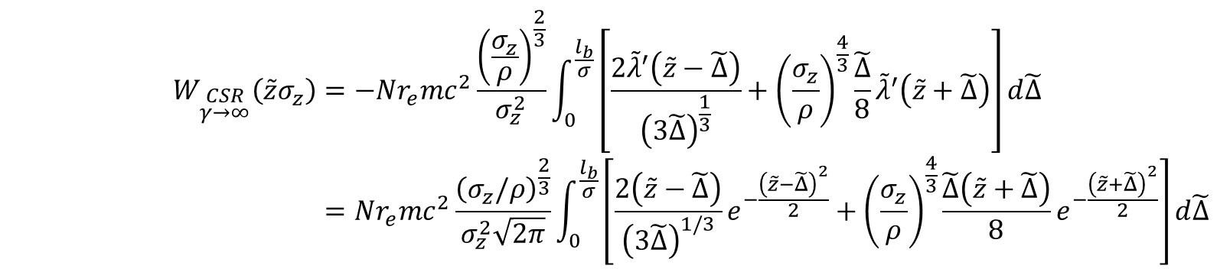
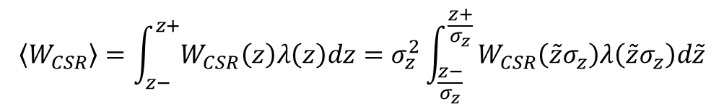
考虑束流能量变化的S-chicane
$$W_{\begin{aligned}CSR \\ γ→∞\end{aligned}}\left(\tilde{z}σ_{z}\right)=−Nr_{e}mc^{2}\frac{{\left(\frac{σ_{z}}{ρ}\right)}^{\frac{2}{3}}}{σ_{z}^{2}}\int_{0}^{\frac{l_{b}}{σ}}{\left[\frac{2{\tilde{λ}}^{′}\left(\tilde{z}−\tilde{Δ}\right)}{{\left(3\tilde{Δ}\right)}^{\frac{1}{3}}}+{\left(\frac{σ_{z}}{ρ}\right)}^{\frac{4}{3}}\frac{\tilde{Δ}}{8}{\tilde{λ}}^{′}\left(\tilde{z}+\tilde{Δ}\right)\right]d\tilde{Δ}} \\ =Nr_{e}mc^{2}\frac{{\left(σ_{z}/ρ\right)}^{\frac{2}{3}}}{σ_{z}^{2}\sqrt{2π}}\int_{0}^{\frac{l_{b}}{σ}}{\left[\frac{2\left(\tilde{z}−\tilde{Δ}\right)}{{\left(3\tilde{Δ}\right)}^{1/3}}e^{−\frac{{\left(\tilde{z}−\tilde{Δ}\right)}^{2}}{2}}+{\left(\frac{σ_{z}}{ρ}\right)}^{\frac{4}{3}}\frac{\tilde{Δ}\left(\tilde{z}+\tilde{Δ}\right)}{8}e^{−\frac{{\left(\tilde{z}+\tilde{Δ}\right)}^{2}}{2}}\right]d\tilde{Δ}}$$
$${\tilde{λ}}^{′}\left(\tilde{z}−\tilde{Δ}\right)=−\frac{\tilde{z}−\tilde{Δ}}{\sqrt{2π}}e^{−\frac{{\left(\tilde{z}−\tilde{Δ}\right)}^{2}}{2}}$$
$${\tilde{λ}}^{′}\left(\tilde{z}+\tilde{Δ}\right)=−\frac{\tilde{z}+\tilde{Δ}}{\sqrt{2π}}e^{−\frac{{\left(\tilde{z}+\tilde{Δ}\right)}^{2}}{2}}$$
$$λ\left(\tilde{z}\right)=\frac{1}{\sqrt{2π}}e^{−\frac{{\tilde{z}}^{2}}{2}}=σ_{z}λ\left(z\right)$$
$$\tilde{z}=\frac{ρ\left(θ−θ_{0}\right)}{σ_{z}}$$
$$\left\langle W_{CSR}\right\rangle =\int_{z−}^{z+}{W_{CSR}\left(z\right)λ\left(z\right)dz}=σ_{z}^{2}\int_{\frac{z−}{σ_{z}}}^{\frac{z+}{σ_{z}}}{W_{CSR}\left(\tilde{z}σ_{z}\right)λ\left(\tilde{z}σ_{z}\right)d\tilde{z}}$$
只能数值积分
C. Mayes and G. Hoffstaetter, Phys. Rev. STAccel. Beams 12, 024401 (2009)

Slide 4
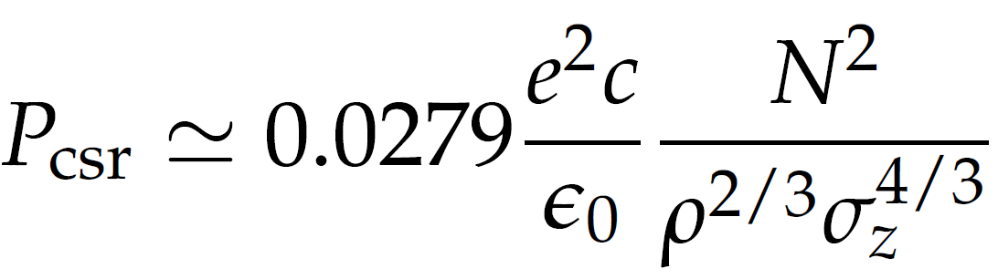
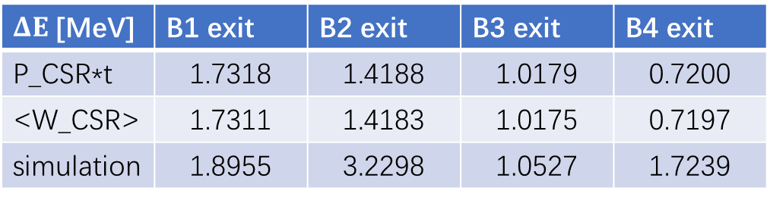
考虑束流能量变化的S-chicane
利用辐射功率计算$出$的能量变化与积分得到的几乎一样
$ΔE$ [MeV] | B1 exit | B2 exit | B3 exit | B4 exit
P_CSR*t | 1.7318 | 1.4188 | 1.0179 | 0.7200
<W_CSR> | 1.7311 | 1.4183 | 1.0175 | 0.7197
simulation | 1.8955 | 3.2298 | 1.0527 | 1.7239
B4
B3
B1
B2
M. Dohlus, T. Limberg and P. Emma. In: ICFA Beam Dyn. Newslett. 38 (2005)

Slide 5
Elegant: 由辐射引起的参考能量变化的跟踪
实际中，磁场强度B改变，偏转角度θ不变
C-chicane
S-chicane
Cxp
4.665360e-05
-8.984350e-07
-3.45117e-05
-1.51128e-07

Slide 6
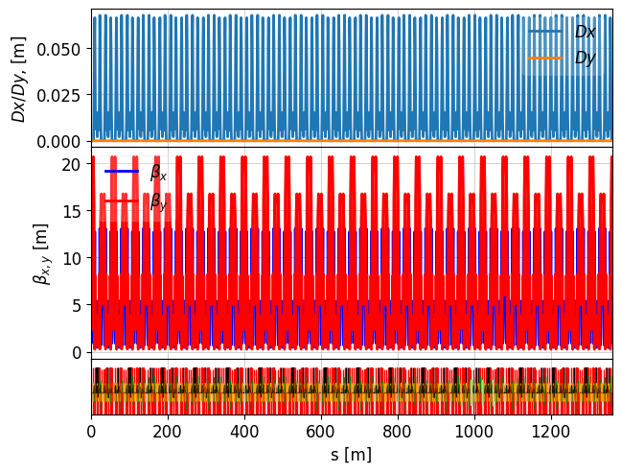
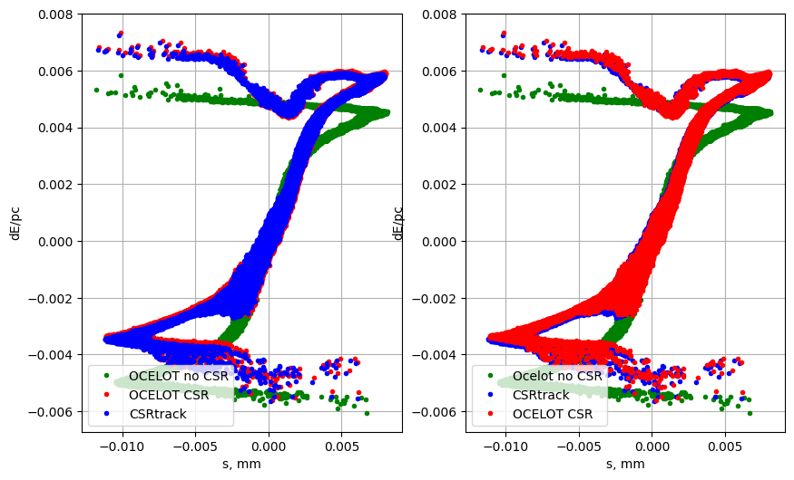
Ocelot安装学习
基于python
文件转换需补充部分elegant的元件类型
HEPS_storage_ring

Slide 7
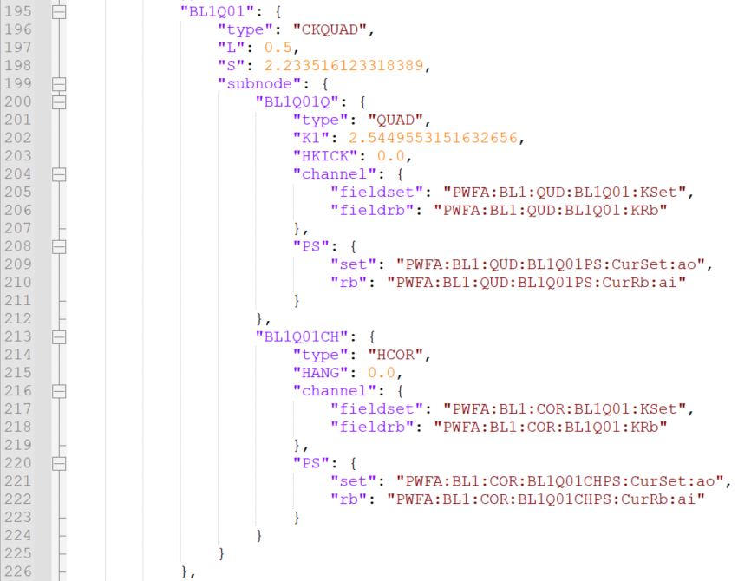
json
PV，相应的物理量在控制网络中的地址

Slide 8
束线2IP2束流横向尺寸优化
E = 150 MeV
K_BL2Q07 = 5.0314 T/m
5 nC
Sx=108.8558 um
Sy=94.56748 um

