Slide 1
2025/07/14
组会

Slide 2
工作列表
IOC磁铁数据准备
  整理束线1所有sequence
  处理后的数据与原磁测数据比较，并整理文档（7.25之前）
准备SAP2025摘要
学习调束软件，看代码
CSR
  推导抵消束流水平offset的chicane条件
  找到考虑辐射后的正确elegant输入文件设置
BAPD文章
实验考虑和设计
束线1 PMQ优化

Slide 3
束线1sequence
Bunch compressor
Transverse Focus
Beam Diagnosis
 | chicane | 合束二极铁 | BL1AM4
Sequence 1 | 开 | - | -
Sequence 2 | 关 | - | -

Slide 4
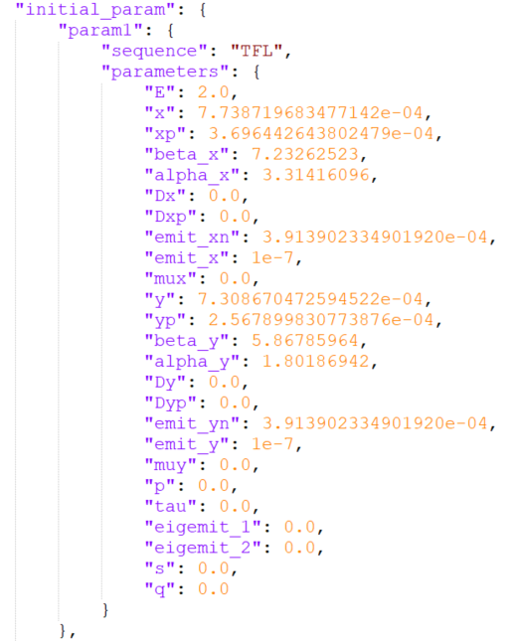
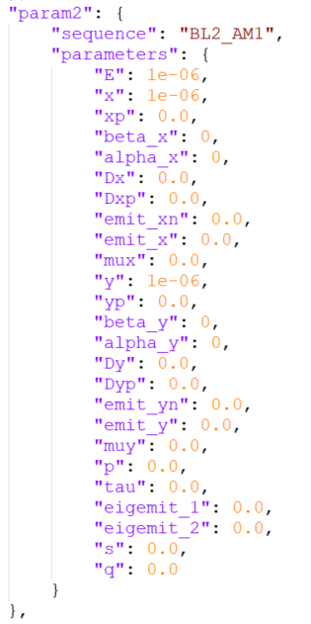
.json初始束流参数
已添加束线1初始电子束参数，缺少束线2初始束流参数

Slide 5
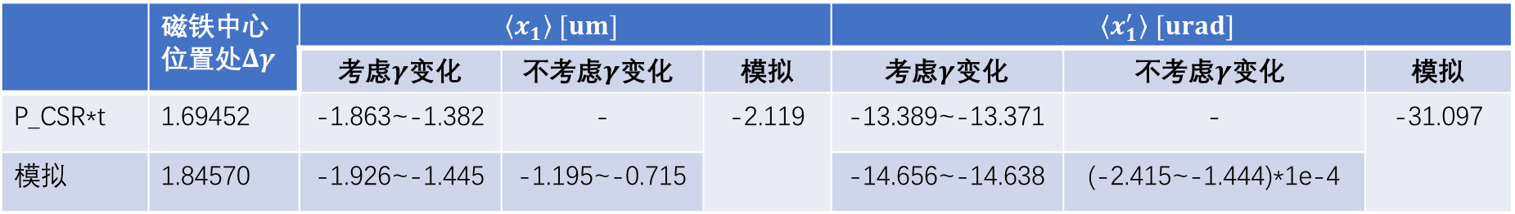
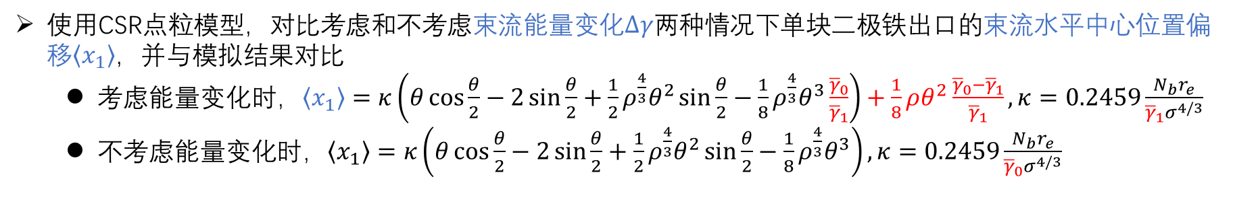

抵消CSR引起的束流横向offset的chicane条件
使用CSR点粒模型，对比考虑和不考虑束流能量变化$Δγ$两种情况下单块二极铁出口的束流水平中心位置偏移$\left\langle x_{1}\right\rangle$，并与模拟结果对比
  考虑能量变化时，$\left\langle x_{1}\right\rangle =κ\left(θ\cos{\frac{θ}{2}}−2\sin{\frac{θ}{2}}+\frac{1}{2}ρ^{\frac{4}{3}}θ^{2}\sin{\frac{θ}{2}}−\frac{1}{8}ρ^{\frac{4}{3}}θ^{3}\frac{{\overline{γ}}_{0}}{{\overline{γ}}_{1}}\right)+\frac{1}{8}ρθ^{2}\frac{{\overline{γ}}_{0}−{\overline{γ}}_{1}}{{\overline{γ}}_{1}},κ=0.2459\frac{N_{b}r_{e}}{{\overline{γ}}_{1}σ^{4/3}}$
  不考虑能量变化时，$\left\langle x_{1}\right\rangle =κ\left(θ\cos{\frac{θ}{2}}−2\sin{\frac{θ}{2}}+\frac{1}{2}ρ^{\frac{4}{3}}θ^{2}\sin{\frac{θ}{2}}−\frac{1}{8}ρ^{\frac{4}{3}}θ^{3}\right),κ=0.2459\frac{N_{b}r_{e}}{{\overline{γ}}_{0}σ^{4/3}}$
参数：500 MeV，500 pC，$σ_{z0}=2 um$，$ρ=12.99886 m$，$θ=−0.015 rad$
 | 磁铁中心位置处$Δγ$ | $$\left\langle x_{1}\right\rangle [um]$$ |  |  | $$\left\langle x_{1}^{′}\right\rangle [urad]$$
 |  | 考虑$γ$变化 | $$\text{不}\text{考虑}γ\text{变化}$$ | 模拟 | 考虑$γ$变化 | $$\text{不}\text{考虑}γ\text{变化}$$ | 模拟
P_CSR*t | 1.69452 | -1.863~-1.382 | - | -2.119 | -13.389~-13.371 | - | -31.097
模拟 | 1.84570 | -1.926~-1.445 | -1.195~-0.715 |  | -14.656~-14.638 | (-2.415~-1.444)*1e-4
不考虑$Δγ$会低估$\left\langle x_{1}\right\rangle$
$$Δγ={\overline{γ}}_{1}−{\overline{γ}}_{0}=\frac{0.0279r_{e}}{8π}\frac{N_{b}^{2}}{σ^{4/3}}ρ^{1/3}θ$$

Slide 6
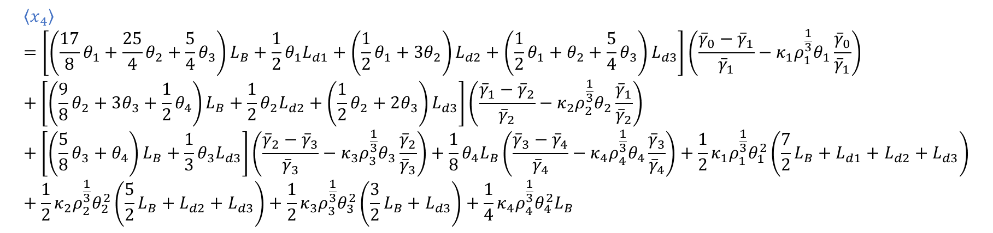
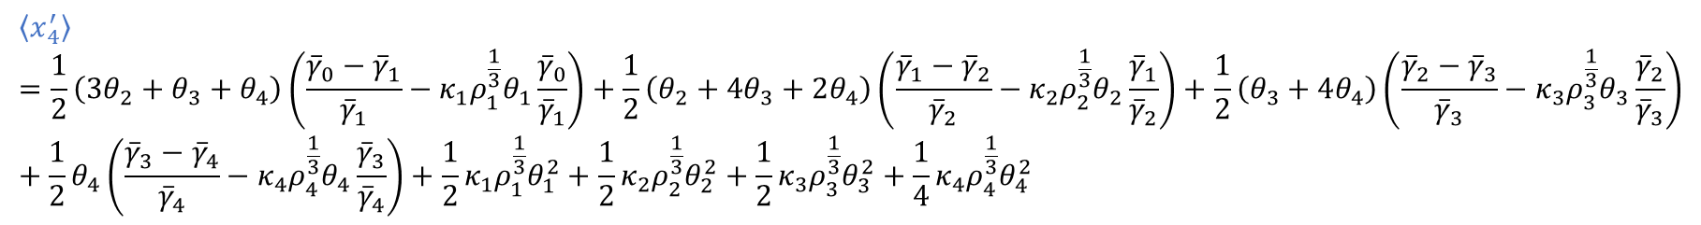
抵消CSR引起的束流横向offset的chicane条件
考虑消色散条件，chicane出口的束流水平中心位置偏移$\left\langle x_{4}\right\rangle$和平均水平散角$\left\langle x_{4}^{′}\right\rangle$：
$$\left\langle x_{4}\right\rangle =\left[\left(\frac{17}{8}θ_{1}+\frac{25}{4}θ_{2}+\frac{5}{4}θ_{3}\right)L_{B}+\frac{1}{2}θ_{1}L_{d1}+\left(\frac{1}{2}θ_{1}+3θ_{2}\right)L_{d2}+\left(\frac{1}{2}θ_{1}+θ_{2}+\frac{5}{4}θ_{3}\right)L_{d3}\right]\left(\frac{{\overline{γ}}_{0}−{\overline{γ}}_{1}}{{\overline{γ}}_{1}}−κ_{1}ρ_{1}^{\frac{1}{3}}θ_{1}\frac{{\overline{γ}}_{0}}{{\overline{γ}}_{1}}\right)+\left[\left(\frac{9}{8}θ_{2}+3θ_{3}+\frac{1}{2}θ_{4}\right)L_{B}+\frac{1}{2}θ_{2}L_{d2}+\left(\frac{1}{2}θ_{2}+2θ_{3}\right)L_{d3}\right]\left(\frac{{\overline{γ}}_{1}−{\overline{γ}}_{2}}{{\overline{γ}}_{2}}−κ_{2}ρ_{2}^{\frac{1}{3}}θ_{2}\frac{{\overline{γ}}_{1}}{{\overline{γ}}_{2}}\right)+\left[\left(\frac{5}{8}θ_{3}+θ_{4}\right)L_{B}+\frac{1}{3}θ_{3}L_{d3}\right]\left(\frac{{\overline{γ}}_{2}−{\overline{γ}}_{3}}{{\overline{γ}}_{3}}−κ_{3}ρ_{3}^{\frac{1}{3}}θ_{3}\frac{{\overline{γ}}_{2}}{{\overline{γ}}_{3}}\right)+\frac{1}{8}θ_{4}L_{B}\left(\frac{{\overline{γ}}_{3}−{\overline{γ}}_{ }}{{\overline{γ}}_{4}}−κ_{4}ρ_{4}^{\frac{1}{3}}θ_{4}\frac{{\overline{γ}}_{3}}{{\overline{γ}}_{4}}\right)+\frac{1}{2}κ_{1}ρ_{1}^{\frac{1}{3}}θ_{1}^{2}\left(\frac{7}{2}L_{B}+L_{d1}+L_{d2}+L_{d3}\right)+\frac{1}{2}κ_{2}ρ_{2}^{\frac{1}{3}}θ_{2}^{2}\left(\frac{5}{2}L_{B}+L_{d2}+L_{d3}\right)+\frac{1}{2}κ_{3}ρ_{3}^{\frac{1}{3}}θ_{3}^{2}\left(\frac{3}{2}L_{B}+L_{d3}\right)+\frac{1}{4}κ_{4}ρ_{4}^{\frac{1}{3}}θ_{4}^{2}L_{B}$$
$$\left\langle x_{4}^{′}\right\rangle =\frac{1}{2}\left(3θ_{2}+θ_{3}+θ_{4}\right)\left(\frac{{\overline{γ}}_{0}−{\overline{γ}}_{1}}{{\overline{γ}}_{1}}−κ_{1}ρ_{1}^{\frac{1}{3}}θ_{1}\frac{{\overline{γ}}_{0}}{{\overline{γ}}_{1}}\right)+\frac{1}{2}\left(θ_{2}+4θ_{3}+2θ_{4}\right)\left(\frac{{\overline{γ}}_{1}−{\overline{γ}}_{2}}{{\overline{γ}}_{2}}−κ_{2}ρ_{2}^{\frac{1}{3}}θ_{2}\frac{{\overline{γ}}_{1}}{{\overline{γ}}_{2}}\right)+\frac{1}{2}\left(θ_{3}+4θ_{4}\right)\left(\frac{{\overline{γ}}_{2}−{\overline{γ}}_{3}}{{\overline{γ}}_{3}}−κ_{3}ρ_{3}^{\frac{1}{3}}θ_{3}\frac{{\overline{γ}}_{2}}{{\overline{γ}}_{3}}\right)+\frac{1}{2}θ_{4}\left(\frac{{\overline{γ}}_{3}−{\overline{γ}}_{4}}{{\overline{γ}}_{4}}−κ_{4}ρ_{4}^{\frac{1}{3}}θ_{4}\frac{{\overline{γ}}_{3}}{{\overline{γ}}_{4}}\right)+\frac{1}{2}κ_{1}ρ_{1}^{\frac{1}{3}}θ_{1}^{2}+\frac{1}{2}κ_{2}ρ_{2}^{\frac{1}{3}}θ_{2}^{2}+\frac{1}{2}κ_{3}ρ_{3}^{\frac{1}{3}}θ_{3}^{2}+\frac{1}{4}κ_{4}ρ_{4}^{\frac{1}{3}}θ_{4}^{2}$$
$$θ_{3}（L_{d3}+L_{B}）+θ_{2}（L_{d2}+L_{d3}+2L_{B}）+θ_{1}\left(L_{d2}+L_{d3}+3L_{B}\right)=0$$
$$θ_{1}+θ_{2}+θ_{3}+θ_{4}=0$$
消色散条件：

Slide 7
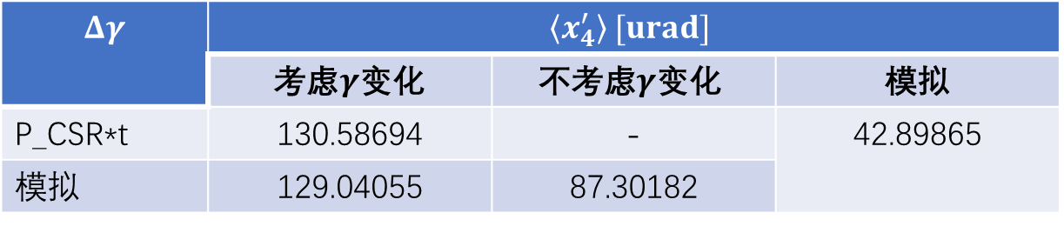
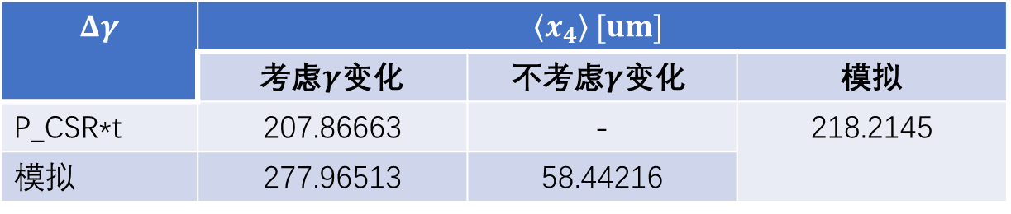
抵消CSR引起的束流横向offset的chicane条件
$\left\langle x_{4}\right\rangle$与模拟较符合，但$\left\langle x_{4}^{′}\right\rangle$与模拟相差较大
$$Δγ$$ | $$\left\langle x_{4}\right\rangle [um]$$
 | 考虑$γ$变化 | $$\text{不}\text{考虑}γ\text{变化}$$ | 模拟
P_CSR*t | 207.86663 | - | 218.2145
模拟 | 277.96513 | 58.44216
$$Δγ$$ | $$\left\langle x_{4}^{′}\right\rangle [urad]$$
 | 考虑$γ$变化 | $$\text{不}\text{考虑}γ\text{变化}$$ | 模拟
P_CSR*t | 130.58694 | - | 42.89865
模拟 | 129.04055 | 87.30182
$\left\langle x_{4}\right\rangle 与\left\langle x_{4}^{′}\right\rangle 表达$式复杂（尚未带入$Δγ$和$σ$表达式），较难化简及参数优化

Slide 8
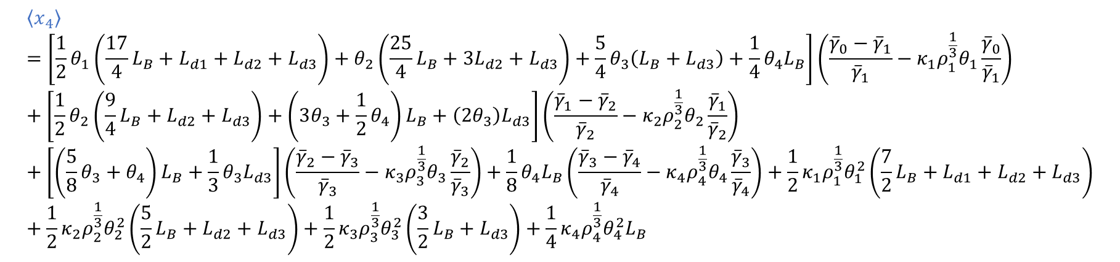
抵消CSR引起的束流横向offset的chicane条件
考虑消色散条件，chicane出口的束流水平中心位置偏移$\left\langle x_{4}\right\rangle$和平均水平散角$\left\langle x_{4}^{′}\right\rangle$：
$$\left\langle x_{4}\right\rangle =\left[\left(\frac{17}{8}θ_{1}+\frac{25}{4}θ_{2}+\frac{5}{4}θ_{3}\right)L_{B}+\frac{1}{2}θ_{1}L_{d1}+\left(\frac{1}{2}θ_{1}+3θ_{2}\right)L_{d2}+\left(\frac{1}{2}θ_{1}+θ_{2}+\frac{5}{4}θ_{3}\right)L_{d3}\right]\left(\frac{{\overline{γ}}_{0}−{\overline{γ}}_{1}}{{\overline{γ}}_{1}}−κ_{1}ρ_{1}^{\frac{1}{3}}θ_{1}\frac{{\overline{γ}}_{0}}{{\overline{γ}}_{1}}\right)+\left[\left(\frac{9}{8}θ_{2}+3θ_{3}+\frac{1}{2}θ_{4}\right)L_{B}+\frac{1}{2}θ_{2}L_{d2}+\left(\frac{1}{2}θ_{2}+2θ_{3}\right)L_{d3}\right]\left(\frac{{\overline{γ}}_{1}−{\overline{γ}}_{2}}{{\overline{γ}}_{2}}−κ_{2}ρ_{2}^{\frac{1}{3}}θ_{2}\frac{{\overline{γ}}_{1}}{{\overline{γ}}_{2}}\right)+\left[\left(\frac{5}{8}θ_{3}+θ_{4}\right)L_{B}+\frac{1}{3}θ_{3}L_{d3}\right]\left(\frac{{\overline{γ}}_{2}−{\overline{γ}}_{3}}{{\overline{γ}}_{3}}−κ_{3}ρ_{3}^{\frac{1}{3}}θ_{3}\frac{{\overline{γ}}_{2}}{{\overline{γ}}_{3}}\right)+\frac{1}{8}θ_{4}L_{B}\left(\frac{{\overline{γ}}_{3}−{\overline{γ}}_{ }}{{\overline{γ}}_{4}}−κ_{4}ρ_{4}^{\frac{1}{3}}θ_{4}\frac{{\overline{γ}}_{3}}{{\overline{γ}}_{4}}\right)+\frac{1}{2}κ_{1}ρ_{1}^{\frac{1}{3}}θ_{1}^{2}\left(\frac{7}{2}L_{B}+L_{d1}+L_{d2}+L_{d3}\right)+\frac{1}{2}κ_{2}ρ_{2}^{\frac{1}{3}}θ_{2}^{2}\left(\frac{5}{2}L_{B}+L_{d2}+L_{d3}\right)+\frac{1}{2}κ_{3}ρ_{3}^{\frac{1}{3}}θ_{3}^{2}\left(\frac{3}{2}L_{B}+L_{d3}\right)+\frac{1}{4}κ_{4}ρ_{4}^{\frac{1}{3}}θ_{4}^{2}L_{B}$$
$$\left\langle x_{4}\right\rangle =\left[{\frac{1}{2}θ}_{1}\left(\frac{17}{4}L_{B}+L_{d1}+L_{d2}+L_{d3}\right)+θ_{2}（\frac{25}{4}L_{B}+3L_{d2}+L_{d3}）+{\frac{5}{4}θ}_{3}\left(L_{B}+L_{d3}\right)+\frac{1}{4}θ_{4}L_{B}\right]\left(\frac{{\overline{γ}}_{0}−{\overline{γ}}_{1}}{{\overline{γ}}_{1}}−κ_{1}ρ_{1}^{\frac{1}{3}}θ_{1}\frac{{\overline{γ}}_{0}}{{\overline{γ}}_{1}}\right)+\left[\frac{1}{2}θ_{2}\left(\frac{9}{4}L_{B}+L_{d2}+L_{d3}\right)+\left(3θ_{3}+\frac{1}{2}θ_{4}\right)L_{B}+\left(2θ_{3}\right)L_{d3}\right]\left(\frac{{\overline{γ}}_{1}−{\overline{γ}}_{2}}{{\overline{γ}}_{2}}−κ_{2}ρ_{2}^{\frac{1}{3}}θ_{2}\frac{{\overline{γ}}_{1}}{{\overline{γ}}_{2}}\right)+\left[\left(\frac{5}{8}θ_{3}+θ_{4}\right)L_{B}+\frac{1}{3}θ_{3}L_{d3}\right]\left(\frac{{\overline{γ}}_{2}−{\overline{γ}}_{3}}{{\overline{γ}}_{3}}−κ_{3}ρ_{3}^{\frac{1}{3}}θ_{3}\frac{{\overline{γ}}_{2}}{{\overline{γ}}_{3}}\right)+\frac{1}{8}θ_{4}L_{B}\left(\frac{{\overline{γ}}_{3}−{\overline{γ}}_{4}}{{\overline{γ}}_{4}}−κ_{4}ρ_{4}^{\frac{1}{3}}θ_{4}\frac{{\overline{γ}}_{3}}{{\overline{γ}}_{4}}\right)+\frac{1}{2}κ_{1}ρ_{1}^{\frac{1}{3}}θ_{1}^{2}\left(\frac{7}{2}L_{B}+L_{d1}+L_{d2}+L_{d3}\right)+\frac{1}{2}κ_{2}ρ_{2}^{\frac{1}{3}}θ_{2}^{2}\left(\frac{5}{2}L_{B}+L_{d2}+L_{d3}\right)+\frac{1}{2}κ_{3}ρ_{3}^{\frac{1}{3}}θ_{3}^{2}\left(\frac{3}{2}L_{B}+L_{d3}\right)+\frac{1}{4}κ_{4}ρ_{4}^{\frac{1}{3}}θ_{4}^{2}L_{B}$$
$$θ_{3}（L_{d3}+L_{B}）+θ_{2}（L_{d2}+L_{d3}+2L_{B}）+θ_{1}\left(L_{d2}+L_{d3}+3L_{B}\right)=0$$
$$θ_{1}+θ_{2}+θ_{3}+θ_{4}=0$$
消色散条件：

