Slide 1
5m scintillator test
Ming-Kuan Yuan
Fudan University
2025.6.20
CEPC muon detector

Slide 2
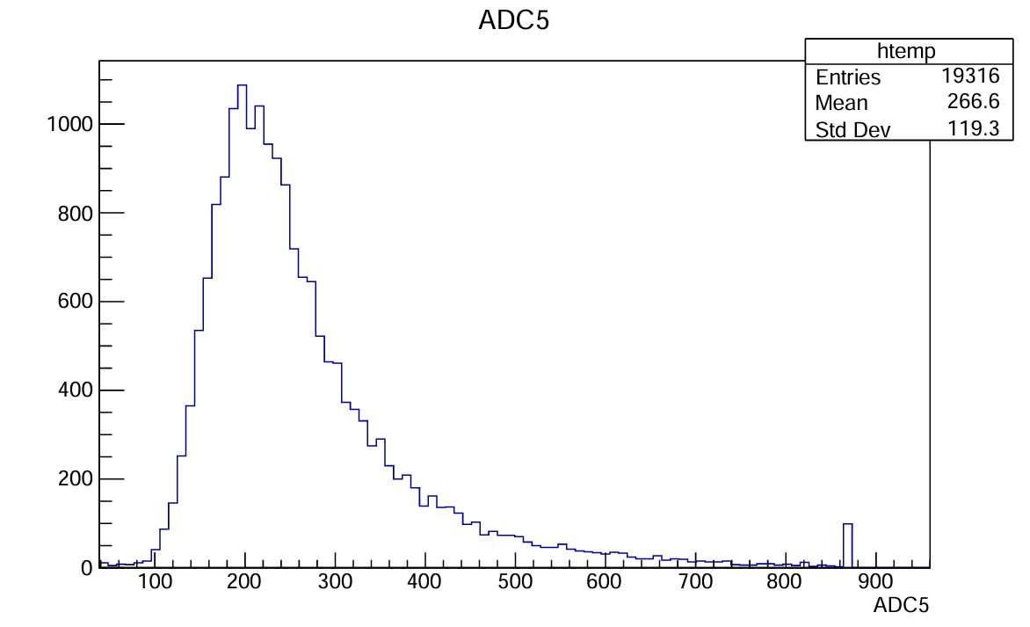
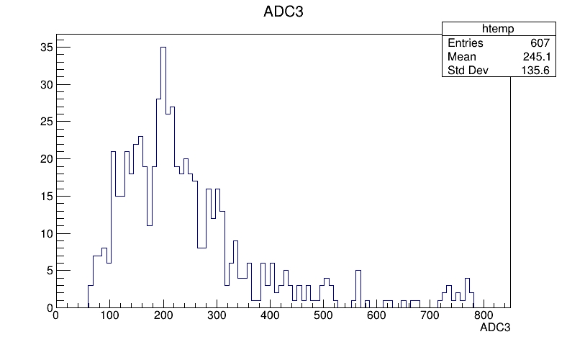
5m scintillator test
No AL at 1m @fudan
Scin5m at 1m @ihep

Slide 3
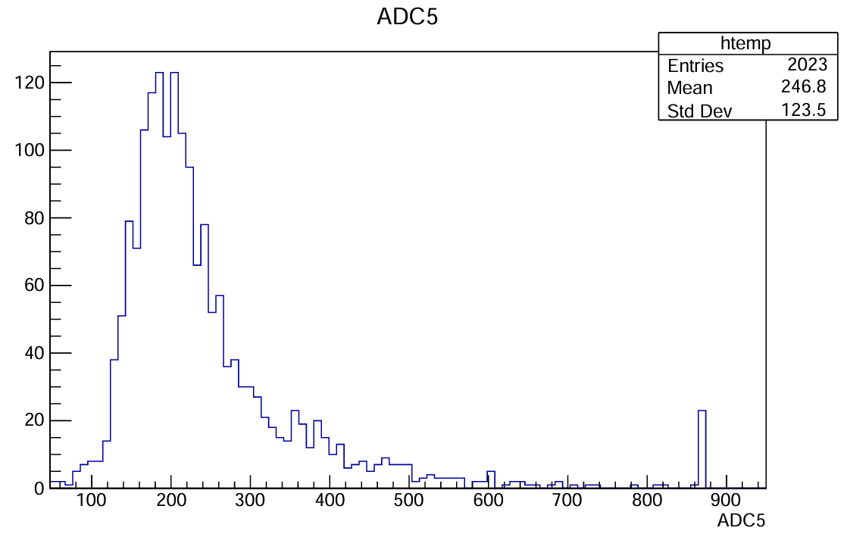
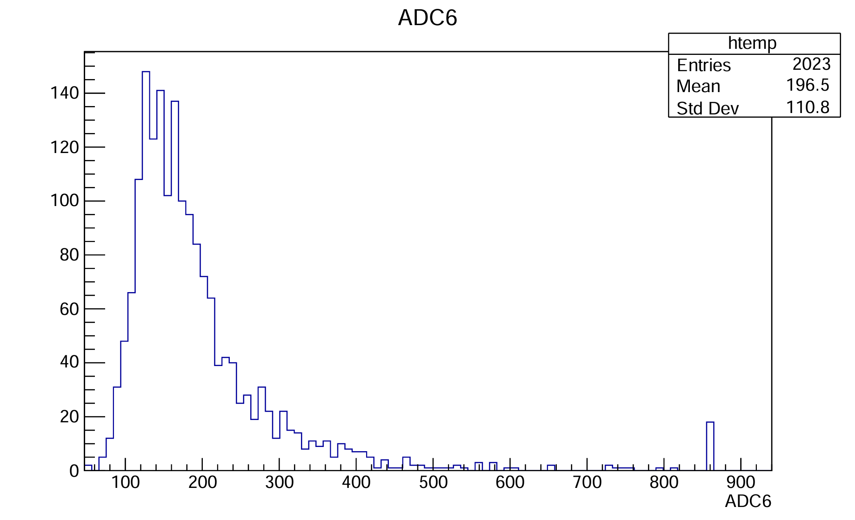
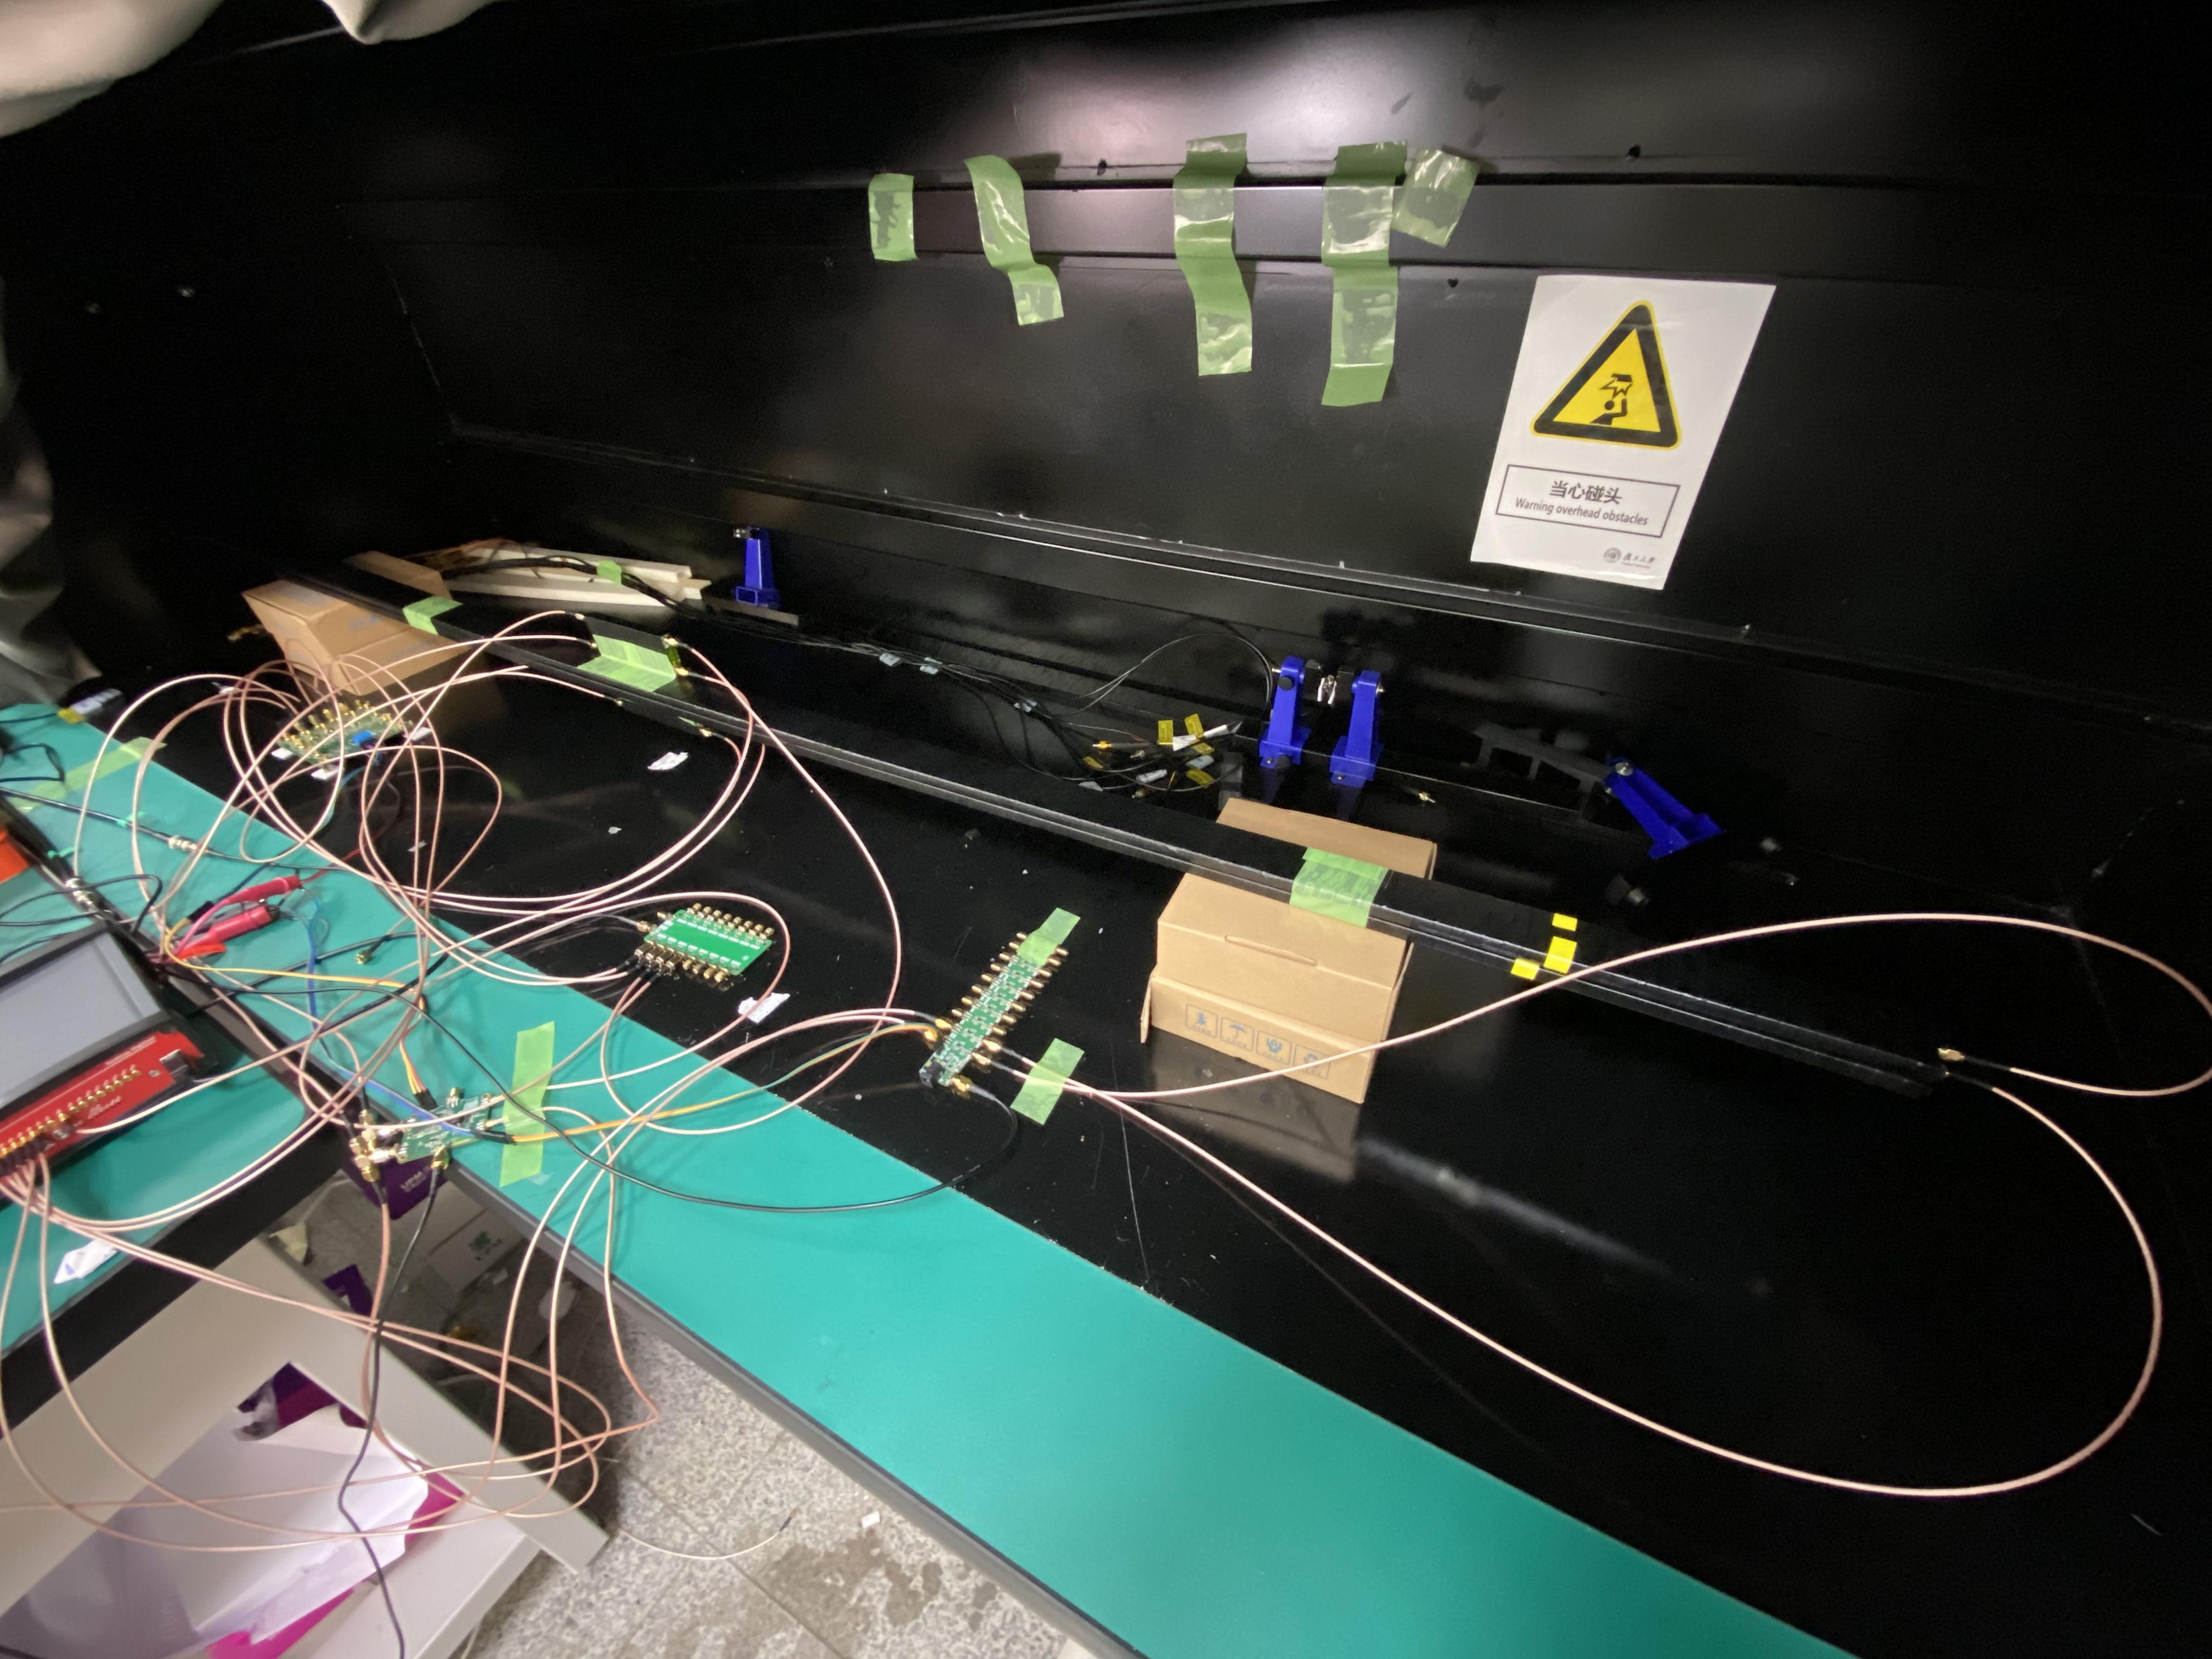
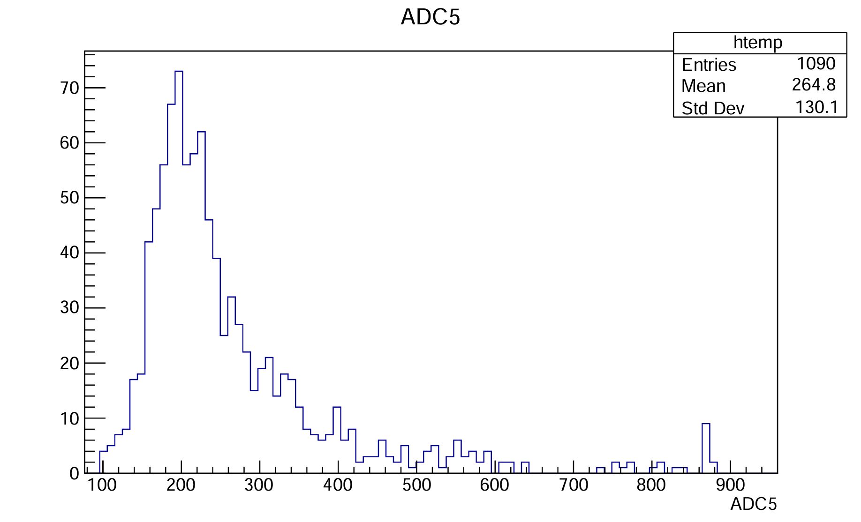
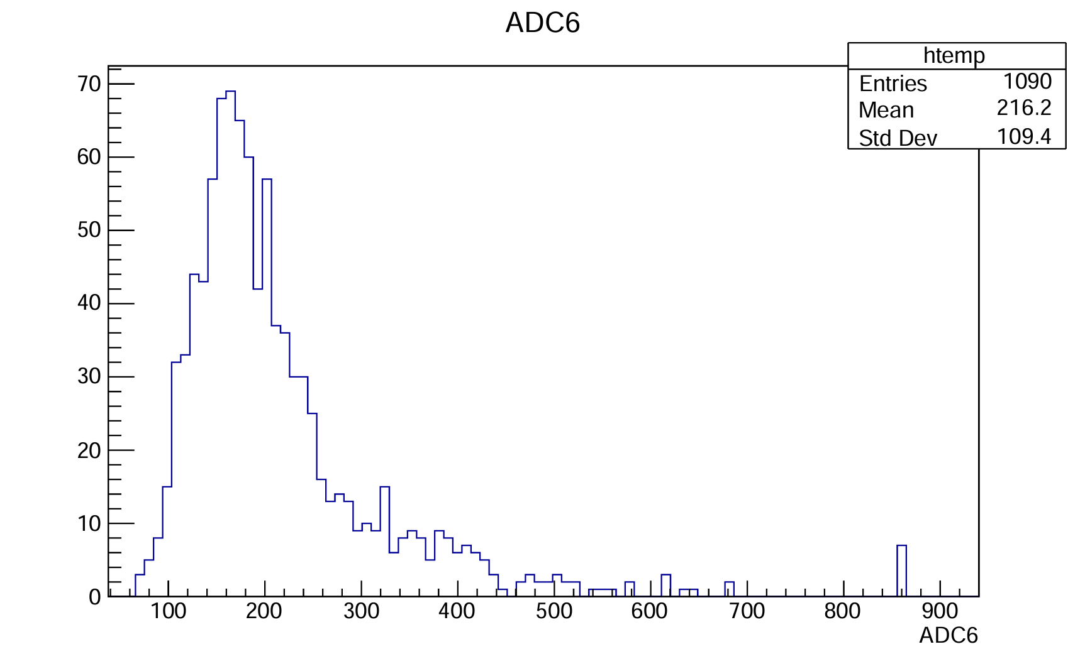
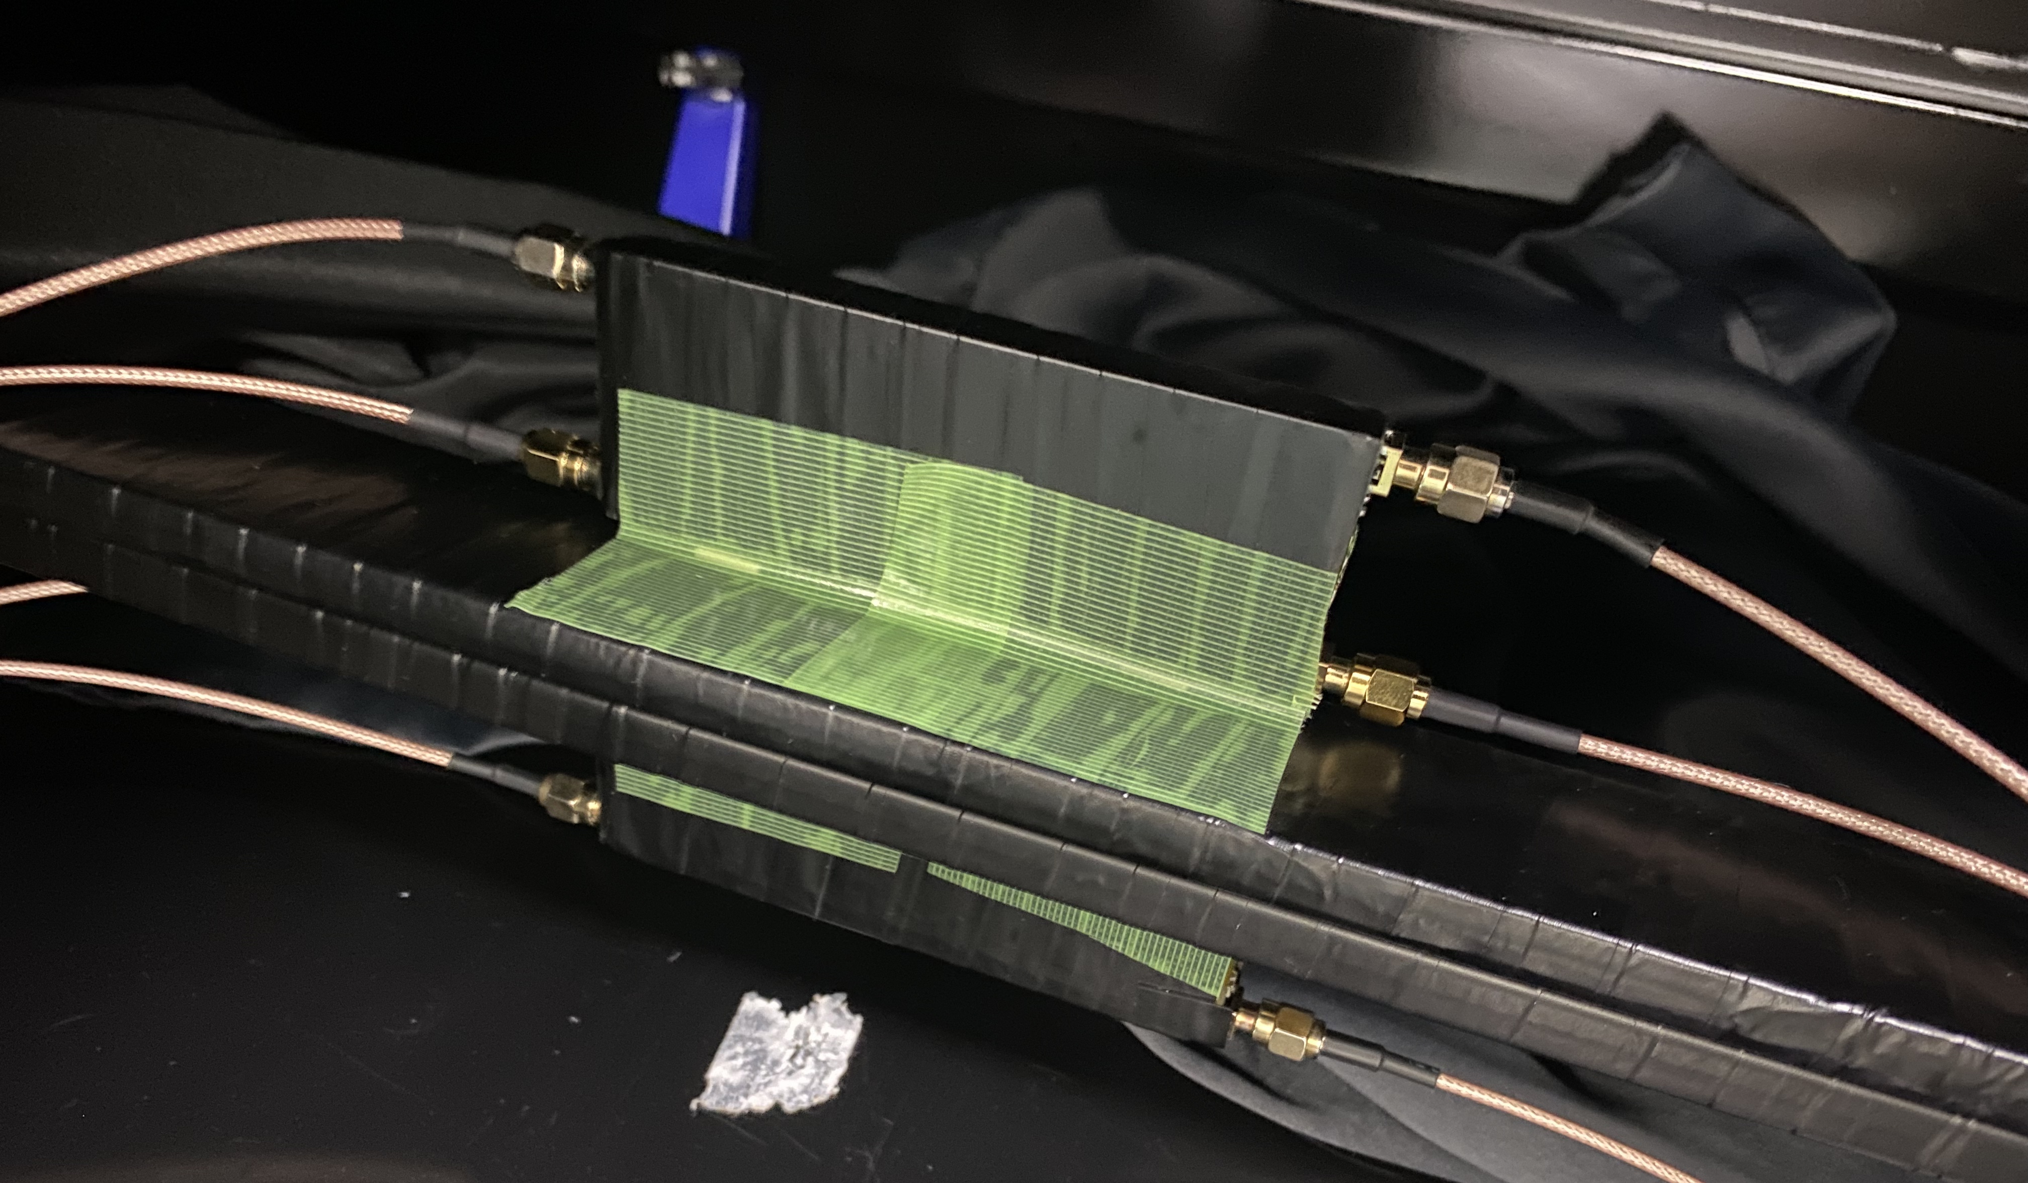
5m scintillator test
与SiPM相距1m
from 5 m
1.6 m
与光纤水平距离 1.5 cm
测试setup
from 5 m
1.6 m
与光纤水平距离 0.5 cm

