Slide 1
Gluondynamics under rotation
Kun Xu
Beijing Institute of Technology
2025.06.18@UCAS, Yanqi Lake Campus

Slide 2
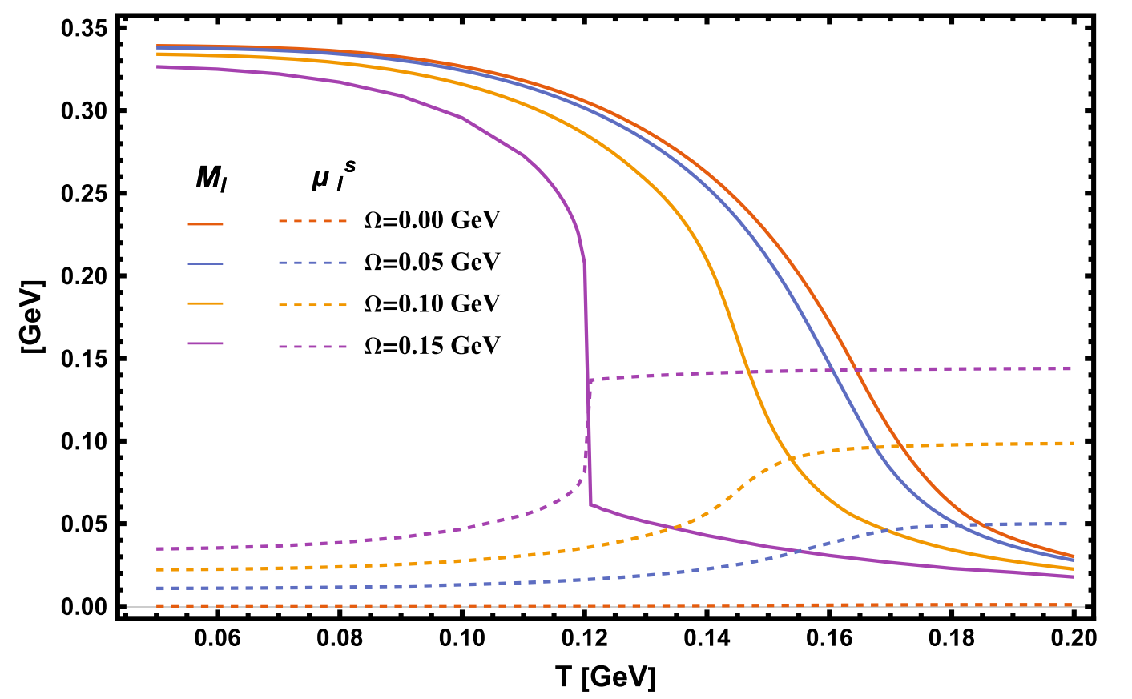
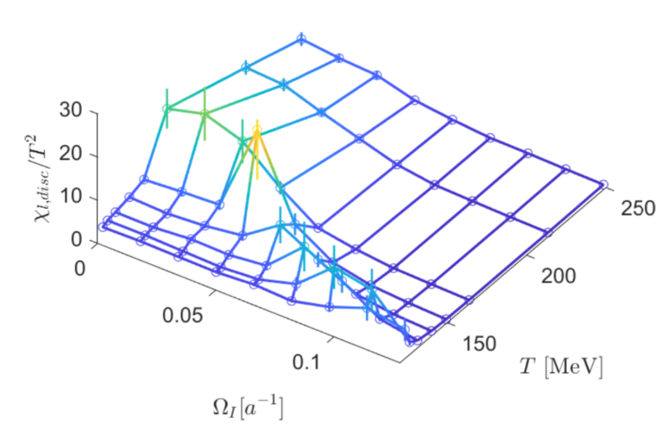
Background
2205.02420
Jichong Yang, Xuguang Huang.
2307.05755
LQCD: (Imaginary) rotation enhances chiral condensate
NJL: rotation reduces chiral condensate
Gluon!

Slide 3
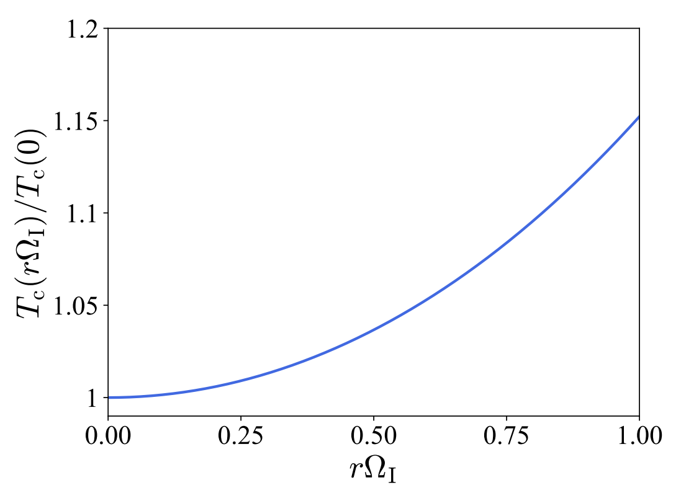
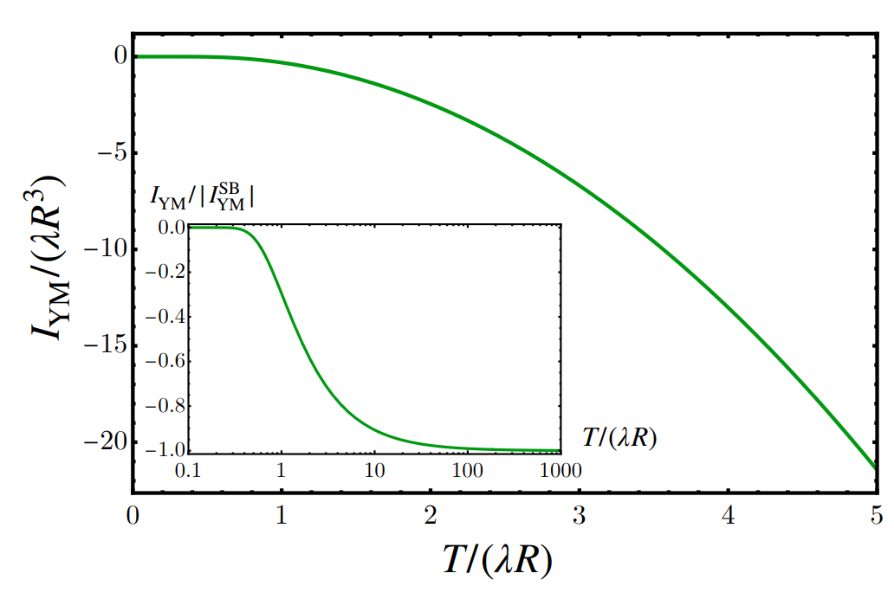
Negative moment of inertia
Imaginary Rotating Gluonic Matter and Polyakov loop
Maxim Chernodub
[2506.06230]
Kenji Fukushimaa , Yusuke Shimada
[2506.03560]

Slide 4
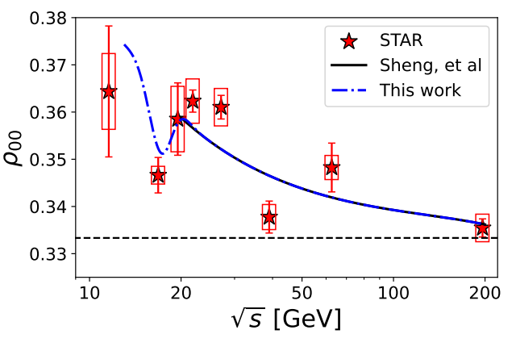
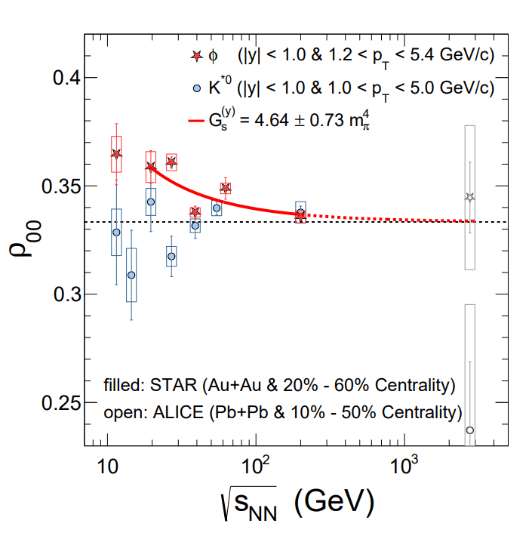
Rotation & magnetic field
Spin polarization
Spin alignment
IMC&MC
Magnetic susceptibility
Meson property（mass, decay constant…）
EoS
CEP(chiral phase transition…)
CME
Magnetic field is not enough to solve all these phenomena simultaneously,
Chromo-magnetic field is missed.

Slide 5
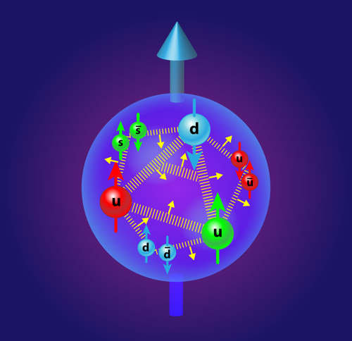
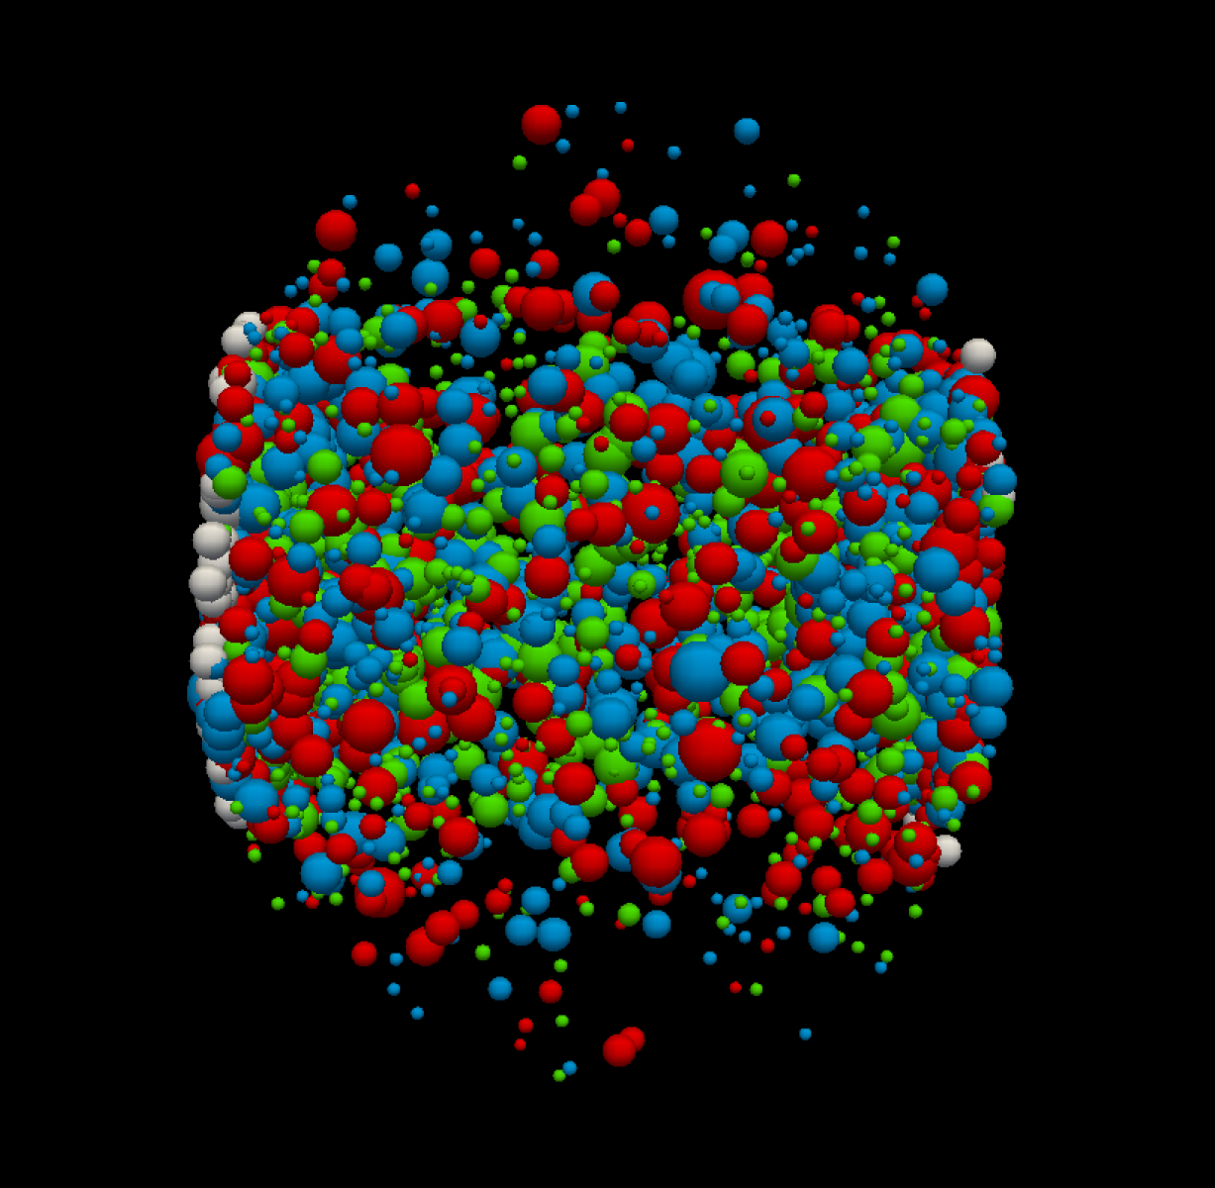
Proton spin crisis
Quark gluon plasma
Glue Spin and Helicity in the Proton from Lattice QCD
Yi-Bo Yang, Raza Sabbir Sufian, Andrei Alexandru, Terrence Draper, Michael J. Glatzmaier, Keh-Fei Liu, and Yong Zhao (χQCD Collaboration).
Phys. Rev. Lett. 118, 102001 (2017)
Same order of mass, larger spin…
Gluon is important!
LQCD: 50% of proton spin comes from gluon!

Slide 6
Physical picture of “Savvidy Vacuum”
Spin-1 charged particle under magnetic field
$E^{2}=\left(2n+1+2s\right)gH+p_{z}^{2}+m^{2}$
Para-magnetism:
Magnetic field → more spin align with magnetic field→ stronger magnetic field
Stronger magnetic field → lower energy of vector fields
But higher magnetic field self-energy
Equilibrium state → finite magnetic field

Slide 7
Higgs mechanism picture
LLL of Spin-1 charged particle under magnetic field
$E^{2}=m^{2}−gH+p_{z}^{2}$/ $E^{2}=−gH+p_{z}^{2}$
(1) gH increases, energy decreases, more stable.
(2) Negative mass square →unstable Tachyon mode
Higgs mechanism →$\left\langle A\right\rangle ≠0$→Gluon mass

Slide 8
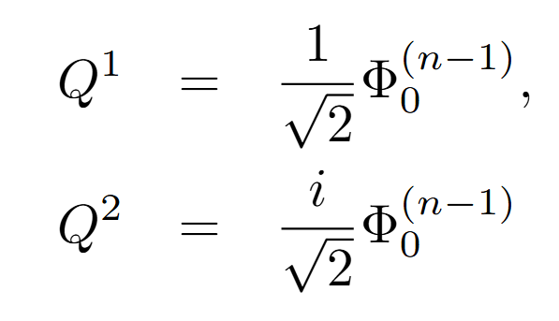
SU(2) Yang-Mills theory
Free charged gluon under chromo-magnetic field:
EoM:
Laguerre function
Solution in the x-y plane in infinite system:
Spin –up polarization vector:
LLL

Slide 9
Effective Lagrangian of LLL
Only consider the 1- and 2- component of the vector field $Q_{μ}/Q_{μ}^{∗}$, and define:
$$W_{+}=\frac{1}{\sqrt{2}}(Q_{1}+iQ_{2})$$
$$W_{−}=\frac{1}{\sqrt{2}}(Q_{1}−iQ_{2})$$
Now the Lagrangian:
$W_{+}$ has negative square mass while $W_{−}$ is normal, i.e., $W_{+}$ dominant:

Slide 10
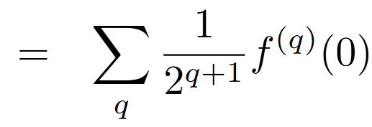
Field expansion
Only l=0 gives Tachyon mode
Integral over x-y plane:
The free part:
the interaction term:
Notice
Thus:

Slide 11
Only n=0 contributes
…
The effective Lagrangian:
The effective Lagrangian of LLL(l=0, n=0):

Slide 12
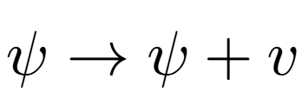
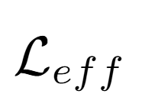
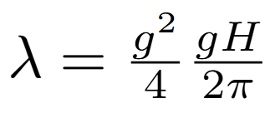
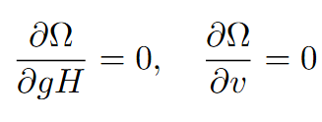
Higgs Mechanism
Effective mass:
Self energy:
Thermodynamical potential:
Of order λ

Slide 13
Finite size: $Φ\left(\frac{1}{2}gHR^{2}\right)=0$
Confluent hypergeometric function
Dispersion relation:
Where λ is the zero-point of Confluent hypergeometric function
is the normalization constant
Effective Lagrangian of LLL at finite size:
Where $ξ$ is the first zero-point of $_{1}F_{1}(ξ,1,\frac{1}{2}gHR^{2})$, and $N_{0,0}$ is the normalization constant for LLL
if $ξ>1/2$, Tachyon mode disappears.

Slide 14
Rotation
$ω$: angular velocity
Rotating gluon EoM:
Replacement: $E→E+(n±1)ω$
And for LLL(n=0): $E→E−ω$
The Bose-Einstein distribution:
$$f=\frac{1}{e^{\frac{E}{T}}−1}$$
$$f=\frac{1}{2}\frac{1}{e^{\frac{E+ω}{T}}−1}+\frac{1}{2}\frac{1}{e^{\frac{E−ω}{T}}−1}$$

Slide 15
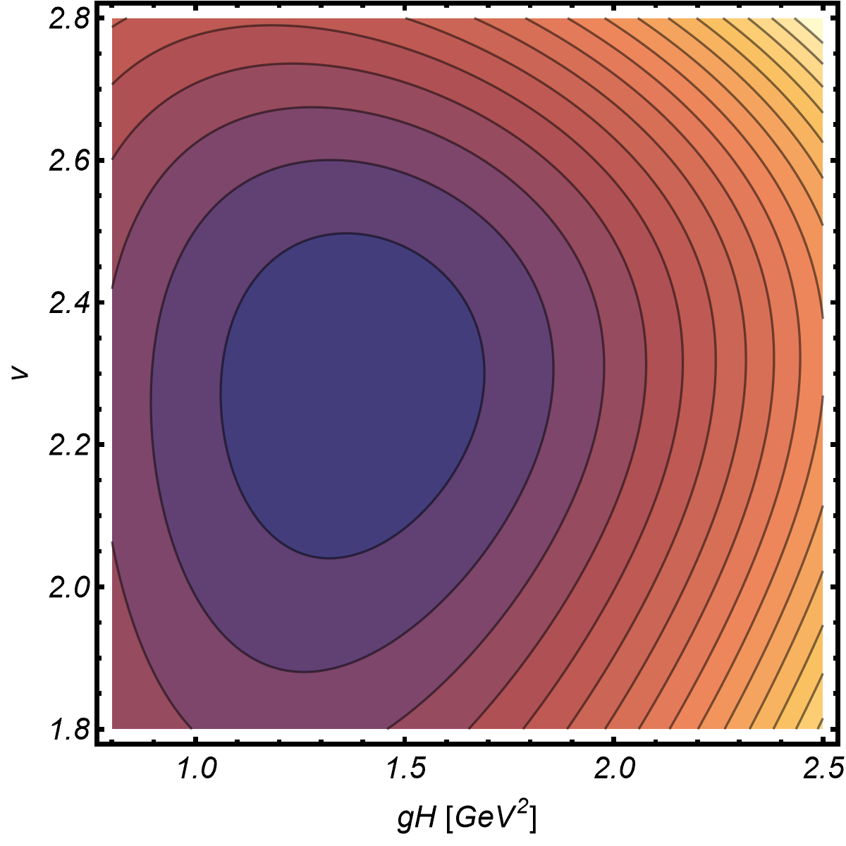
Numerical results
The minimal is located at non-zero gH and non-zero v.
i.e., a chromo-magnetic field is spontaneously generated,
and gluons possess mass.
Effective potential as a function of gH and v
T=0

Slide 16
gH and v as a function of temperature
R=0.6fm, $ω=0$
A phase transition(seems first order) occurs at high temperature, temperature destroys condensates!
Thermal mass from loop

Slide 17
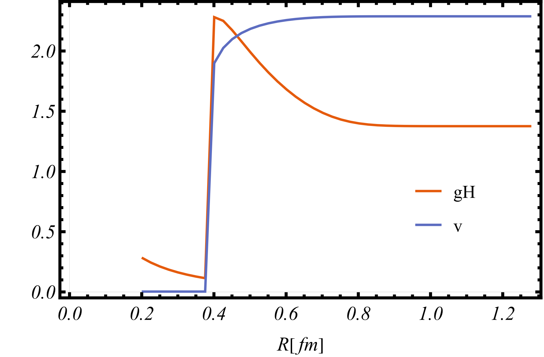
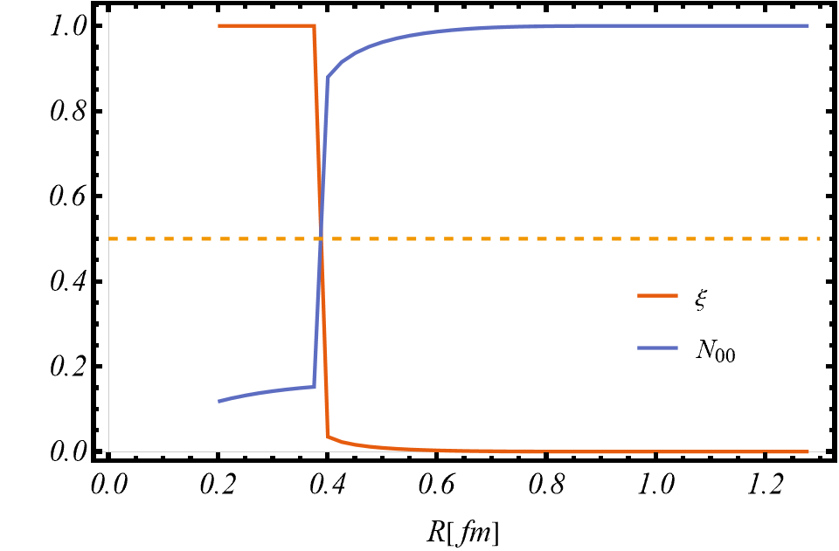
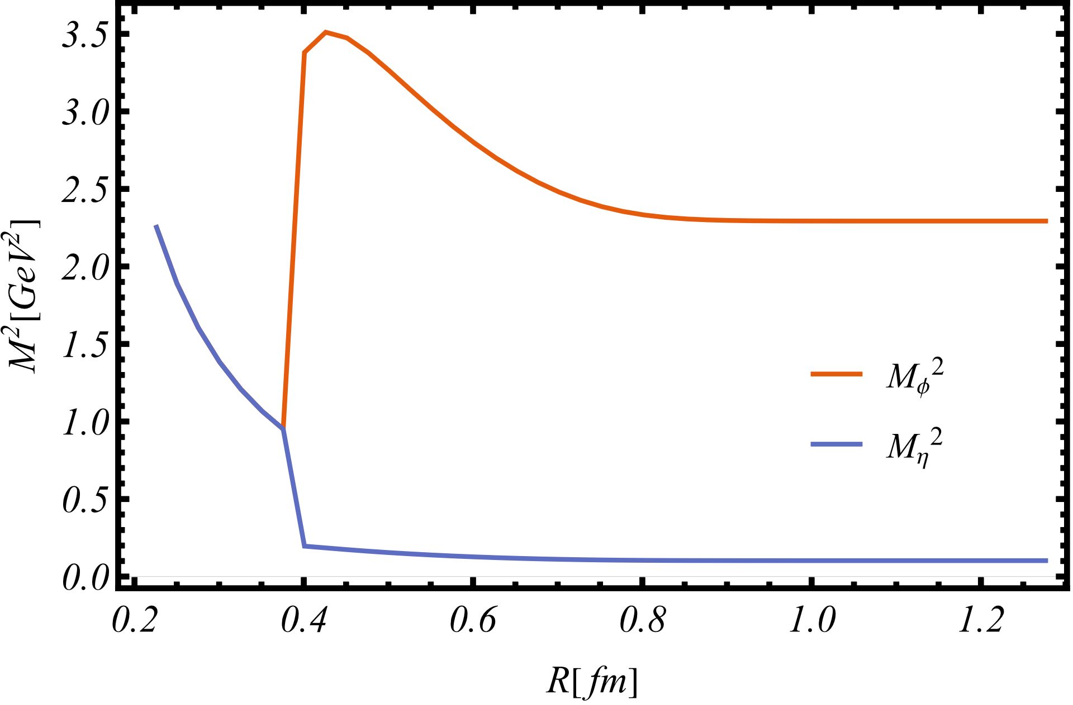
For large size $R≳0.4fm$,as the size increases, gH decreases, while v increases. Both saturated at infinite size.
What happened at $R\sim 0.4fm$
$$E^{2}=\left(2ξ−1\right)gH+p_{z}^{2}$$
For small enough system, $ξ>1/2$
Tachyon mode disappears! In small system!
For large size $R≳0.4fm$, One is Goldstone particle.
Another obtains mass, and decreases with size.

Slide 18
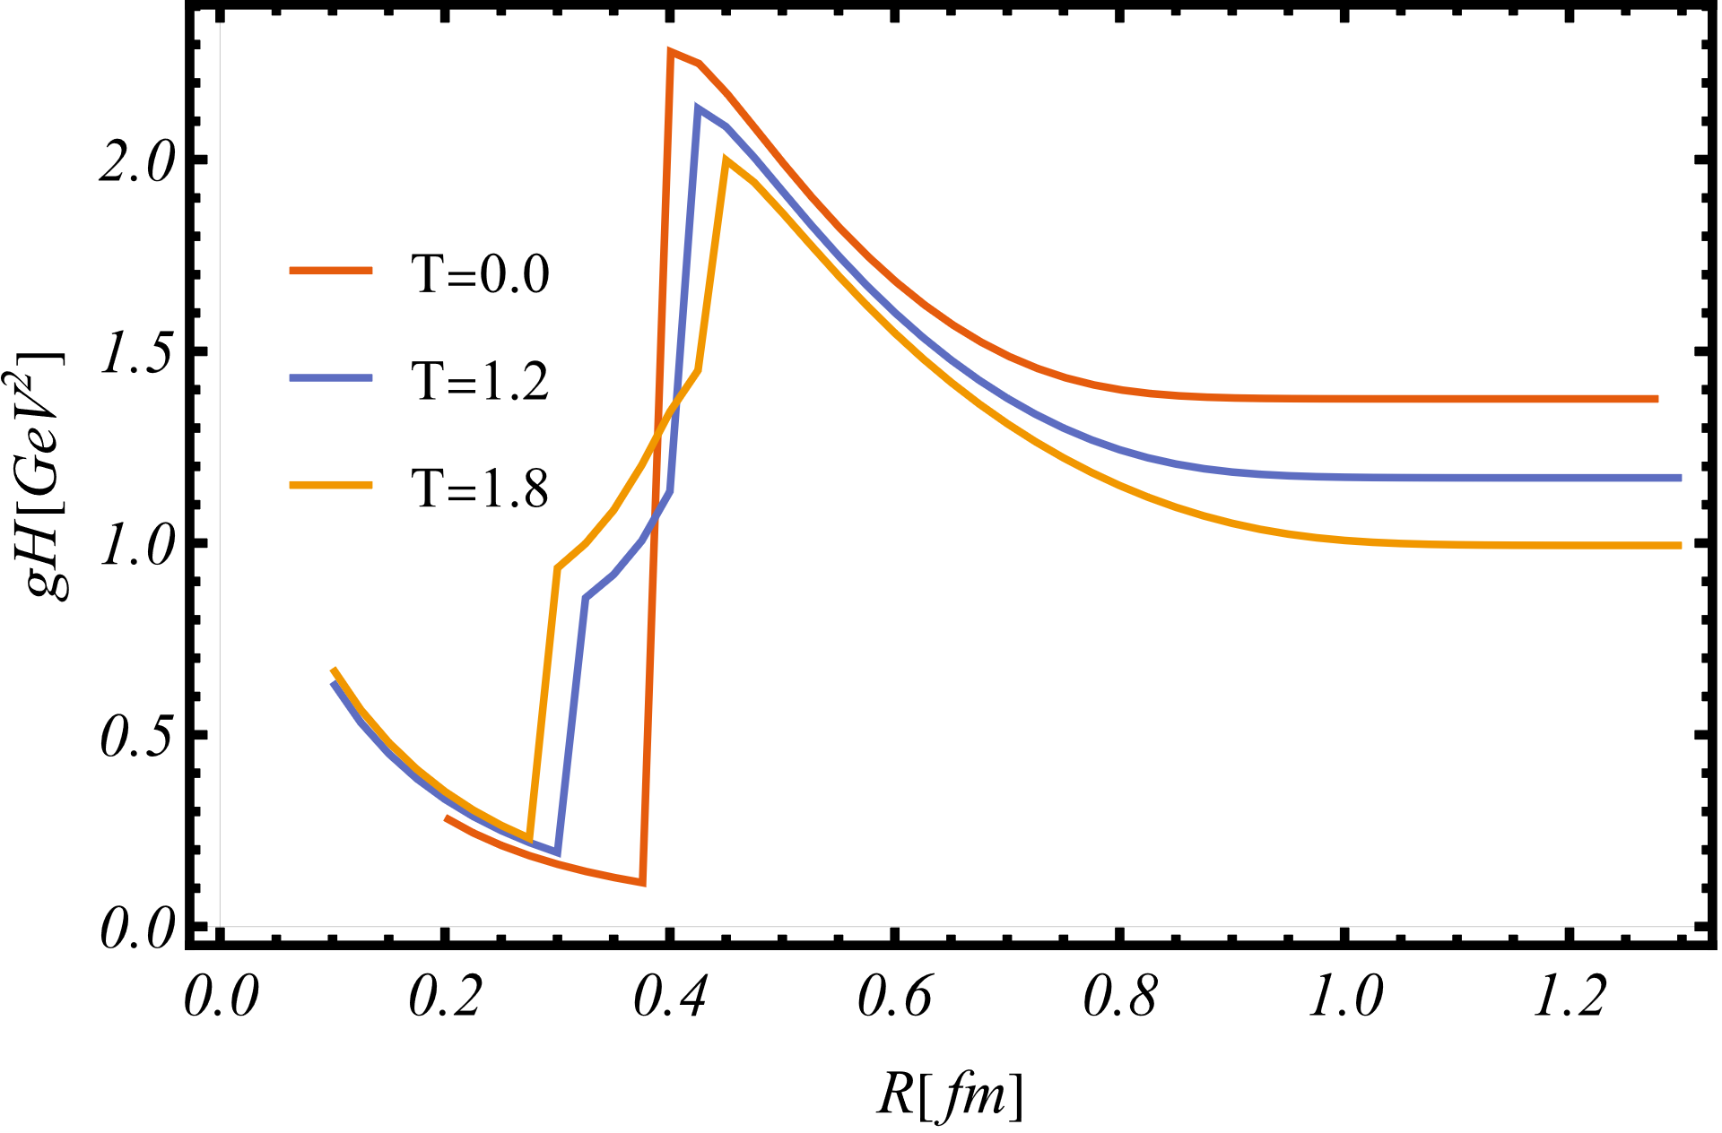
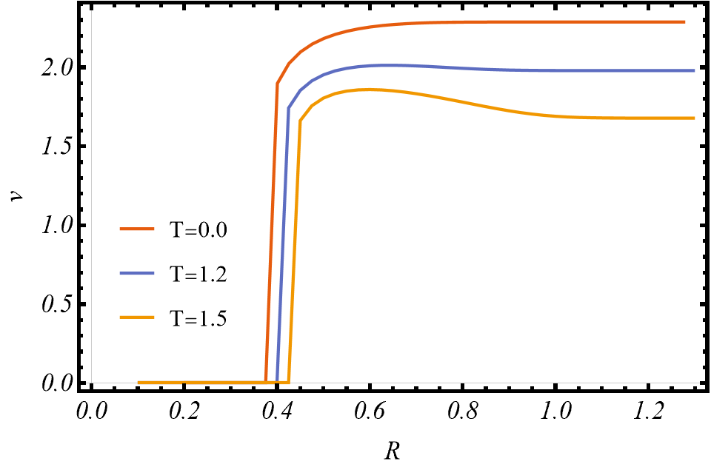
gH and v as a function of the radius of system

Slide 19
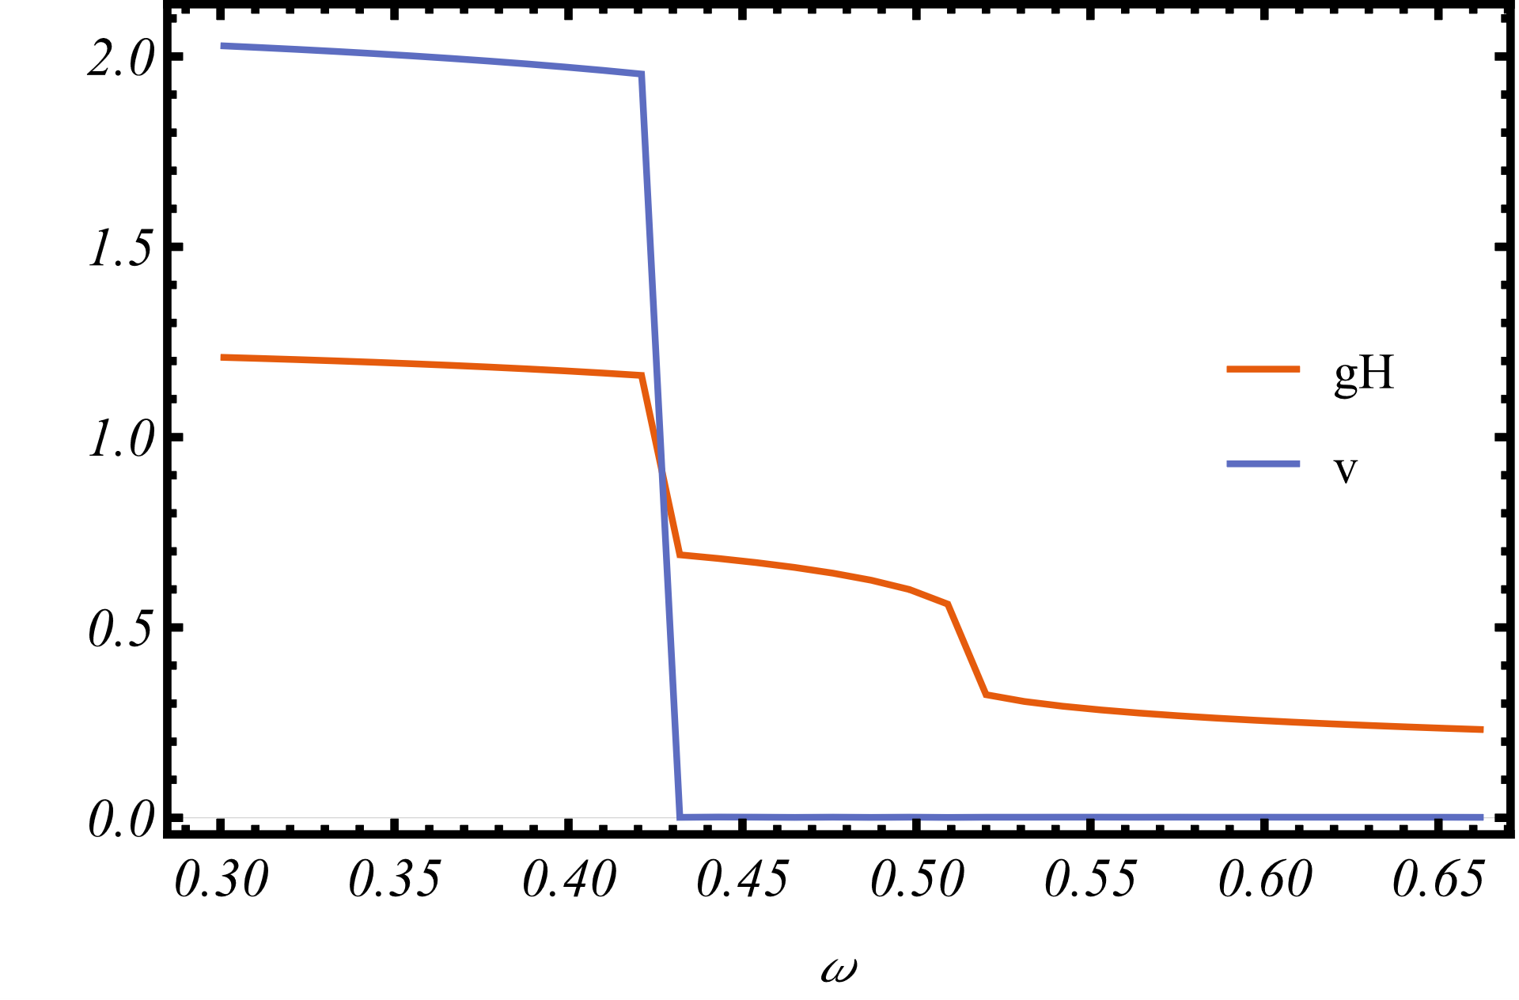
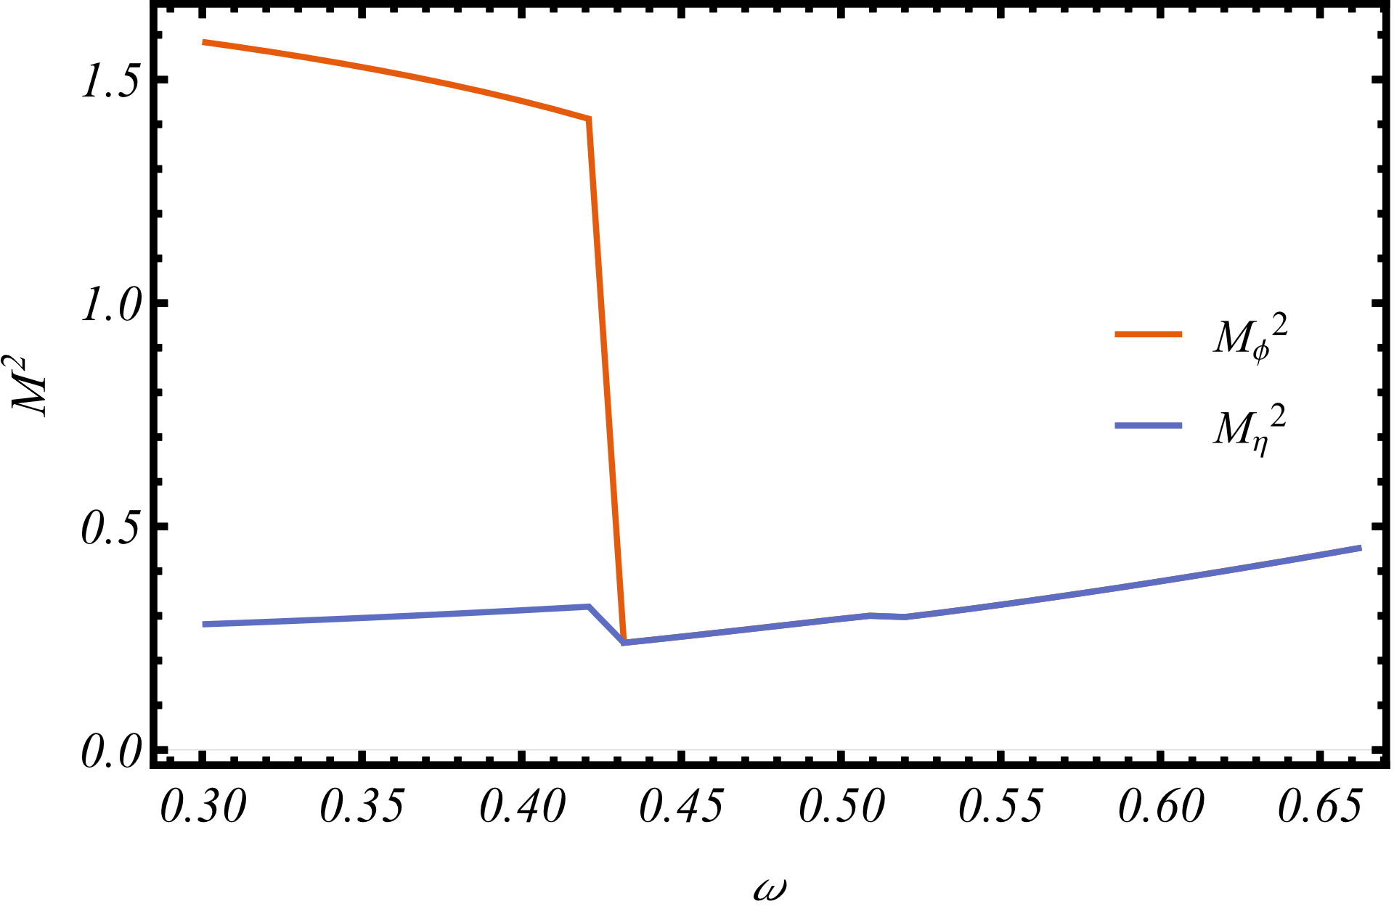
As a function of angular velocity
$T=1GeV$, $R=1.5fm$
A phase transition occurs at finite angular velocity,
i.e., rotation destroys condensates! Just like quark/chiral condensate.

Slide 20
Possible implications
To spin alignment: a chromo-magnetic field is present in HIC, which could lead to $ρ_{00}>\frac{1}{3}$. Also spin polarization.
IMC: electro-magnetic field induce chromo-magnetic field via quark loop.
CME
Meson mass, with both quark and gluon under considered.
……
Thank you!
Next
SU(3)
Polyakov loop
……

Slide 21
BACKUP

Slide 22
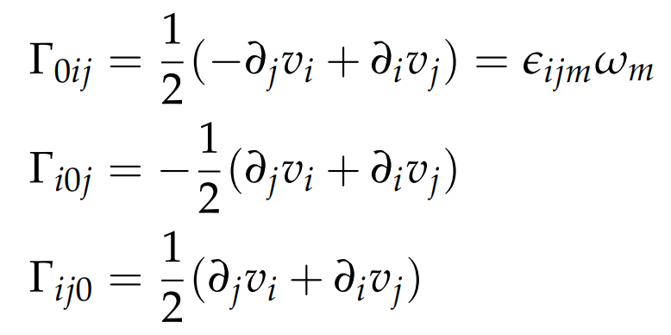
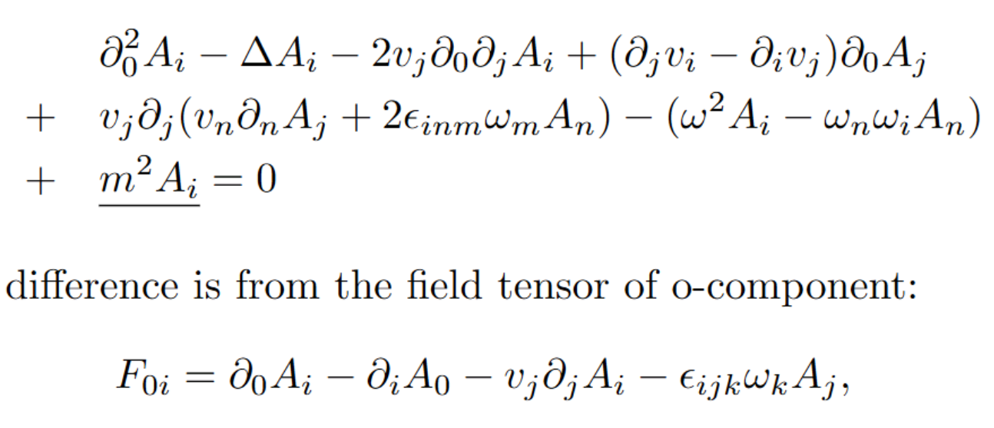
Vector particle under rotation
Reference:
Chernodub:1807.10705
Yin Jiang:2106.04851
XG Huang:2006.03591
define
EoM
Bessel function
Spin-up and spin-down
The only effect of Rotation on spin-1 particle
In cylindrical coordinate

Slide 23
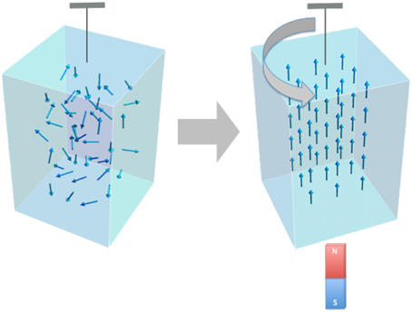
Rotation enhances magnetic field
Barnett effect
Magnetization by Rotation

Slide 24
Future improvements
SU(3)
Gluon mass.
Gluon interaction and two-loops
Quark loop to gluon
Quark induces chromo-magnetic field
Dyson-Schwinger equation
…

Slide 25
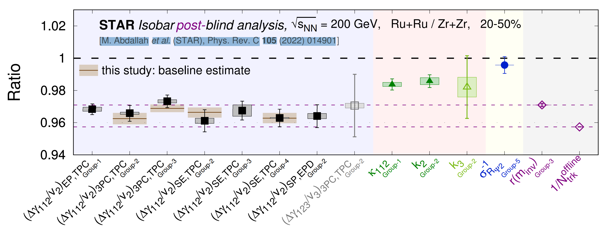
Magnetic field: QCD v.s. QED
color charge electric charge
u1 quark + +
u2 quark - +
Chromo-magnetic field weakens electro-magnetic field (effectively)
Competition! Could induce non-monotonic behavior
SU(3), more complicated…
May explain the different
background in isobar collision

Slide 26
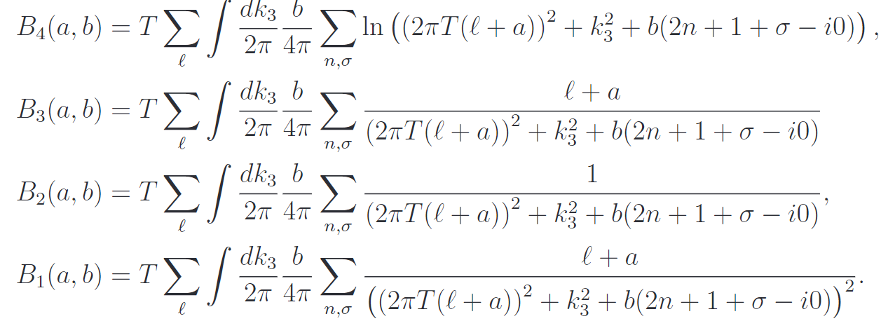
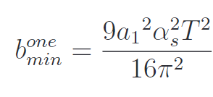
2305.00757
Chromo-magnetic field generated spontaneously
Background field method
the effective potential
Related to Polyakov-loop
Chromomagnetic field
(1) The magnetic field at high temperature:
(2) For pure A0:

Slide 27
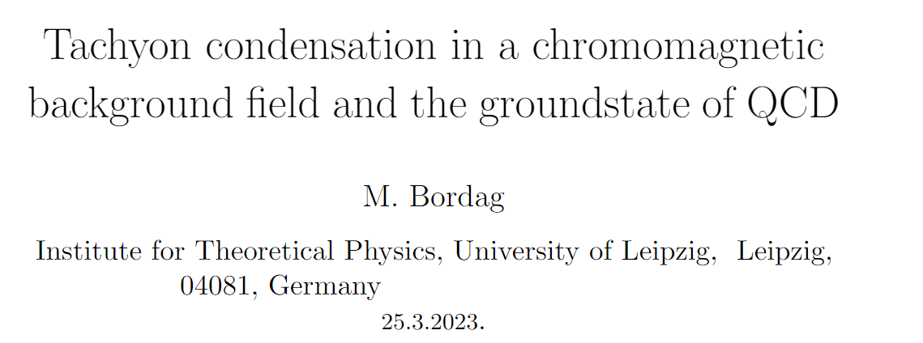
2305.00757
1910.00654
/hep-ph/0110280
2207.08711

Slide 28
Firstly, physical picture
Why chromo-magnetic field spontaneously generated
Magnetic susceptibility: paramagnetism v.s. diamagnetism
Scalar, spinor, vector particle
Orbital v.s. Spin angular momentum

