Slide 1
Introduction of Particle Physics
Yifang Wang
Institute of High Energy Physics
Kaiping, July 5, 2024

Slide 2

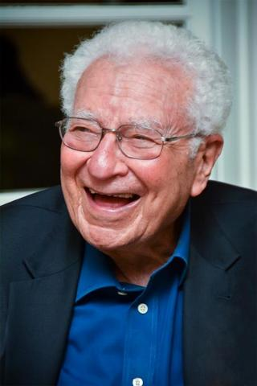

Particle Physics: Looking for Ultimate Structure of Matter
In 50’s to 60’s, hundreds of new particles were discovered
In 1964，Gell-Mann et al. postulated that these particles are made up of more fundamental elements: Quarks
In the Gell-Mann’s Model, there are 3 types of Quarks：up(u), down(d) and strange(s)
−
π⁺(ud )
K⁺(us)
Mesons are made of quarks and anti-quarks
−
Proton(uud)
Baryons are made of 3 quarks
Neutron(udd)
Why only three type of quarks ? More ?
Why only two types of hadrons? More ?
M. Gell-Mann

Slide 3
Achievements: Building Blocks of Matter
  In 1974年，Ting and Richter discovered J/Ψ
  (c‾c ), mc ~ 1.5GeV
Heavier
Charge
  In 1977，Lederman discovered ϒ ( 9.5GeV )
  (b‾b ), mb ~ 5GeV
+2/3
u
c
t
  In 1995, CDF、D0 discovered Top quark
  (t)，mt ~ 173GeV
In addition to quarks, another type of elementary particles: Leptons
-1/3
d
s
b
In 1897， J.J. Thomson discovered electrons
In 1936，Anderson discovered muons
e
μ
τ
In 1956， Renies discovered ν_{e}
-1
In 1962， Lederman et al discovered ν_{μ}
ν_{e}
ν_{μ}
ν_{τ}
In 1975， Perl discovered tau lepton (τ)
0
In 2000，DONUTexperiment discovered ν_{τ}
3 generations
I II III
In 1990，LEP discovered that there exist only three generations

Slide 4
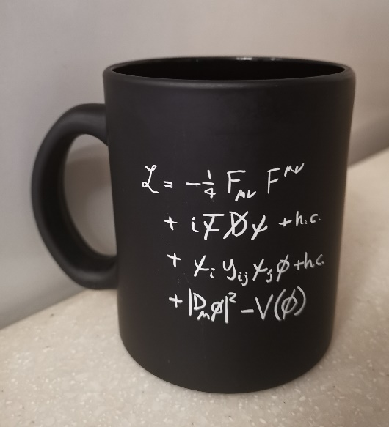

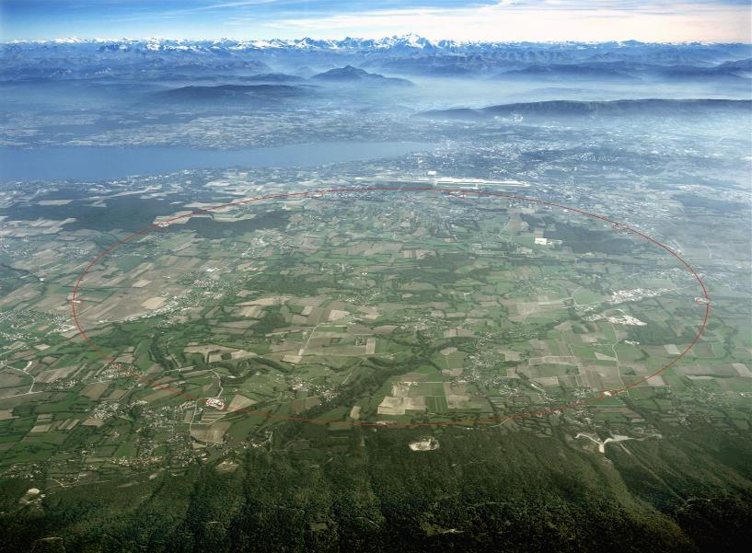

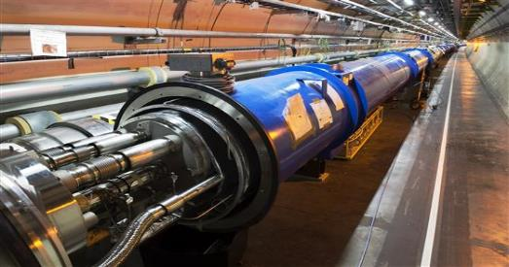
Standard Model of Particle Physics
Matter are made of quarks and leptons:
Interactions are mediated by particles:
photons — electromagnetic
W± & Z — weak
Gluons — strong QCD
Origin of mass:
Higgs
electroweak

Slide 5
Great Success of Particle Physics
  Since 60’s, Standard Model was established（8 times of Noble Prize ）
  all elementary paticle were discovered, in great agreement with the Standard Model （9 times of Nodel prize ）
  Accelerator and detector technologies（3 times of Nobel prize ）
  great contributions to the understanding of the origin and evolution of the Universe and its Standard Model（3 times of Noble Prize ）
question：
End of Particle Physics ？
Where are opportunities ?

Slide 6
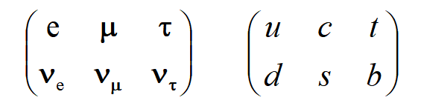
粒子物理未来发展方向：基本粒子还能再分吗 ？
这里的味对称让我们有极为自然的联想：
这些费米子存在更深层次的结构
但复合模型等尝试均不太成功

Slide 7
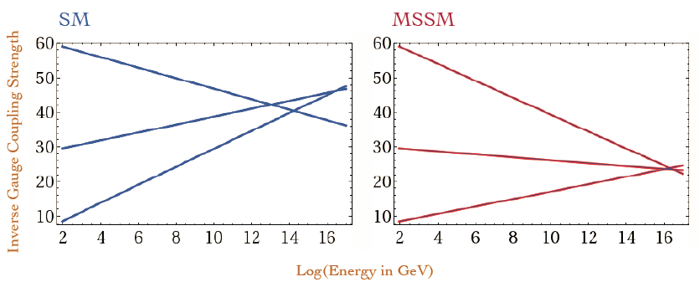
粒子物理未来发展方向：大统一 ？
在电弱统一的基础上，还能有电弱 + 强作用的大统一吗 ？
  SU(5)，超对称(supersymmetry)，超维(Extra-dimension)……
  已有实验证据表明需要这样的大统一理论，标准模型是不完备的
  需要新的实验证据 ➔ 新的大加速器
再大统一：电弱 + 强 + 引力 作用
  超弦理论（string，superstring）
  目前无法通过实验证明

Slide 8
粒子物理未来发展方向：宇宙学对粒子物理的挑战
粒子物理标准模型里没有暗物质粒子的位置
粒子物理标准模型无法解释为什么宇宙中反物质会消失
研究新的理论
寻找新的实验现象
1、新的引力理论
完善牛顿定律或广义相对论的适用范围，以在新理论中避免暗物质、暗能量的引入
1、在空间与地下寻找暗物质粒子
2、在空间中寻找反物质
3、寻找新的反物质与物质之间衰变行为的不同：基于加速器或中微子的实验
2、新的粒子物理理论
包容暗物质暗能量
引入更大的物质-反物质不对称性

Slide 9
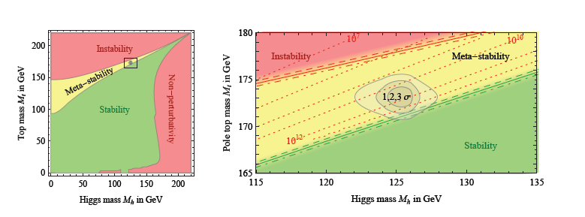
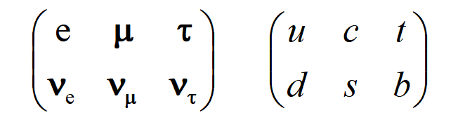
粒子物理标准模型的“问题”
实验
  中微子质量不为零
  W粒子质量等许多3-4σ 的偏差
理论：
    真空不稳定 ？
    味对称的来源 ？
    希格斯粒子质量来源及其精细调节
    基本粒子质量之间的巨大差距
    标准模型参数的精细调节 ？
    暗物质粒子 ？
    宇宙中正反物质不对称 ？
标准模型只是一个能标达0.1-1.0 TeV的有效理论
质量是中心问题

Slide 10
Current Experiments in the World
China-based
China-participated
Others
Higgs: ILC,FCC,
CEPC/SPPC
LHC: ATLAS/CMS
High Energy
Compositeness
AMS, PAMELA
Extra-dimension
super-symmetry
Anti-matter
Neutrinos：Daya Bay, T2K,Nova, SuperK, JUNO, HyperK, DUNE,
PINGU, ORKA, SNO+,EXO/nEXO, KamLAND-Zen, Gerda,Katrin…
Higgs
CP Violation
COMET, mu2e, g-2,
K-decays,…
Standard Model
（SM）
Precision measurement
Neutrinos
Quarks and Hadrons:
BESIII,LHCb,BELLEII,
PANDA,…
rare decays
Standard Model of Cosmology
hadron Physics and QCD
Cosmology
Dark matter
LUX, Xenon, LZ, PandaX, CDEX, Darkside, …
Axions
High Precision
ADMX,…
Fermi, DAMPE, AMS,…

Slide 11
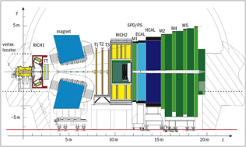
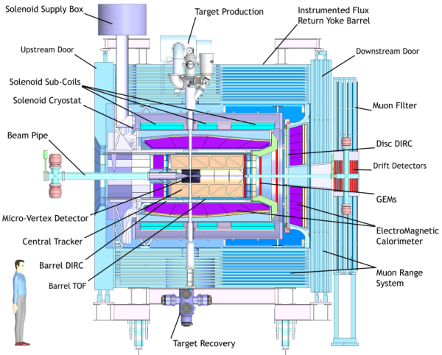
I. Quarks and Hadrons
BESIII at BEPCII (2009 – 2030)
  Threshold production of charmed hadrons, rich gluons
  Achievements：new light hadrons, 4-quark states (~ 30)
LHCb (p on target）at LHC in CERN (2010 - )
  Higher energy, higher hadron yield，higher backgrounds
  Achievements：DDbar mixing, 5-quark states, 4-quark states (~60)
PANDA(ppbar collider) at FAIR in GSI (2030 - )
  higher hadron yield，higher backgrounds
BELLE II（e⁺e⁻ collider @~10 GeV）at KEK in Japan (2020 -)
  Higher energy，higher luminosity
GlueX (e on target) experiment at Jlab in the US

Slide 12
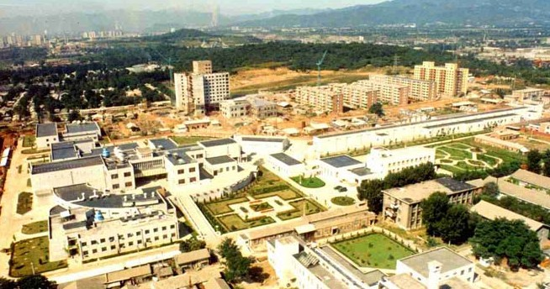
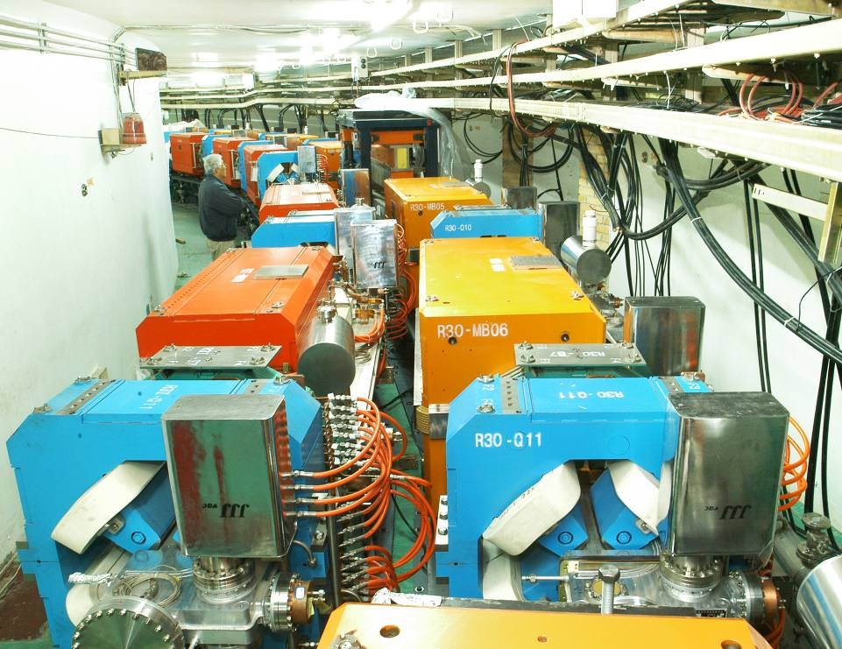
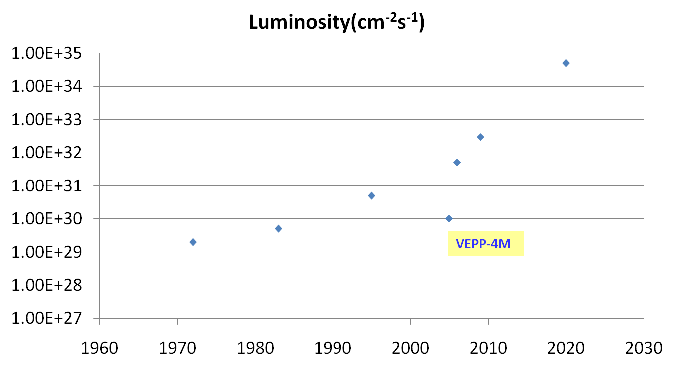
Quarks：Beijing Electron-Positron Collider（BEPC）
Beginning of Particle Physics in China
Construction of BEPC: 1984-1988
Upgrade of BEPC: 2004-2009
For physics of light hadrons, exotic hadrons, QCD study and SM test
BEPCII
BEPC
DORIS I
CESRc
SPEAR
ADONE

Slide 13
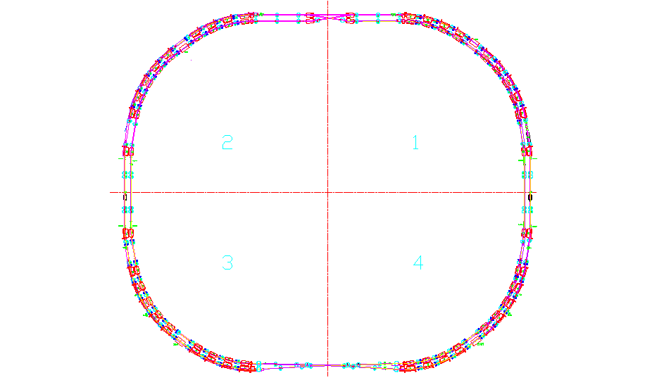
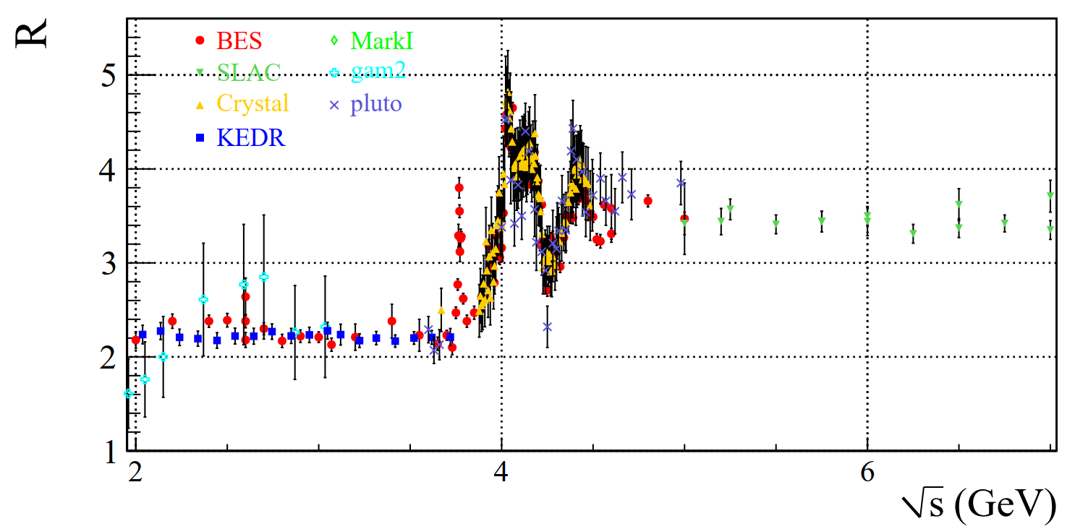
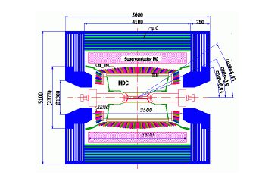
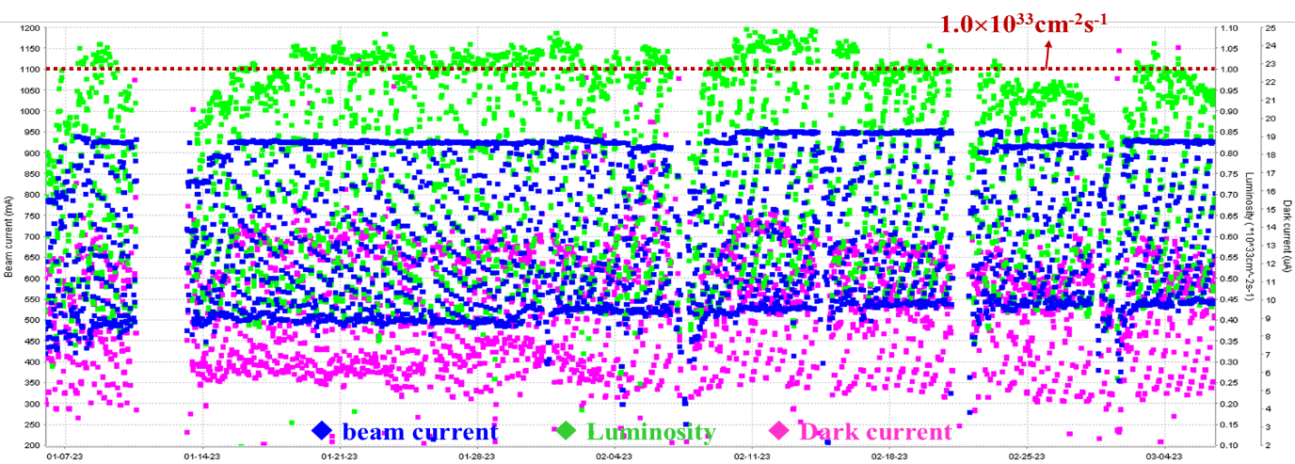
BEPCII/BESIII
13

Slide 14
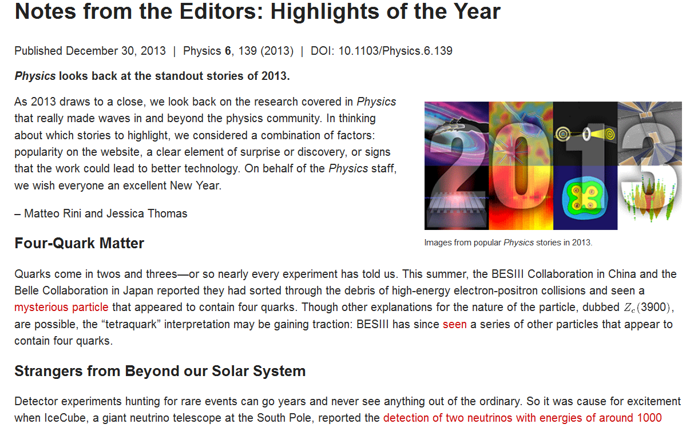
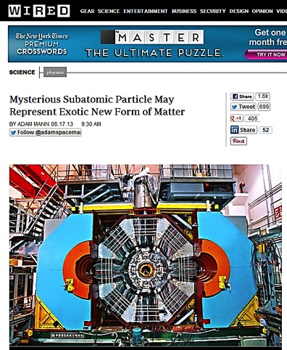
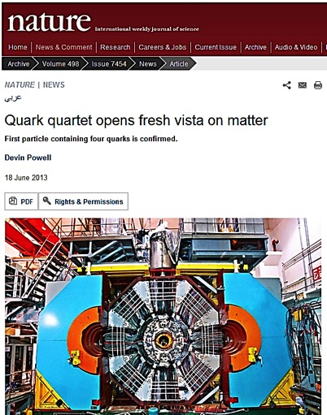
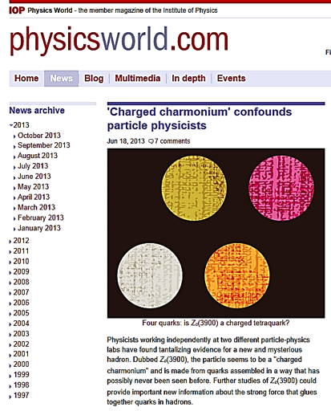
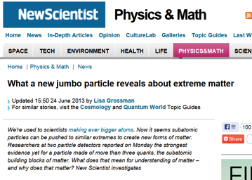
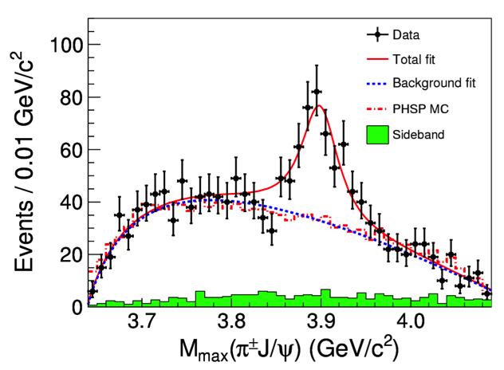
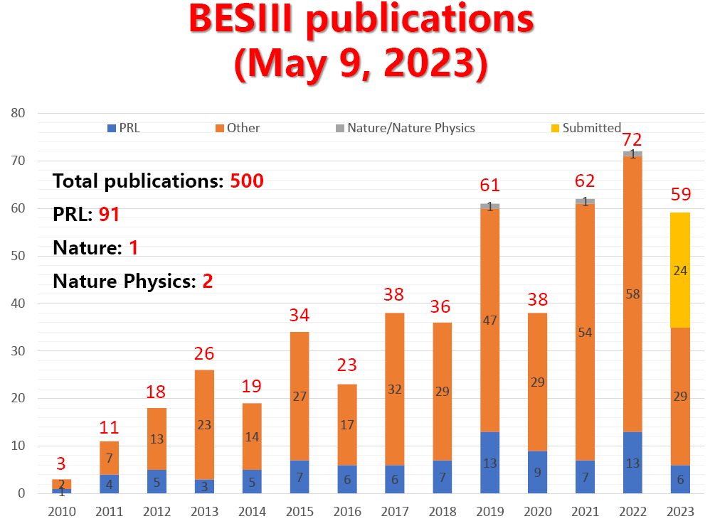
Great results from BEPCII/BESIII
New hadrons were searched for in the last 50 yrs
In 2013, BESIII discovered 4-quark states Z_{c}±(3900) ，and Z_{c}⁰(3900), Z_{c}⁰(4020), Z_{cs}(3985) afterwards，provided strong evidence for the existence of exotic hadrons
  Well covered by international media
  Top results of 2013 selected by“Physics”of APS
  Citation >1000
BESIII: PRL 110, 252001 (2013)
Z_{c}±(3900)
PRL110, 252001 (2013)

Slide 15
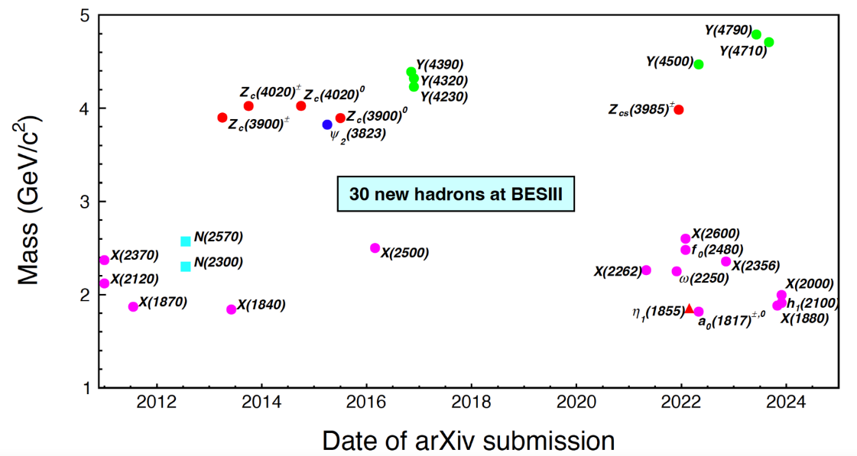
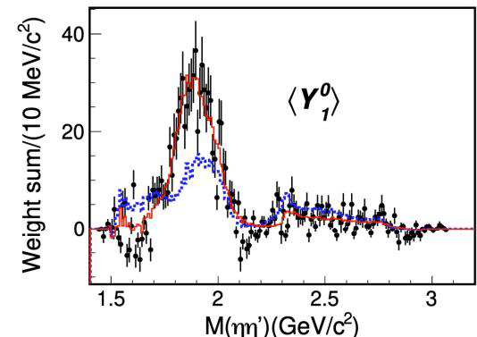
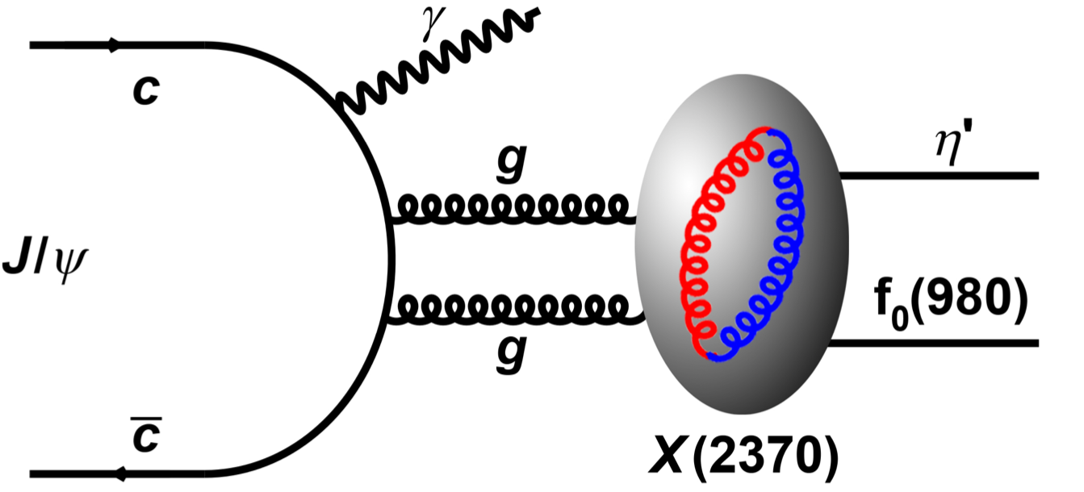
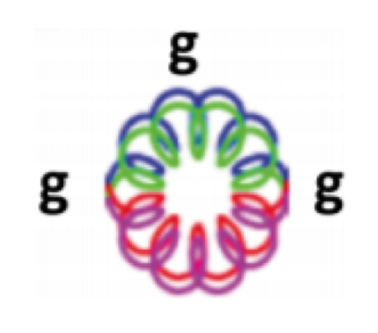
Highlights：30 New Hadrons Discovered at BESIII
Isoscalar 𝟏⁻⁺ 𝛈_{𝟏}(𝟏𝟖𝟓𝟓)
Hybrid/Molecule/Tetraquark?
PRL 129 192002(2022), PRD 106 072012(2022)
Glueball ？
“force” particle ！

Slide 16
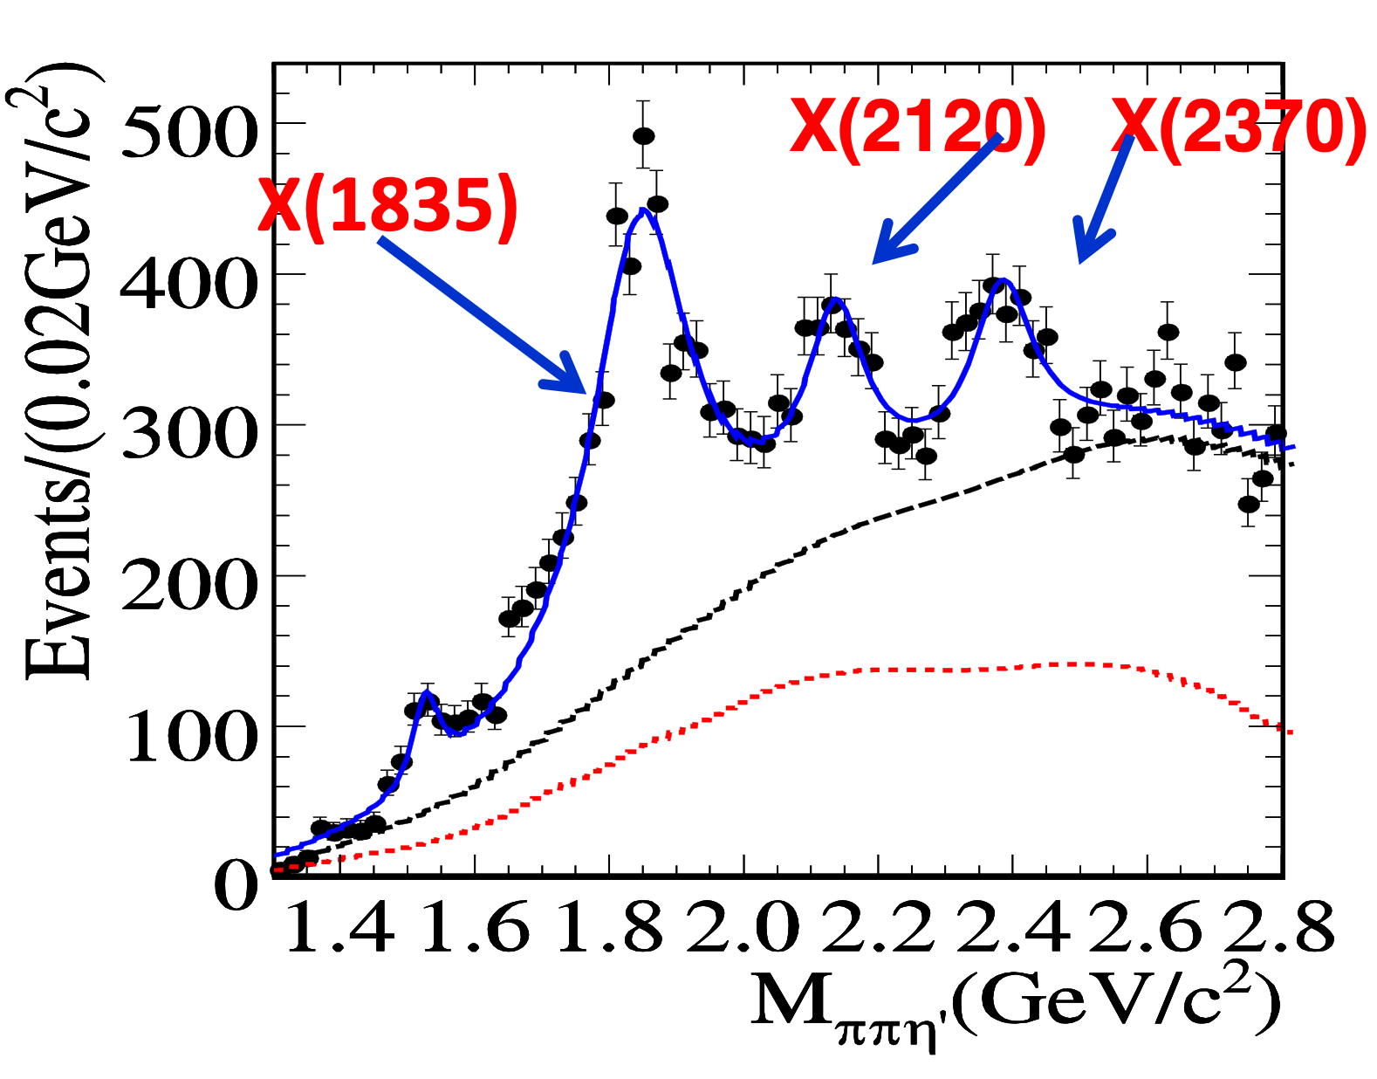
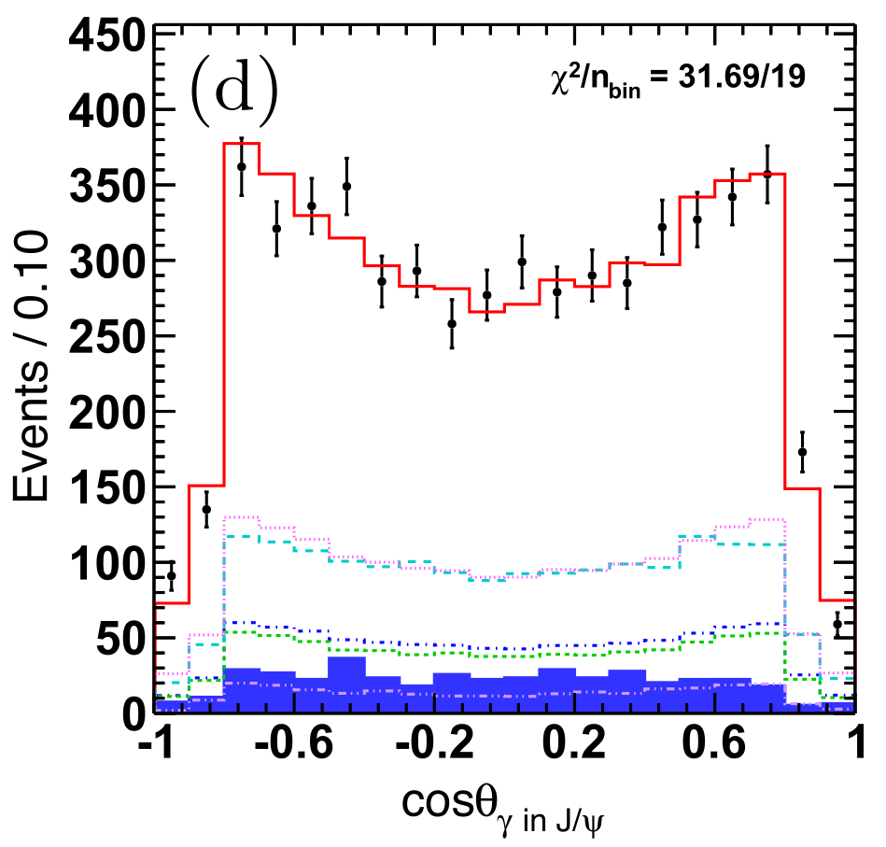
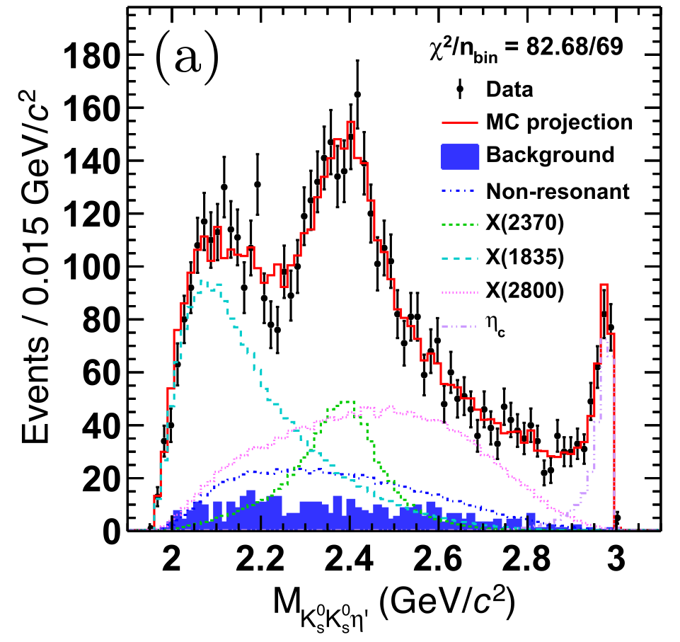
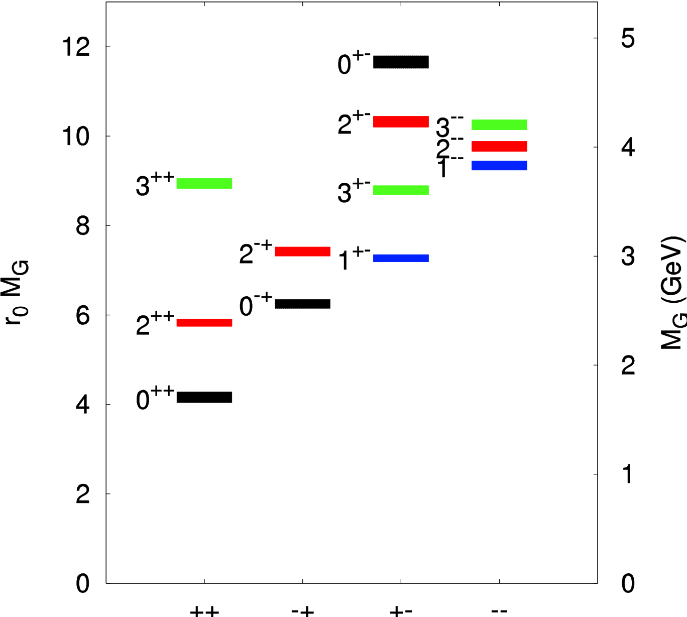
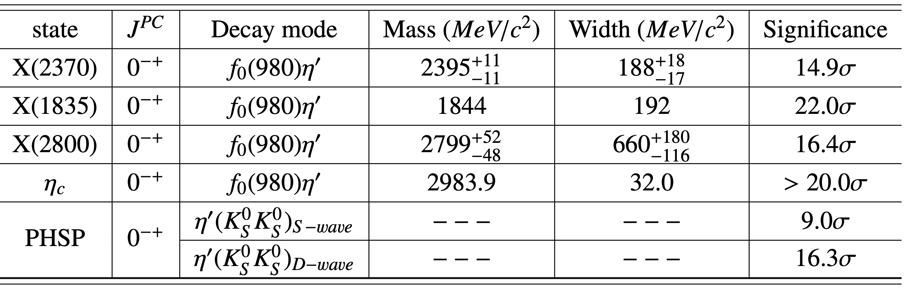
Highlights：A Glueball-like Particle: X(2370)J^{PC}=0⁻⁺
PRL 106, 072002 (2011)
PRL 132 (2024) 181901
LQCD prediction on glueball
Produced in J/ψ radiative decay; flavor symmetric decay modes

Slide 17
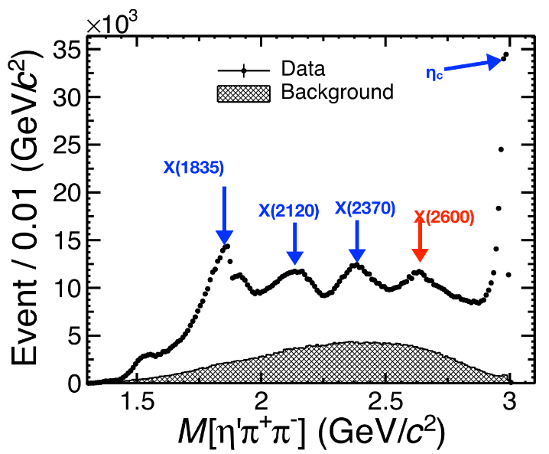
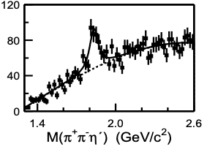
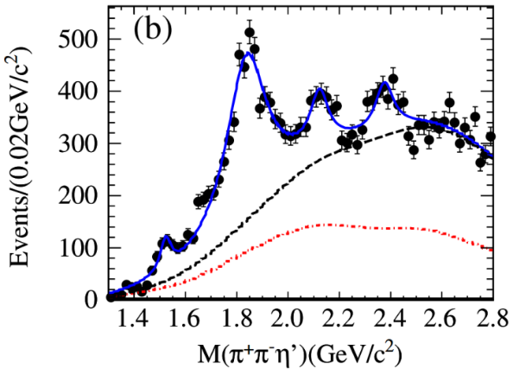
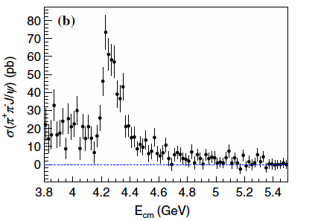
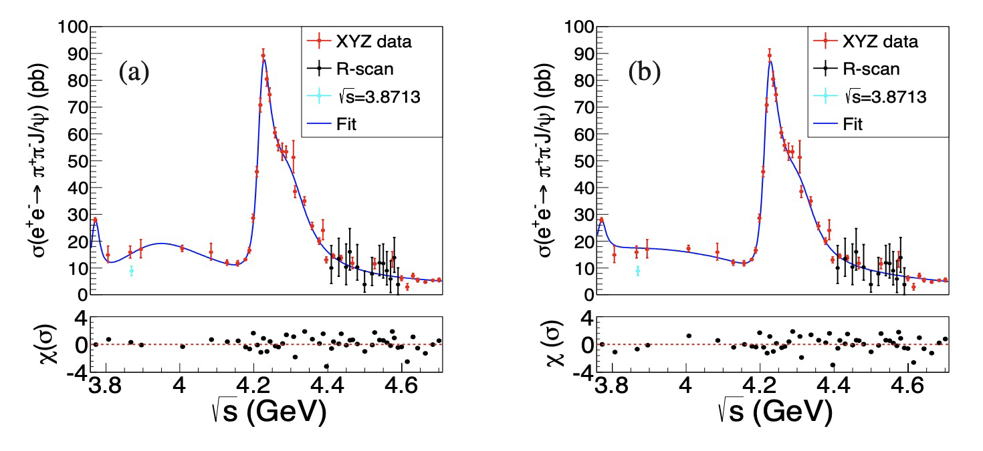



Highlights：More Data ➔ Fine Structures
220 Million J/$ψ$
10 billion J/$ψ$
PRL129 (2022) 042001
58M J/$ψ$
PRL95(2005)262001
PRL106, 072002 (2011)
BESIII
BESIII
BESII
Y(4260)
Belle Resolution: about 5-10 MeV
BESIII Resolution: 1 - 2 MeV
Phys.Rev.D 102 (2020) Phys.Rev.Lett. 118 (2017)

Slide 18
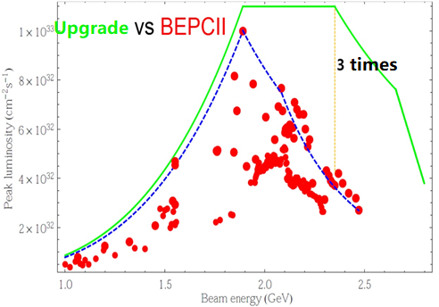
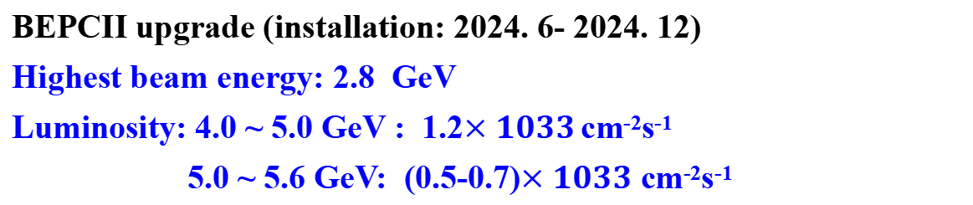
Future of BESIII
BEPCII upgrade (installation: 2024. 6- 2024. 12)
Highest beam energy: 2.8 GeV
Luminosity: 4.0 ~ 5.0 GeV : 1.2$×1033$ cm⁻²s⁻¹
5.0 ~ 5.6 GeV: (0.5-0.7)$×1033$ cm⁻²s⁻¹
arXiv:1912.05983 : Chin.Phys. C44 (2020) no.4, 040001
Another 6 years running to collect >60 fb⁻¹ data at different energies .

Slide 19



BESIII Collaboration
Europe (17/115)
Germany (6): Bochum University,
GSI Darmstadt, Helmholtz Institute Mainz, Johannes Gutenberg University of Mainz, Universitaet Giessen,University of Münster
Italy (3): Ferrara University, Frascati, University of Torino
Netherlands (1):KVI/University of Groningen
Poland (1)National Centre for Nuclear Research
Russia (2): Budker Institute of Nuclear Physics, Dubna JINR
Sweden (1):Uppsala University
Turkey (1):Turkish Accelerator Center Particle Factory Group
UK (2): University of Manchester, University of Oxford
Asia (6/10)
Pakistan (2): COMSATS Institute of Information Technology
University of the Punjab, University of Lahore
Mongolia (1): Institute of Physics and Technology
Korea (1): Chung-Ang University
India (1): Indian Institute of Technology madras
Thailand (1): Suranaree University of Technology
USA(4/8)
Carnegie Mellon University
Indiana University
University of Hawaii
University of Minnesota
China (58/367)
Institute of High Energy Physics (146), other units(221): Beijing Institute of Petro-chemical Technology, Beihang University,
China Center of Advanced Science and Technology, Fudan University,
Guangxi Normal University, Guangxi University,
Hangzhou Normal University, Henan Normal University,
Henan University of Science and Technology,
Huazhong Normal University, Huangshan College, Hunan University,
Hunan Normal University, Henan University of Technology
Institute of modern physics, Jilin University, Lanzhou University, Liaoning Normal University, Liaoning University, Nanjing Normal University, Nanjing University, Nankai University, North China Electric Power University,
Peking University, Qufu normal university, Shanxi University,
Shanxi Normal University, Sichuan University, Shandong Normal University,
Shandong University, Shanghai Jiaotong Univeristy, Soochow University,
South China Normal University, Southeast University, Sun Yat-sen University,
Tsinghua University, University of Chinese Academy of Sciences, University of Jinan, University of Science and Technology of China,
University of Science and Technology Liaoning,
University of South China, Wuhan University, Xinyang Normal University,
Zhejiang University, Zhengzhou University,YunNan University , China University of Geosciences
South America (1/1)
Chile: University of Tarapaca
~600 members
(more than 130 from outside of China)
From 84 institutions in 17 countries
Notes:
The Collaboration is well organized fully following the international practice
for large experiments

Slide 20
II. 中微子
中微子是构成物质世界的最基本单元之一：
奇怪的中微子：只有左旋中微子 ➔弱作用宇称不守恒
粒子物理标准模型：中微子质量为零
    中微子螺旋性测量
宇宙学标准模型: 中微子质量不为零
    宇宙大尺度结构的要求
    宇宙中的中微子~ 300/cm³，其质量对宇宙学有重要影响
中微子有质量吗 ？

Slide 21
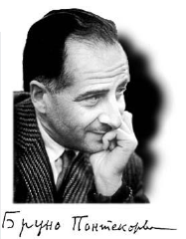
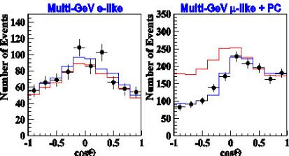
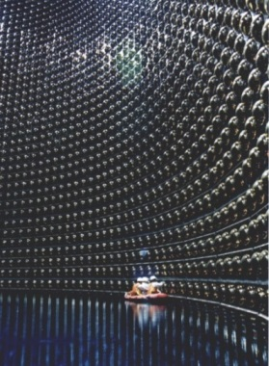
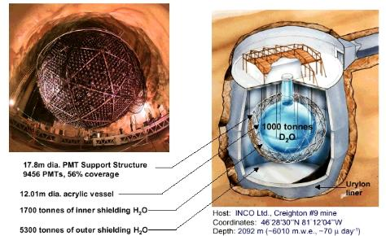
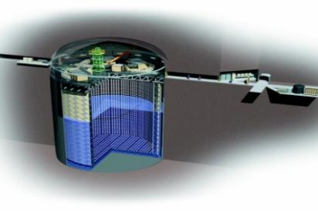
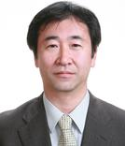


中微子振荡：确定中微子是否有质量的最灵敏办法
20世纪50、60年代
布鲁诺·庞蒂科夫等提出中微子之间可以发生振荡：一种中微子在飞行过程中可以变为另一种中微子
1998年，日本“超级神冈”实验发现大气中微子振荡
2002年，加拿大SNO实验发现太阳中微子振荡
梶田隆章
阿瑟·麦克唐纳
中微子有质量是超出标准模型的新物理 ！

Slide 22
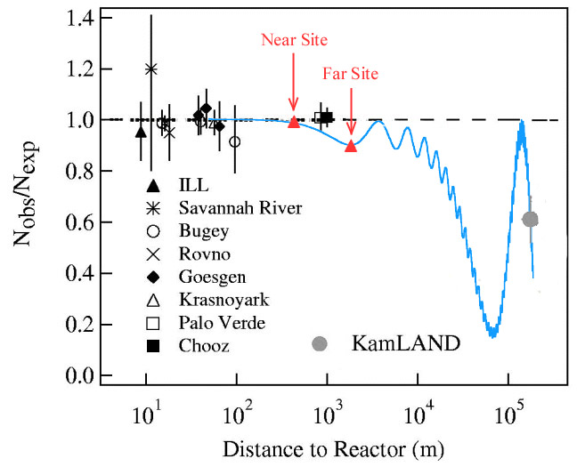
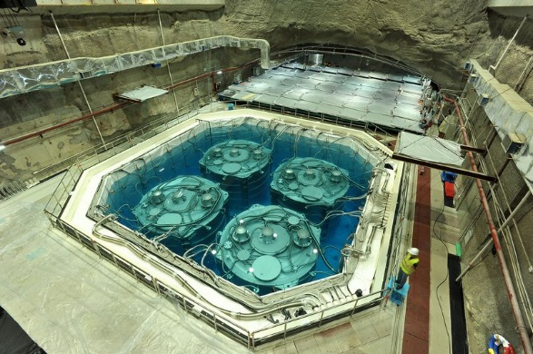
大亚湾实验：寻找新的中微子振荡
ν₁
ν₂
ν₃
θ₁₂ 太阳中微子振荡
θ₁₃ ?
θ₂₃ 大气中微子振荡
必须比过去的实验精度提高~10倍
  基本物理规律：完整的振荡图像
  基本物理参数：标准模型的28个参数之一
  决定未来中微子物理研究的方向
    如果θ₁₃太小，无法测量中微子的CP破坏
物质与反物质衰变速率不同，可以解释宇宙中为什么没有反物质 ！

Slide 23
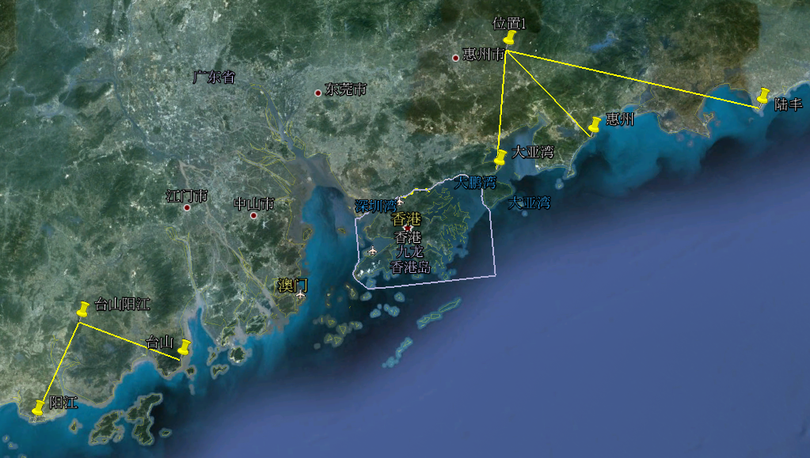
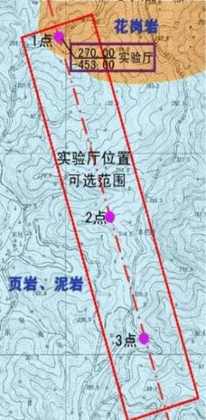
下一步: 江门中微子实验(JUNO)
方案：延续大亚湾实验的反应堆中微子和液体闪烁体技术路线
科学目标：确定中微子质量顺序(>3 σ ) ，测量中微子3个振荡参数(<1%)，研究超新星中微子、太阳中微子、地球中微子等，后期研究中微子双β衰变(中微子绝对质量)…
2008年提出，2013年立项，2015年开建，2025年完成
岩石覆盖层 ~ 700 m
大亚湾实验
江门实验
江门实验
台山
阳江

Slide 24




III. Higgs
欧洲核子中心（CERN）2012年发现希格斯粒子，解决了基本粒子质量的起源问题，完成粒子物理标准模型“最后一块拼图”
但仍有众多“乌云”有待解决，《科学》杂志(2005、2021)发布“125个最具挑战的科学问题”中，多个与希格斯粒子密切相关
奇怪的希格斯粒子：唯一自旋为0的基本粒子，新的非规范相互作用，与标准模型的许多“问题”有关
希格斯粒子是通往新物理体系的突破口
➔ 希格斯质量起源及其自然性问题，暗物质质量来源 ？
➔ 电弱对称性破缺
➔ 宇宙早期演化
➔ 连接暗物质的桥梁
宇宙早期电弱相变
正反物质不对称

Slide 25


Higgs：the Window to New Physics
A very special particle：
  The only elementary particle with spin 0
    Really elementary ？
    Similar to π, Cooper pair ?
      Higgs potential = Landau-Ginzburg potential
  The only elementary particle with non-gauge interactions: Self-coupling and Yukawa coupling
Directly related to physics beyond SM & Cosmology
  Origin of the mass of Higgs ?
  Why the vacuum is meta-stable ?
  Very probable to couple with dark matter
  Higgs potential shape determine the EW phase transition ➔ the evolution of the Universe
Goal: detailed and precise measurement of Higgs properties to understand these issues
Highest priority in EU and the US
Detailed study of Higgs can not be skipped

Slide 26




Best Approach ?
  “Small cost” to look for hints. If yes, go for direct searches
  No signal at LHC:
  Direct searches: M ~ 1 TeV
  10% precision: M ~ 1 TeV
Look for signals at CEPC/FCC-ee:
1% precision ➔ M ~10 TeV
10 TeV: 10⁻⁴ New Physics likely < 10 TeV ?
If not, a more profound theory is needed ➔ a 1% machine is valuable even for the case of not-seeing new physics

Slide 27
Why Future High Energy Colliders ?
Science
  Fundamental questions:
    Space, time, Universe, Big bang, elementary particles, unification,…
  Immediate questions:
    Higgs properties, EW, QCD, flavors, searches for SUSY, extra-D, compositeness, dark matter, sterile/seesaw neutrinos, …
  Evaluation: directly or indirectly related to fundamental problems ? single or multiple purpose ? searches or measurements ? new search territory ? sensitivity ?
  Don’t forget about the gut feeling and luck
Other benefits:
  Technology, education and personal Training, etc.

Slide 28
Future High Energy Colliders
e⁺e⁻
  Linear Collider：
    ILC: 250 GeV, 1×10³⁴ cm⁻²s⁻¹，~7B$, ~2025/2035
    CLIC: 380 GeV, 1×10³⁴ cm⁻²s⁻¹，~7B$, ~2030/2040
  Circular Collider
    FCC-ee: 90-350 GeV, 8×10³⁴ cm⁻²s⁻¹，~10B$, ~2030/2040
    CEPC: 90-250 GeV, 5×10³⁴ cm⁻²s⁻¹，~5B$, ~2025/2035
PP
    FCC-hh: 100 TeV, ~1×10³⁵ cm⁻²s⁻¹, ~20B$, ~2050/2060
    FCC-hh(Low), 40 TeV, ~1×10³⁵ cm⁻²s⁻¹, ~10+5B$, ~2030/2040
    SPPC: 100 TeV, ~1×10³⁵ cm⁻²s⁻¹, ~10B$, ~2045/2055
ep
μ⁺μ⁻
    Proton driver: muon cooling ?
    e⁺: enough intensity ?
wake-field acceleration
    Beam quality, power efficiency, …
    may be used by CEPC(ILC & CLIC ?) as injectors
Europe：
FCC-ee，upgradable to FCC-hh
CLIC as an option
Japan：
ILC
HyperK
US：
PIPII/DUNE for neutrinos
Muon collider after 2045
China：
JUNO
CEPC，upgradable to SPPC

Slide 29


CEPC: Introduction
Since 2005, we were thinking about the next machine after BEPCII/BESIII
After its discovery, we realized that Higgs is the best portal for new physics and for the future of HEP
The idea of a Circular e+e- Collider(CEPC) followed by a possible Super proton-proton collider(SPPC) was firstly proposed in Sep. 2012, and reported at Fermilab during the workshop: “Higgs Factories 2012” in Oct. 2012
It quickly gained momentum in China and in the world
Optimum circumference for H/Z/Top
D. Wang et al 2022 JINST 17 P10018
Fermilab-Conf-13-037-APC
arXiv:1302.3318[physics.acc-ph]

Slide 30






CEPC: From Kick-off to TDR
2013
2015
2018
2023
http://cepc.ihep.ac.cn

Slide 31


Design Concept of CEPC
Notes:
The science calls for us to understand these important problems with required precision
The CEPCprovide the interactions, the data, and the international exp. Collab. Will extract physics to reach the desired precisions,
In turn to address the scientific problems.
This is basically the route

Slide 32




CEPC Layout and Design Essentials
100km circumference
Compatible tunnel for CEPC and SPPC
Baseline: 100 km, 30 MW;
Upgradeable to 50 MW, High Lumi Z, ttbar
Switchable operation: Higgs, W/Z, top
A very high energy Synchrotron radiation facility
H/W/Z/ttbar bypass scheme

Slide 33



CEPC Accelerator Baseline Parameters
Linac
Booster
Collider
Parameter | Symbol | Unit | Baseline
Energy | E_{e-}/E_{e+} | GeV | 30
Repetition rate | f_{rep} | Hz | 100
Bunch number per pulse |  |  | 1 or 2
Bunch charge |  | nC | 1.5 (3)
Energy spread | σ_{E} |  | 1.5×10⁻³
Emittance | ε_{r} | nm | 6.5
 |  | tt | H |  | W | Z
 |  | Off axis injection | Off axis injection | On axis injection | Off axis injection | Off axis injection
Circumfer. | km | 100
Injection energy | GeV | 30
Extraction energy | GeV | 180 | 120 |  | 80 | 45.5
Bunch number |  | 35 | 268 | 261+7 | 1297 | 3978 | 5967
Maximum bunch charge | nC | 0.99 | 0.7 | 20.3 | 0.73 | 0.8 | 0.81
Beam current | mA | 0.11 | 0.94 | 0.98 | 2.85 | 9.5 | 14.4
SR power | MW | 0.93 | 0.94 | 1.66 | 0.94 | 0.323 | 0.49
Emittance | nm | 2.83 | 1.26 |  | 0.56 | 0.19
RF frequency | GHz | 1.3
RF voltage | GV | 9.7 | 2.17 |  | 0.87 | 0.46
Full injection from empty | h | 0.1 | 0.14 | 0.16 | 0.27 | 1.8 | 0.8
 | Higgs | Z | W | $$t\overline{t}$$
Number of IPs | 2
Circumference (km) | 100.0
SR power per beam (MW) | 30
Energy (GeV) | 120 | 45.5 | 80 | 180
Bunch number | 268 | 11934 | 1297 | 35
Emittance ε_{x}/ε_{y} (nm/pm) | 0.64/1.3 | 0.27/1.4 | 0.87/1.7 | 1.4/4.7
Beam size at IP σ_{x} /σ_{y} (um/nm) | 14/36 | 6/35 | 13/42 | 39/113
Bunch length (natural/total) (mm) | 2.3/4.1 | 2.5/8.7 | 2.5/4.9 | 2.2/2.9
Beam-beam parameters ξ_{x} /ξ_{y} | 0.015/0.11 | 0.004/0.127 | 0.012/0.113 | 0.071/0.1
RF frequency (MHz) | 650
Luminosity per IP (10³⁴ cm^{–2} s^{–1}) | 5.0 | 115 | 16 | 0.5
Electron and Positron Injection Linac
Transport lines
③
④
⑤
⑦
①
②
Collider
Linac
Booster
⑥
⑧
⑨
30~180GeV
180GeV
dump
DR
1.1GeV
⑩

Slide 34


Scientific Objectives:
“Discovery + Precision Measurement”
Higgs coupling measurement can be improved by orders magnititude
Direct and indirect proble to new physics up to 10 TeV, ×10 higher then HL-LHC
Electroweak measurement can be improved by a large factor
CEPC physics white papers:
1. Higgs physics, arxiv:1810.09037
Chin. Phys. C 43(2019) 043002
2. Flavor physics, arxiv:2412.19743
3. New Physics Search at the CEPC:
a General Perspective arXiv.2505.24810
4. Electroweak physics, to be published
5. QCD, to be published

Slide 35


CEPC Design Based on 30 yrs Experience of BEPC
  Valuable experience from the construction and stable operation of BEPCII with a beam current exceeding 900mA and the peak luminosity above 1.1×10³³cm⁻²s⁻¹
  Acumulated luminosity reached 8.1 fb⁻¹ in 2022
  Machine running time was ~ 10 months(with 2.5 months for dedicated synchrotron radiation), and the BESIII DAQ time was >5 months

Slide 36













Experience at HEPS
6 GeV, 36 nm⋅rad
Magnets & alignment
Vacuum pipe and NEG coating
Electron gun
L. Feedback kicker
Power source
BPM, feedthrough and electronics

Slide 37

R&D: Key Technologies
  Key technologies R&D span over all components listed in CDR/TDR
  About 10% remaining (eg. RF power source, control, alignment, SC magnets, machine integration) to be completed by 2026.
✔ Specification Met ✔ Prototype Manufactured
Accelerator | Fraction
✔ Magnets | 27.3%
✔ Vacuum | 18.3%
✔ RF power source | 9.1%
✔ Mechanics | 7.6%
✔ Magnet power supplies | 7.0%
✔ SC RF | 7.1%
✔ Cryogenics | 6.5%
✔ Linac and sources | 5.5%
✔ Instrumentation | 5.3%
✔ Control | 2.4%
✔ Survey and alignment | 2.4%
✔ Radiation protection | 1.0%
✔ SC magnets | 0.4%
✔ Damping ring | 0.2%

Slide 38




Accelerator TDR Published
Accelerator TDR Review
June 12-16, 2023, Hong Kong
arXiv:2312.14363
1114 authors
278 institutions
38 countries
1090 pages
Accelerator TDR Cost Review
Sept. 11-15, 2023, Hong Kong
Domestic Civil Engineering
Cost Review, June 26, 2023, IHEP
CEPC accelerator TDR link:（arXiv： 2312.14363）
CEPC accelerator TDR releasing news:
http://english.ihep.cas.cn/nw/han/y23/202312/t20231229_654555.html
total TDR cost of 36.4B RMB (~ 5B €)
9th CEPC IAC 2023 Meeting
Oct. 30-31, 2023, IHEP

Slide 39


Next Step for the Accelerator：EDR
EDR tasks start with 35 WGs aiming for issues like further R&D of new technologies, mass production, mockup for installation, etc.
A full cryomodule containing six 650 MHz 2-cell cavities
Higher efficiency klystrons
Automatic production for NEG coated vacuum chambers
Automatic production for magnets
More prototypes of magnets
C-band LINAC test band
CCT type SC quadrupole magnet for final focusing
MDI design and background studies
Control and timing
Alignment and installation plan
Mockup for installation
PWFA test facility
….

Slide 40






EDR Example 1: SRF Cavities and Modules
High G High Q 1.3GHz 9-cell Cavity
In TDR phase: 650MHz 2*cell short module and 1.3GHz full module has been completed, exceeding spec.
In EDR: a full 11 m-long cryomodule containing six 650 MHz 2-cell cavities will be built
Status： construction started

Slide 41








EDR Example 2: Higher Efficiency Klystrons
Energy recovery Klystron: a test stand reached eff. of ~88%
In TDR phase: CW 800 kW klystron reached effi. of ~78%
In EDR: A full Energy recovery Klystron aiming for an efficiency >85%, construction will start soon

Slide 42

EDR Example 3: Automatic Production for Magnets
Starting from booster dipole magnet: ~15000 magnets needed
Can work 24h/day, 7days/week, may reduce the cost by ~30-50%
Thanks for your attention
Status： design completed and construction started, commissioning test next year

Slide 43





EDR Example 4: Automatic Production for NEG Coated Vacuum Chamber
A total of 200 km needed
Can work 24h/day, 7days/week, may reduce the cost by ~30-50%
Assembling for NEG coating
NEG coating
Cleaning
Spraying heating film
Layout of production line
NEG coating facility by horizontal method
Thanks for your attention
Production line of NEG coating, spraying
AGV(Automatic Guided Vehicle) transport
7-axis robot for assembling
Status：design completed and construction started, , commissioning test next year

Slide 44


EDR R&D for options: Polarization
Both the transverse and longitudinal polarization are feasible
Future Plan
Implement the lattice design to accommodate polarized beams: spin rotator, wiggler, Compton polarimeters, dumping ring and booster design, etc.
R&D of equipment: Compton polarimeter, polarized electron sources, spin rotator, etc.
Simulate the process and effects of errors
Carry out experiments at BEPCII & HEPS booster

Slide 45



Efforts Towards a Green Accelerator
Construct the underground tunnel in granite: minimum use of concrete and steel, re-use of granite, …
Experience at HEPS
  Solar panel: 10 MW ➔ 10% saving
  Permanent magnet: 5.6 GWh saving/yr
  Hot water(13 MW@42ºC) for heating
R&D for CEPC
  High eff. Klystron, energy recovery Klystron, Solid State Transformer, permanent magnet, …
  Design and R&D of a “cooling-compressor + heating-pump system” to recover hot water in winter and cooling water in summer for use at HEPS
  Continue to investigate power generator using low-T hot water
Solar panel on the roof of HEPS

Slide 46

CEPC Detector：Reference Detector TDR
Advantage: Higher sampling ratio for better energy resolution ~ 35%/√E
Challenges: Light yield, transparency, mass production.
Solenoid Magnet (3T / 2T )
Scint Glass/Steel
PFA HCAL
Advantage: HCAL absorbers act as the return yoke.
Challenges: thin enough magnet not to affect the jet resolution; stability
Transverse Crystal bar ECAL
Draft, to be published soon
~ 100 institutions involved
Advantage: good e/γ energy resolution ~ 3%//√E, 2D readout + timing for 3D PFA capabilities
Challenges: 3D shower reconstruction for PFA
A Drift chamber optimized for PID
Advantage: improve Si tracking, good PID
Challenges: suitable for high event rate; good dN/dx for sufficient PID power
Muon+Yoke
Si Tracker
Si Vertex

Slide 47

Vertex and Silicon Tracker
Vertex: MAPS silicon sensors bend to a tube, for σ of 5 μm
20 m² Inner tracker using HV-CMOS pixel for σ <10 μm
80 m² outer tracker using AC-LGAD strips for σ<10 μm, σ_{t}<50 ps
TPC for tracking and PID for σ<150 um, dN/dx ~ 3%
  A dummy wafer, thinned to 40μm, can be curved to 12mm
12 mm 14 mm
8 μm for 150 μm strip pitch
38 ps
AC-LGAD test Performance

Slide 48
Electromagnetic Calorimeter
Crystal bars are arranged in x-y direction alternatively, read by a 3×3 mm² SiPM at each end
Good 3D shower reconstructed for PFA
Shower separation ~ 2× crystal cross section
Beam test at CERN with BGO bars: 1cm² cross section, 12cm long, Energy resolution: 1.3%/√E⊕0.7%
Crystal cross section of 15×15mm² selected

Slide 49


Hadron Calorimeter
High density glass scintillator for HCAL: much higher sampling ratio(~30%) and good energy resolution ~30%/√E
Small size of glass tile: good for PFA
Glass R&D for high density and high light yield:
  Novel Gadolinium Fluoro-Oxide glass
  Density: 6g/cm³
  Size: 40*40*10 mm³
  Light yield: ~1500 ph/MeV with a 3×3 mm² SiPM
  Decay time: 600 ns
Light yield of Glass scintillators

Slide 50


Jet Performance
Dijet Higgs well reconstructed, BMR in barrel reaches 3.87%, design goal achieved (<4%)
For the same BMR, crystal ECAL has a much better energy resolution
Glass HCAL has a very good energy resolution, may be suitable for ECAL if light yield further improved ➔ A full absorption ECAL+HCAL

Slide 51


Site Selection
Site selection will compare geology, electricity supply, transportation, environment for foreigners, local support & economy,…
Final decision will depend on the negotiation between the central and local governments
All sites have been investigated: good geology, mostly granite
Good living conditions, and local support

Slide 52
Civil Design and Planning
3 companies working on the design for different sites.
Most of the tunnel(75-95%) in granite, greatly impact the cost
Construction method yet to be determined
Time for construction is ~5 yrs
52

Slide 53
Ideal Schedule
15th FY
16th FY

Slide 54
Towards Far Future

Slide 55
未来高能加速器的发展路径及我们的选择
技术已成熟
~100 km环形正负电子对撞机 (250-360 GeV)
超导腔、聚焦磁体
~20 km 直线正负电子对撞机 (250–500 GeV)
超导腔、聚焦磁体
~20年后技术成熟
~100 km环形质子对撞机
(100 TeV)：
高场超导磁铁
~30 km直线正负电子对撞机(1-10 TeV)：
等离子体加速（PWFA）、能量回收（ERL）
~1km 缪子对撞机
(1-10 TeV)：
相空间“冷却”、快加速、中微子辐射防护
目标：不仅要现在领先，还要50年后持续领先
关键：技术的可持续性，方案，技术成熟度，造价，能源利用效率
结论：环形加速器是目前最佳的路线选择，但不放弃直线加速器的技术研发

Slide 56
Future Proton Collider
For cost effectiveness and energy efficiency, Circular collider is still the only choice
For circular collider, acceleration capability is not the key issue since particles can be accelerated many times
The bending capability is the key to make particles traveling in a circular machine
The higher the bending capability, i.e., the higher magnetic field strength, the higher the beam energy
Cost effective high field magnet is the key !!!

Slide 57



R&D High Tc superconductor for SPPC
Iron-based superconducting materials are very promising for high-field magnets
  Isotropic
  May go to very high field
  Raw materials are cheap
  Metal, easy for production
Technology spin-off can be enormous
Major R&D goals
  High Jc: > 1000A/mm²@4.2K
  Long cable: > 1000 m
  Low cost: < 5$/kA⋅m
A collaboration formed in 2016 by IHEP, IOP, IOEE, SJTU, etc., and supported by CAS
World first: 1000m IBS cable, IBS coil, ➔ magnet
1st Iron-based Superconducting solenoid Coil at 24T

Slide 58



直线加速器的未来：束流驱动等离子体尾场加速器
减速场
超高加速梯度：~10-100 GV/m
  超过传统加速器 ~ 100-1000倍！
高能量转换效率 （~ 30-90%）
支持高重频（~ kHz-MHz）
驱动器采用传统加速器，支持高平均功率（~ kW-MW）
被加速束
驱动束
加速场
基本等同于传统加速器
~ 50 GeV/m
转换效率>30%

Slide 59



等离子体有望将高能加速器规模缩小一个量级以上
紧凑型100 keV超硬X射线光源 10公里 → 1公里
高重频
等离子体源
波荡器
电子枪
高平均功率射频加速器
高平均功率光源
高变压比
尾场加速
紧凑型0.5 TeV直线正负电子对撞机 31公里 → 2公里
高平均功率射频加速器
电子枪
高品质正电子加速
电子枪
电子枪
0.25 TeV
电子束团
0.25 TeV
正电子束团
电子枪
多级级联加速
阻尼环

Slide 60

R&D: Plasma Injector
  New idea: plasma accelerator in combination with traditional accelerators
    cost saving to double/triple the energy
    Beam quality improved by traditional accelerators before and after the plasma accelerator
  Conceptual design based on simulation shows that the scheme is feasible
  Experimental proof and prototyping is required

Slide 61



A Test Facility Based on BEPCII
For positron acceleration and cascade acceleration
Development of technologies: high charge electron gun, high power lasers
~ 661 MeV
e+ target, ~240 MeV
PWFA lab
Diagnostics
2.5 GeV e-/e+ beamline + PW-level high performance laser system
61

Slide 62
Final Remarks
In 60’s, particle physics was facing a turning point: a huge number of questions and no one knows if there are answers ➔Pessimists lost the confidence and left the field：they missed the great opportunities
from late 60’s, Unbelievable success of GIM-mechanism, Quark Model, CKM, Electroweak theory, QCD, and their collection, the Standard Model
Today we are facing a similar turning point:
  a theory beyond the Standard Model ?
  experimental approach ?
Let’s follow the past heroes, and find a way out

