Slide 1
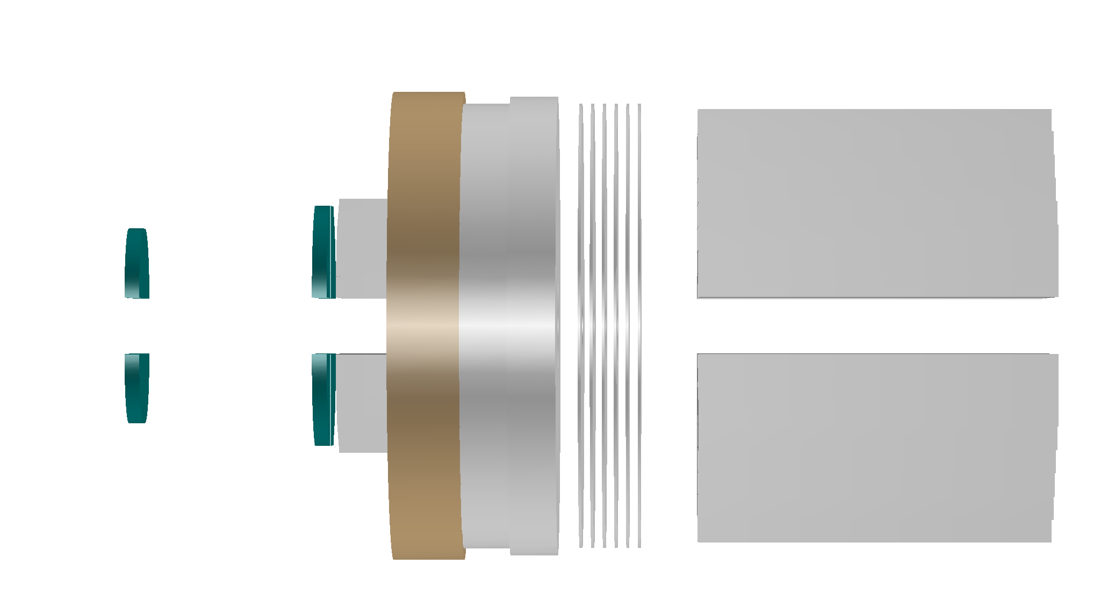
120GeV e-
43.6mrad
560
640
700
800
950
z(mm)
Si-det
LYSO
Flange
Bellow
LYSO

Slide 2
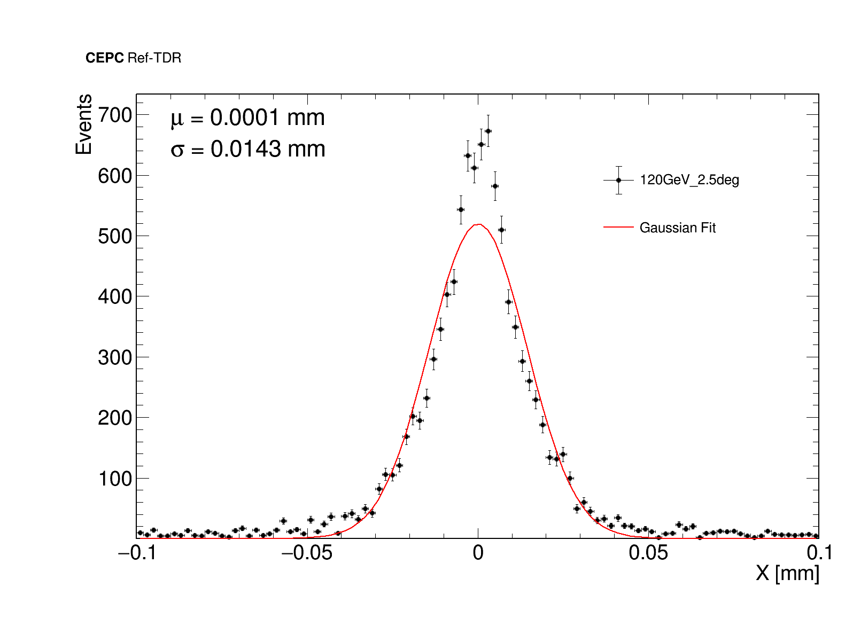
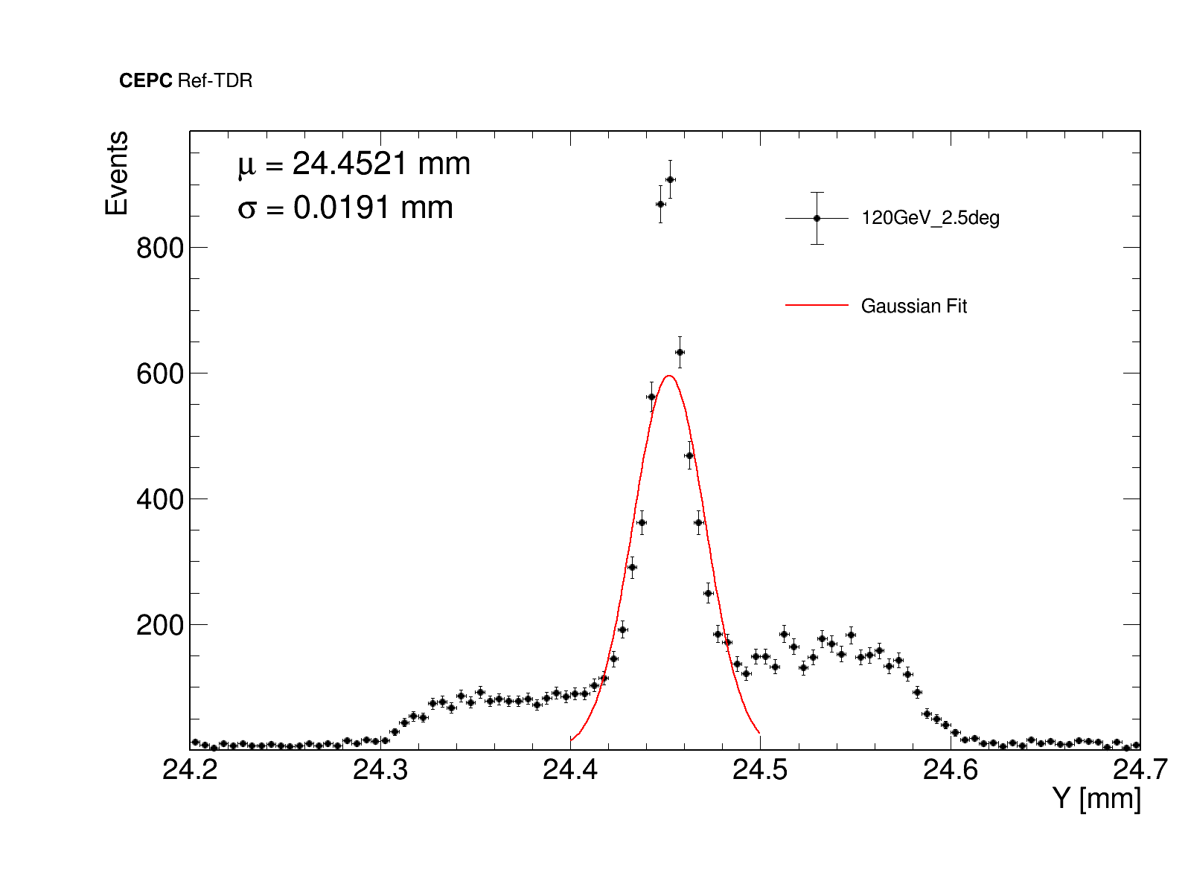
Lumical Si分辨测试
1st Si-wafer z = 560mm
x Position Distribution
y Position Distribution

Slide 3
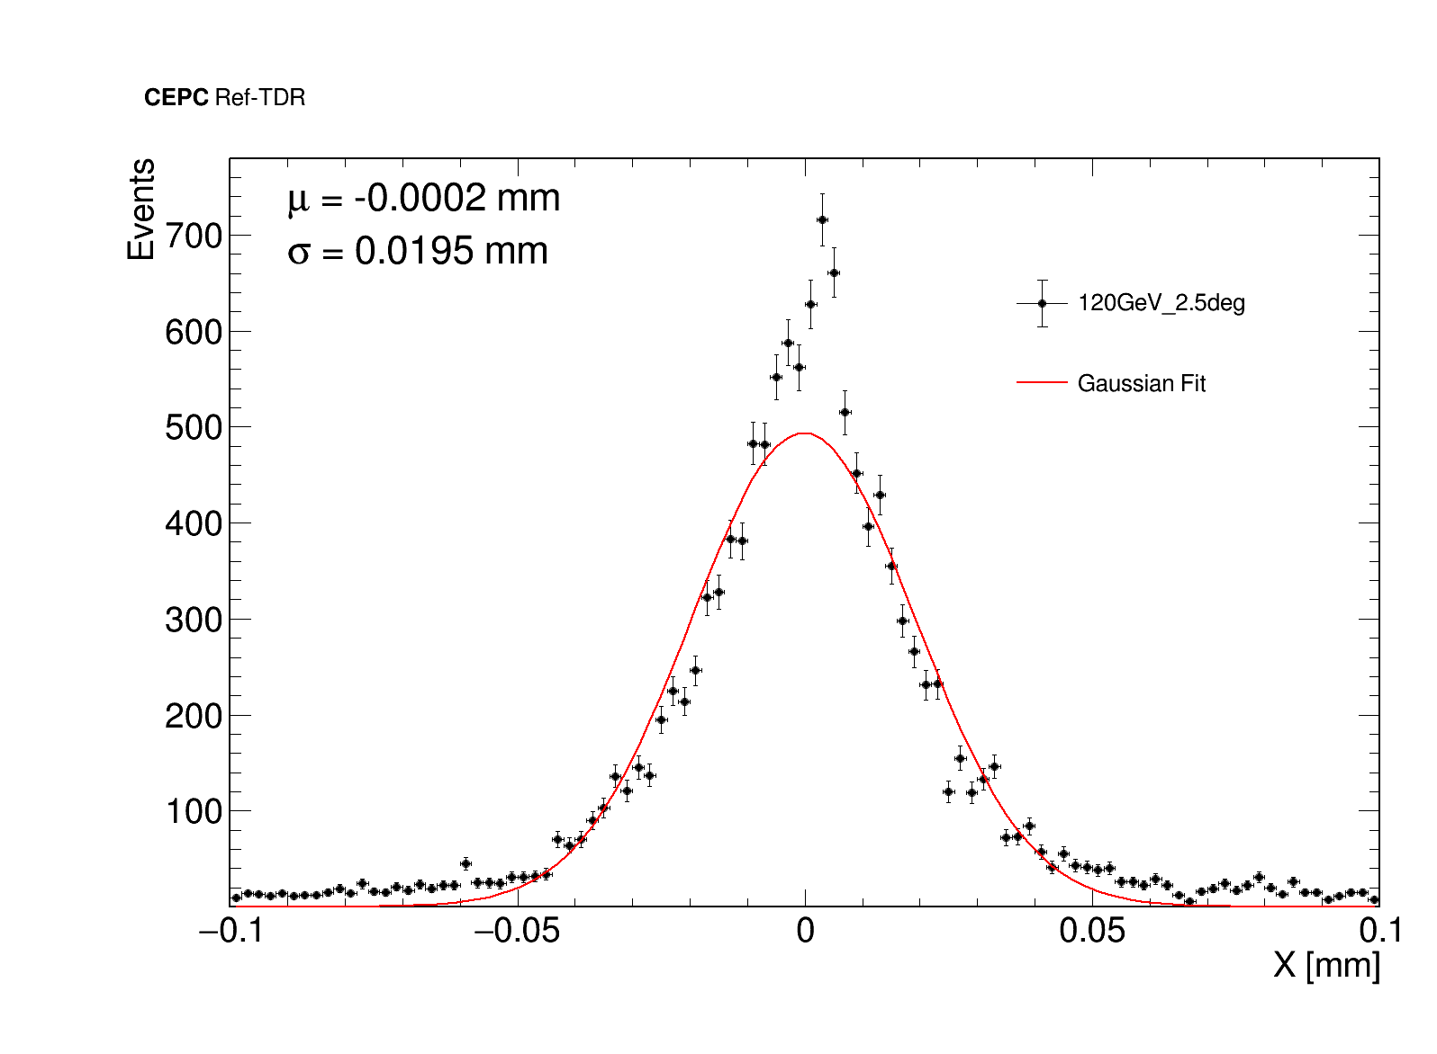
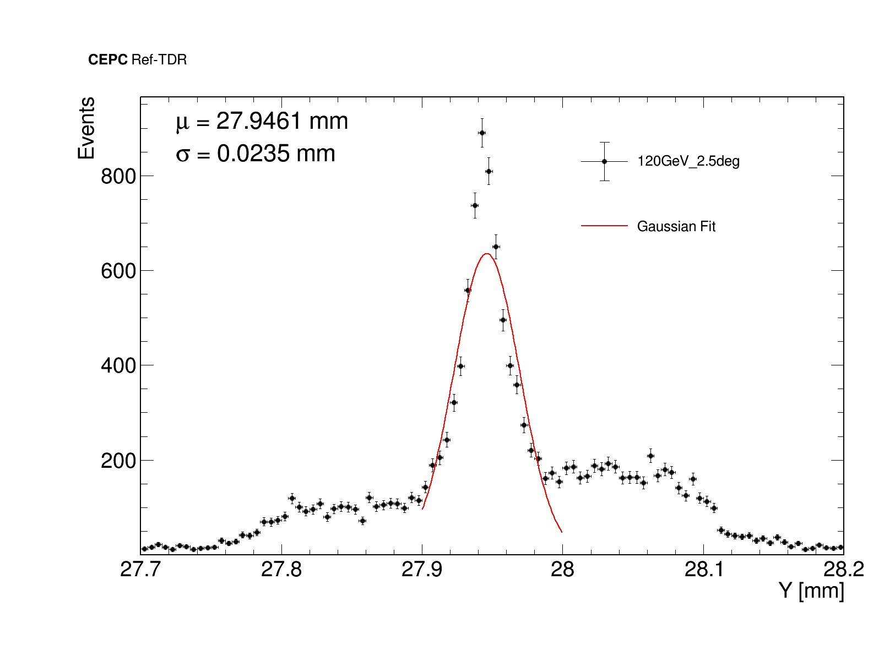
Lumical Si分辨测试
2nd Si-wafer z = 640mm
x Position Distribution
y Position Distribution

Slide 4
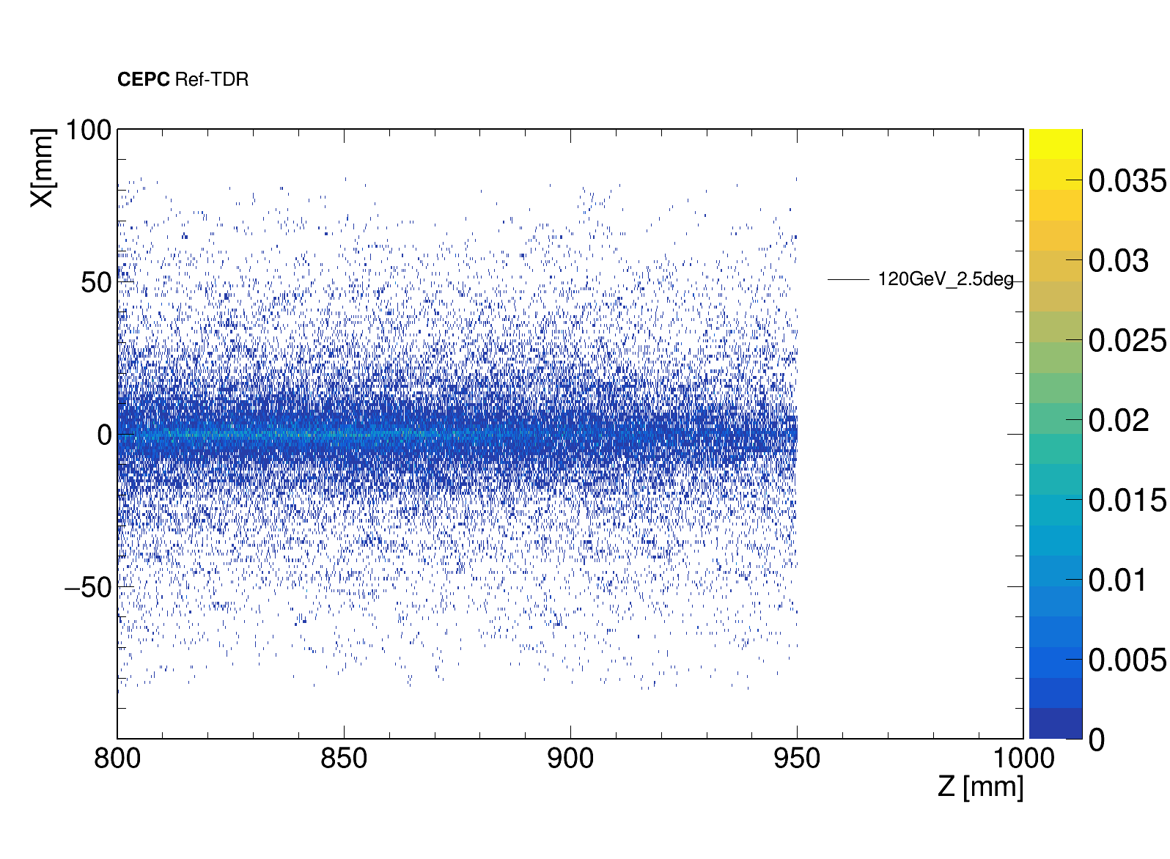
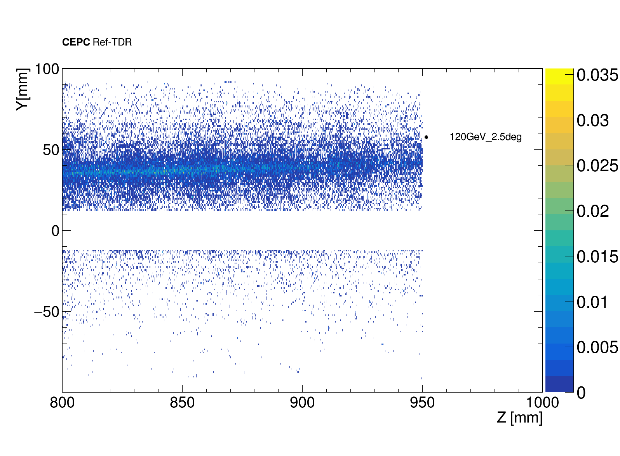
第二层LYSO内簇射
x - z Distribution
y - z Distribution

