Slide 1
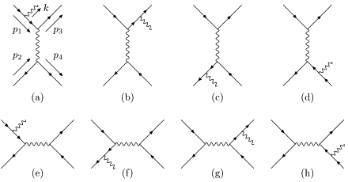
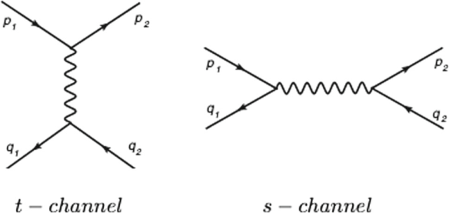
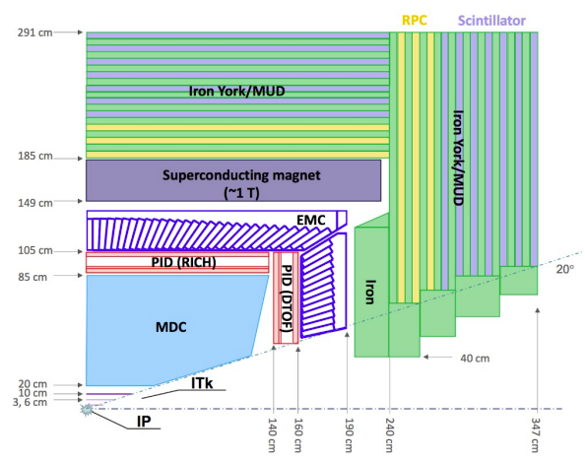
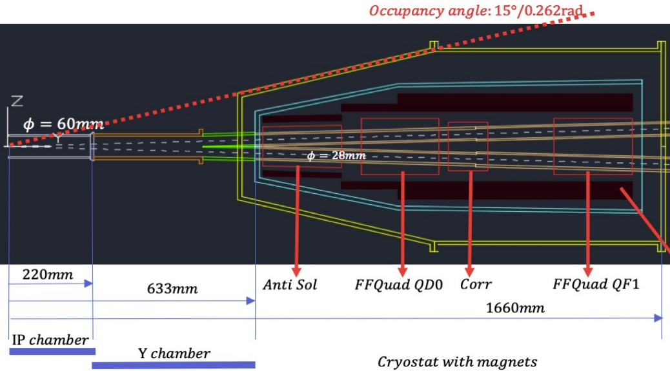
https://indico.pnp.ustc.edu.cn/event/3672/
2025 超级陶粲装置研讨会
Precision test of QED and
measurement of Luminosity at STCF
侯書雲 Suen Hou
Academia Sinica
2025.07.03
Radiative Bhabha elastic scattering
LO NLO

Slide 2
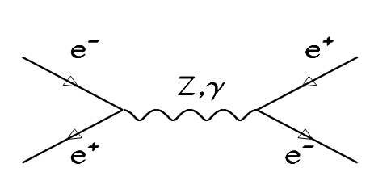
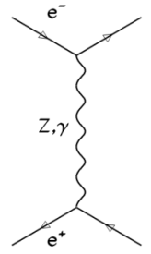
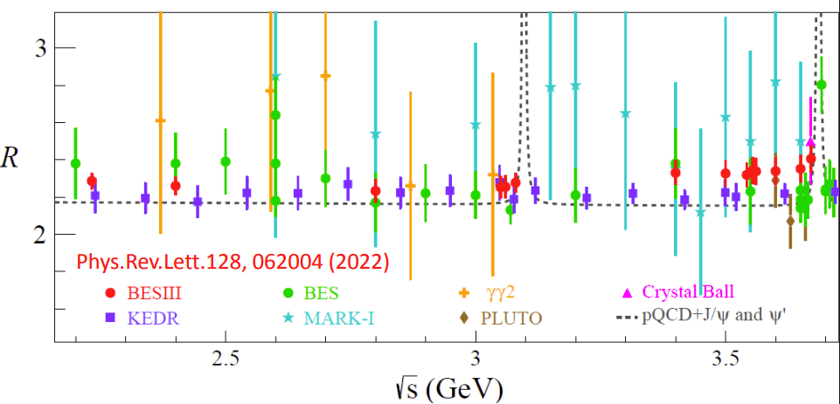
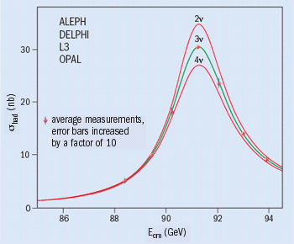
Luminosity precision to SM, R
SM e⁺e⁻ → Z → qq‾ , R(s) ratio
QED Luminosity by counting Bhabha e⁺e⁻ → e⁺e⁻
LEP: 17 Million Z (4 IP)
L = 4.3 10³¹/cm²s (E=46GeV)
= 1x10³²/cm²s (E=100 GeV)
R(s) ratio for SM predictions
a_{μ} = (g_{μ}-2)/2 and Δα_{had}(M_{Z})
N_{ν} = 2.9840 ± 0.0082
M_{Z} = 91187.5 ± 2.1 MeV 2.3 × 10⁻⁵
G_{Z} = 2495.2 ± 2.3 MeV 1‰
N_{ν} = 2.9840 ± 0.0082
Precision luminosity 3.4x10⁻⁴
BESII in 2–5 GeV, precision 6%
BESIII 2022 3%
2 November 2005

Slide 3
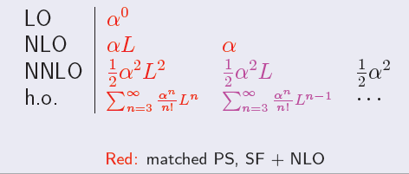
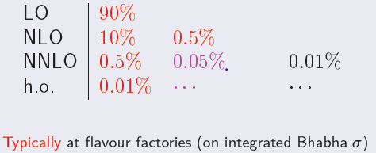
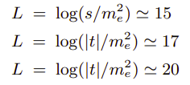
QED precision on Bhabha
e⁺e⁻ → e⁺e⁻ (nγ)
Methods used for multiple photon corrections
SF: analytical collinear QED Structure Functions
YFS exponentiation Small angle 0.054% BHLUMI (LEP)
PS: Parton Shower Large angle 0.1% BabaYaga@NLO (Flavor F.)
e⁺e⁻ collision luminosity
by coybtubg Bhabha events
Flavor Factories
collinear log :
C.M. Carloni Calame
ECFA Higgs CERN 2021
Luminosity errors:
Experiment
Theory
collinear log :
G. Montagna
Ustron, 2015
Large angle @ Flavor
Small angle @ LEP
Small angle @ t—t thresh.

Slide 4
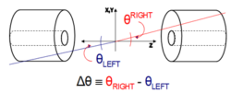
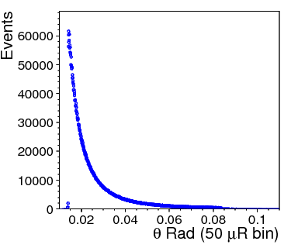
Bhabha event counting to 10⁻⁴ SM an order improvement to LEP
Luminosity L is derived by
Bhabha detected for
a pair of back-back electrons,
precision θ of e,e(γ) in fiducial region
e⁺e⁻ → e⁺e⁻(nγ)
Bhabha enter of mass
θ distribution
detector spatial resolution
count Bhabha
in Fiducial region
δL/L ~ 2 δθ/θ_{min}
δL/L = 10⁻⁴
at z = ± 1000 mm, θ_{min} = 20 mRad
→ δθ = 1 μRad, or dr = 1 μm
error due to offset on Z
→ 50 μm on Z eq. dr = δz x θ = 1 μm
Luminosity systematics due to
event counting in/out fiducial edge
offset on the mean of θ_{min}

Slide 5
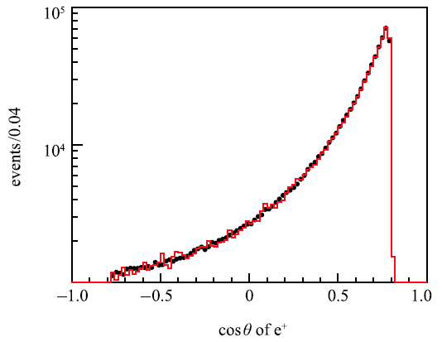
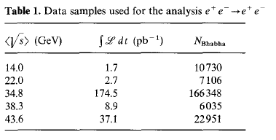
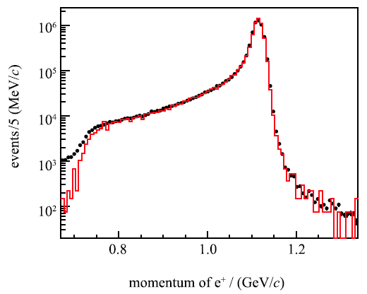
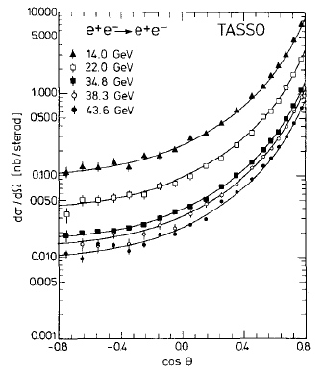
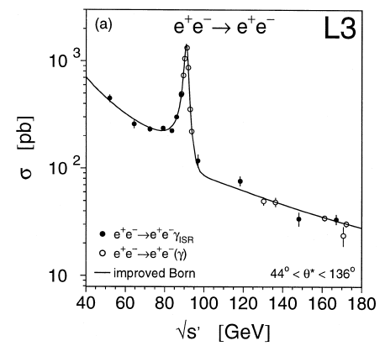
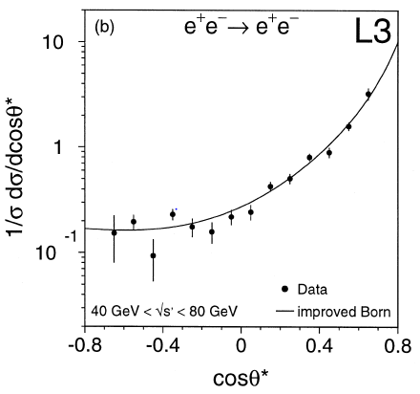
Bhabha experimental results
e⁺e⁻ → e⁺e⁻ (γ)
BESIII Luminosity (γ)e⁺e⁻, (γ)γγ
Systematic error ~0.7%
√s = 2.23 - 4.59 GeV
TASSO Bhabha
Systematic error ~3%
√s = 12 - 47 GeV
[2017, Ch.P. C41 063001 ]
L3 radiative Bhabha with ISR
Systematic error at ~1% level
√s= 50 ~ 170 GeV, 232 pb⁻¹, 2856 event
[1998, PLB 439, 183]
[ 1988, ZPC 37, 171]

Slide 6
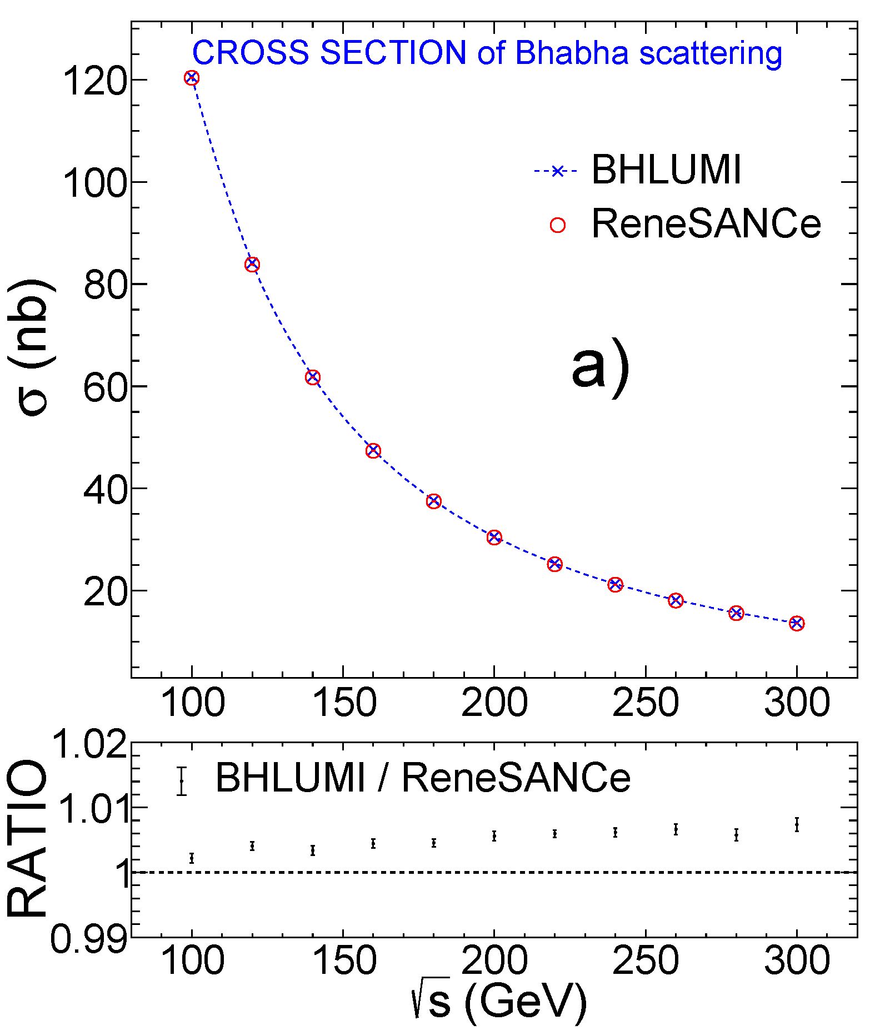
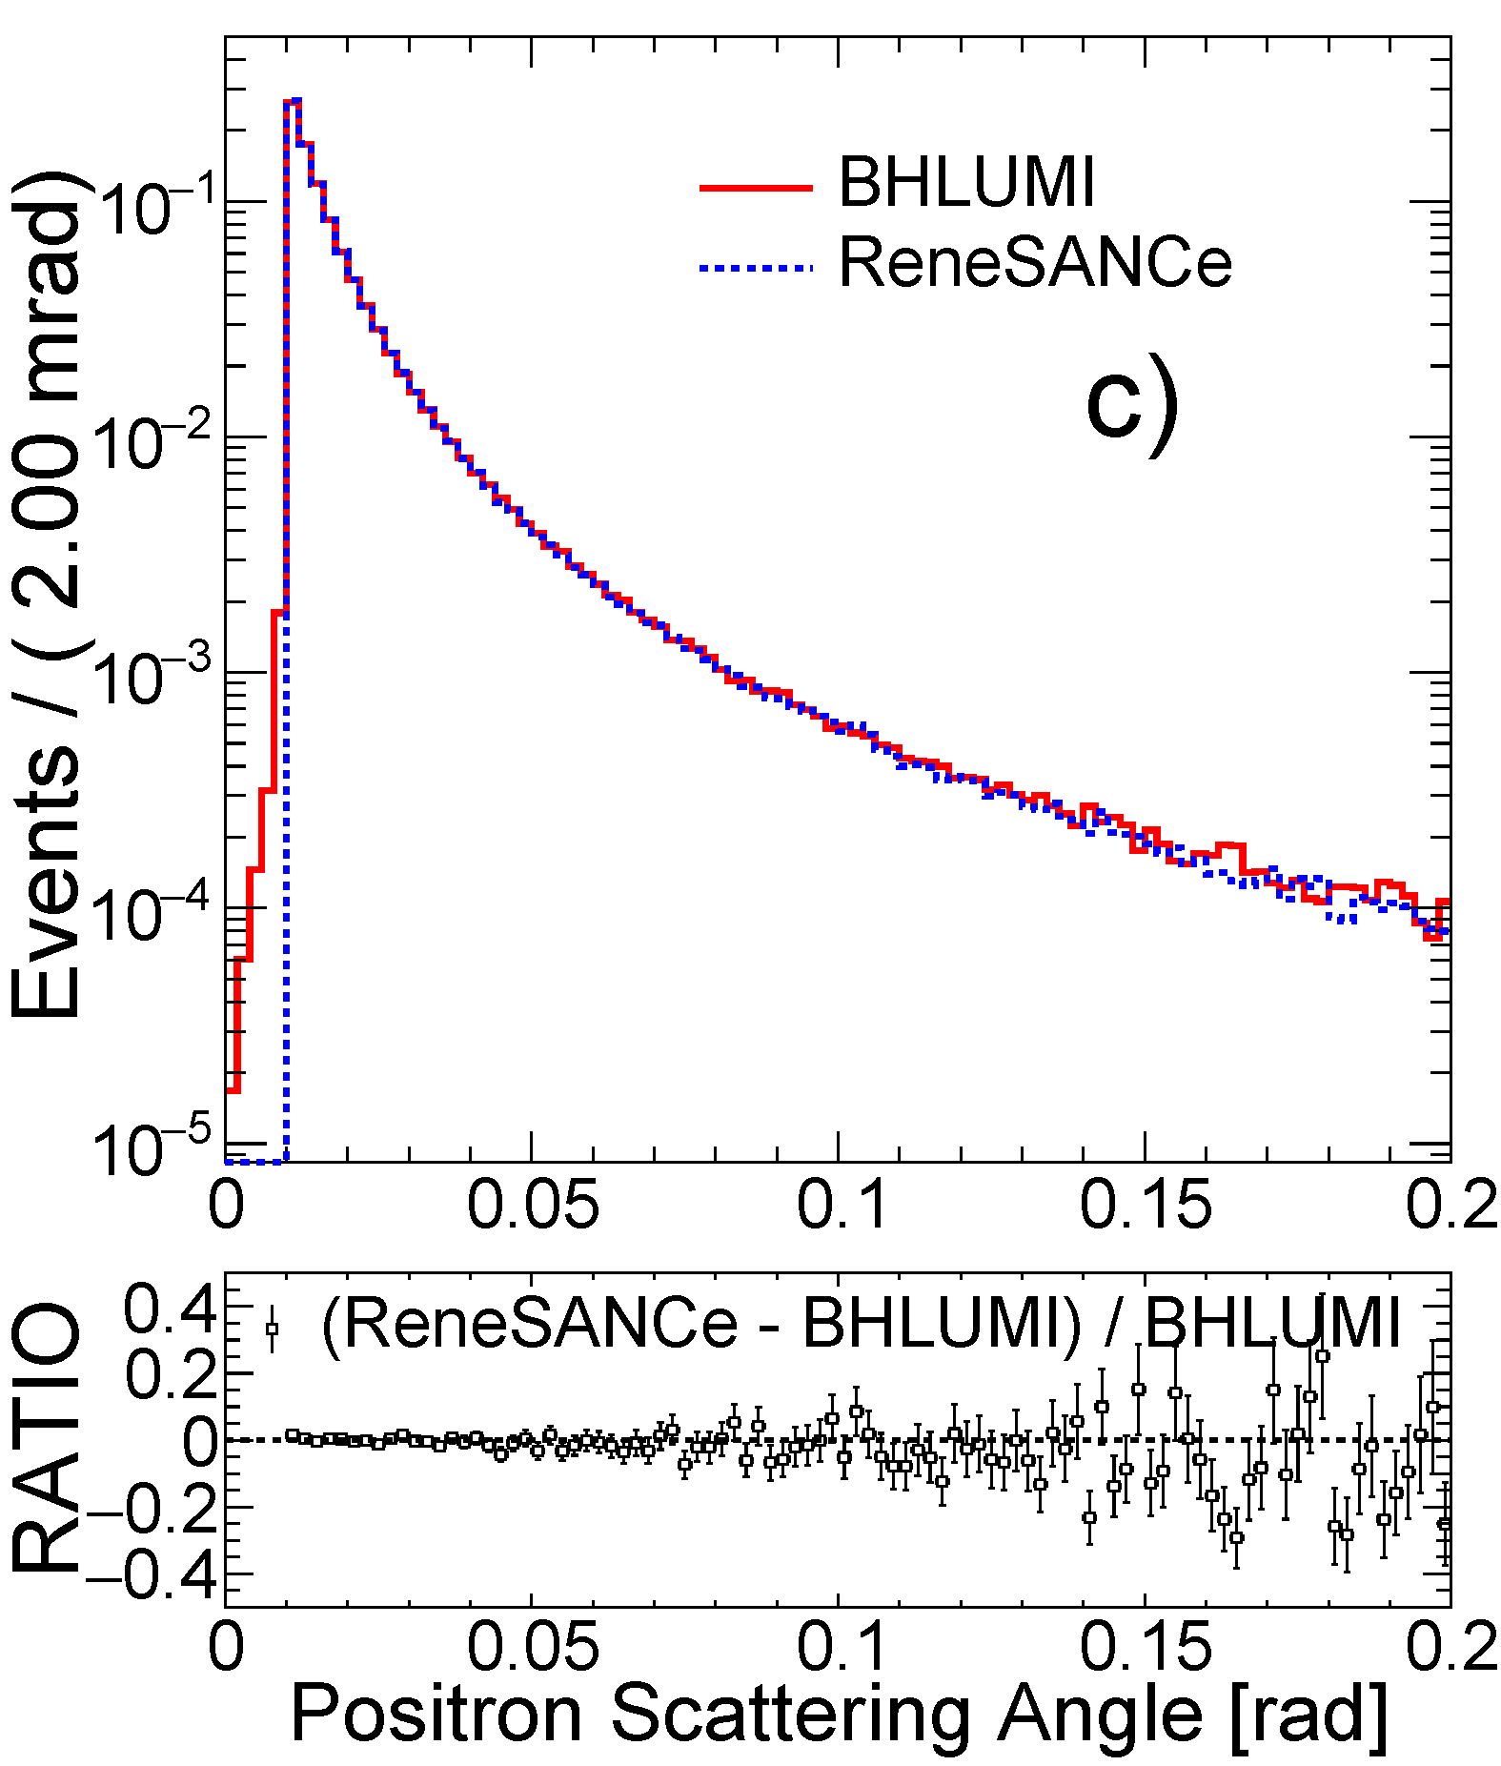
Challenge: QED α²L² shall be measured
BHLUMI 4.04
2020 systematic 0.037%
[PLB 803 (2020) 135319]
ReneSANCe
[CPC 256 (2020) 107455]
Compare √s = 92.3 GeV
BHLUMI: YFS exponentiation e⁺e⁻ → e⁺e⁻(nγ)
ReneSANCe: NLO calculation e⁺e⁻ → e⁺e⁻(γ)
Bhabha
Cross section
Bhabha E(e)=50 GeV
e⁺ theta angle

Slide 7
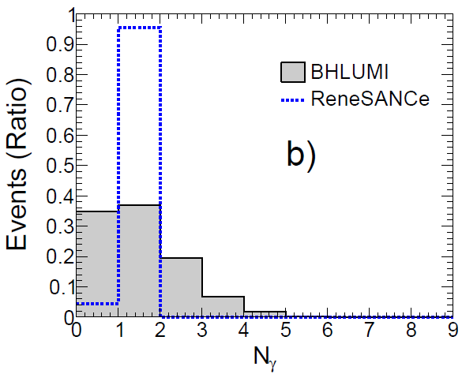
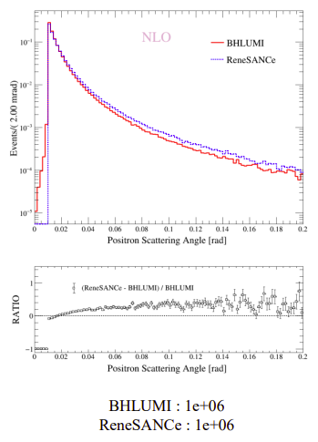
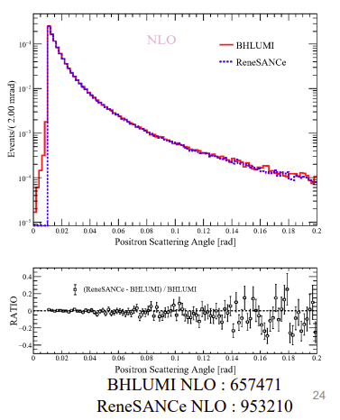
Challenge: QED α²L² shall be measured
BHLUMI: e⁺e⁻ → e⁺e⁻(nγ)
ReneSANCe: e⁺e⁻ → e⁺e⁻(γ)
e± theta angle
NLO 0γ discrepancy
eγ opening angle
Consistent
# photons
Differ very much
BHLUMI E(γ)>5MeV
Event final states | BHLUMI generated
e⁺e⁻ | 36.4%
e⁺(e⁻γ) or (e⁺γ)e⁻ | 47.8%
(e⁺γ)(e⁻γ), | 15.8%

Slide 8
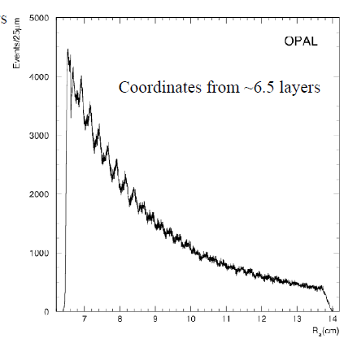
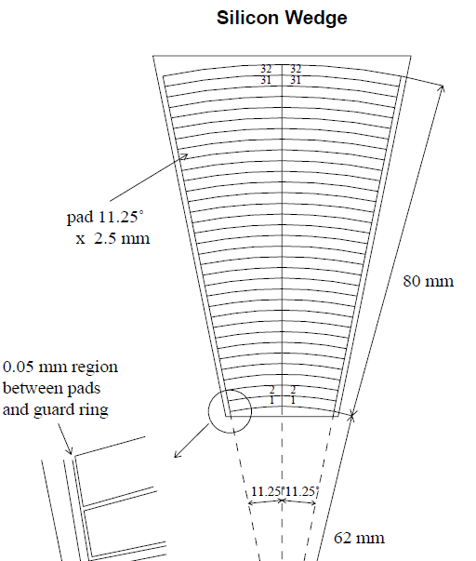
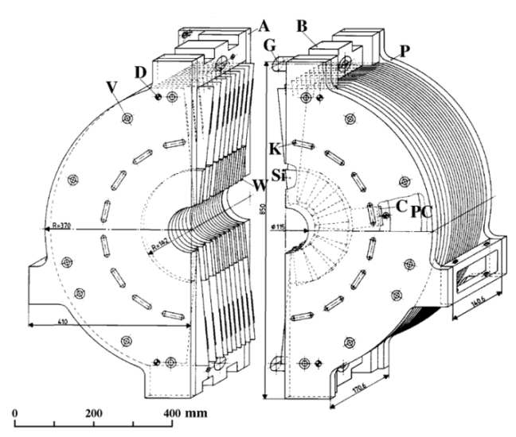
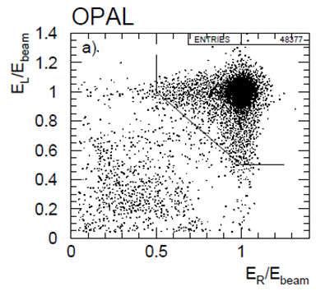
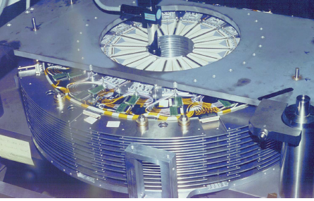
LEP luminosity achieved
Si pad 2.5mm pitch
Bhabha events
EPJC 14 (2000) 373
OPAL precision
σ_{Bhabha} 79 nb
Expt 3.4 x 10⁻⁴
Theo 5.4 x 10⁻⁴
6.2 – 14.2 cm,
θ = 25 – 58 mrad

Slide 9
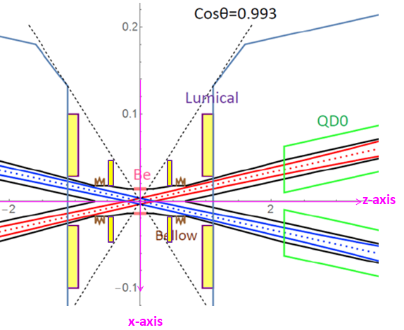
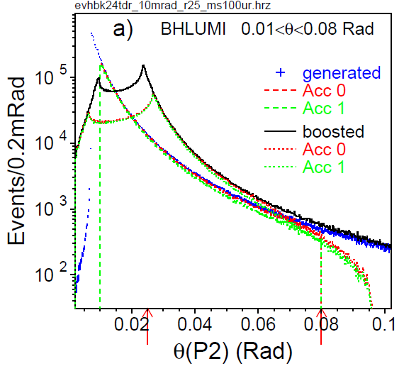
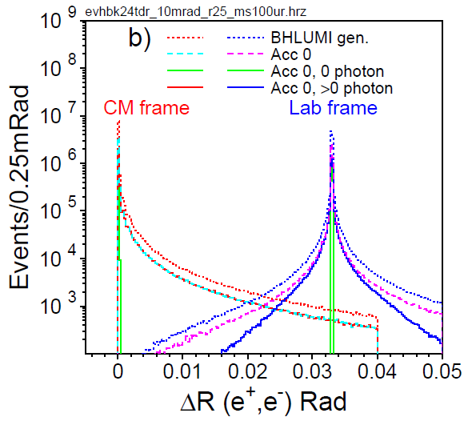
Bhabha e⁺e⁻ → e⁺e⁻(nγ) at CEPC
LEP Luminosity template
BHLUMI demo.f cuts
ACC 0 CMS 10 mRad < θ(e±) < 80 mRad
ACC 1 .and. s’(P2,Q2)/s(P1,Q1) >0.5
Beam crossing, 33 mRad
Boost in x direct
e⁺, e⁻ offset by 33 mRad
events with 0 photos
Show δ back-back distribution

Slide 10
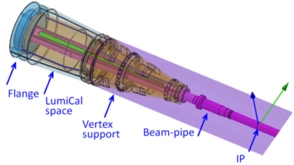
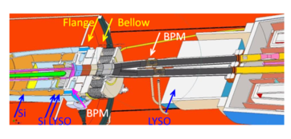
CEPC LumiCal design
L=2x10³⁶/cm²s¹ @Z-pole,
ø 20 mm racetrack,
beam-crossing 33 mRad
IP bunch :
σ_{x} σ_{y} σ_{z} = 6 μm, 35 nm, 9 mm
Bunch crossing: 23 ns
before Flange z = 560~700 mm
Low-mass beampipe window:
Be 1mm thick
traversing @22 mRad traversing L= 45 mm,
= 0.13 X₀ (Be), 0.50 X₀ (Al)
Two Si-wafers for e± impact θ
2X₀ LYSO = 23 mm
behind Bellow z= 900~1100 mm
Flange+Bellow : ~60 mm, 4.3 X₀
13X₀ LYSO 150 mm

Slide 11
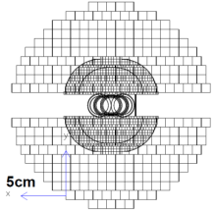
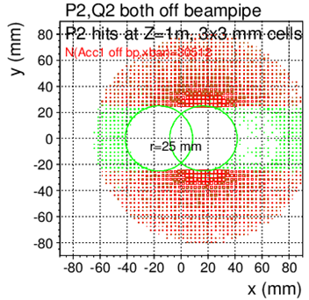
CEPC LumiCal acceptance
BHLUMI event distribution
detecting back-to-back e⁺, e⁻ pair
@|z|=1000mm
Θ > 25mRad outside pipe centers
|y|>25 mm
Events in shaded area
counted for Xsec
e⁺, e⁻ back-to-back symmetric
to out-going pipe center
LumiCal acceptance at |z|=1000mm
e⁺, e⁻ back-to-back detected
θ>25 mRad | θ>25mR & |y|>25mm
85.4 nb | 78.0 nb

Slide 12
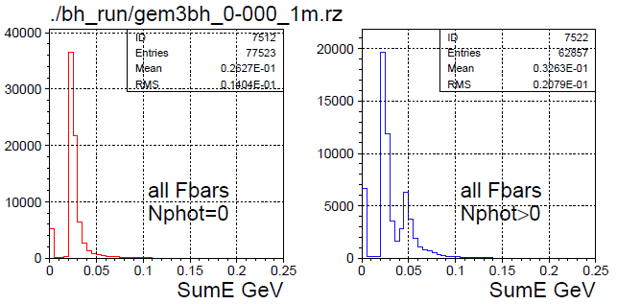
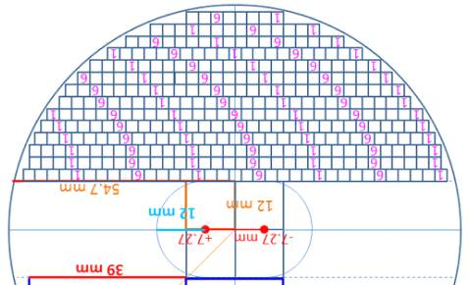
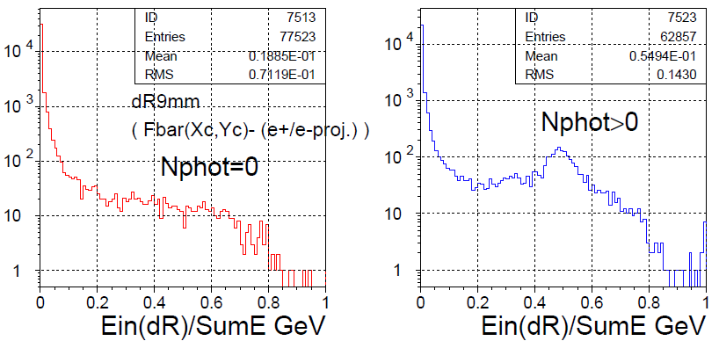
Front 2X₀ LYSO, on radiative e,γ
2X₀ LYSO
@ z=647mm
Bhabha hits on LYSO, |y|>12mm
Incident particles are e±,(γ)
GEANT sum dE/dx in each LYSO bars
3x3mm², 23 mm long, 2X₀
Deviation to e± truth (impact hit >E_{b}/2)
mostly < 0.2mm
Hit distributions in a Bar
distributed due to Bhabha θ, w./w.o. photon
BHLUMI events, GEANT simulation
Nγ=0 Nγ>0
sumE
sum dE/dx all LYSO bars (a plane)
e± one track : sumE min. 20 MeV
(e± + FSRγ) : two MIPs, sumE x2
sumE(R<9mm)/sumE
Nγ=0 Nγ>0

Slide 13
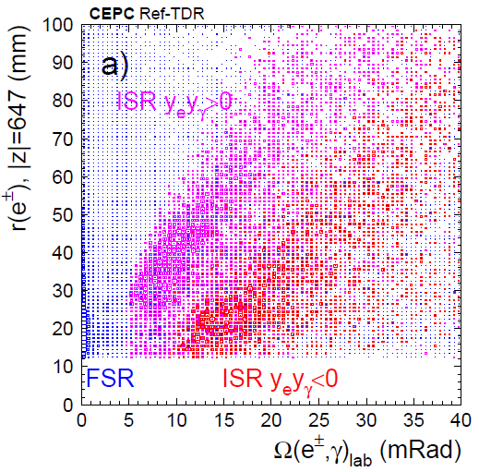
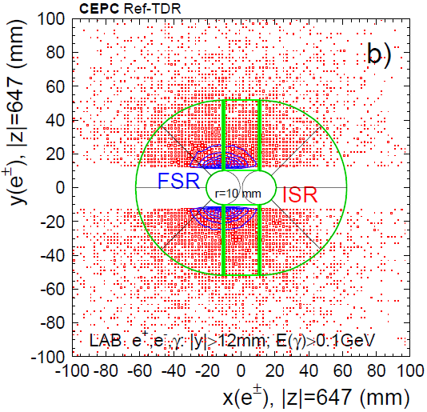
Photons in e⁺e⁻ → e⁺e⁻(nγ) @Z-pole
γ to nearest electron
Bhabha events in LumiCal acceptance
e⁺,e⁻,γ : |y|>12 mm at LYSO front face ±z=647mm
±z Hemispheres | BHLUMI generated | & P2,Q2 |y|>12mm
e± | 60.3 % | 3.87 %
e± γ | 39.7 %* | 3.16 %
γ distribution
*ISR 20.3%, FSR 19.4%
Detectable Bhabha, e⁺,e⁻,γ : |y|>12 mm
±z Hemispheres | P2,Q2 |y|>12mm | & E(γ)>0.1GeV |y(γ)|>12mm
e± | 55.1 % | 14.7 %
e± γ | 44.9 % | ISR 0.89 % FSR 13.8 % FSR 2.96%*
⬅ measurable
*FSR Ω(e±,γ) > 5 mRad

Slide 14
Challenge: 10⁻⁴ on Bhabha e⁺e⁻ → e⁺e⁻(nγ) @CEPC
Bhabha electron θ (set by 2 points ) : IP – Si-det hit
Requirement: 1 μRad on mean of θ
IP by BPM (beam position monitor) on beam current
x,y by BPM, z by timing
LumiCal Si-wafer position mounted on Flanges
reference to “beam center” at Flanges
→ 1. construction survey to sub-micron
2. monitoring on Flanges z position

Slide 15
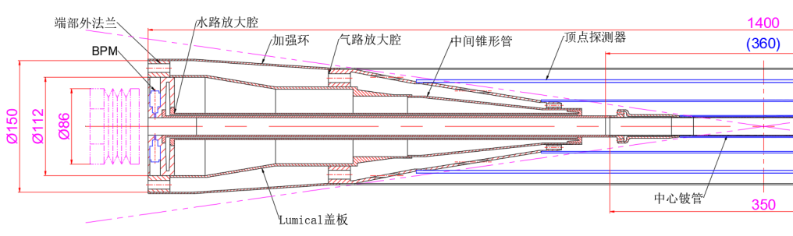
Survey/monitoring, for Beam IP position
Beam Probe Monitor BPM , IP x,y to 1 μm
Position monitoring, Flange dx,dy ~1 μm, dz~ 50 μm
CEPC WS2023
Jun He
Precision required
1. Flanges dx,dy 1 μm, dz 50 μm
2. Beam positions dx,dy 1 μm
BPM

Slide 16
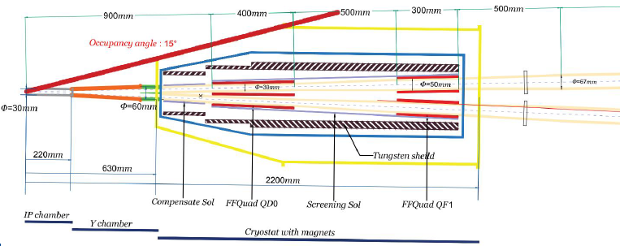
Forward Calorimeter @ STCF
Small Angle Bhabha 60 – 240 mRad ( 3.4º - 14º)
Precision QED Bhabha at Flavor factories to better than 10⁻³
e/γ by Si-det + Crystal → NLO, NNLO radiative Bhabha detection
Propose: Forward region
Z = 450 – 630 mm
Θ = 60 – 240 mRad

Slide 17
Proposing precision Bhabha @ SCTF
QED Bhabha needs NNLO on hadronics to 10⁻⁴
Detecting Bhabha to better than 10⁻⁴:
detect e/γ: identify radiative Bhabha deviation
Si-det on electron θ: multi. scatt. ~50 μRad
mean-on-error on Bhabha counting
monitoring IP: BPM on electron beams to 1 μm
monitoring LumiCal: survey to beam-pipe centers on flanges
Δz of flanges on +,-z side < 50 μm/1.4m

