Slide 1
CGEM TIGER COMMUNICATION ERROR statistics and CGEM Histogram
Tingxuan Zeng
IHEP DAQ Group , 2025/6/19

Slide 2
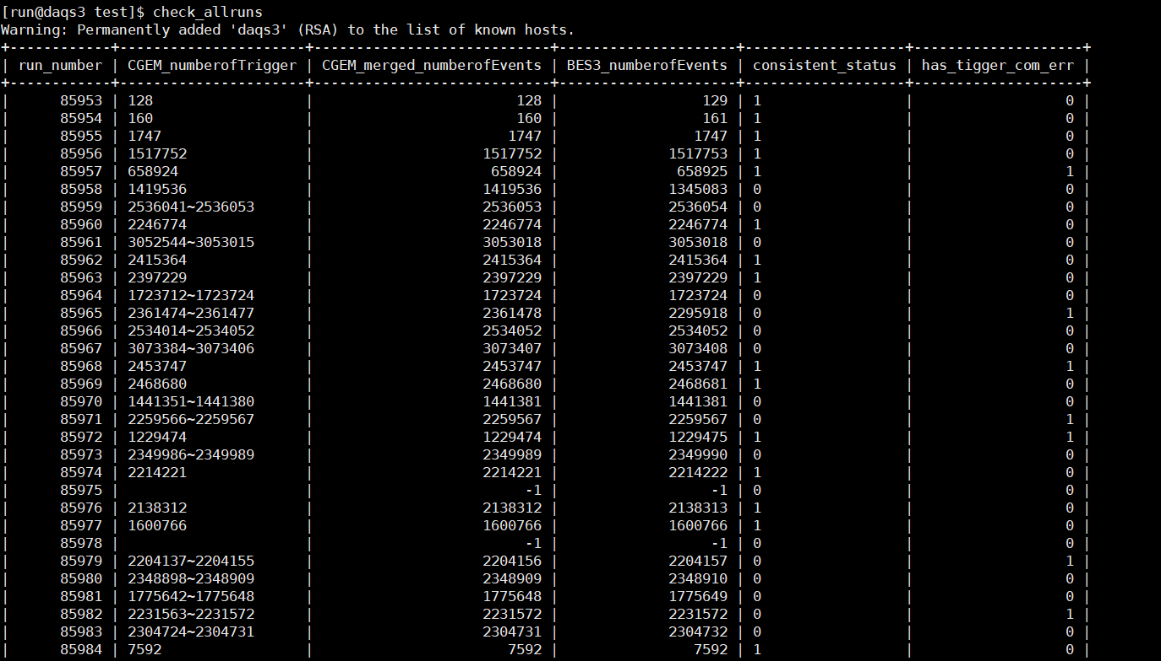
Automated Check Script
check each run for TIGER COMMUNICATION ERROR, alignment status and details. The results are stored into the database.
Simple commands are provided for querying and summary: check_allruns

Slide 3
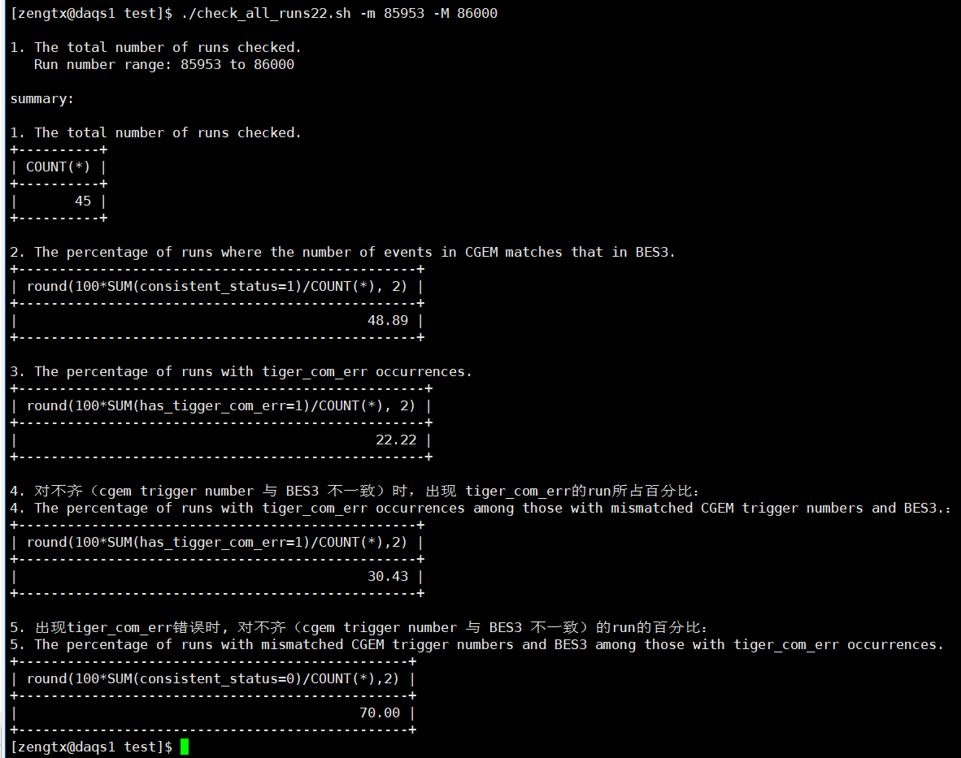
Check Conclusion （ignore mode）
RUN 85983~RUN 86000
48.89% of the run CGEM is consistent with BESIII.
TIGER communication errors occurred in 22.22% of the all runs.
The presence of TIGER communication errors does not necessarily imply a failure in data alignment.

Slide 4
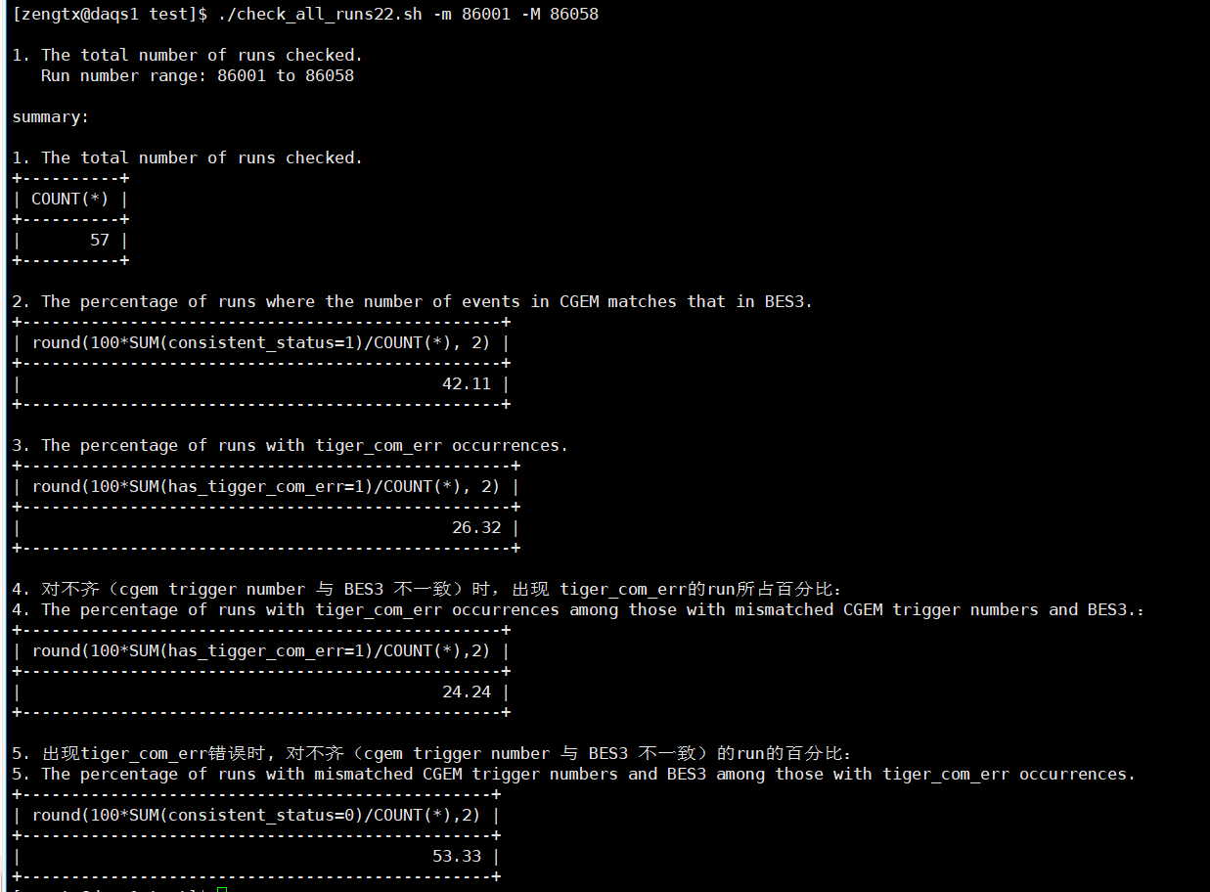
Check Conclusion （abort mode）
RUN 86001~RUN 86058
42.11% of the run CGEM is consistent with BESIII.
TIGER communication errors occurred in 26.32% of the all runs.
The presence of TIGER communication errors does not necessarily imply a failure in data alignment.

Slide 5
CGEM Histogramc from merged file
Implement automated scripts to produce histograms from the merged CGEM files for each run.
The resulting ROOT files are saved under /home/run/histogram/run/.
An interactive ROOT macro is provided for visual inspection： draw_CGEM_hist.C
root [1] [run@daqs1 ~]$ root -l
root [0] .x draw_CGEM_hist.C("/home/run/histogram/run/CGEMData_run_85954.root")

Slide 6
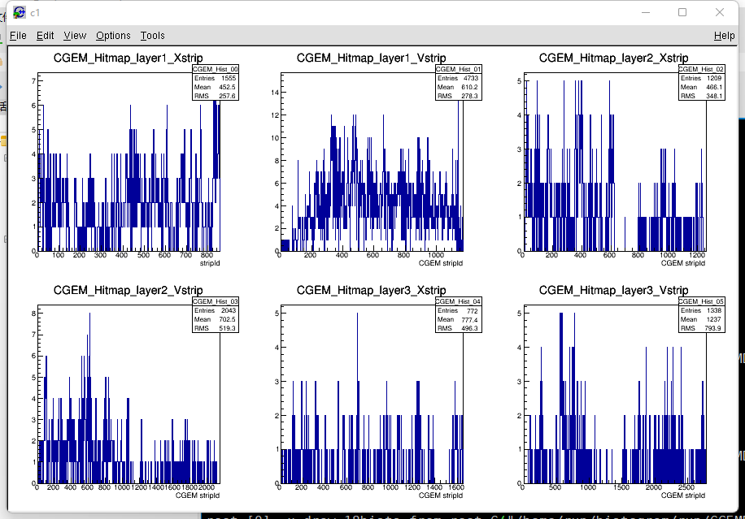
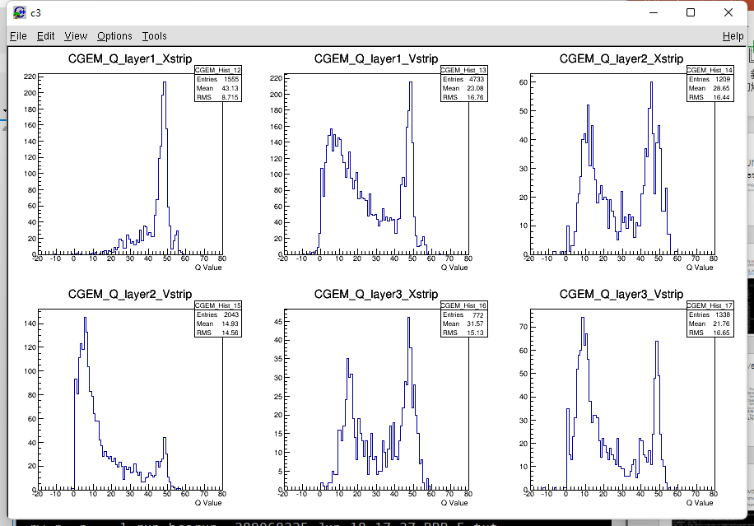
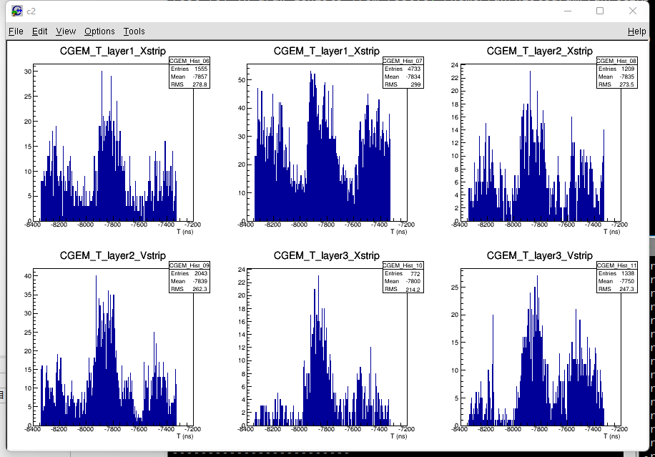
Can be checked as soon as the run finished, currently Include :
Hitmap
T distribution
Q distribution
Thanks!

Slide 7
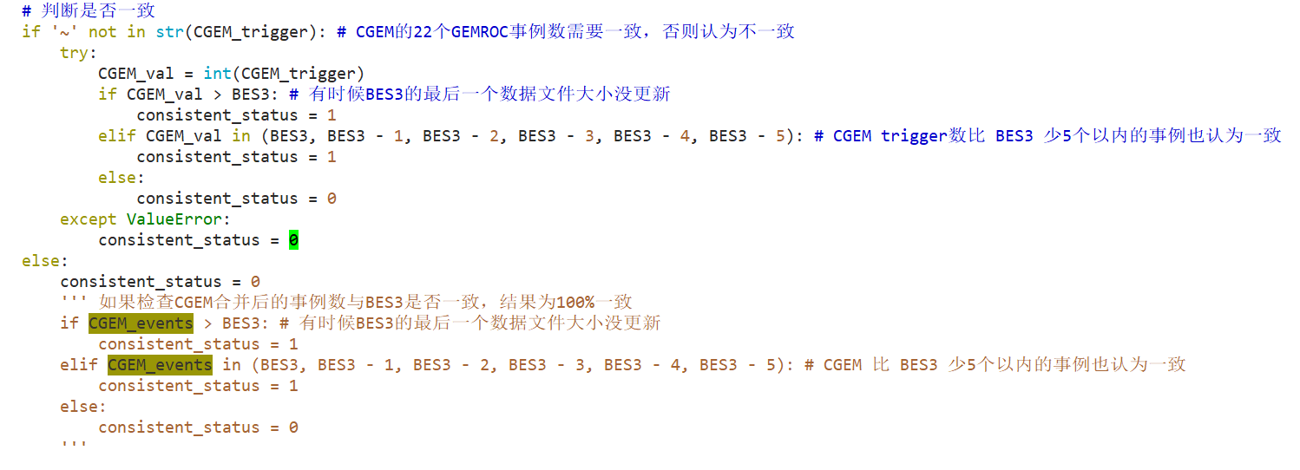
backup

