Slide 1
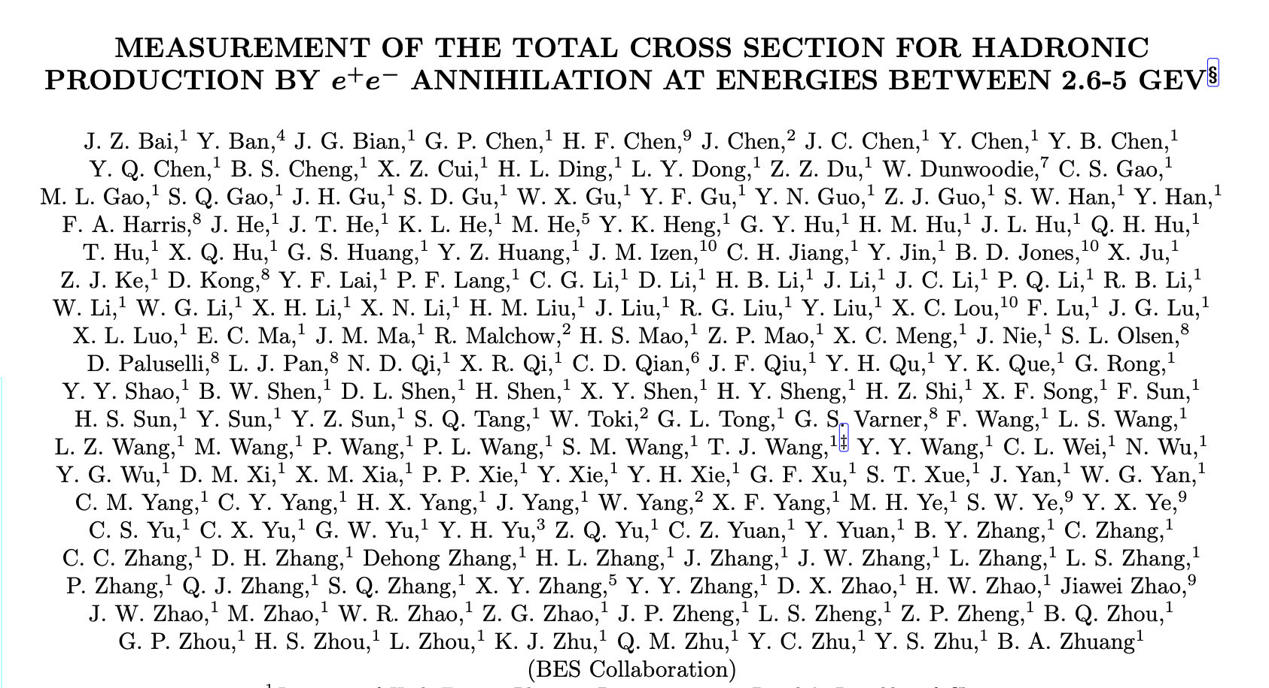
About R-scan

Slide 2
What is the R value
$R≡\frac{σ(e^{+}e^{−}→hardons)}{σ(e^{+}e^{−}→μ^{+}μ^{−})}=3ΣQ_{i}^{2}$
$\sqrt{s}<3Gev u,d,s R=2$
$3Gev<\sqrt{s}<10Gev u,d,s,c R=\frac{3}{10}$
$10Gev<\sqrt{s}<350Gev u,d,s,c,b R=\frac{3}{11}$

Slide 3
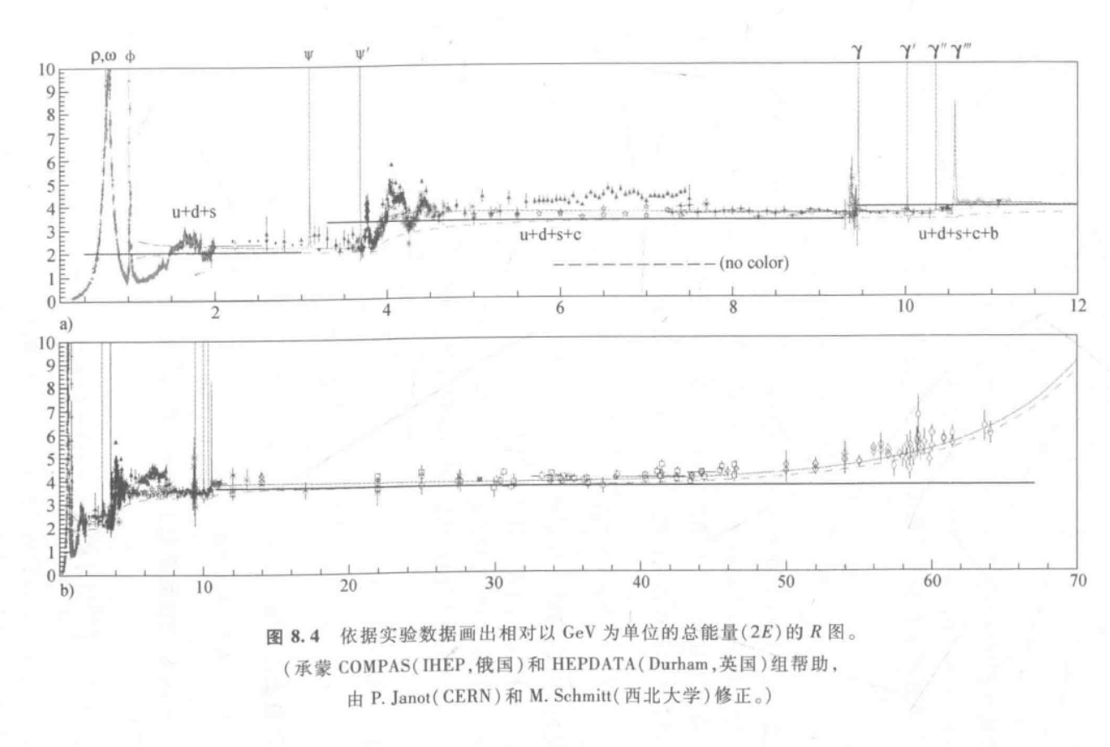
What is the R value

Slide 4
How to test R value
Need to get: $N_{had}^{obs}, N_{bg}, N_{ll}, N_{γγ}, σ_{μμ}^{0}, ε_{had}, δ$
$N_{had}^{obs}, N_{ll}, N_{γγ}$ from events selection
$N_{bg}=f×N_{sep}$
$σ_{μμ}^{0}={4πα^{2}}/{3s}$
$ε_{had}$ are from events selection
$ε_{trg}$
$δ,$?

Slide 5
How to select events
These conditions can be used for reference

Slide 6
Consider background
束流背景沿束流，沉积能量小，多为质子
每个能量点都采集了分离束数据
应用相同的挑选条件，得到N_sep
$f=\frac{碰撞区压力×碰撞束运行时积分束流}{碰撞区压力×分离束运行时积分束流}$. ???

Slide 7
Get trigger efficency
$J/ψ$ resonance
Different trigger requirements in special runs

