Slide 1



第三届超周边碰撞物理研讨会
Heavy-flavor mesons in a strong electric field
Jiayun Xiang
School of Physics And Astronomy Sun Yat-sen University
JX and G.Cao, Phys. Rev. D 110, 054033 (2024).
Notes:
公众号壹课

Slide 2
01
Introduction
02
One dimension
outline
03
Two dimension
04
Three dimension
05
Summary
Notes:
公众号壹课

Slide 3

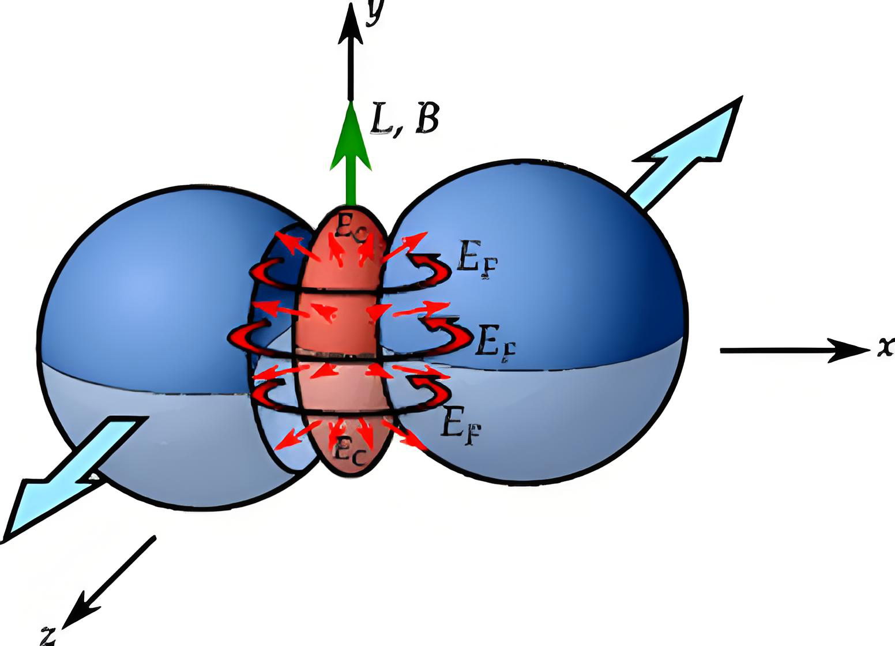
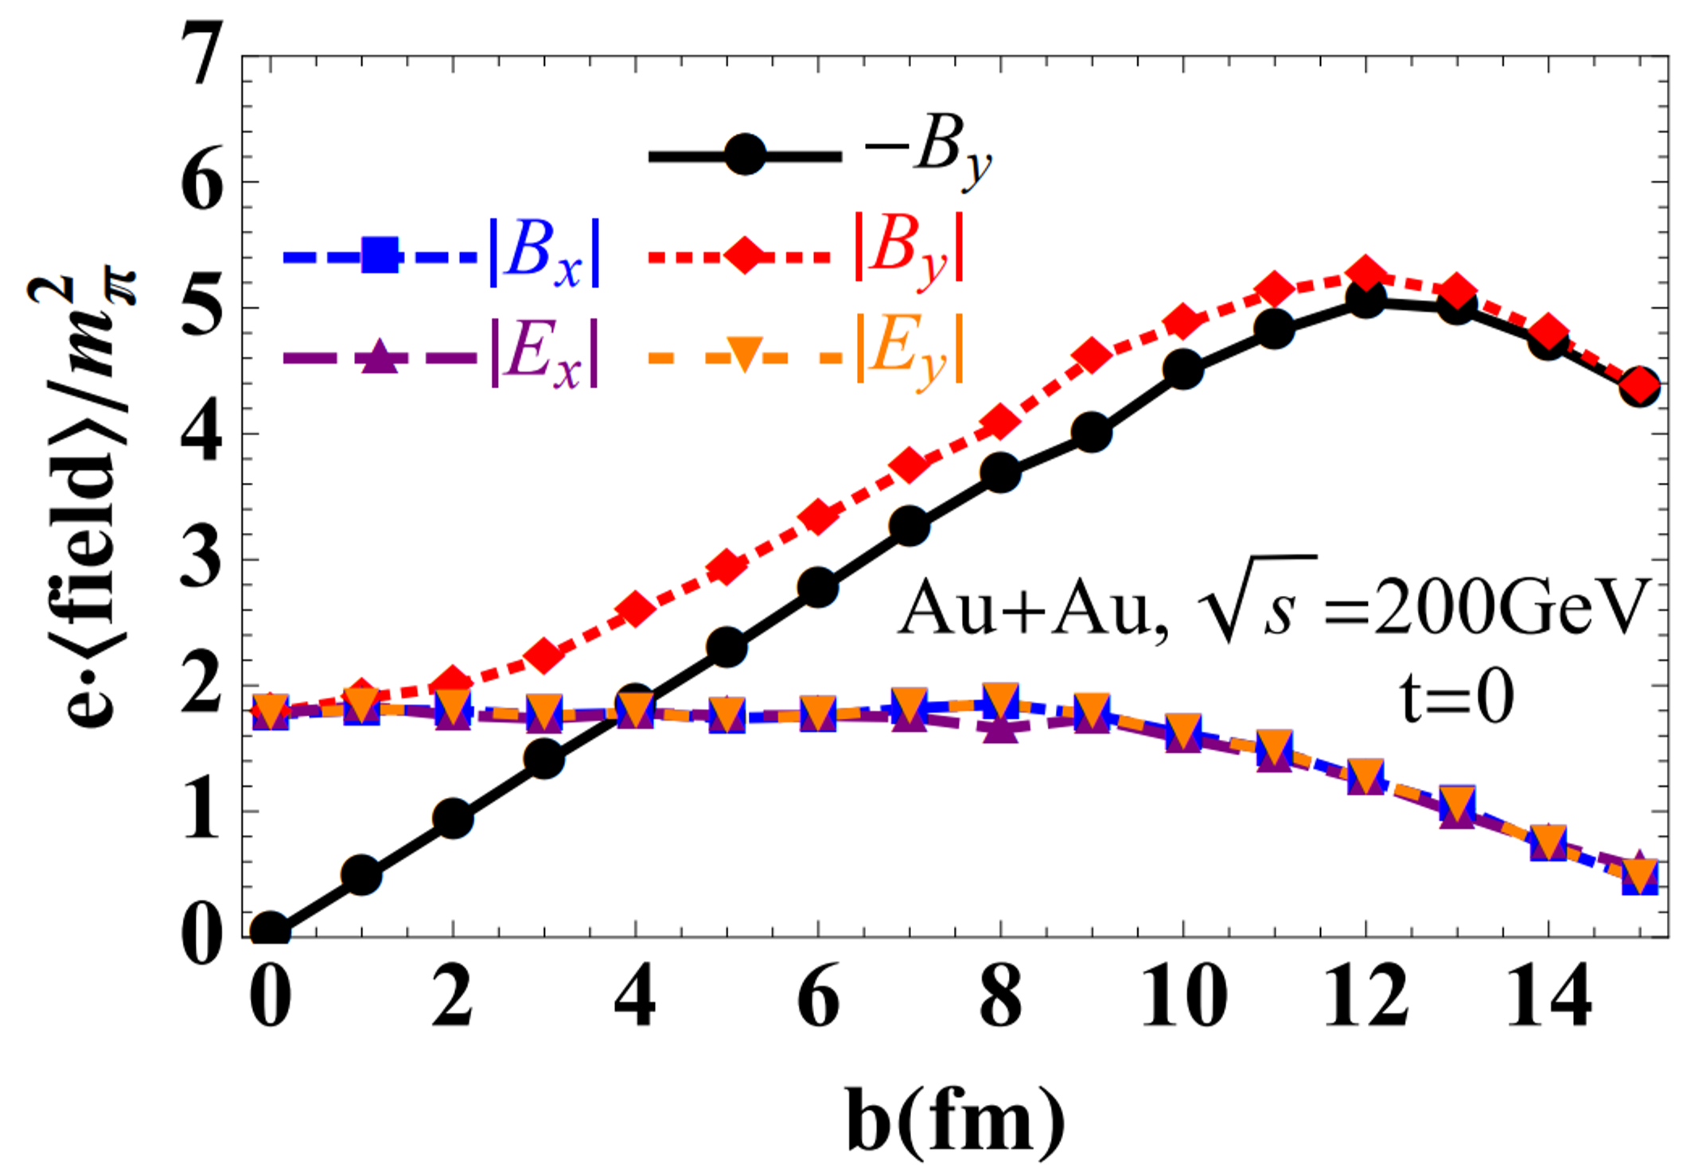
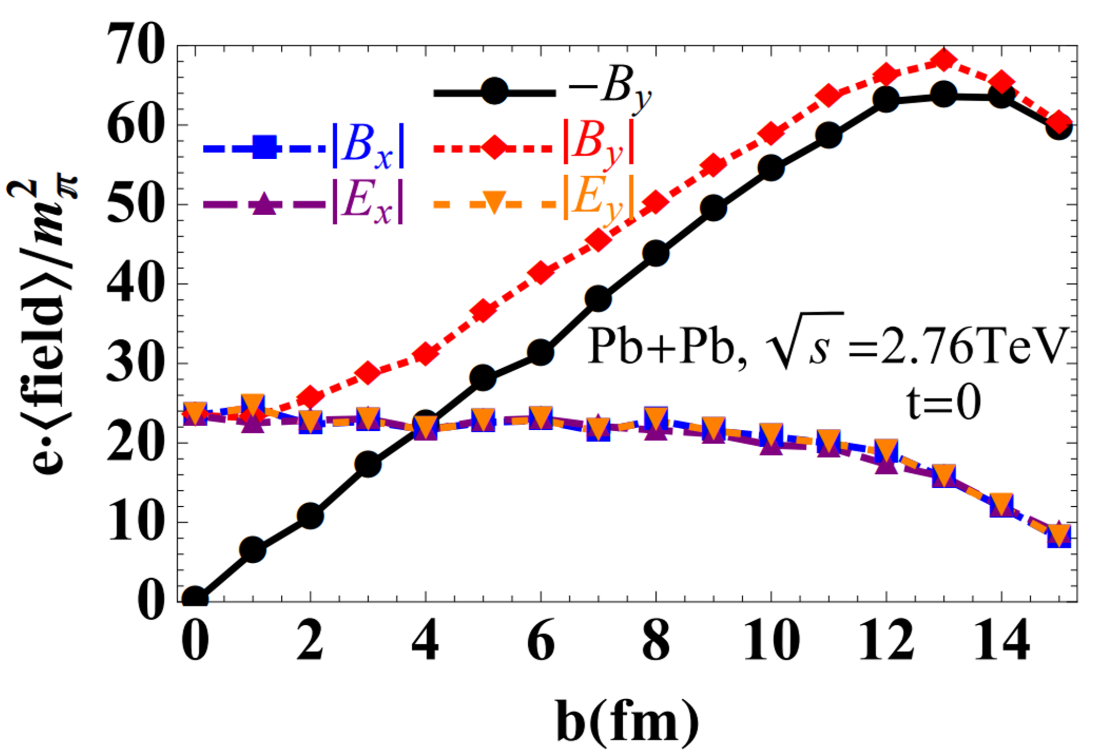
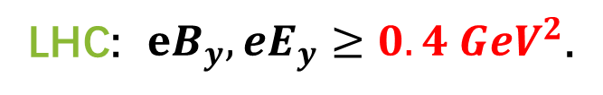

Introduction
One dimension
Two dimension
Three dimension
Summary
1.Strong EM field in heavy ion collisions
RHIC: $eB_{y}, eE_{y}≥0.04 GeV^{2}$;
LHC: $eB_{y}, eE_{y}≥0.4 GeV^{2}$.
W.Deng and X. Huang, PRC (2012).
Notes:
本PPT制作者公众号壹课，强烈谴责资料盗用

Slide 4
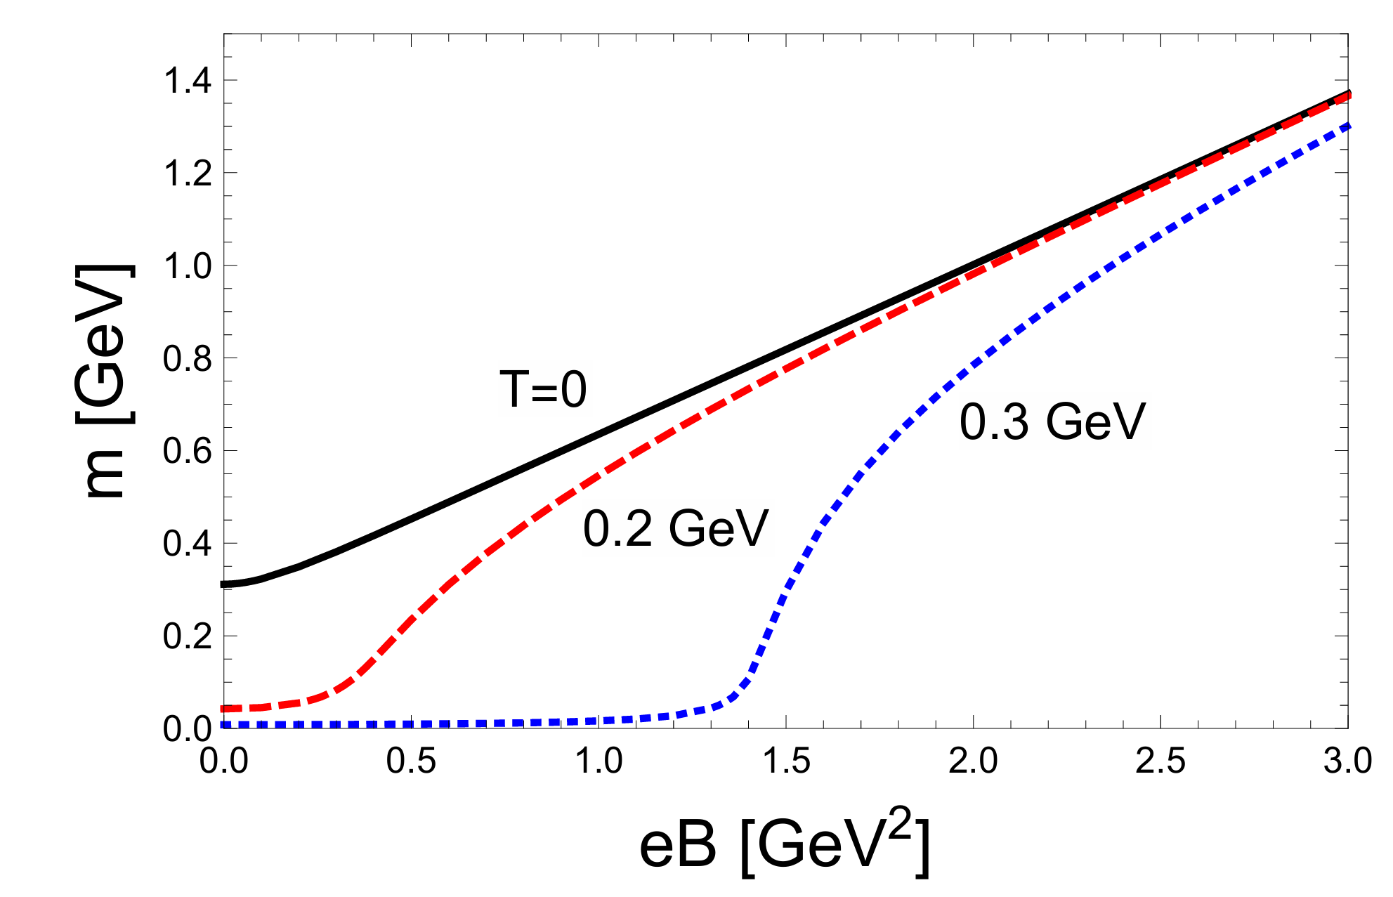
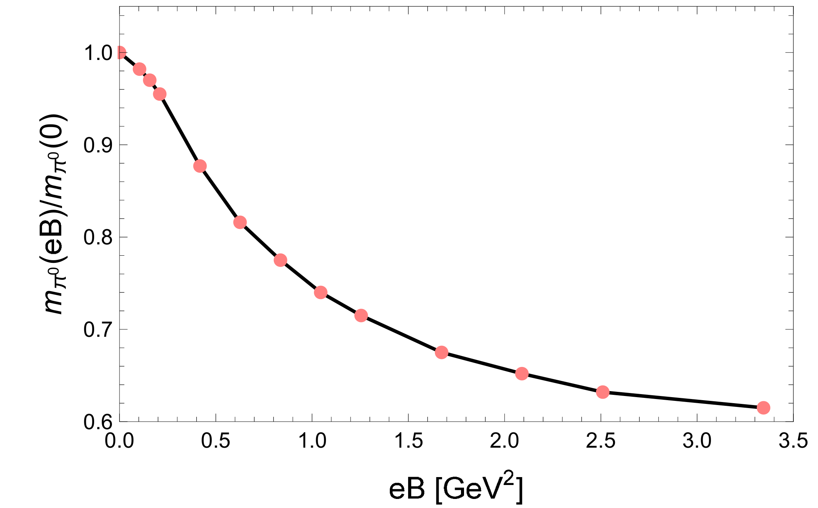
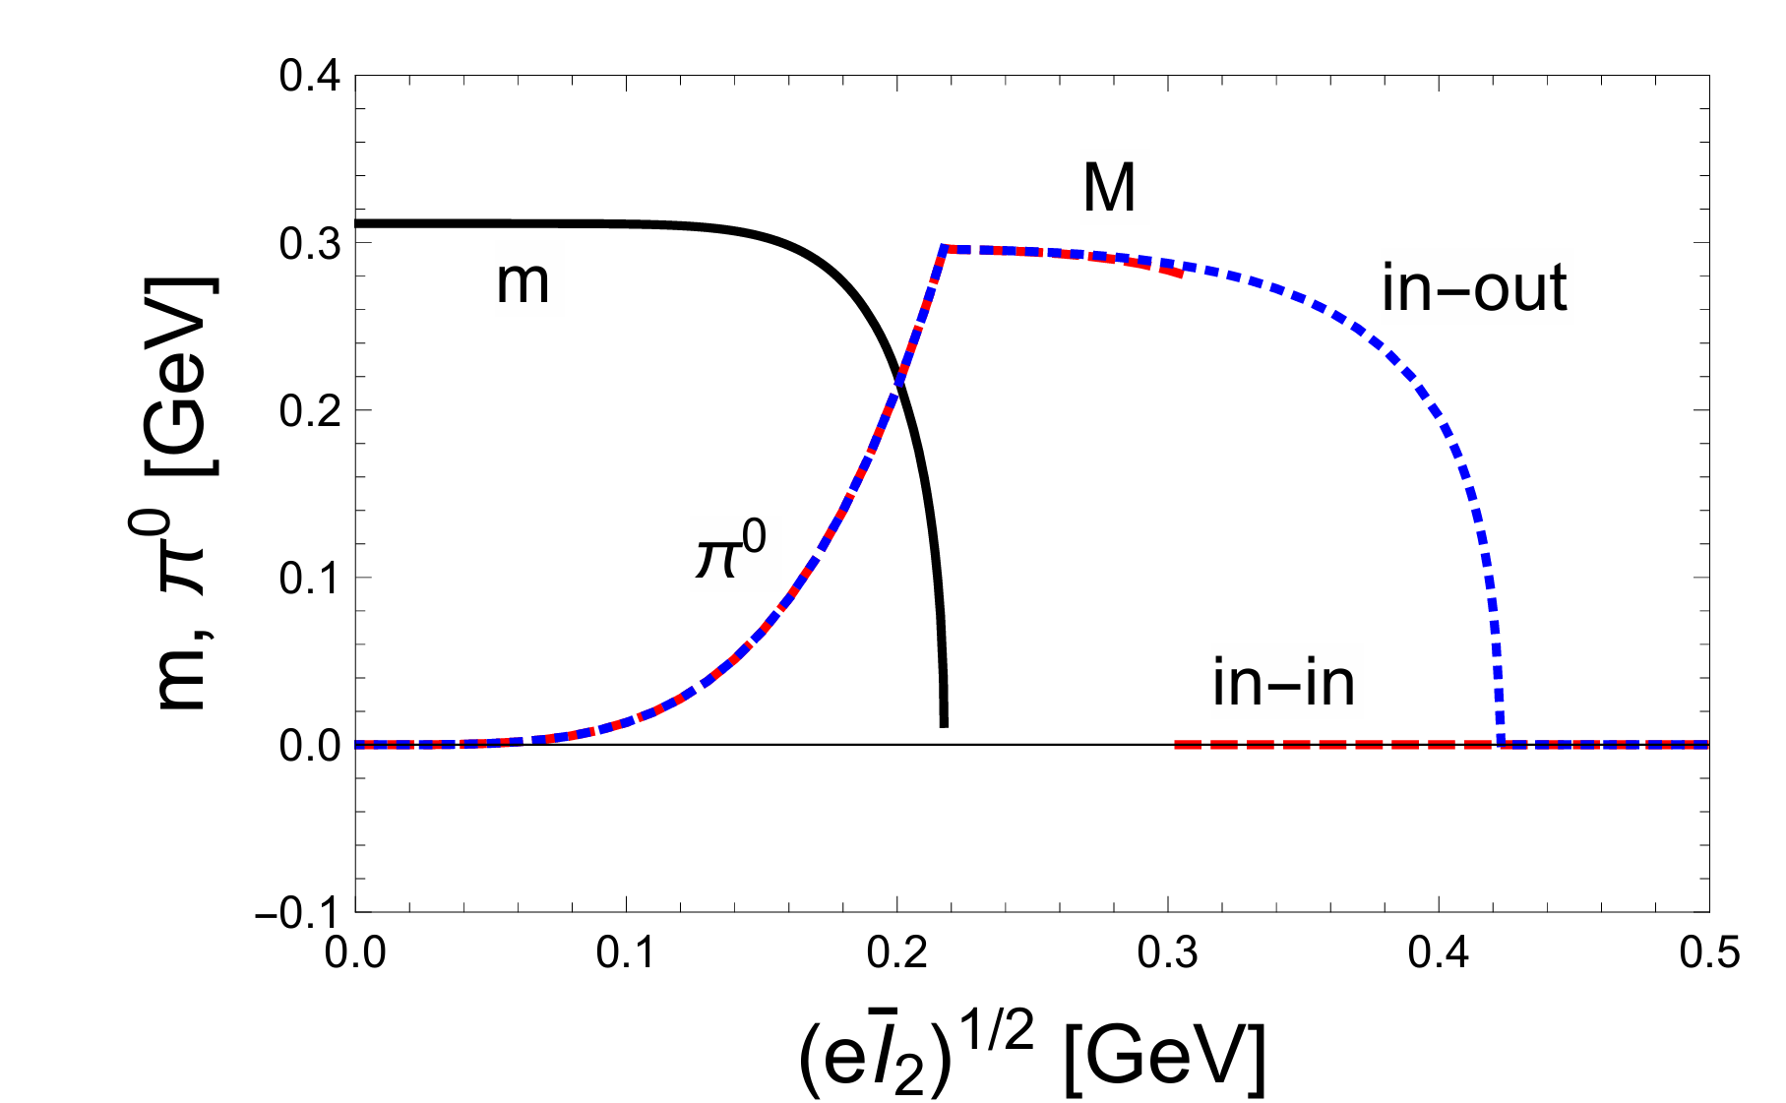
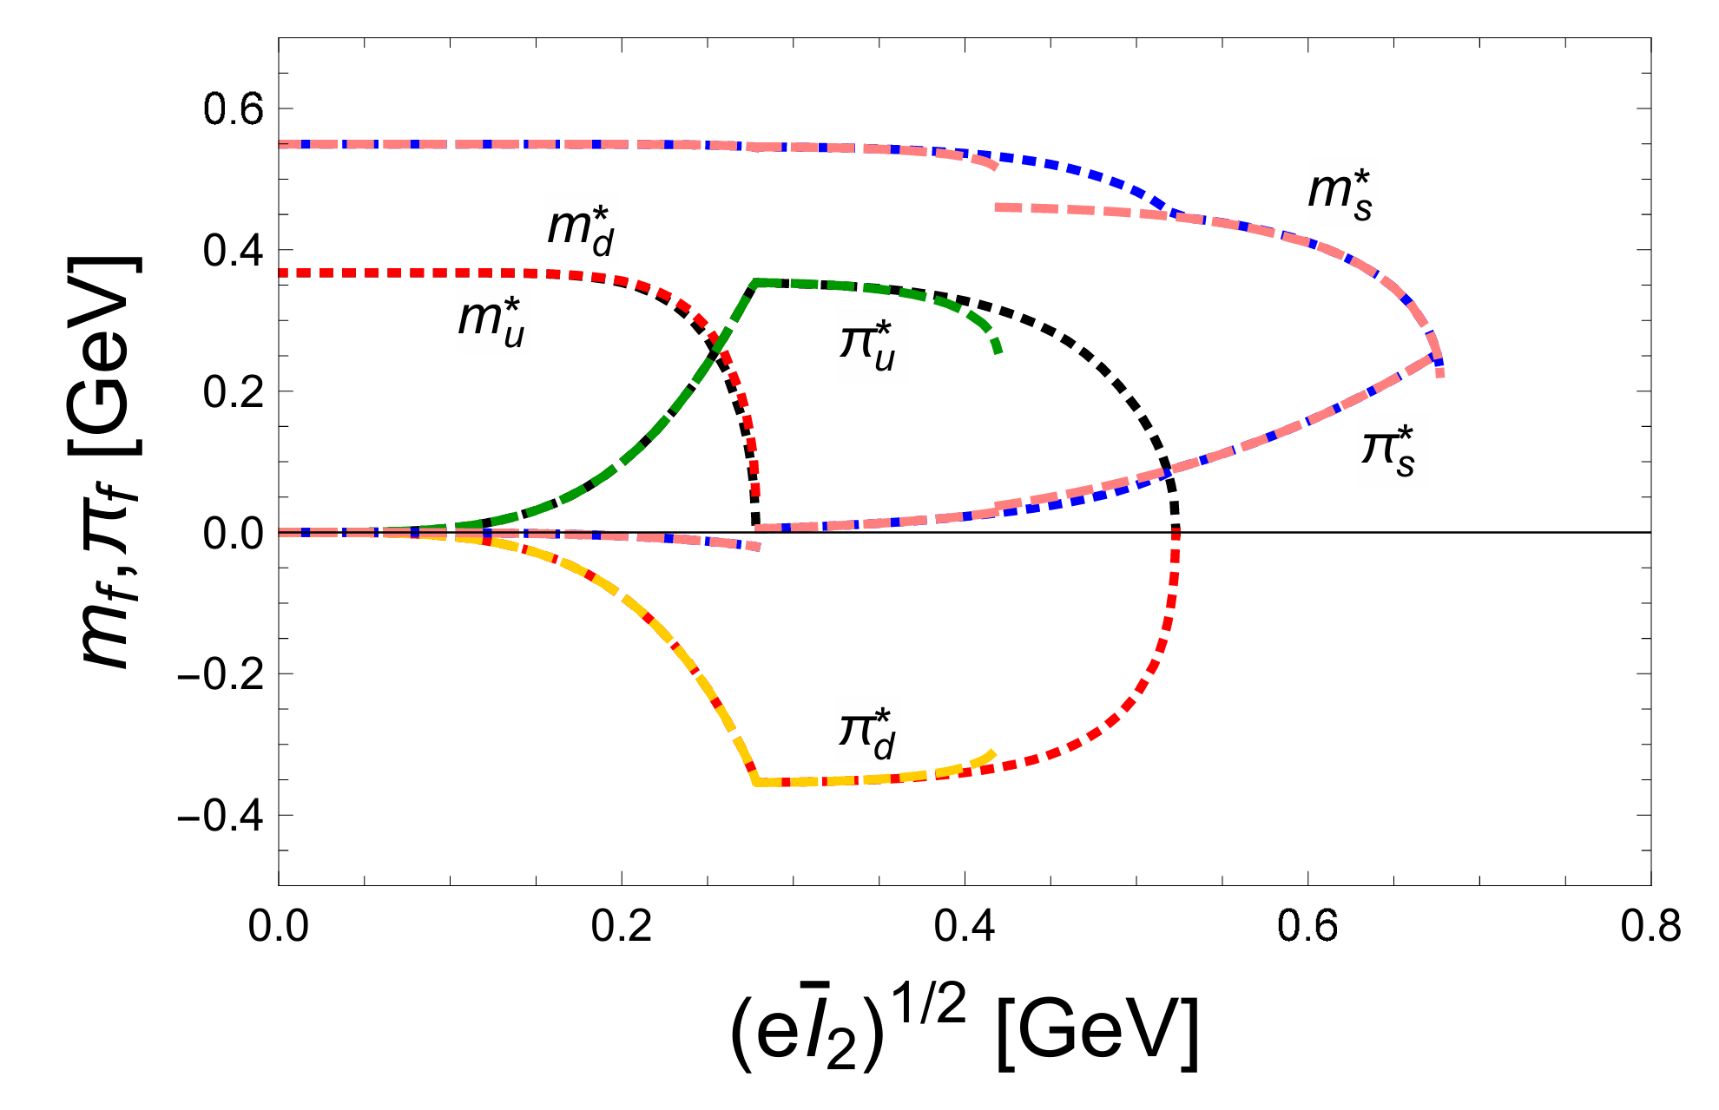
Introduction
One dimension
Two dimension
Three dimension
Summary
2. Properties of QCD in External Fields
G.Cao Eur.Phys.J.A 57 (2021) 9, 264
G.Cao Phys.Rev.D 101 (2020) 9, 094027
Notes:
本PPT制作者公众号壹课，强烈谴责资料盗用

Slide 5
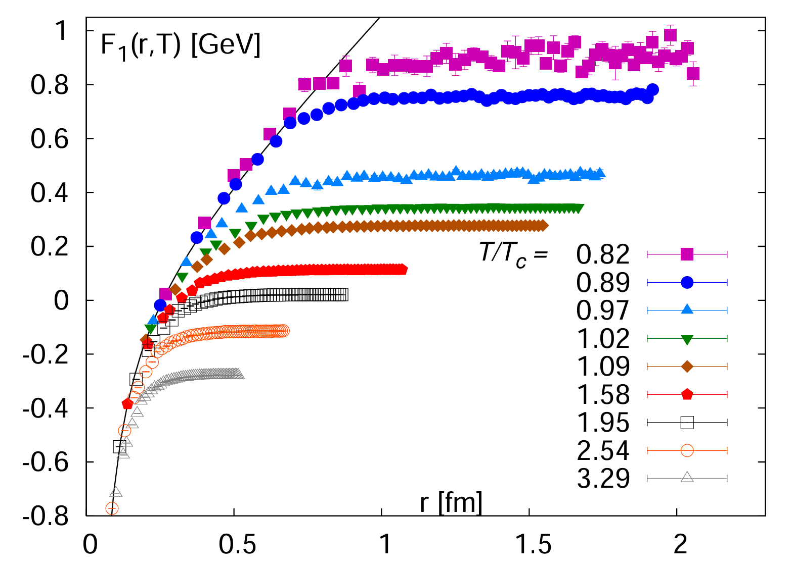
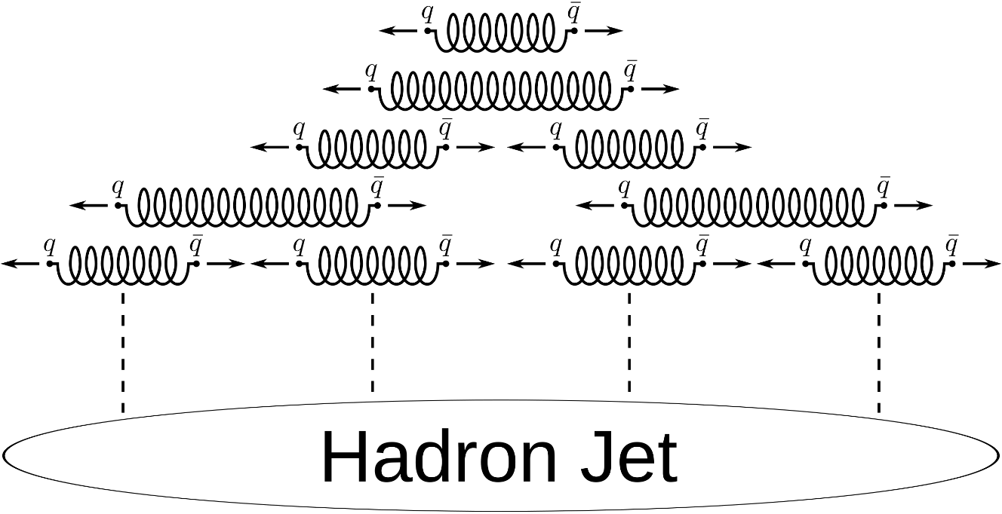
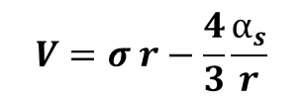
Introduction
One dimension
Two dimension
Three dimension
Summary
3. confinement and deconfinement
Cornell potential:
$$V=σ r−\frac{4}{3}\frac{α_{s}}{r}$$
P. Petreczky, Quarkonium in Hot Medium, J. Phys. G 37, 094009 (2010).
Notes:
本PPT制作者公众号壹课，强烈谴责资料盗用

Slide 6
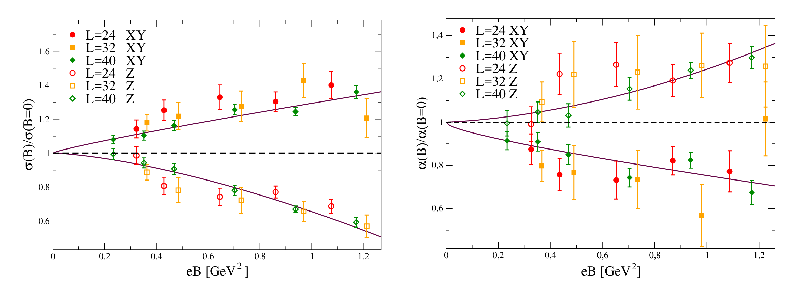
Introduction
One dimension
Two dimension
Three dimension
Summary
4.Heavy flavor mesons
Review: J. Zhao, et. al., Prog. Part. Nucl. Phys. 114, 103801 (2020).
Notes:
本PPT制作者公众号壹课，强烈谴责资料盗用

Slide 7

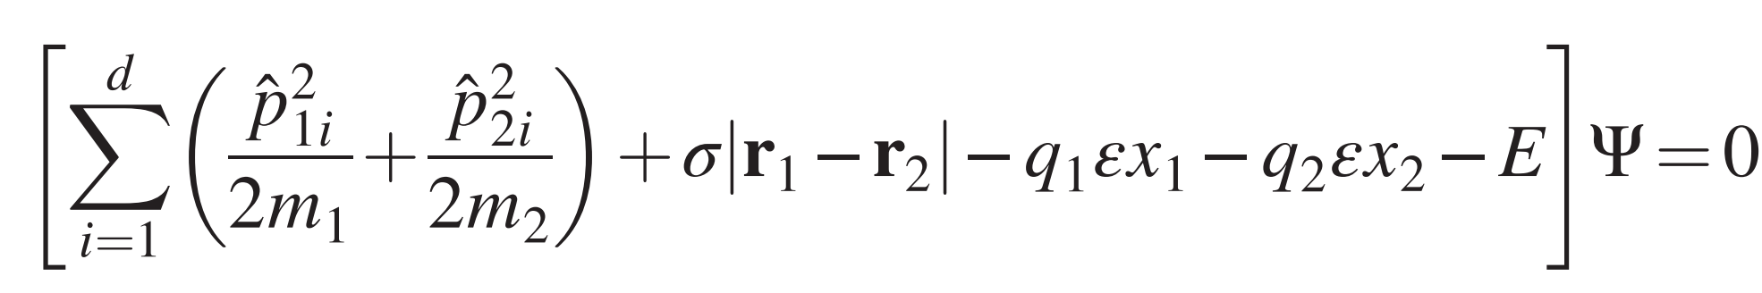


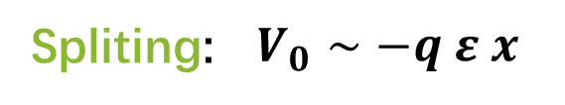
Introduction
One dimension
Two dimension
Three dimension
Summary
D-dimensional Schrodinger equation
$$\vec{ε}$$
+
+
-
-
Confinement: $V∼σ r$
Spliting: $V_{0}∼−q ε x$
Two-body Schrodinger equation:
Notes:
本PPT制作者公众号壹课，强烈谴责资料盗用

Slide 8

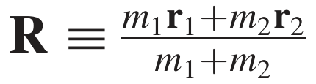
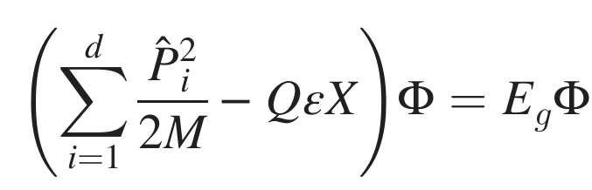
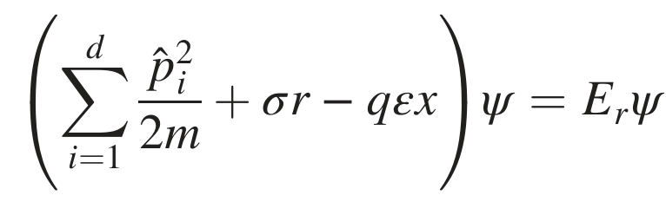
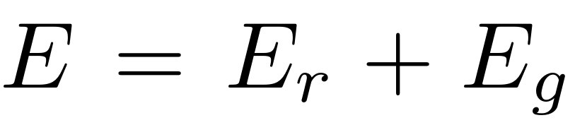
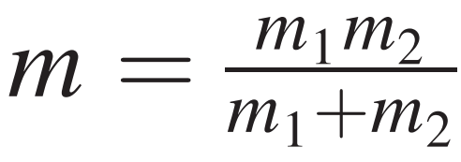
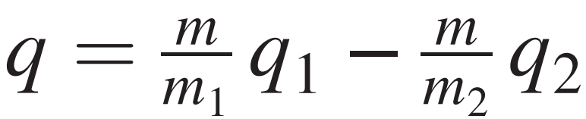
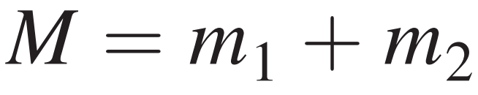
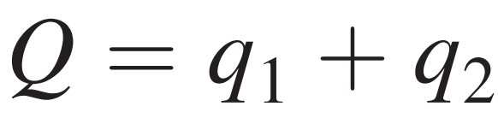
Introduction
One dimension
Two dimension
Three dimension
Summary
Transform to the center of mass frame:
relative
center of mass
Take the second particle as stationary and positively charged
We are just interested in the relative motion and will concentrate on the relative part
Notes:
本PPT制作者公众号壹课，强烈谴责资料盗用

Slide 9
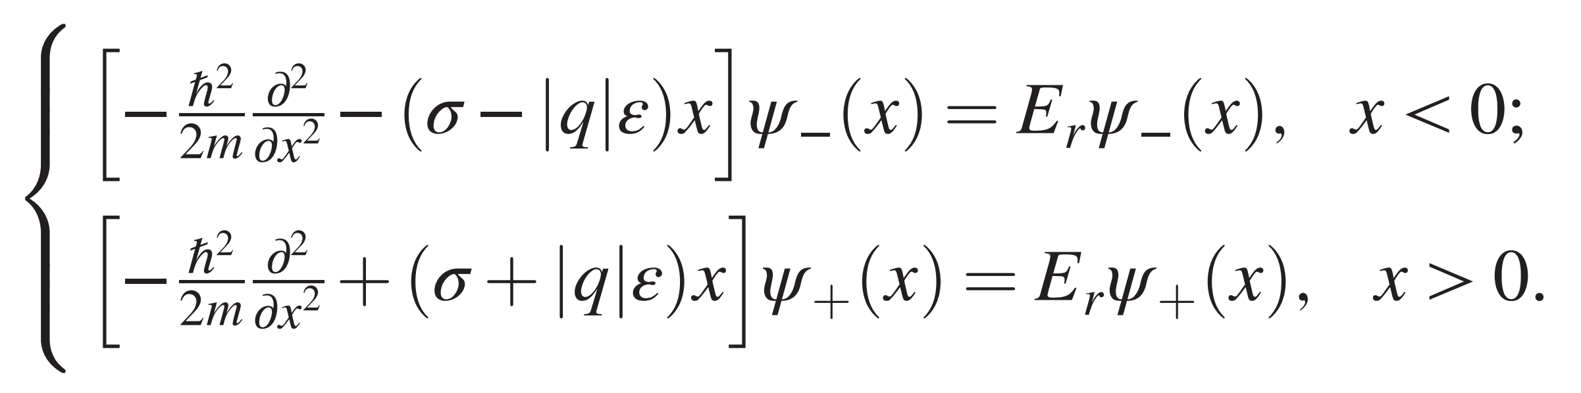
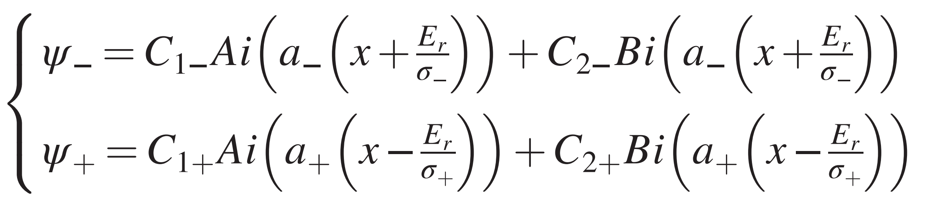
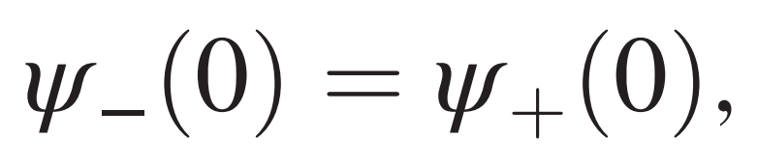
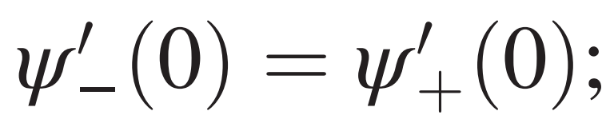
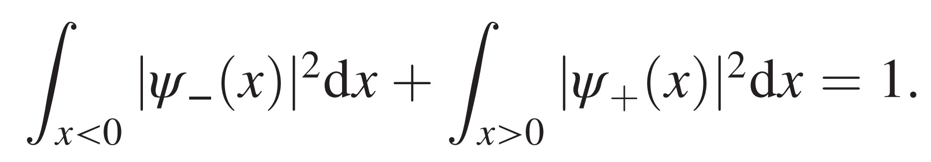
Introduction
One dimension
Two dimension
Three dimension
Summary
Two branches
Wave function
Continuity condition
Normalization condition
Notes:
本PPT制作者公众号壹课，强烈谴责资料盗用

Slide 10
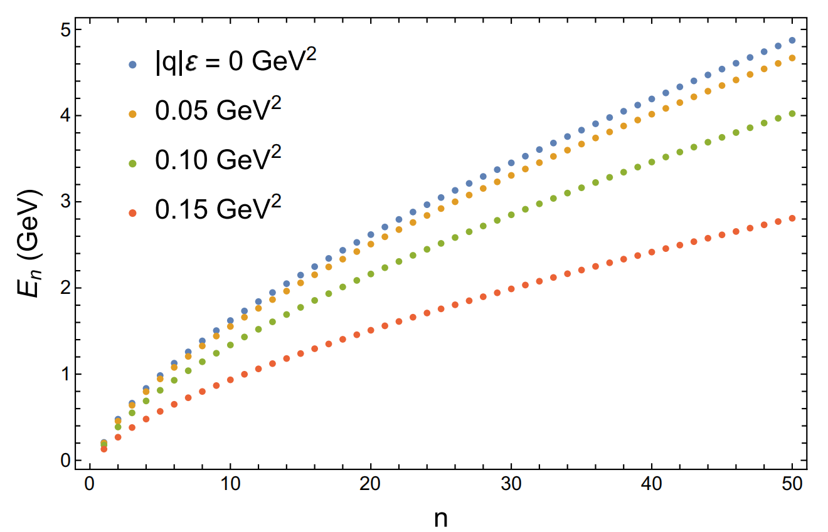
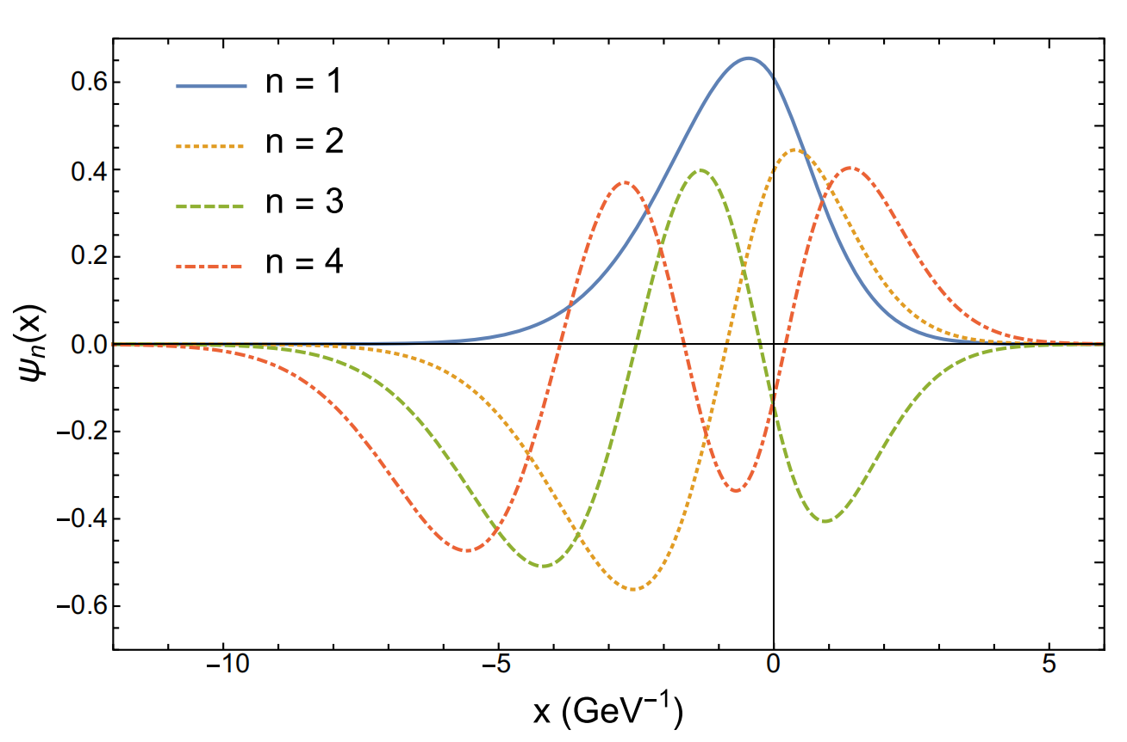
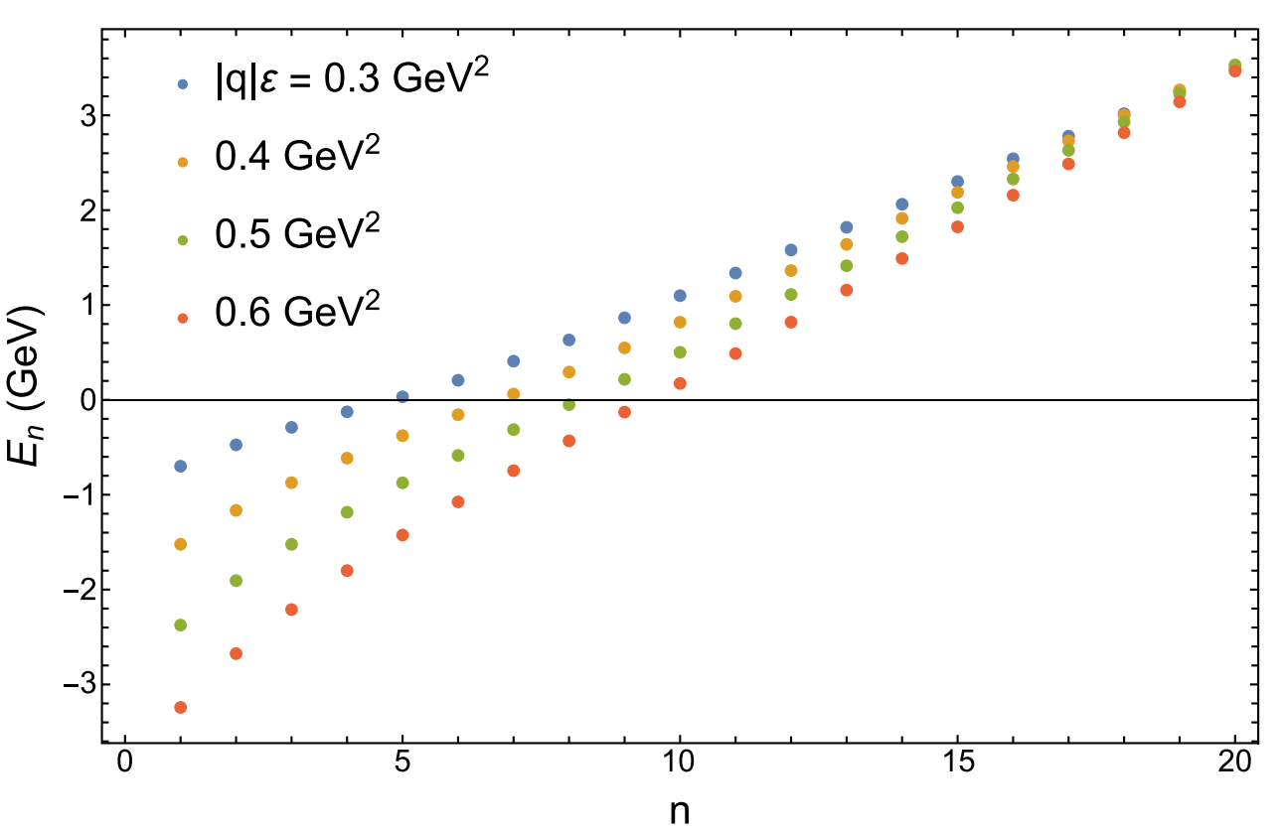
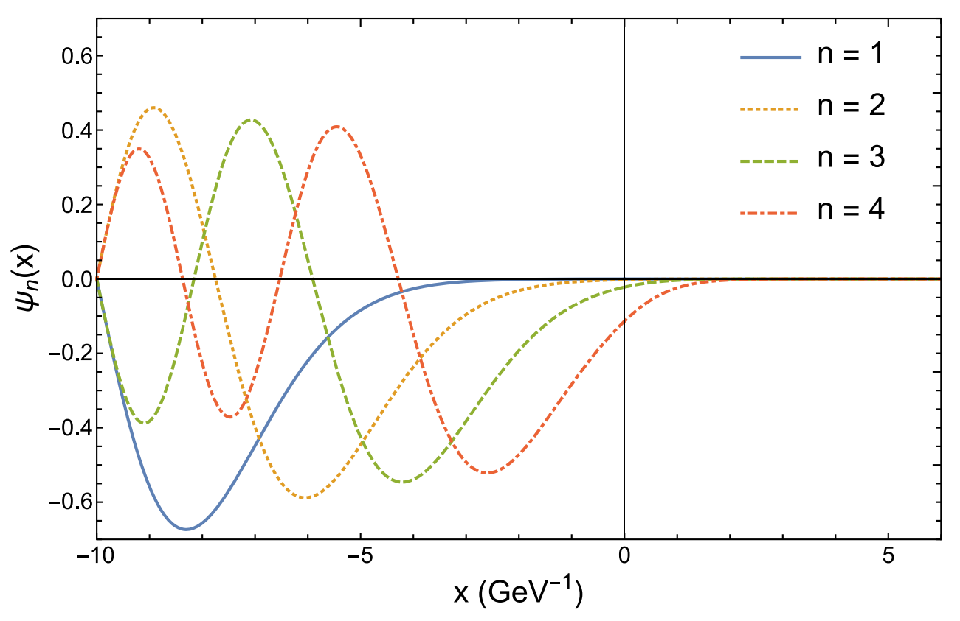


Introduction
One dimension
Two dimension
Three dimension
Summary
$$1.σ>|q|ε$$
2$.σ<|q|ε$
Notes:
本PPT制作者公众号壹课，强烈谴责资料盗用

Slide 11
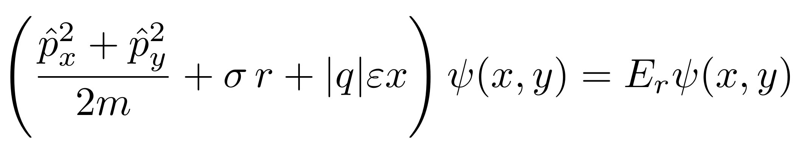
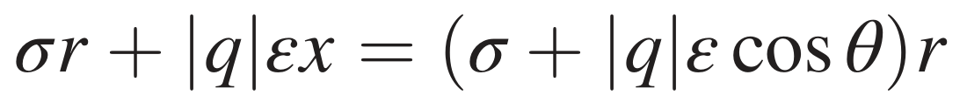
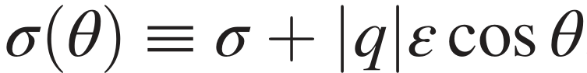
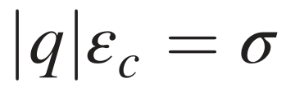
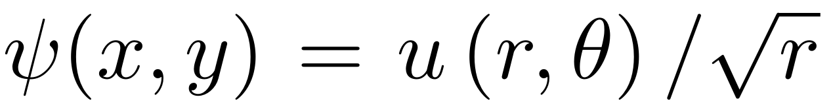
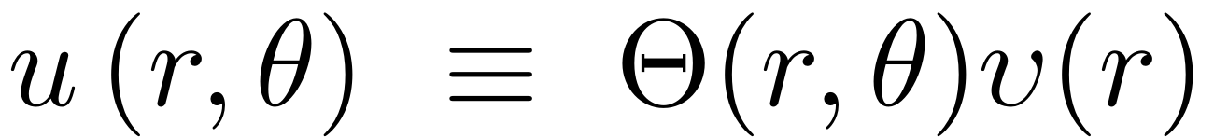
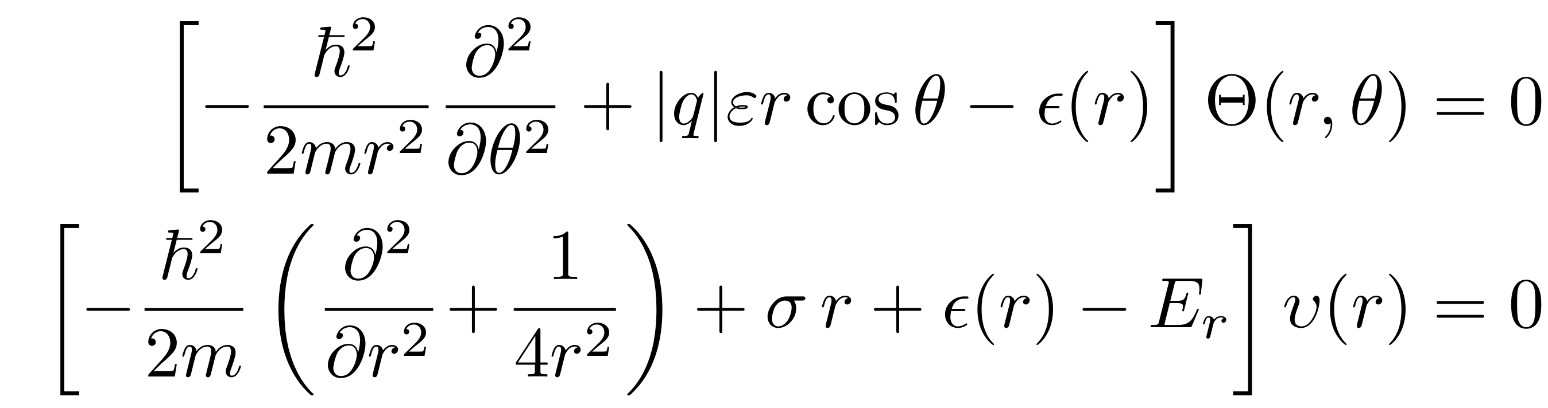
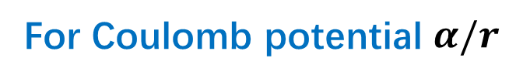
Introduction
One dimension
Two dimension
Three dimension
Summary
Two dimension
Landau, “Quantum mechanics”
For Coulomb potential $α/r$
Solve with parabolic coordinate
is also the critical electric field
In Polar coordinate, assume
Notes:
本PPT制作者公众号壹课，强烈谴责资料盗用

Slide 12
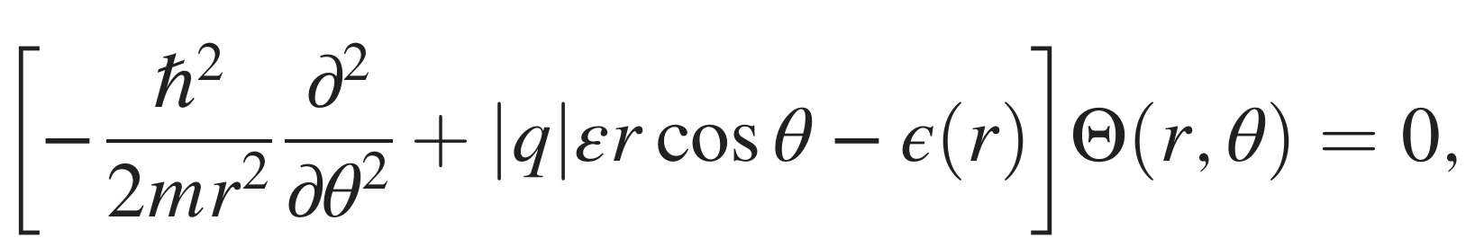
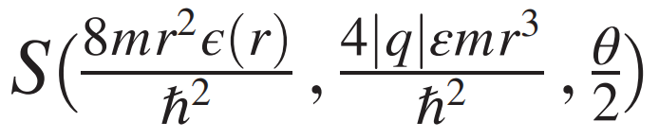
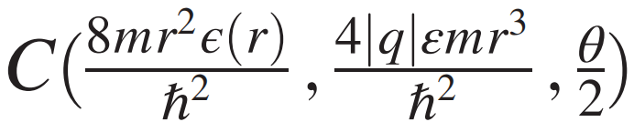
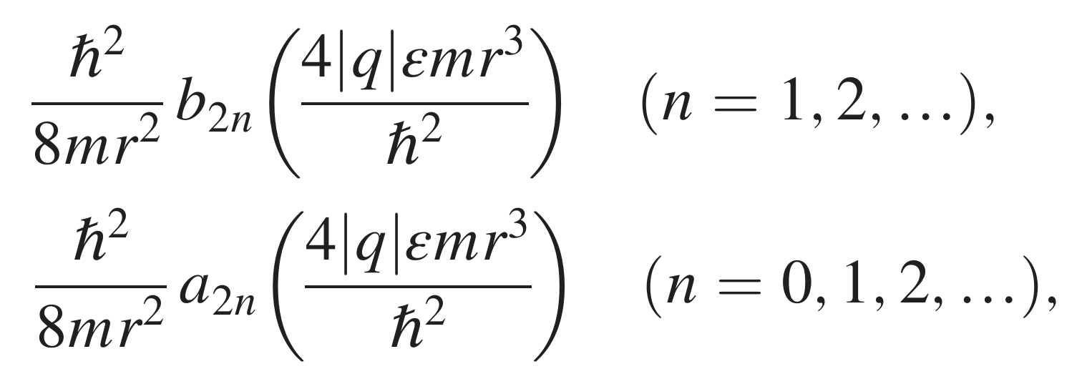
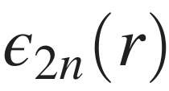
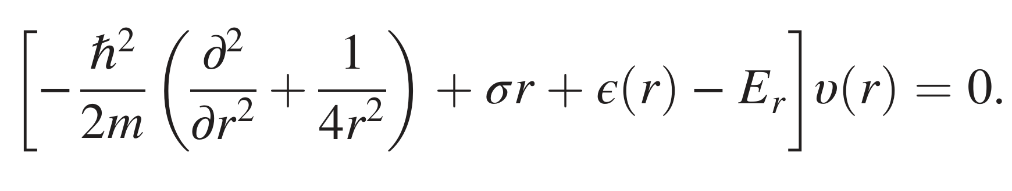
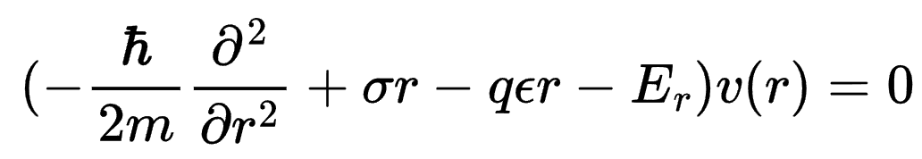


Introduction
One dimension
Two dimension
Three dimension
Summary
Two dimension
$$r→∞$$
Mathieu functions
The 2π-periodicity constrains the eigenenergy
=
$$ε\left(r\right)≈−\left|q\right|εr$$
Effective radial equation
Notes:
本PPT制作者公众号壹课，强烈谴责资料盗用

Slide 13
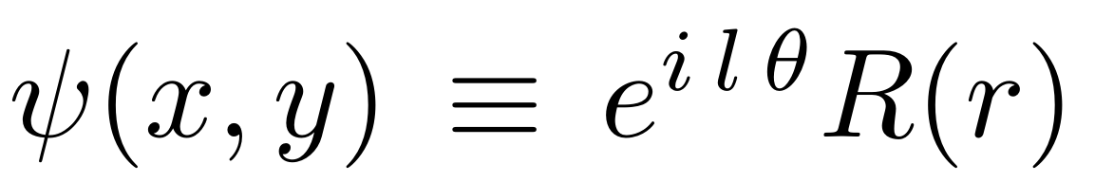
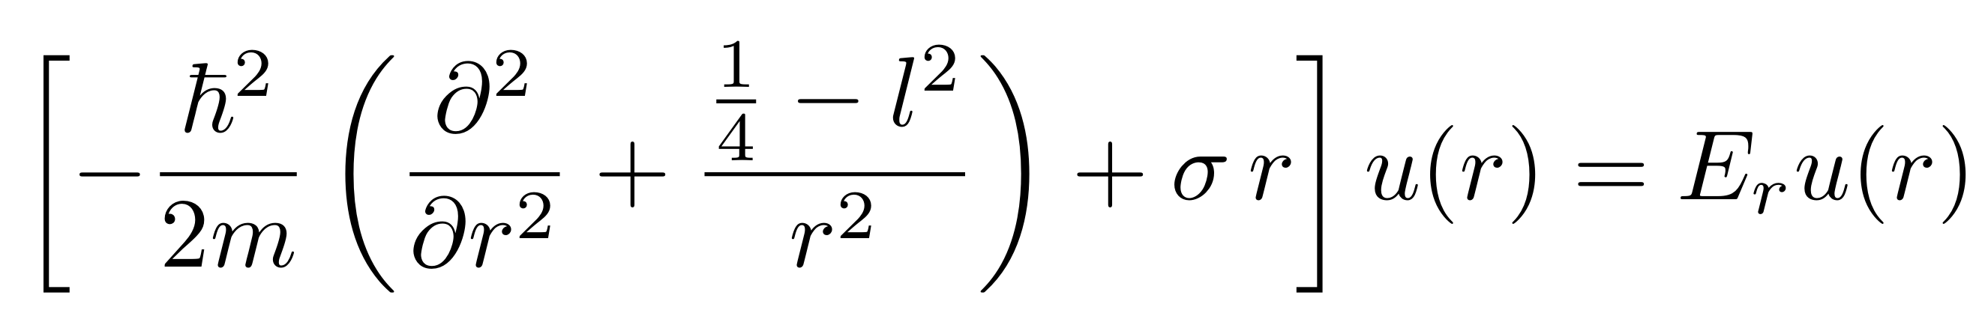
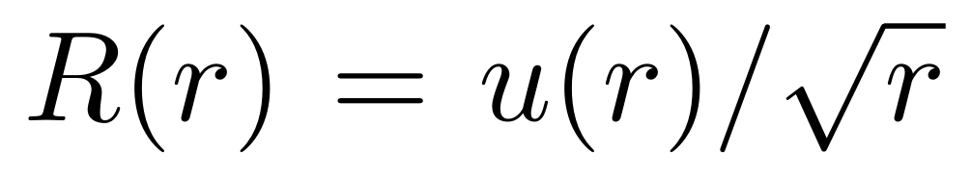
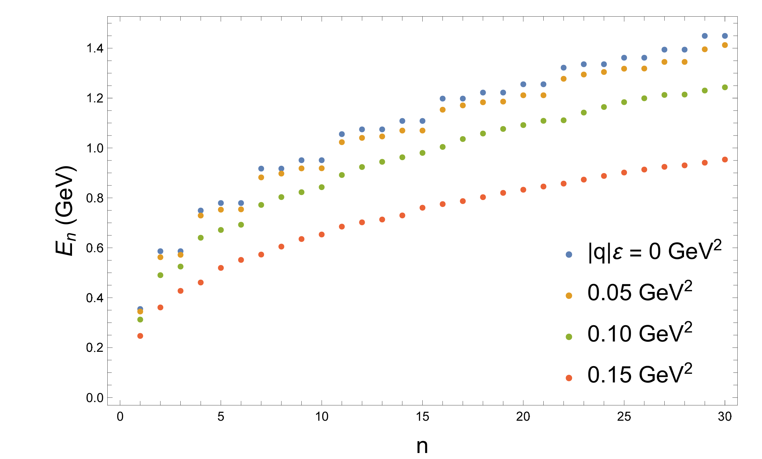


Introduction
One dimension
Two dimension
Three dimension
Summary
In the limit of $ε$=0
Notes:
本PPT制作者公众号壹课，强烈谴责资料盗用

Slide 14








Introduction
One dimension
Two dimension
Three dimension
Summary
Three dimension
Landau, “Quantum mechanics”
For Coulomb potential $α/r$
Solve with parabolic coordinate
In Cylindrical coordinate, assume
$$r→∞$$
Mathieu functions
$$ε\left(r\right)≈−\left|q\right|εr$$
Notes:
本PPT制作者公众号壹课，强烈谴责资料盗用

Slide 15






Introduction
One dimension
Two dimension
Three dimension
Summary
Three dimension
In the limit of $ε$=0
Notes:
本PPT制作者公众号壹课，强烈谴责资料盗用

Slide 16




Introduction
One dimension
Two dimension
Three dimension
Summary
B.Wu,B.Chen and X.Zhao, Nucl.Phys.Rev. 36 (2019) 3, 278-288
Some radial excition of quarkonium
Notes:
本PPT制作者公众号壹课，强烈谴责资料盗用

Slide 17




Introduction
One dimension
Two dimension
Three dimension
Summary
There is a critical electric field which means deconfinement of heavy mesons and electric dipole moment prefer to be parallel to the electric field
The electric field reduces the relative of heavy-flavor mesons
Electric field would break the degeneracy
The relative energes of and would slghtly increase first then decreases though decreases monotonically
Notes:
本PPT制作者公众号壹课，强烈谴责资料盗用

