Slide 1


Measurements of Photon-photon Interactions
in Ultra-Peripheral Collisions
Wangmei Zha
University of Science and Technology of China
The 3rd Workshop on Ultra-Peripheral Collisions Physics,
South China Normal University, Guangzhou − 09/11/2025

Slide 2
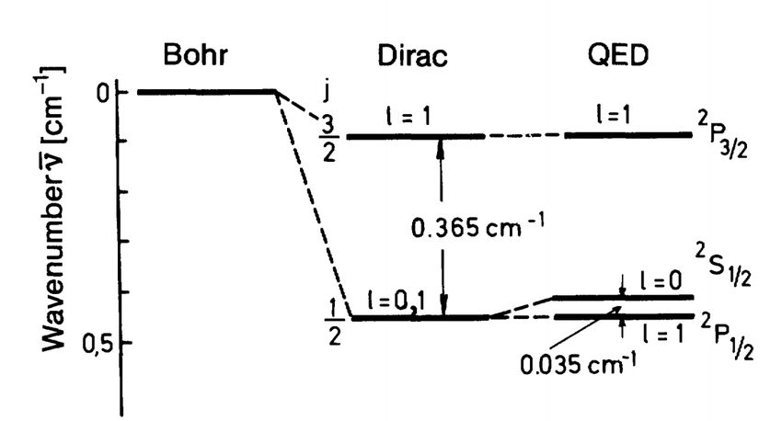
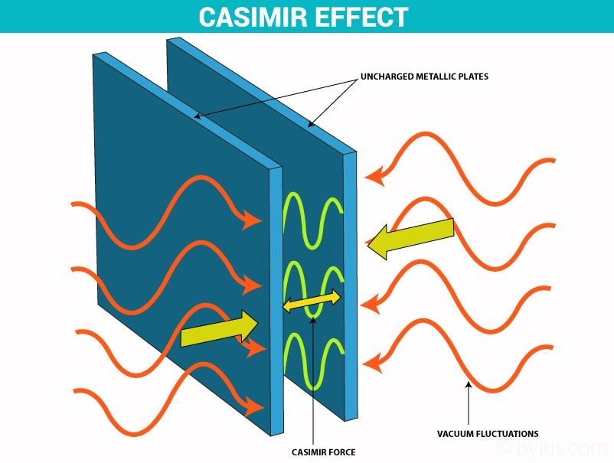
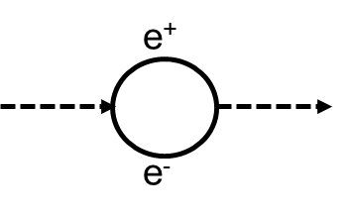
The Vacuum --- Exactly Nothing?
Occupies all space
Has no charge
Has no angular momentum (isotropic)
Has no preferred origin (homogeneous)
Non-dispersive (c(λ)=constant)
Energy density = ?Zero??
W. E. Lamb, and R. C. Retherford,
Phys. Rev. 72 (1947) 241
Zero point energy
  The random quantum fluctuations of virtual pairs
H.B.G. Casimir
Indag.Math. 10 (1948) 261-263

Slide 3
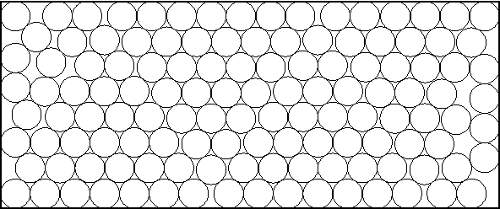
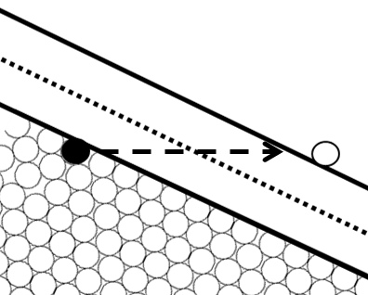
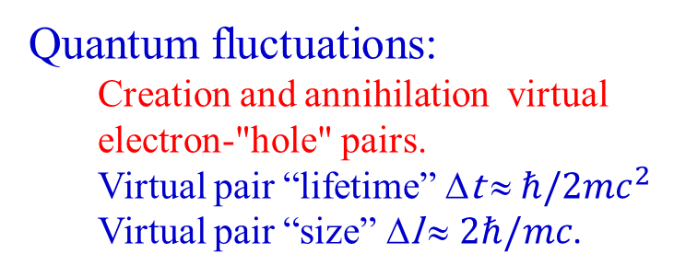

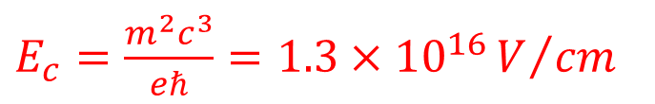

Sparking the Vacuum --- The Schwinger Mechanism
An insulator with a negative energy "sea" filled with electrons
Dirac's View of Vacuum
E
mc²
E=0
-mc²
Quantum fluctuations:
  Creation and annihilation virtual electron-"hole" pairs.
  Virtual pair “lifetime” Δt ≈$ℏ/2mc^{2}$
  Virtual pair “size” Δl ≈ $2ℏ/mc$.
With an electric external field
J.S. Schwinger
Phys. Rev. 82 (1951) 664
E
$$V\left(x\right)=−eEx$$
$$eE_{c}l=2mc^{2}$$
$E_{c}=\frac{m^{2}c^{3}}{eℏ}=1.3×{10}^{16}V/{cm}$
The Schwinger Critical Field
x

Slide 4
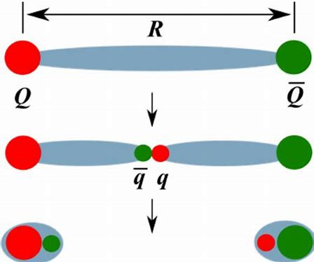
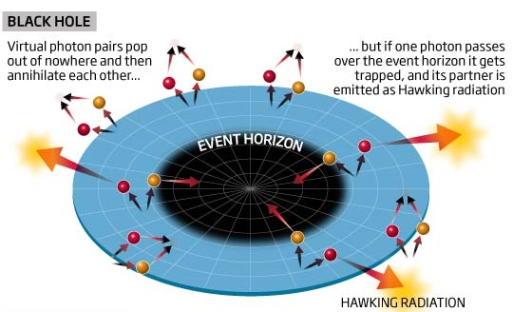
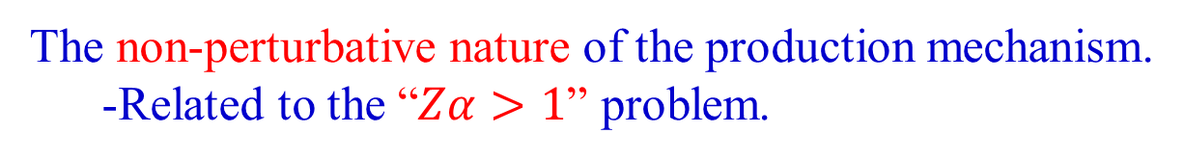
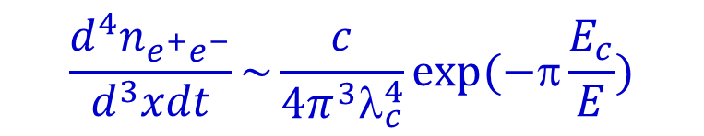
Why should We Care?
The production rate of Schwinger Mechanism at a given constant electric field E:
C. Itzykson, J.B. Zuber
Quantum Electrodynamics of Strong Fields
$$\frac{d^{4}n_{e^{+}e^{−}}}{d^{3}xdt}\sim \frac{c}{4π^{3}λ_{c}^{4}}exp⁡(−π\frac{E_{c}}{E})$$
The non-perturbative nature of the production mechanism.
  -Related to the “$Zα>1$” problem.
Motivated analysis in many parts of quantum field theory:
  -Models of string breaking in QCD.
  -Insights into Hawking radiation near black holes.

Slide 5
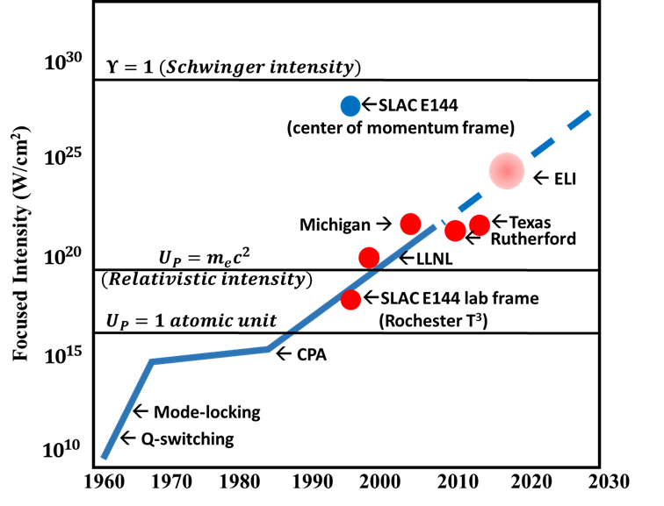
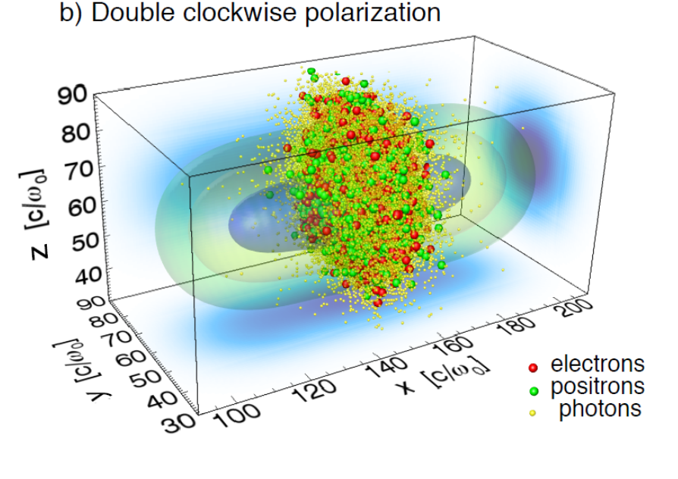
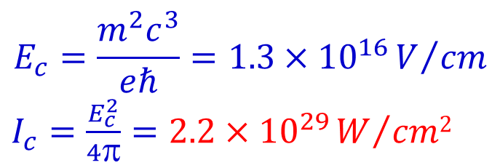
How to Achieve in Laboratory
Colliding laser beams above the Schwinger threshold
$$E_{c}=\frac{m^{2}c^{3}}{eℏ}=1.3×{10}^{16}V/{cm}$$
$I_{c}=\frac{E_{c}^{2}}{4π}=2.2×{10}^{29}W/{cm2}$
Still orders of magnitude lower than the Schwinger threshold!

Slide 6
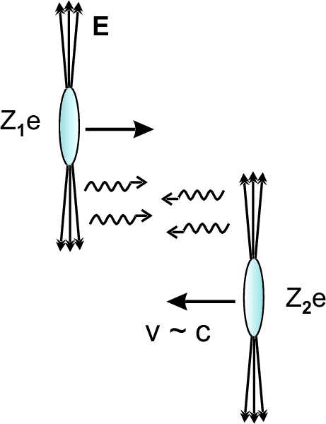
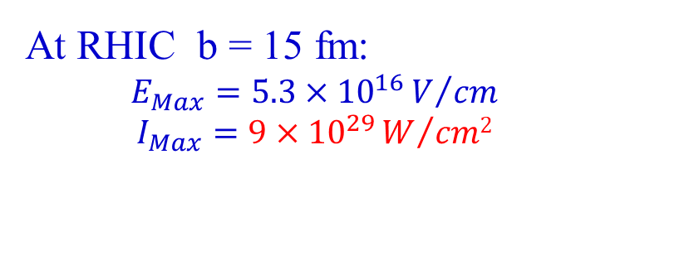
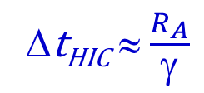

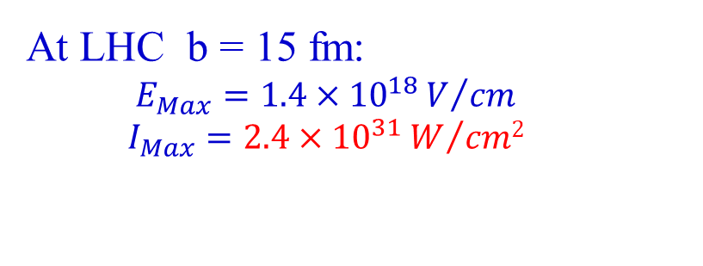
More powerful “laser” facility --- Heavy Ion Collider
At RHIC b = 15 fm:
  $$E_{Max}=5.3×{10}^{16}V/{cm}$$
  $$I_{Max}=9×{10}^{29}W/{cm2}$$
$${≫I}_{c}=2.2×{10}^{29}W/{cm2}$$
At LHC b = 15 fm:
  $$E_{Max}=1.4×{10}^{18}V/{cm}$$
  $$I_{Max}=2.4×{10}^{31}W/{cm2}$$
Colliding Clouds of Quasi-real photons
The duration time of the strong field in heavy-ion collisions:
Δt_{HIC} ≈$\frac{R_{A}}{γ}$
0.06 fm/c at RHIC 0.0025fm/c at LHC
The pulse duration of PW laser system: Δt_{Laser} ~ 10⁸ fm/c
  Virtual pair “lifetime” Δt ≈$ℏ/2mc^{2} \text{≈} 5×{10}^{3}$fm/c
Non-perturbative
Δt_{Laser} >> Δt >> Δt_{HIC}
Perturbative

Slide 7
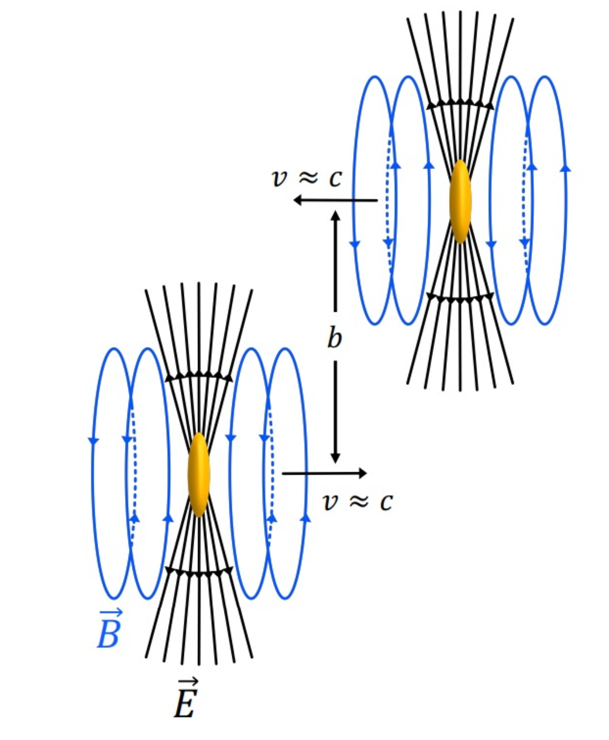
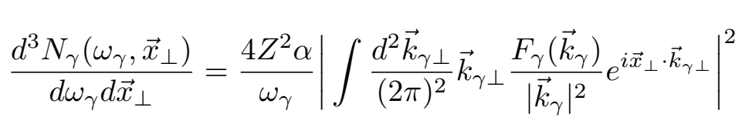
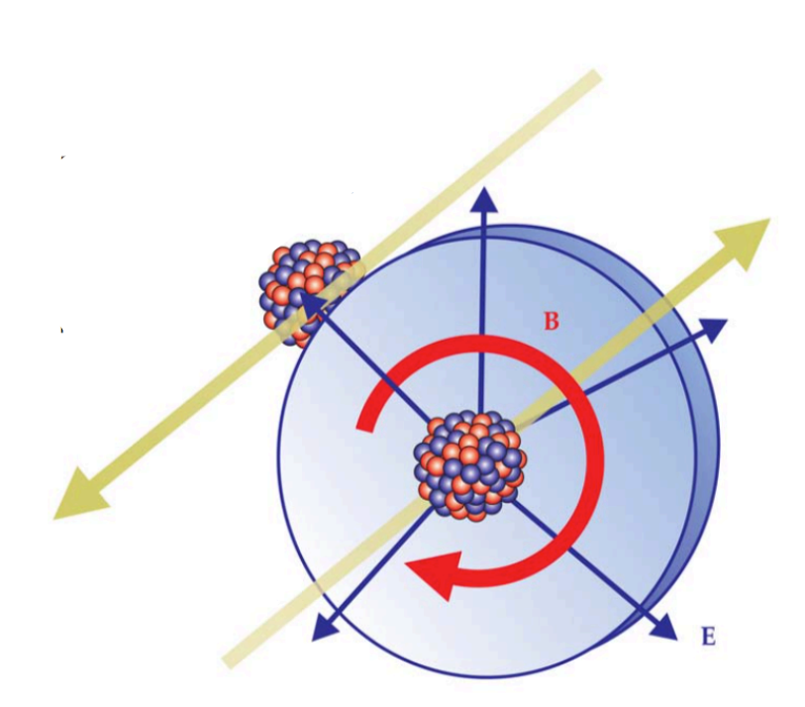
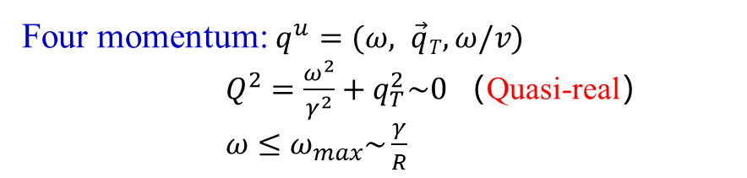
The Quasi-real Photons in Heavy-ion Collisions
E.J. Williams, Phys. Rev. 45 (1934) 729-730
Equivalent Photon Approximation
C.F. von Weizsacker, Z. Phys. 88 (1934) 612-625
Four momentum: $q^{u}=(ω, \vec{q}T,ω/v)$
$Q^{2}=\frac{ω^{2}}{γ^{2}}+q_{T}^{2}\sim 0$ （Quasi-real）
$ω≤ω_{max}\sim \frac{γ}{R}$
View “quasi-real” photons as partons
Larger transverse extend
    R_{Nuc} ∼ 6.3 fm (Au) R_{photons} >> R_{Nuc}
    Strong interactions without nuclear overalp
Ultra-peripheral collisions (UPC， b>2R_{Nuc})
S. Klein, Physics Today 70(10) (2017) 40

Slide 8
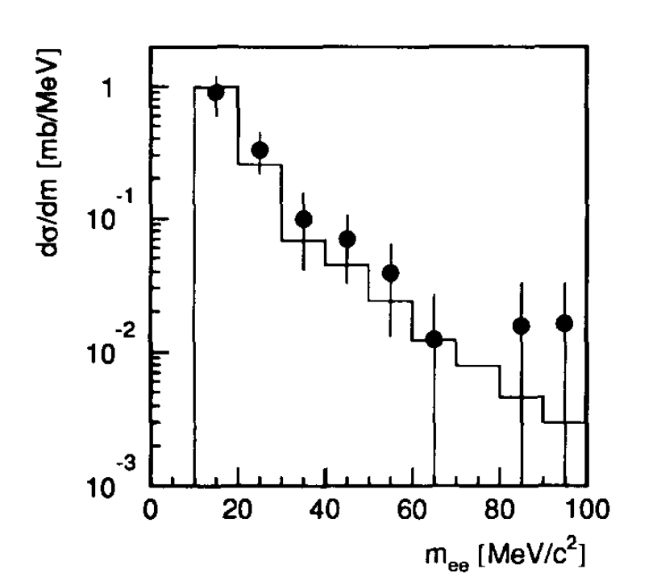
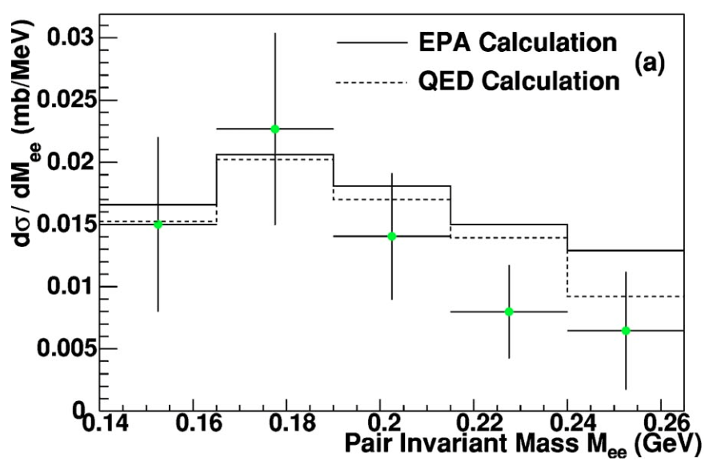
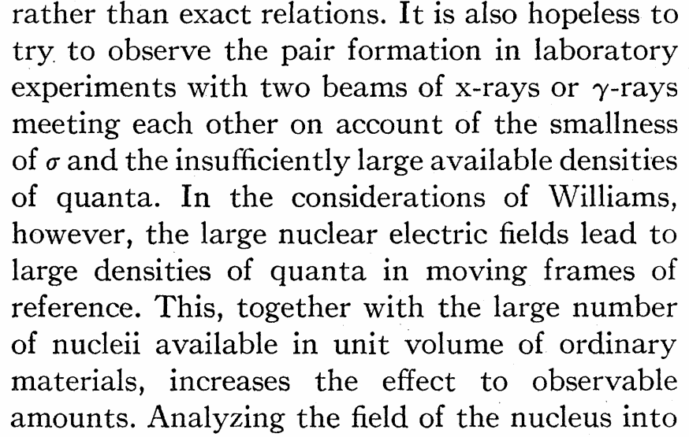
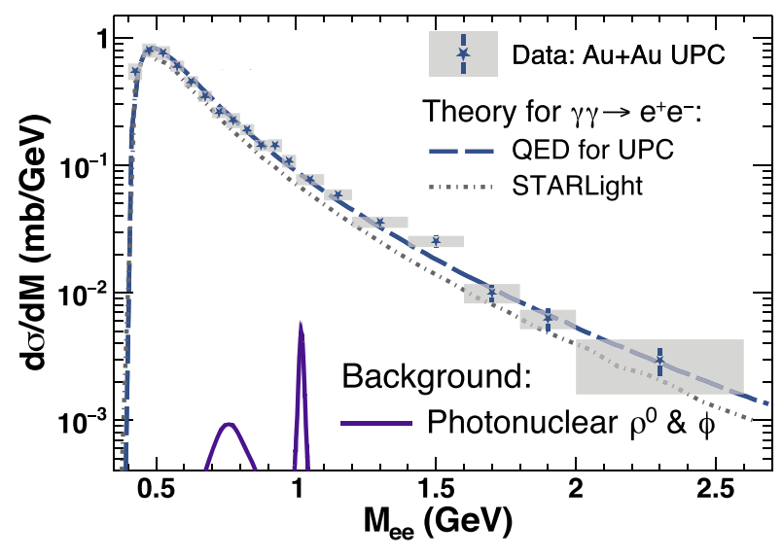
Collision of Two Light Quanta：Di-Electron
NA45, Phys. Lett. B 332 (1994) 471-476
STAR, Phys. Rev. C 70 (2004) 031902
STAR, Phys. Rev. Lett. 127 (2021) 052302
Breit-Wheeler Process
Observation of B-W Process！
G. Breit and J. A. Wheeler, Phys. Rev. 46 (1934) 1087

Slide 9
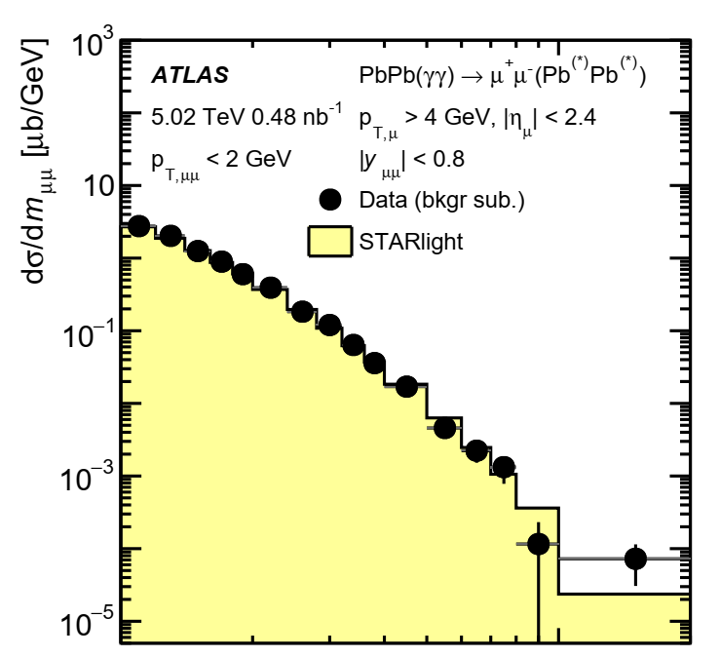
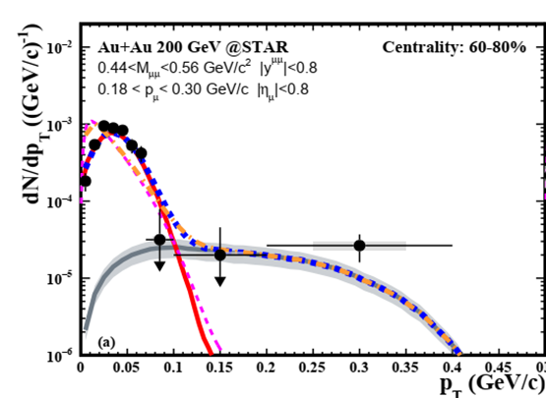
Collision of Two Light Quanta：Di-Muon
ATLAS, Phys. Rev. C 104, 024906 (2021)
Observation of dimuon photoproduction in UPC and PC！

Slide 10
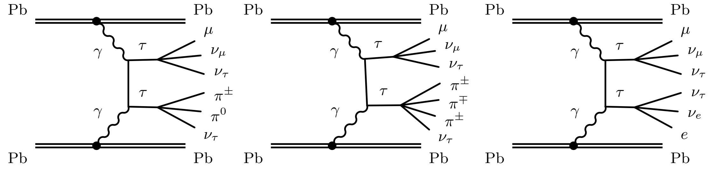
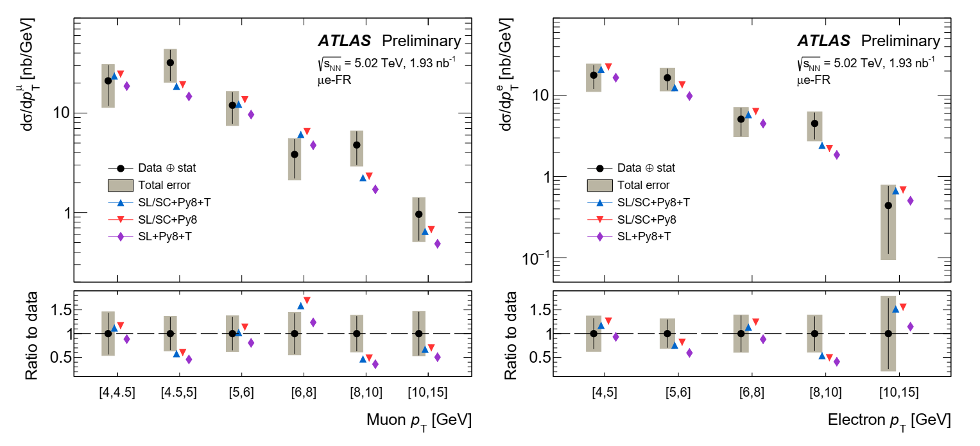
Collision of Two Light Quanta：Di-Tau
CMS: Phys. Rev. Lett. 131 (2023) 151803
ATLAS: Phys. Rev. Lett. 131 (2023) 151802
ATLAS-CONF-2025-004
Extends light-by-light scattering to the τ-lepton sector!

Slide 11
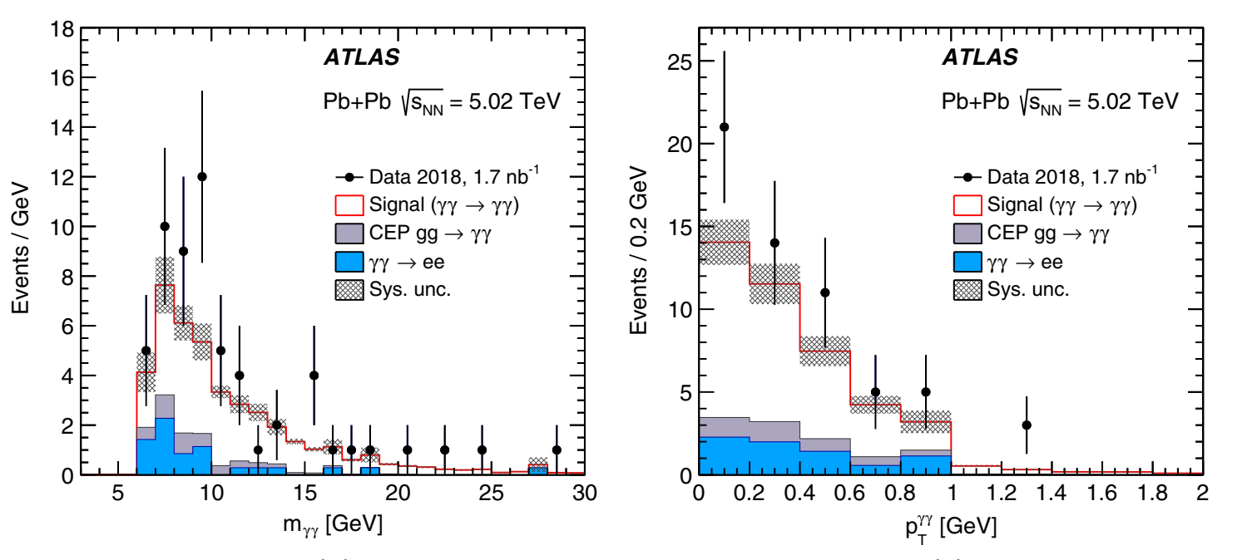
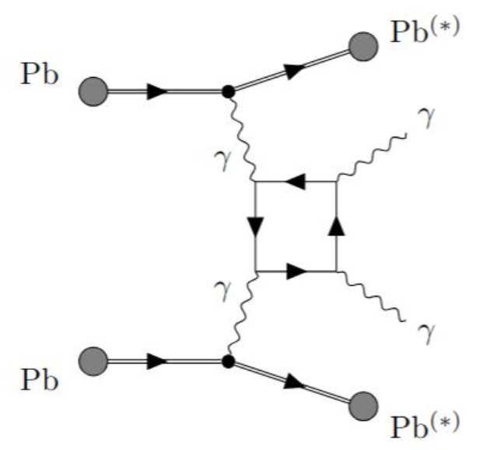
Collision of Two Light Quanta：Di-Photon
ATLAS, Nature Phys. 13 (2017) 852 ATLAS, Phys.Rev.Lett. 123 (2019) 052001
From “quasi-real” to real！

Slide 12
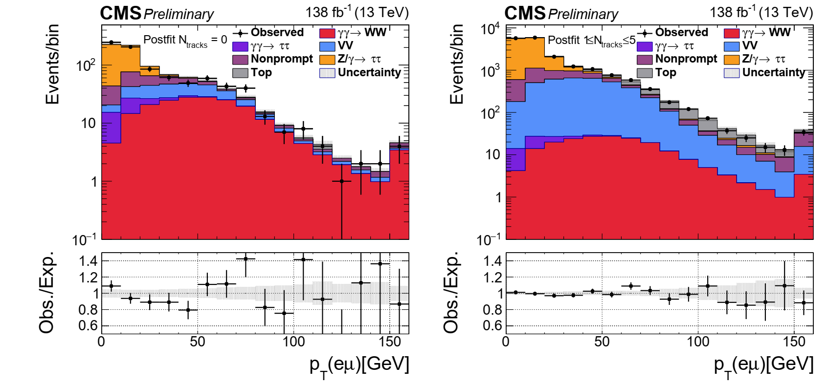
W boson pair production
CMS, JHEP 08 (2016) 119 CMS PAS SMP-24-019

Slide 13
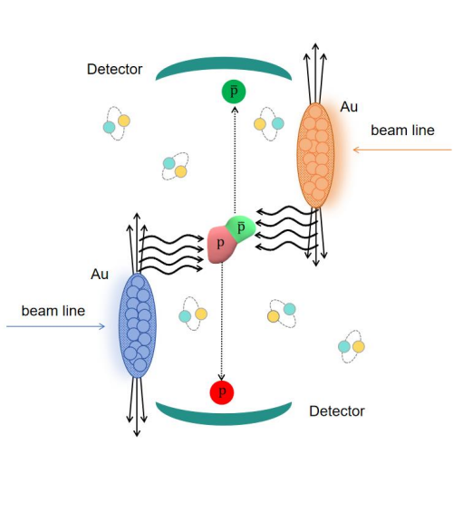
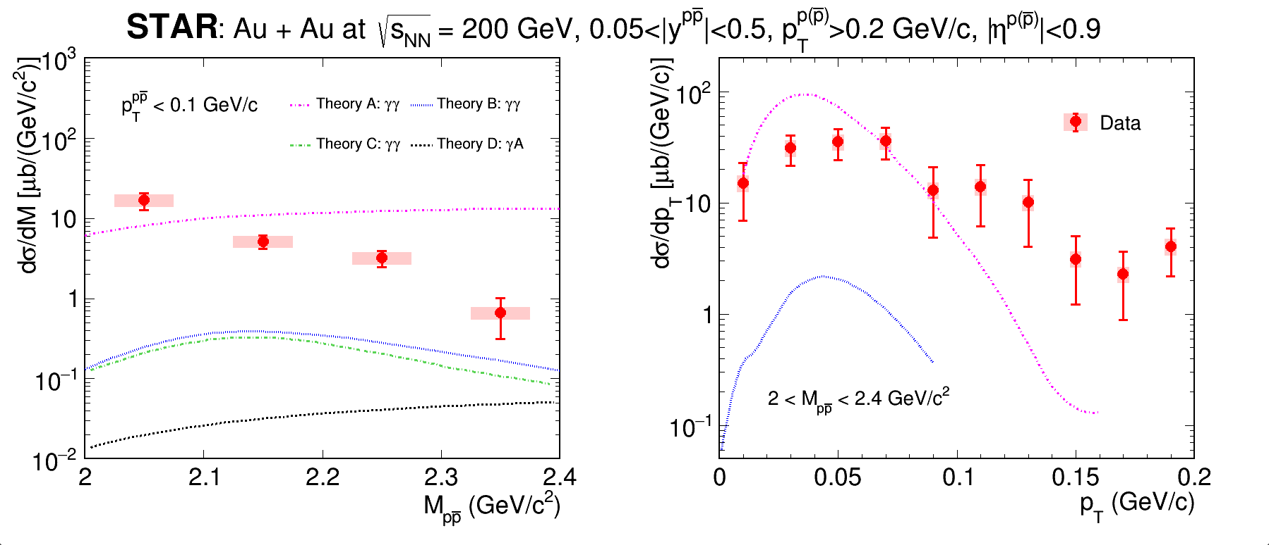
Di-baryon Pair Production
Theory A: Pu et al., arXiv:2407.06091
Theory B : Shao et al., arXiv:2406.05618
Xin Wu, SQM2024
The observation of photoproduction of $p\overline{p}$ pairs in heavy-ion collisions
From light by light scattering?

Slide 14
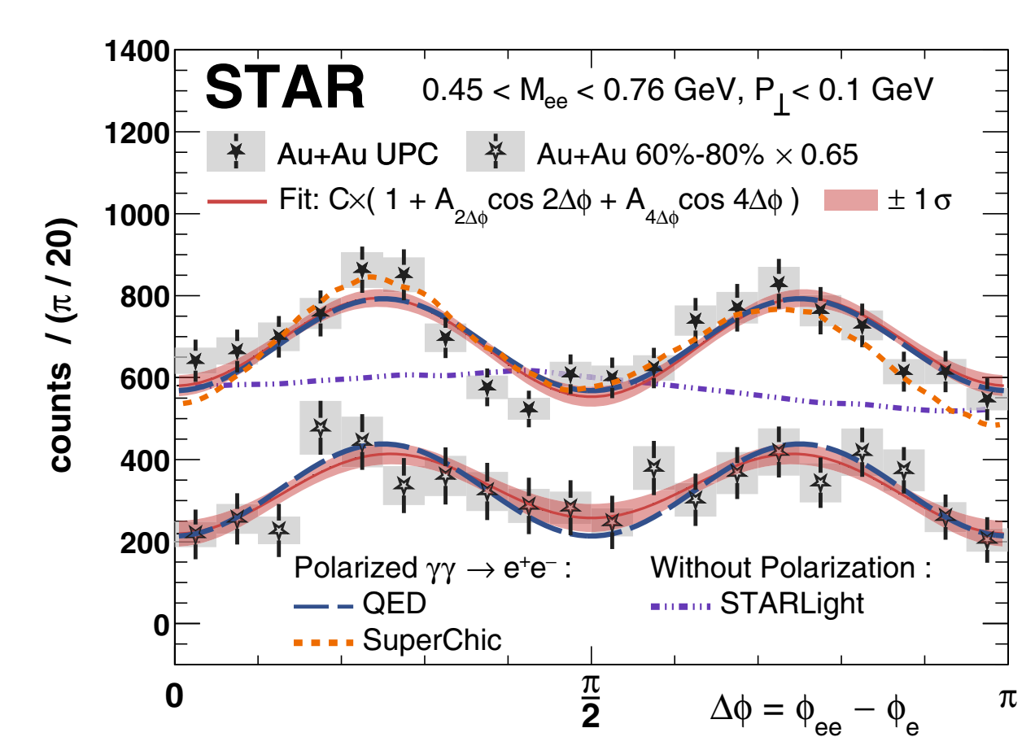
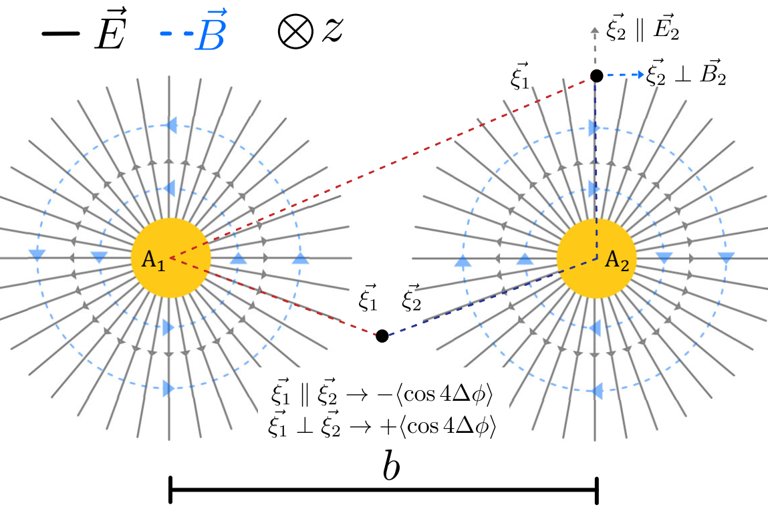
Linear Polarization of The Light Quanta
C. Li, J. Zhou, Y.-j. Zhou, Phys. Lett. B 795, 576 (2019)
Linearly Polarized Photons
STAR, Phys. Rev. Lett. 127 (2021) 052302
Experimental Confirmation of Linear Polarization in the Photoproduction Process!
Fourth-Order Cosine Oscillations in the Electron Emission Angle of the Breit-Wheeler Process

Slide 15
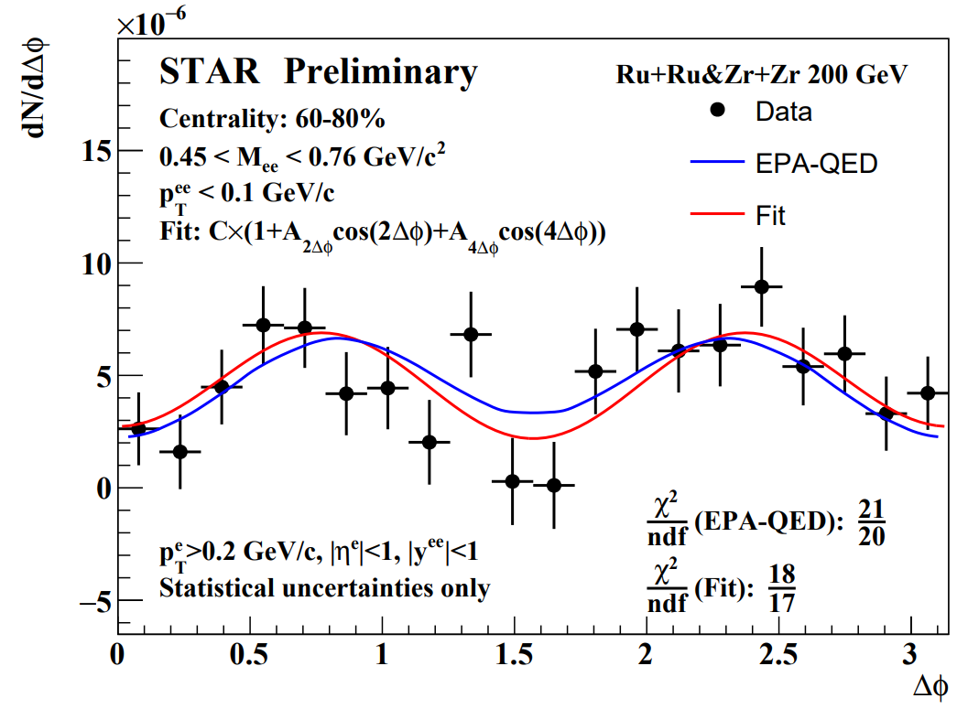
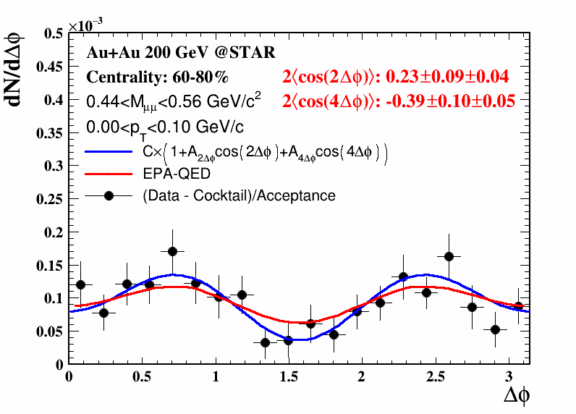
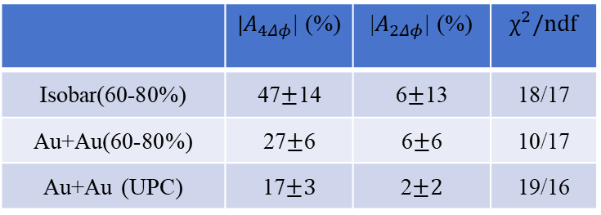
Linear Polarization of The Light Quanta
 | |$A_{4Δφ}$| (%) | |$A_{2Δφ}$| (%) | $$χ^{2}/ndf$$
Isobar(60-80%) | 47$±$14 | 6$±$13 | 18/17
Au+Au(60-80%) | 27$±$6 | 6$±$6 | 10/17
Au+Au (UPC) | 17$±3$ | 2$±2$ | 19/16
Indication of impact parameter dependence!
Lepton universality

Slide 16
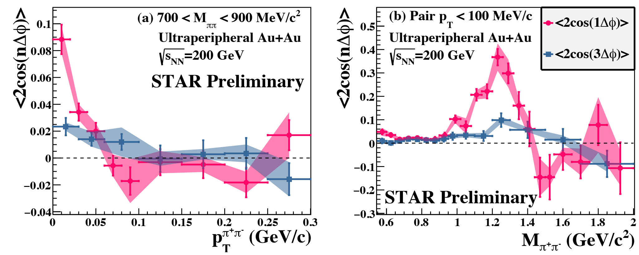
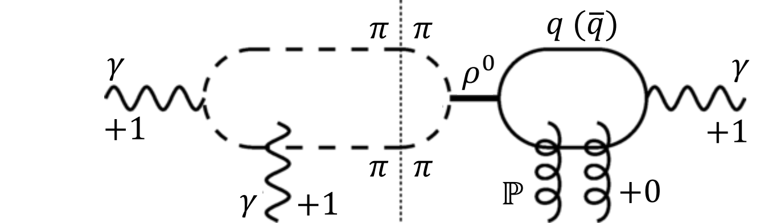
The Mixing between γγ and γA
Hagiwara et al.,, Phys. Rev. D 103 (2021) 074013
Significant 1st order and 3rd cosine modulation
Spin-interference between different angular momentum
  Two photon process: 0 or 2 one photon process: 1

Slide 17
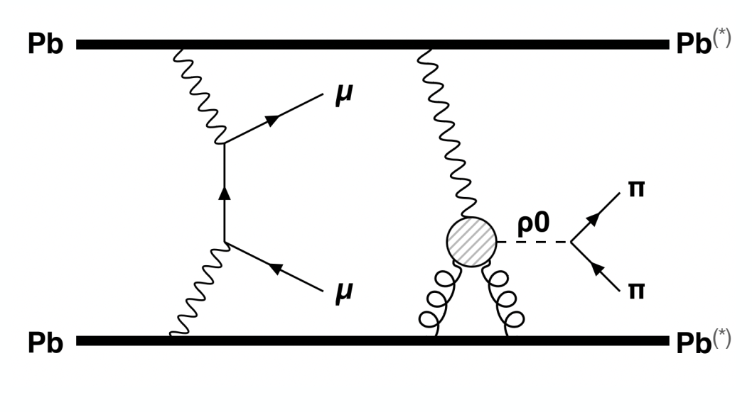
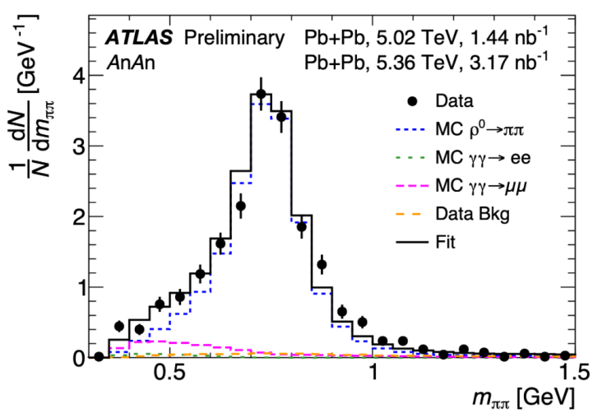



Associated Production in γ–γ and γ–A Interactions
$$γ+γ→μ^{+}+μ^{−}$$
$$+$$
$$γ+A→ρ^{0}→π^{+}+π^{−}$$
ATLAS, CERN-EP-2025-071
Experimental observations of multiphoton-induced processes!

Slide 18
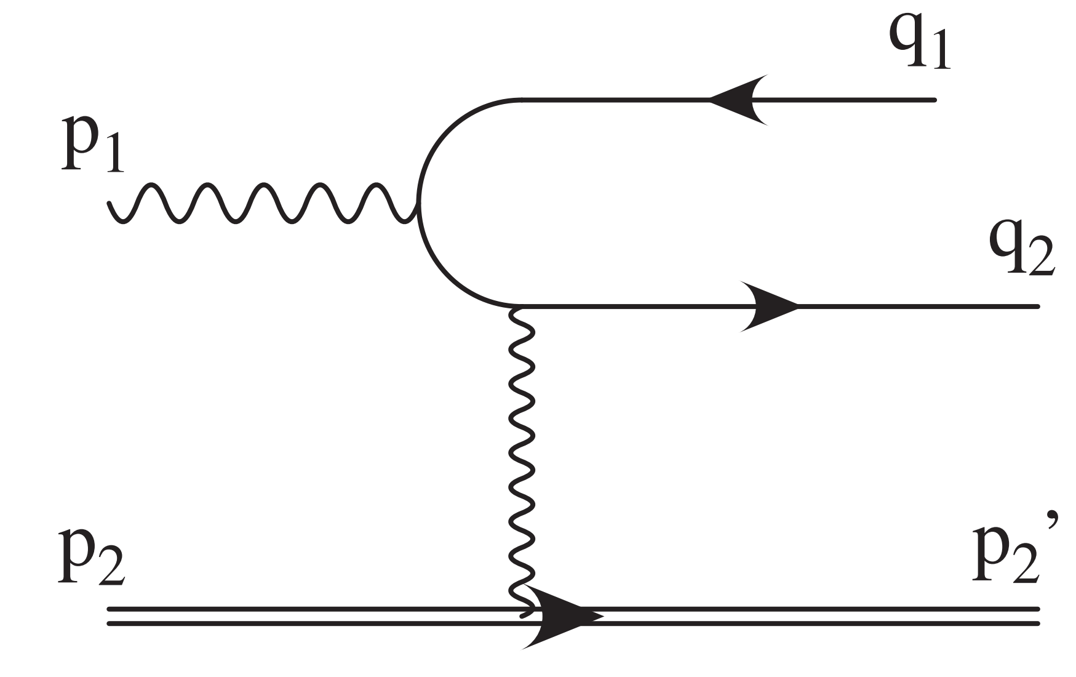
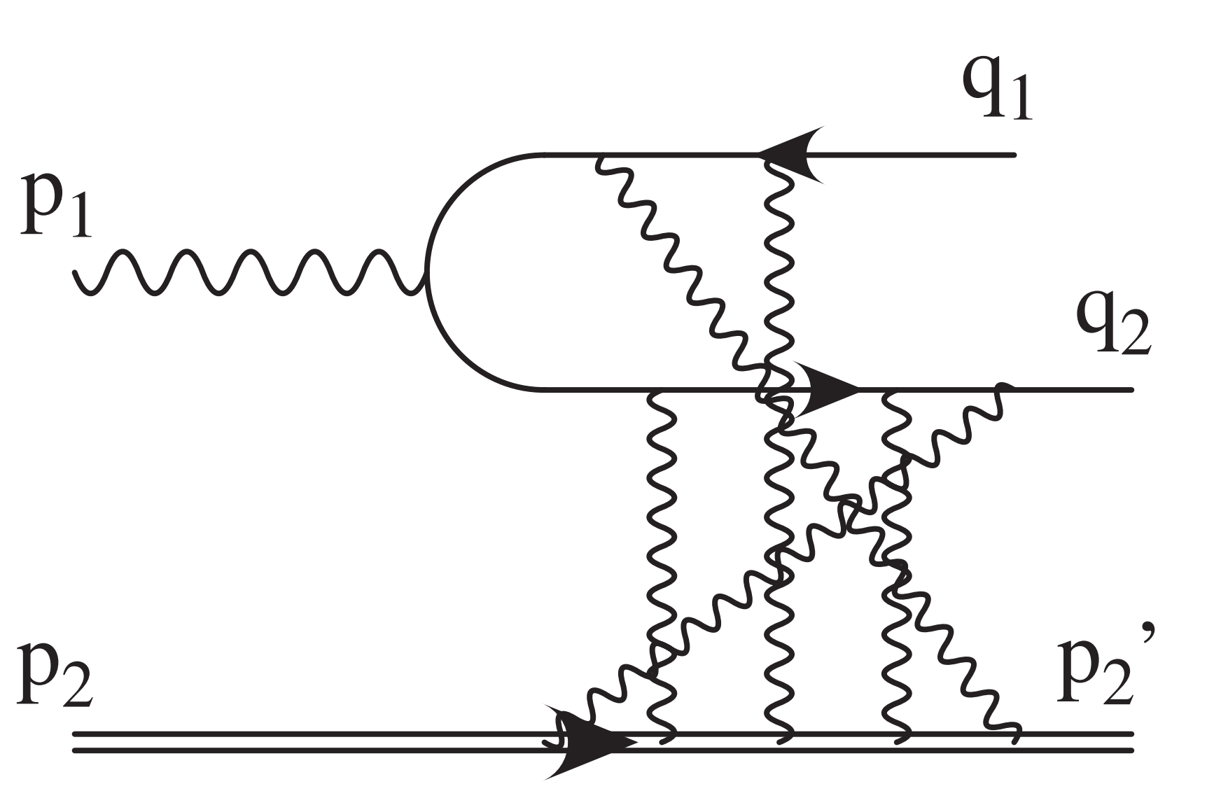
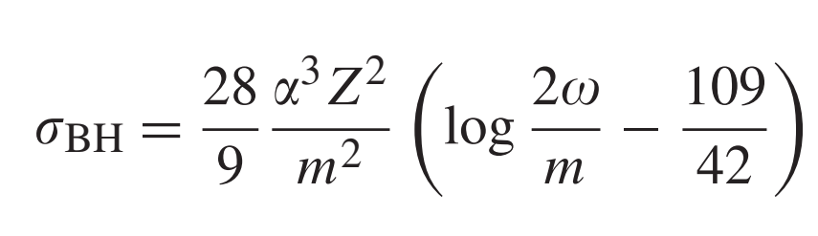
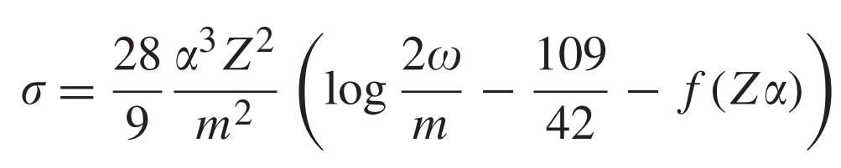
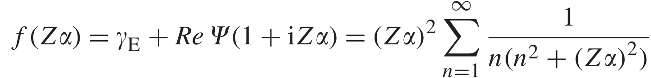
How about Higher Order Effect?
The lowest order results:
With higher-order correction:
H. A. Bethe, W. Heitler
Proc. Roy. Soc. Lond. A 146 (1934) 83
H.A. Bethe, L.C. Maximon
Phys. Rev. 93 (1954) 768
Sommerfeld-Maue type approach
  -Equivalent to the standard Feynman diagram approach.
Sizable negative correction!

Slide 19




How about Higher Order Effect?
Zα ~ 0.6
Disfavor
Favor
G. Baur, K. Hencken and D. Trautmann
Phys. Rep. 453, 1 (2007)

Slide 20


The Puzzle for Di-hadron Photoproduction
L. Wang et al., arXiv2505.00996
Q² difference?

Slide 21



Hunt for New Physics
CMS-PAS-HIN-21-015
CMS, Rep. Prog. Phys. 87 (2024) 107801

Slide 22
Summary
QED vacuum pair production has been observed in HIC!
  Dielectron, Dimuon, Ditau
  Linearly polarization process
  More products – Di-photon, Dihadron
The higher order QED effect for vacuum pair production?
  Link the crossover from perturbative to nonperturbative.
  A nice reference for QCD study
Multi-pair production!
Coherent vs Incoherent
Investigate QGP properties
Relation to initial geometry

