Slide 1
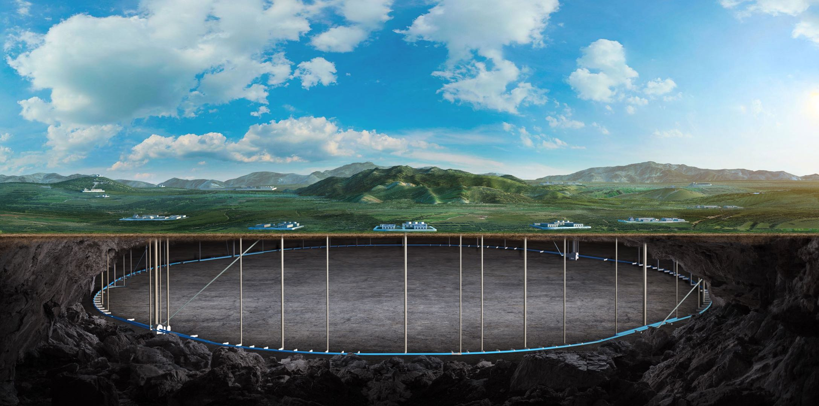
CEPC vertex Detector
Zhijun Liang
(On behalf of the CEPC physics and detector group)
Apr. 15th , 2025, CEPC Detector Ref-TDR Review

Slide 2
Timeline
update another vertex section version this weekend
updated overall TDR version by July 7th
2nd IDRC review July 21st ?

Slide 3
Review comments
chapter 4.1 should present an overview of teh detector that we propose to build. This should present the layout and all main points of this detector. You should NOT talk about alternative designs in this section. This section should all present CLEARLY what are the specifications/physics requirements for the detector.
Chapter 4.2 is supposed to give the detailed design of the detector. This is where for instance, you can discuss in detail the regions in the wafer that will make up each layer, etc... Again, you should NOT talk about alternative designs in this section either.

Slide 4
Comments on electronics
REB , LEB also sound like bad definitions. "Block" does not mean anything. One should indicate what block means. I would suggest Right Readout Block and Left Readout Block, or it could be Right-end Readout Block, Left-end Readout Block, if needed. (In general, try to use the least number of words that define something
It is not clear to me how the modules in the middle of the sensor are read

Slide 5
Comments on layout
BVTX is a terrible name because B can easily be understood as barrel, also Bent is not a geometrical term, while planar is. I would suggest to call this Cylindrical Vertex Layer, or Curved Vertex Layer. Bent can be any shape, not necessarily curved

