Slide 1
CSNS & CSNS-II beam instr. Apr. 28 week
R. Yang

Slide 2
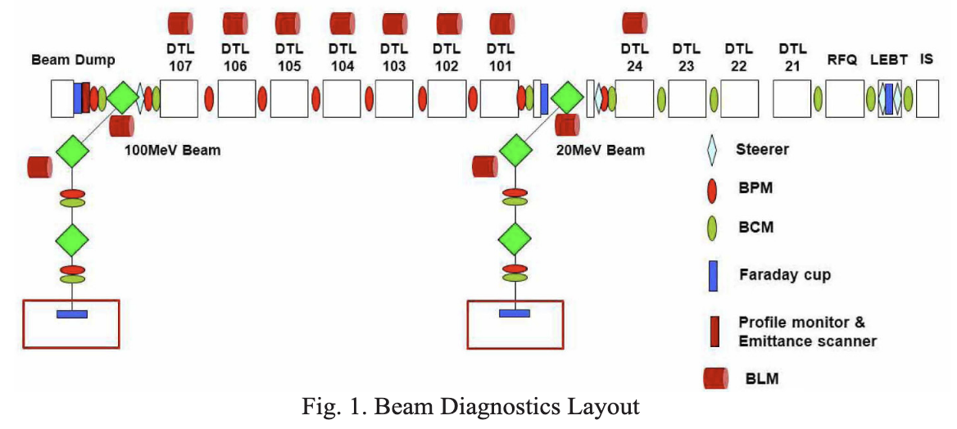
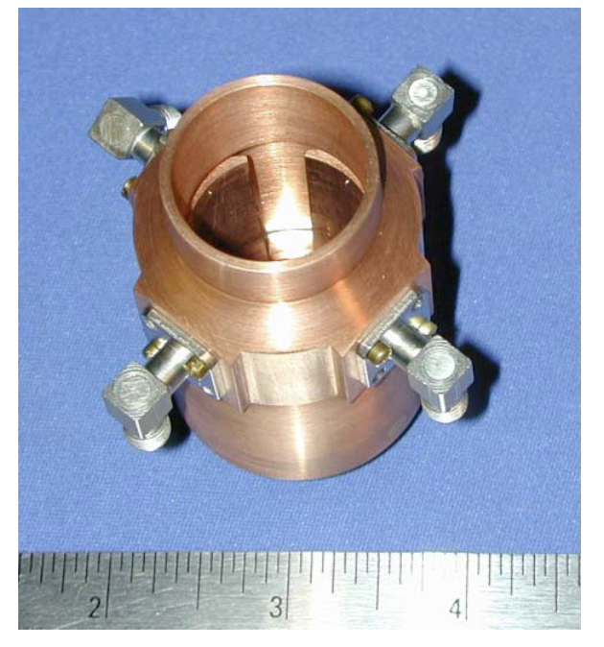
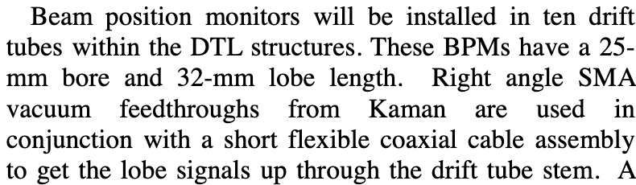
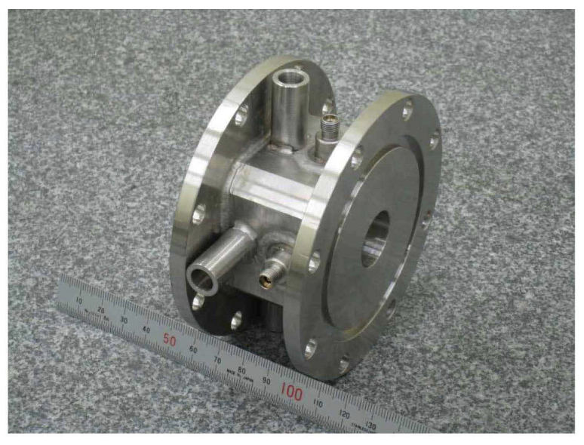
BPM inside DTL
BPM inside DTL might be needed for the neutron source in Suzhou (May 13, 2025, Jun Peng)
Prototype R&D should be launched in 2025-2026
BPM inside drift tubes@SNS
BPM body in between drift tubes@PEFP LINAC, Korea
The vacuum pipe and the inner conductor were aligned mechanically by using an alignment pin.
placing the BPPM gap near the DT center reduces the RF-induced signal significantly
Signal processing at 2*f_RF to avoid RF induced interference at f_RF
[1] J. Power et al., BPPM for SNS LINAC, PAC2001
[2] H. Kwon et al., NET 45:4, 2013

Slide 3
CSNS instr. (2025)
Injection
BCT (W. Huang: detector arrived, cal. tool ok; R. Qiu: preparing electronics, X2, processing)
MWS (CNT wire, detector to be weld, mover, analog electronics)
E-Col (fabricating, F. Li/R.Qiu: amplifier/filter(BW=100 kHz))
BLM (ready)
Rectangular BPM (electrodes CNC machining, lead time: <6.15)
Screen (welded/check on-site, mover!)
RABT
d290 mm BPM (R2BPM01): to be machined, lead time: July 2025

Slide 4
CSNS instr.
RCS BPM
Re-Mapping; CST simulations (w/ pipe); electronics (algorithm)
New electronics (PXIe vs. mTCA, hurry!)
LINAC BLM
icBLM & electronics (specification, survey of ESS case)
DAQ system (BI+Control, designed)
Discussion in early May
BSM
Status: prepare discussion meeting (May 7, 2025)

Slide 5
CSNS instr.
LW prototype
Prototype-v1 succeeded, experiments almost finished
Chamber update (done)
H0 detection (LGAD sensor preparation) => review meeting
RCS IPM
Experiments on the e-col. mode ( -> discussion meeting)
Gated IPM test & commissioning in lab.
BxB feedback
Simulation effort
FPGA function programming
Power amplifier specification & supplier

Slide 6
Meeting and Discussions in April
RCS BPM electronics design (R. Qiu, Z. Xu, 23-24/04/2025)
RCS BPM measurement accuracy discussion (28/03/2025)
LRBT FCT re-location (F. Li, Dr. W. Huang)
BSM progress, status and new requirements (Dr. W. Huang)
Injection MWS and CNT wire (Z. Lu, 16/04/2025)
LINAC 50 Hz summary (Z. Xu, F. Li)
LW experiments and new design (R. Yang, 14/04/2025)
FPS: Monitor part
BxB Feedback discussion

Slide 7
Others
CSNS Operation:
user-friend GUI oriented to CSNS-II;
necessary upgrade, e.g., WS mover control?
CSNS-II:
in align with the CPM plan!
BPM & BPM electronics!!
Others
be ready for the Isotope project

Slide 8
One major project one person until 2025.12
W. Huang, BSM prototype
Zhihong Xu, LabView Linux (INJ MWS)
Ruiyang Qiu, Analog Front-end design (URGENT)
Lei Zeng, demo of <10 us response time of icBLM electronics
Fang Li, new GUI, Control&DAQ@Ions Source
Zhijun Lu, CNT wire experiments in lab.
M. Rehman, Gated IPM design & report

Slide 9
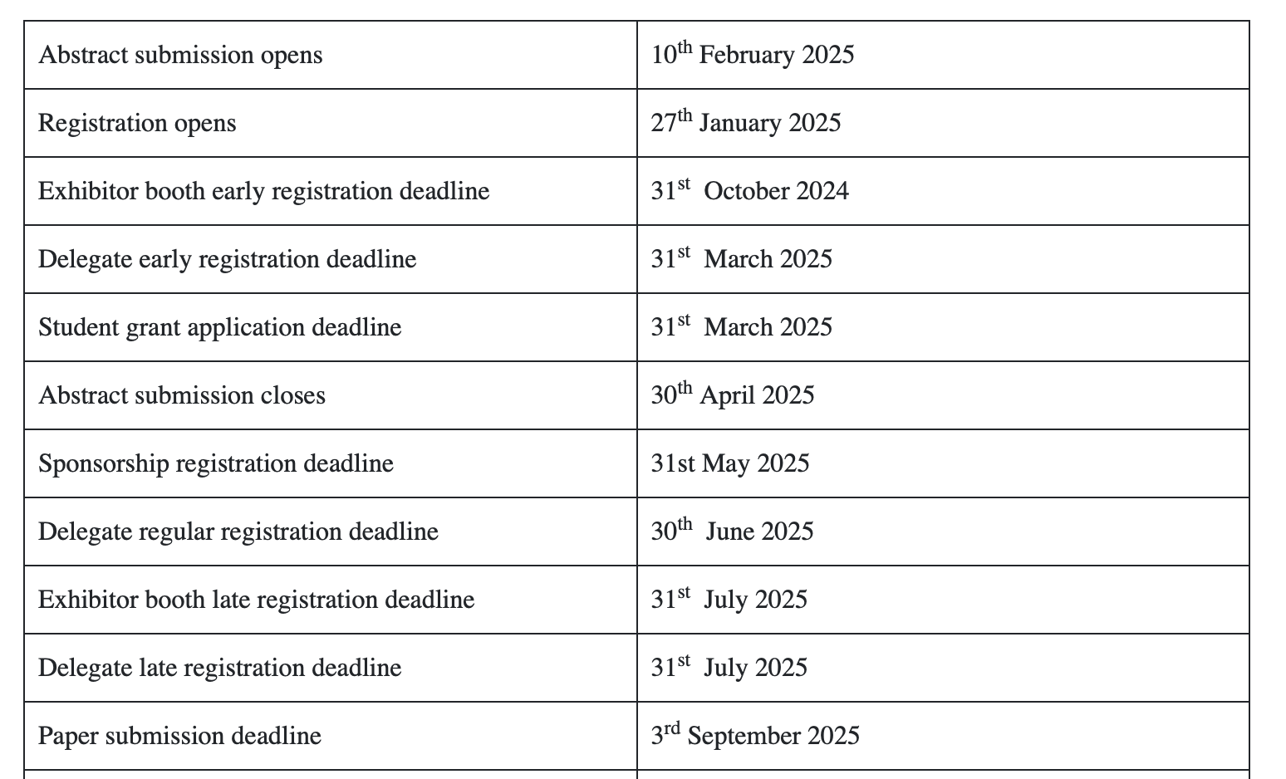
IBIC2025

