Slide 1
CGEM software updates
Wang xinnan

Slide 2
Content
CGEM background mixing and validation
Integration of CGEM simulation into BOSS800

Slide 3
CGEM background mixing and validation
In order to improve the consistency between the simulation and the data, a background mixing algorithm for CGEM is developed
Work flow
Simulation
Read raw files of random triggers
background mixing
Decode and convert to background digits
Insert background digits to DigiCollection
Reconstruction

Slide 4
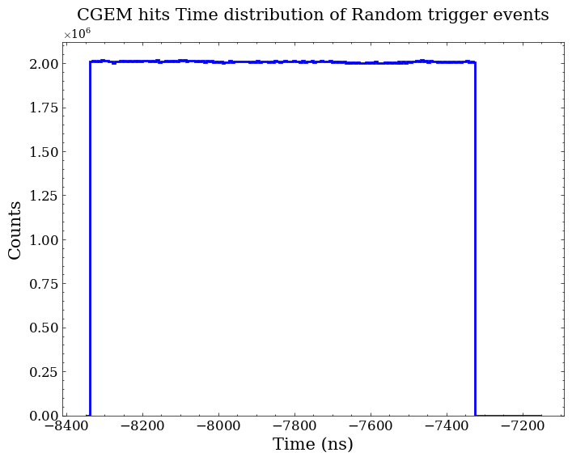
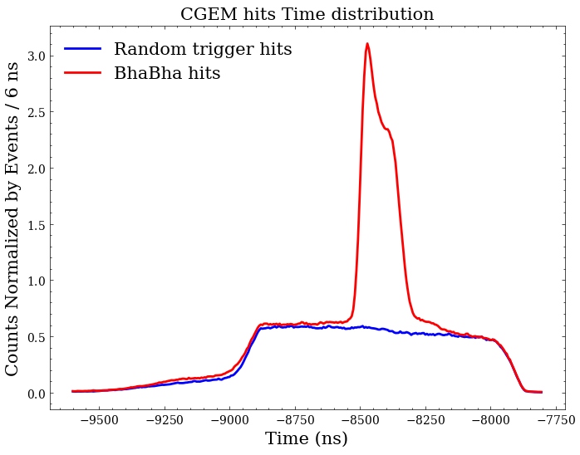

CGEM background mixing and validation
Check on background
BhaBha events and random triggers at 25/07/06 are used for analysis
After subtracting $T_{0}$
Flat in random trigger
No time dependence
Similar noise level after subtracting event start time

Slide 5
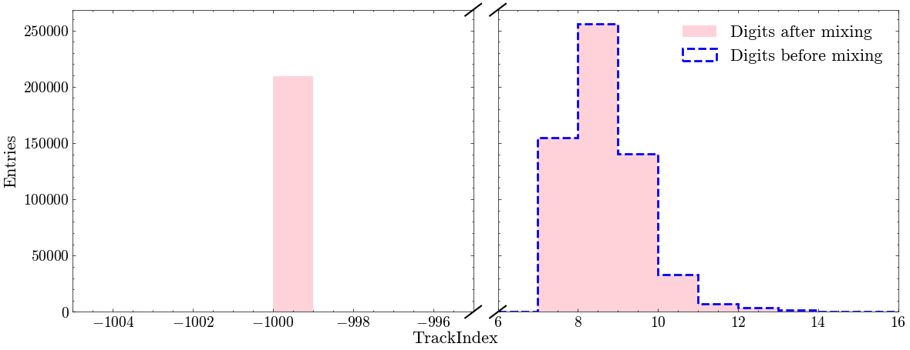

CGEM background mixing and validation
Validation on mixing algorithm
Background digits after mixing
Track Index for background digits set to -1000
Test with $J/ψ→ρπ$, total events are 10000

Slide 6
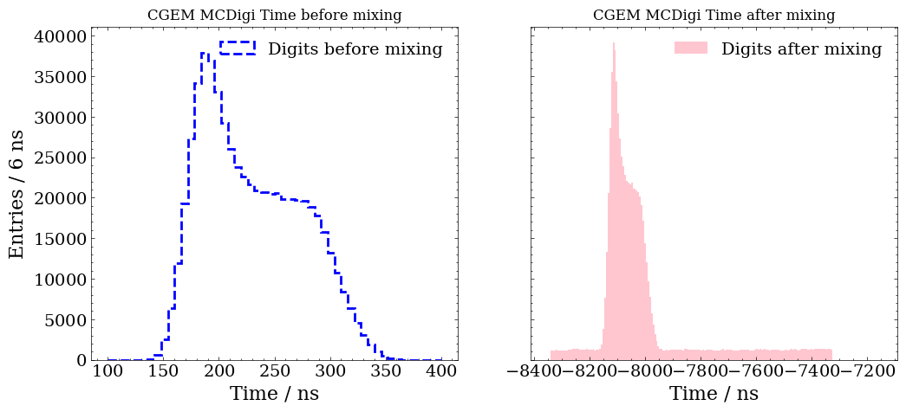
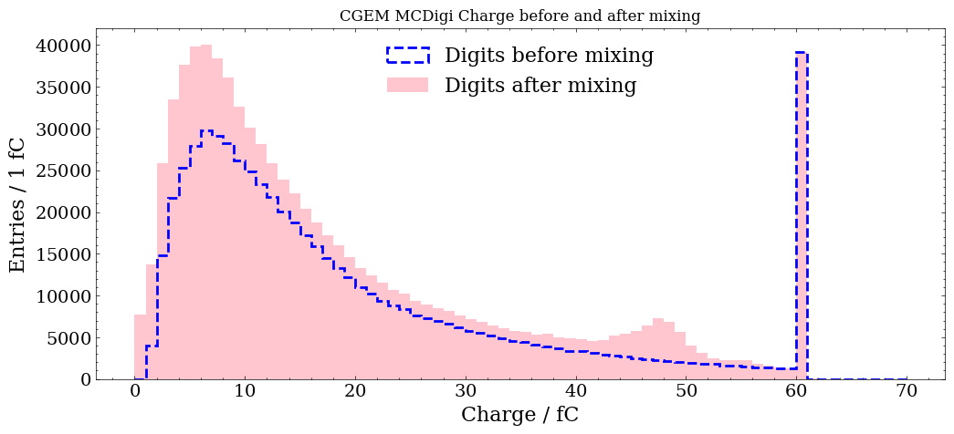

Results comparison
Test with $J/ψ→ρπ$, total events are 10000
Validation on mixing algorithm
Mix background digits
and shift T0
Time distribution
Charge distribution

Slide 7
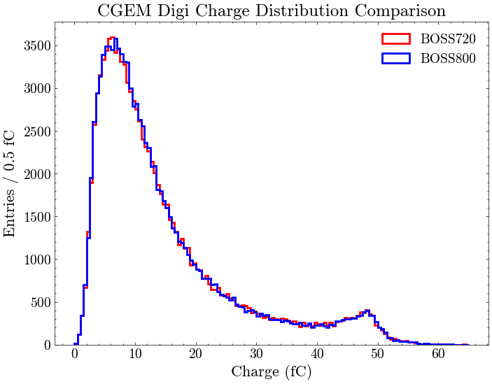
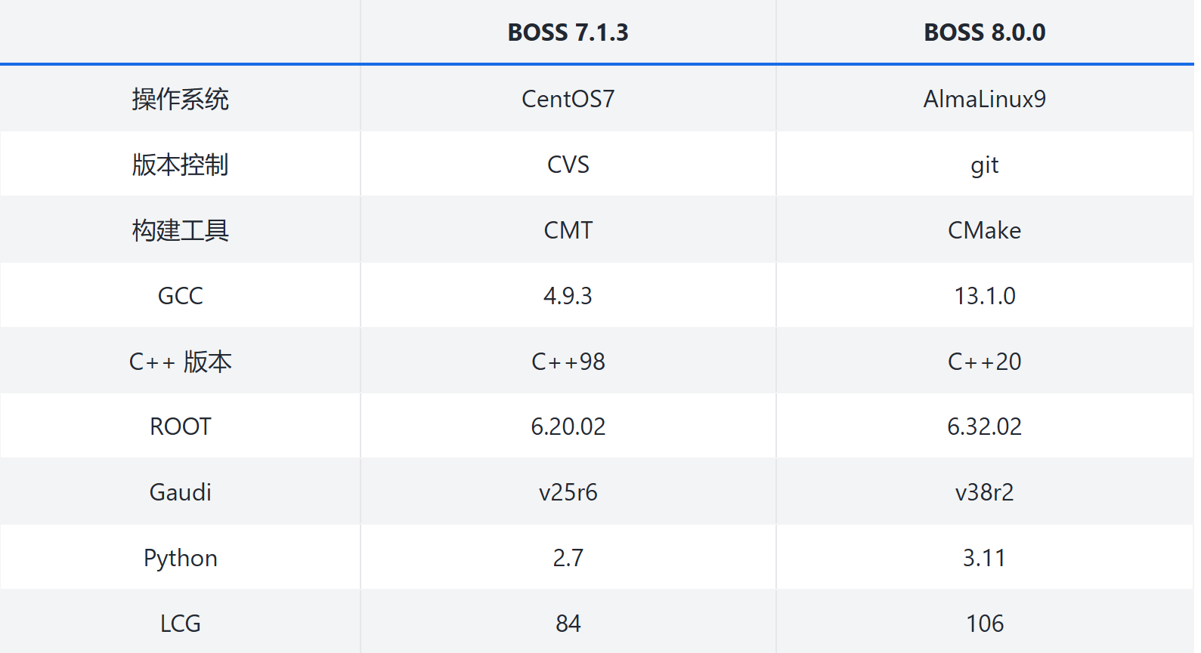
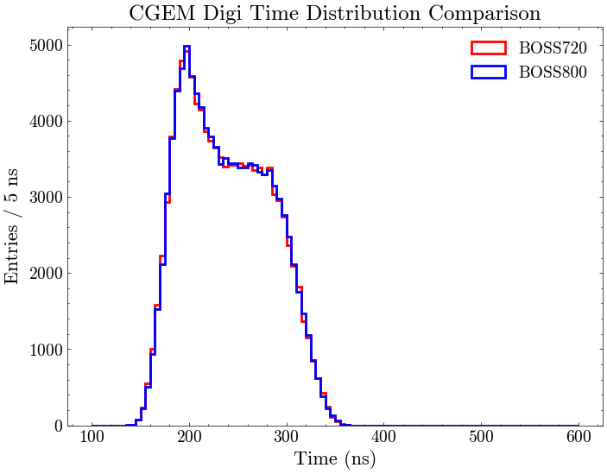
Integration of CGEM simulation into BOSS800
Leapfrog update in Bes Offline Software System
Add packages
Cgem/CgemRawEvent
Cgem/CgemRecEvent
Cgem/CgemGeomSvc
Cgem/CgemDigitizerSvc
Simulation/BOOST/CgemSim
Modify packages
DetectorDescription/GdmlManagement
DetectorDescription/Identifier
DetectorDescription/G4Geo
Event/AsciiDmp
Event/EventModel
Event/RootEventData
Event/McTruth
Event/RawEvent
Event/DstEvent
Event/RootCnvSvc
Event/RootIO
Simulation/BOOST/SimUtil
Simulation/BOOST/MdcSim
Simulation/BOOST/BesSim
Simulation/G4Svc
Mdc/MdcGeomSvc
Mdc/MdcRecEvent
Utilities/DetVerSvc
Charge distribution
From Li Mingrun
Consistent
Time distribution

Slide 8
Summary
Check on background in random triggers has been performed:
  No time dependence
  Similar noise level with BhaBha events
Simulation softwares of CGEM have been integrated to BOSS800

Slide 9
Back up

Slide 10
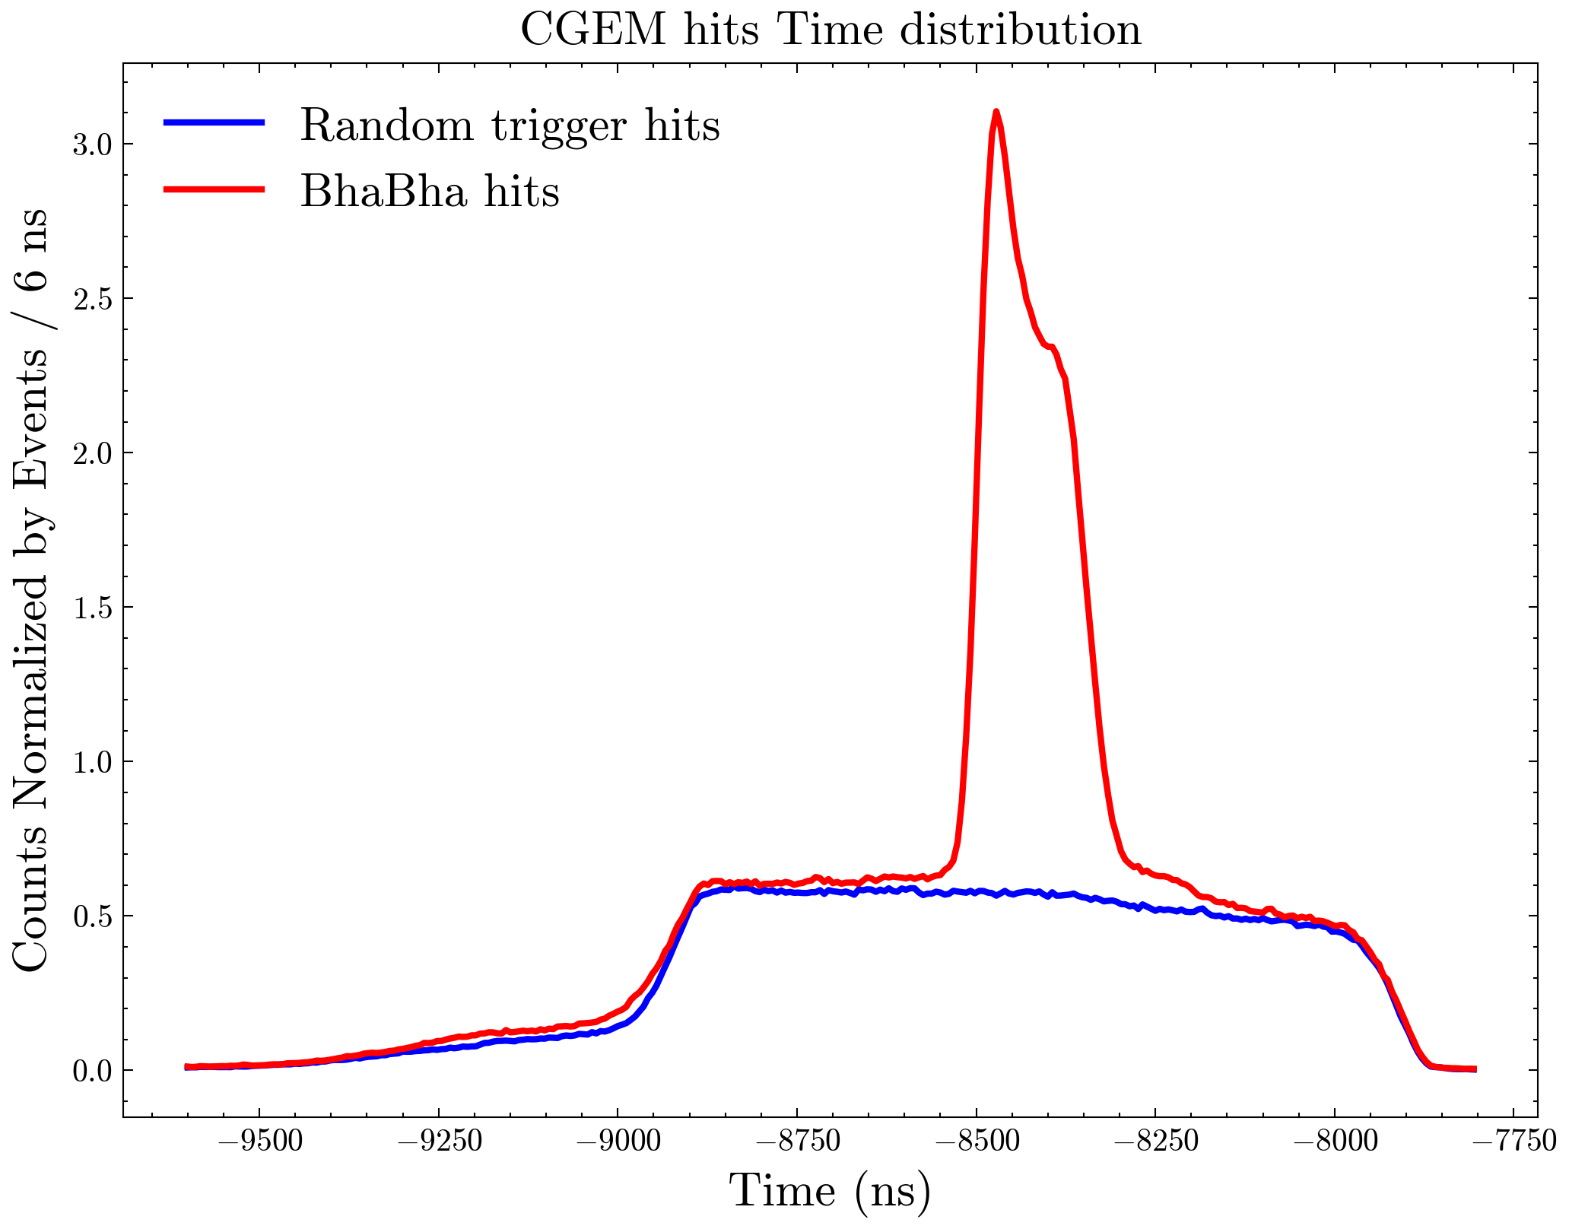
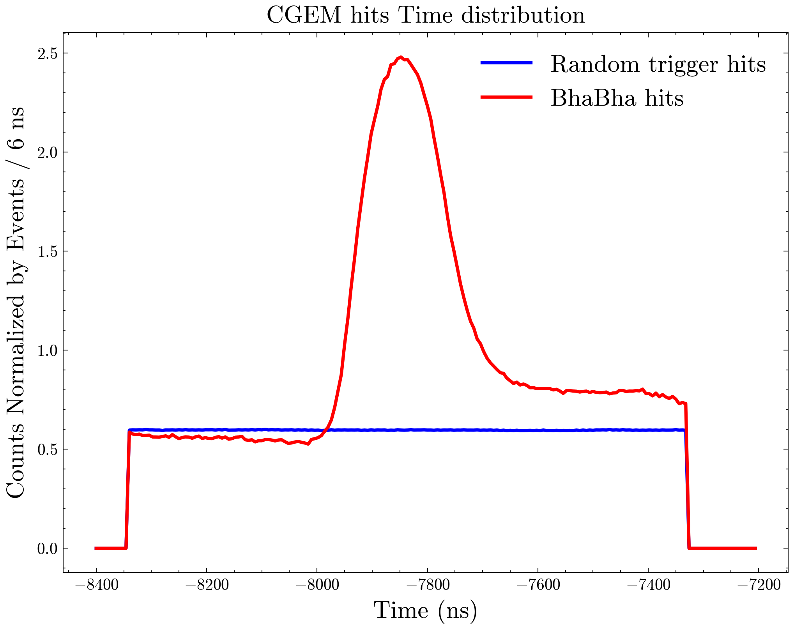


Subtract $T_{0}$
Not subtract $T_{0}$

Slide 11
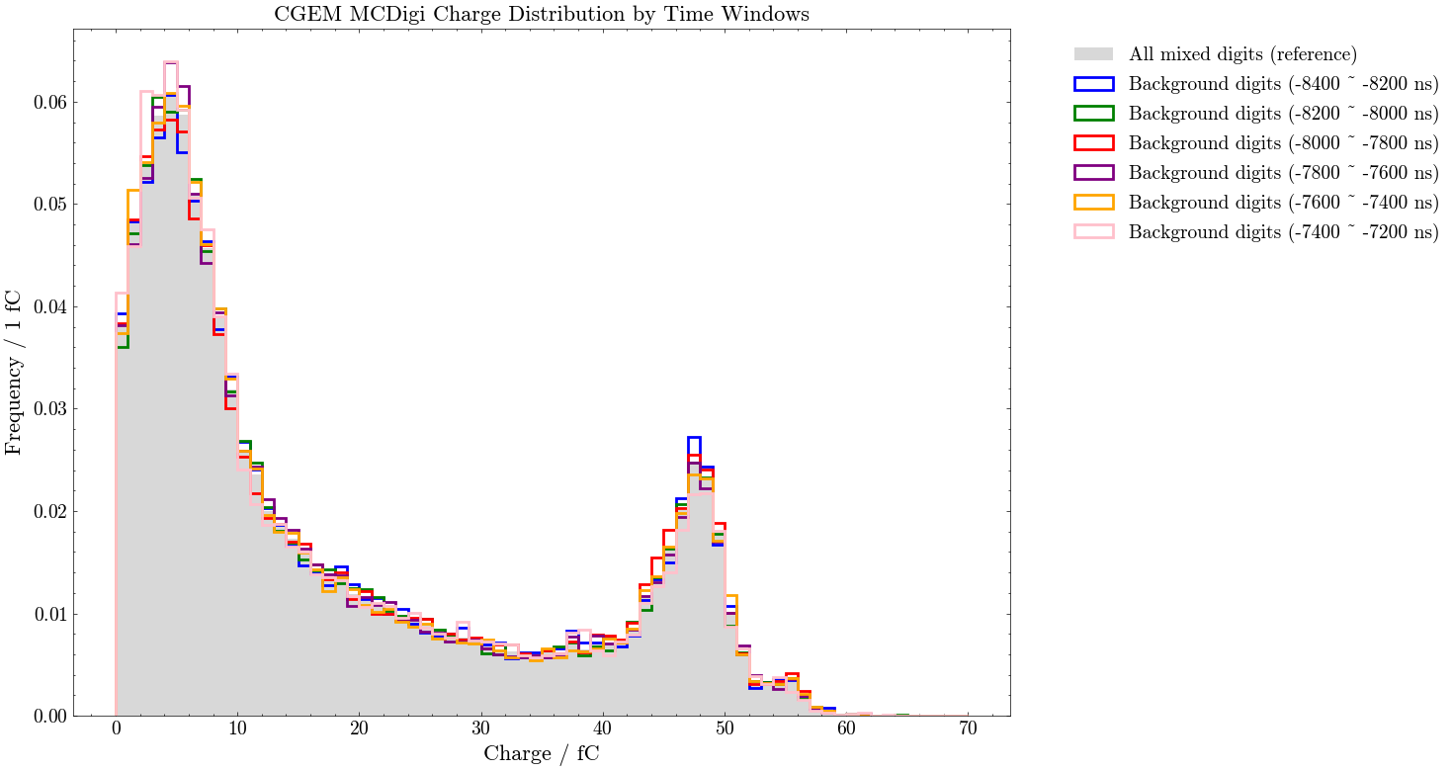
Test with $J/ψ→ρπ$, total events are 10000
Charge distribution for background digits for different time windows are similar
Background mixer based on side-band digits is feasible

Slide 12
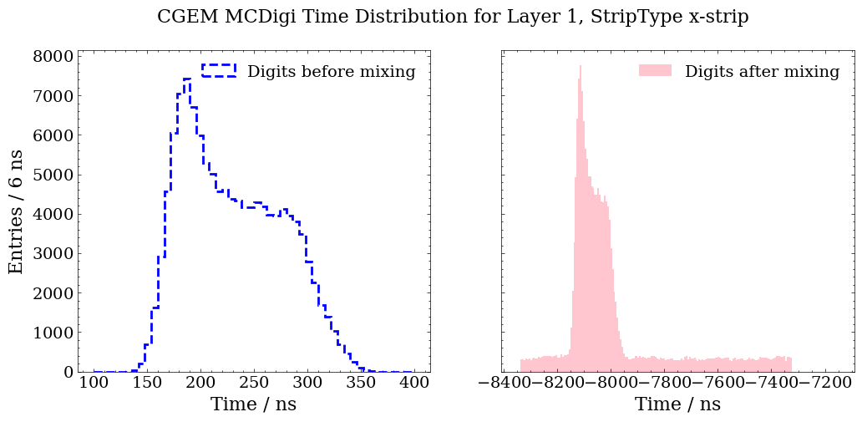
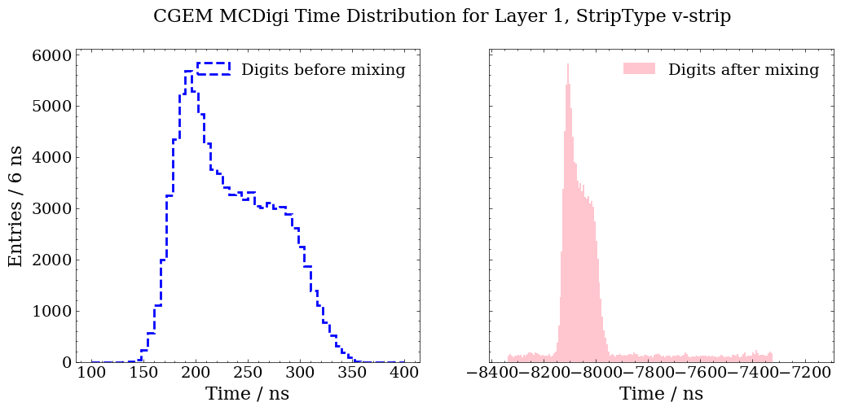
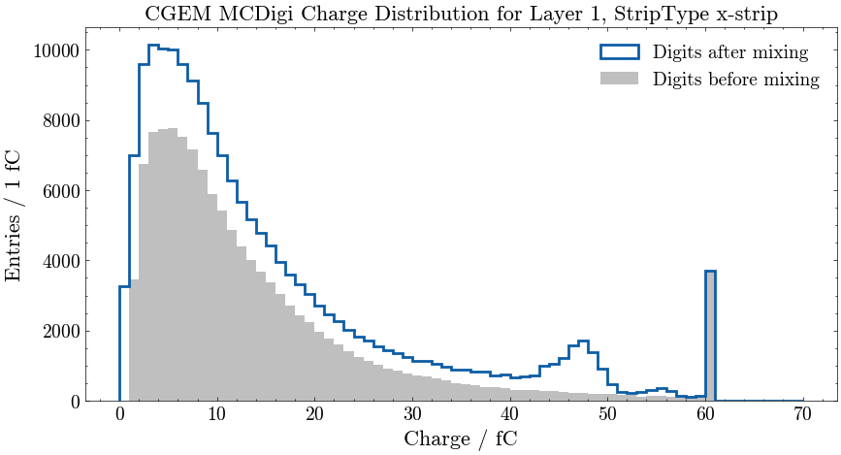
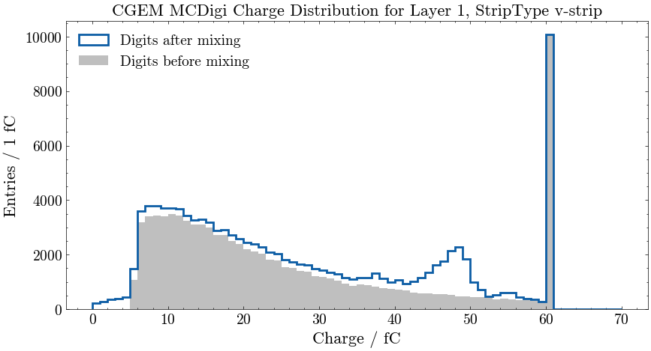
X-view
V-view
Time and Charge distribution for layer 1
X-view
V-view

Slide 13
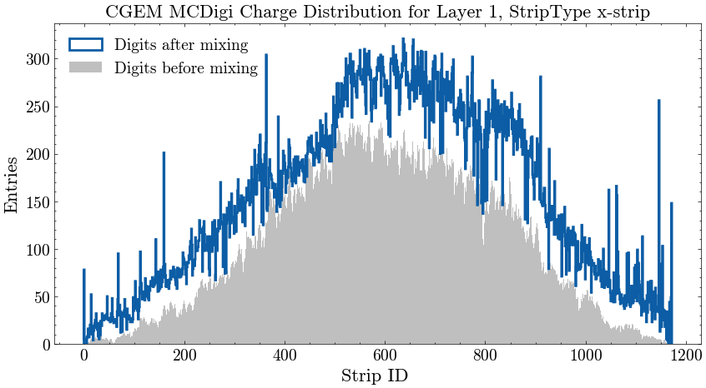
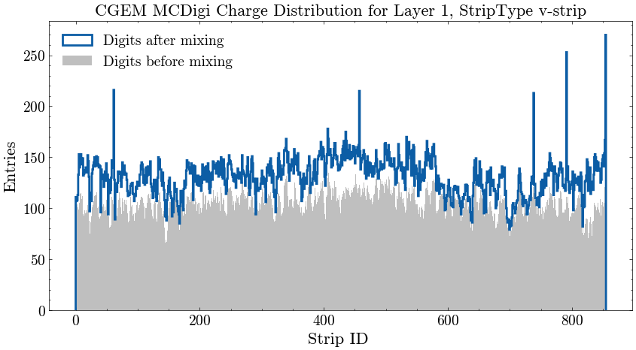
X-view
V-view
Strip ID for layer 1

Slide 14
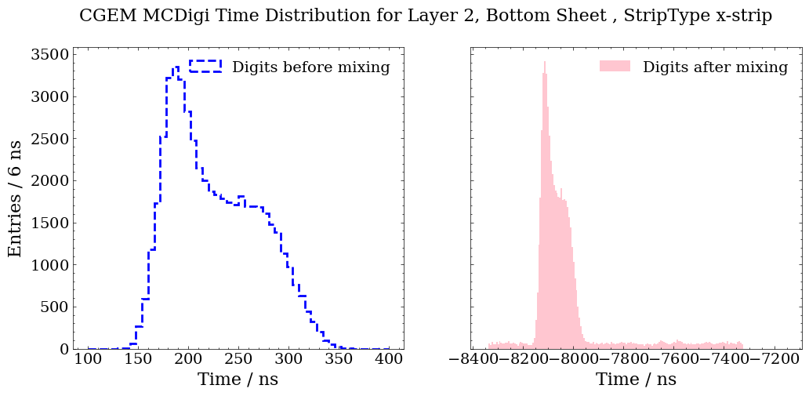
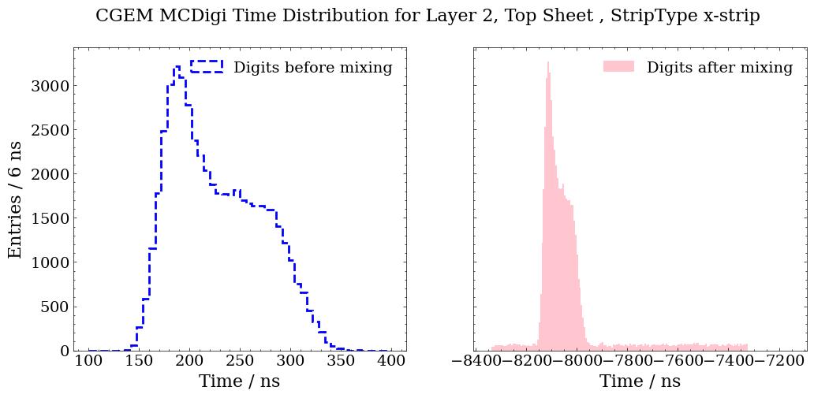
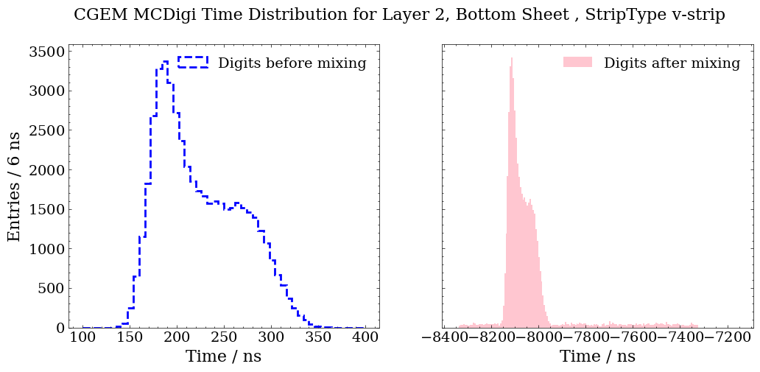

Bottom
X-view
V-view
Time distribution for layer 2
X-view
Top
V-view
Notes:
全部事例sideband、桶部BhaBha、Random Trigger按事例归一，看时间谱噪声的平台高度

Slide 15
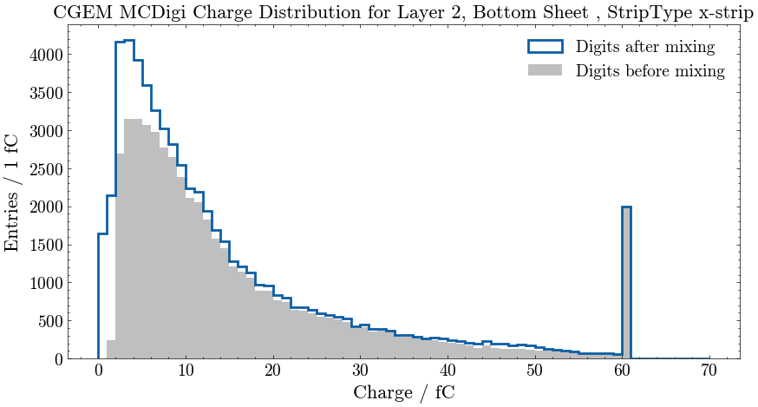
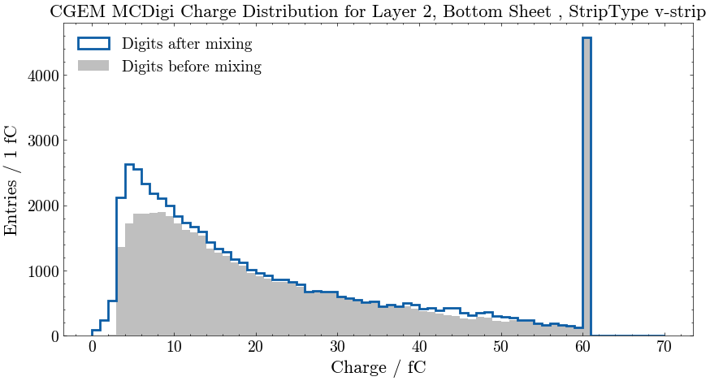
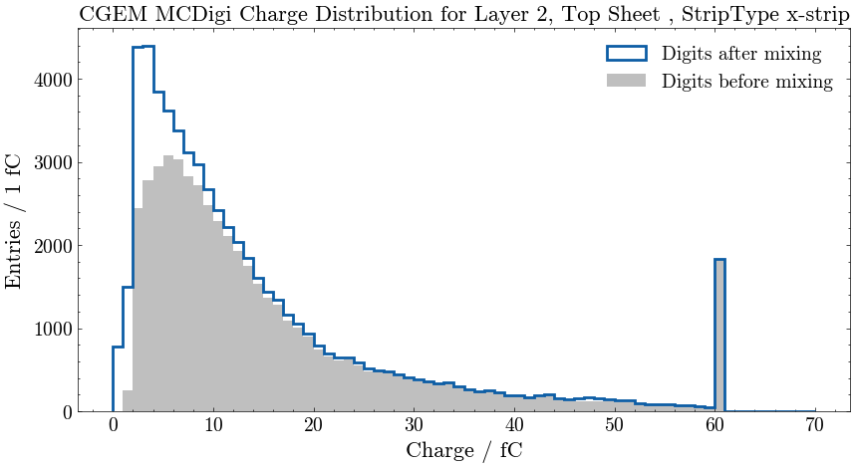
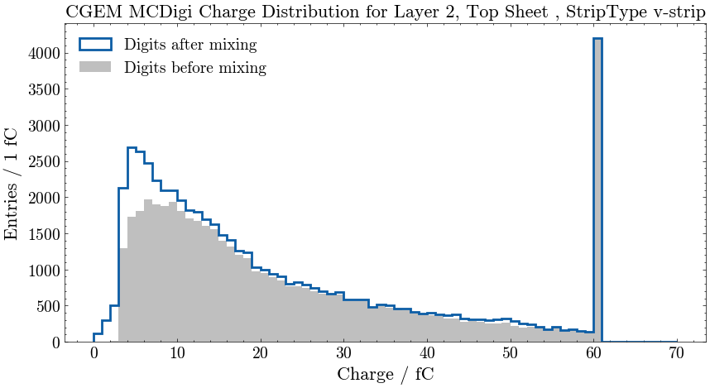
Bottom
X-view
V-view
Charge distribution for layer 2
X-view
Top
V-view

Slide 16
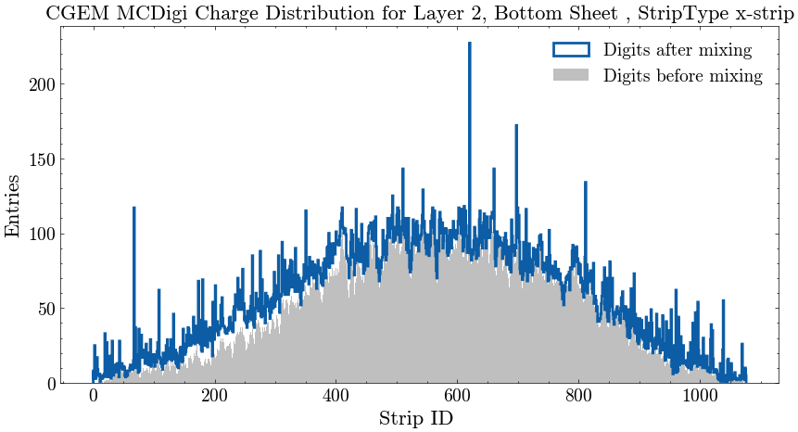
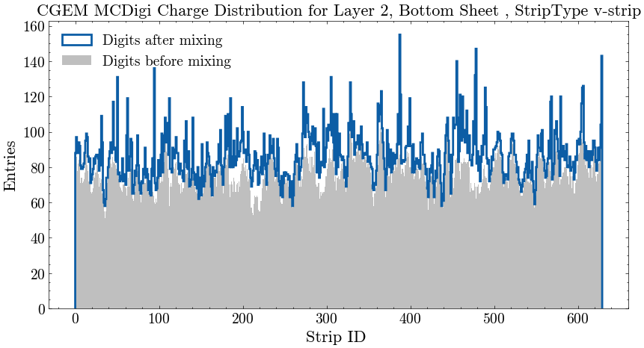
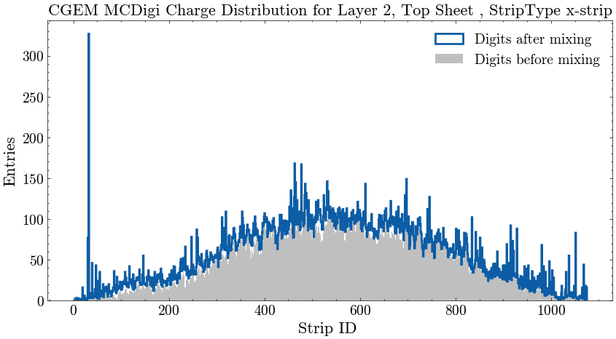
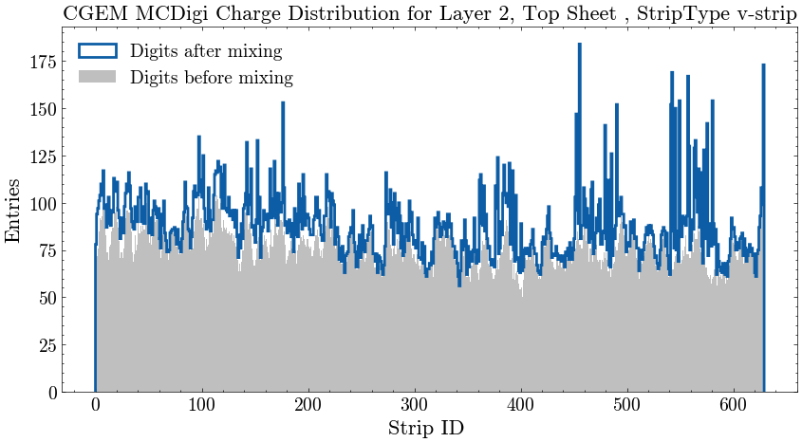
V-view
X-view
Bottom
Strip ID for layer 2
V-view
X-view
Top

Slide 17
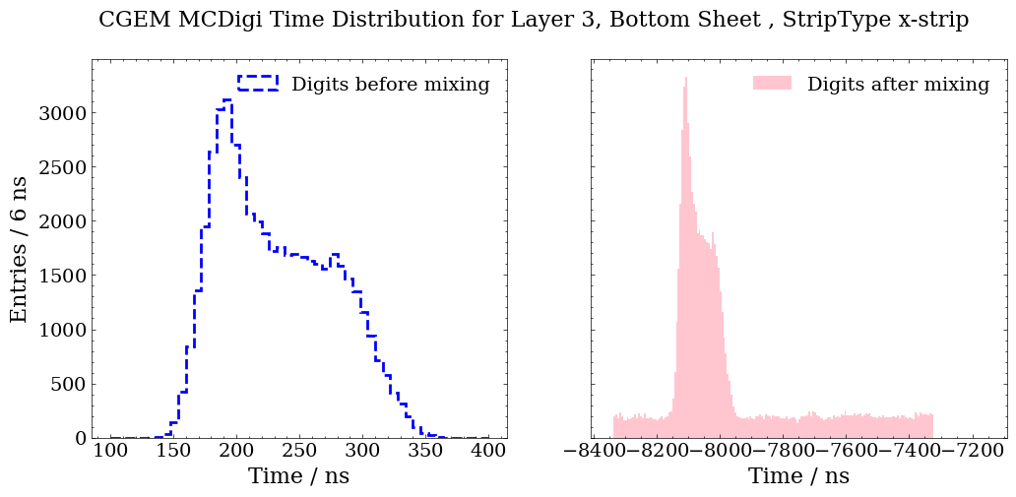
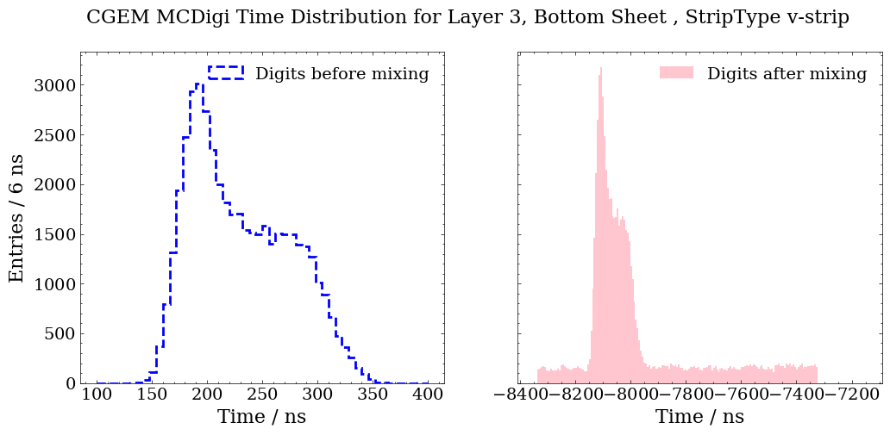
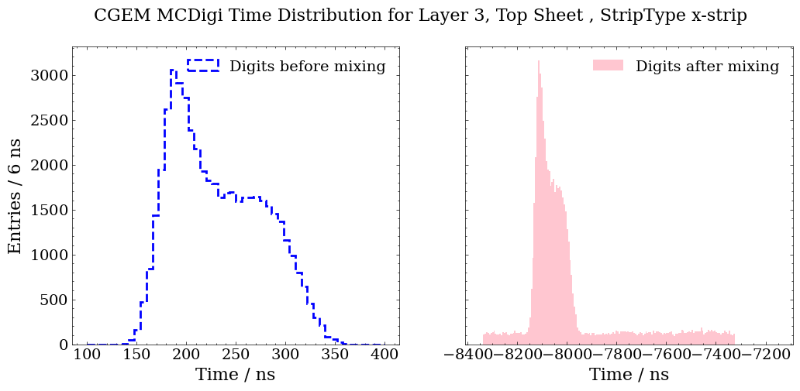
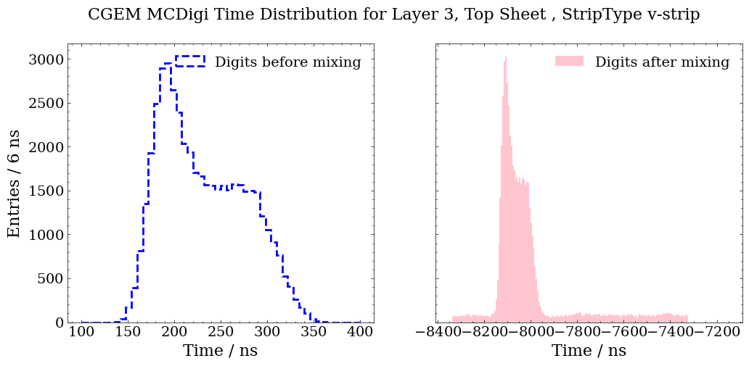
Bottom
X-view
V-view
Time distribution for layer 3
X-view
Top
V-view

Slide 18
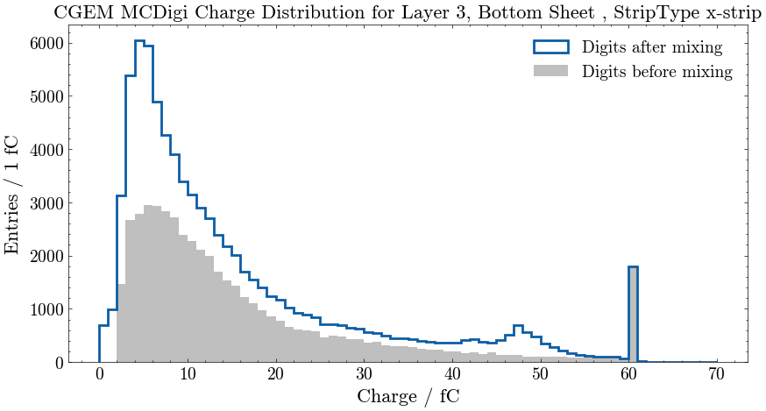
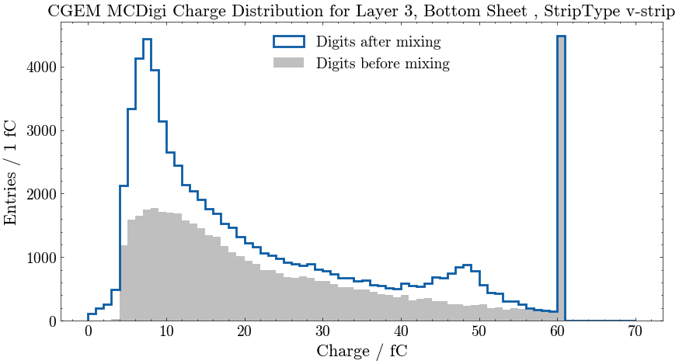
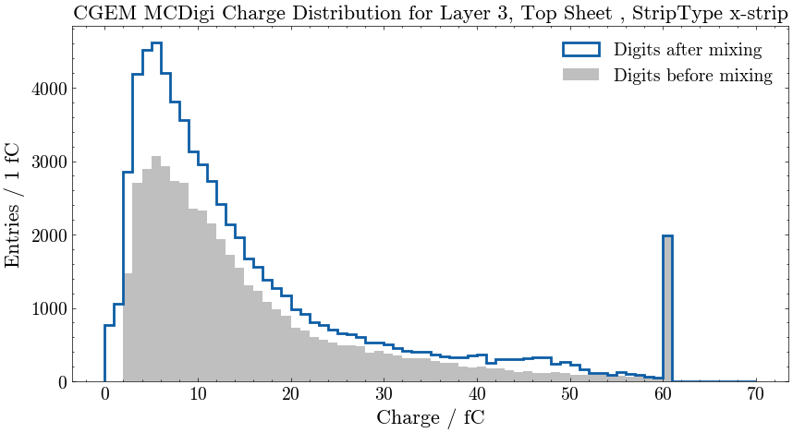
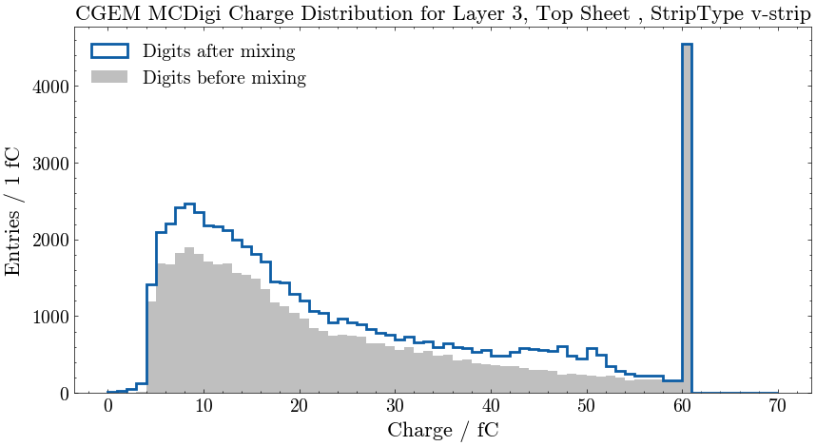
Bottom
X-view
V-view
Charge distribution for layer 3
X-view
Top
V-view

Slide 19
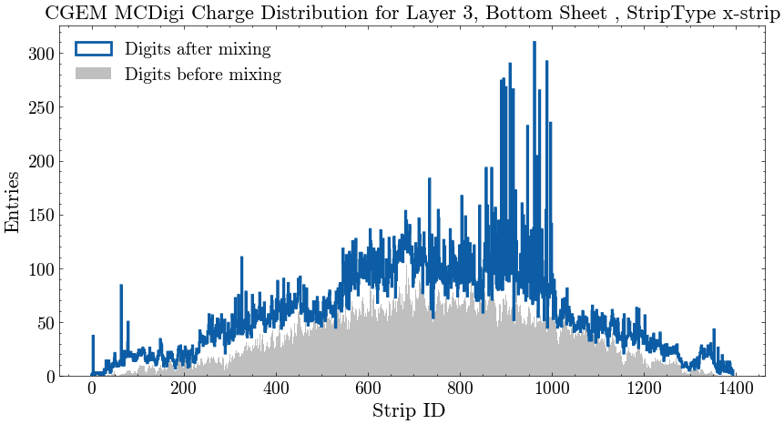
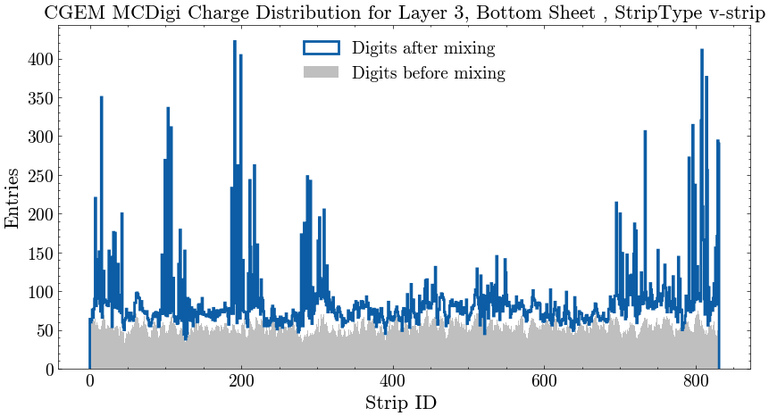
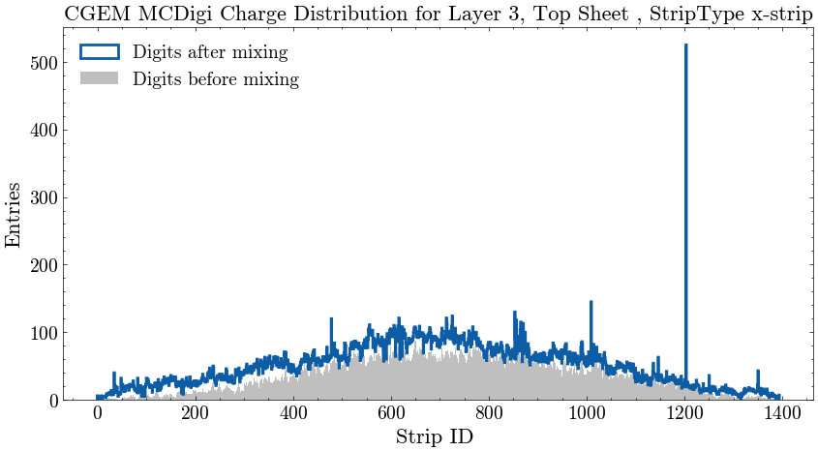
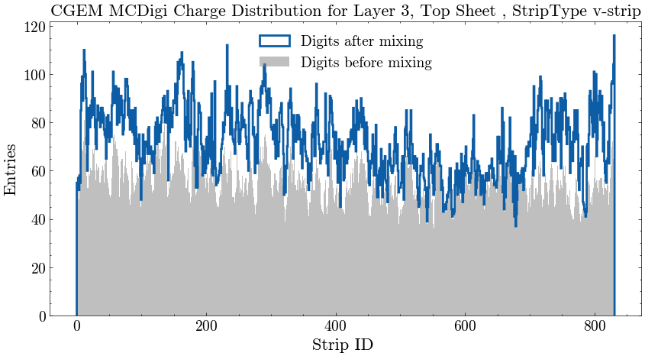
Bottom
V-view
X-view
Strip ID for layer 3
V-view
X-view
Top

