Slide 1
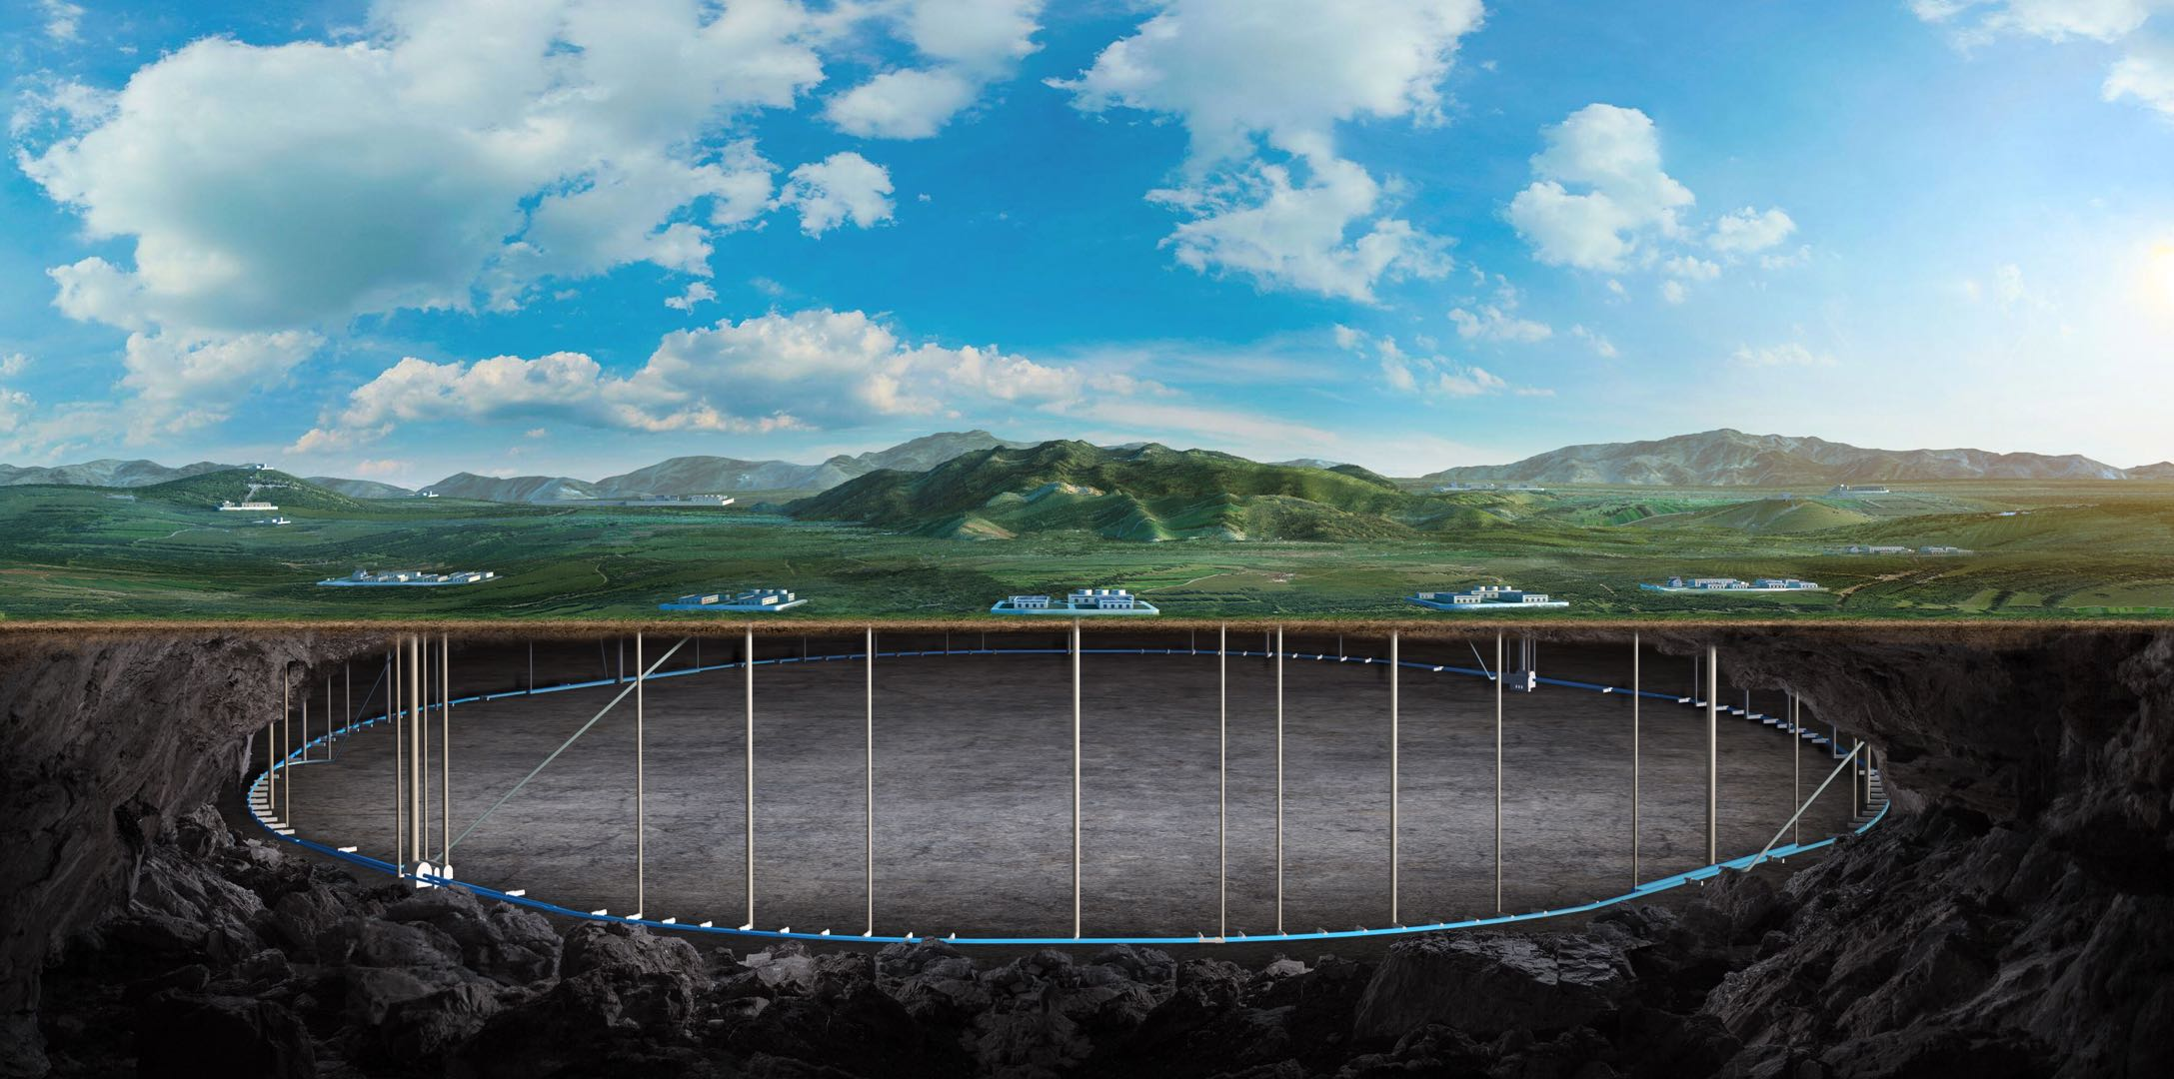
CEPC vertex Detector
Zhijun Liang
(On behalf of the CEPC physics and detector group)
Apr. 15th , 2025, CEPC Detector Ref-TDR Review

Slide 2
Update
Receive comments from Joao last Tuesday (Jun 24th )
Receive comments from Hongbo Zhu last weekend (Jun 27th )
Implement 80% of Joao’s comment, 30% of Hongbo’s comment by far
Still need one more week to implement the comments

