Slide 1
Weekly Report
Minghao Li 2025.07.01

Slide 2
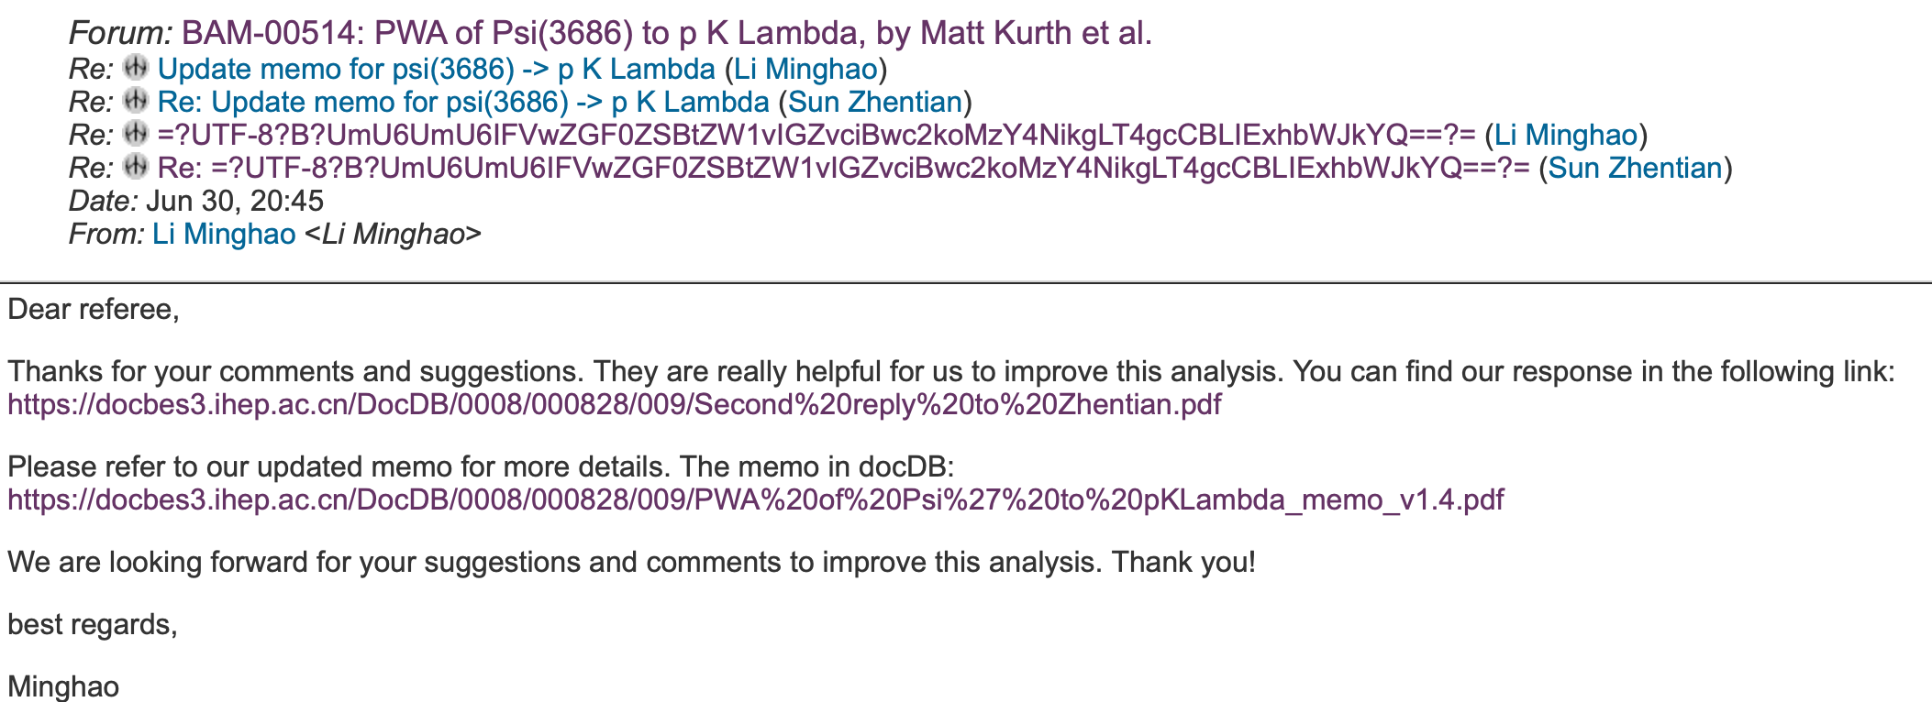
$$ψ\left(3686\right)→pK^{−}\overline{Λ}+c.c.$$
The systematic uncertainty in determination of mass and width of X(2085) through partial wave analysis are estimated by considering the quoted mass and width of involved resonance states from PDG, mass window, and background number.
We have completed the response to Prof. Sun's questions and updated the memo.

Slide 3
$$ψ\left(3686\right)→pK^{−}\overline{Λ}+c.c.$$
Yesterday, we received the latest questions from Prof. Zhao. We are currently studying this questions.
We are going to write the draft.

