Slide 1
Observation of ferroelectric domains

Slide 2
Phase transformation
Temperature rise: $T↑$
Ferroelectric phase
Paraelectric phase
Example:
ice
water
Experiment aim: Observe the complex ferroelectric domains during the phase transition process

Slide 3
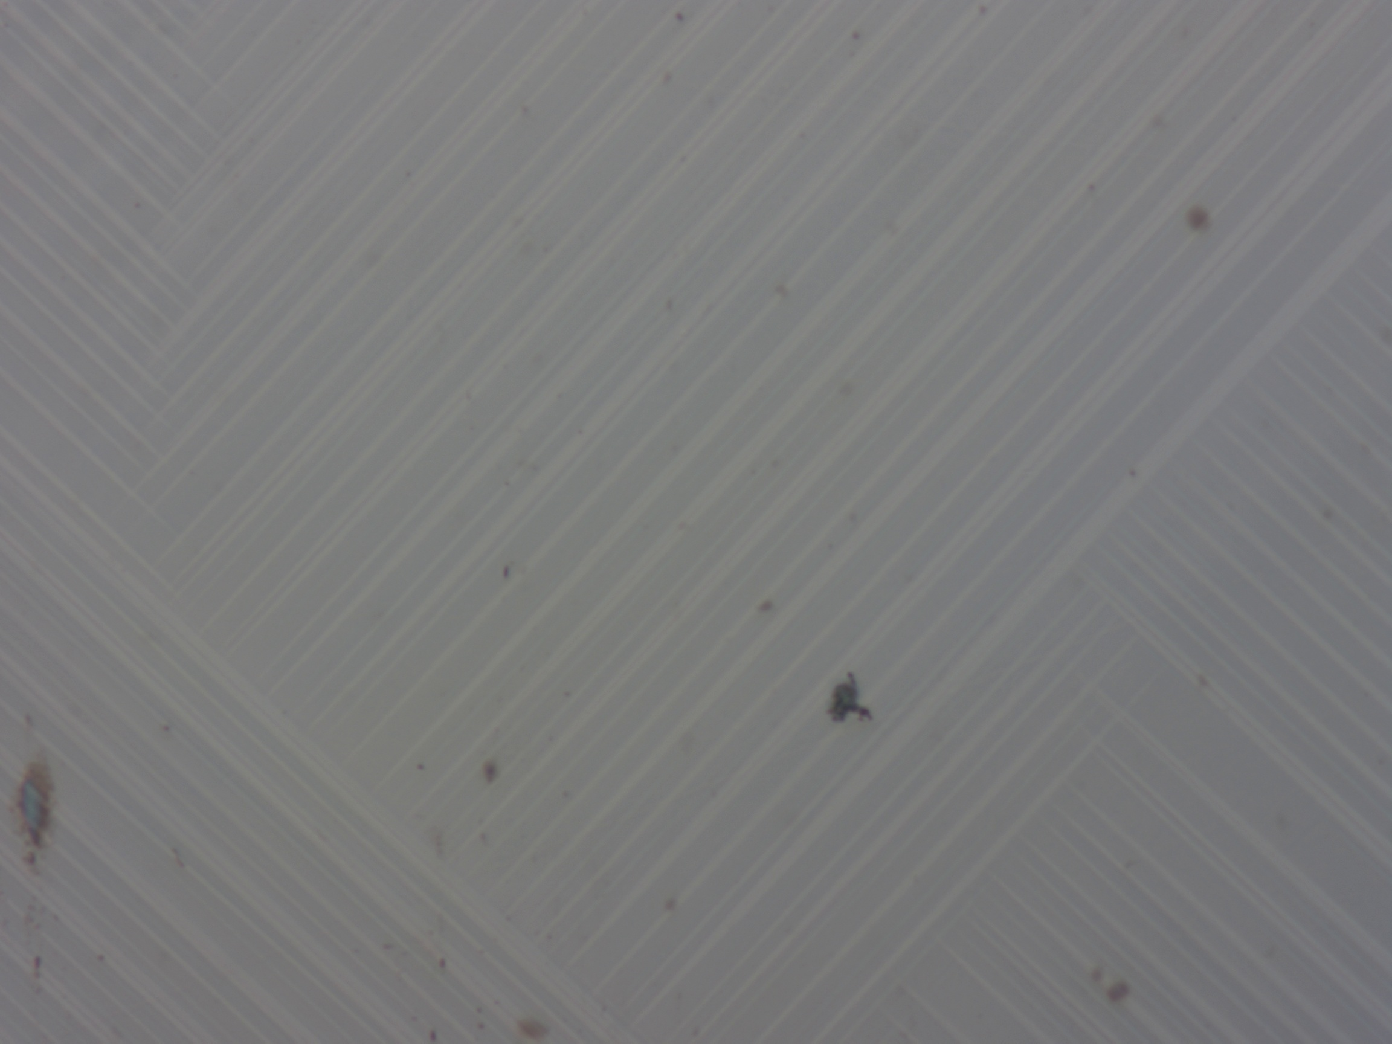
ferroelectric domains of each sample
24AA001
20.9$℃$
50×
24AA004
28.2$℃$
5×
24AA006
41.4$℃$
50×

Slide 4
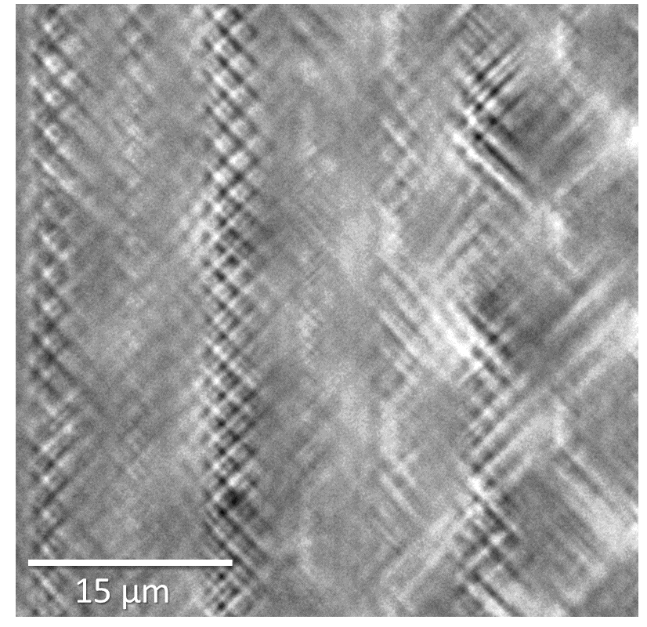
Observation of complex ferroelectric domains
Pro Xin
24AA001
20.9$℃$
JHW
50×
24AA006
41.4$℃$
JHW
50×

Slide 5
Reproduction of experimental result
Pro Xin

