Slide 1
Current Work 1：Learning the program Geant4 for detecting the neutrino.
Current Work 2：Read some papers or reports for Radiation.And read some papers of neutrino.
Next Plan:
1.I enrolled one activity.It starts from the 07/03,ends up to 07/11.
2.Another thing is that I will participate the activity named Nanshanqingbei that Prof. Yu hosted from 07/20 to 07/31.
3.Seemly maybe I will participate another activity named The 2nd JUNO neutrino summer school which sent by Prof.Yu from 08/17 to 08/24.This afternoon Prof.Yu told me ,and later I will consult more precise information about this meeting toward Prof.Qi.

Slide 2
Conclusion of Recent Work
Study of Shielding Design for SANS at CSNS written by Prof.Liang:
1.It introduced the fundamental concept of radiation and reaction of neutrons.
The type of Neutron nuclear reaction are divided into two types,Scattering and Absorbing.
Character of Neutron Nuclear Reaction
 | Character
Elastic Scattering | The total energy no change,the direction of neutron will change.
Inelastic Scattering | Neutron must have the enough energy,this reaction will happen.This is one threshold response.
Absorbing | The reaction will product the new particles.And it can be divinded into many types like (n,$γ$) (n,c) (n,f) and so on.

Slide 3
The Determination of the Radiation Background Level of the Beijing Spectronmeter
It is the chinese paper.I think next information is useful for me.
1.When electrons with energy greater than the critical energy Ec(how much ?) are incident on a medium, bremsstrahlung is produced.
The photon with energy higher than 1.02 MeV,and the electron will produce the bremsstrahlun.The photon will produce the pair of electron and positron.The process will happen repeatedly until the energy is lost completely.
2.Partly the photon with enough energy will react with Nucleon($$γ,n$$).It will produce the neutron.
the energy of photon(Ep) | the name of reaction
30MeV>Ep>the threshold of photonuclear reaction | Big resonance reaction
Ep>30MeV | The pseudo-deuterium nuclear reaction (It will produce neutron with energy of 20MeV)

Slide 4
Estimation of the radiation backgrounds in the CEPC vertex detector
The source of Radiation:
1.Photon backgrounds
Photons originating from the synchrotron radiation and pair production processes
2.Synchrotron radiation
3.Pair production
Beam–beam interaction could cause the emission of Beamstrahlung photons because of the pinch effect.Consequently, electron–positron pairs could be produced either coherently or incoherently from the interaction between the real and/or virtual photons.
4.Beam loss backgrounds
The beam loss particles can interact with the beam pipe and give rise to the radiation backgrounds.

Slide 5
Current Learning Condition of Geant4
I have implement the fundamental program.But I can’t implement the complex function include the visiualizing and scoring.I need to learn how to use these method in further time.
Progress of CryoCsI R&D from COHERNT(Report)
The CryoCsI means that Cryogenic Cesium Iodide.
1.High light yield and good resolution
2.High quenching factor
3.Low afterglow
A Lower shreshold down to 1keVnr.

Slide 6
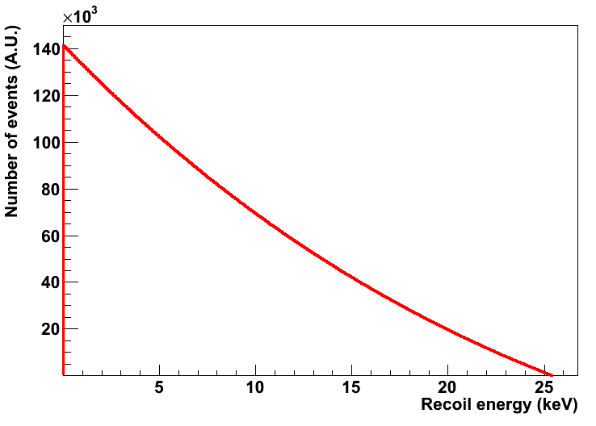
Coherent Elastic Neutrino-Nucleus Scattering + COHERENT results and future
A neutrino smacks a nucleus via exchange of a Z, and the nucleus recoils as a whole;coherent up to En~ 50 MeV(This energy seemly cover the region of energy I want.)
Large cross section (by neutrino standards) but hard to observe due to tiny nuclear recoil energies.The max recoil energy is ~2Ev{^2}/M(25keV for Ge) .The only experimental signature is tiny energy deposited by nuclear recoils in the target material.

Slide 7
From the picture,the cross section of CsI seemly is the biggest.

