Slide 1
BEPCII-U and HEPS status
Daheng Ji
BEPCII-U & HEPS commissioning team
2025.07.18

Slide 2
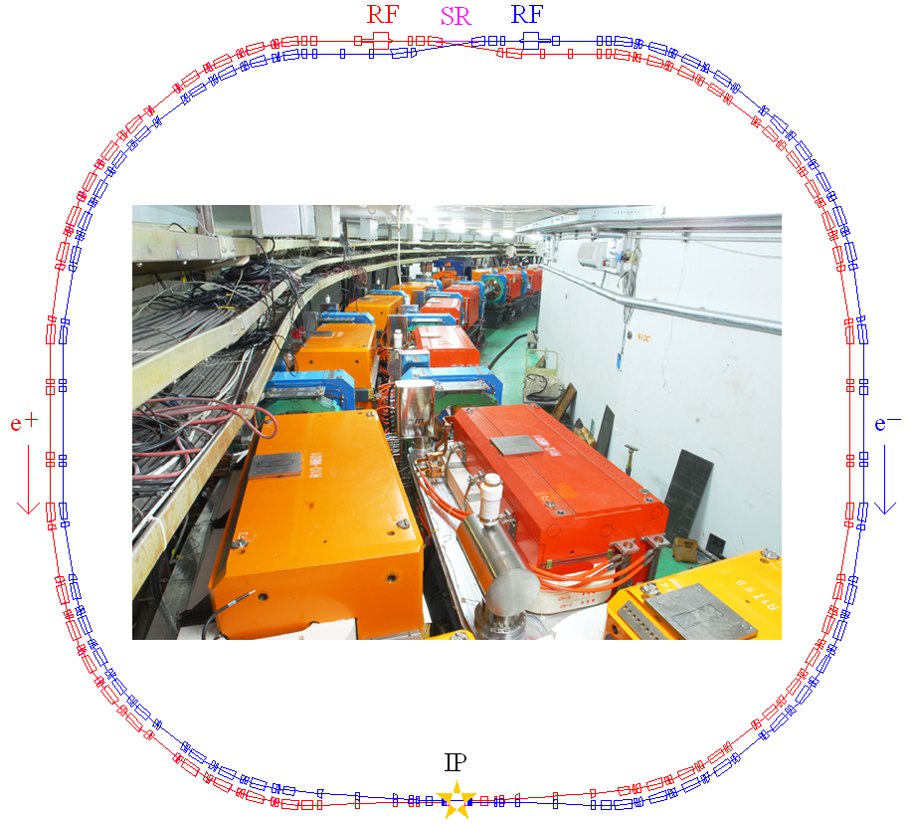
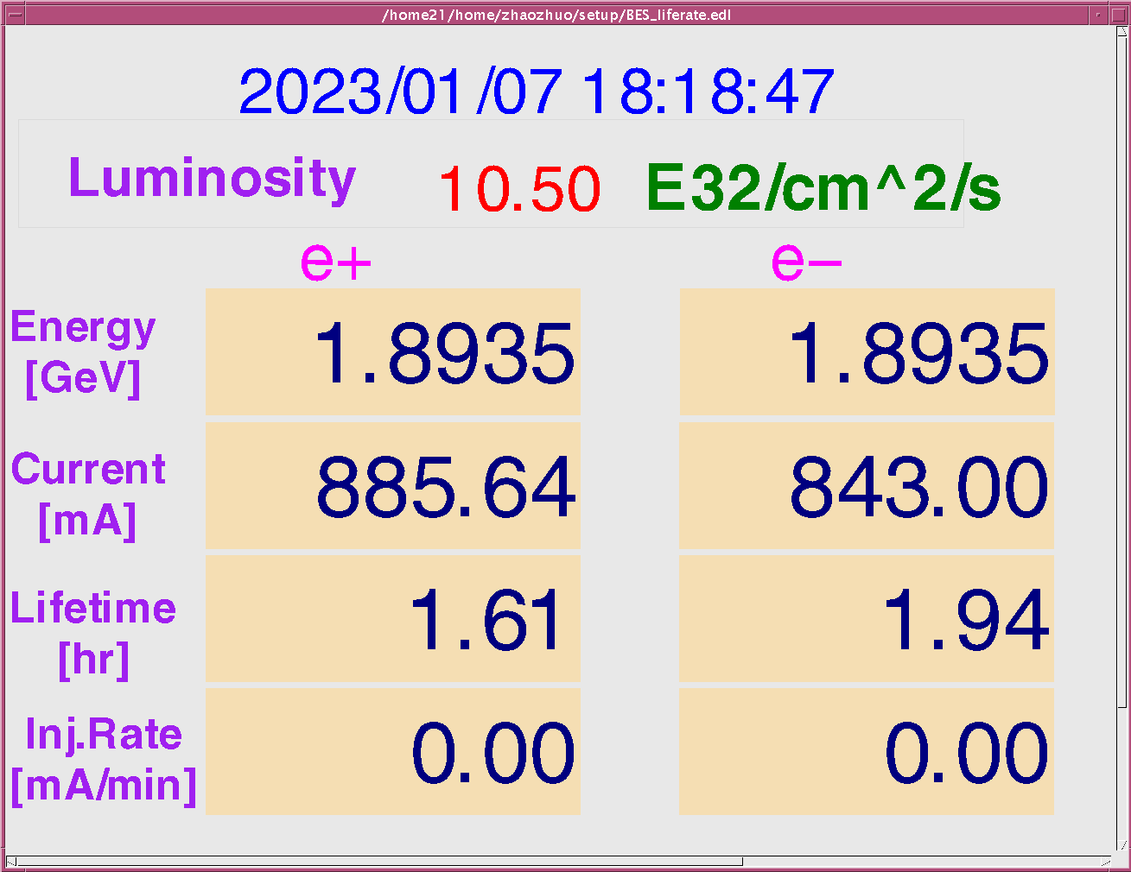
BEPCII-U
Design goals of BEPCII：
HEP
Beam energy range 1-2.1 GeV
Optimized beam energy 1.89 GeV
Beam current 910 mA
Luminosity 1×10³³cm⁻²s⁻¹ @1.89 GeV
Synchrotron radiation
Beam energy 2.5 GeV
Beam current 250 mA
BEPCII-U: Increase luminosity at higher Energy
Squeeze bunch length and 𝛽_{𝑦}∗ by increasing RF voltage + Increase beam current

Slide 3
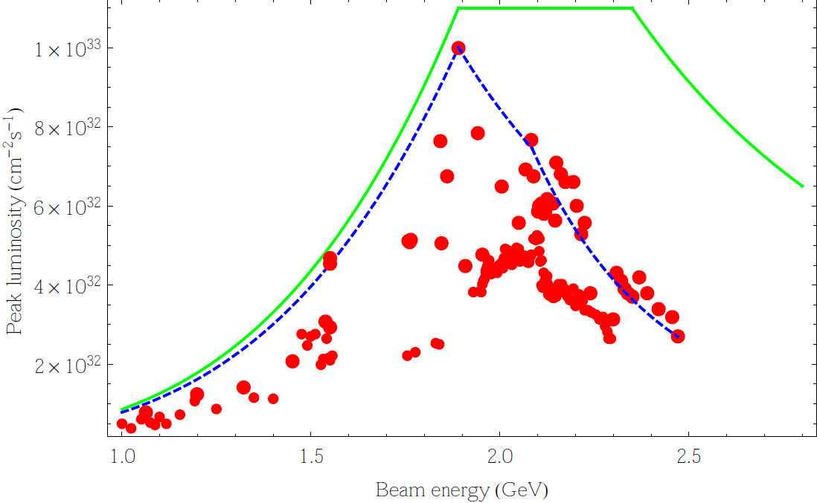
Design parameters before/after upgrade
Beam Energy：2.35GeV
BEPCII-U vs BEPCII
 | BEPCII | BEPCII-U
Lum [10³²cm⁻²s⁻¹] | 3.5 | 11
$β_{y}^{∗}$ [cm] | 1.5 | 1.3
Bunch Current [mA] | 7.1 | 7.5
Bunch Num | 56 | 120
SR Power [kW] | 110 | 250
$$ξ_{y,lum}$$ | 0.029 | 0.036
Emittance [nmrad] | 147 | 152
Coupling [%] | 0.53 | 0.35
Bucket Height | 0.0069 | 0.011
$σ_{z,0}$ [cm] | 1.54 | 1.04
$σ_{z}$ [cm] | 1.69 | 1.3
RF Voltage | 1.6 MV | 3.3 MV
3 times
Luminosity is increased by a factor of 3 @2.35GeV
Maximum beam energy is increased from 2.1GeV to 2.8GeV.

Slide 4
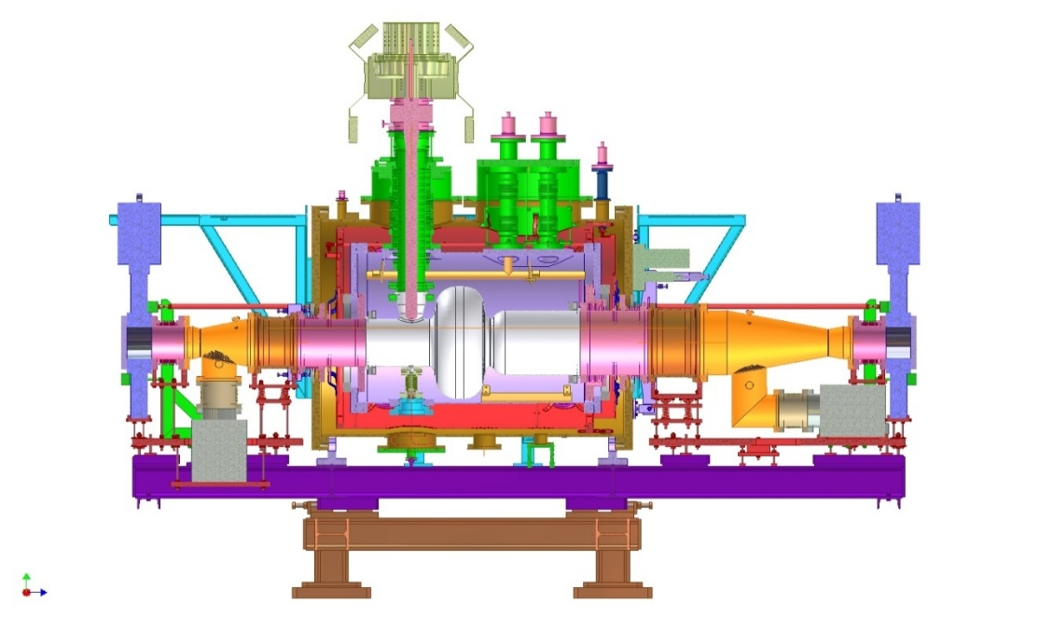
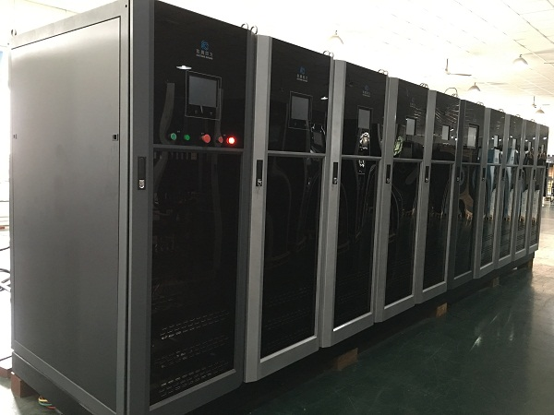
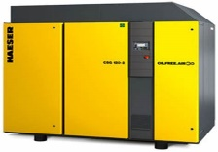
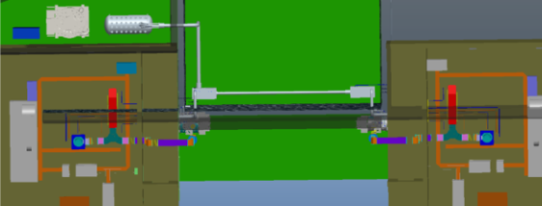
Hardware upgrade: RF
new cavity
BEPCII-U RF region
new cavity
1 existing + 1 new RF Cavity/ per ring
2 old cavities; 1 backup cavity; 1 new cavity
Survey will be kept exactly the same as BEPCII
Two sets of 500MHz, 200kW solid state power source are installed
Cryogenic system: upgraded with a new refrigerator
Photon absorber capacity upgraded from 110 kW to 250 kW

Slide 5
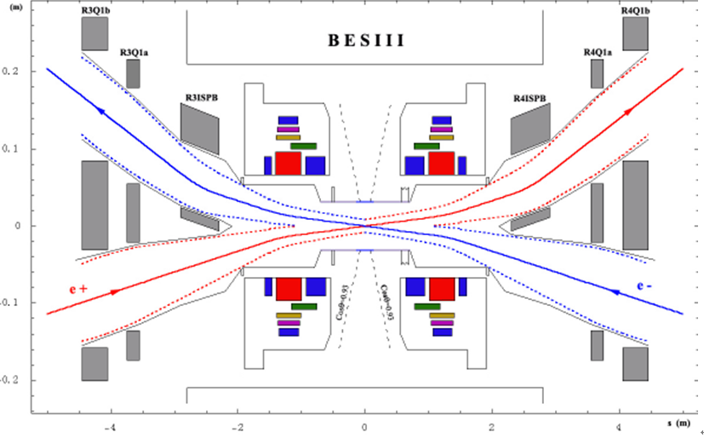
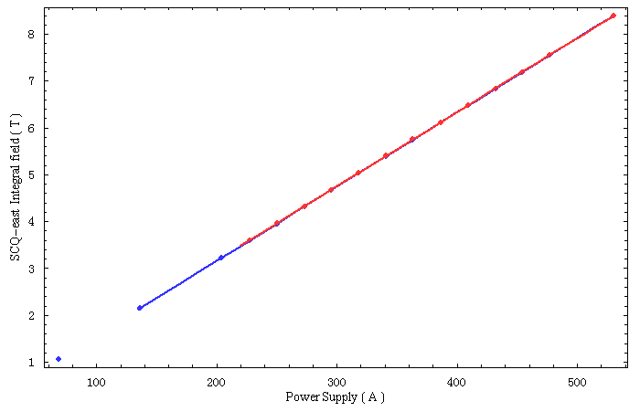
Hardware upgrade ----SCQ
530A
The strength of SCQ(Superconducting Quadrupole) is critical for high luminosity at 2.8 GeV (current SCQs exceed quench current limit).
New SCQs replace existing ones for 2.8 GeV operation.

Slide 6
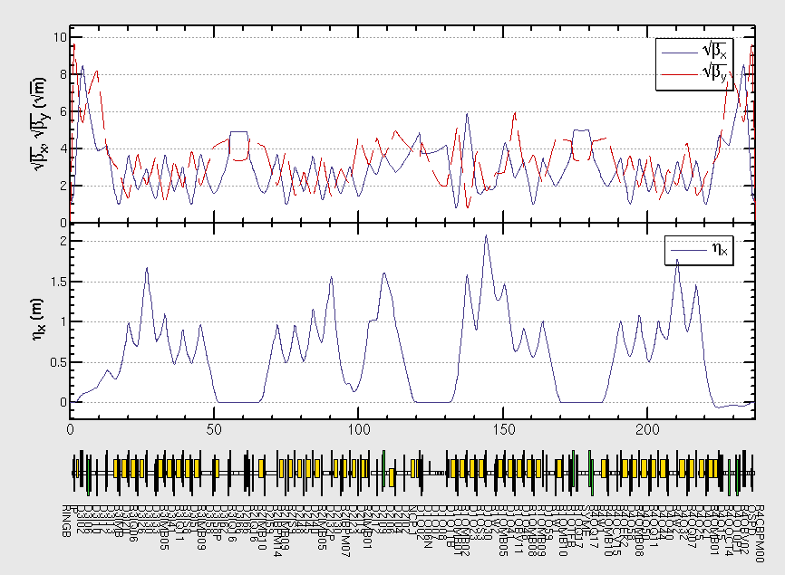
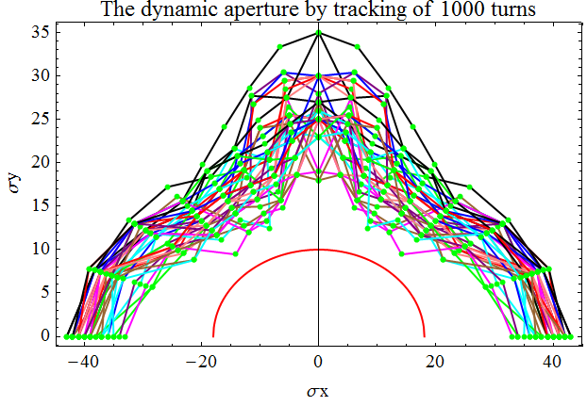
Lattice modified @2.35GeV
Local optics redesigned at the RF region
Global tuning has been done to minimize the emittance
Dynamic aperture is optimized to ensure enough beam lifetime
Intensive multiparticle tracking has been done to make sure the luminosity performance

Slide 7
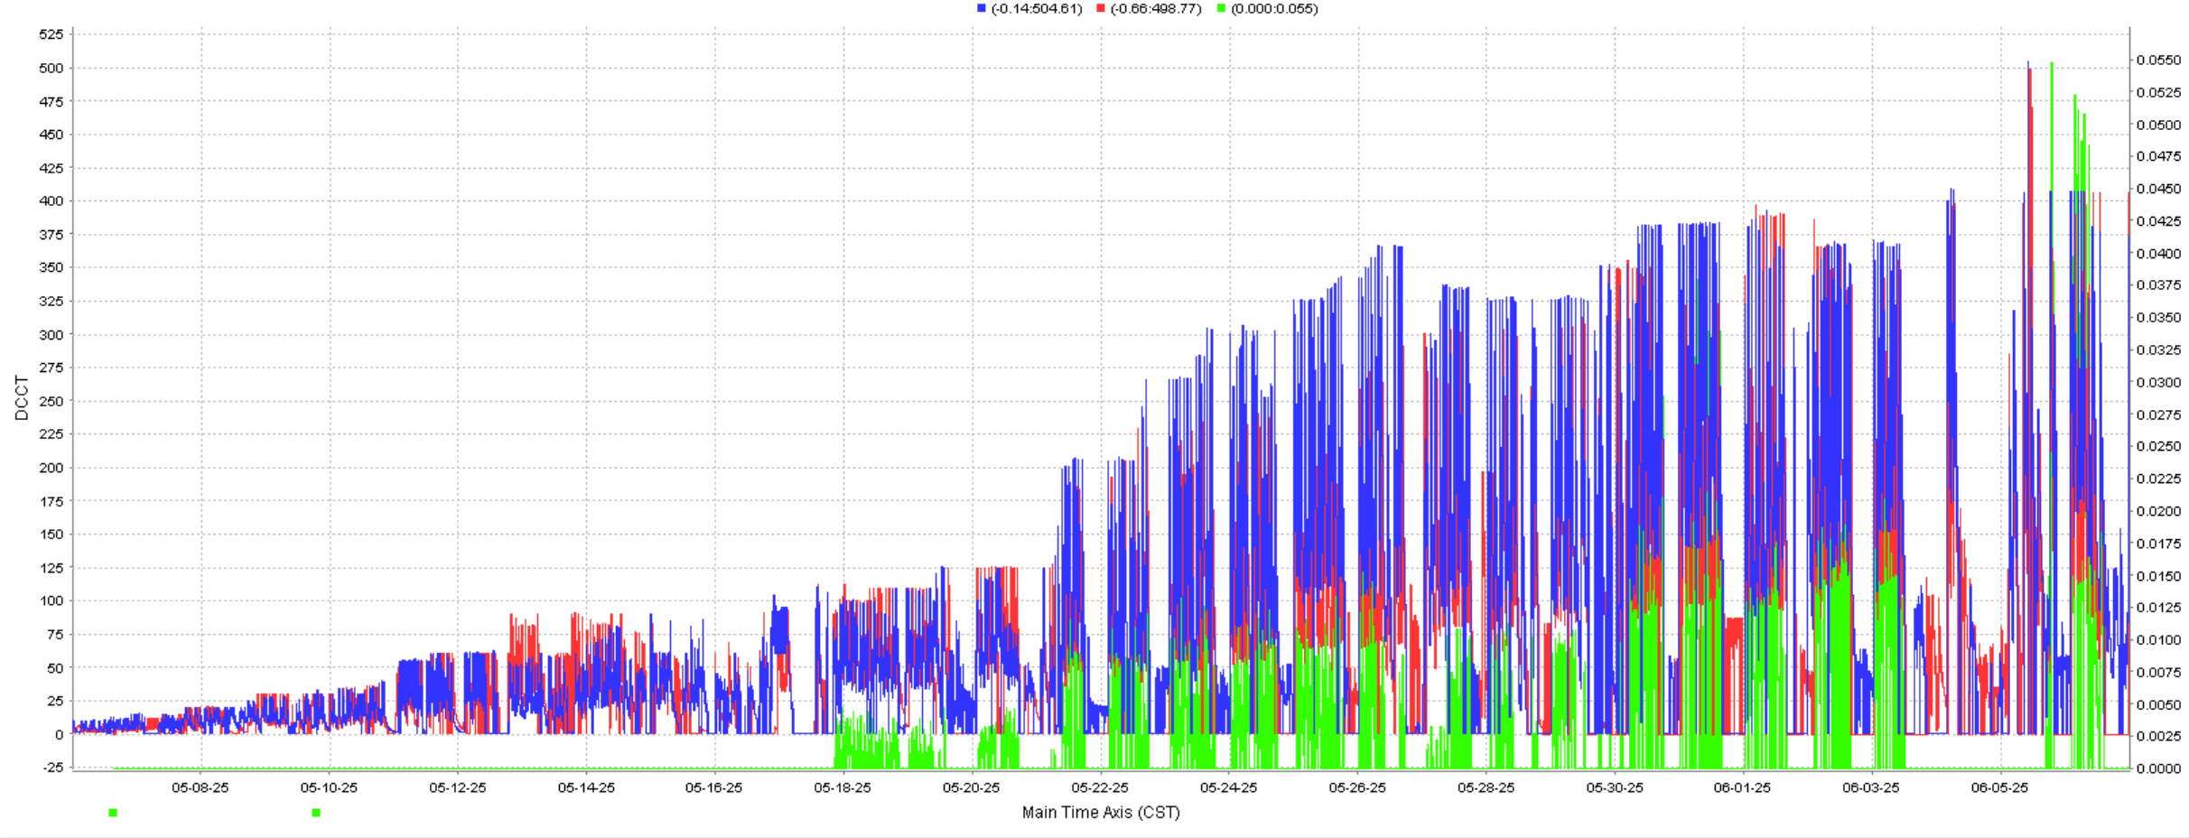
Schedule
2024 .7-12, Shut down for hardware dismantling and installation
2025-2028, Operation at 1.89~2.5GeV, and prepare for energy upgrade
Current status: Commissioning at 1.89 GeV until August 2025
2028.6-9, Energy upgrade to 2.8GeV
2028.9~2030, Operation at 2.5~2.8GeV
e+, e-, Lum.

Slide 8
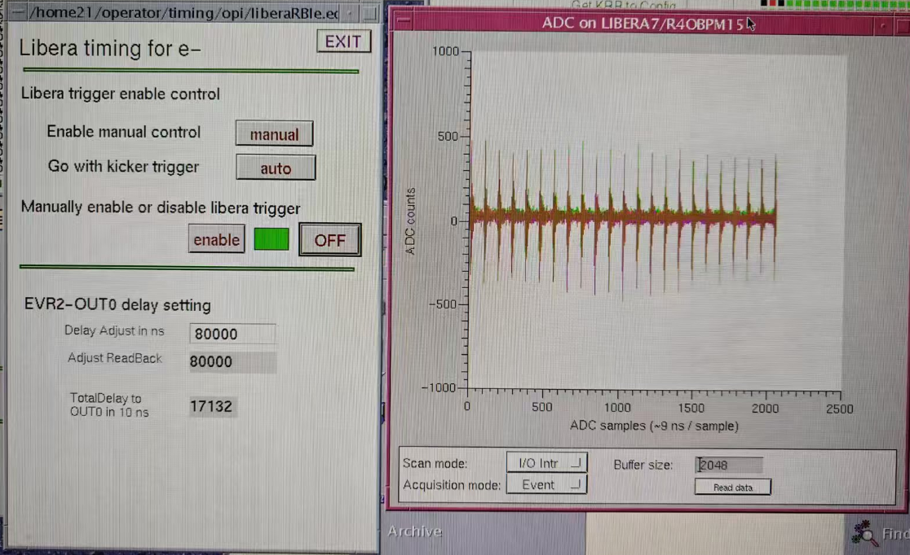
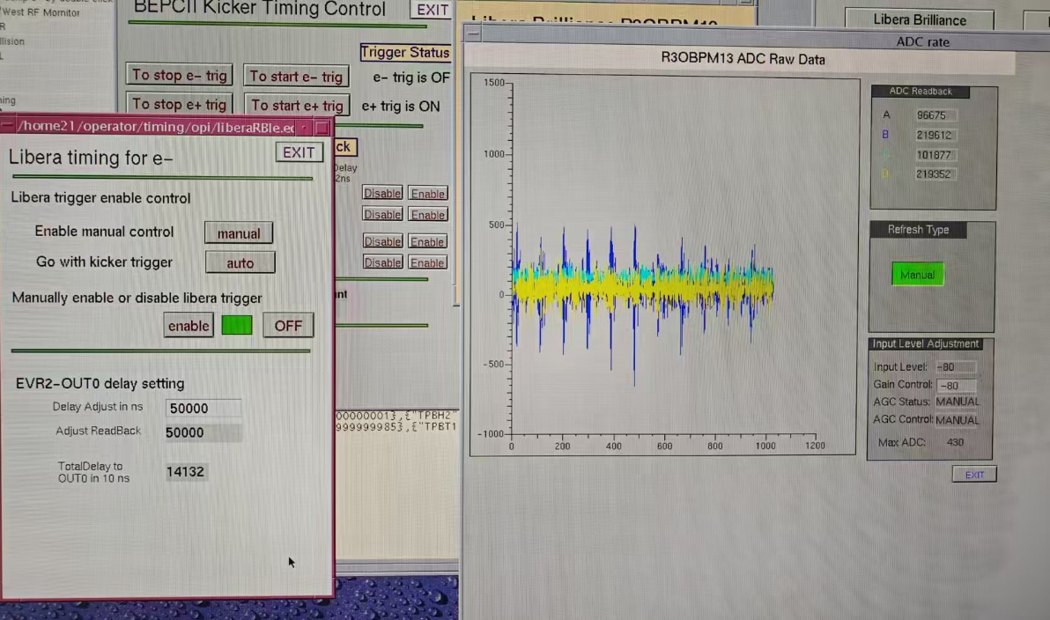
Beam Commissioning w/o RF
The cryogenic system was ready at May 2nd.
In March and April, commissioning of injection beams at 1.89GeV was conducted without the RF system, with the BPR and BER obtaining beam signals of 80 turns and 100 turns respectively.
BER 120 turns
BPR 80 turns

Slide 9
Beam Commissioning with RF
May 2: RF cavity on;
May 3: electron accumulation;
May 5: positron accumulation;
May 6: RM measured, initial orbit and optics correction completed;
May 12: 1W1 and 4W1 on.
May 15: Synchrotron radiation facility commissioned.
May 16: Beam collision achieved.
May 17: BESIII starts data taking.
June 6: 1W2 added; beam collision current >400 mA, luminosity >0.5×10³² cm⁻²s⁻¹.
e+, e-, Lum.

Slide 10
Current Status of BEPCII-U
BEPCII-U is currently with one cavity per ring, and the installation of new cavities is scheduled for completion in the Q3.
High-energy physics experiments were previously conducted at 1.89 GeV, and the energy scan for these experiments has recently been successfully concluded.
Concurrently, synchrotron radiation experiments have been carried out in parallel.
Machine commissioning activities have been progressing alongside these experiments.
Preliminary mode correction, coupling adjustment, Beam-Based Alignment (BBA), and partial hardware debugging was finished.
The team will focus on more refined optics calibration and luminosity optimization to further enhance the collider's performance.

Slide 11
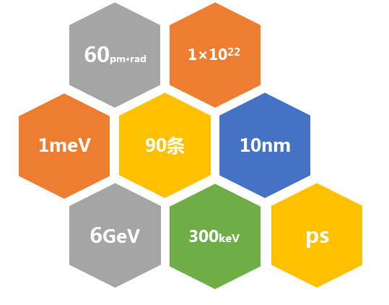
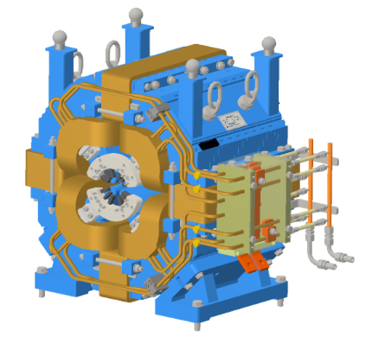
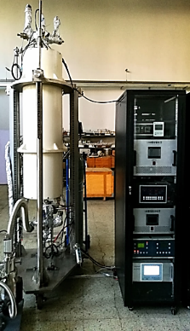
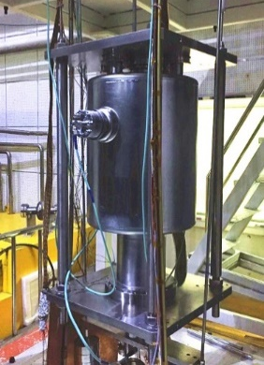
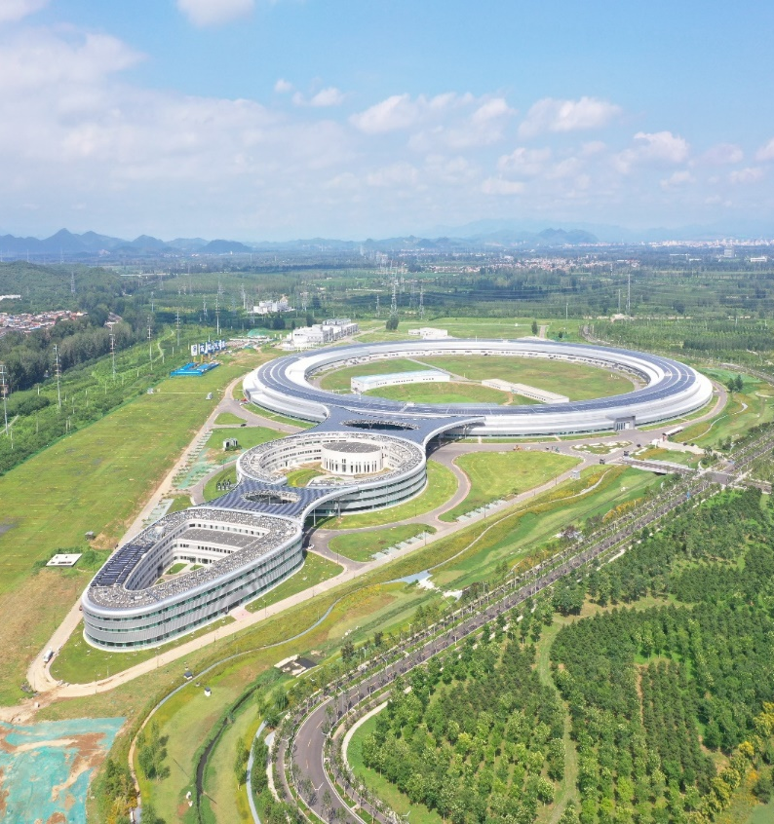
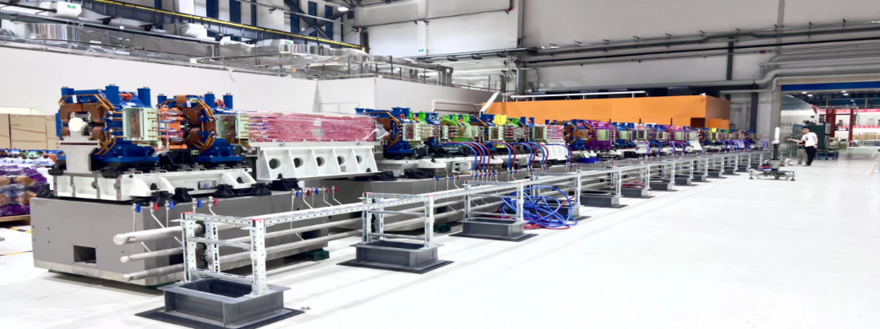
High Energy Photon Source(HEPS)
4th-generation synchrotron radiation light source
Circumference | 1360.4 | m
Energy | 6 | GeV
Emittance | ≤0.06 | nm·rad
Brightness | >1×10²² | phs/s/mm²/mrad²/0.1%BW
Beam Line | ≥90 | Initially: 14
Photon Energy | 0.1-300 | keV

Slide 12
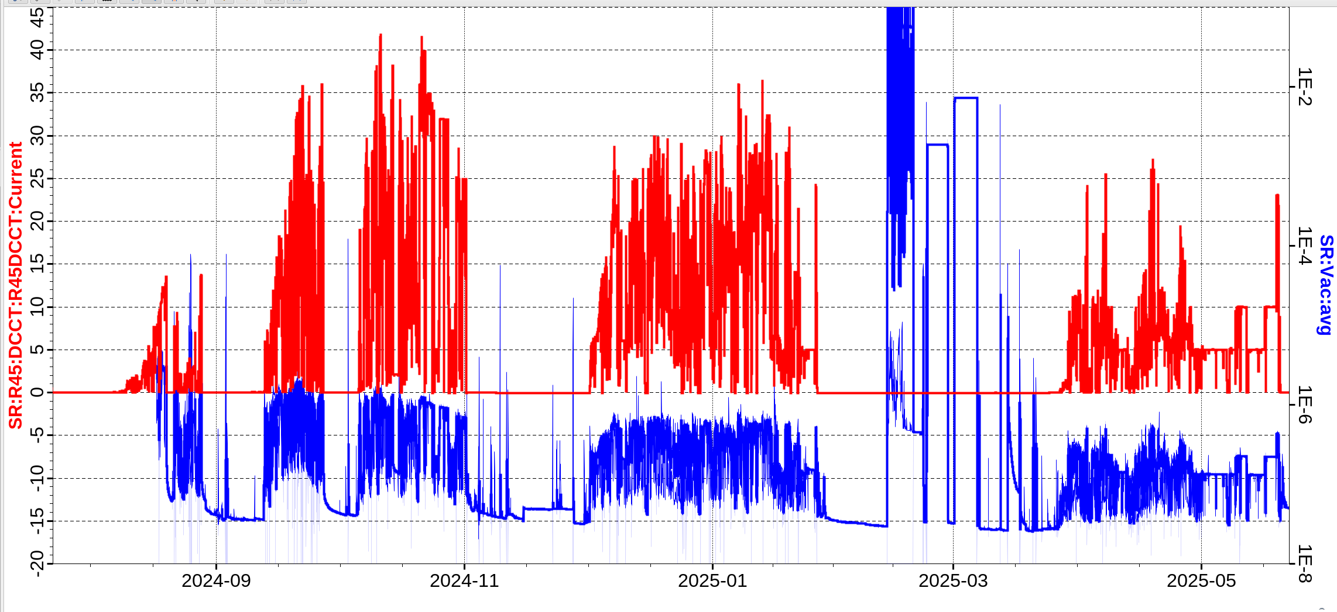
HEPS Storage Ring Commissioning
Phase 1
Phase 2
Phase 3
Phase 4
Phase 5
Shut down#1
Shut down#2
Shut down#3
Shut down#4

Slide 13
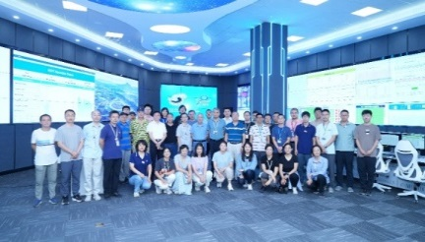
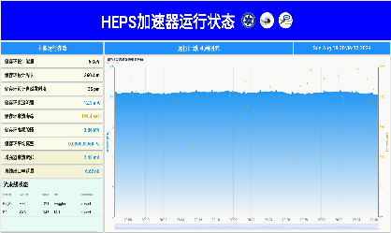
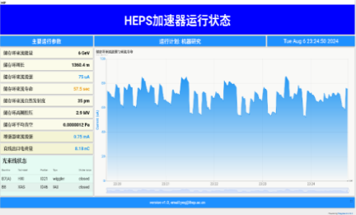
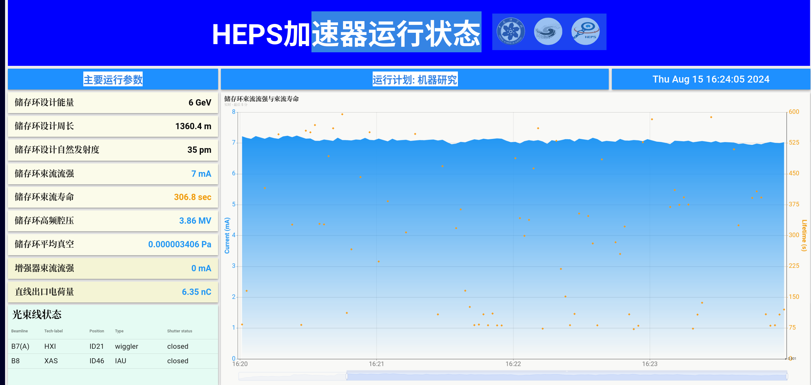
Phase 1: Achieved beam storage with current >10 mA.(7.23-8.27)
第11圈束流信号
12th turn singal
~1.3sec
Current~ 0.4 mA
Life time~ 1 mins
Current~ 12 mA
Life time~ 2 mins
Commissioning begin
10 turns
Beam Accumulation
Multi Bunch
Current 12mA
07.23
08.04
08.06
08.15
07.23
07.29
08.06
08.08
08.18
1st-turn
1000 turns
Life time 1 min
7mA
>1000 turns
current~ 60 uA
Life time~ 1 min
Current~ 7 mA
Life time~ 2 mins
2nd turn signal
Shut down #1:
Replace injection kicker and power supply;
Replace R20VC14 vacuum chamber.

Slide 14
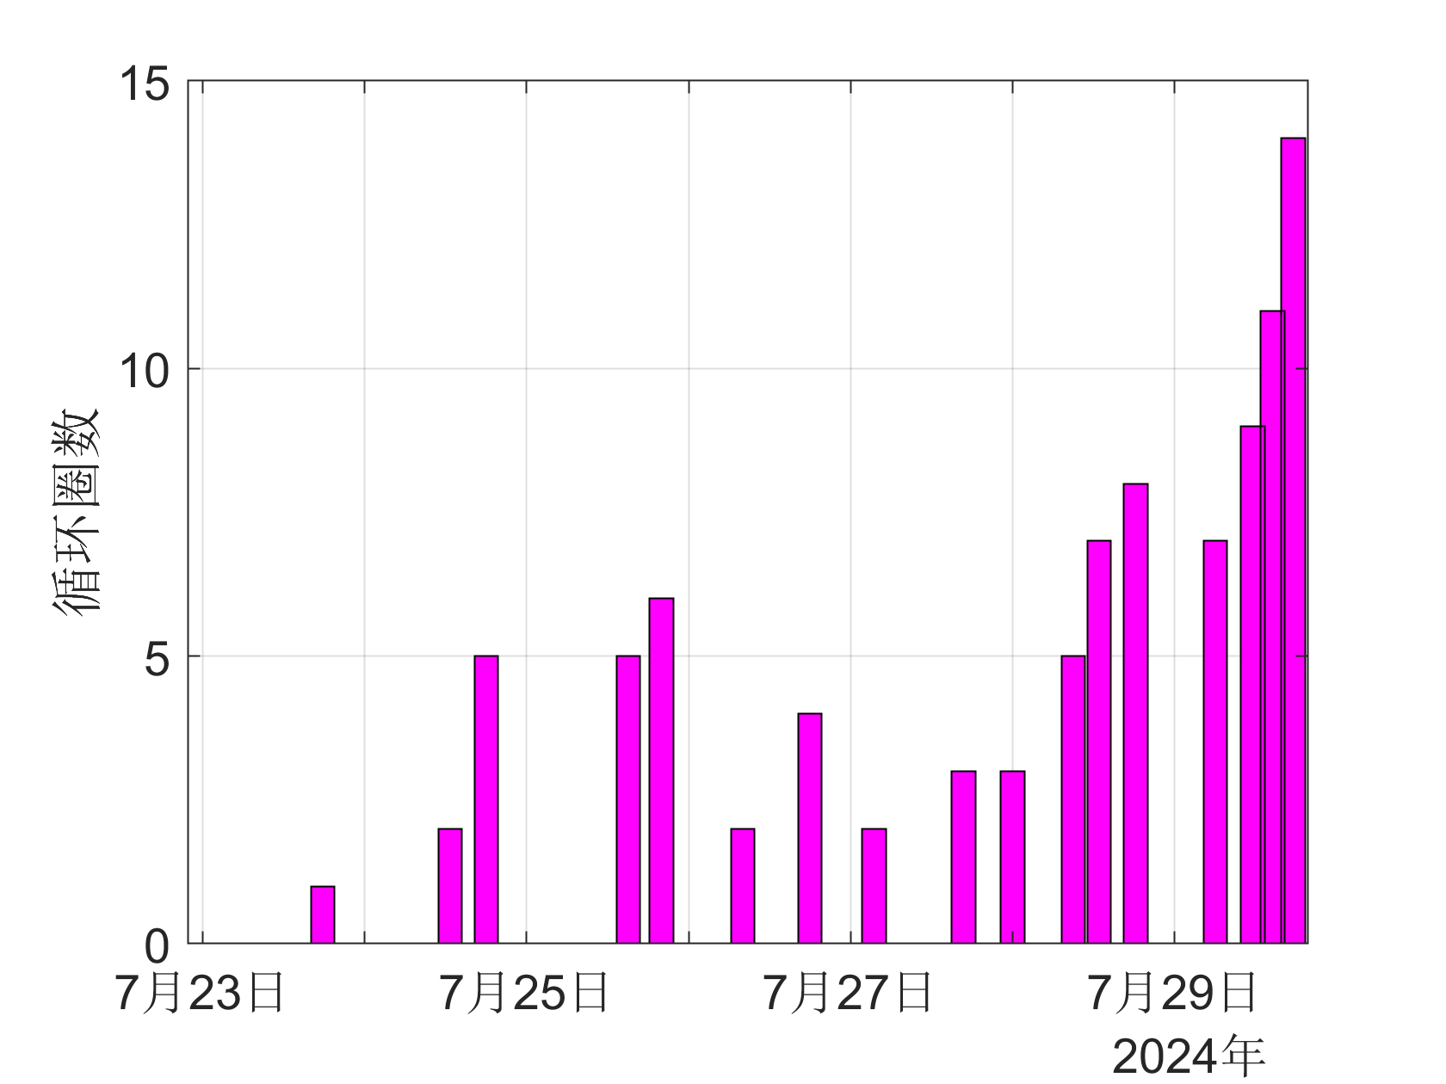
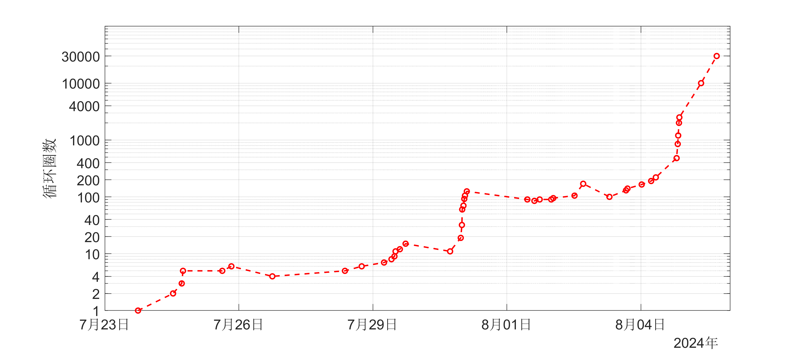
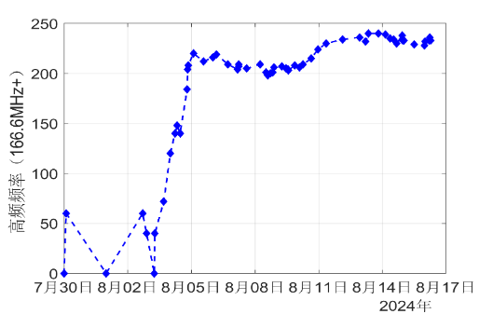
Phase 1 commissioning:
The first full loop circulation on the 1st day
proving the absence of any major obstacles and showcasing excellent magnet alignment work
The small beam aperture at the two LSM magnet locations
±2.5 mm aperture in a 1.6-meter-long magnet
multi-turn automatic correction
Encountering abnormal high-order effects during
despite thorough preparation and calibration of beam position monitors (BPM) beforehand. Most of the time was spent observing signals from the beam position monitors rather than utilizing automatic correction based on beam position information.
Vacuum anomal:
Abnormally high ion pump current at R20VC14 vacuum chamber
Shut down #1
Replace injection kicker and power supply;
Replace R20VC14 vacuum chamber.
Corrector
Injection Energy
Tune
corrector
ΔFrequency~200 Hz
Multi-trajectory correction
RF on. Sextupole on

Slide 15
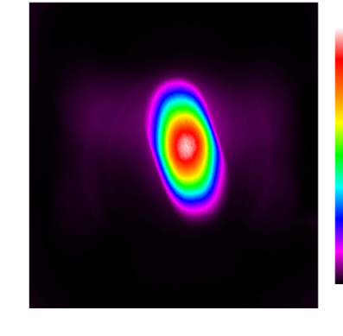
Phase 2: Current increased to ~40 mA.(9.12-9.26)
R20 vacuum chamber replaced to address vacuum limitations.
Injection kicker replaced to resolve current limitations.
Beam cleaning performed.
9-23 SR from Bend
Shutdown #2: Replace ID21/42/46 vacuum chambers.
Monochromatic light near the focal point Experimental station

Slide 16
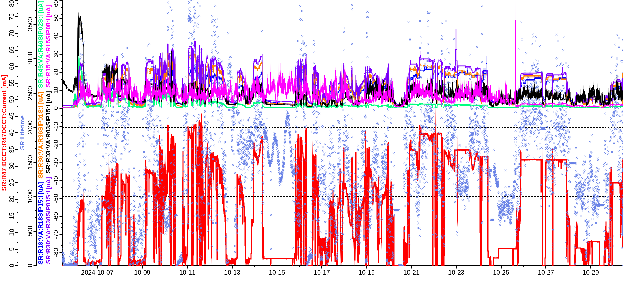
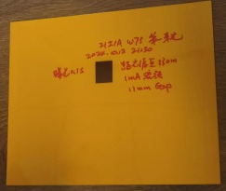
Phase 3: First light, beamline experiments. (10.5-11.1)
Accelerator recovery
B7 beamline tuning
(low corrent)
Accelerator tuning
B7 optimization
(high corrent)
First Light
Shutdown #3:
Install ID09 ID;
Replace ID08 and ID30 vacuum chambers;
Install three collimators;
Replace superconducting cavity.
Other beamlines tuning

Slide 17
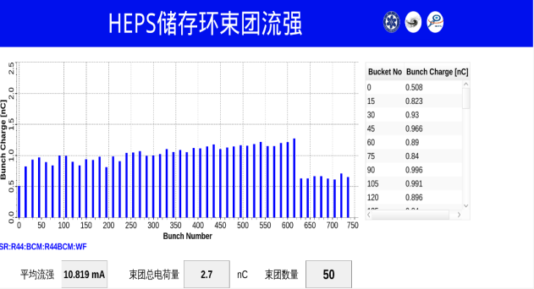
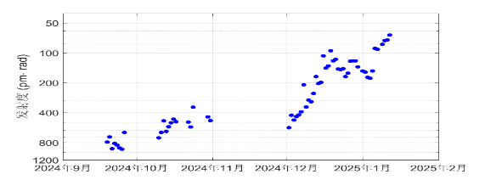
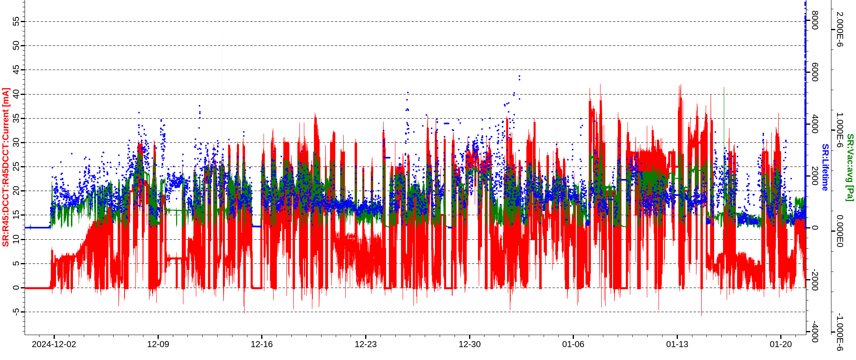
Phase 4: Preliminary beam dynamics optimization completed.(11.30-1.26)
Verified swap-out injection with high-energy accumulation in the booster.
Beam emittance reduced to <100 pm·rad at 27 mA.
COD(rms): ~100/100 mm.
Beta beating (rms): ~3%/3%.
Dispersion deviation (std): ~4/3 mm.
Shutdown #4:
Install most ID;
Perform full-ring precise alignment;
Install pre-kicker.

Slide 18
Phase 5:Optimization of storage ring current, lifetime, and vacuum. (3.23-5.20)
Accelerator recovery
BBA, Optics correction
Beamline tuning
Pre-kicker and collimator tuning
SOFB on
Shutdown #5 (Now):
Install all 166 MHz cavity;
Replace collimator.

Slide 19
Considerations for Next Phase
Preparations and Tests During Shutdown
Programs for harmonic cavity stretching, streak camera operation, LLRF feedback.
Simulation of low-frequency beam fluctuations on BBA measurements.
Mode correction program based on TBT data.
FOFB physics tuning program.
Sextupole mover tests.
Research and discussion on low-frequency beam fluctuations.
September - Mid-October (1.5 months)
Resume beam operation with 166 MHz superconducting cavity as fundamental frequency.
Stretch bunch length with harmonic cavity to increase current to 100 mA.
BBA and mode correction.

Slide 20
Thanks to BEPCII-U & HEPS Commissioning Team
Thank you !

